Slide 1
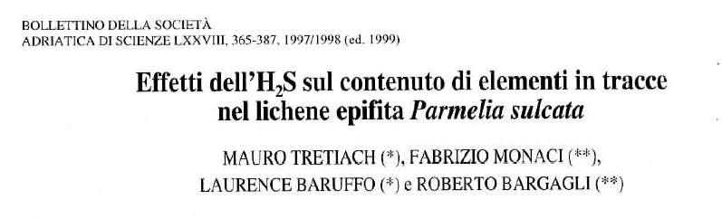

Slide 2

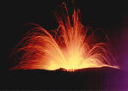
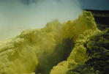

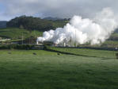
H₂S (hydrogen sulphide)
- The main reduced sulphur compound cycling throught the atmosphere (Brown & Bell, 1986; Sawyer et al., 1994).
- Its principal sources are biogenic processes and phenomena related to volcanic activity.
- Anthropogenic sources are industrial fonts, like the paper-industry and the exploitation of geothermal fields.
1200 tons H₂S x year!
(Dall´Aglio, 1988)

Slide 3
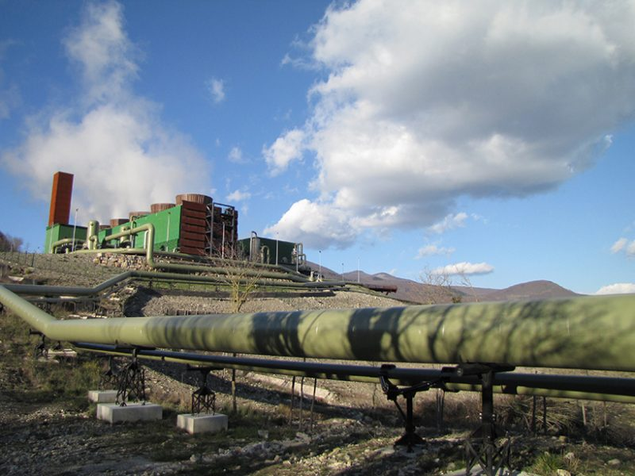
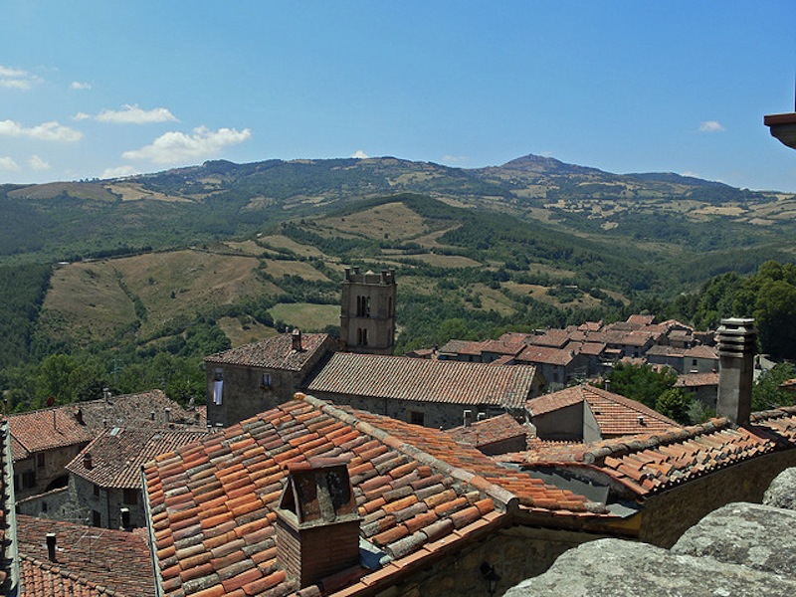
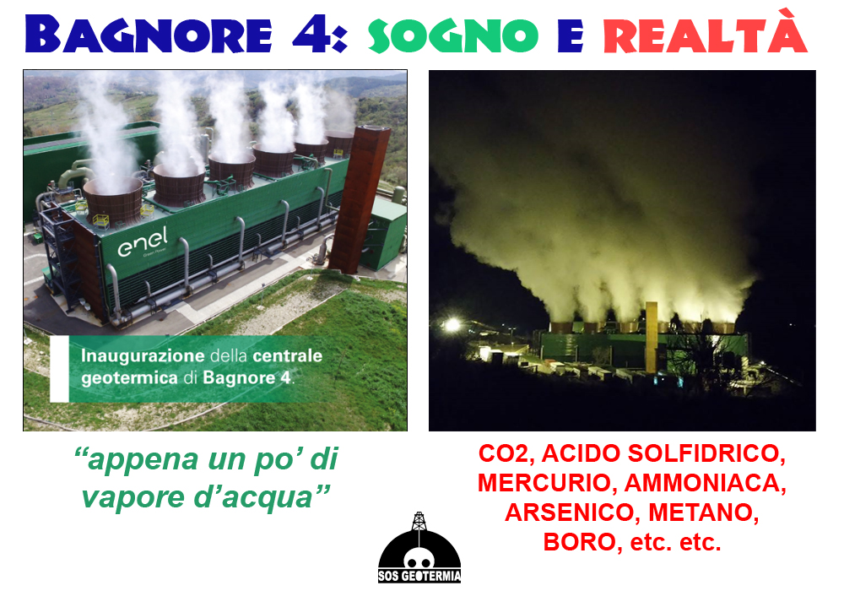

Slide 4
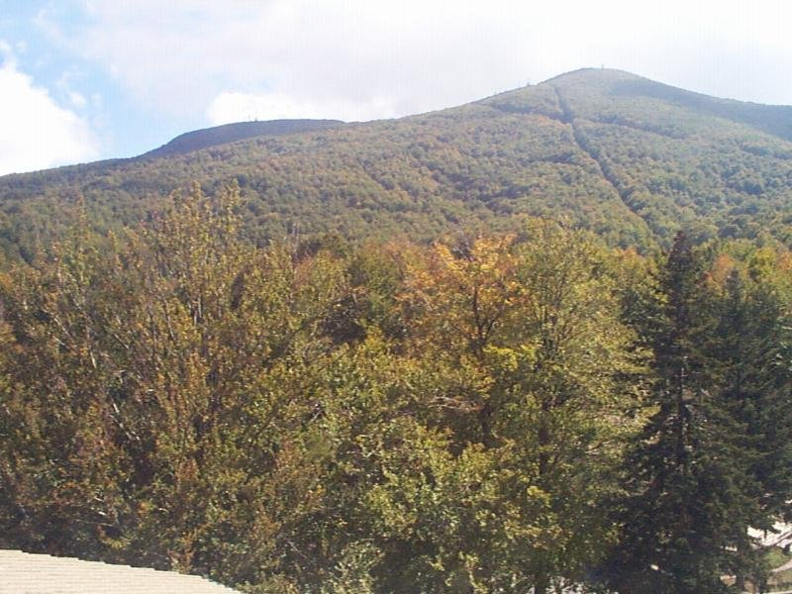
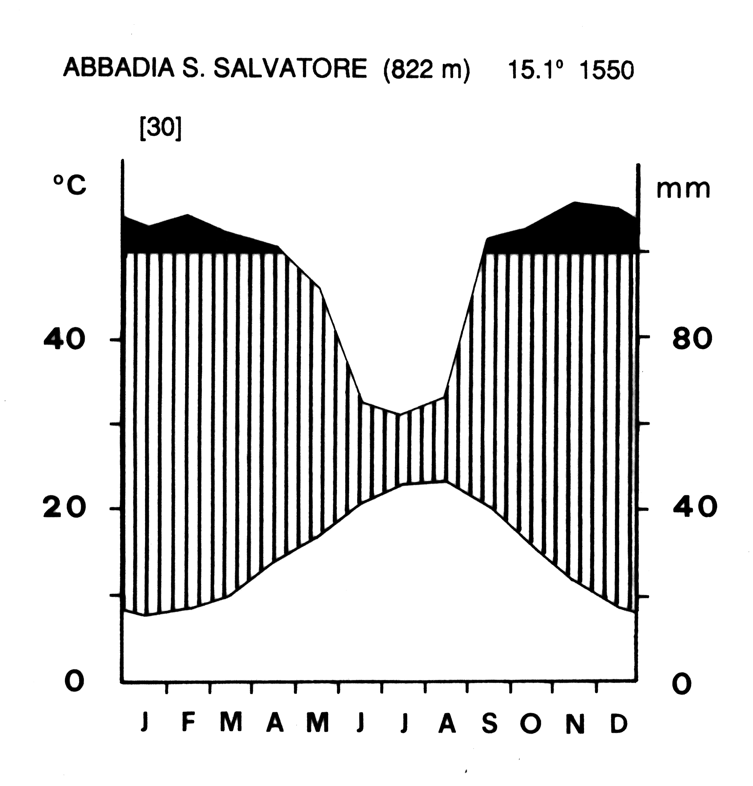
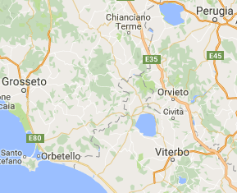
STUDY AREA: Mt. Amiata (Italy-Tuscany), 1738 m s.l.m.
Climatic diagram of Abbadia S. Salvatore (according to Walter & Lieth 1960; data from Barazzuoli & Salleolini 1992), 2 km far from the study area. The x-axis = the months of the year, from January to December. The y-axis = mean monthly temperatures (lower line) and mean monthly precipitations (upper line).a

Slide 5
The chestnut wood in Acquapassante (Mt. Amiata, Tuscany)

Slide 6
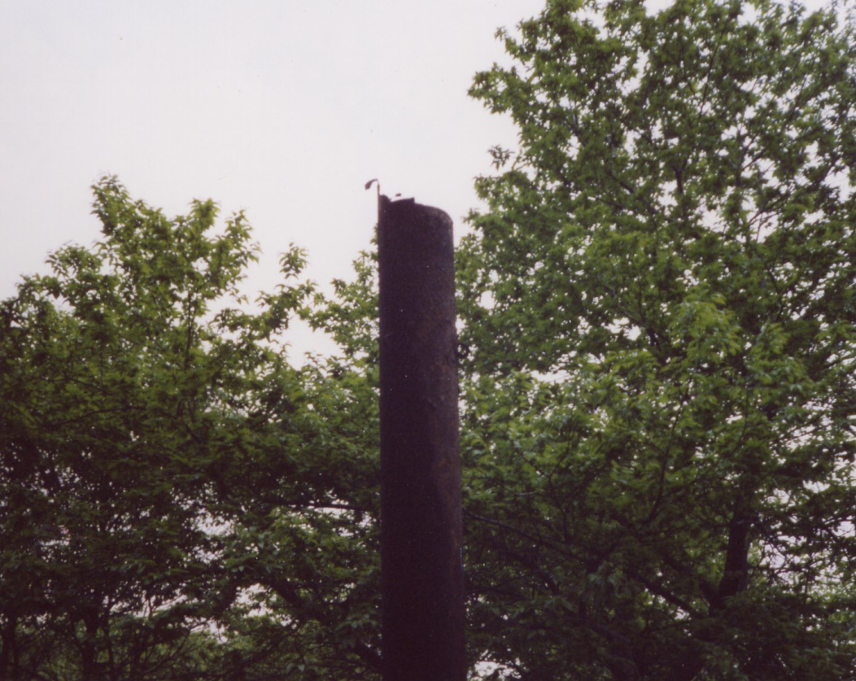
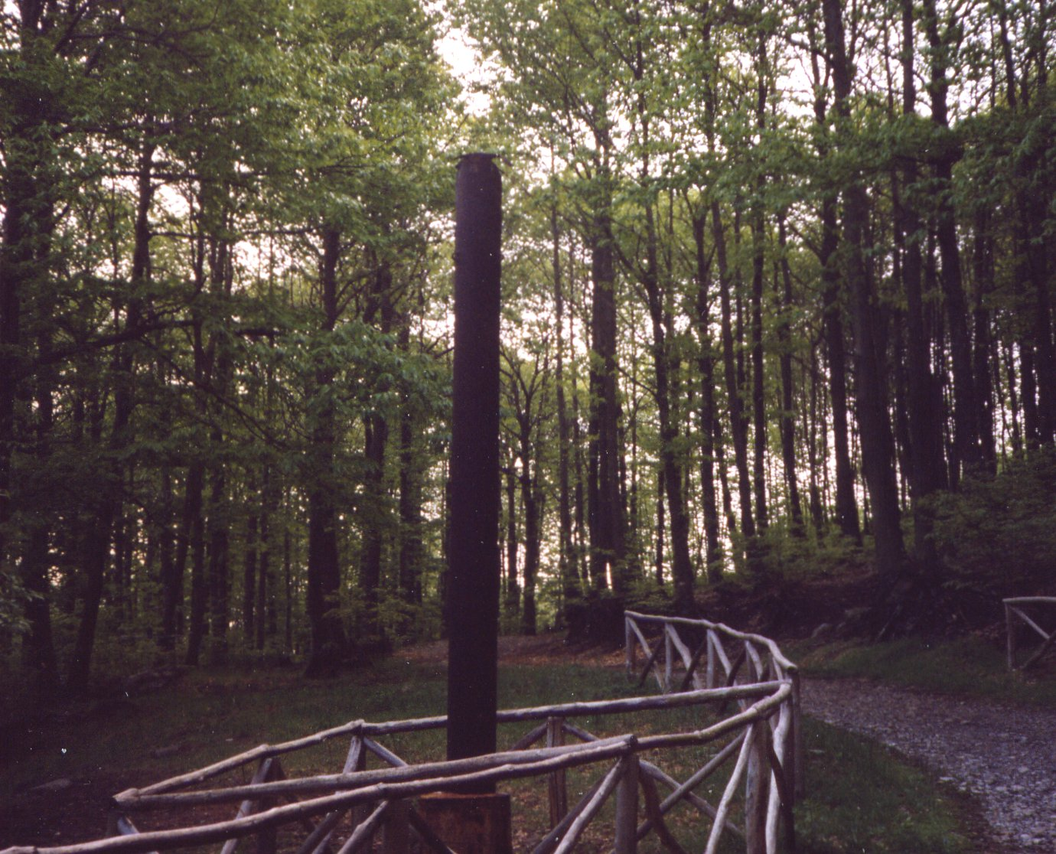
The iron chimney in the A zone
Gasses emitted:
- H₂S
- CO₂
- H₂O

Slide 7
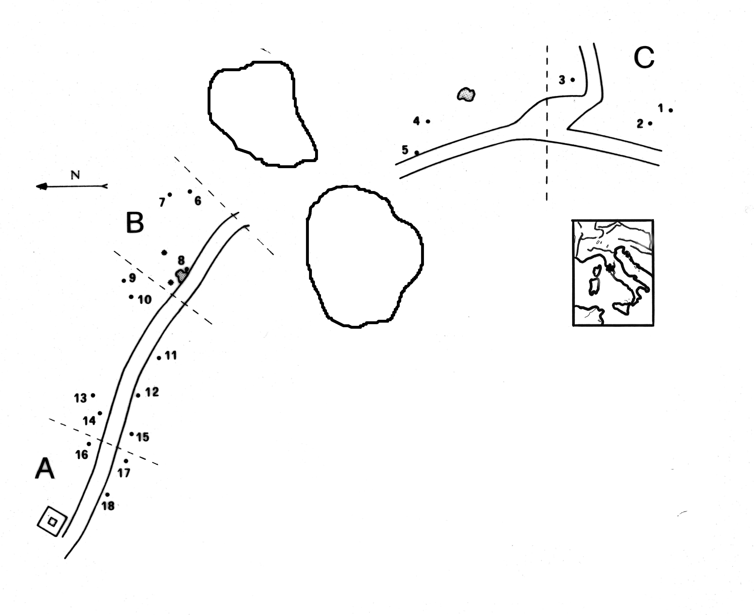
Tretiach M. & Ganis P., 1999. Effects of H2S on epiphytic lichen vegetation: a study case from M. Amiata (Central Italy). Lichenologist 31: 163-181.
0.5 ppb
Map of the transect from the H₂S vent (square) through the chestnut wood of Acquapassante (M. Amiata, Central Italy). Capital letters and broken lines identify the three areas where specimens of Parmelia sulcata were collected and transplanted. The numbers refer to the trees surveyed by Tretiach & Ganis (1999). The dotted areas correspond to an 8-years-old coppice that interrupted the mature chestnut wood.
2 ppm
H₂S vent
100 ppm
Notes:
7
serrdbsshhshst

Slide 8
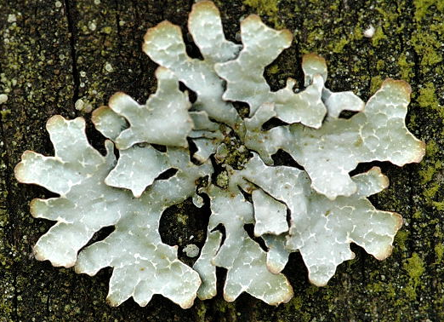
Parmelia sulcata
BIOMASSA (mg dm⁻²)
DISTANZA MASSIMA DALLA SORGENTE (m)

Slide 9
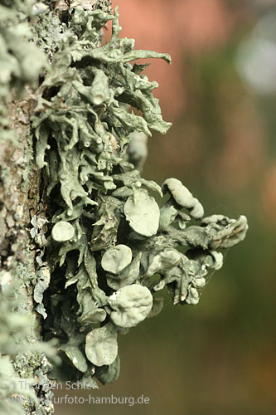
Ramalina fastigiata
BIOMASSA (mg dm⁻²)
DISTANZA MASSIMA DALLA SORGENTE (m)

Slide 10
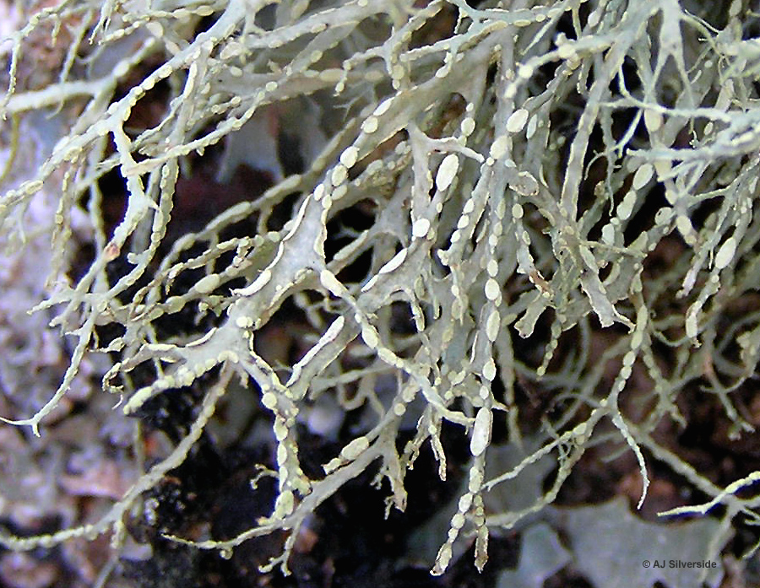
Ramalina farinacea
BIOMASSA (mg dm⁻²)
DISTANZA MASSIMA DALLA SORGENTE (m)

Slide 11
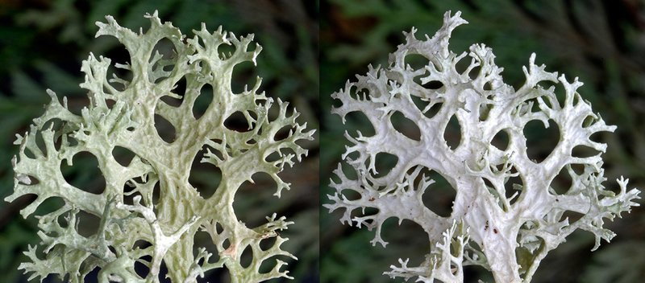
Evernia prunastri
BIOMASSA (mg dm⁻²)
DISTANZA MASSIMA DALLA SORGENTE (m)

Slide 12
BIOMASSA (mg dm⁻²)
DISTANZA MASSIMA DALLA SORGENTE (m)
Biomass of selected fruticose and foliose lichens along the transect of the study area
( Ramalina fastigiata, R. farinacea, Evernia prunastri, Parmelia sulcata).
Notes:
12
serrdbsshhshst

Slide 13
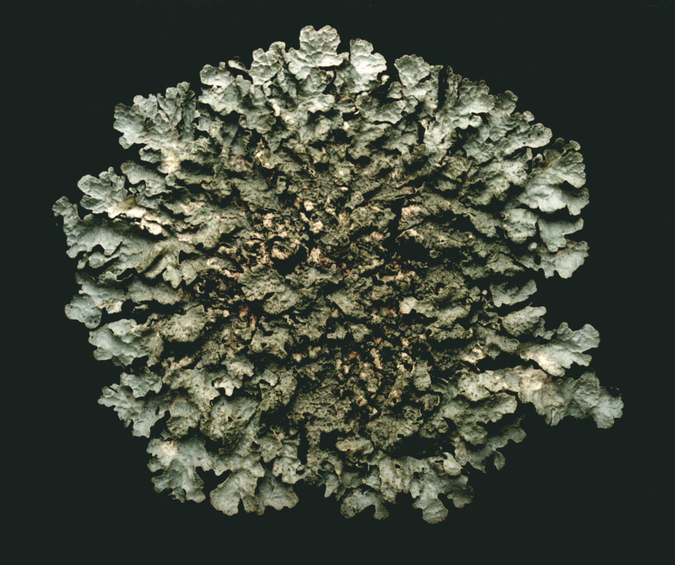
The selected species
Parmelia sulcata Taylor

Slide 14
r²=0,792
C
B
A
Distance (m)
Mean yearly radial growth (cm yr⁻¹)
Correlation between mean yearly radial thallus growth rate (cm yr⁻¹, abscissa), and distance of each thallus from the H₂S emitting chimney.
Notes:
14
serrdbsshhshst

Slide 15
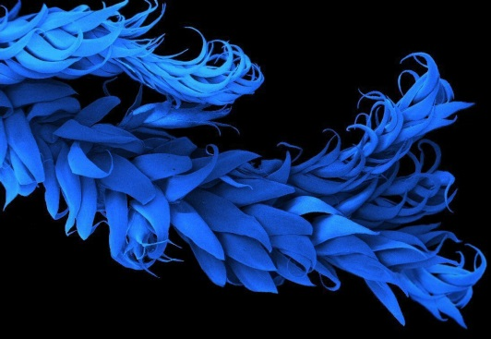
t(A-B) 3,07** 2,71** 0,54 3,94**
t(A-C) 9,12** 9,15** 2,14* 6,34**
t(B-C) 4,43** 6,16** 2,46* 2,78**
Seasonal radial growth (mm) in 30 thalli of Parmelia sulcata, 12 from A ( ), 9 from B ( ), and 9 from C ( ); t = Student’s values (* = 1% < p < 5%; ** = p < 1%).

Slide 16
L’evidente differenza nella crescita lineare è legata ai drastici effetti sul processo fotosintetico dei fotobionti: ratei più ridotti di assimilazione della CO₂ implicano per il micobionte meno molecole organiche da utilizzare per la crescita.
Tretiach M. & Baruffo L., 2001. Effects of H₂S on CO₂ gas exchanges and growth rates of the epiphytic lichen Parmelia sulcata Taylor. Symbiosis 31: 35-46
Si tratta di una vera e propria azione di inibizione, perché l’H₂S si lega reversibilmente al sistema multi-enzimatico della fotolisi dell’acqua, inattivando progressivamente il flusso di elettroni della catena redox.
Bertuzzi S., Tretiach M., 2013. Hydrogen sulphide inhibits PSII of lichen photobionts. Lichenologist, 45: 101-113.

Slide 17
%

Slide 18
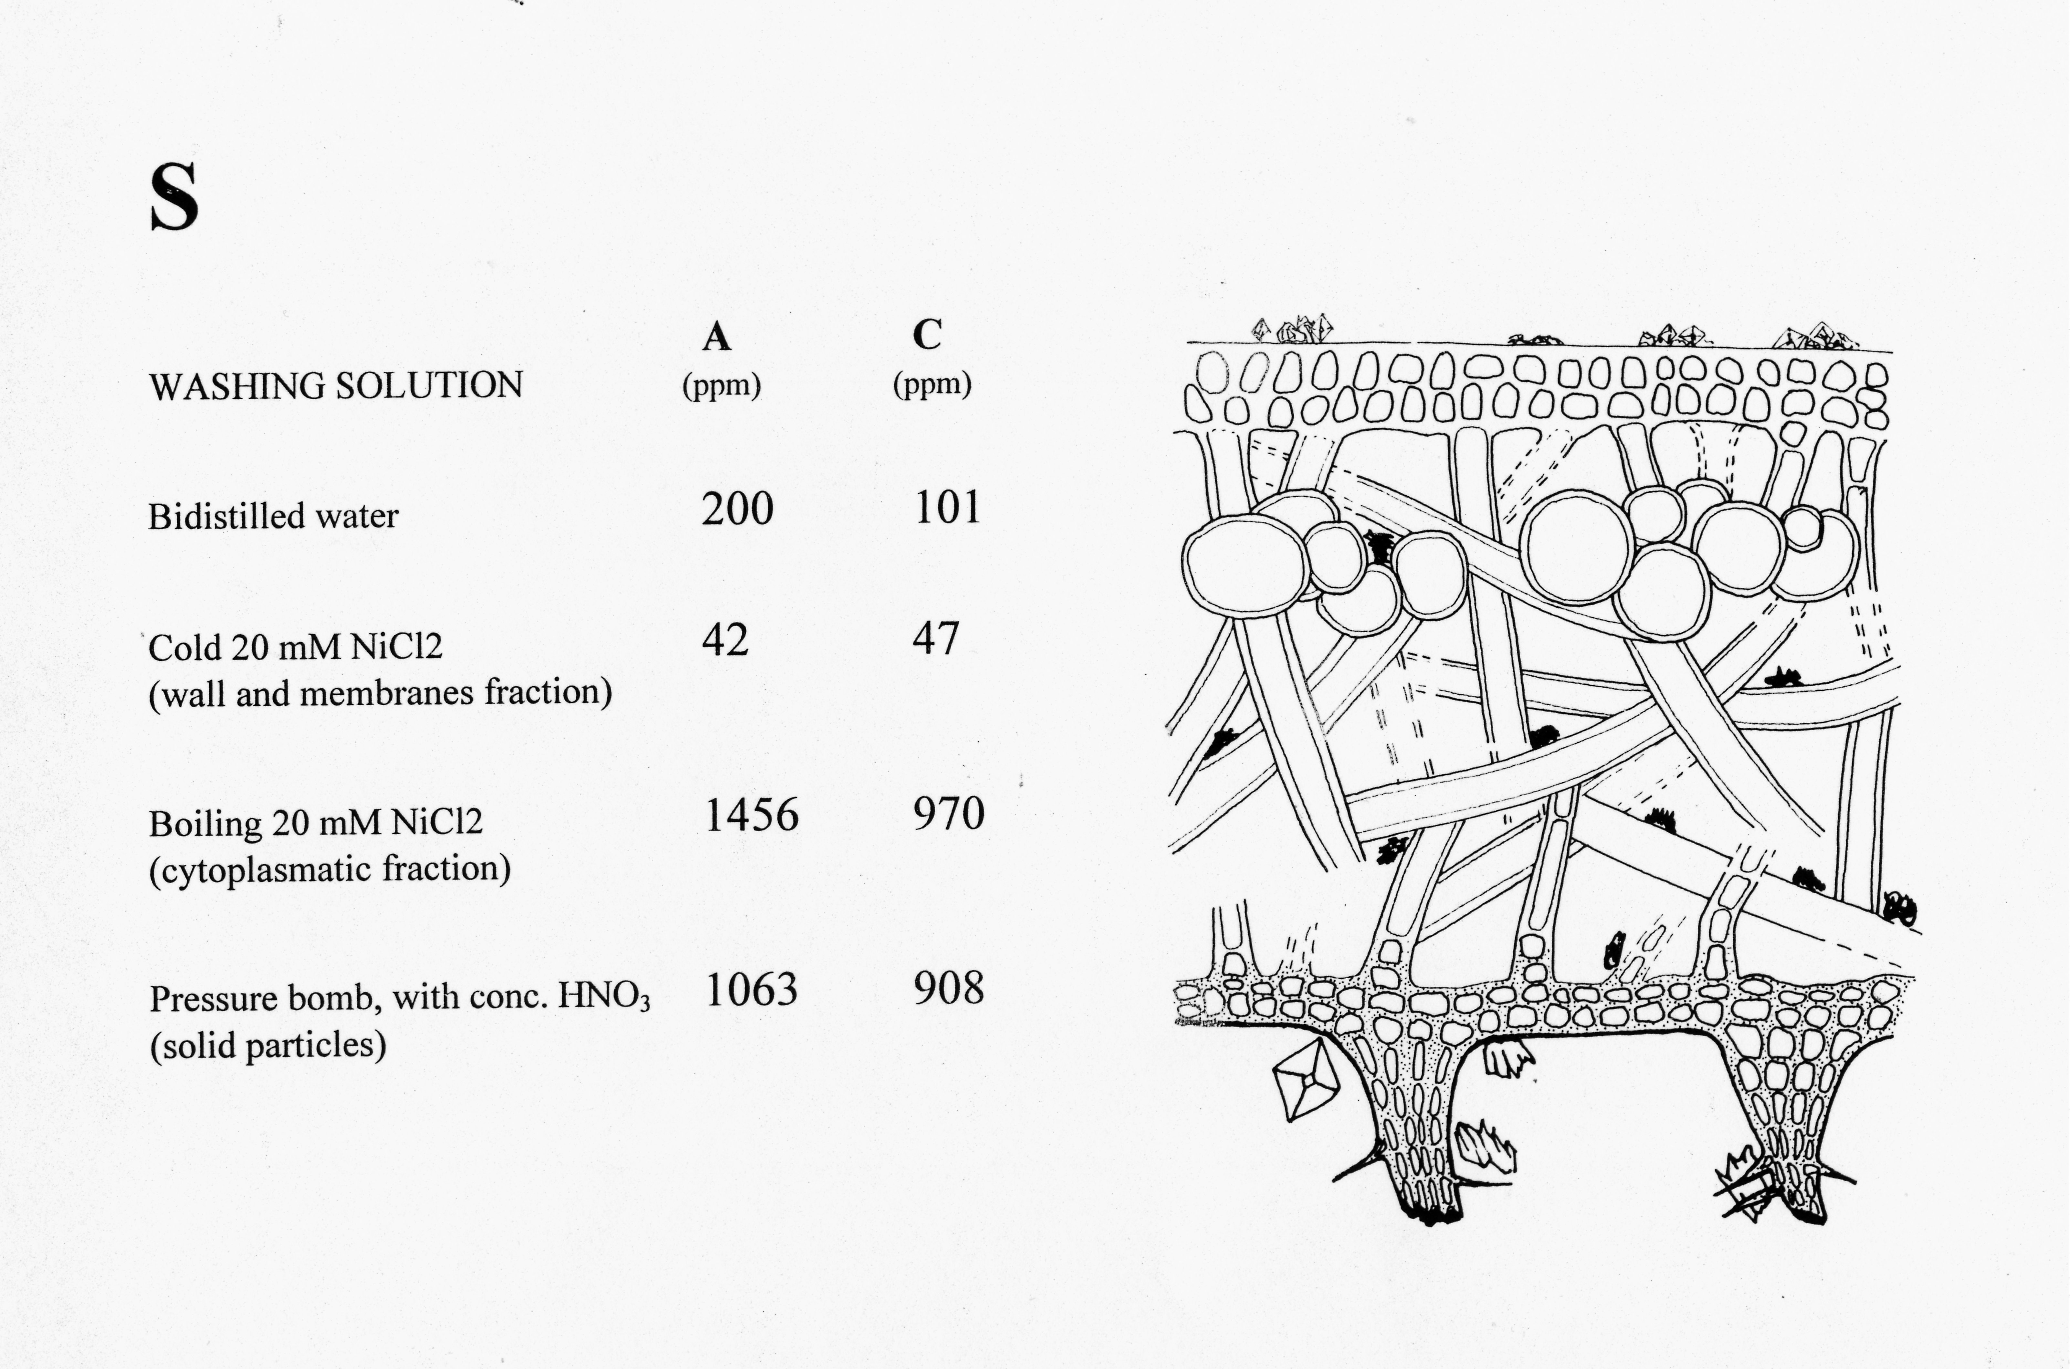
Vicino alla sorgente
Lontano dalla sorgente

Slide 19
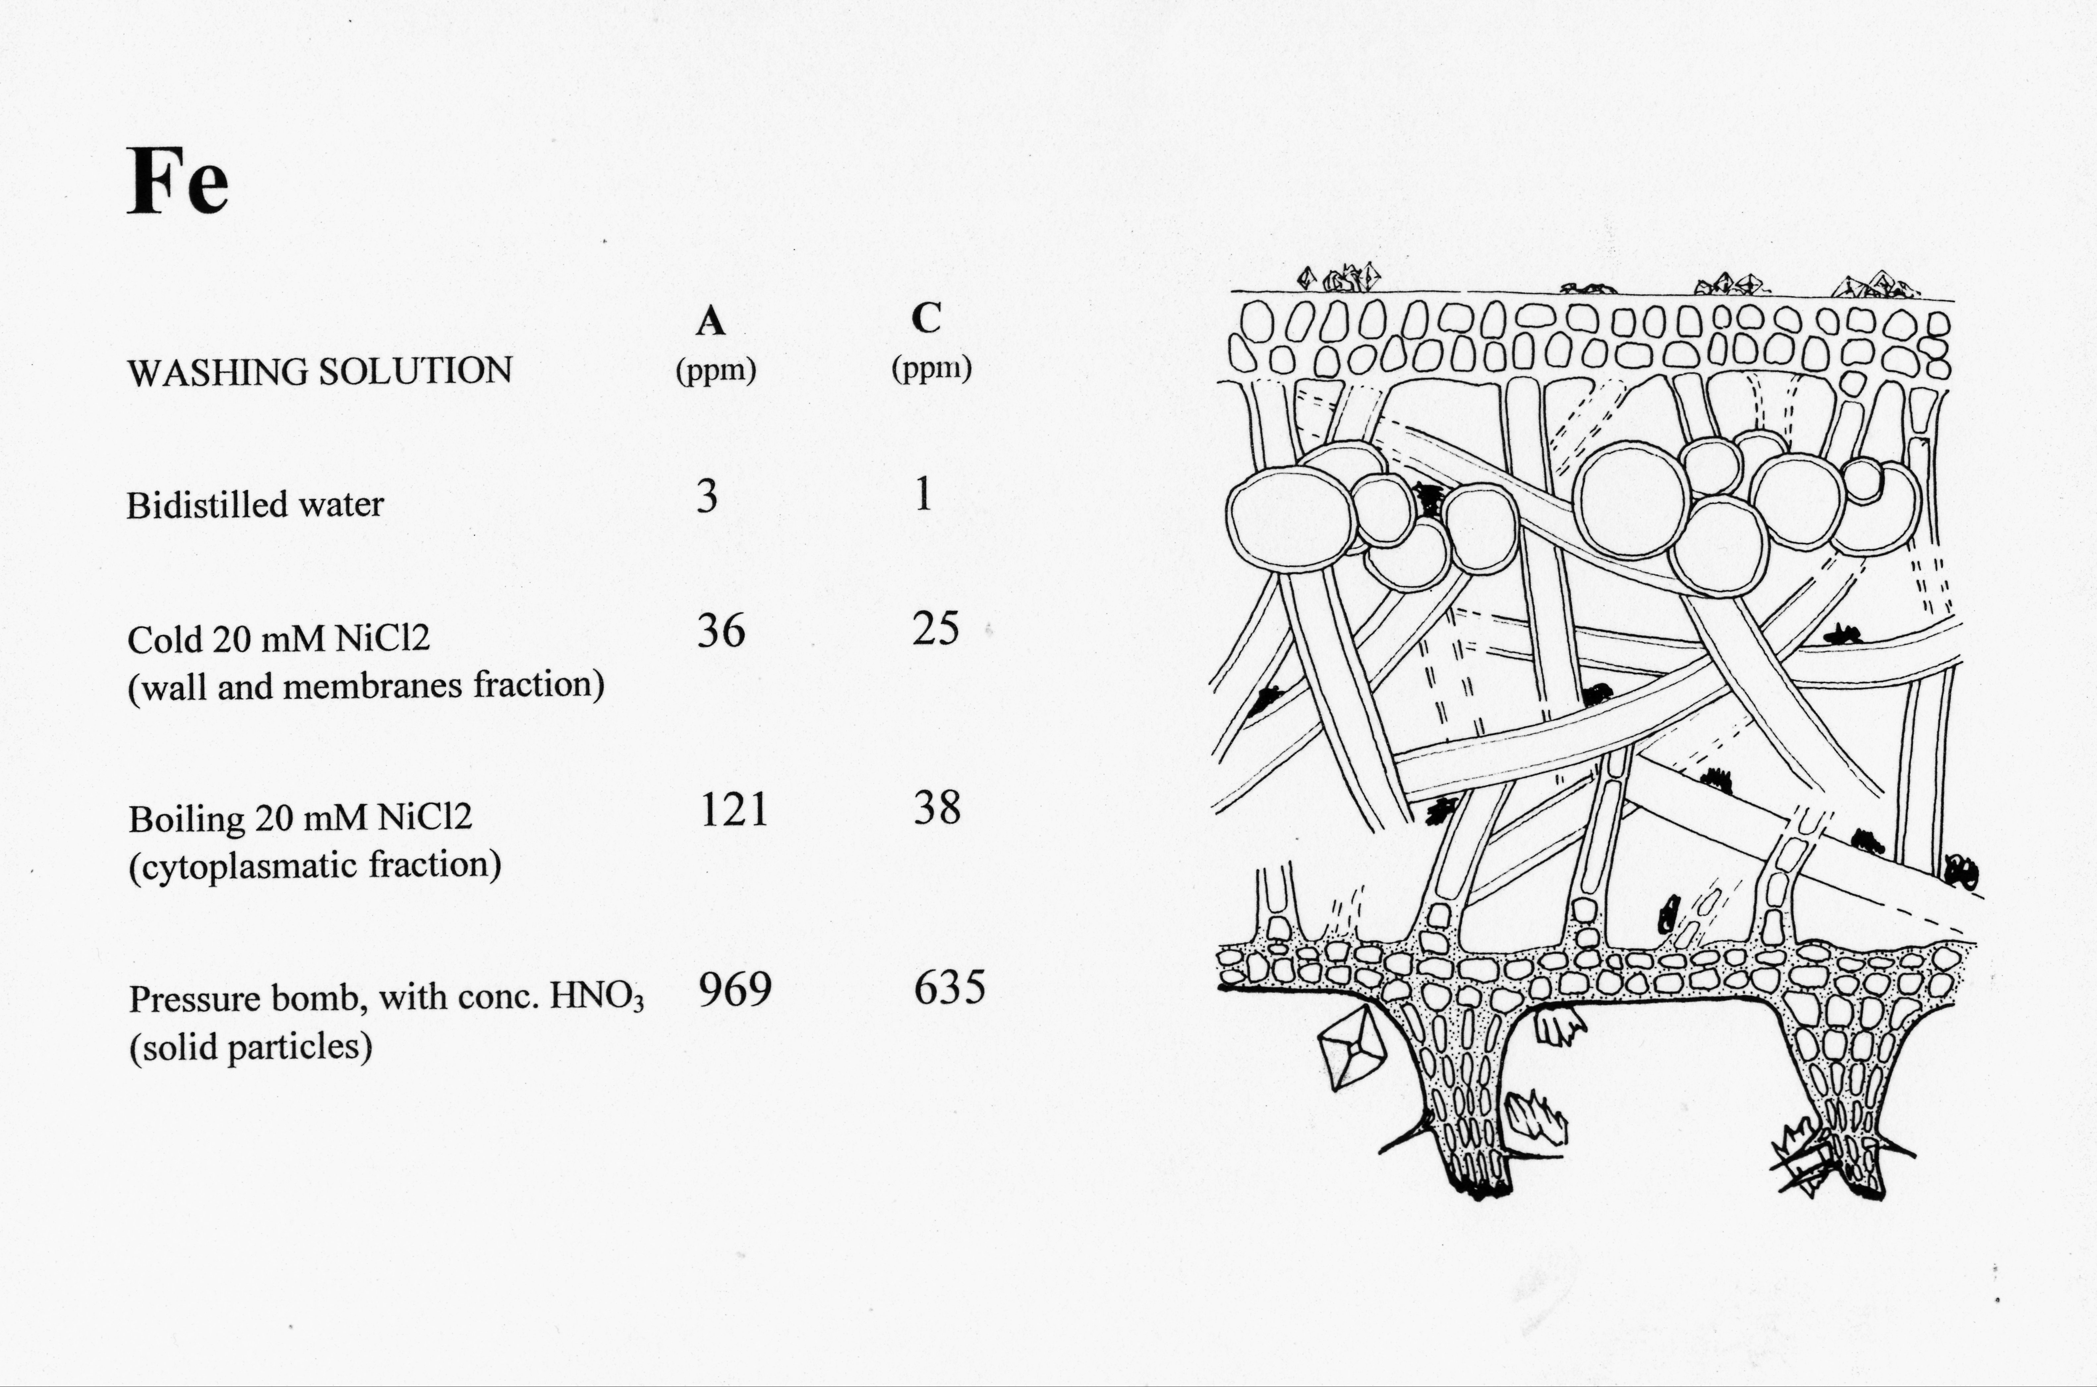
Vicino alla sorgente
Lontano dalla sorgente

Slide 20
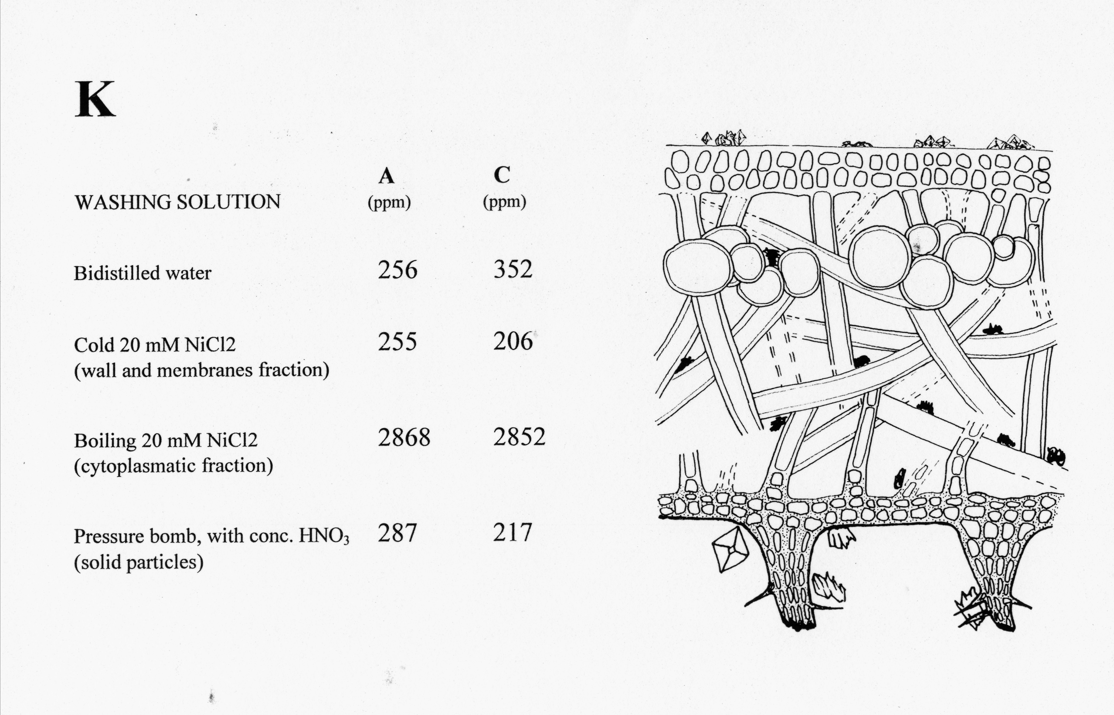
Vicino alla sorgente
Lontano dalla sorgente

Slide 21
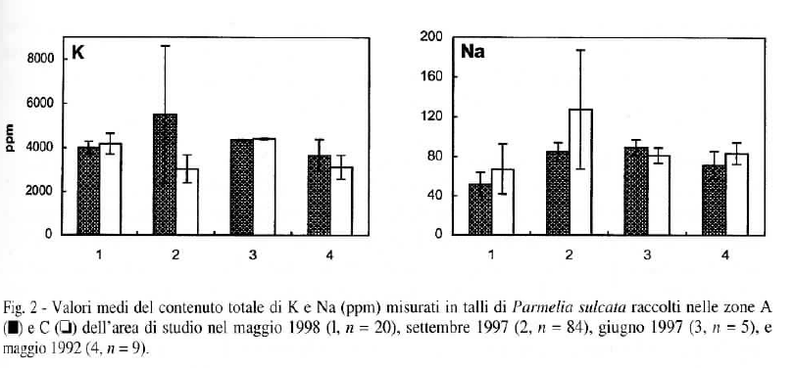

Slide 22
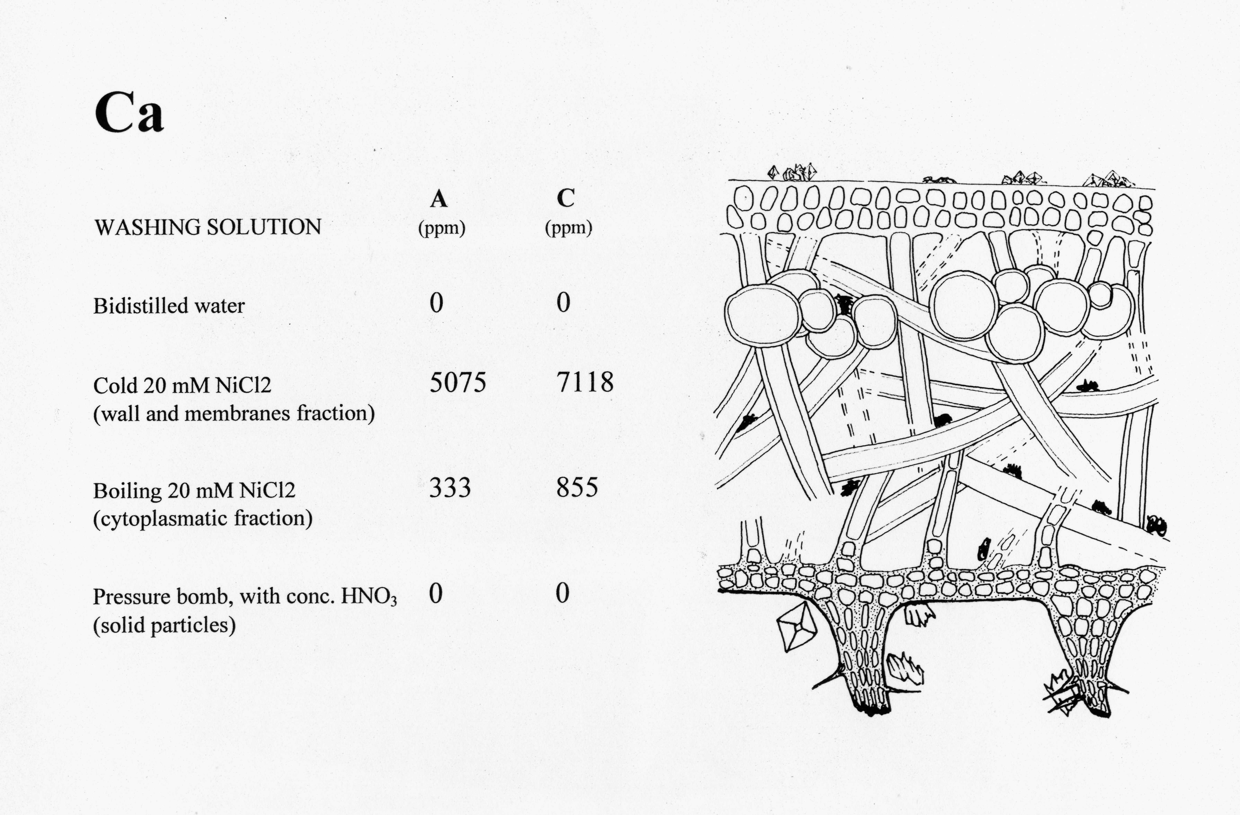
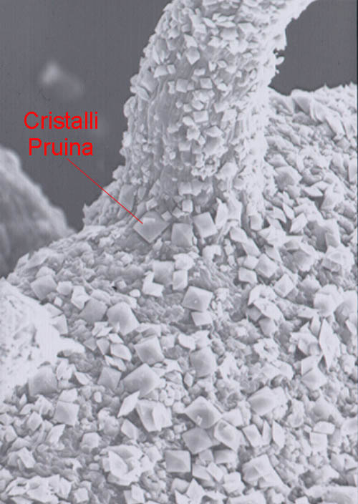
Vicino alla sorgente
Lontano dalla sorgente

Slide 23
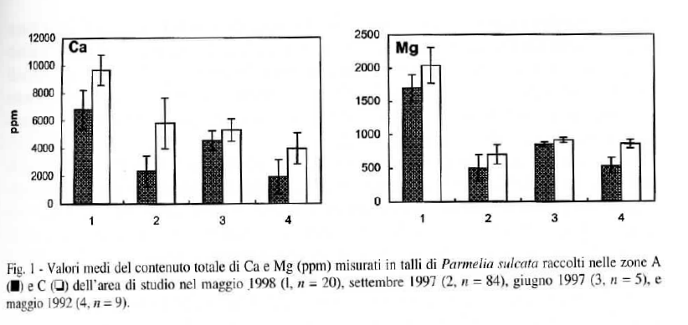

Slide 24
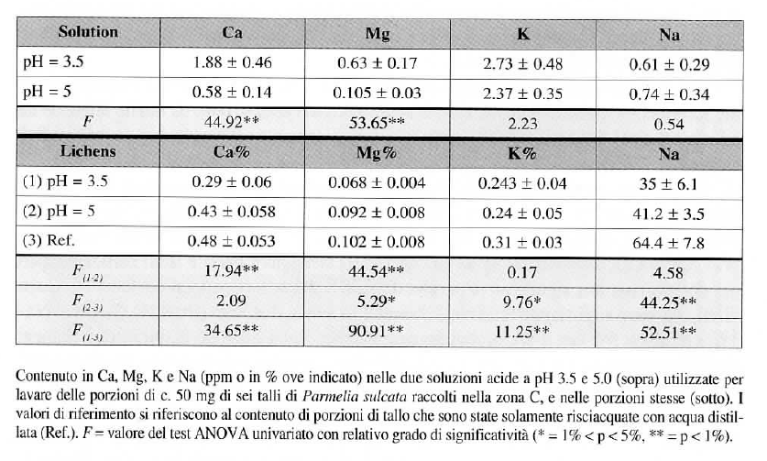

Slide 25
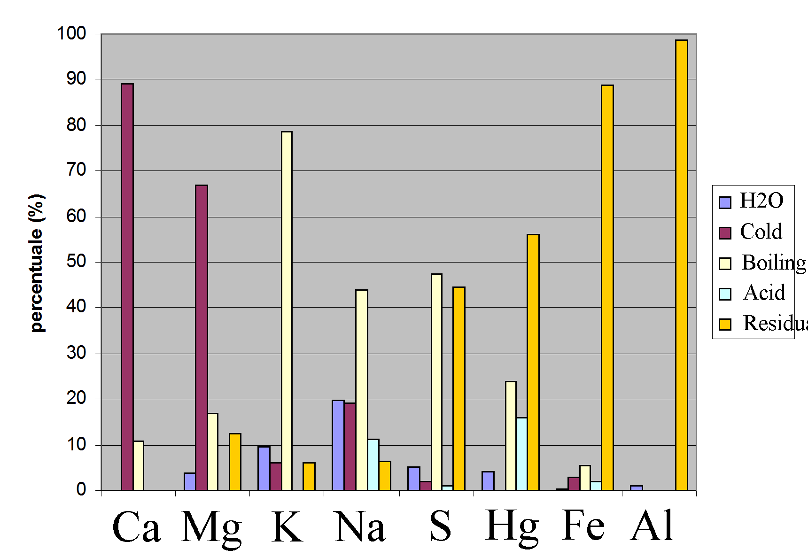

Slide 26
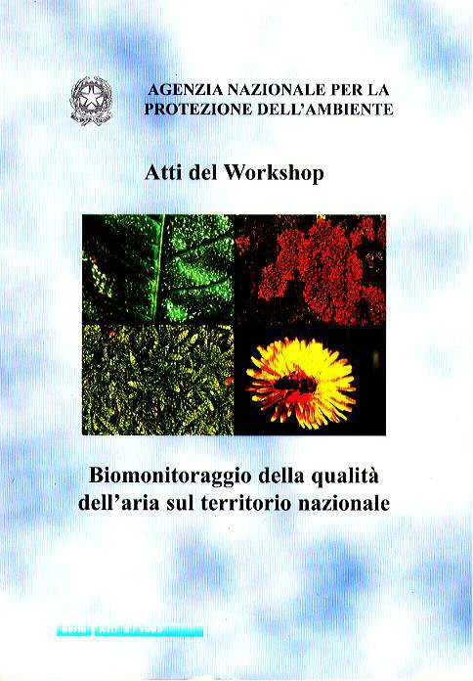
Biomonitoring of persistent pollutants by using autochthonous material
the target species;
the sampling;
sample processing and analysis;
difference among species;
how to compare different data sets:
the naturality scale proposed by Nimis & Bargagli
(1999).

Slide 27
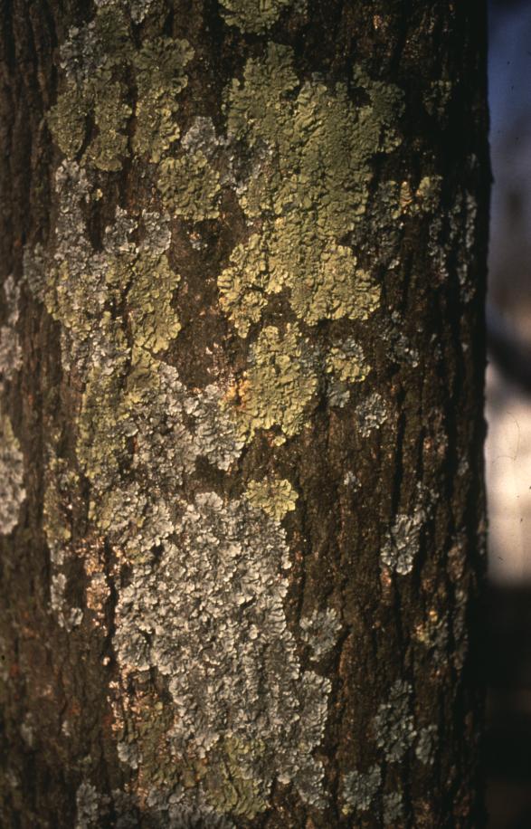
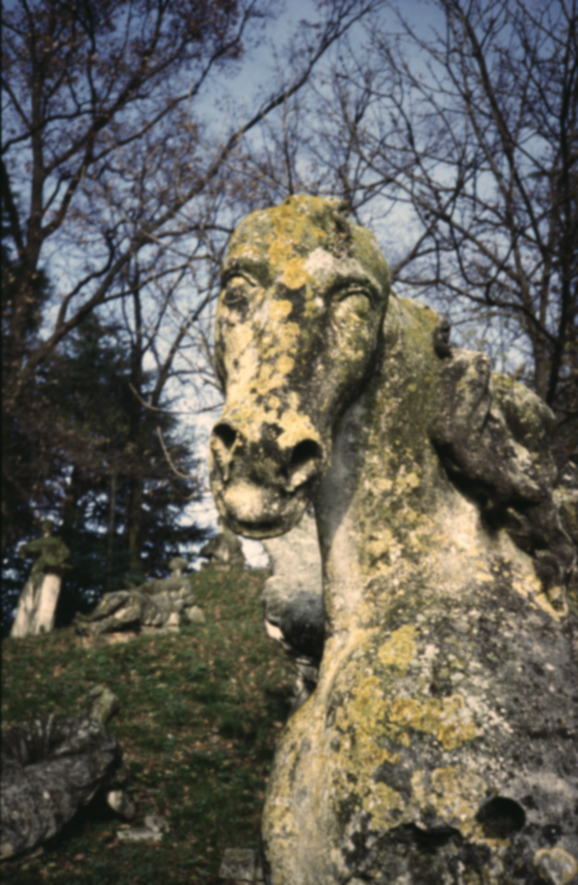
LICHENS
Foliose lichens are preferred, because relatively large quantities of material are necessary for the analytical work. Fruticose lichens are unfortunately very rare in urbanized areas.
Epiphytic (= growing on plants, usually trees) lichens are preferred to epilithic (= growing on rocks) ones, because soil contamination is generally lower.

Slide 28
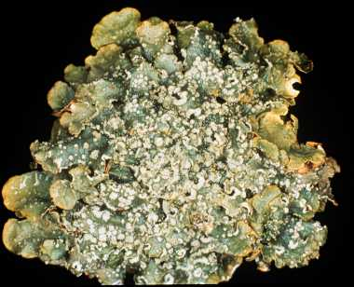

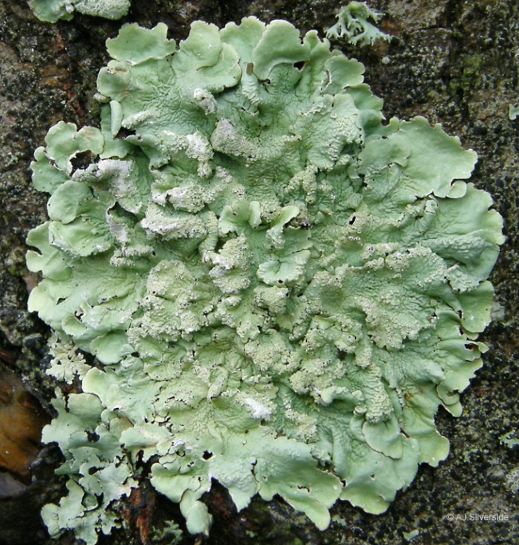
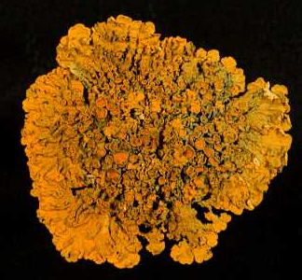
The selected species are rather resistant to airborne pollutants, and have a broad distributional range on the territory. This makes comparisons among different survey areas possible.
Flavoparmelia caperata (L.) Hale
Parmelia sulcata Taylor
Punctelia subrudecta s. lat.
Xanthoria parietina (L.) Th. Fr.

Slide 29
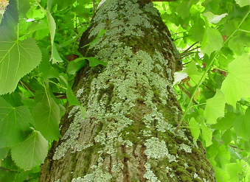
Sampling sites
The stations must be homogeneous, selected far from roads with heavy traffic (or all of them should be near roads with heavy traffic...), in areas covered by meadows.
Lichen sampling is carried out on trunks of deciduous trees, with inclination <10º, without decorticated areas, or evident injuries.
The most common tree species is selected.

Slide 30
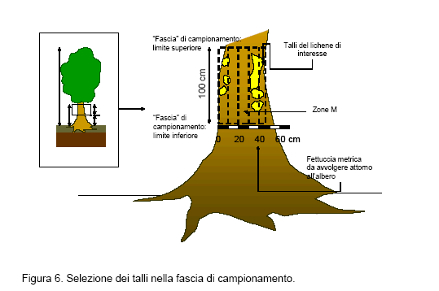
Sampling: from 1 to 2 m above ground, using a ceramic knife („Made in Japan“!), and putting the material in envelopes made with Whatman paper, and – when dry - in a numbered petri dish (preservation?).
If there are more than three thalli, sampling must be random.
1 m
2 m

Slide 31
Sampling chard
photographs of the trees;
a short description of the area;
list of species sampled and list of accompanying taxa;
exposition on the truncks;
height above the ground;
lichen health indications (N: necrosis; D mechanical damage; S: bleaching; 0=absent; 1=low; 2=med-ium; 3=strong);
map (1:5000) of the area;
UTM coordinates;
Critical remarks.

Slide 32
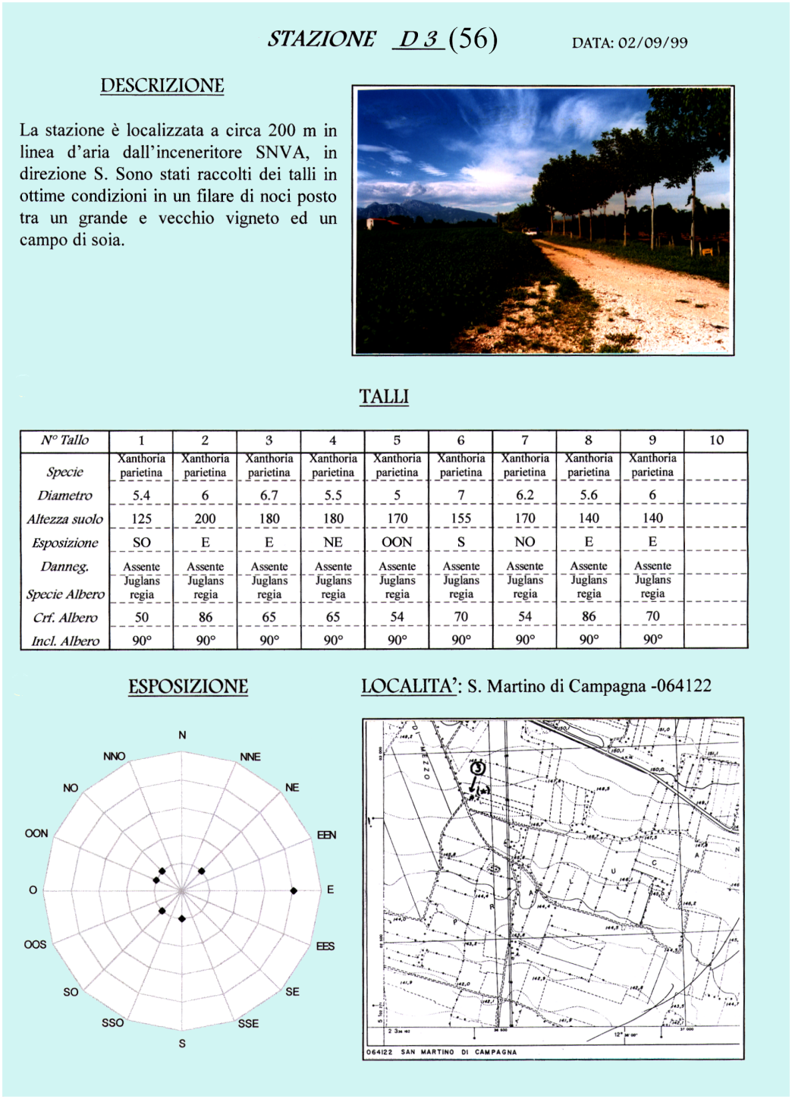
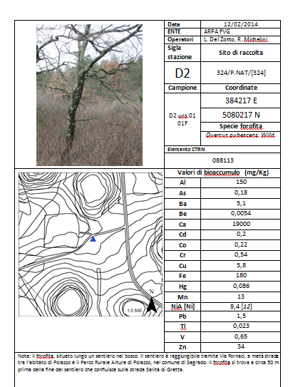

Slide 33

WHEN - Not during rains or at the end of a prolonged drought season. Sampling should be carried out in the shortest time, e.g. in one-two days, without rain events in between. It is preferable that a single operator carries out the sampling.

Slide 34
Sample preparation

Slide 35
Come preparare i campioni
prima dell’analisi?
Una preparazione accurata di campioni di Xanthoria parietina abbatte le concentrazioni di elementi ampiamente diffusi nel suolo quali Al e Fe, mentre per gli altri elementi la variabilità nell’intercettazione delle particelle di suolo non consente di fare previsioni affidabili.
Loppi, Paoli, Frati, Baragatti (2004)

Slide 36
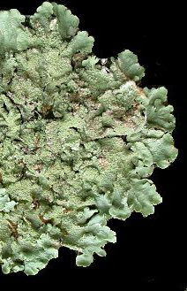
Zonation of trace metal accumulation in three species of epiphytic lichens belonging to the genus Parmelia
Bargagli, Iosco, D’Amato (1987)
Al, Cr, Cu, Fe, Mn, Pb, Se, Zn
Confronto tra specie:
Flavoparmelia caperata
Parmelia saxatilis
Parmelia sulcata
Confronto tra ambienti
Confronto tra parte interna ed esterna del tallo
Lavaggio dei campioni
Notes:
36

Slide 37
Mean metal content in the peripheral (Pe) and central (C) parts of five thalli of Flavoparmelia caperata.
ppm (μg g⁻¹)
II
I
40
III
Pe
Pi
M
C
IV
35
30
25
20
15
10
5
0
Al
Ba
Cr
Cu
Fe
Mn
Ni
Pb

Slide 38
Mean metal content in the external (Pe) and central (C) parts of five thalli of Parmelia caperata.
35
Pe
Pi
M
C
I
II
30
III
IV
25
20
15
10
5
0
Mg
Zn

Slide 39
3
3
2
2
1
Cr ppm
1
0
C
2
M
5.2
Pi
Distanza
dalla strada
5.6
Parte
del tallo
7.3
Pe
16.2
(m)
The central part of foliose lichens (C), being older, has higher metal contents than the peripheral lobes (Pe).

Slide 40
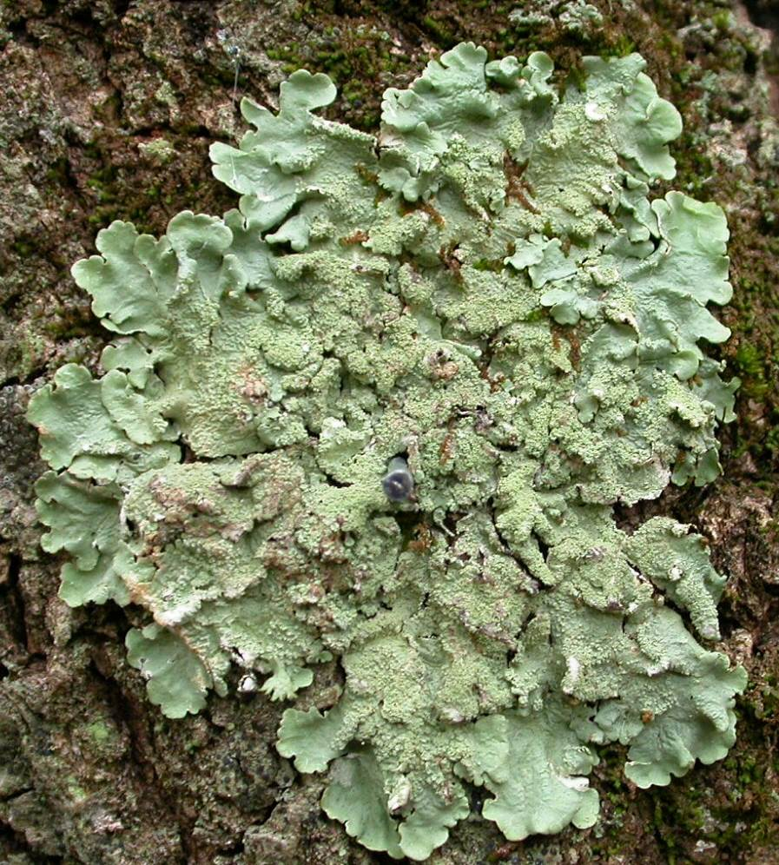
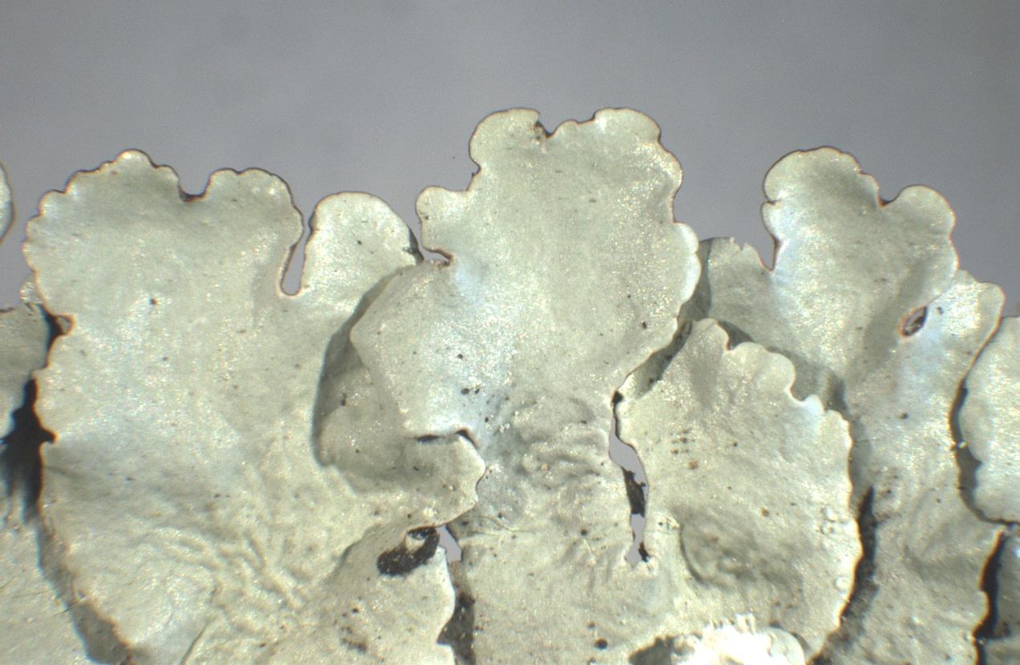
Flavoparmelia caperata (L.) Hale

Slide 41
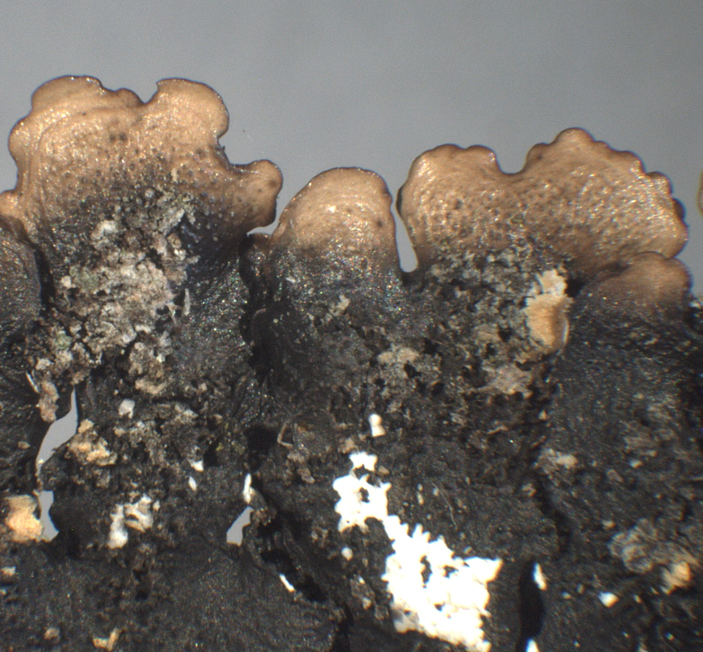
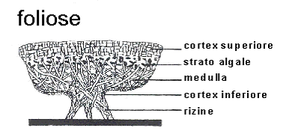
Foliose lichens
Under the stereomicroscope...
Approximately 2-4 hours are needed to clean a sample of 200 mg (!).

Slide 42
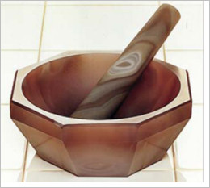
The fragments obtained are carefully homogenized in a agata mortar or are finely chopped using a ceramic knife.
Great care must be used to avoid contamination. A good rule is to dress lattice gloves rinsed in distilled water, and dried out.

Slide 43
The pulverized samples can be preserved for a long time in small envelepes of Whatman paper closed in petri dishes or in teflon tubes until use.
Before analysis, they are dried out at low temperatures (40°C, although a thermal treatment at 120º does not reduce the Hg content!). A small aliquot is used to determine the water content of the material, which generally is below 5-6%.

