Slide 1
Human computer interction
An introduction

Slide 2
Introduction
Interacting with technology has become an essential part of everyday life for the majority of people.
The average user of a computer system is now less likely to understand the technology. Since, there are different types of technology they have to use.
People are busy and may spend little or no time actually learning a new system.

Slide 3
Therefore, computer systems should be easy to use, easy to learn, and with no errors.
To design and develop of such a system is a major concern of HCI

Slide 4
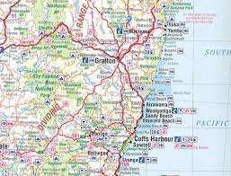
Useful and usable
The ultimate goal of design in HCI is to create interfaces that are both useful and useable. Useful means that the interface allows the user to achieve some task, but usefulness is a pretty low bar. For example, a map is useful in finding your way from one place to another, but it isn't the most useable thing in the world.

Slide 5
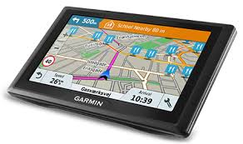
So our big concern is usability. That's where we get things like navigation apps. Notice how we have to focus on understanding the task when we're performing design.
If we set out to design a better map… we don’t make it usable
It was through understanding the task of navigation itself that we realized we could offload a lot of the cognitive load of navigation onto the interface, closing the loop between the user and the task of navigation.

Slide 6
What is HCI?
Human-computer interaction (HCI): “is a discipline concerned with the design, evaluation and implementation of interactive systems for human use and with study of major phenomena surrounding them.”

Slide 7
What is HCI?
HCI (human-computer interaction) is the study of interaction between people (users) and computers.
Interaction between users and computers occurs at the user interface
The golden principle in HCI is that “people should come first”. (TO BE DISCUSS!!)

Slide 8
HCI consists of three parts:
Human: could be an individual user or a group of users.
Computer: could be any technology ranging from the general desktop computer to a large scale computer system.
Interaction: any direct or indirect communication between a human and computer.

Slide 9
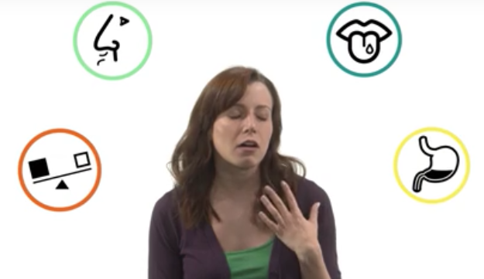
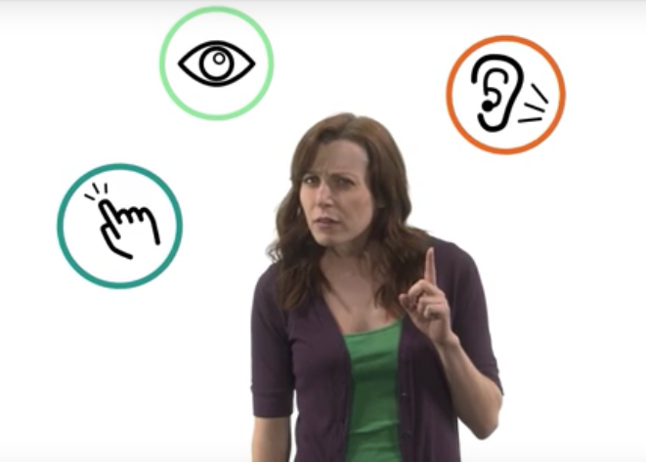
A human interact with the environment through different senses (complexity keyboard… VR)
A human has memory, experience, skills, knowledge

Slide 10
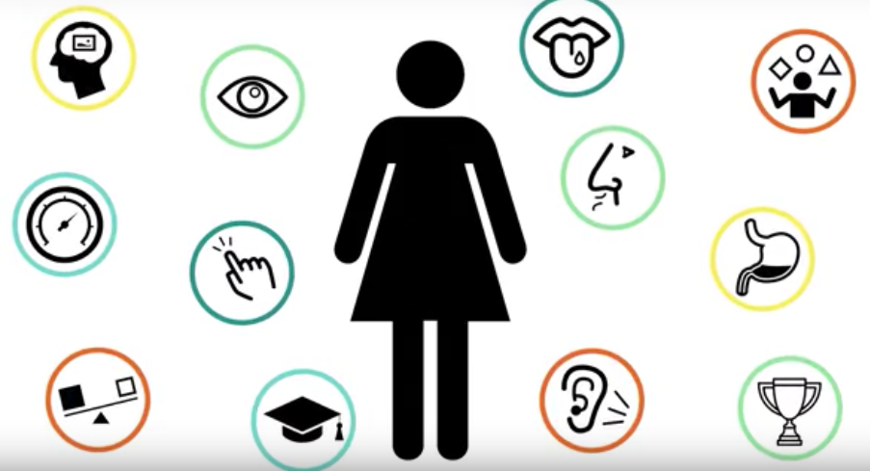
In HCI all the elements have to be taken into account

Slide 11
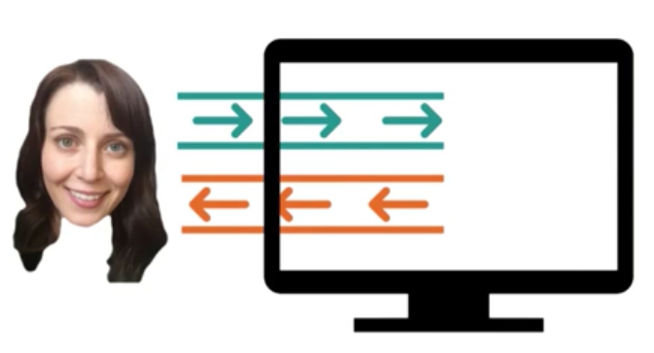
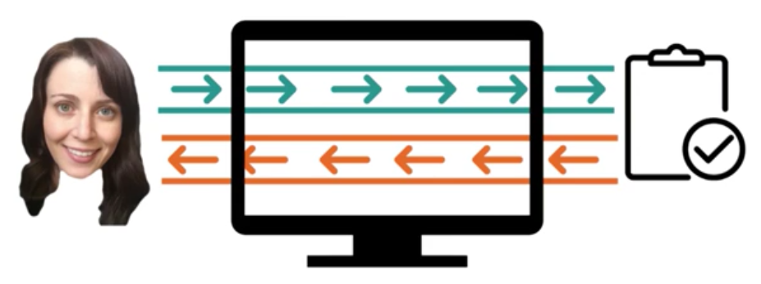
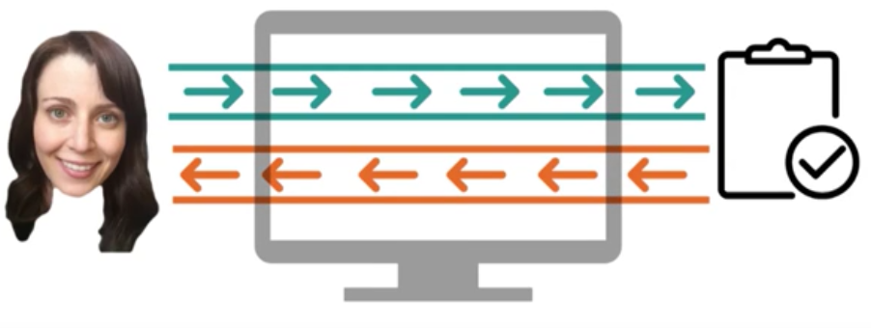
The human interact with the computer (simplistic scenario)
The computer interacts with a task through a computer (real scenario)
Goal: make the interface almost invisible

Slide 12
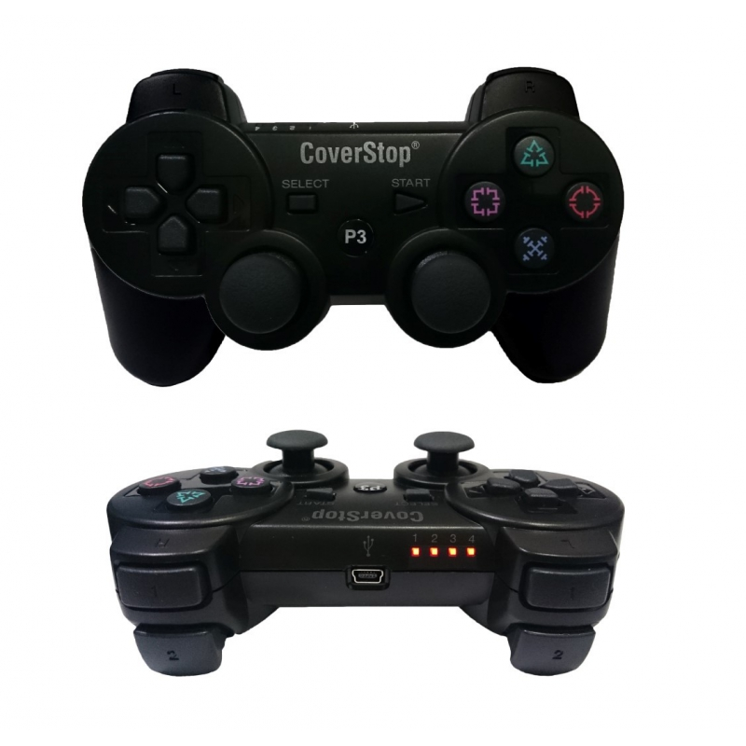
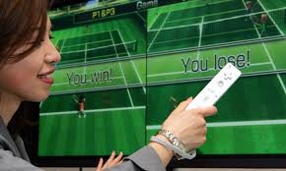
Example (input for tennis game)

Slide 13
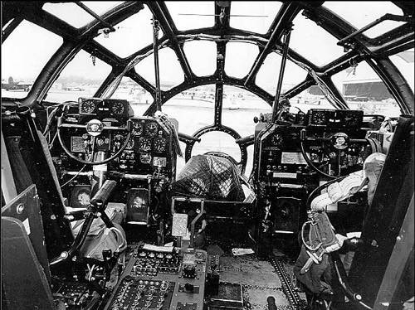
HCI concentrates on the study of human factors
The study of human factors started during the Second World War by US army.
Usability was born because of badly designed arms that caused “friendly fire” during war.
It was during war time that the value of human factors and ergonomics was recognised as a great way to create more efficient and effective soldiers, i.e. better killing machines. Our usability predecessors spent their days working on the battleground, ensuring that soldiers could get on with their daily tasks in the most optimal manner. What kinds of things did they do? Their work involved much more focus on human factors and ergonomics, taking into account the effects of workload, fatigue, physical task design, mental workload, teamwork, environmental effects.
It was during the second world war, that practitioners expanded their focus to aircraft and how through more intuitive design of airplane cockpits, pilot error could be greatly reduced.

Slide 14
The HCI Challenge

Slide 15
HCI is Not about
Making the interface look pretty
Only about desktop computers (and that goes for computing as well!)
Something that would be nice to do but usually there’s no time for it

Slide 16
HCI is about
Understanding the users
Understanding users tasks
Understanding the surrounding environment
Design prototype
Evaluate the system

Slide 17
The goals of HCI
The goal of HCI “is to develop or improve the safety, utility, effectiveness, efficiency and usability of system that include computers.”
(Interacting with computers, 1989, p3)

Slide 18
What is Usability?
A usable system is:
easy to use
easy to learn
easy to remember how to use
effective to use
efficient to use
safe to use
enjoyable to use
The words effective and efficient both mean "capable of producing a result," but there is an important difference.
Effective means "producing a result that is wanted".
Efficient means "capable of producing desired results without wasting materials, time, or energy".

Slide 19
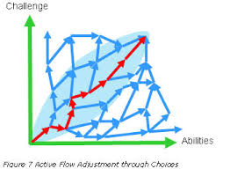
Perché si gioca? …tra gli altri motivi: Felicità di Flusso
Mihaly Csikszentmihalyi
La felicità è quel particolare stato della mente nel quale si è chiamati ad affrontare una sfida riuscendo a completare il task.

Slide 20
Intense and focused concentration on the present moment
Merging of action and awareness
A loss of reflective self-consciousness
A sense of personal control or agency over the situation or activity
A distortion of temporal experience, one's subjective experience of time is altered
Experience of the activity as intrinsically rewarding, also referred to as autotelic experience

Slide 21
Why is usability important?
A Good user-interface can:
1. Earn a company billions.
2. Increase users loyalty.
3. Increase users trust.
4. Makes users happy : )

Slide 22
The importance of HCI
Can Preventing accidents
Health and safety concerns
Can reduce the cost of customer training and support
Direct correlation between HCI and sales

Slide 23
A Bad user-interface can:
1. be annoying, frustrating, and even deadly.
2. Increase mistakes in data entry and system operation.
3. Makes functions become completely inaccessible.
4. System failure because of user rejection.

Slide 24
Why HCI is Important in the Context of WWW?
• Competition is very close (just another link…)
• Comparison is easily possible (example – Online-Shop)
• Users who can’t find the product in the shop can not buy it
• Users who are not able to fill in correctly the order form are not going to buy

Slide 25
It is not Simple to Make Good User Interfaces
Basic misconceptions:
• If I (the developer) can use it, everyone can use it
• If our non-technical staff can use it, everyone can
• Good user interfaces are applied common sense
• A system is usable if all style guidelines are met

Slide 26
Examples of good and bad design

Slide 27
Examples ..(cont.)

Slide 28
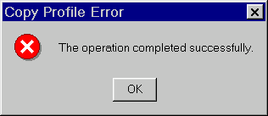
Examples ..(cont.)

Slide 29
Examples ..(cont.)

Slide 30
Examples ..(cont.)

Slide 31
Disciplines Contributing to Human-Computer Interaction

Slide 32
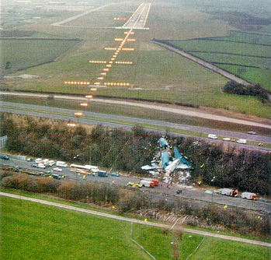
A real life example
1) If the video doesn’t record a TV
program because we pressed
the wrong button, we are likely
to feel angry.
2) A real example: a pilot shuts down the wrong engine and the plane crashes (as happened near Leicestershire, in England on the M1 motorway in 1989), this is obviously more serious. 47 died
https://it.wikipedia.org/wiki/Volo_British_Midland_92

Slide 33
Fact
- Fletcher Buckley (Member board of IEEE) “: 85% of Software projects are either late or delivered without satisfying the specification.”
But WHY?

Slide 34
Reasons for Failures
Projects in general fail for various reasons:
lack of senior management commitment
lack of user involvement
lack of user requirements specifications
poor project planning and team problems

Slide 35
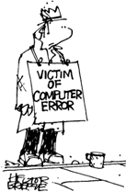
Traditional approaches to system development
Is concerned with producing software, software specification, maintainability, and testing
Generally considers the interface to be just another software component.

Slide 36
Example of traditional approach
requirements analysis encompasses those tasks that go into determining the needs or conditions to meet for a new or altered product or project, taking account of the possibly conflicting requirements of the various stakeholders, analyzing, documenting, validating and managing software or system requirements
Requirements specification
The waterfall model
Analysis
Design
Software design Software design may refer to either "all the activity involved in conceptualizing, framing, and ultimately modifying complex systems" or "the activity following requirements specification and before programming, in a stylized software engineering process."
Software design usually involves problem solving and planning a software solution. This includes both a low-level component and algorithm design and a high-level, architecture design (ex. car simulator).
Implementation
Testing
Operation and maintenance

Slide 37
Introduction to User Centered approach
This approach normally involves a number of key activities throughout the development of the software including:
Involving users
Obtaining their feedback on the design
Providing prototypes for system evaluation and re-design in light of user feedback and comments.

Slide 38
The life cycle for interactive systems
user needs
Requirements specification
Analysis
Design
Implementation
Testing
Operation and maintenance

Slide 39
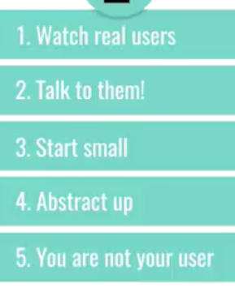
TIPS to identify the task
Start to identify the smallest operations in each task (decompose)
Keep asking why they are performing a specific action
Live behind your previous experince

Slide 40
User Centered Development Steps to perform…
Data Collection
Data Analysis
Prototyping
Design
Evaluation

Slide 41
1. Data Collection
Data recording
Using media
Interviews
Stakeholder interviews
User and customer interviews
Questionnaires
Surveys, product reviews
Literature review
Studying existing systems

Slide 42
3. Prototyping
Advantages of Prototyping:
Users are actively involved in the development
It provides a better system to users
Errors can be detected much earlier
Quicker user feedback is available leading to better solutions

Slide 43
5. Evaluation
Testing the usability, functionality and acceptability of an interactive system
Expert evaluation
Evaluation by Subject Matter Experts
User evaluation
Evaluation by user or customer
A subject-matter expert (SME) or domain expert is a person who is an authority in a particular area or topic

Slide 44
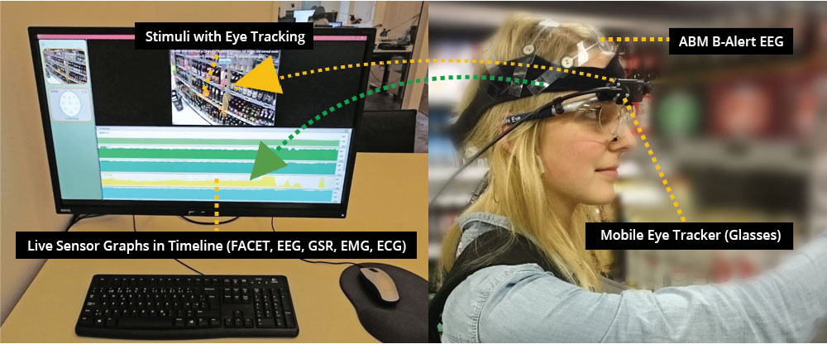
measuring

Slide 45
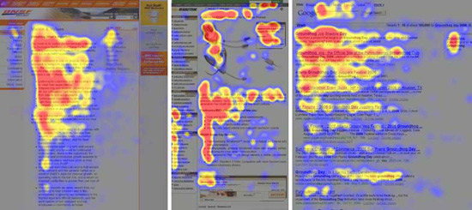
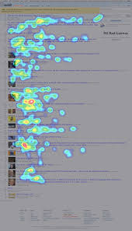
«L» shape
Reaction time (remoted monitored)

Slide 46
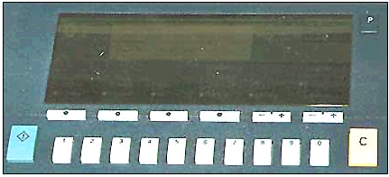
Designer vs. Users
Designer meant by ‘C’ = Clear People thought that ‘C’ = Copy
Why this photocopier does not work?

Slide 47
Examples ..(cont.)

Slide 48
Examples ..(cont.)

Slide 49
Examples ..(cont.)

Slide 50
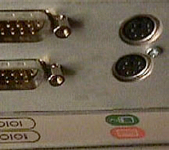
Examples ..(cont.)

Slide 51
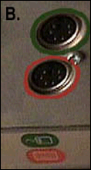
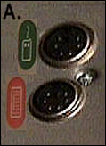
Examples ..(cont.)

Slide 52
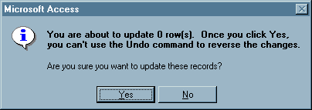
Examples ..(cont.)

Slide 53
Examples ..(cont.)

Slide 54
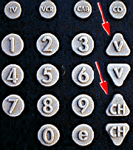
Examples ..(cont.)

Slide 55
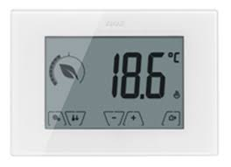
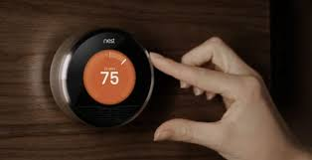
Mistakes into designing interface
One of the mistakes many novice designers make, is jumping too quickly to the interface, without understanding the task.
For example, think about designing a new thermostat. If you focus on the interface, the thermostat itself, you're going to focus on things like the placement of the buttons or the layout of the screen, on whether or not the user can actually read what's there, and things like that. And those are all important questions. But the task is controlling the temperature in an area.
When you think about the task rather than just the interface, you think of things like nest, which is a device that tries to learn from its user and act autonomously.
https://www.youtube.com/watch?v=1qkSkOn4h-A

Slide 56
References
http://www.cs.bham.ac.uk/~rxb/Teaching/HCI%20II/intro.html
http://www.baddesigns.com/examples.html
http://www.goodexperience.com/tib/archives/webtech/
http://pages.cpsc.ucalgary.ca/~saul/hci_topics/topics/psych.html
http://homepage.mac.com/bradster/iarchitect/
www.useit.com
http://faculty.ed.umuc.edu/~meinkej/inss690/wilson.htm

Slide 57
New topic Obiquitous computing
Embedded computer in everyday life
Referred to as pervasive computing
Related to Internet of things
Ubiquitous requeire that we need to develope interfaces for everyday activities
Wearable technologies

Slide 58
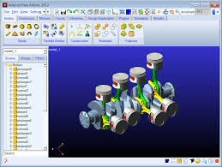
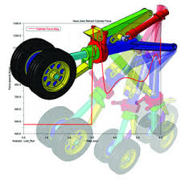
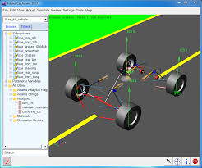
Goal oriented software (adams example)

Slide 59
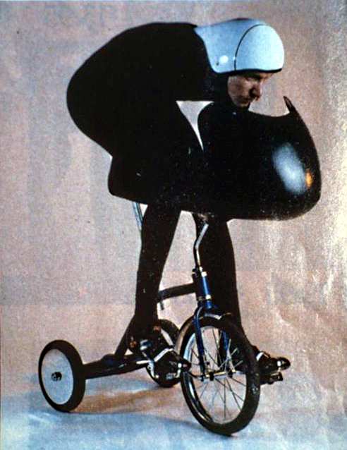
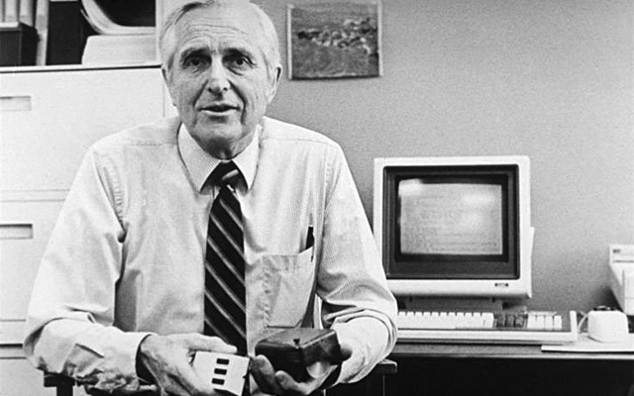
“if ease of use was the only valid criterion, people would stick to tricycles and never try bicycles”
Douglas Engelbart
(the inventor of the mouse)

Slide 60
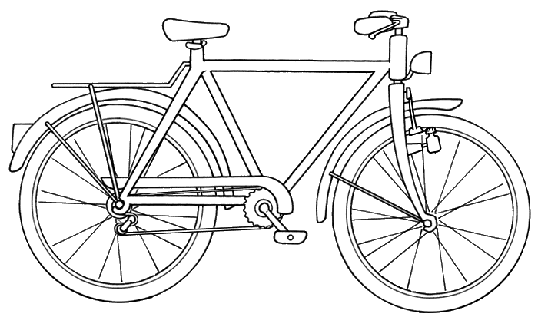
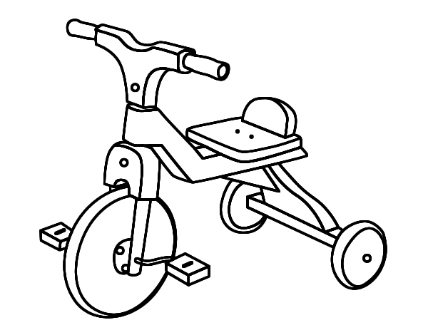
Performance vs Usability
PERFORMANCE
- Human adapt himself to the machine
How to move forward?
Human and the machine co-adapt: progressive coadaptation
USABILITY

Slide 61
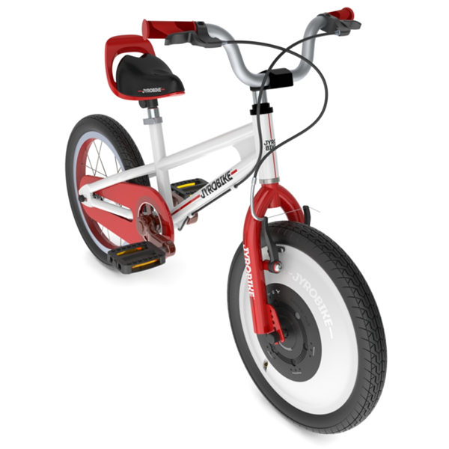
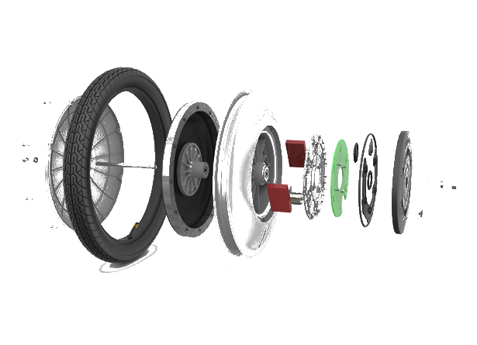
Example of progressive coadaptation
Progressive coadaptation is obtained
by progressively decreasing the speed of the gyroscopic wheel
according to the skill.
https://www.youtube.com/watch?v=Mjmjwfvg78k
Gyroscopic wheel

Slide 62
Human-centered approach
The aim of human-centered (or user-centered) coadaptation is to create a pleasant interface (Dixon,2012) that maximizes usability.
According to ISO 9241-210:2010 (Jokela et al., 2003), human-centered design is an “approach to systems design and development that aims to make interactive systems more usable by focusing on the use of the system and applying human factors/ergonomics and usability knowledge and techniques”

Slide 63
Goal-oriented approach
Goal-oriented co-adaptation focuses instead on designing a user interface that can be exploited at its maximum potential.
This approach makes the assumption that the user is very skilled in performing the task.

Slide 64
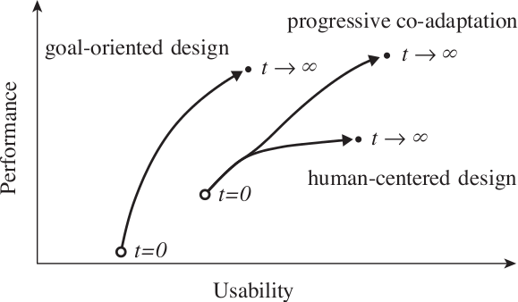
Goal-oriented and user-centered design in user interfaces

Slide 65
Progressive co-adaptation
The co-adaptation design approach aims to combine the advantages of human-centered design with the final performances achievable using the goal-oriented design by creating an interface that can adapt to the skills of the user assessed over time.
Not only the interface adapts itself to the user’s skills, but also trains the user.
The training forces the user to improve his skill

Slide 66
USER
INTERFACE
MACHINE
= set of parameters that
characterize the interface
Φ represents the set of measurable parameters
related to human skills.
Σ represents the group of measurable parameters
related to the interface: time-delay during
telemanipulation, operator model uncertainties, environment
force uncertainties, stability parameters, etc.

Slide 67
Simple tracking task with a mouse
χ is the mouse acceleration = $\frac{vel cursor}{vel mouse}$
(the cursor distances increases if the mouse is moved quickly)
Φ is the average of the inverse tracking error (skill index)
When dΦ/dt -> 0 (no more improvements), χ is increased
Φ
TIME

Slide 68
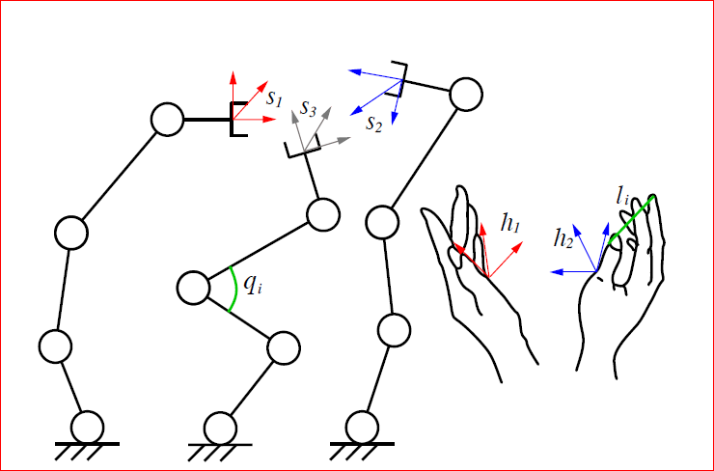
The third robot is controlled in a direct rate control
mode by the other fingers. Let qi be the command
speed of each joint of the robot and li the distance
of a fingertip from the origin of the frame h1 (or h2).
The control role of each robot’s joint is given then by
the set of relations: qi = ki×(li-lio).
Goal: teleoperate three 6-DoFs robots
independent by means of two hands.
The two thumb poses h1 and h2 are used to
control the end-effectors of two robots s1 and s2
according to a Resolved Position Control approach.
ki is progressively modified according to the
prograssive coadaptation approach.

Slide 69
Neural Network Co Adaptation (pogo visual game example, see desktop file)

