Slide 1
BLAST
Acronym for Basic local alignment search tool
BLAST is the most important tool for comparing nucleotide and protein sequences
Input sequence (query) vs database
Can be used online (NCBI BLAST) or locally on your own PC
Database: publicly available (UniprotKB, NCBI Genomes, etc.) or custom (e.g. local database)

Slide 2
Some background
Based on the di Smith-Waterman algorithm, which is used for local alignment
Highly sensitive, so it is optimal for detecting small regions of similarity in squences with low homology
Encoutered a great success in bioinformatics with FASTA and BLAST applications (FASTA was another tool for sequence similarity searches whcih we will not study in detail)
Based on similarity matrices (PAM o BLOSUM) which assign positive scores to identical or similar amino acids and negative scores to dissimilar amino acids and gaps

Slide 3
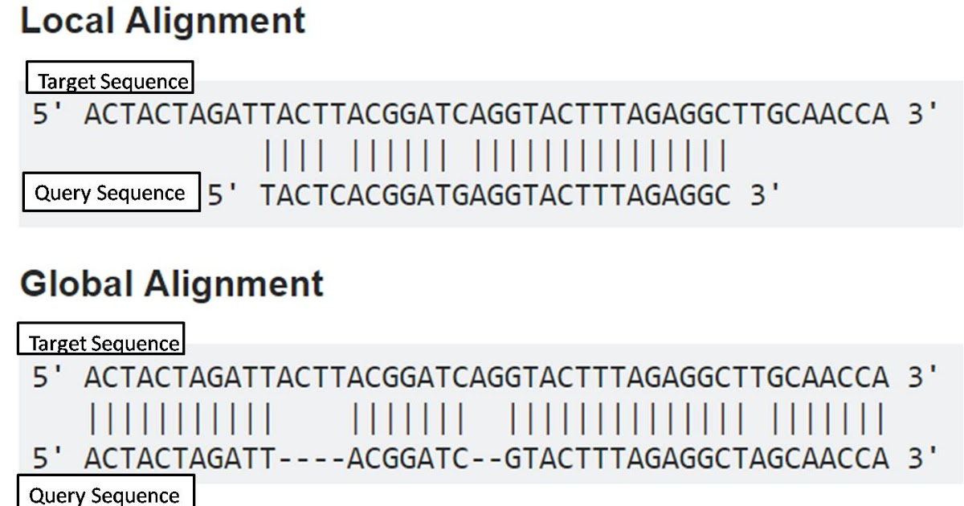
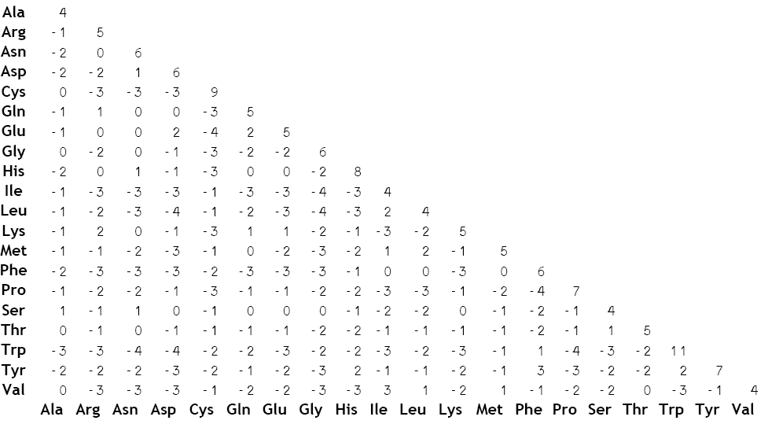
Some basic concepts for bioinformatics noobs
Local vs global alignment
An example can be seen below… which one is the «best» alignemnt?
We need to thing about what we are mostly interested into
Similarity matrix
Two-enry matrix with positive and negative scores calculated based on the similarity among amino acids (i.e. charge, hydrophobicity, etc.)
Can be of two types, PAM or BLOSUM, and they have a numeric index (e.g. PAM250)

Slide 4
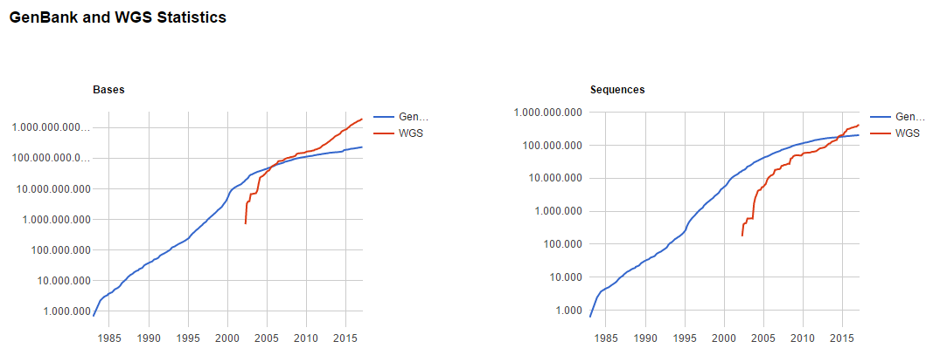
An heuristic approach to sequence alignment
Sequence similarity searches are carried out in enormous databases… we simply can’t expect to evaluate all alignemnt possibilities
N.B. the graphs below are in Log10 scale!!!

Slide 5
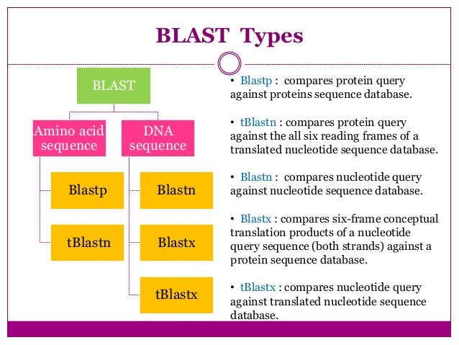

Slide 6
BLAST parameters
Depend on the type of BLAST!
We can limit the database to taxonomical entries (e.g. Metazoa, Bacteria, Homo sapiens, Primates, etc.)
Word size (W): «word» use to nucleate regions of similarity: high W -> higher speed, lower sensitivity; low W: slower speed, higher sentitivity
Substitution matrix: PAM/BLOSUM. In BLASTn match/mismatch
Gap cost: penalties applied to gap existence and extension

Slide 7
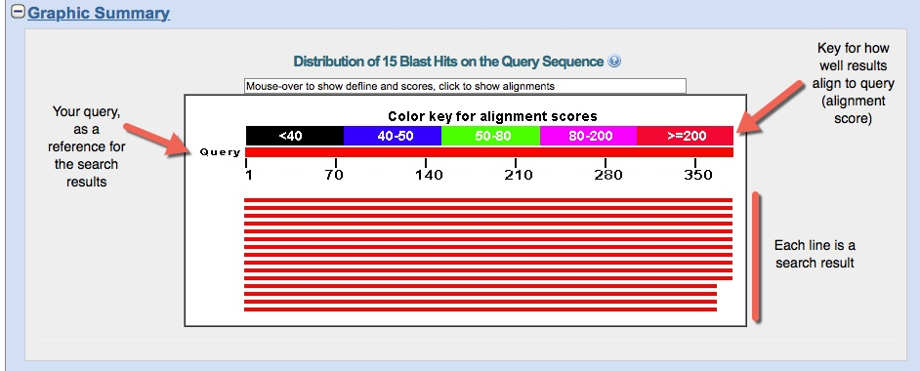
How to intepret BLAST results?
All the parameters mentioned above are combined to give you an e-value: describes the number of hits one can "expect" to see just by chance when searching a database of a particular size

Slide 8
How to intepret BLAST results?
Results will be ordered from the «best» result to the «worst» result, i.e. from the most the least significant hit
Basically, the significance of each hit is evaluated by the alignment score of the alignment between your query sequence (input) and the subject sequence (the hit found in the database)
The lower the e-value, the better the result, i.e. highly significant hits will tend to have an-value = 0 or very close to 0
The e-value depends on the score of the alignement, determined by the similarity between the query and the subject (calculated with a PAM/BLOSUM matrix) and by the length of the alignment

Slide 9
BLAST in genomic studies
Annotation of intron/exon regions: mRNAs (query) vs genome (database)
Functional annotation of genes (by similarity/orthologies): similar genes in different species are likely to encode proteins with similar/identical functions
Gene prediction: annotation of genes by similarity. E.g. The position and intron/exon organization can be inferred by BLASTing human mRNAs vs the orangutan genome
Different applications: metagenomics (OTUs assignment), comparative genomics/phylogenomics and many others!

Slide 10
Be careful with your interpretation! SIMILARITYvs HOMOLOGY
We need to pay attention to the different meaning of these two words in a biological context. They are not synonymous and considering them as such would be a mistake
SIMILARITY: does not imply any hypothesis concerning the reasons behind similarity itself
HOMOLOGY: two sequences are homologous if the share the same phylogenetic ancestry
Biological similarity is often due ti homology, but it can also occurr by chance or be linked to adaptive convergence

Slide 11
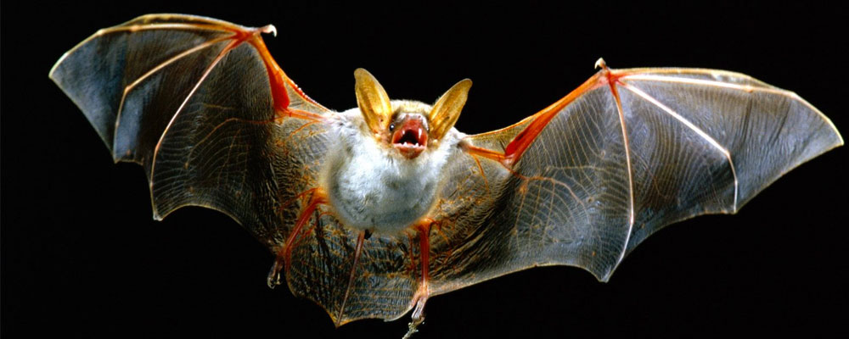
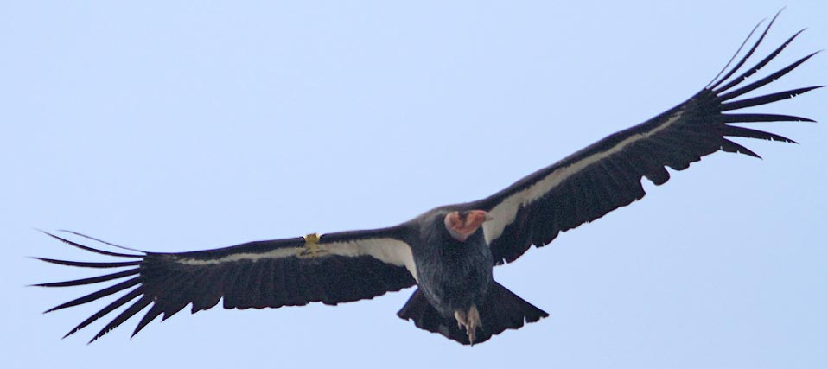
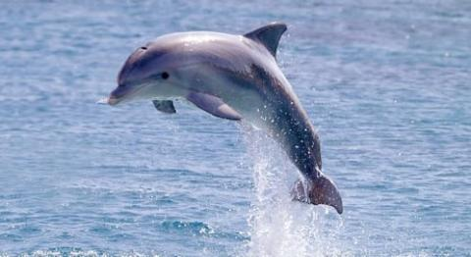
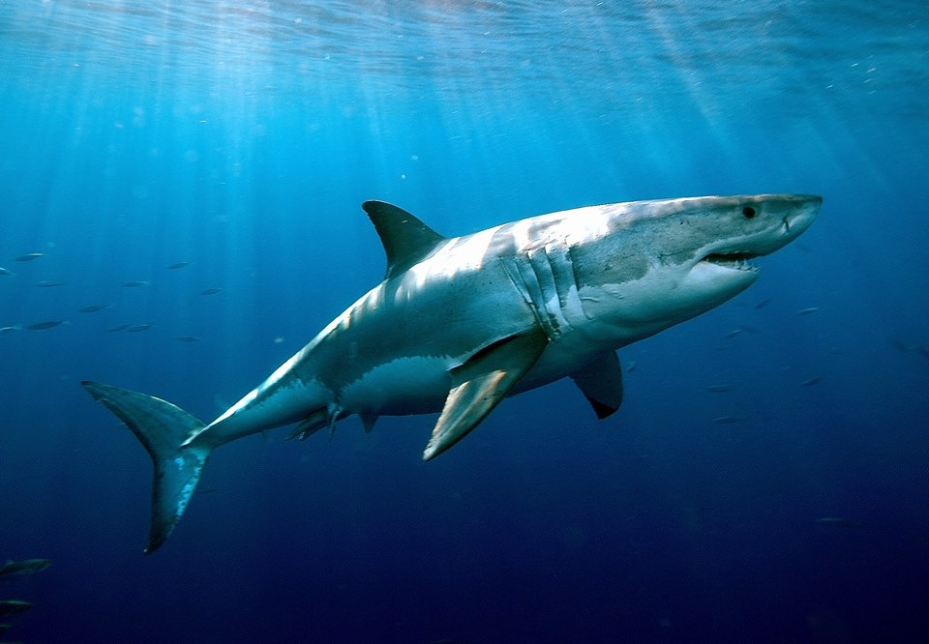
HOMOPLASY: SIMILAR FEATURES WITH INDEPENDENT EVOLUTIONARY ORIGIN (CONVERGENT EVOLUTION)

Slide 12
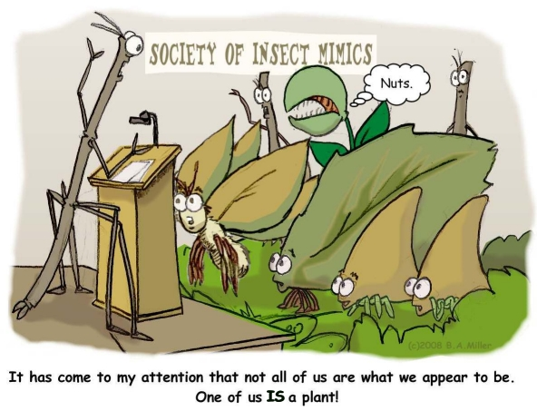
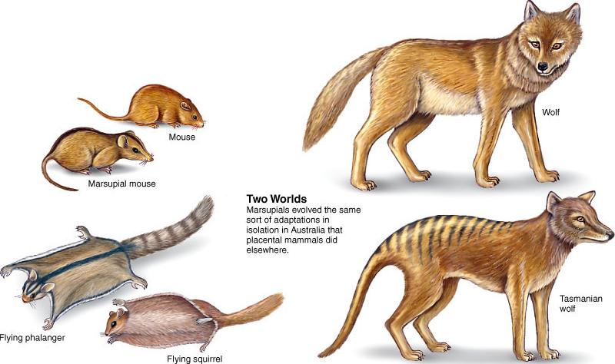
It may be easier to approach these concepts by thinking about species, which will be more familiar to students without a molecular biology background
We need to keep in mind that sequences evolve in parallel with species and, although they can be subject to particular selective pressure, they are strictly linked with the species of origin

Slide 13
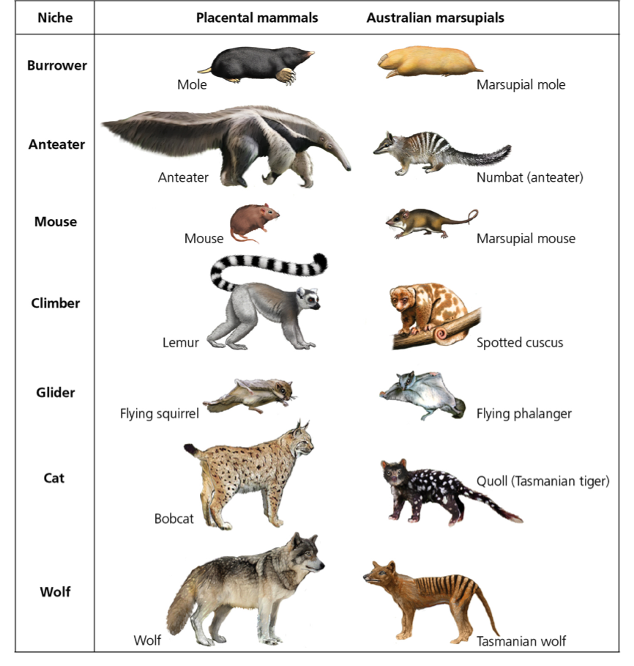
Marsupials represent a great example if we compare them with placental mammals
Although all these lifeforms have been developed morphologically after the split between marsupials and placentals, we can notice extraordinary morphological (and behavioral) similarity between species
The classification of these animals based on simple «similarity» criteria would produce trivial errors as it would probably not identify marsupials as descending from a common ancestor

Slide 14
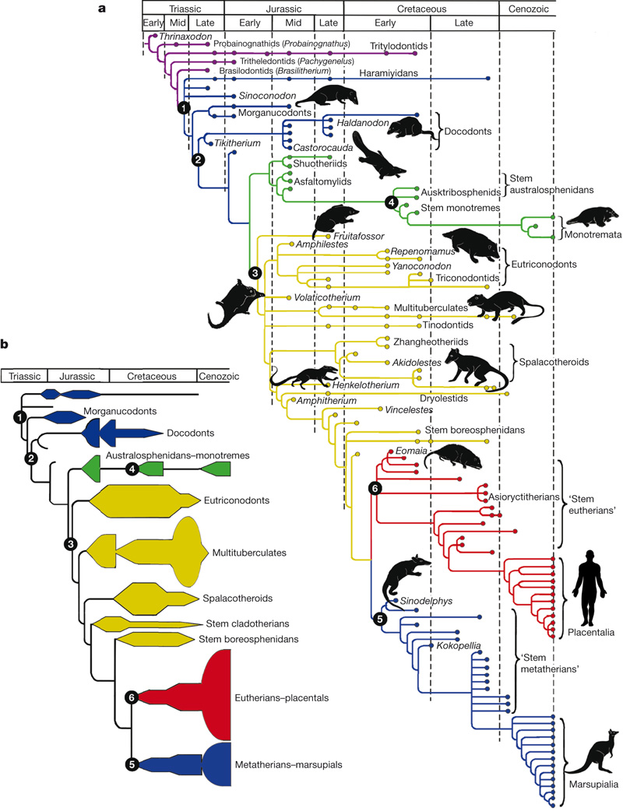
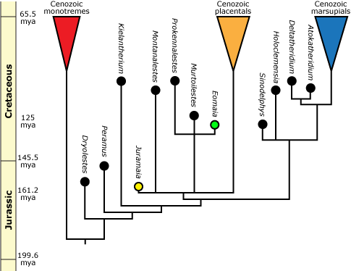
La radiazione delle varie forme morfologiche dei marsupiali e dei vertebrati è avvenuta indipendentemente. Sono pressioni selettive comuni ed ambienti simili ad aver portato a similaritù notevoli

Slide 15
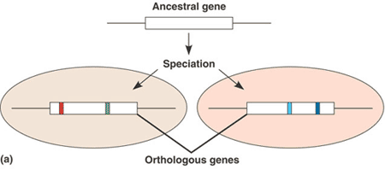
QUANDO DUE SEQUENZE SONO SIMILI, OMOLOGHE, ORTOLOGHE O PARALOGHE?
Nel trattare le sequenze è sempre più corretto utilizzare il termine similarità, in quanto è sempre possibile stabilire quanto due sequenze siano simili, mentre non sempre si può decidere se la similarità sia dovuta ad omologia, a convergenza adattativa, oppure al caso
strutture o sequenze ortologhe in due organismi sono sequenze omologhe che sono evolute dalla stessa caratteristica nel loro ultimo antenato comune ma che non necessariamente mantengono la loro funzione ancestrale.

Slide 16
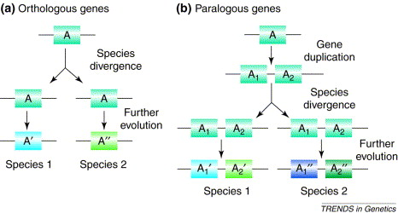
QUANDO DUE SEQUENZE SONO SIMILI, OMOLOGHE, ORTOLOGHE O PARALOGHE?
sequenze omologhe la cui evoluzione riflette invece eventi di duplicazione genica si definiscono paraloghe.
per esempio, la catena alfa dell’ emoglobina e’ un paralogo della catena beta dell’ emoglobina e della mioglobina, dal momento che ambedue si sono evolute dallo stesso gene ancestrale attraverso ripetuti eventi di duplicazione genica.

Slide 17
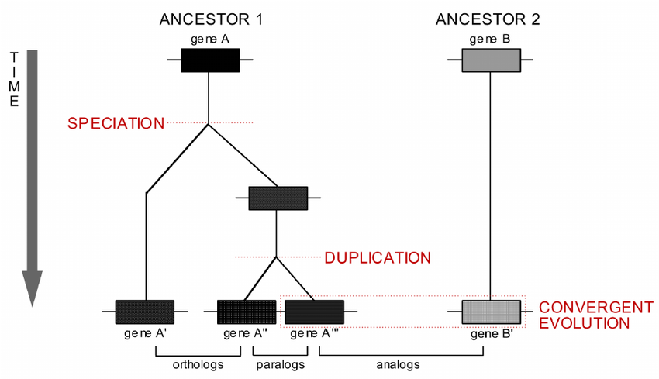
QUANDO DUE SEQUENZE SONO SIMILI, OMOLOGHE, ORTOLOGHE O PARALOGHE?
Ci possono essere casi più complessi in cui, un pò come per le specie ed i loro caratteri morfologici, si osserva similarità di sequenza senza che ci sia un’origine comune da un unica sequenza ancestrale
Possiamo in questo caso parlare di sequenze analoghe, o molto più semplicemente parlare di similarità di sequenza senza omologia

Slide 18
ALCUNI ALTRI IMPORTANTI CONCETTI DA RICORDARE
Tenete bene a mente che la similarità di sequenza non nesessariamente si traduce in similarità funzionale
Spesso due sequenze ortologhe svolgono funzioni leggermente diverse in specie diverse. In caso contrario viene mantenuta anche omologia funzionale
Spesso due sequenze paraloghe svolgono funzioni diverse nello stesso organismo. In caso contrario c’è una ridondanza funzionale.
Molto spesso sequenze con nessuna omologia o scarsa similarità svolgono funzioni molto simili se non addirittura identiche

