Slide 1
Seismometers
2 types of seismic sensors:
Extensometers and inclinometers. Measure the relative motion of a point with respect to a second point
Inertial. Measure the motion of the ground relative to a suspended mass
Notes:
1

Slide 2
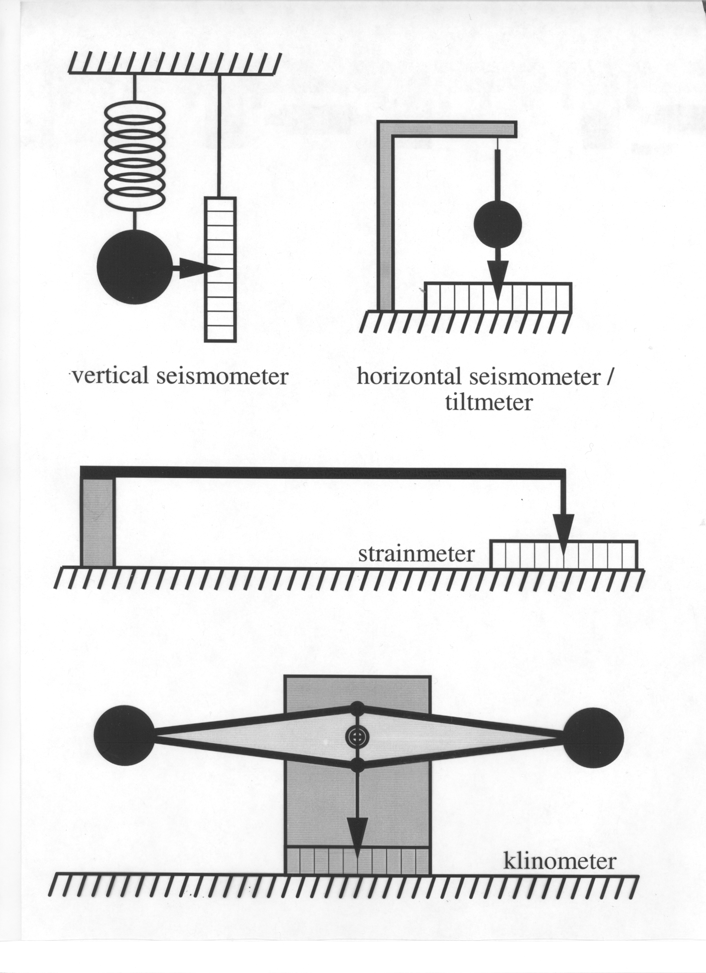

Slide 3
Clinometers
Grotta Gigante pendulums
SBP
LBP

Slide 4
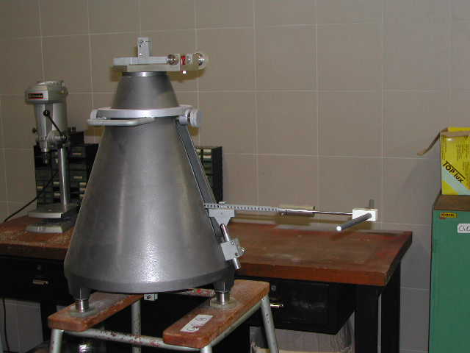
Clinometers
SBP

Slide 5
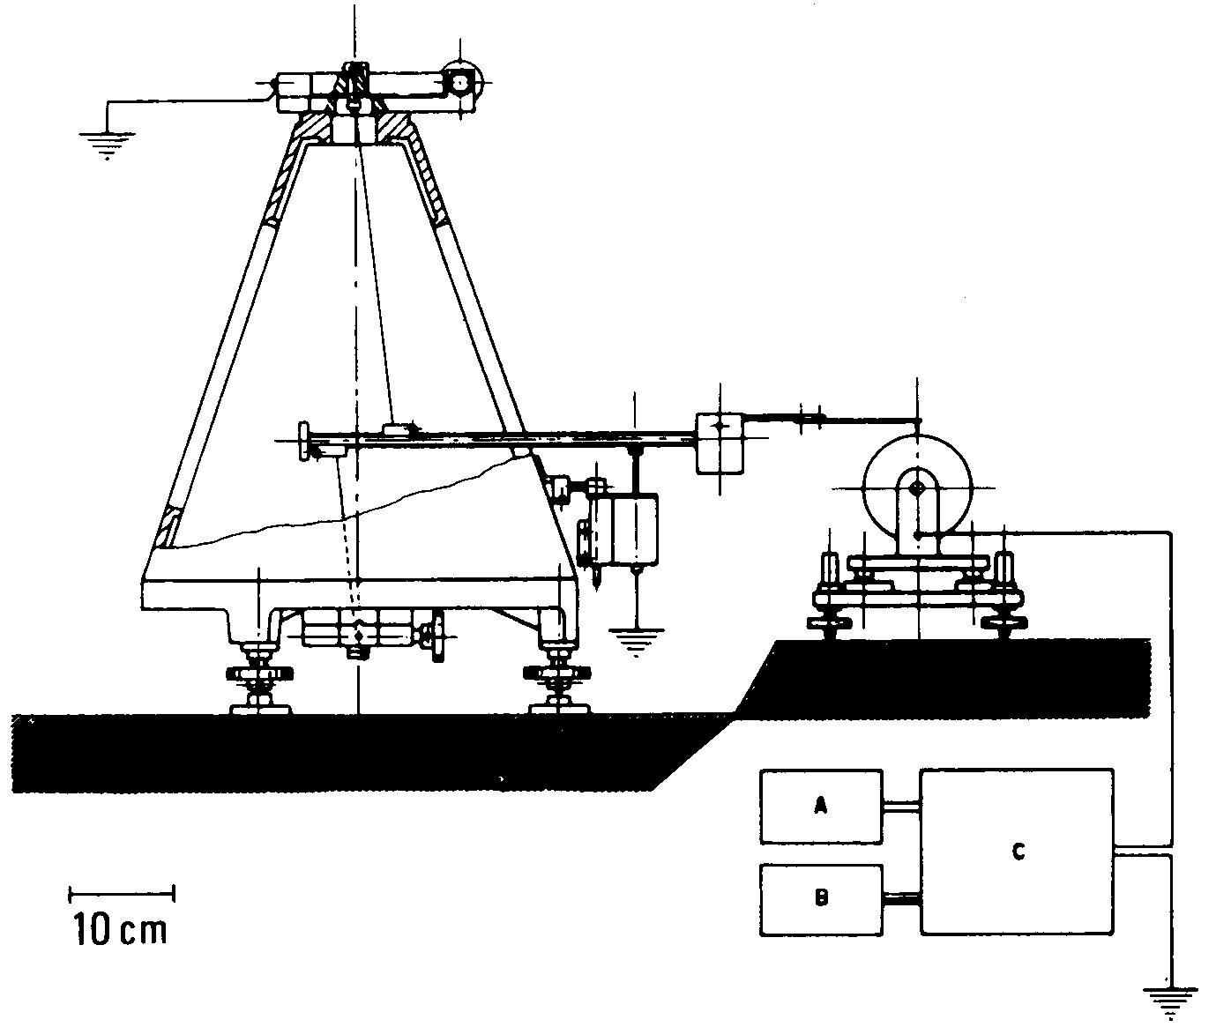
Clinometers

Slide 6
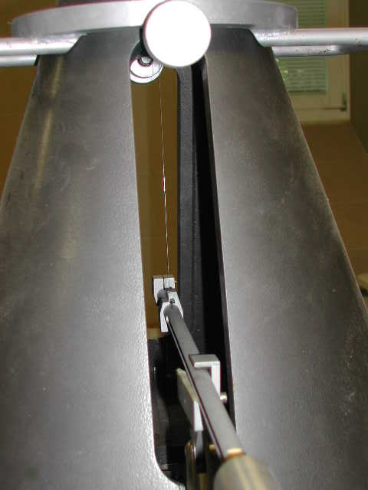
Clinometers

Slide 7
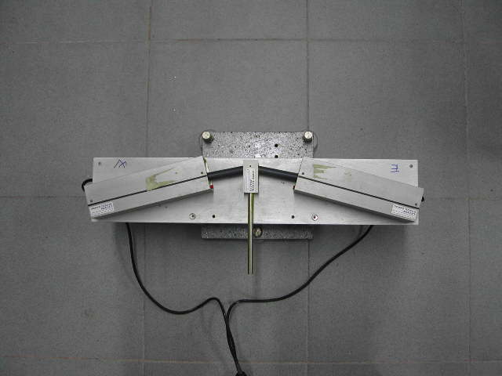
Clinometers

Slide 8
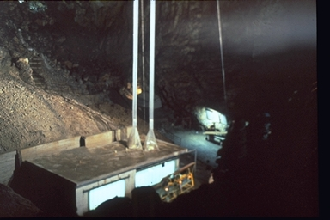
Grotta Gigante Pendulums
LBP

Slide 9
Grotta Gigante Pendulums

Slide 10
Esempio di registrazioni LBP.
Sono visibili: effetti annuali (effetti termoelastici degli strati della crosta superiore); la marea; alcuni effetti dovuti alle piene del fiume sotterraneo Timavo.
Example of LBP recordings
Are visible: the annual effects (thermoelastic effects of the layers of the upper crust); the tide; some effects due to the flooding of the underground river.

Slide 11
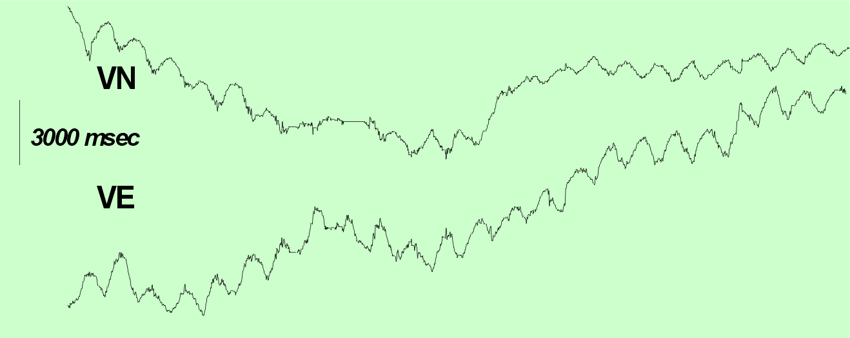
LBP – Grotta Gigante
SBP – Grotta di Villanova
LBP – Grotta Gigante
SBP – Grotta di Villanova

Slide 12
2 types of seismic sensors:
Extensometers and inclinometers. Measure the relative motion of a point with respect to a second point
Inertial. Measure the motion of the ground relative to a suspended mass
Notes:
12

Slide 13
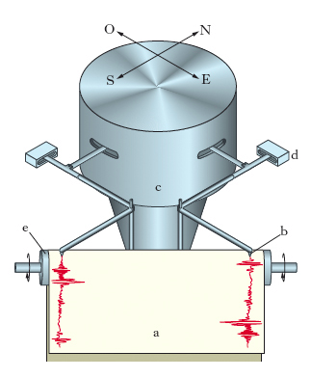
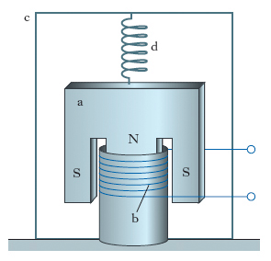
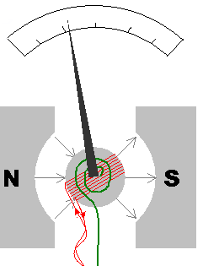
TRANSDUCER
MECHANICAL
GEOPHONE
ELECTROMAGNETIC
A GALVANOMETER
BROADBAND ELECTRONIC
Notes:
13

Slide 14
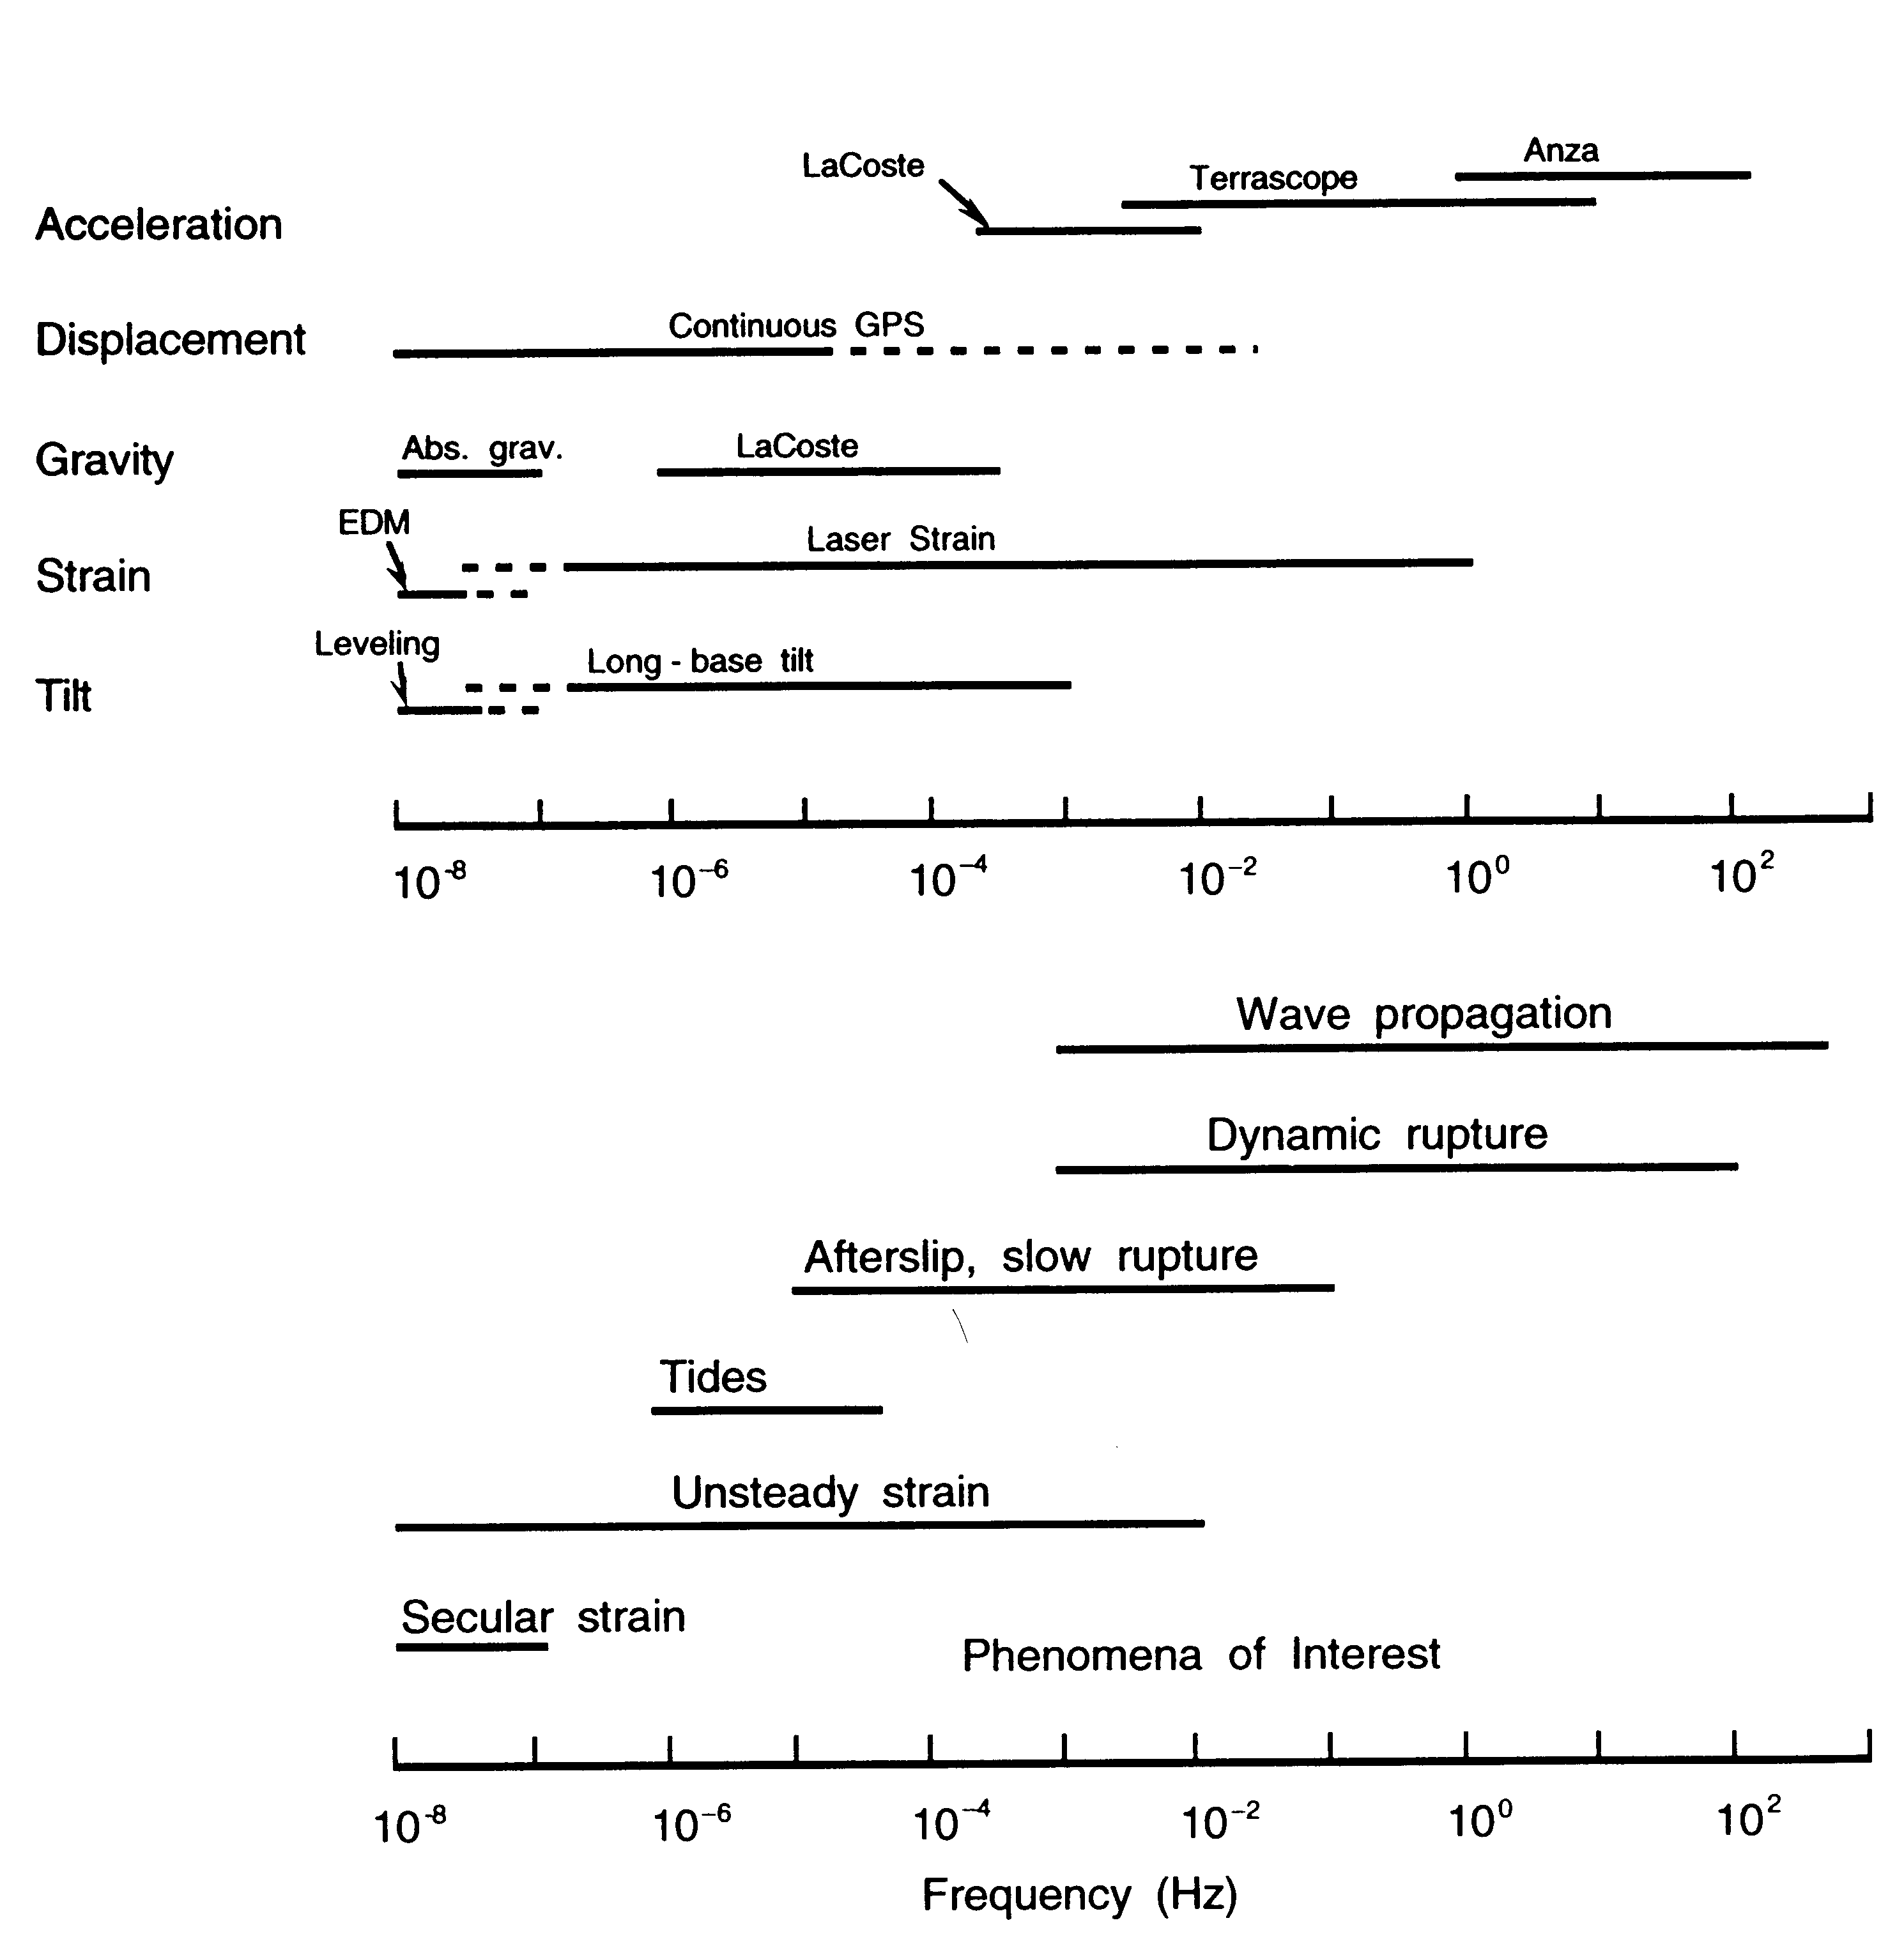
Notes:
14

Slide 15
To measure the time dependence of the ground displacement on where the instrument is, using the
principle of inertia:
For a fast enough ground motion a suspended mass will remain immobile and will give us a reference point against which to measure the ground motion.
Notes:
15

Slide 16
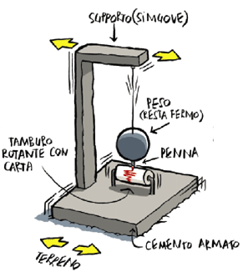

Slide 17
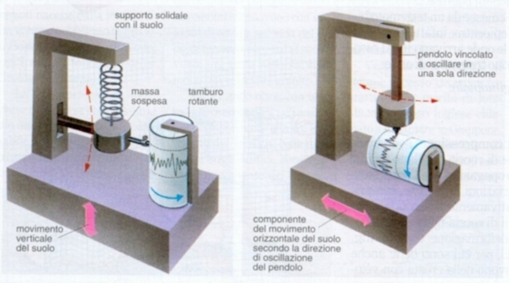

Slide 18
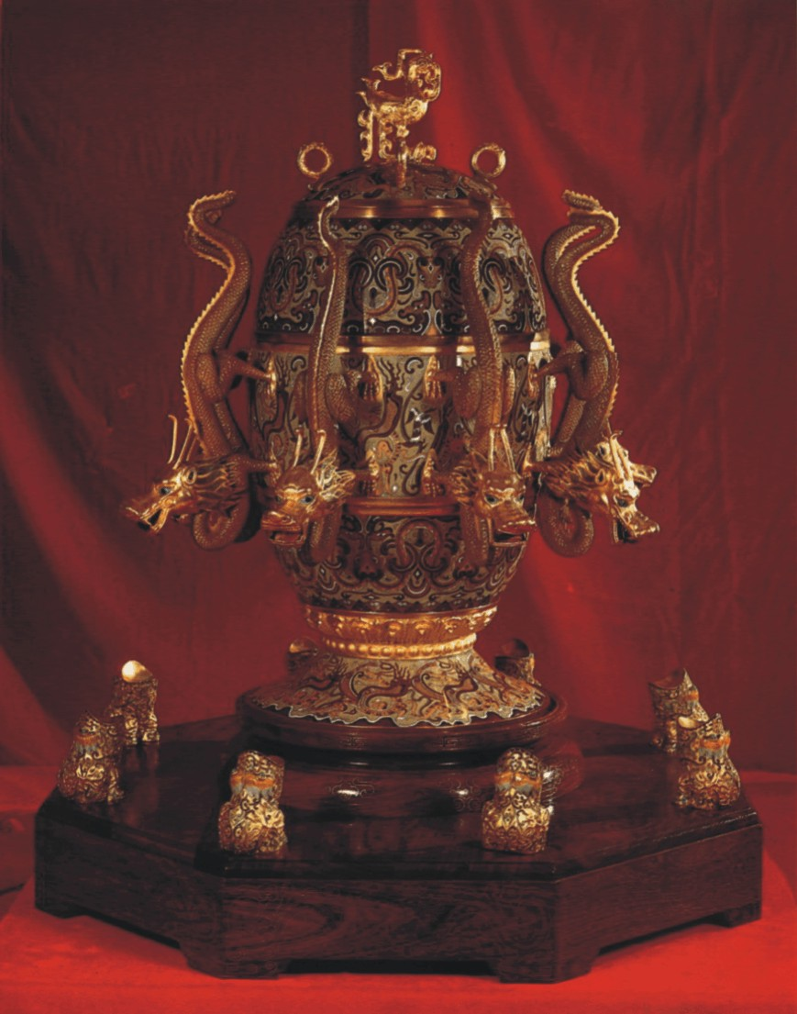
Chang Heng 132 a.c

Slide 19
Chang Heng 132 a.c

Slide 20
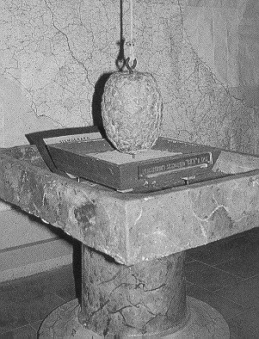
Bina 1751

Slide 21
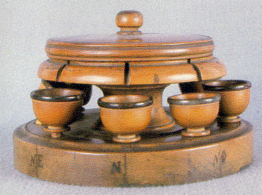
Cacciatore 1818

Slide 22
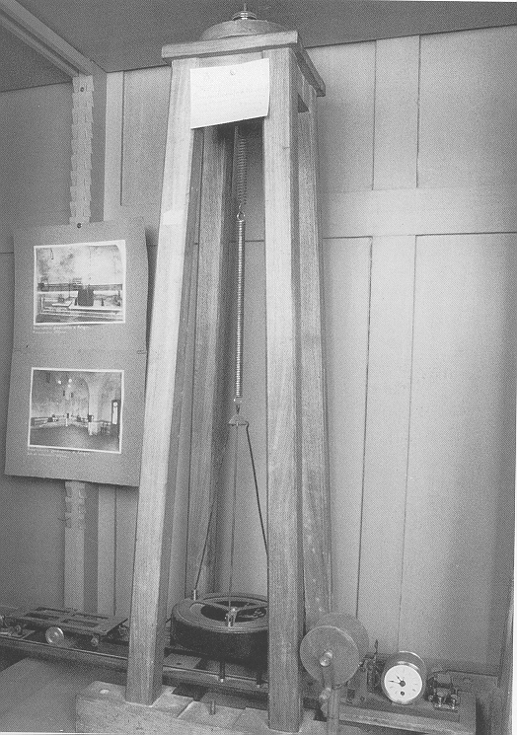
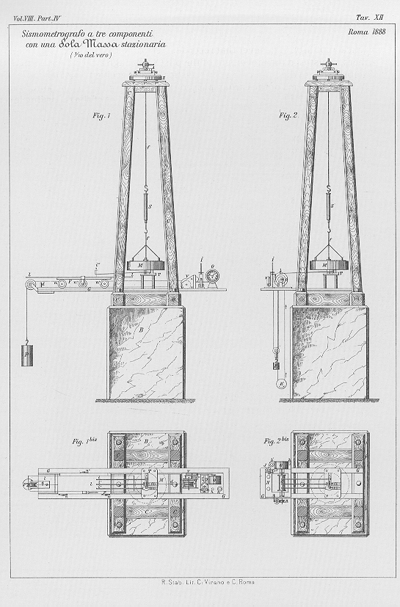
Brassart 1888

Slide 23
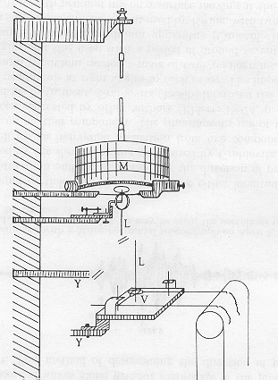
Brassart 1888

Slide 24
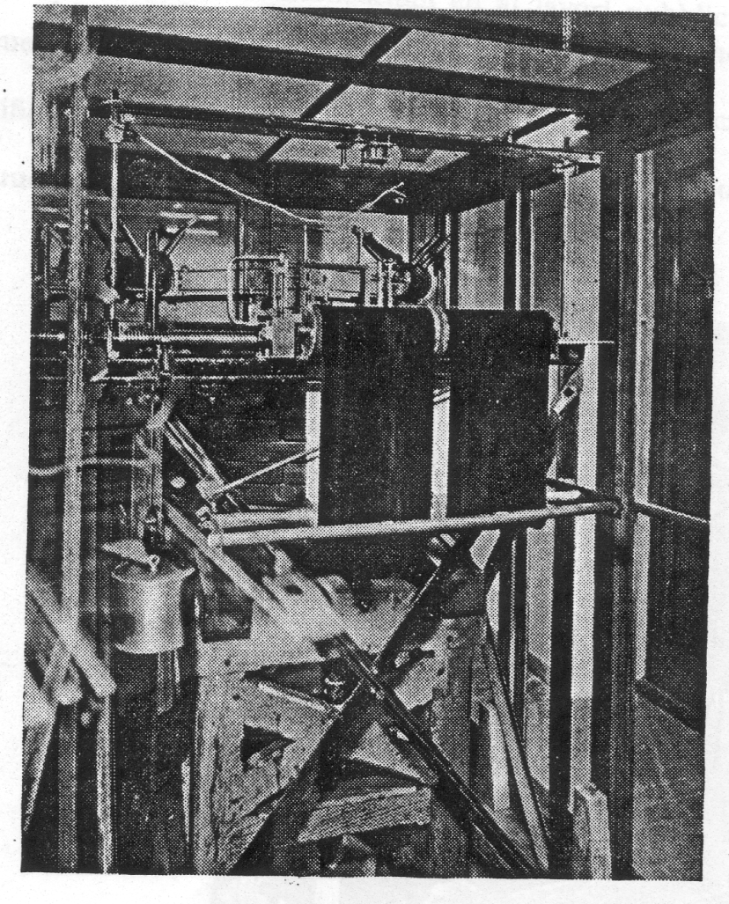
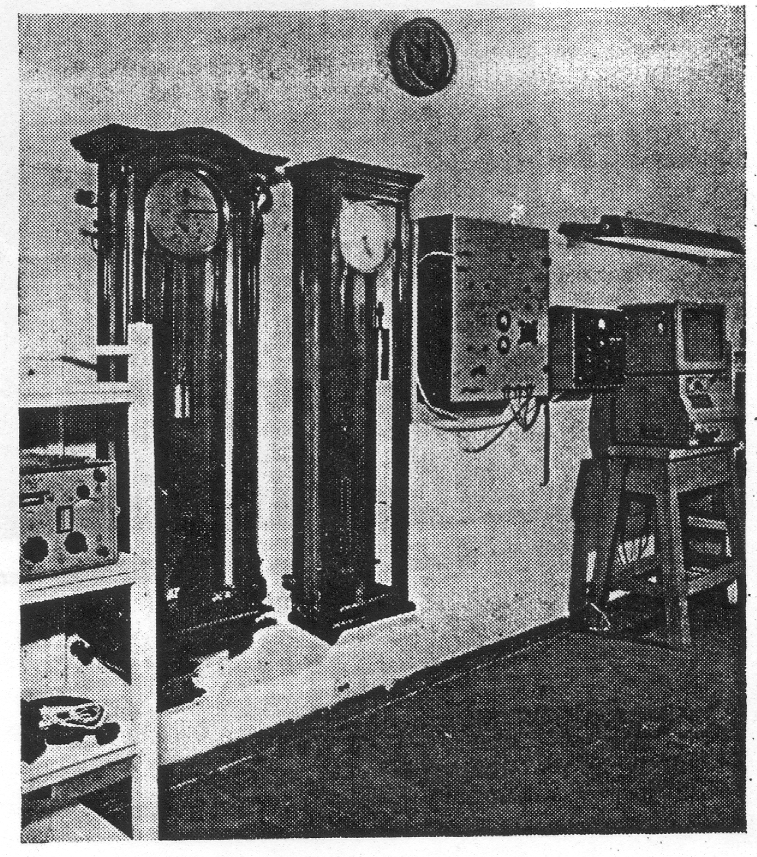
Wiechert 1903

Slide 25
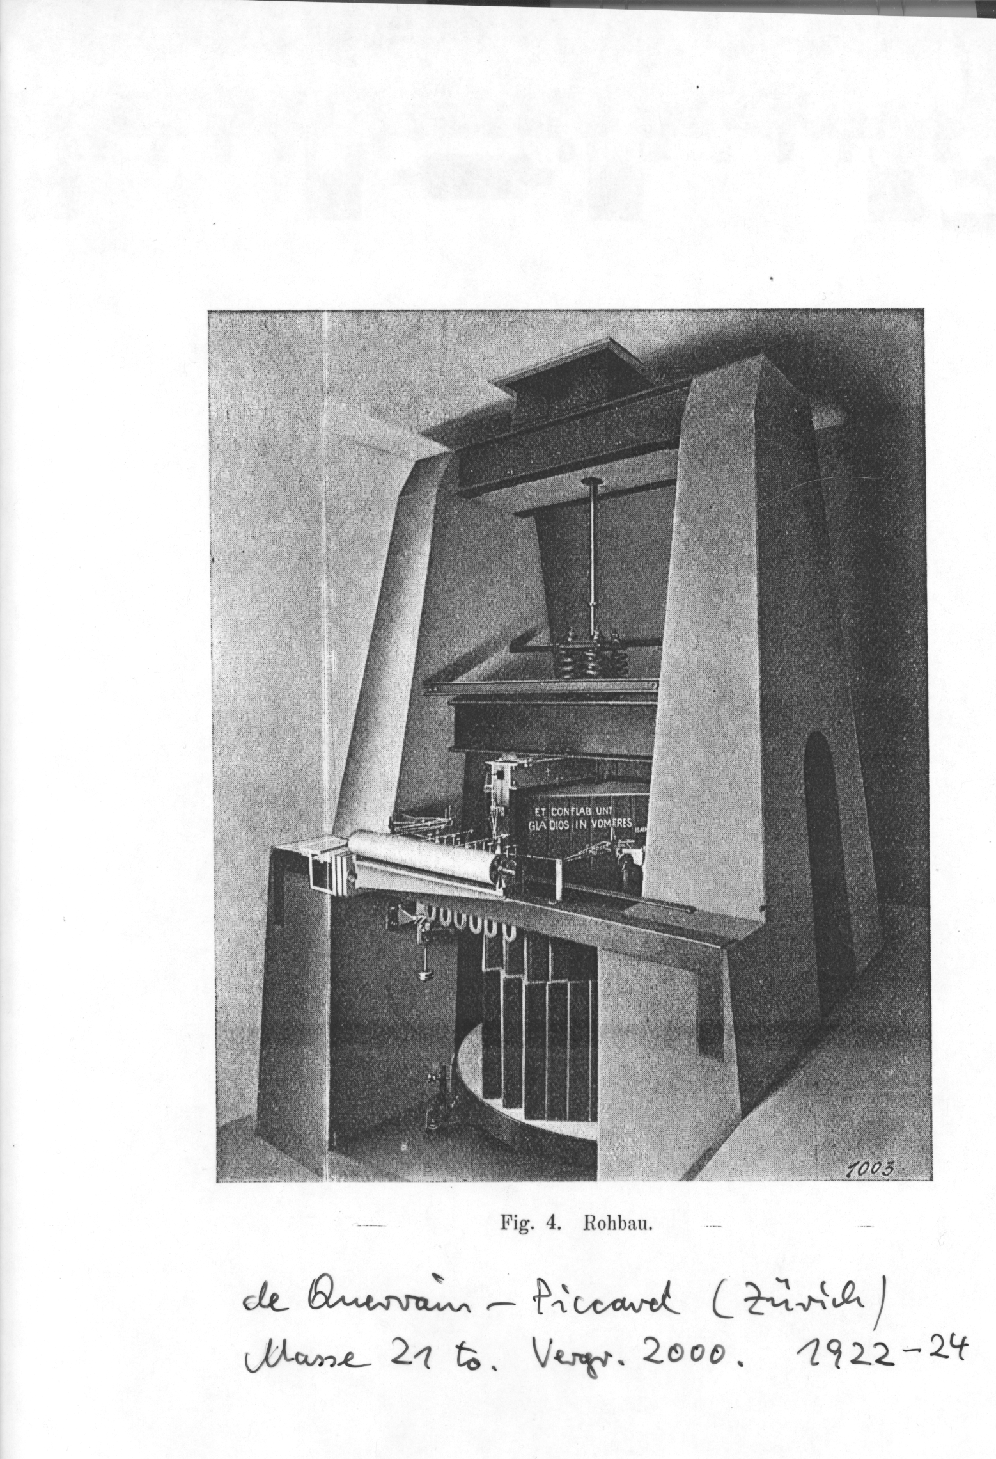

Slide 26
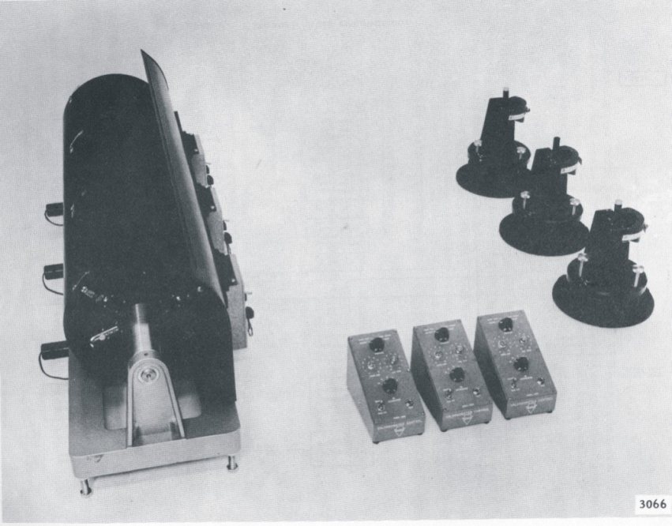
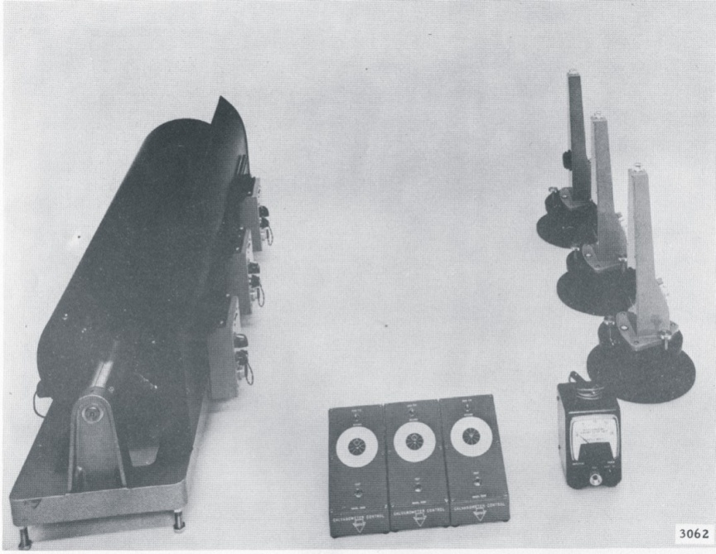
Surface equipment of TRI-117 WWSSN station
Short period (on the left) and long period (on the right) seismograph recording instruments

Slide 27
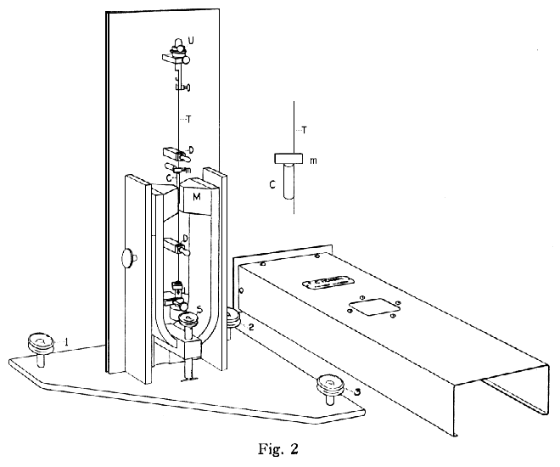
Wood-Anderson 1922

Slide 28
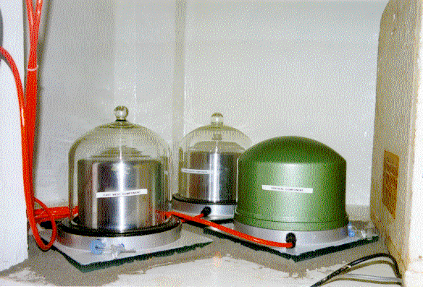
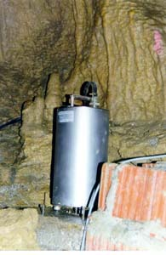


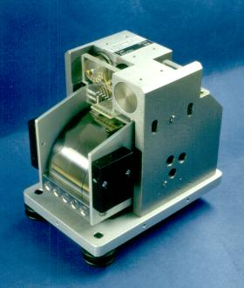
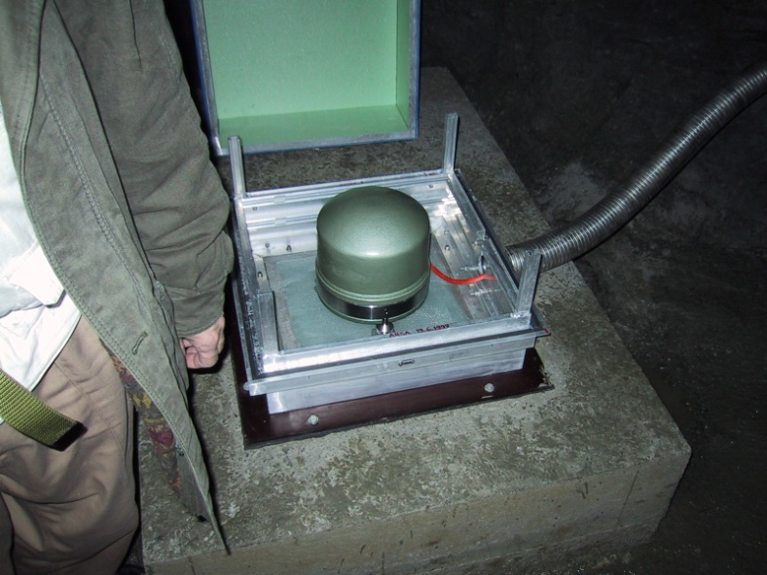
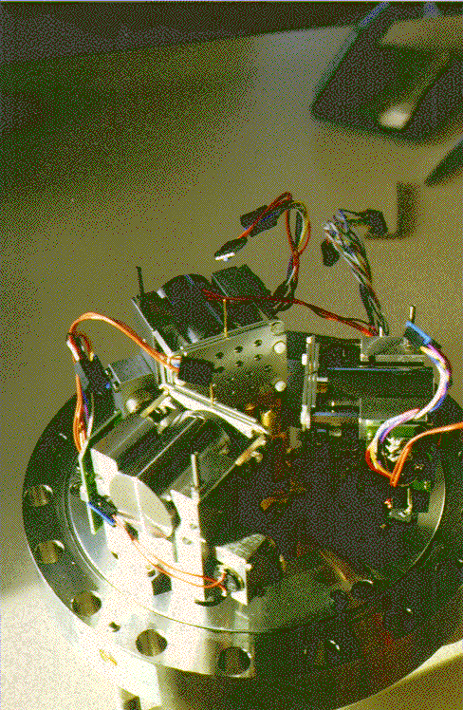
STS 1
Guralp CMG 3T
STS 1
STS 2
STS 2

Slide 29
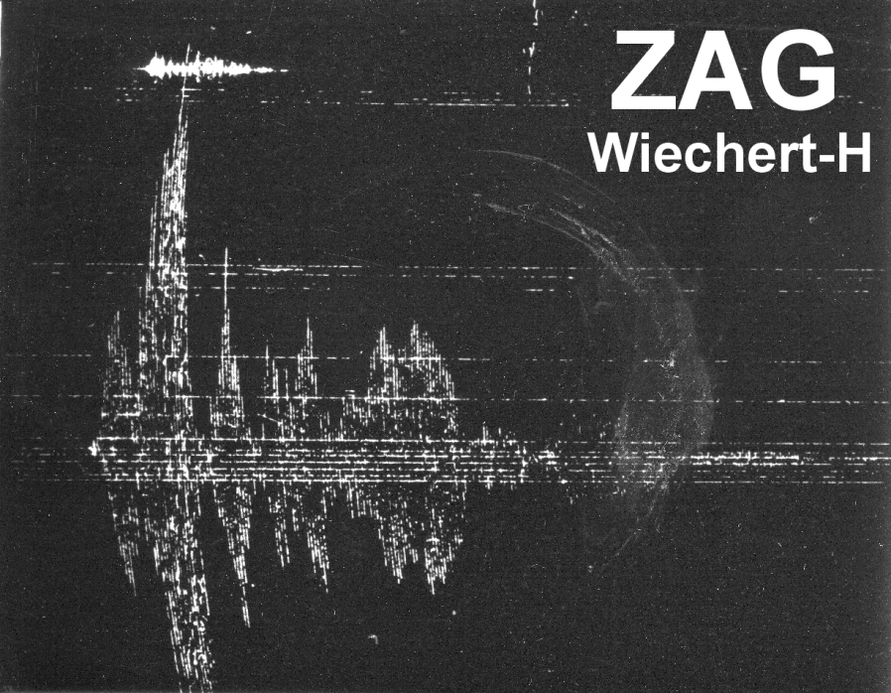
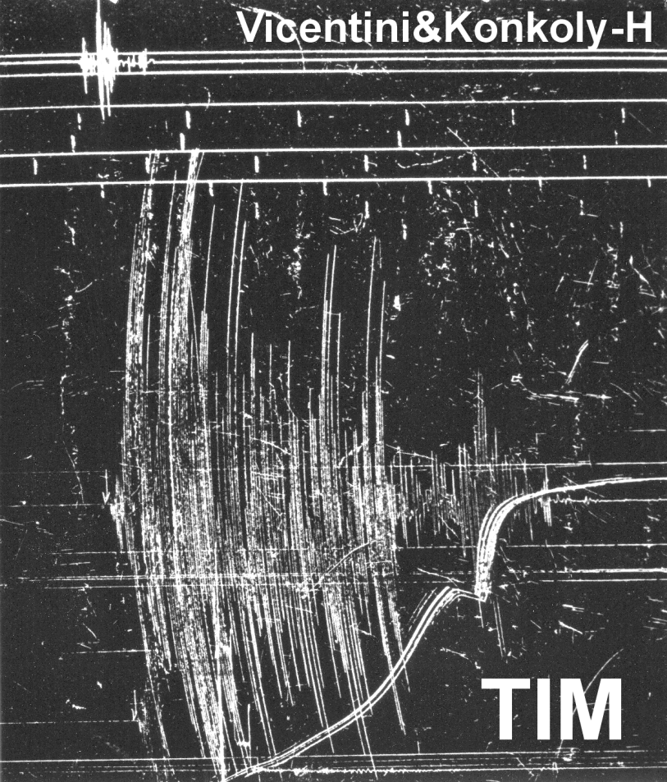
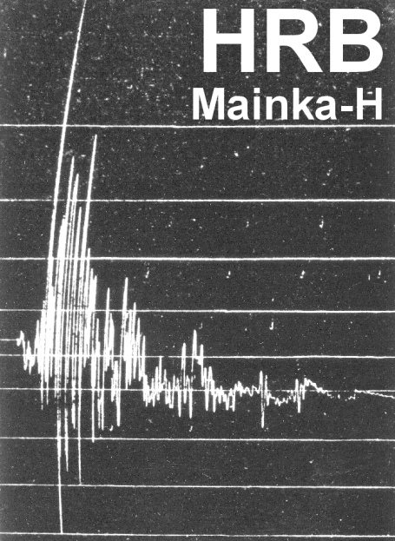
Kecskemét 1911, M 5.6

Slide 30
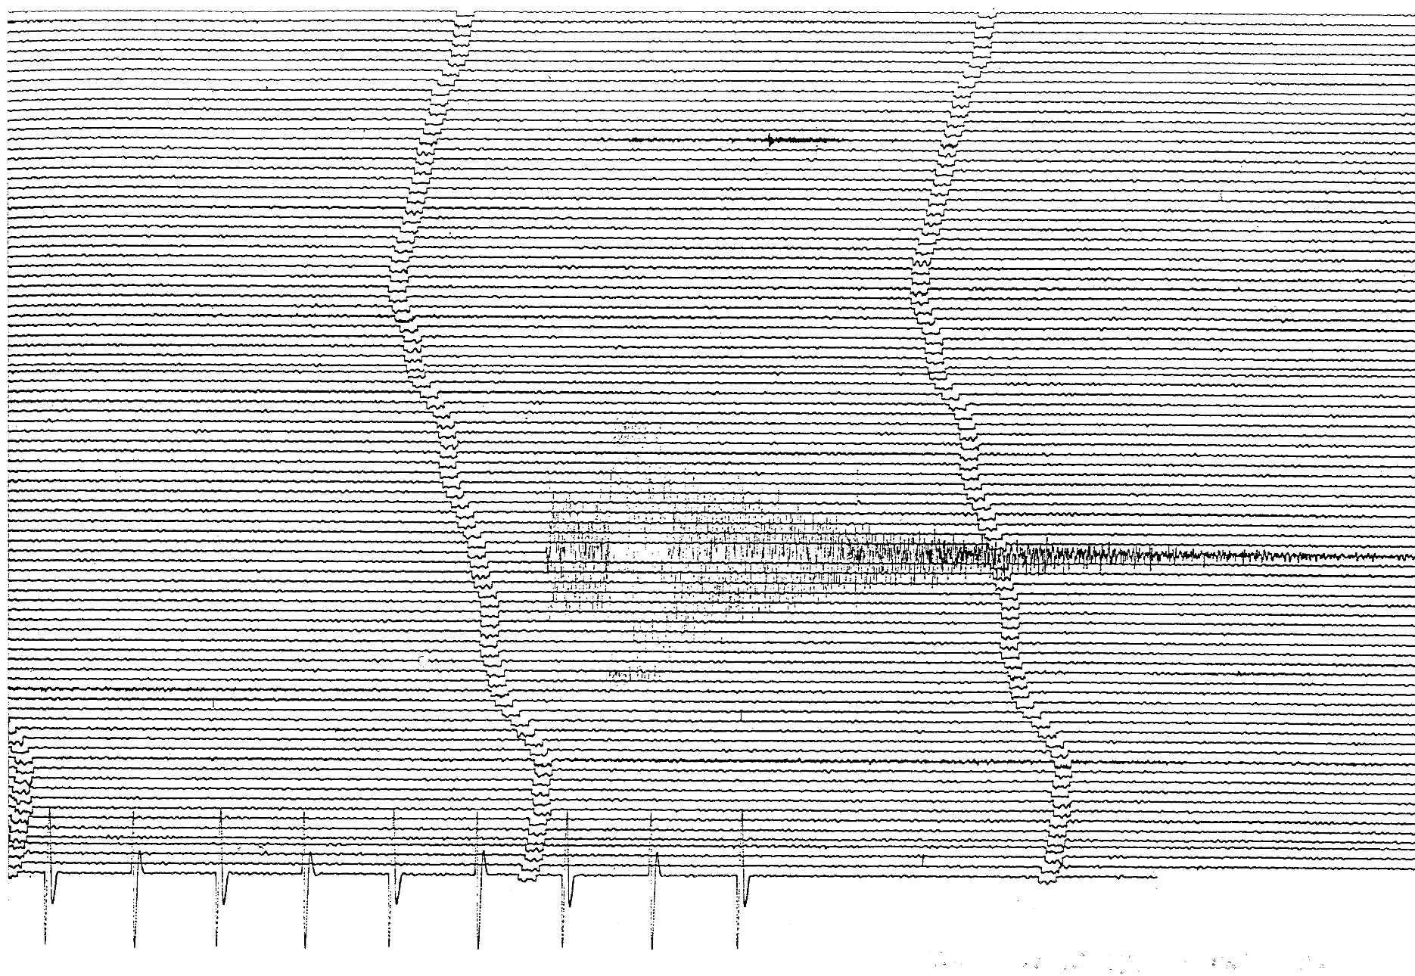

Slide 31
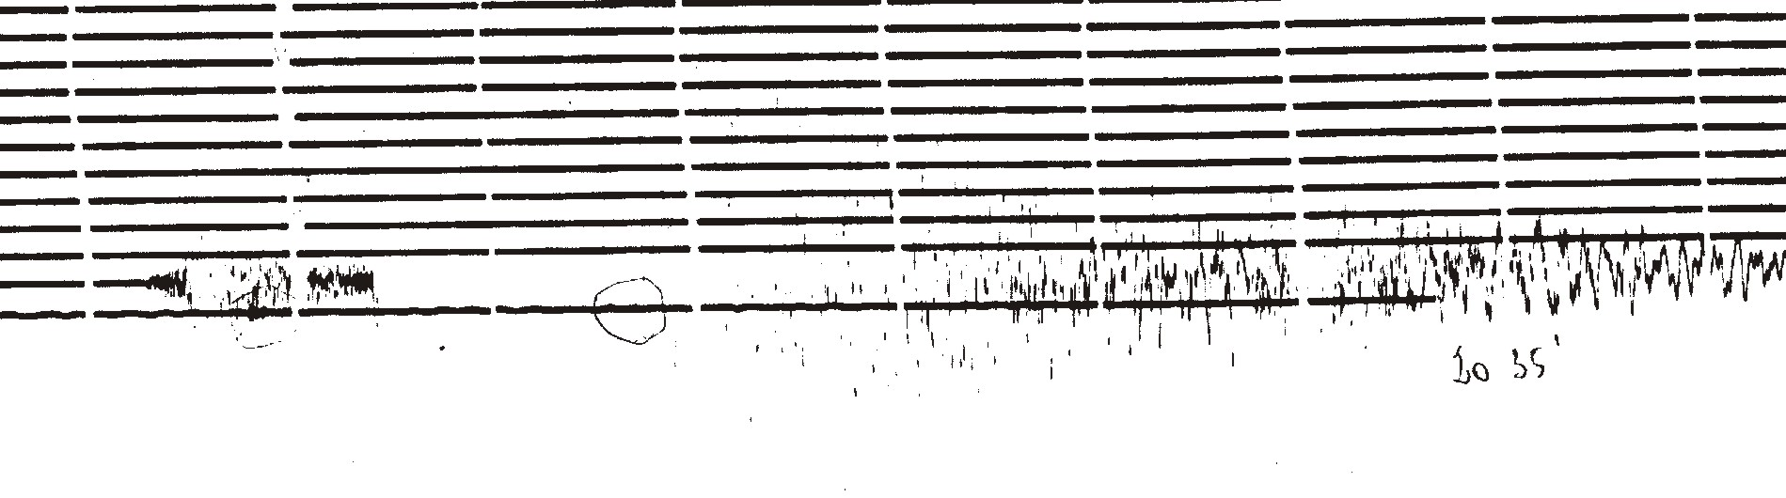
Friuli 1976 Ml 6.5 – Wood-Anderson

Slide 32
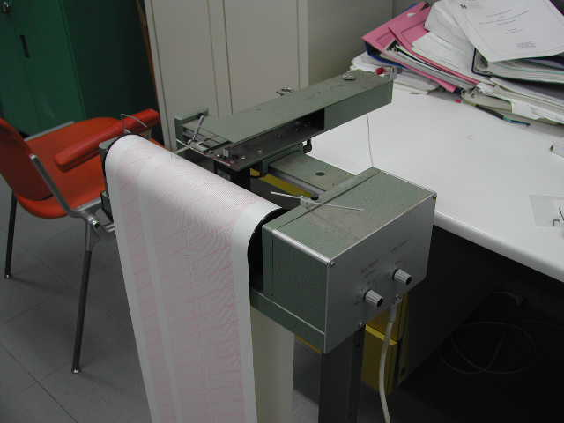
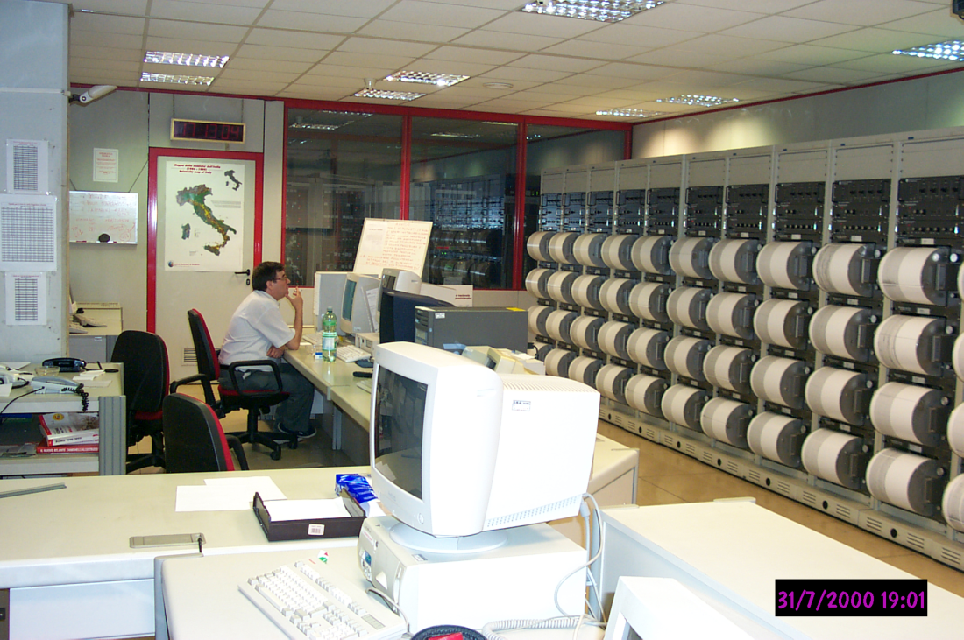
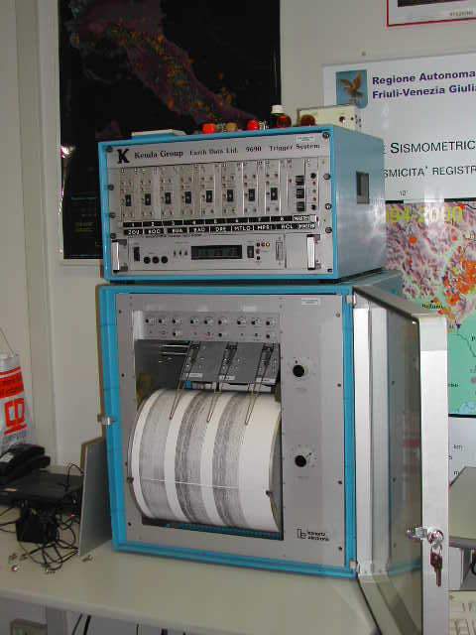
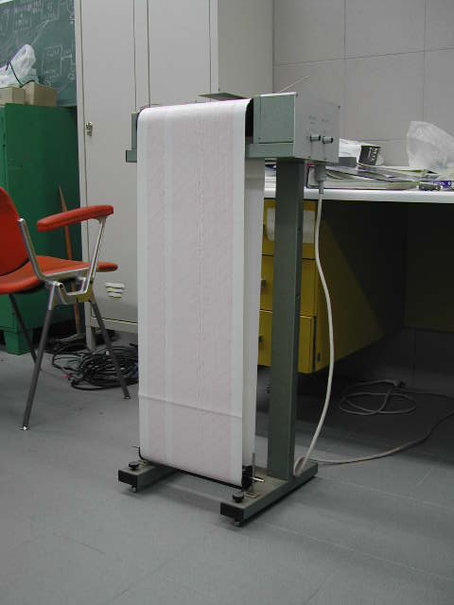

Slide 33
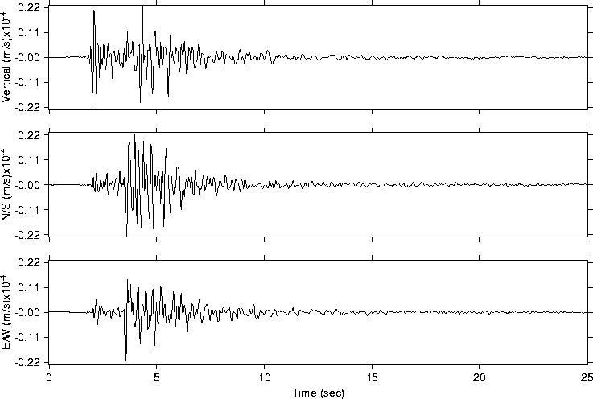
Evento Lusevera 25 maggio 2002 Md: 2.5 dist.: 4 km
P
S

Slide 34
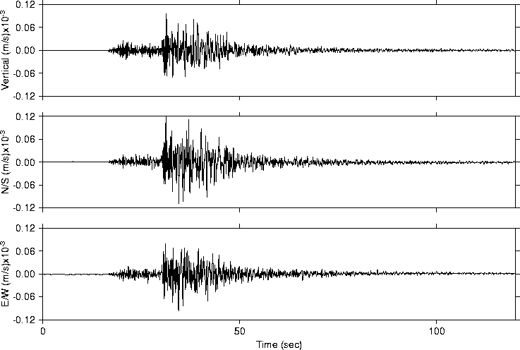
Evento M. Nevoso 2 giugno 2002 Ml: 3.7 dist.: 101 km
P
P
S

Slide 35
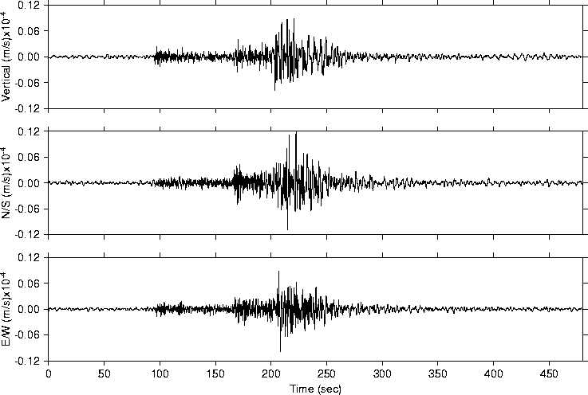
Evento Albania 28 maggio 2002 Ml: 4.4 dist.: 696 km
P
S

Slide 36
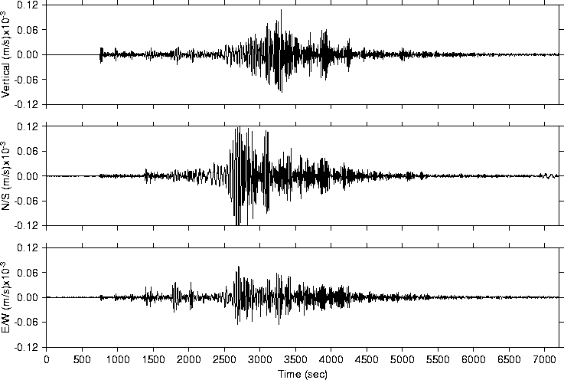
Evento Taiwan 15 maggio 2002 Ms=6.2 dist.: 9357 km

Slide 37
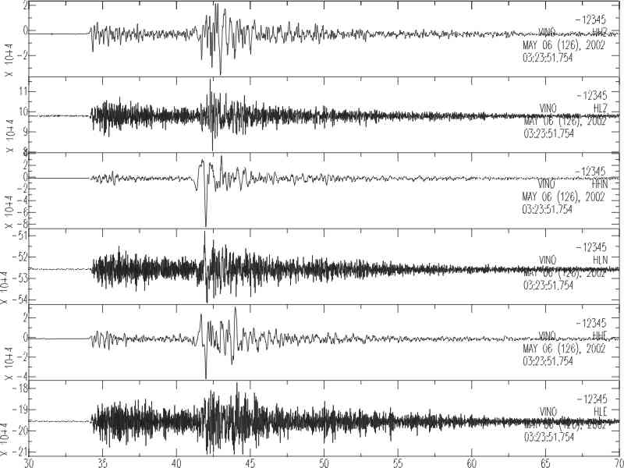
Evento Carnia 6 maggio 2002 3:23:51.754
velocità
accelerazione
velocità
accelerazione
velocità
accelerazione

Slide 38
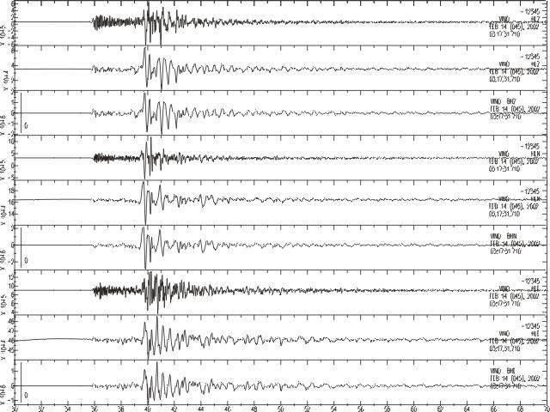
Evento Carnia 6 maggio 2002 3:17:31.710
Strong-motion (acceleration)
Strong-motion (velocity)
Broadband (velocity)
Strong-motion (acceleration)
Strong-motion (velocity)
Broadband (velocity)
Strong-motion (acceleration)
Strong-motion (velocity)
Broadband (velocity)

Slide 39
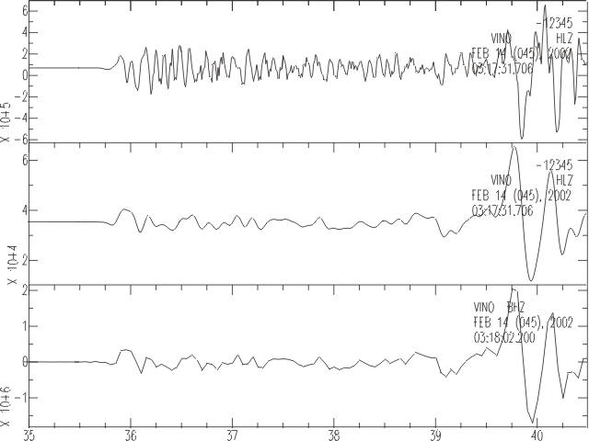
Evento Carnia 6 maggio 2002 3:17:31.710
Strong-motion (acceleration)
Strong-motion (velocity)
Broadband (velocity)

Slide 40
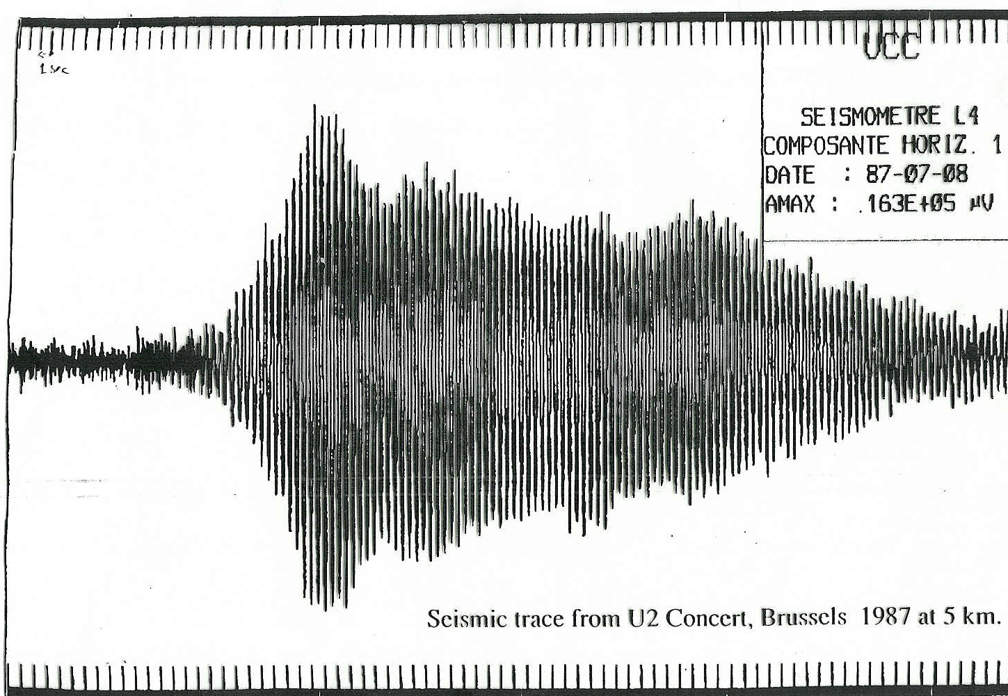

Slide 41
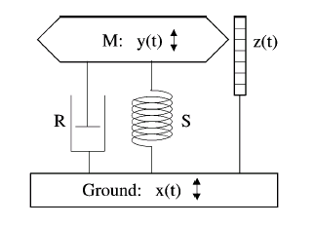
MECHANIC PENDULUM
M
The seismograph pendulum consists of a mass M hanging from a spring with a constant K and a damper with constant D in parallel.
K
D
U
The spring force is proportional to the displacement, the damper force instead to speed.
If is the mass displacement, the equation of motion will be:

Slide 42
M
Dividing for M and introducing the quantity
K
D
U
We have:
From this equation we can find the groun motion and its time derivative.
Notes:
42

Slide 43
M
The instrument response to the motion at a some frequency can be determined using the time dependence of the displacement due to a wave:
K
D
U
Assuming the same time dependence for and remembering that
We obtain the motion equation:
Notes:
43

Slide 44
The ratio:
Is named frequency responce that is the transfer function of the instrument. It is a complex number, so it can be divided in an amplitude response and in a phase response
The amplitude response curve of an instrument shows which frequencies are amplified and good recorded and says in which frequency band the instrument are not sensible.
Notes:
44

Slide 45
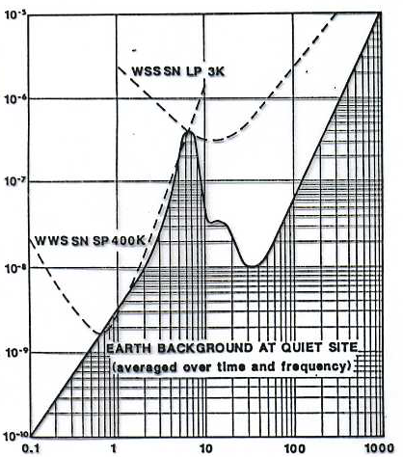
Displacements (m)
Period (s)
Notes:
45

Slide 46
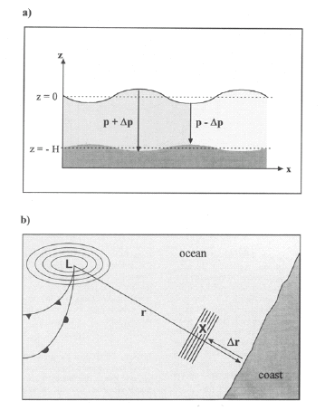

The dynamic magnification curves of the TRI-117 WWSSN station seismometer
The ocean waves produce large amounts of energy to periods of around 6 s. These waves recorded by seismometers are called microsystems and dominate the ground motion at these times.
To make the instruments more sensitive to this band, were introduced two types of standard instruments.
The first is called a short period, with periods of less than 6s (typically 1s) so that records well at high frequencies. It usually has very large amplifications.
Notes:
46

Slide 47
The second is called in the long period, with longer periods of 6 s (typically 15 s Ts) that records good low frequency.
As the inelasticity of the Earth attenuates high frequencies, the short period instruments (SP) are used to record local earthquakes, while teleseismic will be recorded well in the long period (LP) instruments.
The modern electronic filtering tecnique allow you to use a single mechanical sensor today with a high response whithin a broad band frequencies range. These instruments are called broadband.
The unwanted frequency bands can be eliminated or reduced with numeric filtering. Furthermore, the digital acquisition allows a higher dynamic bandwidth, which allows the recording of both small and large displacements of the same time series.
Notes:
47

Slide 48
Notes:
48

Slide 49

Fourier
amplitude spactral density
angular frequency
phase spectrum

Slide 50


Slide 51

The transient f (t) is formed by the sum of infinite harmonic terms.
The amplitude of each harmonic is determined from the amplitude spectrum, while the phase shift of each harmonic is determined from the phase spectrum.
f(t)

Slide 52


The TRI-117 WWSSN Trieste station seismometers
(a)
(b)
(a): Short period Benioff seismometers; component: Z, N-S, E-W; magnification: 50000; period: 1 s.
(b): Long period Ewing-Press seismometers; component: Z, N-S, E-W; magnification: 3000; period: 15 s.

Slide 53


Slide 54

Notes:
54

Slide 55

Notes:
55

Slide 56

Notes:
56

Slide 57


Slide 58



Slide 59


Slide 60
Seismometers and “Force balance” accelerometer
The inertial force is compensated (or balanced) with a force electrically generated so as to move the mass the less possible. A small movement is still necessary otherwise the inertial force can not be observed.

Slide 61
Balance with replacement of automatic weight
Feedback Seismometer a controreazione

Slide 62


Slide 63

Suspension of La Coste
a vertical
b horizontal

Slide 64

STS 1
STS 2
a Wielandt
b Streckeisen

Slide 65

STS 1

Slide 66
STS 1

Slide 67


Slide 68


STS 2

Slide 69


Slide 70


Slide 71


Slide 72


Slide 73


Slide 74



Sensors
Acquisition system
Disk driver for the data storage
at the station
Switch for the connection to
the network for the data
transmission
Broad band sensor
Accelerometric sensor,
24 bits Datalogger
6 channels
GPS Antenna for the time syncronization
Via satellites
3 components
3 components
power
Power pack
backup battery

Slide 75
Sensors
Acquisition system
Disk driver for the data storage
at the station
Switch for the connection to
the network for the data
transmission
Broad band sensor
Accelerometric sensor,
24 bits Datalogger
6 channels
GPS Antenna for the time syncronization
Via satellites
3 components
3 components
power
Power pack
backup battery

Slide 76
Sensors
Acquisition system
Disk driver for the data storage
at the station
Switch for the connection to
the network for the data
transmission
Broad band sensor
Accelerometric sensor,
24 bits Datalogger
6 channels
GPS Antenna for the time syncronization
Via satellites
3 components
3 components
power
Power pack
backup battery

Slide 77
Sensors
Acquisition system
Disk driver for the data storage
at the station
Switch for the connection to
the network for the data
transmission
Broad band sensor
Accelerometric sensor,
24 bits Datalogger
6 channels
GPS Antenna for the time syncronization
Via satellites
3 components
3 components
power
Power pack
backup battery

Slide 78
Sensors
Acquisition system
Disk driver for the data storage
at the station
Switch for the connection to
the network for the data
transmission
Broad band sensor
Accelerometric sensor,
24 bits Datalogger
6 channels
GPS Antenna for the time syncronization
Via satellites
3 components
3 components
power
Power pack
backup battery

Slide 79
Sensors
Acquisition system
Disk driver for the data storage
at the station
Switch for the connection to
the network for the data
transmission
Broad band sensor
Accelerometric sensor,
24 bits Datalogger
6 channels
GPS Antenna for the time syncronization
Via satellites
3 components
3 components
power
Power pack
backup battery

Slide 80
Sensors
Acquisition system
Disk driver for the data storage
at the station
Switch for the connection to
the network for the data
transmission
Broad band sensor
Accelerometric sensor,
24 bits Datalogger
6 channels
GPS Antenna for the time syncronization
Via satellites
3 components
3 components
power
Power pack
backup battery

Slide 81



Slide 82




