Slide 1
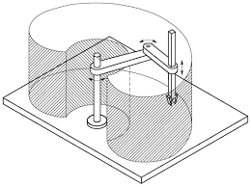
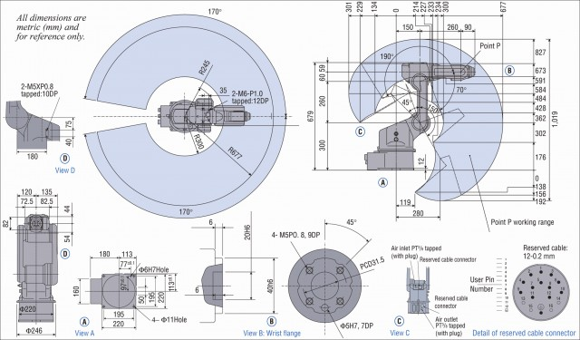
Workspace
the region described by the origin of the end-effector frame when all the manipulator joints execute all possible motions
Joint limits

Slide 2
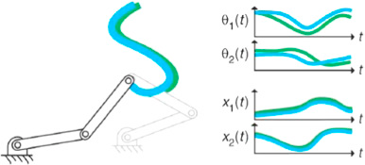
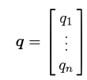
Joint space and working space
Joint space
Working space
The problem of describing end-effector orientation can be done by means of minimal representations.
There is this link
operational space
joint space

Slide 3
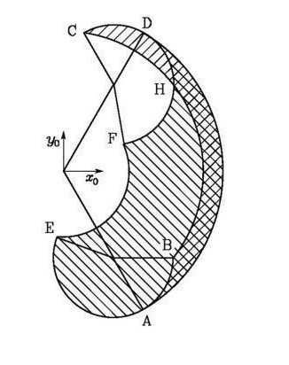
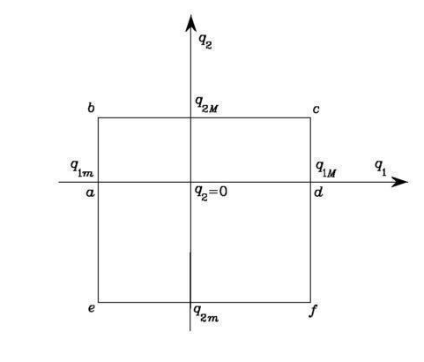
Dexterous workspace
The region that the origin of the end-effector frame can describe while attaining different orientations
Consider the simple two-link planar arm.

Slide 4
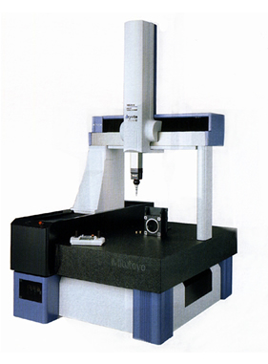
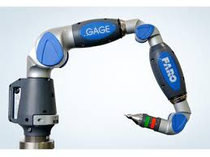
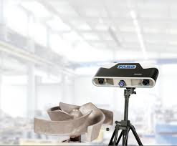
Robot Calibration
Geometric robot parameters have values different form nominal ones
because of:
Machining errors;
Assembling errors;
To correct them it is necessary to have an accurate measuring machine:
vision based;
mechanical;

Slide 5
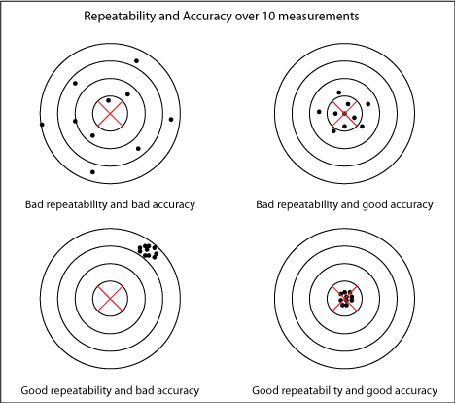
Errors: accuracy and repetibility
Calibration can improve accuracy, not repeatibility

Slide 6
2 DoF example
Error = Misured pose – nominal pose
q2
Let’s assume that the lengths of the links are affected
by errors Δl1 and Δl2
q1
$P=\left\{\begin{matrix}Px \\ Py\end{matrix}\right\}=\left(l1+∆l1\right)\left\{\begin{matrix}cos\left(q1\right) \\ sin\left(q1\right)\end{matrix}\right\}$+$\left(l2+∆l2\right)\left\{\begin{matrix}cos\left(q1+q2\right) \\ sin\left(q1+q2\right)\end{matrix}\right\}$

Slide 7
In matrix form
$$\left\{\begin{matrix}Px \\ Py\end{matrix}\right\}=l1\left\{\begin{matrix}cos\left(q1\right) \\ sin\left(q1\right)\end{matrix}\right\}\text{+}l2\left\{\begin{matrix}cos\left(q1+q2\right) \\ sin\left(q1+q2\right)\end{matrix}\right\}+\left[\begin{matrix}cos\left(q1\right) & cos\left(q1+q2\right) \\ sin\left(q1\right) & sin\left(q1+q2\right)\end{matrix}\right]\left\{\begin{matrix}∆l1 \\ ∆l2\end{matrix}\right\}$$
unknowns
Nominal pose (Pn)
A
Measured pose (Pm)
Results of calibration
$$∆l{=A}^{−1}\left(Pm−Pn\right)$$

Slide 8
In case we have more measured points (n points)
$$Pm1−Pn1=A1 ∆l$$
$$Pm2−Pn2=A2 ∆l$$
$$\left\{\begin{matrix}Pm1−Pn1 \\ ⋮ \\ Pmn−Pnn\end{matrix}\right\}=\left\{\begin{matrix}A1 \\ ⋮ \\ An\end{matrix}\right\} ∆l$$
⁞
$$Pmn−Pnn=An ∆l$$
$$∆P=Φ ∆l$$
$Φ$ is not squared: 2xn rows
2 columns
Using the pseudoinverse of $Φ$
This solution minimizes the error
$$Φ^{T}∆P=Φ^{T}Φ ∆l$$
$${{∆l =\left(Φ^{T}Φ\right)}^{−1}Φ}^{T}∆P$$
$e=\left\|∆P−Φ ∆l \right\|$

Slide 9
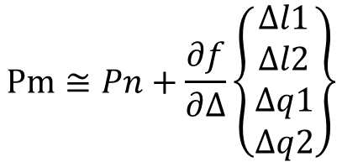
Let’s assume an error on the encoder
$P=\left\{\begin{matrix}Px \\ Py\end{matrix}\right\}=\left(l1+∆l1\right)\left\{\begin{matrix}cos\left(q1+∆q1\right) \\ sin\left(q1+∆q2\right)\end{matrix}\right\}$+$\left(l2+∆l2\right)\left\{\begin{matrix}cos\left(q1+∆q1+q2+∆q2\right) \\ sin\left(q1+∆q1+q2+∆q2\right)\end{matrix}\right\}$
Since the relationship between measured pose and unknowns parameters
is not linear, it is necessary to linearize
$$Pm≅Pn+\frac{∂f}{∂∆}\left\{\begin{matrix}∆l1 \\ ∆l2 \\ ∆q1 \\ ∆q2\end{matrix}\right\}$$
$Pn=l1\left\{\begin{matrix}cos\left(q1\right) \\ sin\left(q1\right)\end{matrix}\right\}$+$l2\left\{\begin{matrix}cos\left(q1+q2\right) \\ sin\left(q1+q2\right)\end{matrix}\right\}$
where
$$\frac{∂f}{∂∆}=\left[\begin{matrix}cos\left(q1\right) & cos\left(q1+q2\right) & l1\left(−\sin\left(q1\right)\right)+l2(−sin⁡(q1+q2)) & l2(−sin⁡(q1+q2)) \\ sin\left(q1\right) & sin\left(q1+q2\right) & l1\left(\cos\left(q1\right)\right)+l2(cos⁡(q1+q2)) & l2(cos⁡(q1+q2))\end{matrix}\right]$$
For each pose we can write
$$∆Pj={\frac{∂f}{∂∆}}_{j}∆l$$
where
$$∆Pj=Pmj−Pnj$$

Slide 10
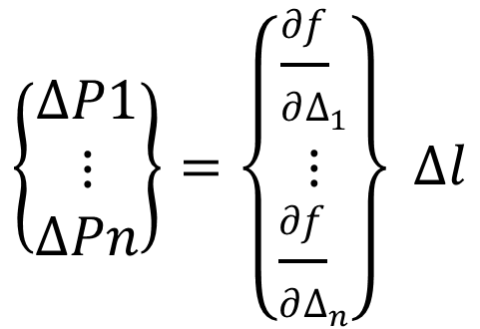
Combining all the poses
$$\left\{\begin{matrix}∆P1 \\ ⋮ \\ ∆Pn\end{matrix}\right\}=\left\{\begin{matrix}{\frac{∂f}{∂∆}}_{1} \\ ⋮ \\ {\frac{∂f}{∂∆}}_{n}\end{matrix}\right\} ∆l$$
$$∆P=Φ ∆l$$
Using the pseudoinverse of $Φ$
$$Φ^{T}∆P=Φ^{T}Φ ∆l$$
$${{∆l =\left(Φ^{T}Φ\right)}^{−1}Φ}^{T}∆P$$

Slide 11
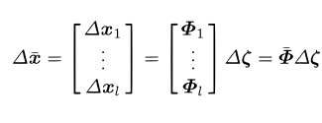
Calibration of The Denavit-Hartenberg parameters
Consider the direct kinematics equation in which he pose can be rewritten by emphasizing the dependence of the operational space variables on the fixed DH parameters
Linearization
Measured pose – nominal pose
Combining all the pose
Solution
All the D-H parameters

Slide 12
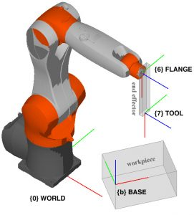
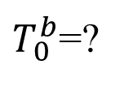
Robot-Base Calibration
$T_{0}^{b}$=?
The robot is calibrated
$${P^{0}=T}_{7}^{0}P^{7}$$
The tool is moved to a pose $P_{A}^{b}$on the base,
which is known with respect to the base frame
The equation that we can write is
$${P_{A}^{b}=T_{0}^{b}T}_{7}^{0}P^{7}$$
The unknowns are the parameters of the matrix $T_{0}^{b}$
If we consider more points it is possible to solve the problem

Slide 13
Exercise: calirbation of a 2DoF robot, introdusing a random error

