Slide 1
Inverse Kinematics Problem
Equations of the Inverse Kinematics
The inverse kinematics problem consists of the determination of the joint variables corresponding to a given end-effector position and orientation.
The equations to solve are in general nonlinear
It is not always possible to find a closed-form solution
Multiple solutions may exist
The existence of solutions is guaranteed only if the given end-effector position and orientation belong to the manipulator dexterous workspace
Infinite solutions may exist, e.g., in the case of a kinematically redundant manipulator

Slide 2
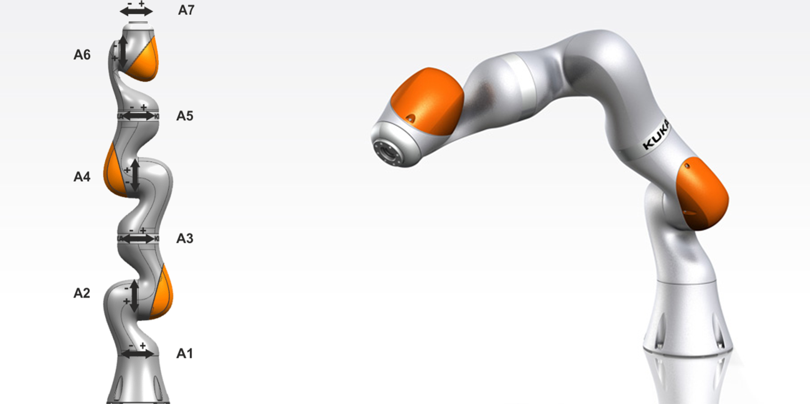
7 DoF (redundant manipulator)

Slide 3
Why is useful the inverse kinematic?
Off-line programming
Show video “self-programming” CMA

Slide 4
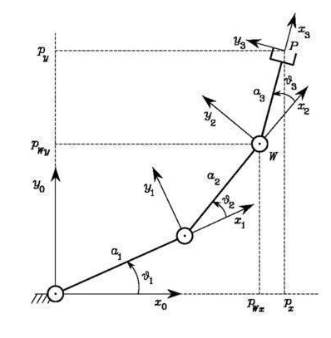
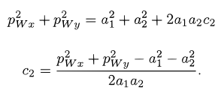
Example: Solution of Three-link Planar Arm
INPUT: px,py,φ
Squaring and summing
The existence of a solution obviously imposes that -1 < c2 < 1
[…]

Slide 5
An alternative geometric solution
cosine theorem
[…]

Slide 6
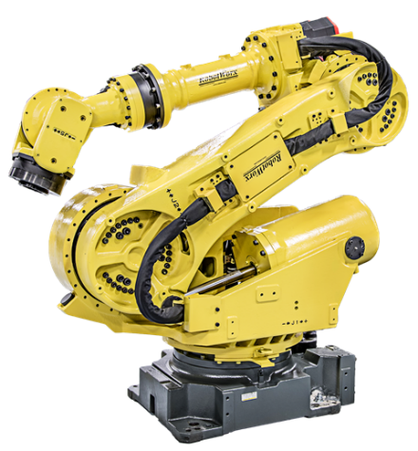
Solution of Manipulators with Spherical Wrist
three consecutive revolute joint axes intersect at a common point

Slide 7
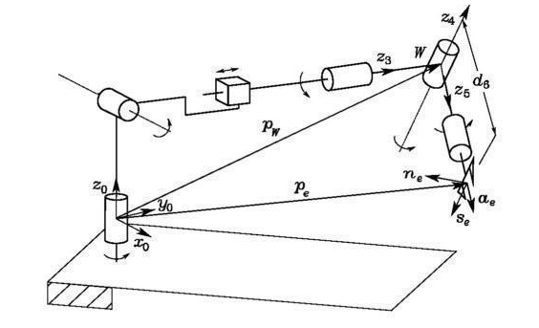
point W at the intersection of the three terminal revolute axes
the wrist position can be found as
$$p_{w} {=R}_{1}^{0}\left(q1\right)R_{2}^{1}\left(q2\right)R_{3}^{2}\left(q3\right)\left\{\begin{matrix}0 \\ 0 \\ 0 \\ 1\end{matrix}\right\}$$
It possible to calculate
q1,q2,q3

Slide 8
$$R_{e}^{0} is known$$
$${R_{e}^{0}=R_{3}^{0}R}_{4}^{3}\left(q4\right)R_{5}^{4}\left(q5\right)R_{6}^{5}\left(q6\right)$$
It possible to calculate
q4,q5,q6

Slide 9
three consecutive revolute joint axes are parallel facilitate the solution

Slide 10
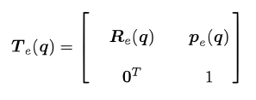
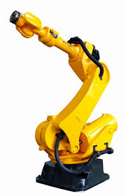
Differential kinematics
Consider an n-DOF manipulator. The direct kinematics equation can be written in the form
e-frame
where q = is the vector of joint variables.
Both end-effector position and orientation vary as q varies
The goal of the differential kinematics is to find the relationship between the joint velocities and the end-effector linear and angular velocities

Slide 11
relations are both linear in the joint velocities
= Geometric Jacobian
Geometric Jacobian is a function of q

Slide 12
Jacobian of Typical Manipulator Structures
Three-link Planar Arm
(EXERCISE: different procedure from the text)

Slide 13
Kinematic Singularities
those configurations (q) at which J is rank-deficient are termed kinematic singularities.
Therefore, when det(J)=0
Singularities represent configurations at which mobility of the structure is reduced, i.e., it is not possible to impose an arbitrary motion to the end-effector
infinite solutions to the inverse kinematics problem may exist
small velocities in the operational space may cause large velocities in the joint space

Slide 14
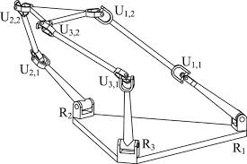
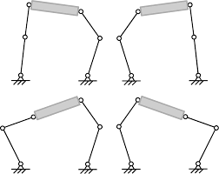
Boundary singularities that occur when the manipulator is either outstretched or retracted
Internal singularities that occur inside the reachable workspace and are generally caused by the alignment of two or more axes of motion

Slide 15
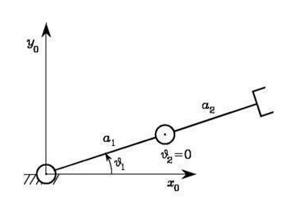
two-link planar arm
singularity

Slide 16
Inverse Differential Kinematics
inverse kinematics problem admits closed form solutions only for manipulators having a simple kinematic structure.
the differential kinematics equation represents a linear mapping between the joint velocity space and the operational velocity space
PROBLEM
Suppose that a motion trajectory is assigned to the end-effector in terms of v_{e}(t) and the initial conditions on position and orientation
determine a feasible joint trajectory (q(t), $\dot{q}$(t))
it is necessary that the Jacobian be square and of full rank

Slide 17
Problem in invertion
It follows that the computed joint variables q do not coincide with those satisfying
the
Therefore, reconstruction of joint variables q is numerical integration involves drift phenomena of the solution; as a consequence, the end-effector pose corresponding to the computed joint variables differs from the desired one.

Slide 18
Analytical Jacobian
minimal representation (Euler angles)
It is possible to compute the Jacobian via differentiation of the direct kinematics function with respect to the joint variables
Analytical Jacobian
In general $\dot{Φ≠}\dot{ω}$

Slide 19
Inverse Kinematics Algorithms
space error between the desired and the actual end-effector position and orientation
Consider the time derivative
It is necessary to choose a relationship between q and e that ensures convergence of the error to zero.
If K is a positive definite (usually diagonal) matrix, the system is asymptotically stable.
The error tends to zero along the trajectory with a convergence rate that depends on the eigenvalues of matrix K

Slide 20
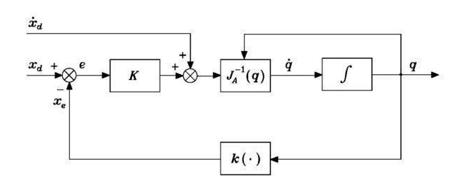
Replacing and inverting
If the values of k are too high, there could be instability

