Slide 1



STATICS
with the manipulator at an equilibrium configuration,
determine the relationship between:
the generalized forces applied to the end-effector
and the generalized forces applied to the joints (forces for prismatic joints) (torques for revolute joints)
Principle of virtual work
As for the joint torques, the elementary work associated with them is
Introducing the geometric jacobian
Forces
(at end-effector)
Torques

Slide 2



Since virtual and elementary displacements coincide
According to the principle of virtual work

Slide 3



Indeces to evaluate the dexterity of the manipulator: Manipulability Ellipsoids
represent the attitude of a manipulator to arbitrarily change end-effector position and orientation
Consider the set of joint velocities of constant (unit) norm
(a sphere in the joint velocity space)
We can replace
$$v_{e}^{T}{(J^{−1})}^{T}J^{−1}v_{e}^{}=1$$
is the equation of the points on the surface of an ellipsoid in the endeffector velocity space

Slide 4

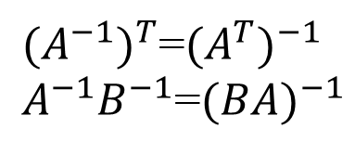

$$v_{e}^{T}{(J^{−1})}^{T}J^{−1}v_{e}^{}=1$$
Morover, since
${(A^{−1})}^{T}$=${(A^{T})}^{−1}$
$A^{−1}B^{−1}$=${(BA)}^{−1}$

Slide 5
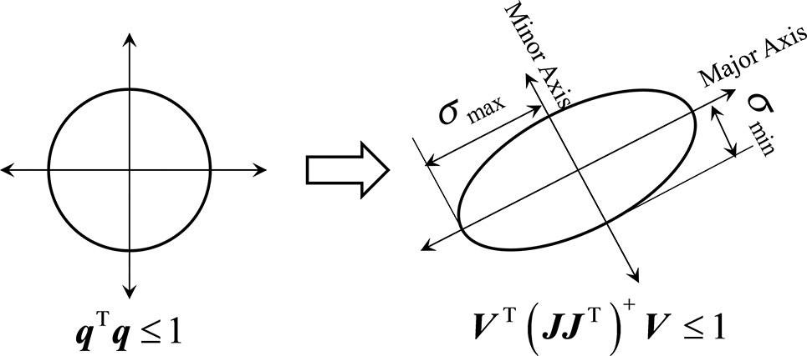
Graphically
the points on the surface of the sphere in the joint velocity space are mapped into points on the surface of the ellipsoid in the end-effector velocity space
Along the direction of the major axis of the ellipsoid, the end-effector can move at large velocity, while along the direction of the minor axis small end-effector velocities are obtained

Slide 6
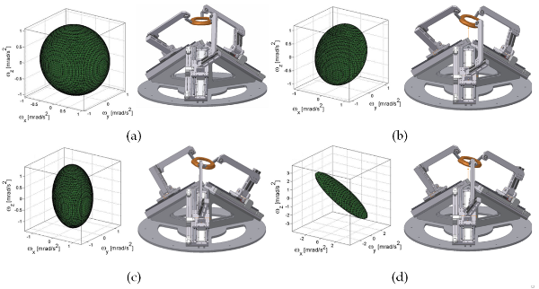

Slide 7
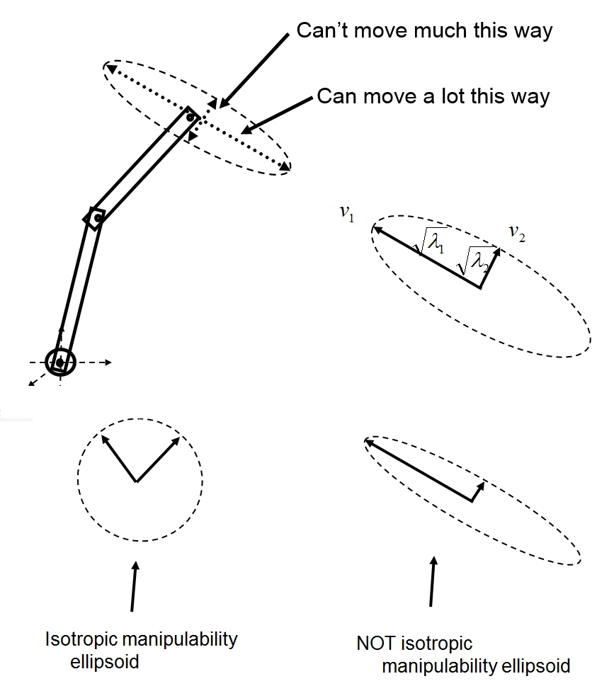

Slide 8
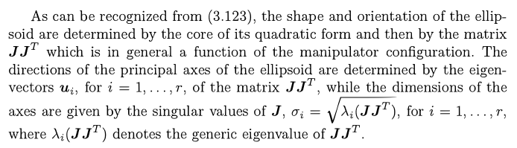

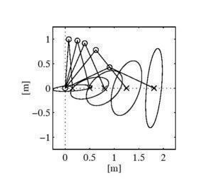
Direction of the principal axis of the ellipsoid
the volume of the ellipsoid is proportional to

Slide 9



Manipulability Ellipsoids related to forces
$τ{=J}^{T}γ$
Relationship between forces and torques
Starting from a «sphere» of torques at joints
$$τ^{T}τ=1$$
One obtains
$$γ^{T}{({JJ}^{T})}^{}γ=1$$

