Slide 1
SIEGE OF SARAJEVO
Everyday life during war

Slide 2
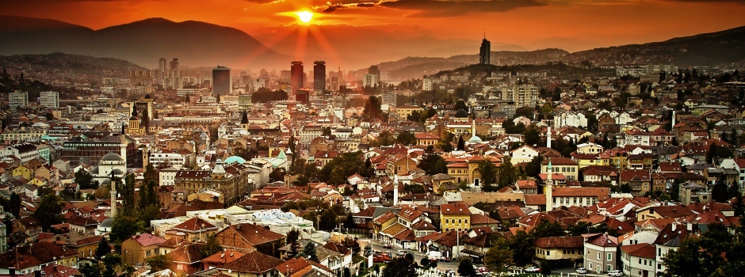

Slide 3
"Man likes to create and lay down paths, that is indisputable. But why does he also love destruction and chaos so passionately?“
Fyodor Dostoevsky

Slide 4
Life and Death
Death as material and epistemological destruction
Life as cultural creation of meaningfulness
Anthropological perspective – participant observation (from “within” and not from “above”)
Socio-political vs. spiritual life

Slide 5
Getting used to the destruction and the omnipresence of the destruction leading to new forms of power between and in people to fight back
Bauman: through the crucial frames of knowledge and their expressions
Schopenhauer’s procreative « will to live »
Maffesoli’s « pouvoir » vs. « puissance »
Nietzsche’s art against moral narowness as a“saviour from fatal truth »

Slide 6
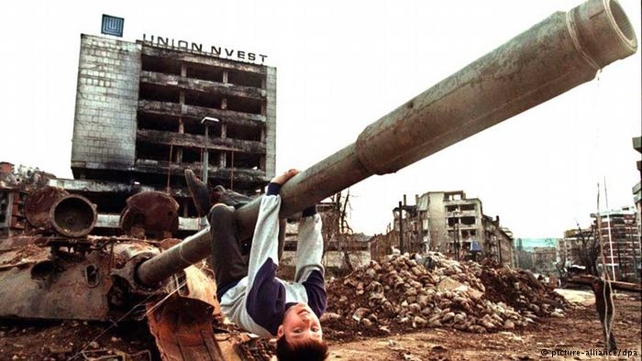
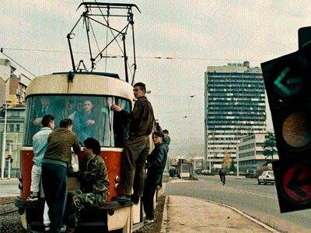

Slide 7
Feeling the Mortality
Names become numbers
Renaming the streets as part of historical revisionism, unrecognizable parts of the city
War experience incorporated in the body of the town
Constant exposure to shelling, snipers, winter cold, scarcity of water and food, no electricity

Slide 8
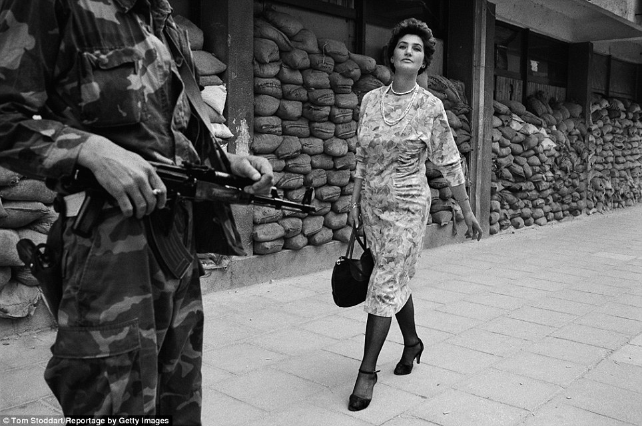

Slide 9
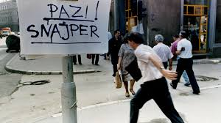

Slide 10
Between Indifference and Panic
Always partly aware of their exposure
Different reactions on air-raid alarms
Irrational behaviour (podrumaši – cellar people)
Acception of fear as a social norm
Never-ending pendulum between Depression and Strenght
Various techniques of dealing with it

Slide 11
Memories of pre-war life
Double-edged sword: A) helping people escape from the destruction of their war-lives
B) the thoughts of life they once had were too painful
“Nothing is so painful as to in misfortune remember the happy moments” Dante

Slide 12
Beyond human powers and on the borderline of human cognition
Taking the refugees in as a supra-human notion, solidarity making people stronger
Impossibility of making plans and of living a decent life
RELIGION / DESTINY /ART /DENYING THE DANGERS

Slide 13
Socio-cultural peculiarities
Bosnian humor
“How does a Bosnian call a stupid one?” – “From a phone abroad!”
Urban life – kafane, markets, water-pipes, restaurant’s basements
No electricity, gas or water – theatre and concerts at 1 p.m.

Slide 14
Art as resistance
Extreme existential danger produced creative force that fine arts provide
Civilian life over war
Anti-war messages
Materials available – from destruction to creation
Evoking the Olympic Games in 1984 – call to the world!

Slide 15
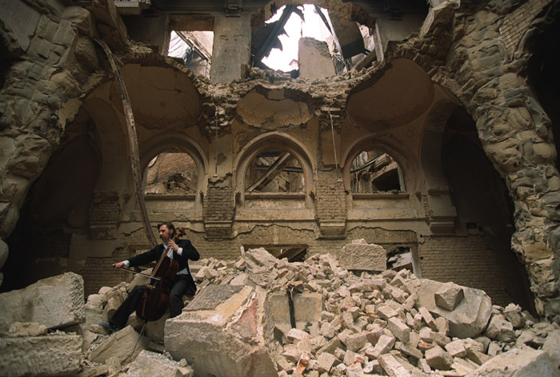
Vedran Smailović playing in the destroyed National Library in Sarajevo 1992

Slide 16
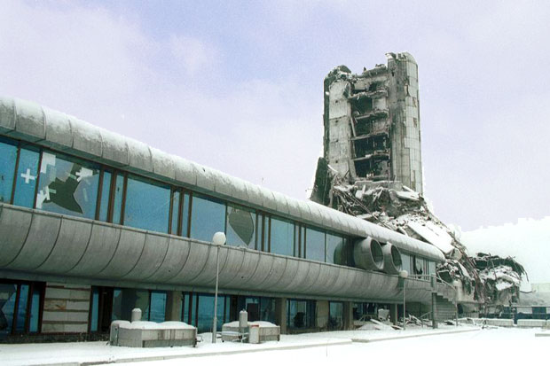
Oslobođenje – the world’s newspapers of 1992

Slide 17
Cultural life in Sarajevo was pretty dynamic, wasn’t it? Musical life, theatre and publishing all went on.
Izet Sarajlic: The Latin saying whereby people fall silent when the guns roar is false. Some very fine work was produced in Sarajevo during the war. It would be a good thing if foreigners could read some of the stuff we wrote, so that they could understand that civil war is a plague, that it is contagious and that it could happen elsewhere in the world, in an even more terrible form.
In one of your books, Recueil de guerre, you say: “If I’ve survived all this it’s thanks to poetry and to a dozen or so people, ordinary folk, true saints of Sarajevo, whom I hardly knew before the war.”
Izet Sarajlic: I wrote my two war books in my cellar as shells whistled overhead. I couldn’t, like Eluard, paint the word “freedom” on the walls of Sarajevo because no walls were left standing. So I said to my wife: “Look at me, I am like a late twentieth-century Milton, writing a Paradise Lost by candlelight.”But I didn’t start out with the idea of writing poetry. I didn’t care about poetry. It’s a long time since I was interested in poetry. Just before the war, I wrote that the worst places for poetry were the very places where poetry could be found. When I said that poetry had saved me, I meant that these extremely unhappy war years were perhaps the happiest years of my life as a poet. I was motivated, I had readers, or rather listeners. We had no paper for printing and I was not on close terms with the few publishers who had any. In any case, they specialized in pseudo-religious work and propaganda, and so I wasn’t very keen on being published by them. Nevertheless, my poems reached the public, which made me very happy indeed. During the war, my literary and moral standing in the eyes of my fellow citizens seemed to be high. I saw that they wanted to help me in one way or another. They would step aside for me when we queued for water, although I naturally never took advantage of that, and they would give me a cigarette, or an apple for my grandson.

Slide 18
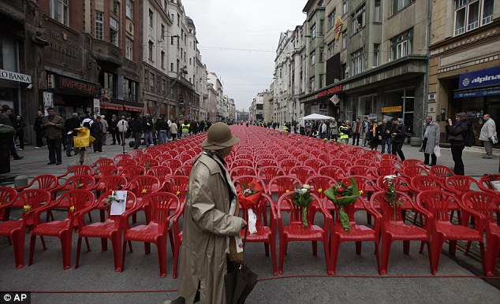
11541 red chairs

Slide 19
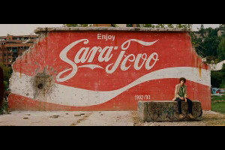
Luck In Sarajevo
In the spring of 1992,
Everything is possible:
You go stand in a bread line
And end up in an emergency room
With your leg amputated.
Afterwards, you still maintain
That you were very lucky.

Slide 20
Hvala!
https://www.youtube.com/watch?v=Za8-THNtk-M

