Slide 1
Kinematics
Paolo Gallina
pgallina@units.it
040 5583829
Office: Buolding. C5, first floor, room 27

Slide 2
Book: L. Sciavicco, B. Siciliano, Robotics: Modelling, Planning and Control, Springer

Slide 3
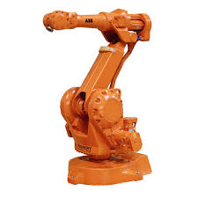
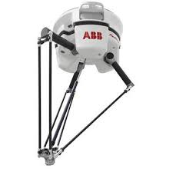
Strutture cinematiche
Open kinematic chain
Closed kinematic chain

Slide 4
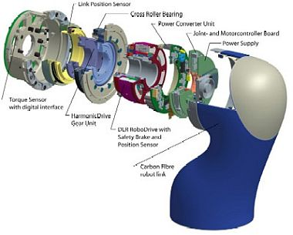
JOINTS
Prismatic joint
Revolute joint

Slide 5
Structures
Cartesian
SCARA

Slide 6
Structures
DELTA

Slide 7
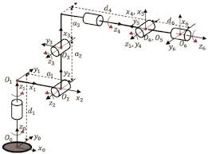
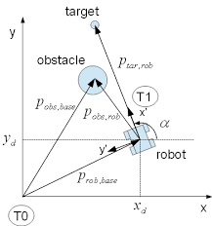
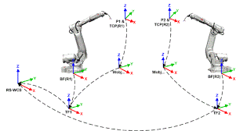
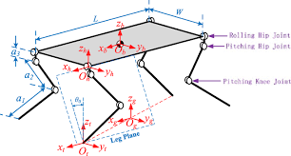
A robot is made up of links (need to elaborate tools for considering relative position of frames)

Slide 8
Kinematics
A manipulator can be schematically represented from a mechanical viewpoint as a kinematic chain of rigid bodies (links) connected by means of revolute or prismatic joints.
One end of the chain is constrained to a base, while an end-effector is mounted to the other end.
It is necessary to describe the end-effector position and orientation.
This allows the end-effector position and orientation (pose) to be expressed as a function of the joint variables of the mechanical structure with respect to a reference frame.

Slide 9
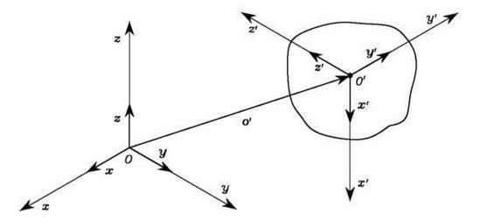
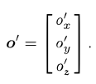
A rigid body is completely described in space by its position and orientation (in brief pose) with respect to a reference frame.
The position of a point 0' on the rigid body
It can be compactly written as the (3 x 1) vector

Slide 10
Let then O'-x'y'z' be such a frame with origin in 0' and x', y', z' be the unit vectors of the frame axes (it is attached to the rigid body).
The unit vectors are expressed with respect to the reference frame O-xyz
The components of each unit vector are the direction cosines of the axes of frame O'-x'y'z' with respect to the reference frame O-xyz.

Slide 11
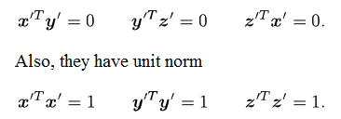
Rotation Matrix
Definition:
the column vectors represent the unit vectors of an orthonormal frame
the column vectors of matrix R are mutually orthogonal
therefore

Slide 12
Therefore R is an orthogonal matrix
…therefore
If both sides of (2.4) are postmultiplied by the inverse matrix R-1

Slide 13
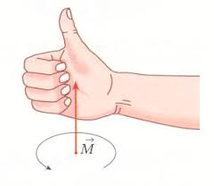
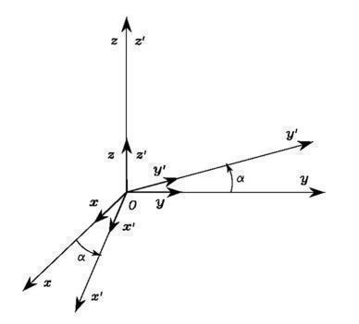
Elementary Rotations
elementary rotations of the reference frame about one of the coordinate axes.
rotations are positive if they are made counter-clockwise about the relative axis.
rotated by an angle
α about axis z
The unit vectors of the new frame can be described in terms of their components with respect to the reference frame

Slide 14
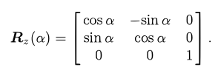
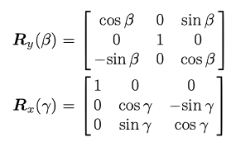
the rotation matrix of frame O-x'y'z' with respect to frame O-xyz is
it can be shown that the rotations by an angle β about axis y and by an angle γ about axis x are: (show with the real frame)
It holds
(see mathematically… exercise)

Slide 15
Exercise
x
x
y
0
y
1
R⁰₁=?
x
z
y
x
0
1
R⁰₁=?

Slide 16
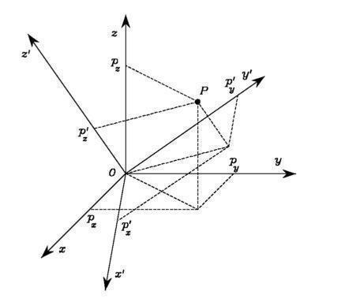
Representation of a Vector
consider the case when the origin of the body frame coincides with the origin of the reference frame

Slide 17
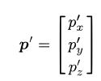
with respect to
frame O-xyz
The point P cam be expressed in both reference frame
with respect to
frame O-x'y'z'
The rotation matrix R represents the transformation matrix of the vector coordinates in frame O-x'y'z' into the coordinates of the same vector in frame O-xyz.

Slide 18
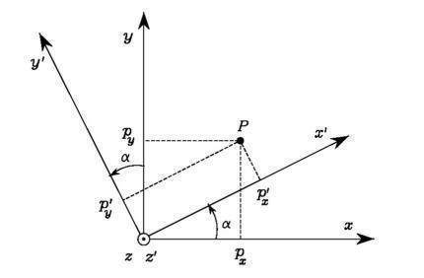
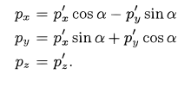
Example
Consider two frames with common origin mutually rotated by an angle α about the axis z. Let p and p' be the vectors of the coordinates of a point P, expressed in the frames O-xyz and O-x'y'z', respectively
p’cos(α)
p’sin(α)
The matrix represents not only the orientation of a frame with respect to another frame, but it also describes the transformation of a vector from a frame to another

Slide 19
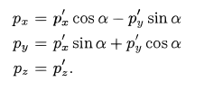
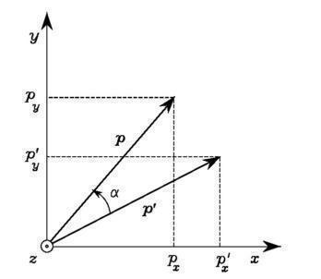
Rotation of a vector
A rotation matrix can be also interpreted as
the matrix operator allowing rotation of a vector by a given angle about an arbitrary axis in space
Students: demonstration
α
Somm cos

Slide 20
Summary: A Matrix
describes the mutual orientation between two coordinate frames; its column vectors are the direction cosines of the axes of the rotated frame with respect to the original frame.
It represents the coordinate transformation between the coordinates of a point expressed in two different frames (with common origin).
It is the operator that allows the rotation of a vector in the same coordinate frame.

Slide 21
Composition of Rotation Matrices
Consider 2 frame with the same origin and different orientations
p_{0,} p_{1,} p₂ are the same vector with respect to different frames
0
1
or
p₁
p₀
p₂
Replacing and combining

Slide 22
Interpretation of rotation
The relationship in can be interpreted as the composition of successive rotations. Consider a frame initially aligned with the frame 0.
Two steps:
• First rotate the given frame, so as to align it with frame 1
• Then rotate the frame, now aligned with frame 1, so as to align it with frame 2.
Notice that the overall rotation can be expressed as a sequence of partial rotations; each rotation is defined with respect to the preceding one.
The frame with respect to which the rotation occurs is termed current frame.

Slide 23
Composition of successive rotations is then obtained by postmultiplication of the rotation matrices following the given order of rotations
matrix product is not commutative

Slide 24
Rotation with respect to the fixed or the current frame
Let’s assume that we have the chain R1 R2 R3
If the next rotation R is with respect to the
fixed frame
(exampe: a robot that rotate at the base)
R R1 R2 R3
If the next rotation R is with respect to the current frame
R1 R2 R3 R

Slide 25
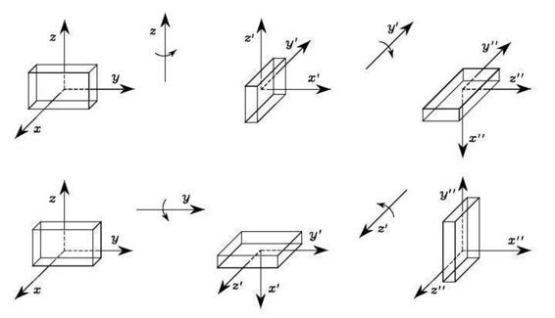
If rotation matrix are commuted (current frame), it is evident that the final object orientation is different in the two cases

Slide 26
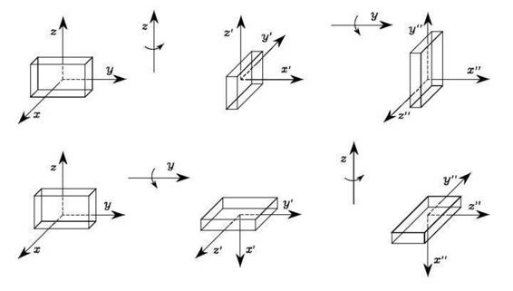
Rotation with respect to the fixed frame (commutated)

Slide 27
Euler angles
three parameters are sufficient to describe orientation of a rigid body in space = minimal representation
A generic rotation matrix can be obtained by composing a suitable sequence of 3elementary rotations
12 distinct sets of angles
The most used are:
ZYZ angles
ZYX (or Roll-PitchYaw) angles

Slide 28
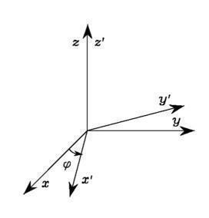
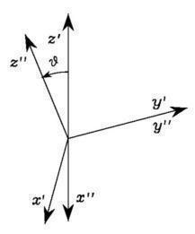
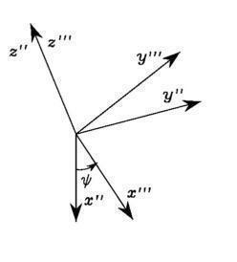
ZYZ angles

Slide 29
It is possible to calculate the Euler angles starting from the rotation matrix
From the third column

Slide 30
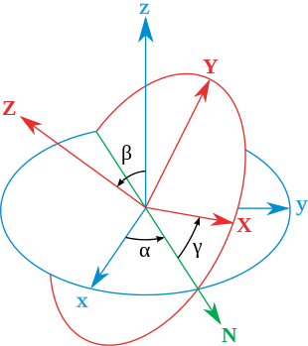
Line of nodes =
perpendicular to Z and z
The rotated frame is the one in red

Slide 31
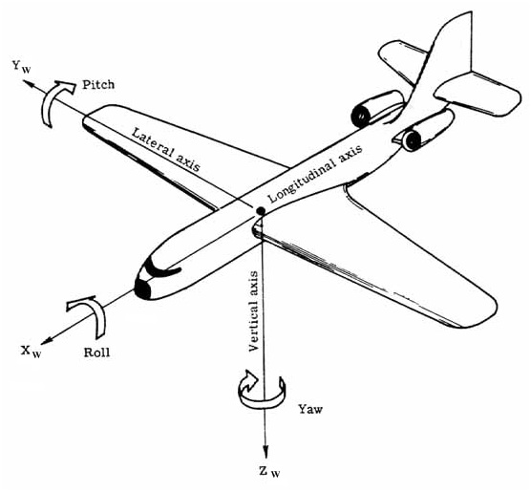
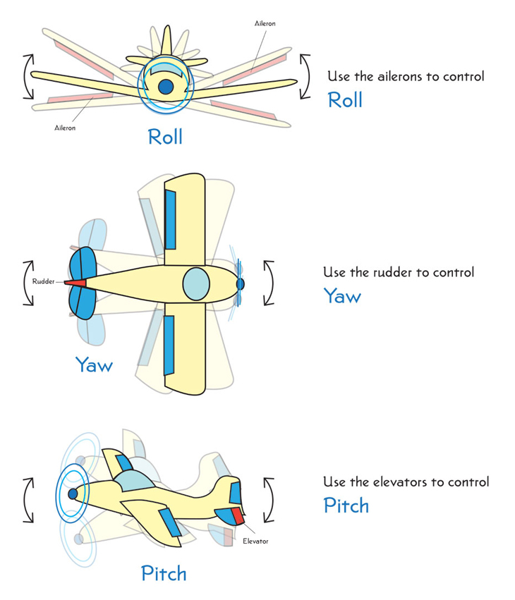
Roll-PitchYaw angles (ZYX)
https://www.youtube.com/watch?v=UpSMNYTVqQI

Slide 32
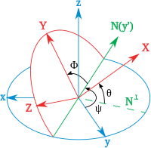
Sequence of rotation
Line of nodes
N┴z
N┴X
The rotated frame is the one in red

Slide 33
Angle and Axis
Let r be the unit vector which represents the axis of rotation of a given frame.
It is expressed with respect to the reference frame O-xyz.
In order to derive the rotation matrix R(θ, r) expressing the rotation of an angle θ about axis r, it is convenient to compose elementary rotations about the coordinate axes of the reference frame.
The angle is taken to be positive if the rotation is made counter-clockwise about axis r.

Slide 34
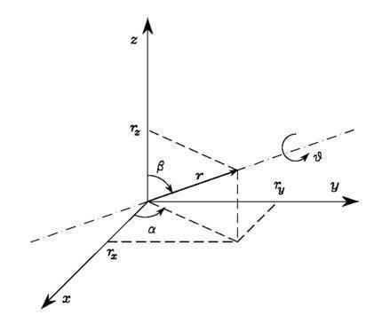
How to derive the formula
$$R\left(θ,r\right)$$
has the property
$r=R\left(θ,r\right)$ $r$
replacing
$$r=R_{z}\left(α\right)R_{y}\left(β\right)\left\{\begin{matrix}0 \\ 0 \\ 1\end{matrix}\right\}$$
$$r=R_{z}\left(α\right)R_{y}\left(β\right)R_{z}\left(θ\right)\left\{\begin{matrix}0 \\ 0 \\ 1\end{matrix}\right\}$$

Slide 35
$R\left(θ,r\right)R_{z}\left(α\right)R_{y}\left(β\right)\left\{\begin{matrix}0 \\ 0 \\ 1\end{matrix}\right\}$=$R_{z}\left(α\right)R_{y}\left(β\right)R_{z}\left(θ\right)\left\{\begin{matrix}0 \\ 0 \\ 1\end{matrix}\right\}$
In order to satisfy the equation
$R\left(θ,r\right)R_{z}\left(α\right)R_{y}\left(β\right)$=$R_{z}\left(α\right)R_{y}\left(β\right)R_{z}\left(θ\right)$
$R\left(θ,r\right)$=$R_{z}\left(α\right)R_{y}\left(β\right)R_{z}\left(θ\right)R_{y}^{−1}\left(β\right)R_{z}^{−1}\left(α\right)$
$R\left(θ,r\right)$=$R_{z}\left(α\right)R_{y}\left(β\right)R_{z}\left(θ\right)R_{y}\left(−β\right)R_{z}\left(−α\right)$

Slide 36
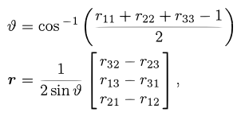
Inverse problem: given the matrix, calculate the vector and the angle
when θ = 0 (null rotation), the unit vector r is arbitrary (singularity)

Slide 37
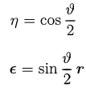
Quaternions
scalar part of the quaternion
Let’s define
vector part of the quaternion
They are constrained by the condition
unlike the angle/axis representation, a rotation by - θ about -r gives the same quaternion as that associated with a rotation by θ about r; this solves the above nonuniqueness problem

Slide 38
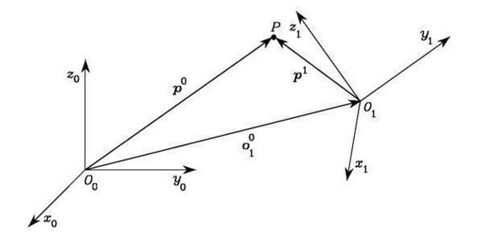
Homogeneous Transformations
p° be the vector of coordinates of P with respect to 0°x°yOz°
o₁° be the origin of Frame 1 with respect to Frame 0
R° be the rotation matrix of Frame 1 with respect to Frame 0
p₁ be the vector of coordinates of P with respect to Frame 1.

Slide 39
Chain of vector
The inverse transformation can be obtained by premultiplying both sides of equation by the transpose of the rotation matrix
or
Homogeneous representation
of a generic vector p

Slide 40
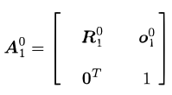
Homogeneous transformation matrix
$$A_{1}^{0}=\left[\begin{matrix}R_{1}^{0} & \begin{matrix}o_{1}^{0}x \\ o_{1}^{0}y \\ o_{1}^{0}z\end{matrix} \\ \begin{matrix}0 & 0 & 0\end{matrix} & 1\end{matrix}\right]$$
or
The transformation of a vector from Frame 1 to Frame 0 is expressed by a single matrix containing the rotation matrix of Frame 1 with respect to Frame 0 and the translation vector
Inverse problem
homogeneous
representation
Note that

Slide 41
Inverse of homogeneous matrix
For a chain of frames, it holds

Slide 42
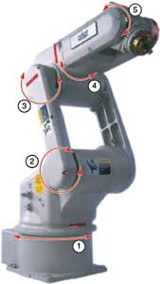
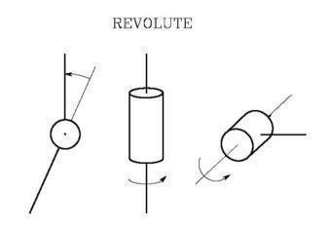
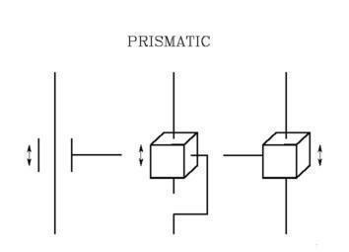
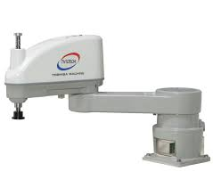
Direct Kinematics
A manipulator consists of a series of rigid bodies (links) connected by means of kinematic pairs or joints. Joints can be essentially of two types:
Revolute
Prismatic

Slide 43
SCARA Robot

Slide 44
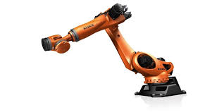
Open chain
Closed chain = parallel robot

Slide 45
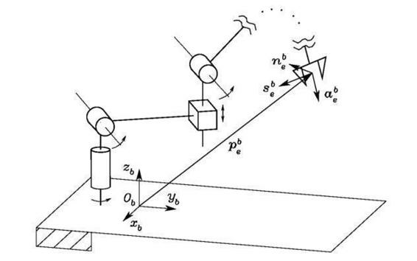
Each DOF of a robot is typically associated with a joint articulation and constitutes a joint variable.
Problem of Direct kinematics = computing the pose of the end-effector as a function of the joint variables
The pose of the end-effector is defined by

Slide 46
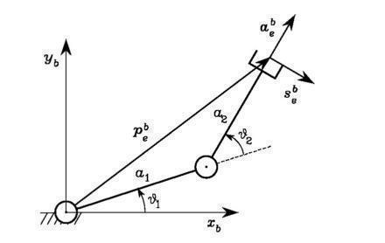
Example: two-link planar arm

Slide 47
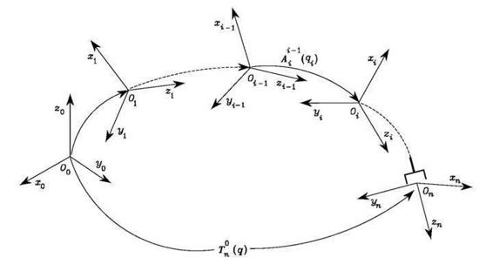
Consider the Direct kinematics for an open chain
- Link 0 is conventionally fixed to the ground
each joint provides the mechanical structure with a single DOF
it is worth defining a coordinate frame attached to each link

Slide 48
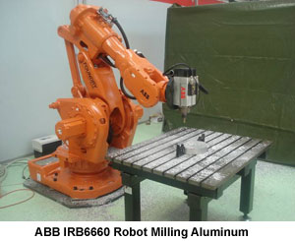
If we consider also the presence of a tool (with its frame) and the base
n (end-effector)
e (tool)
b (base)
0 (base of the robot)

Slide 49
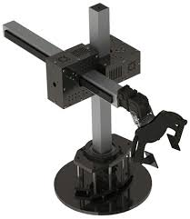
Exercise: rototranslation matrices
Kinematics of a cylindrical robot
Identify the rototranslation matrix
from the end-effector to the base
See main1.m

Slide 50
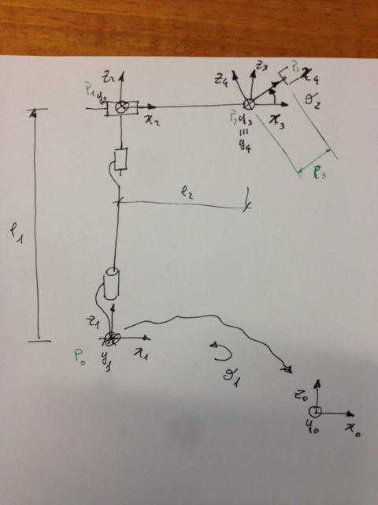
Possible solution

Slide 51
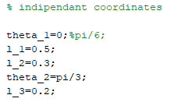
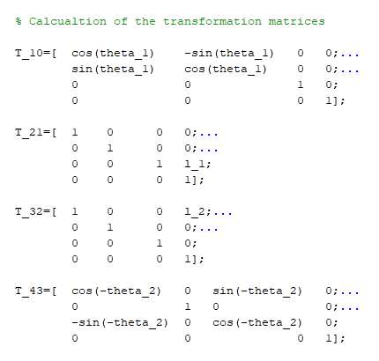

Slide 52
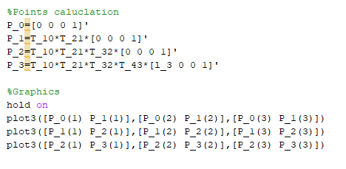
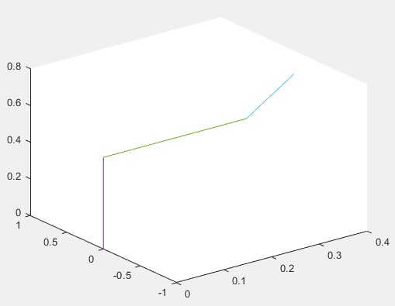

Slide 53
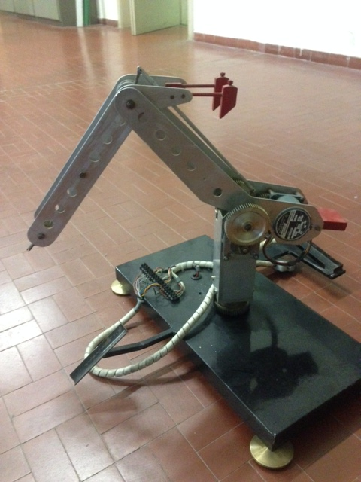
Exercise: rototranslation matrices
Kinematics of a 3 DoF robot
Identify the rototranslation matrix
from the end-effector to the base

