Slide 1
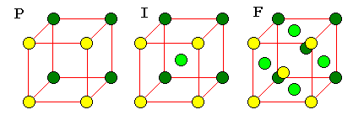
Solid state chemistry

Slide 2
Difference Between Amorphous and Crystalline Solids
Amorphous
Amorphous solids (means without form) are the solids which lacks the regular arrangement of atoms or molecules and hence they have a short range order or no order in their structure : ABCBBACBCACCB...
Do not have sharp melting point (because all bonds are not equally strong)
Isotropic (Physical properties are same in different directions)
Examples: glass, wax, plastics, etc.
Crystalline
A crystalline solid is the one in which there is a regular repeating pattern in the structure, or in other words, there is long-range order : ABCABCABCABC…
Have sharp melting point (because all bond are equally strong)
Anisotropic (Physical properties are different in different directions)
Examples: diamond, table salt, ice, methanol, sodium chloride, etc.

Slide 3
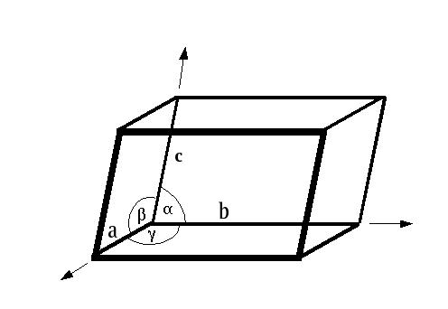
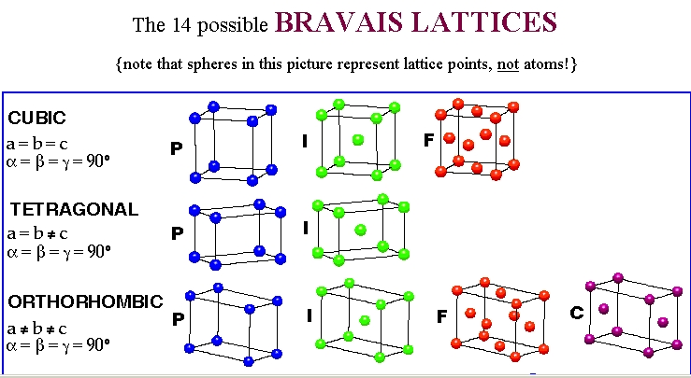
Type of unit cells
Lattice parameters
a, b, c
α, β, χ
P Simple
I Body-centred
F Face-centred
C Base(side)-centred

Slide 4
CRYSTAL SYSTEMS AND BRAVAIS LATTICES
Crystals of different substances have similar shapes and hence the crystals are classified into the so called crystal systems depending upon their axial ratio and the interfacial angles α, β and γ. In three-dimension, there are 7 crystal systems. Bravais showed that throughout the seven crystal systems there are fourteen unique lattice types possible. These are known as Bravais or space lattices. These seven crystal systems with examples are :
Cubic(CsCl, NaCl, Cu)
Tetragonal(SnO2)
Orthorhombic(PbSO4, MgSO4)
Monoclinic(FeSO4, LiSO4 ⋅ H2O)
Triclinic(FeSO4 ⋅ 5H2O, K2Cr2O7)
Trigonal (Rhombohedral)(Sb, As, CaCO3)
Hexagonal(Zn, Cd, Ni, As, SiO2)
The characteristics features of these crystal systems and the corresponding Bravais lattices are as follows:

Slide 5
No. | Crystal class | Intercepts on Axes | Angles between Axes | Bravais space lattice
1 | Cubic | a = b = c | α = β = γ = 90⁰ | Simple, body-centred, face-centred
2 | Tetragonal | a = b ≠ c | α = β = γ = 90⁰ | Simple, body-centred
3 | Orthorhombic | a ≠ b ≠ c | α = β = γ = 90⁰ | Simple, body-centred, face-centred, Base(side)-centred
4 | Trigonal | a = b = c | α = β = γ ≠ 90⁰ | Simple
5 | Hexagonal | a = b ≠ c | = β = 90⁰, γ = 120⁰ | Simple
6 | Monoclinic | a ≠ b ≠ c | α = γ = 90⁰ ≠ β | Simple, base-centred
7 | Triclinic | a ≠ b ≠ c | α ≠ β ≠ γ | Simple

Slide 7
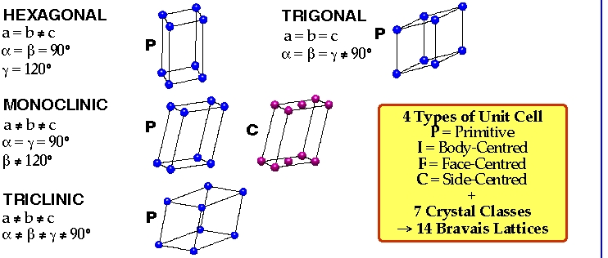

Slide 8
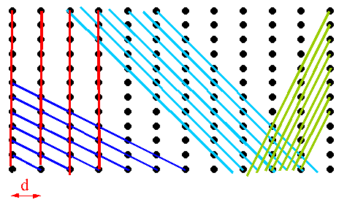
MILLER INDICES
The crystal structure may be regarded as made up of an aggregate of a set of parallel equidistant planes passing through at least one lattice point or a number of lattice points. These planes are known as Lattice Planes. For a given crystal, lattice planes can be chosen in different ways as shown in Fig.
Miller Indices are the three smallest possible integers, which have the same ratio as the reciprocals of intercepts of the plane concerned on the three axis.

Slide 9
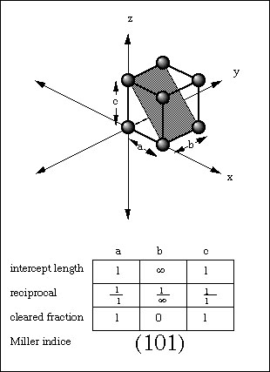

Slide 10
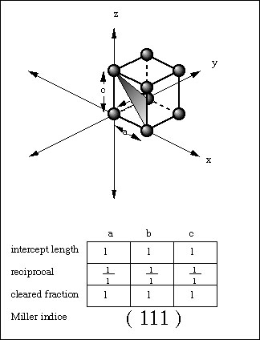

Slide 11
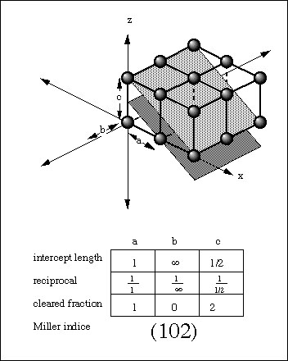

Slide 12
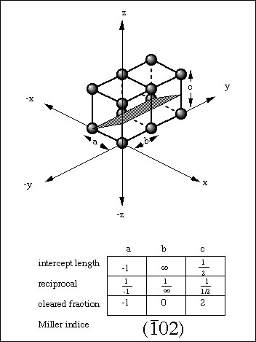

Slide 13
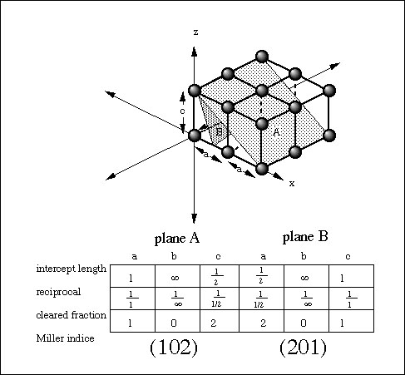

Slide 14
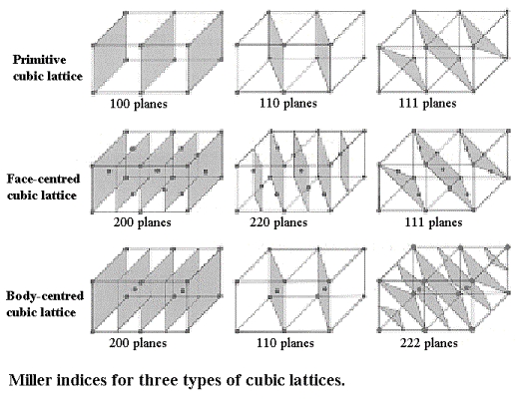

Slide 15
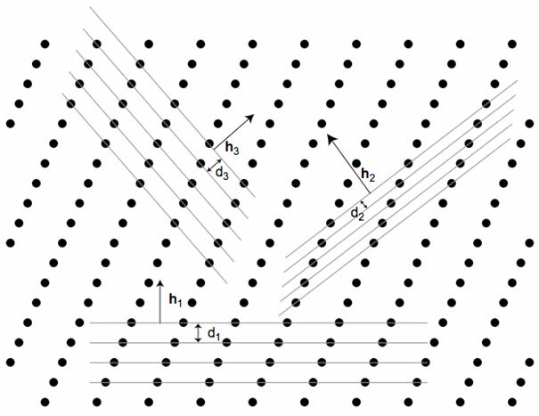
INTERPLANER DISTANCE OR SPACING
Interplaner spacing is defined as the perpendicular distance d_{hkl} between corresponding planes. It is also perpendicular distance from the origin to the set of parallel planes (see Fig.)

Slide 16
For a cubic lattice, a = b = c, therefore, we get
Also, For a cubic lattice,
d₁₀₀ = a, d₁₁₀ = a/√2 and d₁₁₁ = a/√3.

Slide 17
Physical Parameters for Crystal Structure
(i) Number of Atoms per Unit Cell
Number of atoms per unit cell determines how closely the solid is packed and is given by
N = N_{c}/8 + N_{f}/2 + N_{i}
here N_{c} is the number of corner atoms, N_{f} the number of face centred atoms and N_{i} the number of body centred atoms(see Fig.).
For SC crystal : In a SC crystal, there are 8 atoms only, each at one corner. Each atom is shared by 8 unit cells. Therefore, we have
N = N_{c}/8 = 8/8 = 1
For BCC crystal :N = N_{c}/8 + N_{f}/2 + N_{i} = 8/8 + 0 + 1 = 2
For FCC crystal :N = N_{c}/8 + N_{f}/2 + N_{i} = 8/8 + 6/2 + 0 = 4

Slide 18
(ii) Coordination Number (CN)
In a crystal, the number of nearest neighbours of the same type and at equal distances from the given atom is called coordination number.
For SC : The corner atoms are the nearest neighbours of each other. Here CN = 6 (see Fig.) which is a group of 8 unit cell and atom at the centre has six corner atoms as its nearest neighbours).

Slide 19
For BCC : In this case all the corner atoms are at equal distances from the body centered atom.
Hence CN = 8.
For FCC : Here the nearest neighbours of any corner atom are the face centered atoms of the surrounding unit cells. Now for any corner atom there are 4 face centered atoms in each plane and there are three such planes. Therefore, CN = 12.

Slide 20
(iii) Atomic Radius and Nearest Neighbour Distance (NND)
In a crystal the atoms are assumed to be spheres in contact. Now atomic radius is defined as half the distance between the nearest neighbours in a crystal of pure element, i.e., the distance between the centres of neighbouring atoms.
For SC : In a SC structure, corner atoms are the nearest neighbours and are in touch with each other. If the side of the unit cell is ‘a’ and ‘r’ be the radius , then
2r = a or r = a/2
Now Nearest Neighbour Distance(NND) is given by 2r
Therefore, NND = 2r = a

Slide 21
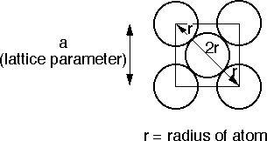
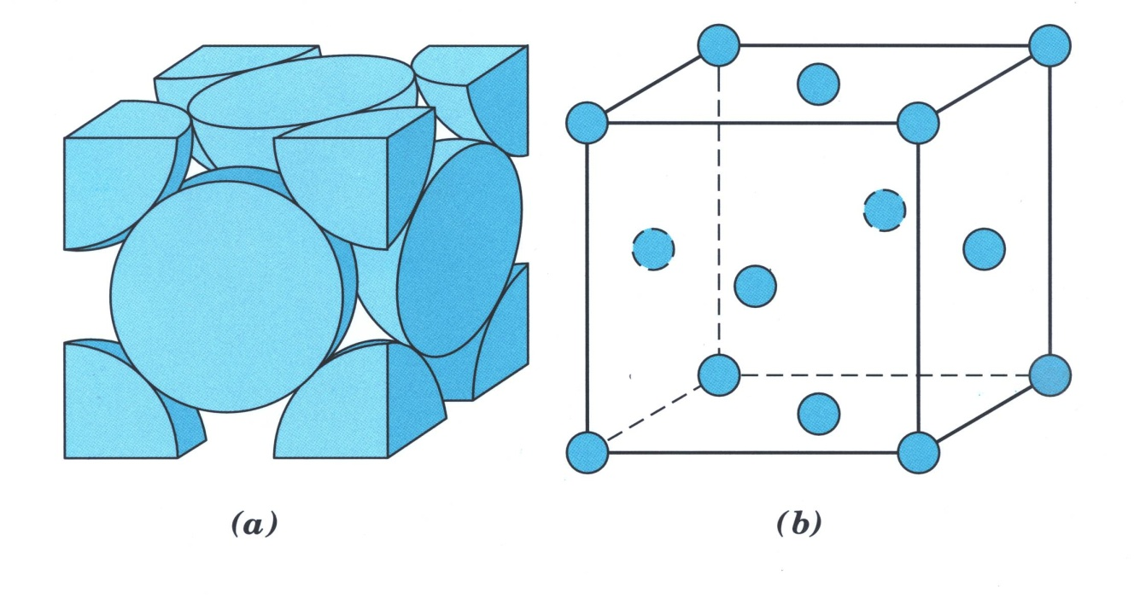
For FCC : r = √2 a/4
NND = a/√2

Slide 22
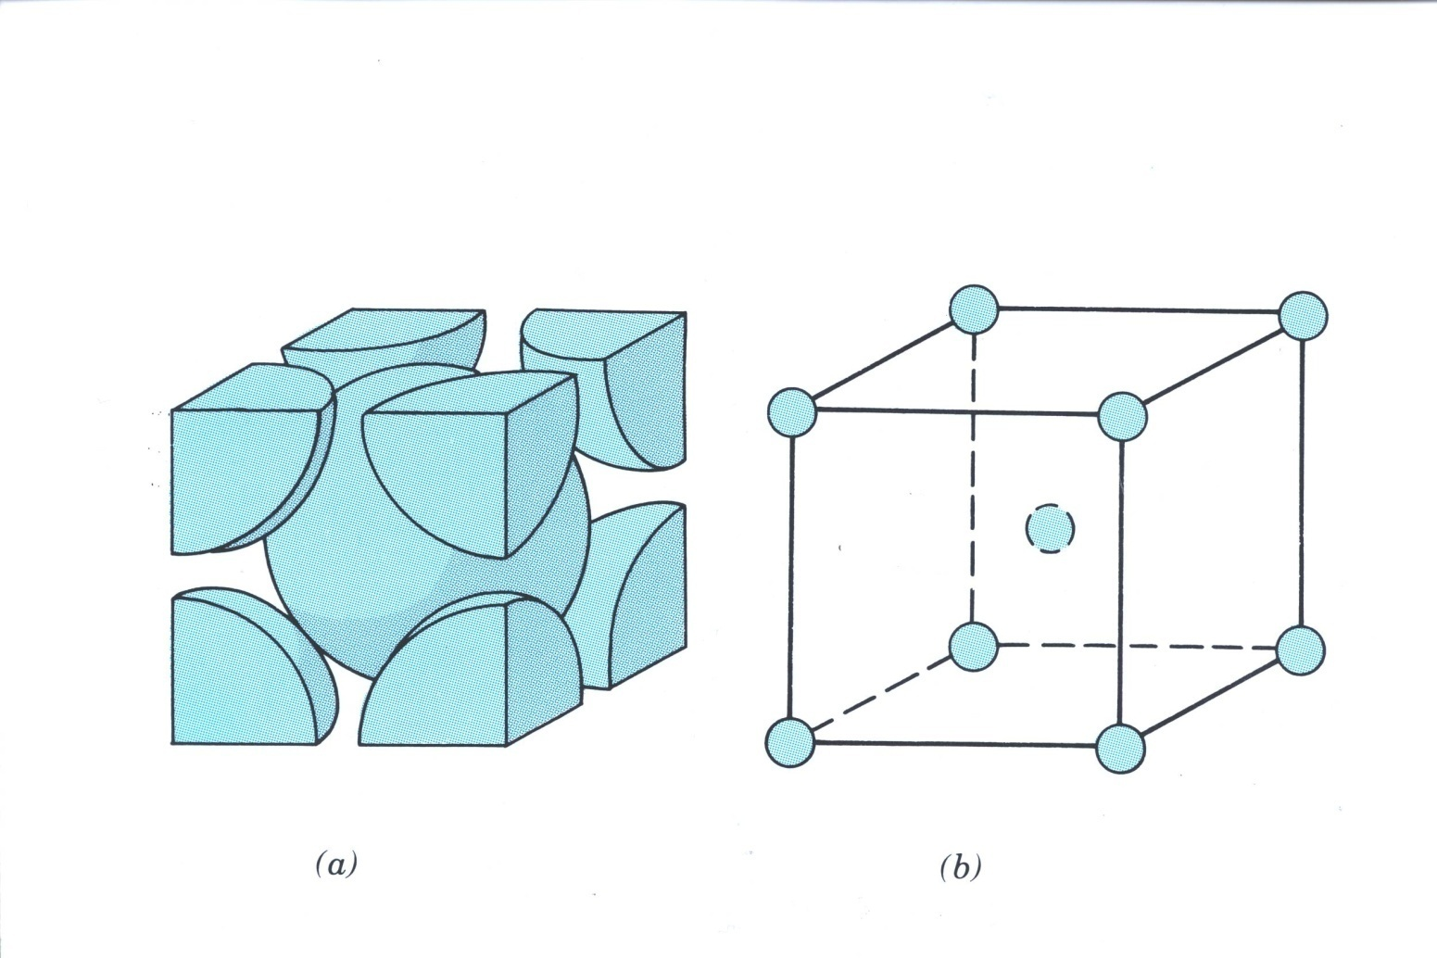
For BCC : r = √3 a/4
NND = √3 a/2.

Slide 23
(iv) Atomic Packing Fraction (or Factor) (APF)
It is defined as the ratio of the volume of the atoms occupying the unit cell to the volume of the unit cell. It is also called relative packing density.
APF = Volume occupied by the atoms in a unit cell / Volume of the unit cell.
SC Crystal : No. of atoms/unit cell = 1
Volume of one atom = 4/3 πr³
Side of the unit cell = a = 2r
Volume of the unit cell = a³
APF = = = π/6 = 0.52 = 52%.
BCC Crystal : No. of atoms/unit cell = 2
Volume of two atoms = 2x4/3 πr³
Side of the unit cell = a = 4r/√3
Volume of the unit cell = a³
APF = = = √3π/8 = 0.68 = 68%.
FCC Crystal : No. of atoms/unit cell = 4
Volume of four atoms = 4x4/3 πr³
Side of the unit cell = a = 4r/√2
Volume of the unit cell = a³
APF = = = √2π/6 = 0.74 = 74%.

Slide 24
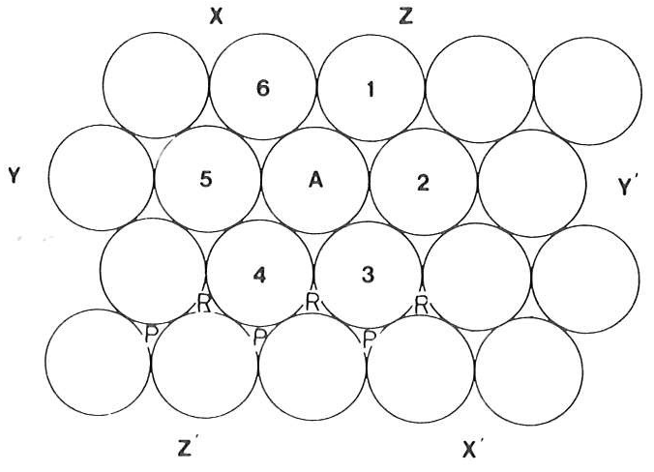
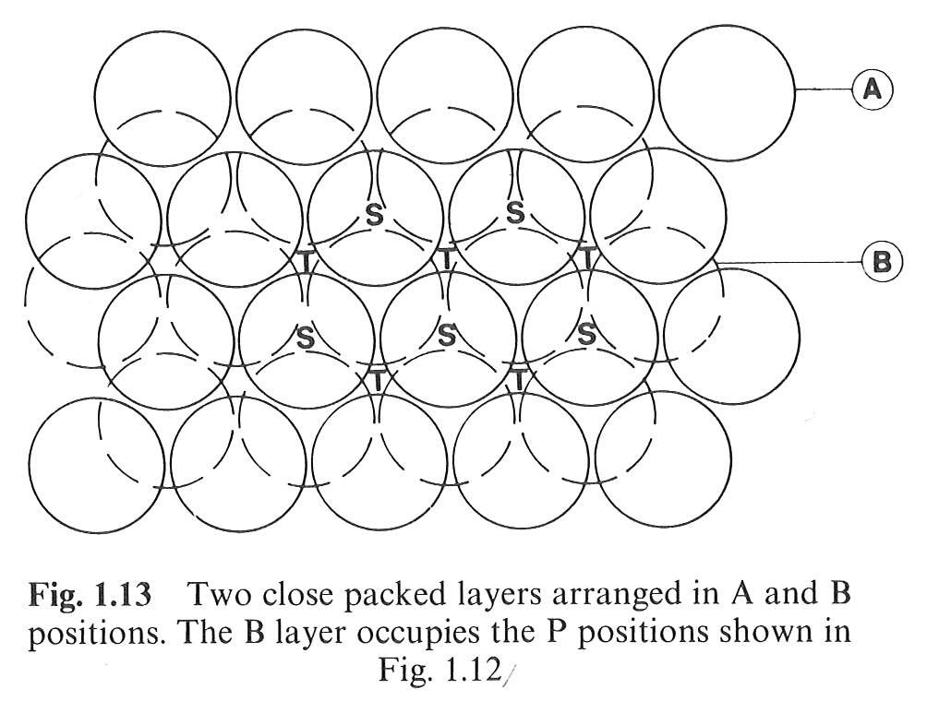
Closed Packed Structures
In a closed packed structure the constituent atoms are so arranged as to occupy minimum possible volume, reaching the maximum density.
2-layers closed packed structure
Planar closed packed spheres

Slide 25
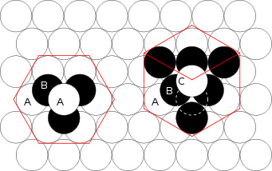
Closed Packed Structures
hcp
ccp
Hexagonal Closed Packed
Cubic Closed Packed

Slide 26
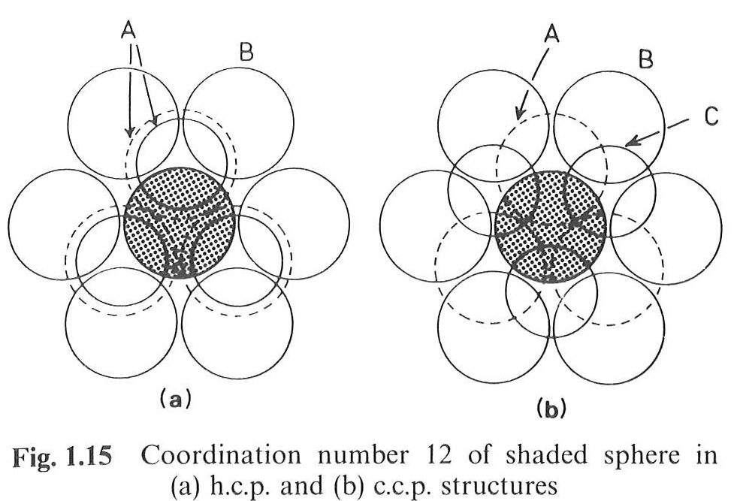
Closed Packed Structures
hcp
ccp
Hexagonal Closed Packed
Cubic Closed Packed

Slide 27
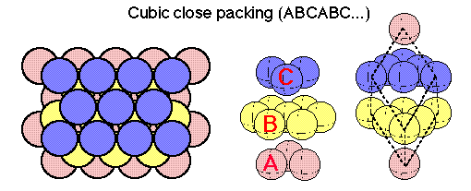
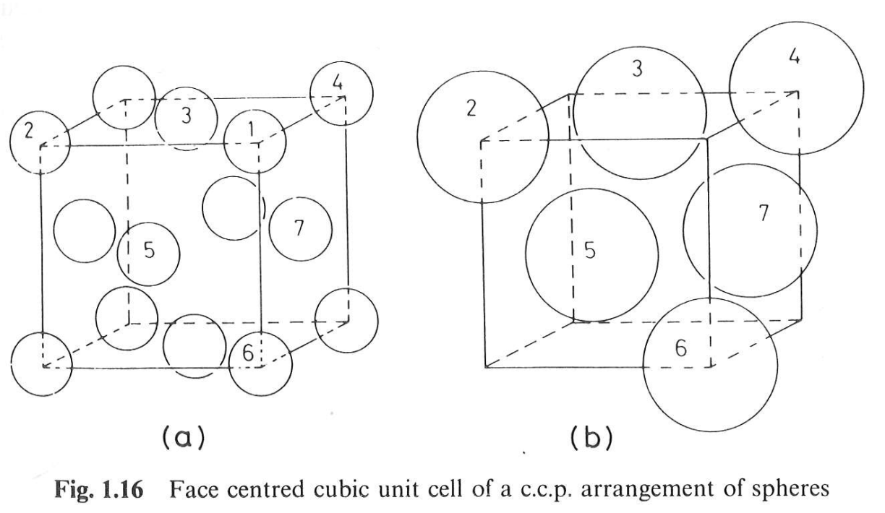
c.c.p. structure
(111) Of a FCC structure

Slide 28
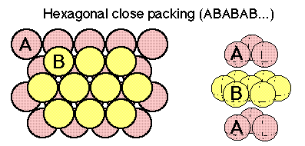
h.c.p. structure

Slide 29
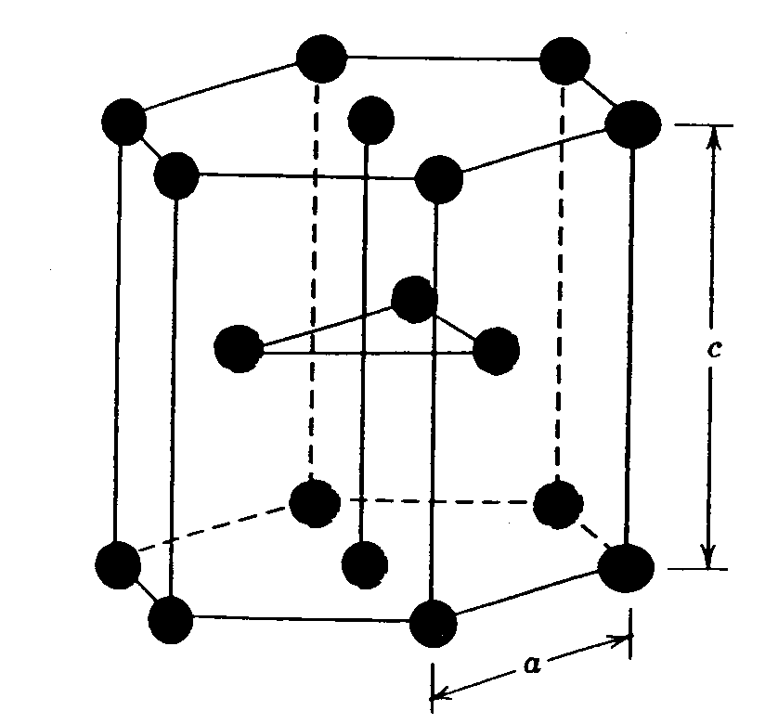
h.c.p. structure

Slide 30
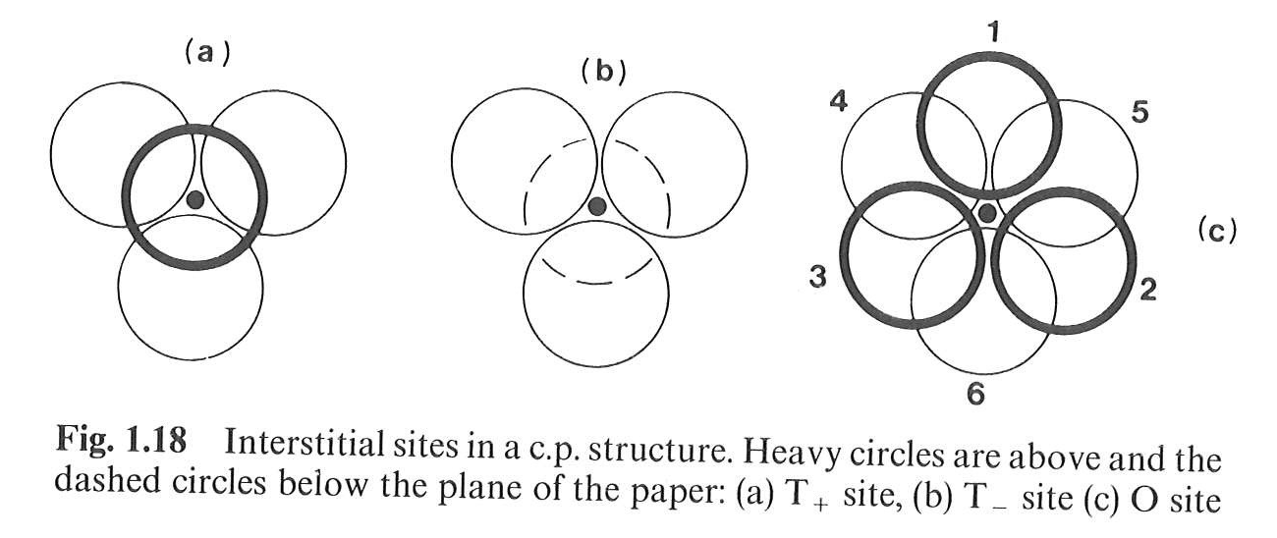
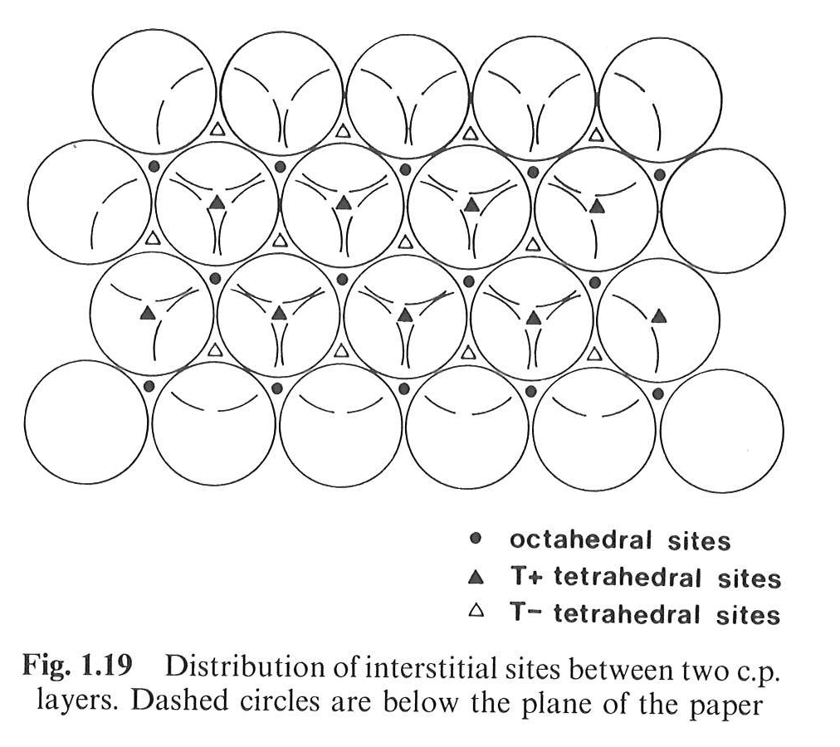
Interstitial sites in Closed Packed Structures

Slide 31
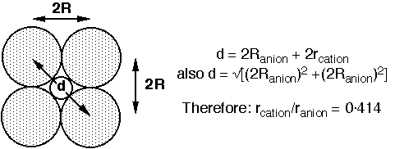
Interstitial sites in Closed Packed Structures
Having determined what types of interstitial sites are available, we must now decide:
(a) Which sites are occupied by a given cation: this determined by the radius ratio (= r_{cation}/r_{anion})
(b) How many sites are occupied: this is determined by the stoichiometry.
For an octahedral site:
For a tetrahedral site, r_{cation}/r_{anion} = 0.225.
For these two values, the close packed structure of anions is maintained.

Slide 32
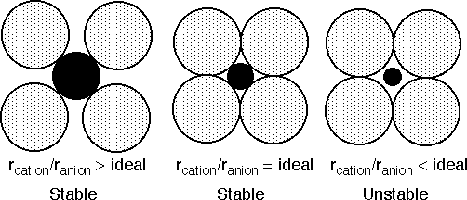

Interstitial sites in Closed Packed Structures
Stable Bonding Configurations in Ionic solids.
In reality an ideal fit of a cation into the close packed anion arrangement almost never occurs. Now consider what would be the consequence of placing a cation that is (a) larger than the ideal, (b) smaller than the ideal, into the cation sites.
For a stable coordination the bonded cation and anion must be in contact with each other.
If r_{cation}/r_{anion} becomes too big, the close packed structure of anions is converted into a simple cubic structure

Slide 33
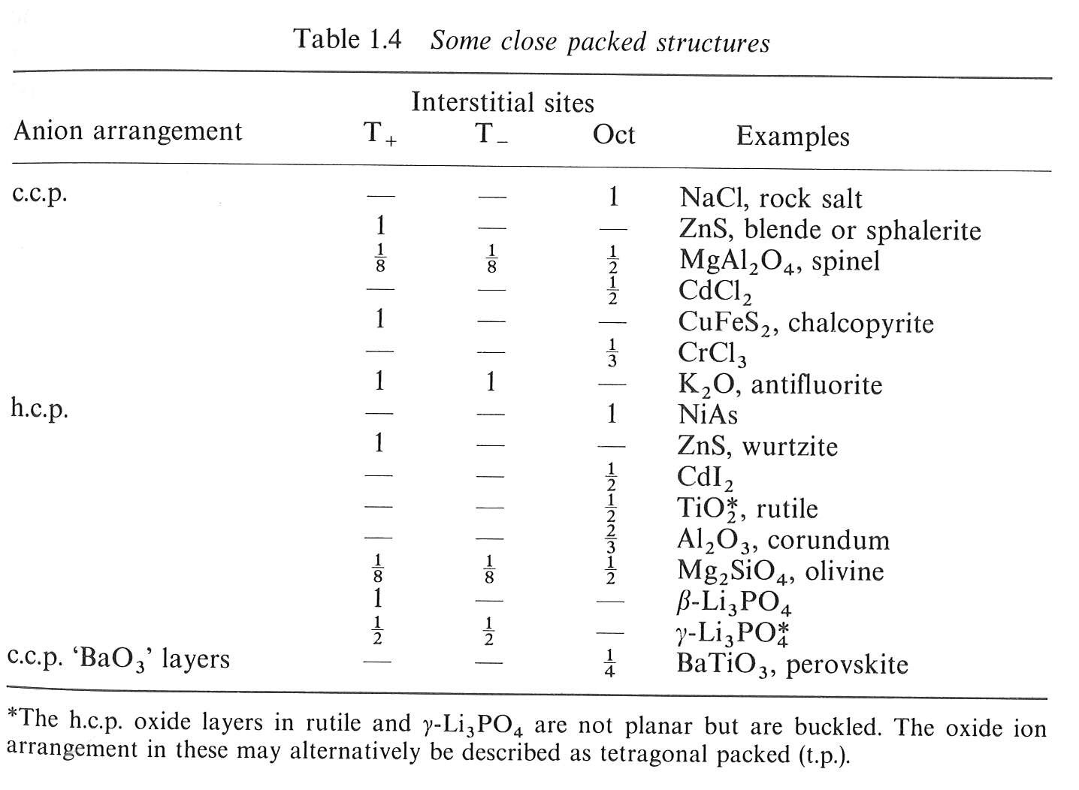
Interstitial sites in Closed Packed Structures

Slide 34
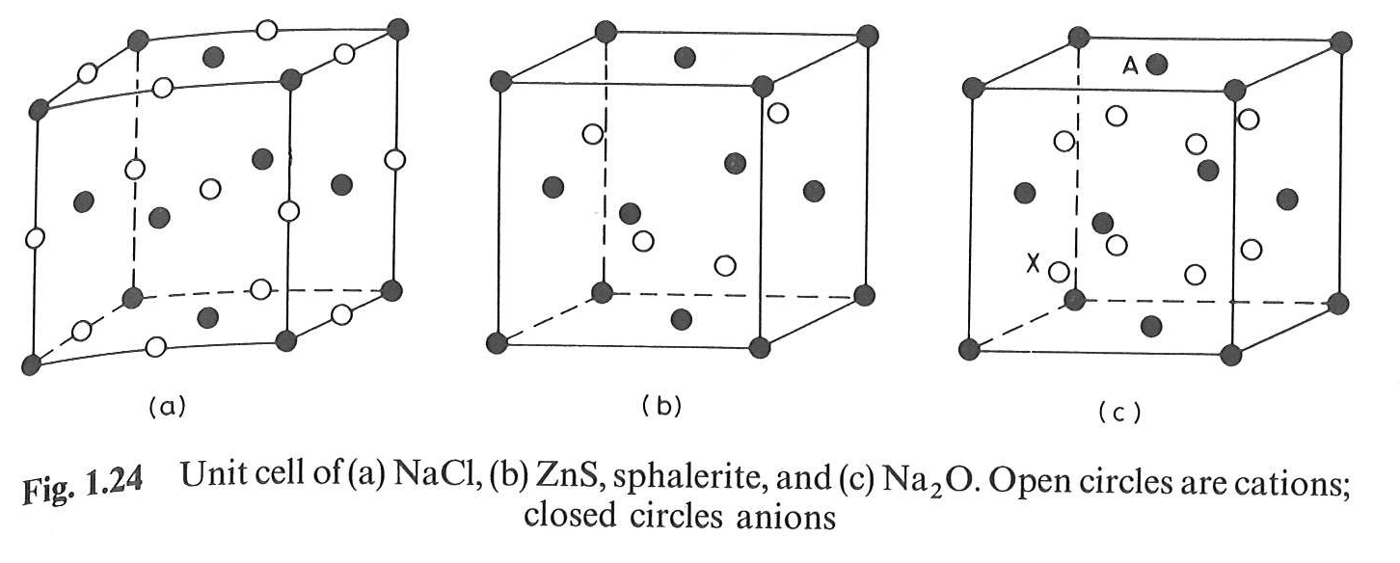
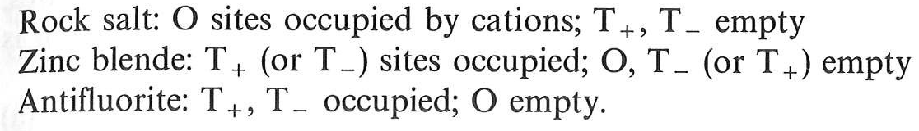
Cubic structures

Slide 35
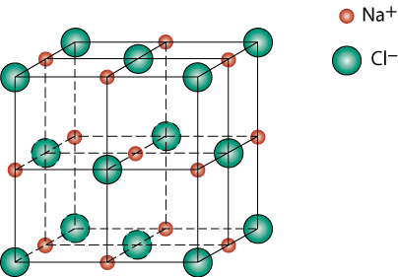
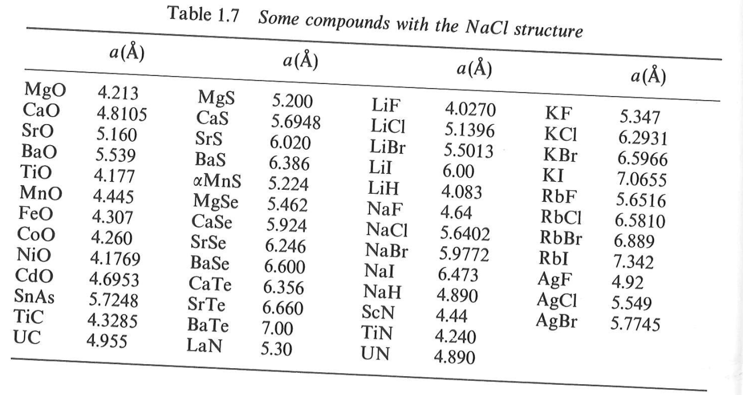
Rock salt structure
r_{Na} = 0.102 nm
r_{Cl} = 0.181 nm
r_{Na}/r _{Cl} = 0.564
Octahedral sites preferred

Slide 36
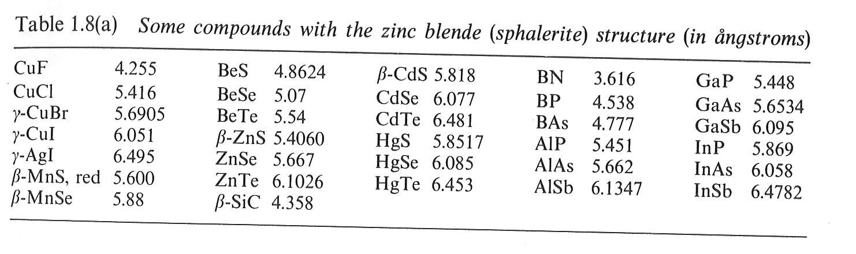
Zinc blende structure
Zn ²⁺
S ²⁻
r_{Zn}/r_{S} = 0.074/0.184= 0.402
tetrahedral sites preferred

Slide 37
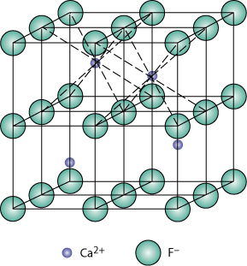
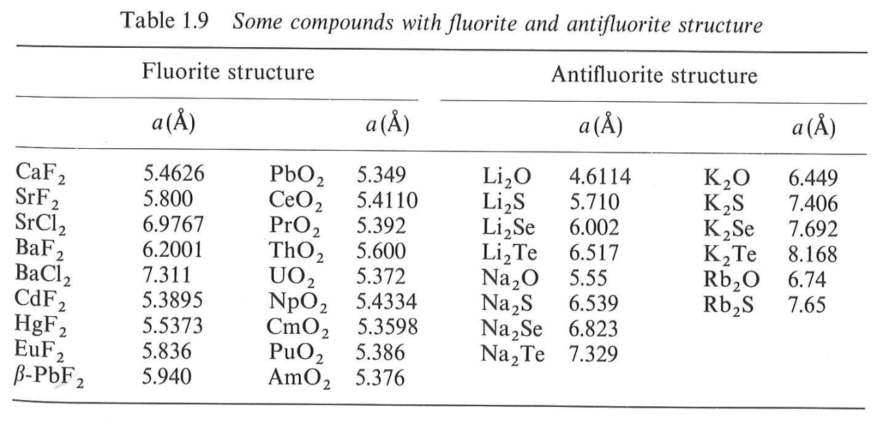
Fluorite and antifluorite
Calcium Fluorite (CaF₂)
Cations in cubic sites
UO_{2,} ThO₂, ZrO₂, CeO₂
Antifluorite structure –
positions of cations and
anions reversed
Fluorite structure

Slide 38
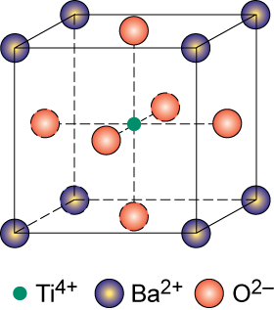
Perovskite ABO₃
Perovskite structure
Ex: complex oxide
BaTiO₃

Slide 39
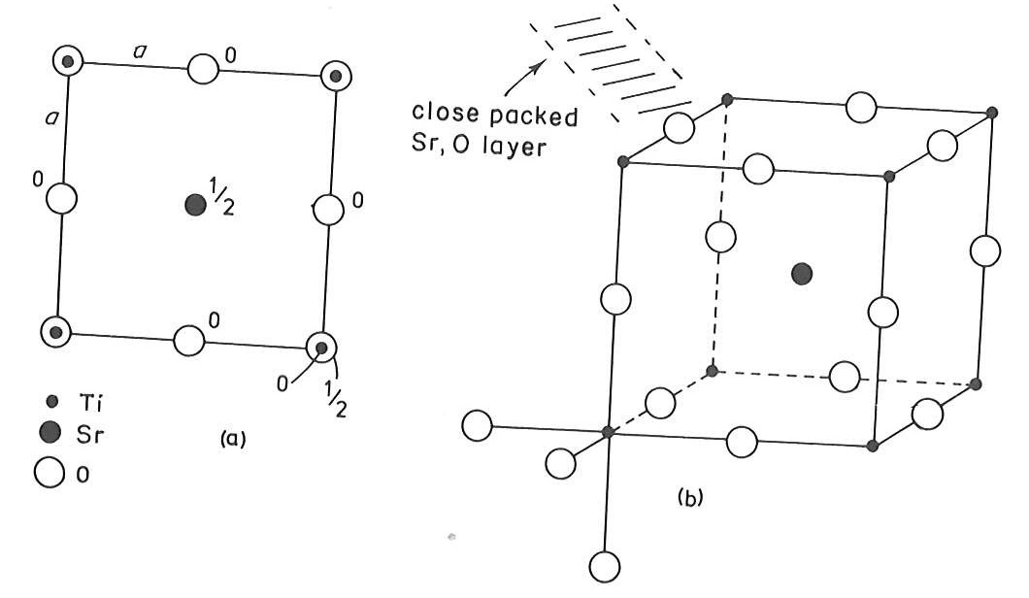
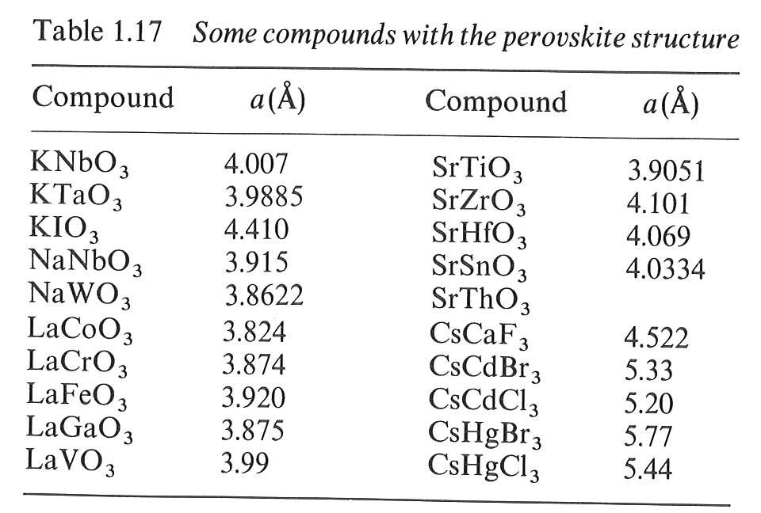
Perovskite ABO₃

Slide 40
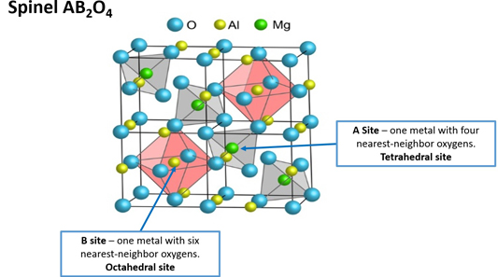


Spinels
Normal
Inverse

Slide 41
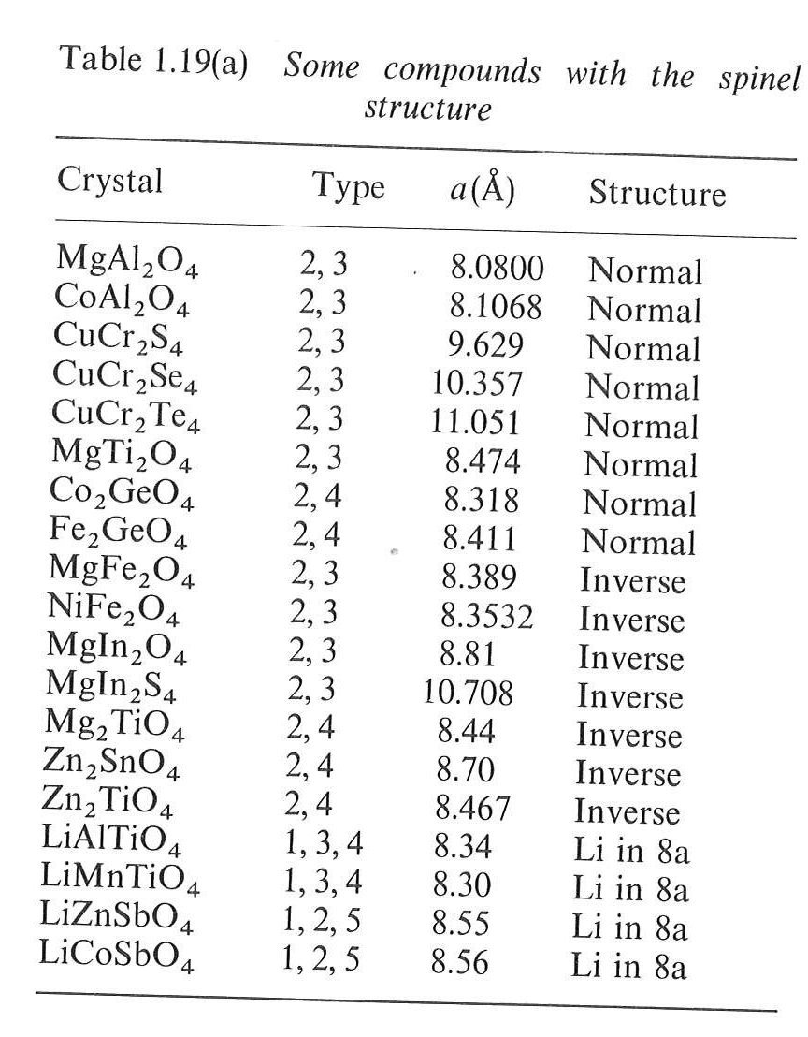
Spinels
Normal
Inverse
In order to explain the adoption of a particular cation distribution in a spinel structure, one must take into account the crystal field stabilization energies (CFSE) of the transition metals present. Some ions may have a distinct preference for the octahedral site depending on the d-electron count. If the A²⁺ ions have a strong preference for the octahedral site, they will displace half of the B³⁺ ions from the octahedral sites to tetrahedral sites. Similarly, if the B³⁺ ions have a low or zero octahedral site stabilization energy (OSSE), then they will occupy tetrahedral sites, leaving octahedral sites for the A²⁺ ions.

Slide 42
DEFECTS IN SOLIDS
No real crystal is perfect. Real crystals feature defects or irregularities in their ideal arrangements and it is these defects that critically determine many of the electrical and mechanical properties of real materials.
Ideally a perfect crystal is the one in which atoms are arranged in perfectly regular manner in all directions. The deviations of crystals from their perfect periodicity are called defects or imperfections.
These imperfections can be of different types such as:
point defects (zero–dimensional defects),
line defects (one–dimensional)
defects over a surface or a plane (two–dimensional) and volume defects (three–dimensional).

Slide 43
Point Defects
A point defect is a very localized imperfection in the regularity of a lattice and it does not spread over more than one or two lattice spacings. These defects are observed in metallic crystals (vacancies, substitutional impurity and interstitials) as well as in ionic crystals (Schottky and Frenkel) and are discussed here in brief.
Vacancies
The absence of an atom or ion from a normally occupied site in a crystal is called a vacancy (see Fig.)
Substitutional Impurity
In this kind of defect, a foreign atom occupy a regular site in the crystal structure (see Fig.), i.e., .substitutional atom replaces the host atom from its position. For example, when a pure semiconductor crystal of Silicon or Germanium is doped with a trivalent or pentavalent impurity, we call it a substitutional impurity.

Slide 44
Interstitial Impurity
An interstitial is an atom or ion which can be inserted into the voids between the regularly occupied sites. In a closed packed arrangement of atoms the packing fraction is generally less than one. Therefore an extra atom, of smaller size than the parent atom, can enter the interstitial space without disturbing the regularly positioned atoms. Such an extra impure atom is called interstitial impurity while an extra atom in an interstitial position is called self – interstitial atom, as shown in Fig. If the size of the extra atom is not small then it will produce atomic distortion.

Slide 45
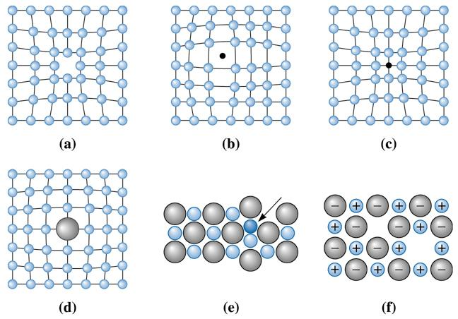
(c) 2003 Brooks/Cole Publishing / Thomson Learning

Slide 46
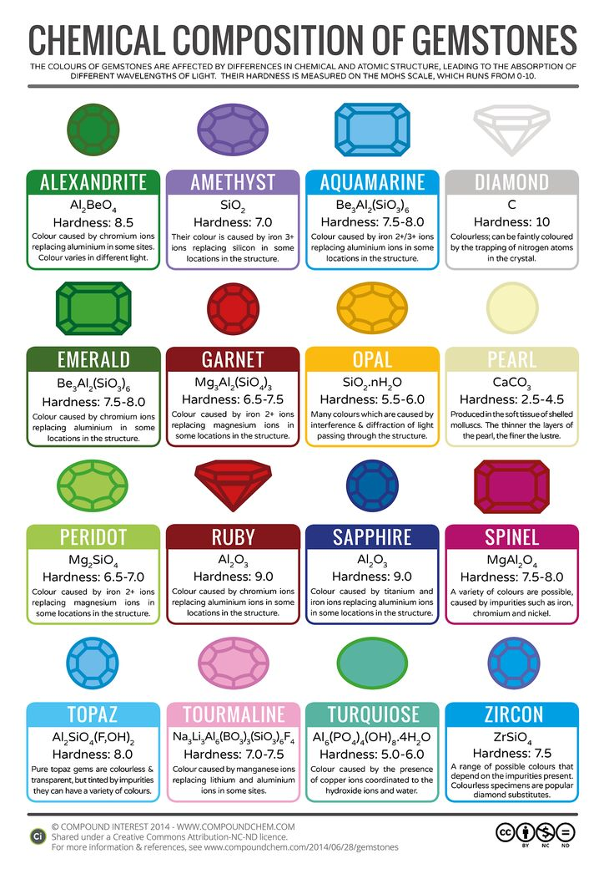
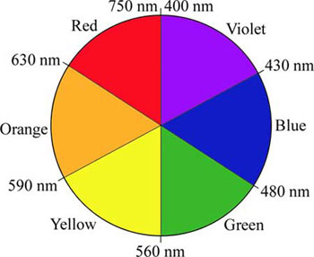
Emerald and Ruby:
Cr³⁺ impurities
Cr₂O₃: green

Slide 47
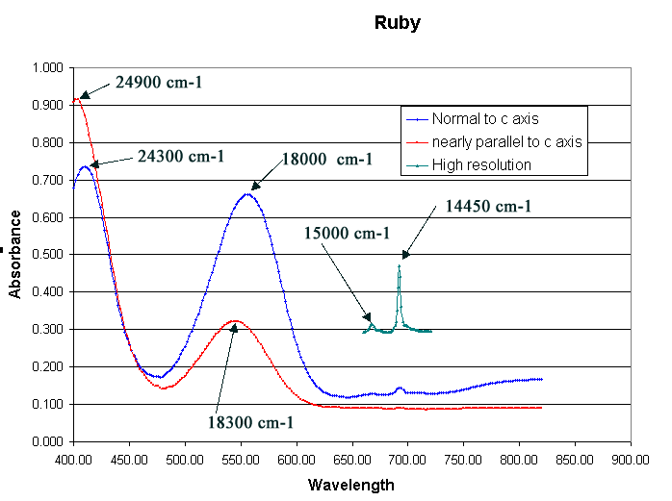
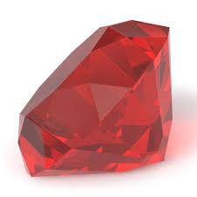
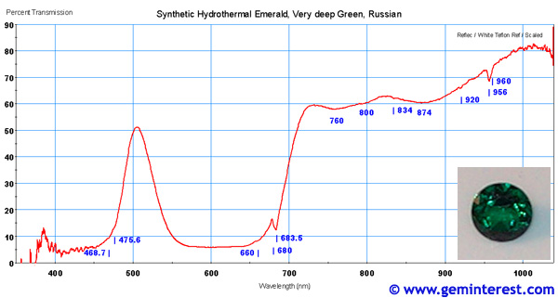

Slide 48
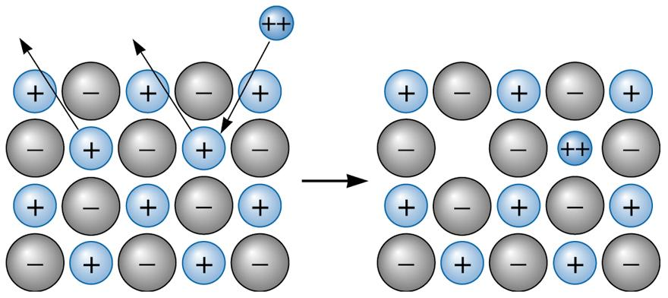
Charge compensation: vacancy formation
When a divalent cation replaces a monovalent cation, a second monovalent cation must also be removed, creating a vacancy.

Slide 49
Charge compensation: change in oxidation state
When a divalent cation replaces a monovalent cation, an anion must change its oxidation state.

Slide 50
Schottky Defect
In a metal, a vacancy is created if an atom is missing from its lattice position. In ionic crystals, a cation – anion pair will be missing from the respective lattice sites, as shown in Fig. Creation of such a pair, of one cation vacancy together with one anion vacancy, is called Schottky defect. Thus the interior of the ionic crystals remain electrically neutral.
Frenkel Defect
When an atom or ion leaves its normal position or site and is found to occupy another position in the interstice we get a Frenkel defect. Thus, in this case, two imperfections are created – an interstitial and a vacancy as shown in Fig. Normally anion leaves its parent site and occupy the interstitial space. These defects are dominant in open structures such as silver halides. Also a Frenkel defect does not affect the electrical neutrality of a crystal.

Slide 51
Shottky defect
n = number of vacancy pairs
N = total number of sites
E = energy required to produce a pair
of vacancies in the interior of a crystal

Slide 52
Frenkel defect
n = number of vacancies = number of atoms in interstitial sites
N = total number of sites
N_{i} = number of interstitial positions in the crystal
E_{i} = energy required to produce a pair of vacancies in the interior of a crystal

Slide 53
Electronic properties of materials
Justify:
Electron transport properties
Optical properties

Slide 54
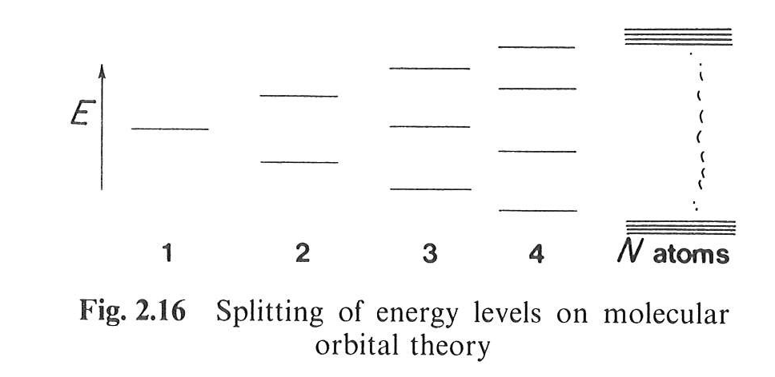
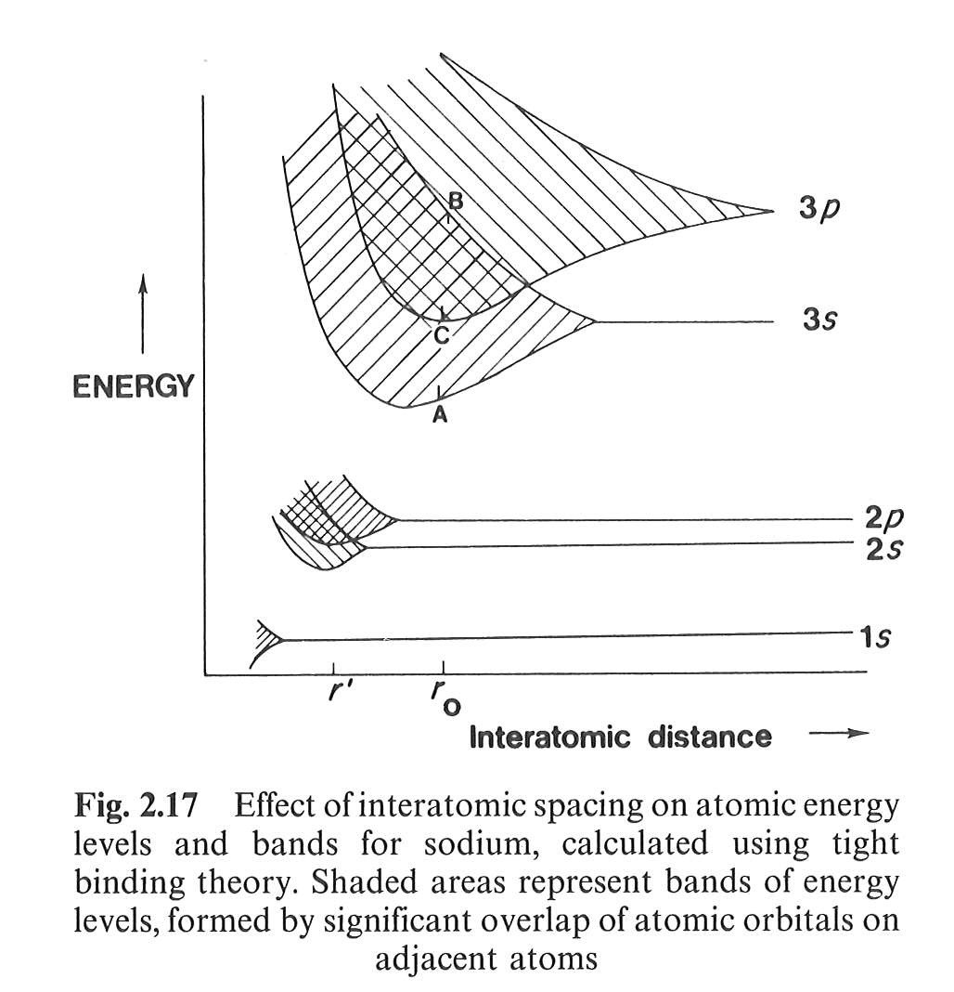
Metallic bond: LCAO model
Molecular orbital for N atoms:
In the case of Na
(and other metals)
Metallic bond
Overlapping of the energy states deriving for higher occupied and lowest unoccupied atomic orbitals: electrons are allowed to spread around over all the atoms in the “molecule” (= crystal).

Slide 55
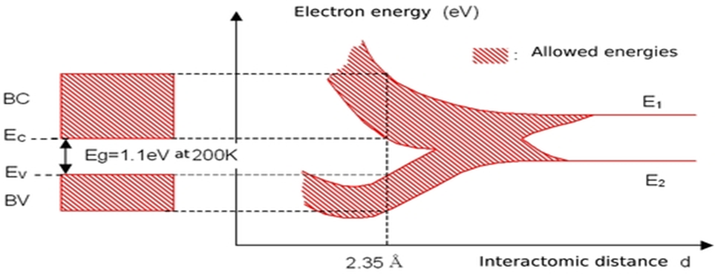
Metallic bond: LCAO model
In the case of Si:
3p
3s

Slide 56





Free Electron Model
In one dimension:
In 3D (crystal):
$$−\frac{h}{8π^{2}m_{e}}\frac{d^{2}Ψ}{dx^{2}}=(E−V)Ψ$$
$$E= \frac{h^{2}}{8m_{e}}\left(\frac{n_{a}^{2} }{a^{2}}+\frac{n_{b}^{2} }{b^{2}}+\frac{n_{c}^{2} }{c^{2}}\right)$$
Many states with the same energy!!!!
$$V=0; Ψ_{x=0}=0;Ψ_{x=a}$$
$$E= \frac{n^{2}h^{2}}{8m_{e}a^{2}}$$

Slide 57


Free Electron Model
Density of states
$$N_{\left(E\right)}dE=\frac{2{\left(2m_{e}\right)}^{3/2}VE^{1/2}}{π^{2}ℏ^{3}}dE$$
Fermi-Dirac “filling” function
E_{F} = Fermi Level
Energy of the highest
occupied state at 0 K

Slide 58


Band structure model
Electrical properties of a material depend on the filling of bands

Slide 59

Band structure model: metal

Slide 60


Band structure model: insulator
$$\text{λ} \left(\text{nm}\right)\text{= }\frac{\text{hc}}{\text{E}\text{ (}\text{eV}\text{)}}\text{=}\frac{\text{1240}}{\text{E}\text{ (}\text{eV}\text{)}}$$

Slide 61

Intrinsic semiconductor
Eg
Band Gap
max 3.2 – 3.3 eV

Slide 62



Extrinsic semiconductor
n-type
p-type

Slide 63

Electron-hole formation

Slide 64


Direct band gap
Indirect band gap

Slide 65


Tauc plot
$$αhυ=A{\left(hυ−E_{g}\right)}^{n}$$
n = 1/2 for direct allowed transitions
n = 2 for indirect allowed transitions
Direct
Indirect
 | Material | Colour | Direct E_{g} (eV) | Indirect E_{g} (eV)
a | CoWO₄ | Blue | 2.68 | 1.80
b | NiWO₄ | Ochre | 2.95 | 1.82
c | CuWO₄ | Brown-Green | 2.41 | 1.78
d | ZnWO₄ | White | 5.85 | 3.14

Slide 66

Surfaces
Represent the place in which the solid interacts with the environment.
Atoms on the surface have different chemical environment with respect to those in the bulk.
Vertex
Corner
Different coordination number
Facet
Number of superficial atoms
Metal dispersion =
Total number of atoms

Slide 67



Surfaces
$$γ=\frac{∂G}{∂A}$$
Surface energy
quantifies the disruption of intermolecular bonds that occur when a surface is created.
$${ΔG}_{i}=\sum_{j}{γ_{j}O_{j}}$$
represents the difference in energy between a real crystal composed of i molecules with a surface and a similar configuration of i molecules located inside an infinitely large crystal. This quantity is therefore the energy associated with the surface.
The equilibrium shape of the crystal will then be that which minimizes the value of ${ΔG}_{i}$.

Slide 68

Metal surfaces

Slide 69

Metal surfaces

Slide 70

Metal surfaces - Superlattice
fcc (100) – (2x2)

Slide 71

Metal surfaces - Superlattice
fcc (111) – (2x2)

Slide 72


Metal surfaces - Superlattice

Slide 73


Metal surfaces - Reconstruction
Pd(110)

Slide 74

Metal surfaces - Reconstruction

Slide 75

Metal surfaces - Reconstruction
(7x7) Reconstruction of Si (111)
19 dangling bonds of (7x7) reconstructed surface
(12 adatom, 6 rest atom, 1 corner hole)

Slide 76

Metal surfaces – High-Miller-Index Stepped Surface
8(111) x (100)
6(111) x (100)
4(111) x (100)

Slide 77
Coverage of adsorbate molecules
Definition of coverage: one monolayer corresponds to one adsorbate atom or molecules for each unit cell of the clean, unreconstructed substrate surface.
For example, the surface coverage of atom on fcc(100) is one-half a monolayer.

Slide 78

Metal surfaces – Adsorbate induced reconstructuring
Ni (100) – c(2x2) – C
Carbon chemisorption induced restructuring of the Ni (100) surface.
Four Ni atoms surrounding each carbon atom rotate to form reconstructed substrate.

Slide 79

Metal surfaces – Adsorbate induced reconstructuring
Fe (110) – (2x2)-S
S-Fe (110), Sulfur-chemisorption-induced restructuring of the Fe(110) surface.

Slide 80

Metal surfaces – Adsorbate induced reconstructuring
Sulfur-chemisorption-induced restructuring of the Ir (110) surface
fcc(110) surface restructures more frequently upon chemisorption than do the closer-packed crystal faces.

Slide 81

Ionic material surfaces
Stable
Not stable
Type 1 is neutral with equal numbers of anions and cations on each plane and type 2 is charged but there is no dipole moment perpendicular to the surface because of the symmetrical stacking sequence. Both these surfaces should have modest surface energies and may be stable with only limited relaxations of the ions in the surface region. The type 3 surface is charged and has a dipole moment in the repeat unit perpendicular to the surface. This surface can only be stabilized by substantial reconstruction.

Slide 82


Ionic material surfaces

Slide 83


Ionic material surfaces

Slide 84

Microscopia a scansione ad effetto tunnel
COS’È?
Punta
CORRENTE
Se sulla superficie ci sono delle asperità anche piccolissime la corrente di tunneling cambia intensità

Slide 85


COME SI USA?
Percorso seguito dalla punta

Slide 86


COSA VEDO?
Superficie (111) di Pt

Slide 87
STM: Scanning Tunneling Microscopy
Developed by Binning and Rohrer at the IBM Zürich research laboratory in the early 1982 (Noble Prize in 1986)
Based on a new concept:
To examine a surface at very close range (near field) with a scanning probe, the position of which can be perfectly controlled in three dimensions to within ± 0.1 nm. The signal generated on each point by the interaction between the probe and the surface atoms is translated electronically into an image of the surface.
Technique for “topografical” investigation of surfaces

Slide 88


Principle of the technique
“The principle of STM in straightforward. It consists essentially in scanning a metal tip over the surface at constant tunnel current. The displacements of the metal tip given by the voltage applied to the piezodrives then yield a topographic picture of the surface. The very high resolution of STM rests on the strong dependence of the tunnel current on the distance between the two electrodes, i.e., the metal tip and the scanned surface.”
G. Binning et al. Phys. Rev. Lett. 49 (1), 57-61 (1982)
Tip
Tunnel
Current
<1nm
Surface

Slide 89


Tunnel effect
In classical physics, an electron cannot penetrate into or across a potential barrier if its energy E is smaller than the potential φ within the barrier.
The quantum mechanics treatment predicts that an electron have a finite probability to exist behind the potential barrier.
This is called TUNNEL EFFECT

Slide 90


Theoretical basis of tunnel effect
A quantum mechanic treatment predicts an exponential decaying solution for the electron wave function in the barrier. For a rectangular barrier of width d:
$$k=\frac{\sqrt{2m\left(Φ−E\right)}}{ℏ}$$
$$Ψ_{(d)}=Ψ_{(0)}e^{−kd}$$
where

Slide 91


Theoretical basis of tunnel effect
A quantum mechanic treatment predicts an exponential decaying solution for the electron wave function in the barrier. For a rectangular barrier of width d:
$$k=\frac{\sqrt{2m\left(Φ−E\right)}}{ℏ}$$
$$Ψ_{(d)}=Ψ_{(0)}e^{−kd}$$
where
The probability of finding an electron behind the barrier of the width d is:
$${W_{(d)}=\left|Ψ_{(d)}\right|}^{2}={\left|Ψ_{(0)}\right|}^{2}e^{−2kd}$$
When a little bias potenzial V is applied between 2 electrodes (sample and tip, in this case), the tunneling of electrons results in a tunneling current I.
The tunneling current is proportional to propability of electrons to tunnel through the barrier:
$$I∝{\left|Ψ_{(0)}\right|}^{2}e^{−2kd}$$
It is necessary that the tip is very close to the surface to have a measureable current!

Slide 92

Theoretical basis of tunnel effect – Bardeen Approach
The current is given by a combination of the local densities of states of the sample and the tip.
In case of a negative potential on the sample the occupied states generate the current, whereas in case of a positive bias the unoccupied states of the sample are of importance. It should finally be mentioned that the probability of tunneling is larger for electrons which are close to the fermi edge due to the lower barrier.

Slide 93




Theoretical basis of tunnel effect – Bardeen Approach
Examples:
Imaging the occupied states of
SiC($000\overline{1}$) 3x3
Imaging the unoccupied states of
SiC($000\overline{1}$) 3x3

Slide 94

Lateral resolution
It is possible to obtain ATOMIC RESOLUTION of the surfaces investigated.
Calculations and experiments showed that there is often a d_{z}² like state near the Fermi edge present at the apex atom which also predominantely contributes to the tunneling current. It is understood that this state (and also the p_{z} like state) is advantageous for a «sharp» tip.

Slide 95

Schematic rappresentation of an STM apparatus

Slide 96

Modes of operation
1. Constant Current Mode
By using a feedback loop the tip is vertically adjusted in such a way that the current always stays constant.
A kind of a topographic image of the surface is generated by recording the vertical position of the tip.

Slide 97

Modes of operation
1. Constant Current Mode
By using a feedback loop the tip is vertically adjusted in such a way that the current always stays constant.
A kind of a topographic image of the surface is generated by recording the vertical position of the tip.
2. Constant Height Mode
In this mode the vertical position of the tip is not changed. The current as a function of lateral position represents the surface image. This mode is only appropriate for atomically flat surfaces as otherwise a tip crash would be inevitable.

Slide 98



COME È FATTO LO STRUMENTO?
0.38 mm

Slide 99



Molecole di NH₃ su una superficie Pt (111)

Slide 100


Applicazioni alla catalisi
Struttura intermedia nella formazione di un ossido sul rodio
40×30 nm²
3.0 Å invece di 2.7 Å
Altezza
53×53 Å²
Distanza lungo il profilo

Slide 101









L’STM COME UNA VIDEOCAMERA
Catalizzatore di rodio ricoperto di ossigeno esposto ad idrogeno
15×15 nm²
Superficie iniziale
I step: l’onda
II step: la reazione continua
Superficie pulita
1 min
3 min
11 min
Un’onda chimica spazza il catalizzatore

Slide 102


Slide 103




50×50 nm²
Superficie iniziale
Coppie di ossigeni
Specie intermedia
Fase finale
1 min
3 min
7 min
Si formano dei prodotti intermedi

Slide 104







60×60 nm²
Superficie iniziale
Reazione
Superficie pulita
Superficie finale
4 min
10 min
2h 39 min
Gli atomi di superficie si riarrangiano

Slide 105








L’STM PER MISURE STATICHE
Ammoniaca (NH₃) + monossido di azoto (NO) sul platino (Pt)
NH₃
NO
NH₃ + NO

Slide 106

Example: CeO₂ (111)
Crystal of CeO₂ provided by Commercial Crystal Inc., grown with (111) orientation
Surface of the crystal
Terraces
Flat
Large enough for topographical study of the surface
200nm x 200nm

Slide 107






Slide 108


Example: CeO₂ (111)
Cleaned surface
10nm x 5 nm
M.A. Henderson et al.
Surface Science 526 (1-2), 1-18 (2003)
The main contribution to the STM image contrast originates from the oxygen 2p states.
H. Nöremberg et al. Physical Review Letters 79 (21), 4222-4225 (1997)

Slide 109

Example: CeO₂ (111)
After cleaning:
sputtering with Ar⁺ + annealing in O₂ up to 1000°C
20nm x 20nm

Slide 110

Example: CeO₂ (111)
After 3h H₂ 1x10⁻⁸ mbar 400°C
Single vacancy
Line
defect
20nm x 20nm

Slide 111

Example: CeO₂ (111)
After 3h H₂ 1x10⁻⁸ mbar 400°C
Oxygen atoms around the vacancies are brighter.
Oxygen vacancies corrisponds to a Ce^{III} in the first sub-layer.
For the explanation of the enhanced brightness of oxygen atoms one has to consider the possibility of a small charge transfer from vacancies to these oxygen atoms.
20nm x 20nm

Slide 112

Difetti superficiali su CeO₂ (111)
Annealing a 900°C
1 min
5 min
F. Esch, S. Fabris, L. Zhou, T. Montini, C. Africh, P. Fornasiero, G. Comelli, R. Rosei Science 309 (2005), 752

Slide 113

Difetti singoli su CeO₂ (111)
F. Esch, S. Fabris, L. Zhou, T. Montini, C. Africh, P. Fornasiero, G. Comelli, R. Rosei Science 309 (2005), 752

Slide 114

Difetti multipli sotto superficiali su CeO₂ (111)
Difetti superficiali di CeO₂:
Siti di attivazione di piccole molecole
Stabilizzazione di cluster di Au attraverso interazione con difetti superficiali / sotto superficiali
F. Esch, S. Fabris, L. Zhou, T. Montini, C. Africh, P. Fornasiero, G. Comelli, R. Rosei Science 309 (2005), 752

