Slide 1
Trenitalia Mission Statement
Trenitalia ha tra i suoi obiettivi garantire al Paese un'offerta di servizi di qualità, in grado di soddisfare, in ambito nazionale ed europeo, le esigenze di mobilità dei viaggiatori, impegnandosi a rendere sempre più moderna e funzionale la struttura industriale e indirizzare l'azienda verso obiettivi di sviluppo tecnologico e di fatturato a costi efficienti, lavorando per competere, con lealtà e professionalità.

Slide 2
Translation
Trenitalia’s Mission:
To guarantee a high-quality service designed to meet the mobility needs of our passengers at a national and European level. We operate in order to achieve a more and more modern and functional industrial structure. Our goal is to steer the company towards technological development and revenue increase while remaining cost-effective. We work in order to compete with loyalty and expertise.

Slide 3
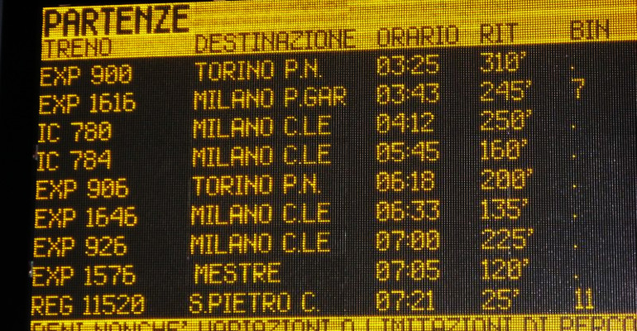
ISSUES AND SOLUTIONS
The original mission statement is one long sentence
which we divided into four shorter ones to make it
easier to understand and more direct
Infinite of purpose
We avoided translating “Paese”
The ambiguity of the sentence “indirizzare l'azienda
verso obiettivi di sviluppo tecnologico e di fatturato
a costi efficienti” led to different translations
Different levels of formality
The syntax of the original statement was way different from standard mission statements in English
Some of the solutions closer to the original felt unnatural
We added phrases such as “high-quality” to make the statement more familiar to an English speaker

