Slide 1
Lesson One

Slide 2
What is a text?

Slide 3
What is a multimodal text?

Slide 4
And consists of the co-deployment of those semiotic resources.

Slide 6
Semiotic modalities

Slide 7
Written Words

Slide 8
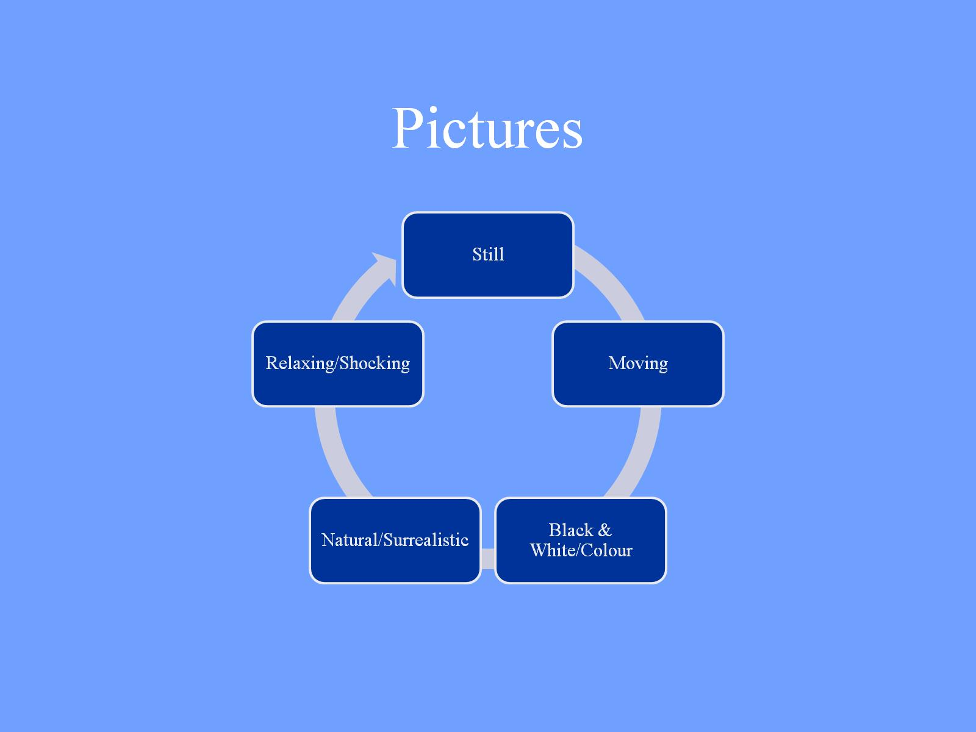
Pictures

Slide 9
Colour

Slide 10
Gesture

Slide 11
Gesture
Co-speech
Pantomime
Emblems
Sign language

Slide 12
Eg a bowl
Drawing
Modelling
Acting
Representing

Slide 13
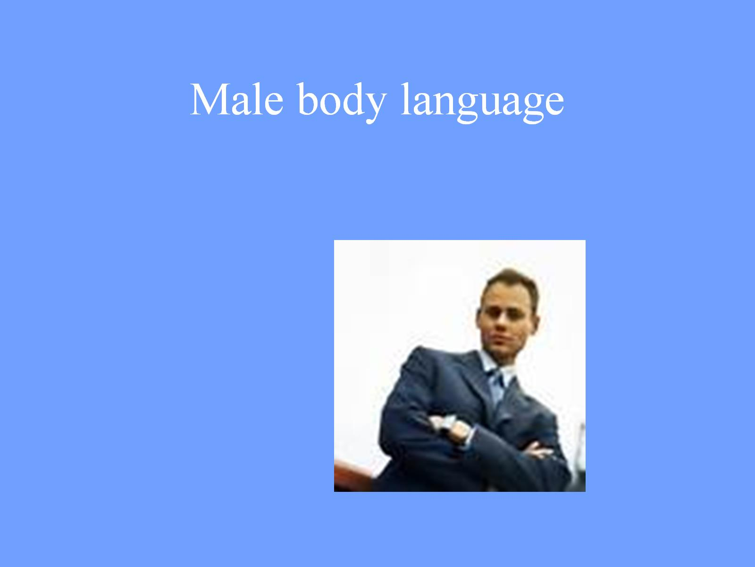
Male body language

Slide 14
Hand gesture

Slide 15
Female body language

Slide 16
Movement

Slide 17
Music

Slide 18
The Green Leaves of Summer The Alamo

Slide 19
The Green Leaves of Summer Inglourious Basterds

Slide 20
Perspective

Slide 21
Camera Angles

Slide 22
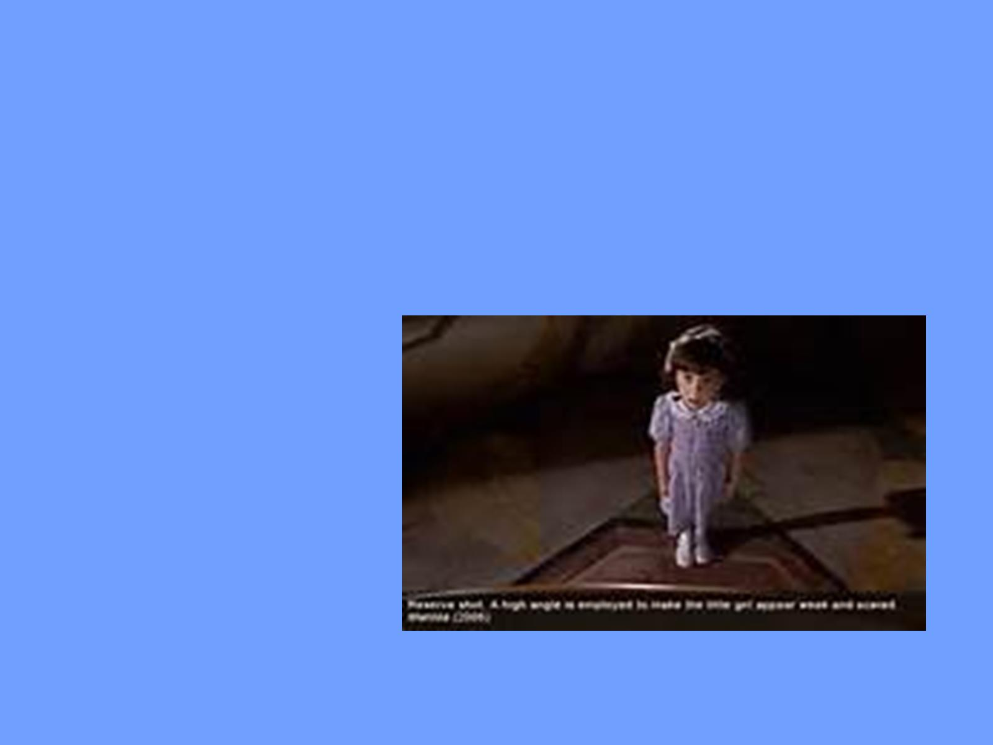

Slide 23
Spoken Words

Slide 24
Sounds

Slide 25
Silence
How to deal with silence in AD.
Silent films? – a constant AD?

Slide 26
Silence cf. Ingmar Bergman ‘The Silence’ «it is inscribed inside the register of speech where it deliniates a certain stance» (Dolar)… …and thus inserted by the director

Slide 27
Silence as a narrative element eg. Mission Impossible: Tom Cruise tries to disable a sound-sensitive alarm system

Slide 28
Eg. 2001 A Space Odyssey ‘The dawn of man’ – the camera moves into space and into silence. Then images of landscapes are shown against the sounds of wind and birds … inducing the idea of silence. Breaking the silence would destroy the effect.

Slide 29
The Marx Brothers ‘Duck Soup’ three minutes of silence during the ‘mirror’ scene Here AD is necessary as there is so much action.

Slide 30
Option 1
Omission
sometimes but aural silence is often accompanied by action. The dilemma is «how to make the silence speak, without making it sound too loud» (Orero).

Slide 31
Option 2
Announce the silence
The silence could be meaningful.
But leaving the silence could be considered a mistake or a breakdown.

Slide 32
Option 3
Audiodescriber decides on function of silence
Could lead to highly subjective interpretations.
But in cases like ‘Duck Soup’ where the Marx Brothers’ sketch is composed of actions, it is clearly necessary to describe.
Whereas the typical silence following a bomb explosion or a gunshot may not need any explanation.

Slide 33
Light

Slide 34
Surreal

Slide 35
Sensual lighting

Slide 36
Signs

Slide 37
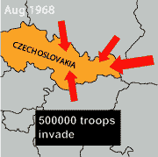
Vectors

Slide 38
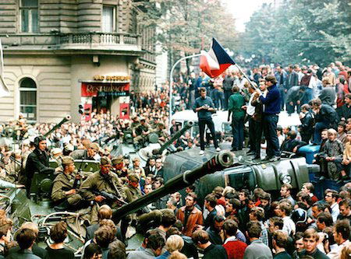

Slide 39
Digital longform journalism SNOWFALL

Slide 40
Reference: A Postgraduate Screen Translation Course IN ‘Readings in Intersemiosis and Multimedia’ ed. Elena Montagna

