Slide 1
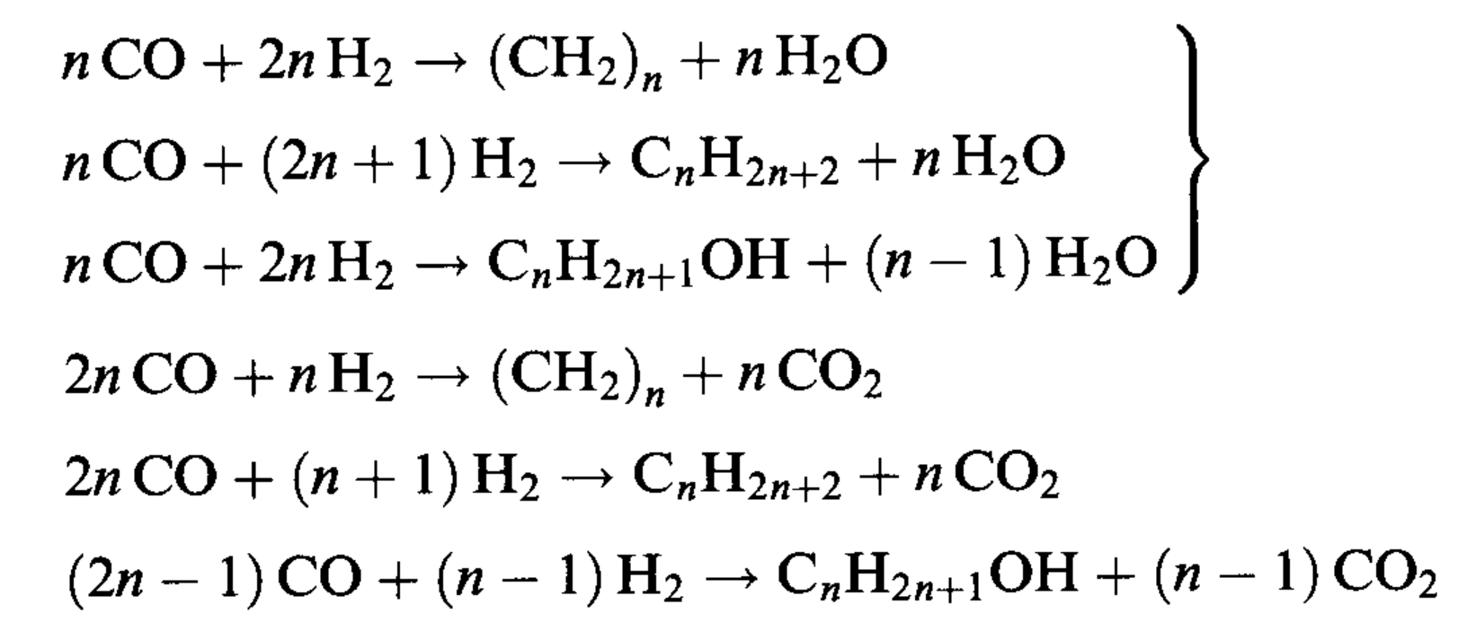
Fischer-Tropsch process
Syn-gas
Hydrocarbons
Germany: World War II
USA: 1950s
South Africa: SASOL I (1)955) & SASOL II (1980)
South African Synthetic Oil Ltd.
All exothermic reactions

Slide 2
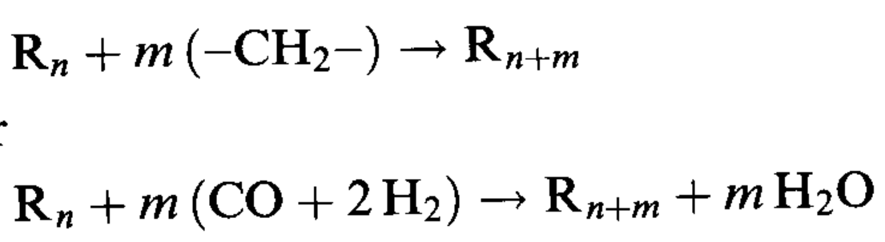
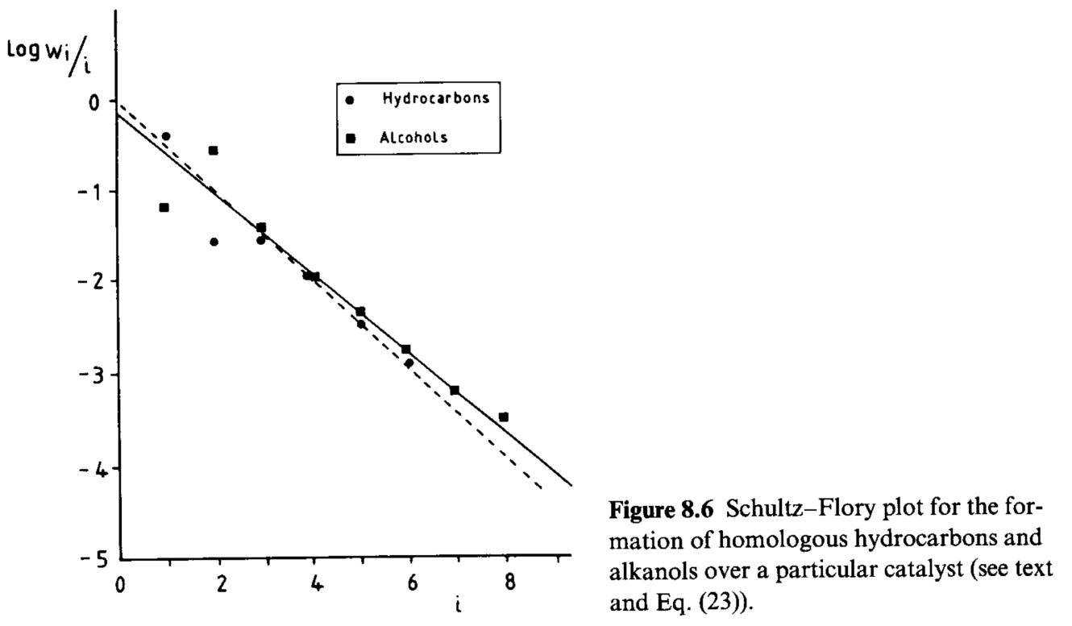
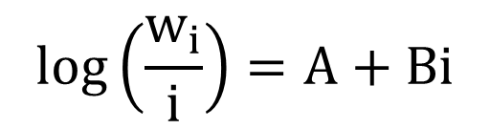
Fischer-Tropsch process
The process can be considered as a polymerazion of –CH₂– units, even if they are not present initially.
$$log\left(\frac{w_{i}}{i}\right)=A+Bi$$

Slide 3
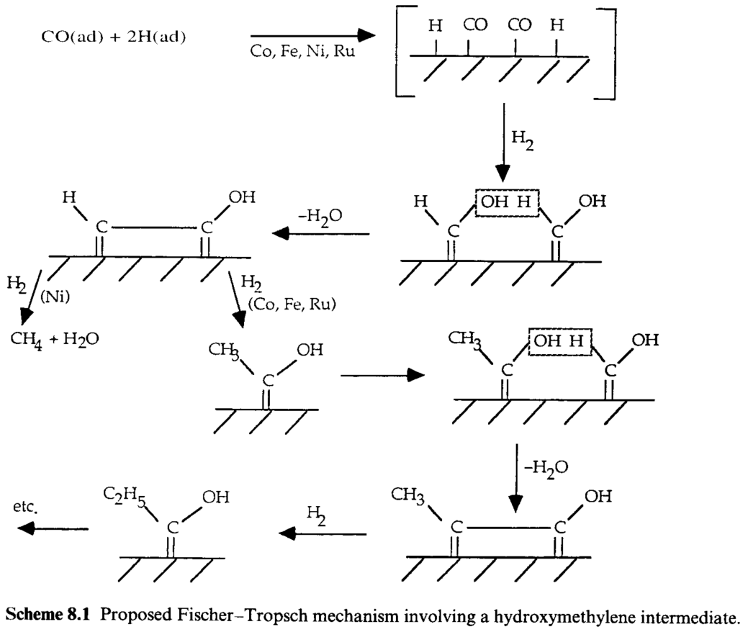
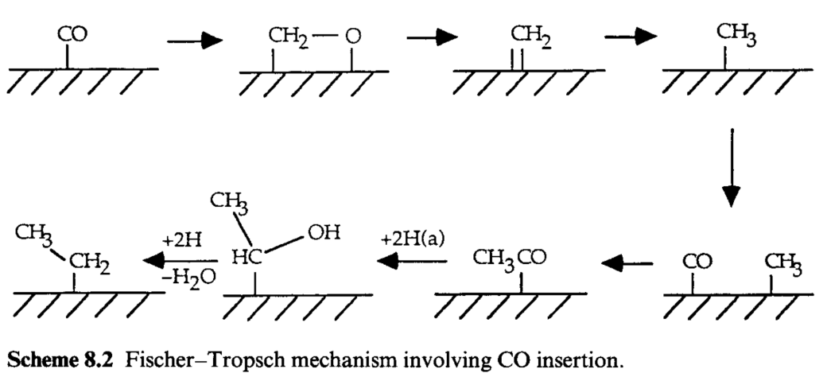
Fischer-Tropsch process: suggested mechanisms
Hydroxymethylene intermediate
CO insertion mechanism

Slide 4
Fischer-Tropsch process: suggested mechanisms
Hydroxymethylene intermediate
Never detected by experimental techniques
CO insertion mechanism

Slide 5
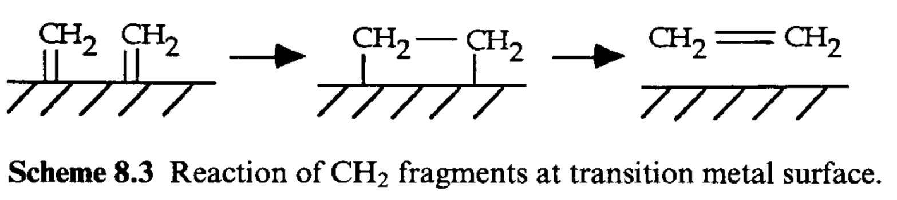
Fischer-Tropsch process: first step requires CO dissociation
All the metals that promotes FT synthesis also dissociates CO easily to its elemental components. In FT process, it is later converted into CH_{ads} and CH_{2ads} (confirmed by ¹³C NMR and HREELS).
Mechanicistic studies using diazomethane CH₂N₂
It forms adsorbed CH₂ immediately when in contact with metal surface
CH₂N₂ in inter gas flow
Dimerization & desorption
No polymerization
Notes:
Co, Ni, Fe, Pd, Ru

Slide 6
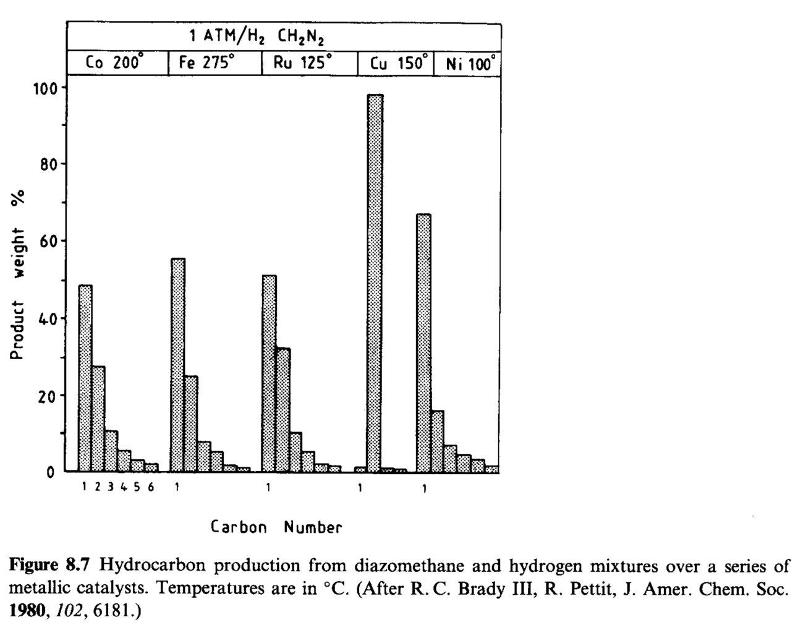
Fischer-Tropsch process: first step requires CO dissociation
Mechanicistic studies using diazomethane CH₂N₂
CH₂N₂ + H₂ vs CO + H₂
Notes:
Cu non è in grado di dissociare H2: quindi formazione di H è fondamentale per la produzione di idrocarburi.

Slide 7
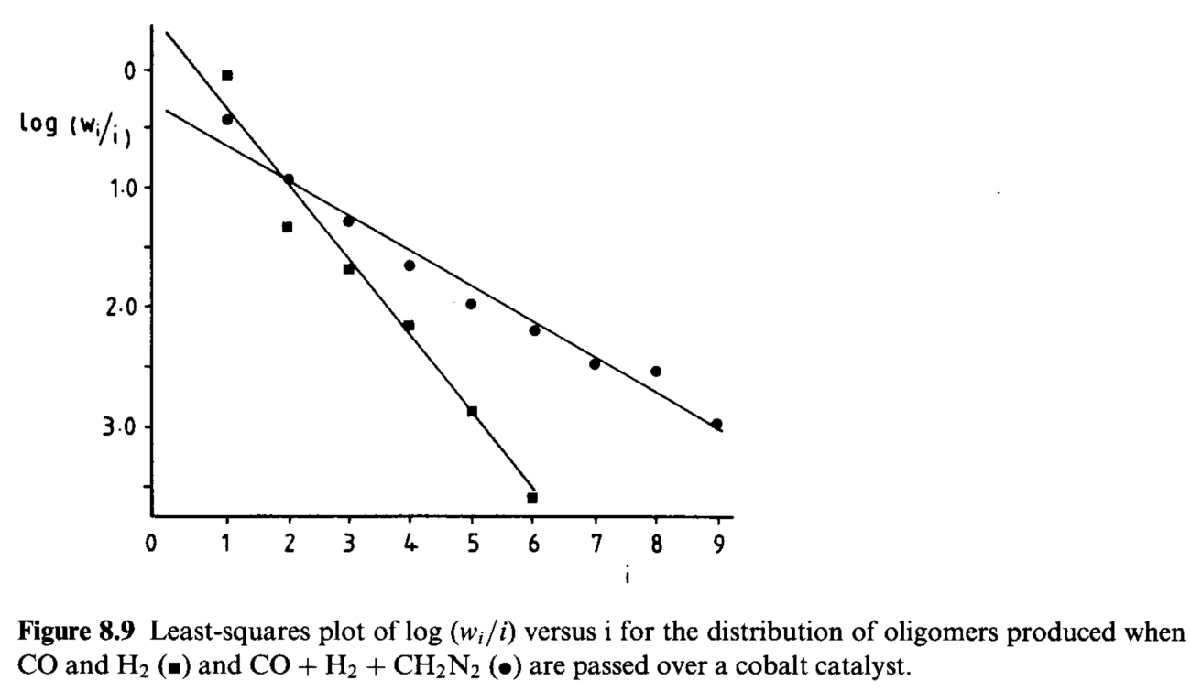
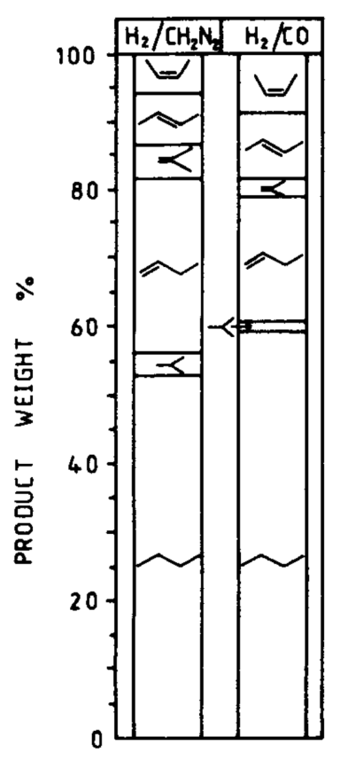
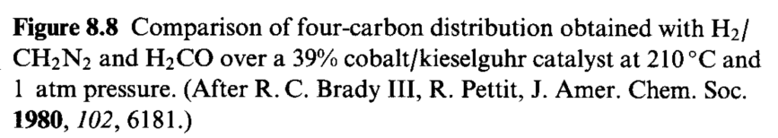
Fischer-Tropsch process: first step requires CO dissociation
Mechanicistic studies using diazomethane CH₂N₂
CH₂N₂ + H₂ vs CO + H₂

Slide 8
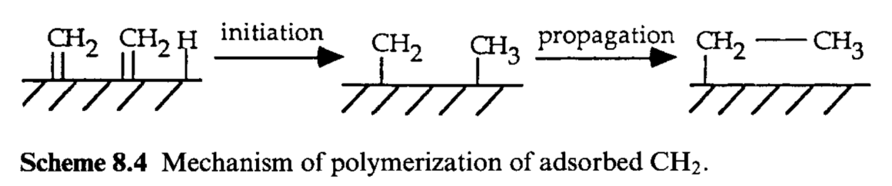
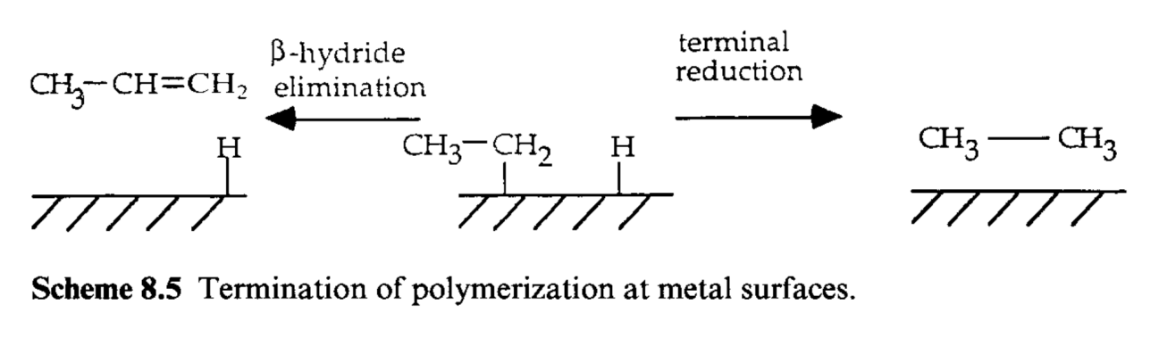
Fischer-Tropsch process: first step requires CO dissociation
Mechanicistic studies using diazomethane CH₂N₂
CH₂N₂ + H₂ vs CO + H₂

Slide 9
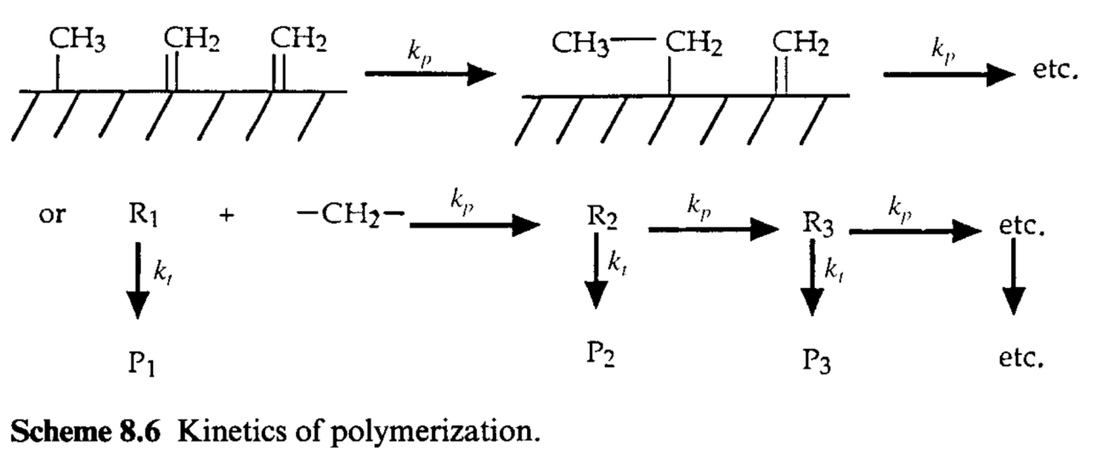
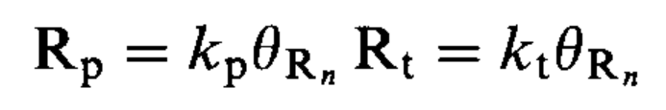
Fischer-Tropsch process
Schultz – Flory distribution
Propagation
Termination
(β-hydride elimination + terminal reduction)
Notes:
Rn = frammento alchilico di lunghezza n
Pn = prodotto di lunghezza n
kp e kt siano indipendenti da n

Slide 10
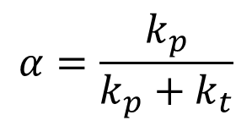
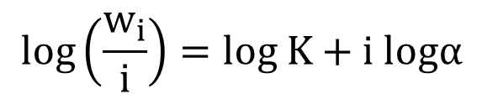
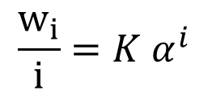

Fischer-Tropsch process
Schultz – Flory distribution
$$α=\frac{k_{p}}{k_{p}+k_{t}}$$
The distribution of products concentrations is governed by:
${Cp}_{n+1}=α$ ${Cp}_{n}$
A succession of i steps will occur with probability $α^{i}$. The chance to obtain the product P_{i} is proportional to $α^{i}$ or, in other words,
$${\frac{w_{i}}{i}=K α}^{i}$$
$$log\left(\frac{w_{i}}{i}\right)=log K+i logα$$
Notes:
Rn = frammento alchilico di lunghezza n
Pn = prodotto di lunghezza n
kp e kt siano indipendenti da n

Slide 11
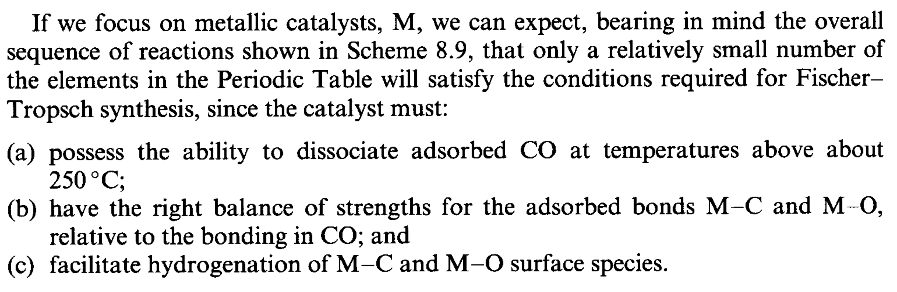
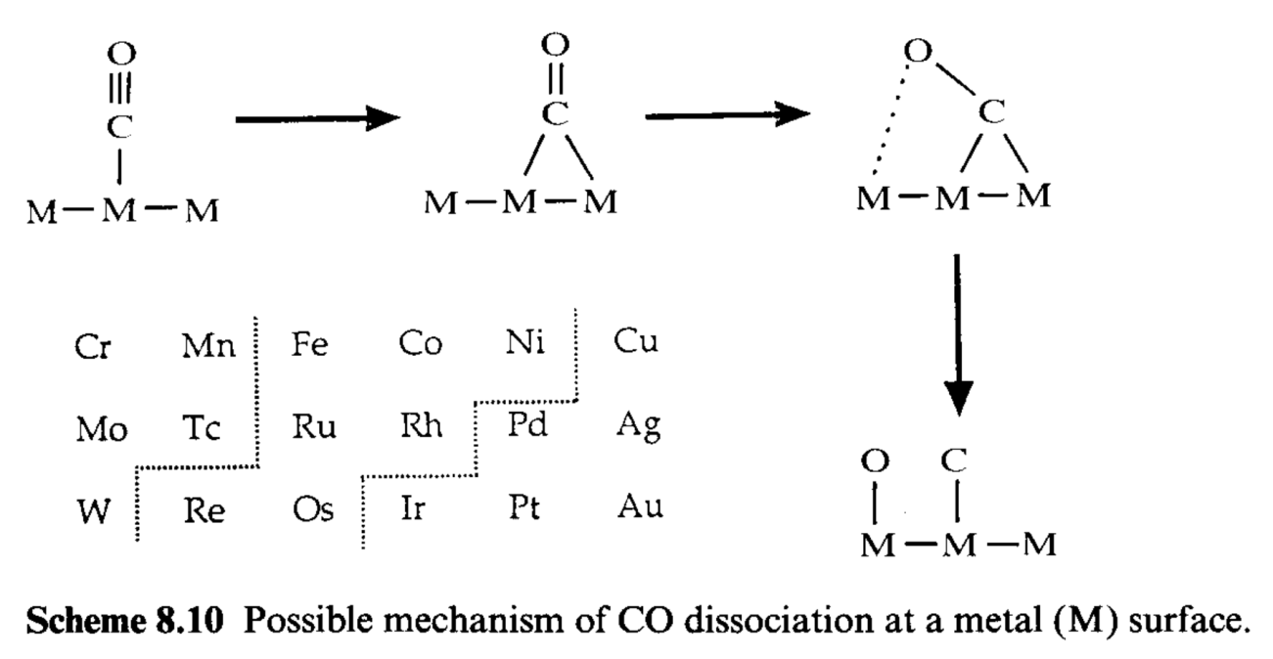
Fischer-Tropsch process

Slide 12
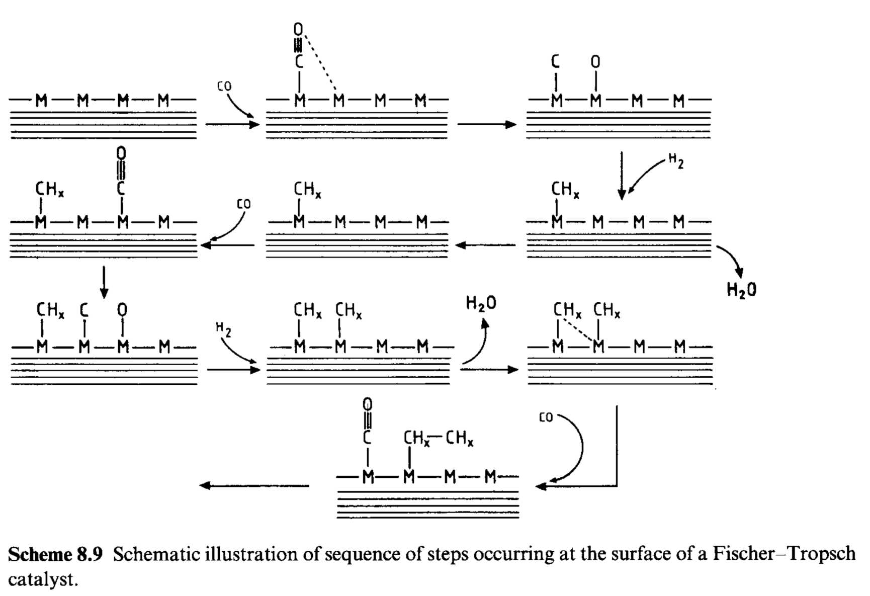
Fischer-Tropsch process
Notes:
CO si adsorbe e si dissocia.
H2 si adsorbe e si dissocia.
O adsorbito viene rimosso come H2O o CO2, liberando i siti per adsorbimento di altro CO.
CHx formati polimerizzano per dare i prodotti

Slide 13
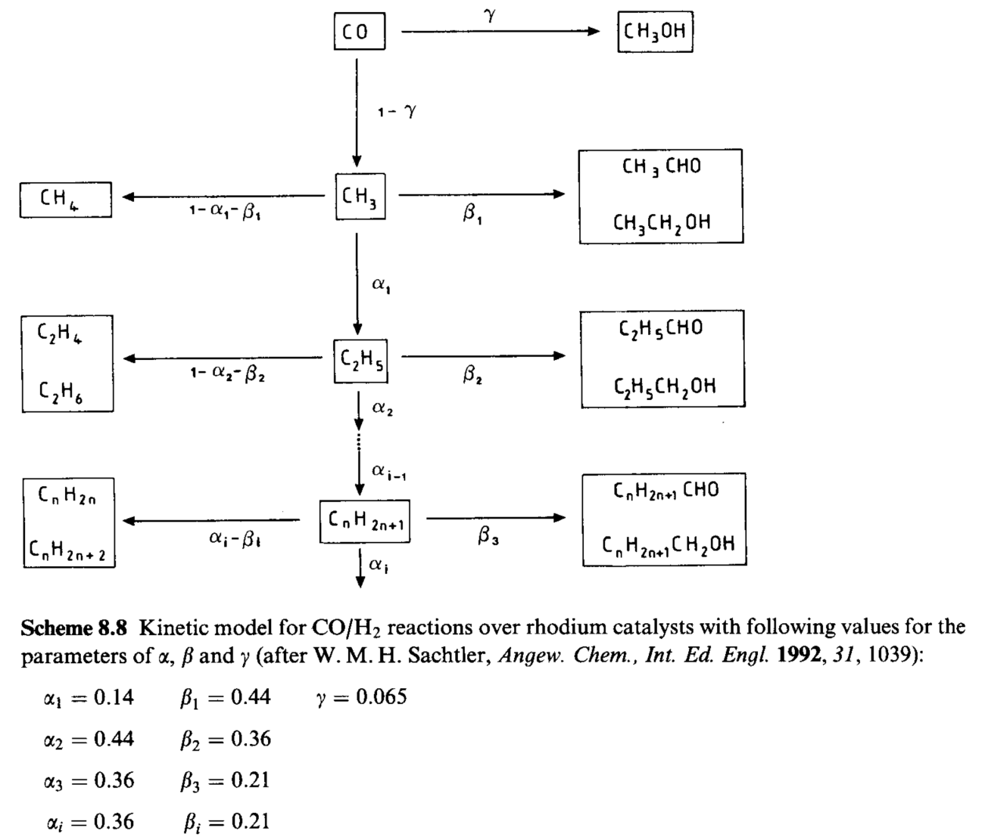
Fischer-Tropsch process
The real mechanism is more complicated, considering that a complex mixture of products is obtained, comprising alkanes, alkenes, alcohols and aldehydes.

Slide 14
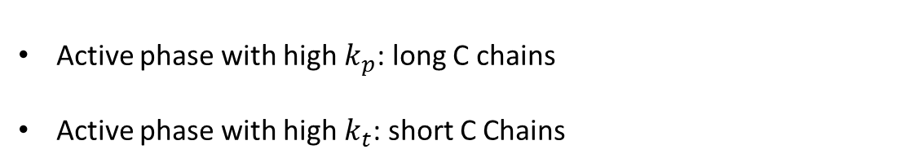
Fischer-Tropsch process
The catalyst composition must be tuned to manipulate $α=\frac{k_{p}}{k_{p}+k_{t}}$
Active phase with high $k_{p}$: long C chains
Active phase with high $k_{t}$: short C Chains
SASOL Process:
Oxygenated synthesis
Catalyst:
Fe₂O₃ + CuO + K₂SiO₃
Catalyst:
Rh-based material
Main products: Alcohols, mainly ethanol
Fe + Cu + K₂O + SiO₂
Catalyst for FT
Stabilizer for texture
Promoter for Fe₂O₃ reduction

Slide 15
Fischer-Tropsch process
The catalyst composition must be tuned to manipulate $α=\frac{k_{p}}{k_{p}+k_{t}}$
Active phase with high $k_{p}$: long C chains
Active phase with high $k_{t}$: short C Chains
SASOL Process:
Oxygenated synthesis
Catalyst:
Fe₂O₃ + CuO + K₂SiO₃
Catalyst:
Rh-based material
Main products: Alcohols, mainly ethanol
Fe + Cu + K₂O + SiO₂
Catalyst for FT
Stabilizer for texture
Promoter for Fe₂O₃ reduction
Promoter for CO dissociation

Slide 16
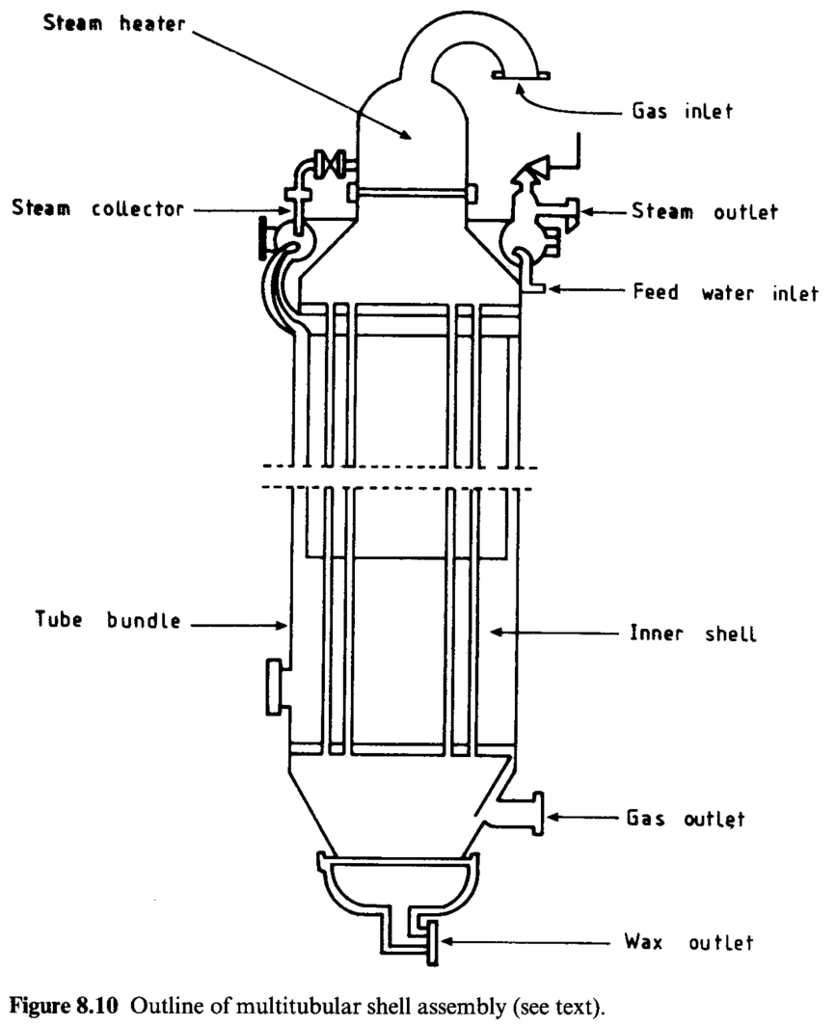
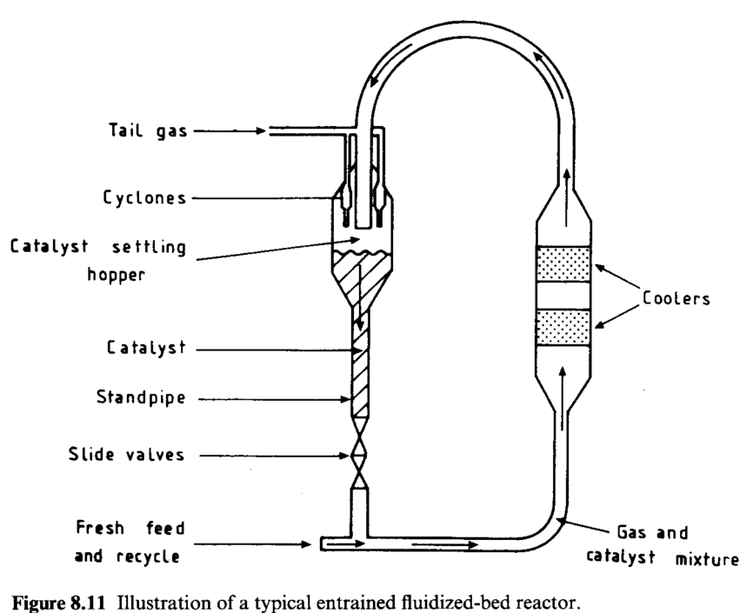
Fischer-Tropsch process: SASOL I & II
FEED
H₂ 43%, CO 43%, CH₄ 12%, CO₂ 1%, N₂ balance
Fluidized bed reactor
320-360°C, 25bar
High space velocity
Products: C5-C11 (gasoline)
Fixed bed reactor
220-350°C, 30bar
Low space velocity
Products: C1-C35 (waxes 45%, diesel & gasoline 32%)

Slide 17
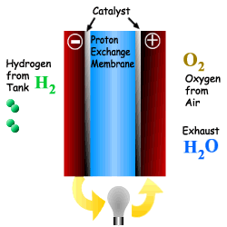
Purification of H₂ from Syn-Gas
PEMFC
basso contenuto di CO (<10ppm)
basse temperature per reforming

Slide 18
Processes for CO removal
Water - Gas Shift Reaction
PReferential OXidation
of CO in excess H₂
CO + H₂O
CO₂ + H₂
HTS: Fe₂O₃ / Cr₂O₃
LTS: Cu/ZnO/Al₂O₃
CO + 1/2 O₂
CO₂
Pt / CeO₂ / Al₂O₃
Au / CeO₂
CuO / CeO₂
Cu, Ni, Fe, Co, Pd, Pt su CeO₂
Au / CeO₂
Notes:
PROX è selettivo se il metallo adsorbe preferenzialmente CO e non H2.

Slide 19
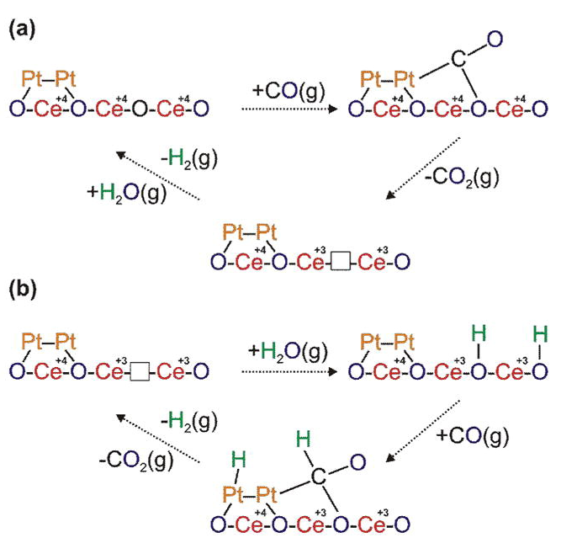
WGSR
“Redox” mechanism
“Associative formate with –OH regeneration” mechanism
The factor governing WGSR is the extension of the metal-promoter interface, as a result of a good contact between the two components.

Slide 20
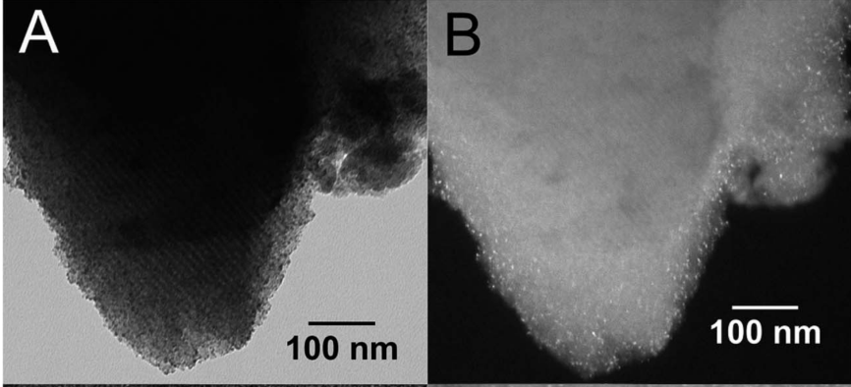
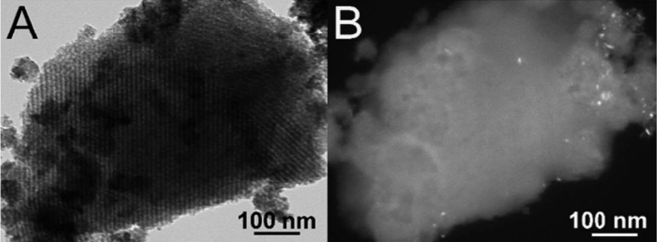
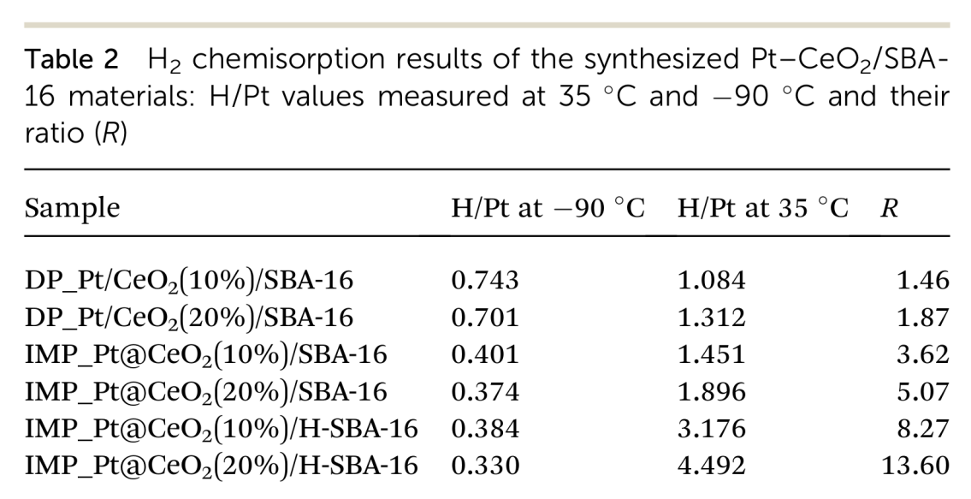
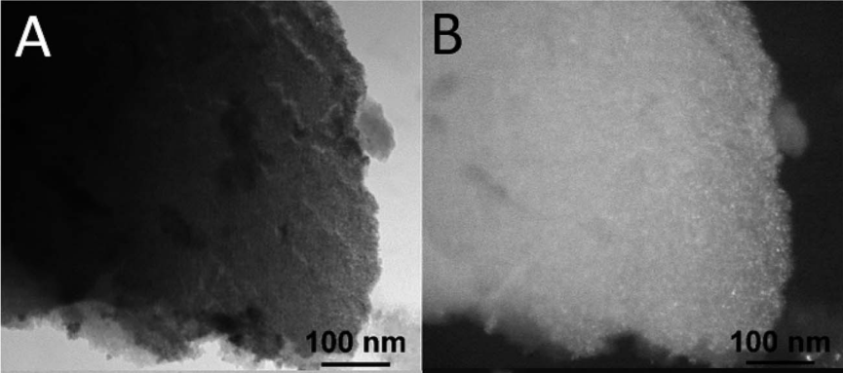
WGSR
J. Mater. Chem. A, 5 (2017), 20024–20034

Slide 21
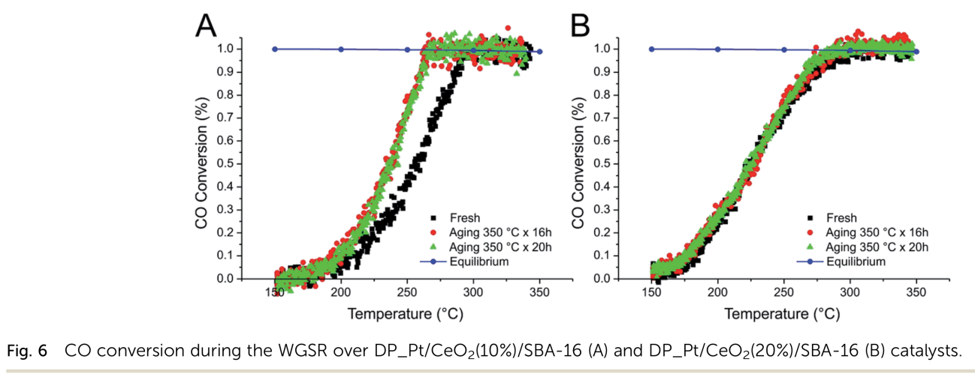
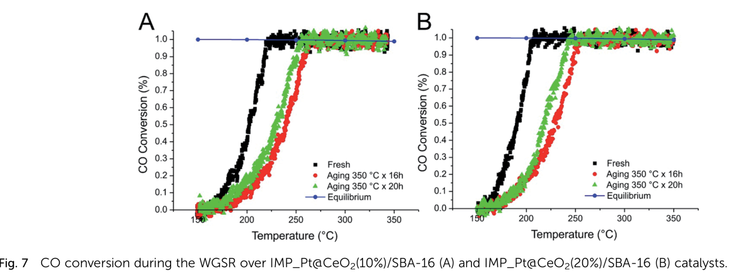
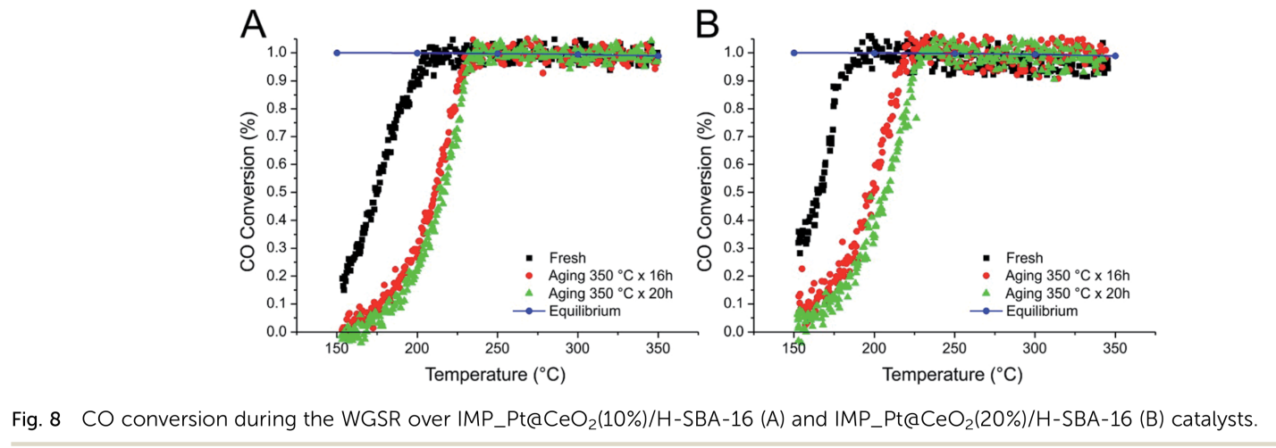
WGSR
Deposition-precipitation on SBA-16
Deactivation by sintering (irreversible)
Impregnation of SBA-16 with Pt-DT and Ce(OR)₄
Deactivation by deposition of intermediates and/or electronic effects (reversible)
Impregnation of hydrophobic SBA-16 with Pt-DT and Ce(OR)₄
J. Mater. Chem. A, 5 (2017), 20024–20034

