Slide 1
991SV Biochemistry of Health-related Diseases SM54 - NEUROSCIENZE
Prof. Sabina Passamonti, Dr. med., PhD biochimica
University of Trieste
Department of Life Sciences
Building C11, 2° floor, lab 227
Tel 040 558 8747 Mob 3665898629
e-mail: spassamonti@units.it

Slide 2
Lecture 1
Introduction to the course and learning targets and evaluation
Course plan (topics)
Students engagement
Learning evaluation
Topic
Oxygen radical chemistry (ROS). Oxidative damage to biological macromolecules

Slide 3
Course presentation
The schedule of topics
The students engagement
The exam
essential features
additional features

Slide 4
Schedule
hours | Dates | Main topics
6 | 2-3 APR | Part 1:
 |  | BIOCHEMISTRY OF OXIDATIVE STRESS
6 | 9-10 APR | Part 2:
 |  | ALTERATIONS OF METABOLISM IN AGE-RELATED DISEASES
6 | 16-17 APR | Part 3:
 |  | DIETS AND HEALTH
6 | 29-30 APR | Part 4:
 |  | MOLECULAR NUTRITION

Slide 5
Students engagement
You are the teacher!

Slide 6
Engagement reward
Principle
Learning by teaching
Outcome
Teaching = learning
Assessment
Your teaching material and performance will be 80% of your final score
20% will be discussion on other topics

Slide 7
When will you catch this opportunity?
Check the detailed schedule
next slide

Slide 8
Oxygen radical chemistry (ROS)

Slide 9
ROS are the chemical agents of oxidative stress

Slide 10
Overeview
Principles of
oxygen chemistry and reactivity
oxidation of biological molecules
The main sites of ROS generation
The main endogenous defense systems agains ROS and ROS-mediated changes
ROS in cell signalling and regulation

Slide 11
Objective
Enabling to critically reading the literature and critically understanding experimental results
To feel at ease in a maze of information
WARNING
THIS REVIEW IS NOT COMPREHENSIVE

Slide 12
Free radicals are active participants in diverse processes and they cannot be considered anymore as only damaging agents, but real players in many normal functions of living organisms. V.I. Lushchak / Chemico-Biological Interactions 224 (2014) 164–175

Slide 13
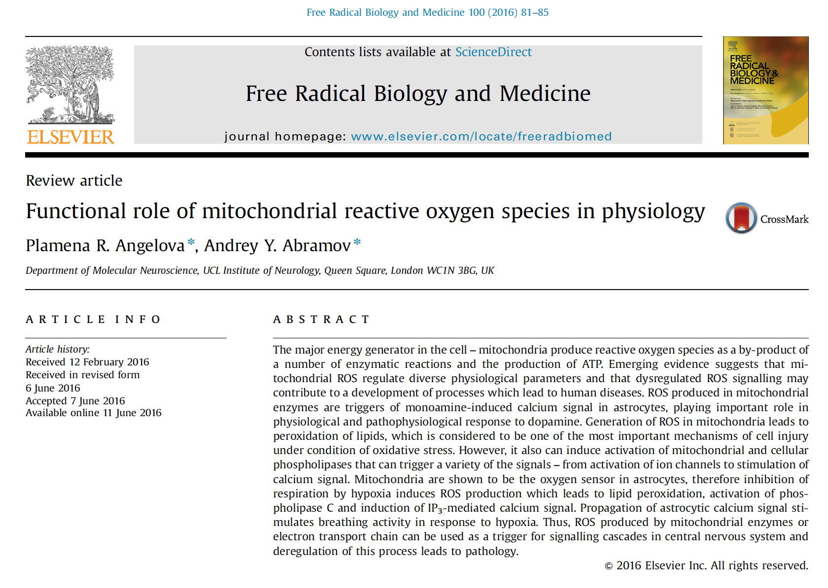

Slide 14
ROS as bioactive compounds
1954 – Discovery of free radicals in biological materials
1969 – Discovery of Superoxide Dismutase
1973 – Discovery of bactericidal activity of superoxide
1987 – Discovery of nitric oxide as vosorelaxant
1995 – Discovery of regulation of hydrogen peroxide by insulin

Slide 15
Notes:
source
https://slideplayer.com/slide/7614952/

Slide 16
Le reazioni redox termini
Trasferimento di elettroni (e⁻) da una specie all’altra
Ossidazione = perdita di un e⁻
Riduzione = guadagno di un e⁻
Ossidante = Accettore di un e⁻
il numero di ossidazione dell’accettore diminuisce (è meno positivo o più negativo)
Riducente = Donatore di un e⁻
il numero di ossidazione dell’accettore aumenta (è più positivo o meno negativo)

Slide 17
Types of ROS
Reactivity
Interconversion

Slide 18
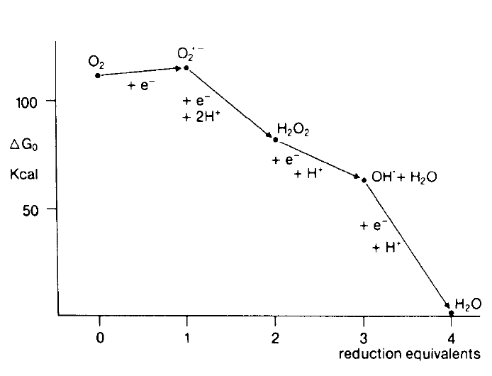
Types of ROS and their free energy
ROS formation is exergonic: O₂ → ROS
superoxide anion, free radical
hydrogen peroxide, non radical
hydroxyl radical, free radical

Slide 19
Types of ROS and their half-life reactivity directly depends of their half-life
microseconds
minutes
nanoseconds

Slide 20
ROS in disease
Diabetes mellitus
Neurodegenerative disorders
(Parkinson's disease, Alzheimer's disease and Multiple sclerosis),
Cardiovascular diseases
(atherosclerosis and hypertension)
Respiratory diseases
(asthma)
Cataract development
Rheumatoid arthritis
Various cancers
(colorectal, prostate, breast, lung, bladder cancers).

Slide 21
ROS in disease
Biochemical mechanisms

Slide 22
ROS attack on biological molecules
Lipids
Proteins
Nucleic acids
Let’s see a few examples

Slide 23
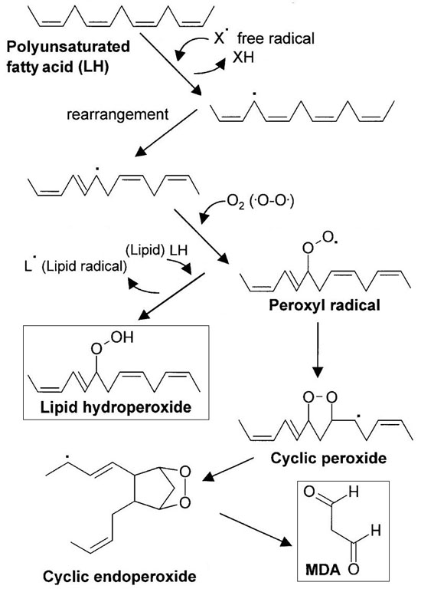
Lipid peroxidation & malodialdehyde formation

Slide 24
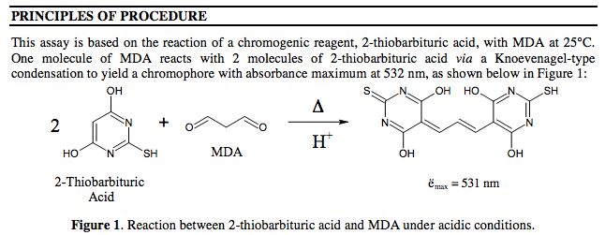
Malon dialdehyde assay
Thiobarbituric acid reacts with malondialdehyde and other lipid peroxides
TBARS thiobarbituric acid reactive substances

Slide 25
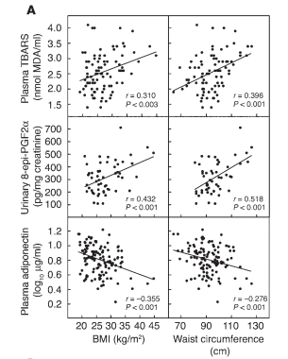
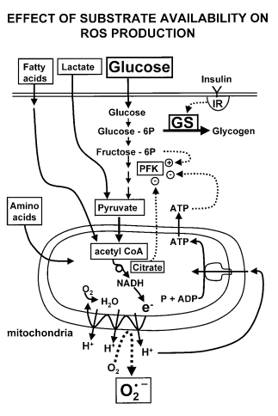
MALON DIALDHEYDE ASSAY IN CLINICS Obesity increases ROS
Dröge, W. Physiol Rev 82: 47–95, 2002
Furukawa, S. et al.
J. Clin. Invest. 114:1752–1761 (2004).
Dröge, W. Physiol Rev 82: 47–95, 2002
WHY ?

Slide 26
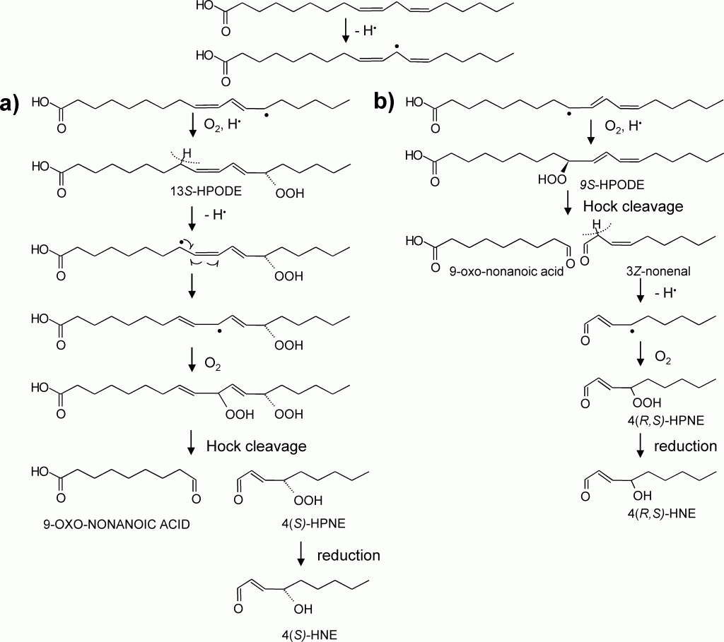
Lipid peroxidation & 4-hydroxynonenale formation
Linoleic acid

Slide 27
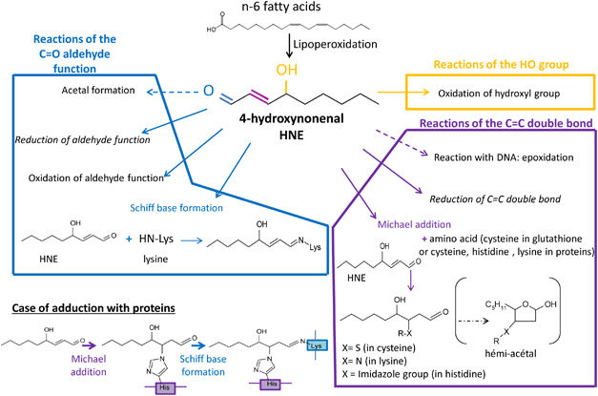
4-HNE is reactive
Cell death and diseases related to oxidative stress:4-hydroxynonenal (HNE) in the balance. Cell Death and Differentiation (2013) 20, 1615–1630 doi:10.1038/cdd.2013.138

Slide 28
4-HNE is pathogenic

Slide 29
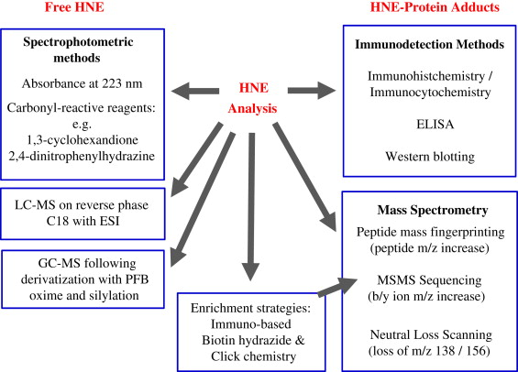
Methods to measure 4-HNE
The lipid peroxidation product 4-hydroxy-2-nonenal: Advances in chemistry and analysis. Redox Biology, 2013, 1, 145-152. DOI: 10.1016/j.redox.2013.01.007

Slide 30
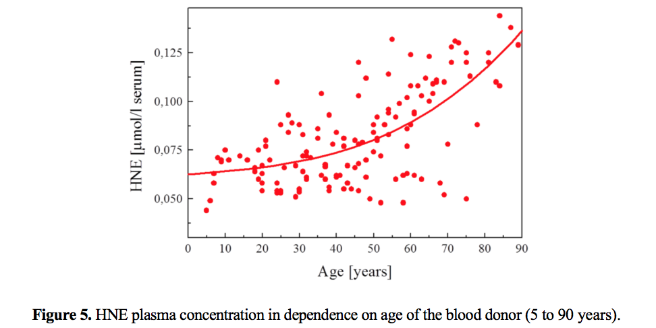
4-Hydroxy-nonenal—A Bioactive Lipid Peroxidation Product. Biomolecules 2015, 5, 2247-2337; doi:10.3390/biom5042247

Slide 31
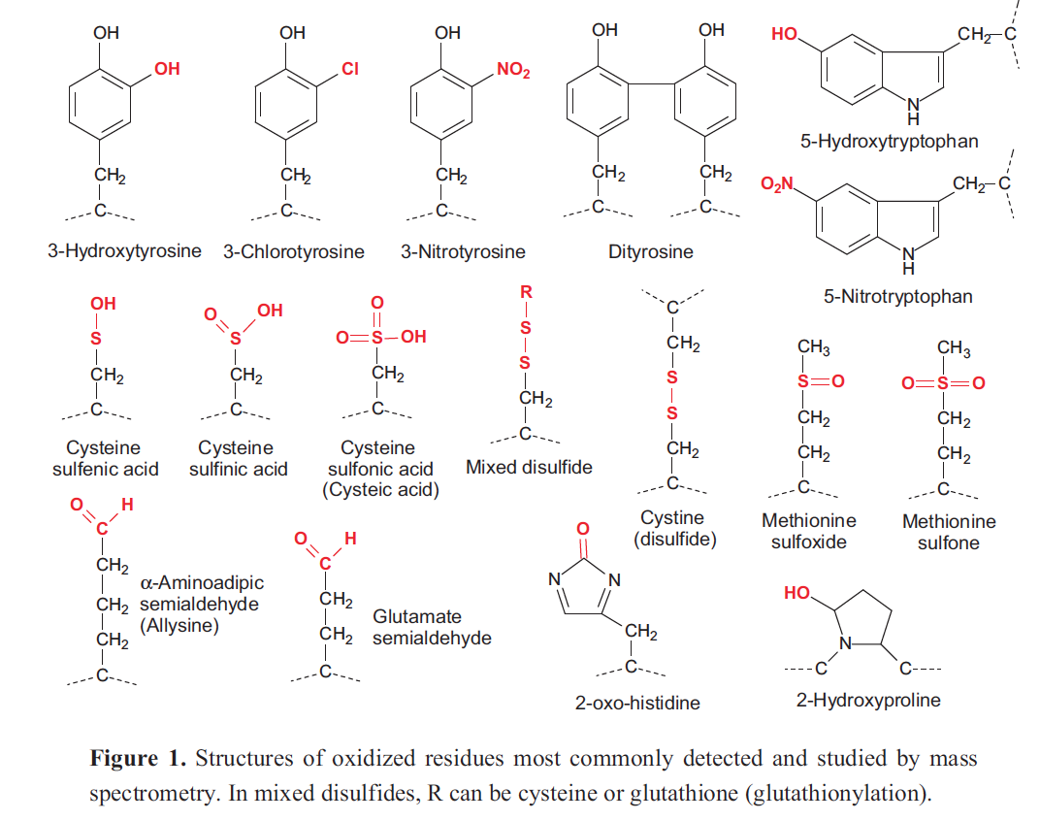
Aminoacids as victims of HO• Biomolecules 2015, 5, 378-411; doi:10.3390/biom5020378

Slide 32
General types of protein oxidative modification
Sulfur oxidation (Cys disulfides, S-thiolation; Met sulfoxide)
Protein carbonyls (side chain aldehydes, ketones)
Tyrosine crosslinks, chlorination, nitrosation, hydroxylation
Tryptophanyl modifications
Hydro(pero)xy derivatives of aliphatic amino acids
Chloramines, deamination
Amino acid interconversions (e.g., His to Asn; Pro to OH-Pro)
Lipid peroxidation adducts (MDA, HNE, acrolein)
Amino acid oxidation adducts (e.g., p-hydroxyphenylacetaldehyde)
Glycoxidation adducts (e.g., carboxymethyllysine)
Cross-links, aggregation, peptide bond cleavage

Slide 33
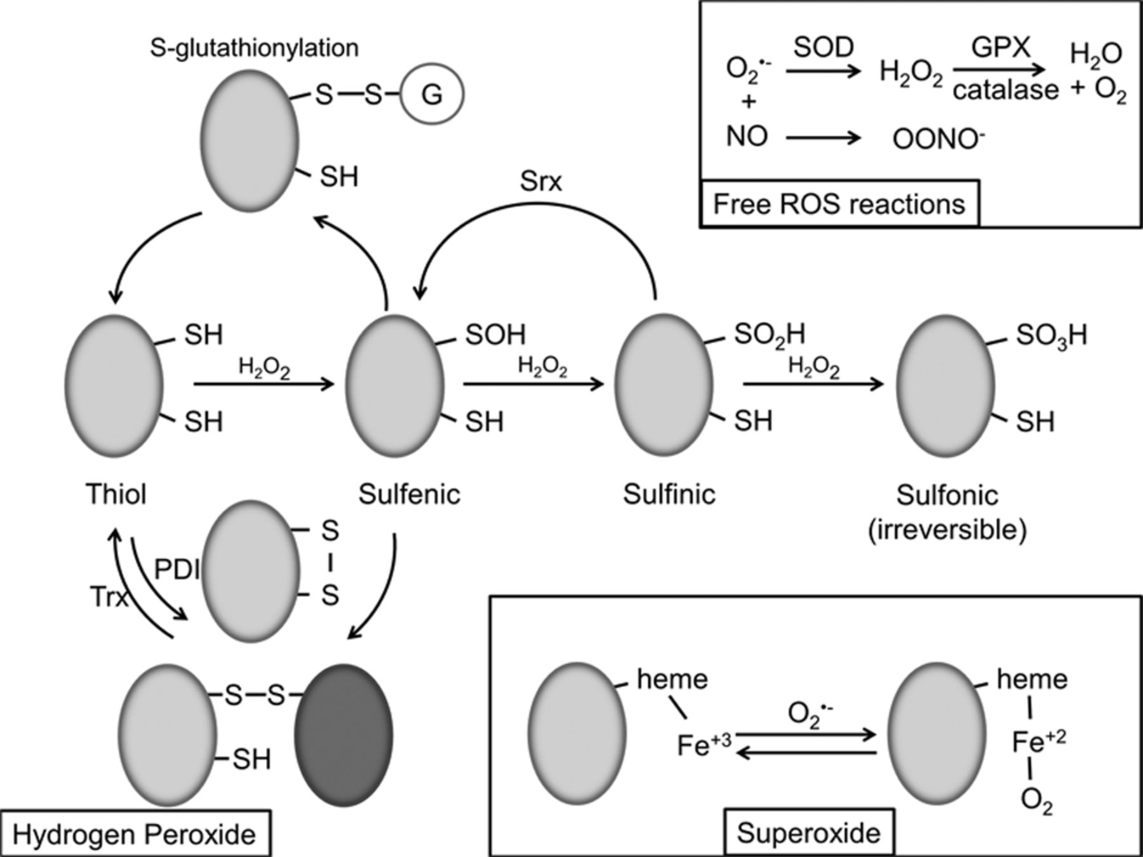
Oxidative modifications.
David I. Brown, and Kathy K. Griendling Circ Res. 2015;116:531-549
Copyright © American Heart Association, Inc. All rights reserved.
Notes:
Oxidative modifications. Hydrogen peroxide (H₂O₂), low pKa protein thiols react with H₂O₂ to produce various oxidative modifications. Initial oxidation results in formation of the sulfenic acid functional group, which is subject to s-glutathionylation and disulfide bond formation. Disulfide bonds are also created by protein disulfide isomerase (PDI) and reversed by thioredoxin (Trx). Subsequent oxidation of sulfenic acid forms sulfinic acid, which may be reversible by sulfiredoxin (Srx), and sulfonic acid, which is thought to be irreversible. Superoxide (O₂^{•−}) reversibly reacts with heme Fe³⁺ to form Fe²⁺+O₂. Free reactive oxygen species (ROS) reactions, free O₂^{•−} in the cell is converted to H₂O₂ by superoxide dismutase (SOD) and H₂O+O₂ by glutathione peroxidase (Gpx) and catalase. Free O₂^{•−} can also react with nitric oxide (NO) to form peroxynitrite (OONO⁻).

Slide 34
ROS-mediated protein carbonylation
ARGININE, PROLINE
PROLINE
LYSINE
THREONINE

Slide 35
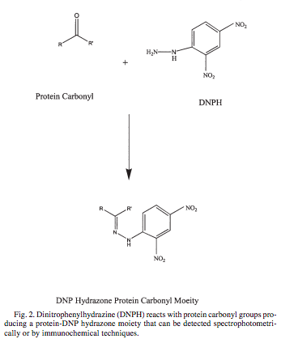
Protein carbonyls can be assayed in biological fluids
Castagna A. et al. Protein Carbonyl Levels— An Assessment of Protein Oxidation
From: Methods in Pharmacology and Toxicology: Methods in Biological Oxidative Stress
Edited by: K. Hensley and R. A. Floyd © Humana Press Inc., Totowa, NJ 2003

Slide 36
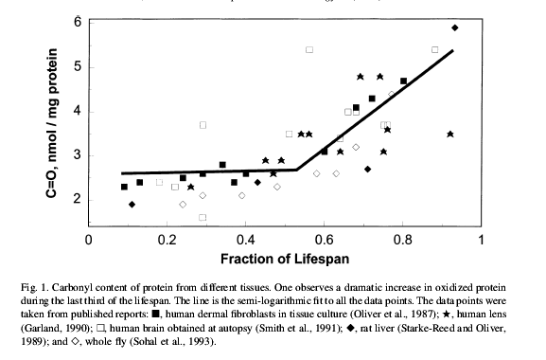

Slide 37
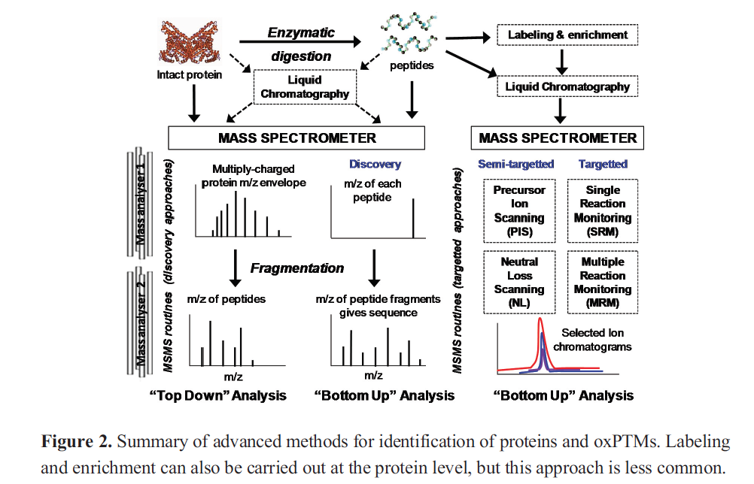
Methods to measure carbonyls in the proteome Biomolecules 2015, 5, 378-411; doi:10.3390/biom5020378

Slide 38
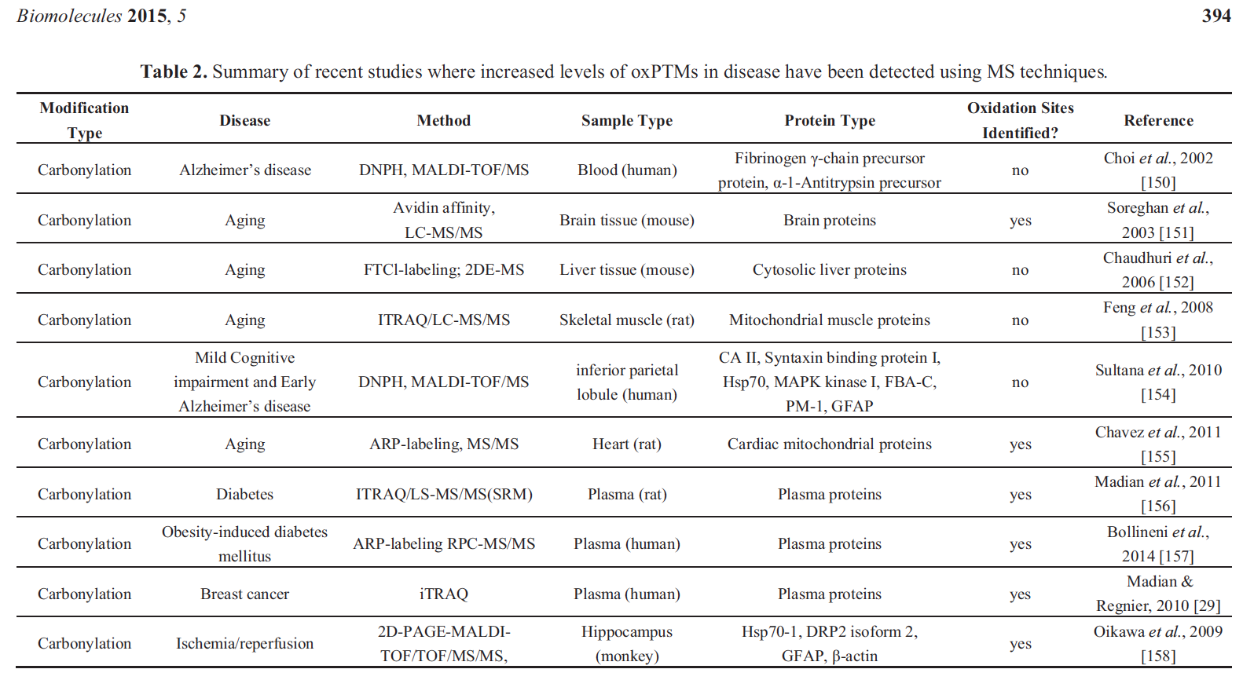

Slide 39
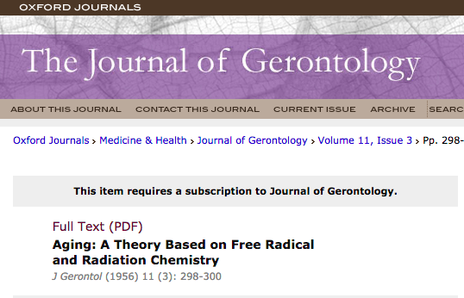
D. Harman

Slide 40
controversies …
Free Radic Biol Med. 2014 Jun;71:368-78. doi: 10.1016/j.freeradbiomed.2014.03.038. Epub 2014 Apr 4.
Revisiting an age-old question regarding oxidative stress.
Edrey YH1, Salmon AB2.
https://www.ncbi.nlm.nih.gov/pmc/articles/PMC4049226/

Slide 41
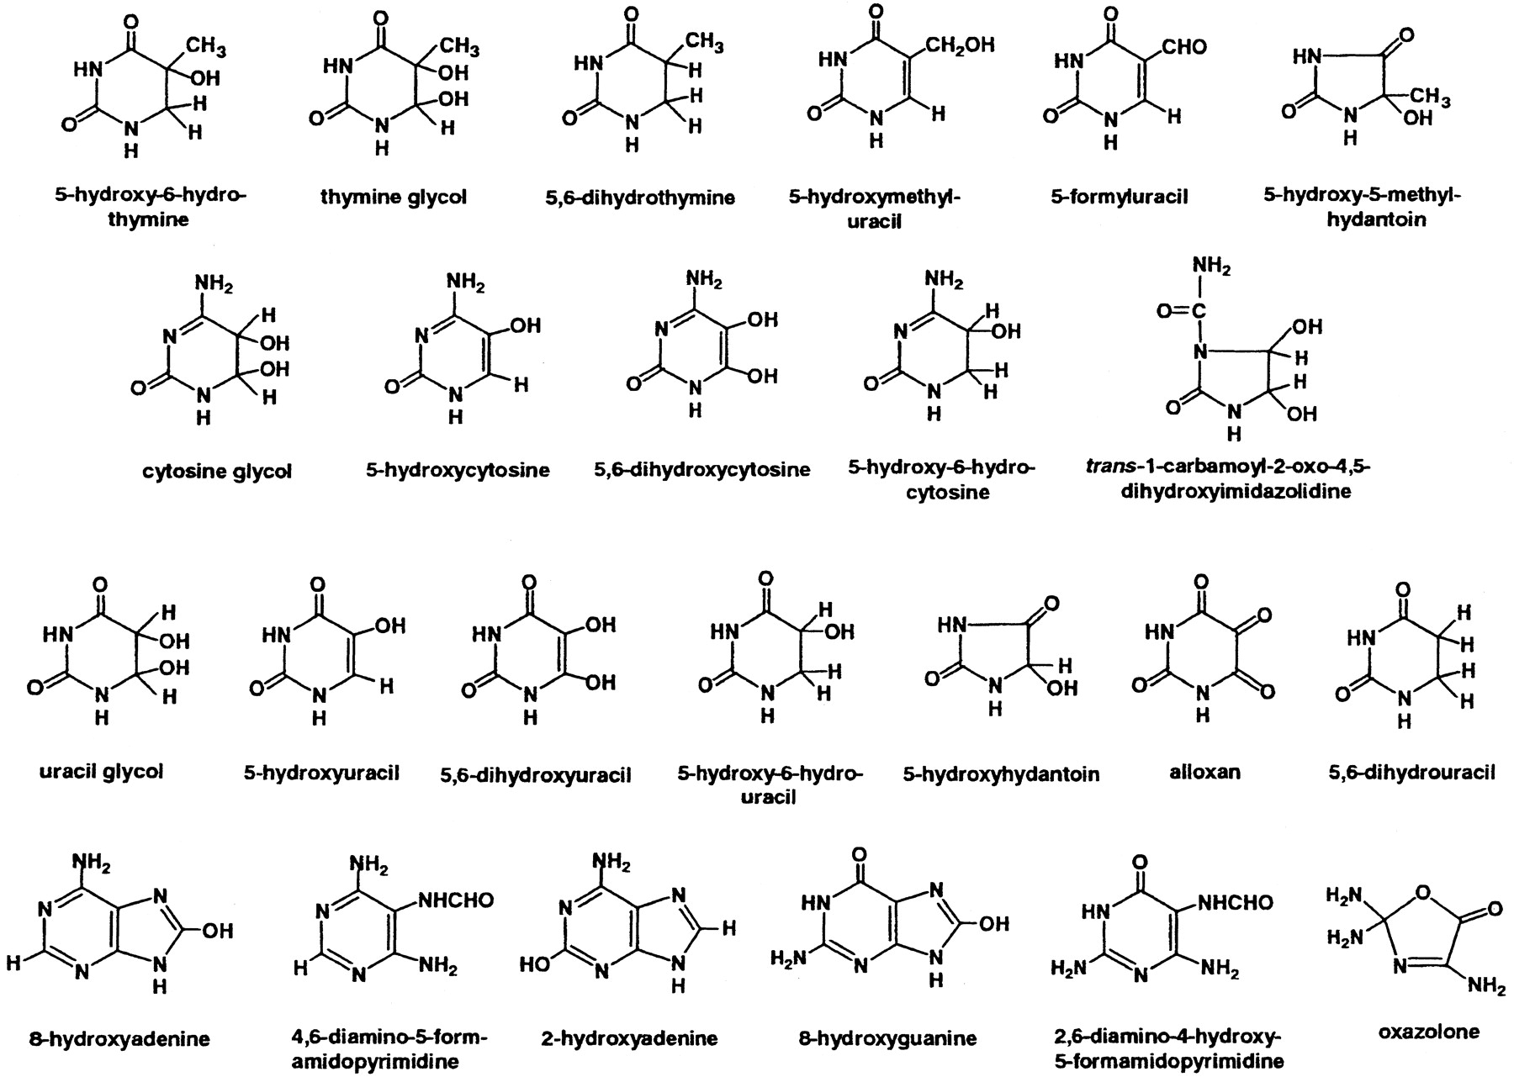
Figure 1. DNA base products of interaction with reactive oxygen and free radical species.
COOKE M S et al. FASEB J 2003;17:1195-1214
Copyright Federation of American Societies for Experimental Biology (FASEB). Please see the journal's copyright policies at www.fasebj.org to obtain permission to use this image.
Notes:
DNA base products of interaction with reactive oxygen and free radical species.

Slide 42
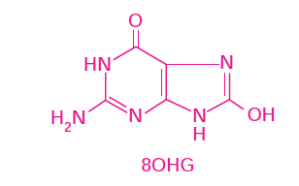
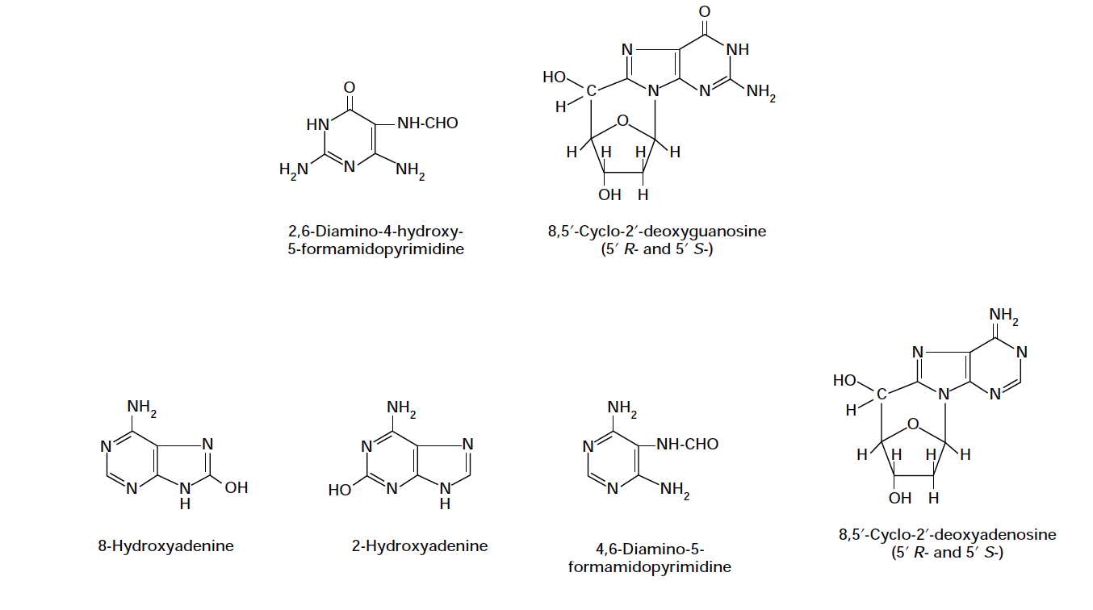

Slide 43
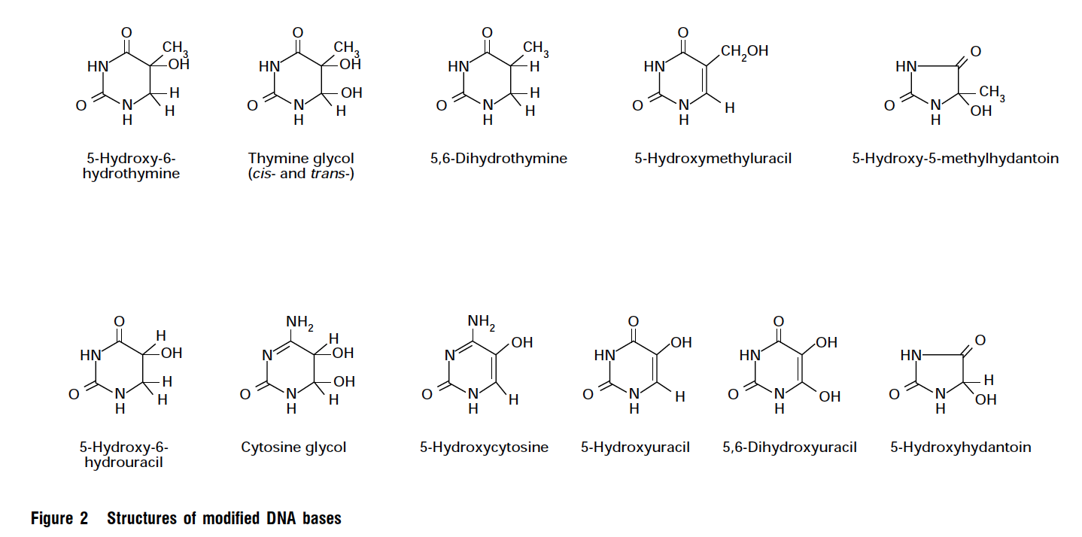
Continued from slide 25

Slide 44
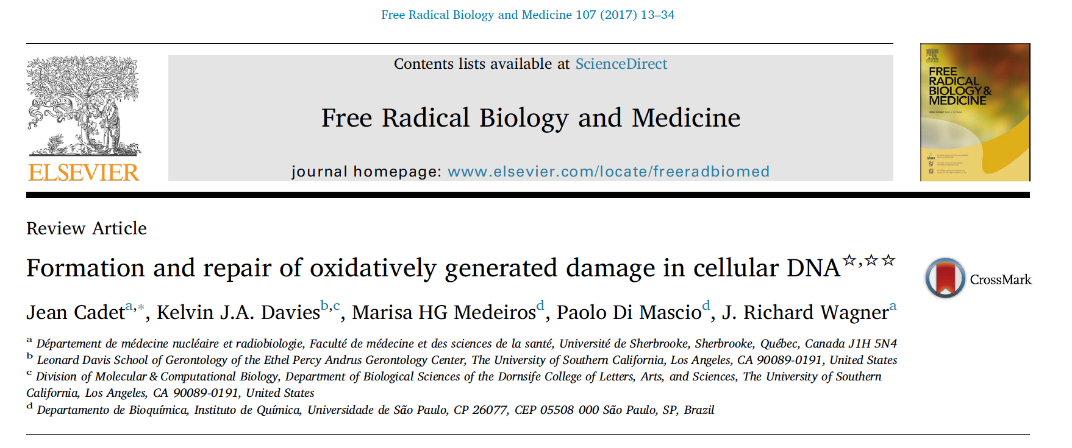
Oxidatively generated damage in cellular DNA – many issues

Slide 45
Measurement of oxidatively generated damage in cellular DNA
Formation and repair of oxidatively generated damage in cellular DNA. Free Radical Biology and Medicine 107 (2017) 13–34. DOI: 10.1016/j.freeradbiomed.2016.12.049
It is possible
Data will strengthen your observations of biological/toxicological/pharmacological/ … effects
You can involve researchers from other disciplines (interdisciplinary research)
Your joint efforts have more publication opportunities, usually in better journals

Slide 46
A critical survey of available analytics
Immunoassays
Enzymatic assays
Gas chromatography-mass spectrometry (GC-MS)
High performance liquid chromatography-electrochemical detection (HPLC-ECD)
High performance liquid chromatography – mass spectrometry (HPLC-MS)
High performance liquid chromatography – tandem mass spectrometry (HPLC-MS/MS)
Formation and repair of oxidatively generated damage in cellular DNA. Free Radical Biology and Medicine 107 (2017) 13–34. DOI: 10.1016/j.freeradbiomed.2016.12.049

Slide 47
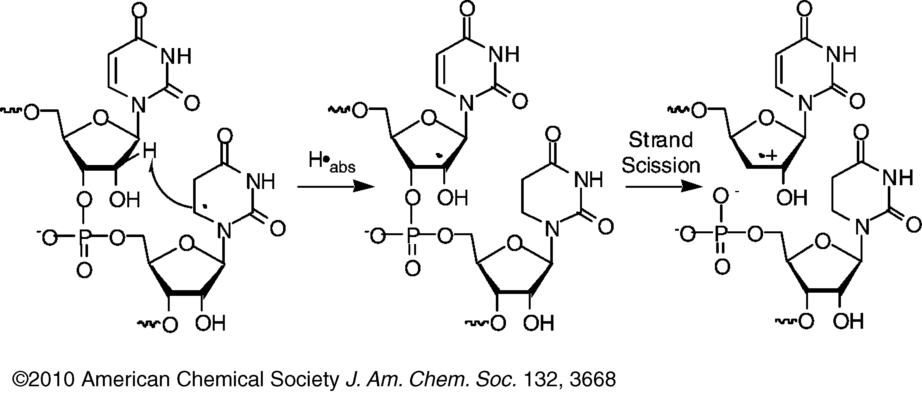
Direct Strand Scission from a Nucleobase Radical in RNA J. Am. Chem. Soc., 2010, 132 (11), pp 3668–3669. DOI: 10.1021/ja100281x

Slide 48
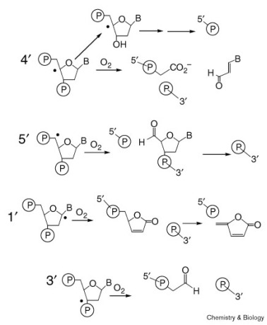
The importance of being r: greater oxidative stability of RNA compared with DNA. DOI: 10.1016/S1074-5521(00)00080-6

Slide 49
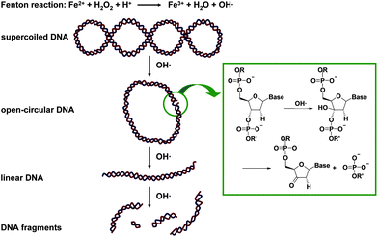
Hydroxylation of ribose

Slide 50
ROS (O₂^{•-}) generation
Where in the cell?
At proteins having redox-active prosthetic groups
Heme,
FMNH₂
CoQH₂
Mitochondrium → electron transport chain
Peroxisome → many oxidases, esp. beta-oxidation of long-chain fatty acids
Endoplasmic reticulum → cytochrome P450
Plasma membrane → NADPH oxidase
Cytosol → nitric oxide synthase, xantine oxidase, etc.

Slide 51
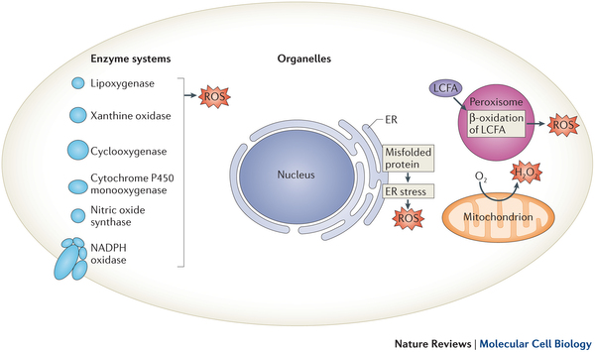
Intracellular sources of reactive oxygen species
Holmström KM, Finkel T.
Nat Rev Mol Cell Biol. 2014 Jun;15(6):411-21

Slide 52
Structure and catalytic mechanisms of functional NOS
NOS is a mini-electron transport chain
Ulrich Förstermann, and William C. Sessa Eur Heart J 2012;33:829-837
Published on behalf of the European Society of Cardiology. All rights reserved. © The Author 2011. For permissions please email: journals.permissions@oup.com
Notes:
Structure and catalytic mechanisms of functional NOS. (A) NOS monomers are capable of transferring electrons from reduced nicotinamide-adenine-dinucleotide phosphate (NADPH), to flavin-adenine-dinucleotide (FAD) and flavin-mononucleotide (FMN) and have a limited capacity to reduce molecular oxygen to superoxide (O2−•).18,163,164 Monomers and isolated reductase domains can bind calmodulin (CaM), which enhances electron transfer within the reductase domain.165 NOS monomers are unable to bind the cofactor (6R-)5,6,7,8-tetrahydrobiopterin (BH4) or the substrate l-arginine and cannot catalyze NO production.163,166 (B) In the presence of haem, NOS can form a functional dimer.163,166 Haem is essential for the interdomain electron transfer from the flavins to the haem of the opposite monomer.165,167 Due to differences in the calmodulin-binding domain, elevated Ca2+ is required for calmodulin binding (and thus catalytic activity) in nNOS and eNOS, whereas calmodulin binds to inducible NOS with high affinity even in the absence of Ca2+. When sufficient substrate l-arginine (l-Arg) and cofactor BH4 are present, intact NOS dimers couple their haem and O2 reduction to the synthesis of NO (fully functional NOS). l-Citrulline (l-Cit) is formed as the byproduct. For clarity, the flow of electrons is only shown from the reductase domain of one monomer to the oxygenase domain of the other monomer. NOS enzymes perform two separate oxidation steps, one to form Nω-hydroxy-l-arginine and a second to convert this intermediate to NO.18 All NOS isoforms contain a zinc ion (Zn) coordinated in a tetrahedral conformation with pairs of CXXXXC motifs at the dimer interface. This site is of major importance for the binding of BH4 and l-arginine. Electron transfer from the reductase domain (*) enables NOS ferric (Fe3+) haem to bind O2 and form a ferrous (Fe2+)-dioxy species. This species may receive a second electron (**) preferentially from BH4 or from the reductase domain. The nature of the resulting oxidized BH4 has been identified as the trihydrobiopterin radical (BH3•) or the trihydropterin radical cation protonated at N5 (BH3•H+). The BH3• radical (or radical cation) can be recycled to BH4 by the NOS itself (using an electron supplied by the flavins). Alternatively, there is evidence that reducing agents such as ascorbic acid (AscH, which is present in cells in millimolar concentrations) can reduce the BH3• radical back to BH4103 (Asc·, ascorbate radical).

Slide 53
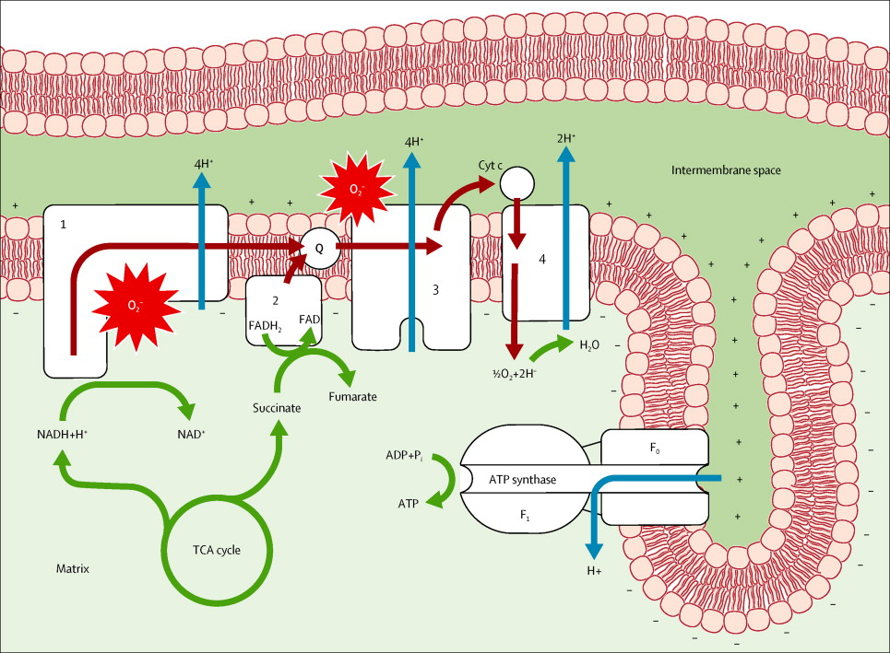

Slide 54
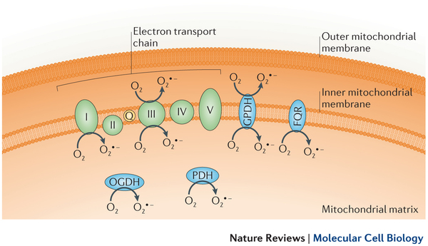
Superoxide anion O₂^{•-} in mitochondria
Complex I
Complex III
2-oxo-glutarate DH
Pyruvate DH
Glyceraldehyde 3-P DH
Electron transfer flavoprotein-ubiquinone oxidoreductase

Slide 55
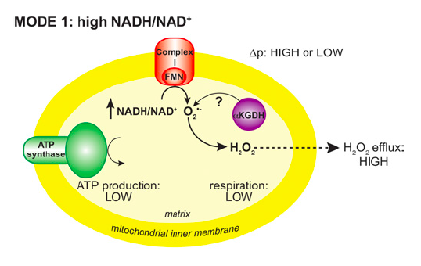
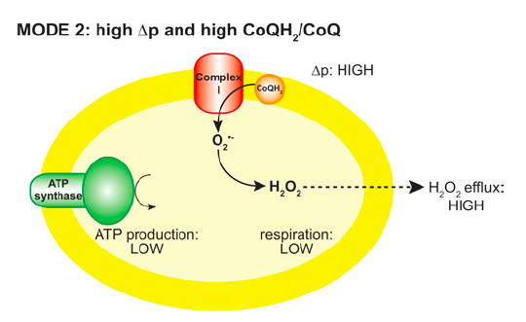
O₂^{•-} generation at Complex I When?
It happens when the rate of oxygen consumption is low, due to low availability of ADP (ATP hydrolysis is slow)
„principle of respiratory control“
Scheme from: M. Murphy, Biochem. J. (2009) 417, 1–13

Slide 56
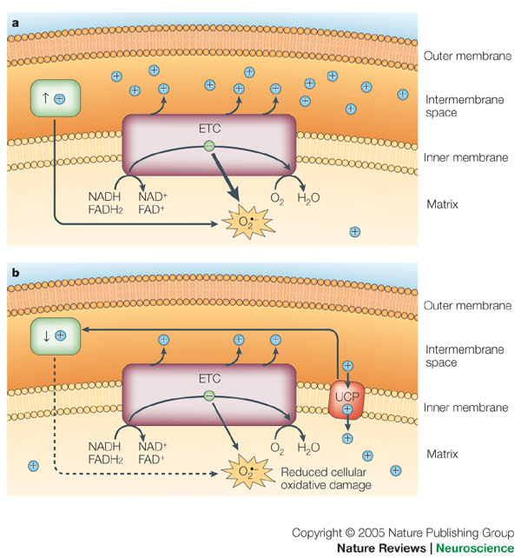
An increase in the mitochondrial membrane potential (↑+) promotes reactive oxygen species (ROS) production
FROM:
Mitochondrial uncoupling proteins in the cns: in support of function and survival
Zane B. Andrews, Sabrina Diano & Tamas L. Horvath
Nature Reviews Neuroscience 6, 829-840 (November 2005)
MEMO: the membrane potential increases when ADP is not available, i.e. ATP is in excess

Slide 57
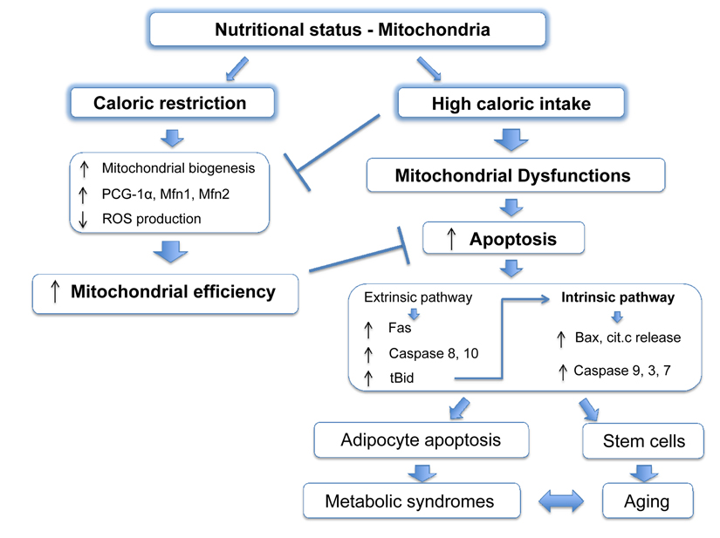

Slide 58
Fine

Slide 59
Lezione 2
Aggiornamenti

Slide 60
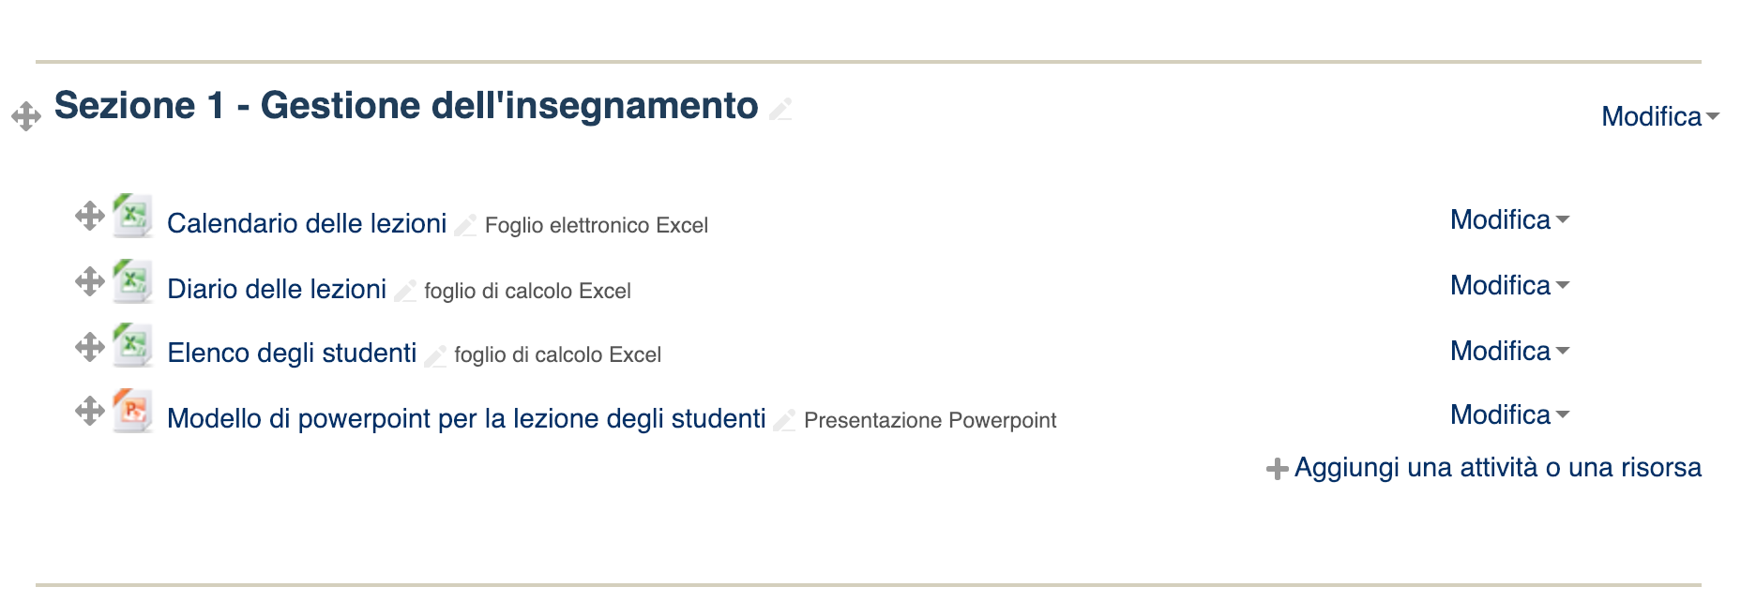
Moodle - 1

Slide 61
Moodle 2

Slide 62
Moodle - 3

Slide 63
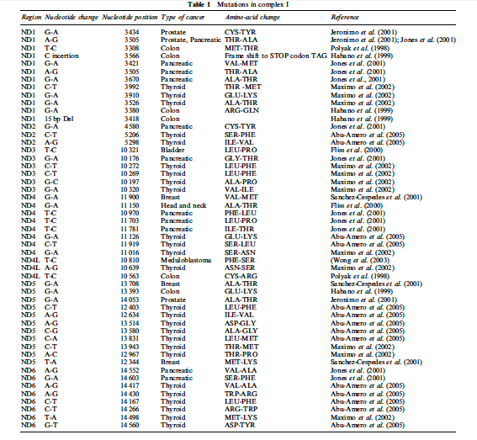
ROS can damage mtDNA coding for Complex I as found in various cancers

Slide 64
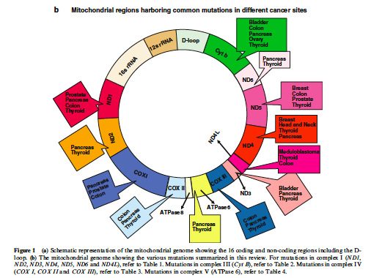
Other mtDNA can be mutated and mitochondrial dysfunction further increases ROS
Common mutations in cancer

Slide 65
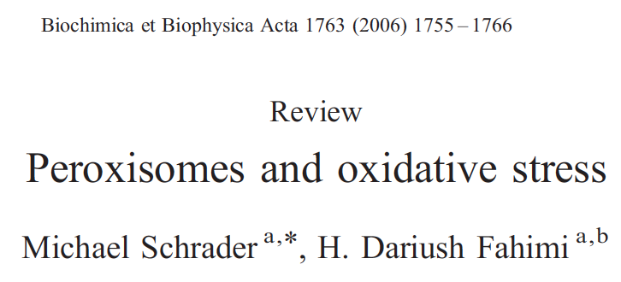
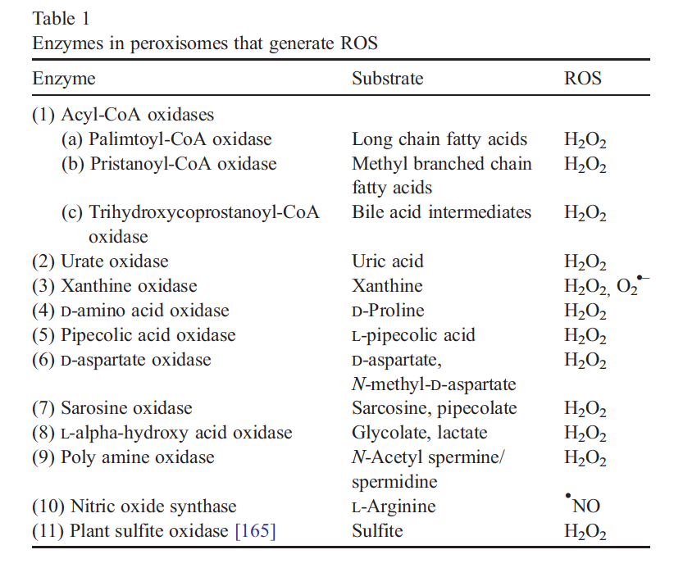
THE PEROXISOME

Slide 66
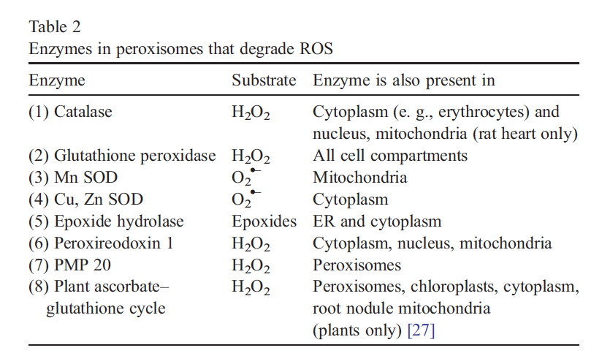
THE PEROXISOME

Slide 67
Superoxide anion O₂^{•-} on endoplasmic reticulum
Cytochrome P450

Slide 68
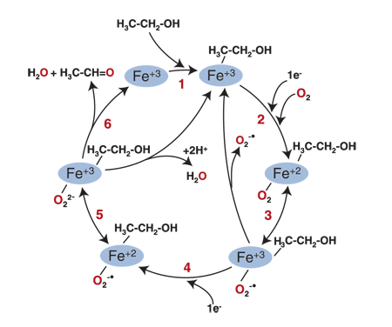
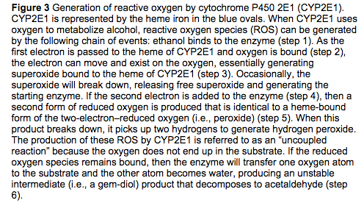
Alcohol Metabolism’s Damaging Effects on the Cell A Focus on Reactive Oxygen Generation by the Enzyme Cytochrome P450 2E1 Dennis R. Koop, Ph.D. http://pubs.niaaa.nih.gov/publications/arh294/274-280.htm

Slide 69
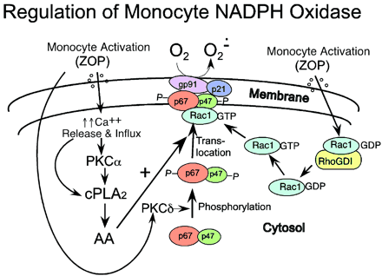
Superoxide anion O₂^{•-} on the plasma membrane
O₂
O₂⁻
ex
e⁻
e⁻
e⁻
in
NADPH
NADP⁺
Components of the monocyte/macrophage NADPH oxidase are shown in color-filled circles. The regulatory pathways, controlling NADPH oxidase assembly and activation, are also indicated. Upon monocyte activation by a physiological stimulus, for example opsonized zymosan (ZOP), a serum-coated yeast cell wall, the cytosolic components move to join the membrane components gp91phox and p21phox. The assembly and activation of the NADPH oxidase enzyme complex is regulated by calcium influx, calcium release from intracellular stores, PKC-dependent phosphorylation of cPLA₂, and arachidonic acid (AA) production. AA regulates the translocation of p47phox and p67phox to the membrane. These latter 2 components will not translocate unless first phosphorylated. Recent studies indicate that these phosphorylation events are regulated by PKC. Rac1 is the predominant Rac isoform expressed in monocytes, in contrast to Rac2 in neutrophils. Rac1 dissociates from its inhibitor rhoGDI upon monocyte activation and also translocates to the membrane, where it participates in the fully assembled and active NADPH oxidase.

Slide 70
Enzyme-catalysed conversion of ROS to water and oxygen
Enzyme-catalysed defenses against ROS

Slide 71
The reaction of superoxide dismutase (EC-Number 1.15.1.1 )
2 H⁺ + 2 O₂⁻ → O₂ + H₂O₂
2 H⁺
2
2
O₂

Slide 72
Hydrogen peroxide Why it’s better to get rid of
Fe²⁺
Fenton reaction
Fe³⁺
OH⁻

Slide 73
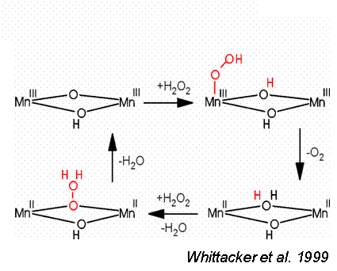
The reaction of catalase (EC-Number 1.11.1.6 )
2
2

Slide 74
Competitive race of the catalase and the Fenton reactions to consume hydrogen peroxide
Fe²⁺
Fenton reaction
Fe³⁺
OH⁻
catalase
1.11.1.6

Slide 75
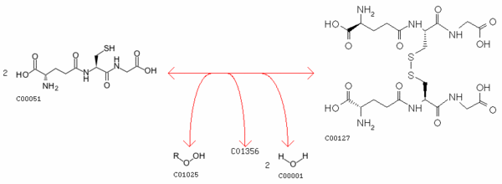
The reaction of glutathione peroxidase (EC-Number 1.11.1.12)
Peptide bonds
Hydrogen peroxide
glutathione
Glutathione disulfide
Lipid
Lipid hydroperoxide
Glutathione is a tripeptide:
γ-glutamylcysteinyl glycine

Slide 76
Another competitive race of the glutathione peroxidase and the Fenton reactions to consume hydrogen peroxide
Fenton reaction
Fe²⁺→ Fe³⁺
GPX
1.11.1.12
2GSH
GSSH

Slide 77
SOD is the first line of defence Catalase and glutathione reductase are together in the last defence line
2 H⁺
SOD
1.15.1.1
O₂
Fe²⁺
Fenton reaction
Fe³⁺
OH⁻
GPX
1.11.1.12
catalase
1.11.1.6
2GSH
GSSH

Slide 78
The reaction of glutathione reductase (EC-Number 1.8.1.7) regenerates reduced glutathione
GSSG
2 GSH
NADPH+H⁺
NADP⁺

Slide 79
Recommended reading

Slide 80
Endogenous defenses against ROS: non-enzymatic anti-oxidants
lipoic acid, bilirubin, uric acid, ascorbic acid, flavonoids, carotenoids, … a few examples …

Slide 81
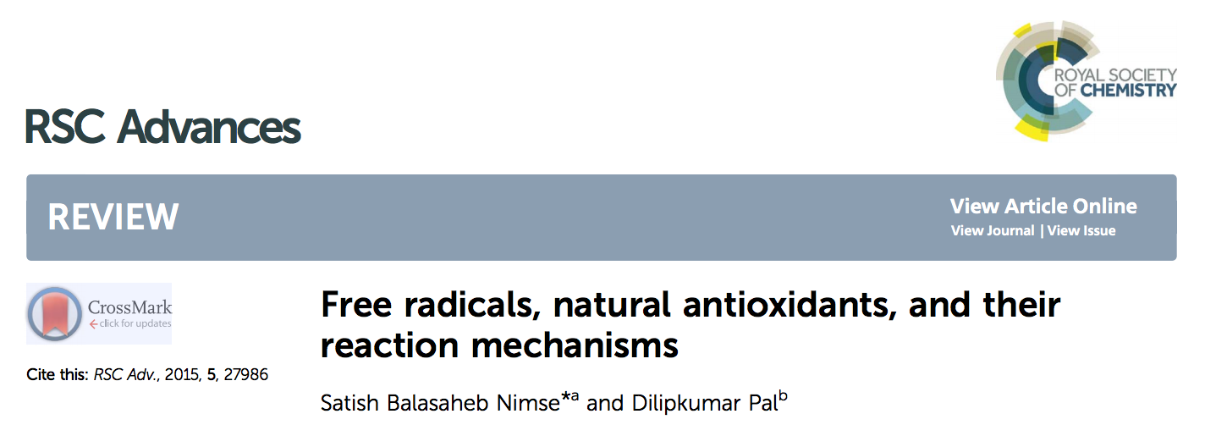
Great resource! DOI: 10.1039/c4ra13315c

Slide 82
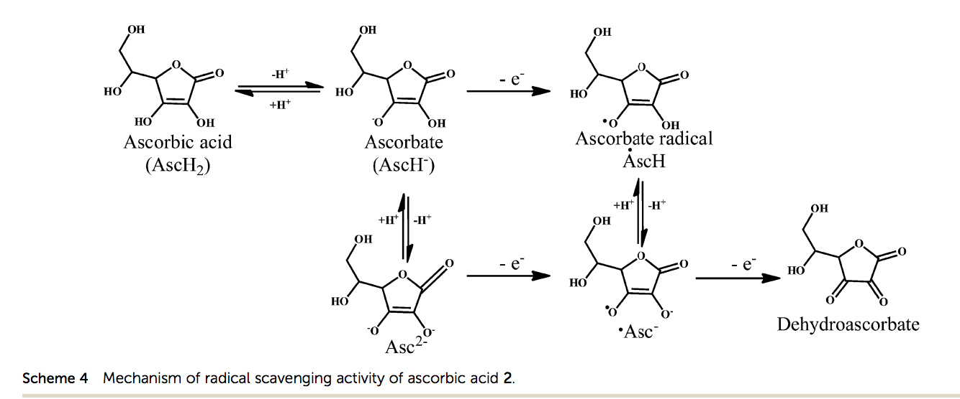
Ascorbate to Dehydroascorbate, sinking single electrons

Slide 83
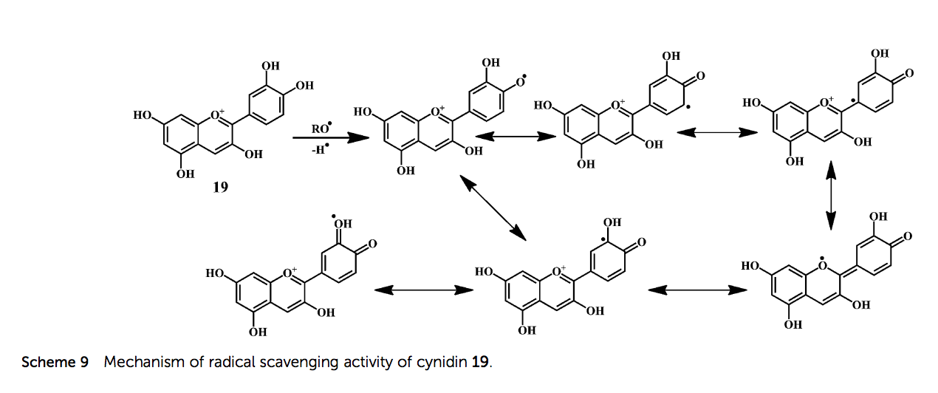
A dietary flavonoid, sinking single electrons DOI: 10.1039/c4ra13315c

Slide 84
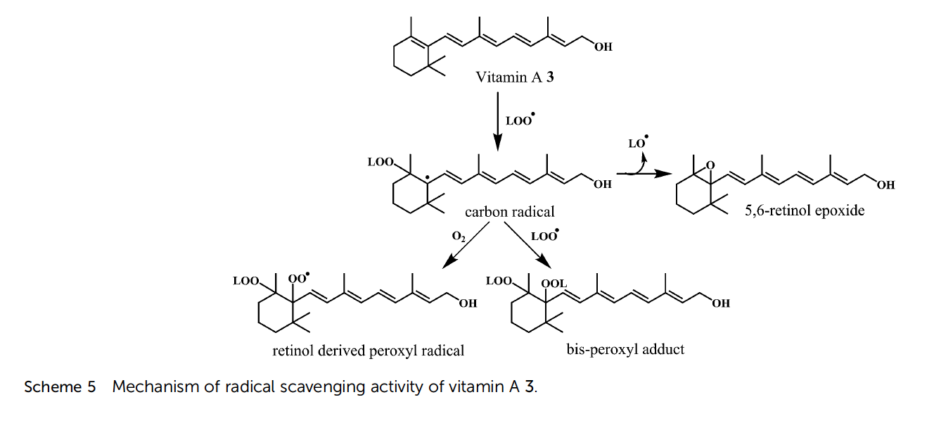
Vitamin A3, sinking single electrons DOI: 10.1039/c4ra13315c

Slide 85
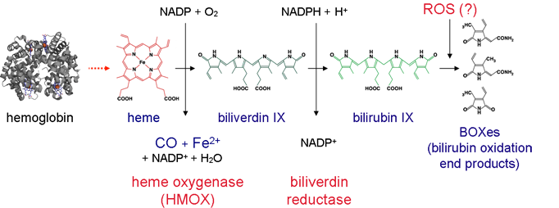
Bilirubin metabolic origin and degradation by ROS
Notes:
source
http://www.photonics4life.eu/P4L/Research/Local-Cluster-Projects/HHDP-Heme-and-heme-degration-products-Alternative-Functions-and-signaling-mechanisms

Slide 86
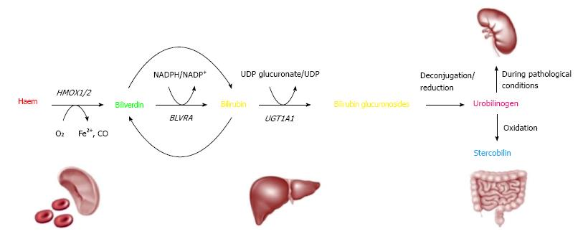
Bilirubin metabolic origin and recycling to biliverdin
Notes:
source
https://www.wjgnet.com/2150-5349/full/v7/i4/469.htm

Slide 87
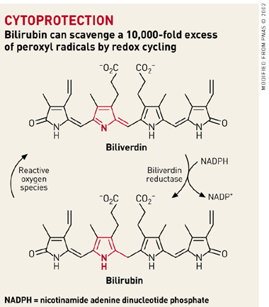
The bilirubin/biliverdin redox couple

Slide 88
Uric acid, sinking electrons DOI: 10.1039/C2MD20287E

Slide 89
ROS in PHYSIOLOGY
Biochemical mechanisms

Slide 90
ROS signalling

Slide 91
http://www.sciencedirect.com/science/article/pii/S0960982212014510

Slide 92
Physiologic role of NADPH oxidase-derived ROS. Green arrows indicate activation, and red lines with blunted ends indicate inhibition.
Mona Sedeek et al. JASN 2013;24:1512-1518
©2013 by American Society of Nephrology
Notes:
Physiologic role of NADPH oxidase-derived ROS. Green arrows indicate activation, and red lines with blunted ends indicate inhibition. NoxS, renal NADPH oxidases; VEGF, vascular endothelial growth factor; HIF, hypoxia inducible factor; ER, endoplasmic reticulum; MCP-1, monocyte chemotactic protein-1; MAP kinase, mitogen activated protein kinase; JNK, c-Jun N-terminal kinase 1; ERK, extracellular signal-regulated kinases; P38, p38 kinase.

Slide 93
Cysteine biochemistry allows for redox-dependent signaling.
Finkel T J Cell Biol 2011;194:7-15
©2011 by Rockefeller University Press
Notes:
Cysteine biochemistry allows for redox-dependent signaling. Specific reactive cysteine (Cys) residues within target proteins can be covalently modified by oxidative stress. Much like phosphorylation on serine or threonine residues, alteration of the thiol group can in turn modify enzymatic activity. Although the sulfenic form (SOH) is readily reversible, higher states of oxidation generally, but not always, lead to irreversible modification.

Slide 94
Redox-dependent signalling CYS chemistry Cellular mechanisms and physiological consequences of redox-dependent signalling. Holmström KM, Finkel T. Nat Rev Mol Cell Biol. 2014 Jun;15(6):411-21.

Slide 95
Reversible cys oxidation

Slide 96
Protein modification can cause either gain or loss of protein function and either gain or loss of cell function

Slide 97
Physiological protein carbonylation

Slide 98
ROS-dependent regulation of signaling pathways
ROS cause autophosphorylation of EGF receptor
MAPK cascades
ERK (extracellular signal-regulated kinase)
JNK (c-Jun NH2-terminal kinase)
Notes:
source
https://en.wikipedia.org/wiki/Epidermal_growth_factor_receptor

Slide 99
Ras - overview
Notes:
source
http://cc.scu.edu.cn/G2S/Template/View.aspx?courseType=1&courseId=17&topMenuId=113301&menuType=1&action=view&type=&name=&linkpageID=113472

Slide 100
Ras glutathionylation in Nox signalling
Notes:
source
http://go.galegroup.com/ps/anonymous?p=AONE&sw=w&issn=15230864&v=2.1&it=r&id=GALE%7CA209536907&sid=googleScholar&linkaccess=fulltext

Slide 101
Ras glutathionylation in Angiotensin II signalling
Notes:
source
https://www.semanticscholar.org/paper/Hydrogen-peroxide%3A-a-signaling-messenger.-Stone-Yang/d27ecd4026245359bffb0b90ab0ad281dd7e15da/figure/12

Slide 102
RTK overview
Notes:
Figure 1 FOXO factor transcriptional activity is regulated by Akt/PKB, SIRT and JNK activity. Growth factor (GF) stimulation leads to activation of PI3K, which results in Akt/PKB activation. Akt/PKB phosphorylates and inactivates FOXO proteins. FOXO activity towards different target genes and subsequent cell fate is influenced by SIRT- and JNK-dependent modifications. PDK, phosphoinositide-dependent kinase.
source
https://www.researchgate.net/publication/6743984_FOXO_transcription_factors_Key_regulators_of_cell_fate/figures?lo=1

Slide 103
Reversible oxidation of phosphatase and tensin homolog (PTEN) alters its interactions with signaling and regulatory proteins
Notes:
source
https://www.sciencedirect.com/science/article/pii/S0891584915011028

Slide 104
Redox Regulation of the Tumor Suppressor PTEN by Hydrogen Peroxide and Tert-Butyl Hydroperoxide
Notes:
source
https://www.mdpi.com/1422-0067/18/5/982/htm

Slide 105
Thioredoxin Thioredoxin is a 12-kD oxidoreductase enzyme containing a dithiol-disulfide active site. It is ubiquitous and found in many organisms from plants and bacteria to mammals.
Fig. 1. Mechanism of disulfide reduction by thioredoxin. During the thiol-disulfide exchange reaction, a transient mixed disulfide bond is formed between thioredoxin and its substrate. After completion of the catalytic cycle, a reduced substrate protein is released and thioredoxin is converted to the oxidized form. Trx: thioredoxin; red: reduced; ox: oxidized.
Notes:
source
https://www.sciencedirect.com/science/article/pii/S1359610113000026#fig0005

Slide 106
Thioredoxin reduces intramolecular disulfide bonds
Fig. 2. The reduced form of thioredoxin catalyzes reduction of disulfide bonds in target proteins. Oxidized thioredoxin is regenerated to the reduced state by the NADPH-dependent flavoenzyme thioredoxin reductase. TrxR: thioredoxin reductase.
Notes:
source
https://www.sciencedirect.com/science/article/pii/S1359610113000026#fig0005

Slide 107
Redox regulation of phosphatase function
Notes:
source
http://www.biochemsoctrans.org/content/32/6/1018

Slide 108
PTEN domains
Notes:
Fig. 3
Post-translational modifications of PTEN. PTEN is subject to several post-translational modifications including phosphorylation, oxidation, acetylation, ubiquitination and SUMOylation. Phosphorylation of multiple sites on the C-terminal region of PTEN affects protein stability, phosphatase activity and protein–protein interactions. Oxidation of PTEN at Cys124 leads to the formation of a disulfide bond with Cys71 resulting in decreased PTEN activity. PTEN is also acetylated at Lys125 and Lys128 by PCAF and at Lys402 by CBP. Ubiquitination of PTEN at Lys13 and Lys 289 by NEDD4-1, XIAP, and WWP2 regulates PTEN stability and cellular localization. PTEN SUMOylation at K254 and K266 is critical for PTEN tumor suppressive functions
source

Slide 109
Notes:
source
http://cancerdiscovery.aacrjournals.org/content/3/10/1099

Slide 110
MITOHORMESIS PROMOTING HEALTH AND LIFESPAN BY INCREASED LEVELS OF REACTIVE OXYGEN SPECIES Michale Ristow, 2014

Slide 111
Recommended reading

Slide 112
It’s a very long story …
For today it’s enough !
THANK YOU
Contact details
Sabina Passamonti
University of Trieste,
Department of Life Sciences
via L. Giorgieri 1, 34127 Trieste
spassamonti@units.it
tel: +390405588747 Mob: +393665898629
www.sabinapassamonti.org

