Slide 1
Parallel robot

Slide 2
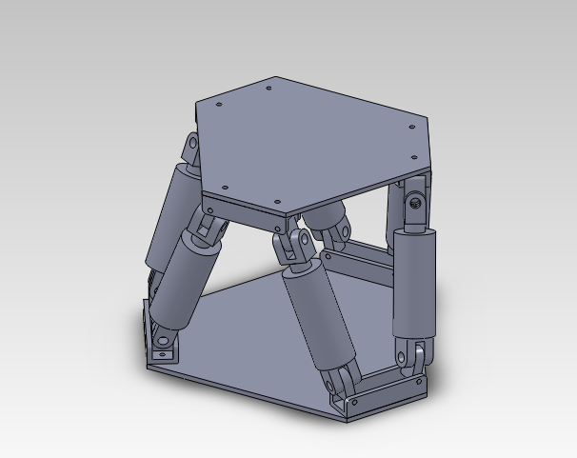
Stewart Platform
DoF
N=6x(membri-1)-4xcoppie=
=6x(14-1)-4x18=6

Slide 3
Video
Structure
https://www.youtube.com/watch?v=WmKnnp1xTPg
Apelmann (offshore application)
https://www.youtube.com/watch?v=aBn7w1S8MtY
Modified Stewart Platform (for simulators)
https://www.youtube.com/watch?v=PIl8Epy9xIw
https://www.youtube.com/watch?v=zNUBZfrOXUc&t=28s

Slide 4
Source: https://www.youtube.com/watch?v=5wCK6XGC3ig&list=PLggLP4f-rq02vX0OQQ5vrCxbJrzamYDfx&index=33
Prof: Kevin Lynch and Frank Park
book "Modern Robotics: Mechanics, Planning, and Control,"book "Modern Robotics: Mechanics, Planning, and Control,“

Slide 5
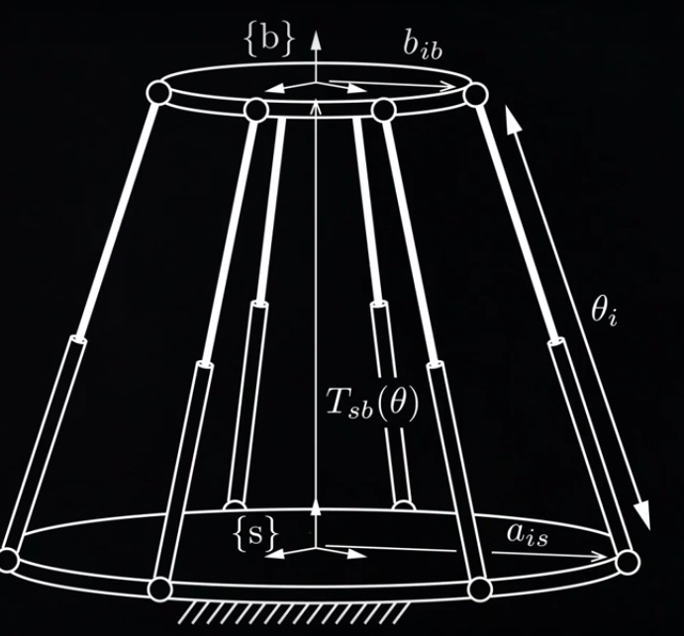
Inverse Kinematics: given the end-effector position, calculate the values of the joints $θ_{i}$
b is the end-effector frame
s is the base frame
$T_{sb}(θ)$ is the rototranslation matrix from b to s (it is known)
$b_{ib}$ and $a_{is}$ are parameters (vectors)
$b_{is}=T_{sb}$ $b_{ib}$
Now it is possible to calculate the joint variables $θ_{i}=\left\|b_{is}−a_{is}\right\|$

Slide 6
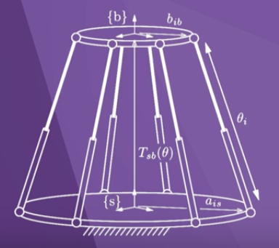
Forward Kinematics: given $θ_{i}$, calculate $T_{sb}$ (numerical methods)
Multiple solutions
Example: the RPR has up to 6 solutions
Example: Stewart platform up to 40 solutions
Only 4 are the real ones usually

Slide 7
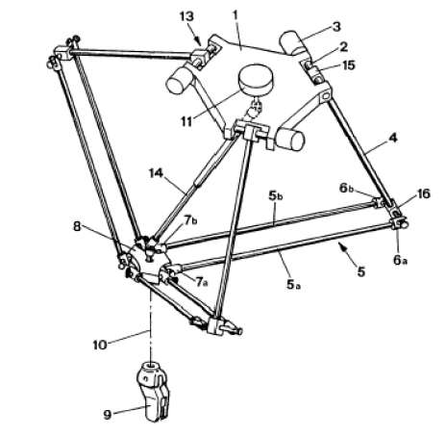
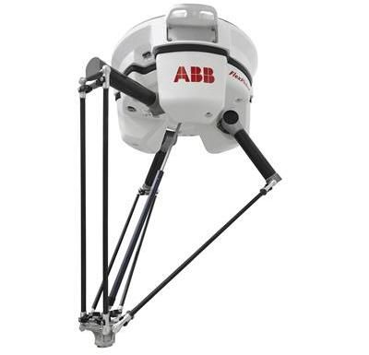
Delta robot source: The Delta Parallel Robot: Kinematics Solutions, Robert L. Williams II, Ph.D.
The top revolute joints are actuated via base-fixed rotational actuators.

Slide 8
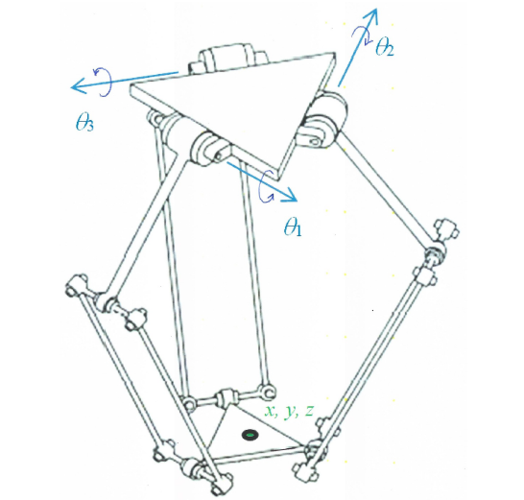
Structure
control variables are
$θ_{i}$, i =1,2,3 about the axes shown.
The universal (U) joints are implemented using
three non-collocated revolute (R) joints (two parallel and one perpendicular, six places)
The three-dof Delta Robot is capable of XYZ translational control of its moving platform within
its workspace.

Slide 9
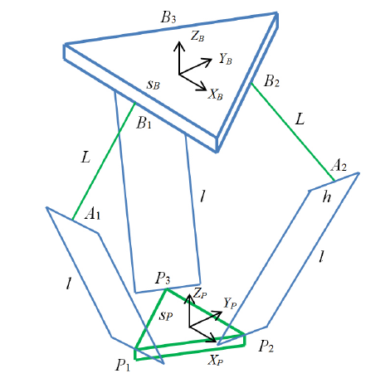
Points B_i are the hips, points A_i are the knees, and points P_i are the ankles.
The side length of the base equilateral triangle is sB and the side length of the moving platform equilateral triangle is sP.
The fixed base Cartesian reference frame is {B}
The moving platform Cartesian reference frame is {P}
The orientation of {P} is always identical to the orientation of {B} so rotation matrix $R_{P}^{B}=I$
The joint variables are $θ_{i}$, Cartesian variables are x y z

Slide 10
Dof
If we consider all the constraints
N=6x(membri-1)-5xcoppie=
=6x(17-1)-5x21=-9 !!!!!!!
The robot is overconstrained.
If we remove one of the long parallel four-bar mechanism links, along with two revolute joints each the kinematic doesn’t change
N=6x(membri-1)-5xcoppie=
=6x(14-1)-5x15=3

Slide 11
Kinematics
Kinematic chain
Kinematic chain
Constraints on the leg lengths
End-effector coordinates
Function of the joint variables
Geometric parameters

Slide 12
Inverse kinematics problem
The inverse position kinematics (IPK) problem is: Given the Cartesian position of the moving platform control point (the origin of {P=x,y,z}), calculate the revolute joint angles .
The IPK solution for parallel robots is often straightforward but the IPK solution for the Delta Robot is not trivial, but can be found analytically.
The IPK problem can be solved independently for each of the three RUU legs.
Geometrically, each leg IPK solution is the intersection between a known circle (radius L, centered on B_i) and a known sphere (radius l, centered on the moving platform vertex P_i)

Slide 13
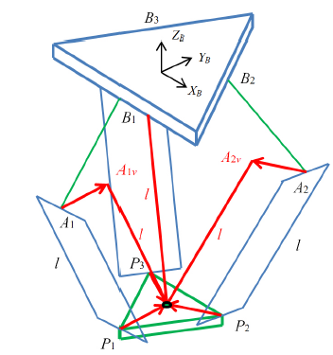
Forward Position Kinematics (FPK) Solution
The 3-dof Delta Robot forward position kinematics (FPK) problem is stated: Given the three actuated joint angles, calculate the resulting Cartesian position of the moving platform
x,y,z.
The FPK solution for parallel robots is generally very difficult.
Thanks to the translation-only motion of the 3-dof Delta Robot, there is a straightforward
analytical solution. Since $θ_{i}$ are given, we calculate the three absolute vector knee points using
Then we define three virtual sphere centers
Therefore, the FPK unknown point x,y,z is the intersection of the three known spheres centered in A_iv

Slide 14
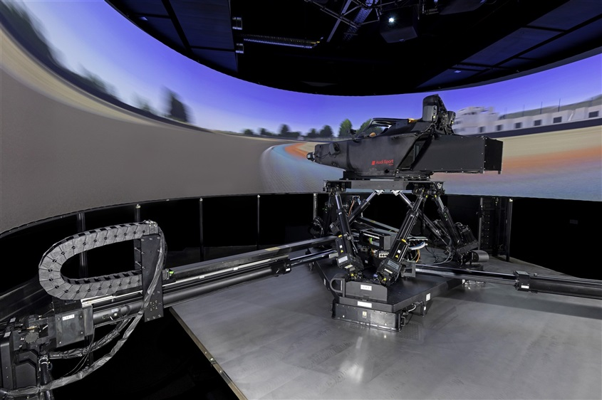
Combination of parallel robots
https://www.youtube.com/watch?v=mlfn6EpGA40
VI-Grade

Slide 15
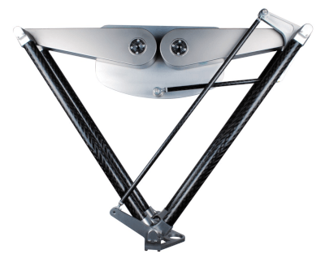
Exercise in matlab: Forward kinematics of a 2DoF parallel robot use Newton-Raphson
Omron
X-Delta 2+1

