Slide 1
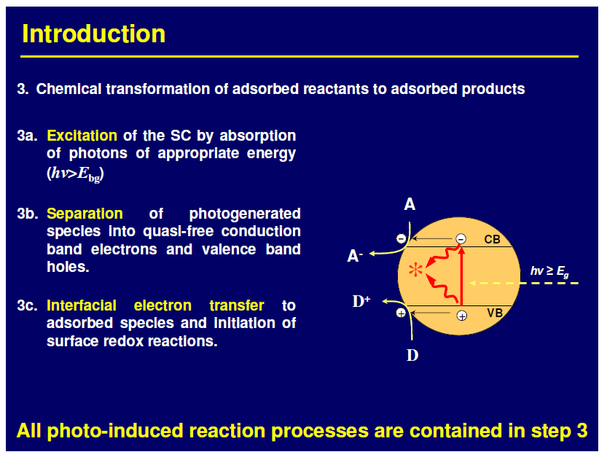

Slide 2
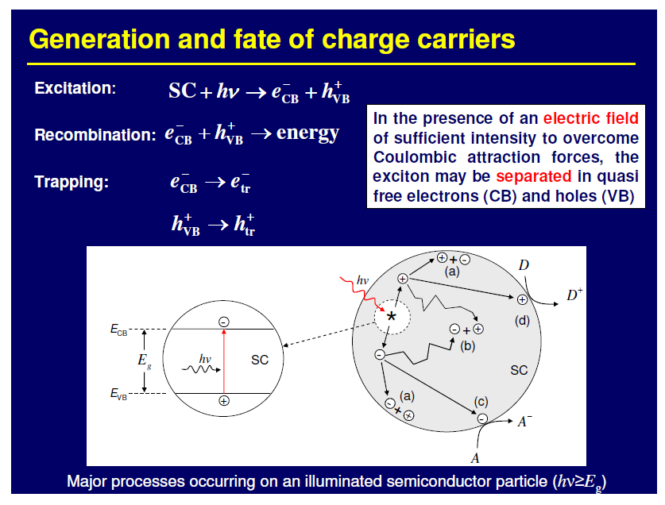

Slide 3
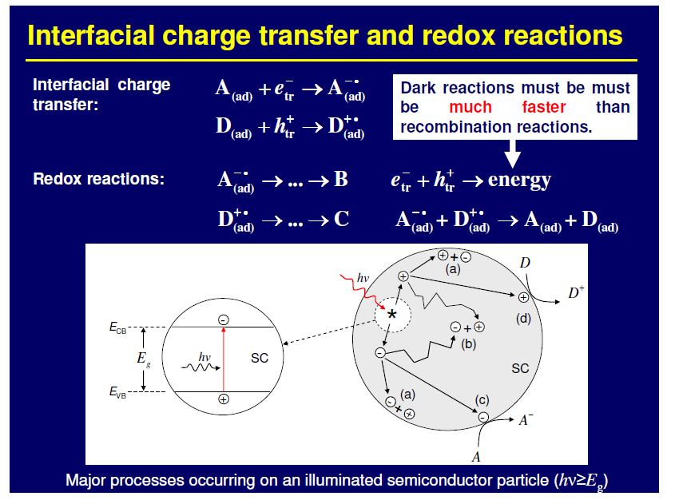

Slide 4
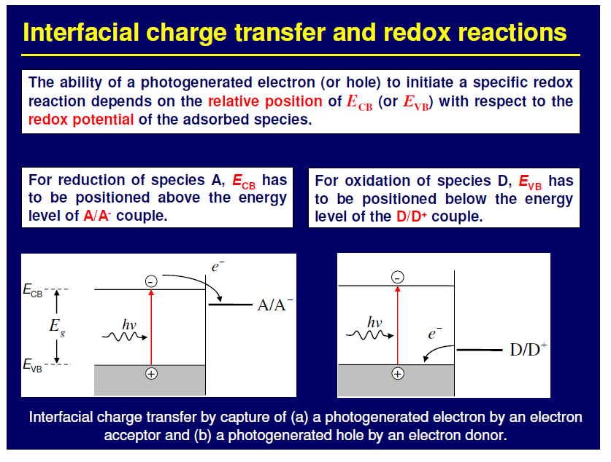

Slide 5
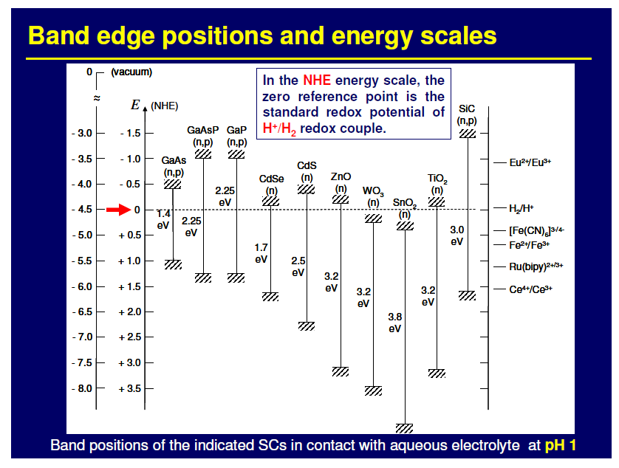

Slide 6
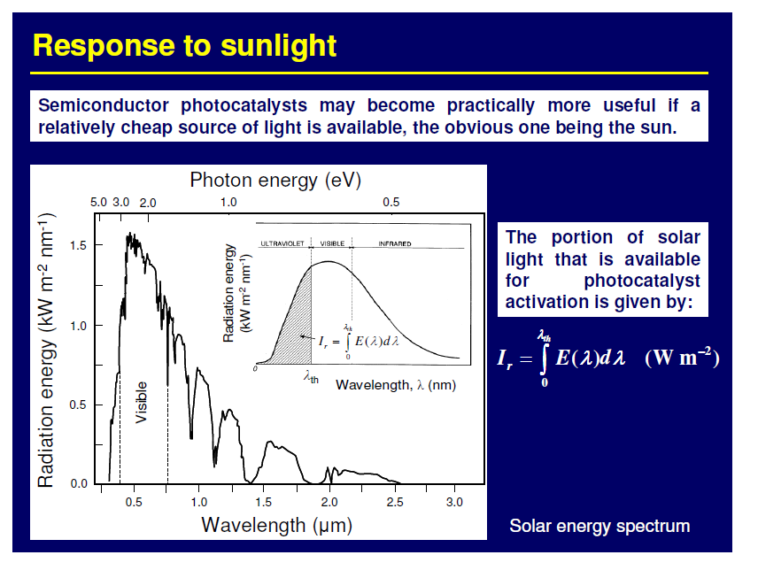

Slide 7
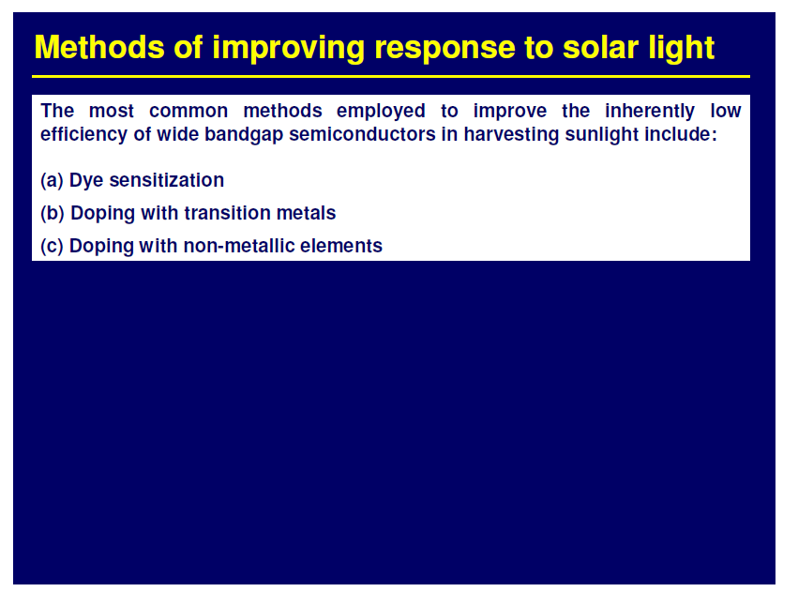

Slide 8
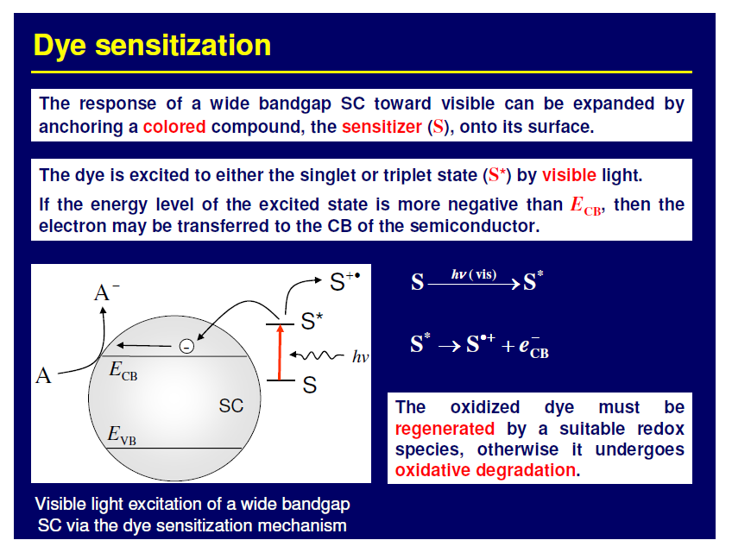

Slide 9
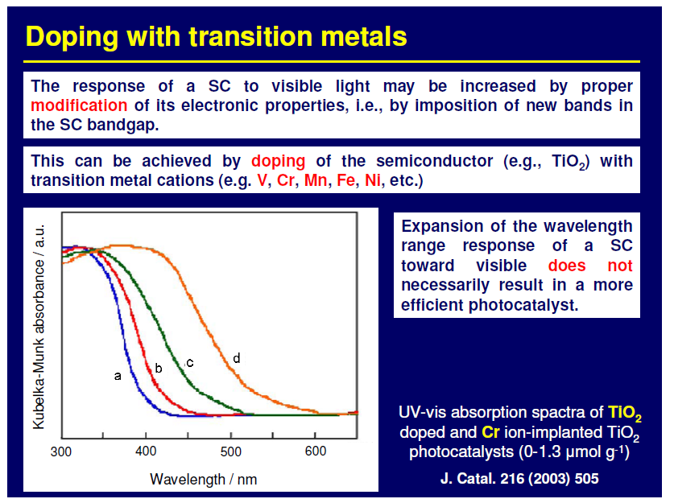

Slide 10
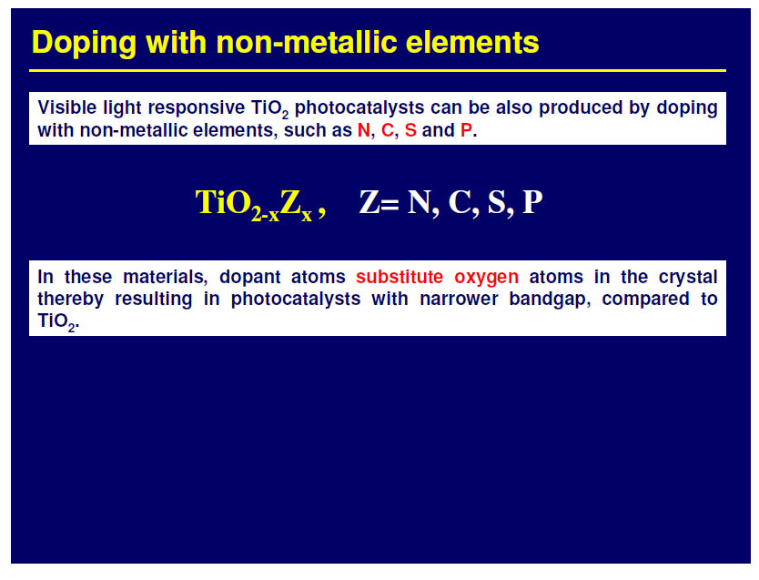

Slide 11
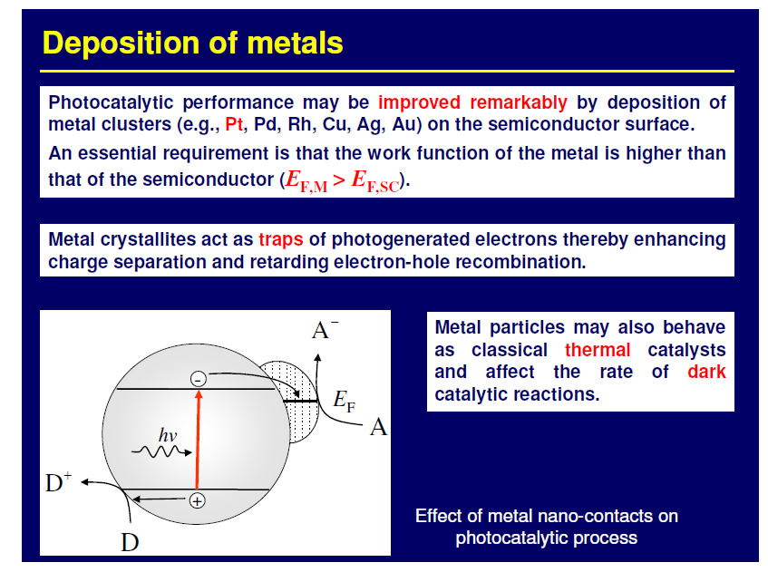

Slide 12
Position of the redox potentials of various metallic couples related to the energy levels of the conduction and valence bands of TiO₂ Degussa P25 at pH=0

Slide 13
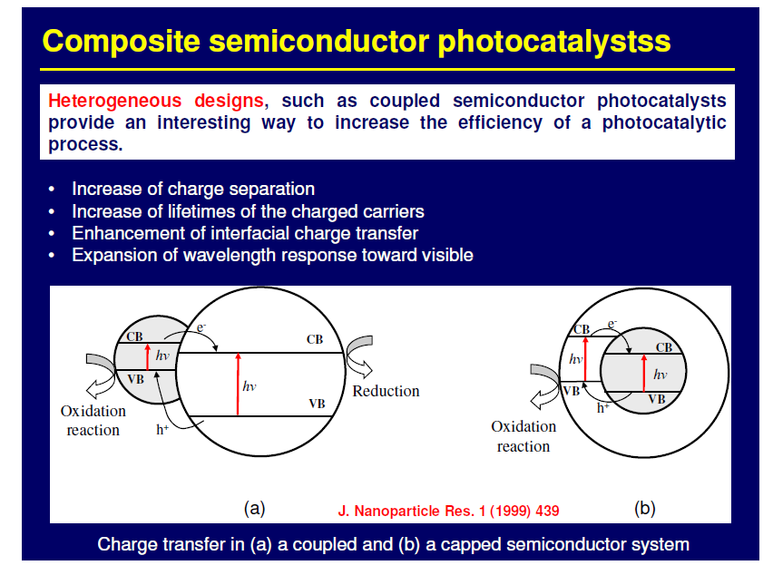

Slide 14
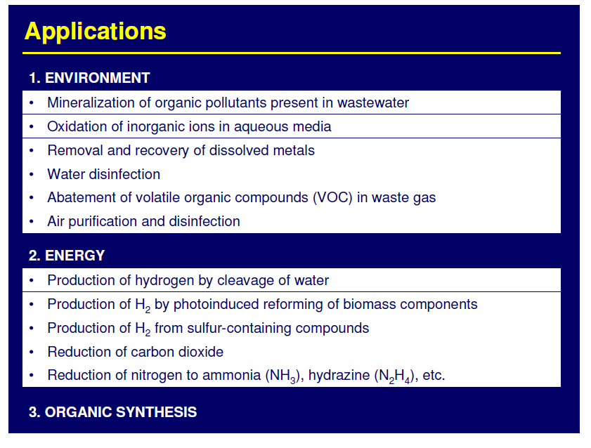

Slide 15
Mineralization of organic pollutants
semiconductor
Organic pollutant + O₂
CO₂ + H₂O + minerals
hν> E_{bg}
The reaction is non-selective and pratically all organic pollutants can be degraded under selected conditions

Slide 16
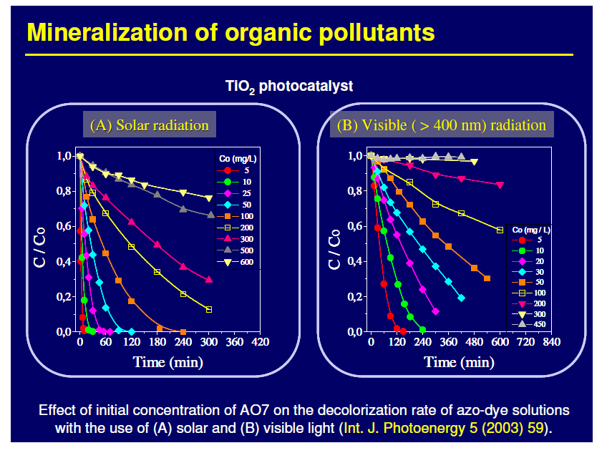

Slide 17
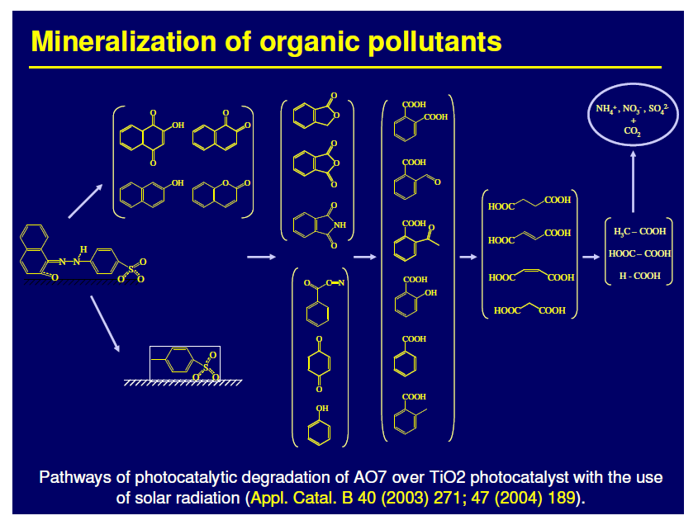

Slide 18
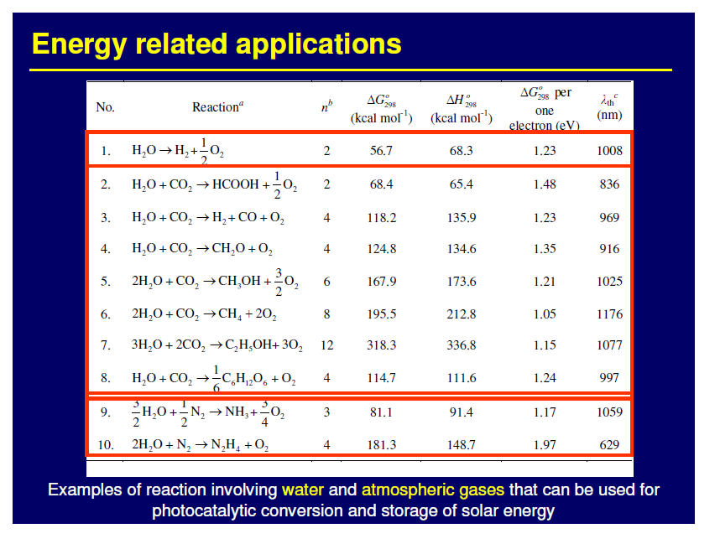

Slide 19
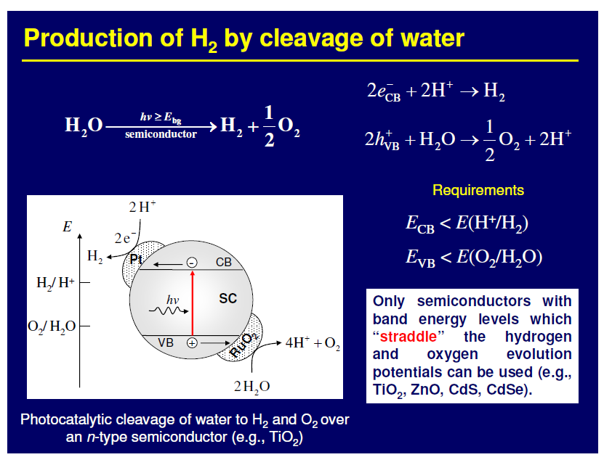

Slide 20
Band-gap energies and relative band position of different semiconductors relative to the water oxidation/reduction potential (vs. NHE)
-2.0
ZrO₂
ZnS
SiC
KTaO₃
SrTiO₃
CdS
GaP
-1.0
TiO₂
CdSe
Si
0
MoS₂
WO₃
Fe₂O₃
H⁺/H₂
1.0
V vs NHE (pH=0)
O₂/H₂O
2.0
3.0
4.0
5.0
3.4
3.2
3.0
3.6
2.4
1.7
2.25
3.0
1.1
1.75
2.8
2.3 eV

Slide 21
Metal / TiO₂
TiO₂
Metal
+ ½ O₂
e⁻
H₂
H₂O
Conduction Band
cat
2H⁺
hν
h⁺
Valence band
H₂O
2H⁺+½O₂
Thechnological solution: separation of red and Ox reactions
Chemical solution: use of sacrifical agents
Inorganic compounds: S²⁻/SO₃²⁻, Ce⁴⁺/Ce³⁺, IO₃⁻/I⁻
Organic compounds: EDTA, methanol, ethanol, glycerol, etc.

Slide 22
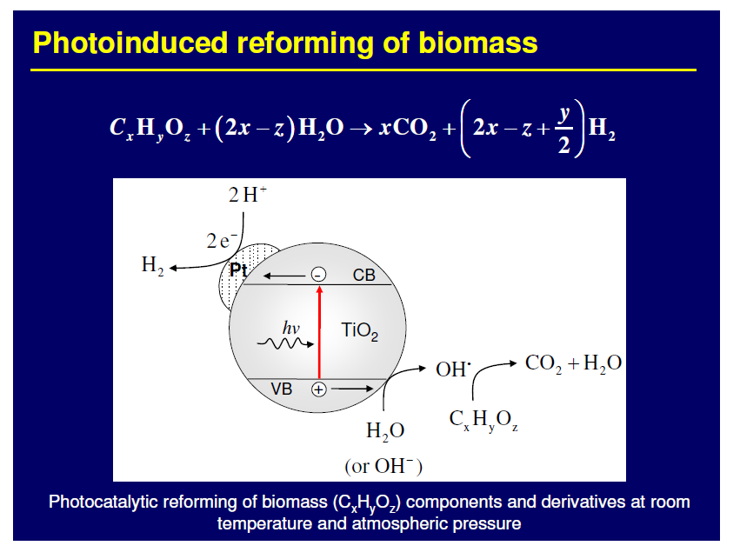

Slide 23
Pt/TiO₂ photocatalysts were prepared through photodeposition procedure

Slide 24
675 μmol h⁻¹ g⁻¹
Cu/TiO₂ photocatalysts were prepared through wet impregnation procedure

Slide 25
Pt/TiO₂ photocatalyst was prepared through impregnation procedure
Unknown amount of Pt deposited on TiO₂ films
Max H₂ production in EtOH/water:
Approx. 11000 μmol h⁻¹ g⁻¹

Slide 26
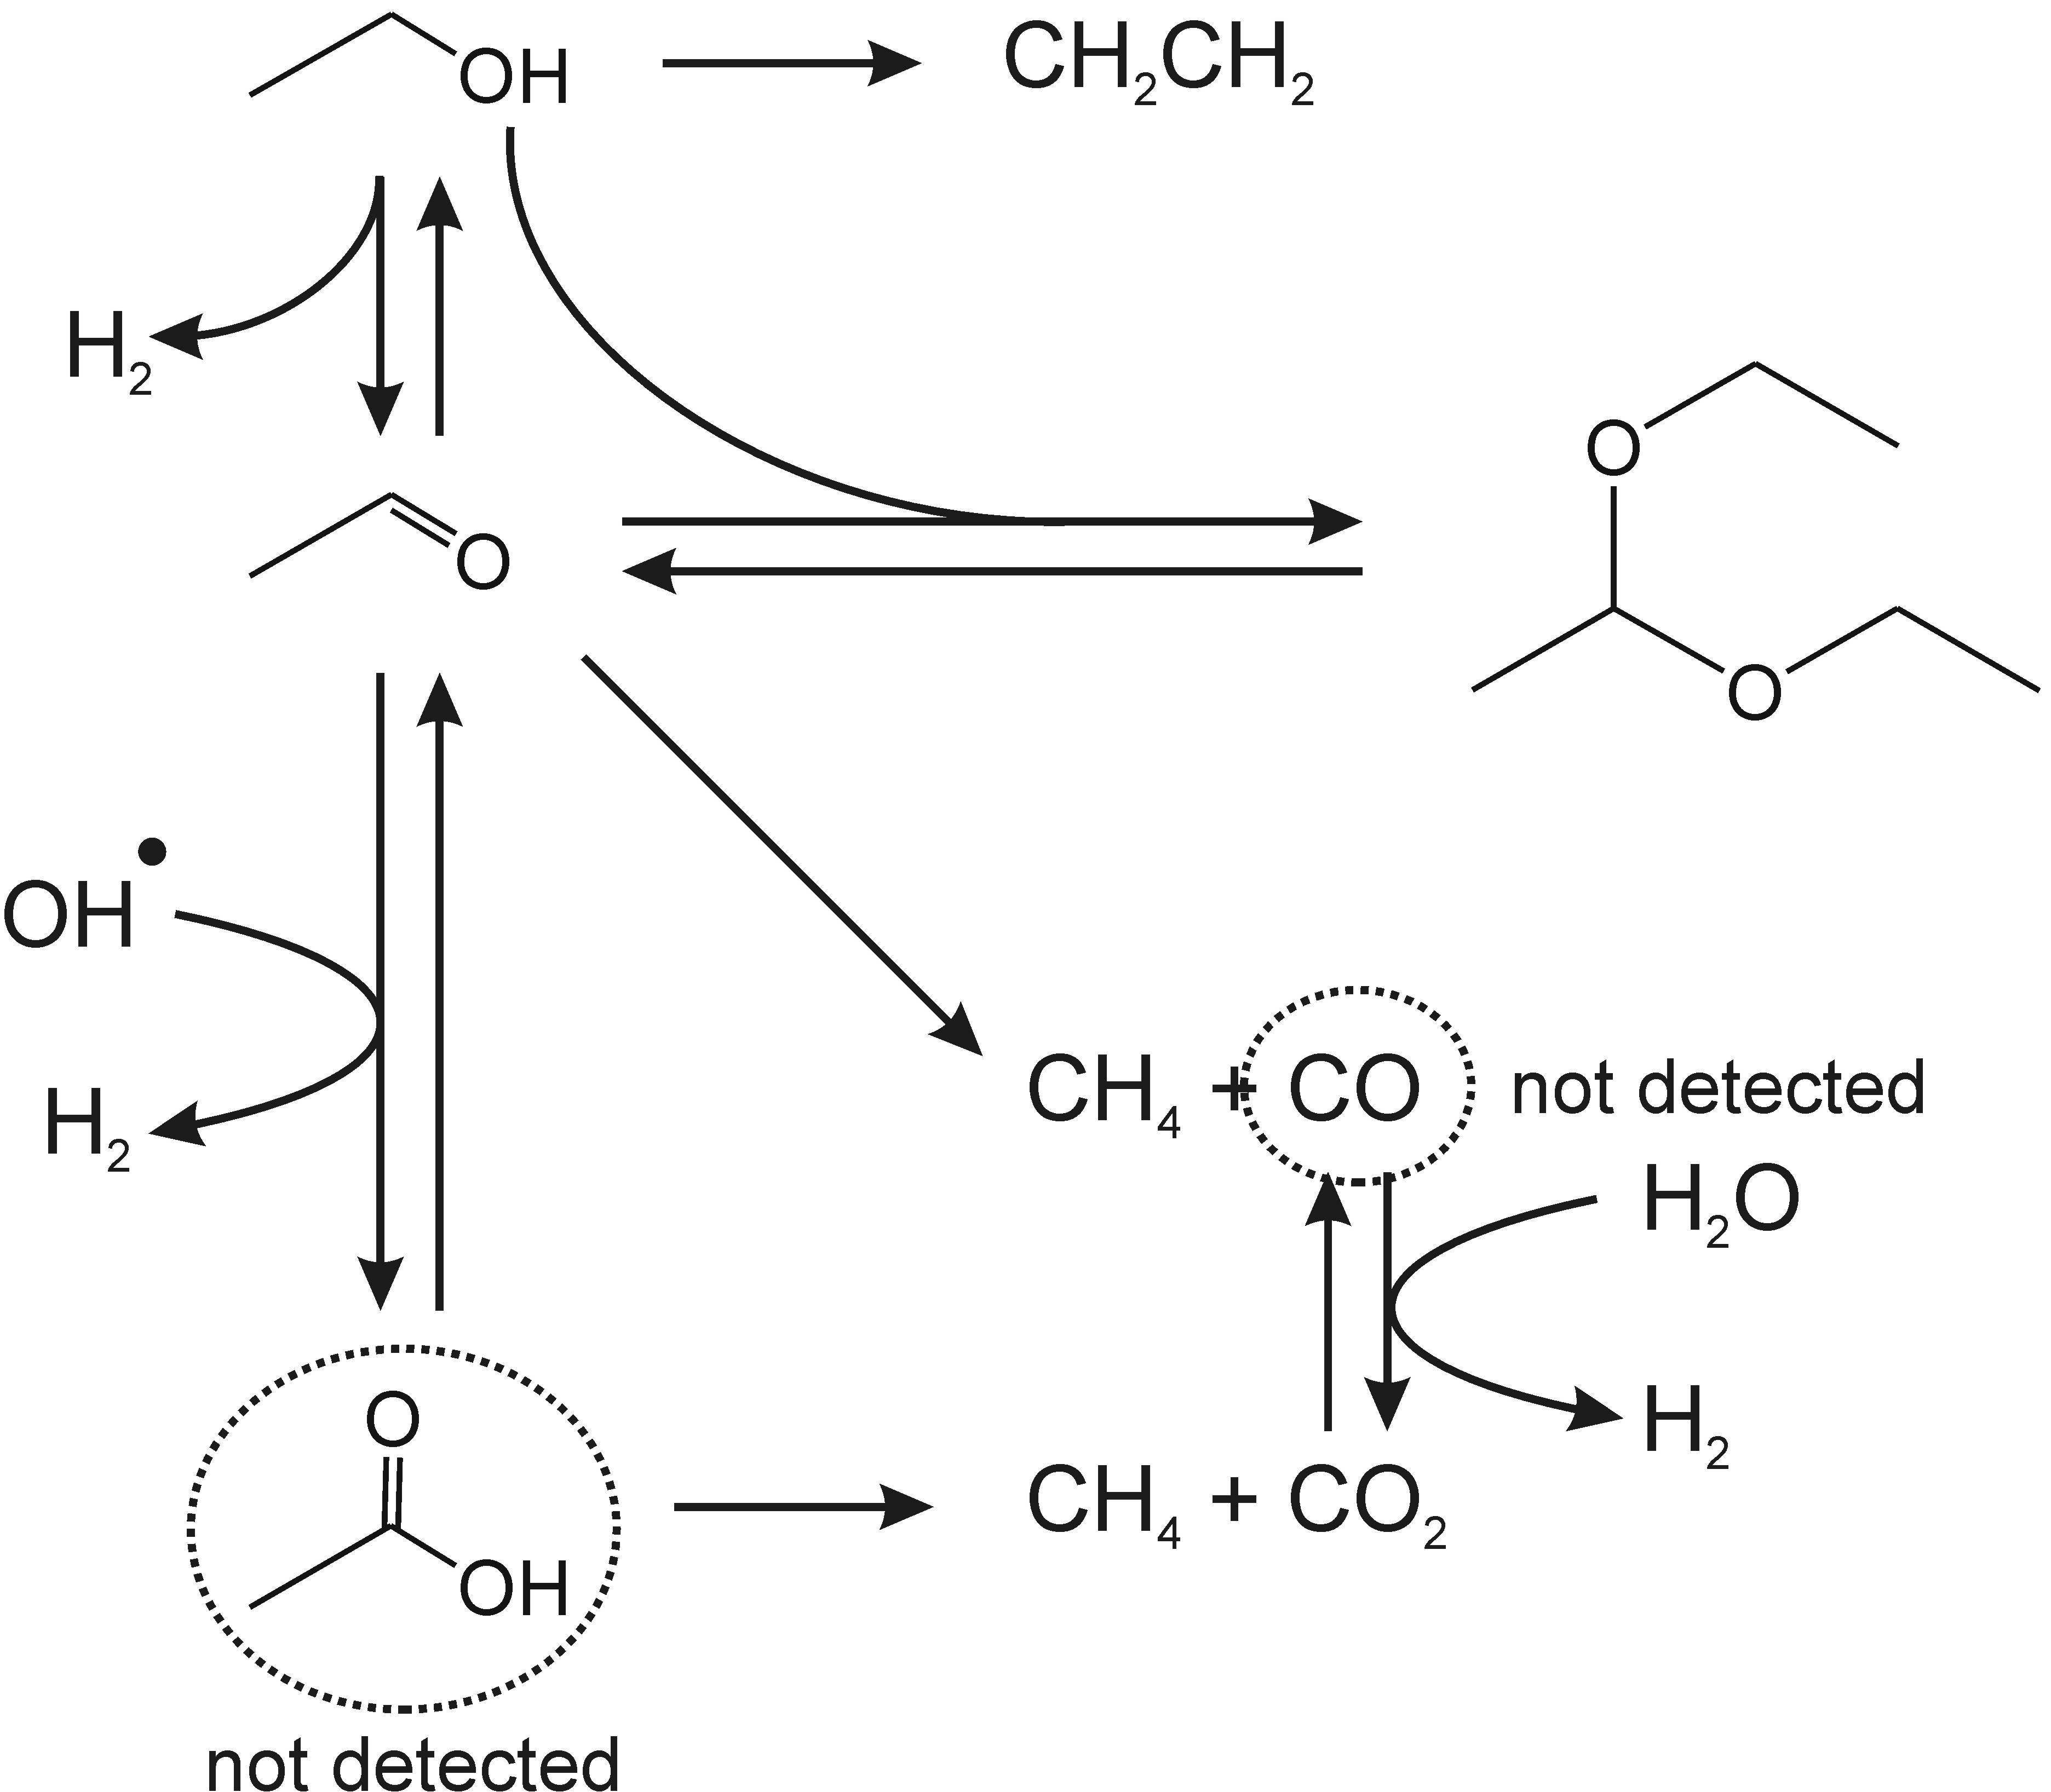
H₂ production from ethanol
Possible pathway
Accumulated
in solution
ChemCatChem 3 (2011), 574-577

Slide 27
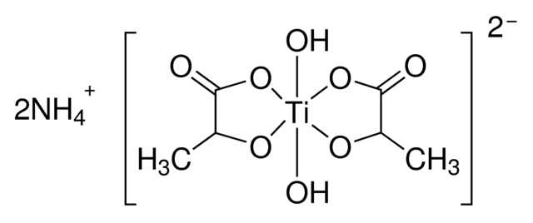
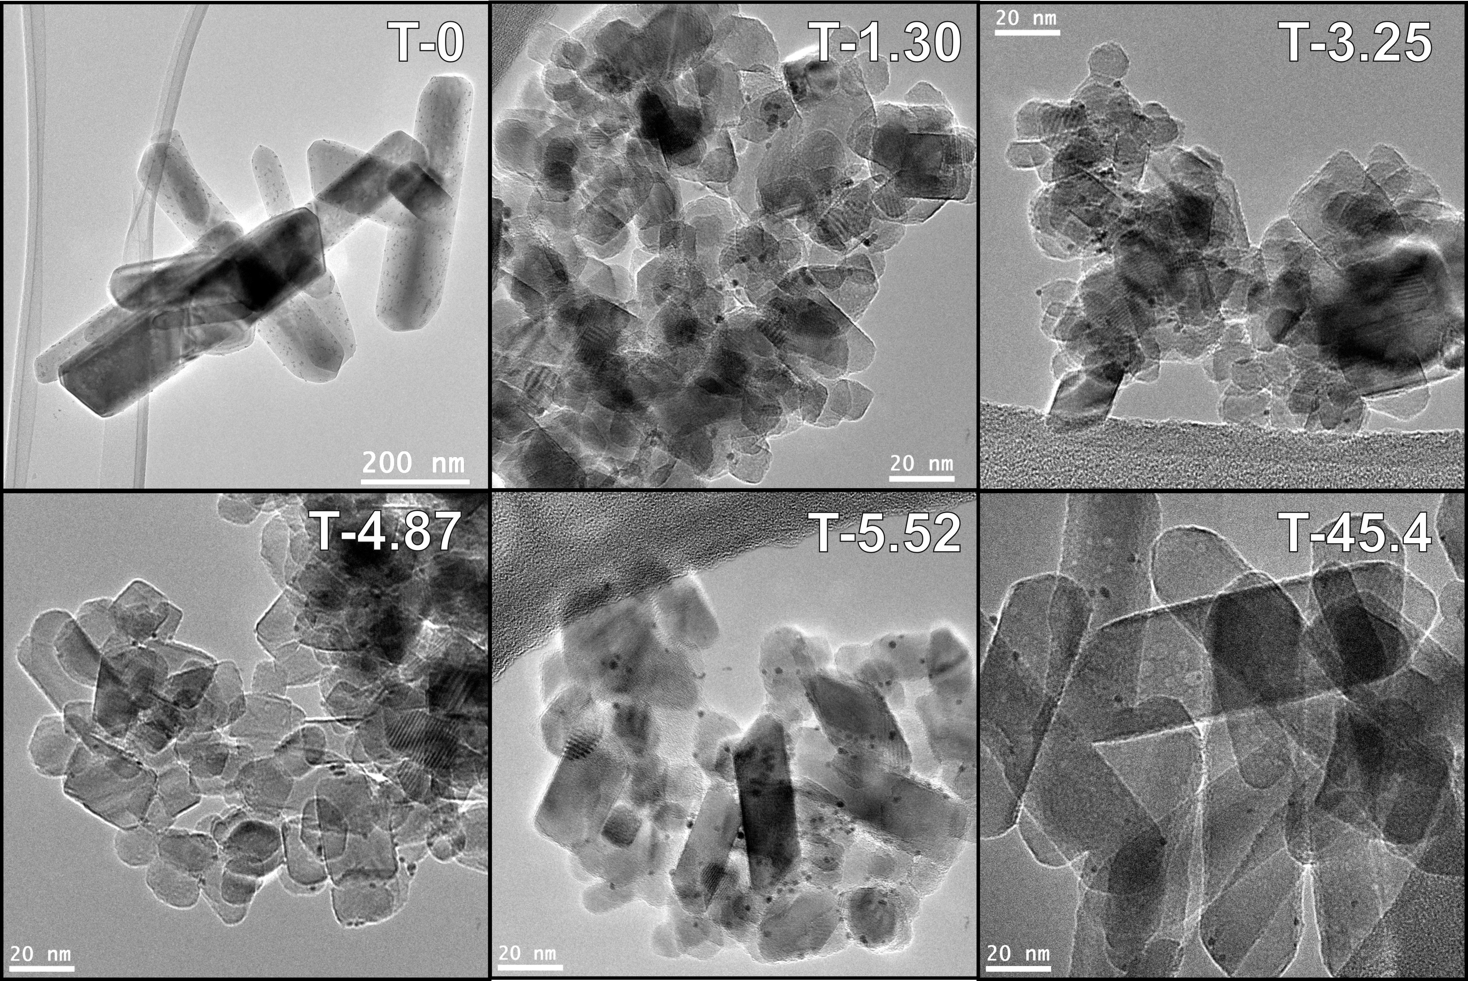
TUNING TiO₂ COMPOSITION
+ Urea
TiO₂
160°C x 24h
R + A
Rutile
Anatase
A + B
A + B
Brookite
Appl. Catal. A-Gen. 518 (2016), 167-175

Slide 28
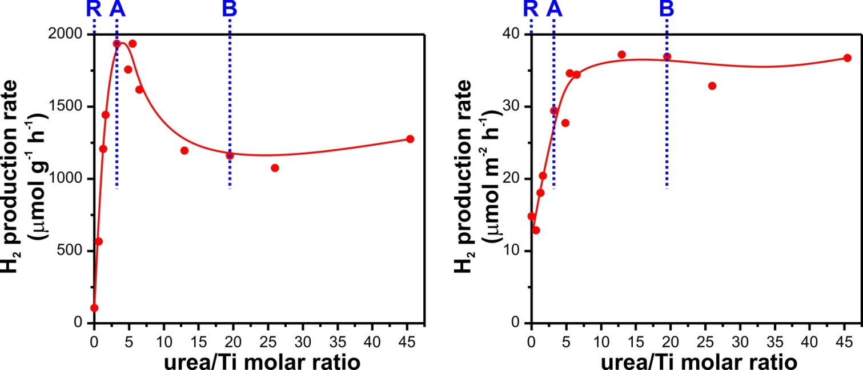
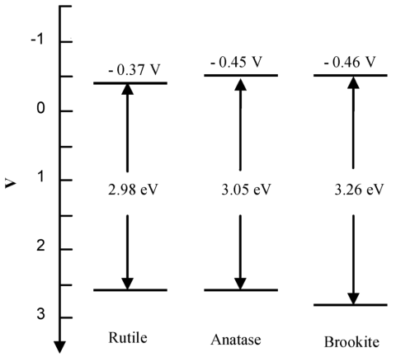
TUNING TiO₂ COMPOSITION
Ethanol/water solution
Simulated sunlight
Per mass
Per surface area
Pt 0.2 wt% added as co-catalysts
Brookite:
Favorable electronic properties
Well defined morphology and exposed facets
Appl. Catal. A-Gen. 518 (2016), 167-175

Slide 29
Pt/TiO₂ photocatalysts were prepared through wet impregnation procedure

Slide 30
H₂ production from glycerol
Possible pathway
Accumulated
in solution
ChemCatChem 3 (2011), 574-577

Slide 31
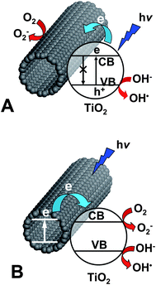
TiO₂/CARBON NANOMATERIALS
Formation of hybrid materials
CNTs as electron sink
CNTs as sensitizer
W.-D. Zhang, B. Xu, L.-C. Jiang, J. Mater. Chem. 20 (2010), 6383.

Slide 32
Pd@TiO₂/CARBON NANOTUBES
After calcination
20 nm
Porous Pd@TiO₂ shell around CNT
Anatase phase
EF-TEM
500 nm
Green Chem. doi: 10.1039/C6GC01979J

Slide 33
Pd@TiO₂/CARBON NANOTUBES
Ethanol/water solution
H₂ production under
UV-vis irradiation
Glycerol/water solution
Green Chem. doi: 10.1039/C6GC01979J

Slide 34
Photocatalytic oxidation of naphtalene in aqueous and organic solvents

Slide 35
Selective oxidation of alcohols in gas phase using light activated TiO₂
J. Catal. 2002, 211, 434-444

Slide 36
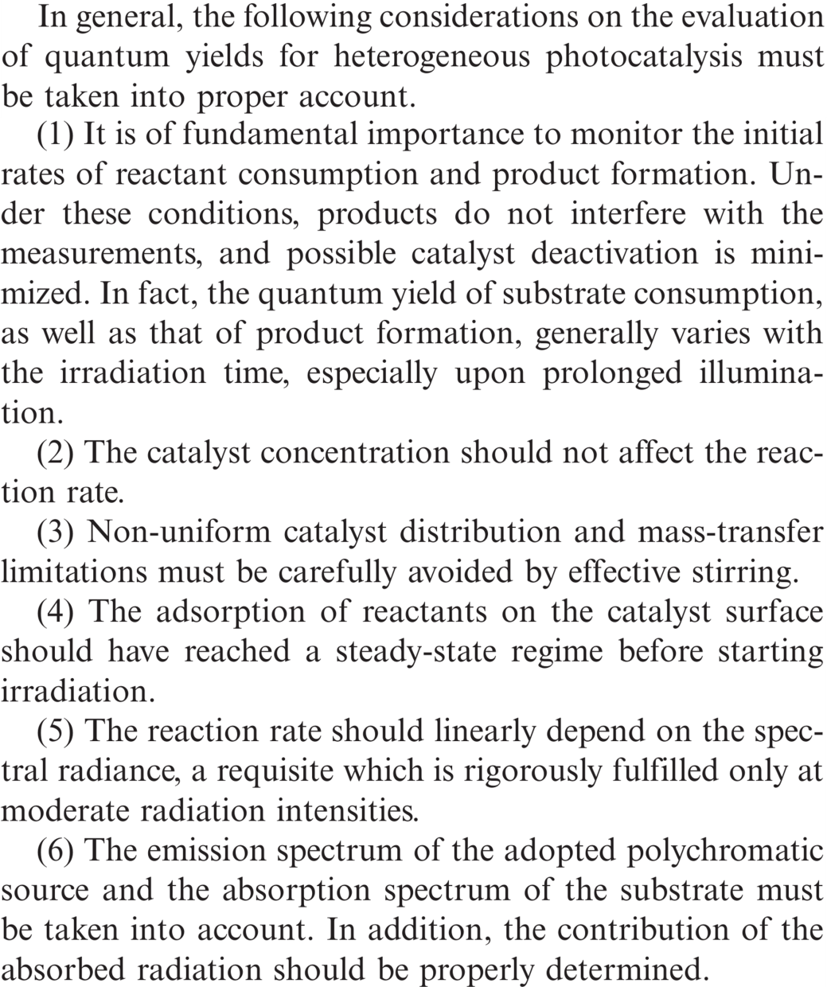
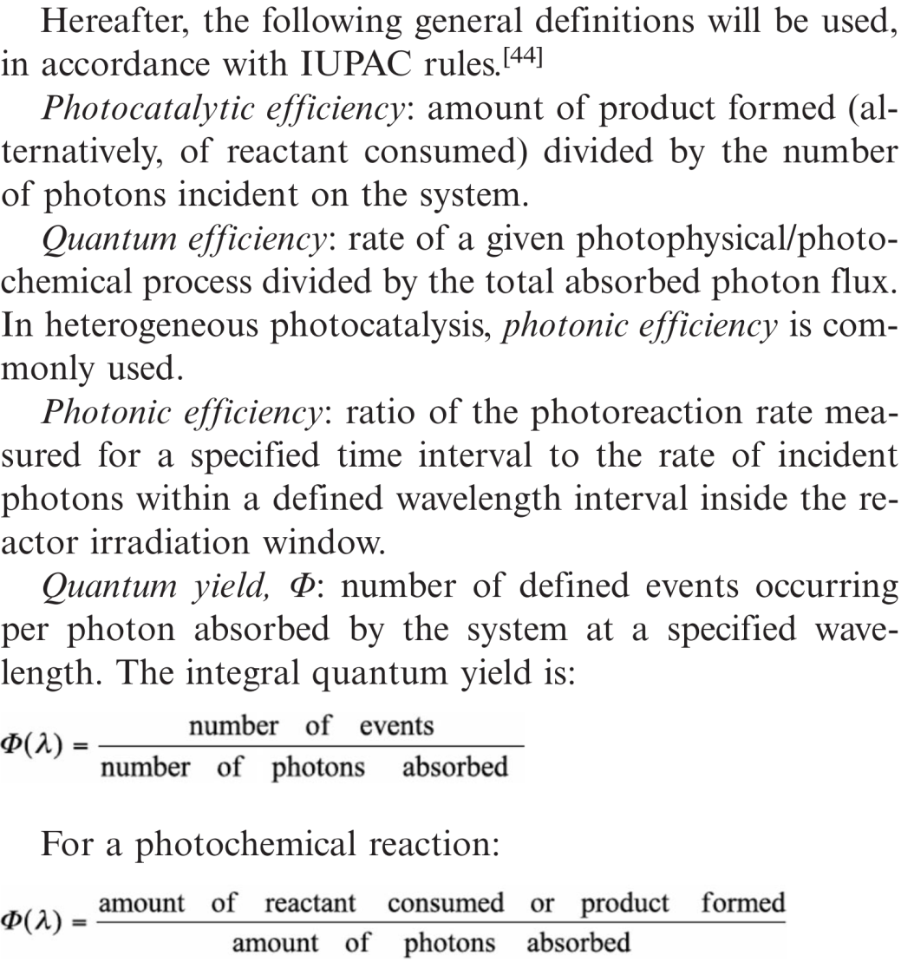
QUANTUM YIELD
Eur. J. Inorg. Chem. 2011, 4309–4323

Slide 37
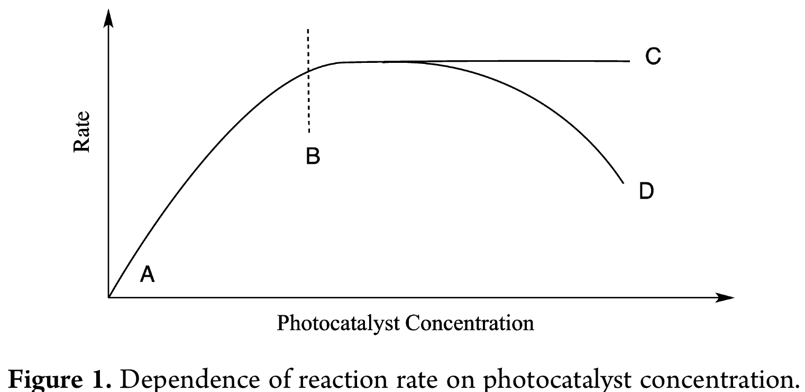
BEST PRACTICE IN PHOTOCATALYSIS
OPTIMAL
Limited by light absorption
Limited by mass transfer and/or light scattering
J. Phys. Chem. Lett. 2015, 6, 1907−1910

