Slide 1
Lecture 4
Nutrition for the ageing brain

Slide 2
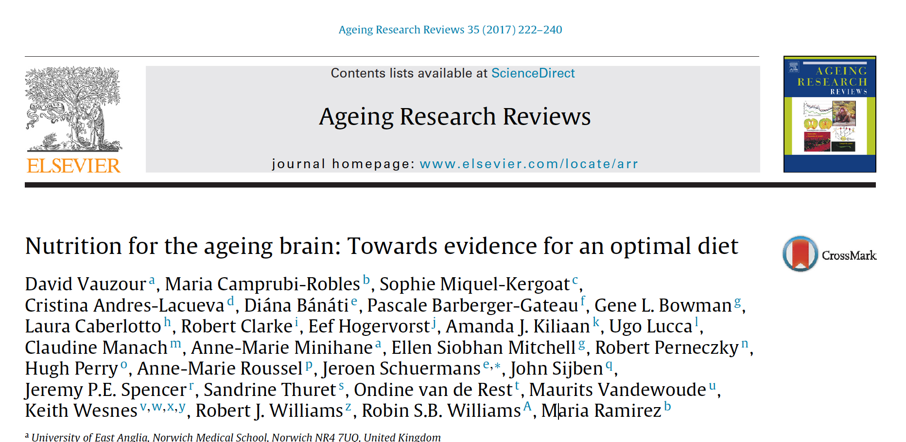

Slide 3
Decline in cognitive function
NORMAL
Starts in healthy subjects the late 20s
Continues throughout adult lifetime
quantitatively important (up to 2 standard deviations)
no drug is effective
R&D on new drugs has stopped
public opinion adverse because of suspects that pharma industry aims at selling to sell drugs to treat something which occurs in most individuals

Slide 4
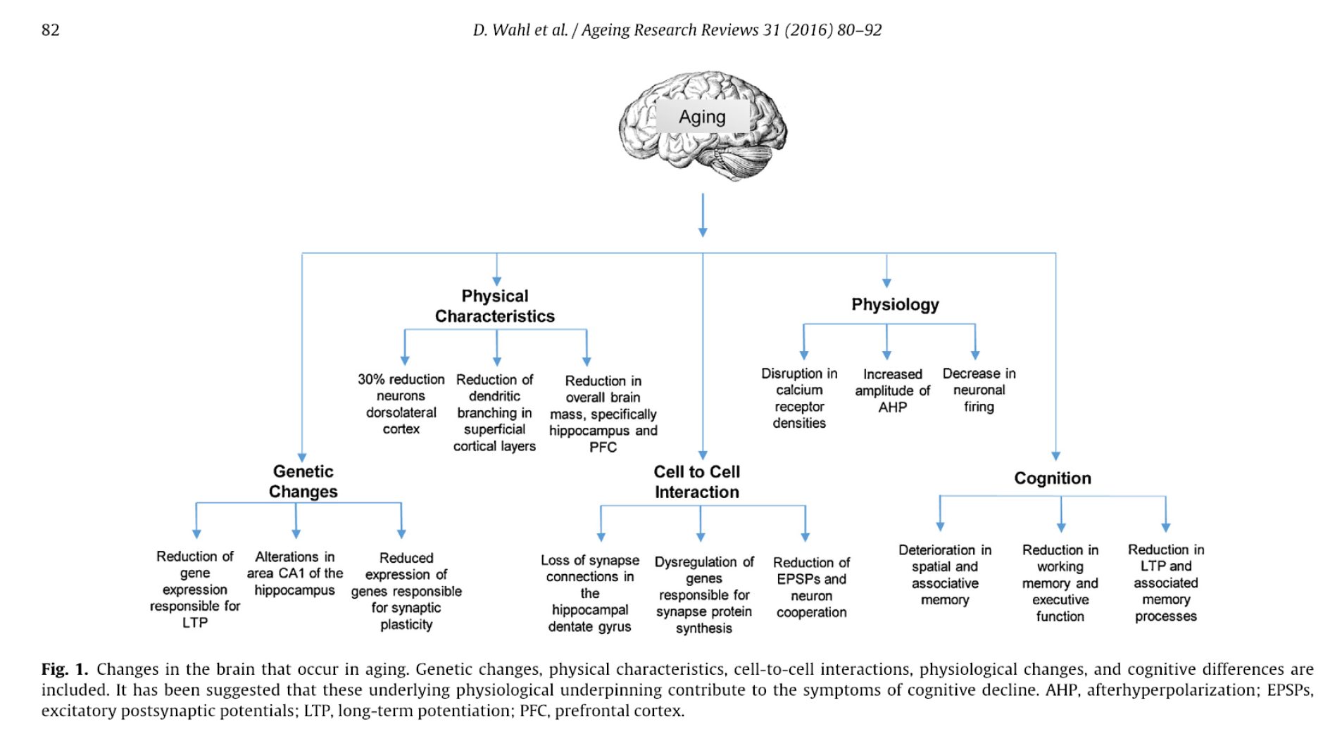
Notes:
source
see next slide

Slide 5
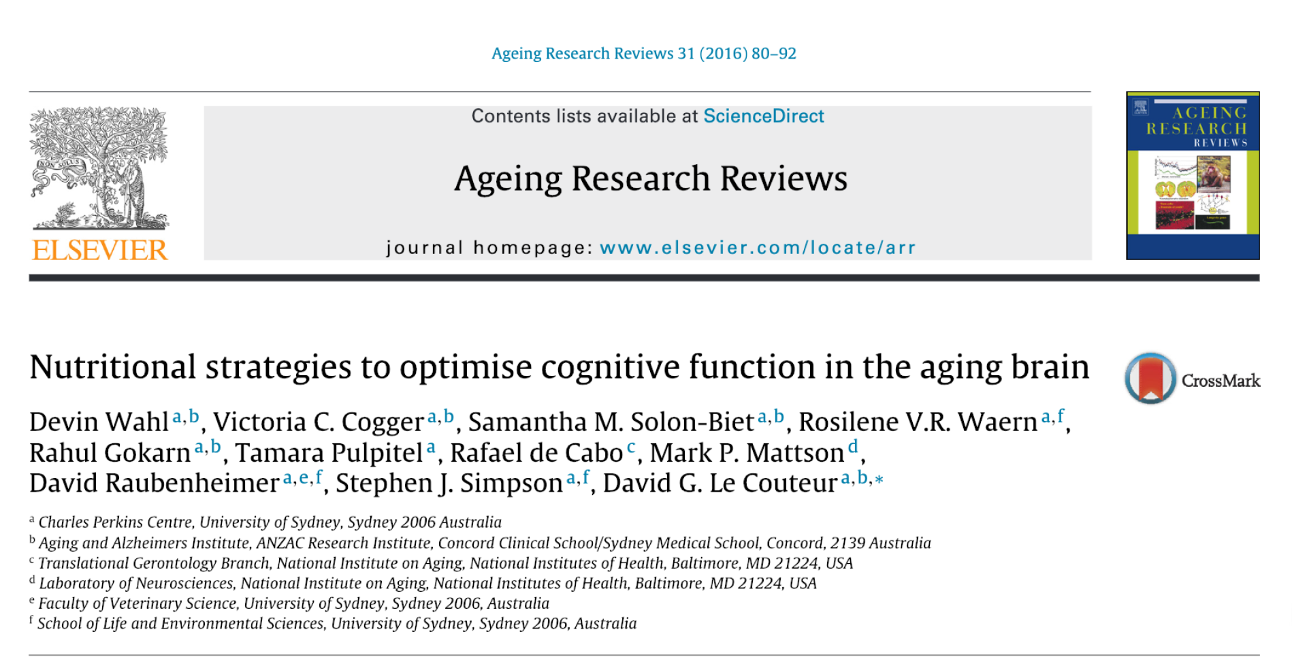

Slide 6
Decline in cognitive function Alzheimer’s Disease (AD)
Three clinical stages
Pre-clinical, asymptomatic
Declined cognitive function
Memory-based dementia and loss of autonomy

Slide 7
The AD hallmark it is an organ pathology
Tissue changes precede the onset of clinical signs by many years
Neuropathological lesions can be found in elderly individuals who presently do not have cognitive impairment and associated disability

Slide 8
Organic features of AD
It starts with:
Overproduction of the amyloid-beta precursor protein (AbetaPP)
due to rare mutations in PSEN1 or PSEN2 genes
Malfunctioning of Abeta degrading proteases
Ineffective active or passive transport mechanisms involved in clearing proteolytic fragments
CONSEQUENCES
Amiloid beta protein accumulates in the extracellular space - plaque

Slide 9
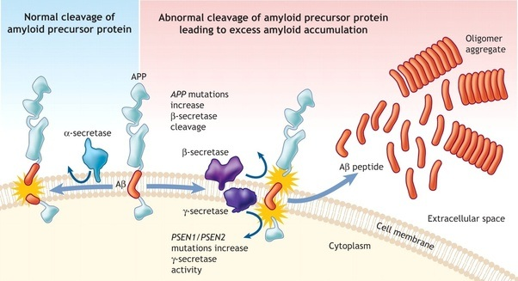
Notes:
source
http://debuglies.com/2018/02/17/amyloid-protein-transmission-through-neurosurgery/

Slide 10
Consequences of amiloid plaques
loss of synapses and neurons
impaired glucose utilisation
oxidative damage, brain metabolic reduction,
tau hyperphosphorylation and associated neurofibrillary tangle formation
neurotransmitter changes
WIDESPREAD NEURODEGENERATION

Slide 11
Early diagnosis of AD neurodegeneration
Depends on
biomarker of organ/tissue/cell damange
cerebrospinal fluid (CSF) levels of Abeta1-42
positron emission tomography (PET) tracers of fibrillar amyloid
Magnetic Resonance Imaging (MRI) and fluorodeoxyglucose PET

Slide 12
Early diagnosis of AD neurodegeneration or cognitive decline
Related to disruption of the blood-brain barrier
white matter hyperintensities (WMH)
accumulation in paraventricular and sub-cortical areas, next to the blood-brain barrier, due to demyelination
CSF/plasma ratio of blood derived albumin

Slide 13
Metabolic and molecular mechanisms contributing to brain ageing
Cardiovascular and metabolic risk factors
aortic stiffness
impaired microvascular function
Overweight
35% of European population (Eurostat 2012)
Obesity
17% of European polution (Eurostat 2012)
Type-2 diabetes mellitus

Slide 14
Risk of AD by excess body mass Study in USA
Overweight and obese individuals (aged 40–45 years) showed an odds-ratio (OR) 95% confidence interval (CI) of dementia of 1.35 (1.14–1.60) and 1.74 (1.34–2.26), respectively, relative to normal weight individuals

Slide 15
Risk of AD by Metabolic Syndrome (MetS)
Relative risk of 1.20 (1.02–1.41; 95% CI) of cognitive impairment was evident in MetS subjects as compared to healthy controls

Slide 16
Relative Risk (RR) of Dementia by Diabetes mellitus
AD
RR: 1.46, 95% confidence interval (CI): 1.20–1.77
Vascular dementia
RR: 2.48, 95% CI: 2.08–2.96
Any dementia
RR: 1.51, 95% CI: 1.31–1.74
MCI (Mild Cognitive Impairment)
RR: 1.21, 95% CI: 1.02–1.45

Slide 17
Neuropathogenic factors of diabetes and metabolic syndrome
impaired vascular function and brain perfusion
low grade inflammation, including altered adipose tissue production of adipokines
poor glucose tolerance and utilisation
loss of insulin sensitivity independent of the impact on glucose metabolism

Slide 18
AD as an “insulin resistant brain state”
Brain insulin derives from:
the pancreas (beta cells); largest fraction
dentate gyrus (hippocampus)
olfactory system
In neurons, insulin regulates:
energy metabolism
differentiation
growth
survival
synaptic plasticity
neurotransmission
hippocampal long-term potentiation (LTP)
learning and memory

Slide 19
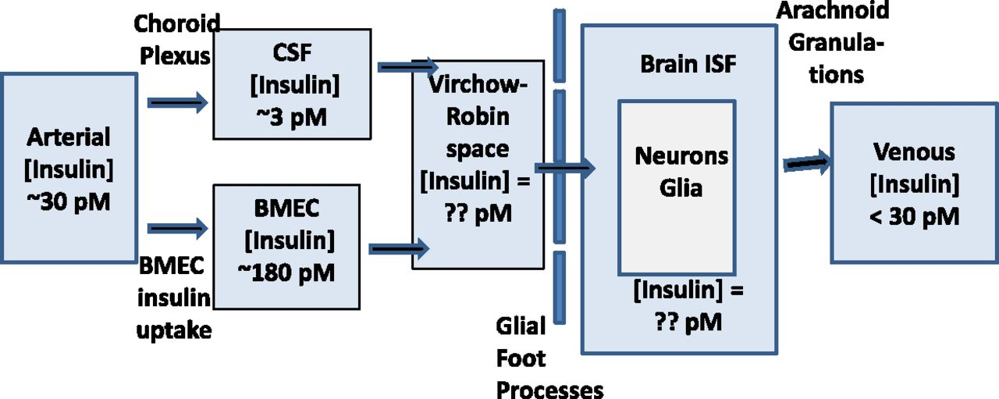
The potential pathways for insulin entry into brain ISF. The arterial and CSF insulin concentration is typical of that found in peripheral blood and in human lumbar CSF in postprandial healthy humans.
Sarah M. Gray et al. Diabetes 2014;63:3992-3997
©2014 by American Diabetes Association
Notes:
The potential pathways for insulin entry into brain ISF. The arterial and CSF insulin concentration is typical of that found in peripheral blood and in human lumbar CSF in postprandial healthy humans. The brain microvascular endothelial cell (BMEC) insulin concentration is estimated based on the observed ability of aortic endothelial cells to concentrate insulin (55).
source
Perspectives in Diabetes
Insulin Regulates Brain Function, but How Does It Get There?
Sarah M. Gray, Rick I. Meijer and Eugene J. Barrett⇑
+ Author Affiliations
Corresponding author: Eugene J. Barrett, ejb8x@virginia.edu.
Diabetes 2014 Dec; 63(12): 3992-3997.
https://doi.org/10.2337/db14-0340

Slide 20
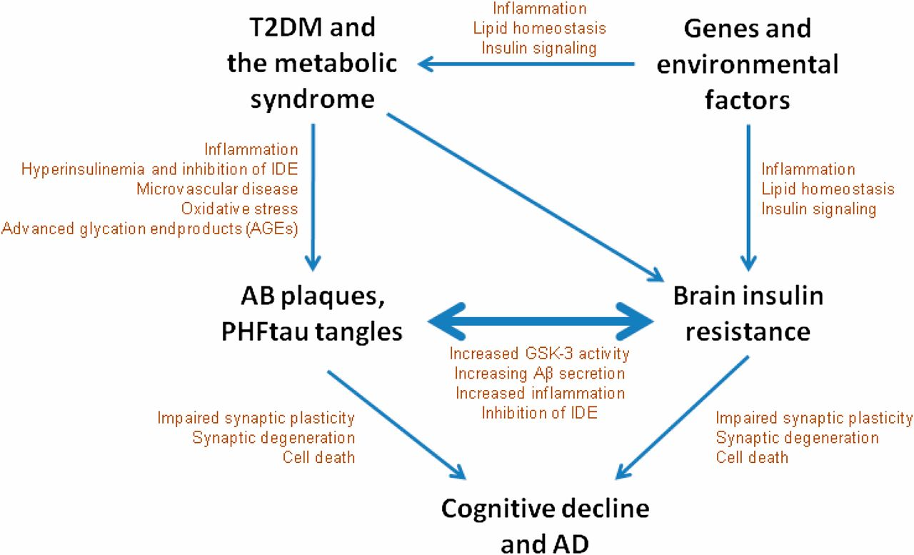
T2DM, brain insulin resistance, and AD have been linked in a number of different epidemiological, clinical, and animal studies.
Mark Yarchoan, and Steven E. Arnold Diabetes 2014;63:2253-2261
©2014 by American Diabetes Association
Notes:
T2DM, brain insulin resistance, and AD have been linked in a number of different epidemiological, clinical, and animal studies. One model for this link is displayed. Initially, genes and lifestyle promote insulin resistance in peripheral and brain tissue. Insulin resistance in peripheral tissues leads to T2DM and the metabolic syndrome, which further promotes brain insulin resistance as well as AD pathology though hyperinsulinemia, reactive oxygen species, and AGEs. AD pathology and brain insulin resistance may drive one another in a reciprocal cycle that eventually leads to synaptic loss and clinical dementia due to AD.
SOURCE
http://diabetes.diabetesjournals.org/content/63/7/2253

Slide 21
Anemia in cognitive function
Controversial role
Chronic low oxygenation of the aerobic cortical tissue
role of Hypoxia-induced factor?

Slide 22
Oxidative stress in cognitive function
Moderate oxy-radical production by the mitochondria (physiological level of oxidative stress)
up regulate the mitochondrial biogenesis program and brain antioxidant capacity, and to act in brain protection
Uncontrolled free radical production
loss of neuronal homeostasis and neurodegenerative diseases development

Slide 23
Neuroinflammation
Systemic inflammation triggers neuroinflammation
microglia activate the local innate immune response, via secretion of cytokines
Ageing, as the main risk factor for AD development, occurs with:
a chronic, low-grade systemic upregulation of the pro-inflammatory T helper type 1 response
a relative decline in the anti-inflammatory T helper type 2 response

Slide 24
Prevention of cognitive decline through nutritional and other lifestyle interventions
PROBLEM
Assessment of nutritional status
How to get QUANTITATIVE data about nutrition and lifestyle?

Slide 25
Nutritional assessment methods
anthropometric methods
Body mass index, waist circumference
clinical examination
analysis of vitamins or minerals
questionnaires
self-reporting (with intrinic limitations)
biomarkers
analytical data about molecules occurring in biofluids

Slide 26
Biomarkers types
Targeted analysis
Analysis focuses on one o few chemical entities, selected by a hypothesis-driven approach
Fast and accurate
Untargeted analysis
Metabolomic analysis scans ideally all molecules or very large sets of molecules occurring in a sample
Slow, for technical problems in annotation (identification and caracterisation of chemical entities)

Slide 27
Specific nutritional factors

Slide 28
Micronutrients
Selenium (se)
Cofactor of the enzyme glutathione peroxidase
Plasma Se negatively correlates with cognitive decline
Zinc (Zn) and Chromiun (Cr)
improve insulin sensitivity
IMPORTANT
Supplementation does not reverse cognitive decline

Slide 29
Polyphenols
Polyphenols are plant secondary metabolites
compounds synthetised by complex metabolic pathways
no role in energy metabolism (i.e. ATP synthesis)
role in plant physiology (adaptation to environment, resistance to pathogens, etc)
Polyphenols occur in plant-derived food and drinks

Slide 30
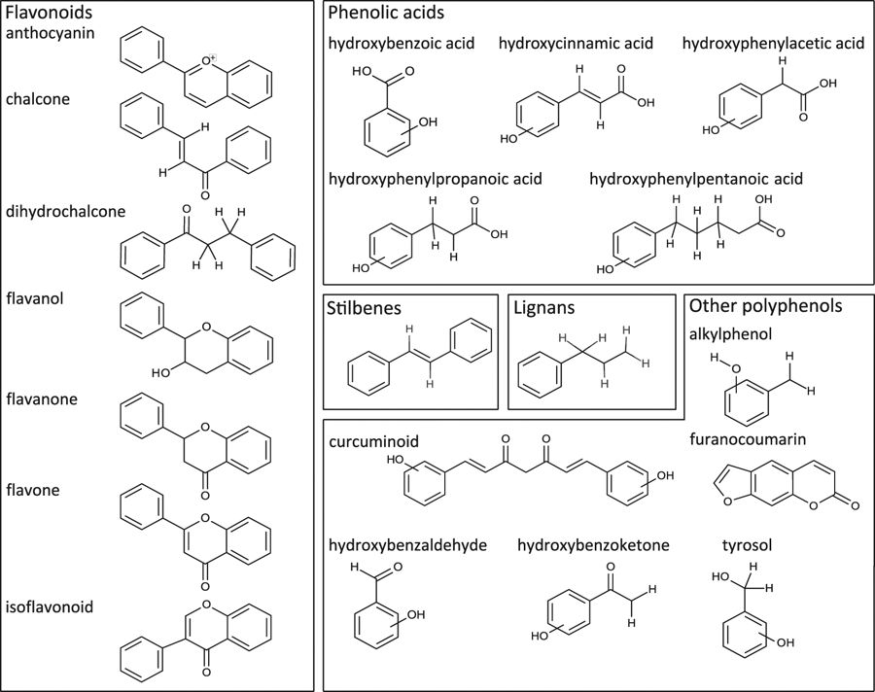
Notes:
Forty-three distinct substructures of polyphenols produce 5 classes: (i) flavonoids (9 subclasses: anthocyanins, chalcones, dihydrochalcones, dihydroflavonols and flavanone, flavone and flavonol, isoflavonoid), (ii) lignans, (iii) phenolic acids (hydroxybenzoic acids, hydroxycinnamic acids, hydroxyphenylacetic acids, hydroxyphenylpropionic acids, hydroxyphenylpentanoic acids), (iv) stilbenes, and (v) other polyphenols (alkylmethoxyphenols and hydroxyphenylpropenes and alkylphenols, curcuminoids, furanocoumarins, hydroxybenzaldehydes and hydroxycinnamaldehydes, hydroxybenzoketones, tyrosols). Some polyphenol subclasses have several scaffolds (e.g., phenolic acids) to describe ortho-, para-, and meta- substitutions, while several polyphenol subclasses (e.g., flavonols and flavones) have a single substructure. Some substructures include more than one subclass (redundancy). Non-polyphenolic metabolites (6th class) could not be queried, as not having fixed structural features.
source
https://www.nature.com/articles/s41598-018-20625-5#Fig1

Slide 31
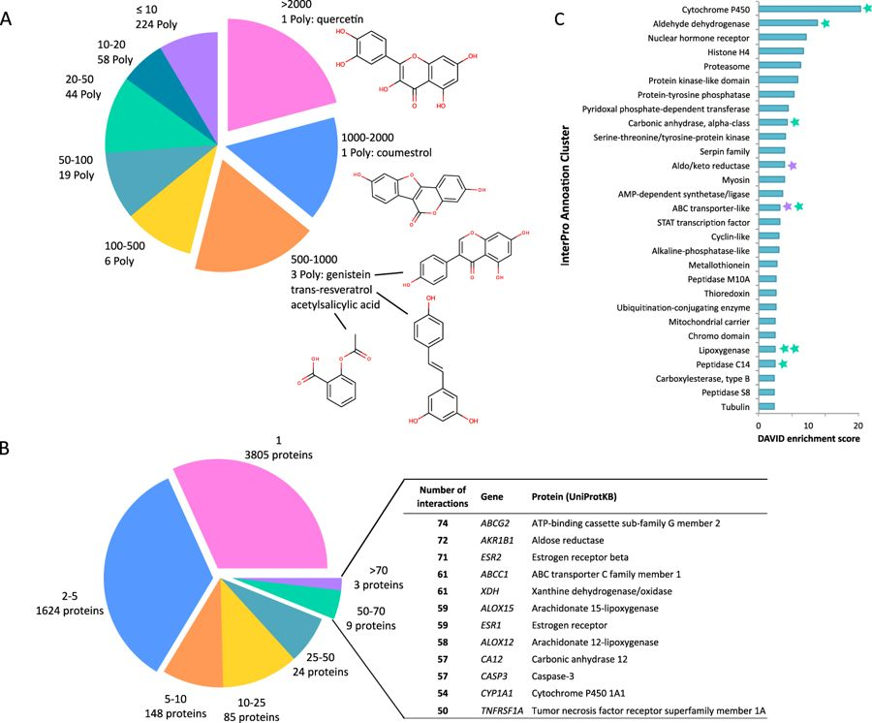
Notes:
(A) Distribution of polyphenol-protein interactions (polyphenols interacting with: >2000, 1000–2000, 500–1000, 100–500, 50–100, 20–50, 10–20, and ≤10 proteins) and associated number of polyphenols (Poly). (B) Distribution of polyphenol-protein interactions (proteins interacting with: >70, 50–70, 25–50, 10–25, 5–10, 2–5, and 1 polyphenols) and associated number of proteins. Proteins interacting with >50 polyphenols: gene name, corresponding protein name (according to UniProtKB) are noted. (C) DAVID annotation clustering of polyphenol interacting proteins with enrichment score >3, using InterPro classification. Proteins with >70 (violet) and 50–70 (green) interactions belonging to InterPro annotation clusters are indicated.
source
https://www.nature.com/articles/s41598-018-20625-5#Fig1

Slide 32
Polyphenols and health
A diet rich in polyphenols (>600 mg/d) reduced the risk of:
all-cause mortality
by 30%
cognitive decline in global cognitive function (using the minimental state examination)
by 47%
attention decline (using the Trail Making Test A)
by 48%

Slide 33
Polyphenols actions The case of flavonoids, a sub-class of polyphenols
Antioxidants
PROBLEM: they do not attain significant concentrations in biofluids and tissues (esp. the brain!). Other mechanisms are in action.
Recruit of anti-apoptotic signalling pathways
Increase antioxidant gene expression
Reduce AMPK-autopathology

Slide 34
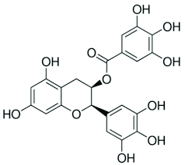
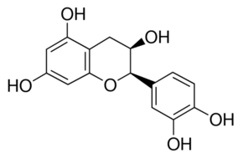
Effects of the flavanols (-)-epicatechin (EC) and epigallocatechin

Slide 35
Effects of the flavanols (-)-epicatechin (EC) and epigallocatechin
IN RODENT NEURONS
reduced beta/gamma-secretase activity and beta-Amiloid production
at nanomolar concentrations
IN VIVO MICE (APP-PS1 mutant)
reductions in beta-Amiloid pathology
following oral administration of EC

Slide 36
(-)-epicatechin (EC) from diet to brain
EC is readily absorbed and circulates primarily as glucuronidated, sulfated, and O-methylated forms in human plasma,
it is actively excreted
it cannot be trasported through the blood-brain barrier
the observed bioactivity is most likely to reside in an EC metabolite.
hypothesis: dietary EC acts as a “prodrug”

Slide 37
Other molecular effects of flavonoids
in particular flavanols and anthocyanins
Activation of e-NOS (endothelial nitric oxide synthase)
Increase of NO in the endothelium
Diffusion of NO to the muscular layer of vessels
Activation of NO-signalling in smooth muscle cells
Vasodilation
increase in blood flow
increase in gas exchange (oxygen and carbon dioxide)
Support of CEREBRO-VASCULAR COUPLING
The vascular response associated with cognitive performance
The vascular effects of lavonoids are ACUTE AND TRANSIENT, but they may underpin long-term effects on cognitive function

Slide 38
Vitamins
Vitamin D
Vitamin E
Vitamin B6
Vitamin B12
Poor evidence of effects

Slide 39
Omega-3 Polyunsaturated Fatty Acids Omega 3 PUFA
Omega 3 PUFA provide some beneficial effects (contradicting results in randomised clinical trials)
Effect on the plasma membrane and inflammation
precursors of inflammation mediators

Slide 40
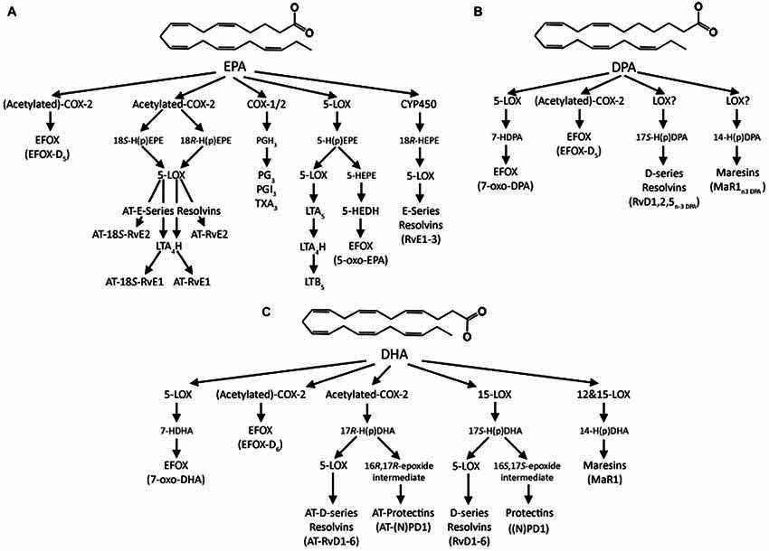
Notes:
source
https://www.researchgate.net/publication/274257030_Long-chain_omega-3_fatty_acids_and_the_brain_A_review_of_the_independent_and_shared_effects_of_EPA_DPA_and_DHA/figures?lo=1

Slide 41
Calorie restriction
Modulates Adult Hippocampal Neurogenesis (AHN) and synaptic plasticity
Calorie restriction activates AMPK signalling
change in expression of genes related to synaptogenesis
NMDA receptors are upregulated
improved Long Term Potentiation (LPT)

Slide 42
Ketogenic diet
Ketone bodies (KB) act as neuroprotective agents by
raising ATP levels
diminishing the production of reactive oxygen species in neurological tissues
enhancing the regulation of synaptic function though mitochondrial biogenesis

Slide 43
Exercise
Reduces risk of dementia by
lowering blood pressure
Lowering total cholesterol
reducing abdominal fat
improving immune and lung function
improving cardiovascular function
improving cerebral blood flow.

Slide 44
take home message
Risk factors for AD are similar to those for CVD, such as
high blood pressure
smoking
high cholesterol
obesity
Risk factors need to be treated in midlife at the latest to reduce the risk of dementia later in life
A multi-disciplinary change in lifestyles is required, combining exercise with healthy diets) with a focus on
These changes in the lifestyle can reduce the risk for both heart disease and dementia.

Slide 45
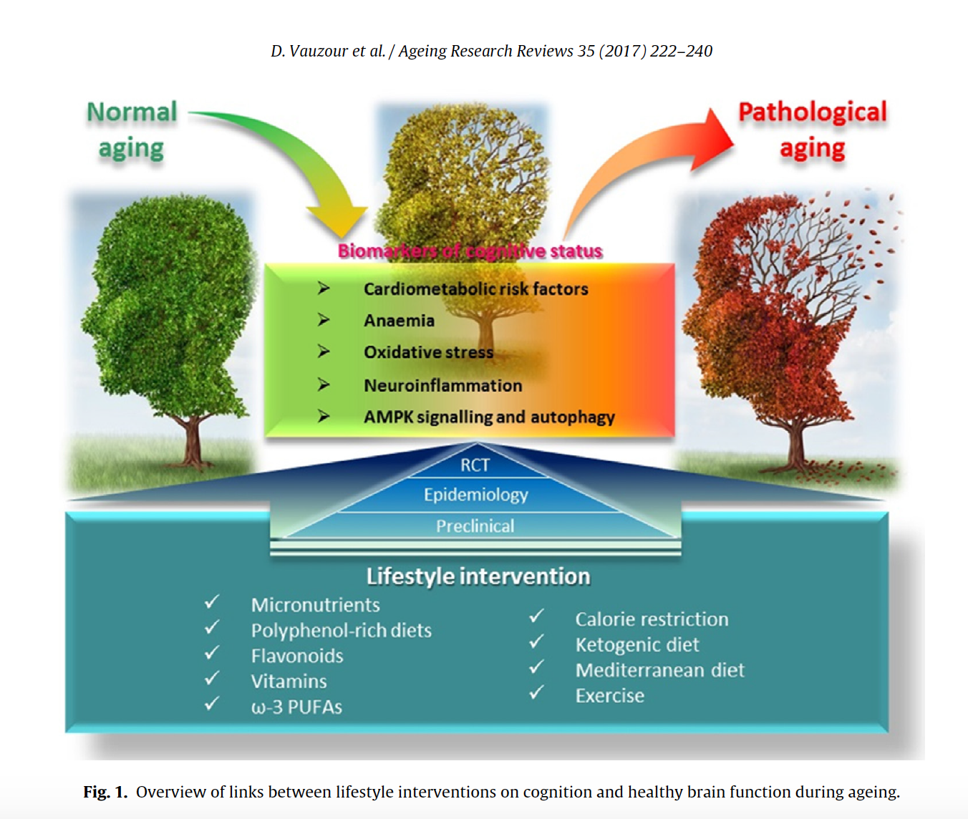

Slide 46
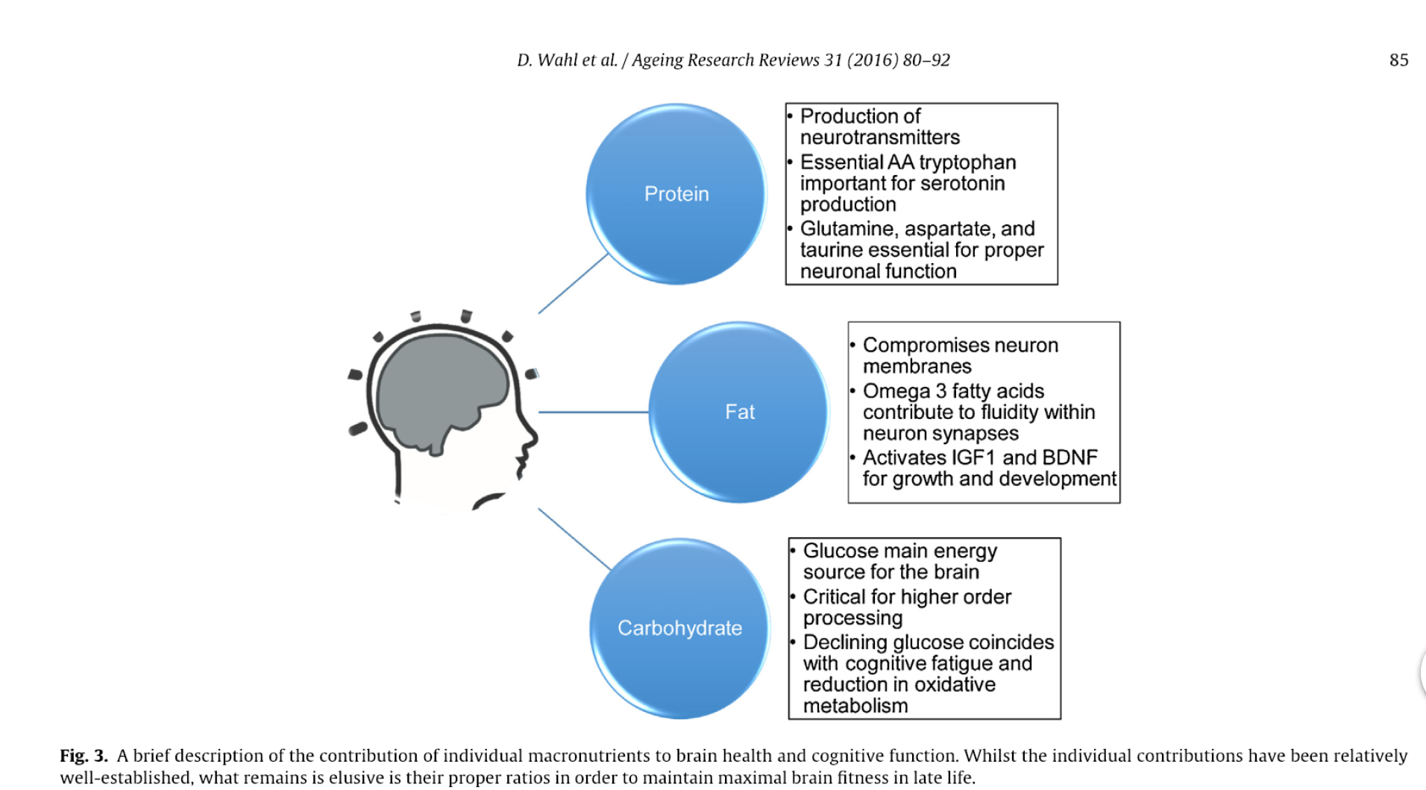
Notes:
source
see slide n. 4

