Slide 1
Methods for obtaining chiral non-racemic compounds
a) Isolating a chiral product from natural sources
b) Biochemical methods
c) Physical methods
□ Mechanical sorting of enantiomorphous
crystals of a racemic compound
□ Preferential separation of one type of
enantiomorphous crystals from a racemate
□ Preferential trapping of one enantiomer
in a chiral pocket

Slide 2
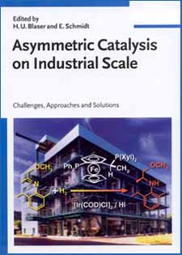
Methods for obtaining chiral
non-racemic compounds
d) Chemical methods
□ Reversible transformation into
diastereomeric derivatives
□ ASYMMETRIC CATALYSIS

Slide 3

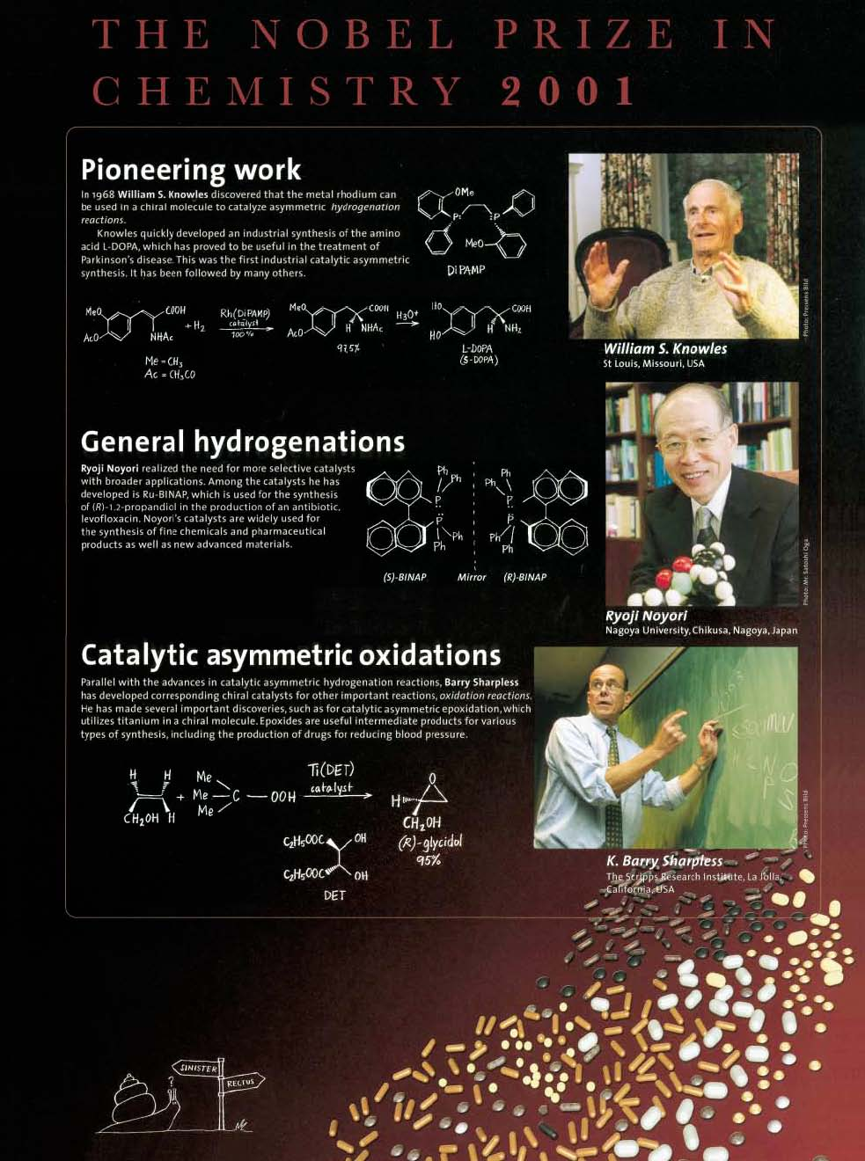
2001
Most of the catalytic synthesis
of chiral molecules is presently
done homogeneously.
Nobel Prize in Chemistry 2001
was awarded to R. Noyori, W.S.Knowles, and K.B. Sharpless for their development of
homogeneous asymmetric hydrogenation and oxidation
W.S.Knowles, Angew.Chem.Int.Ed.41(2002)1998

Slide 4
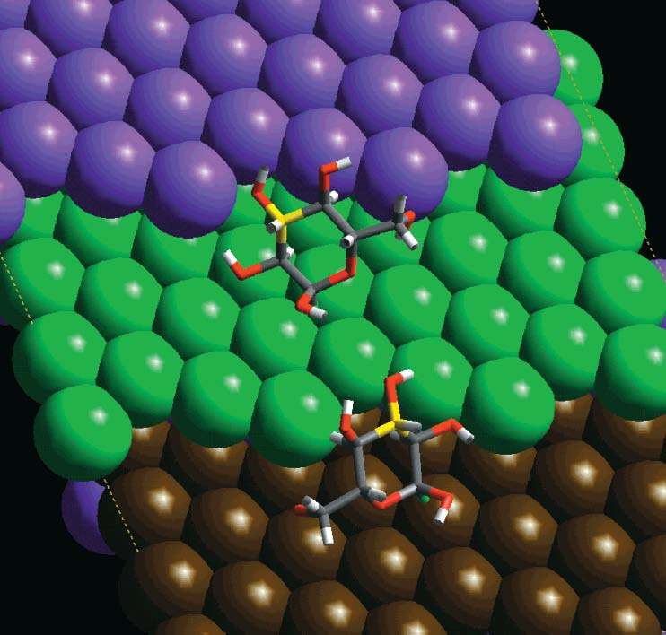
Design of Heterogeneous Chiral Catalyst
It is evident that for metal-catalysed enantioselectivity to be achieved, the reaction must take place in a chiral environment which includes the metal atoms that constitute the active site. Conventional heterogeneous catalysts contain no such chiral environment so that, where enantiomers are formed a racemic mixture is produced.
A chiral environment may be achieved ... HOW ?

Slide 5
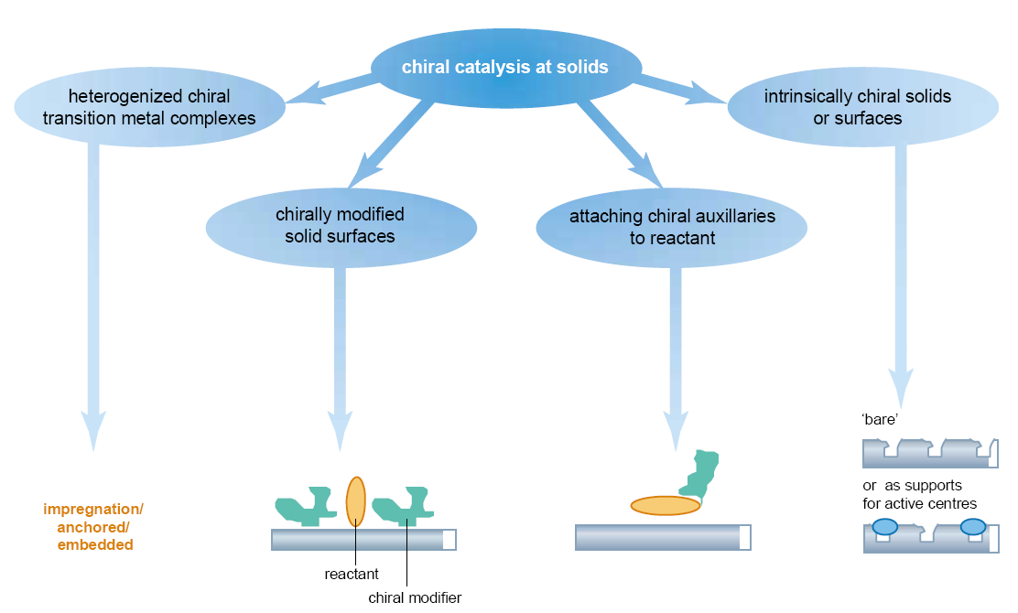
Design of Heterogeneous Chiral Catalyst
R.Raval, CATTECH 5(2001)12

Slide 6


Chirally modified solid surfaces
Adsorption of a chiral organic compound from solution onto a metal surface is a simple and efficient approach to create a chiral surface.
e.g.
Subtle differences in geometry and energy between S (left) and R zwitterionic cinchonidine-pyruvate adducts --S is more stable-- control enantioselectivity in hydrogenation reactions

Slide 7
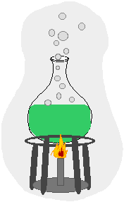
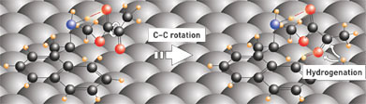
Chirally modified solid surfaces
The modifiers which represent the source of chirality influence the selectivity and activity of the catalyst by adding them to the catalyst or to the reaction mixture.
The modifier is an organic compound, which adsorbs strongly on the metal surface of the catalyst and creates a chiral environment. The substrates are in interaction simultaneously with the catalyst and the modifier, so to give optically active product.
S.Lavoie, M.-A.Lalibertè, P.H.McBreen,
J.Am.Chem.Soc.125(2003)15756

Slide 8
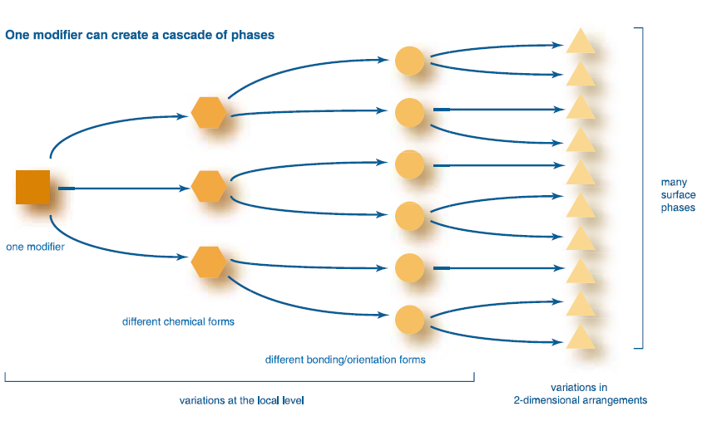
Chirally modified solid surfaces
Modifiers can take up many different combinations of molecular structure, bonding, orientation, and 2-dimensional order at a surface,
yielding many different phases.
Each phase is expected to have a different response to the substrate!
R.Raval, CATTECH 5(2001)12

Slide 9


Enantioselective Heterogeneous Catalysts
ATTENTION!
When the modifier is chiral,
the reaction can be carried out
enantioselectively - at least in principle!
In reality, this strategy has
been successful only in a
limitated number of cases
due to the high substrate specificity of such catalysts.
Only a particular combination of a metal, a modifier and a
substrate type leads to good enantioselectivity.
Already quite small variations in one of the three components can lead to drastic changes in enantiodiscrimination.

Slide 10
Enantioselective Heterogeneous Catalysts
The most important asymmetric catalysts types are:
Ni catalysts modified with tartaric acid, useful for β-functionalized ketones with ee up to 98.6%;
Pt catalysts modified with cinchona alkaloids and related modifiers, successful for α-functionalized ketones with ee up to 98%;
Pd catalysts modified with cinchona alkaloids which achieve ees up to 94% for selected activated C=C bonds.

Slide 11
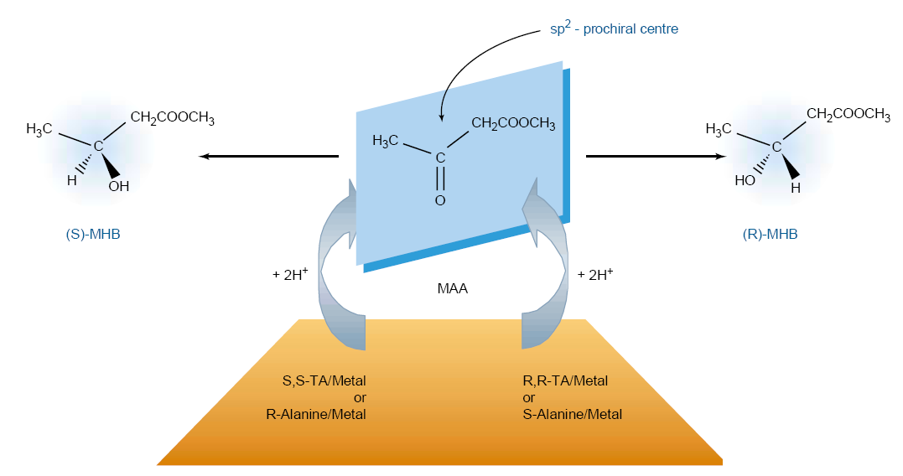
Tartaric Acid modified-Ni
MAA Methylacetoacetate
R.Raval, CATTECH 5(2001)12

Slide 12
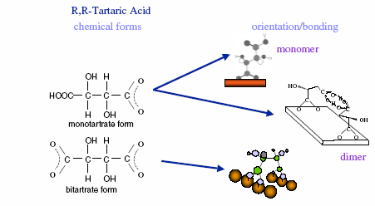
Tartaric Acid modified-Ni
How is chirality expressed at a surface?
Do chiral molecules adsorb and self organise at metal surface?
There is a discrepancy concerning the binding mode of tartrate on the Ni surface.
It is possible that only one carboxylate group is bound to Ni or both carboxylate groups.
R.Raval, J.Phys.-Condensed Matter 14(2002)4119

Slide 13
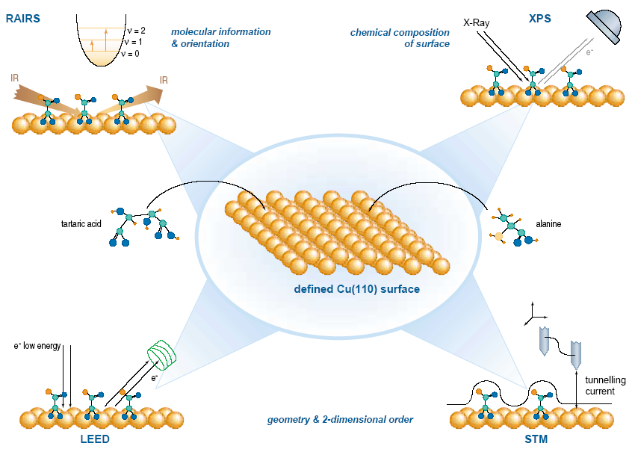
Surface Science Approach applied to Tartaric Acid modified-metal surface
The use of model modifier/metal interfaces created in ultra-high vacuum environments
on defined single crystal
metal surfaces allows fundamental factors of the system to be addressed.
The use of a complementary range of surface spectroscopic tools enables a local and extended view of the modified interface to be constructed.
R.Raval, CATTECH 5(2001)12

Slide 14
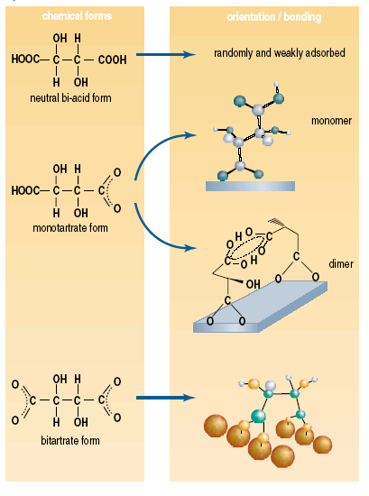
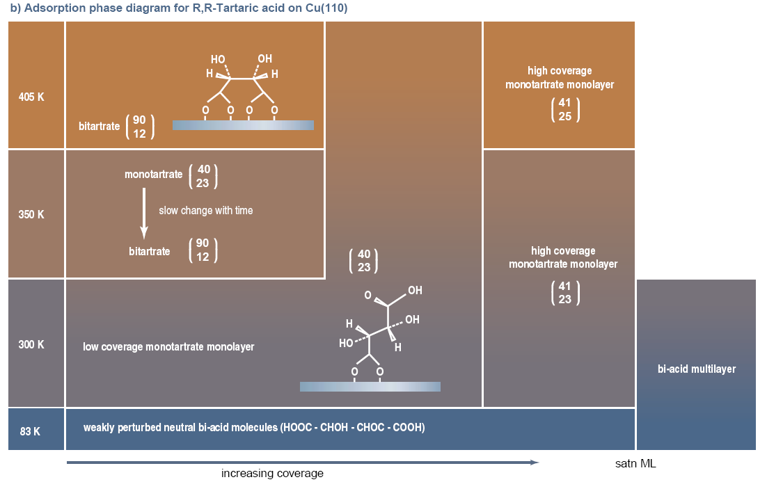
Surface Science Approach applied to Tartaric Acid modified-Cu surface
Modifiers can adopt a number of different local adsorption forms at a metal surface.
Spectroscopic studies have allowed the variations in local chemical structure, bonding and orientations to be identified for Tartaric acid on Cu(110).
R.Raval, CATTECH 5(2001)12

Slide 15
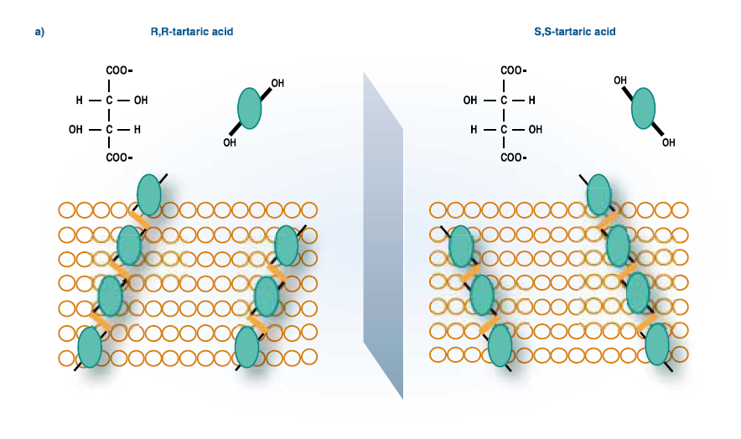
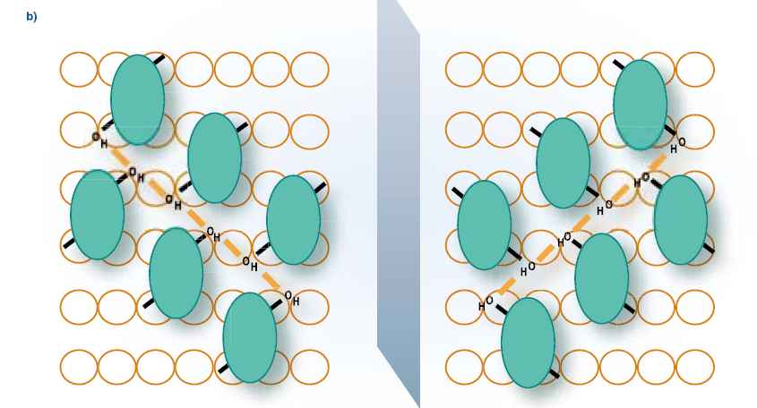
Surface Science Approach applied to Tartaric Acid modified-Cu surface
One way to rationalize opposite enantiomer grow directions is
via H-bonding between adsorbed bitartrate molecules.
For R, R-TA and S, S-TA the mirror positions of the hydroxyl groups
would lead to a switch in interaction directions:
a) along the columns
b) along the trimer rows,
leading to mirror modifier arrangements.
R.Raval, CATTECH 5(2001)12

Slide 16
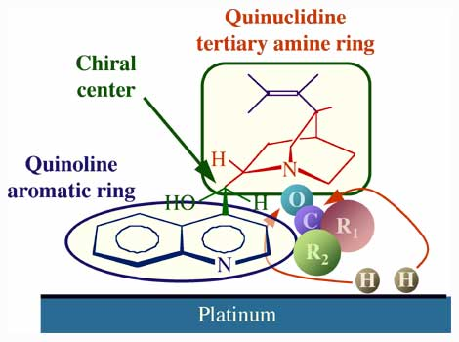
Chinchona alkaloids modified-Pt
The proposed mechanism by which the cinchona is believed to exert its effect is shown schematically in the figure.
Three functional parts have been identified in
these modifiers:
the anchoring quinoline aromatic ring, the moiety believed to be responsible for adsorption to the metal;
(2) the tertiary quinuclidine ring, an amine group with a basic nitrogen atom which facilitates complexation with the reactant;
the stereogenic region around the C8 and C9 carbon atoms responsible for the chirality of the product.
Each of these moieties appears to play
a specific role in chiral catalysis
Z.Ma, I.Lee, J.Kubota, F.Zaera, J.Mol.Catal.A: Chem.216(2004)199

Slide 17
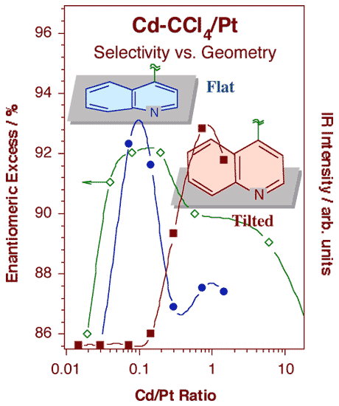
Chinchona alkaloids modified-Pt
Signal intensities for the infrared features at 1217 (filled circles) and 1512 cm-1 (filled squares) associated with flat and tilted adsorption geometries, respectively, as a function of cinchonidine concentration in a carbon tetrachloride solution.
The changes seen in these spectra correlate quite nicely with those reported for the activity and enantioselectivity of 10,11-dihydrocinchonidine-modified platinum towards the hydrogenation of ethyl pyruvate.
J.Kubota, F.Zaera, J.Am.Chem.Soc.123(2001)11115

Slide 18
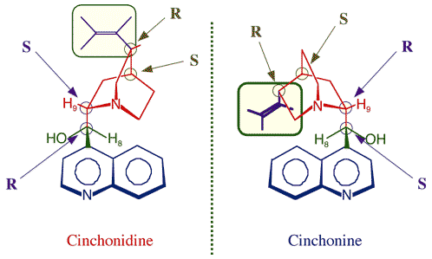
Chinchona alkaloids modified-Pt
Structural details of the near enantiomers cinchonidine and cinchonine. Highlighted here is the fact that the vinyl group in the quinuclidine ring imposes rotational restrictions on the latter, blocking stable configurations available to the former. These differences may be responsible for the differences seen in physical properties such as solubility, adsorption and catalysis.
Z.Ma, F.Zaera, J.Phys.Chem.B 109(2005)406

Slide 19
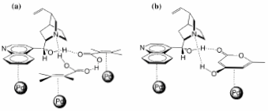
Chinchona alkaloids modified-Pd
The figure shows the proposed activated complexes of cinchonidine in open conformation adsorbed on the Pd surface:
a) with an α,β-unsaturated acids dimmer
b) with hydroxymethylpyrone.
In both cases hydrogen bond to the OH groups of the cinchonidine is considered to be essential for good enantioselectivity.
A detailed picture about the nature
of the involved interactions is unkown.
W.-R.Huck, T.Mallat, A.Baiker, Catal.Lett.80(2002)87

Slide 20
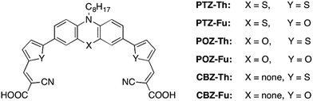
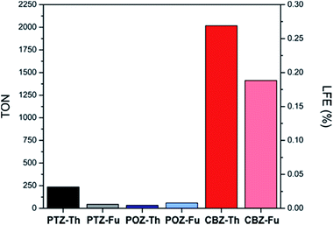
Attuali argomenti di ricerca (proposte di tesi)
Dye-sensitizers per produzione di H₂
Dye/Pt/TiO₂ P25
Uso di diversi tipi di TiO₂ e diversi metalli quali co-catalizzatori

Slide 21
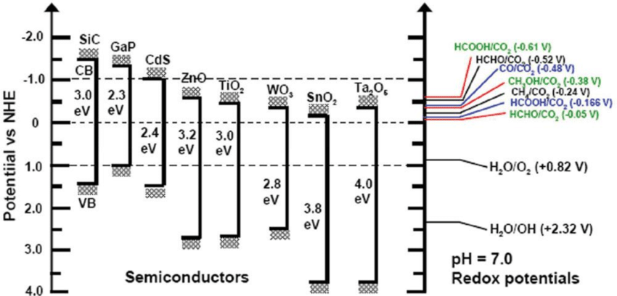
Attuali argomenti di ricerca (proposte di tesi)
Fotoriduzione di CO₂
CO₂ + H₂O
Prodotti
Uso di brookite
Compositi contenenti CNT, grafene ecc.

Slide 22
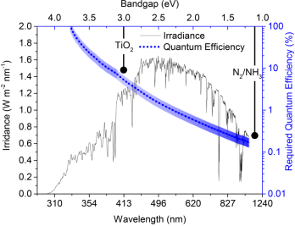
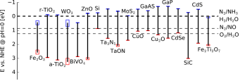
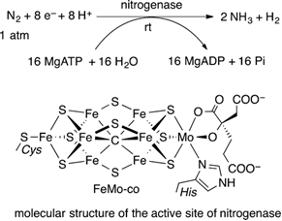
Attuali argomenti di ricerca (proposte di tesi)
Fotoriduzione di N₂
N₂ + 3 H₂O
2 NH₃ + 3/2 O₂
Uso di brookite
Uso di solfuri metallici (Fe, Mo, W ecc.)

Slide 23
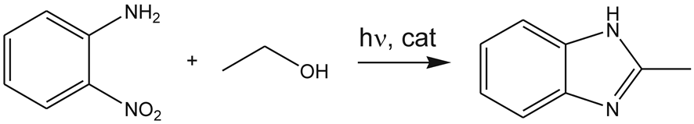
Attuali argomenti di ricerca (proposte di tesi)
Sintesi organica
Benzimidazole
Sviluppo di metodologie di sintesi per:
Benzoxazole
Benzothiazole

Slide 24
Attuali argomenti di ricerca (proposte di tesi)
Sintesi organica
Sviluppo di catalizzatori fotoattivati tramite plasmon heating

Slide 25
Attuali argomenti di ricerca (proposte di tesi)
Sintesi organica
Sviluppo di catalizzatori fotoattivati tramite plasmon heating

