Slide 1
Meet the Professor
Dr. Abe Harraf, Professor
Monfort College of Business
University of Northern Colorado
Greeley, Colorado

Slide 2
Classroom Expectations
Participate: Ask and answer questions from the instructor
Focus: Do not talk to one another to avoid disturbing the class
Arrivals and departures: Be on time and leave during the breaks if necessary
Ask to repeat: If you need to take a note or explain further

Slide 3
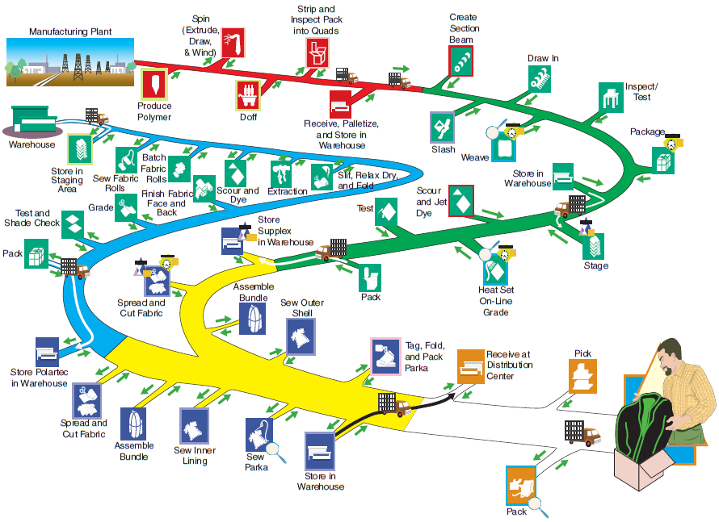
Process Steps for Men’s Nylon Jacket

Slide 4
What Is Operations Management?
Production is the creation of goods and services
Operations management (OM) is the set of activities that creates value in the form of goods and services by transforming inputs into outputs

Slide 5
Organizing to Produce Goods and Services
Essential functions:
Marketing – generates demand
Production/operations – creates the product
Finance/accounting – tracks how well the organization is doing, pays bills, collects the money

Slide 6
Organizational Charts
Commercial Bank
Operations
Teller Scheduling
Check Clearing
Collection
Transaction processing
Facilities design/layout
Vault operations
Maintenance
Security
Finance
Investments
Security
Real estate
Marketing
Loans
Commercial
Industrial
Financial
Personal
Mortgage
Accounting
Auditing
Trust Department
Figure 1.1(A)

Slide 7
Organizational Charts
Airline
Operations
Ground support equipment
Maintenance
Ground Operations
Facility maintenance Catering
Flight Operations
Crew scheduling Flying Communications Dispatching
Management science
Finance/ accounting
Accounting
Payables Receivables General Ledger
Finance
Cash control International exchange
Marketing
Traffic administration
Reservations Schedules Tariffs (pricing)
Sales
Advertising
Figure 1.1(B)

Slide 8
Organizational Charts
Manufacturing
Operations
Facilities Construction; maintenance
Production and inventory control Scheduling; materials control
Quality assurance and control
Supply-chain management
Manufacturing Tooling; fabrication; assembly
Design Product development and design Detailed product specifications
Industrial engineering Efficient use of machines, space, and personnel
Process analysis Development and installation of production tools and equipment
Finance/ accounting
Disbursements/ credits
Receivables Payables General ledger
Funds Management
Money market International exchange
Capital requirements
Stock issue Bond issue and recall
Marketing
Sales promotion
Advertising
Sales
Market research
Figure 1.1(C)

Slide 9
Why Study OM?
OM is one of three major functions (marketing, finance, and operations) of any organization
We want (and need) to know how goods and services are produced
We want to understand what operations managers do
OM is such a costly part of an organization

Slide 10
What Operations Managers Do
Basic Management Functions
Planning
Organizing
Staffing
Leading
Controlling

Slide 11
The Critical Decisions
Service and product design
What good or service should we offer?
How should we design these products and services?
Quality management
How do we define quality?
Who is responsible for quality?
Table 1.2 (cont.)

Slide 12
The Critical Decisions
Process and capacity design
What process and what capacity will these products require?
What equipment and technology is necessary for these processes?
Location
Where should we put the facility?
On what criteria should we base the location decision?
Table 1.2 (cont.)

Slide 13
The Critical Decisions
Layout design
How should we arrange the facility and material flow?
How large must the facility be to meet our plan?
Human resources and job design
How do we provide a reasonable work environment?
How much can we expect our employees to produce?
Table 1.2 (cont.)
Notes:
Using this and subsequent slides, you might go through in more detail the decisions of Operations Management. While greater detail is provided by these slides than the earlier one, you may still decide to have the students contribute examples from their own experience.

Slide 14
The Critical Decisions
Supply-chain management
Should we make or buy this component?
Who are our suppliers and who can integrate into our e-commerce program?
Inventory, material requirements planning, and JIT
How much inventory of each item should we have?
When do we re-order?
Table 1.2 (cont.)

Slide 15
The Critical Decisions
Intermediate and short–term scheduling
Are we better off keeping people on the payroll during slowdowns?
Which jobs do we perform next?
Maintenance
Who is responsible for maintenance?
When do we do maintenance?
Table 1.2 (cont.)

Slide 16
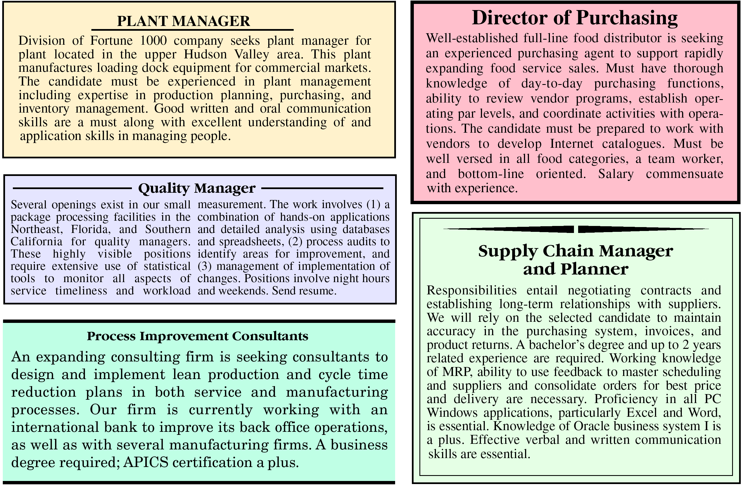
Where are the OM Jobs?
Figure 1.2

Slide 17
Where are the OM Jobs?
Technology/methods
Facilities/space utilization
Strategic issues
Response time
People/team development
Customer service
Quality
Cost reduction
Inventory reduction
Productivity improvement

Slide 18
Contributions From
Human factors
Industrial engineering
Management science
Biological science
Physical sciences
Information science

Slide 19
New Challenges in OM
From
To
Local or national focus
Batch shipments
Low bid purchasing
Lengthy product development
Standard products
Job specialization
Global focus
Just-in-time
Supply chain partnering
Rapid product development, alliances
Mass customization
Empowered employees, teams

Slide 20
Characteristics of Goods
Tangible product
Consistent product definition
Production usually separate from consumption
Can be inventoried
Low customer interaction

Slide 21
Characteristics of Service
Intangible product
Produced and consumed at same time
Often unique
High customer interaction
Inconsistent product definition
Often knowledge-based
Frequently dispersed

Slide 22
Industry and Services as Percentage of GDP
90 −
80 −
70 −
60 −
50 −
40 −
30 −
20 −
10 −
0 −
Australia
Canada
China
Czech Rep
France
Germany
Hong Kong
Japan
Mexico
Russian Fed
South Africa
Spain
UK
US
Services
Manufacturing

Slide 23
Goods Versus Services
Attributes of Goods (Tangible Product)
Attributes of Services (Intangible Product)
Can be resold
Can be inventoried
Some aspects of quality measurable
Selling is distinct from production
Product is transportable
Site of facility important for cost
Often easy to automate
Revenue generated primarily from tangible product
Reselling unusual
Difficult to inventory
Quality difficult to measure
Selling is part of service
Provider, not product, is often transportable
Site of facility important for customer contact
Often difficult to automate
Revenue generated primarily from the intangible service
Table 1.3

Slide 24
Goods and Services
Automobile
Computer
Installed carpeting
Fast-food meal
Restaurant meal/auto repair
Hospital care
Advertising agency/
investment management
Consulting service/
teaching
Counseling
100% 75 50 25 0 25 50 75 100%
| | | | | | | | |
Percent of Product that is a Good Percent of Product that is a Service
Figure 1.4

Slide 25
Development of the Service Economy
100
90
80
70
60
50
40
30
20
10
0
Services
Manufacturing
Agriculture
1800 1850 1900 1950 2000
Figure 1.5 (A)

Slide 26
Development of the Service Economy
30 –
25 –
20 –
15 –
10 –
5 –
0 –
– 150
– 125
– 100
– 75
– 50
– 25
– 0
Industrial production
Manufacturing employment
Employment (millions)
Index: 1997 = 100
Estimate
1950 1970 1990 2010
Figure 1.5 (B)

Slide 27
Development of the Service Economy
United States
Canada
France
Italy
Britain
Japan
W. Germany
| | | | |
40 50 60 70 80
1970 2005
Percent
Figure 1.5 (C)

Slide 28
New Trends in OM
Past Causes Future
Local or national focus |  | Low-cost, reliable worldwide communication and transportation networks |  | Global focus
Batch (large) shipments |  | Short product life cycles and cost of capital put pressure on reducing inventory |  | Just-in-time shipments
Low-bid purchasing |  | Quality emphasis requires that suppliers be engaged in product improvement |  | Supply-chain partners, Enterprise Resource Planning, e-commerce
Figure 1.6

Slide 29
New Trends in OM
Past Causes Future
Lengthy product development |  | Shorter life cycles, Internet, rapid international communication, computer-aided design, and international collaboration |  | Rapid product development, alliances, collaborative designs
Standardized products |  | Affluence and worldwide markets; increasingly flexible production processes |  | Mass customization with added emphasis on quality
Job specialization |  | Changing socioculture milieu; increasingly a knowledge and information society |  | Empowered employees, teams, and lean production
Figure 1.6

Slide 30
New Trends in OM
Past Causes Future
Low-cost focus |  | Environmental issues, ISO 14000, increasing disposal costs |  | Environmentally sensitive production, green manufacturing, recycled materials, remanufacturing
Figure 1.6

Slide 31
Productivity Challenge
Productivity is the ratio of outputs (goods and services) divided by the inputs (resources such as labor and capital)
The objective is to improve this measure of efficiency
Important Note!
Production is a measure of output only and not a measure of efficiency

Slide 32
The Economic System
Inputs
Processes
Outputs
Labor, capital, management
The U.S. economic system transforms inputs to outputs at about an annual 2.5% increase in productivity per year. The productivity increase is the result of a mix of capital (38% of 2.5%), labor (10% of 2.5%), and management (52% of 2.5%).
Goods and services
Feedback loop
Figure 1.7

Slide 33
Productivity
Units produced
Input used
Productivity =
Measure of process improvement
Represents output relative to input
Only through productivity increases can our standard of living improve

Slide 34
Productivity Calculations
Labor Productivity
Units produced
Labor-hours used
Productivity =
1,000
250
= = 4 units/labor-hour

Slide 35
Multi-Factor Productivity
Output
Labor + Material + Energy + Capital + Miscellaneous
Productivity =
Also known as total factor productivity
Output and inputs are often expressed in dollars

Slide 36
Measurement Problems
Quality may change while the quantity of inputs and outputs remains constant
External elements may cause an increase or decrease in productivity
Precise units of measure may be lacking

Slide 37
Productivity Variables
Labor - contributes about 10% of the annual increase
Capital - contributes about 32% of the annual increase
Management - contributes about 52% of the annual increase

Slide 38
Key Variables for Improved Labor Productivity
Basic education appropriate for the labor force
Diet of the labor force
Social overhead that makes labor available
Maintaining and enhancing skills in the midst of rapidly changing technology and knowledge

Slide 39
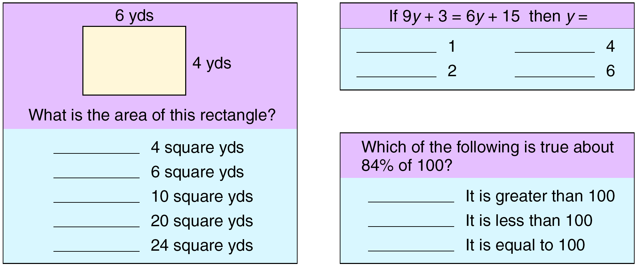
Labor Skills
About half of the 17-year-olds in the US cannot correctly answer questions of this type
Figure 1.8

Slide 40
Investment and Productivity in Selected Nations
10
8
6
4
2
0
Japan
Belgium
Netherlands
Percent increase in mfg productivity
Italy
France
Canada
US
UK
10 15 20 25 30 35
Percentage investment

Slide 41
Service Productivity
Typically labor intensive
Frequently focused on unique individual attributes or desires
Often an intellectual task performed by professionals
Often difficult to mechanize
Often difficult to evaluate for quality

Slide 42
Ethics and Social Responsibility
Challenges facing operations managers:
Developing safe quality products
Maintaining a clean environment
Providing a safe workplace
Honoring community commitments

Slide 43
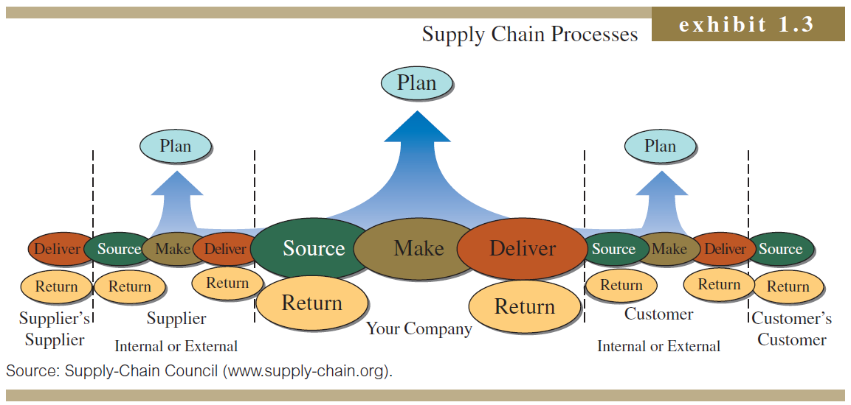

Slide 44
Process Activities
Planning – processes needed to operate an existing supply chain
Sourcing – selection of suppliers that will deliver the goods and services needed to create the firm’s product
Making – producing the major product or service
Delivering – logistics processes such as selecting carriers, coordinating the movement of goods and information, and collecting payments from customers
Returning – receiving worn-out, excess, and/or defective products back from customers

