Slide 1
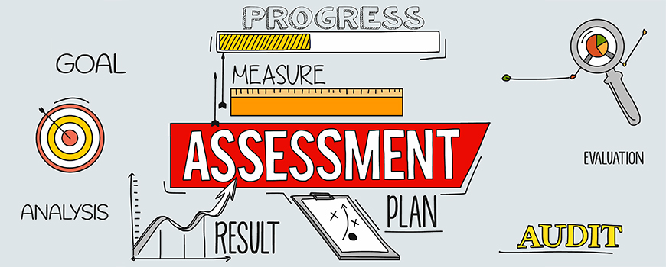
Management Decision and Control
Place image(s) in this area.

Slide 2
Decision-Making Process & Challenges
Decision-making process: choosing a course of action among alternatives
The process is often linear, looking back is common
Decisions are heavy ECONOMIC in orientation concrete on such aspects as RETURN ON INVESTMENT (ROI)
Degree of managerial involvement depends on the:
  Structure of the subsidiaries
  Locus of decision making
    Can be centralized or decentralized

Slide 3
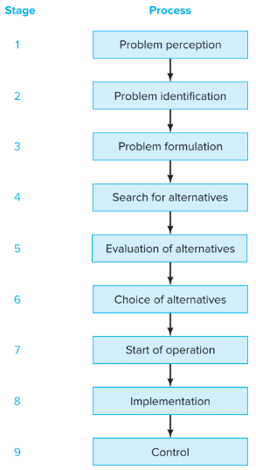
Figure 11.1 - Decision-Making Process

Slide 4
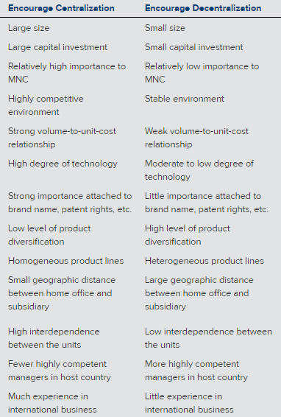
Table 11.1 - Factors That Influence Centralization or Decentralization of Decision Making in Subsidiary Operations

Slide 5
Factors Affecting Decision-Making Authority
Efficient process become increasingly important as diversification or differences between the parent & subsidiary increase
The father apart the two units are in are either geographical area or cultural beliefs, the higher the level of decentralization
If the subsidiary has highly competent local managers, the chances for decentralization are increased because of the confidence they have in them

Slide 6
Cultural Differences in Decision Making
How managers view time in the decision-making process
  French managers tend to spend ample time on searching for and evaluating alternatives
  Danish managers want to act first and take advantage of opportunities

Slide 7
Cultural Differences in Decision Making (continued 1)
Germans and Scandinavian countries both have codetermination
  Codetermination: Legal system that requires workers and their managers to discuss major decisions
  Germans tend to be fairly centralized, autocratic, and hierarchical
  Swedes focus more on quality of work life and the importance of the individual in the organization

Slide 8
Cultural Differences in Decision Making (continued 2)
Japanese are different from Europeans though they employ a long-term focus
  Use the following decision-making processes:
    Ringisei: Decision making by consensus
    Tatemae: Doing the right thing according to the norm
    Honne: What one really wants to do

Slide 9
Total Quality Management Decisions
Total Quality Management (TQM): is an organizational strategy & accompanying techniques that results in delivery of high-quality products or services to customers (Ch 8)
Critical to achieve world-class competitiveness
Has a big impact in the manufacturing area
  Employs concurrent engineering or inter-functional teams to develop new products
Used by MNCs to tailor their output to customer needs

Slide 10
Total Quality Management Techniques
TQM uses Employee Empowerment: the process of giving individuals & teams the resources, information, and authority they need to develop ideas & effectively implement them.
Another technique is the use of ongoing training to achieve continual improvement.
  Ranges from statistical quality control to team meetings designed to generate ideas for streamlining operations and eliminating waste
  The Japanese call this Kaizen: continuous improvement
Rewards and recognition
  Merit pay, discretionary bonuses, pay-for-skills and knowledge plans, plaques, and public recognition

Slide 11
ISO 9000 Certification
International Standards Organization
Indirectly related to TQM
  Quality products and services
Examines design, process control, purchasing, service, inspection and testing, and training
Part of screening for business in US and globally

Slide 12
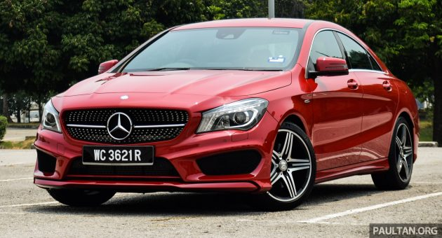
Decisions to Attack Competition
Ford Motor Company
  Challenged markets in Asia and African companies such as Tata
  100,000 vehicles in Asian markets
Audi
  Targeted younger demographic for luxury cars
BMW
  More body customizations (100 combinations)
Mercedes
  Low-cost strategy (CLA 250 starting $30,000)

Slide 13
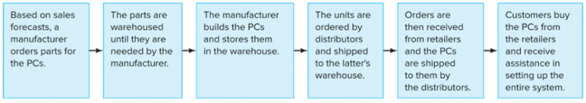
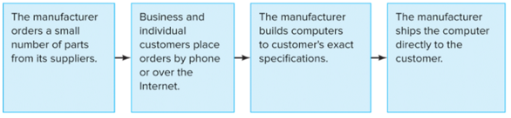
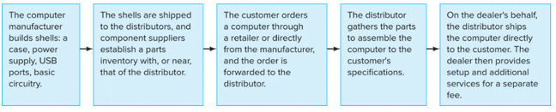
The Controlling Process
Traditional Model
Direct Sales Model
Hybrid Model

Slide 14
Internal & External Controls
Internal Control: Focus on what MNC does best
External Control: Ensures there's a market for offered goods and services to targeted customers
Ex: Blackberry (slow market response)
Ex: Universal Studios Japan

Slide 15
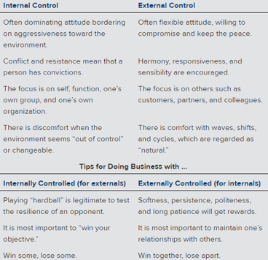
Impact of Internal and External Controls

Slide 16
Direct & Indirect Controls
Direct Controls: Face-to-face/personal meetings to monitor operations
  Ex: Executives visiting to learn problems and challenges of affiliates (ITT monthly meeting in NY)
Indirect Controls: Reports or written forms to communicate control of operations
  Ex: monthly operating reports (cheaper)

Slide 17
Approaches to Control
Major Differences
U.S.
Europe
More focus on quantifiable, objective aspects
Allows comparative analysis between foreign & domestic operations
Precise budgets and plans for comparison
More focus on control to measure qualitative aspects
Allows control to be exercised unit-by-unit basis
Companywide understanding and agreement on behavior of firm

Slide 18
Approaches Continued
U.S.
Europe
Large central staff and centralized information processing capability
Do not encourage lengthy stays in foreign management positions
Larger cadre capable expatriate that can be abroad for a while
More decentralized

Slide 19
Performance Evaluation
Financial Performance
Quality Performance
Personnel Performance

Slide 20
Financial Performance
Profit
  Amount remaining after all expenses are deducted from total revenues
ROI
  Return measured by dividing profit by asset
Notes:
Fluctuations in currency value
If a country devalues its currency, subsidiary export sales will increase
If a country revalues its currency, export sales will decline
Moving excess cash from subsideraries located in contries with weak currencies to contries with with strong currency to protect the value

Slide 21
Quality Performance
Quality control (QC)
  Major function of production and operations management
Quality Control Circle (QCC)
  A group of workers who meet to discuss ways of improving the quality of work

Slide 22
Personnel Performance
Periodic Appraisal of Work Performance
Variation are found across countries in:
  Methods of evaluations
  How the control is actually handled
  Rewards and monitoring of performance
Assessment centers

Slide 23
Hay Group
7 common themes
  Top managers take their mission statement seriously and expect everyone else to do the same
  Success attracts the best people- and the best people sustain success
  Top companies know exactly what they are looking for
  Firms see career development as an investment, not a chore

Slide 24
Hay Group Continued
5. Whenever possible, these companies promote from within
6. Performance is rewarded
7. Firms are genuinely interested in what their employees think, and they measure work satisfaction often and thoroughly

Slide 25
Questions?

