Slide 1
ROS mediated Neurodegeneration
Tommaso Biagini
tommaso.biagini@studenti.units.it
Marco Ferrari
marco.ferrari3@studenti.units.it
Martina Pandinelli
martina.pandinelli@studenti.units.it

Slide 2
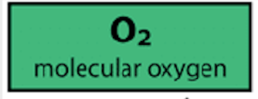
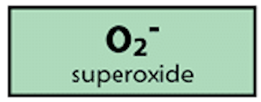
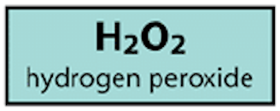
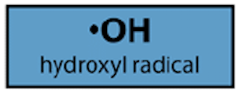

ROS and Oxidative Stress
+ e⁻
Reactive Oxygen Species (O₂˙⁻, H₂O₂, OH˙)
Chemical consequences of the imbalance between ROS production and elimination
+ e⁻
+ e⁻
ROS are commonly produced inside cells and Neurons among them.
Mitochondria are the first ROS production sites.
ROS take part in physiological signaling pathways and can drive pathological outcomes.
+ e⁻

Slide 3

Neurodegeneration
Process of progressive loss of structure and function of the Nervous System. Neuronal death is at its basis.
A wide spectrum of diseases causes neuronal loss and neurodegeneration (Alzheimer’s disease (AD), Parkinson’s disease (PD), Amyotrophic Lateral Sclerosis (ALS), Huntington’s disease).
Common features:
  Accumulation of abnormally aggregated proteins with toxic effect
  Oxidative stress
  Mitochondrial dysfunction
  Observed in aging population

Slide 4
Aging
Wide prevalence of Neurodegenerative diseases in aging population (AD affects 5% of >65 y.o., PD affects 1% of >65 y.o. worldwide)
Aging population is increasing
Social impact and cost is extremely high and bound to further increase
Aging processes are mediated by ROS signaling

Slide 5
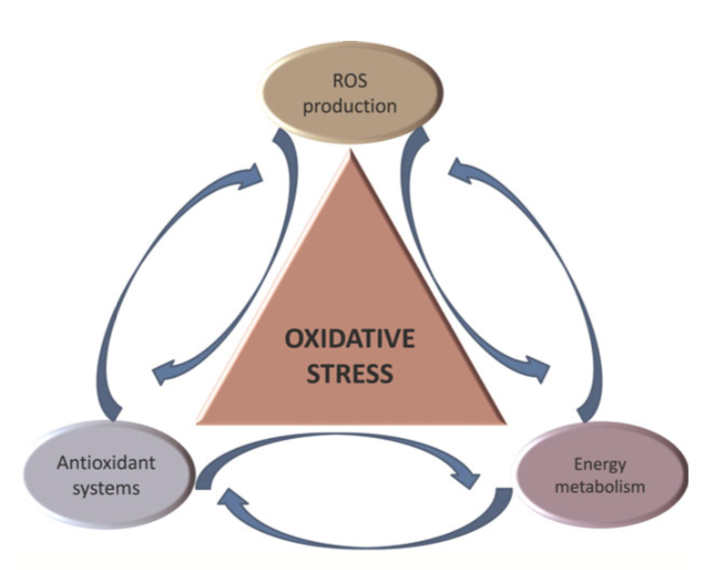
Topics overview
Neurons and ROS production
ROS physiology in neurons
ROS driven aging
ROS and neurodegeneration
Specific insights: CI in pathology
Lack of knowledge and future perspectives

Slide 6
Neurons and ROS production
Plasma membrane (NOS)
Endoplasmic reticulum (Cyt P450)
Peroxisomes (many systems)
Mitochondria (Complexes I, III, TCA cycle enzymes…)
+ ROS
SOD
Catalase
GPX
- ROS

Slide 7
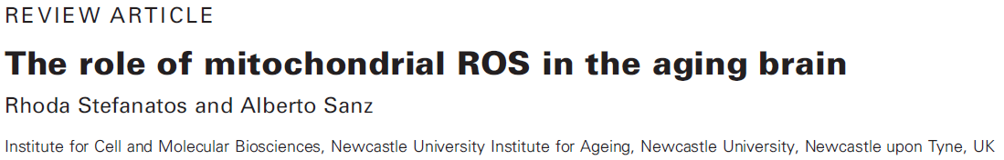
ROS physiology in neurons and aging
“… current consensus is that ROS cause oxidative stress, damaging mitochondria and resulting in an energetic crisis that triggers neurodegenerative diseases and accelerates aging. However, in model organisms, increasing mitochondrial ROS (mtROS) in the brain extends lifespan, suggesting that ROS may participate in signalling that protects the brain.“

Slide 8
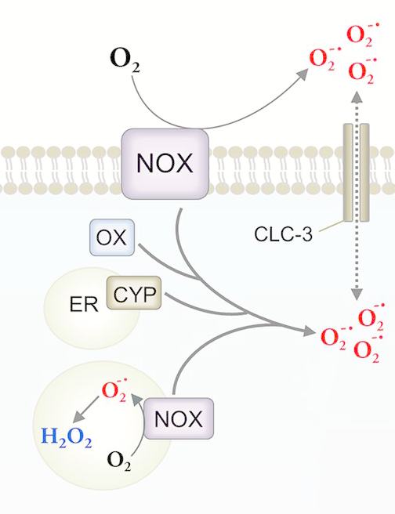
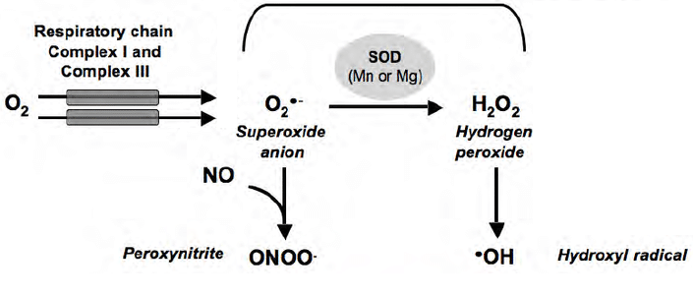
ROS physiology in neurons
ROS types
Mitochondrial ROS
Extra-mitochondrial ROS
Fenton or Haber-Weiss reaction

Slide 9
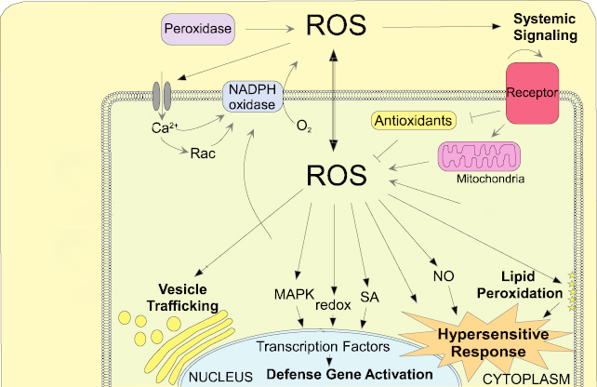
ROS physiology in neurons
ROS signaling
ROS signaling involves:
Activation of quality control mechanisms
Impact on cell signaling proteins (NF-κB, MAPK, redox systems, PI3K-Akt)
Can trigger inflammation responses
Only loROS are involved in cell programmed signaling!

Slide 10
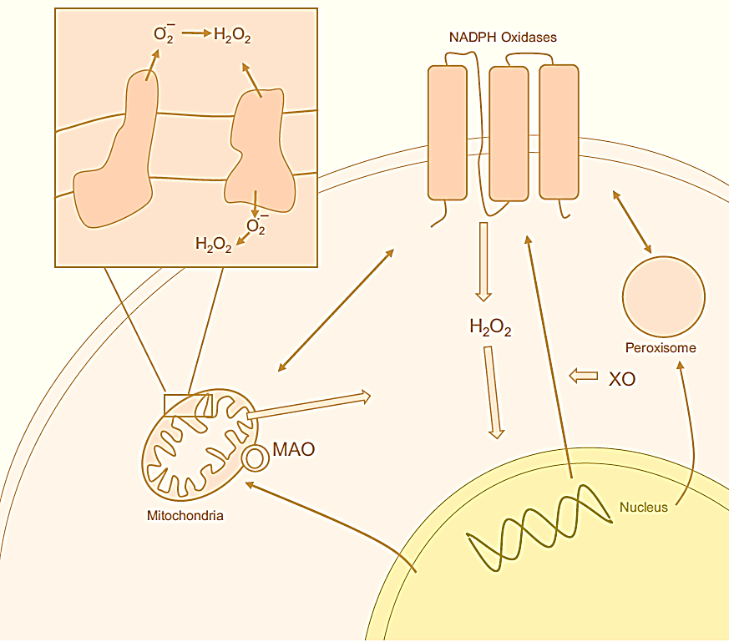
ROS physiology in neurons
Cross-talk between cell and ROS
ROS produced by mitochondria are pumped either to matrix or cytoplasm, according to Ubiquinone pool, allowing a sensing of the energy state of the mitochondrion
Thick arrows indicate signaling that maintains homeostasis, while thin arrows indicates cross-talk between organelles

Slide 11
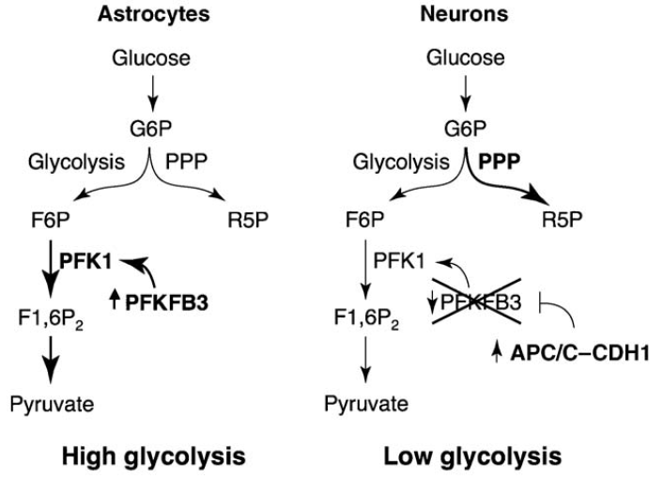
ROS physiology in neurons
Neuron vs Glia
Different metabolism in neuronal cells and glial cells
A different position of mitochondria inside the cell could reflect a different and specialized function
Experiment on rat primary culture demonstrating that in ex vivo models glia produces more ROS than neurons
ROS produced by RET at CI influence the assembly of respirasomes and therefore the rate of mitochondrial aging
Notes:
Astrocytes express the glycolysis-promoting enzyme PFKFB3, which activates the ratelimiting enzyme of glycolysis, PFK1. PFKFB3 is targeted for proteasomal degradation following ubiquitylation by APC/C–CDH1, whose activity is low in astrocytes. By contrast, APC/C–CDH1 activity is high in neurons, and thus PFKFB3 is continuously degraded. This results in a low glycolytic rate in neurons, and diversion of G6P through the PPP, which generates antioxidants and promotes survival.
NDUFS1 protein is responsible for recruiting of CI into respiratory supercomplex in neurons, therefore causing a minor electron leakage and less ROS production in neurons.
Manipulation via knockdown or overexpression in neurons and glia respectively.

Slide 12
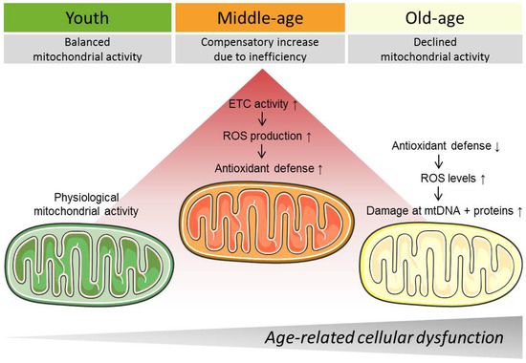
ROS driven aging
Changes in aging mitochondria
Decreased activity of complexes I and IV, causing alterations to electron state of the cell → C IV reduced activity increases electron leak
Mutator mice with reduced respiration rate exhibit progeria-like phenotype, not increasing ROS levels → in contrast with other experiments
Vicious cycle hypothesis
Notes:
Mutator mice has been accused of not being a good model for addressing the biological case

Slide 13
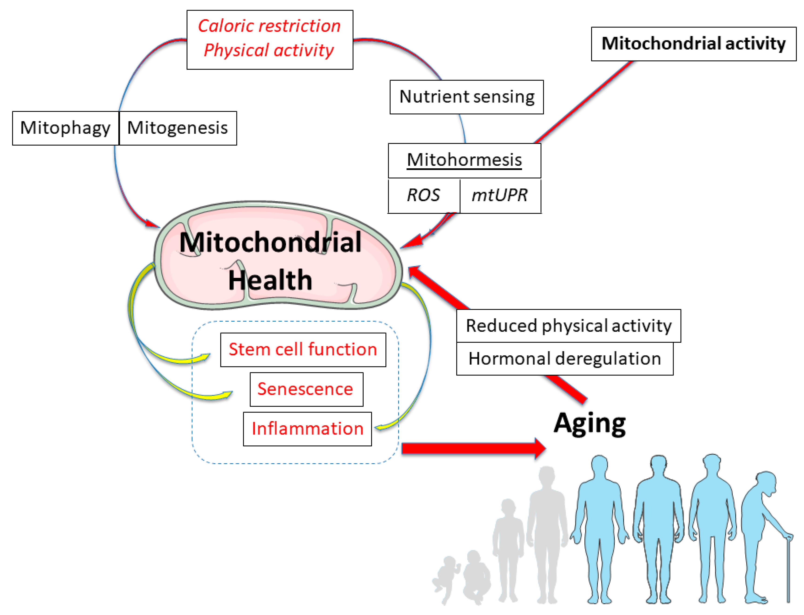
ROS driven aging
ROS: cause or consequence of aging?
Mutation of mice COQ7 causing interruption of electron flow via Ub biosynthetic pathway shortens lifespan but does not increase ROS production. Moreover normal conditions can be restored treating with 2,4 DHB
Contradiction with Theory of aging
Mithormesis phenomenon: the increase of ROS levels in worms and flies can extend lifespan, by activating protective and repairing mechanisms. Counteracted by feeding antioxidants.
Notes:
2,4 DiHydroxybenzophenone

Slide 14
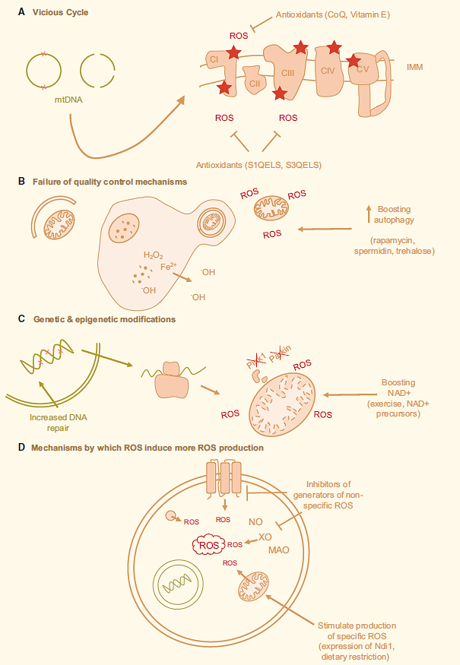

ROS driven aging
Visual summary

Slide 15
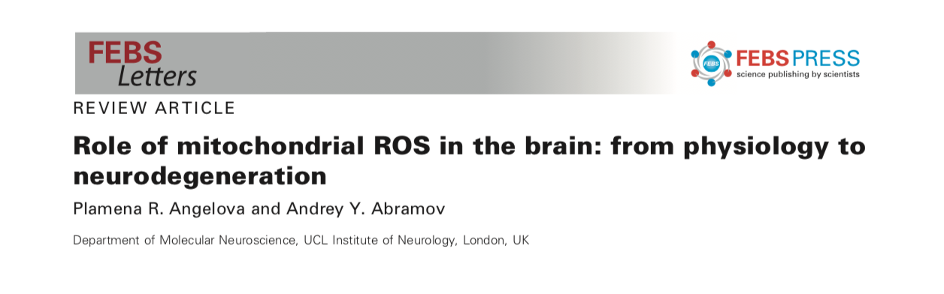
ROS and Neurodegeneration

Slide 16
ROS and Neurodegeneration
Post mitotic cells: functions must be maintained for a lifetime.
Neurons are very sensitive to oxidative stress by ROS.
Relatively low level of antioxidants
Extremely high oxygen demand
Great abundance of peroxidation-susceptible lipids
ROS imbalances are always implicated in neuronal pathology.

Slide 17
ROS and Neurodegeneration
Amyotrophic Lateral Sclerosis (ALS)
Huntington’s Disease (HD)
Loss of spinal cord and cortical motor neurons leads to progressive paralysis and death.
Familial ALS forms might include SOD1 mutations :
Cu/Zn-SOD mutated (Cytosolic)
Increased mitochondrial ROS and oxidative stress
Mutation in Huntigntine protein encoding gene cause motor and cognitive progressive dysfunction due to neuronal loss.
Oxidative stress and inflammation:
Increased level of MnSOD (mitochondrial), Cu/ZnSOD, GPX, Catalase
No gene products from canonical antioxidant response element controlled genes

Slide 18
ROS and Neurodegeneration
Alzheimer’s Disease (AD)
Parkinson’s Disease (PD)
Cognitive impairment associated with deposition of 𝛽-amyloid plaques and tau protein tangles causing neuronal death.
Membrane NADPH oxidase major source of ROS
Consequent mitochondrial damage
Further ROS production
Mitochondrial ROS induce PTP and cell death
Motor impairment due to Substantia Nigra dopamine neurons loss and basal ganglia dysfunction.
Wide evidence of oxidative stress in post-mortem tissues (MDA, 4HNE)
Many mutations to mtDNA (complex I, mitochondrial kinase PINK1)
Lewy Bodies inhibit complex I

Slide 19
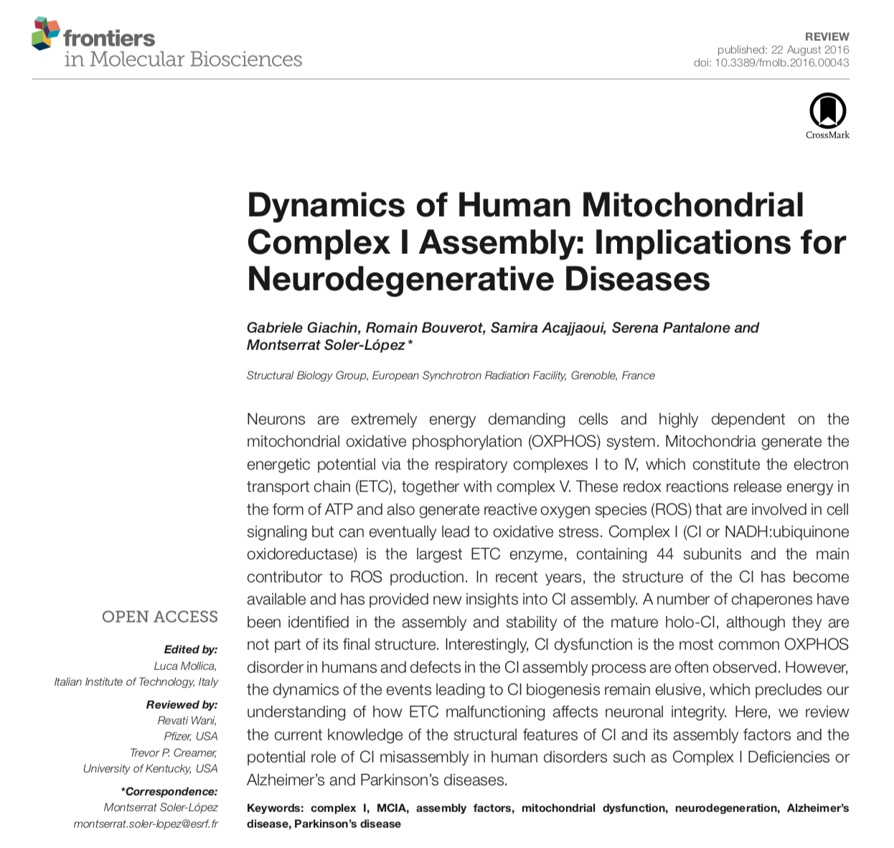
Specific insights: Complex I in pathology
CI dysfunction is the most common OXPHOS disorder in humans and defects in the CI assembly process are often observed.
However, the dynamics of the events leading to CI biogenesis remain elusive, which precludes our understanding of how ETC malfunctioning affects neuronal integrity.

Slide 20
Mitochondrial Complex I
Oxidation of NADH to NAD⁺ and transfer to the iron-sulfur clusters
N-module →
Q-module →
Presence of the iron-sulfur cluster and transfer of the 2 electrons to the Q₁₀(ubiquinone) pool
P_{p}/P_{d}module →
Transport of four protons from the mitochondrial matrix to the periplasm

Slide 21
Mitochondrial complex I assembly: (MCIA) complex
Main Complex I assembly Factors:
ACAD9
NDUFAF1
ECSIT
TMEM126B
TIMMDC1
Representation of mammalian mitochondrial CI model is based on the bovine heart cryo-EM structure

Slide 22
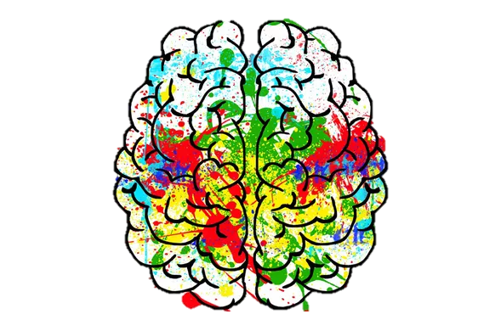
Neuronal cells are particularly susceptible to ROS-induced damage because they mainly rely on oxidative metabolism for ATP generation, in contrast to glial cells, which are highly glycolytic […] there are metabolic interactions from astrocytes to neurons that appear to play an important role in the control of neuronal activity and excitability
CID is the most prevalent genetic defect in mitochondrial energy metabolism, accounting for approximately a third of the OXPHOS disorder cases […] Early investigations on CID patient-derived fibroblasts showed partial or incomplete CI assembly and diminished catalytic activity which was inversely correlated with ROS production

Slide 23
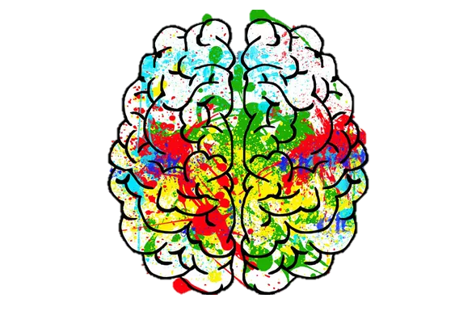
Additional CID clinical phenotypes have been associated with other childhood NDs, including Leigh- like syndrome, leukoencephalopathy, MELAS (mitochondrial encephalomyopathy, lactic acidosis and stroke-like episodes), and NARP (neuropathy, ataxia and retinitis pigmentosa) syndromes
Mitochondrial dysfunction represents a common pathogenic mechanism in NDs like Alzheimer’s disease (AD), Parkinson’s disease (PD), amyotrophic lateral sclerosis, Huntington’s disease, and prion diseases

Slide 24
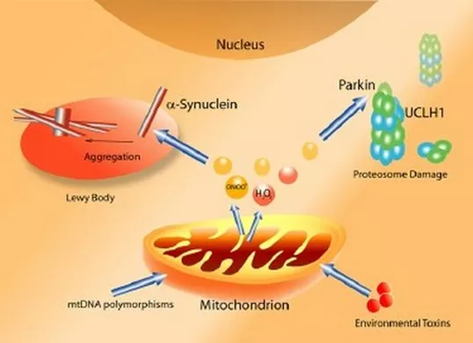
Complex I dysfunction and Parkinson’s disease
CI defects and increased oxidative damage are consistent features of both sporadic (idiopathic) and familial (genetic) PD forms. Decrease of CI activity has been reported in the substantia nigra and in the cortex of PD patients
In vivo data have shown a progressive accumulation of a-synuclein in the mitochondria resulting in impaired CI functioning and increased oxidative stress.
CI misassembly may play a role in PD onset and progression. However, the molecular mechanisms are yet unclear.

Slide 25
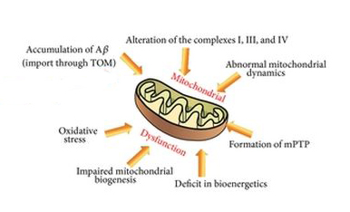
Complex I dysfunction and Alzheimer’s disease
Cells showing Aβ deposits due to human mutant APP expression, display increased ROS production, decreased cytochrome oxidase activity, morphological mitochondrial alteration, and apoptosis
With aging and in presence of both Aβ plaques and NTF, defects on CI and CIV become more marked.
The result is a significant decrease of respiratory parameters, reduced mitochondrial membrane potential and increased ROS level: further evidence of a synergistic detrimental effect of Aβ and tau on ETC.

Slide 26
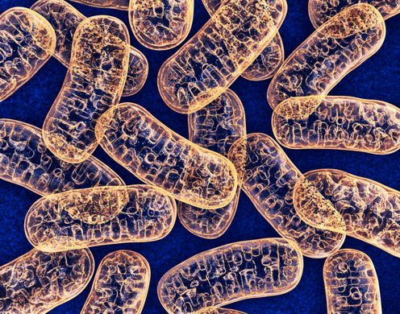
Perspectives in mitochondrial neurobiology
From a clinical point of view, mitochondrial biology holds the promise to provide novel insights into the pathogenesis of several NDs.
Increasing evidence shows that a fully assembled and stable CI is key in various pathways.
A better understanding of the regulatory mechanisms underlying CI assembly will unveil how mitochondria malfunction affects metabolic reprogramming and neuronal integrity.

Slide 27
Take home message
ROS play some important roles in neurons: they are involved in physiological functions of signaling and drive cell aging.
ROS always take part in Neurodegenerative processes as a leading cause of oxidative stress, but also as a result of it, when their production and elimination pathways are imbalanced.

Slide 28
Lack of knowledge and future perspectives
Cause or consequence of neurodegenerative diseases?
Specific role of ROS in each disease?
Why is antioxidant strategy not effective on neurodegenerative diseases?
Need of further studies on each specific disease to clarify the role of ROS and allow effective drug development.

Slide 29
Bibliographic references
Angelova PR, Abramov AY. Role of mitochondrial ROS in the brain: fromphysiology to neurodegeneration. FEBS Lett. 2018 Mar;592(5):692-702.
Stefanatos R, Sanz A. The role of mitochondrial ROS in the aging brain. FEBSLett. 2018 Mar;592(5):743-758.
Giachin G, Bouverot R, Acajjaoui S, Pantalone S, Soler-López M. Dynamics ofHuman Mitochondrial Complex I Assembly: Implications for NeurodegenerativeDiseases. Front Mol Biosci. 2016 Aug 22;3:43.
Uttara B, Singh AV, Zamboni P, Mahajan RT. Oxidative stress andneurodegenerative diseases: a review of upstream and downstream antioxidanttherapeutic options. Curr Neuropharmacol. 2009 Mar;7(1):65-74.
Kim GH, Kim JE, Rhie SJ, Yoon S. The Role of Oxidative Stress inNeurodegenerative Diseases. Exp Neurobiol. 2015 Dec;24(4):325-40.
Dikalov S. Cross talk between mitochondria and NADPH oxidases. Free Radic Biol Med. 2011;51(7):1289–1301.
Bolaños, Juan & Almeida, Angeles & Moncada, Salvador. (2009). Glycolysis: A bioenergetic or a survival pathway?. Trends in biochemical sciences. 35. 145-9. 10.1016/j.tibs.2009.10.006.
Lopez-Fabuel I, Le Douce J, Logan A, et al. Complex I assembly into supercomplexes determines differential mitochondrial ROS production in neurons and astrocytes. Proc Natl Acad Sci U S A. 2016;113(46):13063–13068.
Wang Y, Oxer D, Hekimi S. Mitochondrial function and lifespan of mice with controlled ubiquinone biosynthesis. Nat Commun. 2015;6:6393. Published 2015 Mar 6.
Zhang J, Wang X, Vikash V, et al. ROS and ROS-Mediated Cellular Signaling. Oxid Med Cell Longev. 2016;2016:4350965.

Slide 30
Images references
https://www.researchgate.net/figure/Formation-of-Reactive-Oxygen-Species_fig1_8178811 (ROS)
https://www.neurodegenerationresearch.eu/2017/06/common-factor-links-neurodegenerative-disease-in-young-and-old/ (brain-like tree)
https://www.researchgate.net/figure/Sites-of-ROS-production-Many-different-sites-of-ROS-production-exist-within-a-cell-Most_fig2_272029145 (ROS production/scavenging).
https://www.researchgate.net/profile/Patrick_Lestienne/publication/24188659/figure/fig8/AS:277434680266755@1443156990628/Mitochondrial-signalization-by-ROS-in-cancer-cells-The-mitochondrion-is-implicated-in.png
https://res.mdpi.com/genes/genes-09-00165/article_deploy/html/images/genes-09-00165-g001-550.jpg
https://res.mdpi.com/genes/genes-09-00022/article_deploy/html/images/genes-09-00022-g001.png
https://parkinsonsnewstoday.com/2018/02/27/defects-in-mitochondria-linked-to-parkinsons-stanford-study/ (Mitochondria)
https://www.hindawi.com/journals/omcl/2014/780179/fig2/ (Mitochondria in Alzheimer’s disease)
https://www.researchgate.net/publication/7854782_A_definition_of_Parkinson%27s_disease (Mitochondria in Parkinson’s disease)

