Slide 1
Lecture 3
Metabolic rewiring in cancer
Understanding the Warbur’s effect. Lecture on 09.04.2019
Understanding the Eagle’s effect. Lecture on 17.04.2019

Slide 2
Objectives of the seminar
Integrated overview of the main metabolic pathways and their regulation
described in previous lessons
Shifting from the logic of the textbook to the logic of life of a cancer cell
Mastering biochemistry (at least 2/3 of the programme)
Widening knowledge base of biochemistry
Stimulus to efficient self-learning (up to 1/3 of the programme)
Usefulness of biochmeistry
R&D of drugs
Nutrition
Drugs + nutrition
Lifestyles
Drugs + nutrition + lifestyle
Some scientific English

Slide 3
The hallmark of cancer
Each tumour has a unique genotype
Mutations of oncogenes and tumor-supressor genes
biodiversity, without taxonomy
PERSONALISED MEDICINE (not treated here)
Most tumors have a common metabolic phenotype
lactogenic (Warburg’s effect), “glutaminovore”
the environment can influence the metabolic phenotypes of cancer cells
COMMON PHARMACOLOGICAL APPROACH (next slide)
Each tumour has metabolically heterogenous cells
catabolic and anabolic phenotypes co-exist
METABOLIC INTER-DEPENDENCE

Slide 4
“… understanding the metabolic constraints on cancer cells within the native tumor environment will be important for identifying metabolic drug targets.”
Nature and Nurture: What Determines Tumor Metabolic Phenotypes?
Cancer Research 77.12 (2017): 3131-3134.
DOI: 10.1158/0008-5472.CAN-17-0165

Slide 5
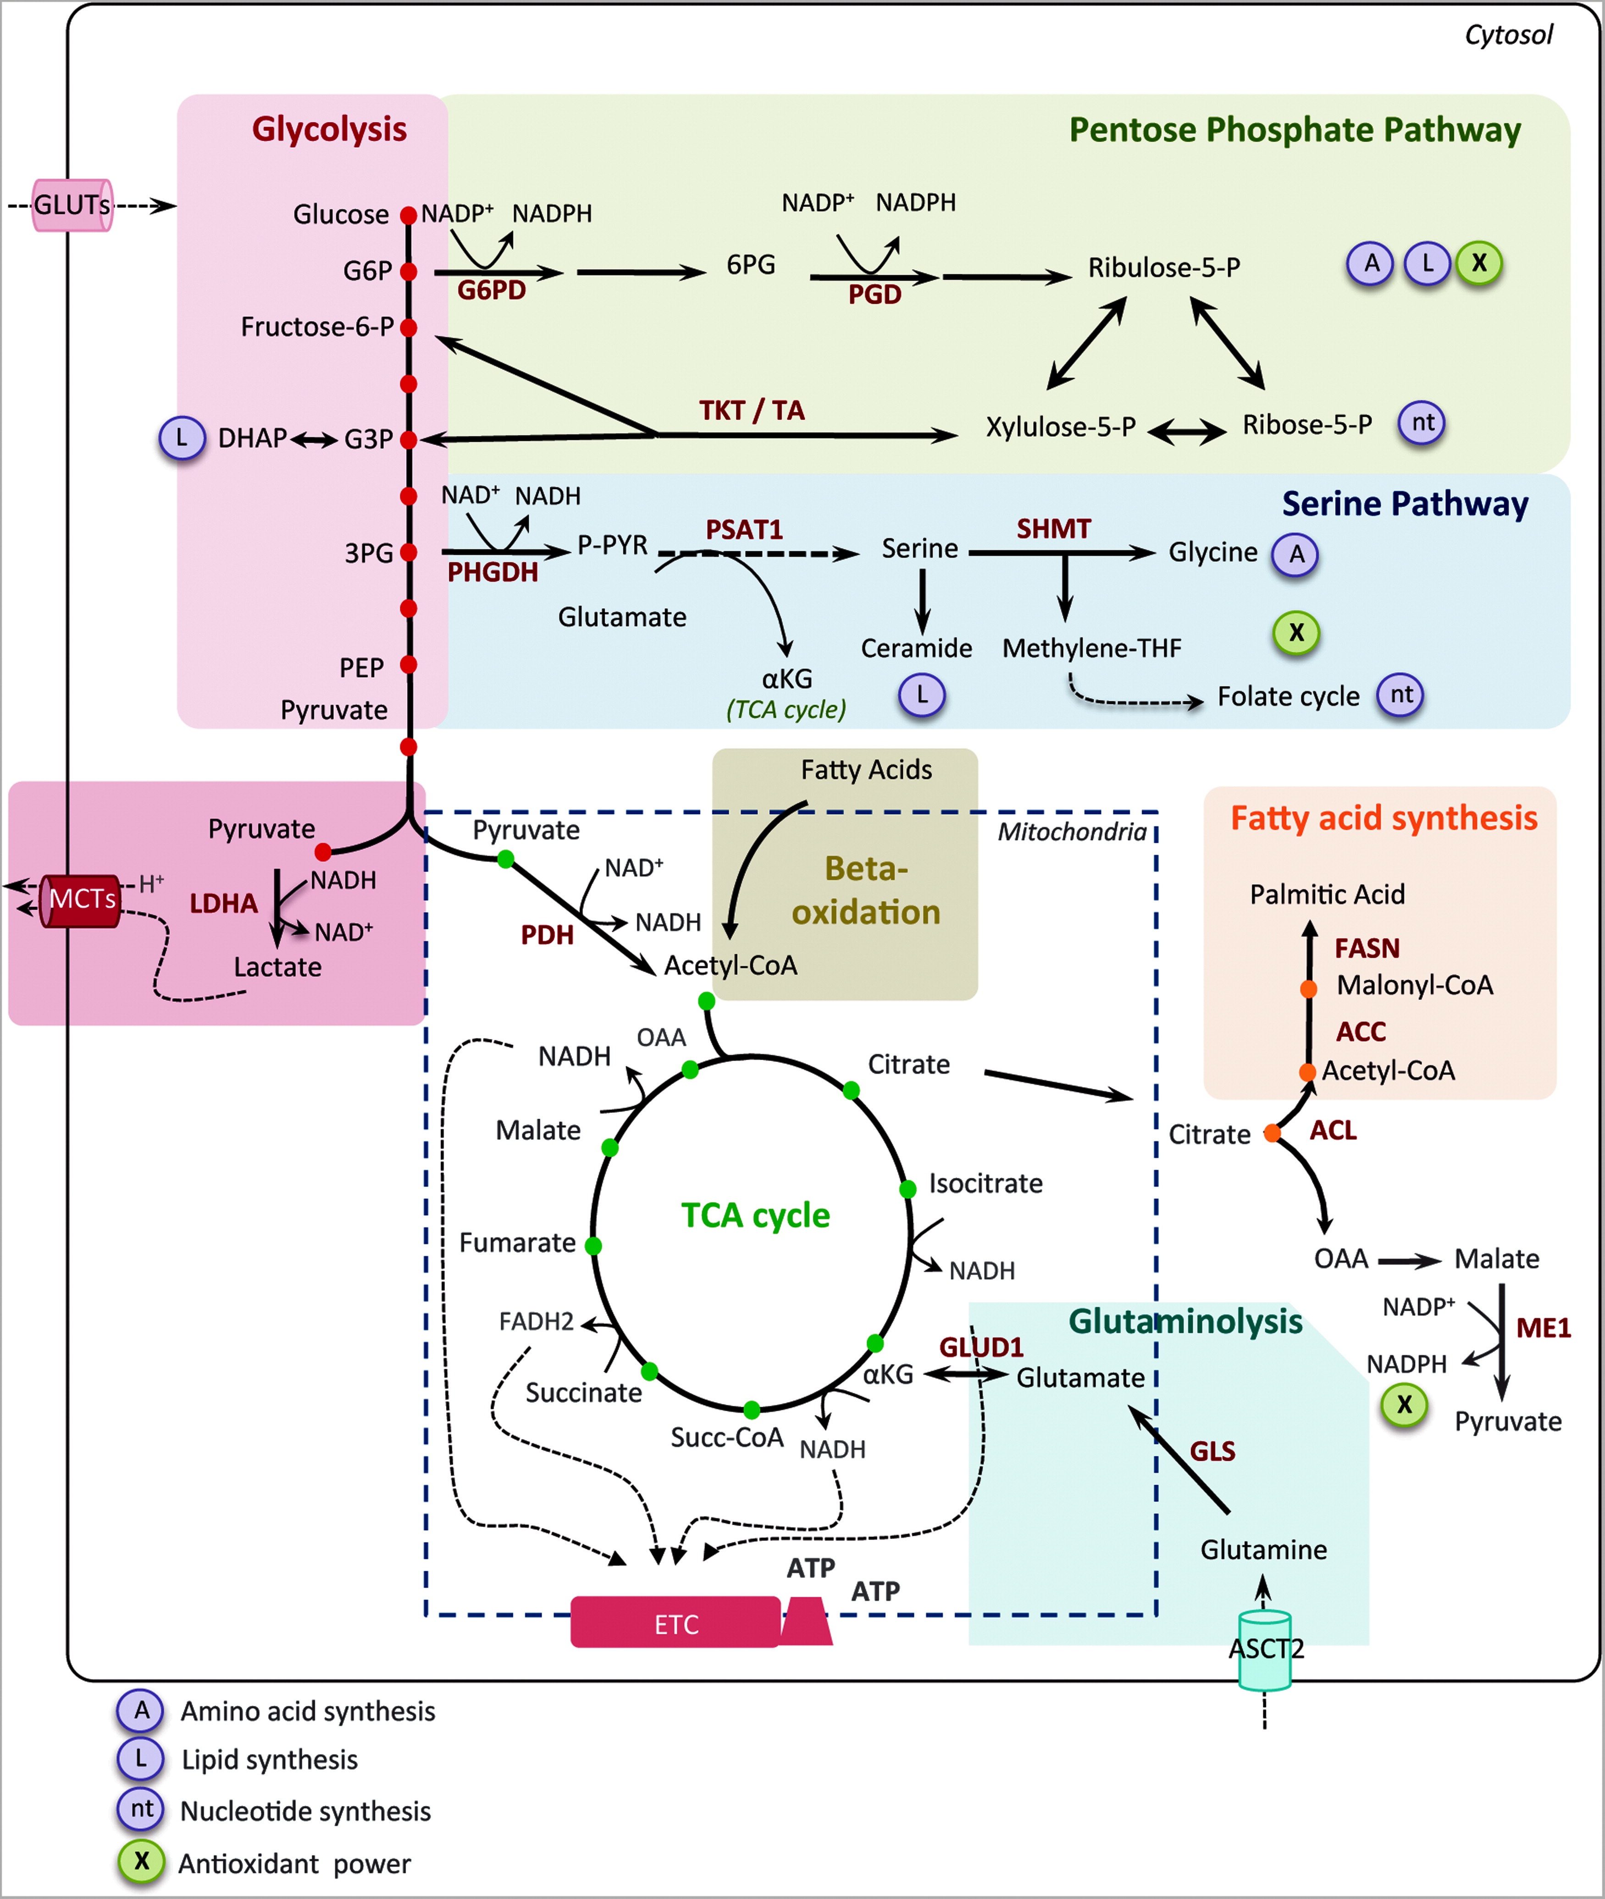
Heterogeneity in Cancer Metabolism: New Concepts in an Old Field. Antioxidants & Redox Signaling. 2017, 26(9): 462-485. DOI: 10.1089/ars.2016.6750
Notes:
FIG. 1. Core metabolic pathways and enzymes in cancer cells. Here are schematically represented the main metabolic pathways altered in cancers, including the glycolysis, the PPP, the serine pathway, the fatty acid synthesis, and the TCA cycle. In cancer cells, the canonical energy metabolism pathways are often truncated (glycolysis, TCA cycle) or redirected (glutaminolysis or serine and lipid biosynthesis). Briefly, glucose enters into cancer cells through glucose transporters and is phosphorylated to G6P by an irreversible reaction catalyzed by the hexokinase. G6P either proceeds through glycolysis to produce pyruvate or through the PPP to generate ribose-5-phosphate and NADPH. The PPP is connected at the first step of glycolysis starting with G6P dehydrogenase (G6PD) and has both an oxidative and nonoxidative arm. G6P oxidation produces the reducing equivalents, in the form of NADPH, important cellular antioxidant, and cofactor for fatty acid biosynthesis. Moreover, the PPP provides cancer cells with pentose sugars for the biosynthesis of nucleic acids. The first enzymes involved in the nonoxidative arm of the PPP are TKT and TA. Ribose-5-phosphate and xylulose-5-phosphate, generated by the oxidative PPP, can be further metabolized into F6P and G3P to reenter into glycolysis for ATP production, depending on the cell requirement. Thus, the PPP plays a key role in cancer cells to supply their anabolic demands and to counteract oxidative stress. The serine pathway is branched to glycolysis via 3-phosphoglycerate (3PG), which is converted by PHGDH into phosphohydroxypyruvate (P-PYR). This pathway produces serine and glycine, essential precursors for synthesis of proteins and nucleic acids through the folate cycle. Following glycolysis, pyruvate is either converted into lactate by LDHA and released through monocarboxylate transporters, MCT4 and MCT1, further causing extra cellular acidification, or converted into acetyl-CoA, through the PDH complex. Acetyl-CoA enters into TCA cycle and produces ATP, NADH, and FADH2 molecules. Reduced cofactors are then oxidized by the ETC complexes for ATP production. Glutamine and other amino acids can also replenish the TCA cycle. Indeed, the first step of glutaminolysis is the conversion of glutamine into glutamate by the GLS. Glutamate is subsequently converted into alpha-ketoglutarate (αKG) that fuels back the TCA cycle. Fatty acid degradation can also supply the TCA cycle through beta-oxidation, which produces acetyl-CoA. Reciprocally, citrate, a TCA cycle intermediate, can be used as a precursor for fatty acid synthesis and for NADPH production through the ACL. Citrate is subsequently converted to acetyl-CoA and OAA into the cytoplasm. Acetyl-CoA is used for fatty acid synthesis through its conversion to malonyl-CoA by ACC and to palmitic acid by the FASN. OAA is converted to malate, which is then decarboxylated into pyruvate, by the ME1 and produces NADPH. Mitochondria are represented by dotted line. ACC, acetyl-CoA carboxylase; ACL, ATP citrate lyase; αKG, alpha-ketoglutarate; ASCT2, amino acid transporter; ATP, adenosine triphosphate; DHAP, dihydroxyacetone phosphate; ETC, electron transport chain; FAD, flavin adenine dinucleotide; FASN, fatty acid synthase; F6P, fructose-6-phosphate; GADP, glyceraldehyde-3-phosphate; G3P, glyceraldehyde-3-phosphate; GLS, glutaminase; G6P, glucose-6-phosphate; GLUT, glucose transporter; LDHA, lactate dehydrogenase A; MCT, monocarboxylate transporter; ME1, malic enzyme; NAD, nicotinamide adenine dinucleotide; NADPH, nicotinamide adenine dinucleotide phosphate; OAA, oxaloacetate; PDH, pyruvate dehydrogenase; PEP, phospho-enol-pyruvate; 6PG, 6-phospho-gluconolactone; 3PG, 3-phopho-glycerate; PGD, phosphogluconate dehydrogenase; PHGDH, phosphoglycerate dehydrogenase; PPP, pentose phosphate pathway; P-PYR, phosphohydroxypyruvate; PSAT1, phosphoserine aminotransferase; SHMT1, serine hydroxymethyl transferase; Succ-CoA, succinyl-CoA; TCA, tricarboxylic acid; TA, transaldolase; TKT, transketolase. To see this illustration in color, the reader is referred to the web version of this article at www.liebertpub.com/ars

Slide 6
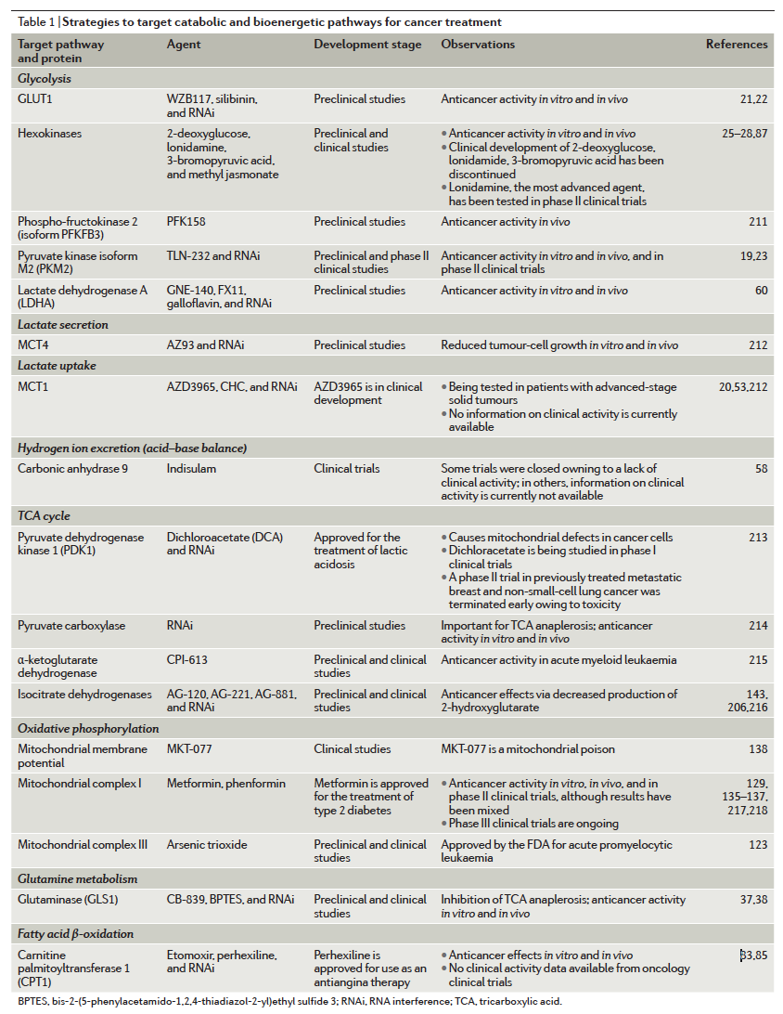
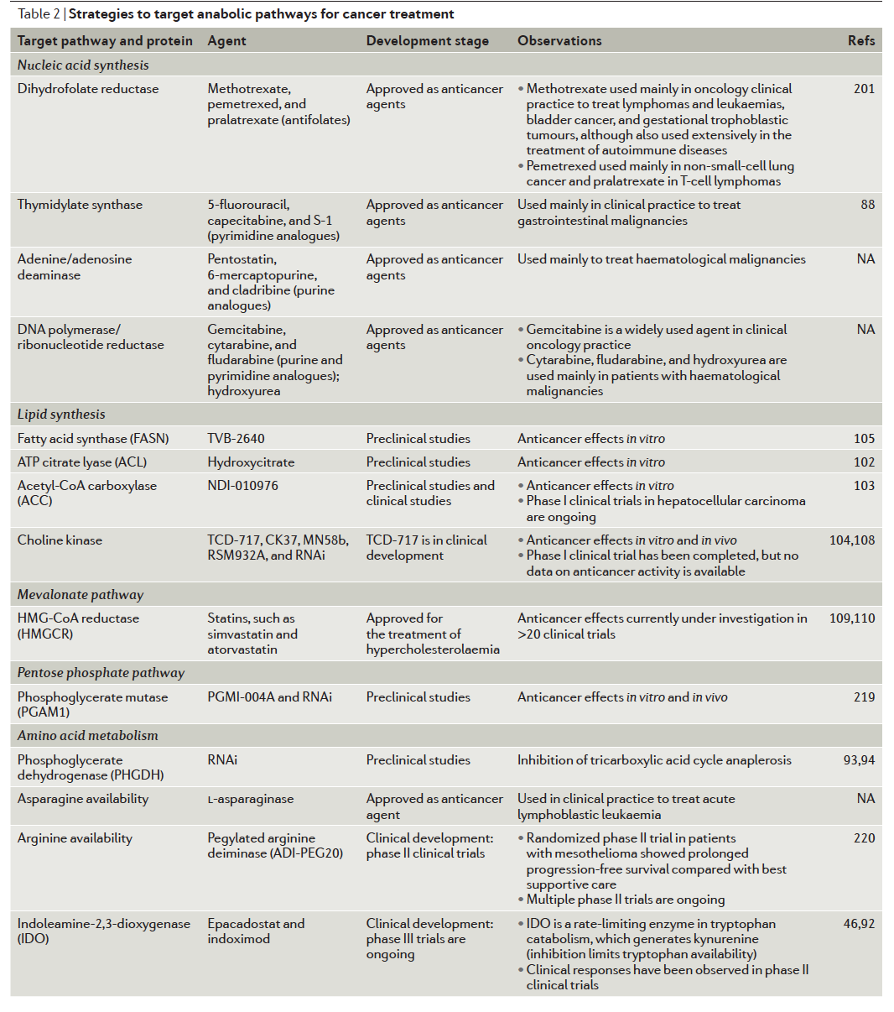
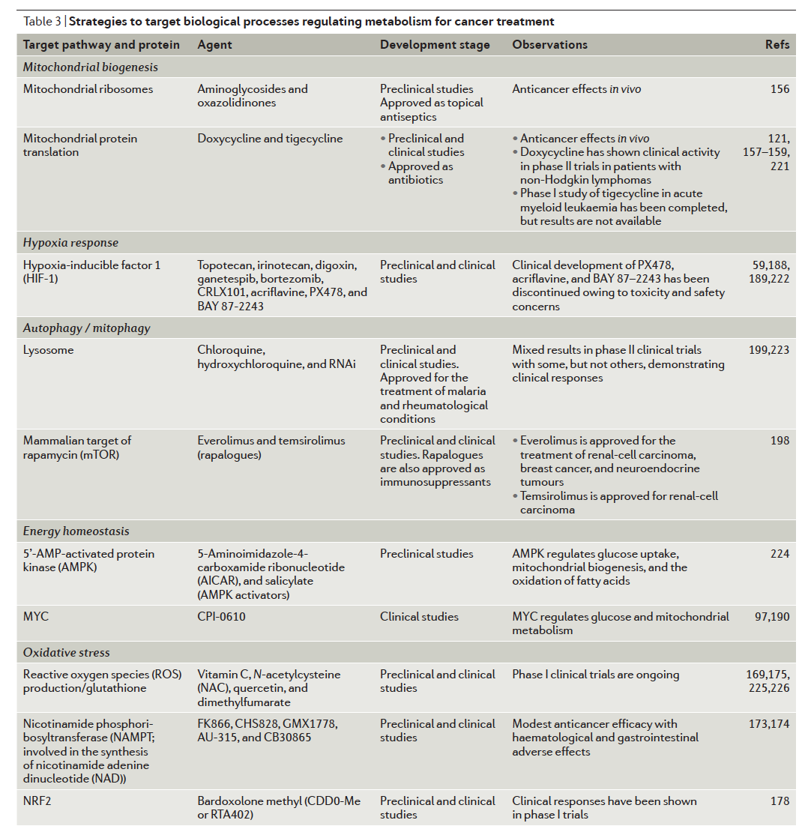
Cancer metabolism: a therapeutic perspective
Nature Reviews Clinical Oncology 14, 11–31 (2017)
doi:10.1038/nrclinonc.2016.60
Table 1 | Strategies to target catabolic and bioenergetic pathways for cancer treatment
Table 2 | Strategies to target anabolic pathways for cancer treatment
Table 3 | Strategies to target biological processes regulating metabolism for cancer treatment

Slide 7
http://biochemistry.sbmu.ac.ir/uploads/nature_reviews_metabolic_targets_for_cancer_therapy.pdf

Slide 8
Cancer and cancer metabolism: a research job perspective
CANCER
CANCER METABOLISM
https://euraxess.ec.europa.eu/jobs/search?keywords=CANCER%20
Your search results (285)
https://euraxess.ec.europa.eu/jobs/search?keywords=CANCER%20METABOLISM%20
Your search results (36)

Slide 9
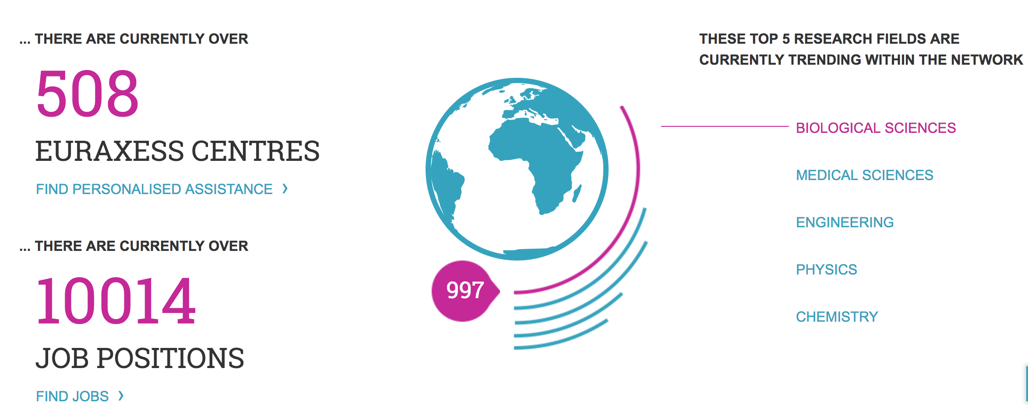
EURAXESS supports researcher mobility and career development

Slide 10
The cancer metabolic phenotype
enhanced glucose consumption, first described by Warburg (1924)
stimulated glutamine utilization, first described by Eagle (1955)
mitochondrial dysfunction
from selective (regulated, transporter-mediated) to abnormal (endocytosis) nutrient uptake
improved fitness gain of function

Slide 11
FOCUS ON
Understanding the Warburg’s effect

Slide 12
Warburg’s effect: abnormal consumption of glucose with atypical lactate production 3-30 times higher than normal. Important: observed in the presence of O₂ and even of “normal” oxidative phosphorylation
NORMAL CELL
glucose
glycolysis
Krebs’ cycle
oxidative phosphorylation
CO₂, H₂O, 36-38 ATP/mole glucose
CANCER CELL
glucose
glycolysis
Krebs’ cycle (+/-)
oxidative phosphorylation (+/-)
lactate, 2 ATP/mole glucose
APPARENT PARADOX
Proliferating cells, which require a lot of energy, do waste energy

Slide 13
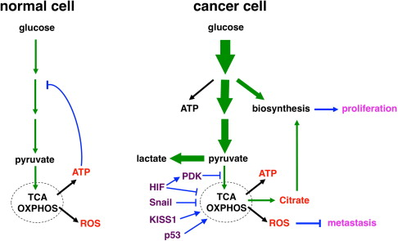
Glycolysis is enhanced

Slide 14
Glycolysis is enhanced by “cataplerotic” pathways
Intermediates of glycolysis that escape to other pathways:
Glucose-6-P
➔ Pentose phosphate pathway (slide 22)
Fructose-6-P
➔ Hexosamine biosynthetic pathway (slide 37-40)
Glyceraldehyde-3-P
➔ synthesis of phosphatidic acid (slide 41)
3-P-glycerate
➔ synthesis of serine (slide 42-45)
Pyruvate
reduction to LACTATE, exported (slide 34)

Slide 15
What does a cancer cell need to proliferate?
Building blocks and energy-rich intermediates:
citrate / acetylCoA, for:
fatty acid and cholesterol synthesis
triose 3-P, for:
triacylglicerol, cardiolipin
non-essential aminoacids (serine, glutamine) → proteins, nucleotides
one-carbon units, for
phospholipids (phospahtidylcholine)
de novo purine synthesis
glutamine and aspartate, for nucleotide synthesis
essential aminoacids, for proteins
NADPH, for:
reductive syntheses (Fatty acids, Cholesterol, Phospholipids)
high GSH/GSSG
ATP, for biosyntheses

Slide 16
What is typical of a cancer cell?
High speed of anabolic pathways for lipids, proteins, nucleic acids
it needs immediately available NADPH
it needs immediately available ATP
PROBLEM More NADPH + H⁺ is needed than ATP

Slide 17
More NADPH + H⁺ is needed than ATP WHY ?
For instance:
Reduction of glutathione:
GSSG + NADPH + H⁺⇄ 2 GSH + NADP⁺
Synthesis of palmitate:
8 acetylCoA + 7 ATP + 14 NADPH+ 14H⁺ → palmitate + 8 CoASH + 7 ADP + 7 Pi + 14 NADP⁺ + 6H₂O.
Synthesis of deoxyribonucleotides (for DNA):
NDP + NADPH+H⁺ → dNDP +NADP⁺ (ribonucleotide reductase)
Synthesis of thymidilate (dTMP): next slide

Slide 18
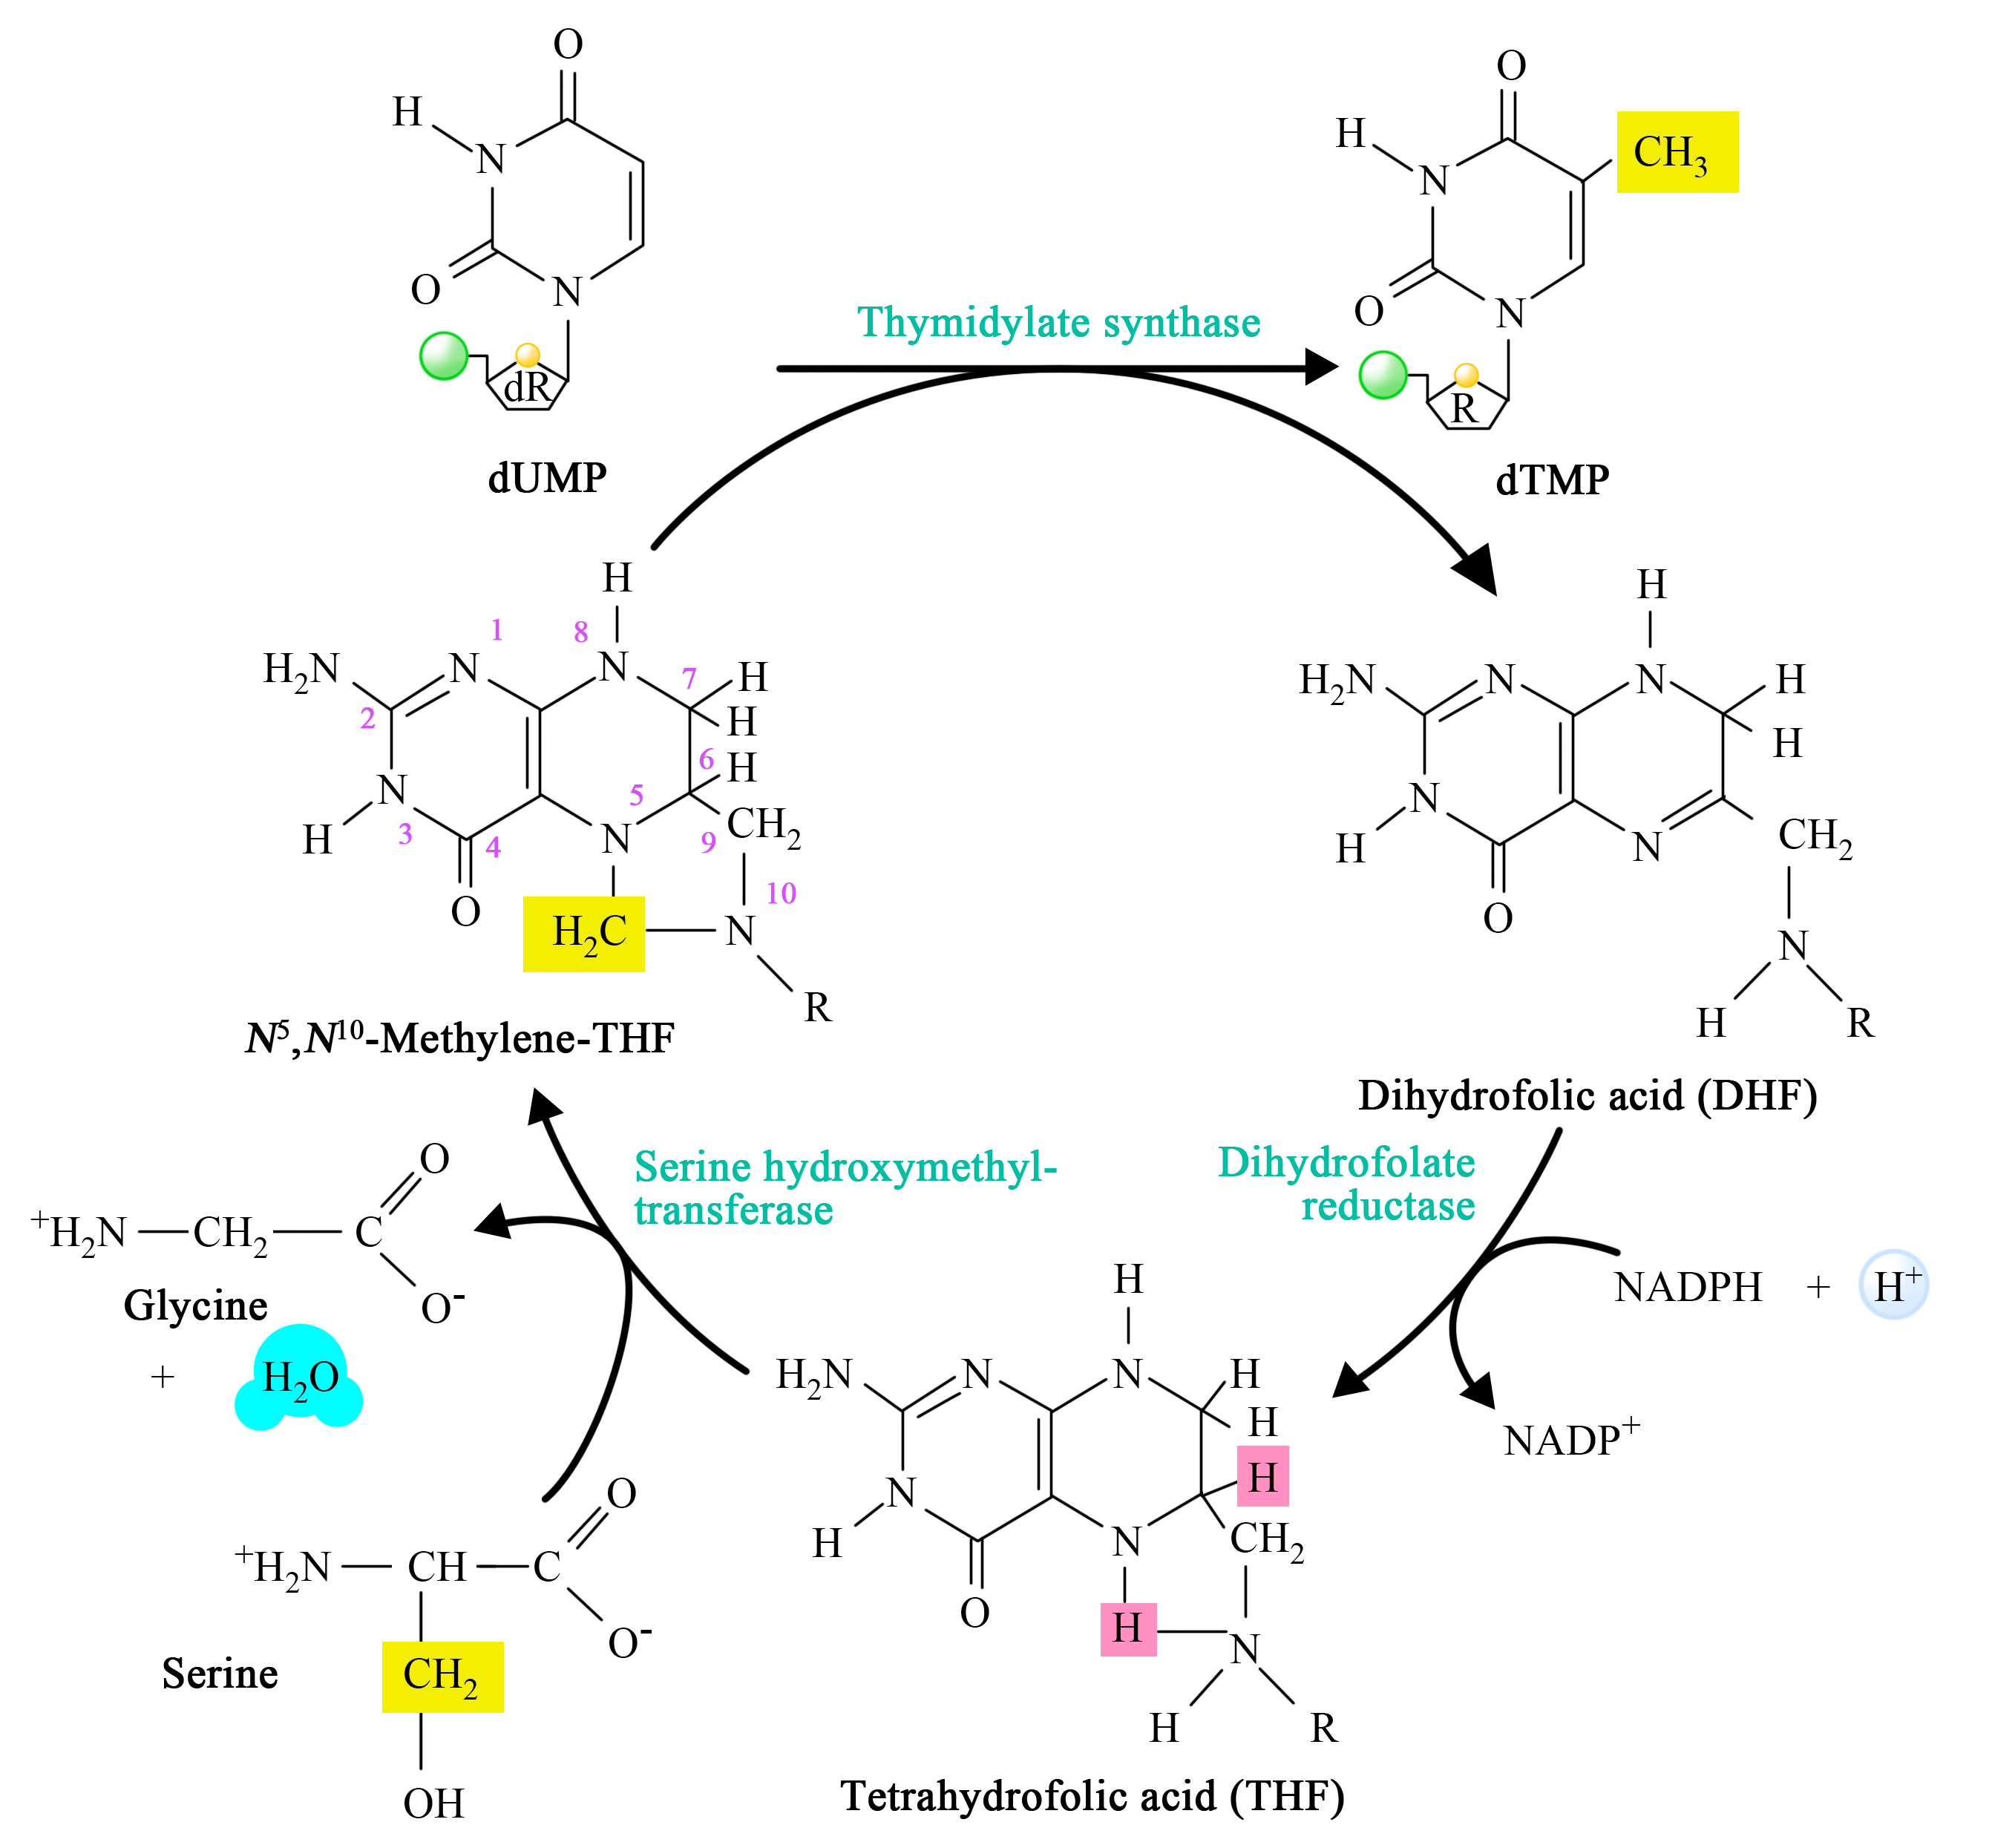

Slide 19
How to keep high NADPH/NADP⁺?
By supplying substrates to NADP⁺-dependent enzymes (slides 20-29)
By removing products of the NADP⁺-dependent enzymes (slides 31-36)

Slide 20
NADP⁺-dependent enzymes and their substrates
In the CYTOSOL
In the MITOCHONDRION
Glucose 6-P DH, 6-P gluconate DH
pentose-P pathway (slide n. 22)
Malic enzyme (slides n. 23-24)
malate to pyruvate
Isocitrate DH (slides n. 25-26)
isocitrate to 2-oxoglutarate
(R)-2-oxoglutarate is an oncometabolite
biomarker of cell transformation
inhibitor of DNA and histone demethylases
Methylene THF dehydrogenase
interconversion of THF-C1
from methylene-THF to methenyl-THF and fomyl-THF, which is consumed by de novo synthesis of purines (Slide n. )
So, glucose, malate, isocitrate
Nicotinamide nucleotide Transhydrogenase (slide 27, 42)
Glutamate DH (slide 28)
So, glutamate (from glutamine) and NADH

Slide 21
Heterogeneity in Cancer Metabolism: New Concepts in an Old Field. Antioxidants & Redox Signaling. 2017, 26(9): 462-485. DOI: 10.1089/ars.2016.6750
Notes:
FIG. 1. Core metabolic pathways and enzymes in cancer cells. Here are schematically represented the main metabolic pathways altered in cancers, including the glycolysis, the PPP, the serine pathway, the fatty acid synthesis, and the TCA cycle. In cancer cells, the canonical energy metabolism pathways are often truncated (glycolysis, TCA cycle) or redirected (glutaminolysis or serine and lipid biosynthesis). Briefly, glucose enters into cancer cells through glucose transporters and is phosphorylated to G6P by an irreversible reaction catalyzed by the hexokinase. G6P either proceeds through glycolysis to produce pyruvate or through the PPP to generate ribose-5-phosphate and NADPH. The PPP is connected at the first step of glycolysis starting with G6P dehydrogenase (G6PD) and has both an oxidative and nonoxidative arm. G6P oxidation produces the reducing equivalents, in the form of NADPH, important cellular antioxidant, and cofactor for fatty acid biosynthesis. Moreover, the PPP provides cancer cells with pentose sugars for the biosynthesis of nucleic acids. The first enzymes involved in the nonoxidative arm of the PPP are TKT and TA. Ribose-5-phosphate and xylulose-5-phosphate, generated by the oxidative PPP, can be further metabolized into F6P and G3P to reenter into glycolysis for ATP production, depending on the cell requirement. Thus, the PPP plays a key role in cancer cells to supply their anabolic demands and to counteract oxidative stress. The serine pathway is branched to glycolysis via 3-phosphoglycerate (3PG), which is converted by PHGDH into phosphohydroxypyruvate (P-PYR). This pathway produces serine and glycine, essential precursors for synthesis of proteins and nucleic acids through the folate cycle. Following glycolysis, pyruvate is either converted into lactate by LDHA and released through monocarboxylate transporters, MCT4 and MCT1, further causing extra cellular acidification, or converted into acetyl-CoA, through the PDH complex. Acetyl-CoA enters into TCA cycle and produces ATP, NADH, and FADH2 molecules. Reduced cofactors are then oxidized by the ETC complexes for ATP production. Glutamine and other amino acids can also replenish the TCA cycle. Indeed, the first step of glutaminolysis is the conversion of glutamine into glutamate by the GLS. Glutamate is subsequently converted into alpha-ketoglutarate (αKG) that fuels back the TCA cycle. Fatty acid degradation can also supply the TCA cycle through beta-oxidation, which produces acetyl-CoA. Reciprocally, citrate, a TCA cycle intermediate, can be used as a precursor for fatty acid synthesis and for NADPH production through the ACL. Citrate is subsequently converted to acetyl-CoA and OAA into the cytoplasm. Acetyl-CoA is used for fatty acid synthesis through its conversion to malonyl-CoA by ACC and to palmitic acid by the FASN. OAA is converted to malate, which is then decarboxylated into pyruvate, by the ME1 and produces NADPH. Mitochondria are represented by dotted line. ACC, acetyl-CoA carboxylase; ACL, ATP citrate lyase; αKG, alpha-ketoglutarate; ASCT2, amino acid transporter; ATP, adenosine triphosphate; DHAP, dihydroxyacetone phosphate; ETC, electron transport chain; FAD, flavin adenine dinucleotide; FASN, fatty acid synthase; F6P, fructose-6-phosphate; GADP, glyceraldehyde-3-phosphate; G3P, glyceraldehyde-3-phosphate; GLS, glutaminase; G6P, glucose-6-phosphate; GLUT, glucose transporter; LDHA, lactate dehydrogenase A; MCT, monocarboxylate transporter; ME1, malic enzyme; NAD, nicotinamide adenine dinucleotide; NADPH, nicotinamide adenine dinucleotide phosphate; OAA, oxaloacetate; PDH, pyruvate dehydrogenase; PEP, phospho-enol-pyruvate; 6PG, 6-phospho-gluconolactone; 3PG, 3-phopho-glycerate; PGD, phosphogluconate dehydrogenase; PHGDH, phosphoglycerate dehydrogenase; PPP, pentose phosphate pathway; P-PYR, phosphohydroxypyruvate; PSAT1, phosphoserine aminotransferase; SHMT1, serine hydroxymethyl transferase; Succ-CoA, succinyl-CoA; TCA, tricarboxylic acid; TA, transaldolase; TKT, transketolase. To see this illustration in color, the reader is referred to the web version of this article at www.liebertpub.com/ars

Slide 22
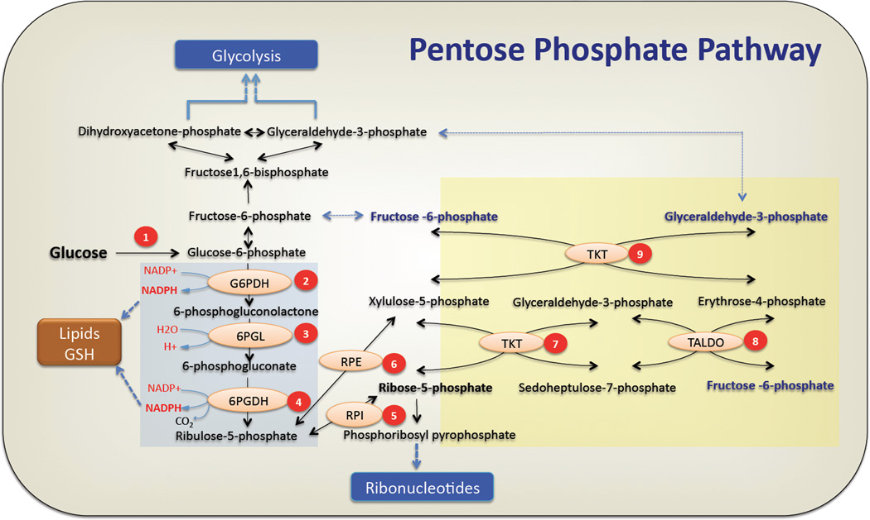
The pentose phosphate pathway and cancer Krushna C. Patra and Nissim Hay Trends Biochem Sci. 2014 Aug; 39(8): 347–354. doi: 10.1016/j.tibs.2014.06.005
Notes:
The pentose phosphate pathway
The oxidative arm of pentose phosphate pathway is initiated by conversion of glucose to glucose-6-phosphate (G6P) by hexokinases. (1) Glucose-6 Phosphate Dehydrogenase (G6PDH) oxidizes glucose-6 phosphate to form 6-phosphogluconolactone while reducing NADP+ to NADPH. (2) Hydrolysis of 6-phosphogluconolactone by 6-Phosphogluconase (6PGL) generates 6-phosphogluconate(6PG). (3) Formation of ribulose-5-phosphate occurs by oxidative decarboxylation of 6-phosphogluconate by 6PGDH. In this step the second molecule of NADPH is generated. NADPH produced in oxidative PPP can be utilized for lipid biosynthesis or ROS detoxification (GSH) (see text for deatails). Ribulose 5 phoshate (Ru5P) undergoes (5) an isomerization by Ribulose-5-Phoshate Isomerase (RPI) or (6) epimerization reaction by Ribulose-5-Phoshate Epimerase (RPE) to generate ribose-5-phosphate(R5P) or xylulose-5-phosphate(Xu5P) respectively. Ribose-5-phosphate is converted to phosphoribosyl-pyrophosphate that serves as the backbone for ribonucleotide synthesis. In the nonoxidative PPP, (7) Transketolase transfers two carbon units from xylulose-5-phosphate to ribose-5-phosphate to generate sedoheptulose-7-phosphate (S7P) and glyceraldehyde-3-phosphate (G3P). (8) Transaldolase transfers three carbon units from sedoheptulose-7-phosphate to glyceraldehyde-3-phosphate to generate erythrose-4-phosphate and the first molecule of fructose-6-phosphate. (9) In a second transketolase reaction, two carbon units from xylulose-5-phosphate are transferred to erythrose-4-phosphate to yield a second molecule of fructose-6-phosphate and glyceraldehyde-3-phosphate. Fructose-6-phosphate (F6P) can either be used for glycolysis or be converted back to G6P to replenish the oxidative PPP, while G3P can be utilized in glycolysis, depending on the cellular requirements (see text for details). The oxidative and nonoxidative branches of the PPP are highlighted by a blue and yellow backgrounds respectively.

Slide 23
The malic ezyme reaction (S)-Malate:NADP+ oxidoreductase(oxaloacetate-decarboxylating) EC 1.1.1.40

Slide 24
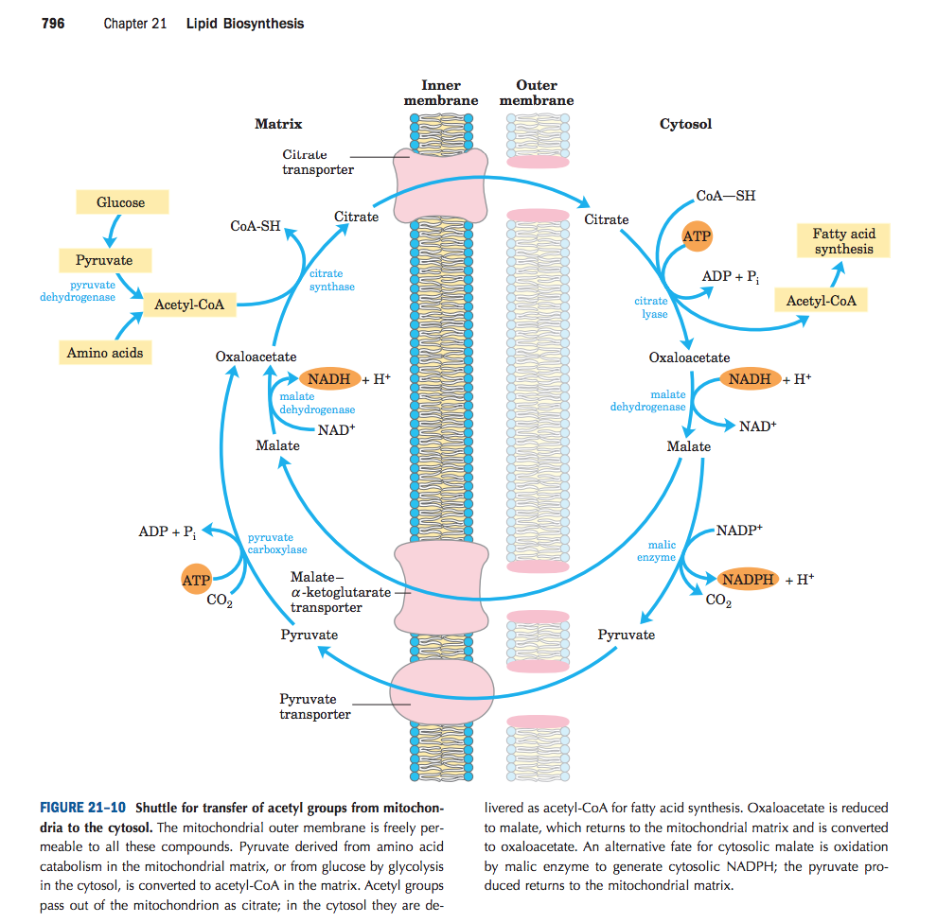
Malic enzyme for fatty acid synthesis

Slide 25
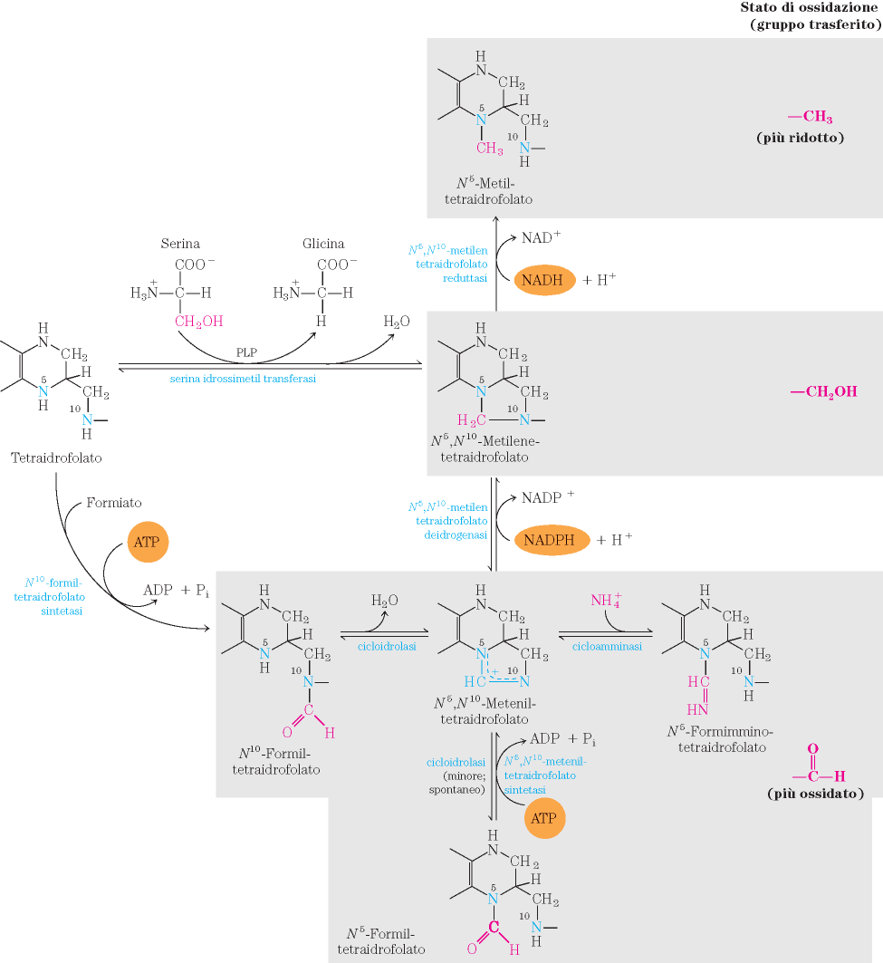
THF-C1 redox cycle (“folate trap”)
triptofano

Slide 26
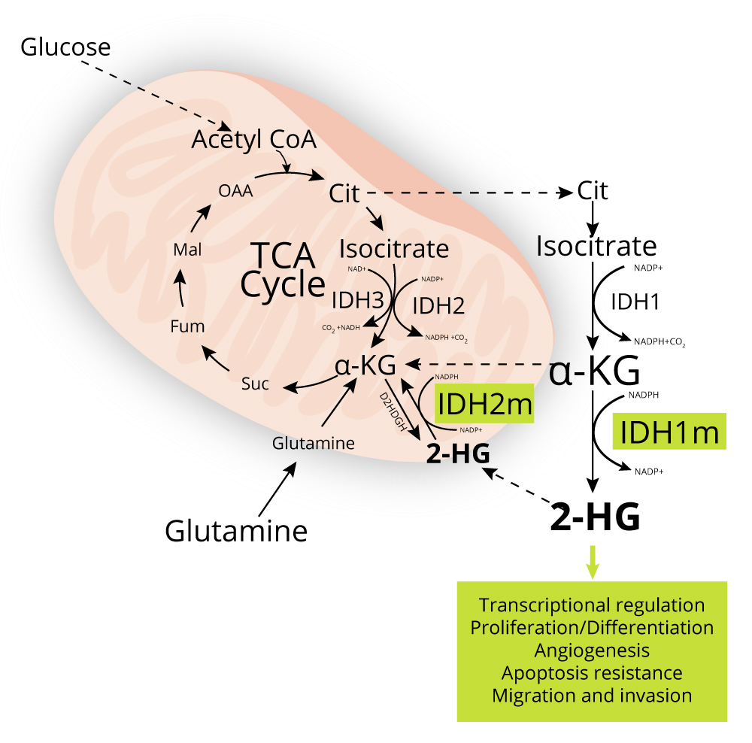
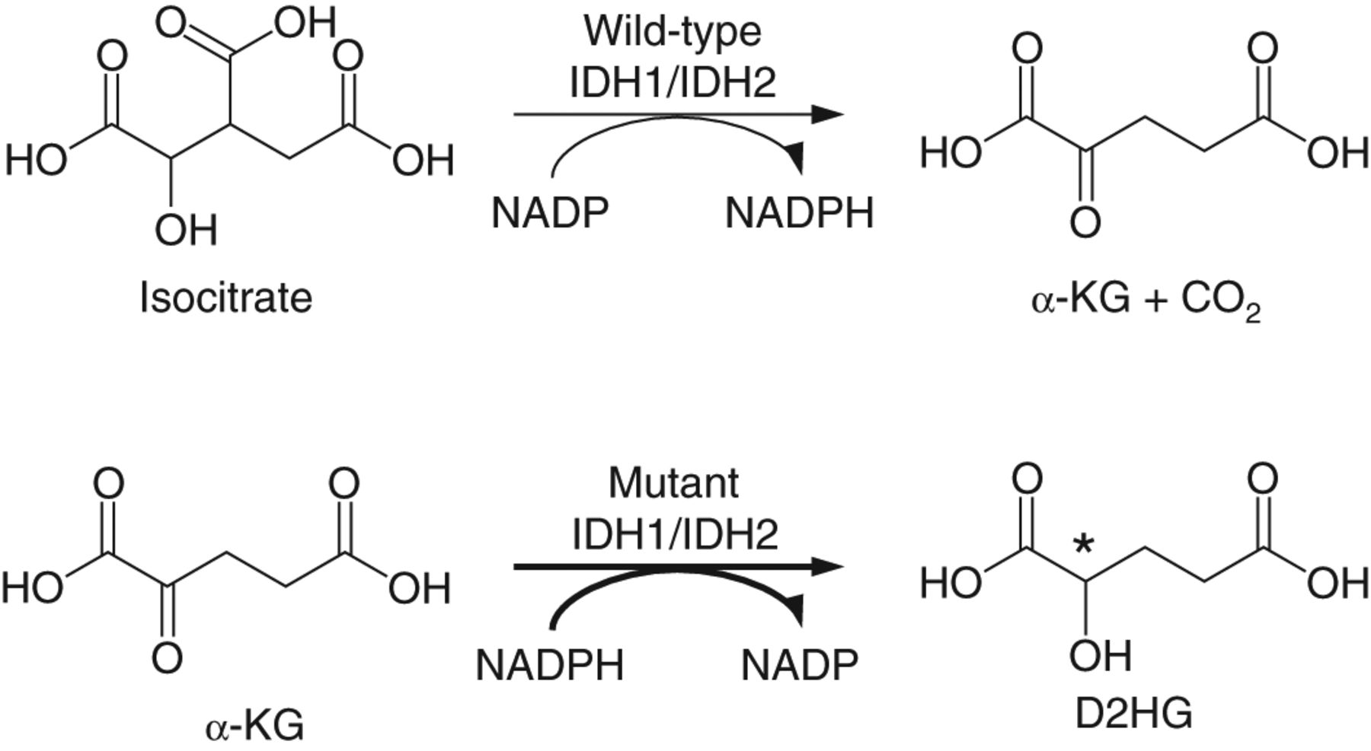
The isocitrate dehydrogenase (IDH) isoenzymes one of them catalyses the synthesis of D-2-hydroxyglutarate D-2-HG, cancer biomarker
... !!!
D2HGDH
FADH₂→FAD⁺
inhibits:
prolyl hydroxylases, cytosine hydroxylases, and histone demethylases
regulator of epigenetics

Slide 27
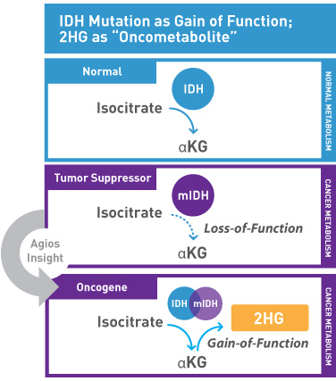
oncometabolites
mitochondrial metabolites that accumulate in cancer cells due to enzyme mutations and act as oncogenic signalling molecules

Slide 28
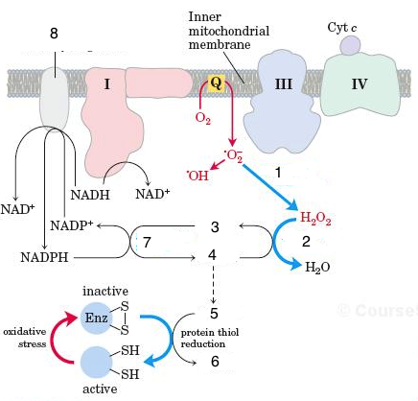
Nicotinamide nucleotide transhydrogenase (NNT) (EC:1.6.1.2): NADPH + NAD⁺ <=> NADP⁺ + NADH
Superoxide dismutase, SOD
GSSG
Glutathione peroxidase, GPx
Glutathione reductase, GR
GSH

Slide 29
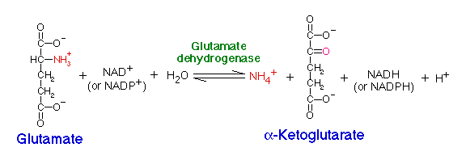
Glutamate DH EC 1.4.1.4 L-glutamate + H₂O + NADP⁺ = 2-oxoglutarate + NH₃ + NADPH + H⁺

Slide 30
How to keep high NADPH/NADP⁺?
By supplying the substrates to NADP⁺-dependent enzymes
By removing the products of the NADP⁺-dependent enzymes

Slide 31
Products of NADPH-producing enzymes
To be removed:
ribulose 5-P (formed by G6PDH, 6-P gluconate DH )
next slides
pyruvate (formed by malic enzyme)
non-essential aminoacids, lactate
2-oxoglutarate (formed by cytosolic isocitrate DH)
non-essential aminoacids
isocitrate (formed by mitochondrial isocitrate DH2, catalysing the reductive carboxylation of 2-oxoglutarate, slide 42)
Methyl-THF (formed by reductase)
de novo synthesis of nucleotides, S-adenosyl methione, etc.

Slide 32
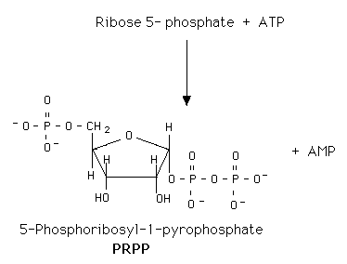
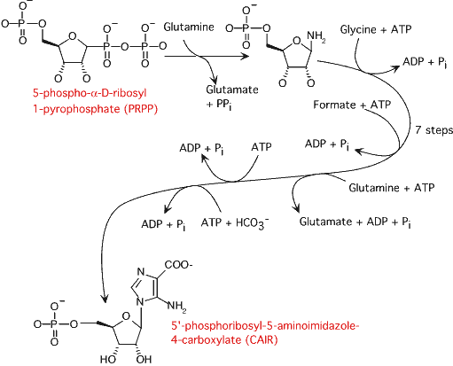
Consumption of ribose 5-P for biosynthesis
via de novo synthesis of purine and pyrimidines → nucleotides → RNA, DNA

Slide 33
Incomplete use of ribose 5-P
If not all ribose 5-P can be converted to nucleotides, the excess goes:
via transaldolase and transchetolase
fructose 6-P → → → pyruvate → LACTATE
glyceraldehyde 3-P → → pyruvate → LACTATE
Both glycoslysis and pentose-P pathway are LACTOGENIC

Slide 34
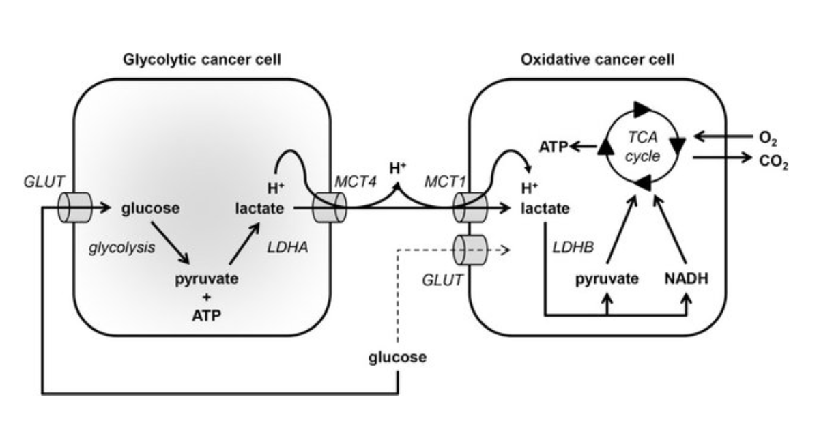
Metabolic symbiosis based on the exchange of lactate between glycolytic and oxidative cancer cells
Notes:
Source: Monocarboxylate transporters in the brain and in cancer
March 2016Biochimica et Biophysica Acta (BBA) - Molecular Cell Research 1863(10)
DOI: 10.1016/j.bbamcr.2016.03.013

Slide 35
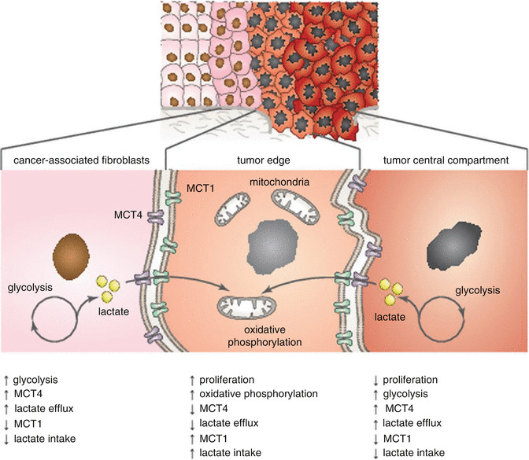
TAKE HOME MESSAGE LACTATE EFFLUX DRIVES THE PENTOSE-P PATHWAY and mediates metabolic symbiosis with nearby cells
source: Google images

Slide 36
“Lactate is necessary for all the major steps in carcinogenesis”
angiogenesis
immune escape
cell migration
metastasis
self-sufficiency of cancer cells
Reexamining cancer metabolism: lactate production for carcinogenesis could be the purpose and explanation of the Warburg Effect.
Carcinogenesis, 2016, 1–15. doi:10.1093/carcin/bgw127

Slide 37
Cataplerosis in glycolysis intrinsic to the Warburg’s effect
Intermediates of glycolysis that escape to other pathways:
BIOSYNTHESIS OF:
Hexosamine (slide 38-41)
Phosphatidic acid (slide 42)
Serine (slide 43-46)

Slide 38
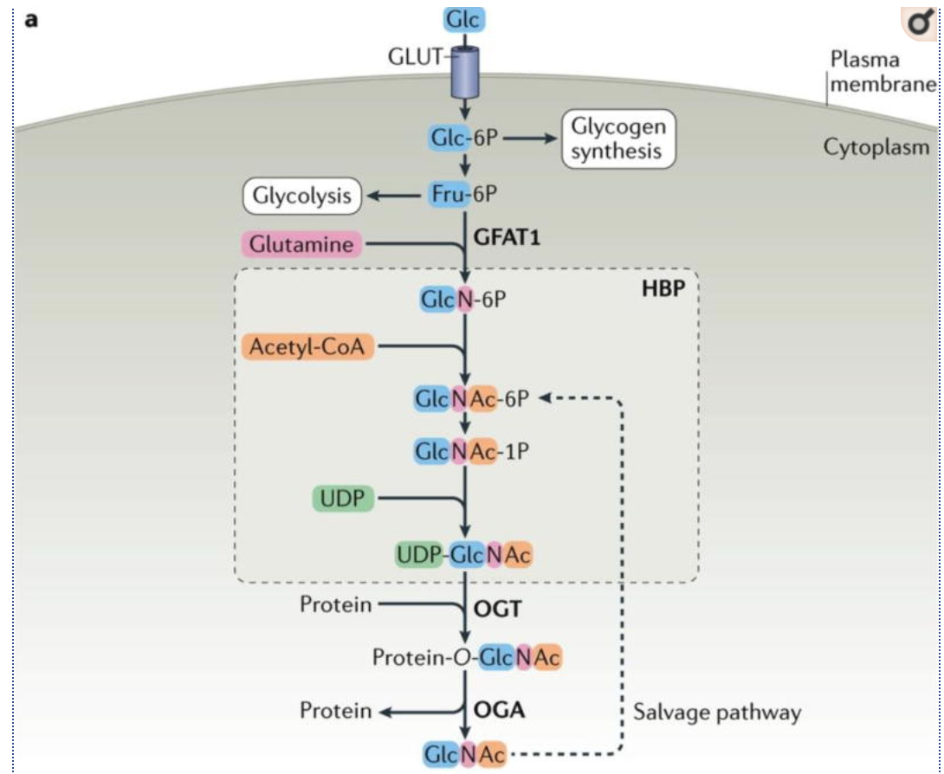
Glycolysis supports biosynthetic pathways
Fructose-6-P for hexosamine biosynthesis
Other details in slide 37
Nat Rev Mol Cell Biol. 2017 Jul;18(7):452-465. doi: 10.1038/nrm.2017.22. Epub 2017 May 10.
Protein O-GlcNAcylation: emerging mechanisms and functions.
Notes:
Nutrient flux through the hexosamine biosynthetic pathway regulates protein O-GlcNAcylation
a | Glucose (Glc) is taken up from the extracellular milieu by glucose transporter (GLUT) proteins. While a majority of glucose is used for glycolysis and glycogen synthesis, ~2–5% of glucose is channeled into the hexosamine biosynthetic pathway (HBP). Glutamine:fructose-6-phosphate amidotransferase (GFAT) catalyzes the rate-limiting step of the HBP, which converts fructose-6-phosphate (Fru-6P) into glucosamine-6-phosphate (GlcN-6P). Subsequent acetylation and uridylation of GlcN-6P yields the donor substrate for protein O-GlcNAcylation, uridine diphosphate N-acetylglucosamine (UDP-GlcNAc). O-GlcNAc transferase (OGT) and O-GlcNAcase (OGA) catalyze the addition and removal of O-GlcNAc, respectively. Free GlcNAc can be recycled via the GlcNAc salvage pathway, which converts GlcNAc into GlcNAc-6-phosphate (GlcNAc-6P) that can be utilized by the HBP.
Source: Nat Rev Mol Cell Biol. Author manuscript; available in PMC 2017 Nov 2.
Published in final edited form as:
Nat Rev Mol Cell Biol. 2017 Jul; 18(7): 452–465.
Published online 2017 May 10. doi: [10.1038/nrm.2017.22]
PMCID: PMC5667541
NIHMSID: NIHMS913110
PMID: 28488703
Protein O-GlcNAcylation: emerging mechanisms and functions
Xiaoyong Yang and Kevin Qian
https://www.ncbi.nlm.nih.gov/pmc/articles/PMC5667541/

Slide 39
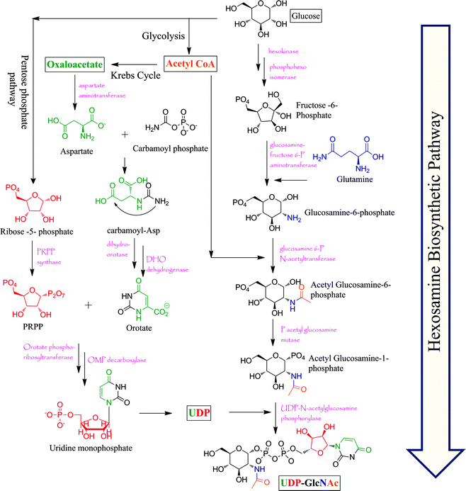
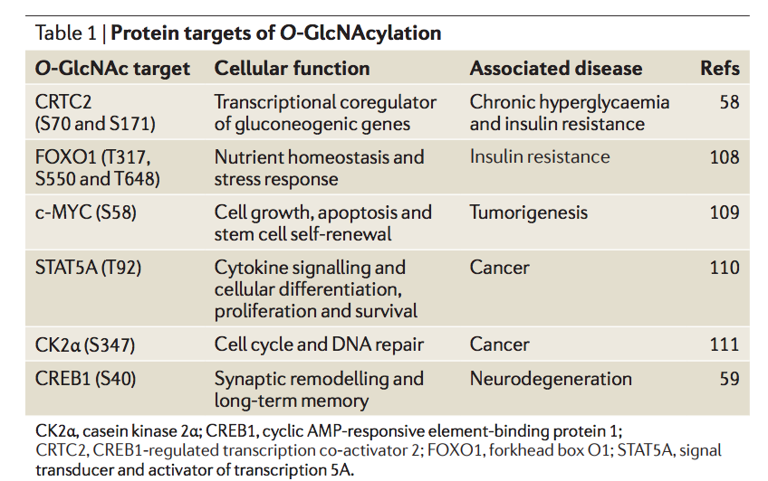
Glycolysis supports biosynthetic pathways
Fructose-6-P for hexosamine biosynthesis
Bittersweet memories: linking metabolism to epigenetics through O-GlcNAcylation. Nature Reviews Molecular Cell Biology 13, 312–321 (2012)
doi:10.1038/nrm3334
N-acetylglucosamine for post-translational modification of proteins
Chemical approaches to study O-GlcNAcylation
Chem. Soc. Rev., 2013,42, 4345-4357.
DOI: 10.1039/C2CS35412H

Slide 40
Post-translational modification by O-linked β-N-acetylglucosamine (O-GlcNAc)

Slide 41
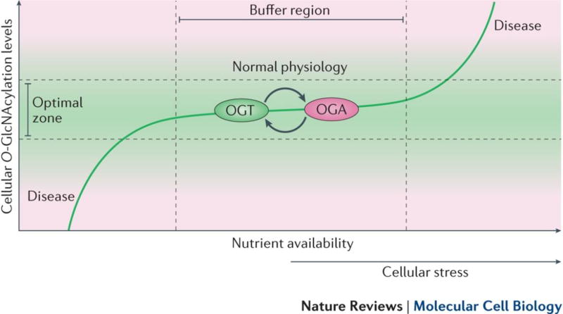
Nutrient availability is thought to regulate cellular O-GlcNAcylation levels by controlling flux through the hexosamine biosynthetic pathway (HBP)
Notes:
Maintenance of O-GlcNAc homeostasis by mutual regulation of O-GlcNAc transferase and O-GlcNAcase
We propose that there exists an “optimal zone” within which global O-GlcNAcylation levels must remain in order to preserve normal cellular function. In response to mild stress stimuli or moderate perturbations in nutrient availability, cellular O-GlcNAcylation levels may be maintained within the “optimal zone” by a “buffering” system consisting of mutual regulation of O-GlcNAc transferase (OGT) and O-GlcNAcase (OGA) at the transcriptional and post-translational levels. However, severe and chronic insults to the cellular O-GlcNAcylation “buffer” may eventually lead to loss of O-GlcNAc homeostasis, which is an important factor contributing to the pathogenesis of various human diseases.
Source: PMC full text:
Nat Rev Mol Cell Biol. Author manuscript; available in PMC 2017 Nov 2.
Published in final edited form as:
Nat Rev Mol Cell Biol. 2017 Jul; 18(7): 452–465.
Published online 2017 May 10. doi: [10.1038/nrm.2017.22].

Slide 42
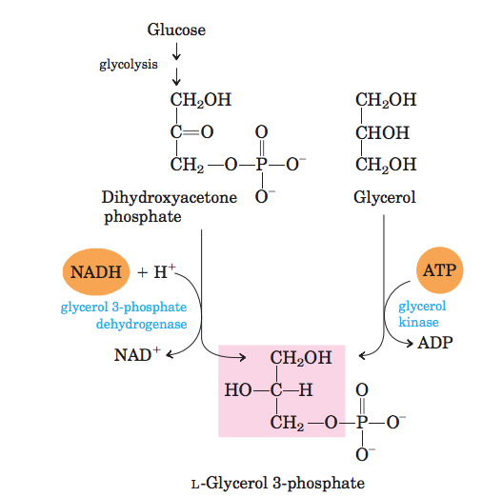
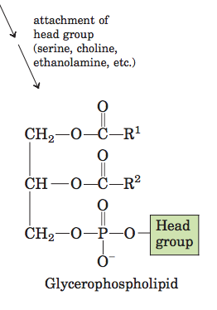
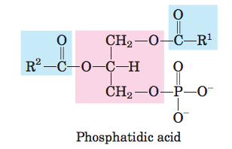
Glycolysis supports biosynthetic pathways
Glyceraldehyde-3-P for glycerophospholipids
source: Lehninger Principles of Biochemistry 4° ed.

Slide 43
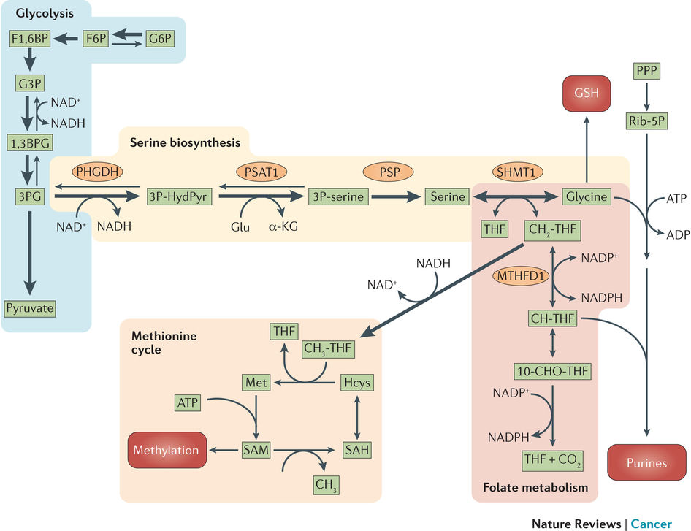
Glycolysis supports biosynthetic pathways
3-phosphoglycerate for serine biosynthesis
Reprogramming glucose metabolism in cancer: can it be exploited for cancer therapy? Nature Reviews Cancer 16, 635–649 (2016)
doi:10.1038/nrc.2016.77

Slide 44
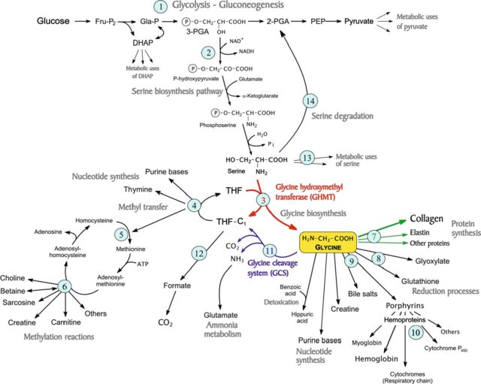
Notes:
Figure 3. Metabolic pathways involved in the biosynthesis of glycine from serine, and its use for different metabolic functions. Pathways: 1, glycolysis-gluconeogenesis system; 2, branch to synthesis of serine and glycine; 3, reaction of glycine hydroxymethyltransferase (GHMT) (EC 2.1.2.1) (shown in red), which converts serine into glycine with the transfer of a C 1 unit to tetrahydrofolate (THF); 4-6, set of reactions of C 1 transfer, necessary for glycine synthesis as they unload the C 1 unit from THF-C1, regenerating free THF so that it can participate again in reaction 3; 7-10, processes of biosynthesis involving glycine, especially the synthesis of collagen and other proteins (reactions 7, shown in green); 11, irreversible reaction of the glycine cleavage system, (EC 1.4.4.2) (shown in blue), which converts glycine into a C 1 unit; 12, oxidation of the C 1 unit to formate and CO 2 , which works as a sink of C 1 units, allowing the capability for glycine synthesis to increase; 13, set of reactions that use serine for other processes, e.g. for choline synthesis; 14, pathways for serine degradation. Symbols: DHAP, dihydroxyacetone-phosphate; Fru-P 2 , fructose 1,6-bisphosphate; Gla-P, glyceraldehyde 3-phosphate; 3-PGA, 3-phosphoglycerate; 2-PGA, 2-phosphoglycerate; PEP, phosphoenolpyruvate; THF-C 1 , 5, 10-methylene-THF. See also fi gure 4.
Source: https://www.researchgate.net/publication/23959817_Branch-point_stoichiometry_can_generate_weak_links_in_metabolism_the_case_of_glycine_biosynthesis/figures?lo=1

Slide 45
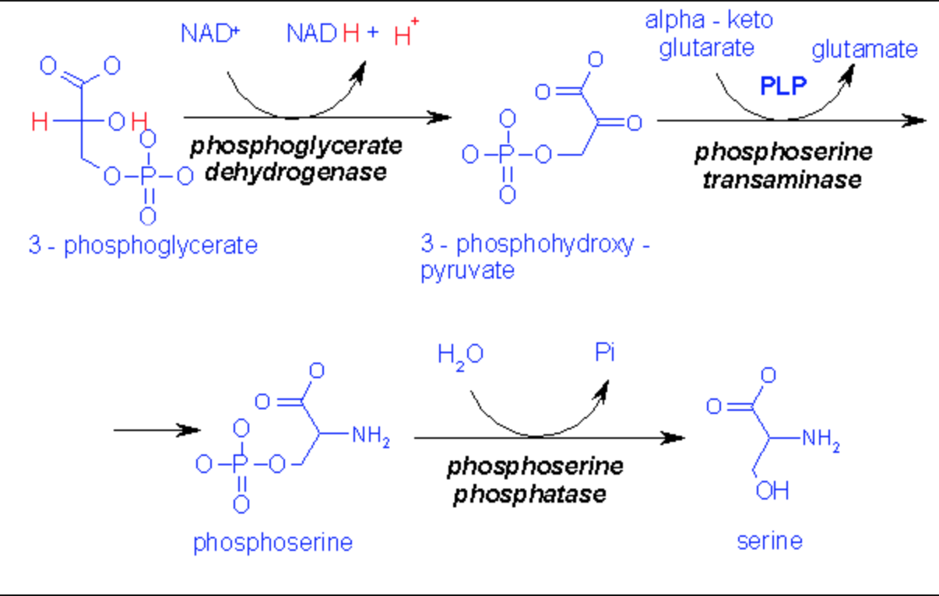
Synthesis of serine from 3-P-glycerate

Slide 46
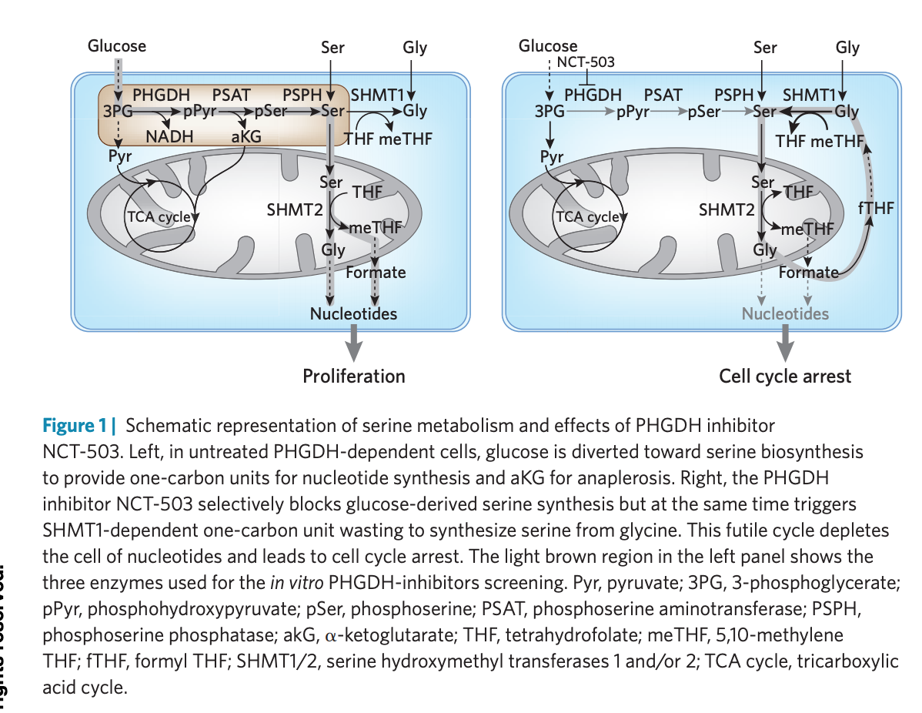

Slide 47
End of lecture of 09.04.2019
To be continued on 17.09.2019

Slide 48
Any advantage to use aerobic glycolysis?
SPEED
Avoid the multi-step mitochondrial control on ATP synthesis:
Is ADP available in the matrix? If so, ATP synthase can work.
Is the ETC ready to accept e⁻ from NADH/FADH₂? If so, NADH and FADH₂ can be oxidised.
Are NAD⁺ and FAD available for PDH and TCA DHs? If so, pyruvate can be converted to acetylCoA and so on.

Slide 49
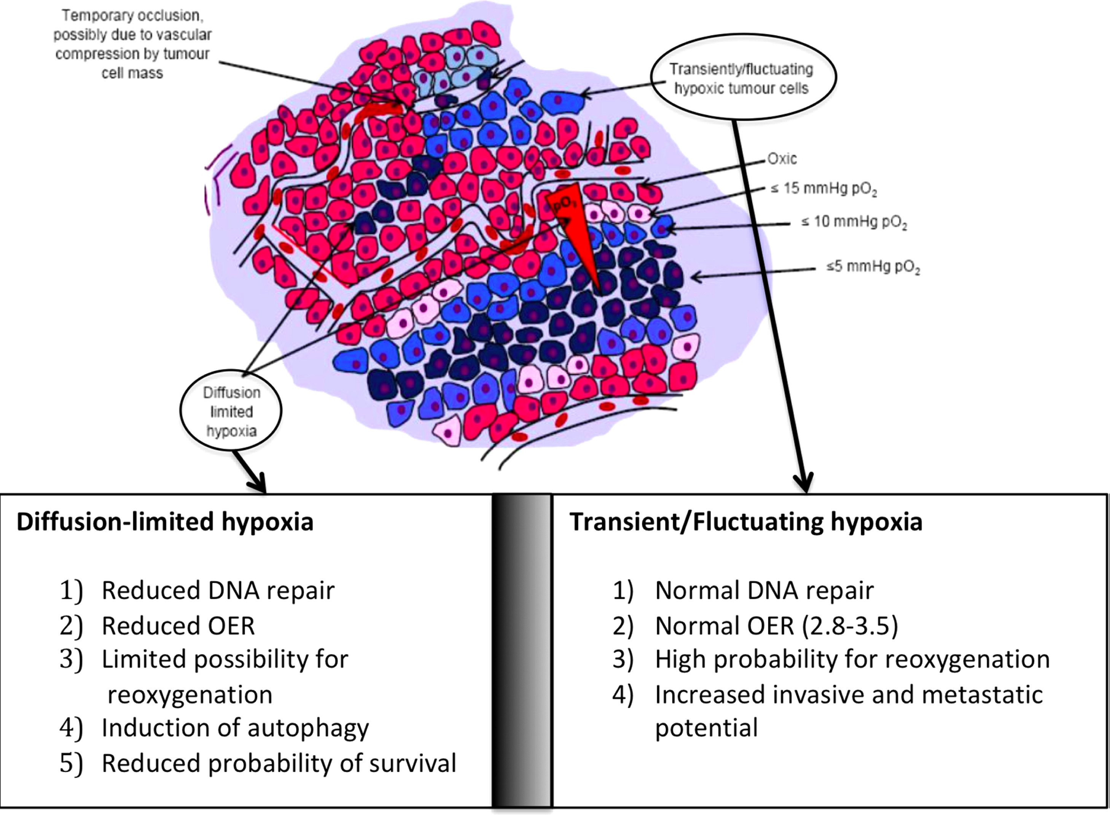
Any advantage to use aerobic glycolysis?
Withstand fluctuating pO₂
Hypoxia and Predicting Radiation Response. Seminars in Radiation Oncology (2015) 25, 260-272. doi: 10.1016/j.semradonc.2015.05.004

Slide 50
Understanding the Eagle’s observation (1955) Cancer cells need glutamine to grow
Glutamine supports biosynthetic reactions
Nucleotides
Glucosamine
Asparagine
non-essential aminoacids
glutathione
Cancer cell metabolism: the essential role of the nonessential amino acid, glutamine." The EMBO Journal (2017): e201696151
DOI: 10.15252/embj.201696151

Slide 51
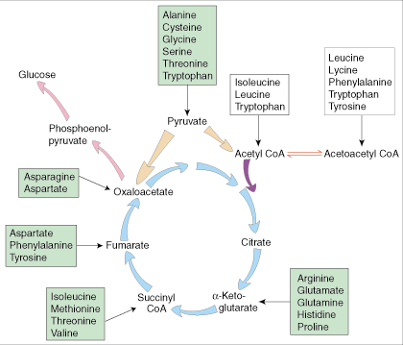
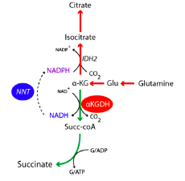
How is citrate supplied in cancer cells? From glutamine, also counter-clockwise
Reductive carboxylation of α-KG by IDH2

Slide 52
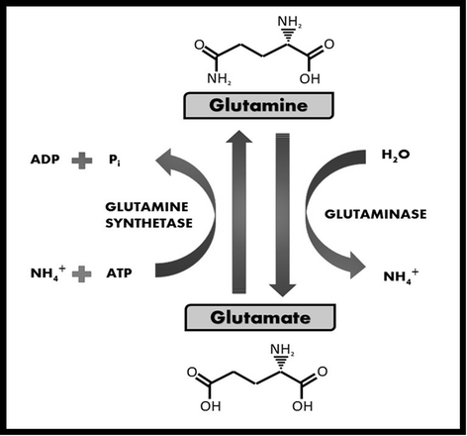
Glutamate and Glutamine interconvert
Glutamine metabolism and its effects on immune response: molecular mechanism and gene expression. Nutrire 2016, 41:14. DOI: 10.1186/s41110-016-0016-8

Slide 53
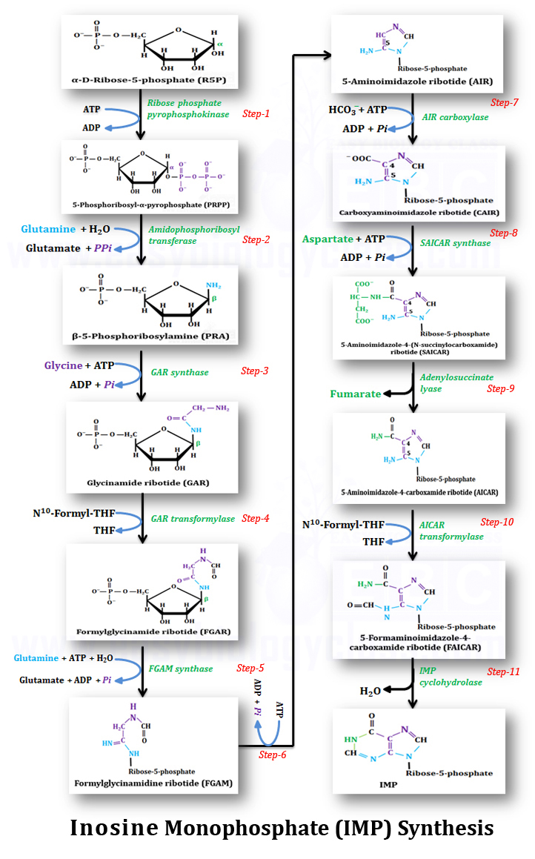
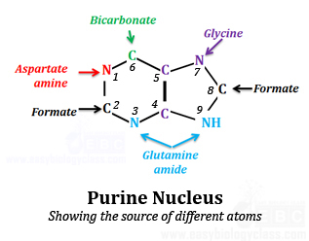
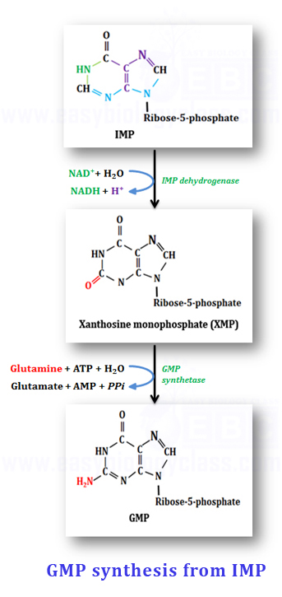
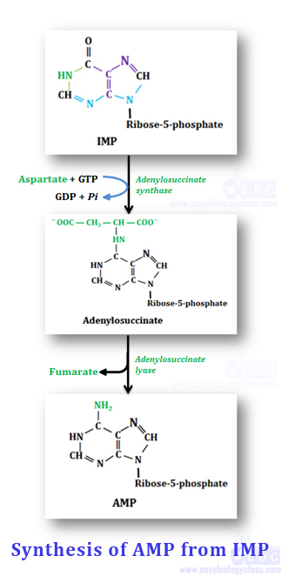

Slide 54
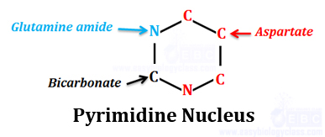

Slide 55
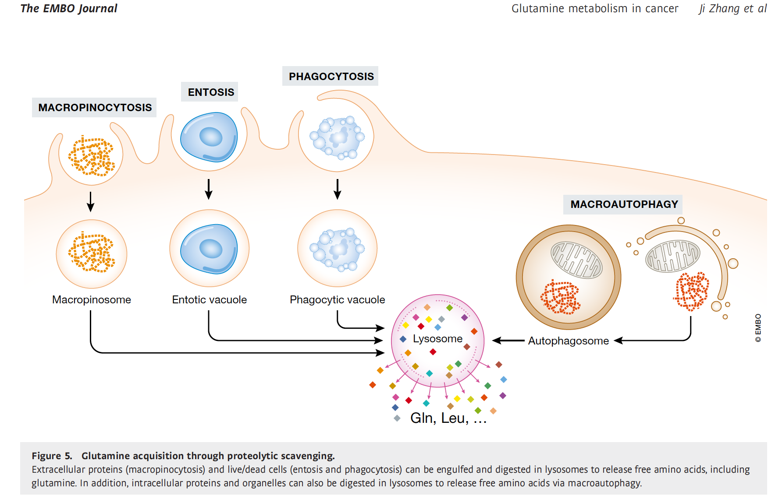
“Glutamine acquisition through proteolytic scavenging”

Slide 56
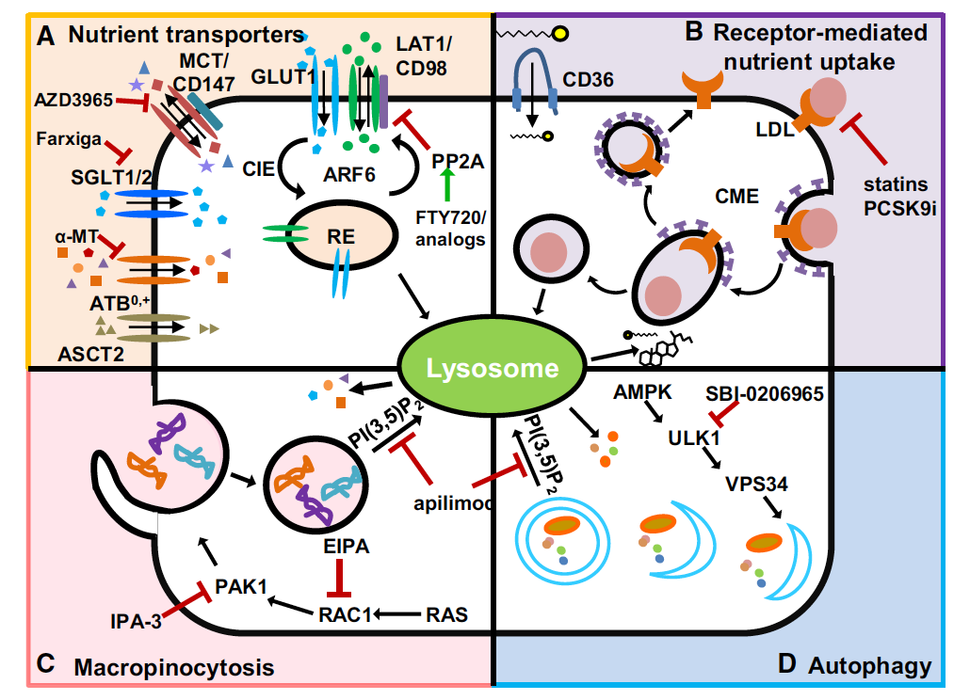
“Attacking the supply wagons to starve cancer cells to death” FEBS Letters 590 (2016) 885–907. doi:10.1002/1873-3468.12121
Notes:
Fig. 1. Nutrient acquisition pathways that feed cancer anabolism and selected agents that disrupt these pathways. (A) Surface nutrient
transporters facilitate the uptake of polar metabolites such as glucose, amino acids, acetate, and lactate. Oncogenic mutations promote
enhanced surface localization of these proteins to maintain a constant nutrient influx. The Arf6 GTPase regulates clathrin-independent
endocytosis (CIE) and recycling of GLUT1 and CD98/LAT1. RE, recycling endosome. For details on inhibitor action, see text and Table 1.
(B) Surface receptors also contribute to oncogenic nutrient uptake. Certain tumors depend on low density lipoprotein (LDL) uptake via
clathrin-dependent endocytosis (CDE) of the LDL receptor to generate cholesterol and fatty acids upon lysosomal degradation. Statins
and PCSK9 inhibitors reduce circulating LDL and would inhibit this pathway. CD36 is a scavenger receptor that promotes fatty acid
import through a mechanism that is poorly defined. (C) Macropinocytosis involves actin rearrangements at the plasma membrane that
extend and engulf extracellular material. Engulfed proteins are delivered to the lysosome where they are digested to amino acids that
can be used by the cell. Nutrient generation by this pathway can be suppressed by either preventing macropinosome biogenesis or
blocking macropinosome degradation. (D) Although a catabolic pathway, autophagy supplies nutrients that can be essential for survival
under stress, and this pathway must be blocked to starve cancer cells. Inhibiting ULK1 specifically blocks autophagy. Agents that block
lysosomal fusion may simultaneously block nutrient acquisition from autophagy and macropinocytosis and may therefore be more
effective.

Slide 57
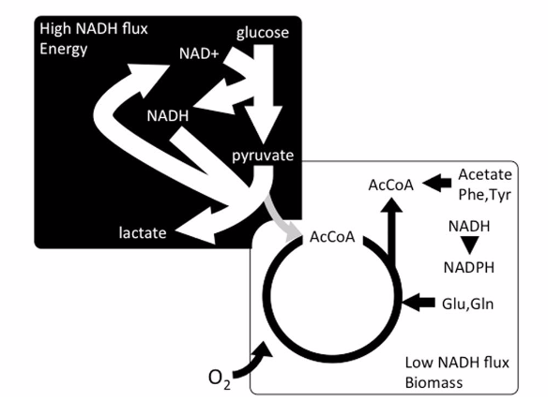
Warburg (black) & Eagle (white)
Limits of aerobic metabolism in cancer cells. SCIENTIFIC REPORTS | 7: 13488 | DOI:10.1038/s41598-017-14071-y

Slide 58
Eagle, H. (1955). The minimum vitamin requirements of the L and HeLa cells in tissue culture, the production of specific vitamin deficiencies, and their cure. J. Exp. Med. 102, 595–600. Warburg O, Wind F, Negelein E: THE METABOLISM OF TUMORS IN THE BODY. J Gen Physiol 1927, 8:519 LP-530
The end

Slide 59
Tackling cancer by its metabolism
Switch from anabolism to catabolism
the biochemical rationale
the nutritional approach
the lifestyle approach

Slide 60
Cancer cell steady-state metabolism
High ATP/ADP
ATP is NOT limiting
ADP is limiting, causing:
decreased NADH oxidation
limited O₂ consumption (→→ Warburg’s effect)
High NADH/NAD⁺
NAD⁺ is limiting:
Krebs cycle arrest, citrate accumulation
switch on anabolic pathways

Slide 61
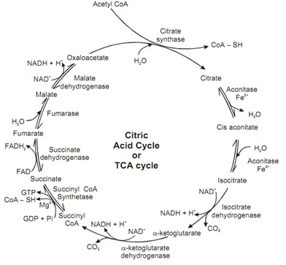
What happens if NAD⁺ is not available? Arrest of Krebs cycle and anabolism
Questions:
What happens if isocitrate accumulates?
What is the fate of citrate?
Can citrate be transported into to the cytosol?

Slide 62
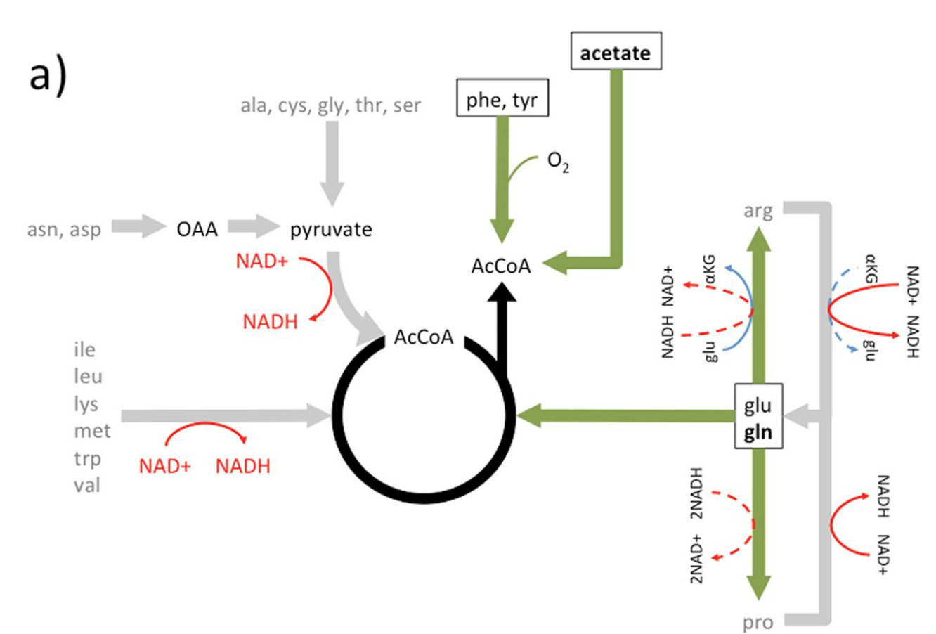
GLUTAMINE the preferred substrate for cancer cell anabolism and growth no NADH formation, no O₂ consumption “ANAEROBIC ANABOLISM”
These reactions produce NADH, which blocks the TCA cycle and overloads the ETC: not the preferred ones
Limits of aerobic metabolism in cancer cells. SCIENTIFIC REPORTS | 7: 13488 | DOI:10.1038/s41598-017-14071-y

Slide 63
Physiological (vs pharmacological) control of cancer cell metabolism Increase of ADP
High ATP/ADP, High NADH/NAD⁺
ATP is NOT limiting
Krebs cycle arrest
switch on anabolic pathways
If ATP/ADP decreases, then
2 ADP → ATP + AMP
AMP (+) → AMPKinase
switch on catabolic pathways
increased respiration
increased ROS
CELL CYCLE ARREST
thus the cancer cell is metabolically regulated
thus, the cancer cell can be killed by switching its steady state metabolism from anabolism to catabolism

Slide 64
Physiological (vs pharmacological) control of cancer cell metabolism Increase of NAD+
High ATP/ADP, High NADH/NAD⁺
ATP is NOT limiting
Krebs cycle arrest
switch on anabolic pathways
If NAD⁺/NADH increases, then
increased respiration
increased ROS
CELL CYCLE ARREST
Any strategy is OK, such as
administration of NAD⁺ and its precurosns (nicotinic acid, nicotinamide,

Slide 65
Control of cancer cell metabolism Decrease of lactate
Physiological (vs pharmacological) control of cancer cell metabolism Decrease of lactate
If Lactate/pyruvate decreases, than
NAD⁺/NADH increases, then
increased respiration
increased ROS
CELL CYCLE ARREST

Slide 66
Soft strategy to control cancer
WATCH YOUR METABOLISM
Ketogenic diet
Caloric restriction
Obesity and cancer
Physical excercise
Biological clock

Slide 67
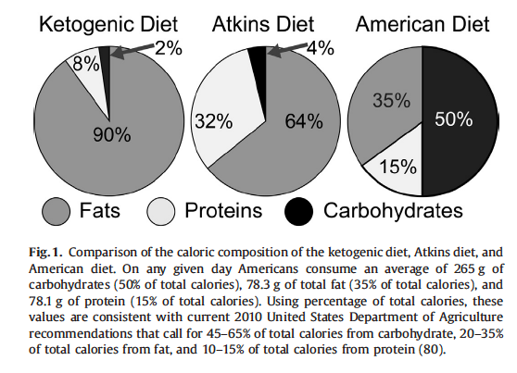
Control of cancer cell metabolism Ketogenic diet

Slide 68
Control of cancer cell metabolism Ketogenic diet
No glucose
No glycolysis:
Less ATP
Less pyruvate/lactate
No pentose-P patway:
less NADPH
less GSH
More oxidative phosphorylation
More mito-ROS
Cancer cell toxicity

Slide 69
Control of cancer cell metabolism Calorie restriction
Reduction (by 30-50%) in calorie intake
without malnutrition
vegetables,
fruits,
whole grains,
nuts,
egg whites,
fish,
low-fat dairy products,
lean meat
essential aminoacids and lipids, vitamins, polyphenols

Slide 70
Calorie restriction: a nutritional experiment
In many species:
yeast,
fruit flies,
nematodes,
fish,
rats,
mice,
and dogs

Slide 71
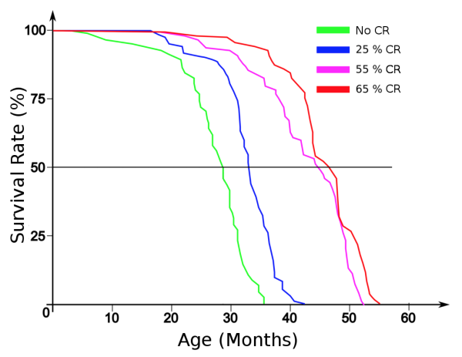
Caloric restriction & life span
Weindruch, R, Walford, R.L. et al. (1986). The retardation of aging in mice by dietary restriction: longevity, cancer, immunity and lifetime energy intake. Journal of Nutrition 116, 641-654.

Slide 72
Calorie restriction in rodents
70-80% of all deaths in rodents are due to cancer.
Calorie restriction inhibits several cancers:
spontaneous,
chemically-induced
radiation-induced
However, chronic CR may also impair some key functions, such as immunity and wound healing.

Slide 73
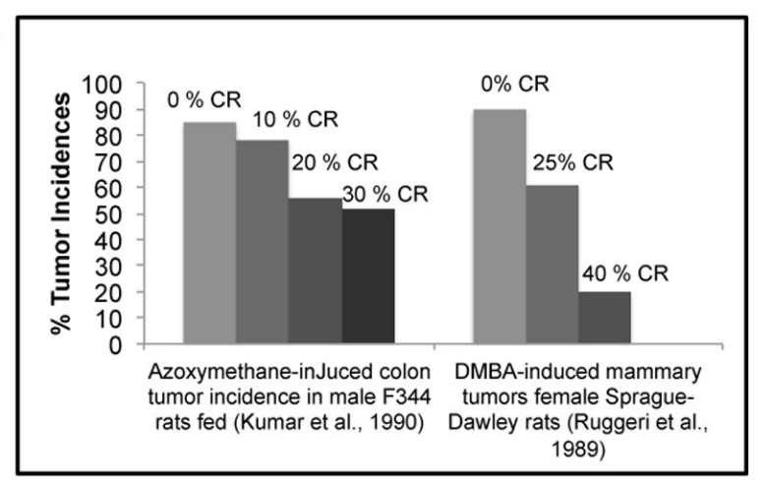
Food intake and tumor incidence chemically-induced tumors in rats
http://journal.frontiersin.org/article/10.3389/fphys.2012.00318/full

Slide 74
Calorie restriction in primates (Wisconsin study)
50% reduction of cancer and cardiovascular disease.
Full protection against obesity and glucose intolerance/type 2 diabetes.
Partial prevention of sarcopenia, associated with advancing aging (lower body mass, higher physical activity? lower joint inflammation?).
Improved T cell function and preservation of gray matter volume in several subcortical regions, including the caudate, putamen, left insula, and in others key regions related to motor function and aspects of executive function.

Slide 75
Obesity
The majority of obese individuals have the metabolic syndrome:
hyperglycemia and hyperinsulinemia
→ increased hepatic release of insulin-like growth factor 1 (IGF-1)
IGF-1 → growth or survival signaling
hypertriglyceridemia
hypertension

Slide 76
Obesity and cancer
Demonstrated obesity-associated enhancements in:
growth signaling,
inflammatory processes,
vascular perturbations,
microenvironmental disruptions.
Obesity prevention or reversal is a major part of several evidence-based cancer prevention guidelines:

Slide 77
Diabetes and cancer
Nature, volume 559, pages 637–641 (2018)

Slide 78
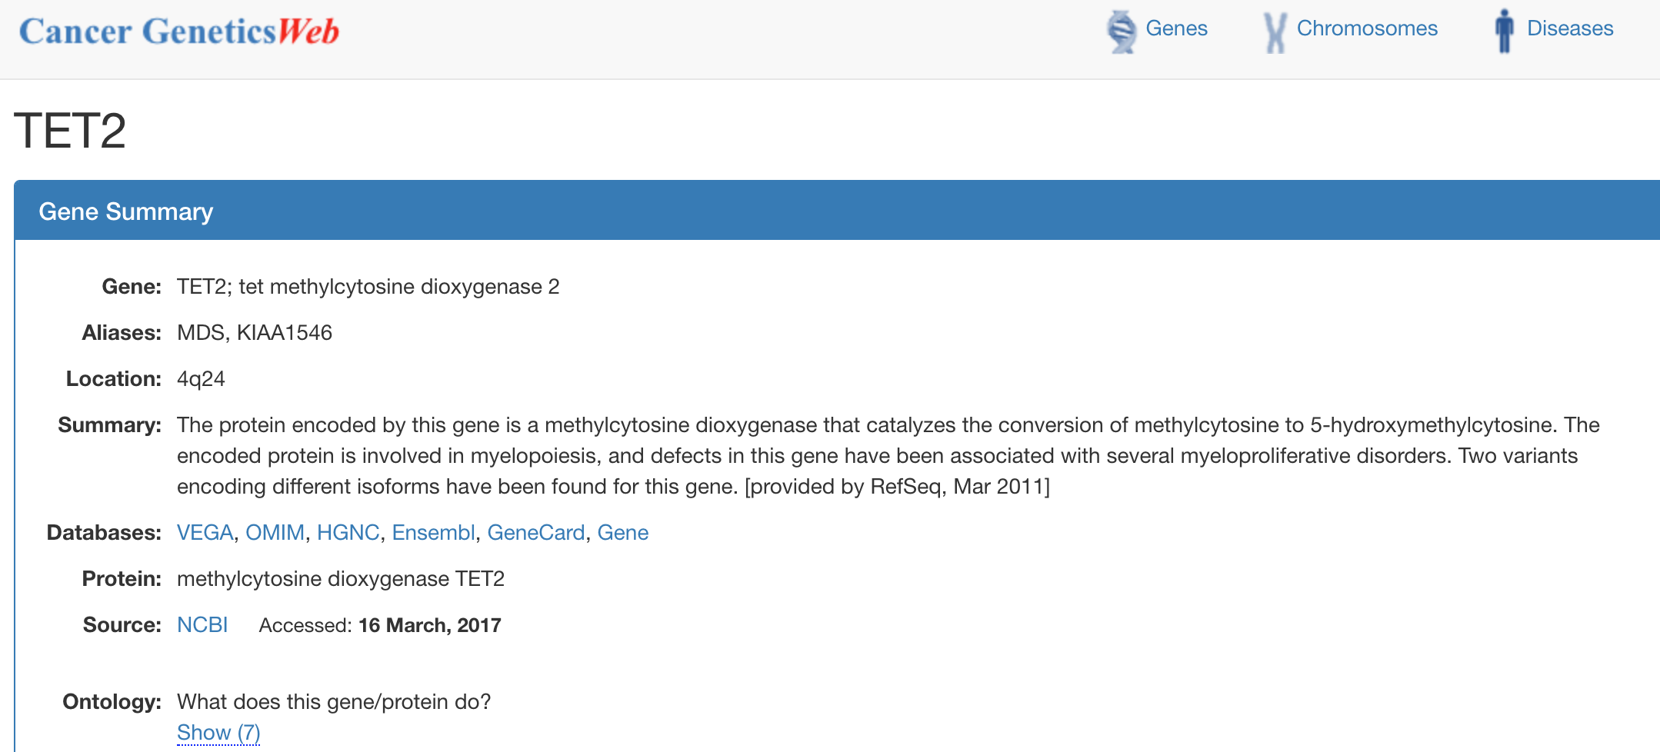
What is TET2?

Slide 79
TET2 molecular function http://www.hmdb.ca/reactions/5584

Slide 80
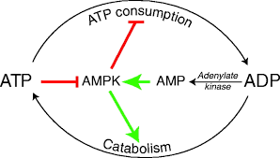
Hypoglycemia activates AMPkinase, and leads to enhanced control of cell growth-related genes

Slide 81
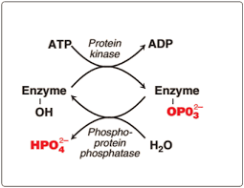
AMPKinase phosphorylates TET2 and stabilises it
AMP-dependent kinase
TET2
TET2

Slide 82
de-phospho-TET2 means less DNA hydroxymethylation
These changes led to the altered expression of 585 genes (both up- and down-regulated), with many associated with cell cycle regulation and various types of cancers
Source: https://epigenie.com/sweet-success-dna-hydroxymethylation-link-diabetes-cancer-discovered/

Slide 83
tight nutrient balance might be a vulnerability of tumours that can be exploited therapeutically
hence, catabolite-deprivation might be a selective and effective anticancer treatment strategy

Slide 84
http://eprints.ucl.ac.uk/4841/1/4841.pdf

Slide 86
Thanks for your interest

