Slide 1
Lecture 5
Metabolic imbalances in diabetes

Slide 2
Outline
Mechanism of glycemic homeostasis
The molecular basis of glucagon and insulin release
Fasting, Starvation, Glucagon signalling and biological effects
Fed state, Insulin signalling and biological effects
Diabetes mellitus, glucotoxicity, insulin resistance
Metabolic changes in type 2 diabetes
glucose metabolism
lipid metabolism
acid-base equilibrium
Mechanisms of glucose toxicity, acute complications of diabetes
Metabolic changes in diabetes

Slide 3
Mechanism of glycemic homeostasis
The prevailing state is fasting
the prevailing hormone is GLUCAGON
Some organs (esp. the brain) consume glucose
Other organs (muscle and liver) consume fatty acids
Glucose is continuously supplied by the liver, via gluconeogenesis → glycemia will not decrease
Upon feeding carbohydrates
the hormone INSULIN is released
Muscle, liver and adipose tissue become the highest consumers of glucose → glycemia will not increase

Slide 4
The molecular basis of glucagon and insulin release and their synchronicity with glycemia changes
Ion channels in action on pancreatic insular alfa and beta cells
These are excitable cells

Slide 5
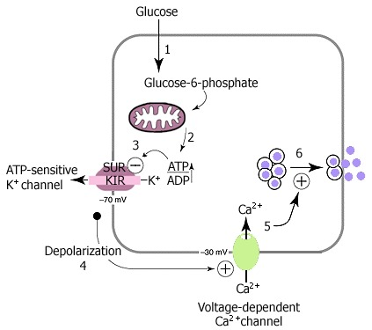
Meccanismo cellulare di rilascio dell’insulina nella cellula β delle Isole di Langherhans (“pacreatic β cells)
Notes:
Figure 1Insulin secretion
1. Glucose is transported into the beta cell by type 2 glucose transporters (GLUT2). Once inside, the first step in glucose metabolism is the phosphorylation of glucose to produce glucose-6-phosphate. This step is catalyzed by hexokinase; it is the rate-limiting step in glycolysis, and it effectively traps glucose inside the cell.
2. As glucose metabolism proceeds, ATP is produced in the mitochondria.
3. The increase in the ATP:ADP ratio closes ATP-gated potassium channels in the beta cell membrane. Positively charged potassium ions (K+) are now prevented from leaving the beta cell.
4. The rise in positive charge inside the beta cell causes depolarization.
5. Voltage-gated calcium channels open, allowing calcium ions (Ca2+) to flood into the cell.
6. The increase in intracellular calcium concentration triggers the secretion of insulin via exocytosis.
Source: https://www.ncbi.nlm.nih.gov/books/NBK1665/figure/A662/
NOTE
KIR=K_{ir}=Inward rectifier K+ channels
SUR (sulfonylurea receptor) is a member of the ATP-binding cassette (ABC) family
These channels are blocked by elevated levels of intracellular ATP, and several therapeutic agents including sulfonylureas,

Slide 6
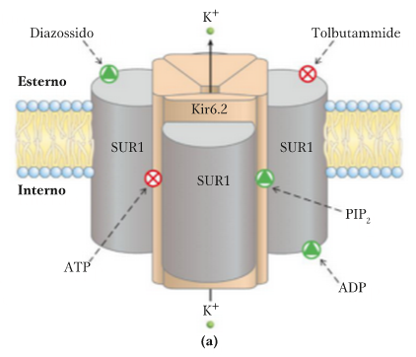
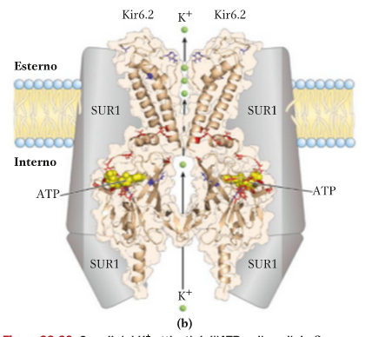
Il canale Kir6.2 sulle cellule insulari beta
Notes:
source
Principi di biochimica Lehninger
ebook per il docente

Slide 7
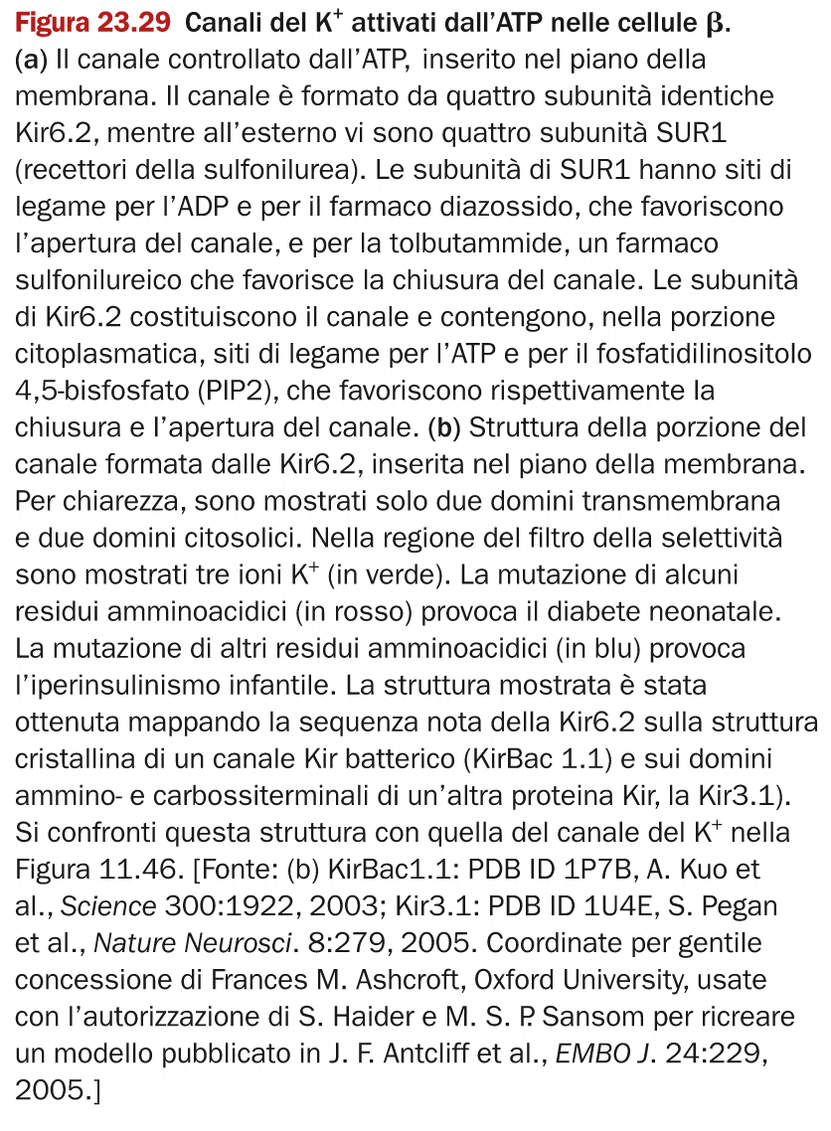
Notes:
source
Principi di biochimica Lehninger
ebook per il docente

Slide 8
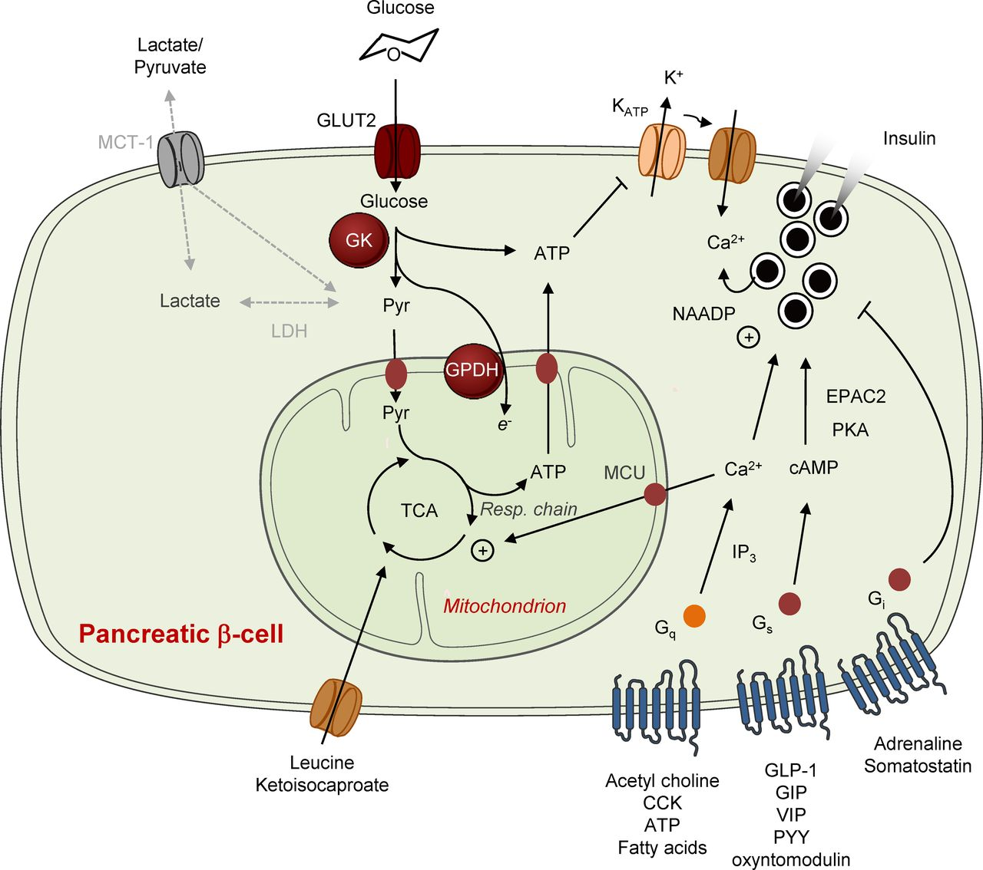
Notes:
Source: REVIEW ARTICLE
Pancreatic β-cell identity, glucose sensing and the control of insulin secretionGuy A. Rutter, Timothy J. Pullen, David J. Hodson, Aida Martinez-Sanchez Biochemical Journal Mar 01, 2015, 466 (2) 203-218;
NOTE
MCU = mitochondrial calcium uniporter

Slide 9
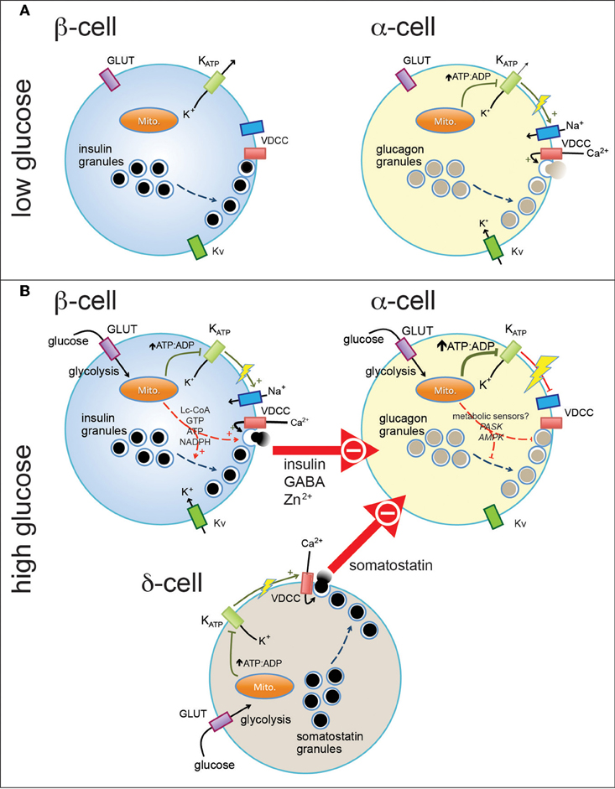
Controllo del rilascio di insulina (β cell) e glucagone (α cell)
Notes:
Figure 1. Pancreatic endocrine cells are regulated by intrinsic and paracrine signals in response to glucose. At basal glucose levels pancreatic β-cells (A, left) are electrically inactive, owing to their open ATP-sensitive K+ (KATP) channels and resultant hyperpolarized membrane potential, and thus do not secrete insulin. In contrast, α-cells in the presence of low glucose (A, right) are electrically active, due to a relatively elevated ATP/ADP ratio (even at low glucose). This results in closure of most, but perhaps not all, KATP channels and a depolarized membrane potential that allows action potential firing mediated by a combination of voltage-dependent Na+, Ca2+ (VDCC), and K+ (Kv) channels. Entry of Ca2+ through VDCCs triggers the exocytosis of glucagon-containing secretory granules. When plasma glucose is increased (B), glucose enters pancreatic islet cells through plasma membrane glucose transporters (GLUT) where it is metabolized through glycolysis and mitochondrial oxidative metabolism. This results in increase in the intracellular ATP/ADP ratio (in the case of α-cells, a further increase) and closure of KATP channels. In the β-cell (B, top left) this results in membrane depolarization and firing of action potentials that, in combination with additional mitochondrial signals, results in the exocytosis of insulin-containing granules. In α-cells, further closure of KATP channels may further depolarize the membrane and lead to the depolarization-dependent inactivation of Na+ channels and VDCCs. Glucagon secretion is also inhibited by paracrine factors secreted from β-cells and pancreatic δ-cells. These signals may interact with putative α-cell metabolic sensors (i.e., PASK and AMPK) to produce the physiological suppression of glucagon secretion.
Source: https://www.frontiersin.org/articles/10.3389/fphys.2012.00349/full

Slide 10
Fasting
Typically, 6-12 h without introducing food
Glycemia:
NORMAL: 3.9-5.4 mM (70-99 mg/dL)
PRE-DIABETES: 5.5-6.9 mM (100-125 mg/dL)
DIABETES: ≥ 7 mM (126 mg/dL)
Hormones:
glucagon
After 4-5 days of fasting, the condition is called starvation (Italian: “inedia”) and adrenalin is released.
Notes:
Data on glycemia: from https://www.diabetes.co.uk/diabetes_care/fasting-blood-sugar-levels.html

Slide 11
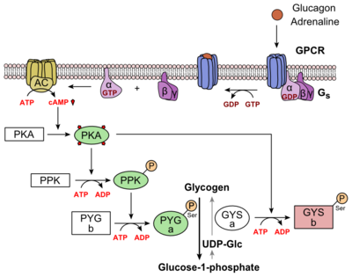
Glucagon signalling
Notes:
Figure 6: Metabolic Regulation of Glycogen by Glucagon.Depicted is the visualization of the glucagon signaling pathway through the GCGR. The location of the GCGR, the release of the alpha subunit from the beta and gamma subunits, and the enzyme cascade to result in the releasing of glucose are depicted. Abbreviations for the enzymes in the cascade include- PPK: phosphorylase kinase; PYG b: glycogen phosphorylase b; PYG a: glycogen phosphorylase a.
source
https://proteopedia.org/wiki/index.php/Glucagon_receptor

Slide 12
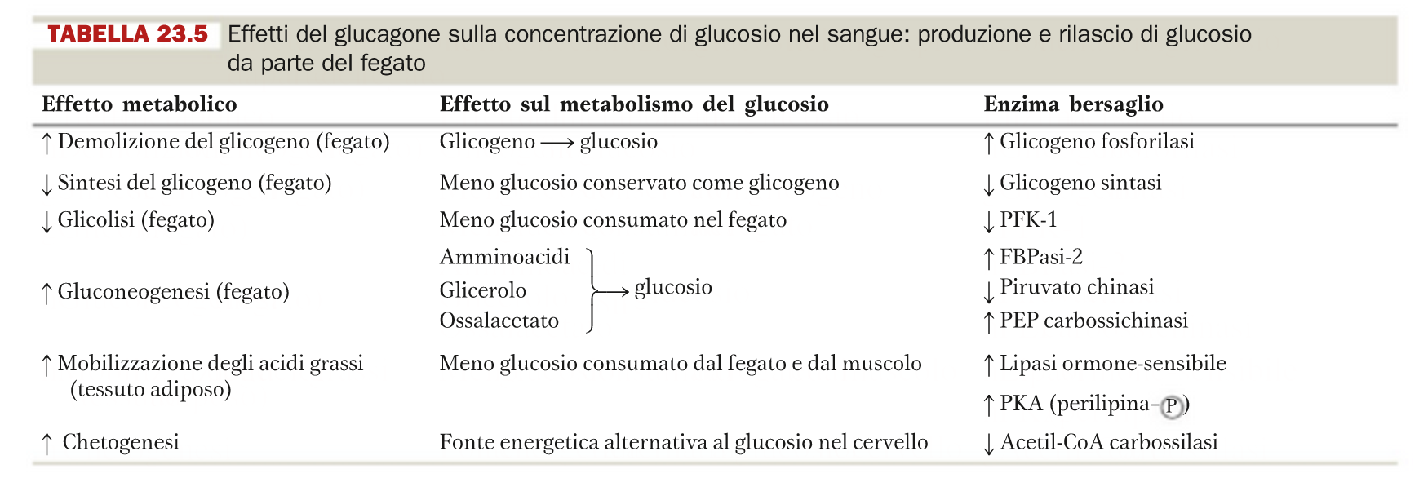
Effects of glucagon
Glucagon activates its receptor on specific tissues:
LIVER
ADIPOSE TISSUE
MUSCLE
Some key enzymes are activated/inhibited by glucagon-dependent effectors
Some metabolic pathways are enhanced or repressed

Slide 13
The effects of glucagon on liver, adipose tissue and muscle

Slide 14
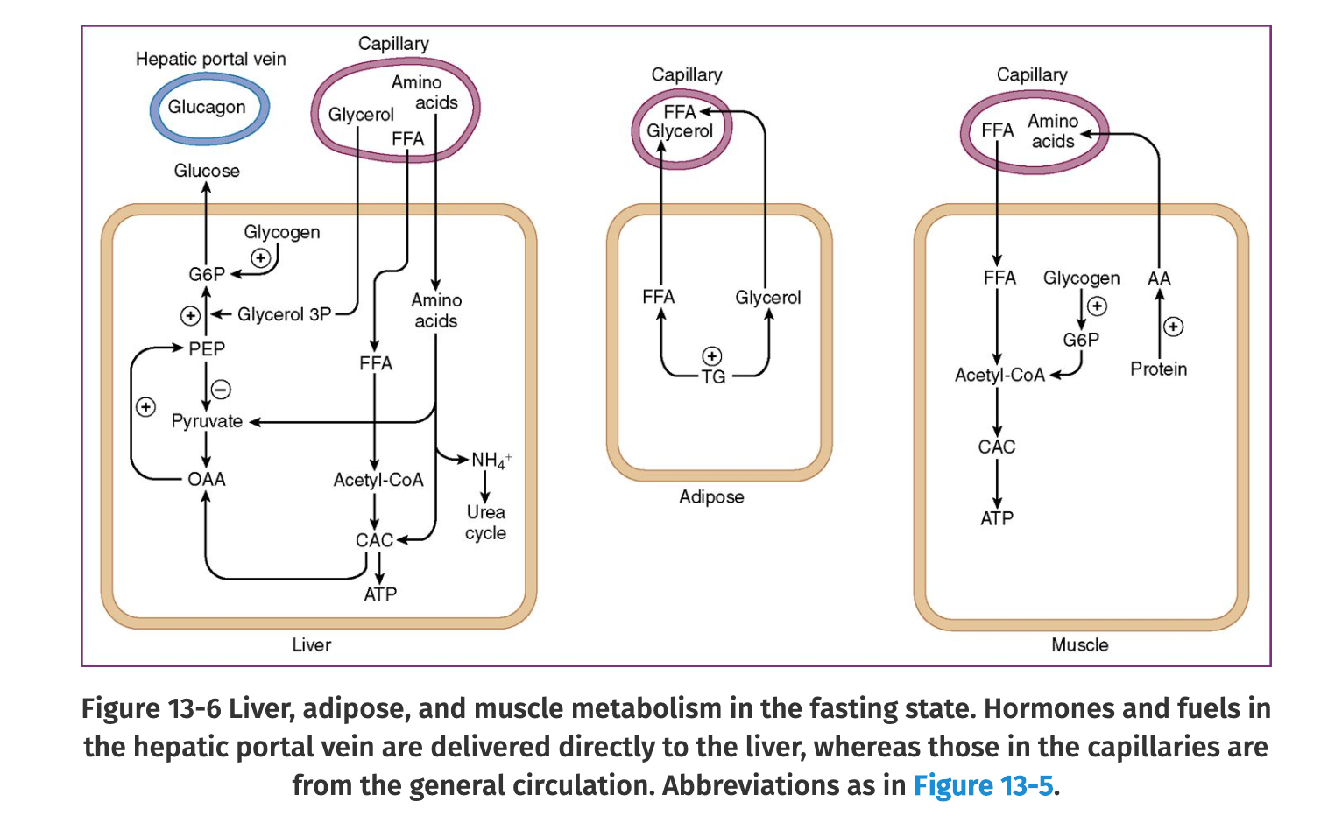
Notes:
source
Elsevier's Integrated Review Biochemistry
John W. Pelley

Slide 15
FASTING
Net effect
The muscle releases amminoacids for hepatic gluconeogenesis
The adipose tissue releases fatty acids for the muscle and the liver
The liver is glucogenic
NO glycolysis (⬇PFK1 and PK)
NO glycogene synthesis (⬇GS)
YES glycogenolysis (⬆ GP)
YES gluconeogenesis (⬆ PEP carboxykinase)
THE BRAIN CAN TAKE UP GLUCOSE

Slide 16
STARVATION chetogenesis
Net effect
The muscle continues to release amminoacids for hepatic gluconeogenesis → loss of mass
The adipose tissue continues to releas fatty acids for the muscles and the liver → loss of mass
The liver is chetogenic
condensation of acetylCoA to produce beta-hydroxybutyrrate
The liver is glucogenic
NO glycolysis (⬇PFK1 and PK)
NO glycogeno synthesis (⬇GS)
NO glycogenolysis because of loss of substrate
YES gluconeogenesis (⬆ PEP carboxykinase)
THE BRAIN CAN TAKE UP BOTH GLUCOSE AND CHETONE BODIES

Slide 17
Fed state
Glucose is absorbed from the intestine
Glycemia increases
Simulataneous release of insulin follows
Arrest of release of glucagon
it is constitutively released
Simulataneous response by insulin-sensitive tissues occurs:
Liver
Muscle
Adipose

Slide 18
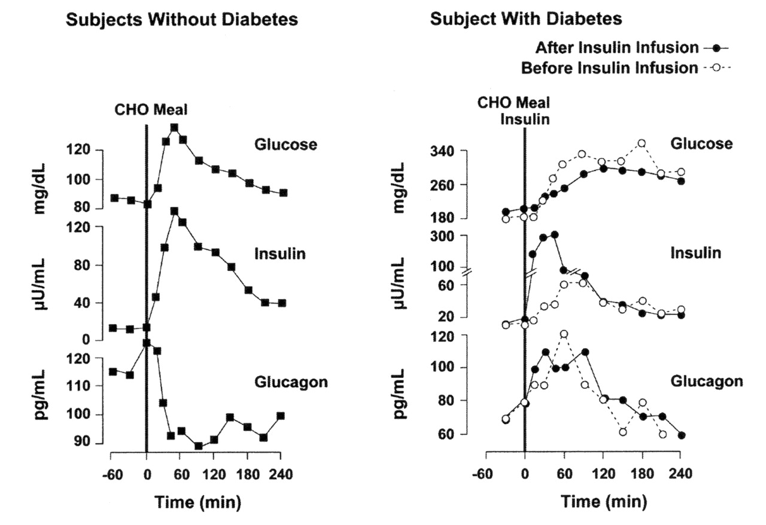
Insulin and glucagon secretion: nondiabetic and diabetic subjects.
Stephen L. Aronoff et al. Diabetes Spectr 2004;17:183-190
©2004 by American Diabetes Association
Notes:
Insulin and glucagon secretion: nondiabetic and diabetic subjects. In nondiabetic subjects (left panel), glucose-stimulated insulin and amylin release from the β-cells results in suppression of postprandial glucagon secretion. In a subject with type 1 diabetes, infused insulin does not suppress α-cell production of glucagon. Adapted from Ref. 38.

Slide 19
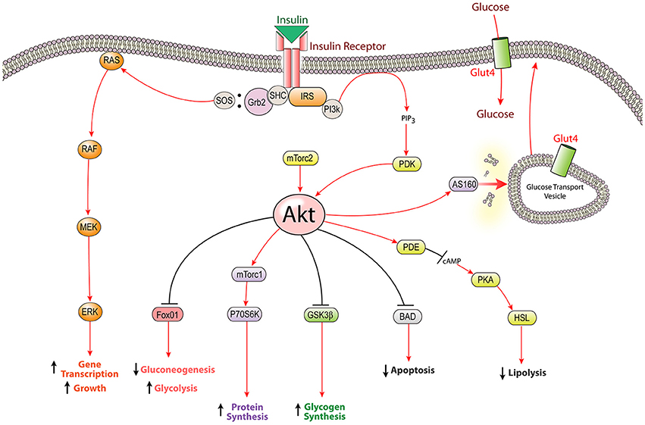
A simple scheme of insulin signalling
Notes:
Figure 1. The insulin signaling pathway: intracellular insulin signaling is initiated by insulin receptor tyrosine kinase activity leading to the activation of both the PI3K-Akt pathway and the MAPK pathway. The most well characterized function of insulin signaling is glucose homeostasis; however insulin stimulates several other cellular mechanisms including the biosynthesis of proteins, glycogen, and lipids. Insulin receptor substrate (IRS), glycogen synthetase kinase β (GSK3β), extracellular signal-related kinase (ERK), Srchomology-2-containing protein (Shc), forkhead box protein O1 (FOXO1), Akt substrate of 160 kDa (AS160), mammalian target of rapamycin complex (mTorc), p70 ribosomal protein S6 kinase (p70S6K), hormone sensitive lipase (HSL), phosphodiesterase (PDE), protein kinase A (PKA), phosphoinositide dependent kinase (PDK), Growth factor receptor-bound protein 2 (Grb2), son of sevenless (SOS).

Slide 20
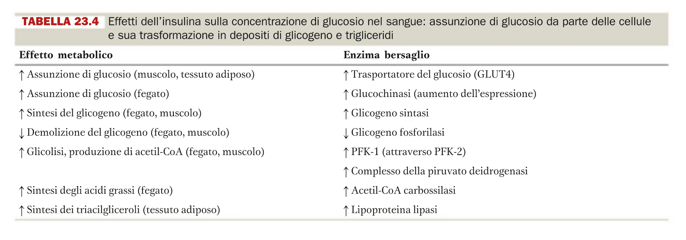
Effects of insulin
Insulin activates its receptor on specific tissues:
LIVER
ADIPOSE TISSUE
MUSCLE
Some key enzymes are activated/inhibited by insulin-dependent effectors
Some metabolic pathways are enhanced or repressed

Slide 21
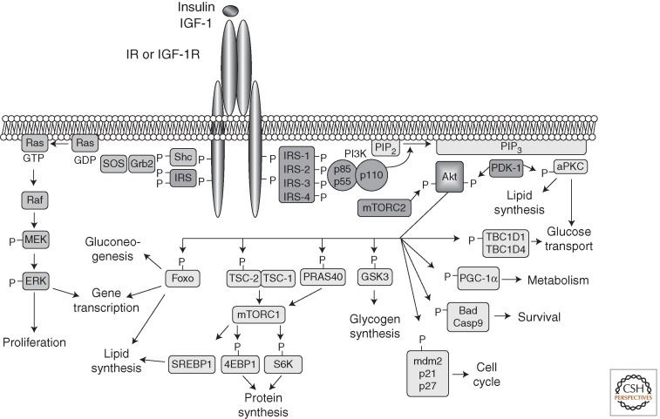
Insulin- and IGF-1-signaling pathways
Notes:
Insulin- and IGF-1-signaling pathways. Activation of insulin and IGF-1 receptors by their ligands initiates a cascade of phosphorylation events. A conformational change and autophosphorylation of the receptors occur at the time of ligand binding, leading to the recruitment and phosphorylation of receptor substrates such as IRS and Shc proteins. Shc activates the Ras-MAPK pathway, whereas IRS proteins mostly activate the PI3K-Akt pathway by recruiting and activating PI3K, leading to the generation of second messenger PIP3. Membrane-bound PIP3 recruits and activates PDK-1, which phosphorylates and activates Akt and atypical PKCs. Akt mediates most of insulin's metabolic effects, regulating glucose transport, lipid synthesis, gluconeogenesis, and glycogen synthesis. Akt also plays a role in the control of cell cycle and survival. The Shc-Grb2-Sos-Ras-Raf-MAPK pathway controls cellular proliferation and gene transcription.
source
Cold Spring Harb Perspect Biol. 2014 Jan 1;6(1). pii: a009191. doi: 10.1101/cshperspect.a009191.
Insulin receptor signaling in normal and insulin-resistant states.
Boucher J1, Kleinridders A, Kahn CR.

Slide 22
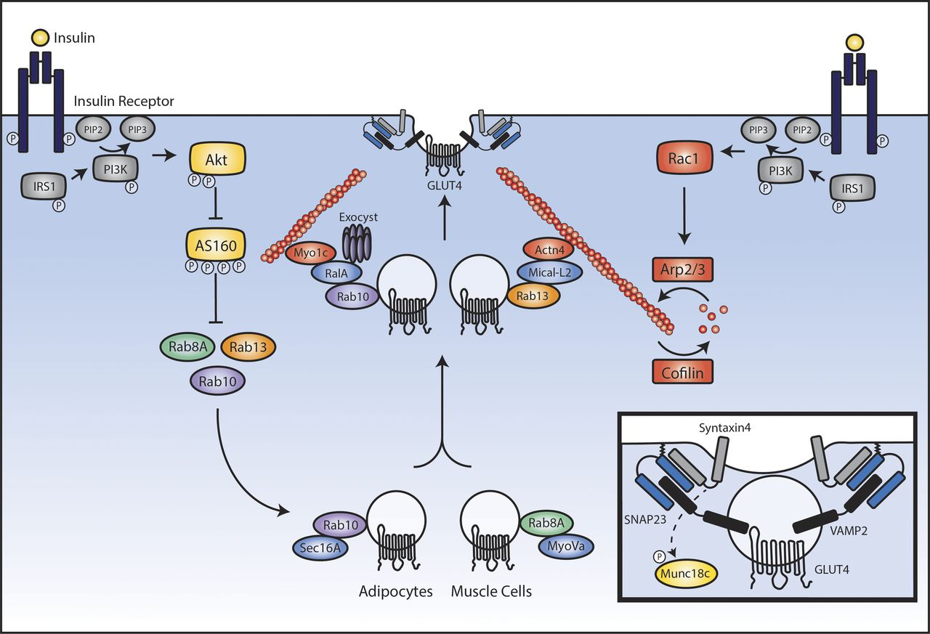
Insulin signaling in muscle and adipose cells leading to recruitment of GLUT4 to the plasma membrane.
Victoria L. Tokarz et al. J Cell Biol 2018;217:2273-2289
© 2018 Tokarz et al.
Notes:
Insulin signaling in muscle and adipose cells leading to recruitment of GLUT4 to the plasma membrane. Insulin binds to its receptor on the surface of muscle or fat cells and activates the canonical insulin-signaling cascade to PI3K and Akt. Downstream of Akt, phosphorylation of AS160 allows for the full activation of Rab8A and Rab13 (in muscle cells) and Rab10 (in adipocytes). In the perinuclear region, Rab8A engages with its effector, MyoVa, and Rab10 with its effector, Sec16A, to promote outward vesicle traffic. Near the plasma membrane, Rab13 engages with MICAL-L2 and Actinin-4, whereas Rab10 engages with RalA, Myo1c, and Exocyst components. Simultaneously, downstream of PI3K, insulin leads to activation of Rac1 that promotes a dynamic cycle of cortical actin remodeling. Together, these actions tether GLUT4 vesicles to the actin cytoskeleton near the plasma membrane. Inset: Docked GLUT4 vesicle ready to fuse with the plasma membrane. Immobilized GLUT4 vesicles fuse with the membrane through formation of a SNARE complex between vesicular VAMP2 and syntaxin4 and SNAP23 on the plasma membrane.

Slide 23
The effects of insulin on liver, adipose tissue and muscle

Slide 24
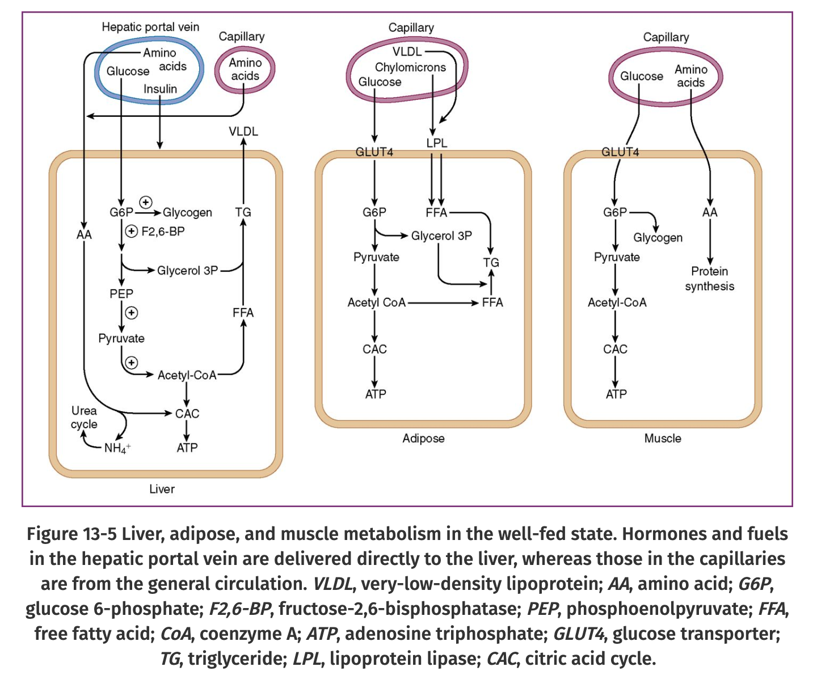
Notes:
source
Elsevier's Integrated Review Biochemistry
John W. Pelley

Slide 25
FED STATE
Net effect
The muscle takes up glucose by GLUT4 transporter (see next slide)
glycogenosynthesis
The adipose tissue takes up glucose by GLUT4
glycolysis
fatty acid and triacylglycerol synthesis
The liver takes up glucose by GLUT2
glycogenosynthesis
glycolysis
fatty acid and triacylglycerol synthesis→ export as VLDL
GLYCEMIA IS BROUGH TO BASAL LEVELS WITHOUT LOSS VIA URINE
THE BRAIN CAN TAKE UP GLUCOSE

Slide 26
DIABETES
Type I
Insulin deficiency
Auto-immune disorder of beta cells
Type II
Insulin resistance
hyperinsulinaemia
beta cells failure
deficiency and resistance combine

Slide 27
Natural history of Type 1 and Type 2 diabetes
Notes:
Figure 1. Models of the contribution of beta cell mass and function to pathogenesis of type 1 diabetes (A) and type 2 diabetes (B). (A): Beta cell mass and function in the development of type 1 diabetes. Initiation of islet autoimmunity by genetic and environmental factors leads to a relapsing-remitting decline of beta cell function, continuously increasing beta cell workload, and stress in the asymptomatic prediabetes phase. Shortly before clinical manifestation of diabetes the prolonged intensified beta cell workload and autoimmunity results in total cellular exhaustion and enhanced cell death leading to a massive decrease in beta cell mass and the onset of hyperglycemia. In some patients, initial insulin treatment induces temporary remission called the “honeymoon phase,” which is attributed to a moderate reduction in beta cell workload and antigenicity, resulting in functional recovery of residual beta cells. However, ongoing autoimmunity and elevated workload lead to recurrence of cellular exhaustion, cell death, and the development of overt diabetes. Black line: beta cell mass; Blue line: beta cell function. The color-coded background indicates the intensity of beta cell workload and stress caused by immune infiltration, metabolic demand and hyperglycemia. (B): Beta cell mass and function in the development of type 2 diabetes. In many individuals, genetic predisposition and unhealthy lifestyle lead to an increased insulin resistance, which is typically met by massive functional and moderate morphological compensation to maintain normoglycemia, thus increasing the workload of each beta cell. In some of these individuals, functional compensation halts, despite prolonged insulin resistance and results in a further escalation of beta cell workload and glucose intolerance. In this prediabetic phase, chronic glucose intolerance and elevated blood glucose levels continuously exacerbate beta cell workload and stress, culminating in cellular exhaustion, cell death, and clinical manifestation of hyperglycemia. Thereafter, uncontrolled hyperglycemia, often in concert with other cytotoxic factors, leads to accelerated beta cell mass loss and functional deterioration in overt diabetic patients. Black line: beta cell mass; Blue line: beta cell function. The color-coded background indicates the intensity of beta cell workload and stress caused by insulin resistance, metabolic demand, hyperglycemia and additional cytotoxic factors.
source
https://www.sciencedirect.com/science/article/pii/S2212877817302259#fig1

Slide 28
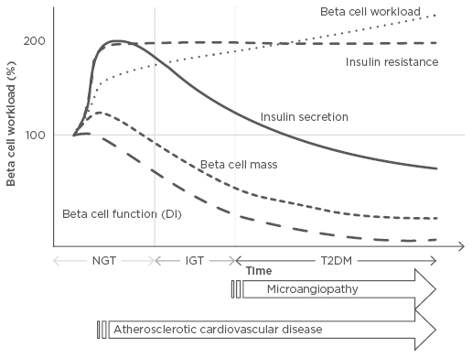
Changes in beta cell workload during the development of Type 2 diabetes mellitus
Notes:
Figure 1: Changes in beta cell workload during the development of Type 2 diabetes mellitus.
Demand for increased insulin secretion upon insulin resistance due to excess caloric intake, physical inactivity, and obesity, but with a modest change in beta cell mass, results in an increase in individual beta cell workload. In this compensatory phase, the resulting hyperinsulinaemia, together with high blood pressure and dyslipidaemia, promotes atherosclerosis. Excess beta cell workload eventually leads to beta cell dysfunction and/or death, resulting in reduced beta cell functional mass. Once beta cell mass is reduced, workload on residual beta cells is further exaggerated, creating a vicious cycle. Finally, when beta cells fail to compensate, hyperglycaemia develops. After the development of diabetes, microvascular complications occur; therefore, to prevent both micro and macrovascular complications, reducing beta cell workload at an earlier stage prior to the onset of diabetes is needed.
DI: disposition index; IGT: impaired glucose tolerance; NGT: normal glucose tolerance; T2DM: Type 2 diabetes mellitus.
source
https://www.emjreviews.com/diabetes/article/editors-pick-how-can-we-develop-more-effective-strategies-for-type-2-diabetes-mellitus-prevention-a-paradigm-shift-from-a-glucose-centric-to-a-beta-cell-centric-concept-of-diabetes/

Slide 29
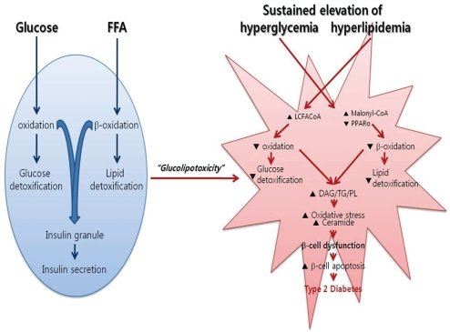
Molecular pathology of b cell apoptosis

Slide 30
The glucose blow
by
sweetened drinks
icecream
chocolate
etc

Slide 31
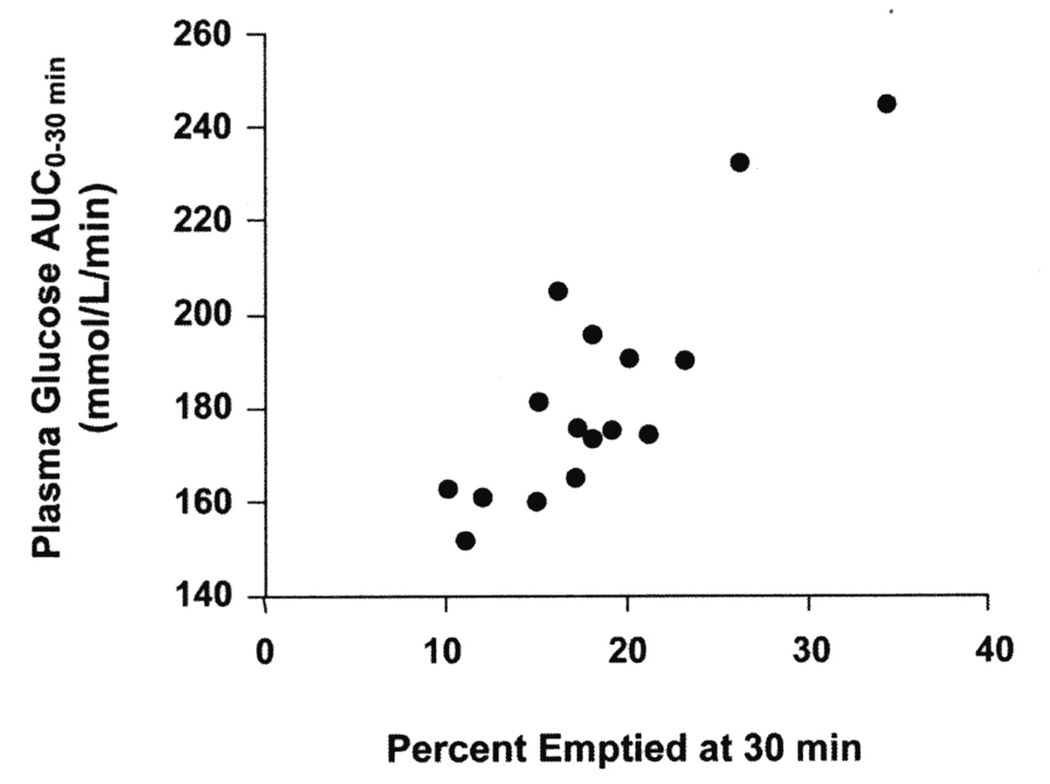
Gastric emptying rate is an important determinant of postprandial glycemia.
Stephen L. Aronoff et al. Diabetes Spectr 2004;17:183-190
©2004 by American Diabetes Association
Notes:
Gastric emptying rate is an important determinant of postprandial glycemia. In nondiabetic subjects (n = 16), plasma glucose concentration increases as the rate of gastric emptying increases (r = 0.58, P < 0.05). Adapted from Ref. 64.

Slide 32
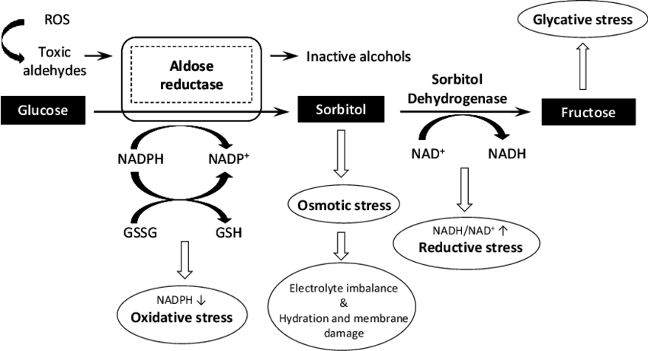
Simple biochemical mechanism of glucotoxicity
Notes:
Fig. (3). Role of AR in diabetic complications. Polyol pathway and various pathogenic factors involved in diabetic complications are shown in the Figure 3. Increased accumulation of sorbitol through polyol pathway may lead to osmotic stress which causes electrolyte imbalance, hydration and membrane damage. Decreased levels of NADPH may lead to oxidative stress and increased NADH/NAD + ratio may lead to reductive stress causing pseudohypoxia resulting in cell damage. Also the phosphorylation of fructose may lead to formation of AGEs and subsequent binding of AGEs with their receptors may lead to production of ROS.
Source
Updates on Aldose Reductase Inhibitors for Management of Diabetic Complications and Non-diabetic Diseases
September 2015Mini Reviews in Medicinal Chemistry 15
DOI: 10.2174/1389557515666150909143737
https://www.researchgate.net/publication/281472166_Updates_on_Aldose_Reductase_Inhibitors_for_Management_of_Diabetic_Complications_and_Non-diabetic_Diseases

Slide 33
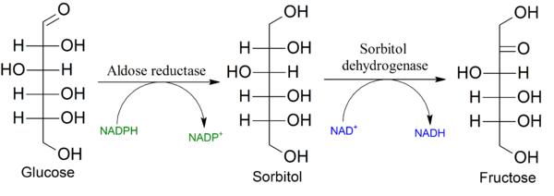
The polyol pathway
osmotic stress
increase of cell volume
Notes:
source

Slide 34
Cells vulnerable to glucolipotoxicity
pancreatic insular beta cells
insulin deficiency
vascular endothelial cells
microvessel damage
arteriosclerosis (with concurring dyslipidemia)
neuronal cells
neuropathy
retina and lens
retinopathy and cataract
kidney
kidney failure

Slide 35
Glucolipotoxicity cause insulin resistance
Insulin resistance is due to the failure of insulin signalling pathway

Slide 36
Mechanisms of insulin resistance
“A central feature of type-2 diabetes is insulin
resistance, a condition in which cells cannot
respond properly to insulin. This occurs primarily
at the level of so-called insulin-sensitive
tissues, such as liver, muscle, and fat, and can
be caused by multiple mechanisms”
Notes:
source
Cold Spring Harb Perspect Biol. 2014 Jan 1;6(1). pii: a009191. doi: 10.1101/cshperspect.a009191.
Insulin receptor signaling in normal and insulin-resistant states.
Boucher J1, Kleinridders A, Kahn CR.

Slide 37
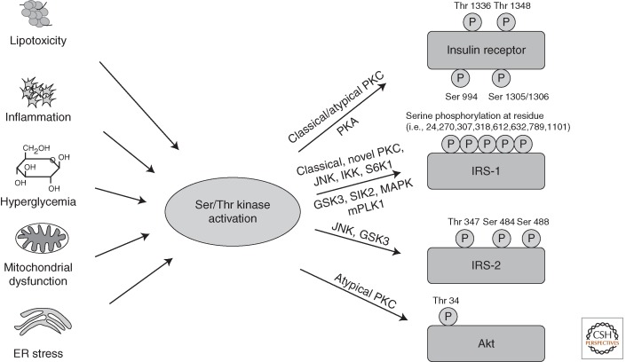
Several mechanisms of insulin resistance
Notes:
Activation of Ser/Thr kinases causes inhibitory phosphorylation on insulin-signaling molecules. Lipotoxicity, inflammation, hyperglycemia, and subsequently oxidative stress, as well as mitochondrial dysfunction and ER stress, all converge on activation of Ser/Thr kinases, inducing inhibitory Ser/Thr phosphorylation of IR, IRS proteins, and Akt on multiple residues, causing insulin resistance.
source
Cold Spring Harb Perspect Biol. 2014 Jan 1;6(1). pii: a009191. doi: 10.1101/cshperspect.a009191.
Insulin receptor signaling in normal and insulin-resistant states.
Boucher J1, Kleinridders A, Kahn CR.

Slide 38
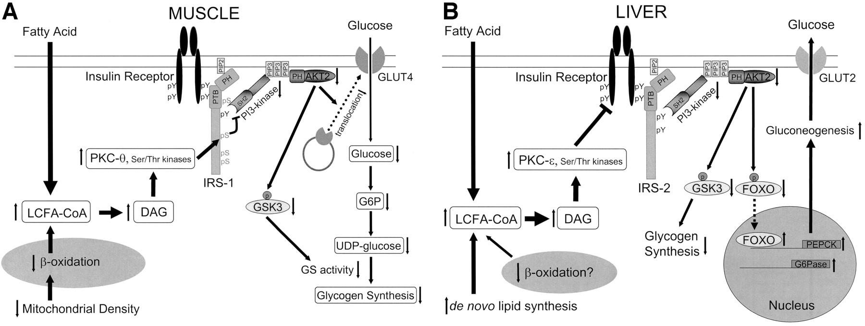
The molecular mechanism of fat-induced insulin resistance in skeletal muscle (A) and liver (B).
Katsutaro Morino et al. Diabetes 2006;55:S9-S15
©2006 by American Diabetes Association
Notes:
The molecular mechanism of fat-induced insulin resistance in skeletal muscle (A) and liver (B). A: Increases in intramyocellular fatty acyl CoAs and diacylglycerol due to increased delivery from plasma and/or reduced β-oxidation due to mitochondrial dysfunction activate serine/threonine kinases such as protein kinase C (PKC-θ rodents, PKC-β and -δ humans) in skeletal muscle. The activated kinases phosphorylate serine residues on IRS-1 and inhibit insulin-induced PI 3-kinase activity, resulting in reduced insulin-stimulated AKT2 activity. Lowered AKT2 activity fails to activate GLUT4 translocation, and other downstream AKT2-dependent events, and consequently insulin-induced glucose uptake is reduced. B: Increases in hepatic diacylglycerol content due to increased delivery of fatty acids from the plasma and/or increased de novo lipid synthesis and/or reduced β-oxidation activate protein kinase C-ε (and potentially other serine kinases), leading to reduced insulin receptor kinase activity and reduced IRS-2 tyrosine phosphorylation, resulting in reduced insulin stimulation of glycogen synthase activation and decreased phosphorylation of forkhead box protein O (FOXO), leading to increased hepatic gluconeogenesis. DAG, diacylglycerol; PTB, phosphotyrosine binding domain; PH, pleckstrin homology domain; SH2, src homology domain; GSK3, glycogen synthase kinase-3.

Slide 39
Metabolic changes in diabetes type 2
Low insulin/glucagon ratio
glucogenic liver (glucagon prevails)
lipolysis in adipose tissue (glucagon prevails)
lipogenesis in the liver (VLDL for export)
ketogenesis
metabolic acidosis

Slide 40
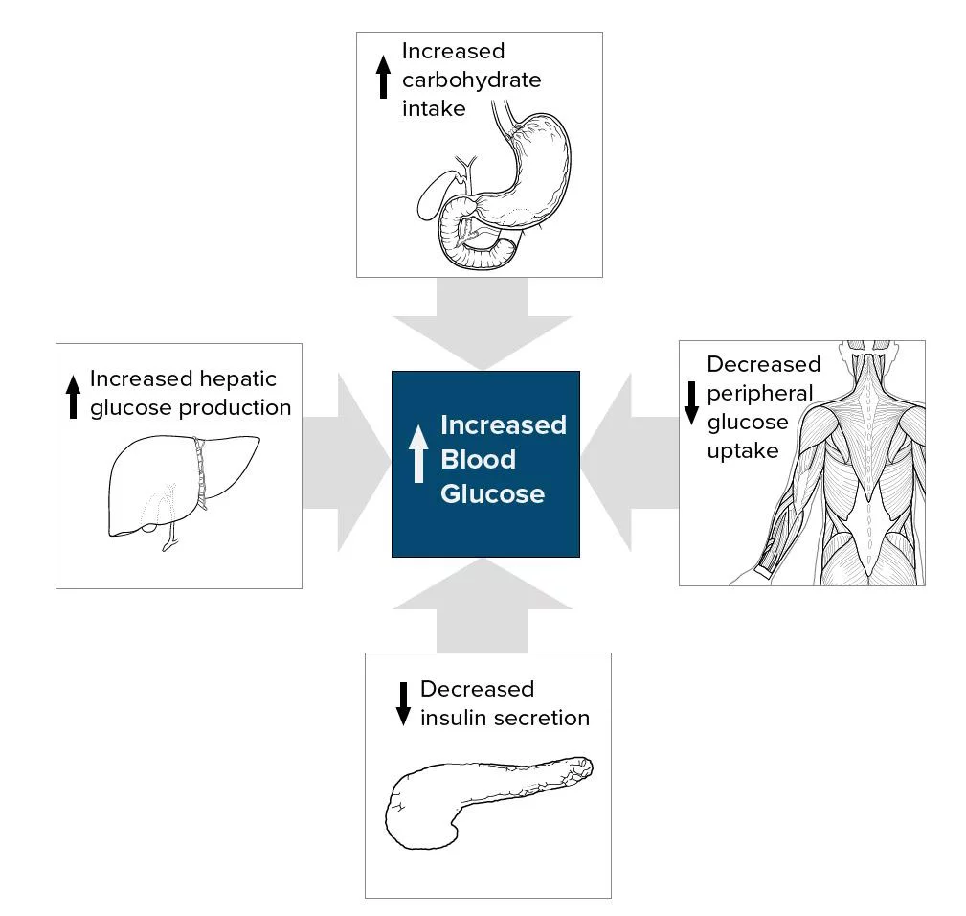
The first cause:
Increased glycaemia
Because of hypo-insulinemia and prevailing glucagone secretion by alpha cells
Because of insulin resistance, i.e. a defect in the insulin response
Because of loss of beta cells, due to sustained stimulation
Notes:
source
https://emedicine.medscape.com/article/117853-overview

Slide 41
THE GLUCOGENIC LIVER

Slide 42
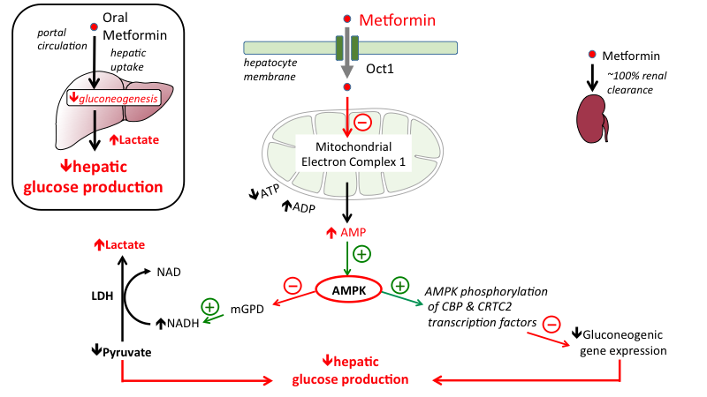
Metformin a first-line anti-diabetic drug that inhibits gluconeogenesis
Notes:
Figure. Metformin acts primarily to suppress glucose production in the liver. While metformin's mechanism(s) of action remain controversial, current evidence indicates that metformin's most important effect in treating diabetes is to lower the hepatic production of glucose (as summarized in the top left box). Current evidence suggests that results from a combination of intracellular effects in the liver. When metformin is taken orally, it is absorbed into hepatocytes from the portal vein through plasma membrane transporters, including the organic cation transporter 1 (OCT1). Inside the cell metformin inhibits mitochondrial respiratory-chain complex 1, resulting in reduced ATP levels and increased AMP. Increased AMP levels activate Adenosine Monophosphate-Activated Protein Kinase (AMPK), which contributes to lowering of glucose production by at least 2 pathways: i) increased AMPK phosphorylates CBP & CRTC2 transcription factors, which inhibits genes involved in the production of glucose (“gluconeogenic genes”); ii) increased AMPK also inhibits mitochondrial glycerol-3-phosphate dehydrogenase (mGPD), leading to an increase in cytosolic NADH, which both stimulates the conversion of pyruvate to lactate, and simultaneously decreases gluconeogenesis. An accumulation of lactate to dangerous levels (lactic acidosis) can occur when metformin is taken by patients with other conditions resulting metabolic acidosis (liver disease, heart failure, sepsis, alcohol abuse), or kidney disease (as indicated by elevated creatinine levels) because metformin is eliminated by renal excretion) (He & Wondisford, 2015; Nolte Kennedy & Masharani, 2015).
source
http://tmedweb.tulane.edu/pharmwiki/doku.php/hypoglycemics_acting_on_liver_muscle_adipose_tissue

Slide 43
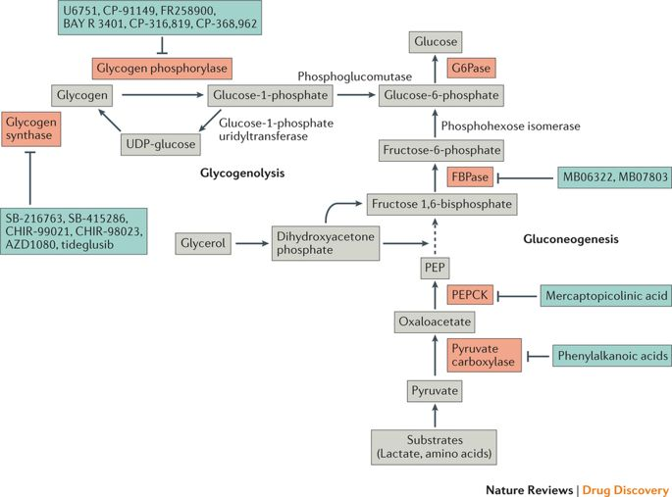
Gluconeogenesis enzymes are targets for anti-diabetic drugs
Notes:
source
Targeting hepatic glucose metabolism in the treatment of type 2 diabetes
Amy K. Rines, Kfir Sharabi, Clint D. J. Tavares & Pere Puigserver
Nature Reviews Drug Discovery volume 15, pages 786–804 (2016)

Slide 44
THE LIPOLYTIC ADIPOSE TISSUE

Slide 45
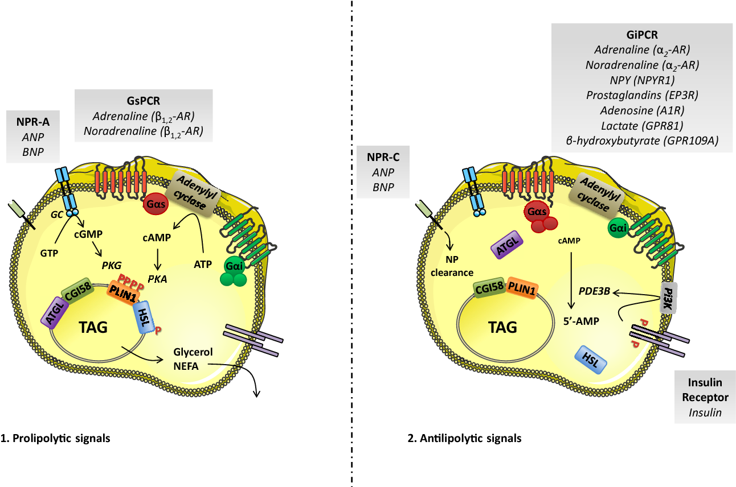
Insulin is anti-lipolytic In diabetes, pro-lipolytic signals prevail over insulin
Notes:
source
Adipocyte lipolysis and insulin resistance.
Pauline Morigny, Marianne Houssier, +1 author Dominique LanginPublished in Biochimie 2016
DOI:10.1016/j.biochi.2015.10.024

Slide 46
THE KETOGENIC LIVER

Slide 47
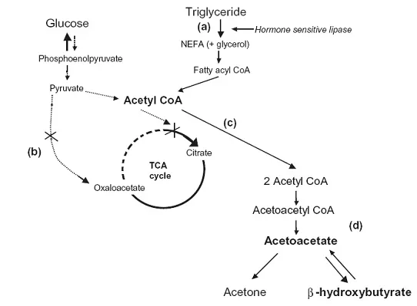
Acetyl CoA from beta oxidation cannot be oxidised by the TCA cycle - it is rather condensend in ketone bodies

Slide 48
Consequences of increased glycolysis
glucose toxicity

Slide 49
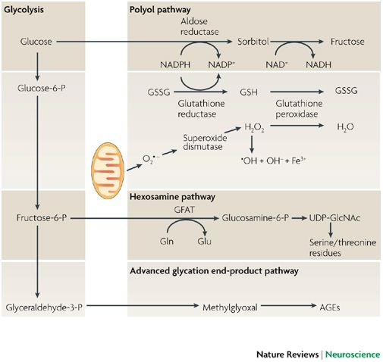
Glucose cytotoxicity
Notes:
source
Glucose neurotoxicity
David R. Tomlinson & Natalie J. Gardiner
Nature Reviews Neuroscience volume 9, pages 36–45 (2008)
https://www.nature.com/articles/nrn2294

Slide 50
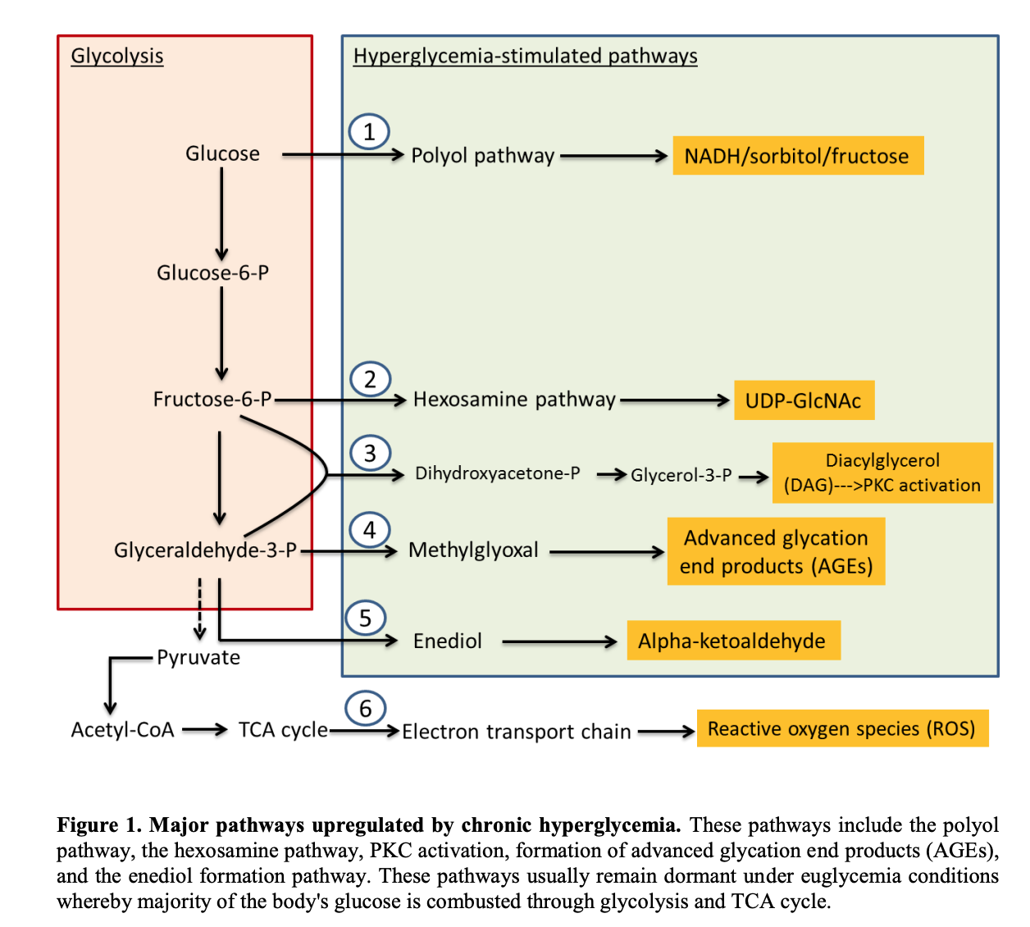
Notes:
source
https://www.ncbi.nlm.nih.gov/pmc/articles/PMC4723237/pdf/ad-7-1-90.pdf

Slide 51
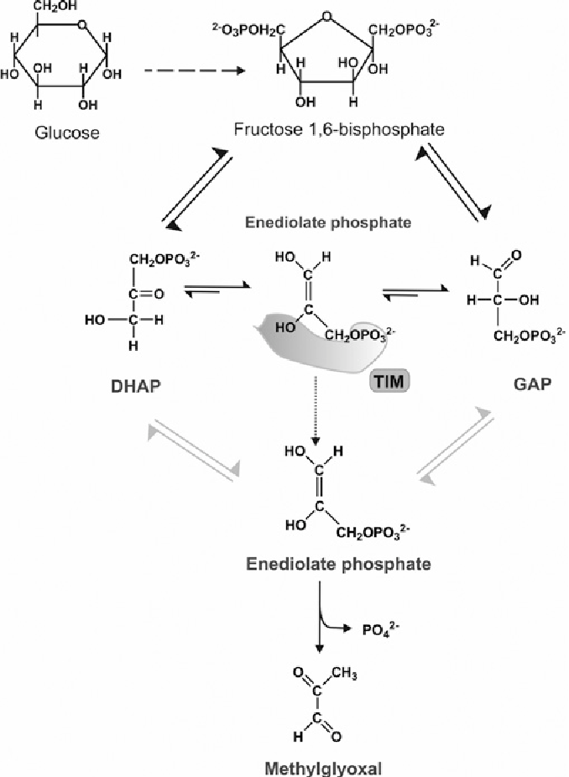
Formation of methylglyoxal from triose phosphates
Notes:
source
The glyoxalase pathway: the first hundred years… and beyondMarta Sousa Silva, Ricardo A. Gomes, Antonio E. N. Ferreira, Ana Ponces Freire, Carlos CordeiroBiochemical Journal Jul 01, 2013, 453 (1) 1-15; DOI: 10.1042/BJ20121743

Slide 52
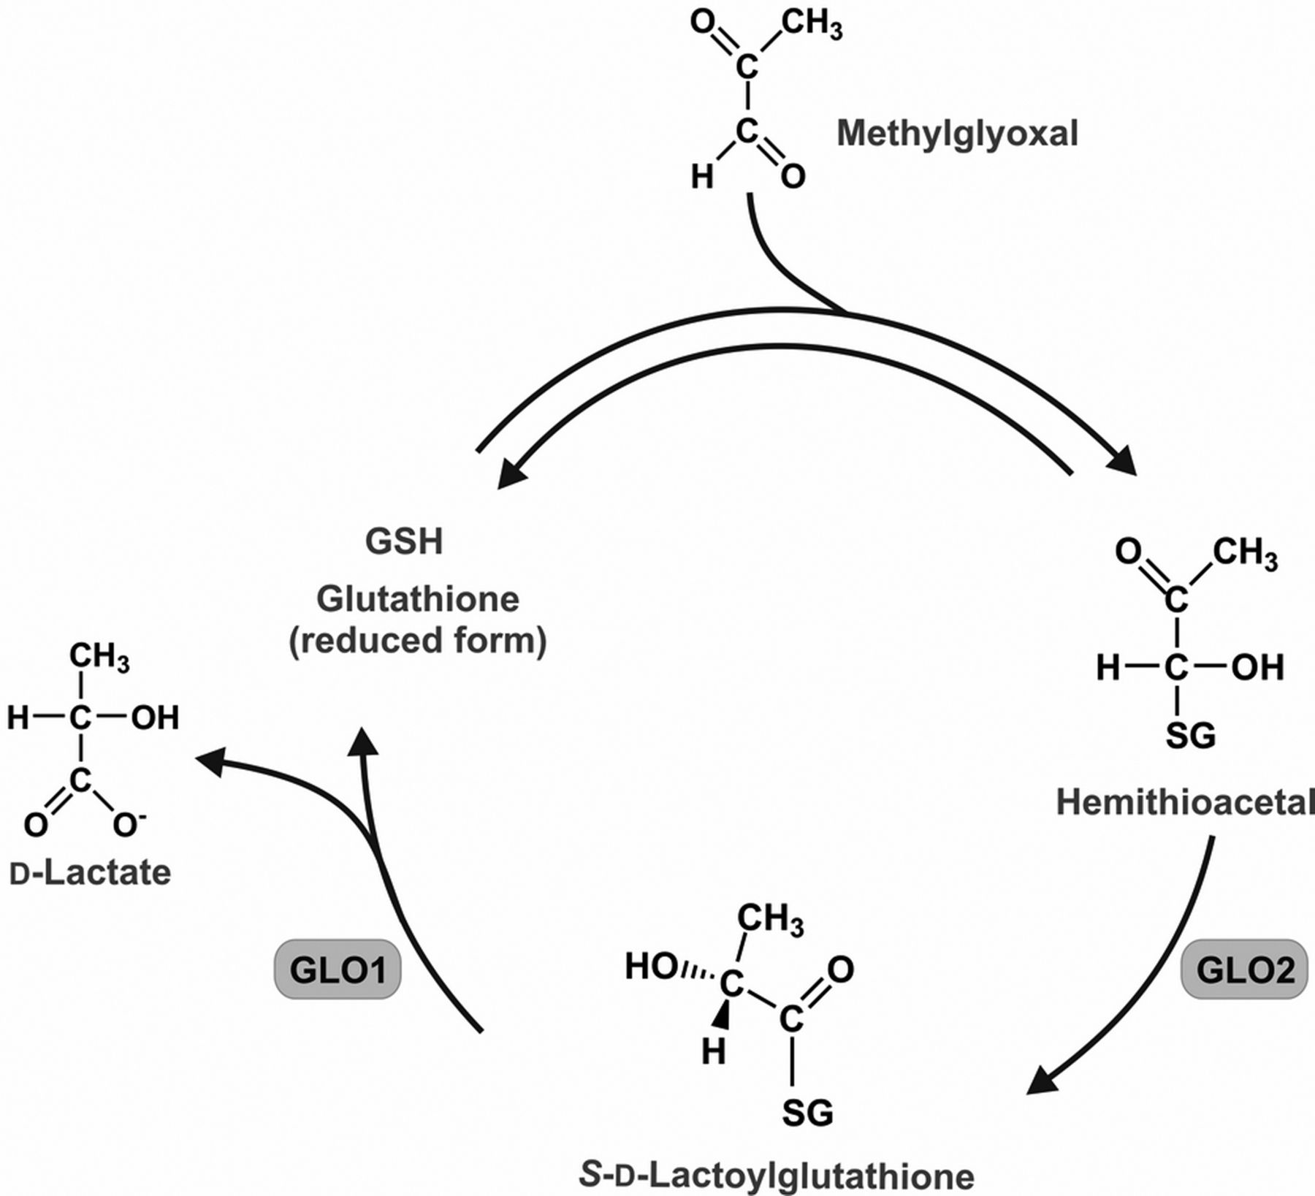
Methylglyoxal reacts with glutathione
Notes:
source
The glyoxalase pathway: the first hundred years… and beyondMarta Sousa Silva, Ricardo A. Gomes, Antonio E. N. Ferreira, Ana Ponces Freire, Carlos CordeiroBiochemical Journal Jul 01, 2013, 453 (1) 1-15; DOI: 10.1042/BJ20121743

Slide 53
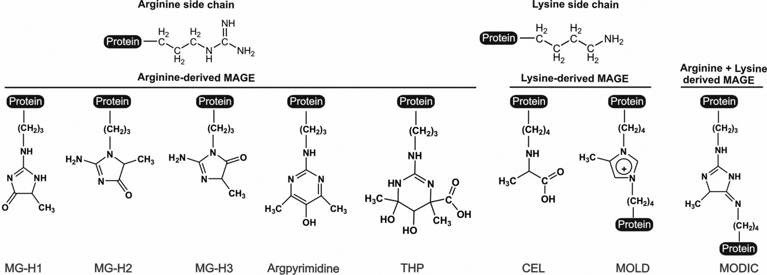
Methylglyoxal reacts with arginyl and lysyl residues
Notes:
Chemical structures of MAGE (MAGE, methylglyoxal-derived AGE; AGE, advanced glycation end-product)
Methylglyoxal reacts preferentially with arginine side chains to form hydroimidazolones (MG-H1, MG-H2 and MG-H3), tetrahydropyrimidine (THP) and argpyrimidine, a fluorescent MAGE. Methylglyoxal reacts also with lysine residues to form CEL. Protein cross-links are also observed with lysine residues, forming MOLD, and with both lysine and arginine residues, originating methylglyoxal-derived imidazolium cross-links (MODIC). To better understand the modification caused by methylglyoxal, arginine and lysine side chains are also shown.
source
source
Investigating the Glycating Effects of Glucose, Glyoxal and Methylglyoxal on Human Sperm
Clare Nevin, Lauren McNeil, Nessar Ahmed, Chris Murgatroyd, Daniel Brison & Michael Carroll
Scientific Reportsvolume 8, Article number: 9002 (2018)
http://www.biochemj.org/content/453/1/1.figures-only

Slide 54
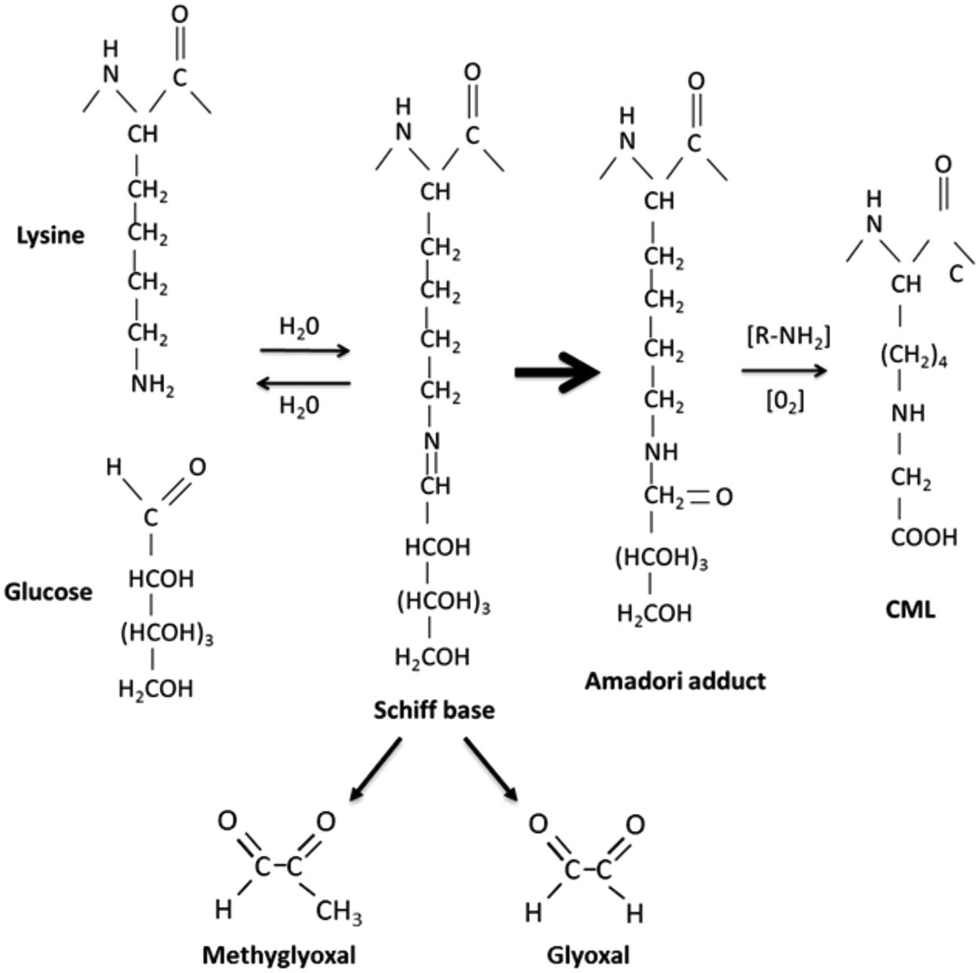
Methylglyoxal can derive from AGE advanced glycated products
Notes:
Glycation through the Maillard reaction. AGEs are formed through the Maillard reaction in which the carbonyl group of a reducing sugar, such as glucose, reacts with the amine group of a protein side chain residue, such as lysine. Initially a reversible Schiff base adduct is formed, which then undergoes a series of rearrangements to form an Amadori product. Further glycation and oxidation reactions lead to the formation of a primary AGE Nε-(carboxymethyl)lysine (CML). Fragmentation of the Schiff base generates the AGE intermediates methylglyoxal (MG) and glyoxal (GO). These reactive carbonyl compounds also react with biomolecules to produce AGEs.
source
Investigating the Glycating Effects of Glucose, Glyoxal and Methylglyoxal on Human Sperm
Clare Nevin, Lauren McNeil, Nessar Ahmed, Chris Murgatroyd, Daniel Brison & Michael Carroll
Scientific Reportsvolume 8, Article number: 9002 (2018)
https://www.nature.com/articles/s41598-018-27108-7#Fig1

Slide 55
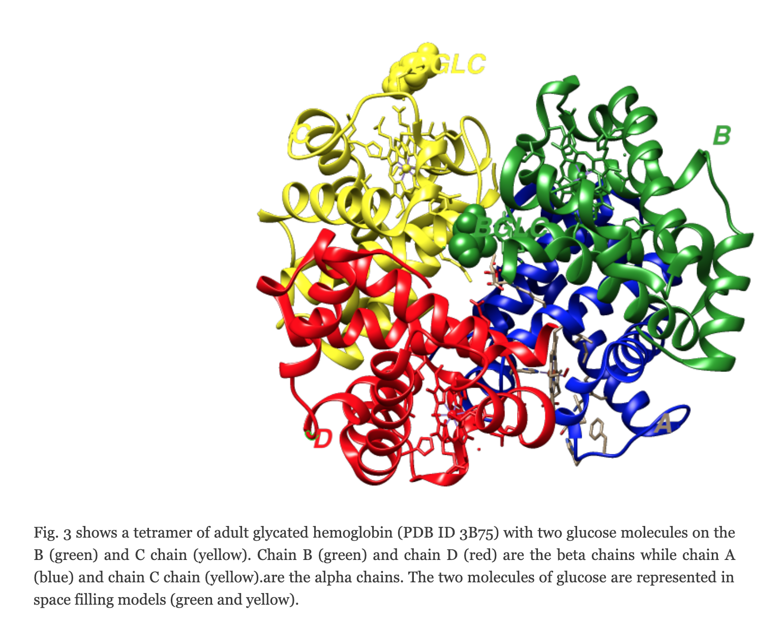
Glycated hemoglobin
Notes:
source
https://map.rcsb.org/?q=node/1143

Slide 56
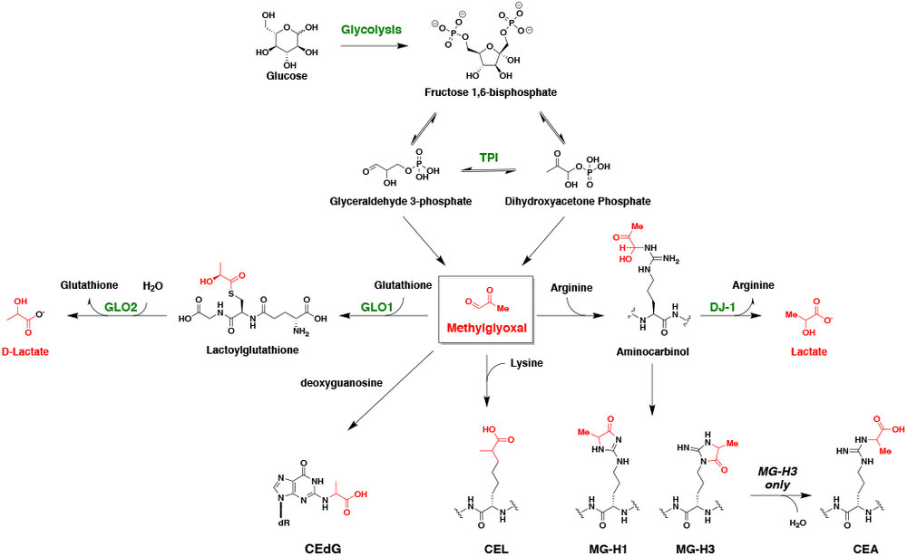
Overview of methylglyoxal reactivity
Notes:
Methylglyoxal (MGO) is generated as a by-product of glycolysis (~0.1% - 0.4% of the total glycolytic flux). Under physiologic conditions, MGO is detoxified by the glyoxalase system, which is comprised of two enzymes (glyoxalase 1, GLO1, and GLO2). When this system is compromised (e.g. diabetes, cancer), concentrations of MGO are elevated, resulting in protein and DNA modifications.
source
https://www.galliganlab.com/methylglyoxal-metabolism-in-disease

Slide 57
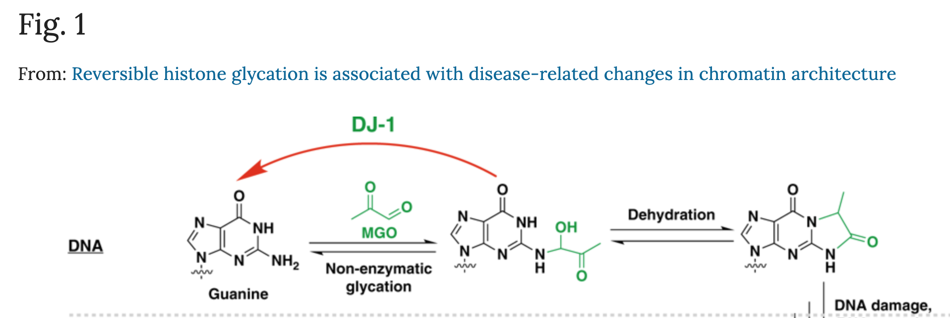
Methylglyoxal reacts with nucleotides
Notes:
source
Reversible histone glycation is associated with disease-related changes in chromatin architecture
Qingfei Zheng, Nathaniel D. Omans, Rachel Leicher, Adewola Osunsade, Albert S. Agustinus, Efrat Finkin-Groner, Hannah D’Ambrosio, Bo Liu, Sarat Chandarlapaty, Shixin Liu & Yael David
Nature Communicationsvolume 10, Article number: 1289 (2019)
https://www.nature.com/articles/s41467-019-09192-z

Slide 58
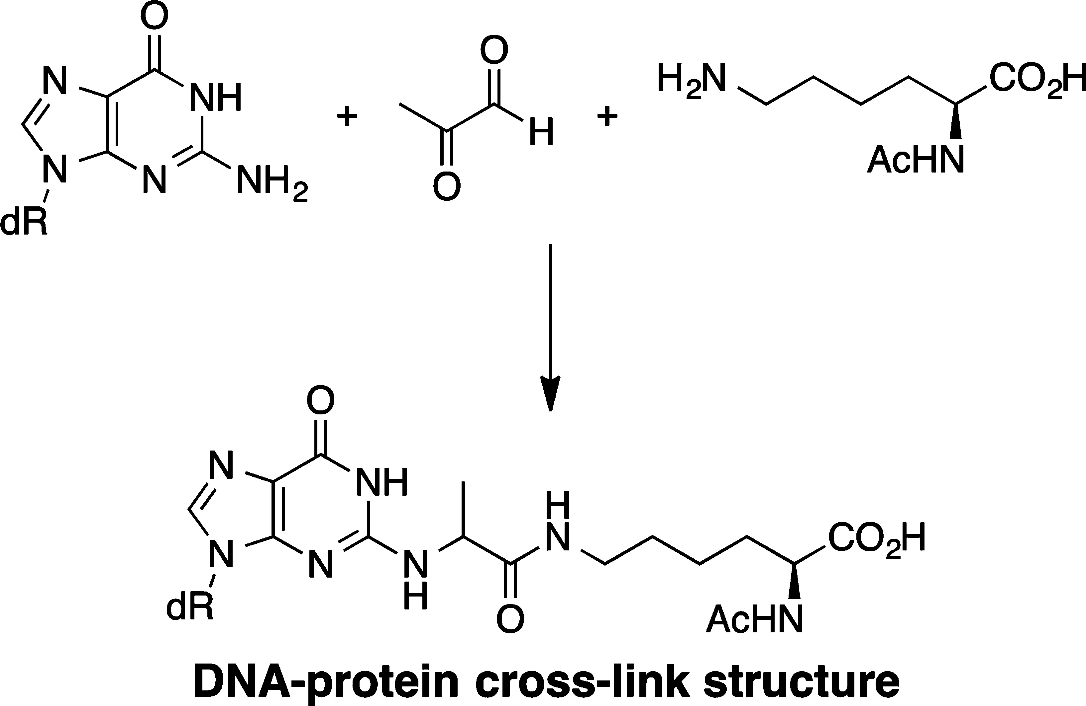
Methylglyoxal can act as a bifunctional reagent, cross-linking DNA with proteins
Published in: Katya V. Petrova; Amy D. Millsap; Donald F. Stec; Carmelo J. Rizzo; Chem. Res. Toxicol. 2014, 27, 1019-1029.
DOI: 10.1021/tx500068v
Copyright © 2014 American Chemical Society

Slide 59
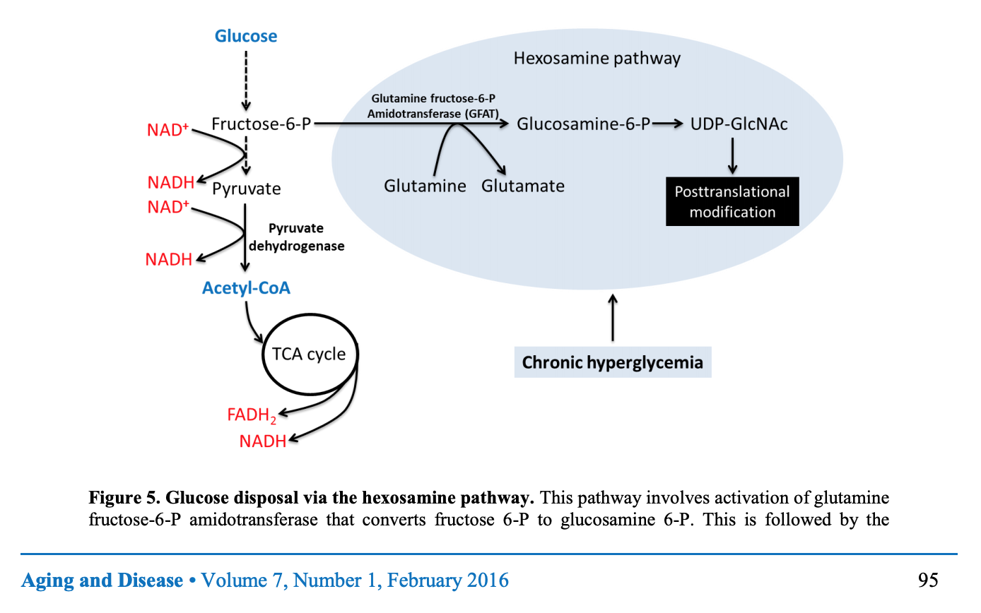
Glycolysis-dependent post-translational modifications

Slide 60
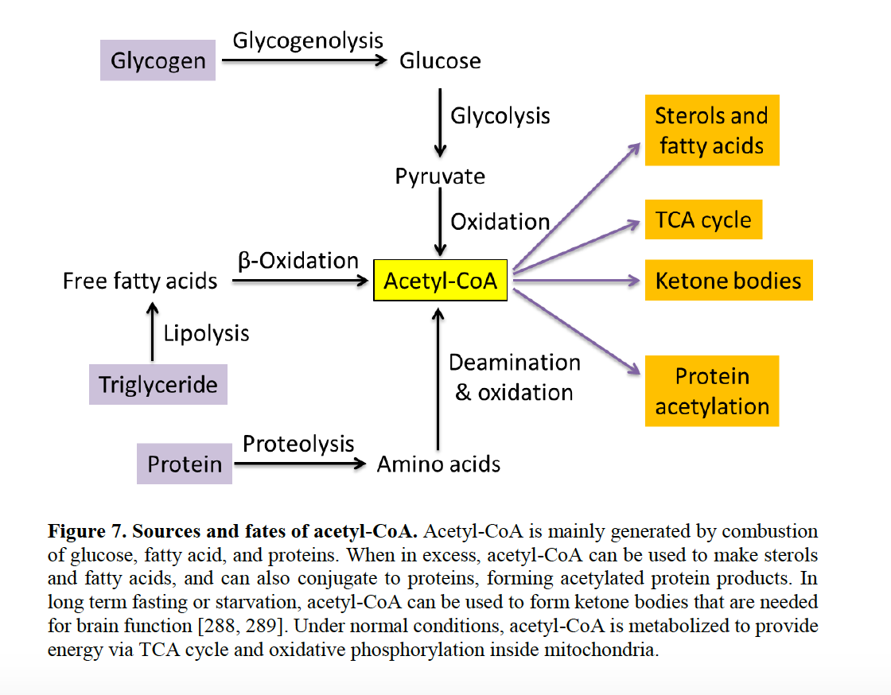
Glycolysis-dependent post-translational modifications

Slide 61
ACUTE METABOLIC COMPLICATIONS OF DIABETES
hyperglycemic hyperosmolar state
glycosuria
dehydration
hyperketonemia
metabolic acidosis (anion gap or decreased alkaline buffer)

Slide 62
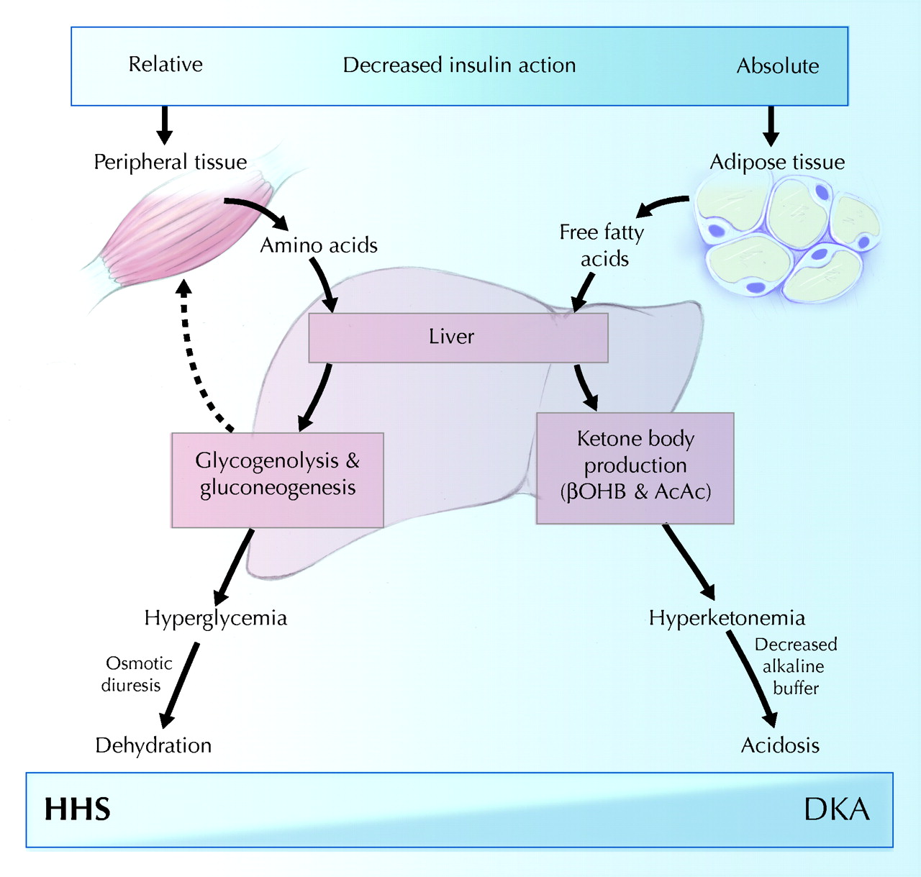
hyperglycemic hyperosmolar state
diabetic ketoacidosis
Notes:
Schematic of the pathogenesis of diabetic ketoacidosis (DKA) and the hyperglycemic hyperosmolar state (HHS). Relative or absolute insulin deficiency stimulates hepatic glucose production, which results in hyperglycemia, osmotic diuresis and dehydration. In severe insulin deficiency, the liver will augment ketone body production, culminating in hyperketonemia and, eventually, acidosis. βOHB = β-hydroxybutyric acid; AcAc = acetoacetic acid. Photo: Chesley Sheppard
source
http://debuglies.com/2018/11/11/type-1-diabetes-diabetic-ketoacidosis-dka-an-enemy-always-lurking/

Slide 63
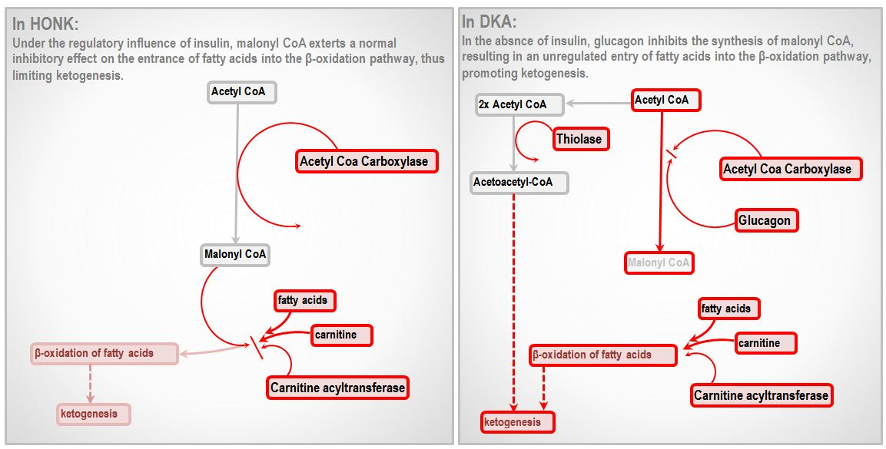
Hyperosmolar non ketotic hyperglycemia
Diabetic ketoacidosis
Notes:
source
https://derangedphysiology.com/main/required-reading/endocrinology-metabolism-and-nutrition/Chapter%20212/hyperosmolar-non-ketotic-hypergycaemic-coma-honk

Slide 64
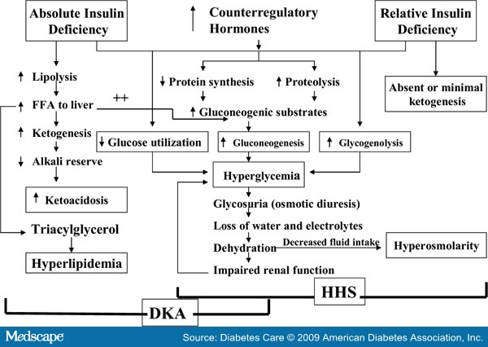
Notes:
source
https://www.stepwards.com/?page_id=2723

Slide 65
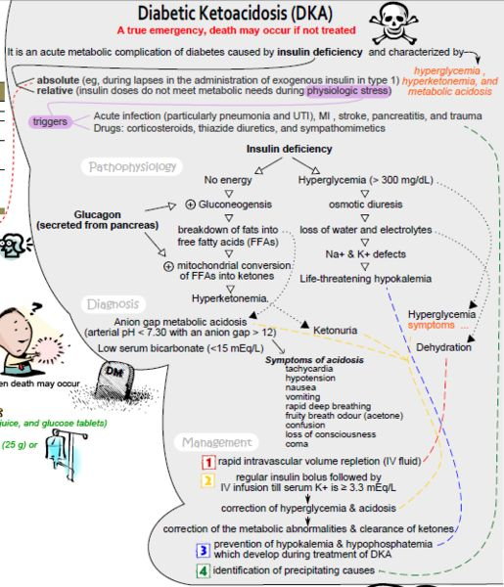

Slide 66
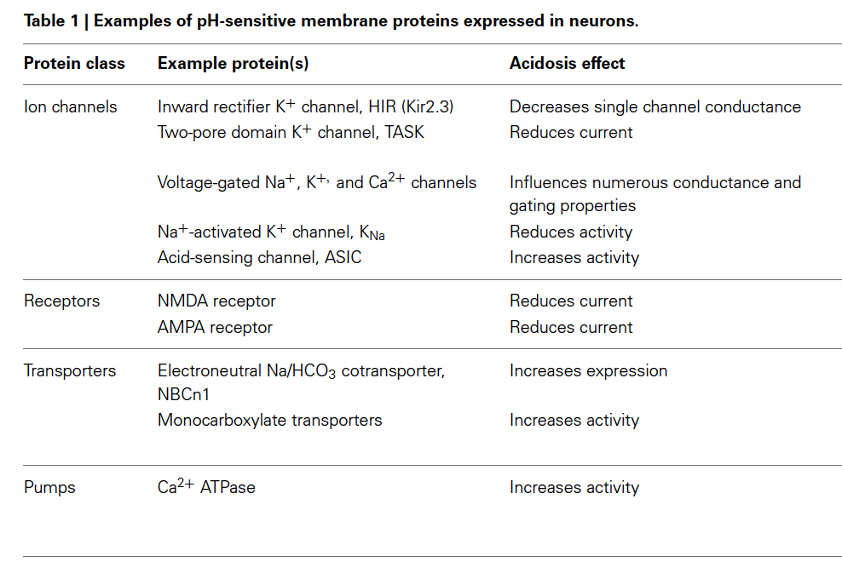
The effect of pH on neurons changes in membrane excitability lead to coma and death
Notes:
source
REVIEW ARTICLE
published: 13February2014
doi: 10.3389/fphys.2014.00043
IntracellularpHregulationbyacid-basetransportersinmammalianneurons
VernonA.Ruffin*, AhlamI.Salameh,WalterF.BoronandMarkD.Parker†

Slide 67
Fine

Slide 68
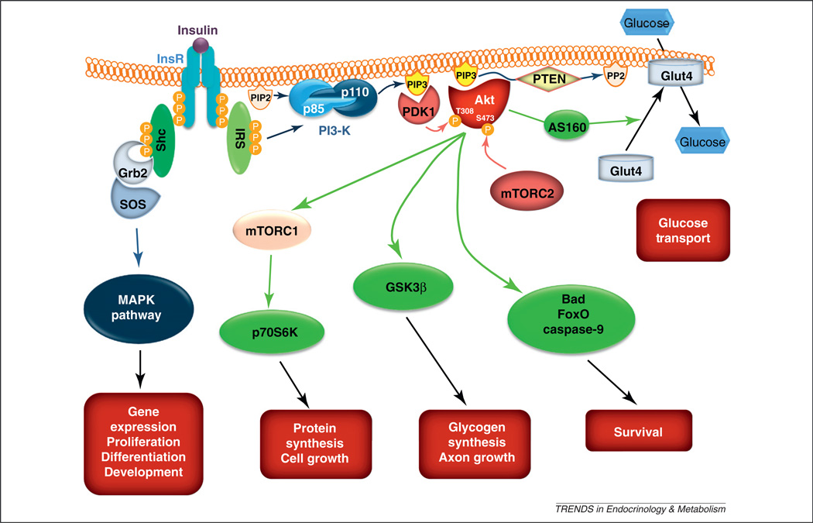
Insulin resistance in the brain
Notes:
source
https://www.ncbi.nlm.nih.gov/pmc/articles/PMC3392648/

