Slide 1
Lecture 6
Metabolic imbalances in obesity
and
correlations with diabetes

Slide 2
Obesity
Excessive accumulation of adipose tissue
usually accompanied by mild, chronic, systemic inflammation
Co-morbidities:
type 2 diabetes mellitus
cardiovascular diseases
some types of cancer
When multiple co-morbities coexist:
METABOLIC SYNDROME

Slide 3
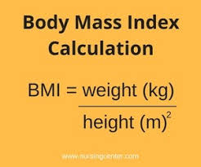
Obesity diagnosis
By means of the BODY MASS INDEX

Slide 4
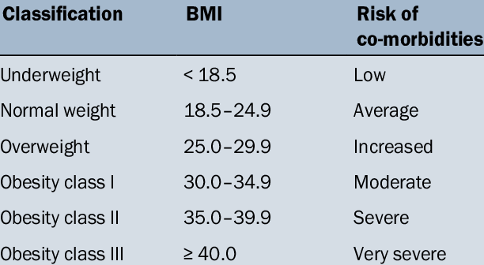
Classification of body mass
Notes:
SOURCE
https://www.researchgate.net/publication/320067348_A_research_on_relationship_between_ABO_blood_groups_and_body_mass_index_among_Turkish_seafarers/figures?lo=1

Slide 5
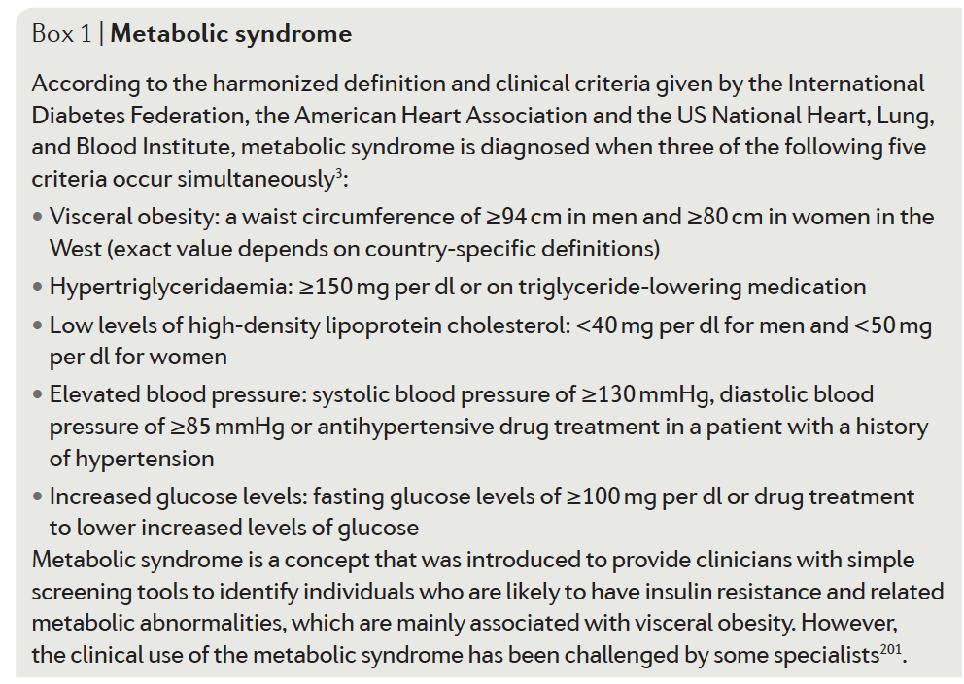
Metabolic syndrome
1
2
3
4
5
Notes:
source
Obesity
Nature Disease Primer
Voleume 3
Article number: 17034
doi:10.1038/nrdp.2017.34

Slide 6
Aetiology of obesity
Imbalance between the caloric intake and energy expenditure
Hormonal, metabolic and neurochemical adaptations
defend against weight loss and promote weight regain

Slide 7
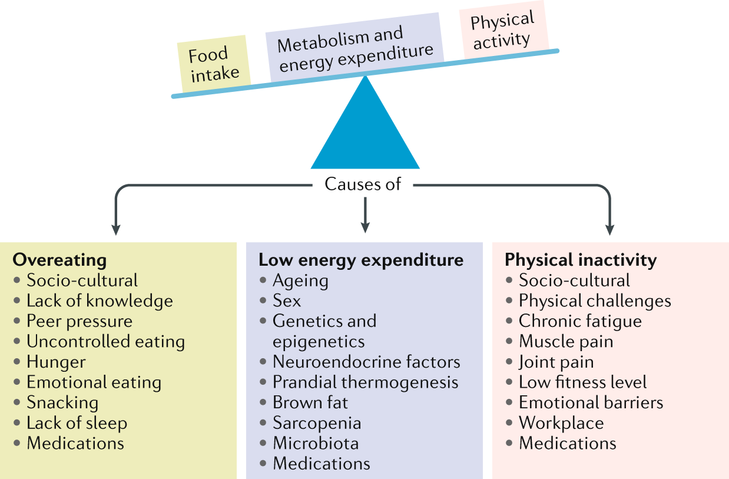
Factors causing obesity
Notes:
source
Obesity: global epidemiology and pathogenesis
Matthias Blüher
Nature Reviews Endocrinologyvolume 15, pages288–298 (2019)
https://www.nature.com/articles/s41574-019-0176-8

Slide 8
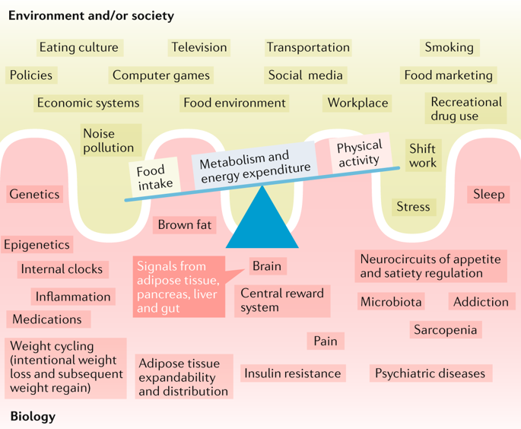
Biological and ennvironmental/societal factor combine in causing obesity
Notes:
source
Obesity: global epidemiology and pathogenesis
Matthias Blüher
Nature Reviews Endocrinologyvolume 15, pages288–298 (2019)
https://www.nature.com/articles/s41574-019-0176-8

Slide 9
Adipose tissue
A loose connective tissue with:
adipocytes (35-70%)
other cells, such as
preadipocytes
mesenchymal stem cells
macrophages and other immune cells
endothelial and smooth muscle cells

Slide 10
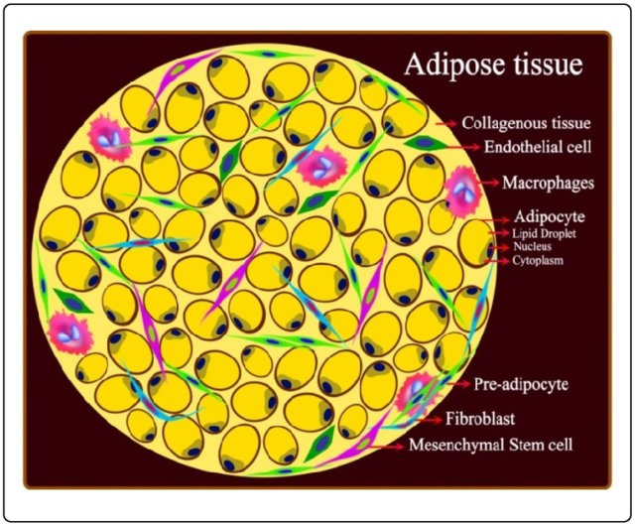
Scheme of adipose tissue
Notes:
Figure 3: Structure of adipose tissue. AT is composed of a collagenous background together with different cell types, which are seeded in this connective tissue. Adipocytes are the major constituent cells of AT and the main site for the storage and release of cytokines and chemokines. Metabolic disorders appeared to stimulate adipocytes to prime inflammation and as consequence the resident or regulated macrophages converted to the activated macrophages and then exacerbated by these activated ATMs. Preadipocytes are the next most abundant cells and the linker between adipocytes (metabolic cells) and macrophages (immune cells). LDs (or fat organelle) cannot be detected by preadipocytes. Other cells of AT are fibroblasts, MSCs and ECs and each AT-cell has an important role in different pathways including the metabolic, coagulation and inflammatory systems. Abbreviations are explained in the text.
source
https://www.researchgate.net/publication/264551515_Differential_role_of_AMP-activated_protein_kinase_in_brown_and_white_adipose_tissue_components_and_its_consequences_in_metabolic_diseases/figures?lo=1

Slide 11
Function of the adipose tisse
Storage of lipids (triacylglycerol)
Energy reserve
Thermal insulator
Endocrine organ
releases ca. 60 adipokines

Slide 12
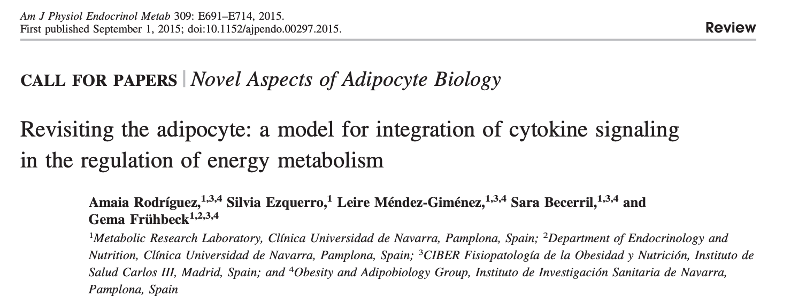
Recommended reading open access

Slide 13
Adipocyte growth
Insulin activates its receptor
Lipolysis is inhibited
triacylglycerols are retained
lipoprotein lipase is activated
increased uptake of free fatty acids from lipoproteins
GLUT4 translocates to the plasma membrane
increased uptake of glucose
glycerol enters the cells via aquaporin channels AQP3, AQP7, and AQP9
increased uptake of glycerol

Slide 14
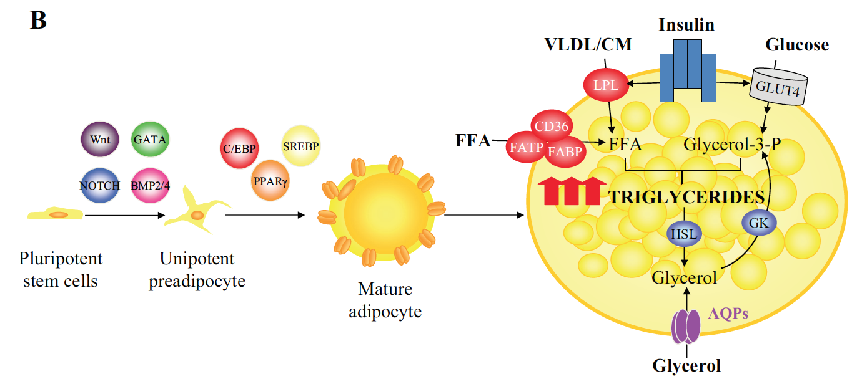
Adipocyte growth
Hormone-sensitive lipase is inhibited
Notes:
During periods of positive energy balance, such as overfeeding or sedentary lifestyle, adipose tissue expansion can
be achieved by hyperplasia and/or hypertrophy. Insulin constitutes one of the major regulators of adipocyte hypertrophy via promotion of the accumulation of
triacylglycerols by the inhibition of lipolysis, activation of lipoprotein lipase, translocation of GLUT4 to the plasma membrane, and upregulation of glycerol
channels AQP3, AQP7, and AQP9 and, hence, glycerol influx into the fat cells.
source
Am J Physiol Endocrinol Metab 309: E691–E714, 2015.
First published September 1, 2015; doi:10.1152/ajpendo.00297.2015.
https://www.physiology.org/doi/full/10.1152/ajpendo.00297.2015?url_ver=Z39.88-2003&rfr_id=ori%3Arid%3Acrossref.org&rfr_dat=cr_pub%3Dpubmed&

Slide 15
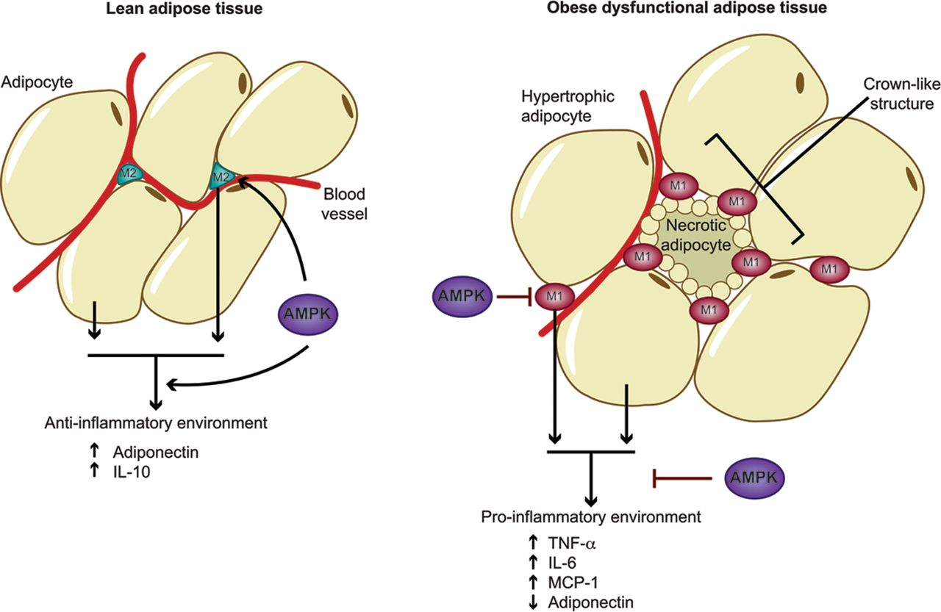
Hypertrohy leads to apoptosis and inflammation
Notes:
Anti-inflammatory actions of AMPK in adipose tissue In lean adipose tissue, small adipocytes and alternatively activated macrophages secrete adipocytokines such as IL-10 and adiponectin, which maintain an anti-inflammatory environment. Production of these adipocytokines is promoted by activated AMPK. Excess calorie intake leads to the development of a pro-inflammatory environment within obese adipose tissue. Adipocytes enlarge, becoming hypertrophic and often necrotic, and there is an increased infiltration of macrophages. The pro-inflammatory environment drives macrophage polarization towards the classically activated M1 state, and they tend to accumulate around necrotic adipocytes, forming crown-like structures. The secretory products of the macrophages and hypertrophic adipocytes further exacerbate this inflammation. Adipose tissue inflammation is linked to obesity-related insulin resistance and Type 2 diabetes. Activation of AMPK can inhibit production of pro-inflammatory cytokines and chemokines, increase adiponectin secretion and inhibit macrophage recruitment and M1 polarization, thereby potentially reducing insulin resistance.
source
Role of AMP-activated protein kinase in adipose tissue metabolism and inflammation
Silvia Bijland, Sarah J. Mancini, Ian P. Salt
Clinical Science Jan 08, 2013, 124 (8) 491-507; DOI: 10.1042/CS20120536
http://www.clinsci.org/image-gallery/adipose-tissue

Slide 16
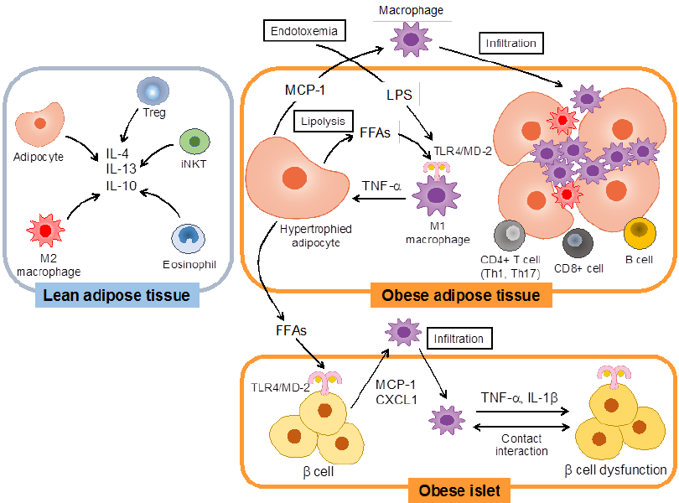
Hypertrophic adipocytes are lipolytic Free fatty acids activate macrophages
Notes:
Figure 1. Inflammatory changes in adipose tissue and pancreatic islets in association with obesity. In the lean state, regulatory T (Treg) cells, esosinophils, invariant natural killer T (iNKT) cells, M2-like resident macrophages, and adipocytes secrete anti-inflammatory cytokines including interleukin (IL)-4, IL-13 and IL-10 and suppress inflammation in adipose tissue. However, in the obese state, macrophages are activated by recognition of free fatty acids (FFAs) from hypertrophied adipocytes or lipopolysaccharide (LPS) through the Toll-like receptor (TLR) 4/myeloid differentiation protein-2 (MD-2) complex to induce tumor necrosis factor- α (TNF- α ) production. Adipocytes secrete monocyte chemotactic protein-1 (MCP-1) in response to TNF- α and promote filtration of macrophages into adipose tissues. In addition, CD4+ or CD8+ T cells and B cells infiltrate adipose tissue during obesity and exaggerate adipose tissue inflammation. FFAs such as palmitate from adipocytes may activate TLR4/MD-2 expressed in cells and induce the production of chemokines, chemokine (C-X-C motif) ligand 1 (CXCL1) and MCP-1. In response to these chemokines, macrophages infiltrate into islets. Cytokines such as TNF- α and IL-1 β from macrophages and contact interactions between cells and macrophages lead to cell dysfunction.
source
https://www.researchgate.net/publication/257071152_Activation_and_Regulation_of_the_Pattern_Recognition_Receptors_in_Obesity-Induced_Adipose_Tissue_Inflammation_and_Insulin_Resistance/figures?lo=1

Slide 17
Increased release of free fatty acids in plasma by the adipose tissue
CONSEQUENCES
Increased availability for organs and tissues
Increased uptake by cells
Increased intracellular metabolism
Metabolic products are cytotoxic

Slide 18
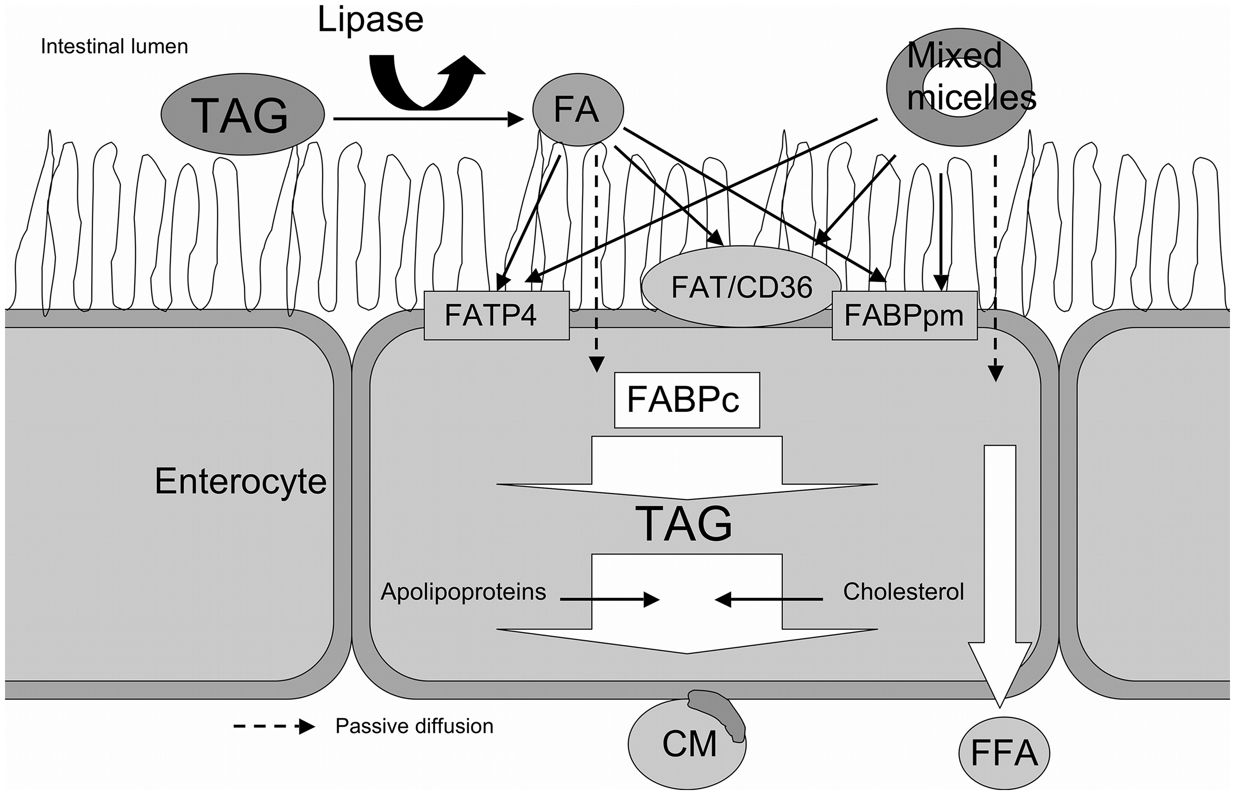
Intestinal uptake of fatty acids
Notes:
Figure 2
Intestinal uptake of dietary fatty acids.
Dietary fatty acids (FA) pass through the intestinal lumen whilst esterified to triacylglycerols (TAG) or incorporated into mixed micelles. Gastric and hepatic lipases free the fatty acids, which are then receptive to uptake. Fatty acids are either transported across the apical membrane actively by FATP4, FAT/CD36 or FABPpm, or passively diffuse (blocked arrows) through the lipid bilayer. In the enterocyte FABPc facilitates fatty acid transport through the cytosol. In the cytoplasm, the major part of fatty acids is re-esterified to triacylglycerols and excreted into chylomicrons (CM), whereas a small part is excreted as free fatty acids (FFA).
source
Fatty Acid- and Cholesterol Transporter Protein Expression along the Human Intestinal Tract
Christiaan J. Masson, Jogchum Plat, Ronald P. Mensink, Andrzej Namiot, Wojciech Kisielewski, Zbigniew Namiot, Joachim Füllekrug, Robert Ehehalt, Jan F. C. Glatz, Maurice M. A. L. Pelsers
Published: April 29, 2010https://doi.org/10.1371/journal.pone.0010380
https://journals.plos.org/plosone/article/figure?id=10.1371/journal.pone.0010380.g002

Slide 19
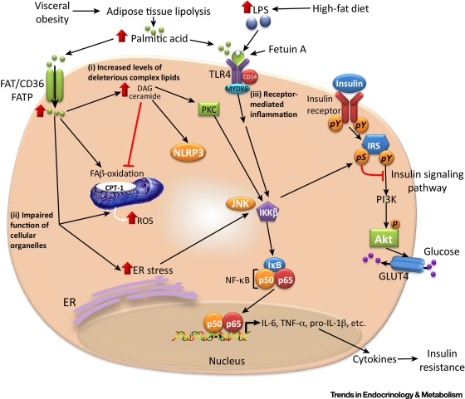
Cellular uptake of Fatty acids
Notes:
source
https://www.cell.com/trends/endocrinology-metabolism/fulltext/S1043-2760(17)30170-4

Slide 20
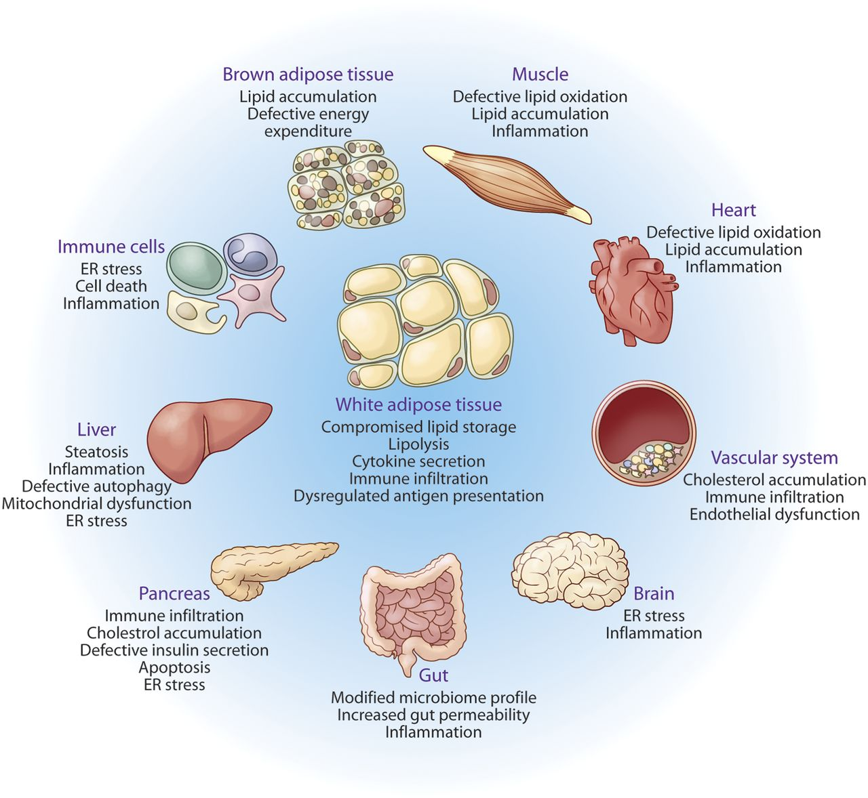
Integrated organ pathology resulting from lipotoxicity and metabolic inflammation
Notes:
Integrated organ pathology resulting from lipotoxicity and metabolic inflammation. White adipose tissue is the designated lipid storage depot of higher organisms. In the presence of prolonged nutrient excess or metabolic disturbances, the storage capacity of white adipose tissue is exhausted, leading to ectopic deposition of lipids and lipotoxicity in several organs, such as muscle, liver, pancreas, and heart, as depicted and explained in detail in the text. Because the lipid homeostatic pathways converge with stress and immune responses, such responses in affected tissue systems are activated by harmful lipid species. The outcomes of lipotoxicity differ in the various target tissues, for example NASH in liver, cardiac failure in the heart, altered feeding behavior and appetite due to lipotoxicity in brain, degenerative changes in muscle and BAT, etc. Furthermore, lipotoxicity leads to sustained and unresolved inflammation, organelle dysfunction and stress, which can lead to a vicious cycle of metabolic deterioration.
source
http://www.jlr.org/lens/jlr/57/12/2099#figures

Slide 21
Lipotoxity
Excess fatty acids are metabolised by cells by two simultaneous pathways
Catabolic pathway
Anabolic pathway
In both cases, products may be cytotoxic

Slide 22
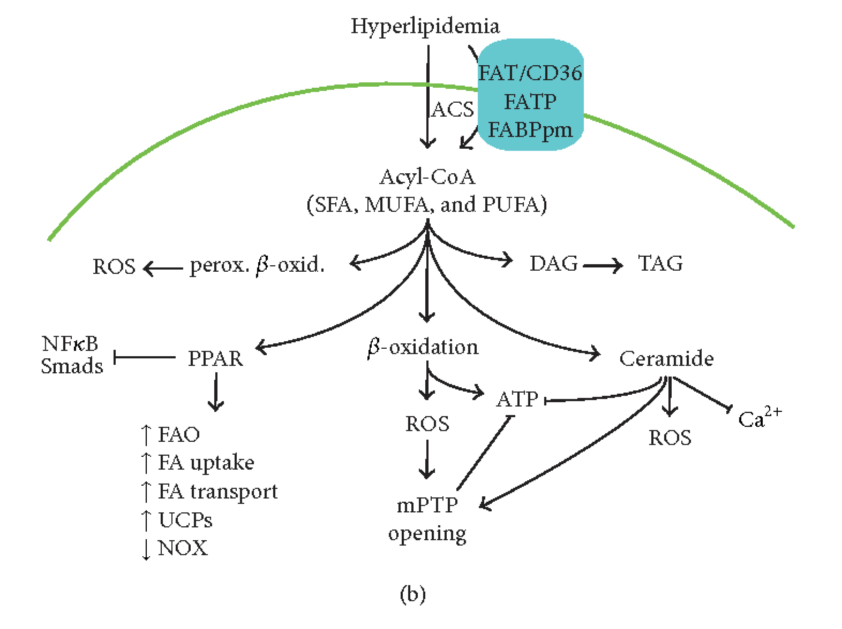
anabolic pathways
catabolic pathways
Notes:
source
https://www.semanticscholar.org/paper/Alteration-of-Energy-Substrates-and-ROS-Production-Lorenzo-Ram%C3%ADrez/d50cc48a0b1be2cc4a47a9bd7a8d84bd6dde8f5a

Slide 23
Mechanisms of lipotoxicity by catabolic pathways
Free fatty acids (FFA) diffuse into the cell via specific transporters (FAT/CD36) and enter the catabolic pathways of beta oxidation in
mitochodria
peroxisomes
This increases endogenous ROS production

Slide 24
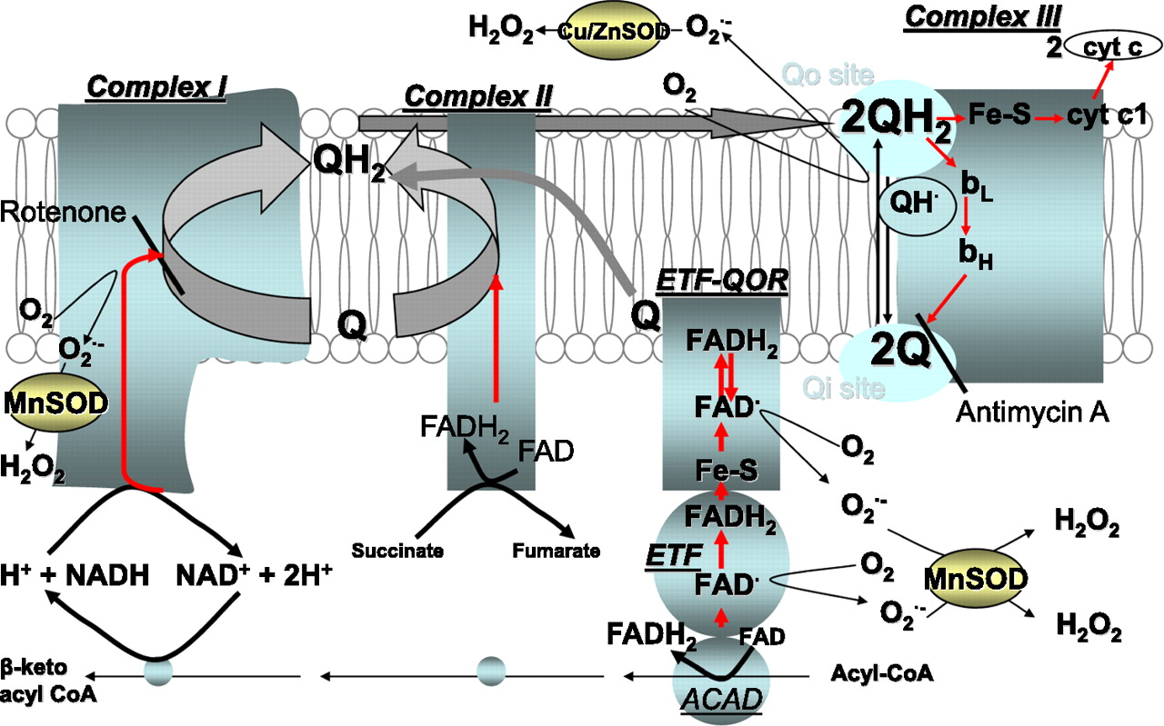
The passage of electrons from FA to the ETC. Sites of electron leak and superoxide production and its dismutation to H2O2 are shown.
Mariana G. Rosca et al. Diabetes 2012;61:2074-2083
©2012 by American Diabetes Association
Notes:
The passage of electrons from FA to the ETC. Sites of electron leak and superoxide production and its dismutation to H₂O₂ are shown. The electron passage is shown in red. Electrons are released by substrate oxidation and captured by NADH and FADH₂, which are oxidized by complexes I and II, respectively. These complexes pass the electrons to ubiquinone (Q). The reduced Q (ubiquinol, QH₂) diffuses to and binds within the QH₂ oxidation site (Qo) in complex III (formed by cytochrome b and the Fe-S protein rotated toward it). ETF linked to ETF-QOR provides an alternative pathway to pass electrons to the ETC. The FAD cofactors in ETF and ETF-QOR carry 1 electron at a time with the formation of intermediate semiquinone state of flavin. Flavin in the ETF is rapidly reduced by one electron by acyl-CoA dehydrogenases (ACAD). The slow complete reduction of flavin facilitates the accumulation of semiquinone. The electrons are donated sequentially to the Fe-S center and flavin in the ETF-QOR. Both electrons are further donated to Q (bound to the ETF-QOR in the mitochondrial inner membrane). The QH₂ product leaves this site and is reoxidized in the Qo center of complex III. The transfer of electrons diverges within the Qo site: one electron is transferred to the Fe-S, followed immediately by the other electron transfer to the Qi (Q reduction site) via cytochrome b_{L}. Under conditions of uninhibited electron flow through complex III, the reaction is rapid, preventing the accumulation of semiquinone (QH∙) in the Qo site. Antimycin A, a Qi site inhibitor, prevents the electron from leaving complex III, leading to accumulation of QH∙ and O₂∙ formation. Rotenone, an inhibitor of the Q reduction site in complex I, prevents the electrons from leaving complex I and reaching complex III, leading to an increase in O₂∙ formation from complex I toward the matrix and decrease in O₂∙ formation from Qo in complex III toward the intermembrane space. Superoxide is dismutated by the matrix Mn-SOD and intermembrane space Cu/Zn-SOD. (A high-quality color representation of this figure is available in the online issue.)‏
source
https://www.ncbi.nlm.nih.gov/pmc/articles/PMC3402323/

Slide 25
Mechanisms of lipotoxicity by anabolic pathways
Free fatty acids (FFA) diffuse into the cell via specific transporters (FAT/CD36) and enter the anabolic pathway (because beta oxidation is inhibited by high NADH/NAD⁺, said “reductive stress”)
FFA are esterified with glycerol
monoacylglycerol
diacylglycerol (co-activator of protein kinase C)
TRIACYLGLYCEROL (inert)
FFA enter the de novo pathway for the synthesis of ceramide

Slide 26
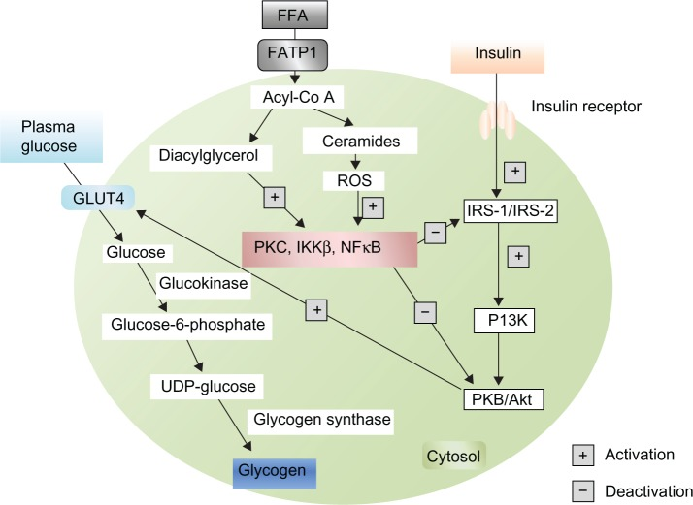

Slide 27
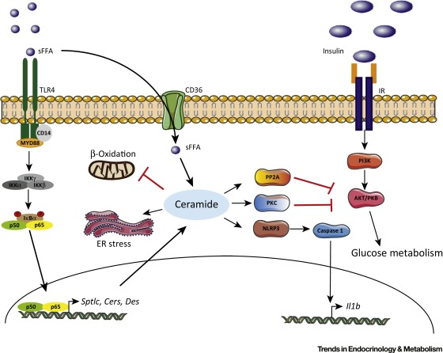
Ceramides – Lipotoxic Inducers of Metabolic Disorders
Notes:
source
https://www.cell.com/trends/endocrinology-metabolism/fulltext/S1043-2760(15)00139-3

Slide 28
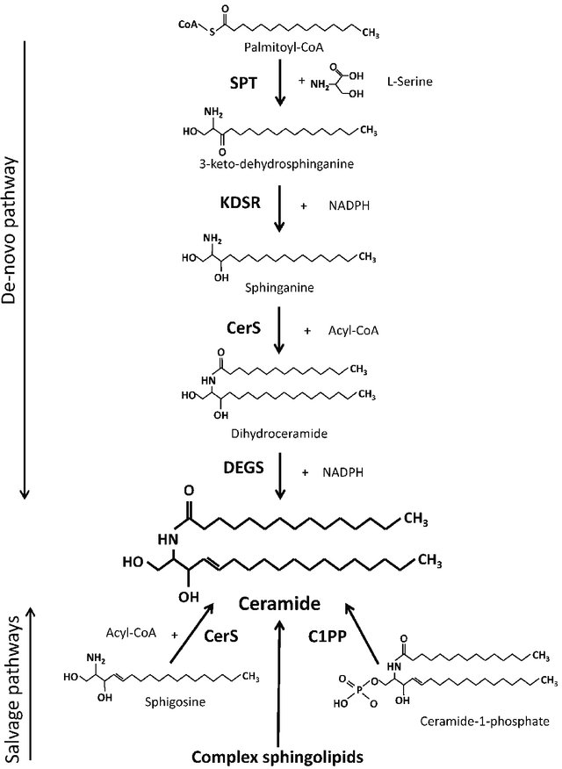
Ceramide synthesis pathways. SPT-serine palmitoyltransferase, KDSR-3-keto-dehydrosphinganine reductase, CerS-ceramide synthase (various isoforms),
DEGS-dihydroceramide desaturase (various isoforms), C1PP-ceramide-1-phosphate phosphatase, Acyl-CoA-fatty acyl coenzyme A, NADPH nicotinamide adenine dinucleotide phosphate, reduced.
Notes:
Source
Effect of plasma free fatty acid supply on the rate of ceramide synthesis in different muscle types in the rat
November 2017PLoS ONE 12(11):e0187136
DOI: 10.1371/journal.pone.0187136

Slide 29
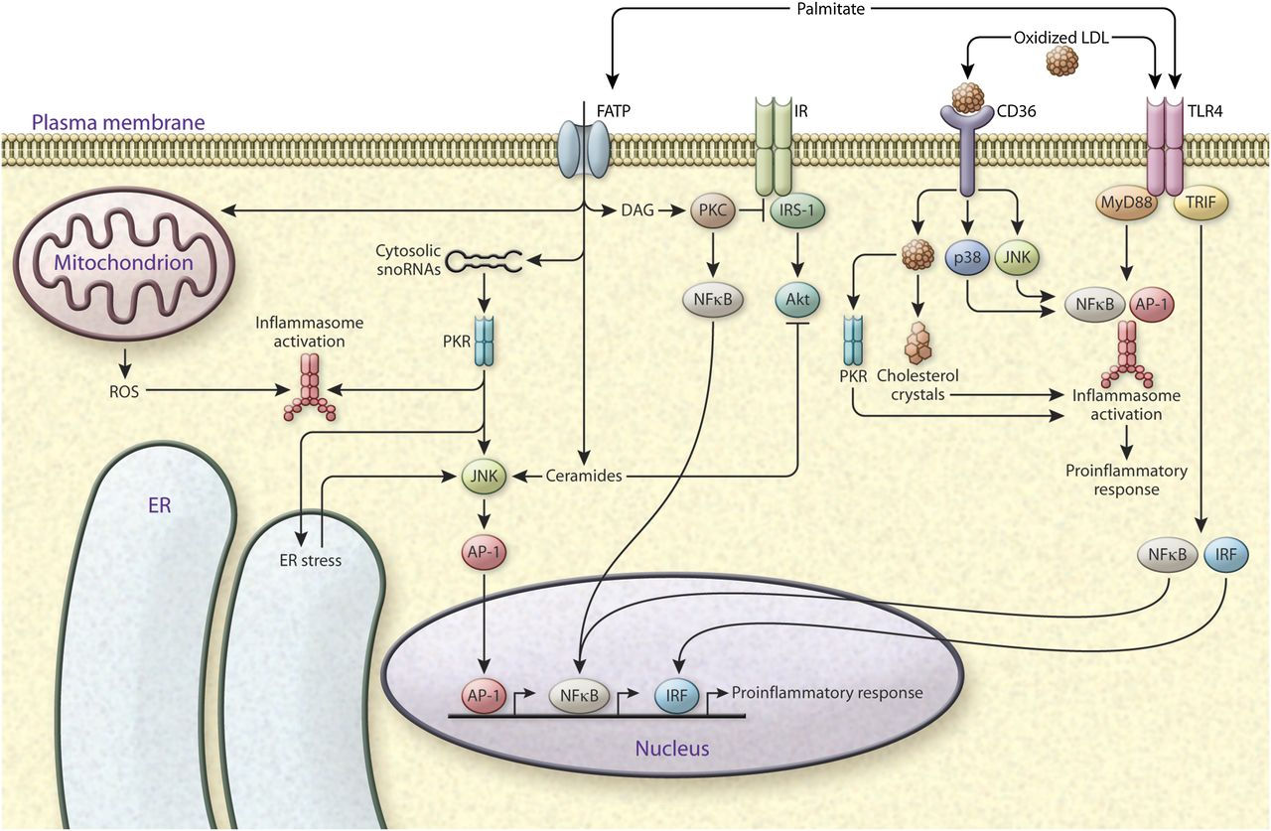
Coupling of toxic and pro-inflammatory lipids and innate immune response
Notes:
Coupling of toxic and pro-inflammatory lipids and innate immune response. Accumulation of toxic lipid classes causes deterioration of metabolic regulation, and the effects of such lipids converge on inflammatory and stress pathways. Saturated fatty acids such as palmitate have been extensively studied for their effects in increasing inflammation and inhibiting insulin action. Palmitate is taken up by the cells via FATPs, and is involved in upregulation of cytosolic snoRNAs, which are implicated in ER stress. PKR is a potential kinase that links palmitate-mediated snoRNA upregulation to ER stress induction. PKR also activates inflammasomes and JNK, and promotes AP-1-mediated inflammatory gene expression. Lipotoxicity can also lead to ROS production from mitochondria, which is linked to inflammasome activation. Palmitate directly contributes to the synthesis of DAGs and ceramides. DAGs activate stress kinases, PKCs, and the NFκB pathway; ceramides activate JNK signaling; and both DAGs and ceramides cause insulin resistance via inhibition of IRS1 and AKT, respectively, downstream of insulin receptor (IR). Palmitate can also activate TLR4 signaling, which leads to activation of inflammasomes and induction of inflammatory gene transcription factors interferon regulatory factor (IRF), NFκB, and AP-1. Cholesterol is taken up by the cells via scavenger receptors (e.g., CD36). Accumulation of oxidized cholesterol or cholesterol crystals also leads to induction of TLR4, PKR, and stress kinase (JNK and p38) signaling or inflammasome activation and pro-inflammatory gene expression, which are central players in atherosclerosis progression.
source
http://www.jlr.org/lens/jlr/57/12/2099#figures

Slide 30
Inhibitory pathway of GLUT4 translocation by free fatty acids via Ceramides and diacylglycerol

Slide 31
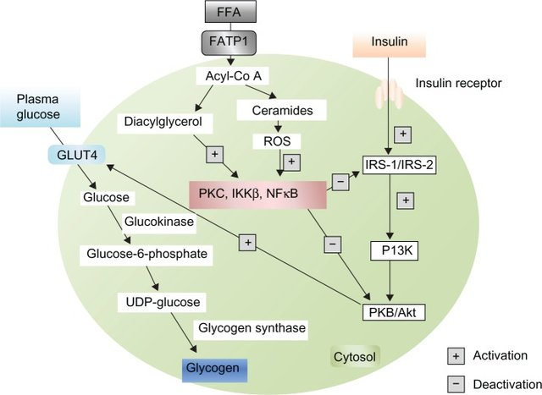
Notes:
Obesity and Insulin Resistance: An Abridged Molecular Correlation
Inhibitory pathway of GLUT4 translocation by free fatty acids. Abbreviations: FATP1, fatty acid-transport protein 1; ROS, reactive oxygen species.
Source
https://www.researchgate.net/publication/266401570_Obesity_and_Insulin_Resistance_An_Abridged_Molecular_Correlation/figures?lo=1

Slide 32
Leptin
Adipokine released by adipose tissue that inhibits orexygenic neurons in the hypothalamus

Slide 33
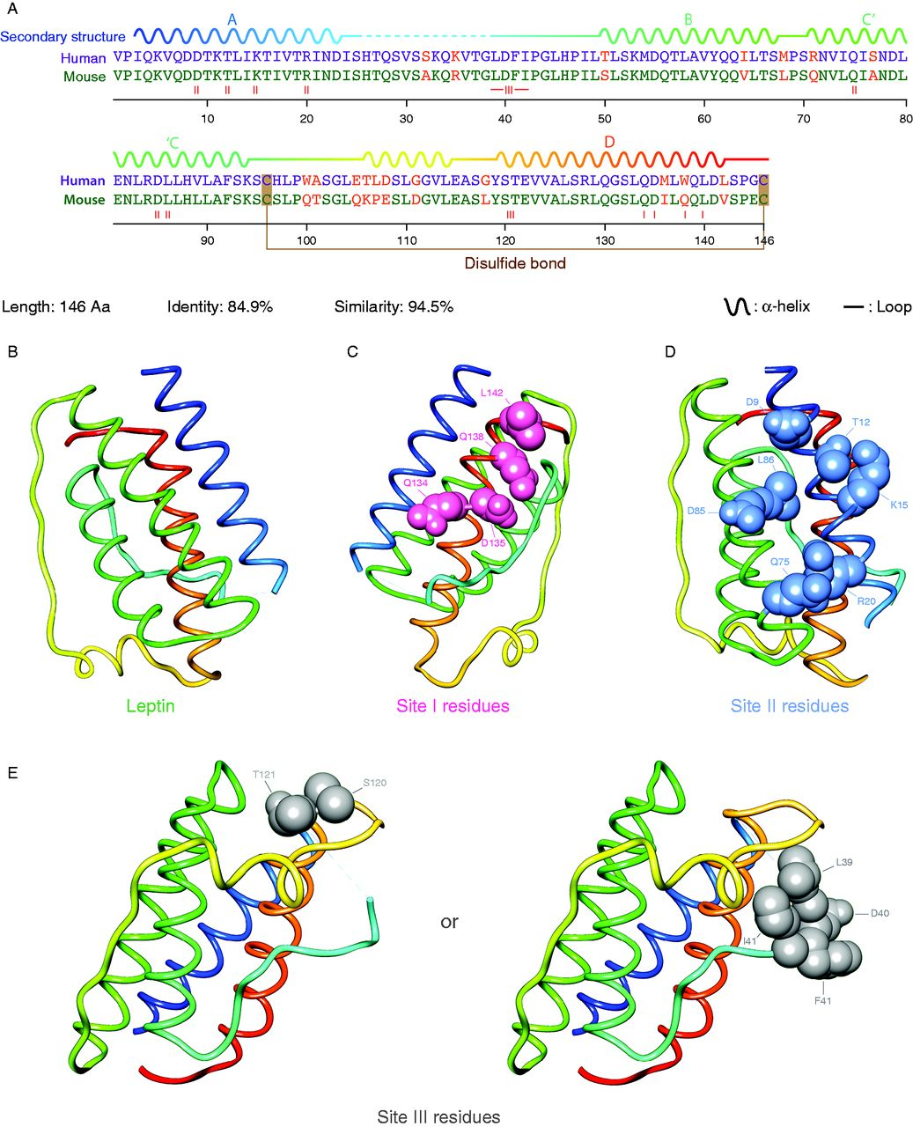
Structure of leptin
Notes:
Leptin sequence, structure, and position of binding-sites. (A) Pairwise sequence alignment of human (purple) and murine (green) leptin shows high sequence conservation (84.9% identity). Differences are shown in red. Secondary structures (α helices and loops), as well as the intramolecular disulfide bridge, are shown based on the crystal structure of human leptin. (B) X-ray crystallographic structure of human leptin W100E (PDB ID:1AX8), shown as cartoon with rainbow color scheme. Residues of binding sites I (C), II (D), and III (E) are shown as spheres.
Citation: Journal of Endocrinology 223, 1; 10.1530/JOE-14-0264
source
https://joe.bioscientifica.com/view/journals/joe/223/1/T9.xml
source

Slide 34
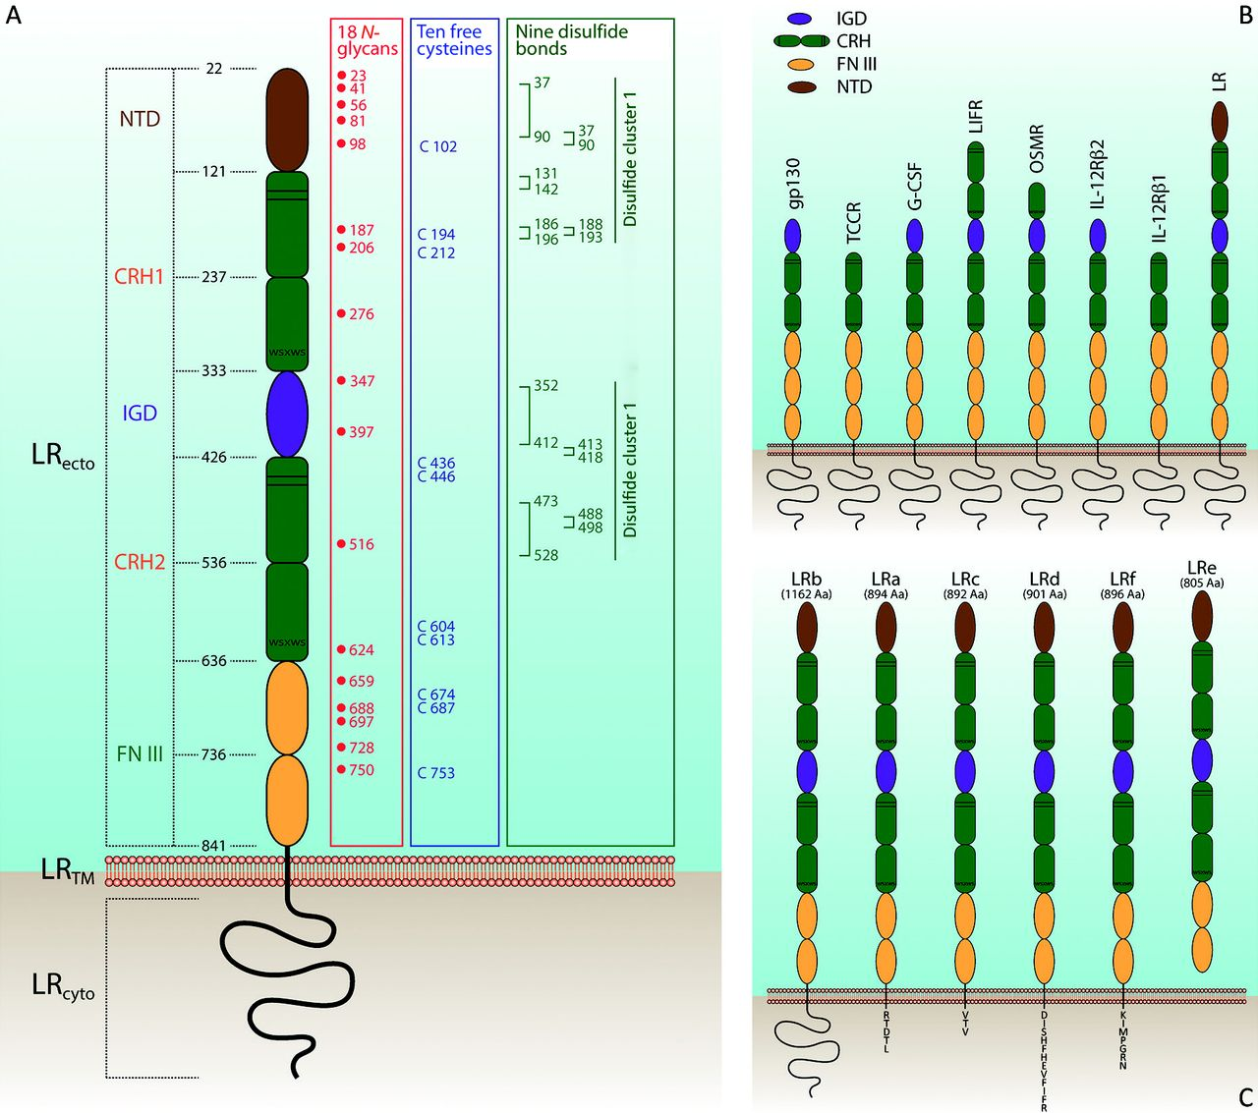
Structure of leptin receptor
Notes:
Structurally, the LR can be classified as a class I cytokine receptor
Schematic structure of leptin receptor (LR). (A) LR can be divided into three parts: extracellular (LRecto), transmembrane (LRTM), and cytoplasmic tail (LRcyto). The extracellular part LRecto is composed of a N-terminal domain (NTD), two cytokine receptor homology (CRH) domains (CRH1 and CRH2), an immunoglobulin-like domain (IGD), and two membrane-proximal fibronectin type III (FN III) domains. Numbers indicate the predicted domain borders. N-linked glycosylation sites (red), position of free cysteines (purple), and disulfide clusters (green) are shown on the right. (B) Modular structure of gp130 family of cytokine receptors. (C) LR isoforms: at least six different LR isoforms are found in human, namely LRa to LRf. LRb is the longest one with fully functional intracellular parts and thus is the only functional isotype. Short forms (LRa, LRc, LRd, and LRf) have unique C-terminal stretch of amino acids. LRe is a soluble variant.
Citation: Journal of Endocrinology 223, 1; 10.1530/JOE-14-0264
source
https://joe.bioscientifica.com/view/journals/joe/223/1/T9.xml

Slide 35
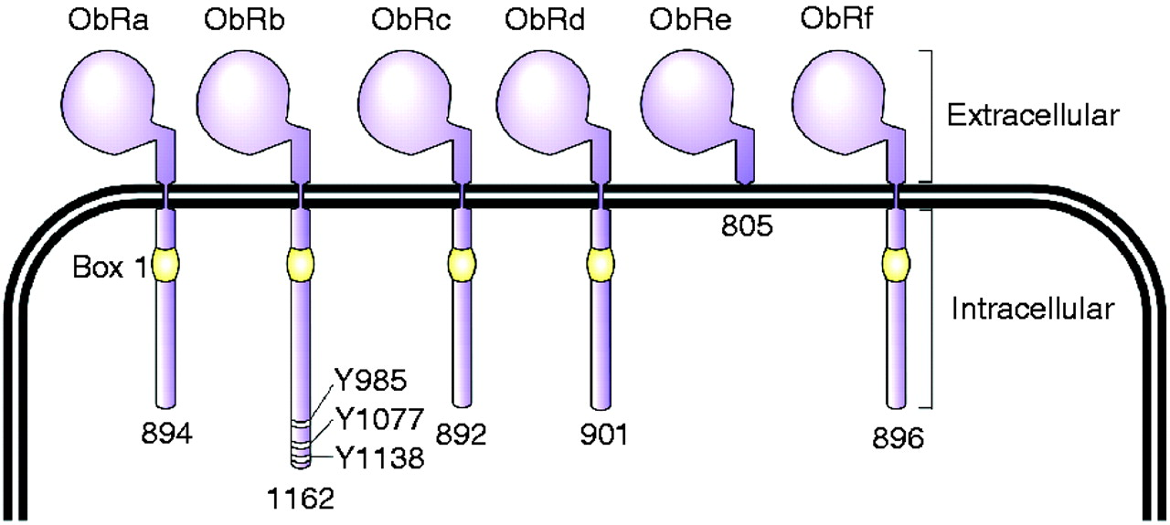
The leptin receptor has six isoforms obtained by alternative splicing
Notes:
The leptin receptor has six isoforms obtained by alternative splicing, which are designated ObRa, ObRb, ObRc, ObRd, ObRe, and ObRf. While the extracellular domain is common for all of these isoforms, the intracellular domain differs from one variant to another. The number below each form indicates the number of amino acids characteristic of each isoform. The box 1 motif is required for JAK interaction and activation. However, only the long form (ObRb) contains motifs for the complete activation of the JAK/STAT pathway. Three tyrosine residues, whose phosphorylation is important for leptin signaling, are indicated in ObRb: Y985 interacts with the SH2-containing protein tyrosine phosphatase 2, Y1077 with STAT5, and Y1138 with STAT3.
Citation: Journal of Molecular Endocrinology 49, 1; 10.1530/JME-12-0025
SOURCE
https://jme.bioscientifica.com/view/journals/jme/49/1/R9.xml

Slide 36
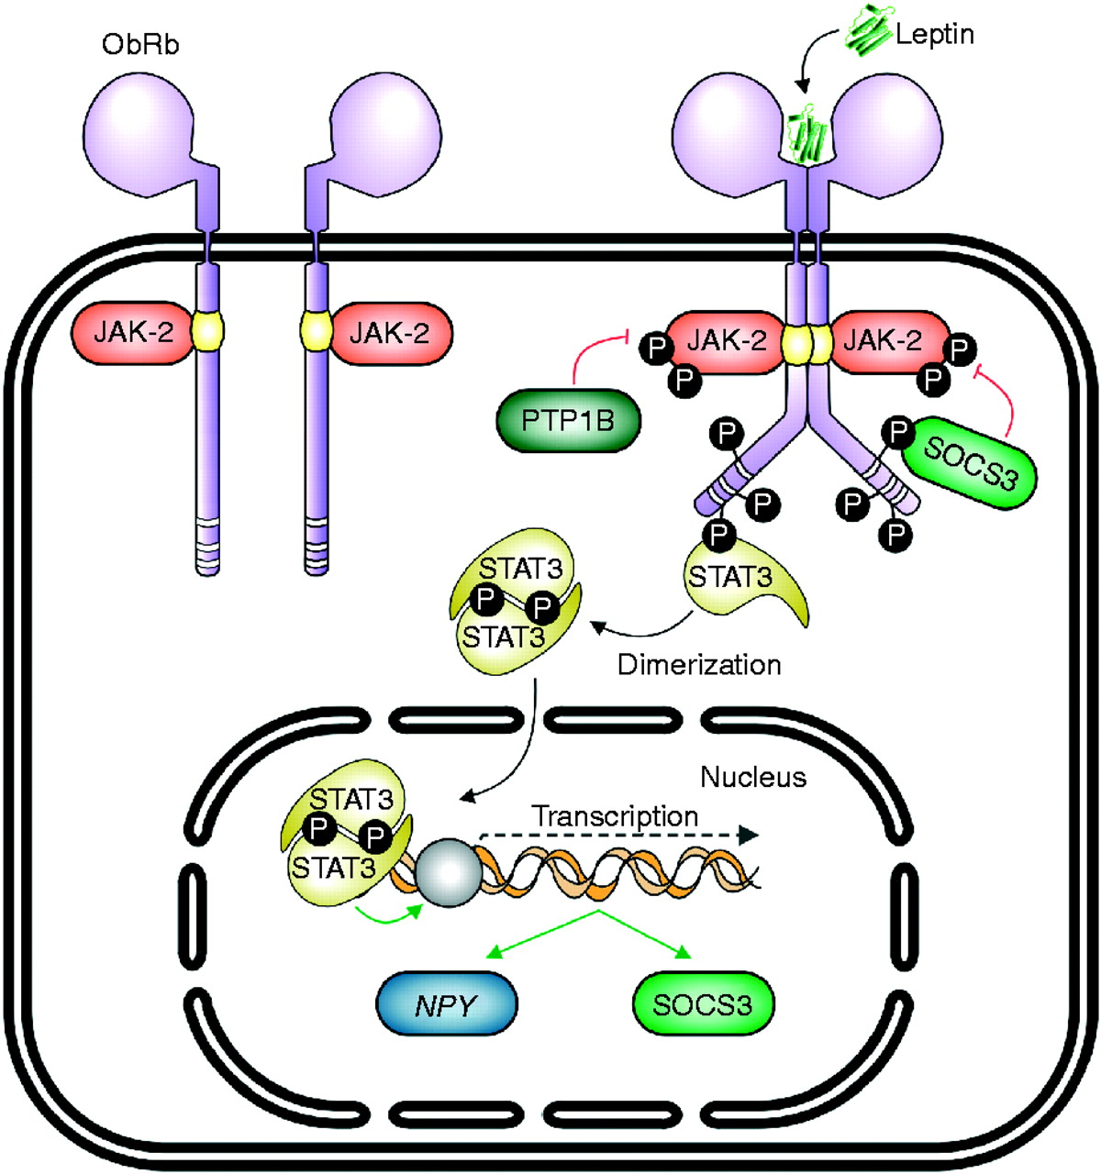
Leptin signalling
Notes:
Figure 2
Leptin binding to its receptor activates the associated JAK-2 tyrosine kinase, which subsequently phosphorylates intracellular tyrosine residues of the receptor. This leads to the activation of STAT3, which dimerizes and migrates to the nucleus, where it works as a transcription factor, promoting the expression of genes like neuropeptide Y (NPY). STAT3 also induces the expression of SOCS3, a protein that acts as a negative regulator of the JAK/STAT pathway. Likewise, PTP1B is another protein that negatively regulates the JAK/STAT route.
Citation: Journal of Molecular Endocrinology 49, 1; 10.1530/JME-12-0025
source
https://jme.bioscientifica.com/view/journals/jme/49/1/R9.xml

Slide 37
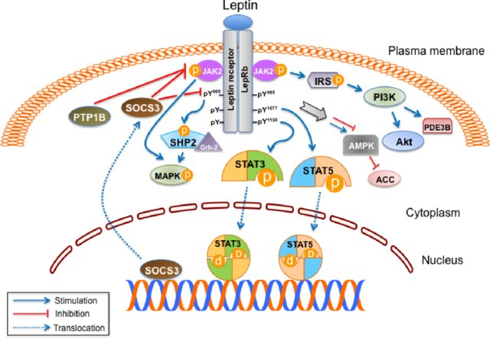
Multiple leptin signalling
Notes:
The binding of leptin to the long isoform of leptin receptor (LepRb) results in its dimerization, leading to the formation of the LepRb/Janus kinase 2 (JAK2)complex. The activated JAK2 phosphorylates itself and also Tyr985, Tyr1077, and Tyr1138in LepRb. Signal transducer and activator of transcription (STAT) 3and STAT5 bind to phospho-Tyr1138and phospho-Tyr1077in LepRb and are subsequently phosphorylated. Active STAT3 and STAT5 dimers then translocateto the nucleus and activate the transcription of their target genes, which mediate leptin’s anorexigenic effect. Suppressor of cytokine signaling 3 (SOCS3), atarget gene of STAT3, inhibits the JAK2/STAT3 pathway by interacting with phospho-Tyr985or JAK2 and acting as a feedback inhibitor of leptin signaling.Protein tyrosine phosphatase 1B (PTP1B) also inhibits leptin signaling through dephosphorylation of JAK2. After JAK2 activation, SH2-containingproteintyrosine phosphatase 2 (SHP2) binds to phospho-Tyr985in the LepRb and recruits the adaptor protein growth factor receptor-bound protein 2 (Grb2),leading to activation of the mitogen-activated protein kinase (MAPK) signaling cascade. Leptin activates MAPK independent of SHP2 and also regulatesphosphatidylinositol 3 kinase (PI3K) signaling through insulin receptor substrate (IRS) phosphorylation. Forkhead box O1 (FoxO1), mammalian target ofrapamycin (mTOR), and phosphodiesterase 3B (PDE3B) are important downstream targets of PI3K in the leptin signaling pathway. Leptin regulates feedingand metabolism through 5’adenosine monophosphate-activated protein kinase (AMPK) and acetyl-CoA carboxylase (ACC) in the brain and peripheralorgans
(14) (PDF) Leptin signaling. Available from: https://www.researchgate.net/publication/8547579_Leptin_signaling [accessed Apr 15 2019].
source
https://www.researchgate.net/publication/8547579_Leptin_signaling/figures?lo=1

Slide 38
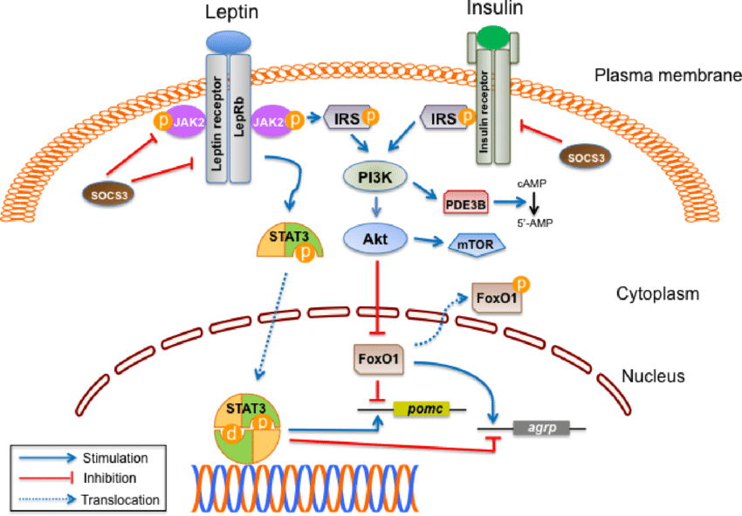
Leptin and insulin cross-talk in the hypothalamus
Notes:
Leptin activates signal transducer and activator of transcription (STAT) 3 when it binds to the long isoform of leptin receptor (LepRb) in the arcuatenucleus,ventromedial hypothalamus, and other hypothalamic neurons. Activated STAT3 stimulatespomcexpression and inhibitsagrpexpression in the hypothalamus.Leptin and insulin signaling pathways converge on phosphatidylinositol 3 kinase (PI3K). Activation of PI3K by either leptin or insulin leads to phosphorylationof Forkhead box O1 (FoxO1) through Akt, which can also activate the mammalian target of rapamycin (mTOR). Inactivation of FoxO1 by phosphorylationresults in its export from the nucleus and allows for the binding of STAT3 topomcoragrppromoter. In addition, the leptin-mediated activation of PI3Krecruits phosphodiesterase 3B (PDE3B), thereby reducing cAMP (cyclic adenosine monophosphate) levels. STAT3 increases the expression of suppressor ofcytokine signaling 3 (SOCS3), which leads to feedback inhibition of leptin and insulin signaling.Abbreviation: JAK2, Janus kinase 2.
source
https://www.researchgate.net/publication/8547579_Leptin_signaling/figures?lo=1

Slide 39
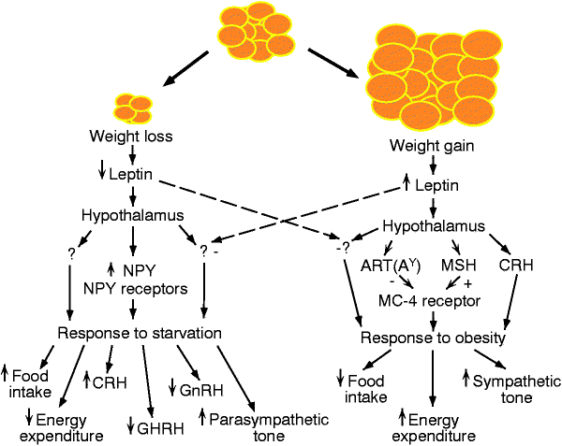
A Simplified Version of the Leptin Signaling Pathway
Notes:
source
https://coledrotman.wordpress.com/2013/07/30/a-simplified-version-of-the-leptin-signaling-pathway/

Slide 40
Cellular targets of leptin
Leptin acts on:
Central nervous system
Sympathetic and parasympathetic nervous system
Pancreatic insular beta cells
Pancreatic insular alpha cells
Pancreatic insular delta cells
Skeletal muscle
White adipose tissue
Brown adipose tissue
Hepatocytes
MECHANISMS ARE NOT YET CHARACTERISED

Slide 41
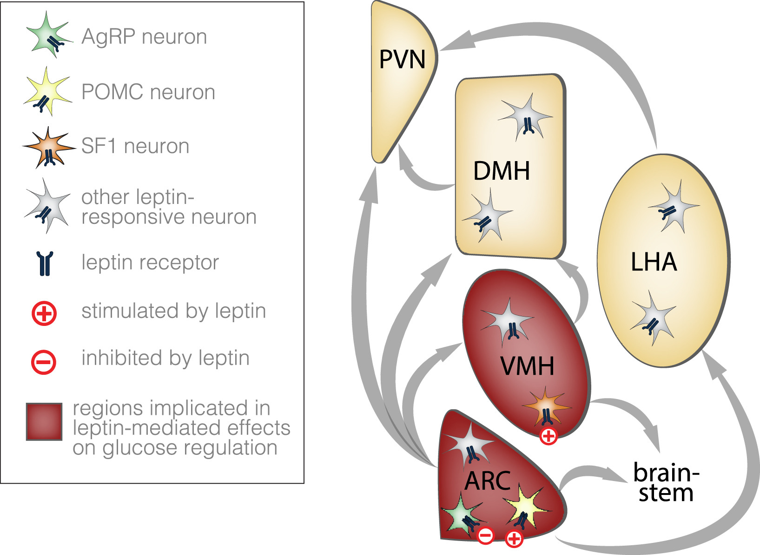
Leptin responsive regions of the hypothalamus
Notes:
Figure 1: Leptin responsive regions of the hypothalamus. Within the hypothala-mus, heterogeneous populations of leptin-responsive neurons are found in the ARC,VMH, DMH, and LHA. The ARC and VMH regions have been implicated in the leptin-mediated control of glucose regulation, including the AgRP and POMC neurons ofthe ARC that are inhibited and stimulated by leptin, respectively, and the leptin-stimulated SF1 neurons of the VMH. Further research is necessary to determinewhether other leptin-responsive neurons in these regions and in the DMH and LHA mayalso play a role in glucose regulation. There are extensive interconnections amongthese four hypothalamic regions (arrows) as well as the PVN, a region that mediatesdownstream effects of AgRP and POMC neurons on food intake and energy expenditurevia MC4Rs. There are additional projections to extra-hypothalamic regions includingbrainstem regions that mediate autonomic outputs. Thus, the full pathways thattranslate leptin action within specific hypothalamic neuronal populations to afinalperipheral effect on glucose homeostasis may be multi-synaptic, and remain to be fullydelineated.
source
https://www.sciencedirect.com/science/article/pii/S2212877817301758#fig1

Slide 42
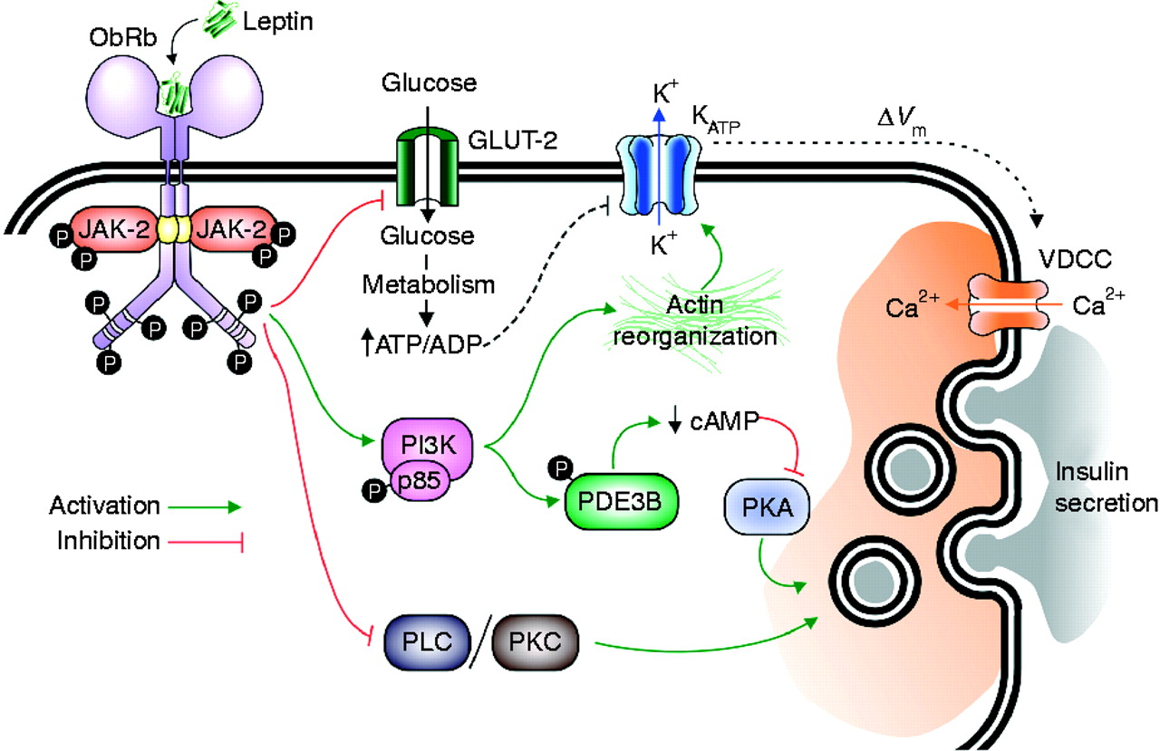
Leptin inhibits insulin release by beta cells
Notes:
The stimulus–secretion coupling of pancreatic β-cells involves several steps. Glucose is incorporated into the cytosol through GLUT-2 transporters. Glucose mitochondrial metabolism allows for an increase of the intracellular ATP/ADP ratio. This increase closes KATP channels, inducing the plasma membrane depolarization and subsequent activation of VDCCs, which leads to an intracellular Ca2+ influx that triggers exocytosis. Leptin inhibits glucose transport through GLUT-2, and, thus, it would inhibit the subsequent events in the stimulus–secretion coupling. Leptin also activates PI3K-dependent reorganization of the actin cytoskeleton, leading to the opening of KATP channels and to plasma membrane hyperpolarization. Additionally, PI3K-dependent activation of PDE3B by leptin reduces cAMP levels, inhibiting the PKA pathway, which is involved in the regulation of Ca2+ channels and exocytosis. Leptin can also inhibit the PLC/PKC pathway.
Citation: Journal of Molecular Endocrinology 49, 1; 10.1530/JME-12-0025

Slide 43
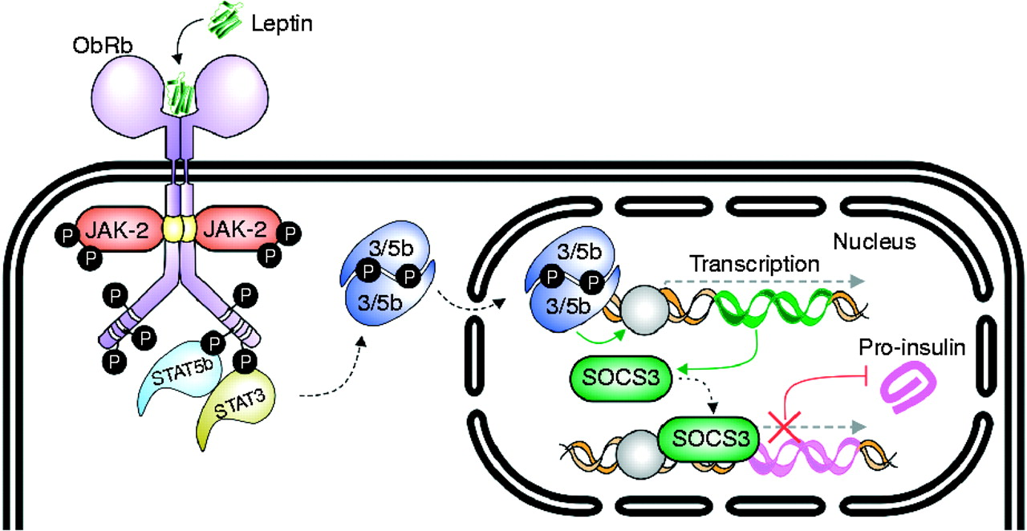
Leptin down-regulates the expression of pro-insulin
Notes:
In the pancreatic β-cell, leptin induces the activation of STAT3 and STAT5B, which migrate to the nucleus and induce the expression of SOCS3. Although SOCS3 is a well-known inhibitor of the JAK/STAT pathway, in the β-cell it inhibits the expression of proinsulin.
Citation: Journal of Molecular Endocrinology 49, 1; 10.1530/JME-12-0025
source
https://jme.bioscientifica.com/view/journals/jme/49/1/R9.xml

Slide 44
Leptin reduces beta cell function and mass
Leptin reduces beta cell mass through changes in proliferation, apoptosis, or cell size
LEPTIN CAUSES OF OBESITY-DEPENDENT INSULIN DEFICIENCY
It seems to be a feed-back loop leading adipose cells to stop taking up glucose and synthetising triacylglycerol, thus to become hyperplastic

Slide 45
Obesity is associated with leptin-resistance
In leptin-sensitive individuals, leptin secretion from the adipose tissue restricts insulin secretion from pancreatic β-cells to adapt glucose homeostasis to the body fat stores
In leptin-resistant overweight individuals, diminished leptin signaling in pancreatic β-cells leads to chronic hypersecretion of insulin (hyperinsulinemia)

Slide 46
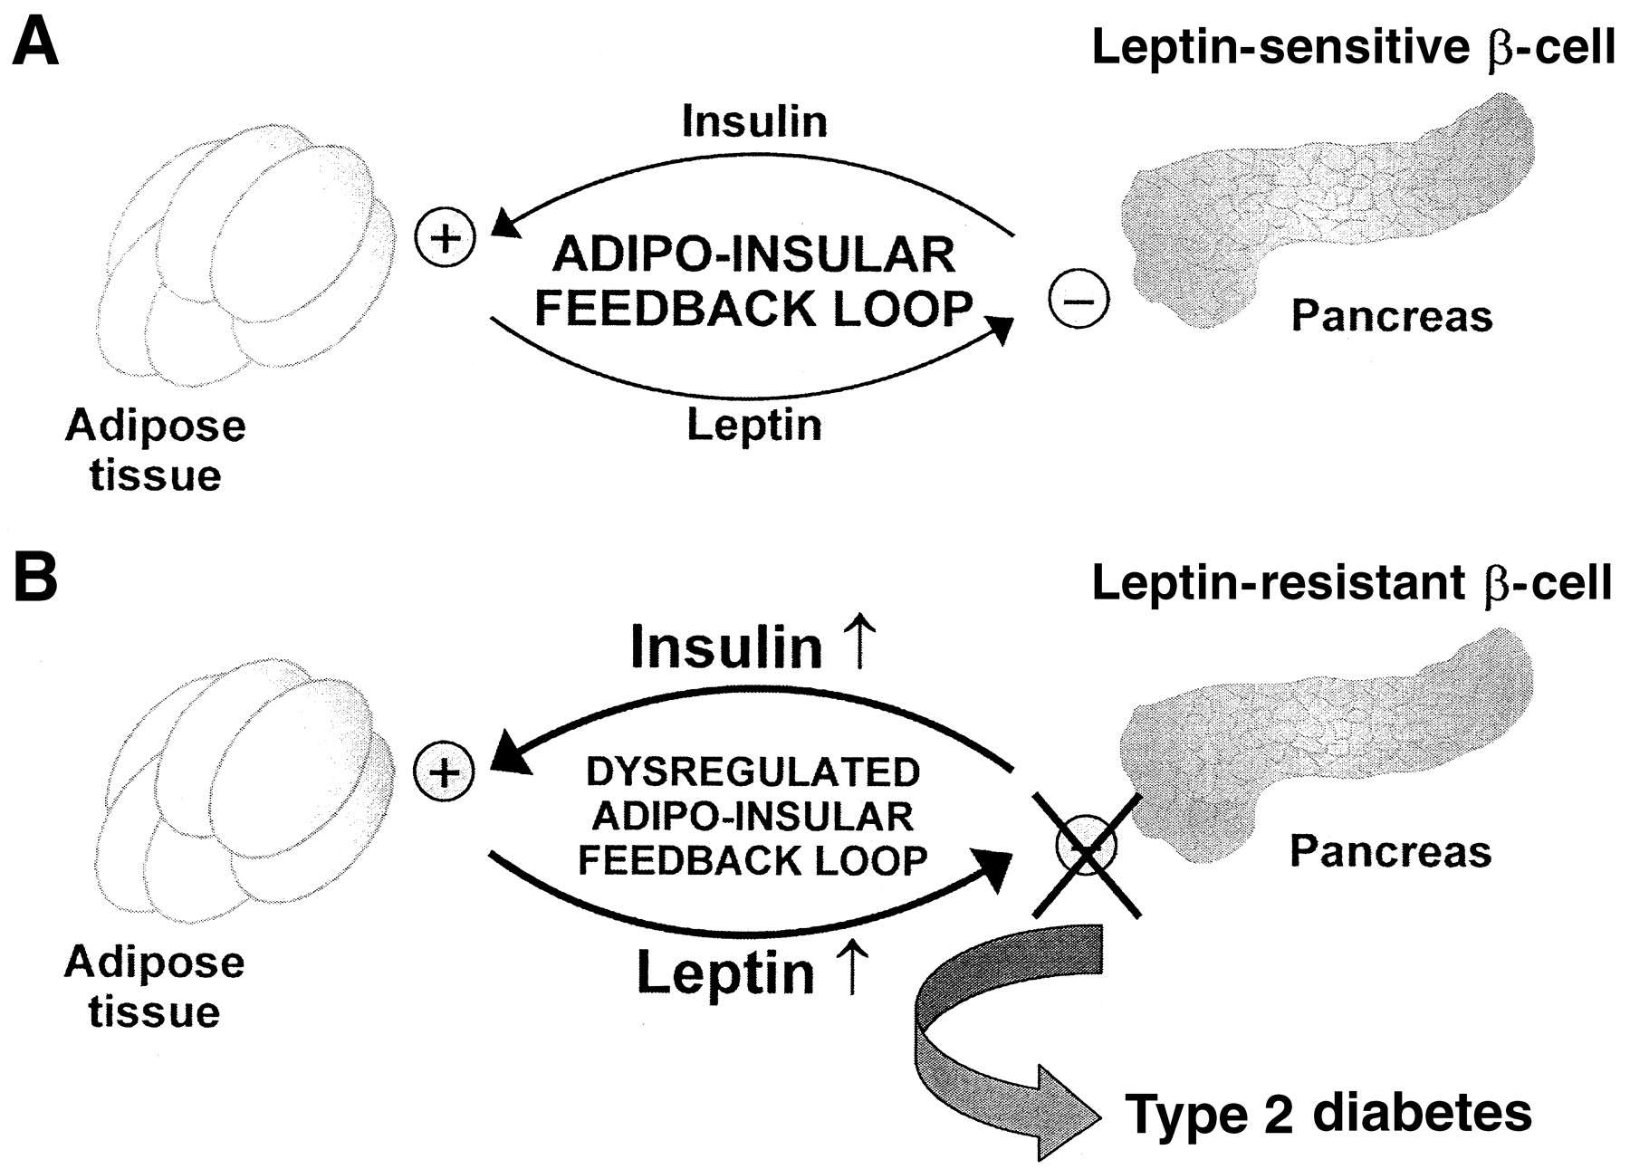
Dysregulation of the adipo-insular axis and pathogenesis of type 2 diabetes.
Jochen Seufert Diabetes 2004;53:S152-S158
©2004 by American Diabetes Association
Notes:
Dysregulation of the adipo-insular axis and pathogenesis of type 2 diabetes. A: In leptin-sensitive individuals, leptin secretion from the adipose tissue restricts insulin secretion from pancreatic β-cells to adapt glucose homeostasis to the body fat stores. B: In leptin-resistant overweight individuals, diminished leptin signaling in pancreatic β-cells leads to chronic hypersecretion of insulin (hyperinsulinemia). Elevated insulin levels promote both insulin resistance and increased leptin biosynthesis and secretion from adipose tissue, which may further desensitize leptin signaling in the endocrine pancreas and increase leptin resistance. Chronic hypersecretion of insulin by the pancreatic β-cell because of a lack of tonic inhibition by leptin may contribute to ultimate pancreatic β-cell failure and eventual manifestation of type 2 diabetes in overweight patients.

Slide 47
Fine

