Slide 1
Lezione 7
The microbiota

Slide 2
Definitions
MICROBIOTA
The microbial community
comprising bacteria, archeae and eukarya
MICROBIOME
All the genes in the microbiota

Slide 3
The gut microbiota
There are more microbial cells in the gut as human cells in the body
Approximately 1,200 different bacterial species found in humans as a whole
The microbiome encodes 500 times more genes than the human genome
human genes are noise in the storm of microbial gene products

Slide 4
Notes:
source
https://www.amnh.org/explore/science-topics/microbiome-health/meet-your-microbiome

Slide 5
The gut microbiota and human health
Many human diseases have their
origin in distorted gut microbiota composition

Slide 6
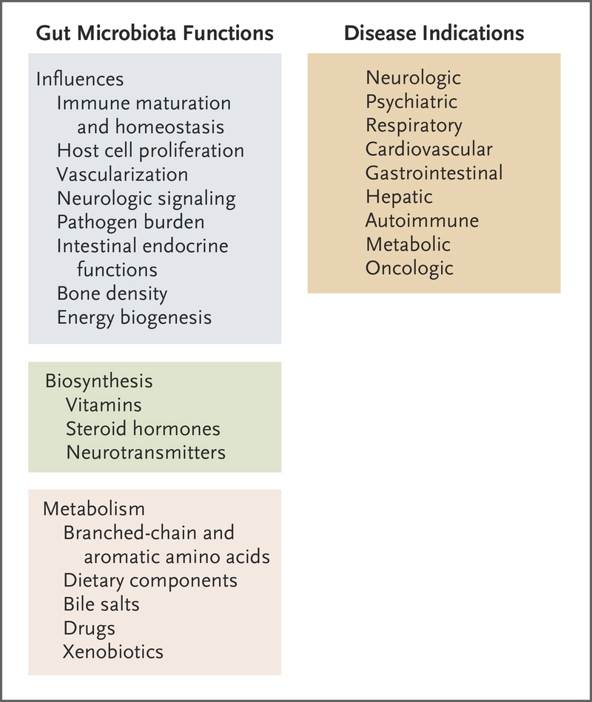
Notes:
source
N Engl J Med 2016; 375:2369-2379
DOI: 10.1056/NEJMra1600266

Slide 7
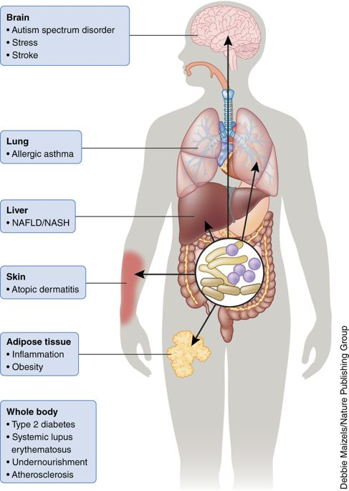
Notes:
source
Signals from the gut microbiota to distant organs in physiology and disease
Bjoern O Schroeder & Fredrik Bäckhed
Nature Medicine volume 22, pages 1079–1089 (2016)
https://www.nature.com/articles/nm.4185

Slide 8
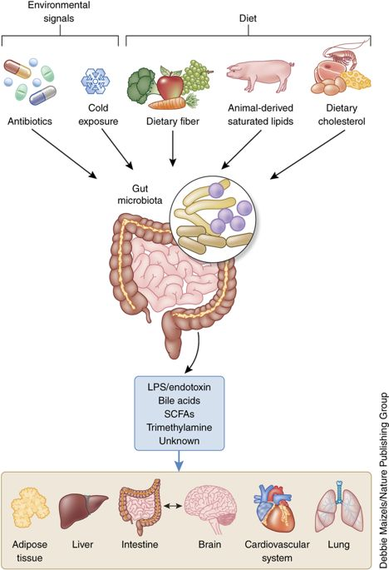
The microbiota as a TRANSDUCER of environmental factors (incl. the diet) to the organs
The microbiota releases environmental-related chemical signals
Notes:
source
Signals from the gut microbiota to distant organs in physiology and disease
Bjoern O Schroeder & Fredrik Bäckhed
Nature Medicine volume 22, pages 1079–1089 (2016)
https://www.nature.com/articles/nm.4185

Slide 9
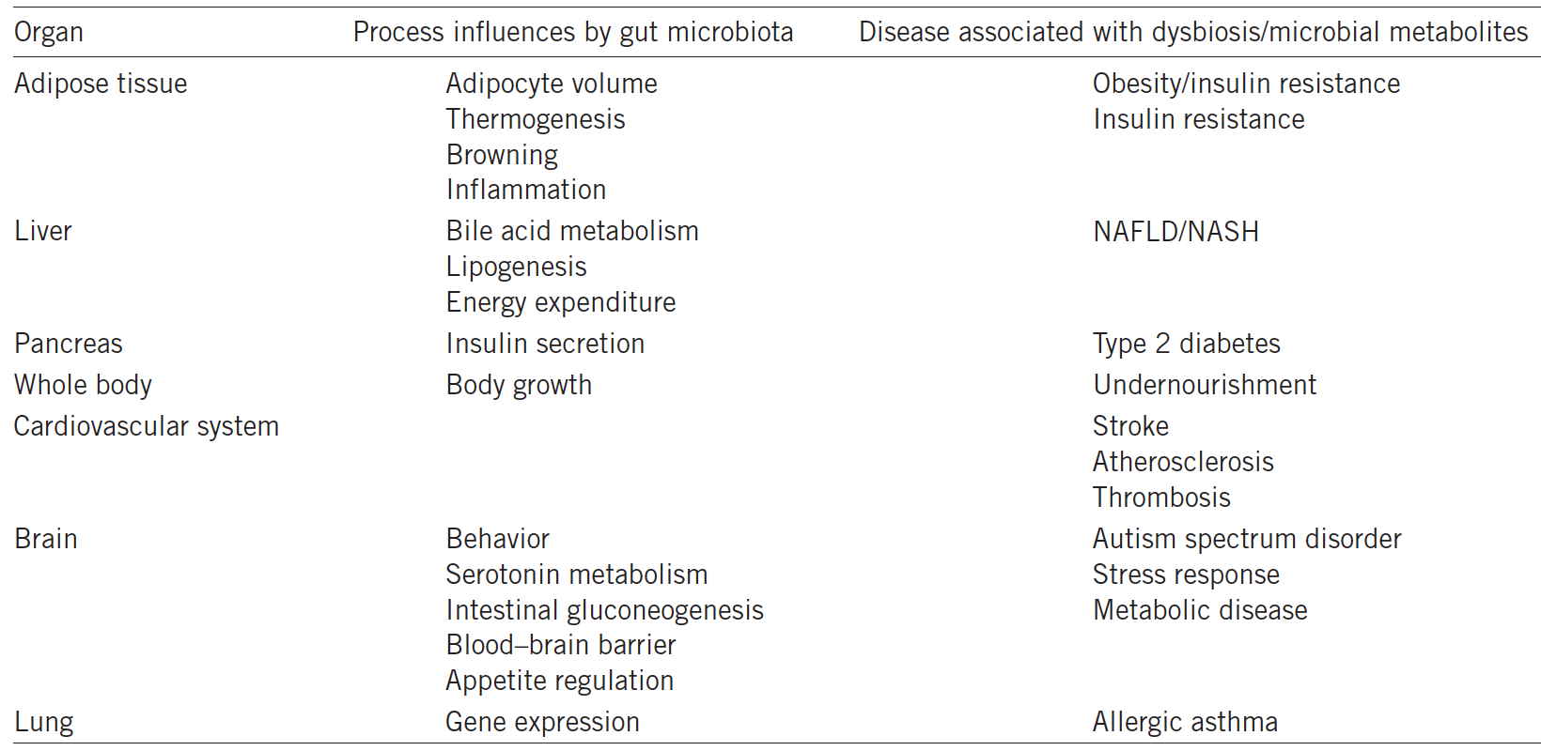
The intestinal microbiota communicates with peripheral organs in the body and influences processes in health and disease
Notes:
source
Signals from the gut microbiota to distant organs in physiology and disease
Bjoern O Schroeder & Fredrik Bäckhed
Nature Medicine volume 22, pages 1079–1089 (2016)
https://www.nature.com/articles/nm.4185

Slide 10
The gut microbiota
Each individual is host to a distinct set of at least 160 species in the gut
A biomass of 1.5–2.0 kg
Bacteria
Archaea, Eukarya and viruses are also present
STRICTLY ANAEROBIC
FERMENTING metabolism → no oxygen consumtion, no water generation, BUT other end products
Some species are aerobic, living in the crypts of the epithelium

Slide 11
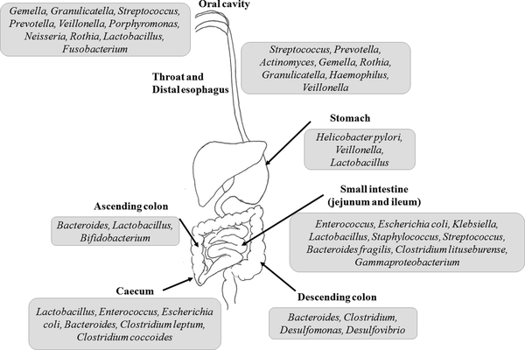
The microbial ecosystem of the human gut it varies along the cranio-caudal axis
Notes:
source
A review of metabolic potential of human gut microbiome in human nutrition
Archives of Microbiology
March 2018, Volume 200, Issue 2, pp 203–217
https://link.springer.com/article/10.1007%2Fs00203-017-1459-x#Sec2

Slide 12
The gut microbial community
FIVE PHYLA
Bacteroidetes
Firmicutes
Actinobacteria
Proteobacteria
Verrucomicrobia

Slide 13
Bacteroidetes
Genera
Bacteroides
Prevotella
Xylanibacter
They degrade fiber

Slide 14
Firmicutes
Genera
Clostridium
Lactobacillus
Ruminococcus
Eubacterium (butyrate producer)
Fecalibacterium (butyrate producer)
Roseburia (butyrate producer)

Slide 15
Actinobacteria
Genera
Bifidobacterium (used as a probiotic)
Proteobacteria
Genera
Escherichia
Desulfovibrio
Verrucomicrobia
Genera
Akkermansia (degrades mucus)

Slide 16
Enterotypes
Each individual can be grouped into one of three bacterial clusters called enterotypes, according to the relative abundance of the genera
Bacteroides,
Prevotella
Ruminococcus
Colonisation is restricted by competition for nutrients

Slide 17
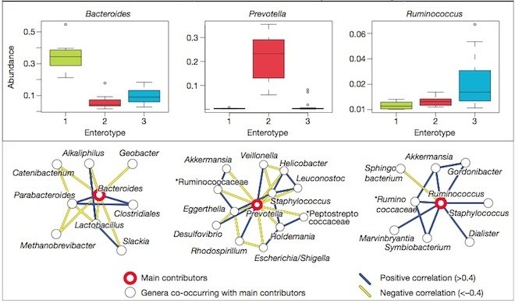
Each of us may contain one of several (=3) possible bacterial communities
Notes:
source
Enterotypes of the human gut microbiome
Manimozhiyan Arumugam, Jeroen Raes[…]Peer Bork
Nature volume 473, pages 174–180 (12 May 2011)
https://www.nature.com/articles/nature09944

Slide 18
The gut microbiota varies with the diet
Any changes in the lifestyle, diet, and environmental conditions directly modulate the microbiota
A study was designed to compare the microbiota of the children from a RURAL village Burkina Faso and the children from URBAN Italy (De Filippo et al. 2010).
Till the breast-feeding stage, the microbiota of the two populations remained same
However, the introduction of solid food in the diet changed the scenario

Slide 19
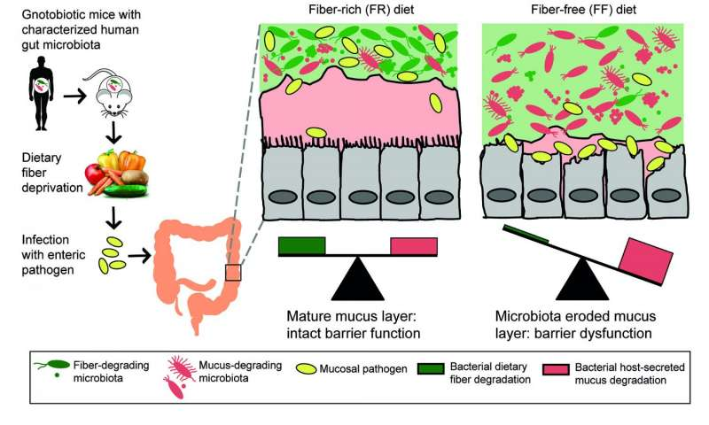
High-fiber diet keeps gut microbes from eating colon's lining, protects against infection
Notes:
In experiments in germ-free mice that received a transplanted set of human gut microbes, a high-fiber diet was associated with a thick mucus layer in the colon's lining, and resistance to infection by a pathogen. But mice raised with a fiber-free diet had a much thinner, patchy mucus layer, as mucus-eating bacteria in the human microbe mix proliferated. The pathogen was able to get through to the cells of the colon wall. Credit: University of Michigan
source
https://medicalxpress.com/news/2016-11-high-fiber-diet-gut-microbes-colon.html
NOTE: Gnotobiotic is an animal with a defined microbial community (see here: https://www.ncbi.nlm.nih.gov/pmc/articles/PMC4814450/)

Slide 20
Microbial-host interactions
The microbiome starts in utero and develops with food (milk) intake.
Many factors determine the microbial composition:
milk (human or not)
food choice
infections
antibiotics
Microbial signals modulate crucial functions of the healthy human body, ranging from host metabolism to brain function

Slide 21
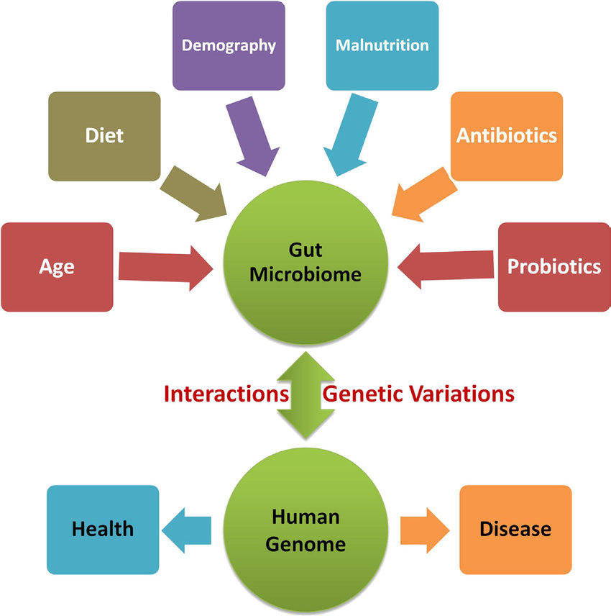
Notes:
FIGURE 9.2 Complex interplay of the human gut microbiome and human genome in human health.
source
https://www.researchgate.net/publication/303997092_A_Metagenomic_Insight_into_Human_Microbiome_Its_Implications_in_Health_and_Disease/figures?lo=1

Slide 22
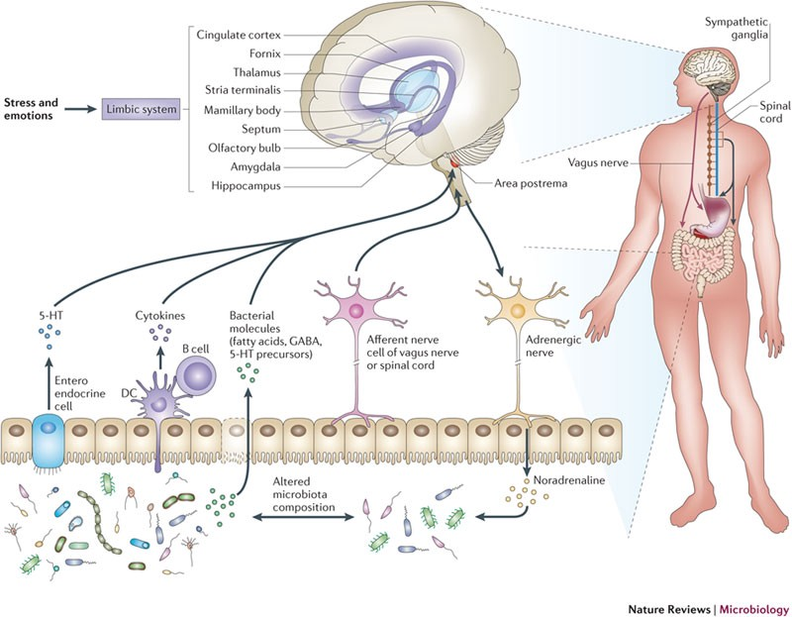
Notes:
source
https://medium.com/@The_Plastics/mind-altering-microorganisms-713790e070c5

Slide 23
Gut-microbiota-derived signaling molecules
Molecules having signalling properties are produced by the microbiome
These molecules may be:
structural components of the bacteria or
metabolites produced from the microbiota
Signalling molecules affect distal organs
directly
indirectly
through nerves
through hormones

Slide 24
Immune signals from the gut microbiota
Microbe-associated molecular patterns (MAMPs)
are structural components of microbes
lipopolysaccharide (LPS),
peptidoglycan,
flagellin
other structural components
Pattern-recognition receptors (PPRs) on epithelial and immune cells bind MAMPs
Toll-like receptors (TLRs),
NOD-like receptors (NLRs
RIG-1-like receptors (RLRs), on epithelial and immune
Some MAMPs might reach the lymph and circulation through
transcellular transport
co-transport with chylomicrons
paracellular diffusion

Slide 25
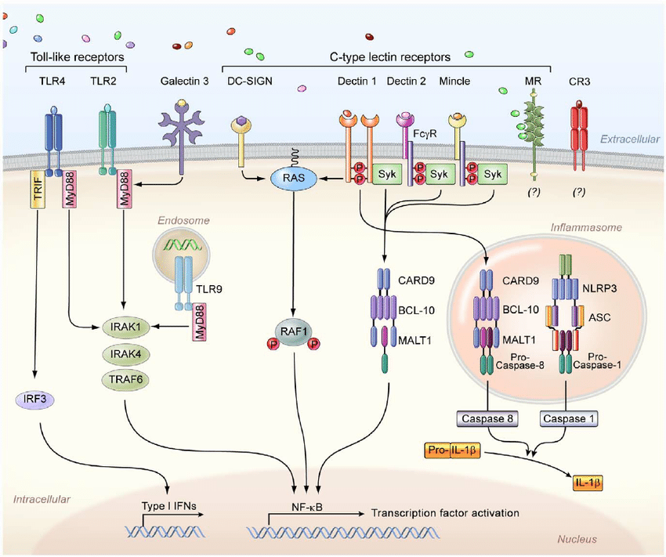
Notes:
Figure 1. The principal cell surface pattern recognition receptors involved in Candida recognition. The Toll-like receptor 2 (TLR2) and TLR4 recognize phospholipomannans and O -linked mannans, respectively, whereas TLR9 within the cytosol recognizes fungal DNA, and intracellular TLR7 (not depicted) recognizes fungal RNA. TLR2 forms heterodimers with TLR1 or TLR6 for downstream signaling (not depicted), whereas TLR4 forms homodimers. Galectin-3, together with TLR2, recognizes b -mannosides. The membrane-bound C-type lectins dendritic cell–specific ICAM3-grabbing non-integrin (DC-SIGN), macrophage-inducible C-type lectin (Mincle), and macrophage mannose receptor (MR) recognize mannose-rich Candida structures. In addition, dectin-1 recognizes b -glucans, and dectin 2, together with the Fc c receptor (Fc c R), recognizes mannans. The complement receptor 3 (CR3) on neutrophils also recognizes b -glucans. Moreover, the NOD-like receptor NLRP3 (nucleotide-binding domain, leucine-rich-repeat- containing family, pyrin domain-containing 3) forms an inflammasome complex with ASC (apoptosis-associated speck-like protein containing a caspase recruitment domain) and caspase 1, which leads to interleukin-1 b (IL-1 b ) production. In addition, downstream dectin-1 signaling through caspase recruitment domain-containing protein 9 (CARD9) leads to non-canonical inflammasome activation and IL-1 b production via caspase 8. IFNs, interferons; NF- k B, nuclear factor- k B; Syk, spleen tyrosine kinase; IRF3, interferon regulatory factor 3; TRIF, TIR-domain-containing adapter-inducing interferon- b ; MyD88, myeloid differentiation primary response gene 88; BCL-10, B-cell lymphoma/leukemia 10; MALT1, mucosa-associated lymphoid tissue lymphoma translocation protein 1; TRAF6, TNF receptor–associated factor 6; IRAK, interleukin-1 receptor-associated kinase. doi:10.1371/journal.ppat.1003079.g001

Slide 26
Metabolic signals from the gut microbiota
Microbial metabolites can pass through the epithelium and regulate the host gene transcription
microbial and host metabolites may be the same
THE CASE OF Lactobacilli
tryptophan → → → indole-3-aldehyde →
aryl hydrocarbon receptor (AHR) on innate lymphoid cells 3 (ILC3s) → interleukin 22 → resistance to the fungus Candida albicans

Slide 27
The gut microbiota as a metabolic organ
The gut microbiota has been named as ‘metabolic organ’ because of its metabolic potential equivalent to the liver

Slide 28
The microbiota anaerobic catabolism
The microbiota performs performs anaerobic degradation and/or fermetantion of
dietary fibers
proteins and peptides
non-digestible carbohydrates,
glycoconjugates derived from the host (glycosphingolipids),
deconjugation and dehydroxylation of bile acids,
biosynthesis of vitamins (K and B) and isoprenoids,
cholesterol reduction
metabolism of amino acids
Metabolism of xenobiotics

Slide 29
Short-chain fatty acids (SCFAs) as metabolic signals from the microbiota
fermentation products of dietary fiber
they provide humans with 6–10% of the total daily energy requirement

Slide 30
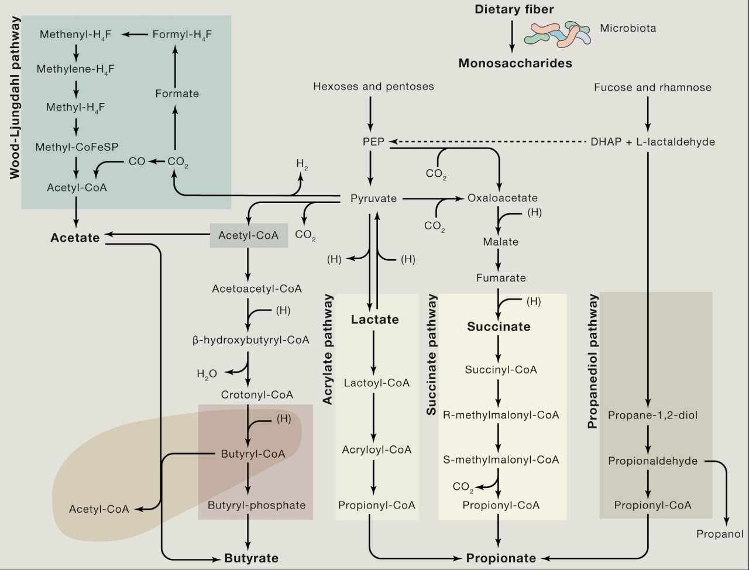
Notes:
Figure 1. Known Pathways for Biosynthesis of SCFAs from Carbohydrate Fermentation and Bacterial Cross-Feeding
The microbial conversion of dietary fiber in the gut results in synthesis of the three major SCFAs, acetate, propionate, and butyrate. Acetate is produced from
pyruvate via acetyl-CoA and also via the Wood-Ljungdahl pathway. Butyrate is synthesized from two molecules of acetyl-CoA, yielding acetoacetyl-CoA, which is
further converted to butyryl-CoA via b-hydroxybutyryl-CoA and crotonyl-CoA. Propionate can be formed from PEP through the succinate pathway or the acrylate
pathway, in which lactate is reduced to propionate. Microbes can also produce propionate through the propanediol pathway from deoxyhexose sugars, such as
fucose and rhamnose. PEP, phosphoenolpyruvate; DHAP, dihydroxyacetonephosphate.
source
From Dietary Fiber to Host Physiology: Short-Chain Fatty Acids as Key Bacterial Metabolites
https://www.cell.com/cell/pdf/S0092-8674(16)30592-X.pdf

Slide 31
SCFA act on intestinal L-cells secrete glucagon-like peptide
bind to G-protein-coupled receptors
GPR41 (or Free Fatty Acid Receptor 3) → increased expression of the enteroendocrine hormone peptide YY (PYY):
decreased intestinal motility
increased energy harvest from the diet
GPR41/GPR43 → secretion of the hormone glucagon-like peptide (GLP)-1, which regulates:
insulin release
appetite

Slide 32
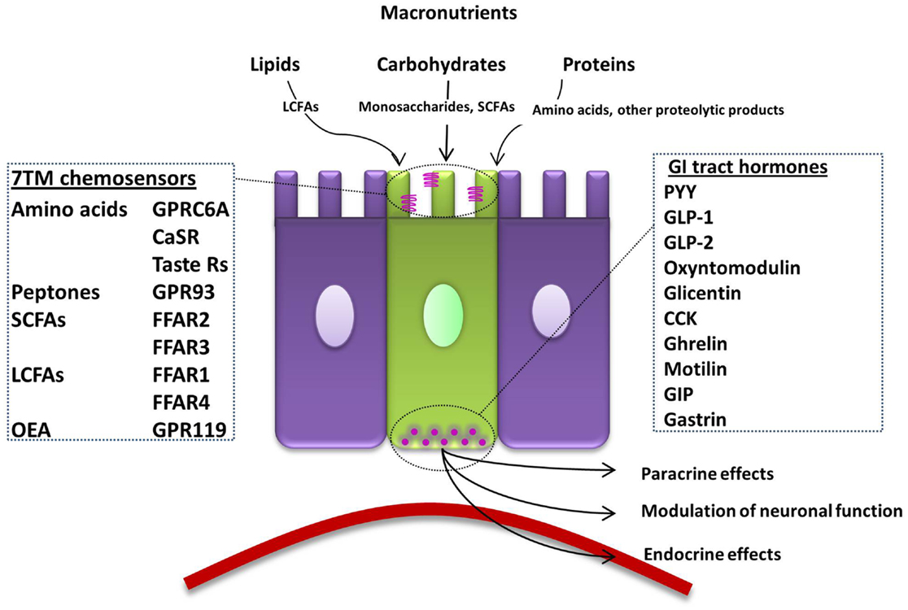
In the intestine, L- cells (green) have chemosensors. The signal is transduced and L-cell release GI hormones

Slide 33
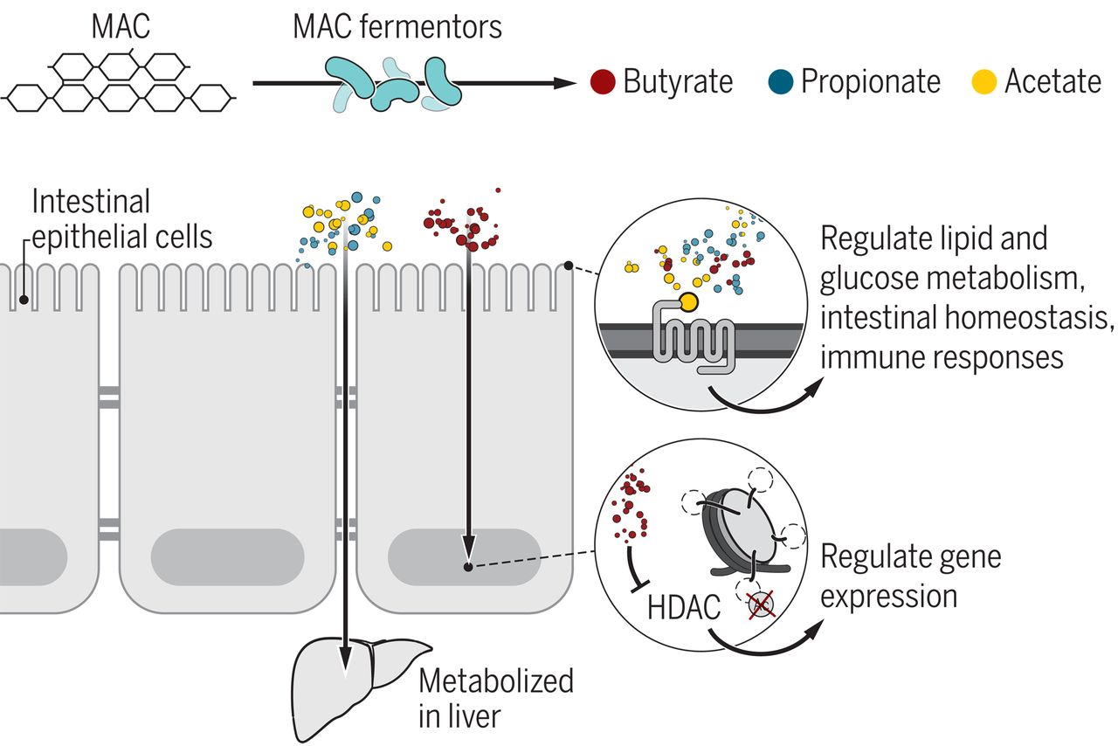
Fig. 1 Microbiota-accessible carbohydrate (MAC) fermentors produce SCFAs that can have multiple interactions with host tissues.
Christopher L. Gentile, and Tiffany L. Weir Science 2018;362:776-780
Published by AAAS
Notes:
MAC fermentors produce SCFAs that can have multiple interactions with host tissues. Butyrate is taken up by epithelial cells and used as a primary source of energy for these cells. Butyrate (and to a lesser degree, propionate) can block histone deacetylases (HDAC) to regulate gene expression. All of the SCFAs can bind with varying affinities to G protein receptors in the intestines and other cells to regulate energy metabolism, intestinal homeostasis, and immune responses. Acetate and propionate are primarily metabolized in the liver, where propionate is used as a substrate for gluconeogenesis and acetate is used as an energy source and for fatty acid synthesis.

Slide 34
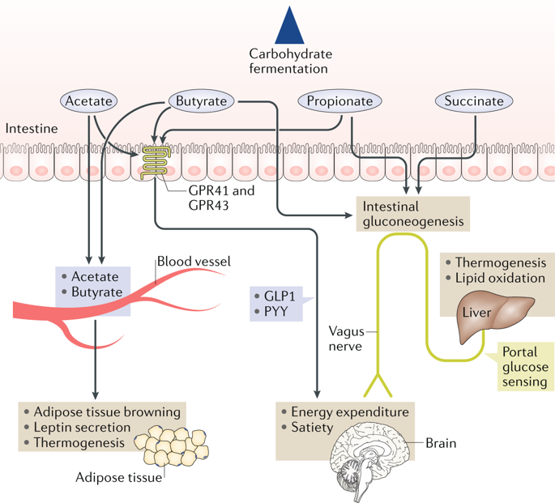
Multi-level effects of SCFA on remote organs
Notes:
source
Gut microbial metabolites in obesity, NAFLD and T2DM
https://www.nature.com/articles/s41574-019-0156-z

Slide 35
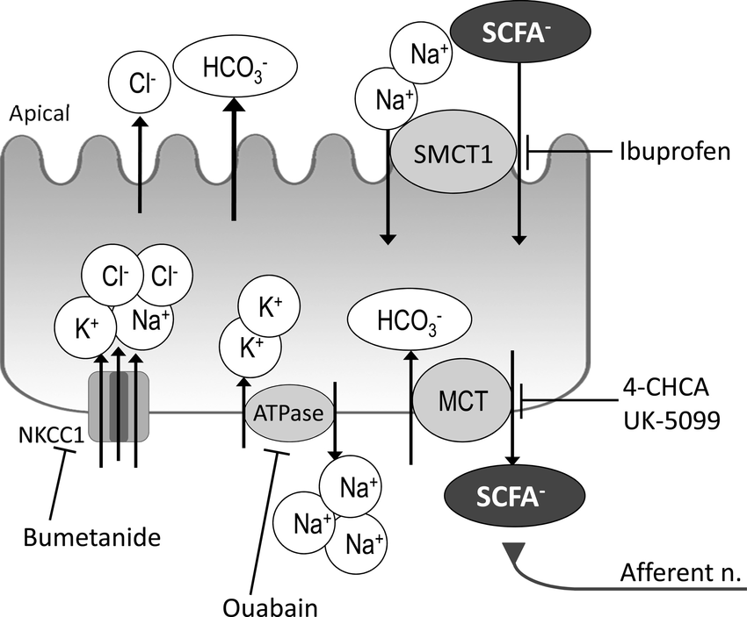
SCFA may directly act on afferent neurons in the intestine
Notes:
Fig. 8. Schematic summary of ion transport and SCFA absorption mechanism of epithelial cells in rat duodenum. Luminal SCFAs are electrogenically cotransported with Na via the apical SMCT1, inhibited by ibuprofen in a bumetanide-facilitated, ouabain-sensitive manner. The SCFAs transported into the duodenocytes are exchanged with HCO 3 via basolateral MCTs, inhibited by 4-CHCA or UK-5099. The SCFAs extruded across the enterocyte basolateral membrane activate subepithelial capsaicin-sensitive afferent nerves, stimulating HCO 3 secretion. ATPase, Na -K -ATPase.
source
https://www.researchgate.net/publication/268283065_SCFA_transport_in_rat_duodenum/figures?lo=1

Slide 36
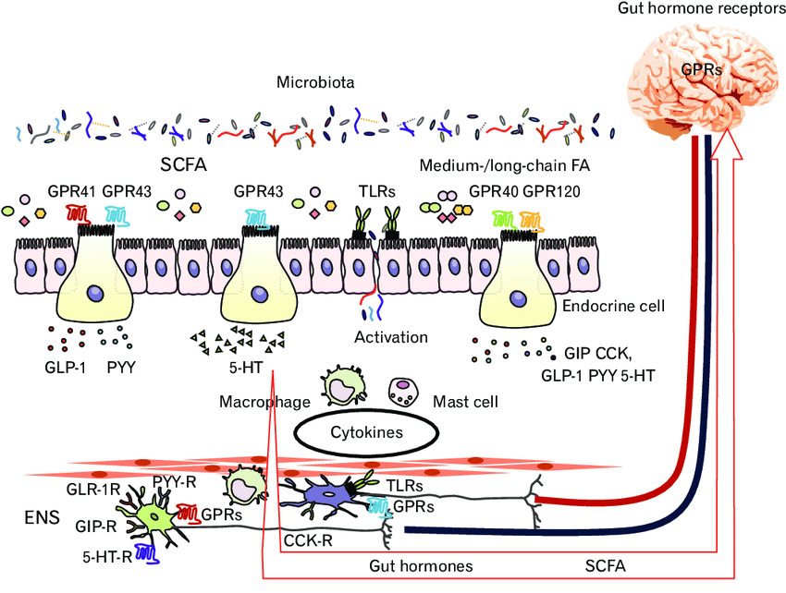
Notes:
Figure. Interaction among gut microbiota, enteroendocrine cells, immune cells, and enteric nervous system (ENS). SCFA, short-chain fatty acid; FA, fatty acid; GPR, G protein-coupled receptor; TLR, toll-like receptor; GLP-1, glucagon-like peptide 1; PYY, peptide YY; 5-HT, 5-hydroxytryptamine; CCK, cholecystokinin; GIP, glucose-dependent insulinotropic polypeptide/gastric inhibitory polypeptide;-R, receptor.
source
https://www.researchgate.net/publication/326346410_Role_of_Gut_Microbiota-Gut_Hormone_Axis_in_the_Pathophysiology_of_Functional_Gastrointestinal_Disorders/figures?lo=1

Slide 37
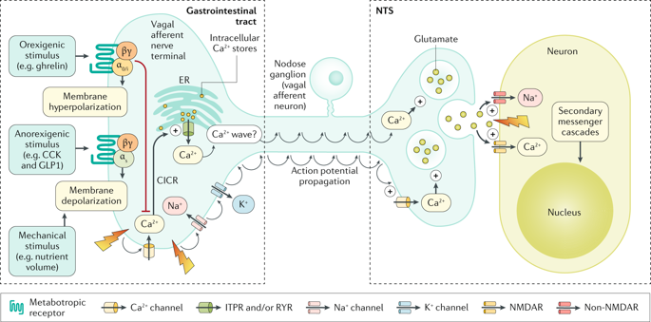
GI hormones bind to metaboltropic receptors on vagal afferent terminals
Notes:
source
Review Article | Published: 05 September 2018
The metabolic role of vagal afferent innervation
T. M. Zaved Waise, Helen J. Dranse & Tony K. T. Lam
Nature Reviews Gastroenterology & Hepatologyvolume 15, pages625–636 (2018)
https://www.nature.com/articles/s41575-018-0062-1

Slide 38
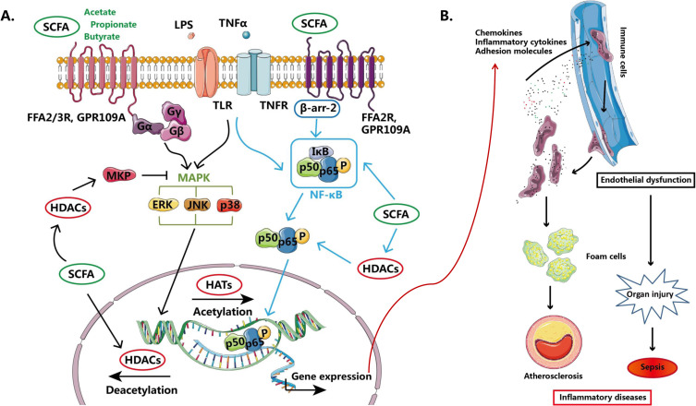
SCFA on endothelial and immune cells
Notes:
Fig. 1. Overview on the effects of SCFAs on LPS- or TNFα-induced endothelial dysfunction and immune cell activation. A: LPS or TNFα binds to its receptor and activates MAPK and NF-κB signaling pathways to modulate gene expression including inflammatory cytokines, chemokines and adhesion molecules which are important factors in the development of atherosclerosis and sepsis. SCFAs, mainly acetate, propionate and butyrate, can regulate MAPK signaling pathway and activation of NF-κB via activation of FFA2 and FFA3 receptors and GPR109A or inhibition of HDACs activity. B: LPS or TNFα-dependent production of inflammatory cytokines, chemokines and adhesion molecules induce immune cell adhesion and recruitment to the inflammation lesion. The recruited immune cells produce excessive cytokines and attract more immune cells which forms a vicious circle which leads to foam cell formation and the development of atherosclerosis. Besides, endothelial dysfunction and activated immune cells are also important in the progression of organ injury and sepsis.
source
https://www.sciencedirect.com/science/article/pii/S0014299918302607#f0005

Slide 39
SCFA on energetic metabolism
Propionate →precursor for intestinal gluconeogenesis
Propionate and butyrate →induce the expression of gluconeogenic enzymes
Acetate → suppresses appetite through central mechanisms

Slide 40
Bile acids (BAs) as metabolic signals from the microbiota
BAs are secreted in the intestine by the liver (through the bile)
BAs can activate:
TGR5 (a G-protein-coupled receptor)
farnesoid X receptor (FXR) in the nucleous:
increased expression of fibroblast growth factor 15 (FGF15) → this suppresses the expression of cholesterol 7α-hydroxylase (CYP7A1) in the liver—the rate-limiting step in bile acid synthesis: less BA
increased obesity and steatosis
The microbes can metabolise BAs and thus change their signalling properties

Slide 41
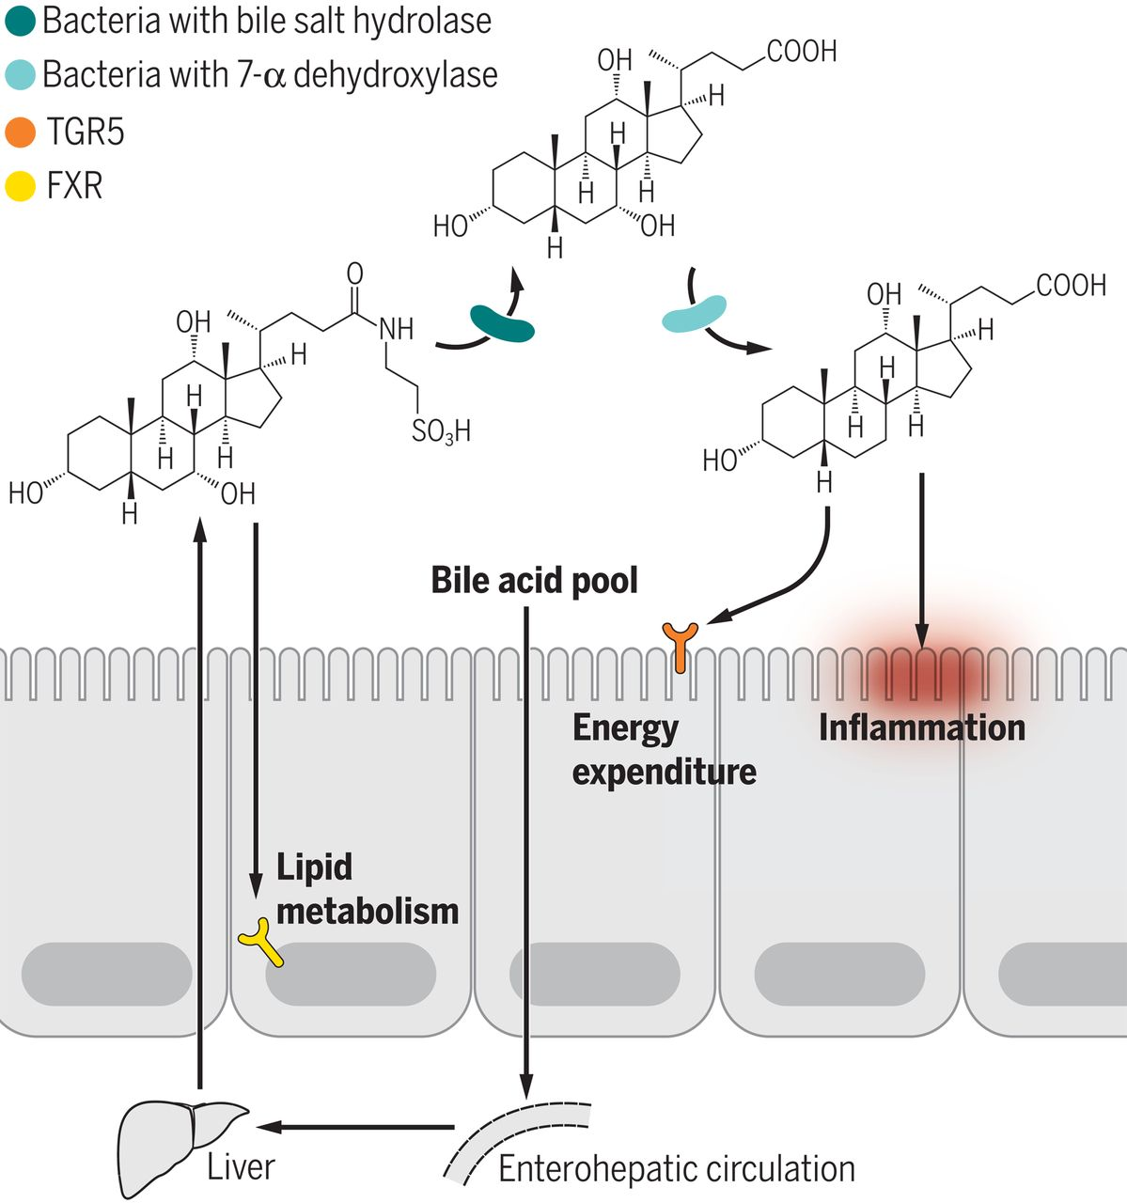
Fig. 2 Gut bacteria play an important role in bile acid modification.
Christopher L. Gentile, and Tiffany L. Weir Science 2018;362:776-780
Published by AAAS
Notes:
Gut bacteria play an important role in bile acid modification. Primary bile acids deposited into the small intestine are deconjugated and dehydroxylated by enzymes from bile-modifying bacteria. These changes influence total bile acid pools available for reabsorption and recycling through enterohepatic circulation. In addition, bile acids can act as regulatory molecules by binding to cell surface or nuclear receptors, influencing host factors such as energy expenditure and lipid metabolism.

Slide 42
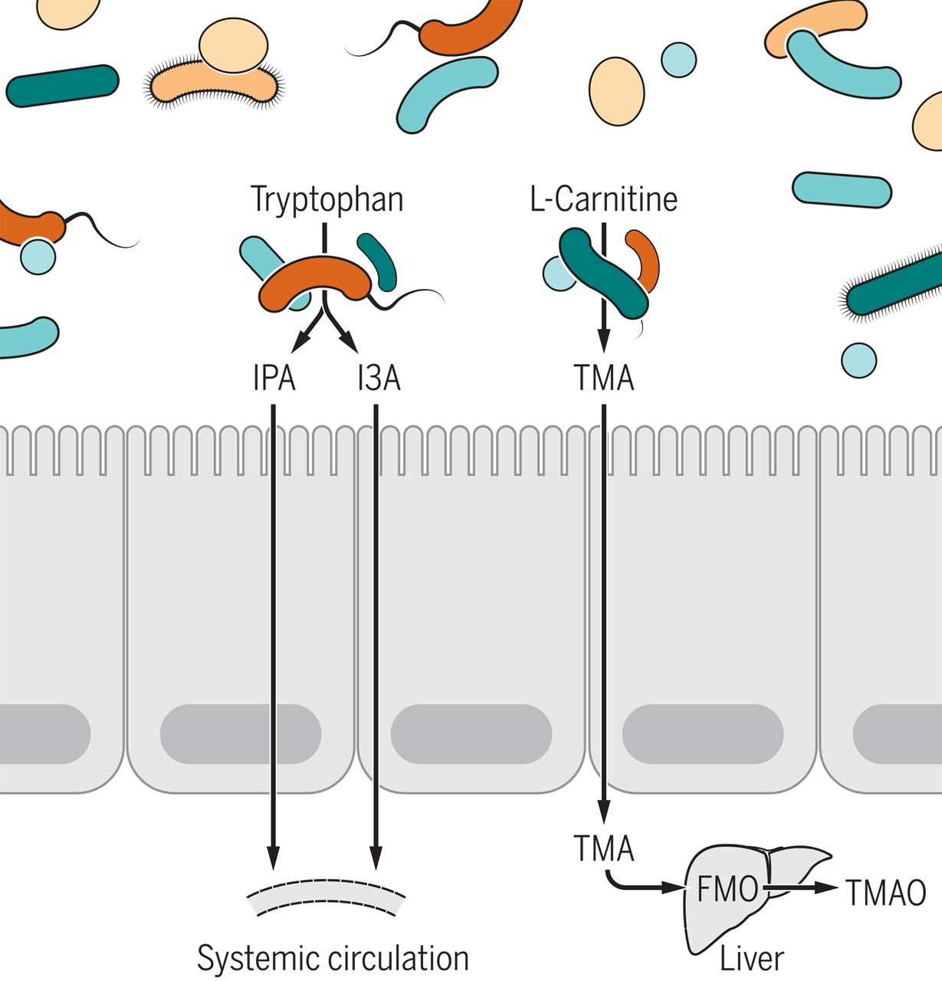
Fig. 3 Interactions between amino acids and the gut microbiota.
Christopher L. Gentile, and Tiffany L. Weir Science 2018;362:776-780
Published by AAAS
Notes:
Interactions between amino acids and the gut microbiota. Microbial metabolism of the amino acid carnitine produces trimethylamine (TMA), which is subsequently oxidized in the liver to TMAO in a reaction catalyzed by flavin-containing monooxygenase (FMO). Increased levels of circulating TMAO have been linked to metabolic disease. Gut microbes metabolize the amino acid tryptophan into various substances, including indolepropionic acid (IPA) and indole-3-acetic acid (I3A), both of which can enter the general circulation. The metabolic effects of IPA, I3A, and other microbially derived amino acid metabolites are only now beginning to emerge.

Slide 43
The microbiota
A role in both physiology and pathology

Slide 44
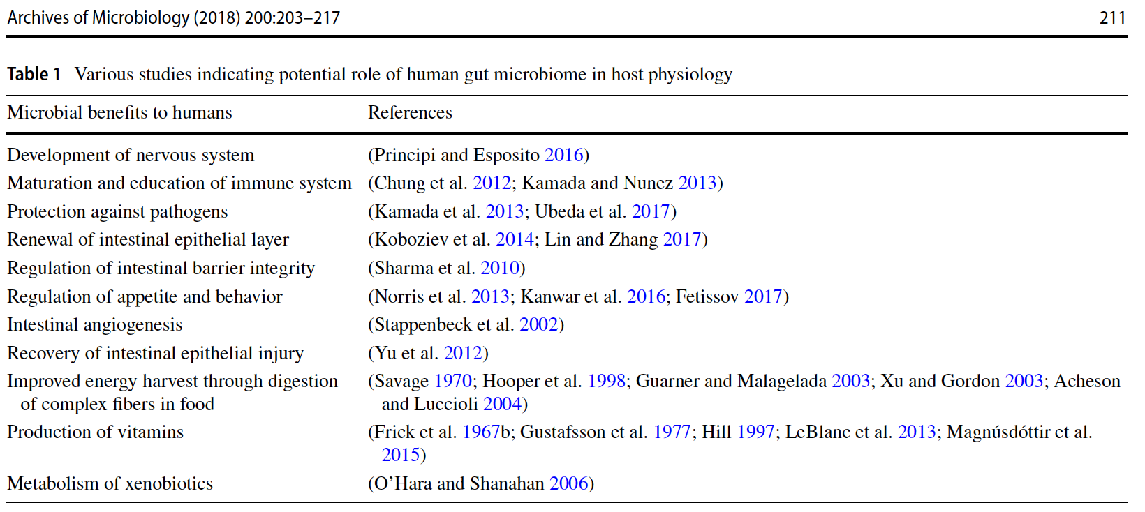
The microbiota regulates the host physiology

Slide 45
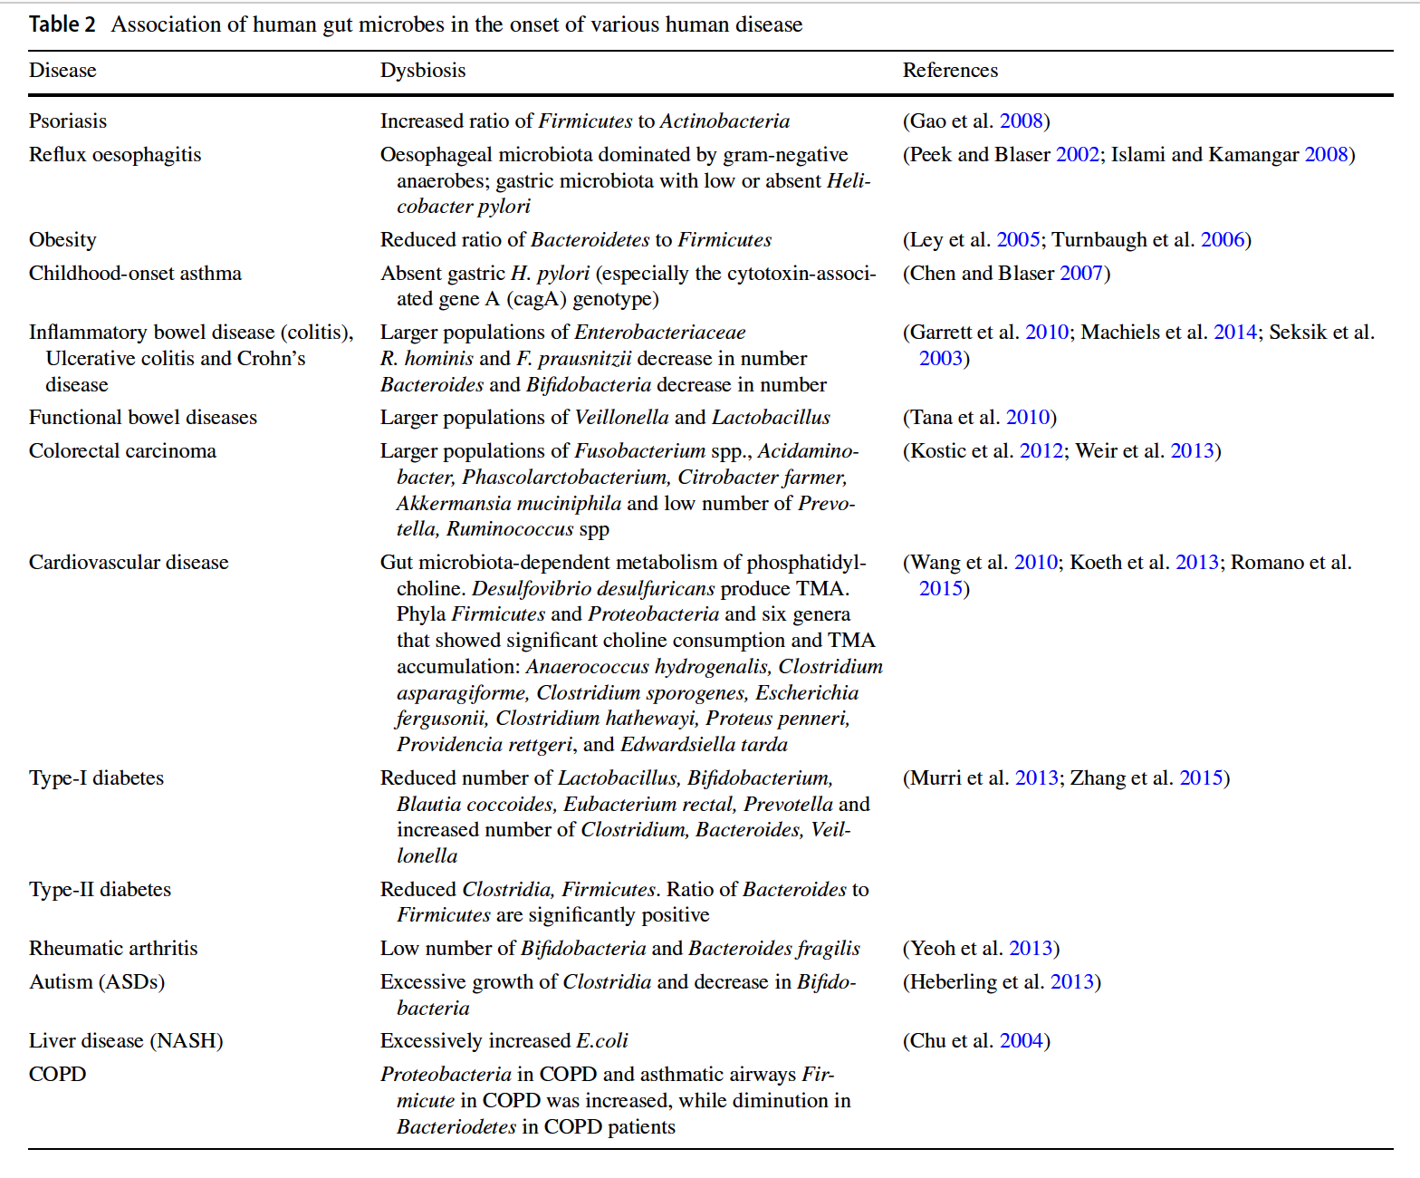
Notes:
source
https://link.springer.com/article/10.1007%2Fs00203-017-1459-x#Sec15

Slide 46
Cold exposure changes the gut microbiota
Cold induces the increase in brown adipose tissue
rich in mitochondria, with increased expression of UCP-uncoupling protein
This might be due to changes in gut bile acid profile, since the bile acid pattern of cold-exposed mice and germ-free mice is similar

Slide 47
Maternal stress influences the baby microbiota
Maternal stress and elevated cortisol concentration were found associated with an abundance of Proteobacterial groups related to pathogens such as Escherichia, Serratia, and Enterobacter along with lower relative abundance of Bifidobacteria and lactic acid bacteria (i.e., Aerococcus Lactococcus, Lactobacillus) in infant’s intestine(Zijlmans et al. 2015)

Slide 48
Gut microbial signals in the gut–brain axis
Germ-free mice have:
structural changes in amygdala and hippocampus
increased hippocampal neurogenesis
hypermyelination of the prefrontal cortex
given that access to the brain is tightly controlled by the blood–brain barrier (BBB), it is likely that a small and specific set of bacterial metabolites modulates brain morphology.

Slide 49
SCFA modulate the blood-brain barrier
Germ-free mice have a more permeable BBB than controls
This phenotype was reversed after colonization with SCFA-producing Clostridium tyrobutyricum or B. thetaiotaomicron

Slide 50
SCFA modulate the glia
Germ-free or antibiotic-treated mice exhibit immature microglia with impaired immune response to bacterial and viral products
Supplementing germ-free mice with a SCFA mix could restore most alterations in microglial function
SCFA act through receptor GPR43

Slide 51
Gut microbial signals influence stress-response and behaviour
Young germ-free mice have:
an elevated stress response
reduced expression levels of BDNF (brain-derived neurotrophic factor) in the cortex and hippocampus in comparison to SPF (specific-pathogen-free) mice
Colonization with SPF-derived feces or Bifidobacterium infantis diminished the stress response when applied at an early developing stage.
Colonization with enteropathogenic E. coli (EPEC) aggravated the stress response
Tests suggest that stress-response is decreased via vagus nerve activation

Slide 52
Most routes of communication between the gut and brain are unknown
When transplanting cecal content from a rather exploratory mouse strain into a timid and anxious strain, the behavioral phenotype was transmissible and occurred independently of circulating cytokines, vagus nerve activation or intestinal serotonin and dopamine levels

Slide 53
The gut microbiota might also contribute to Autism Spectrum Disorder
Study with 99 subjects: children with autistic behavior had more frequent ear infections and a history of higher antibiotic courses

Slide 54
The gut microbiota might also contribute to Autism Spectrum Disorder
Dysbiosis of the intestinal microbiota, in addition to immune and gastrointestinal symptoms seen in ASD, can influence neurodevelopment, neural activity and the manifestation of abnormal behaviors characteristic to ASD
Emerging Roles for the Gut Microbiome in Autism Spectrum Disorder.
Biol Psychiatry. 2017 Mar 1;81(5):411-423. doi: 10.1016/j.biopsych.2016.08.024.

Slide 55
Aetiological factors in ASD
Genetic susceptibility
Short nucleotide polymorphism
Copy number variants
De novo mutations
Epigenetic modifications
Environmental risks
Perinatal infections
Maternal pharmacological exposures
Obstetric complications
Early life stress
Advanced parental age

Slide 56
Co-morbidities in ADS
Gut dysfunctions
Compromised intestinal barrier
Abnormal gut motility
Abdominal pain
Acid reflux
Enteric inflammation
Gut microbial dysbiosis
Altered bacterial abundance and diversity
Changes in gene expression & metabolite profile
Immune dysregulation
Microglial activation
Altered T cell distribution
Altered blood & brain cytokines
Altered immunoglobulin levels
Abnormal monocyte and NK cell response

Slide 57
Neuropathologies in ASD caused by aetiological factors and co-morbidities
Altered synaptic transmission
Purkinje cell deficits
Altered neurochemical signalling
Excitatory/Inhibitory imbalance
Dysrupted circuit connectivity
Behavioural abnormalities

Slide 58
Diet and microbiota

Slide 59
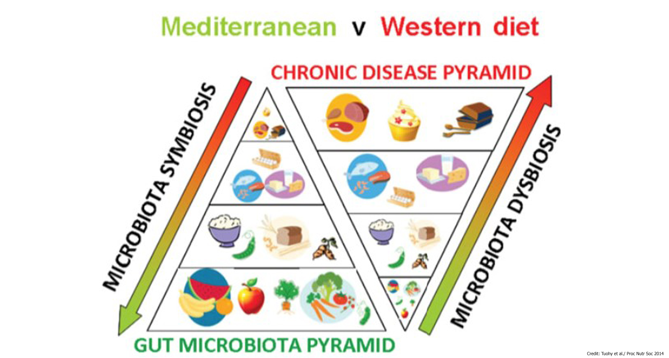
Conserving and restoring the human gut microbiome by increasing consumption of dietary fibre
Notes:
source
https://www.gutmicrobiotaforhealth.com/en/conserving-restoring-human-gut-microbiome-increasing-consumption-dietary-fibre/

Slide 60
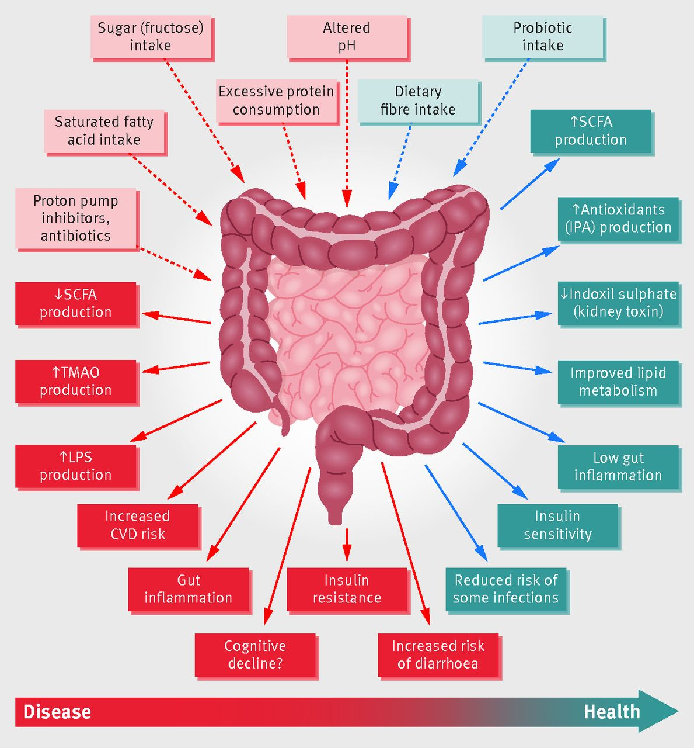
Schematic representation of the role of the gut microbiota in health and disease giving some examples of inputs and outputs.
Ana M Valdes et al. BMJ 2018;361:bmj.k2179
©2018 by British Medical Journal Publishing Group
Notes:
Schematic representation of the role of the gut microbiota in health and disease giving some examples of inputs and outputs. CVD=cardiovascular disease; IPA=indolepropionic acid; LPS=lipopolysaccharide; SCFA=short chain fatty acids; TMAO=trimethylamine N-oxide

Slide 61
Fine

