Slide 1
The wikileaks case
University of Trieste
April 2019
Course: Legal English
Professor: M.J. Hammersley
Student: Lara Devetak

Slide 2
What’s the case about?
leaks of hundreds of thousands of military documents and embassy cables, many of which were classified.
distribution at a slow pace

Slide 3
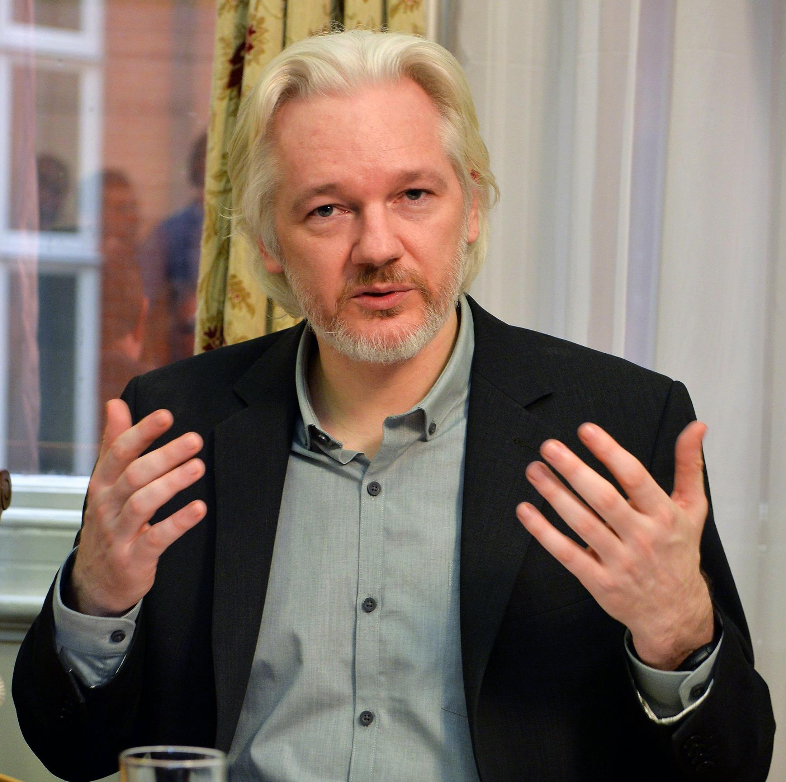
What is wikileaks?
an international non-profit organization that publishes secret information provided by anonymous sources
founded in 2006 in Iceland
PURPOSE:
share important information of public interest
ensure that journalists and whistleblowers are not prosecuted
JULIAN ASSANGE

Slide 4
December 2006
Sheikh Hassan Dahir Aweys
February 2010
Reykjavik 13
April 2010
Baghdad airstrike
October 2010
Iraq War
July 2016
US Secretary
e-mails
July 2010
Afghan War logs
April 2011
Guantanamo
March 2017
Vault 7
THE LEAKS

Slide 5
The Legal procedings
2010: beginning of the investigations.
June 2010: Manning is arrested
August 2010: assault charges and release on house arrest for Assange.
June 2012: political asylum at the Ecuadorean Embassy in London
11th April 2019: Ecuador withdraws asylum. Assange is arrested.

Slide 6
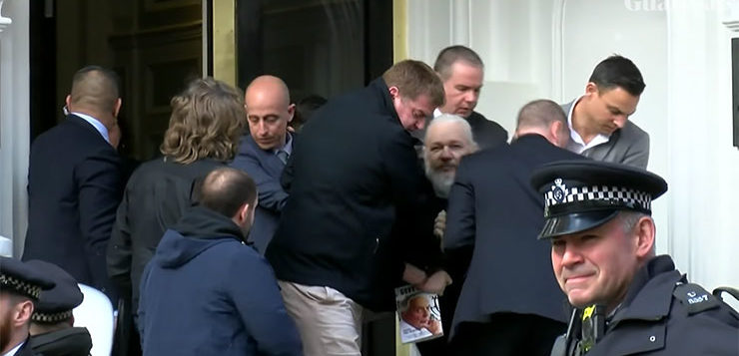

Slide 7
CRITICISMS
“Hillary lacks judgement and will push the United States into endless, stupid wars which spread terrorism: she certainly should not become president of the United States."
ANTI-AMERICANISM
PRO RUSSIA
ANTI CLINTON-PRO TRUMP
ANTI-SEMITISM
MISLEADING CLAIMS
VIOLATION OF PERSONAL PRIVACY

