Slide 1
Ketogenic diet as an adjuvant cancer therapy
Fraccascia Valentina v.fraccascia1@gmail.com
Conci Alessio alessioconci@yahoo.de

Slide 2
Topics
Ketogenic Diet (KD)
Ketone Bodies and metabolism
KD and cancer
Case study: glioma

Slide 3
Ketogenic Diet (KD)
Notes:
La dieta chetogenica è una dieta basata sull’assunzione di un’elevata percentuale di grassi, moderata di proteine e bassa di carboidrati. Questo tipo di dieta si contrappone molto alla tipica dieta mediterranea che invece si basa sull’elevato consumo di carboidrati ed è molto bilanciata nell’assunzione dei maggiori nutrienti. I tipici alimenti previsti per la dieta chetogenica sono panna, maionese, olio, burro, carne, pesce, uova e formaggi, mentre sono molto limitate le verdure, la pasta e tutto ciò che contiene carboidrati per minimizzarne l’apporto.

Slide 4
Fatty acids oxidation occurs when:
starvation, fasting, prolonged exercise
KD
Glucose Ketone bodies
4

Slide 5
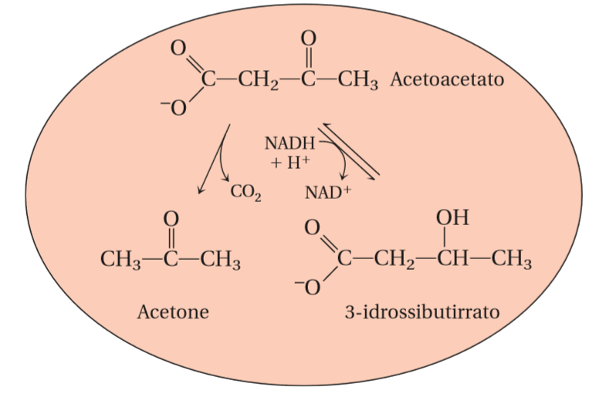
Major ketone bodies
5

Slide 6
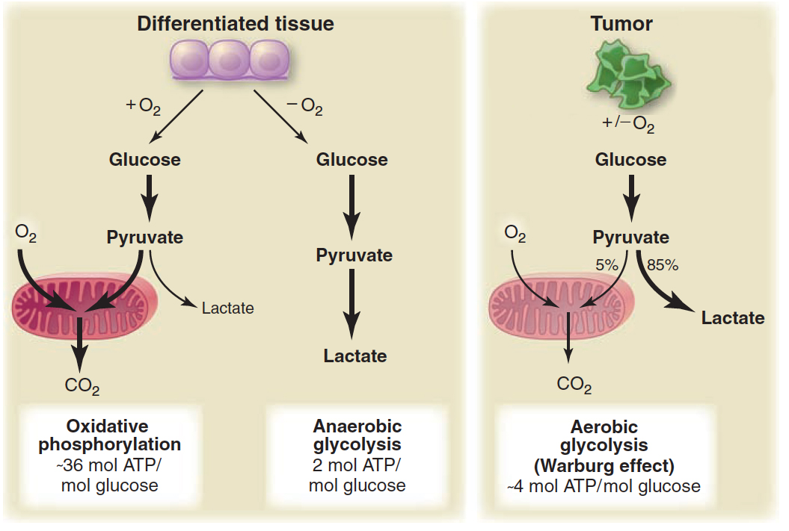
Warburg’s effect
Tumors exhibit a unique metabolic phenotype characterized by high rates of aerobic glycolysis, or fermentation in the presence of oxygen. Following glycolysis, pyruvate is primarily fermented to lactate despite availability of O₂.
6
6
6

Slide 7
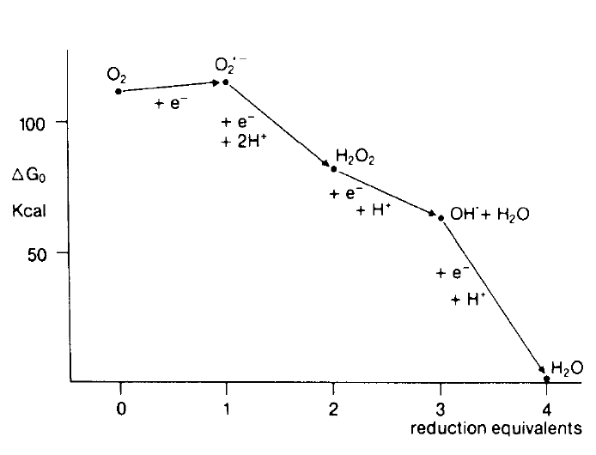
Increased glicolysis to maintain redox homeostasis and control ROS production.
Increased ROS production caused by mutations in mitochondria

Slide 8
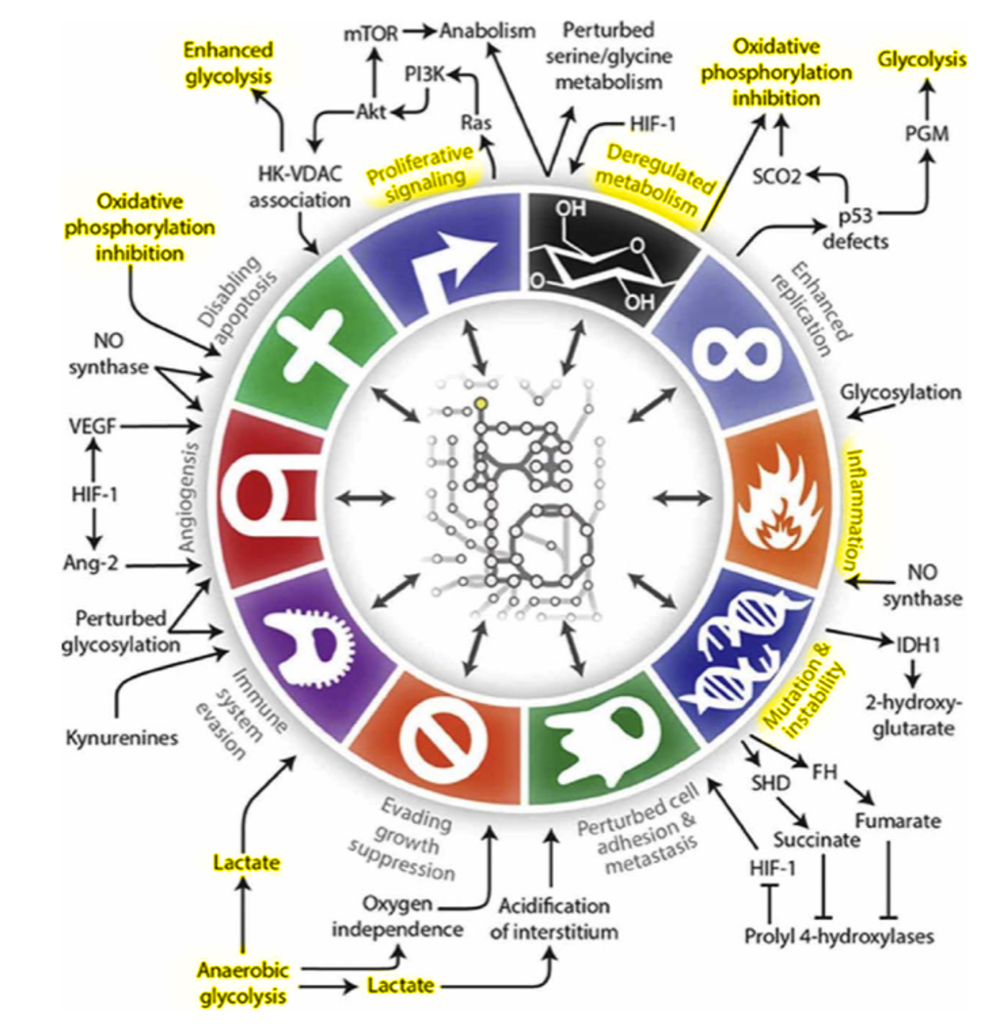
8
8

Slide 9
Roles of ketosis in preventing carcinogenesis or slowing tumor progression:
1) reduction of glucose and insulin;
2) modulation of oxidative stress;
3) reduction of inﬂammation;
4) enhancement of anti-tumor immunity;
5) alteration of gene expression;
6) sensitization of tumors to standard of care and adjuvant therapies.
9

Slide 10
Reduction of glucose and insulin
Hyperglycemia = tumor growth
Ketosis → hypoglycemia = tumor growth
GLUT transporters over-expressed (GLUT1, GLUT3)
Low glucose
Anti-mitosis
Anti-angiogenesis
Low insulin
Pro-apoptosis
Multiple effects
Anti-inflammation
GLUT3
10

Slide 11
Modulation of oxidative stress
ROS
Malfunctioning mitochondria
DNA damage
Carcinogenesis
Anti-oxidants prevent ROS formation and carcinogenesis
Pro-oxidants induce ROS production and cell apoptosis
Ketosis favours survival of normal cells and selectively increases therapeutic damage in tumor cells
11

Slide 12
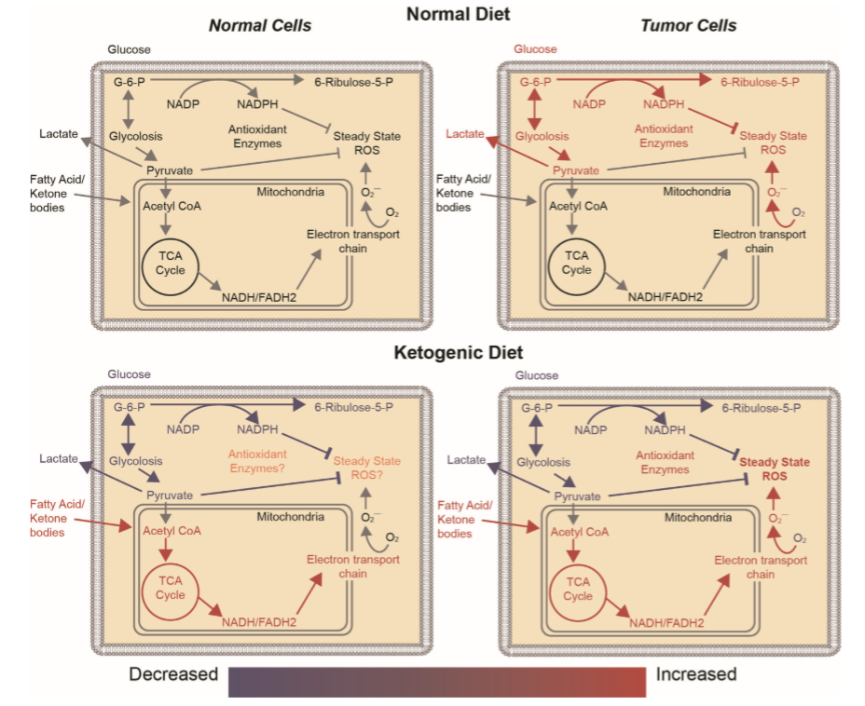
Modulation of oxidative stress
It is possible that KD works in part by reducing basal levels of oxidative stress in tumors.
12

Slide 13
Reduction of inflammation
Ketosis inhibits progression and induces cell death in cancer by inhibiting inflammation
A major player in the inflammatory process of brain tumors (e.g. glioma) is NLRP3 inflammasome
NLRP3 inflammasome activation contributes to tumor growth and radiotherapy resistance
Ketones inhibit NLRP3 inflammasome reducing inflammation and enhancing radio-sensitivity
KD inhibits NFkB and COX-2, resulting in an anti-inflammatory effect
13

Slide 14
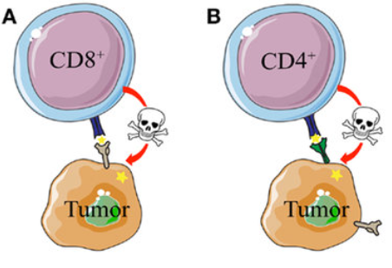
Enhancement of anti-tumor immunity
Ketosis induces CD8+ and CD4+ cells to release cytokines against the tumor
14

Slide 15
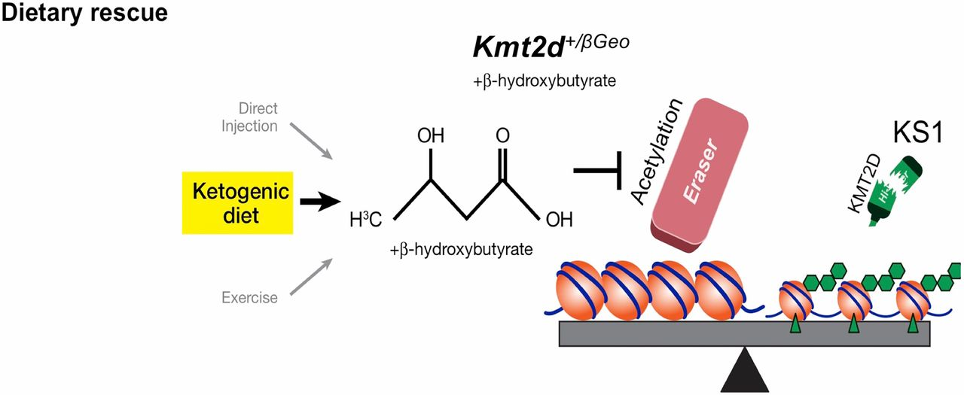
Alteration of gene expression
KD reduces angiogenesis (e.g. VEGF), NFkB response, invasive potential and the expression of hypoxia responsive genes (e.g. HIF-1α)
KD induces tumor gene expression to be normal, or closer to that of the healthy brain tissue
βHB acts as an endogenous HADCi potential anti-cancer efficacy of ketosis
15
15

Slide 16
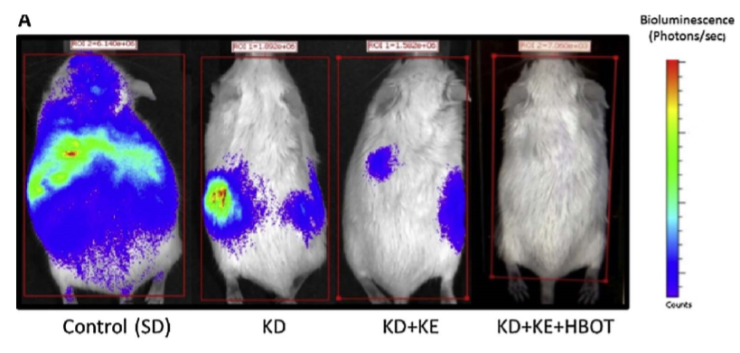
Sensitization of tumors to standard of care and adjuvant therapies
Ketosis appears to be particularly effective when used as an adjuvant to SOC (Standard Of Care).
16

Slide 17
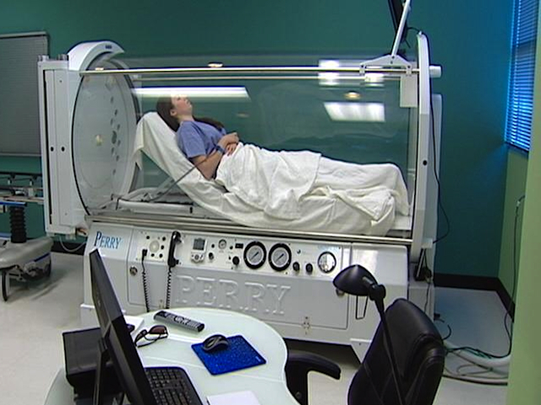
Sensitization of tumors to standard of care and adjuvant therapies
Other adjuvant therapies, like hyperbaric oxygen therapy may also synergize with ketosis.
17

Slide 18
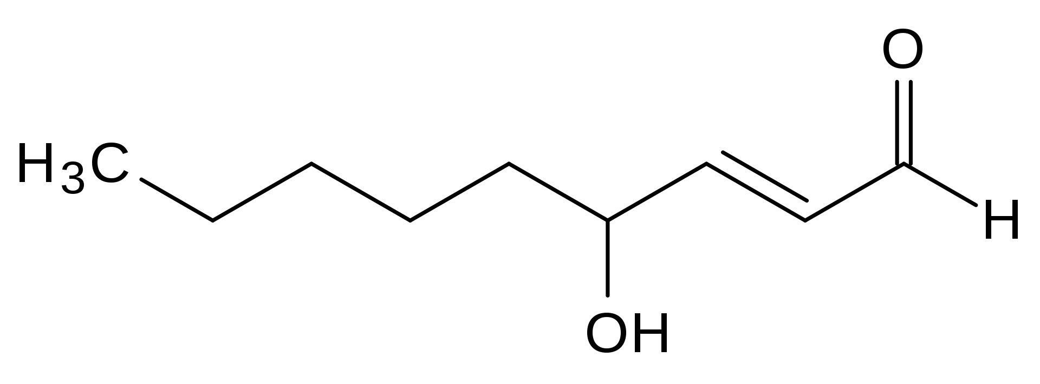
Sensitization of tumors to standard of care and adjuvant therapies
Fasting increases therapeutic response to chemiotherapy in many tumors (e.g. melanoma, glioma & breast cancer);
Fasting and KD reduce SOC toxicity and improve quality of life indices;
Combination of chemiotherapy and radiation increase 4HNE-modified protein levels.
18

Slide 19
CASE STUDY: GLIOMA
19

Slide 20
Many brain tumor cells show the Warburg phenotype, but limited capacity to oxidize KB as an energy source depriving tumors of key metabolic substrates might inhibit tumor growth and progression.
Several tumors (e.g. malignant glioma) lack expression of ketone utilization enzymes.
Some tumors express ketolytic enzymes, but are unable to metabolize βHB to compensate for glucose restriction.
20

Slide 21
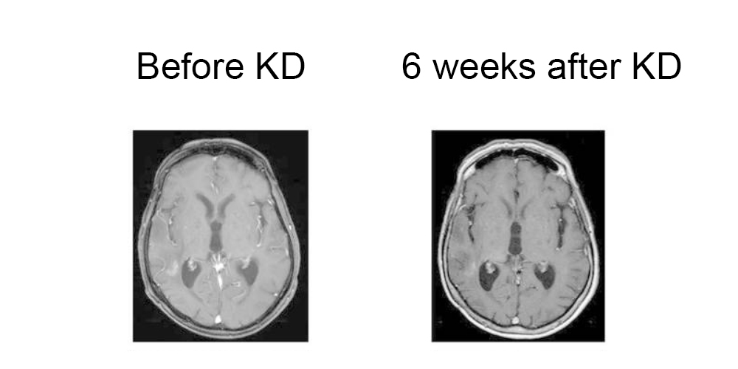
Clinical trials
1995: two pediatric patients with late stage malignant astrocytomas
2011: 65 year old woman with GBM (glioblastoma multiforme)
Currently: several clinical trials (no significant benefits as monotherapy)
21

Slide 22
Clinical applications of KD in other diseases
Epilepsy;
Obesity;
Type 2 diabetes mellitus;
Depression;
Metabolic disorders;
Glucose transporter defects;
Neurodegenerative diseases (Alzheimer’s & Parkinson’s disease): ketosis prevents neuronal death and enhances cognitive function; ketosis may elicit neuroprotective effects.
In glioma, where SOC therapies produce substantial and enduring cognitive and quality of life deficits, the potential implications of KD are significant.
22

Slide 23
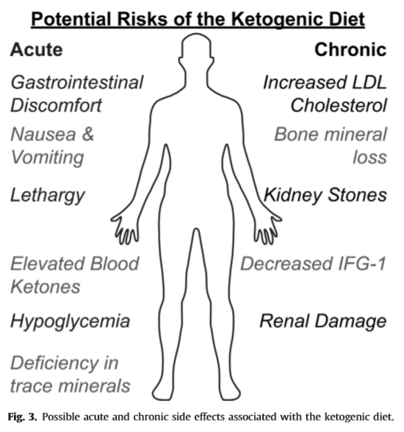
23

Slide 24
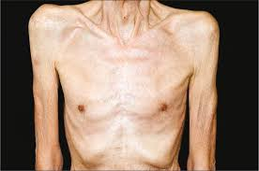
KD has been shown to prevent/alleviate cancer cachexia
Cachexia is a multifactorial syndrome characterized by progressive weight loss as a result of reduction of skeletal muscle mass with or without depletion of adipose tissue.
24

Slide 25
Conclusions
KD represents a potential dietary manipulation that could be rapidly implemented in cancer therapy.
KD induced ketosis may provide a powerful, broad spectrum approach to simultaneously target multiple aspects of cancer, while enhancing the effect of current SOC chemioradiation and protecting healthy tissues from the adverse side effects of treatement.
KD selectively exploits inherent oxidative metabolic differences between cancer cells and normal cells to improve standard therapeutic outcomes;
Adjuvant therapeutic intervention with the KD in cancer merits further investigation, especially in combination with drugs that target tumor metabolism.
25

Slide 26
Bibliography:
Allen, B. G., Bhatia, S. K., Anderson, C. M., Eichenberger-Gilmore, J. M., Sibenaller, Z. A., Mapuskar, K. A., Schoenefeld, J. D., Buatti, J. M., Spitz, D. R., Fath, M. A. (2014). Ketogenic diet as an adjuvant cancer therapy: history and potential mechanism. Redox Biology. http://dx.doi.org/10.1016/j.redox.2014.08.002
Poff, A., Koutnik, A. P., Egan, K. M., Sahebjam, S., D’Agostino, D., Kumar, N. B. (2017) Targeting the Warburg effect for cancer treatment: Ketogenic diets for management of glioma. Seminars in Cancer Biology. https://doi.org/10.1016/j.semcancer.2017.12.011
Vidali, S., Aminzadeh, S., Lambert, B., Ruherford, T., Sperl, W., Kofler, B., Feichtinger, R. G. (2015). Mitochondria: The ketogenic diet-A metabolism based therapy. The International Journal of Biochemistry & Cell Biology. http://dx.doi.org/10.1016/j.biocel.2015.01.022
Abdelwahab, M. G., Fenton, K. E., Preul, M. C., Rho, J. M., Lynch, A., Stafford, P., Scheck, A. C. (2012) The Ketogenic Diet is an effective adjuvant to radiation therapy for the treatment of malignant glioma. PLoS ONE. doi:10.1371/journal.pone.0036197
Lv, M., Zhu, X., Wang, H., Guan, W. (2014) Roles of caloric restriction, ketogenic diet and intermittent fasting during initiation, progression and metastasis of cancer in animal models: a systematic review and meta-analysis. PLoS ONE. doi:10.1371/journal.pone.0115147
26

Slide 27
Thank you for your attention : )
27

