Slide 1
Mobile Robots
Part I
a.a. 2018-2019
Robotics

Slide 2
Something about me
I received my B.E. in 2010 from the University of Trieste with a thesis on the development of a synchrotron light microtomography device.
I received my M.Sc. in mechanical engineering (2012) from the same university with a thesis on bolted assemblies for space structures, developed at ICAM Toulouse, for the CNES (Centre National d‘Ètudes Spatiales).
I received my Ph.D. in 2016 at the University of Trieste, for my research on Large Workspace Robots.
In 2016 I was Research Fellow at the Institute of Robotics and Mechatronics of the German space agency (DLR), working on the development of hybrid locomotion solutions for planetary exploration rovers.
I am now Research Fellow and Assistant Professor at the University of Trieste, studying mobile robots, space robotics and applied mechanics.

Slide 3
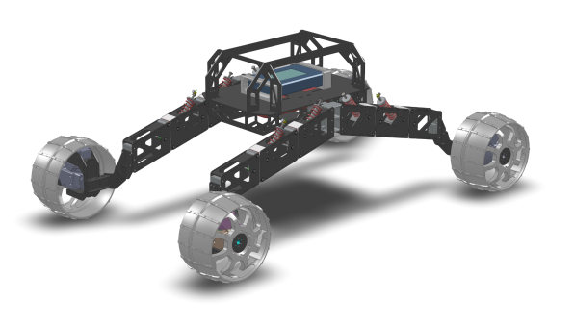
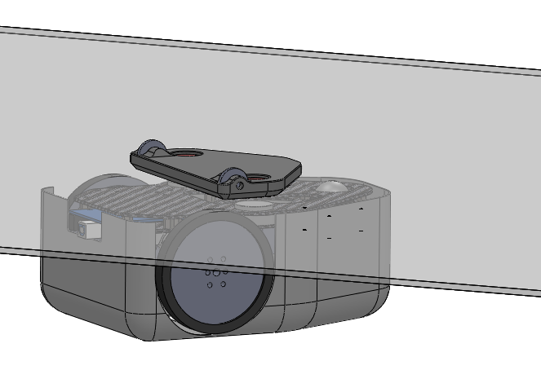
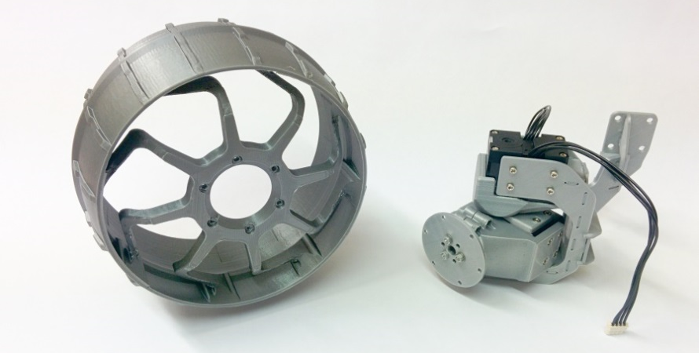
Research
My research interests include:
  Space robotics
  Mobile robotics
  Applied mechanics
  Computer-vision

Slide 4
Course
Contact information
  Seriani Stefano
  E-mail: sseriani@units.it
  Phone: +39 040 558.2540

Slide 5
Suggested reads
Introduction to Autonomous Mobile Robots, R. Siegwart, I.R. Nourbakhsh
Robotics - Modelling, Planning and Control, Bruno Siciliano, Lorenzo Sciavicco (english version)
Lecture presentation in power point (Seriani)

Slide 6
Introduction to mobile robotics
Module 1

Slide 7
Mobile robots
... also called Automated Guided Vehicles, or Autonomous Ground Vehicles (AGV)
... or Rovers when used on rough terrain
Features
  Base is not fixed
  Autonomy
  Most useful when
    Work has to be done on large spaces
    Environment does not allow large fixed structures

Slide 8
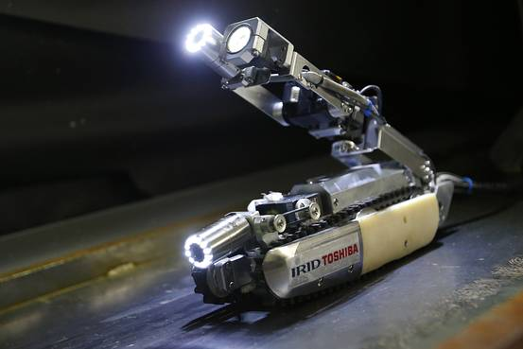
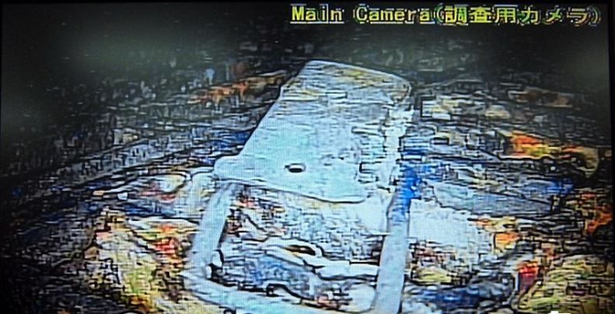
Application example
Fukushima nuclear plant 2011 disaster
  Hazarduous environment
  No infrastructure can be built
  Large space needs to be explored
Mobile robot

Slide 9
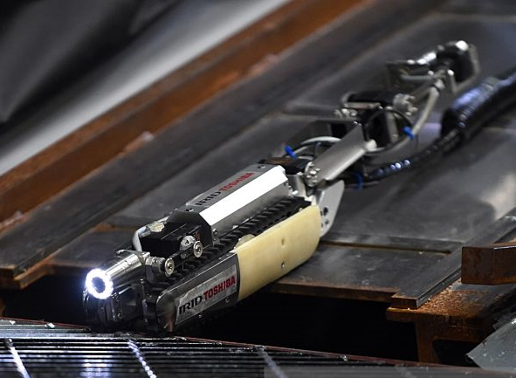
Rugged skid-steer robot
Differential steering
Good performance against uneven terrain
Bad accuracy
Low autonomy
Video skidSteer

Slide 10
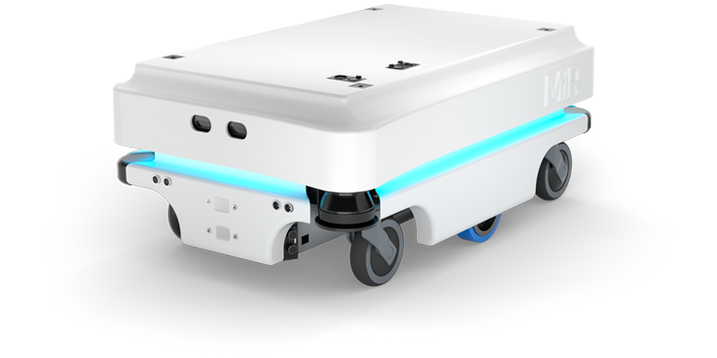
Differential drive robot
Differential steering
Good performance against uneven terrain
Video differentialDrive

Slide 11
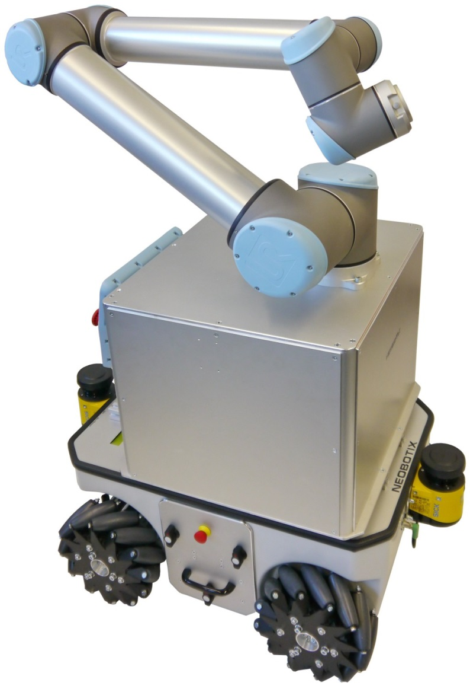
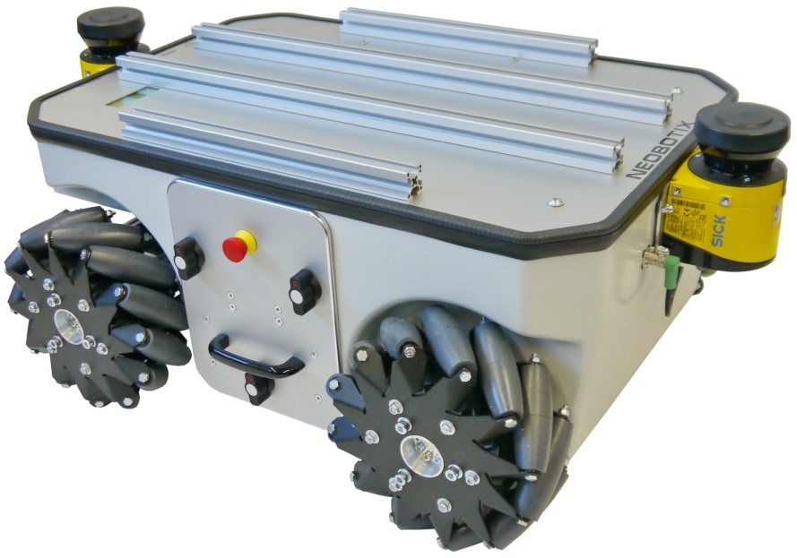
Omnidirectional platform
Can move in all directions
High loads
High positional accuracy
Is used mainly in the industry:
  In warehouse
  Transport and Handling
Bad with uneven terrain
Video orientableWheels
Video mecanumWheels

Slide 12
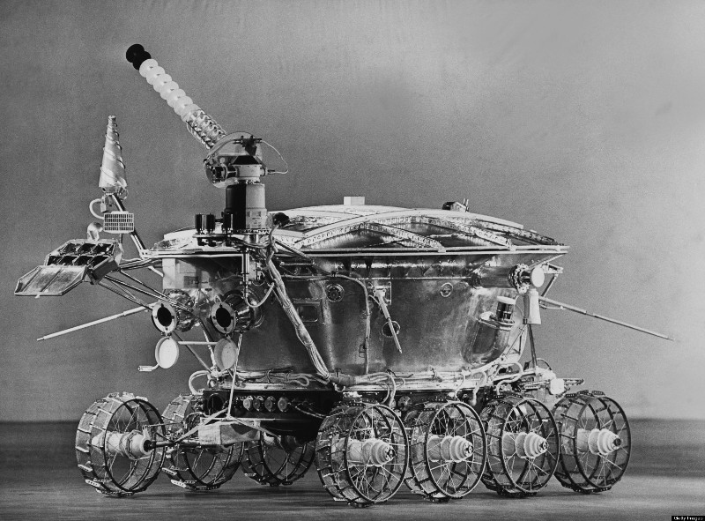
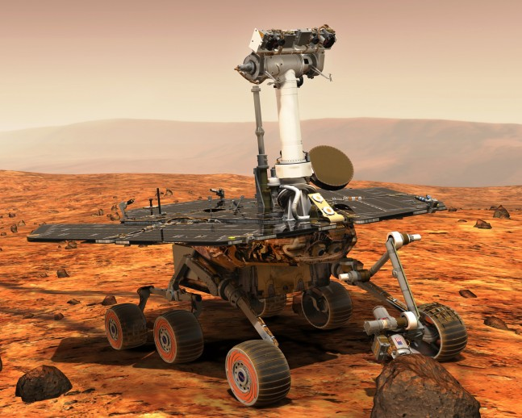
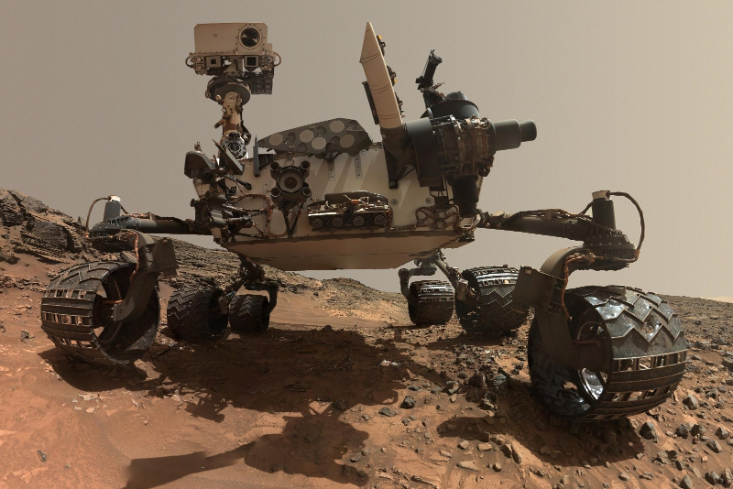
Space exploration rovers
Lunokhod (1970)
Steerable wheels
Exploration of extreme environments
High degree of autonomy
Good on rough terrain
Very expensive
MER A/B (2003)
MSL (2011)

Slide 13
The problem
Go from point A to point B
Obstacles
  Static/dynamic
  Obstacle avoidance
Uneven terrain
  Requires mapping
  Yield
  Traction loss, slopes, etc...
Contamination, etc.
B
A

Slide 14
Issue 1: obstacles
Static obstacles
  Position is fixed in time
Dynamical obstacles
  Position varies with time
  Not always predictable
B
A
?
B
A

Slide 15
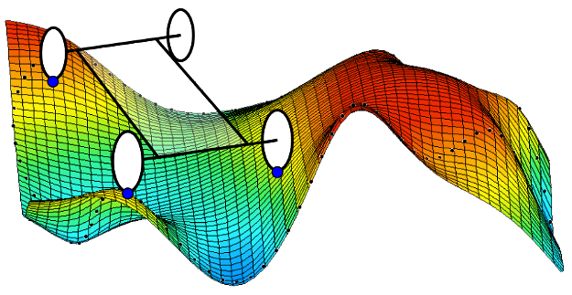
Issue 2: uneven terrain
Risks:
  Loss of contact with the ground
  Terrain yield and traction loss
  Slopes

Slide 16

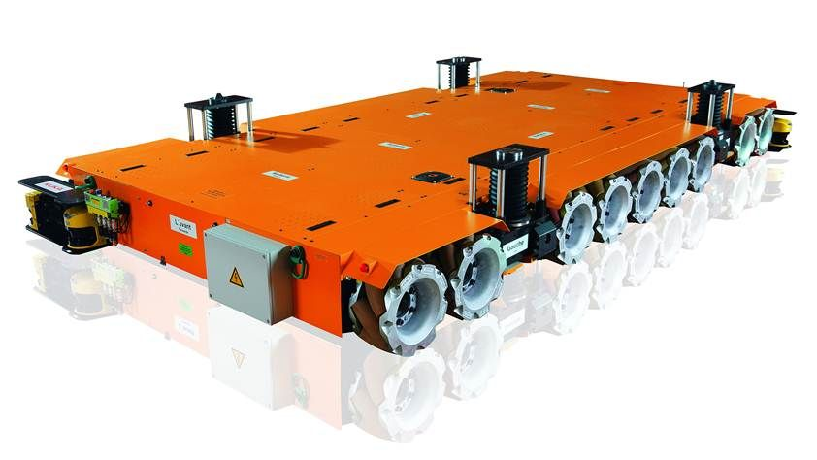
Purpose
Why go from A to B?
  Exploration
  Executing task at B
  Transporting something from A to B
This way we can define the robot’s accessories: solar panels, arms etc.

Slide 17
Features of mobile robots
Module 2

Slide 18
Elementary motions
Motion = combination of:
  Point-to-point motion
  Path following
  Trajectory tracking
  Reactive motion

Slide 19






Elementary motions
Point-to-point motion:
Path following:
Trajectory tracking:
B
A
x
The parameter is $x∈path$
$$t=4s$$
$$t=3s$$
The parameters are
$$t∈\left[0,T\right]$$
$$x∈path$$
$$t=1s$$
$$t=2s$$

Slide 20
Reactive motion
Online obstacle avoidance
Line/wall following
Target tracking
A
Original path
B
Alternative path

Slide 21
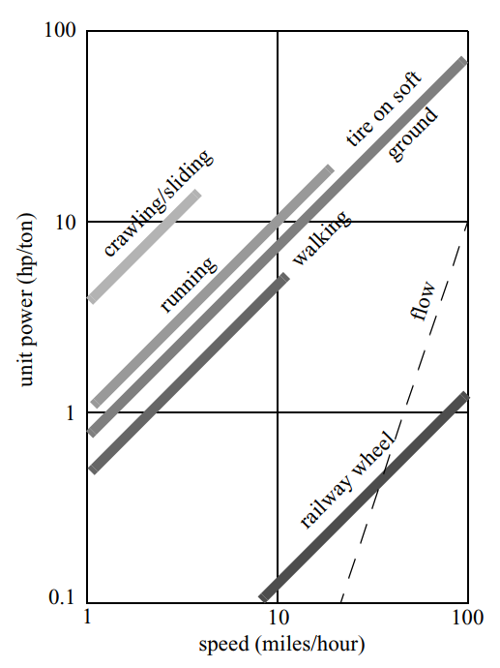
Wheel systems
Why use wheels?
  Legged systems are much more complicated
    Wheel: 2 DoF
    Leg: 6 DoF
  Wheels are efficient on hard terrains
  Legged systems on soft

Slide 22
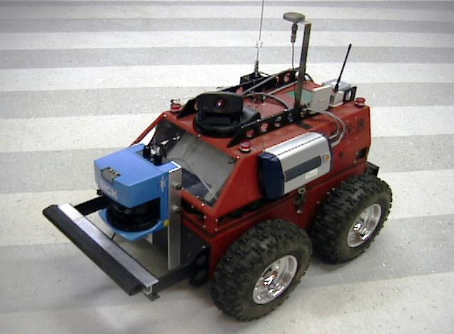
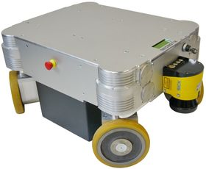

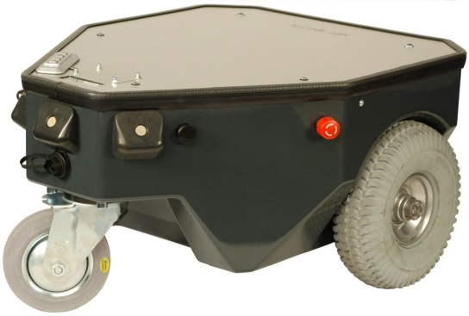
Wheel systems
Simple
Simple wheel
Orientable wheel
Omnidirectional wheel
  Omniwheel
  Mecanum wheel
Passive wheels
  Not actuated, generally used for stability
Omnidirectional
Orientable
Passive
Video differentialDrive

Slide 23
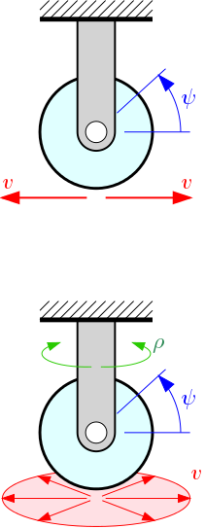
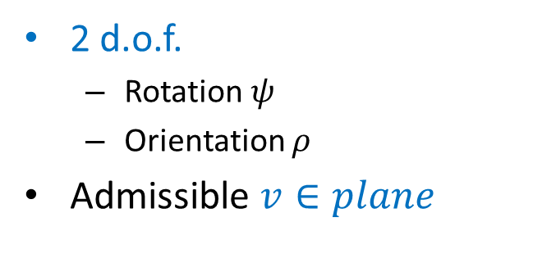
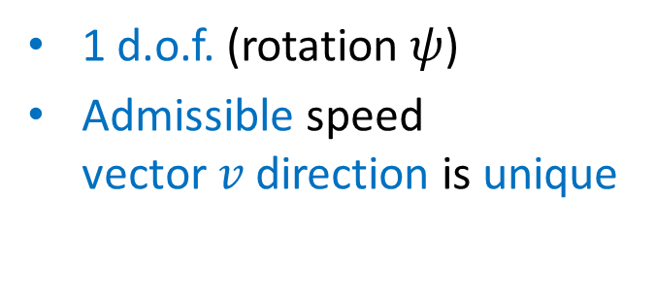
Wheel systems
Simple wheel
Orientable wheel
1 d.o.f. (rotation $ψ$)
Admissible speed vector$v$direction is unique
2 d.o.f.
  Rotation $ψ$
  Orientation $ρ$
Admissible $v∈plane$
No slip on the point of contact!

Slide 24
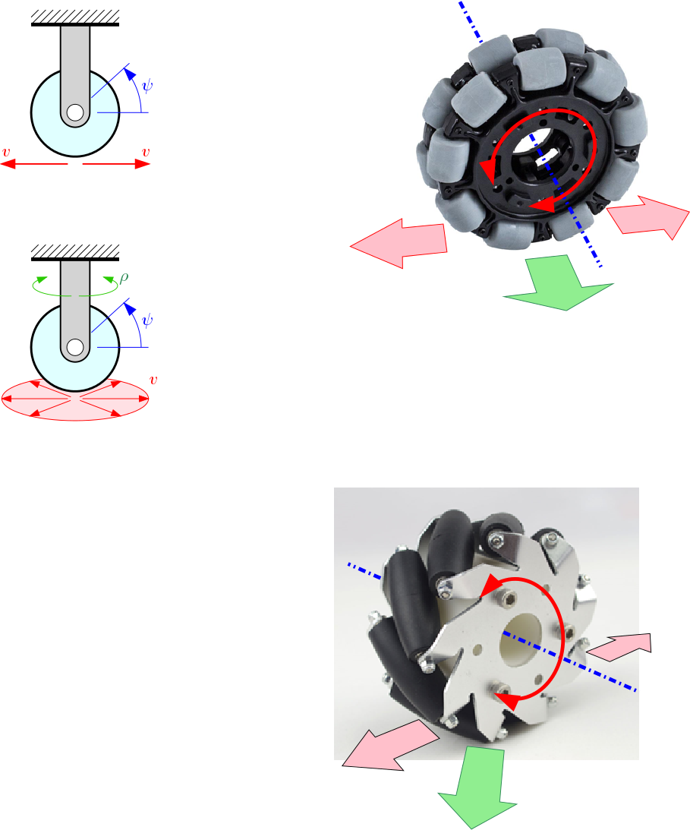

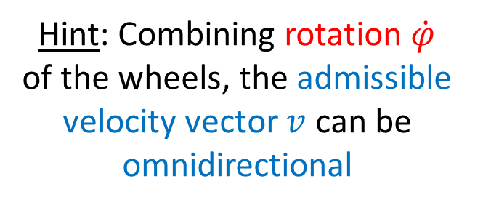

Wheel systems
Omnidirectional wheels (swedish wheels)
Omniwheel
Hint: Combining rotation $\dot{φ}$
of the wheels, the admissible velocity vector $v$ can be omnidirectional
$$\dot{φ}$$
$$v$$
Controlled motion
Lability
Video

Slide 25

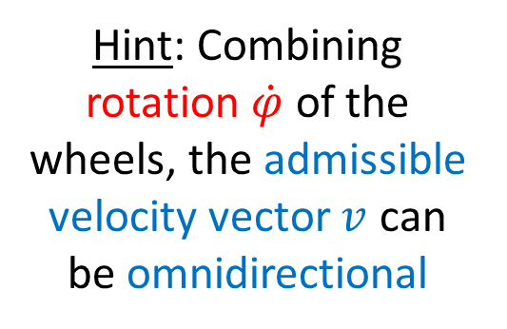


Wheel systems
Omnidirectional wheels (swedish wheels)
  Mecanum wheel or Ilon wheel
Hint: Combining rotation $\dot{φ}$ of the wheels, the admissible velocity vector $v$ can be omnidirectional
$$\dot{φ}$$
$$γ$$
$$v$$
Video mecanum wheels

Slide 26
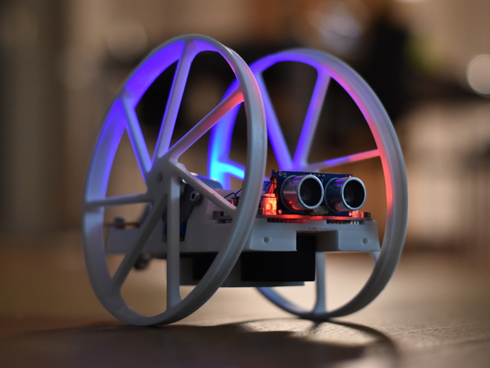
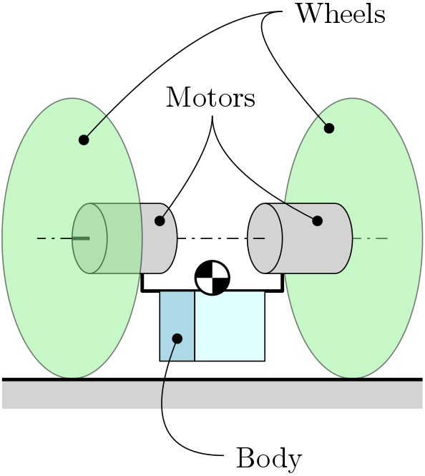
Stability
What is the minimum number of wheels for a passively stable system?

Slide 27
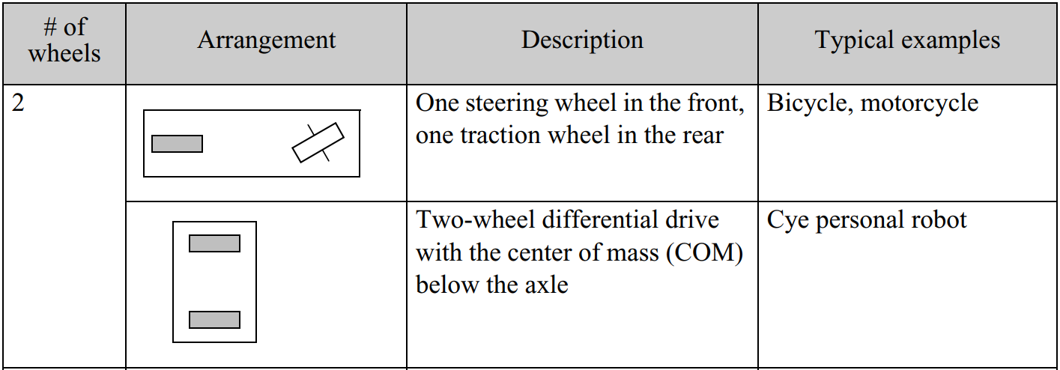
Wheel configurations
2 wheels

Slide 28
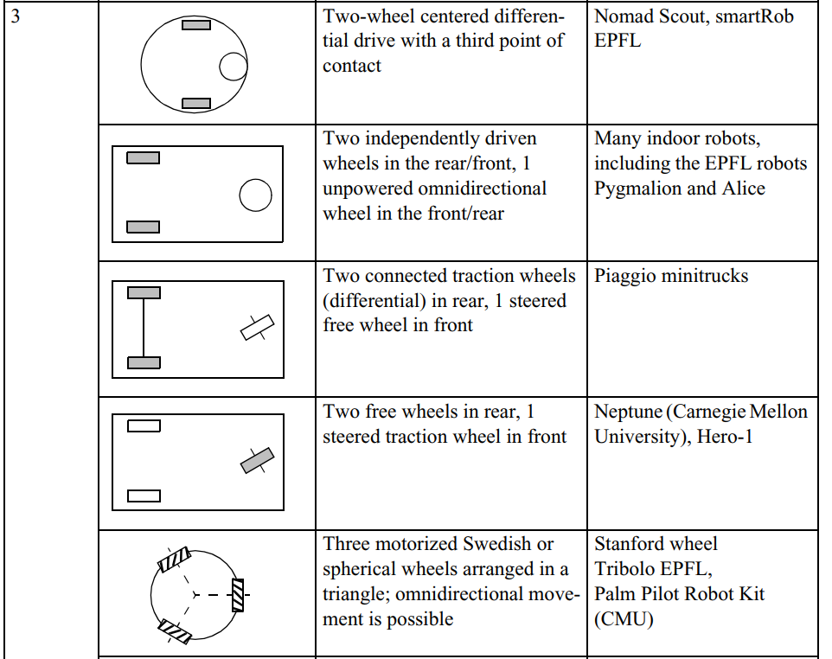
Wheel configurations
3 wheels

Slide 29
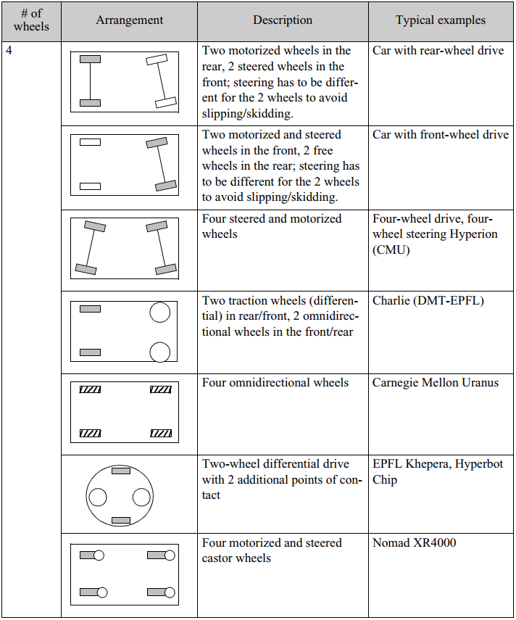
Wheel configurations
4 wheels

Slide 30
Introduction to the Theory
Module 3

Slide 31
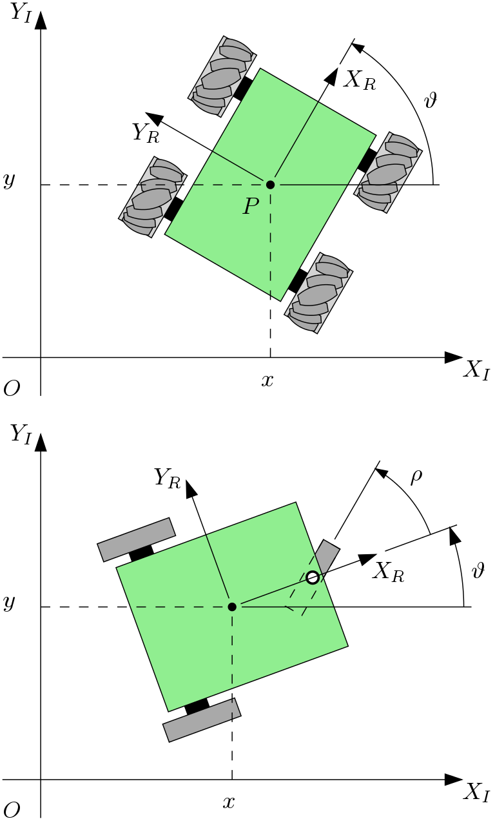
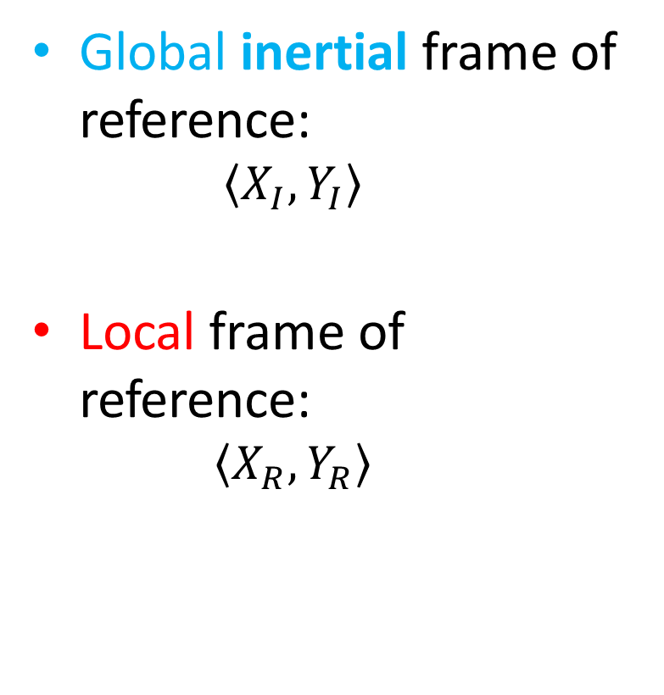
Frames of reference
Global inertial frame of reference:
  $$\left\langle X_{I},Y_{I}\right\rangle$$
Local frame of reference:
  $$\left\langle X_{R},Y_{R}\right\rangle$$

Slide 32
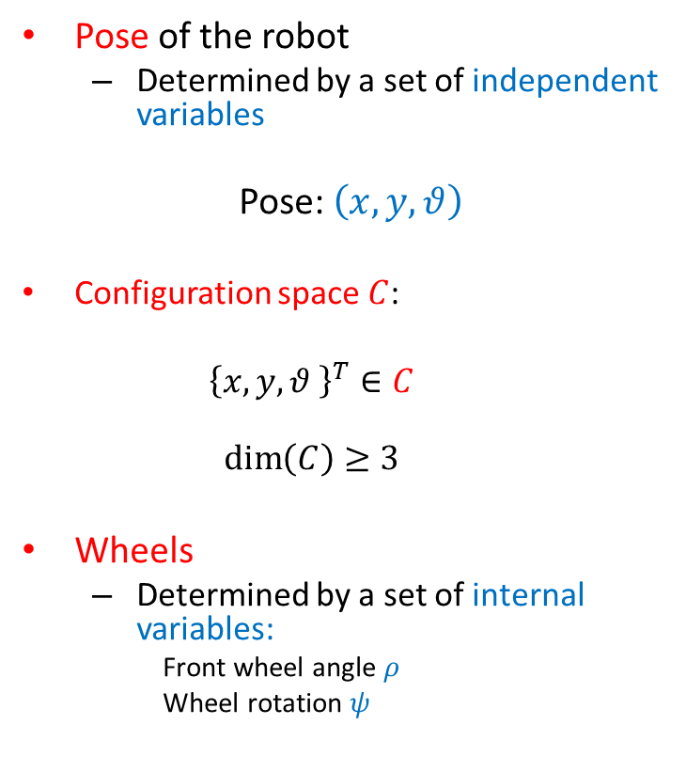
Pose and configuration space
Pose of the robot
  Determined by a set of independent variables
Pose: $\left(x,y,θ\right)$
  Configuration space $C$:
  $${\left\{x,y,θ \right\}}^{T}∈C$$
  $$\dim\left(C\right)≥3$$
Wheels
  Determined by a set of internal variables:
    Front wheel angle $ρ$
    Wheel rotation $ψ$

Slide 33
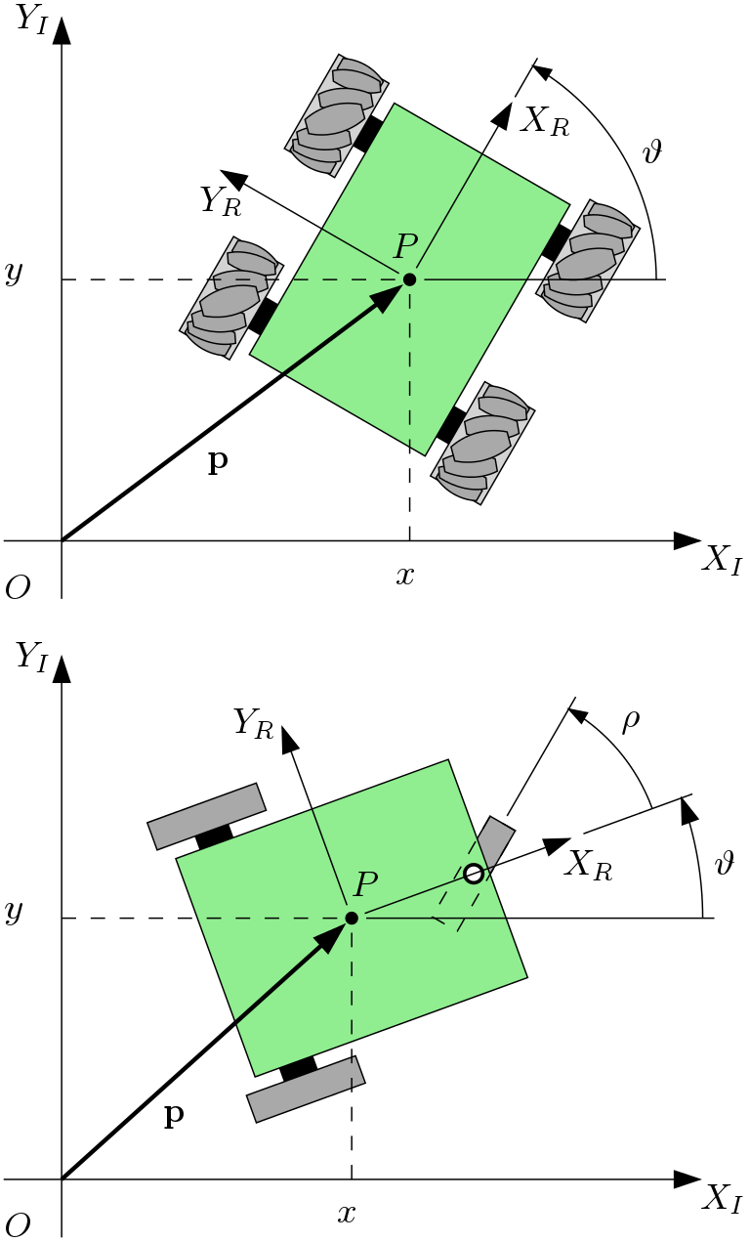
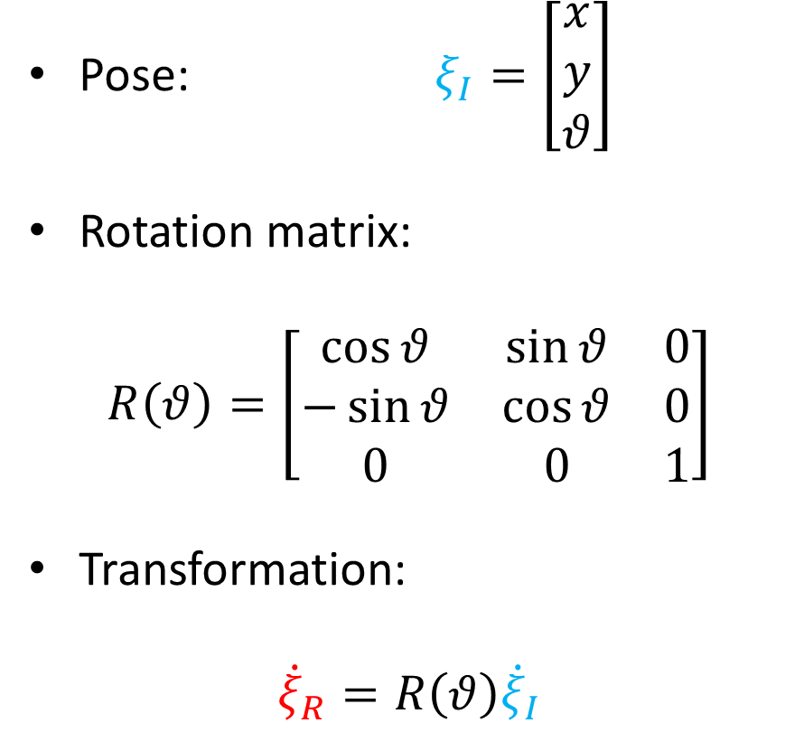

Velocity transformation: global $→$ local
Pose: $ξ_{I}=\left[\begin{matrix}x \\ y \\ θ\end{matrix}\right]$
Rotation matrix:
$$R\left(θ\right)=\left[\begin{matrix}\cos{θ} & \sin{θ} & 0 \\ −\sin{θ} & \cos{θ} & 0 \\ 0 & 0 & 1\end{matrix}\right]$$
Transformation:
$${\dot{ξ}}_{R}=R\left(θ\right){\dot{ξ}}_{I}$$

Slide 34
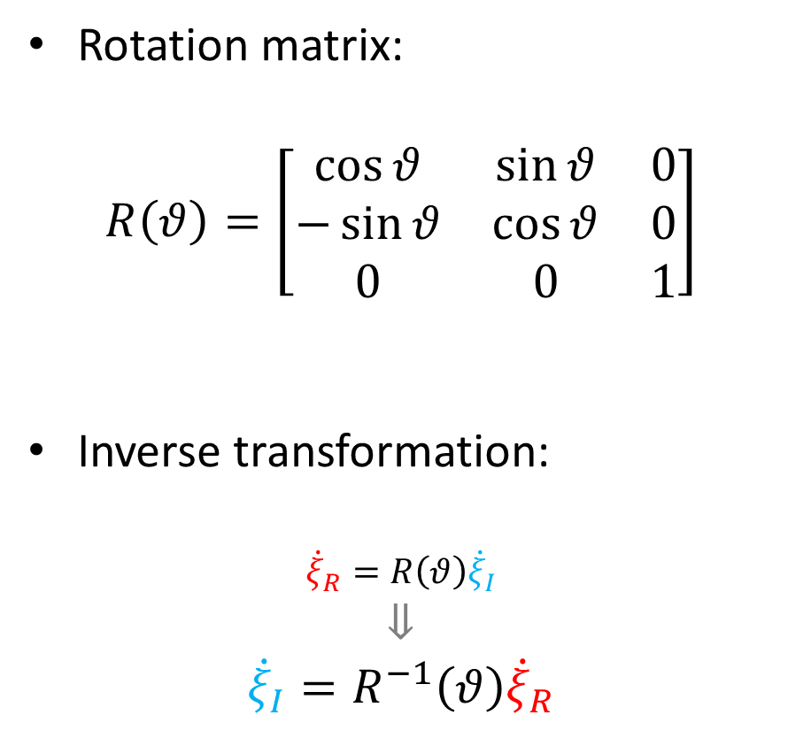

Velocity transformation: local $→$ global
Rotation matrix:
$$R\left(θ\right)=\left[\begin{matrix}\cos{θ} & \sin{θ} & 0 \\ −\sin{θ} & \cos{θ} & 0 \\ 0 & 0 & 1\end{matrix}\right]$$
Inverse transformation:
$${\dot{ξ}}_{R}=R\left(θ\right){\dot{ξ}}_{I}$$
$$⇓$$
$${\dot{ξ}}_{I}=R^{−1}\left(θ\right){\dot{ξ}}_{R}$$

Slide 35
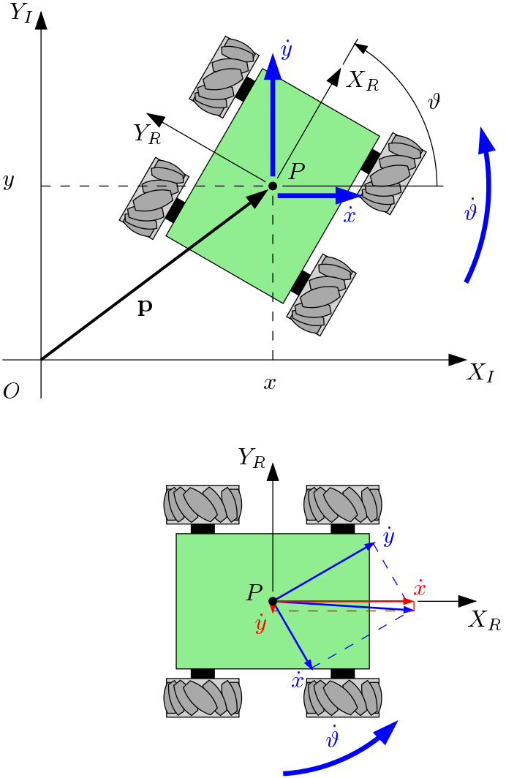
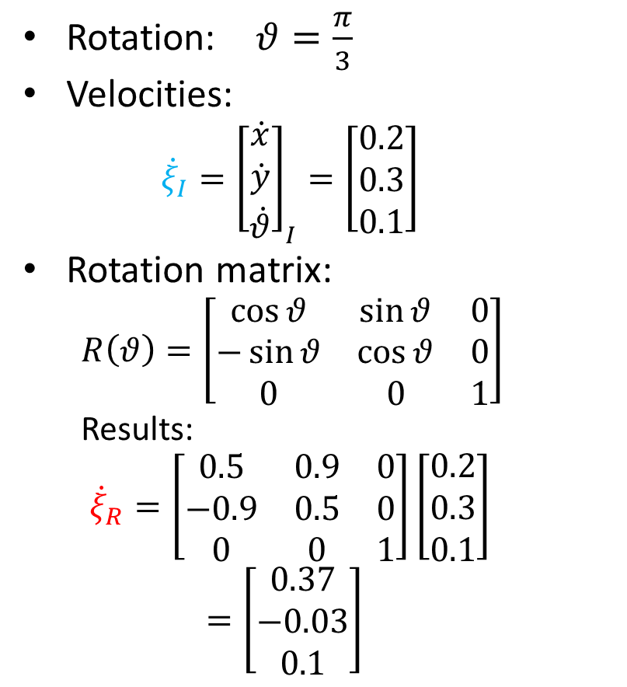



Example
$$\dot{y}$$
$$\dot{θ}$$
Rotation: $θ=\frac{π}{3}$
Velocities:
  $${\dot{ξ}}_{I}={\left[\begin{matrix}\dot{x} \\ \dot{y} \\ \dot{θ}\end{matrix}\right]}_{I}=\left[\begin{matrix}0.2 \\ 0.3 \\ 0.1\end{matrix}\right]$$
Rotation matrix:
  $$R\left(θ\right)=\left[\begin{matrix}\cos{θ} & \sin{θ} & 0 \\ −\sin{θ} & \cos{θ} & 0 \\ 0 & 0 & 1\end{matrix}\right]$$
  Results:
  $${\dot{ξ}}_{R}=\left[\begin{matrix}0.5 & 0.9 & 0 \\ −0.9 & 0.5 & 0 \\ 0 & 0 & 1\end{matrix}\right]\left[\begin{matrix}0.2 \\ 0.3 \\ 0.1\end{matrix}\right]=\left[\begin{aligned}0.37 \\ −0.03 \\ 0.1\end{aligned}\right]$$
$$\dot{x}$$

Slide 36
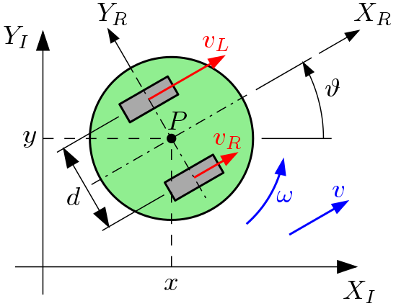
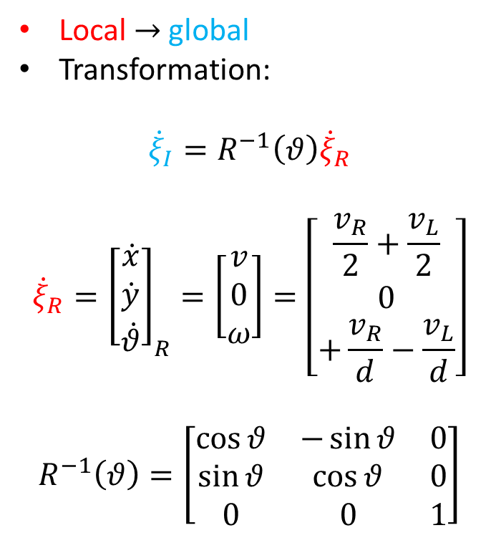



Forward kinematics
$$\dot{y}$$
$$\dot{θ}$$
Local $→$ global
Transformation:
$${\dot{ξ}}_{I}=R^{−1}\left(θ\right){\dot{ξ}}_{R}$$
$${\dot{ξ}}_{R}={\left[\begin{matrix}\dot{x} \\ \dot{y} \\ \dot{θ}\end{matrix}\right]}_{R}=\left[\begin{aligned}v \\ 0 \\ ω\end{aligned}\right]=\left[\begin{aligned}\frac{v_{R}}{2}+\frac{v_{L}}{2} \\ 0 \\ +\frac{v_{R}}{d}−\frac{v_{L}}{d}\end{aligned}\right]$$
$$R^{−1}\left(θ\right)=\left[\begin{matrix}\cos{θ} & −\sin{θ} & 0 \\ \sin{θ} & \cos{θ} & 0 \\ 0 & 0 & 1\end{matrix}\right]$$
$$\dot{x}$$
Note:
The calculation is done separately for each wheel, considering the other wheel as stationary, followed by addition.

Slide 37
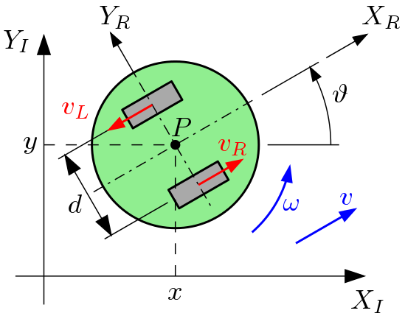
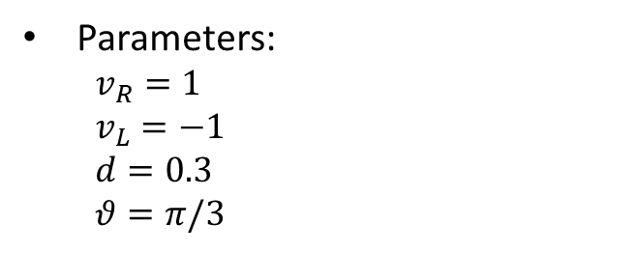
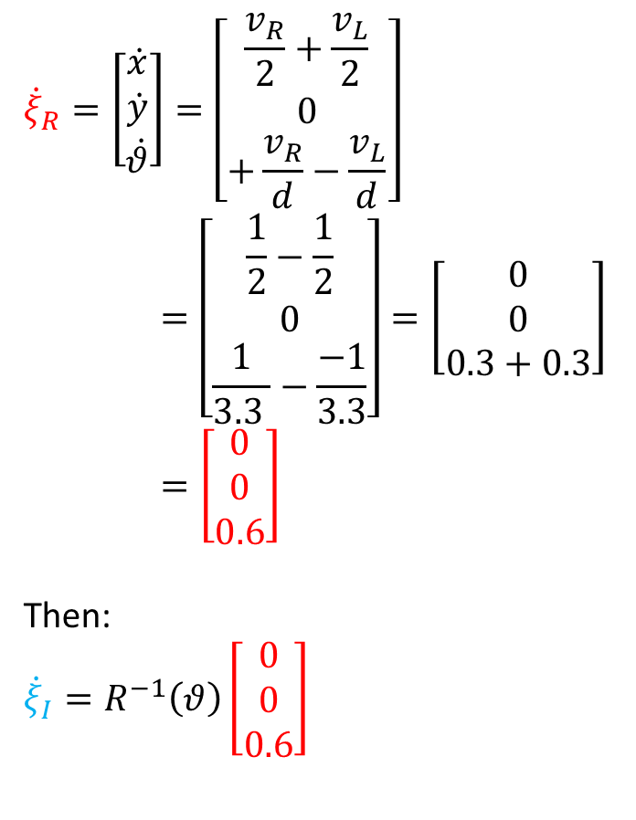
Example
$${\dot{ξ}}_{R}=\left[\begin{aligned}\dot{x} \\ \dot{y} \\ \dot{θ}\end{aligned}\right]=\left[\begin{aligned}\frac{v_{R}}{2}+\frac{v_{L}}{2} \\ 0 \\ +\frac{v_{R}}{d}−\frac{v_{L}}{d}\end{aligned}\right]=\left[\begin{aligned}\frac{1}{2}−\frac{1}{2} \\ 0 \\ \frac{1}{3.3 }−\frac{−1}{3.3}\end{aligned}\right]=\left[\begin{aligned}0 \\ 0 \\ 0.3+0.3\end{aligned}\right]=\left[\begin{aligned}0 \\ 0 \\ 0.6\end{aligned}\right]$$
Then:
$${\dot{ξ}}_{I}=R^{−1}\left(θ\right)\left[\begin{aligned}0 \\ 0 \\ 0.6\end{aligned}\right]$$
Parameters:
  $$v_{R}=1$$
  $$v_{L}=−1$$
  $$d=0.3$$
  $$θ=π/3$$

Slide 38
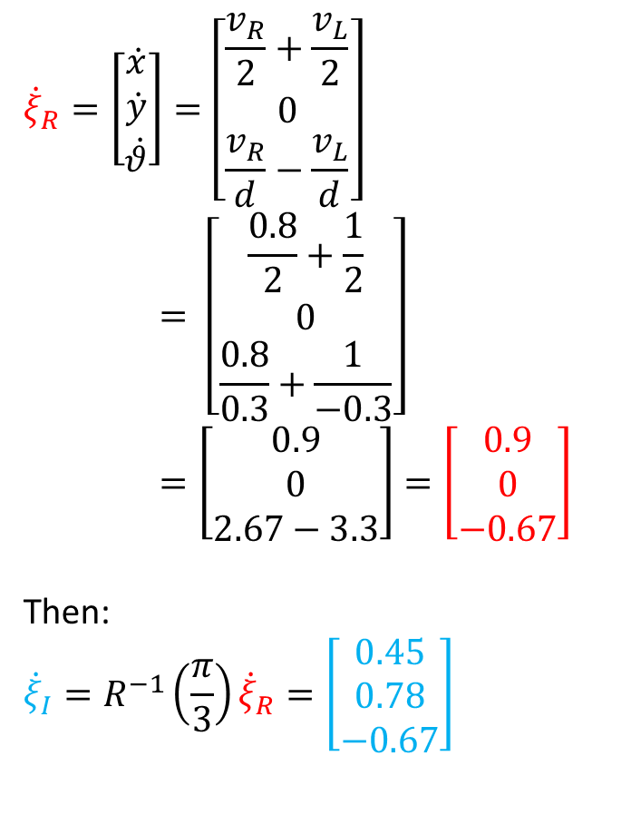
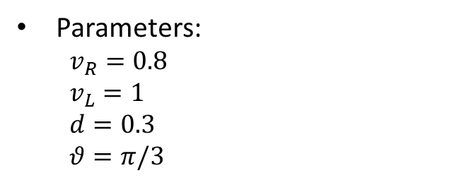

Example
$${\dot{ξ}}_{R}=\left[\begin{aligned}\dot{x} \\ \dot{y} \\ \dot{θ}\end{aligned}\right]=\left[\begin{aligned}\frac{v_{R}}{2}+\frac{v_{L}}{2} \\ 0 \\ \frac{v_{R}}{d}−\frac{v_{L}}{d}\end{aligned}\right]= \left[\begin{aligned}\frac{0.8}{2}+\frac{1}{2} \\ 0 \\ \frac{0.8}{0.3}+\frac{1}{−0.3}\end{aligned}\right]=\left[\begin{aligned}0.9 \\ 0 \\ 2.67−3.3\end{aligned}\right]=\left[\begin{aligned}0.9 \\ 0 \\ −0.67\end{aligned}\right]$$
Then:
$${\dot{ξ}}_{I}=R^{−1}\left(\frac{π}{3}\right){\dot{ξ}}_{R}=\left[\begin{aligned}0.45 \\ 0.78 \\ −0.67\end{aligned}\right]$$
Parameters:
  $$v_{R}=0.8$$
  $$v_{L}=1$$
  $$d=0.3$$
  $$θ=π/3$$
Time integration
$$x_{i}=x_{i−1}+\dot{x}dt$$
$$y_{i}=y_{i−1}+\dot{y}dt$$
$$θ_{i}=θ_{i−1}+\dot{θ}dt$$

Slide 39
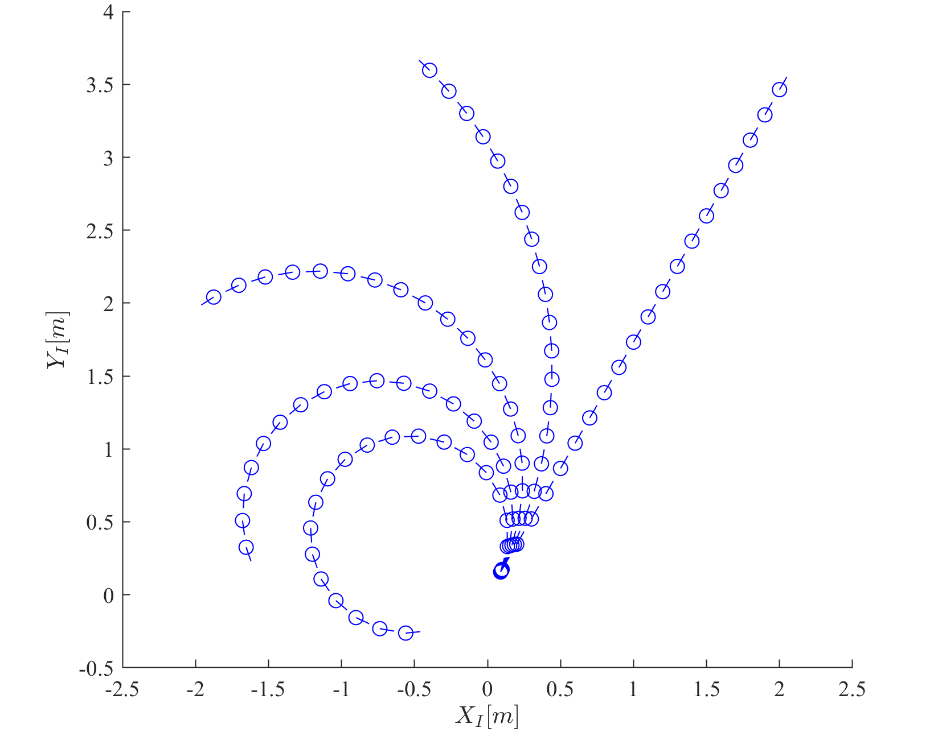

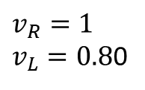



Results
$$v_{R}=1$$
$$v_{L}=0.95$$
$$v_{R}=1$$
$$v_{L}=1$$
$$v_{R}=1$$
$$v_{L}=0.90$$
$$v_{R}=1$$
$$v_{L}=0.85$$
$$v_{R}=1$$
$v_{L}=0.8$0

Slide 40
Wheel models
Module 4

Slide 41


Constraints
No-slip constraint causes:
  Two constraints for each wheel:
    Rolling constraint
    Sliding constraint
$$v_{t}$$
Zero
Constrained to wheel rotation
$$v$$

Slide 42




Fixed/steered wheel model
Wheel spin:
  $$v=\dot{φ}r$$
The motion of the wheel in local frame:
$$v=\dot{x}\sin\left(α+β\right)−\dot{y}\cos\left(α+β\right)−\dot{θ}l\cos{β}−r\dot{φ}=0$$
Thus the rolling constraint:
$${\left[\begin{matrix}\sin\left(α+β\right) \\ −\cos\left(α+β\right) \\ −l\cos\left(β\right)\end{matrix}\right]}^{T}R\left(θ\right){\dot{ξ}}_{I}−r\dot{φ}=0$$
Local reference frame
$${\dot{ξ}}_{R}$$
$$v$$

Slide 43











Rolling constraint
Local reference frame
$$\dot{x}$$
$$\dot{y}$$
$$α+β$$
$$l\dot{θ}$$
$$l\dot{θ}$$
$$β$$
$$\dot{x}$$
$$\dot{y}$$
$$v$$
$$α+β$$

Slide 44



Fixed/steered wheel model
The constraint of the wheel in local frame:
$$v_{t}=\dot{x}\cos\left(α+β\right)+\dot{y}\sin\left(α+β\right)+\dot{θ}l\sin{β}=0$$
Thus the sliding constraint:
$${\left[\begin{matrix}\cos\left(α+β\right) \\ \sin\left(α+β\right) \\ l\sin\left(β\right)\end{matrix}\right]}^{T}R\left(θ\right){\dot{ξ}}_{I}=0$$
Local reference frame
Steering angle
$$v_{t}$$
$${\dot{ξ}}_{R}$$

Slide 45










Sliding constraint
$$v_{t}$$
Local reference frame
$$l\dot{θ}$$
$$\dot{y}$$
$$v_{t}$$
$$l\dot{θ}$$
$$\dot{x}$$
$$β$$
$$α+β$$
$$α+β$$
$$\dot{y}$$
$$\dot{x}$$

Slide 46


Example
$$α=0°$$
$$β=0°$$
Assume $θ=0°$
Then the sliding constraint:
$$\left[\begin{matrix}1 & 0 & 0\end{matrix}\right]\left[\begin{matrix}1 & 0 & 0 \\ 0 & 1 & 0 \\ 0 & 0 & 1\end{matrix}\right]\left[\begin{aligned}\dot{x} \\ \dot{y} \\ \dot{θ}\end{aligned}\right]=\left[\begin{matrix}1 & 0 & 0\end{matrix}\right]\left[\begin{aligned}\dot{x} \\ \dot{y} \\ \dot{θ}\end{aligned}\right]=0$$

Slide 47





Mecanum wheel model
The rolling constraint:
$${\left[\begin{matrix}\sin\left(α+β+γ\right) \\ −\cos\left(α+β+γ\right) \\ −l\cos\left(β+γ\right)\end{matrix}\right]}^{T}R\left(θ\right){\dot{ξ}}_{I}−r\dot{φ}\cos{γ}=0$$
The sliding constraint:
$${\left[\begin{matrix}\cos\left(α+β+γ\right) \\ \sin\left(α+β+γ\right) \\ l\sin\left(β+γ\right)\end{matrix}\right]}^{T}R\left(θ\right){\dot{ξ}}_{I}−r\dot{φ}\sin{γ}−r_{rl}{\dot{φ}}_{rl}=0$$
$$v$$
$$γ$$
$$v$$
Rollers

Slide 48
Mecanum wheel constraints
$$v$$

Slide 49


Example
Consider $γ=0$
The rolling constraint:
$${\left[\begin{matrix}\sin\left(α+β+γ\right) \\ −\cos\left(α+β+γ\right) \\ −l\cos\left(β+γ\right)\end{matrix}\right]}^{T}R\left(θ\right){\dot{ξ}}_{I}−r\dot{φ}\cos{γ}=0$$
The sliding constraint:
$${\left[\begin{matrix}\cos\left(α+β+γ\right) \\ \sin\left(α+β+γ\right) \\ l\sin\left(β+γ\right)\end{matrix}\right]}^{T}R\left(θ\right){\dot{ξ}}_{I}−r\dot{φ}\sin{γ}−r_{rl}{\dot{φ}}_{rl}=0$$
$$=1$$
Equivalent to fixed wheel
The rolling constraint of the rollers!

Slide 50



Example
Consider $γ=\frac{π}{2}$
The rolling constraint:
$${\left[\begin{matrix}\sin\left(α+β+γ\right) \\ −\cos\left(α+β+γ\right) \\ −l\cos\left(β+γ\right)\end{matrix}\right]}^{T}R\left(θ\right){\dot{ξ}}_{I}−r\dot{φ}\cos{γ}=0$$
The sliding constraint:
$${\left[\begin{matrix}\cos\left(α+β+γ\right) \\ \sin\left(α+β+γ\right) \\ l\sin\left(β+γ\right)\end{matrix}\right]}^{T}R\left(θ\right){\dot{ξ}}_{I}−r\dot{φ}\sin{γ}−r_{rl}{\dot{φ}}_{rl}=0$$
Independent from $\dot{φ}$!
Degenerate form

Slide 51
Mobile robot kinematics
Module 5

Slide 52

Robot kinematics
We need to go from single-wheel models to a model for a N-wheel robot:
  Let’s assume $N$ standard wheels:
    $N_{f}$ fixed
    $N_{s}$ steerable
We need to combine the rolling and sliding constraints equations for each wheel.
Let’s consider:
$$φ\left(t\right)=\left[\begin{matrix} \\ \\ \end{matrix}\begin{aligned}φ_{f} \\ φ_{s}\end{aligned}\begin{matrix} \\ \\ \end{matrix}\right]$$
Fixed wheels
Steerable wheels

Slide 53





Rolling constraints
Combine the rolling constraints:
$$J_{1}\left(β_{s}\right)R\left(θ\right){\dot{ξ}}_{I}−J_{2}\dot{φ}=0$$
$$\left[\begin{matrix}r_{1} & 0 & … & 0 \\ 0 & r_{2} & & ⋮ \\ ⋮ & & ⋱ & 0 \\ 0 & … & 0 & r_{M}\end{matrix}\right]$$
$$J_{1f}=\left[N_{f}×3\right]=\left[\begin{matrix}\sin\left(α_{1}+β_{1}\right) & −\cos\left(α_{1}+β_{1}\right) & −l\cos\left(β_{1}\right) \\ ⋮ & ⋮ & ⋮ \\ \sin\left(α_{N_{f}}+β_{N_{f}}\right) & −\cos\left(α_{N_{f}}+β_{N_{f}}\right) & −l\cos\left(β_{N_{f}}\right)\end{matrix}\right]$$
$$\left[\begin{aligned}J_{1f} \\ J_{1s}\left(β_{s}\right)\end{aligned}\right]$$
$$J_{1f}=\left[N_{f}×3\right]=\left[\begin{matrix}\cos\left(α_{N_{f}+1}+β_{N_{f}+1}\right) & \sin\left(α_{N_{f}+1}+β_{N_{f}+1}\right) & l\sin\left(β_{N_{f}+1}\right) \\ ⋮ & ⋮ & ⋮ \\ \cos\left(α_{N_{f}+N_{s}}+β_{{N_{f}+N}_{s}}\right) & \sin\left(α_{{N_{f}+N}_{s}}+β_{N_{f}+N_{s}}\right) & l\sin\left(β_{{N_{f}+N}_{s}}\right)\end{matrix}\right]$$

Slide 54

Sliding constraints
Combine the sliding constraints:
$$C_{1}\left(β_{s}\right)R\left(θ\right){\dot{ξ}}_{I}=0$$
where,
$$C_{1}\left(β_{s}\right)=\left[\begin{aligned}C_{1f} \\ C_{1s}\left(β_{s}\right)\end{aligned}\right]=\left[\begin{aligned}\left[N_{f}×3\right] \\ \left[N_{s}×3\right]\end{aligned}\right]$$

Slide 55

Model
We can finally join the equations:
$\left[\begin{matrix} \\ \\ \end{matrix}\begin{aligned}J_{1}\left(β_{s}\right) \\ C_{1}\left(β_{s}\right)\end{aligned}\begin{matrix} \\ \\ \end{matrix}\right]R\left(θ\right){\dot{ξ}}_{I}=\left[\begin{matrix} \\ \\ \end{matrix}\begin{aligned}J_{2}\dot{φ} \\ 0\end{aligned}\begin{matrix} \\ \\ \end{matrix}\right]$
thus
$${\dot{ξ}}_{I}=R^{−1}\left(θ\right){\left[\begin{matrix} \\ \\ \end{matrix}\begin{aligned}J_{1}\left(β_{s}\right) \\ C_{1}\left(β_{s}\right)\end{aligned}\begin{matrix} \\ \\ \end{matrix}\right]}^{−1}\left[\begin{matrix} \\ \\ \end{matrix}\begin{aligned}J_{2}\dot{φ} \\ 0\end{aligned}\begin{matrix} \\ \\ \end{matrix}\right]$$
Rolling constraints
Sliding constraints

Slide 56




$${\dot{ξ}}_{I}=R^{−1}\left(θ\right){\left[\begin{matrix} \\ \\ \end{matrix}\begin{aligned}J_{1}\left(β_{s}\right) \\ C_{1}\left(β_{s}\right)\end{aligned}\begin{matrix} \\ \\ \end{matrix}\right]}^{−1}\left[\begin{matrix} \\ \\ \end{matrix}\begin{aligned}J_{2}\dot{φ} \\ 0\end{aligned}\begin{matrix} \\ \\ \end{matrix}\right]$$
$${\dot{ξ}}_{I}=R^{−1}\left(θ\right)\left[\begin{aligned}\frac{v_{R}}{2}+\frac{v_{L}}{2} \\ 0 \\ \frac{v_{R}}{+d}+\frac{v_{L}}{−d}\end{aligned}\right]$$
Time integration
$$ξ_{I}\left(t+δt\right)=ξ_{I}\left(t\right)+{\dot{ξ}}_{I}δt$$

Slide 57




Example: differential drive
Model
Right wheel: $α=−\frac{π}{2}$, $β=π$
Left wheel: $α=\frac{π}{2}$, $β=0$
$$\left[\begin{matrix} \\ \\ \end{matrix}\begin{aligned}J_{1}\left(β_{s}\right) \\ C_{1}\left(β_{s}\right)\end{aligned}\begin{matrix} \\ \\ \end{matrix}\right]=\left[\begin{matrix}J_{1f} \\ C_{1f}\end{matrix}\right]=\left[\begin{aligned}\left[\begin{matrix}1 & 0 & l \\ 1 & 0 & −l\end{matrix}\right] \\ \left[\begin{matrix}0 & 1 & 0 \\ 0 & 1 & 0\end{matrix}\right]\end{aligned}\right]$$
And,
$${\dot{ξ}}_{I}=R^{−1}\left(θ\right){\left[\begin{matrix} \\ \\ \end{matrix}\begin{aligned}J_{1}\left(β_{s}\right) \\ C_{1}\left(β_{s}\right)\end{aligned}\begin{matrix} \\ \\ \end{matrix}\right]}^{−1}\left[\begin{aligned}J_{2}\dot{φ} \\ 0\end{aligned}\right]=R^{−1}\left(θ\right)\left[\begin{matrix}\frac{1}{2} & \frac{1}{2} & 0 \\ 0 & 0 & 1 \\ \frac{1}{2l} & −\frac{1}{2l} & 0\end{matrix}\right]\left[\begin{aligned}J_{2}\dot{φ} \\ 0\end{aligned}\right]$$
Remember that $\dot{φ}={\left[\begin{matrix}{\dot{φ}}_{1} & {\dot{φ}}_{2}\end{matrix}\right]}^{T}$ and that $J_{2}$ is the matrix or the radii of the wheels, thus,
$$\left[\begin{aligned}J_{2}\dot{φ} \\ 0\end{aligned}\right]=\left[\begin{aligned}\left[\begin{matrix}r_{1} & 0 \\ 0 & r_{2}\end{matrix}\right]\left[\begin{aligned}{\dot{φ}}_{1} \\ {\dot{φ}}_{2}\end{aligned}\right] \\ 0\end{aligned}\right]=\left[\begin{aligned}{r_{1}\dot{φ}}_{1} \\ r_{2}{\dot{φ}}_{2} \\ 0\end{aligned}\right]$$
$${\left[\begin{matrix}\sin\left(α+β\right) \\ −\cos\left(α+β\right) \\ −l\cos\left(β\right)\end{matrix}\right]}^{T}R\left(θ\right){\dot{ξ}}_{I}−r\dot{φ}=0$$
$${\left[\begin{matrix}\cos\left(α+β\right) \\ \sin\left(α+β\right) \\ l\sin\left(β\right)\end{matrix}\right]}^{T}R\left(θ\right){\dot{ξ}}_{I}=0$$
Same sliding constraint!
$${\dot{ξ}}_{I}=R^{−1}\left(θ\right)\left[\begin{matrix}\frac{1}{2} & \frac{1}{2} & 0 \\ 0 & 0 & 1 \\ \frac{1}{2l} & −\frac{1}{2l} & 0\end{matrix}\right]\left[\begin{aligned}{r_{1}\dot{φ}}_{1} \\ r_{2}{\dot{φ}}_{2} \\ 0\end{aligned}\right]=R^{−1}\left(θ\right)\left[\begin{aligned}\frac{r_{1}{\dot{φ}}_{1}}{2}+\frac{r_{2}{\dot{φ}}_{2}}{2} \\ 0 \\ \frac{r_{1}{\dot{φ}}_{1}}{2l}−\frac{r_{2}{\dot{φ}}_{2}}{2l}\end{aligned}\right]$$

Slide 58




Example: differential drive
$v_{i}=r_{i}{\dot{φ}}_{i}$ !
$${\dot{ξ}}_{I}=R^{−1}\left(θ\right)\left[\begin{aligned}\frac{v_{R}}{2}+\frac{v_{L}}{2} \\ 0 \\ \frac{v_{R}}{d}−\frac{v_{L}}{d}\end{aligned}\right]$$
$${\dot{ξ}}_{I}=R^{−1}\left(θ\right)\left[\begin{aligned}\frac{r_{1}{\dot{φ}}_{1}}{2}+\frac{r_{2}{\dot{φ}}_{2}}{2} \\ 0 \\ \frac{r_{1}{\dot{φ}}_{1}}{2l}−\frac{r_{2}{\dot{φ}}_{2}}{2l}\end{aligned}\right]$$
$d=2l$ !

Slide 59

Example: bicycle

Slide 60



Example: bicycle
Wheel 1
  Sliding constraint
  $$\dot{x}\cos\left(α_{1}+β_{1}\right)+\dot{y}\sin\left(α_{1}+β_{1}\right)+l_{1}\dot{θ}\sin{β_{1}}=0$$
  Rolling constraint
  $$\dot{x}\sin\left(α_{1}+β_{1}\right)−\dot{y}\cos\left(α_{1}+β_{1}\right)−l_{1}\dot{θ}\cos{β_{1}}−{\dot{φ}}_{1}r_{1}=0$$
Wheel 2
  The same applies for the other wheel, with parameters $α_{2}, β_{2}, l_{2}, θ_{2}$ and ${\dot{φ}}_{2}$
  Since the motor wheel is on the rear-wheel, we can discard the rolling constraint equation for wheel 2!
  However, the sliding constraint on wheel 2 must still be enforced!
Wheel 1
Wheel 2
$$\left[\begin{matrix}\cos\left(α_{1}+β_{1}\right) & \sin\left(α_{1}+β_{1}\right) & l_{1}\sin{β_{1}} \\ \sin\left(α_{1}+β_{1}\right) & −\cos\left(α_{1}+β_{1}\right) & −l_{1}\cos{β_{1}} \\ \cos\left(α_{2}+β_{2}\right) & \sin\left(α_{2}+β_{2}\right) & l_{2}\sin{β_{2}}\end{matrix}\right]\left\{\begin{matrix}\dot{x} \\ \dot{y} \\ \dot{θ}\end{matrix}\right\}−\left\{\begin{matrix}0 \\ −r_{1}{\dot{φ}}_{1} \\ 0\end{matrix}\right\}=0$$

Slide 61
Mobility
Module 6

Slide 62





Mobility
We have a lateral zero-slip constraint
  This is valid for each wheel
  It can be specified separately for fixed and steerable wheels:
  $C_{1f}R\left(θ\right){\dot{ξ}}_{I}=0$
  and,
  $C_{1s}\left(β_{s}\right)R\left(θ\right){\dot{ξ}}_{I}=0$
$$C_{1}\left(β_{s}\right)$$
Motion vector
$$⇔$$
$$R\left(θ\right){\dot{ξ}}_{I}∈\ker{C_{1}\left(β_{s}\right)}$$
Motion vector
$$\dot{ξ_{R}}$$
Projection matrix
Sliding constraints

Slide 63

Mobility
Instantaneous Centre of Rotation
Solutions
Instantaneous Centre of Rotation
It is the single solution that allows mobility
Zero motion lines

Slide 64

Kinematics:
Omnidirectional robot
Necessary conditions:
  No single point should exist where all the axes of the rollers intersect
  Same with parallel axes
  If not, then the system is labile.

Slide 65

Mobility
In general, the mobility is a function of the set of independent constraints.
  $⇒$ related to the $rank$ of sliding constraints matrix:
  $$rank\left(C_{1}\left(β_{s}\right)\begin{matrix} \\ \\ \end{matrix}\right)=$$
It should be: $rank\left(C_{1}\right)∈[0, 3]$
n. of independent constraints
Unrestrained motion
Unmovable

Slide 66

Steerability
Degree of steerability
  $$δ_{s}=rank\left(C_{1s}\left(β_{s}\right)\begin{matrix} \\ \\ \end{matrix}\right)$$
  $$δ_{s}∈[ 0 , 2 ]$$
Examples:
  Differential drive robot:
    $rank\left( \right)=0$, $δ_{s}=0$
  Bicycle:
    $rank\left( \right)=1$, $δ_{s}=1$
  Omni wheel robot:
    $rank\left( \right)=0$, $δ_{s}=0$

Slide 67


Example
$$N_{f}=2$$
$$N_{s}=2$$
Fixed wheels
Steered wheels
However:
  Rear wheel:
    Common axle $⇒$ same sliding constraint $⇒rank\left(C_{1f}\right)=1$
  Front wheel:
    Both wheels must have the same ICR
    $⇒$ inter-dependent rolling/sliding constraint
    $$⇒rank\left(C_{1s}\right)=1$$
Thus:
  $$δ_{m}=1$$
  $$δ_{s}=1$$

Slide 68


Maneuverability
Degree of maneuverability:
  $$δ_{M}=δ_{m}+δ_{s}$$
Includes both the direct d.o.f. (wheel spin $φ$) and indirect d.o.f. ($β_{s}$)
Some examples:

Slide 69

Mobile robot workspace
Workspace:
  Possible configurations $W$ in the configuration space $C$:
$$W∈C$$
However, the following is possible:
  $$δ_{M}<\dim\left(W\right)$$
  Which means that the robot can have $δ_{M}=2$ and a workspace of $dim\left(W\right){=3}$!

Slide 70



Example
$\dim{W}=3$ !
Indeed, the robot can reach every possible triplet ${\left\{x,y,θ\right\}}^{T}∈C$
$$δ_{M}=1+1=2$$

Slide 71
Non-Holonomic constraints
Module 7

Slide 72

Non-holonomic Constraints
Holonomic constraints
  Must have the following form:
  $$h\left(x_{1},…,x_{N},t\right)=0$$
  OR integrated in the same form.
  Constraint on positional coordinates
Non-holonomic constraints
  Constraints acting on velocities $\left({\dot{x}}_{1},…,{\dot{x}}_{N}\right)$
  Only if not integrable $⇒$ Not expressible in the previous form

Slide 73

Non-holonomic Constraints
Any wheeled vehicle is subject to kinematic constraints that reduce in general its local mobility, while leaving intact the possibility of reaching arbitrary configurations by appropriate maneuvers.
Example:
  It is impossible to move instantaneously a car in the direction orthogonal to sagittal direction.
  The same car can perform a S-manoeuver: the result is a displacement in the orthogonal direction!

Slide 74









Holonomic/Non-holonomic constraints
P
Pure rolling, no slip
  $x=x_{P}$ is holonomic
    Constraint on a coordinate ($x$)
    In form: $x−x_{p}=h\left(x\right)=0$
  $v_{t}=0$ is non-holonomic
    Constraint on velocity
    Not ascribable to the
    form: $h\left(x_{i}\right)=0$
  $⇒$ The system is non-holonomic
$$P$$
$$\hat{z}$$
$$\hat{x}$$
$$\hat{y}$$
$$x_{P}$$
$$\dot{ψ }$$
$$v_{t}=0$$
$$v$$

Slide 75

Holonomic Constraints
Given configuration $q$
Holonomic constraints
  (Positional constraints)
  $$h_{i}\left(q\right)=0, i=1,…,k<n$$
  reduce the configuration space $C$ to $n−k$
  $k$ is the number of constraints
  $n$ is the number of coordinates
Example: Point in space vs. point in plane

Slide 76



Non-holonomic Constraints
Dependent both on position and velocity!
Kinematic constraints $a_{i}\left(q,\dot{q}\right)=0$
  In Pfaffian form (linear on velocity):
  $a_{i}^{T}\left(q\right)\dot{q}=0$ or $A^{T}\left(q\right)\dot{q}=0$
$∃ k$ holonomous constr. $⇒ ∃ k$ kinematic constr.
  $$\frac{dh_{i}\left(q\right)}{dt}=\frac{∂h_{i}\left(q\right)}{∂q}\dot{q}=0$$
$∃ k$ kinematic constr
$⇏$ $∃ k$ holonomous constr.
$k$ holonomic constraints!
$k$ non-holonomic constraints!

Slide 77

Non-holonomic Constraints
  Consider a Pfaffian constraint: $a_{i}^{T}\left(q\right)\dot{q}=0$
  If holonomous, integration is possible:
    $$\frac{∂h\left(q\right)}{∂q}=γ\left(q\right)a^{T}\left(q\right), γ\left(q\right)≠0$$
    $$\int{\frac{∂h\left(q\right)}{∂q}dq}=\int{γ\left(q\right)a^{T}\left(q\right)dq}=h\left(q\right)−c=0 ⇒ h^{′}\left(q\right)=0$$
    $⇒$ There is loss of accessibility of $C$. Motion is confined in a tangent surface $T_{Q}$ of $C$ of value $c$.
    $$\dim\left(T_{Q}\right)=n−k$$
Linear!
Note: the proof of this is a little too involved for us: it revolves around the Frobenius Theorem and Lie brackets theory.

Slide 78
Non-holonomic Constraints
To summarize:
Non-holonomic constraints are representable only as constraints on velocities and not on positions.
Whatever kinematic constraint that is representable as a positional constraint is holonomic.

Slide 79


Non-holonomic Constraints
If non-holonomous
  Velocities $\dot{q}$ are constrained in a vector subspace of $C$
  Since $a_{i}^{T}\left(q\right)\dot{q}=0$ is non-integrable, there is no limitation for $q$ (position) in $C$.
Non-holonomic systems always
have complete accessibility of the
entire configuration space $C$.

Slide 80

Model derivation
The Pfaffian constraint $a_{i}^{T}\left(q\right)\dot{q}=0$defines $∀q∈C$
  $$\dot{q}∈\ker{A^{T}\left(q\right)}≡\left\{{\dot{q}}^{∗}:A^{T}\left(q^{∗}\right)\dot{q}=0\right\}$$
If $\left\{g_{1}\left(q\right),…,g_{m}\left(q\right)\right\}$ is a base of$A^{T}\left(q\right)$, then the possible instantaneous trajectories (admissible velocities) are solutions of:
  $$\dot{q}=\sum_{j=1 }^{m}{g_{j}\left(q\right)u_{j}}=G\left(q\right)u, m=n−k$$
  where $q∈ℝ^{n}$ configuration or state vector, $u∈ℝ^{n}$ input vector
The base $g_{1},…,g_{m}$ is arbitrary, usually such as that $u_{j}$ are physical quantities (which are controllable!!)
  Since $g$ is a base, $\dot{q}$ can be whatever linear combination using $\left\{u_{j}\right\}$ as coefficients
  That is:
  $$\dot{q}=G\left(q\right)u=g_{1}\left(q\right)u_{1}+…+g_{m}\left(q\right)u_{m}$$

Slide 81






Kinematics: unicycle
The wheel can roll and rotate along the vertical axis
Configuration:
  $$q={\left[ x y θ \right]}^{T}$$
Pure roll constraint:
  $v_{t}=0$
  $$=\dot{x}\cos{θ}−\dot{y}\sin{θ}−\dot{θ}l\cos{β}$$
  $$=\left[\cos{θ},−\sin{θ, 0}\right]\dot{q}=0$$
If $g_{1}$ and $g_{2}$ are bases of $\ker{A^{T}\left(q\right)}$
  $G\left(q\right)=\left[{ g}_{1}\left(q\right){ g}_{2}\left(q\right)\right]=\left[\begin{matrix}\cos{θ} & 0 \\ −\sin{θ} & 0 \\ 0 & 1\end{matrix}\right]$
Model:
  $$\dot{q}=\left\{\begin{aligned}\dot{x} \\ \dot{y} \\ \dot{θ}\end{aligned}\right\}=G\left(q\right)u=\left[\begin{matrix}\cos{θ} & 0 \\ −\sin{θ} & 0 \\ 0 & 1\end{matrix}\right]\left\{\begin{aligned}u_{1} \\ u_{2}\end{aligned}\right\}==\left[\begin{matrix}\cos{θ} & 0 \\ −\sin{θ} & 0 \\ 0 & 1\end{matrix}\right]\left\{\begin{aligned}v \\ ω\end{aligned}\right\}$$
$$X_{R}$$
$$Y_{R}$$
${\dot{ξ}}_{R}=R\left(θ\right){\dot{ξ}}_{I}$ !
$l=0$ !

Slide 82




Kinematics: differential steering
$$X_{R}$$
$$Y_{R}$$
Similar model to the unicycle
  $$\left\{\begin{aligned}v_{Lt}=0 \\ v_{Rt}=0\end{aligned}\right.⟹\dot{q}=\left[\begin{matrix}\cos{θ} & 0 \\ \sin{θ} & 0 \\ 0 & 1\end{matrix}\right]\left\{\begin{aligned}v \\ \\ ω\end{aligned}\right\}$$
Special case:
  Input vector: ${u=\left[v_{L} v_{R}\right]}^{T}$
  Relation to ${\left[v,ω\right]}^{T}$: $\begin{matrix}v=\frac{v_{L}+v_{R}}{2} & , & ω=\frac{v_{R}−v_{L}}{d}\end{matrix}$
  Model: $\dot{q}=\left\{\begin{aligned}\dot{x} \\ \dot{y} \\ \dot{θ}\end{aligned}\right\}=\left[\begin{matrix}1/2cos{θ} & 1/2cos{θ} \\ 1/2{\sin{θ}} & 1/2sin{θ} \\ 1/d & −1/d\end{matrix}\right]\left\{\begin{aligned}v_{R} \\ \\ v_{L}\end{aligned}\right\}$

Slide 83


Kinematics: bicycle Part 1
$q={\left[x y θ φ\right]}^{T}$
Two constraints:
  Rear: $\dot{x}\sin{θ}−\dot{y}\cos{θ}=0$
  Front: $\dot{x_{f}}\sin\left(θ+φ\right)$
  $−\dot{y_{f}}\cos\left(θ+φ\right)=0$
Rigid body constraint:
  $$\begin{matrix}x_{f}=x+l\cos{θ} \\ y_{f}=y+l\sin{θ}\end{matrix}$$
Pfaffian constraint matrix:
  $$A^{T}\left(q\right)=\left[\begin{matrix}\sin{θ} & −\cos{θ} & 0 & 0 \\ \sin\left(θ+φ\right) & −\cos\left(θ+φ\right) & −l\cos\left(φ\right) & 0\end{matrix}\right]$$

Slide 84

Kinematics: bicycle Part 2
  $$A^{T}\left(q\right)=\left[\begin{matrix}\sin{θ} & −\cos{θ} & 0 & 0 \\ \sin\left(θ+φ\right) & −\cos\left(θ+φ\right) & −l\cos\left(φ\right) & 0\end{matrix}\right]$$
Since $dim\left(\ker\left(A^{T}\left(q\right)\right)\right)=n−k=2$ we can define 2 inputs $u_{1}$ and $u_{2}$
  $$\dot{q}=\left[\begin{aligned}\dot{x} \\ \dot{y} \\ \dot{θ} \\ \dot{φ}\end{aligned}\right]=\left[\begin{aligned}\cos{θ}cos⁡φ \\ \sin{θ}cosφ \\ \left(\sin{φ}\right)/l \\ 0\end{aligned}\right]u_{1}+\left[\begin{aligned}0 \\ 0 \\ 0 \\ 1\end{aligned}\right]u_{2}$$
We can choose $u_{2}=ω$ steering speed
What about $u_{1}$?
  Front wheel drive:$u_{1}=v$
  Rear wheel drive:$u_{1}=\frac{v}{\cos{φ}}$
  $⇒$ $\dot{q}=\left[\begin{aligned}\dot{x} \\ \dot{y} \\ \dot{θ} \\ \dot{φ}\end{aligned}\right]=\left[\begin{aligned}\cos{θ} \\ \sin{θ} \\ \left(\tan{φ}\right)/l \\ 0\end{aligned}\right]v+\left[\begin{aligned}0 \\ 0 \\ 0 \\ 1\end{aligned}\right]ω$

Slide 85
Info!
Mobile Robotics – Siegwart
  http://home.deib.polimi.it/gini/robot/docs/siegwart.pdf

Slide 86
Control
Module 8

Slide 87

Control problem
Our kinematics model gives us:
$${\dot{ξ}}_{I}=R^{−1}\left(θ\right){\left[\begin{matrix} \\ \\ \end{matrix}\begin{aligned}J_{1}\left(β_{s}\right) \\ C_{1}\left(β_{s}\right)\end{aligned}\begin{matrix} \\ \\ \end{matrix}\right]}^{−1}\left[\begin{matrix} \\ \\ \end{matrix}\begin{aligned}J_{2}\dot{φ} \\ 0\end{aligned}\begin{matrix} \\ \\ \end{matrix}\right]$$
We need to control $\dot{φ}$ in order to produce a motion vector ${\dot{ξ}}_{I}$ in the global frame.

Slide 88

Control problem
Controlling $\dot{φ}$ means controlling for example:
  The rotational speed of the wheels $v_{L}$ and $v_{R}$
$$X_{R}$$
$$Y_{R}$$

Slide 89


Precomputed trajectory tracking
Division of the trajectory in segments of precise nature:
  Lines,
  Arcs, etc.
Advantages
  Easy to control, because we know the type of trajectory and how to apply the vector $\dot{φ}$
Disadvantages
  Unknown environment,
  Transitions between segments not smooth
  No adaptability to dynamic change

Slide 90
Heading control
Strictly bound to the kinematics

Slide 91


Control basics
In general, to define a control system for a mobile robot we need:
  For $δ_{m}=1,2$
    Control of heading
    Control of linear forward speed
  For $δ_{m}=3$
    Control of rate of rotation
    Control of linear motion

Slide 92

Control basics

Slide 93


Heading control: bicycle Part 1
Variables
  Current heading: $θ$
  Desired heading: $Ψ^{∗}$
  Error: $ε=Ψ^{∗}−θ$
  Controlled variable: $\dot{ρ}$
Linear Proportional-Derivative controller
  $\dot{ρ}=k_{p}\left(ε\right)+k_{d}\left(\frac{dε}{dt}\right)$
  Where $k_{p}$ is the proportional gain and $k_{d}$ is the derivative gain.

Slide 94



Heading control: bicycle Part 2
Basic geometry
  Note that: $\frac{L}{R}=\tan{ρ}$
  and: $V=R\dot{θ}$
  Thus: $\dot{θ}=\frac{V}{L}\tan{ρ}$
If we assume that: $\tan{ρ}≈ρ$
  $$\dot{θ}=\frac{V}{L}ρ ⇒ \dot{θ}=\frac{V}{L}k\left(ε\right)$$
Exponential heading correction $→$
Speed of convergence is determined by a time constant
  $$T_{c}=\frac{L}{kV}$$
Linear control

Slide 95


Heading control: differential steering Part 1
Turn-then-travel
  Step 1: rotation
    $$\dot{θ}=\frac{v_{L}−v_{R}}{d}$$
  Step 2: forward motion
    $$\left[\begin{aligned}\dot{x} \\ \\ \dot{y}\end{aligned}\right]=\left[\begin{matrix}\frac{1}{2}cos{θ^{∗}} & \frac{1}{2}cos{θ^{∗}} \\ \frac{1}{2}{\sin{θ^{∗}}} & \frac{1}{2}sin{θ^{∗}}\end{matrix}\right]\left\{\begin{aligned}v_{R} \\ \\ v_{L}\end{aligned}\right\}$$
Turn-while-traveling
  continues...

Slide 96



Heading control: differential steering Part 2
Turn-while-traveling
    $$\left\{\begin{aligned}ω=\frac{v_{L}−v_{R}}{d} \\ v=\frac{v_{L}+v_{R}}{2}\end{aligned}\right.$$
  Since $v=Rω$ and assuming that $v_{L}>v_{R}$ (Right turn)
    $$v_{R}=v_{L}\frac{2R−d}{2R+d}$$
  Maximize overall speed by imposing $v_{L}=v_{max}$ (saturation)
Desired direction
$$ω$$

Slide 97

Forward speed controller
We can define the PID forward speed controller:
$$v=K_{p}\left(ε_{dist}\right)+K_{d}\left(\frac{δε_{dist}}{δt}\right)+K_{i}\int_{o}^{t}{ε_{dist}}dt$$
With the coefficients $K_{p}$, $K_{d}$ and $K_{i}$ for proportional, derivative and integral gains.

Slide 98

Heading controller
We can define the PID heading controller:
$$v=K_{p}\left(ε_{head}\right)+K_{d}\left(\frac{δε_{head}}{δt}\right)+K_{i}\int_{o}^{t}{ε_{head}}dt$$
With the coefficients $K_{p}$, $K_{d}$ and $K_{i}$ for proportional, derivative and integral gains.

