Slide 1
Mobile Robots
Part II
a.a. 2018-2019
Robotics

Slide 2
Sensing
Module 9

Slide 3
Sensors
Sensors allow measurements of physical quantities
Two kinds:
  Proprioceptive
    Measurement of quantities pertaining to the “self”, i.e. the robot,
    Example: joint positions, wheel speed/angular position, …
  Exteroceptive
    Measurement of quantities related to the environment where the robot lives.
    Example: position of the rover, position of obstacles, temperature, illumination, …

Slide 4
Proprioceptive sensors
Perception of the internal state of the robot
  Position of components
    Pose of the links
    Angular position of the wheels
  Speed
  Acceleration

Slide 5
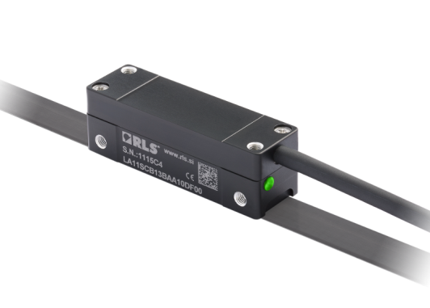
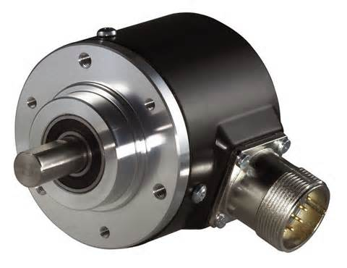
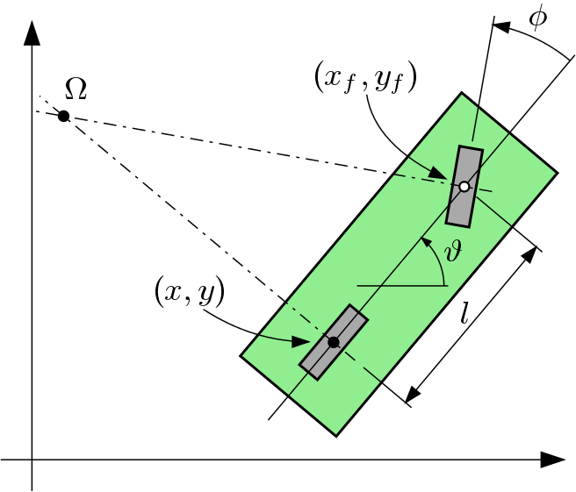
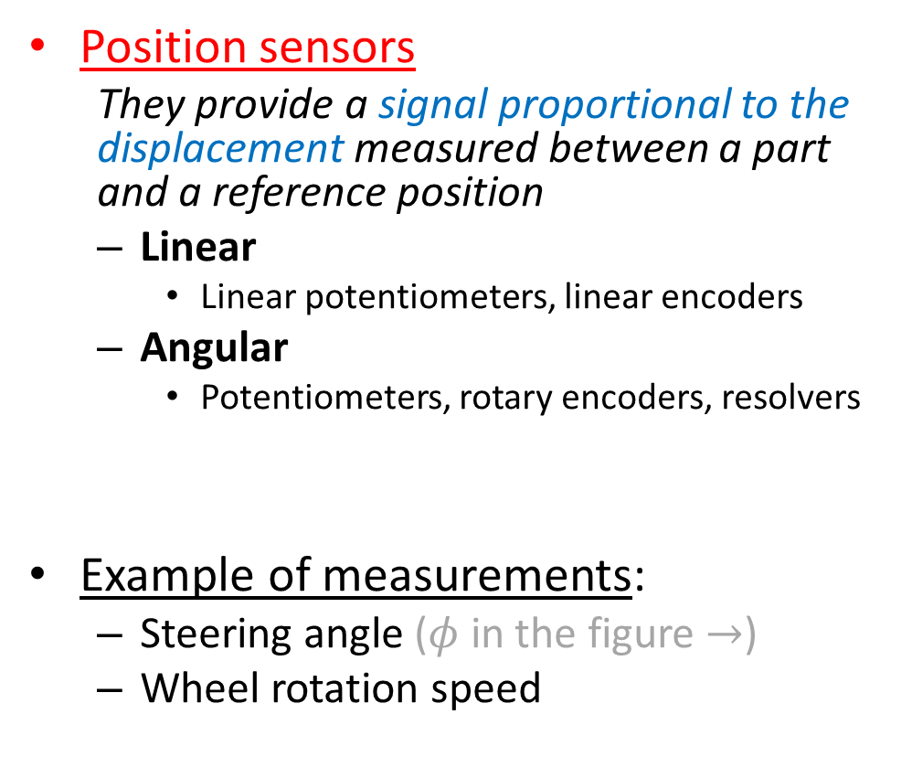
Proprioceptive sensors
Position sensors
  They provide a signal proportional to the displacement measured between a part and a reference position
  Linear
    Linear potentiometers, linear encoders
  Angular
    Potentiometers, rotary encoders, resolvers
Example of measurements:
  Steering angle ($φ$ in the figure $→$)
  Wheel rotation speed

Slide 6


Proprioceptive sensors
Speed sensors
  Generally derived from position sensors’ readings
Acceleration sensors
  Measure of linear acceleration using inertial forces
  Usually Micro Electro-Mechanical Systems (MEMS)
    Principle:
Measurable strain
$$\ddot{z}$$
Strain-gauge
$$m\ddot{z}$$
Test Mass
Cantilever

Slide 7
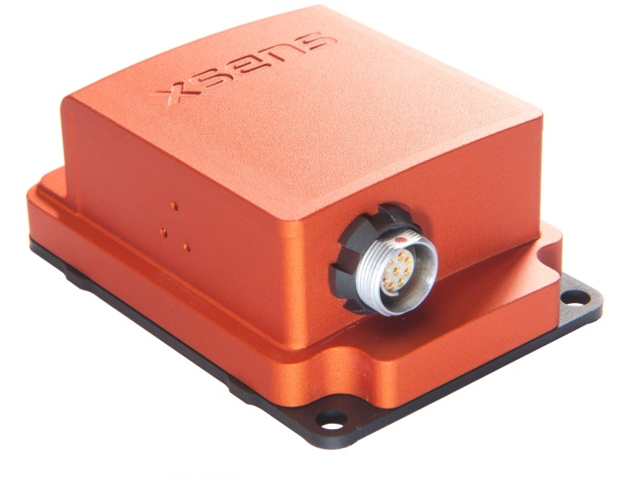
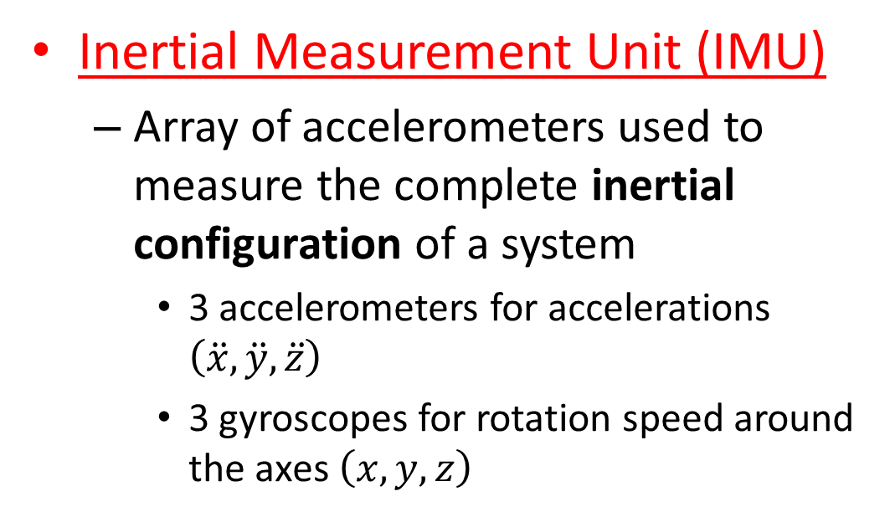
Proprioceptive sensors
Inertial Measurement Unit (IMU)
  Array of accelerometers used to measure the complete inertial configuration of a system
    3 accelerometers for accelerations $\left(\ddot{x},\ddot{y},\ddot{z}\right)$
    3 gyroscopes for rotation speed around the axes $\left(x,y,z\right)$
  NOTE: If used for measuring the gravity vector, it’s considered an exteroceptive sensor.

Slide 8
Exteroceptive sensors
Proximity sensors
  Detection of obstacles/hazards
  Examples:
    Contact/collision sensors
    Infrared reflection sensor
    Magnetic sensor
Distance sensors
  Examples:
    Ultrasound
    Laser scanner (2D or 3D)
    Rotating laser scanner (LiDAR)
    Vision systems
Force sensors
  Load sensing, overload detection
  Examples: load cell, strain gauge
Environmental sensors
  Temperature, humidity, illumination, radiation, …

Slide 9
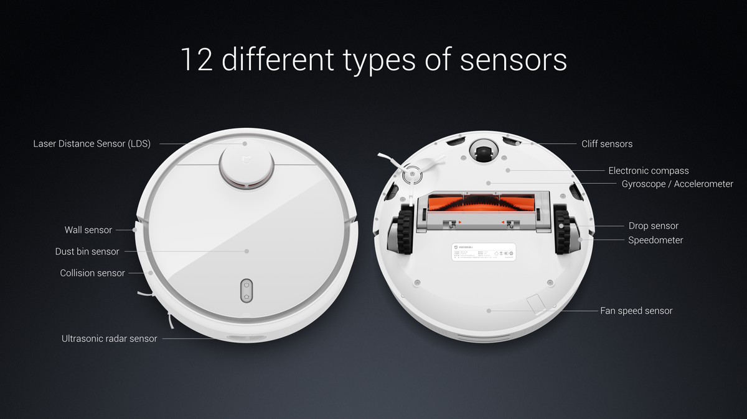
Proximity sensors
Contact/collision sensor
  Bumper in simple mobile robots

Slide 10
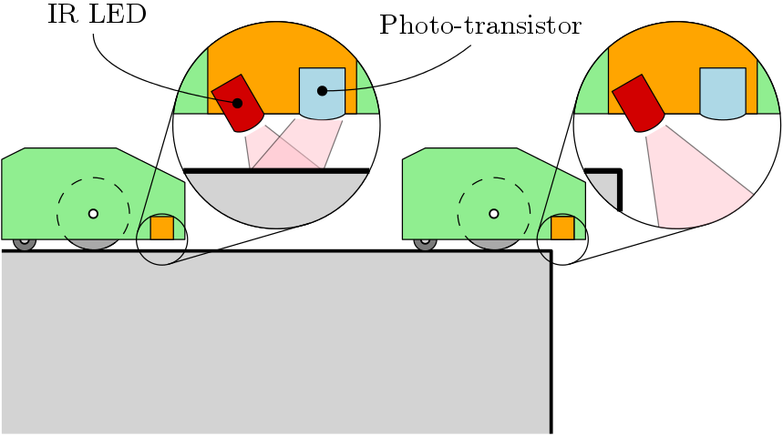
Proximity sensors
Infrared reflection sensor
  Contact-less
  Fail-safe
  Very limited range (4-40 cm or 20-150 cm)
  Reflection is impaired for some materials

❒

Slide 11
Distance sensors
Most widely used in modern mobile robotics
Crucial for mapping and navigation
  Much larger range (100s of meters or more)
  Enables position determination techniques
  Motion and path planning can be done earlier
  Better hazard and obstacle avoidance

Slide 12
Distance sensors
Operating principles:
  Range-finding
    Evaluation of distance through emission-reflection and collection of a signal (sound, light, radar, ...)
    Time of flight (TOF)
    Interferometry
  Scanning
    Multidirectional range-finding
    2D or 3D mapping of objects/environment
  Vision systems
    Image processing/analysis
    Stereoscopy

Slide 13
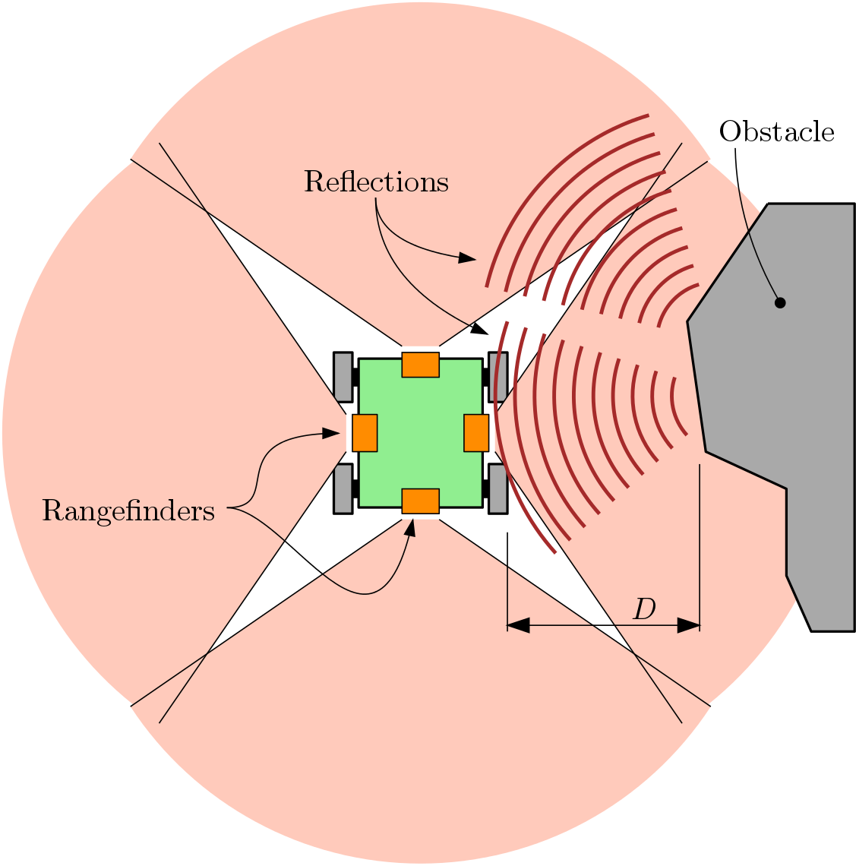
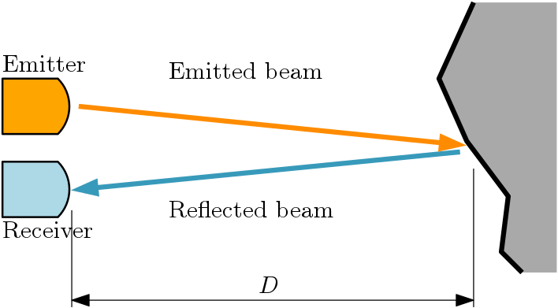
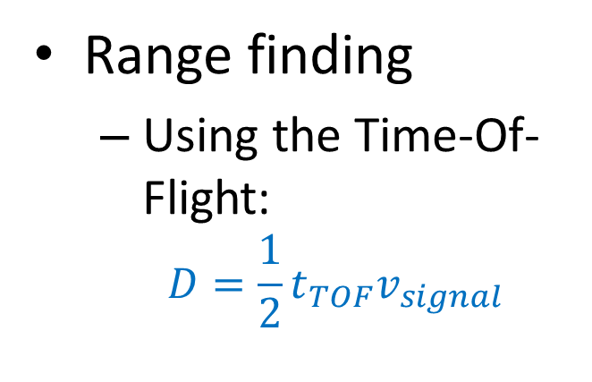
Distance sensing
Range finding
  Using the Time-Of-Flight:
    $$D=\frac{1}{2}t_{TOF}v_{signal}$$

Slide 14
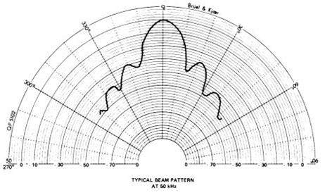
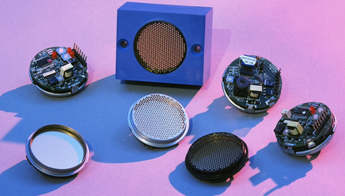
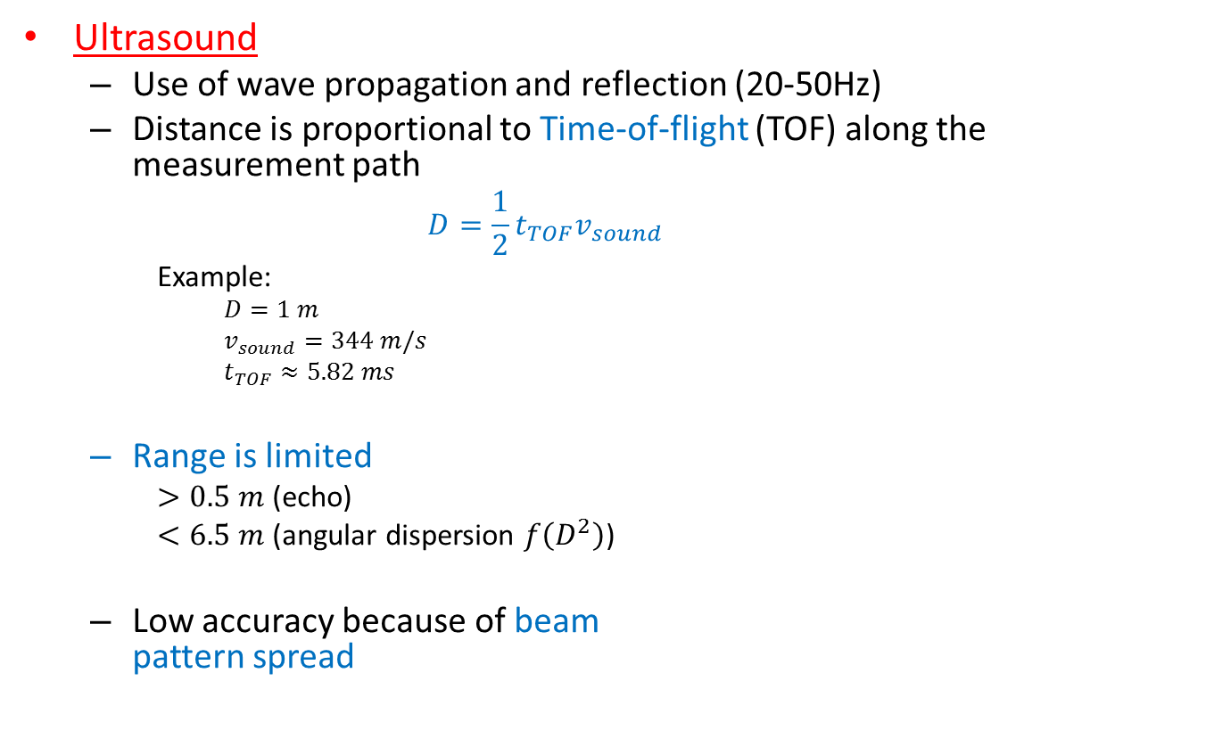
Distance sensing
Ultrasound
  Use of wave propagation and reflection (20-50Hz)
  Distance is proportional to Time-of-flight (TOF) along the measurement path
    $$D=\frac{1}{2}t_{TOF}v_{sound}$$
    Example:
      $$D=1 m$$
      $$v_{sound}=344 m/s$$
      $$t_{TOF}≈5.82 ms$$
  Range is limited
    $>0.5 m$ (echo)
    $<6.5 m$ (angular dispersion $f\left(D^{2}\right)$)
  Low accuracy because of beam
  pattern spread
Beam pattern
Emitter

Slide 15
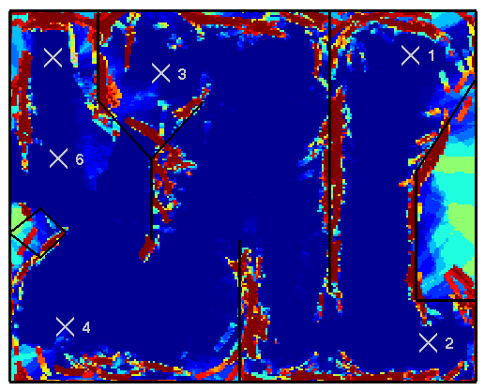
Distance sensing
Mapping with ultrasound sensor

Slide 16
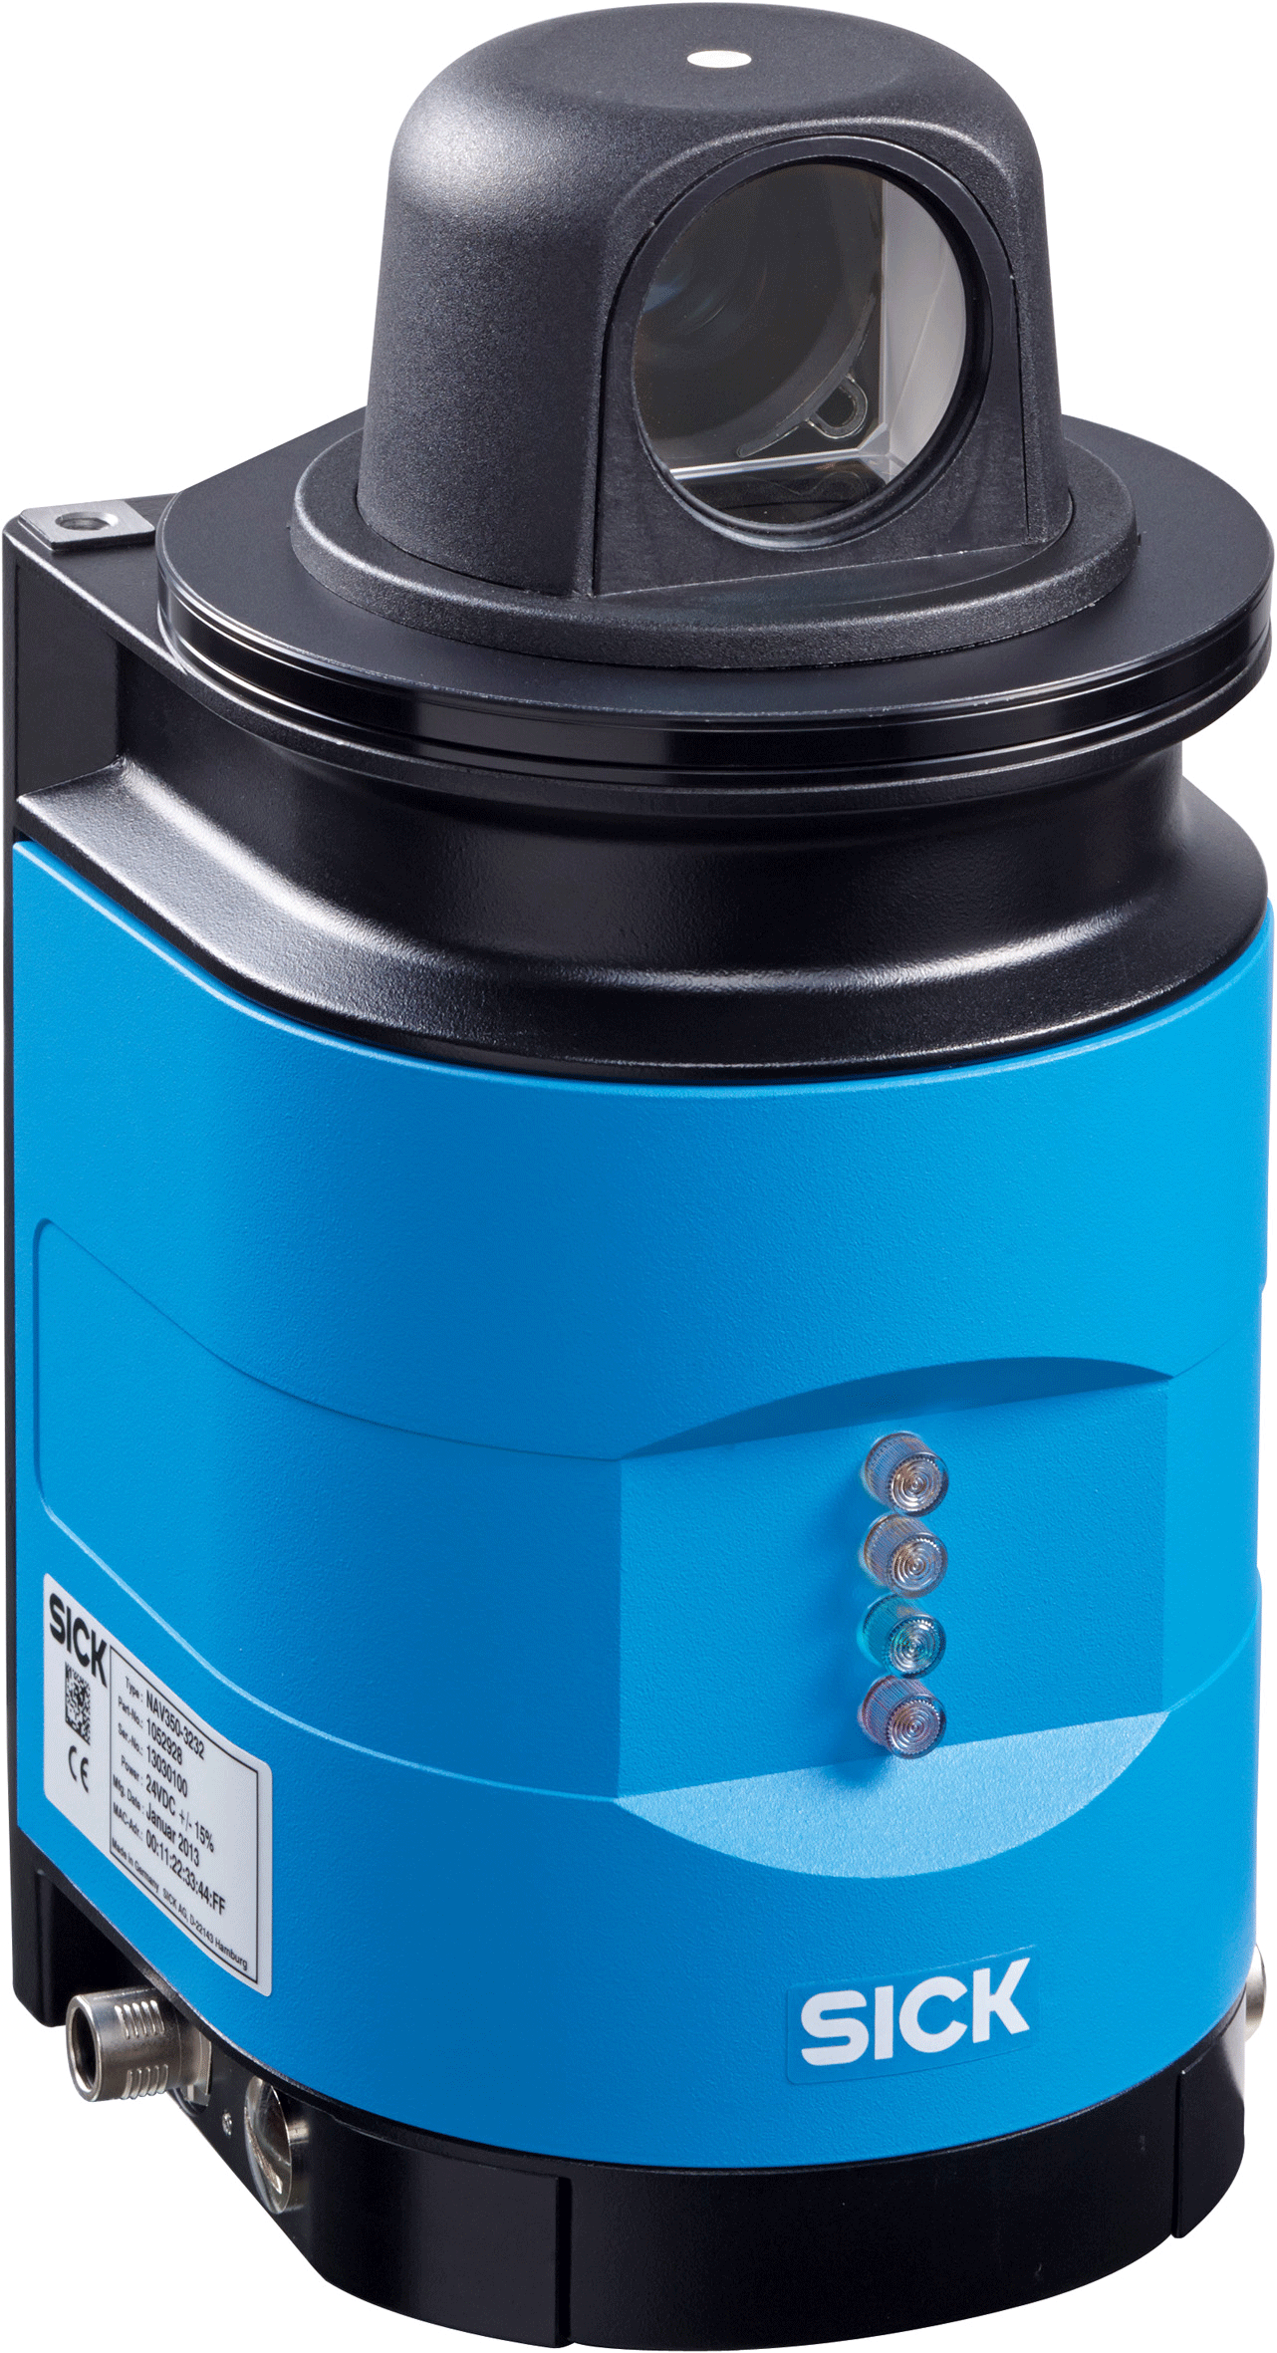
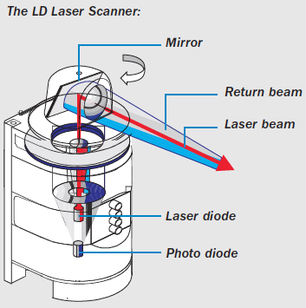
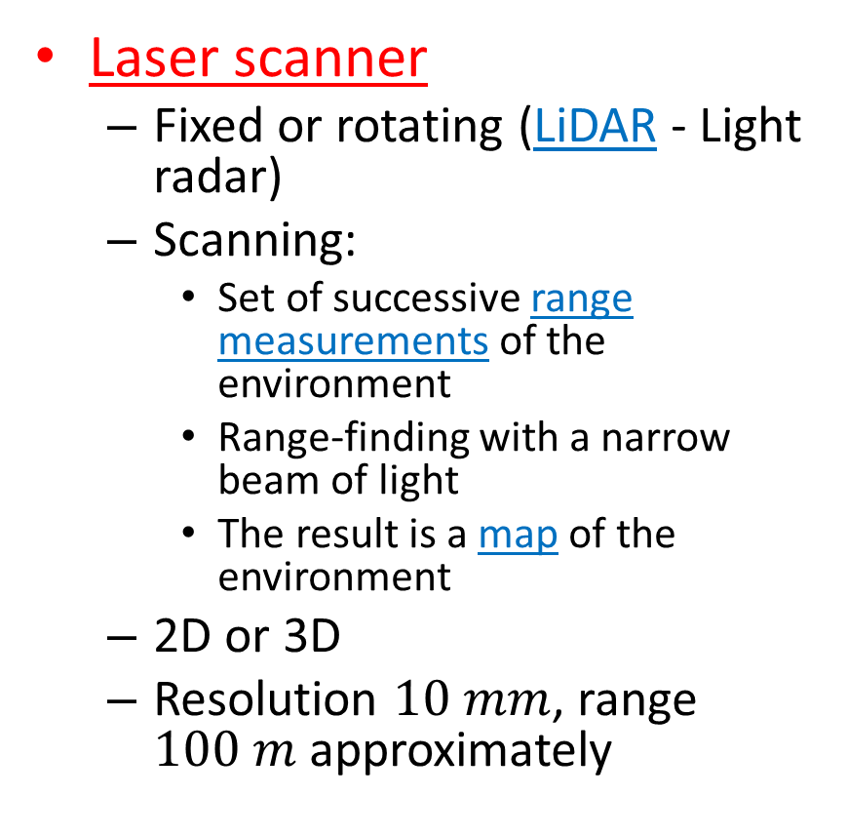
Distance sensing
Laser scanner
  Fixed or rotating (LiDAR - Light radar)
  Scanning:
    Set of successive range measurements of the environment
    Range-finding with a narrow beam of light
    The result is a map of the environment
  2D or 3D
  Resolution $10 mm$, range $100 m$ approximately
Sick S300
2D laser scanner

Slide 17
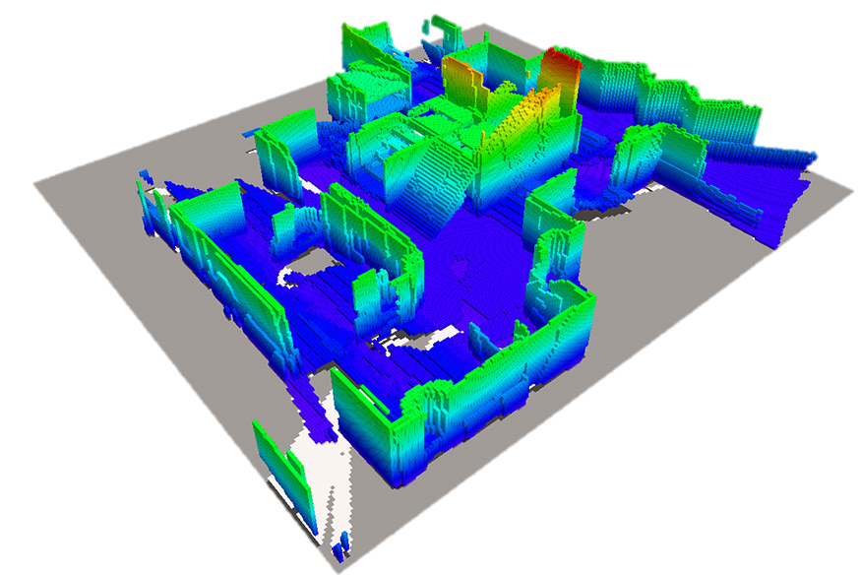
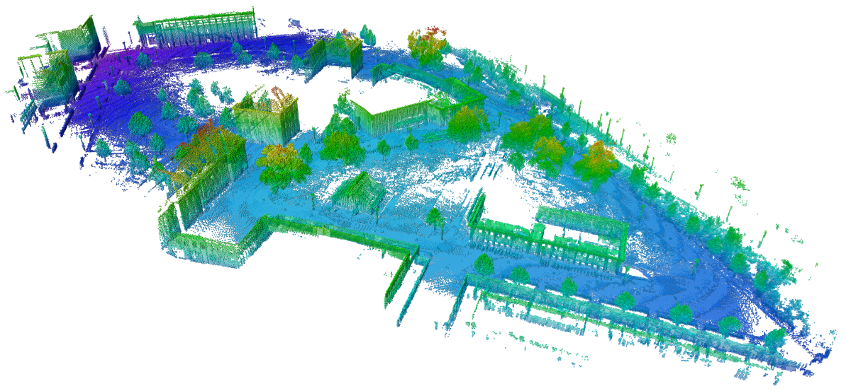
Distance sensing
Mapping with LiDAR
Credits: http://rrt.fh-wels.at/sites/robocup/mapping.html
Credits: http://octomap.github.io/

Slide 18
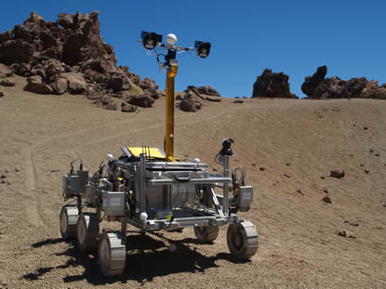
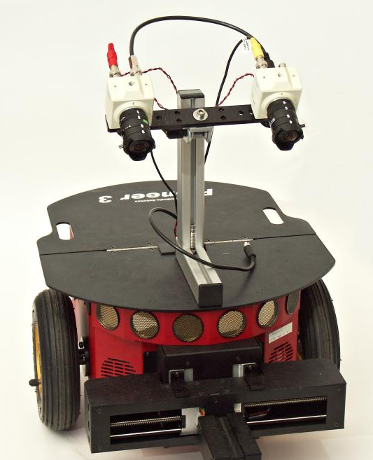
Distance sensing
Vision systems
  Stereo vision
    Depth perception using 2 or more cameras
    Allows 3D mapping of the environment
    Sturdy compared to LiDAR
    Drawbacks:
      Computationally intensive
      Less accurate than LiDAR

Slide 19
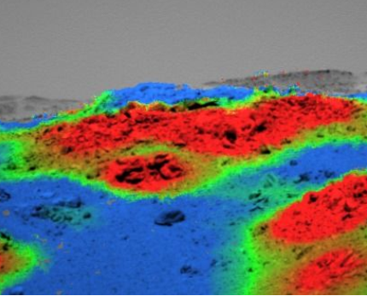
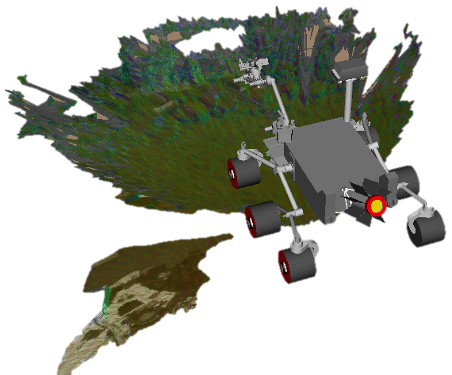
Distance sensing
Mapping with vision systems
C. Laeger et al., Remote image analysis for Mars Exploration
Rover mobility and manipulation operations

Slide 20
MAPPING
Module 10

Slide 21
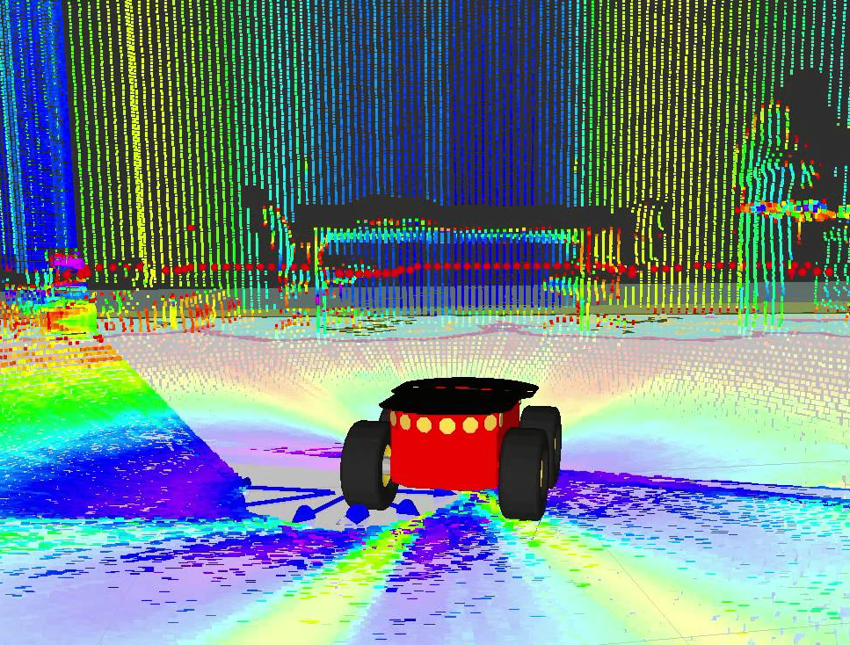
Environment mapping
Creation of a virtual map of the environment surrounding the robot
Contains information on:
  Obstacles
  Terrain geometry
  Locations and Points of
  Interest (POI) (e.g. goal)
  Position of the robot
  itself
Crucial for definition of traversability paths
Obstacles
POI
Terrain
geometry
Robot position

Slide 22
Environment mapping
Type of map:
  Continuous
    Features are determined by mathematically defined objects
      Polygons, lines, points etc.
      High accuracy
      High computational cost
  Discrete
    Based on the decomposition of the environment in discrete elements
      Grids: occupancy grid
      Lower accuracy
      Large datasets

Slide 23
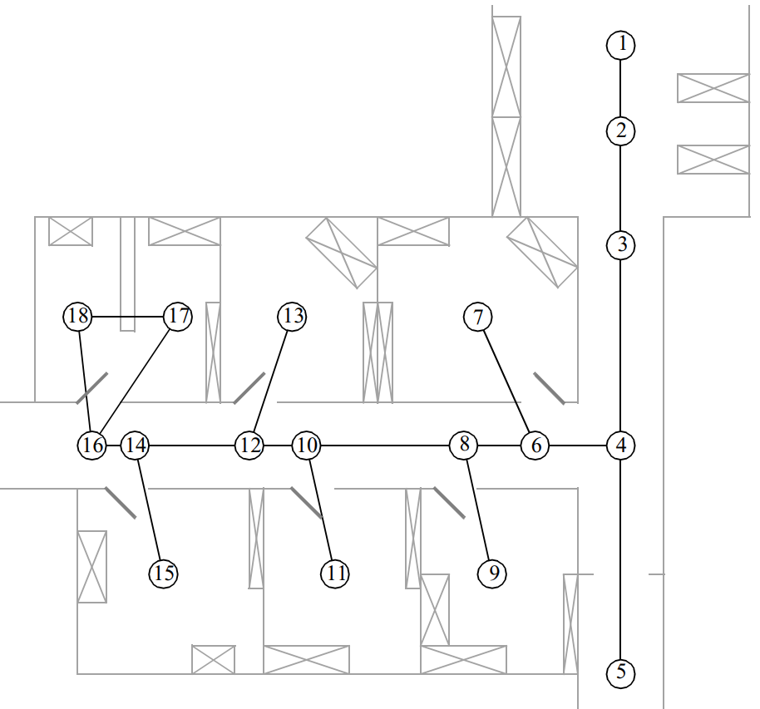
Continuous maps
Nodes
Connections
Topological map

Slide 24
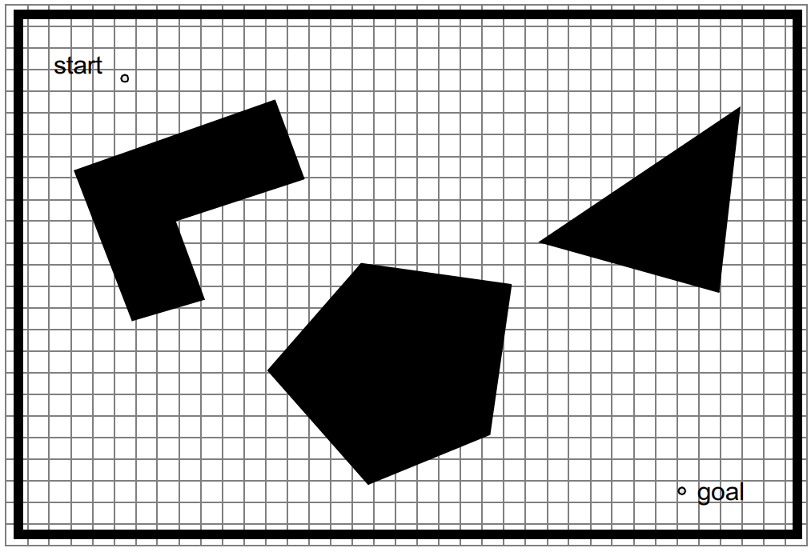
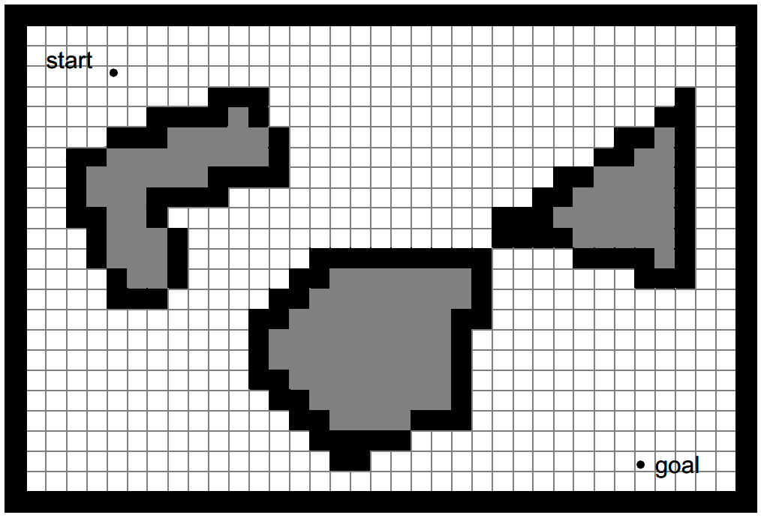
Discrete maps
Occupancy grid-based map

Slide 25
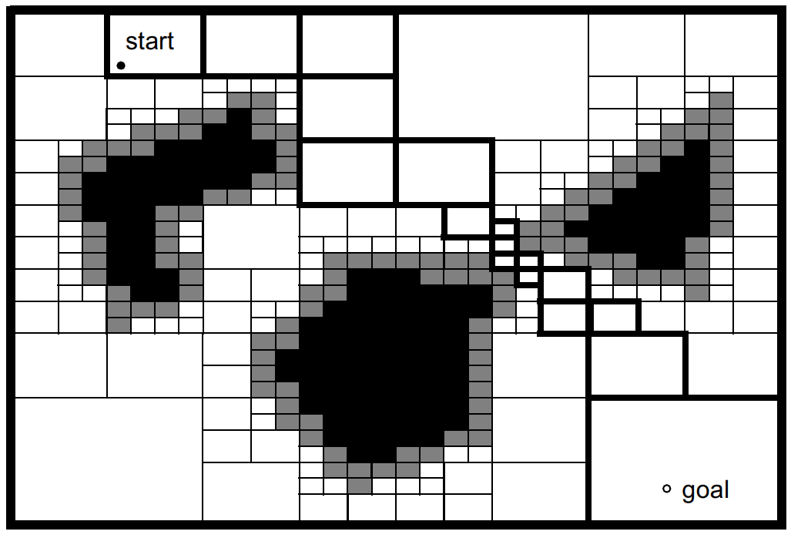
Discrete maps
Variable-cell occupancy grid-based map

Slide 26
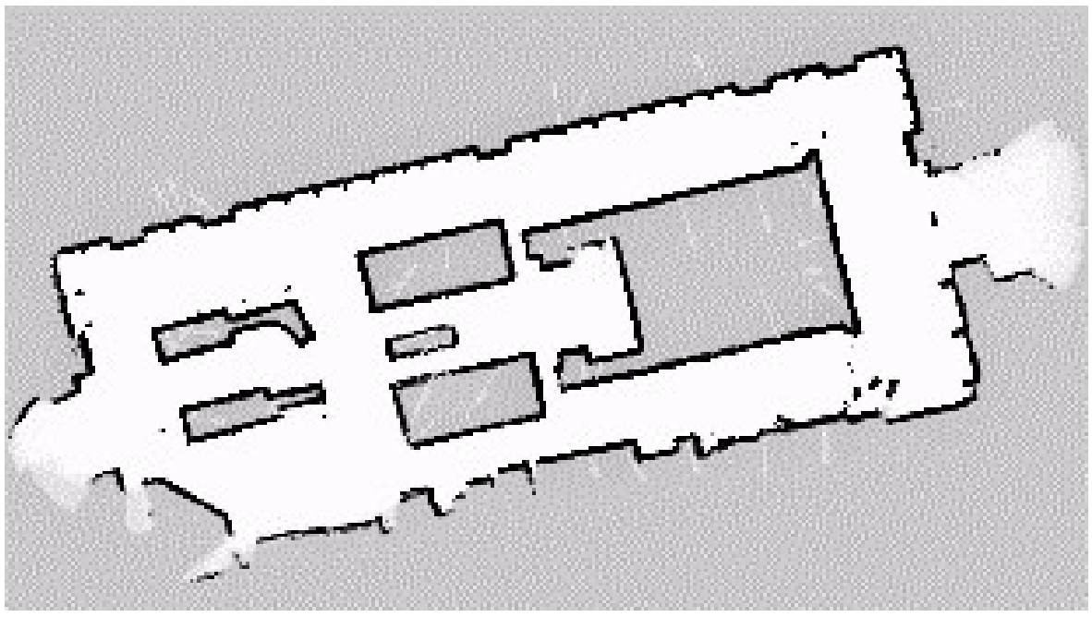
Discrete maps
Occupancy-grid

Slide 27

Environment mapping
Rules:
  Precision of map $⇔$ precision of goals
  Precision of map $⇔$ accuracy of the sensors
  Complexity of map $⇒$ computational cost

Slide 28
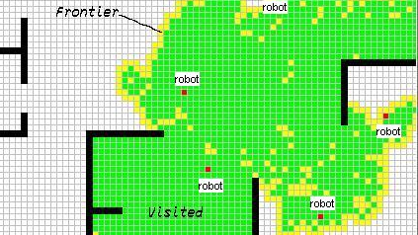
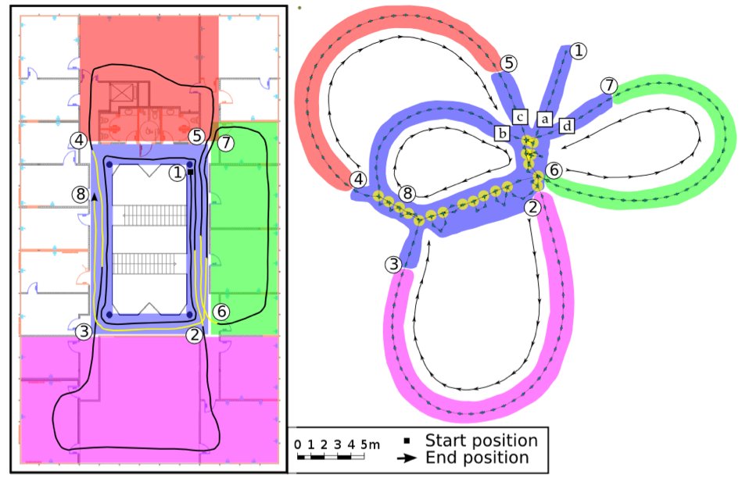
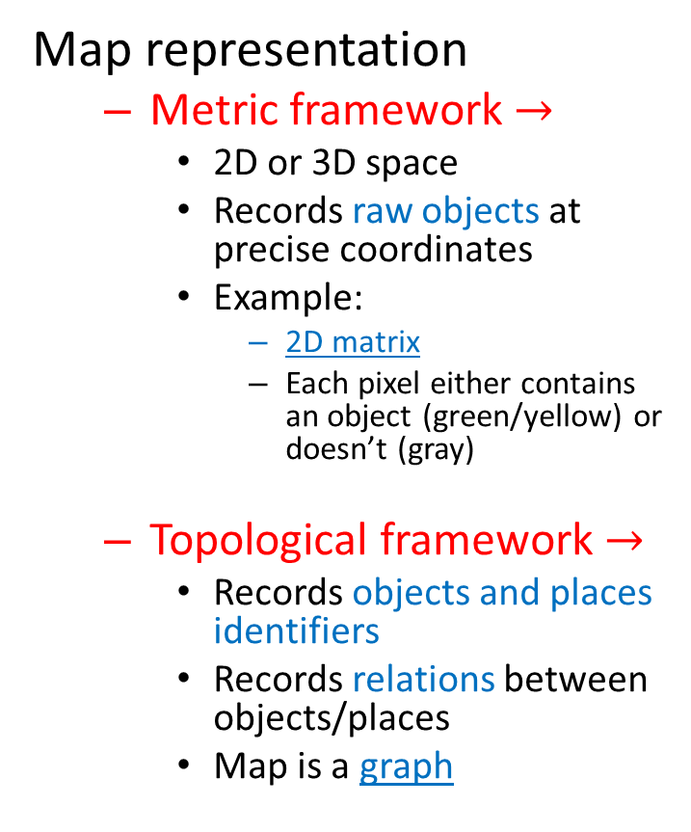
Environment mapping
Map representation
  Metric framework $→$
    2D or 3D space
    Records raw objects at precise coordinates
    Example:
      2D matrix
      Each pixel either contains an object (green/yellow) or doesn’t (gray)
  Topological framework $→$
    Records objects and places identifiers
    Records relations between objects/places
    Map is a graph

Slide 29
Position determination
Belief representation:
  Single unique position?
  Set of possible positions?
  How are they ranked?
Single-hypothesis
  The robot identifies one single unique position
  a certain probability distribution
Multiple-hypothesis
  The position is described in a fuzzy way
  This allows a better description of the degree of uncertainty

Slide 30
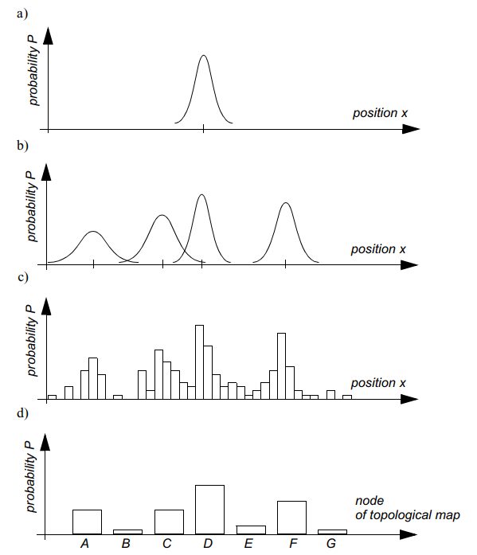
Position determination
Single-hypothesis
Continuous environment
Multiple-hypothesis
Discrete environment

Slide 31
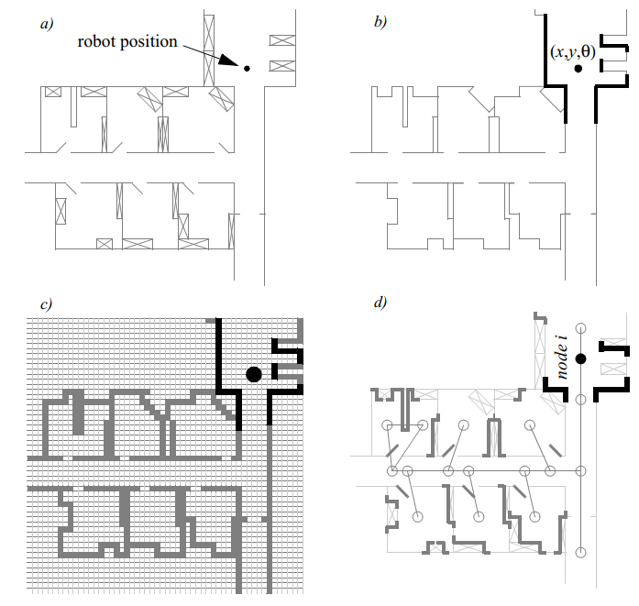
Position determination
Real map
Line-based map
Occupancy grid-based map
Topological map

Slide 32
Navigation
Module 11

Slide 33
Navigation
Definition
  Determination of position and orientation relative to the environment,
  The planning and execution of the maneuvers required to get from point A to point B.

Slide 34
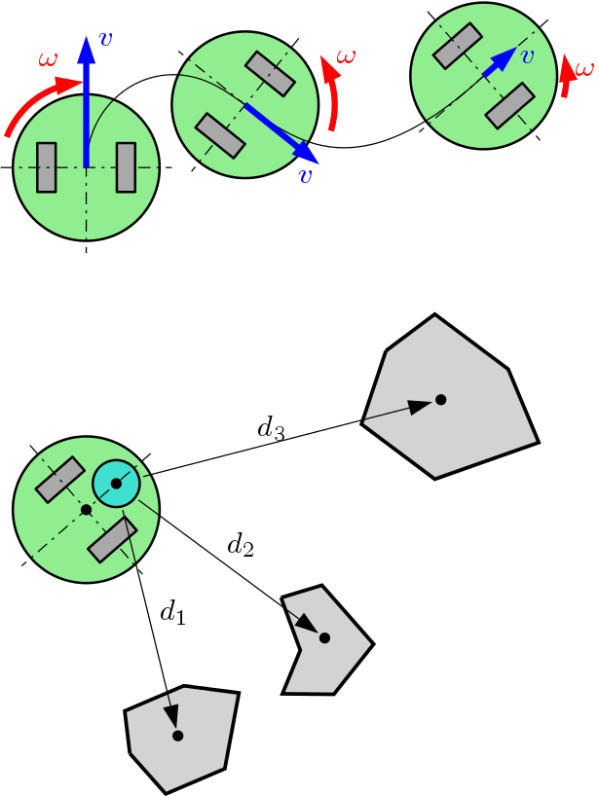
Position determination
Idiothetic sources
  Related to self-motion
  Uses proprioceptive sensors
    Number of wheel rotations,
    IMU
    Also called odometry or dead reckoning
Allothetic sources
  Related to external references
  Uses exteroceptive sensors
    Objects/obstacles
    Landmarks
    Terrain geometry
    Points of interest
Example: Odometry
Example: triangulation

Slide 35
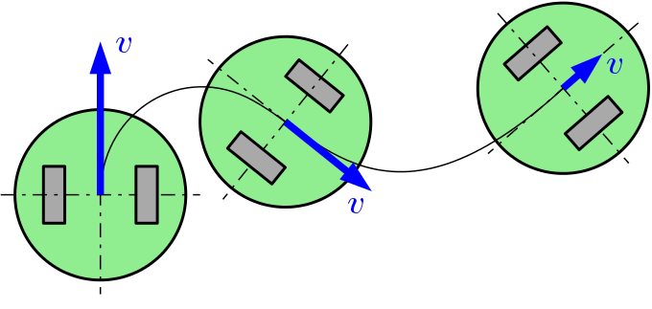
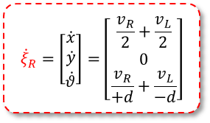
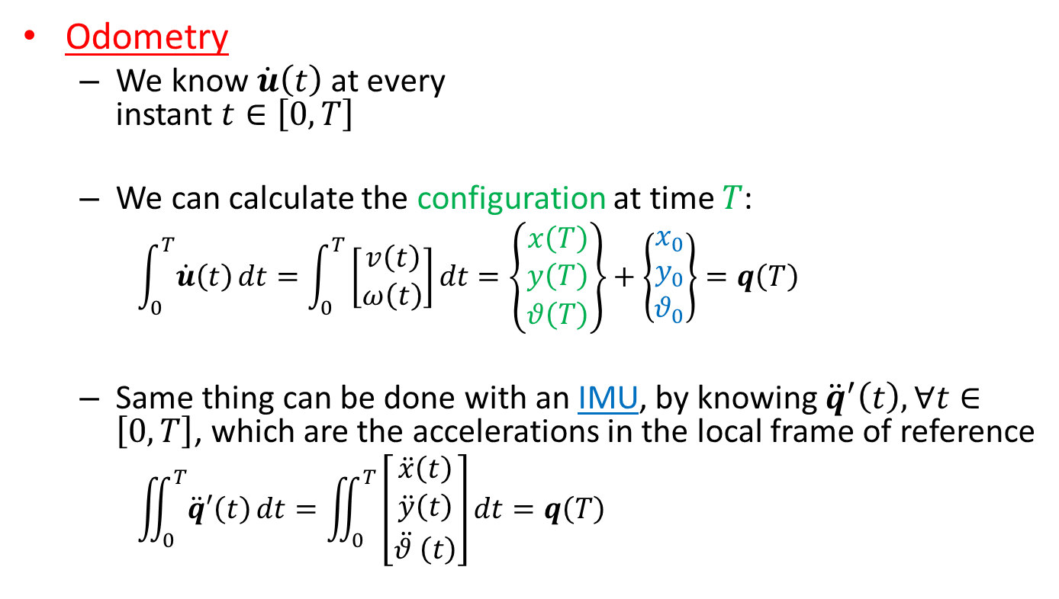




Example: odometry
$$y$$
$$x$$
$$y′$$
$${\dot{ξ}}_{R}=\left[\begin{aligned}\dot{x} \\ \dot{y} \\ \dot{θ}\end{aligned}\right]=\left[\begin{aligned}\frac{v_{R}}{2}+\frac{v_{L}}{2} \\ 0 \\ \frac{v_{R}}{+d}+\frac{v_{L}}{−d}\end{aligned}\right]$$
Odometry
  We know $\dot{u}\left(t\right)$ at every
  instant $t∈\left[0,T\right]$
  We can calculate the configuration at time $T$:
    $$\int_{0}^{T}{\dot{u}\left(t\right)}dt=\int_{0}^{T}{\left[\begin{aligned}v\left(t\right) \\ ω\left(t\right)\end{aligned}\right]}dt=\left\{\begin{aligned}x\left(T\right) \\ y\left(T\right) \\ θ\left(T\right)\end{aligned}\right\}+\left\{\begin{aligned}x_{0} \\ y_{0} \\ θ_{0}\end{aligned}\right\}=q\left(T\right)$$
  Same thing can be done with an IMU, by knowing ${\ddot{q}}^{′}\left(t\right), ∀t∈\left[0,T\right]$, which are the accelerations in the local frame of reference
    $$\iint_{0}^{T}{\ddot{q}′\left(t\right)}dt=\iint_{0}^{T}{\left[\begin{aligned}\ddot{x}\left(t\right) \\ \ddot{y}\left(t\right) \\ \ddot{θ }\left(t\right)\end{aligned}\right]}dt=q\left(T\right)$$
$$x′$$
Initial position

Slide 36
S.L.A.M.
Simultaneous Localization and Mapping
The computational problem of simultaneously mapping the environment and localizing the robot within
Very computationally intensive
Implemented in varying ad-hoc architectures in the whole industry
  E.g. Autonomous cars

Slide 37
Reactive navigation
Line following
  A somewhat «legacy» technology
    No mapping required,
    Limited position determination required,
    Simple sensors (IR or magnetic if the line is magnetized)
    Virtually zero flexibility
  Can be coupled to other more advanced form of navigation
Video logistics
Video carts

Slide 38
Path planning
Aim: producing a continuous path between two points, A (start) and B (goal).
Several possible paths:
Approaches:
  Search algorithms
  Fields
Obstacles
B
A

Slide 39
Path planning
A path-planning or navigation problem can be represented as a graph
  Weights can be
  assigned to the single
  branches to account
  for distance, slope,
  terrain, …
The aim is to find the shortest or best path through the nodes, from A to B
B
B
Nodes
A
A

Slide 40
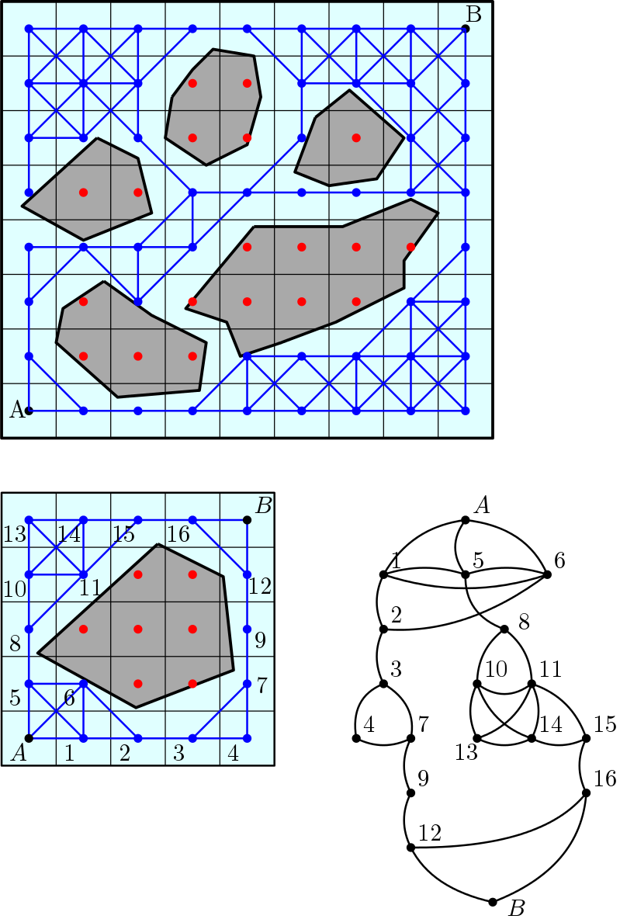
Path planning
Determination of the nodes
  Grid-based search
  Edge visibility graph
Search for optimal path
This is achieved by graph
exploration through efficient
search algorithms:
  Dijkstra, A*, ...

Slide 41
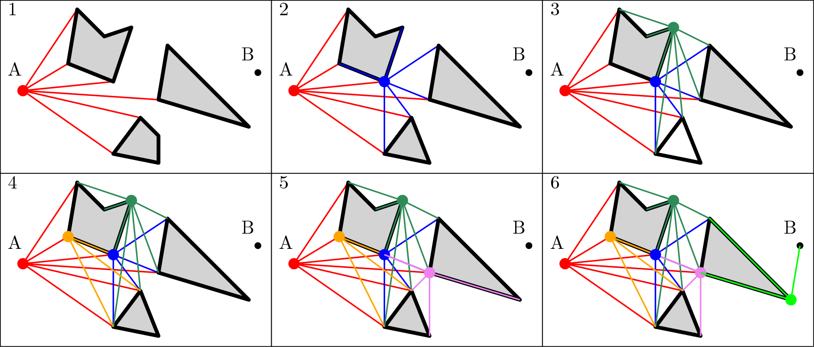
Edge visibility graph
The process is repeated for every visible edge
The result is a graph connecting point A to B

Slide 42
Path planning
Example of graph navigation in matrix form
B
Step 1
Define matrix
Step 2
Find minimum distance path by selecting the lowest neighbor
Exact
Optimal
4 | 3 | 2 | 1 | 0
5 |  |  | 2 | 1
6 | 5 | 4 | 3 | 2
 |  |  | 4 | 3
8 | 7 | 6 | 5 | 4
A
Distance matrix

Slide 43
Path planning
A larger example
  1000x1000 grid
  Long computation
A
B

Slide 44
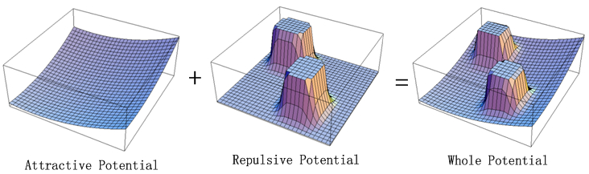
Path planning
Artificial potential fields
  Point A is starting point
  Obstacles are repulsors
  Goal B is an attractor
A
B

Slide 45
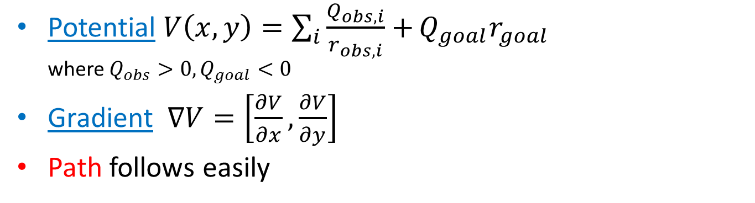
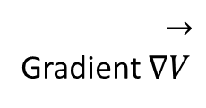
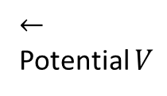
Path planning
Potential $V\left(x,y\right)=\sum_{i}{\frac{Q_{obs,i}}{r_{obs,i}}+}Q_{goal}r_{goal}$
where $Q_{obs}>0, Q_{goal}<0$
Gradient $∇V=\left[\frac{∂V}{∂x},\frac{∂V}{∂y}\right]$
Path follows easily
$$←$$
Potential $V$
$$→$$
Gradient $∇V$

Slide 46
The “real world” issue
Module 12

Slide 47
«The Real World»
Issues in the real world
  Geometry of the terrain
    Loss of contact with the ground
    Slopes
  Terrain yield
    Traction loss
    Sinking
  Position determination accuracy

Slide 48
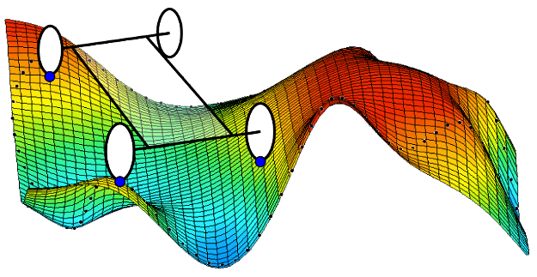
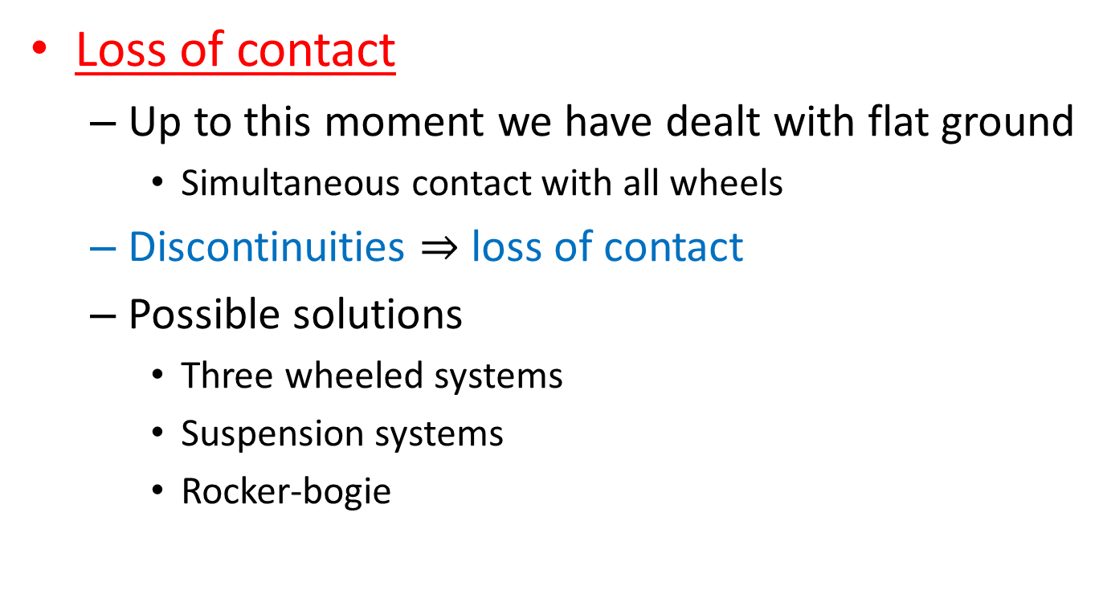
Terrain geometry
Loss of contact
  Up to this moment we have dealt with flat ground
    Simultaneous contact with all wheels
  Discontinuities $⇒$ loss of contact
  Possible solutions
    Three wheeled systems
    Suspension systems
    Rocker-bogie

Slide 49
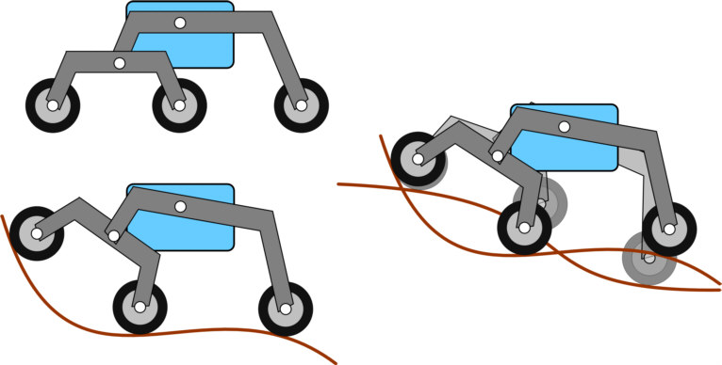
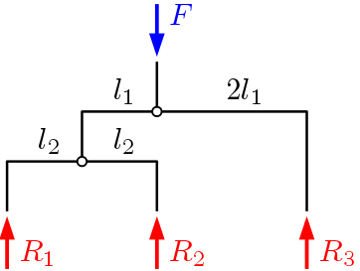
Terrain geometry
Rocker-bogie
  Based on the Whippletree mechanism
  Advantages:
    Distributes loads equally on the wheels
    Allows contact even on complex geometries

Slide 50



Terrain geometry
Slopes
  The actuation motors limit the maximum slope angle
    $F=mg\sin{α}$
    Thus:
    $τ=FR=mgR\sin{α}$
  The maximum slope angle is
    $$α=\operatorname{asin}\left(\frac{τ}{mgR}\right)$$

Slide 51



Terrain Yield
Traction loss
  Bad for odometry: introduces errors (drift)
    Consider using exteroceptive sensors
  Can prevent overcoming slopes
    Lower friction coefficient limits $F$ acting between wheels and ground
  Solutions:
    Keep ground pressure under control
      $σ_{ground}=\frac{mg}{CS}, CS$ contact surface

Slide 52


Terrain Yield
Sinking
  Can happen in 2 occasions
  Very high wheel pressure and/or very loose soil
  Due to digging by slipping wheels
The demise of JPL’s Spirit rover, in 2010

