Slide 1
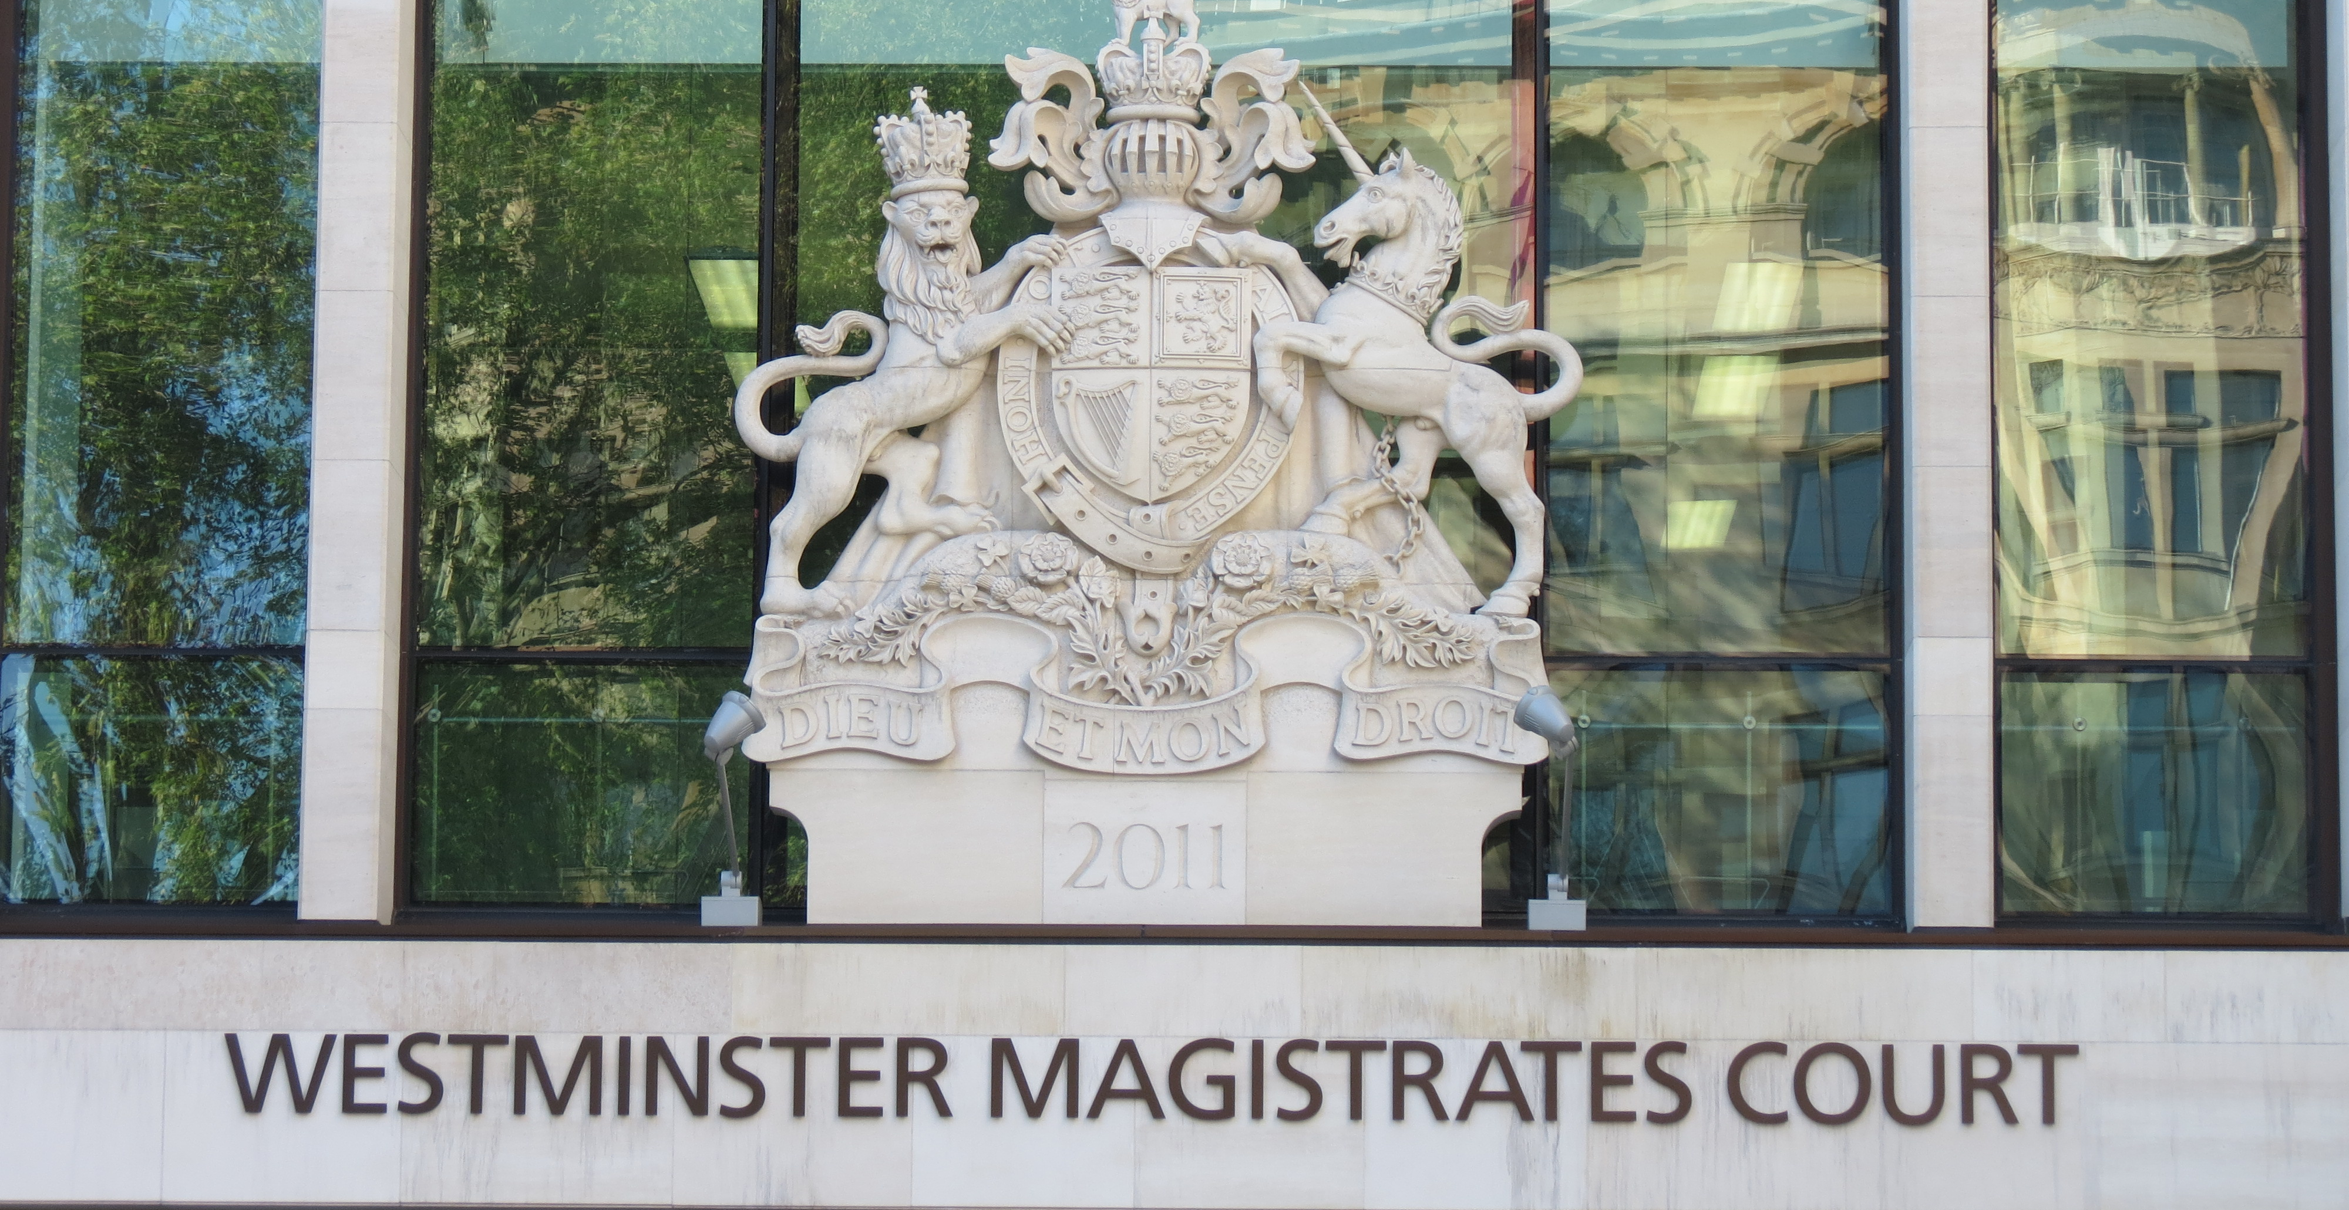
Judicial System in England and Wales
07th May 2019 - De Giacinto Anna

Slide 2
Index
Tribunals
Criminal Courts
County Courts
High Court of Justice
  Queen’s Bench Division
  Chancery Division
  Family Division
Court of Appeal
Supreme Court

Slide 3
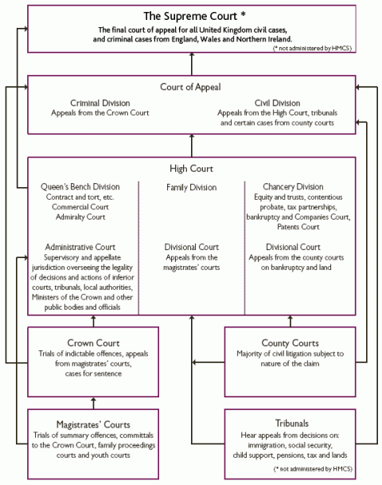


→ Supreme Court
  → Court of Appeal
Senior Courts
→ High Court
→ County Courts
Criminal Courts
→Tribunals

Slide 4
TRIBUNALS
Historically, tribunals have been created by statute to deal with particular types of regulatory, disciplinary or administrative matter. Unlike the courts, which are separate for England and Wales from those of Scotland and Northern Ireland, the tribunal system is UK-wide.
Examples of tribunals include, employment tribunals, Office of Fair Trading adjudicators, the Gender Recognition Panel, the Planning Inspectorate and the Company Names Tribunal.

Slide 5
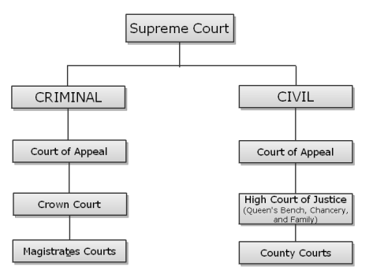
CRIMINAL vs CIVIL
Scrivi per inserire una didascalia.

Slide 6
CRIMINAL COURTS
MAGISTRATES’COURTS:
Magistrates deal with over 90% of criminal cases. The criminal jurisdiction of magistrates’ courts consists of:
deciding less serious cases, known as summary offences,
deciding medium serious offences
dealing with pre-trial issues in relation to the most serious offences, such as bail, reporting restrictions etc.
sending cases in which the defendant has pleaded or been found guilty to the Crown Court for sentencing (if their own sentencing powers are insufficient)
An appeal from a magistrates’ court can go either to the Crown Court or, if it involves a procedural error, to the Administrative Court (part of the Queen’s Bench Division of the High Court).

Slide 7
THE CROWN COURT:
holds trials of more serious criminal offences;
deals with sentencing in cases where the defendant has either pleaded guilty already, or been convicted and referred for sentencing by a magistrate’s court because of the relative seriousness of the offence;
hears appeals from magistrates’ courts.
Most trials in the Crown Court are conducted with a jury.
The Crown Court is a single entity, which sits in a number of locations. The most famous and senior location is the Central Criminal Court (CCC) at Old Bailey in London, often referred to simply as The Bailey.

Slide 8
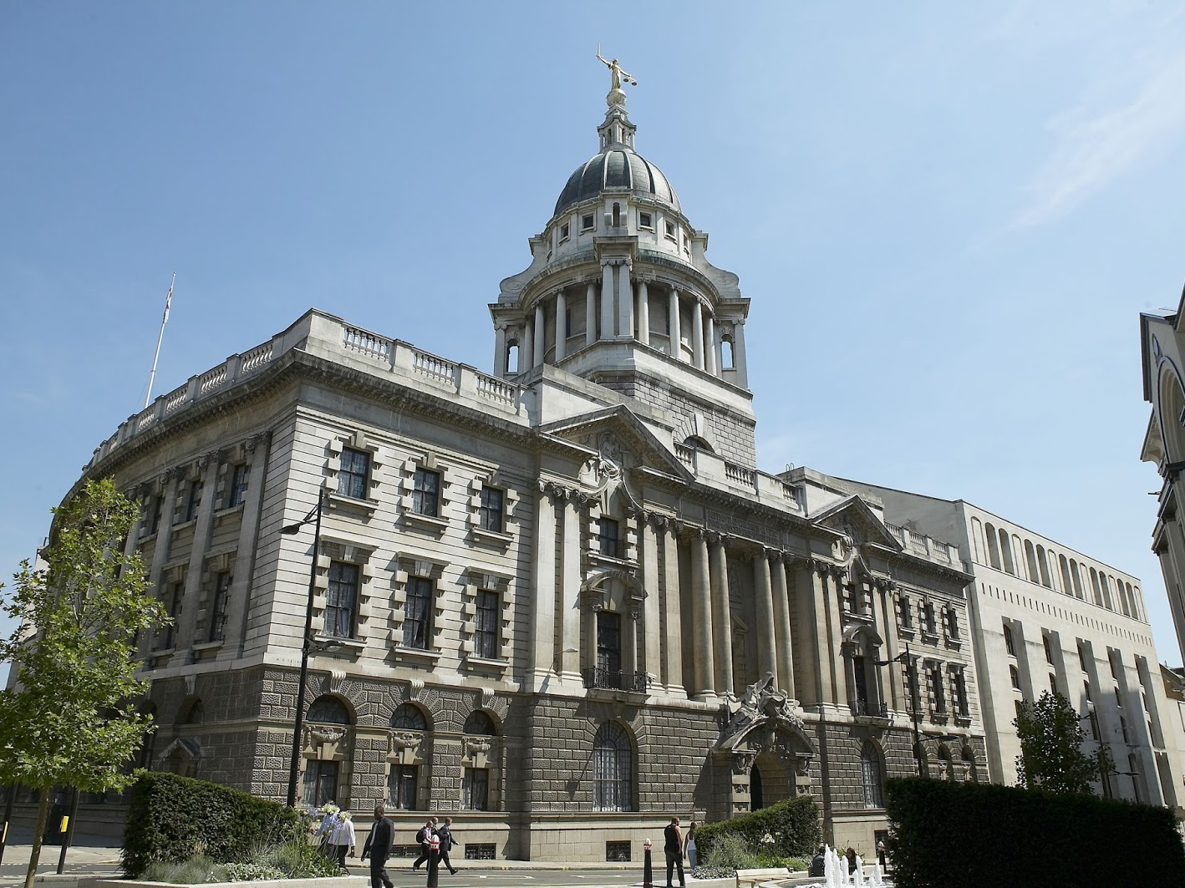
Central Criminal Court of London - Old Bailey, London

Slide 9
COUNTY COURTS
County courts were first introduced in 1846 to provide local justice in those less important or valuable cases that did not need to be heard in the High Court.
The types of civil case dealt with by county courts is governed in part by financial limits: above a certain value, cases are heard in the High Court instead.
There are some specialist county courts, such as the Patents County Court (renamed Intellectual Property Enterprise Court (IPEC) in 2013) and the Mercantile Court (now known as Circuit Commercial Courts), which deal with particular types of subject matter in cases which do not need to be heard in the High Court

Slide 10
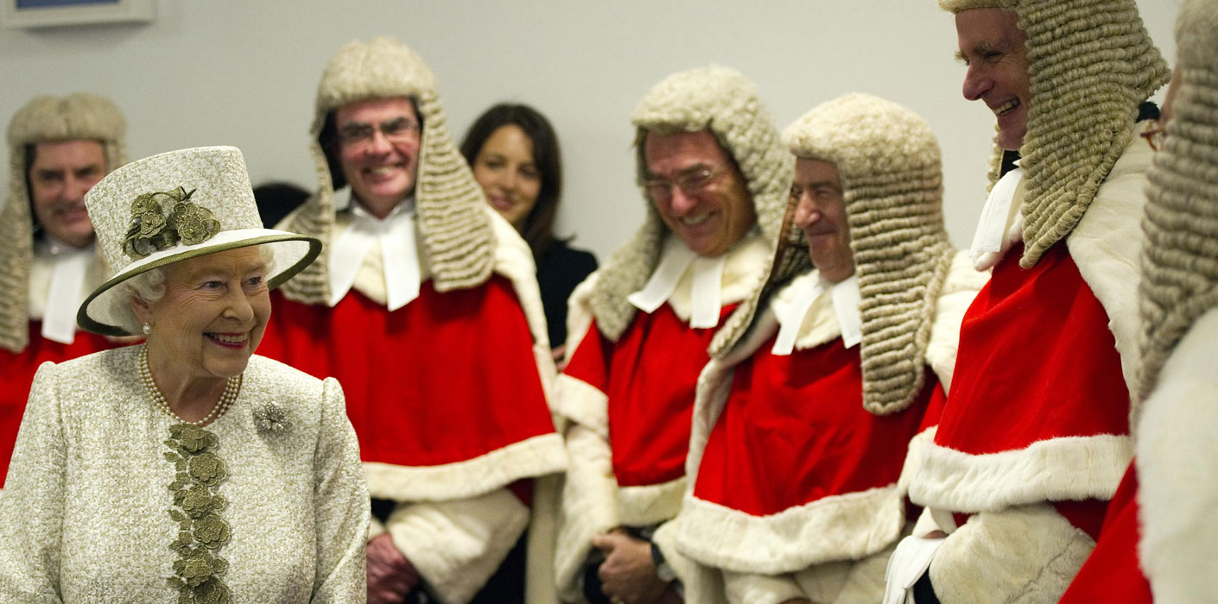
HIGH COURT of JUSTICE
The High Court is divided into three main divisions:
The Queen’s Bench Division (or King’s Bench Division)
The Chancery Division
The Family Division.
These in turn are further sub-divided.

Slide 11
1. QUEEN’S BENCH DIVISION
The Queen’s Bench Division (QBD) deals with general civil disputes involving things like negligence, breach of contract, defamation, and breach of statutory duty. Within it there are a number of specialist courts and lists:
Administrative Court
Admiralty Court
Commercial Court
Mercantile Court and Circuit Commercial Courts
Planning Court
Technology and Construction Court

Slide 12
2. CHANCERY DIVISION
The Chancery Division (ChD) deals with a number of specialist areas of civil law to do with companies, insolvency, real property, trusts, tax, and wills. It includes the following specialist courts and lists:
Business List
Competition List
Insolvency and Companies List
Intellectual Property Enterprise Court (formerly the Patents County Court)
Intellectual Property List
Patents Court
Property, Trusts and Probate List
Revenue List

Slide 13
3. FAMILY DIVISION
The Family Division (Fam D) deals with divorce, financial maintenance, and cases relating to the care and welfare of children. It also hears appeals from the Family Court

Slide 14
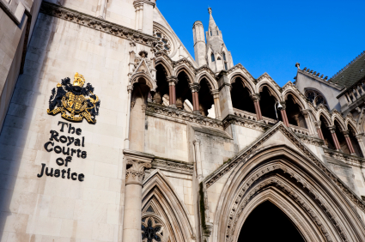
COURT of APPEAL
The Court of Appeal of England and Wales sits in two divisions:
the Criminal Division, which hears appeals from the Crown Court, and
the Civil Division which hears appeals in civil and family matters from the High Court, Family Court, senior tribunals and county courts.
The judges of the Court of Appeal are the Lord Chief Justice (LCJ), the Master of the Rolls (MR), the President of the Queen’s Bench Division (P), the President of the Family Division (P), the Chancellor of the High Court (C) and the Lord or Lady Justices (LJ).Most full appeals are heard by three judges, but preliminary or less important hearings may be heard by one or two judges .

Slide 15
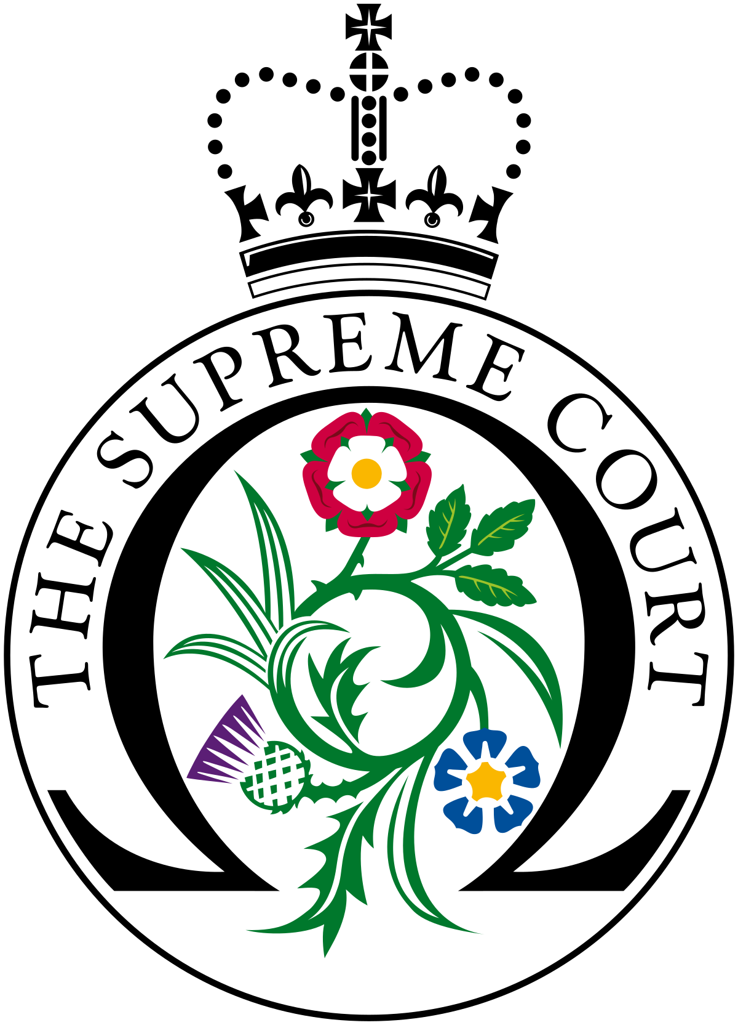
SUPREME COURT
This was established in 2009, replacing the House of Lords* as the final court of appeal in the UK for all civil cases, and for criminal cases from England, Wales and Northern Ireland. Its judges are known as Justices of the Supreme Court (JSC) and are led by a President and Deputy President.
* consequence of the Constitutional Reform Act of 2005

Slide 16
THANK YOU

