Slide 19
Plastics, packaging and trends
According to a report by U.S.-based market intelligence company Transparency Market Research, the green sustainable packaging market (recycled, reusable & (bio) degradable) is expected to surpass US$178 billion by 2018. As more and more consumers become aware of green issue and environmental impact and choose to buy sustainability-conscious products, green packaging can be a big game-changer in the coming years.
There will be three main sustainable packaging trends in the future:
#1 Trend: Bio or Plant-based Plastics despite of falling crude oil price
Plant-based plastics or bioplastics are poised to play a greater role in packaging and will play an even greater role in shaping consumer attitudes towards brands. An example is given by big brand companies such as Coca-Cola, which, as of June 2014, sold over 25 billion of its PlantBottle™ packages in about 40 countries. The company claims this has translated into 525,000 barrels of oil being saved.
#2 Trend 2: Smaller, Lighter and Less Packaging
The biggest brands have already set goals to reduce packaging from sourcing. Mid-size and small brands will feel the pressure to follow suit. According to the Grocery Manufacturers Association (GMA), its members cut packaging weight by 1.5 billion pounds in the past three years and expected to reduce packaging weight by another 2.5 billion pounds through 2020.
#3 Trend: Recyclability
Millions of tons of waste are generated in the process of producing and transporting packaging materials. Most consumers are likely already aware of these environmental issues. They want to know where a brand’s packaging material has been sourced from, what materials have been used for packaging, or whether the packaging can be recycled.

Slide 22
Companies need a single tool that measures environmental impacts in an integrated way together with other business issues. This
is where natural capital valuation comes in. The technique enables companies to put a financial value on a range of impacts, including plastic, so environmental management can be fully embedded within the business.

Slide 24
Currently, there is no correlation between a sector’s disclosure rate and its plastic intensity
or absolute natural capital cost due to plastic. This means that sectors which face the most
significant risks to their revenues from legislation, competition and consumer demand regarding
plastic need to consider being more transparent about how they are managing the potentially
material issue. It also suggests that disclosure may be more driven by external factors, such as
legislation and reputation, rather than an internal understanding of risks and opportunities.
METHODOLOGY
The use of plastic causes environmental and social impacts. For example, incinerating plastic at its end-of-life has associated air pollution impacts. Applying ‘natural capital valuation’ allows these impacts to be expressed in monetary terms, reflecting the scale of damage caused. The overall value or ‘natural capital cost’ gives an indication of the financial cost to companies were they to internalise impacts associated with their current practices.
These costs can also be factored into business and investment decision making.
In order to quantify the natural capital cost of the impacts of plastic, the high-level methodology follows six steps:
sector selection,
plastic use quantification,
scope and boundary selection,
impact quantification,
and natural capital valuation and application.

Slide 25
This research then analyses the exposure of companies to these risks and opportunities by
expressing quantities of plastic used as a natural capital cost. The results show that the total
natural capital cost of plastic used in the consumer goods industry is over $75bn per year. Broken
down by sector, food companies are by far the largest contributor to this cost, responsible for 23%
of the total natural capital cost. The results also show each sector’s natural capital
intensity – or its natural capital cost per $1m of annual revenue. The toy sector has by far the highest
intensity, at 3.9% of revenue.
Waste management, while necessary and better than littering, is costly and wastes resources
that could be put to good use through recycling. Inadequate waste management is expensive to
society and often not internalised by businesses. Collection costs range from $20 to $250 per tonne
depending on the region, while landfill costs $10- $100/tonne and incineration with energy recovery
$40-200/tonne.
According to the World Bank, the quantity of waste and related cost is likely to double by 2025. With
many countries un-prepared to handle this increase, waste and resource management will be an
increasingly important issue in the years to come for companies, particularly those who operate
across borders. Plastic is one of the toughest waste streams to handle, and though the weight of
plastic waste might not be as big as that of other materials, its durability and volume often account for
a large proportion of a country’s waste issues.

Slide 27
The highest profile impact of waste plastic is when it is littered. Once littered, it is costly to recover and becomes a multigenerational problem due to its long degradation time. Although it is typically only considered an eyesore, its impact is felt throughout our communities, environment and increasingly the ocean.
Litter has an impact on land use, transport, animal and human health, safety,
flooding, community spirit and clean-up costs. It often makes its way to the ocean over time, due to its light weight and durability, blown by the wind or via rivers and drains. While there is much uncertainty about the extent of the problem, a report by the United Nations Environment Programme (UNEP) estimates that 6.4m tonnes of litter enter the ocean every year – some eight million items every day.
This figure is likely to be an underestimate as the underlying research was published in 1975. Other studies suggest between 10m and 20m tonnes a year.16,1

Slide 28
Plastic is the most common type of marine litter, comprising up to 80% of total waste in marine litter surveys. Most (over 80%) comes from land-based sources, with marine-based activities such as shipping, cruise lines and fishing accounting for the remainder.5 Studies show that levels of litter in the ocean are increasing in spite of efforts to control the problem. Industry bodies, businesses, governments, civil society and international institutions are recognizing the magnitude of the issue and the need to tackle it.
Plastic litter in the ocean kills, injures and harms wildlife. Larger items such as plastic bags,
plastic strapping for packages and abandoned fishing gear can strangle marine animals. Bottle caps, plastic cutlery, pens and cigarette lighters can be ingested and harm animals through internal damage and starvation. There has been a 40% increase in the number of species reported to be affected by ingestion and entanglement between 1997 and 2012, across all marine debris types. Of 319 publications reviewed in the same 2012 report, the majority of reports (76%) described encounters with plastic debris as opposed to other types of material.

Slide 33
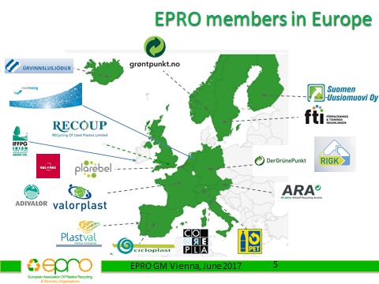
1997 EPRO was founded as pan-European association of 7 plastics recycling and recovery organisations. In the year of its twentieth anniversary, EPRO expanded the number of its members to 20.

Slide 34
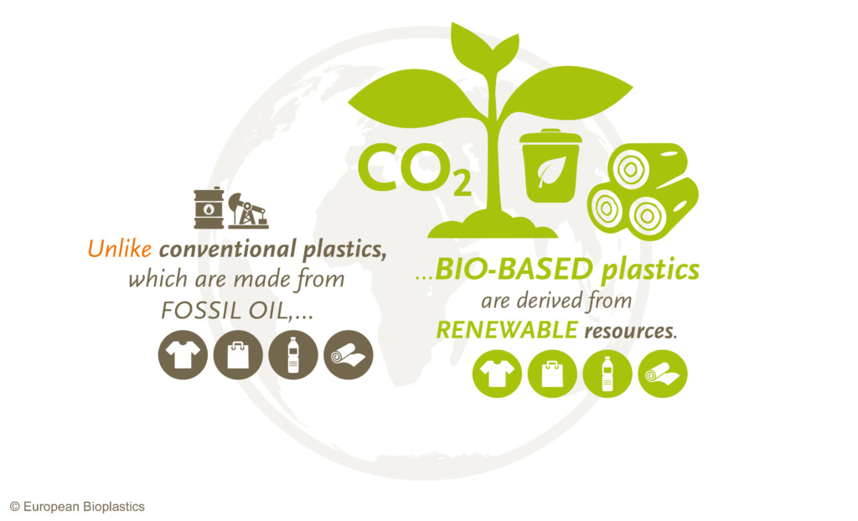




https://www.european-bioplastics.org/
Publications
General
Position Papers
Fact Sheets
Background Papers
Market Data
3rd Party Publications

Slide 35
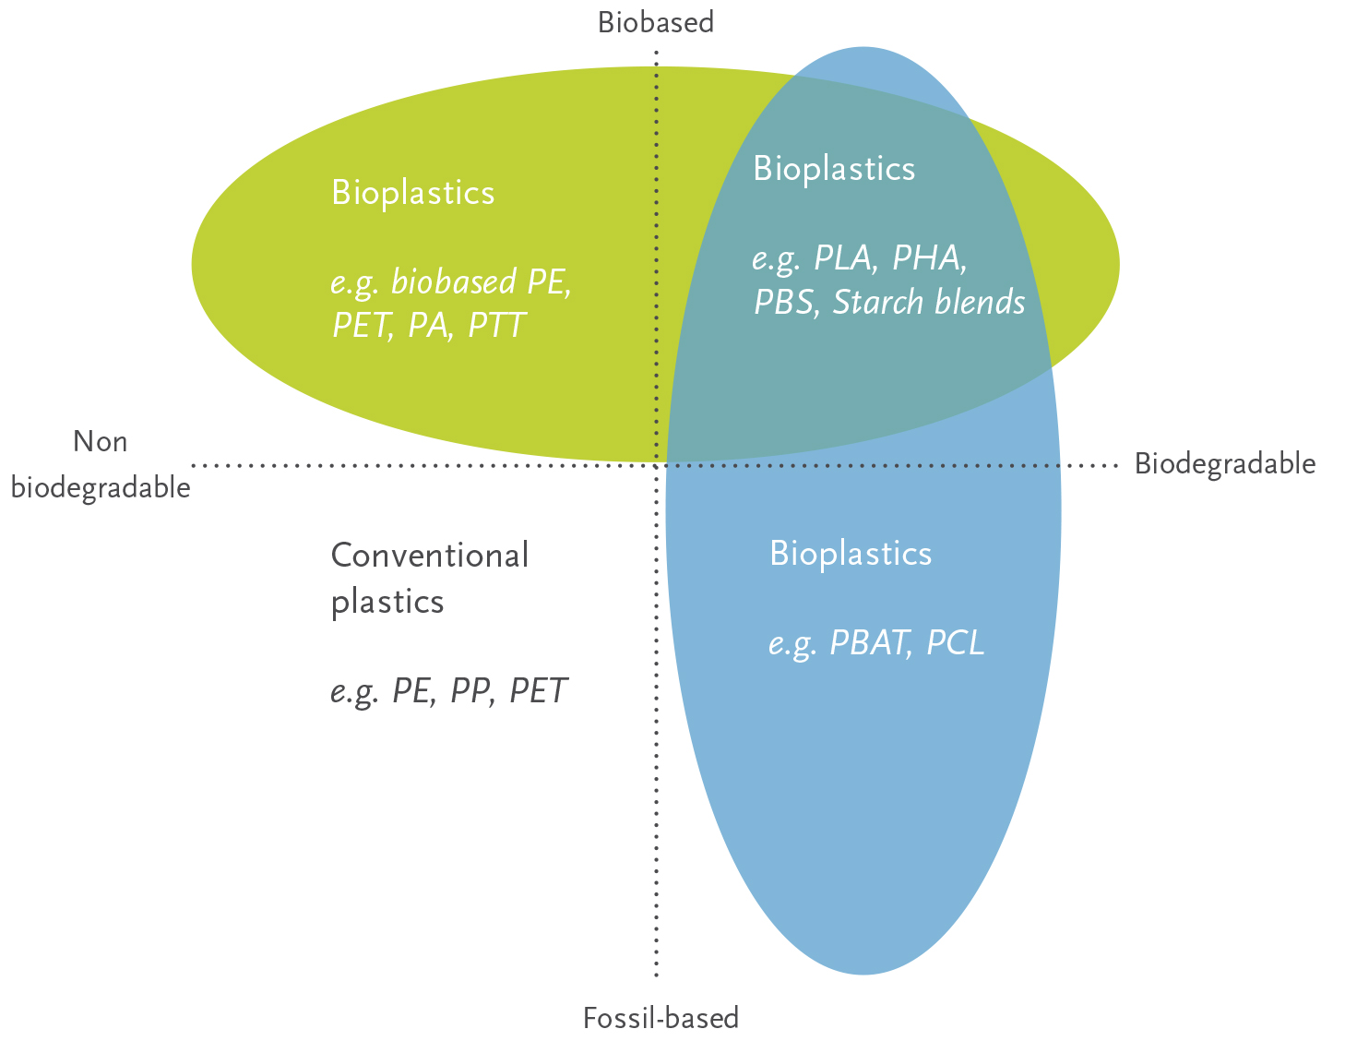
Benefits of bioplastics
Bioplastics are driving the evolution of plastics. There are two major advantages of biobased plastic products compared to their conventional versions: they save fossil resources by using biomass which regenerates (annually) and provides the unique potential of carbon neutrality. Furthermore, biodegradability is an add-on property of certain types of bioplastics. It offers additional means of recovery at the end of a product’s life.

Slide 38
Main players in the bioplastic sector

Slide 39
How much biomass is used worldwide for the production of bio-based plastics?
And how much arable land is used?
The annual global production capacity in 2016 of bio-plastics was about 4.2 million tonnes in 2016.
Depending on the type of polymer and the crop used average yields range between 2 and 6 metric tons of bio-based plastic per hectare. The current global production capacity of bio-based plastics requires about 500,000 hectares of land[1], which corresponds to about 0.01% of available arable land (ca. 5 billion hectares) in the world[2].
Does the industrial use of biomass compete with food/feed productions?
Agriculture must aim primarily to supply food and feed. Compared to the use of biomass, for food, biofuels and other industrial use, the demand for renewable raw materials for the production of bio-based plastics is very small. Although the bio-based polymers market is forecasted to grow rapidly in the next decades, this growth will have only limited impact on the agricultural market overall. Nevertheless, if demand for renewable feedstock grows, this will inevitably lead to competition between food production and the material and energetic use of biomass. Good agricultural practice is part of the sourcing strategy of many companies, e.g., by applying supplier codes of conduct. The use of sustainability certification schemes is a useful tool towards the sustainable sourcing of biomass around the globe. Examples of biomass certification schemes are the ISCC (International Sustainability and Carbon Certification) and the RSPO (Round Table on Sustainable Palm Oil). Further, renewable feedstock of second generation, based on lignocellulosic biomass, will relieve the pressure on agricultural land used today for food production. PlasticsEurope is aware that this is an ongoing learning process and that an open dialogue and commitment of all stakeholders in the value chain is needed to ensure sustainable production and consumption of renewable raw materials worldwide.

Slide 40
How is the European agriculture affected by the use of biomass for bio-based plastics production?
In a conservative scenario the area under agricultural cultivation needed to supply the current European production capacity (2011) can be calculated to be in the region of 107,000 hectares, which is ca. 0.05% of the total agricultural area available in EU countries (the total agricultural land in Europe corresponds to 189 million hectares).(2)
Assuming continued high and maybe even politically supported growth of the bio-based plastics market at the current stage of technology, a production capacity of up to 283,000 tons might be achieved in Europe by the year 2016 (corresponding to 4.9% of the predicted global market capacity), which would account for a maximum of 141,500 hectares, or roughly 0,08 percent of the available farmland in Europe.(2) It is not yet clear to what extent an increased share of food residues, non-food crops or cellulosic biomass will lead to a reduction in the use of arable land for bioplastics.
Does the production of bio-based plastics require the use of genetically modified plants?
The use of GM crops is not a technical requirement for the manufacturing of any bio-based plastic commercially available today.

Slide 41
FUNCTIONALITY
What differentiates bio-based and biodegradable plastics from conventional plastics?
The term bioplastics covers plastics made from renewable resources (bio-based plastics), including plastics that biodegrade under controlled conditions at the end of their use phase. Biodegradable plastics may be derived from renewable resources such as starch, but may also be derived from fossil feedstock, e.g. polycaprolactone. On the other hand, some bio-based plastics have the same structure and material properties as conventional plastics, e.g., bio-polyethylene, bio-polyvinylchloride, bio-polyethylene terephthalate. In this case, the only difference compared to the conventional equivalent is the origin of at least part of their feedstock. There are also a number of bio-based plastics that have no conventional plastic equivalents. Examples are polylactic acid, certain polyamides as well as polyhydroxyalkanoates. These materials have innovative properties that bring additional value to the applications in which they are used.
What are typical applications for bio-based and biodegradable plastics?
Bio-based and biodegradable plastics offer a value proposition for a series of applications. Biodegradable plastics are used in single or short-term use applications such as organic waste collection and diversion, in agricultural and horticultural sectors (e.g., as mulch-films or plant pots) and in packaging applications. Bio-based, plastics can be used in long-lasting applications, such as: automotive, E&E, sports and leisure, and furniture. Due to the rapid growth of the sector and continuous innovations, a wider range of applications is expected to emerge in the coming years.

Slide 42
SUSTAINABILITY/RESOURCE EFFICIENCY
How do bio-based and biodegradable plastics contribute to resource efficiency and climate protection?
The use of renewable resources for the production of bio-based products is often seen as a means of reducing the dependency of the plastics industry on fossil resources. Furthermore, in some cases there may also be a contribution to climate protection through the reduction of greenhouse gas emissions, particularly CO₂. However, as for any other material or product, environmental benefits need to be proven by a life cycle assessment approach. Like conventional plastics, bio-based plastics can be used to reduce energy consumption. For example, high performance bio-based plastics can replace some metal parts in transport applications hence reducing weight and energy consumption. The exploitation of biomass waste derived from agricultural productions and forestry, for the production of bio-based plastics could represent a significant contribution to resource efficiency (waste as feedstock for industrial use) and climate protection. It therefore merits further research efforts and technical development. Compostable plastic waste bags support clean separation and collection of organic waste and divert organic waste from landfill towards high-quality compost production. Composting is of particular importance when soil erosion is a serious problem, for example in some southern European countries. In the future, the European Union will require its member states to collect and dispose of organic waste separately. In Europe approximately 30% of compostable waste is separated from the rest[3] – many countries still deposit it in the same landfill with non-compostable waste. If all of Europe collected and composted its organic waste separately, greenhouse gas emissions from waste disposal could be reduced by 30%.[4]

Slide 43
Is it feasible and would it make sense to replace all conventional plastics with bio-based and biodegradable plastics?
No, this is neither feasible nor would it make sense. Nowadays the bio-based and biodegradable plastics market represents less than 1% of all plastics produced. Although production capacity is expected to grow at about 20% per year, bio-based and biodegradable plastics will continue to be a niche segment in the next few decades. Furthermore, plastics are resource efficient materials in many applications and help to save resources and improve quality of life in many ways during their use phase. Overall, the plastics industry should continue to strive towards a more efficient use of all kinds of resources, irrespective of their origin.
Are bio-based and biodegradable plastics more sustainable than conventional plastics?
PlasticsEurope recommends that any product environmental impact should be measured using comprehensive Life Cycle Assessments together with cost evaluations. It is not correct to assume that bio-based and biodegradable plastics have by definition a lower environmental impact than conventional plastics.

