Slide 1
Trieste, March 15, 2018
Renewable Energy Sources for Blue Growth
Faculty Member Name: Mauro REINI
Organization: University of Trieste
Email: rein@units.it

Slide 2
Summary
Introduction
World trend in the exploitation of Renewable and NON-Renewable Energy Sources
Solar PV
Wind turbibes
Wave energy
Tidal energy
Integrated solutions
Conclusions
Questions
Bibliography

Slide 3
Introduction – 1st an 2nd laws

Slide 4
Introduction – the energy conversion chain

Slide 5
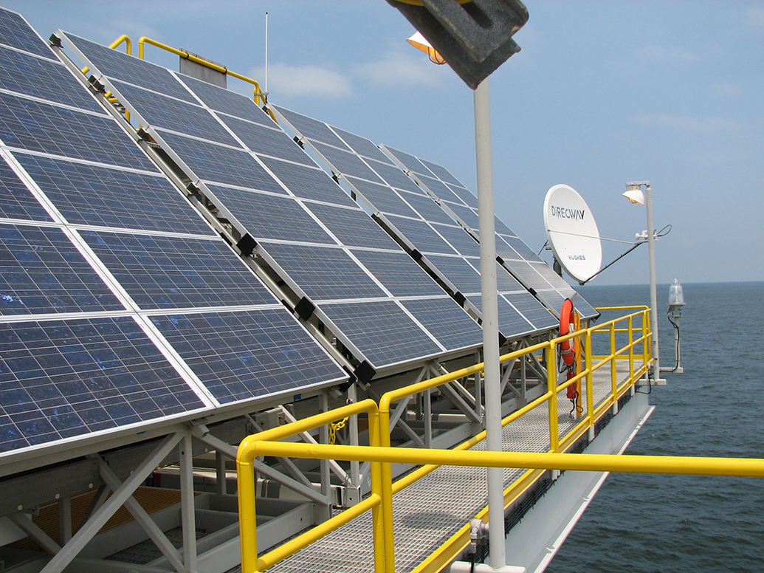
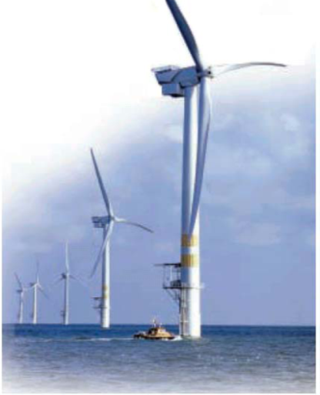
Introduction – Renewable energy for maritime sector
Harvesting Renewable energy in mechanical form (kinetic, potential or electro-magnietic) is generally more efficient than in thermal form!
Solar PV
Wind
Waves
Tidal currents
Solar thermal
Ocean Thermal (OTEC)

Slide 6
World trend for Renewable / NON-Renewable Energy

Slide 7
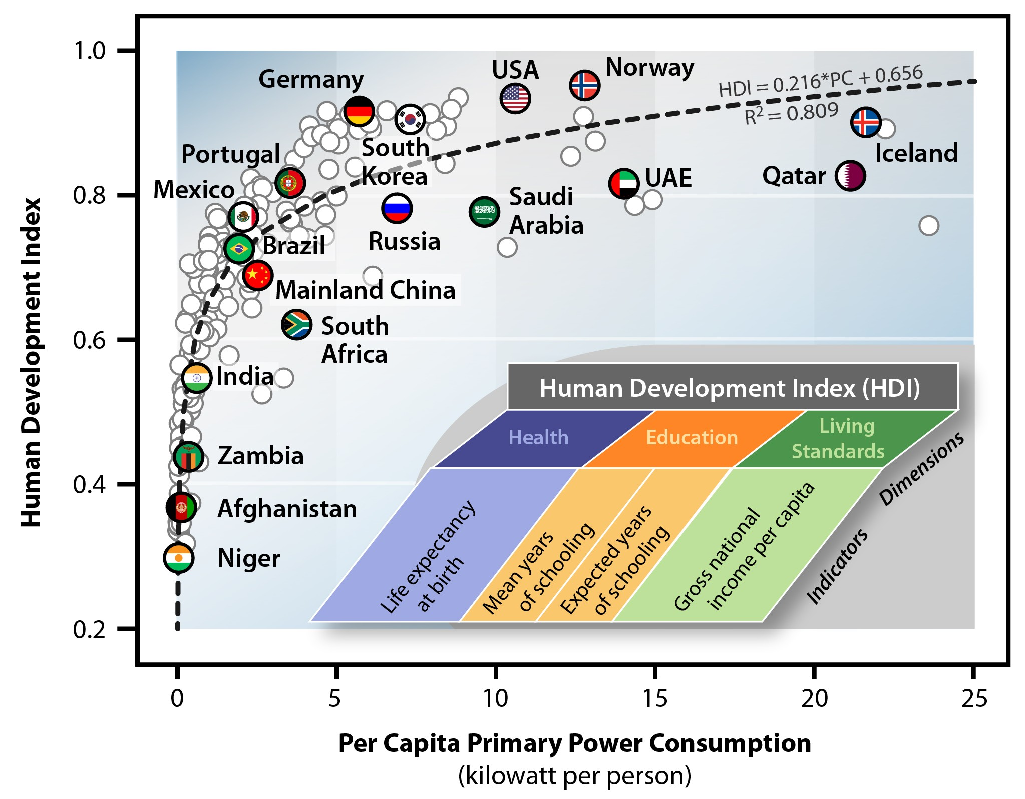
World trend for Renewable / NON-Renewable Energy

Slide 8
World trend for Renewable / NON-Renewable Energy

Slide 9
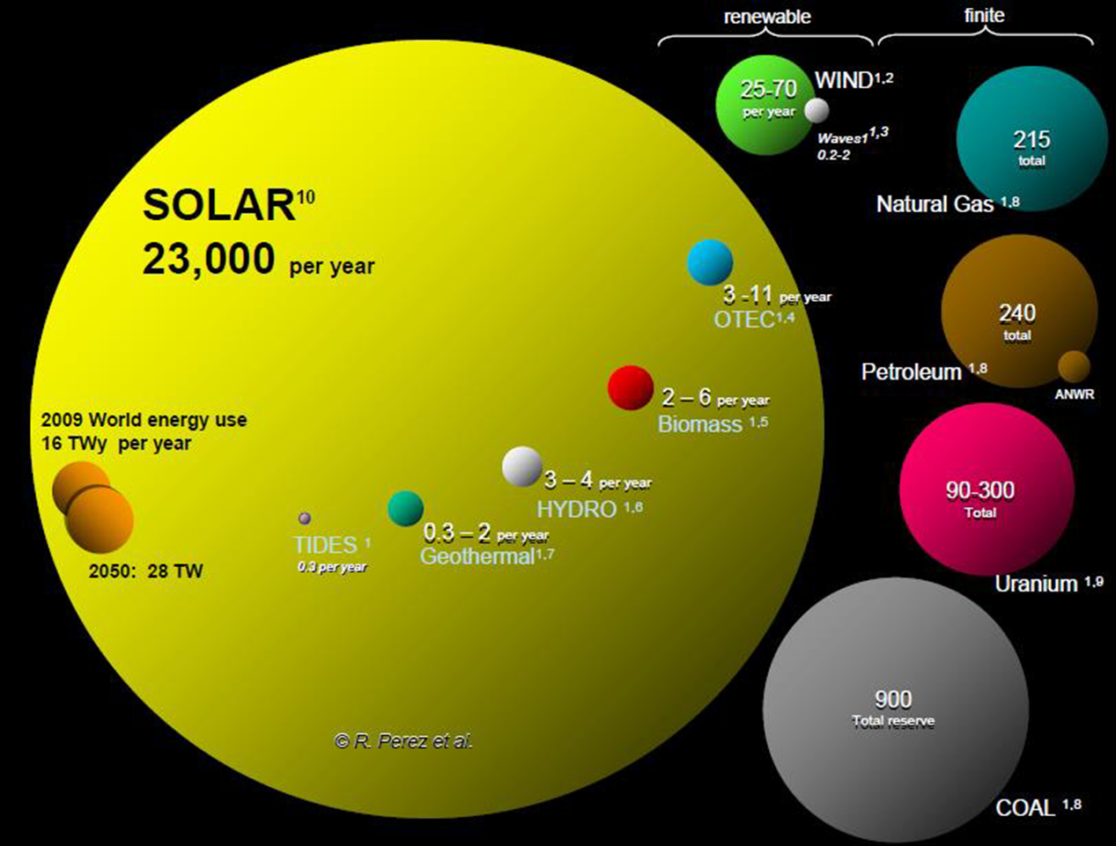
Solar Photovoltaic

Slide 10
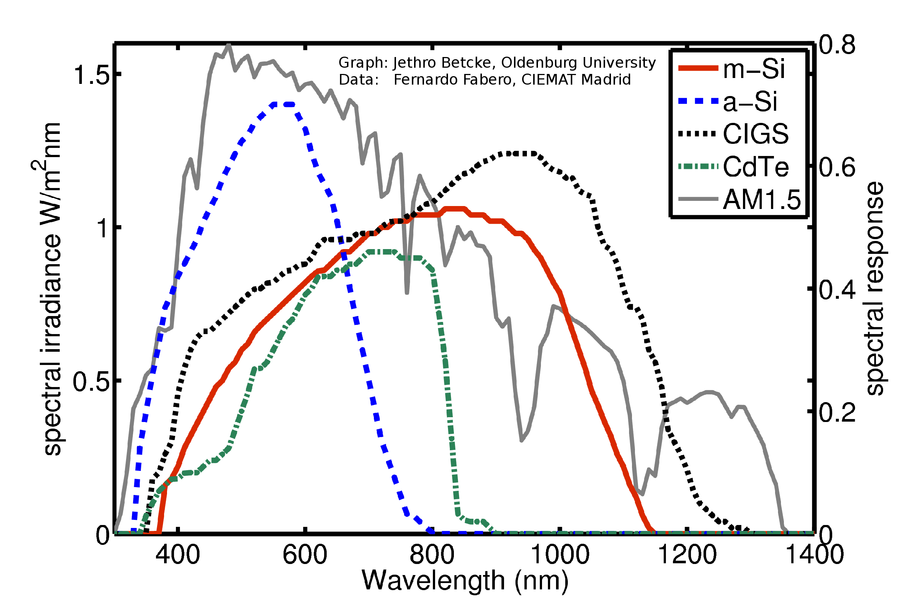
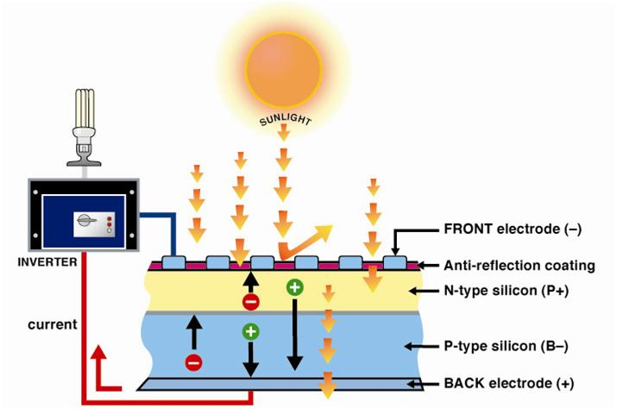
Solar Photovoltaic
Atmospher, clouds, shadows, ….
Response spectrum of PV materials
Panel surface orientation with respect of the apparent position of the sun in the sky

Slide 11
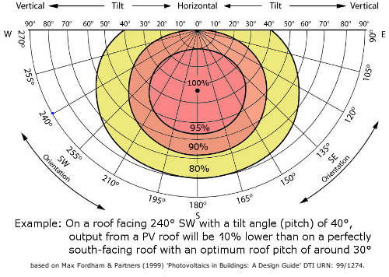
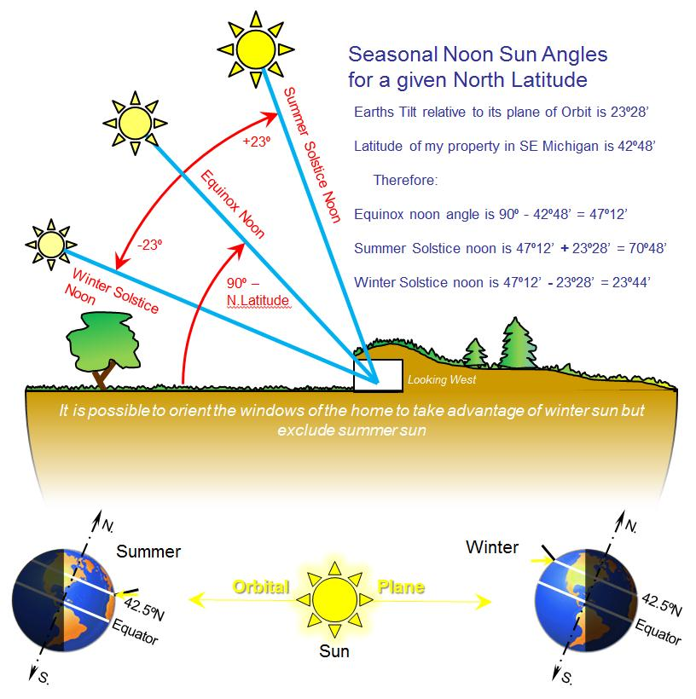
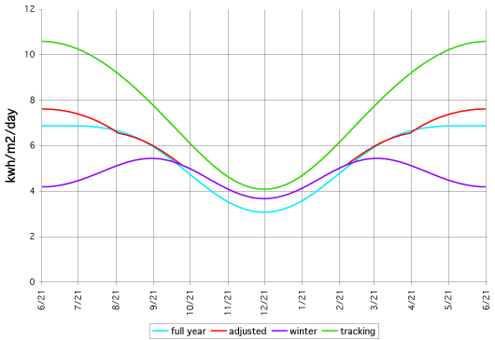
Solar Photovoltaic
Panel surface orientation with respect of the apparent position of the sun in the sky

Slide 12
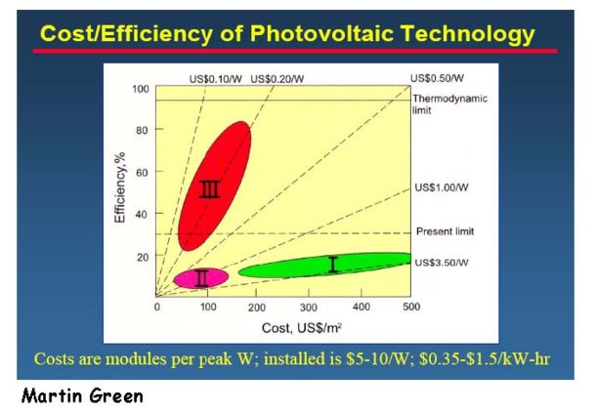
Solar Photovoltaic
First Generation
Solar cells currently on the market, made from crystalline silicon, they are a "mature" technology.
high cost costs needed to create silicon cells with sufficient purity.
Second Generation
are less mature as a PV technology, are generally created using vacuum deposition or chemical vapor deposition (CVD). These include CdTe or copper-indium-gallium-selenide (CIGS) technologies.
Their costs are lower, as are their efficiencies, but they are thinner and lighter than silicon cells.
Disposal at end-of-life is a consideration,
because of the toxicity of Cd, Te, Ga, and Se,
and because of concerns regarding their
earth abundance.
Third Generation
Is the object of current investigation.
High efficiency is not so important.
The goal is to move on lines with
low unit cost of energy production!

Slide 13
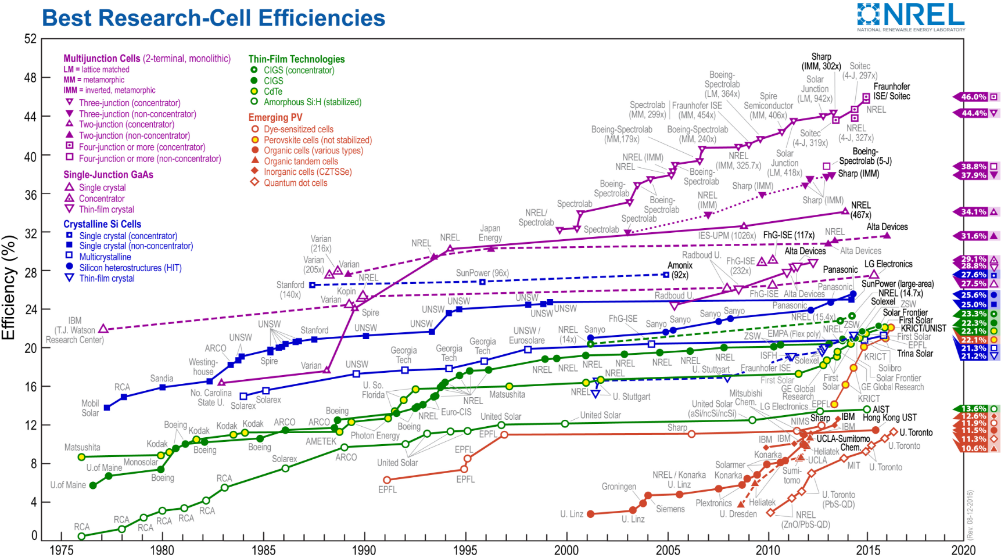
Solar Photovoltaic

Slide 14
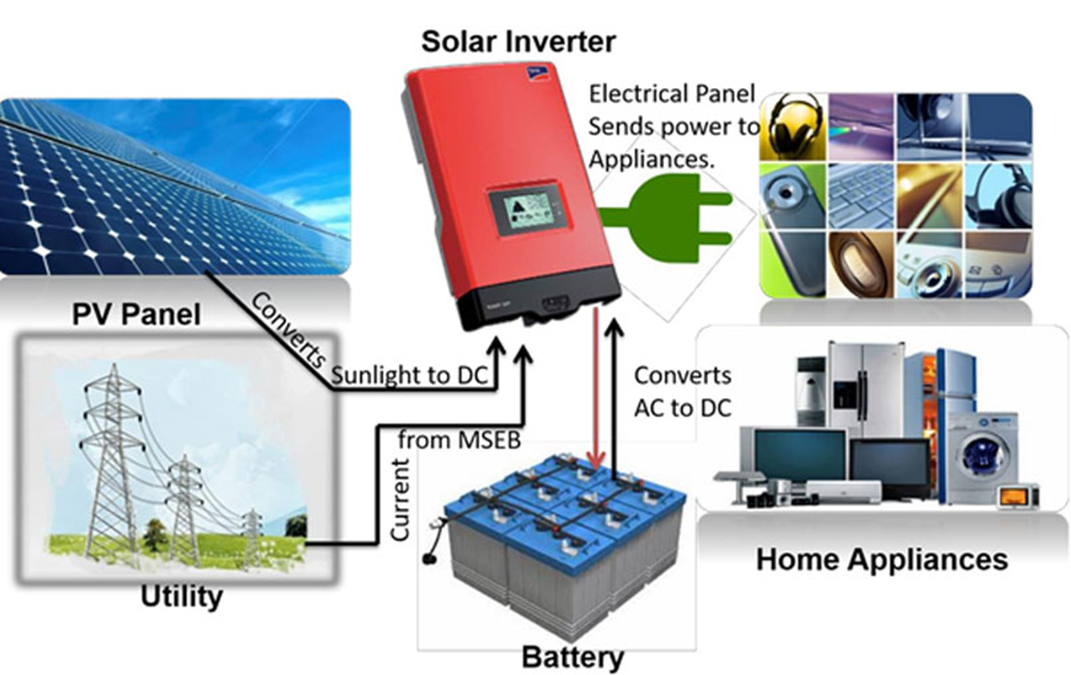
Solar Photovoltaic
Homic resistance of electric connection
Inverter (and battery) losses
BOS
Reduce system efficiency with respect to cell efficiency to about 10% (thin film) or less and to about 15% (cristal silicon)

Slide 15
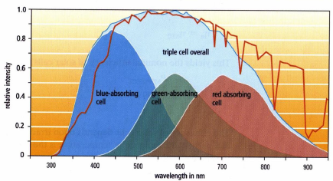
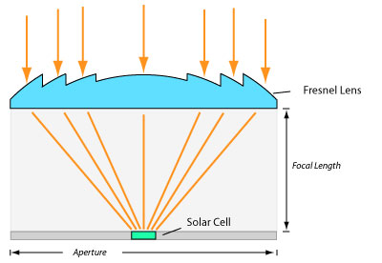
Solar Photovoltaic

Slide 16
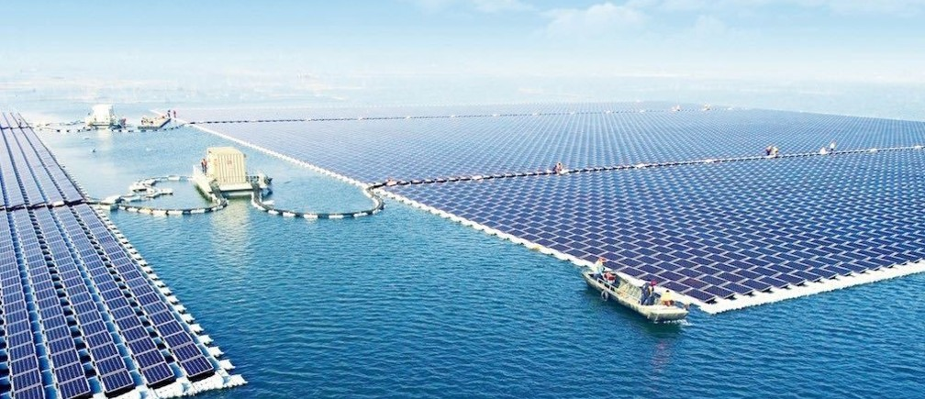
Solar Photovoltaic
China just switched on the world's largest floating solar power plant
The facility is located in the city of Huainan, in China’s eastern Anhui province. It has a capacity of 40 megawatts (MW), enough to power a small town. And in a stroke of pleasing symbolism, the plant floats over a flooded former coal-mining region.

Slide 17
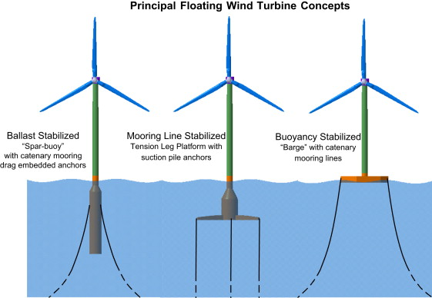
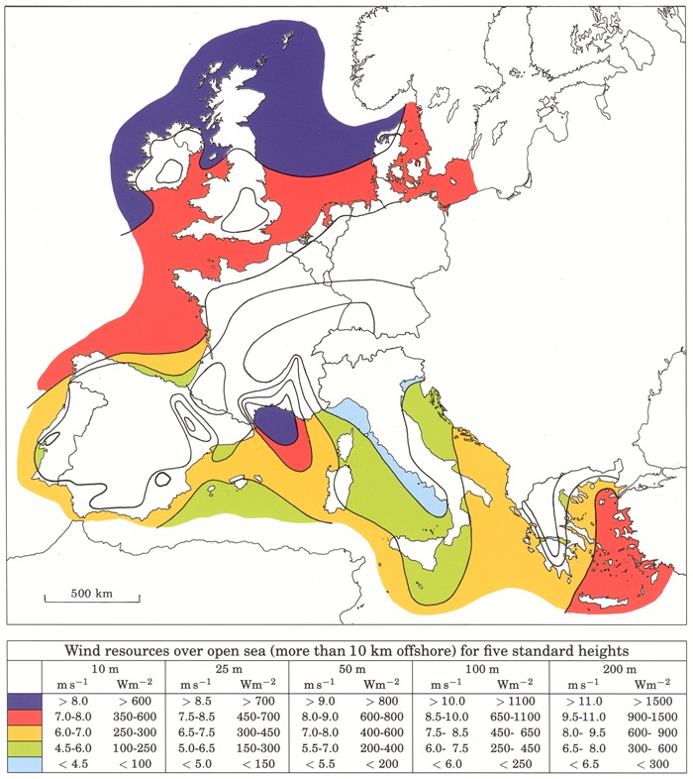
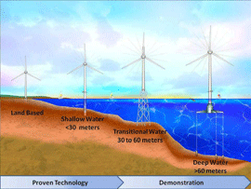
Wind Turbines

Slide 18
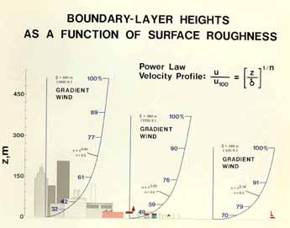
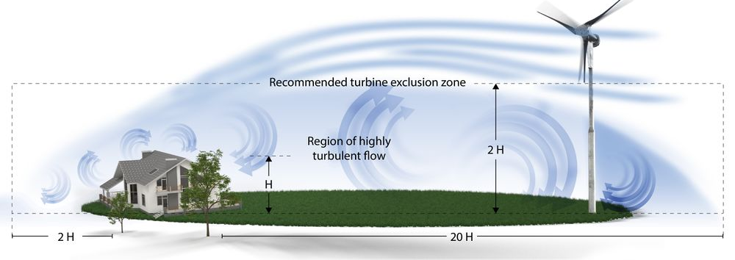
Wind Turbines
Flat surfaces are highly favorable for wind energy exploitation
Horizontal axis wind turbines allow to put the blades where the wind speed is higher
If some obstacle is present, the turbine has to be placed outside the region of highly turbulent air flow.

Slide 19
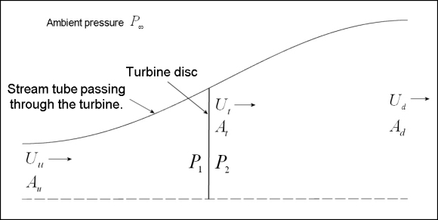
Wind Turbines

Slide 20
Wind Turbines
Stream tube section equal to ZERO
Exit air speed equal to wind speed or Power extraction equal to ZERO

Slide 21
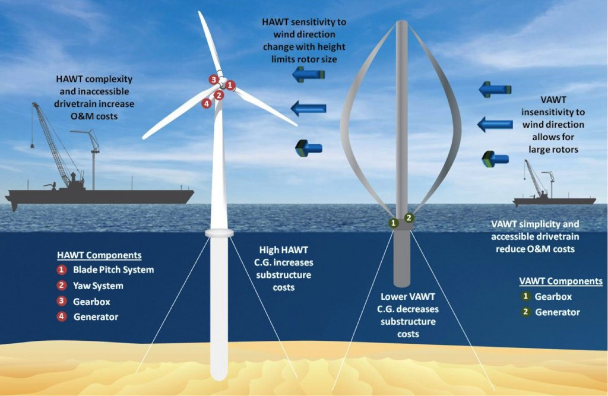
Wind Turbines

Slide 22
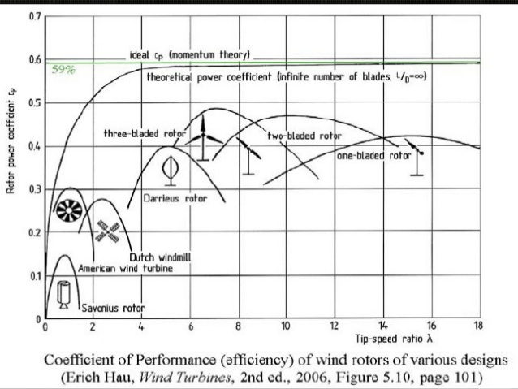
Wind Turbines
BETZ limit

Slide 23
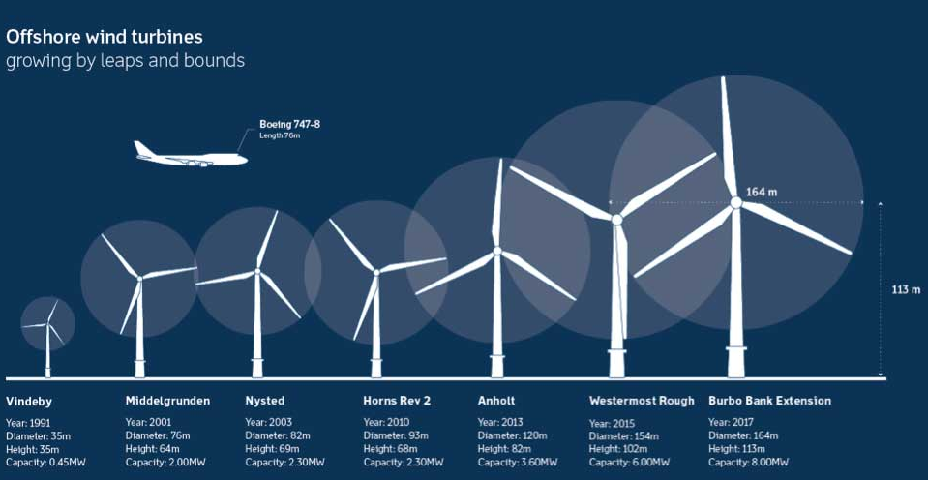
Wind Turbines

Slide 24
Wind Turbines

Slide 25
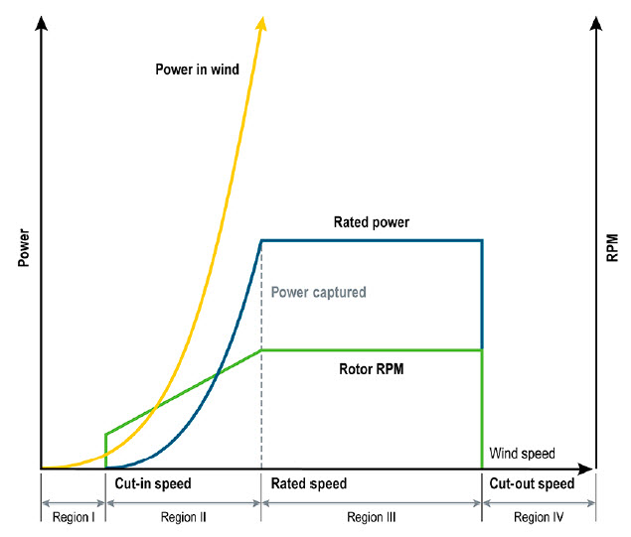
Wind Turbines
The electric power output of a wind turbine as a function of wind speed
In Regions I and IV, the turbine does not operate.
Region II commences at the 3–5 m/s cut-in wind speed, the speed at which the turbine starts to produce power. In Region II, the turbine power output increases with wind speed up to the rated wind speed, typically between 12 m/s and 15 m/s.
In Region III, the power output is held relatively constant at the rated power.
This is accomplished either by passive stall control or, by active blade pitch angle adjustments.
To limit machine loads and prevent damage to a wind turbine's structural components, wind turbines are designed to shut down at cut-out wind speeds between 25 m/s and 30 m/s.

Slide 26
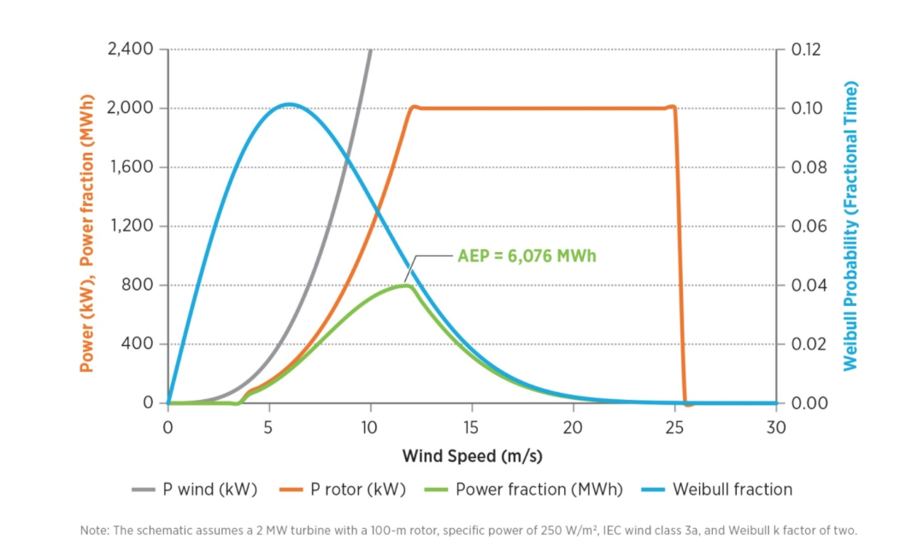
Wind Turbines
The electric power output evaluation through wind speed distribution
The expected yield from a wind turbine (green) is dictated by its capacity (orange) and the typical wind speed at the site (blue).

Slide 27
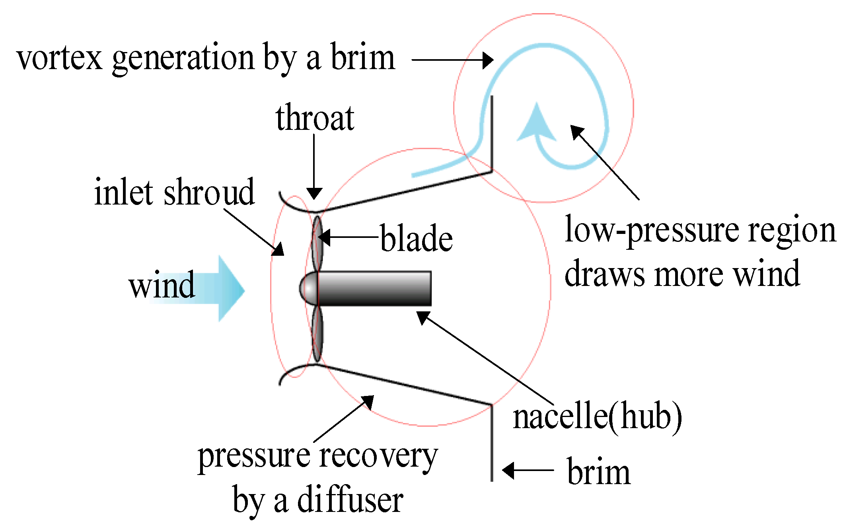
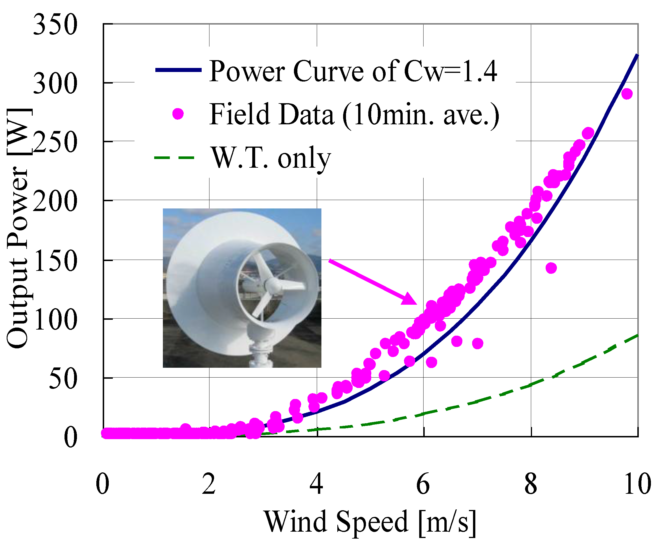
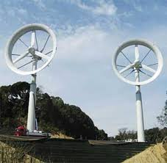
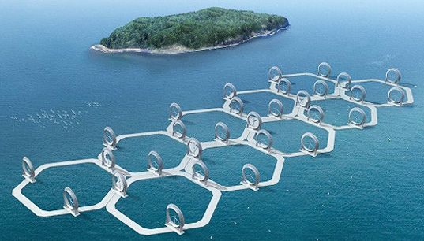
Lens Wind Turbines

Slide 28
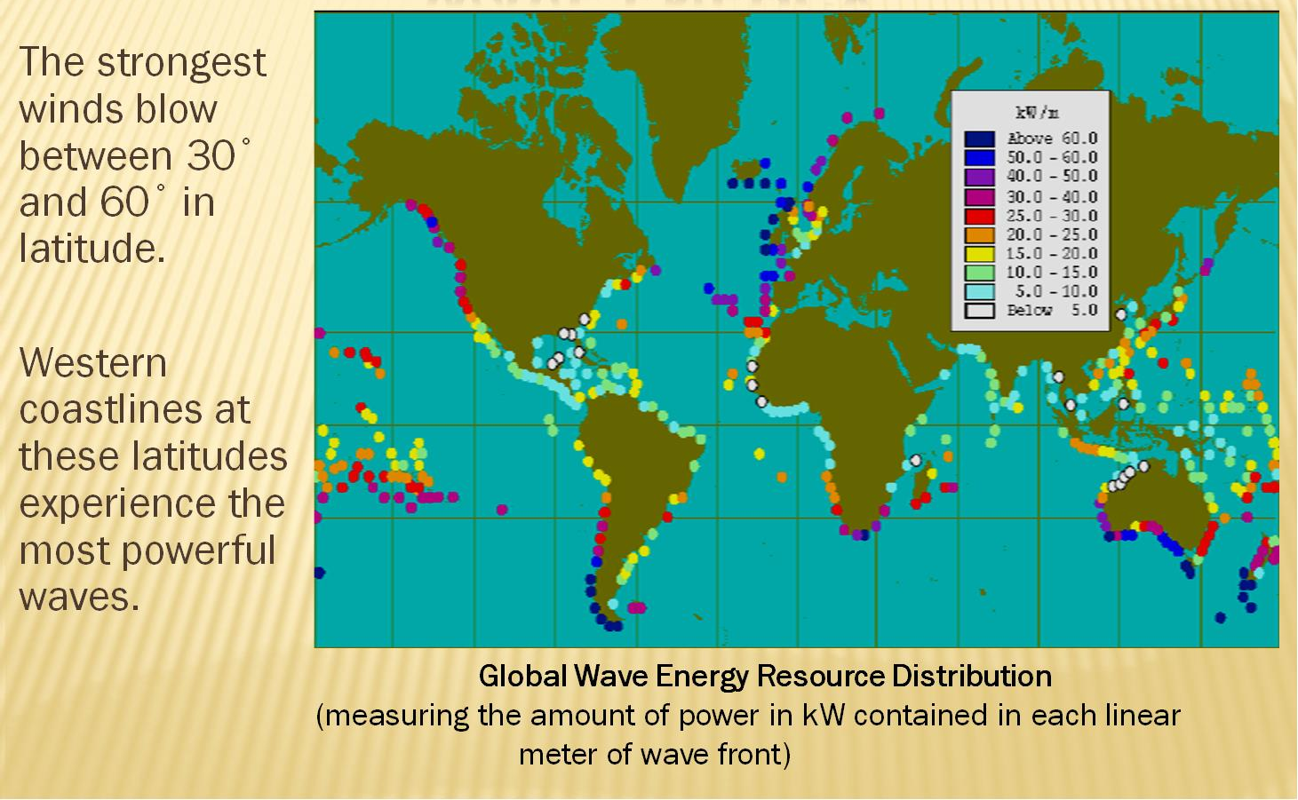
Wave energy

Slide 29
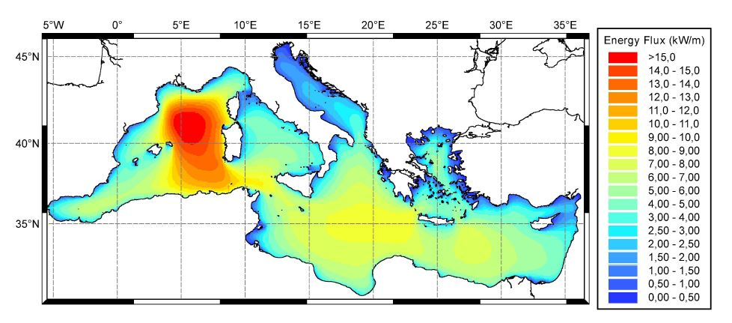
Wave energy
NOTICE THAT, because of wave propagation physics, small energy converters can extract, in principal, energy from a wave front much greater than their own dimension.

Slide 30
Wave energy

Slide 31
Wave energy

Slide 32
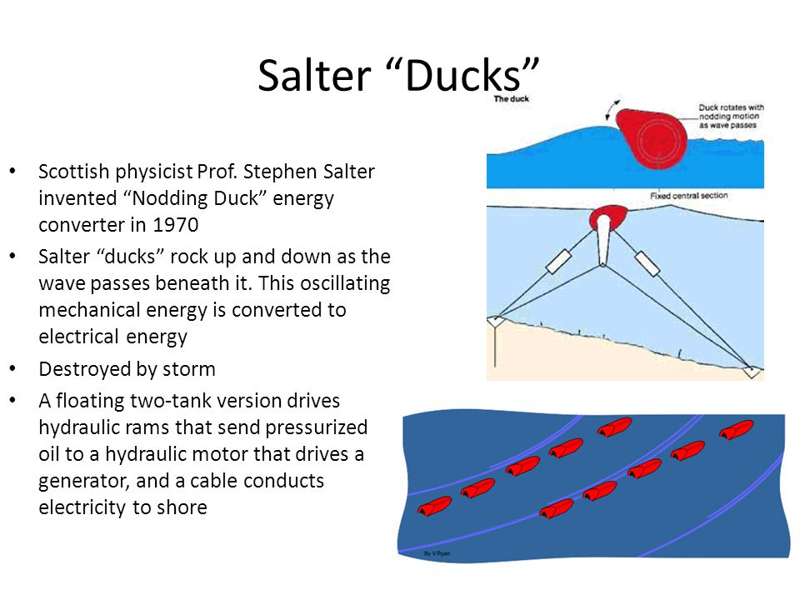
Wave energy

Slide 33
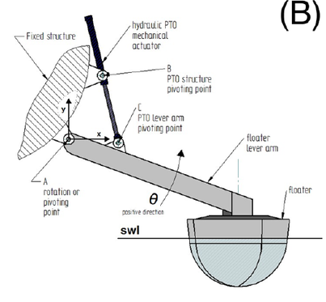
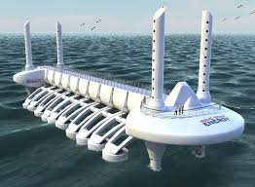
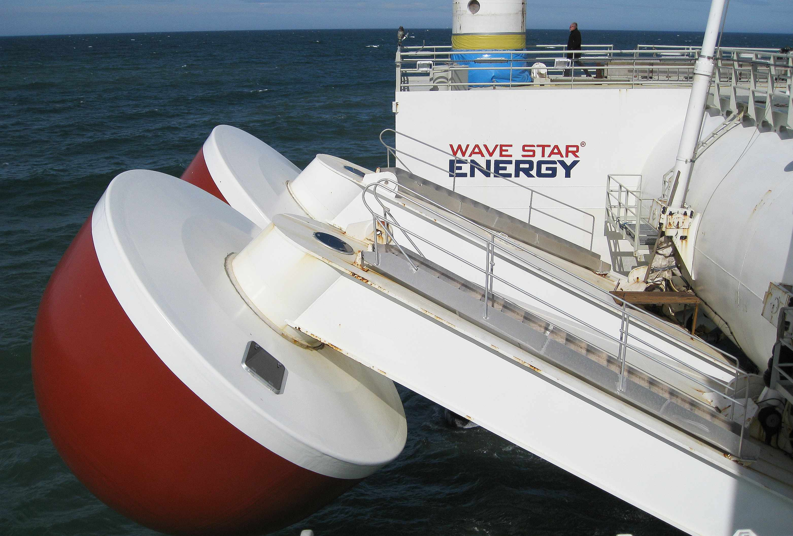
Wave energy
Wave Star

Slide 34
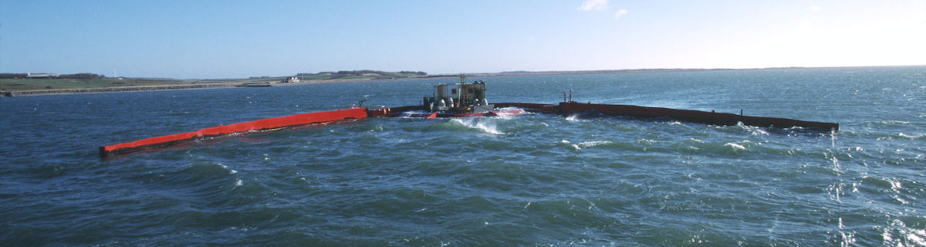
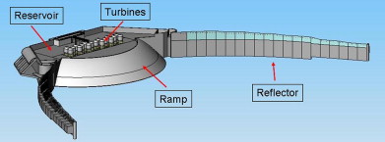
Wave energy
Wave Dragon

Slide 35
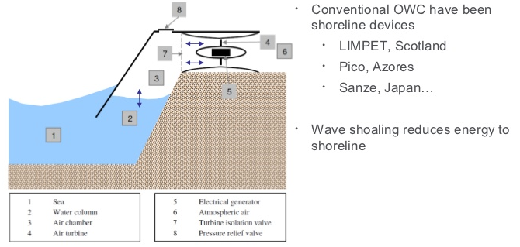
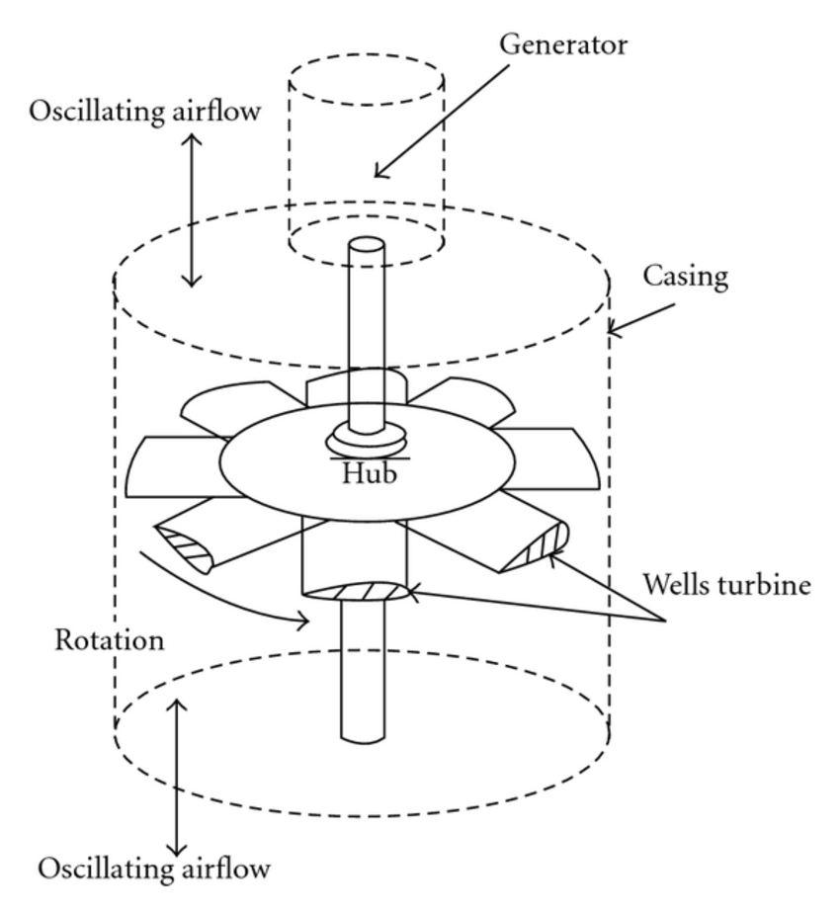
Wave energy
Oscillating water column + Well Turbine

Slide 36
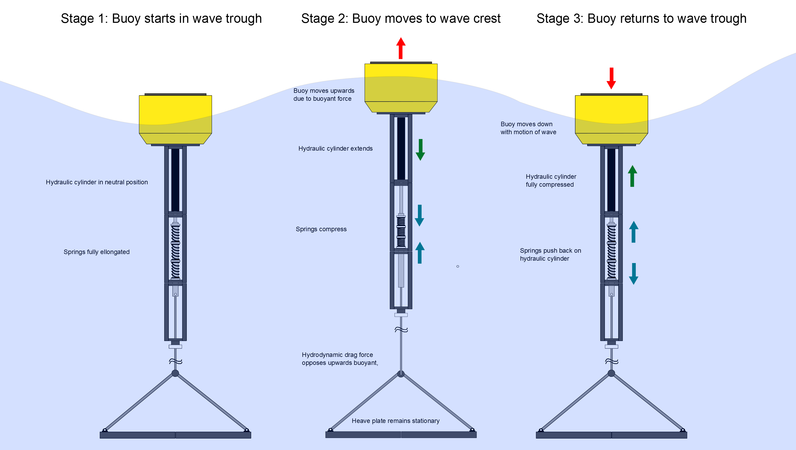
Wave energy
Buoy

Slide 37
Wave energy
AquaBuoy

Slide 38
Tidal energy

Slide 39
Tidal energy

Slide 40
Tidal energy
Tidal power plant in St. Malo / mouth of the river Rance / France

Slide 41
Tidal energy
Lunar Energy

Slide 42
Tidal energy
Seaflow

Slide 43
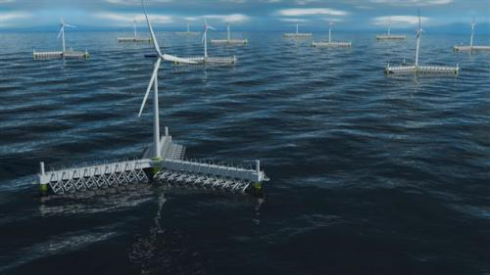
Integrated Ocean energy
Wave Star+Wind turbine

Slide 44
Integrated Ocean energy
Multiple 100m-class Floating Bodies and 300kW WindLens turbines

Slide 45
Conclusion: High efficiency is not so important. The goal is to toward low unit cost of energy production!

Slide 46
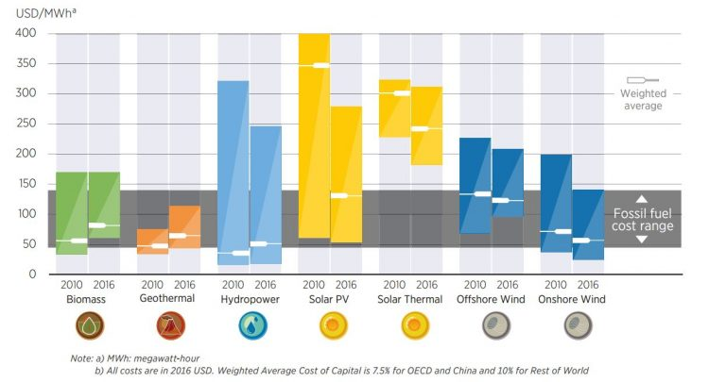
Conclusion: Harvesting Renewable energy in mechanical form (kinetic, potential or electro-magnietic) is generally more efficient than in thermal form!

Slide 47
Questions
Which forms of renewable energy are more suitable for maritime sector?
Which forms of renewable energy can be harvested in mechanical form?
Which kind of relation can be highlighted between Energy use per capita and GDP?
Which factors affect the solar energy collected by a flat surface?
What is the Martin Green diagram and which is its message?
Which are the maximum efficiencies obtained in lab for different kinds of solar cells?
Is the efficiency of a PV solar plant different from that of its solar cells? Why?
Which are the difference between on-shore and off-shore wind turbines?
What is the power coefficient of a wind turbine and what is the Betz limit?
How can be evaluated the annual energy production of a wind turbine?
Which are the main kinds of wave energy converters?
Which are the best places for wind and wave energy harvesting?
Which is the difference between wave and tidal energy?

Slide 48
Bibliography
https://ourworldindata.org/renewables
https://www.weforum.org/agenda/2017/06/china-worlds-largest-floating-solar-power/
https://www.tudelft.nl/ocean-energy/research/wave-energy/
https://www.nrel.gov/docs/gen/fy07/40462.pdf
http://www.ewea.org/fileadmin/files/library/publications/reports/Deep_Water.pdf
Martin A. Green, Solar Cells : Operating Principles, Technology and System Applications, 1986

