Slide 1


Entrepreneurship, knowledge Management, Creativity of cooperative learning of firms and the magic of creativity
Università degli Studi di Trieste
May 9, 2019
Michael Steiner
Institute of Economics
University of Graz

Slide 2
Outline
Who is an entrepreneur?
Features and characteristics
Knowlege sharing and organizational learning new focus of clusters and networks economics theory - empirical analysis – conclusions
Creativity as a challenge for firms – from cultural to creative industries to a creative class and creative firms
A tentative approach of operationalization with new insights
Further reading

Slide 3
Who is an entrepreneur?
Different definitions
`entreprendre´ - to do something
Schumpeter (1942/1946): entrepreneur as innovator not inventor but operator and early adopter
Entrepreneur – translate knowledge into economically useful knowledge
Individual characteristics of persons: own responsibility, creativity, alertness, initiative, willingness to take risks, assertiveness
Mostly connected with foundation of an enterprise, with self- employment and autonomy
In contrast to employed workers/employees yet here: `intrapreneurship´ managers?
Young firms or in the phase of foundation with special dynamics as opposed to old/established firms GEM: nascent-young entrepreneurs vs. established business ownership
Opportunity – necessity entrepreneurship
Value of entrepreneurship?

Slide 4
Features and Characteristics of Entrepreneurship
Analytical differentiation of entrepreneurial action: self-employment, capitalistic enterprise or entrepreneurship
Charisma? Or rather competence and ability to empathise
Cooperation and learning
Creativity

Slide 5
Knowledge sharing and organizational learning of firms in networks and clusters
New focus of clusters and networks
Porter (1998, 2000): clusters as geographic concentrations of interconnected firms in related industries and associated institutions in a particular field that compete but also cooperate
New emphasis
clusters and networks as important elements of the knowledge economy + knowledge management
innovation favoured by regionally concentrated interaction of (mostly) small firms mutually exchanging information in formal and informal ways
concept of clusters and their networks as condensed forms of economic activities combine theoretical elements of
knowledge
proximity
institutional character

Slide 6
Knowledge sharing and organizational learning of firms in networks and clusters
open questions
motives and incentives of firms for cooperation
form and content of interaction
division of labour vs. knowledge sharing
forms of (organizational) learning and knowledge exchange
regional versus global dimensions of interaction
diffusion of knowledge and organization of learning – collective or selective / structured, informal of participative

Slide 7
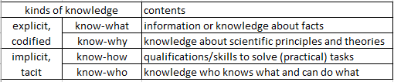
Knowledge sharing and organizational learning of firms in networks and clusters
Theoretical aspects
Networking as an important form of innovative activity for regions, for strategic management and industrial dynamic approaches to inter-firm cooperation
In need of specific guiding and coordinating institutions – not only markets as soon as knowledge is involved
Clusters and networks as coordinating institutions providing a cognitive framework for transforming information into useful knowledge
Dimensions of knowledge
Large heterogenity between sectors and industries in terms of knowledge and transformation into innovations

Slide 8
Knowledge sharing and organizational learning of firms in networks and clusters
Process of information based on division of labor A. Smith: social nature of innovation process requires framework to connect different agents
Knowledge and skills: connectivity in need of specific institutional arrangements
New Institutional economics character of interaction changes in form and impact division of labor: goods and services – competition knowledge sharing: knowledge and skills – cooperation institutional consequence: cooperation is basic institution of the process of the division of knowledge
Individual – organizational learning

Slide 9
How Do Clusters Cooperate and Learn
Clusters as institutions that raise the efficiency of knowledge exchange
Material and immaterial dimensions
Material: firms are linked to one another in a value-adding production chain
meso-level analysis via regional input-output-model
Immaterial: learning and knowledge exchange
micro-perspective
Socio-psychological theories of organizational learning
learning no black box, but as a transparent process of knowledge creation
Operationalization of specific learning systems

Slide 10
Clusters as Learning Organizations
Interfirm communication and interactive processes of learning play decisive role in the process of innovation and growth
Changing character of learning
departure from ‘black box’ conceptualization
from individual process to small groups, whole organizations and even interorganizational activity
Learning as a communicative process rather than a cognitive performance
Organizational learning as outcome of three overlapping spheres of activity: individual, team and system learning

Slide 11
Clusters as Learning Organizations II
Learning systems in organizations:
One-man institutions
mythological learning systems
informal learning systems
participative learning systems
formal management systems
bureaucratic learning systems
For clusters relevant: participative and informal learning systems
made operable through identification of concrete forms
Table 1: Particular forms within learning systems
Learning system | Particular forms at the cluster level
Informal learning system | Informal meetings in bars or at conferences etc.
 | ‚Old boys‘ networks
 | Social networks (clubs, etc.)
 | Facilitated exchange of experiences
Participative learning system | Interfirm research and development teams
 | Interfirm project teams
 | Benchmarking clubs
 | Participation in consortia

Slide 12
Empirical Results
Methodology
starting point: clusters as value chains identified via regional input-output-model
5 clusters: automotive, chemical/pharmaceutical, machinery and metal, wood/paper, IT
Questionnaire sent to 1.631 Styrian firms – return rate 20%
In-depth-interviews with with 149 human resources managers in the specific clusters concerning collaborative behavior and presence of particular forms of learning systems

Slide 13
Empirical results: Learning orientation of the clusters
 | Chemical | Information Technology | Wood | Metal | Automobile
Informal meetings in bars or at conferences | 80 | 90 | 74 | 46 | 67
Communities of practice | 16 | 25 | 22 | 18 | 21
Old boys´ networks | 30 | 50 | 22 | 23 | 31
Social networks | 5 | 10 | 14 | 5 | 21
Facilitated exchange of experience | 42 | 20 | 53 | 33 | 26
Informal learning systems: summary mean figure | 55 | 39 | 37 | 25 | 33
 | Chemical | Information Technology | Wood | Metal | Automobile
Interfirm research and development teams | 50 | 55 | 41 | 41 | 50
Interfirm project teams | 21 | 70 | 50 | 50 | 67
Participation in consortia | 6 | 35 | 12 | 21 | 22
Benchmarking clubs | 17 | 40 | 54 | 47 | 53
Participative learning systems: summary mean figure | 23 | 50 | 39 | 40 | 48

Slide 14
Empirical results III
Learning systems in Styrian clusters
Learning orientation depends on corresponding working cultures within the relevant industries as it does on the existing value chains and the prevailing competitive structure
Collaboration with the regional knowledge infrastructure

Slide 15
Conclusion and Interpretation
Explorative approach
Also immaterial links between clusters
Interpreted as different learning systems
Learning no ‘black box’
Participative approach more common than informal learning
Underlines importance of a conscious effort
Dominant form: interfirm project teams and interfirm R&D teams
Within informal forms social networks rather unimportant
Several factors that influence the form of learning systems
Confirm interpretation of clusters as institutions for knowledge management

Slide 16
Creativity as a challenge for firms
Creative industries as an open economic and political label
From cultural to creative industries to a creative class
Creativity as a continuum
A tentative approach of operationalization
Options for future research and policy

Slide 17
Creativity ?
Creative industries as a key word
‚creative class‘ as a driver of the economy (Florida 2002, Gabe, Florida, Mellander 2012)
additional dimensions
not only a metropolitan phenomenon
also outside of the developed world – ‚The Orange Economy‘ (Buitrago & Duque 2013)
culture and creativity not only for ‚creative industries‘
Critical discussions
only magic word?
coherent construct despite ist heterogeneity?
question of measurement
Two aspects to be adressed
trans-sectoral character of creativeness
creativity as a continuum

Slide 18
From cultural to creative industries to a creative class
Incompatibility of arts/culture and business/economics (Adorno 1947, Adorno Horkheimer 1991) - in 1980s exact opposite
From arts and culture to information and communications technology
Four part value chain: content origination, Manufacturing inputs, reproduction, exchange (Pratt 1997) – later on: integrated whole
Definition of British Department of Culture, Media and Sports emphasizes growth potential and market orientation
‘creative industries’ combine creative arts and cultural industries
Yet no clear line
Is it sector or occupation?
creative activities undertaken by individuals in individual companies
Yet industrial classification systems categorize entire industries in sectors
Ultimate intellectual property is human creative faculty (Florida 2002)
Hence: ‘creative class’ of special occupations with ‘supercreative core’ creating regional income, even happiness of nations
3 Ts: talent technology tolerance - the latter leading to a ‘gay index’
Yet. Still problem of a dividing list – ‘who is in and who is out’

Slide 19
From cultural to creative industries to a creative class
Matrix
Limitations of statistical data
Availability, outdated, confidentiality, freelancers usually not included
 |  | Creative Industries
 |  | Yes | No
Creative Occupation | Yes | Creative industries - core | Creative industries in a broader sense
 | No | Creative industries in a broader sense | Not part of the creative industries

Slide 20
CREATIVITY AS A CONTINUUM
Not reasonable nor realistic to draw a sharp line between being creative or not
New approach: look at creative activity (process) that results in a product or service
Focus on human beings and their activity
Creativity can be observed as a continuum
Criteria based on literature of behavioral aspects, knowledge management, psychology, new organizational forms and changing labor markets
Not just education but actual skills – physical, cognitive, social intelligence
Characteristics of creative activities to form the core of our definition:
not-standardized or precisely defined
modular systems that allow limited adaptations
completely free and new solutions
impossible to determine the exact final result in advance
input cannot be estimated precisely in advance
not possible to determine the final result
The descriptive criteria are used to calculate index of creativity as a new tool
Analysis at the micro-level of (creative) businesses not at the macro-level of cities and regions

Slide 21
A TENTATIVE APPROACH OF OPERATIONALIZATION
A case study on creative firms in Graz on the basis of a phone survey of 515 business (with 495 usable replies) using a traditional sector-based definition of creative industries with about 25.000 employees
Interviewees were confronted with a list of statements without mentioning the term ‘creativity’
‘Index of creativity’: answers to the statements were coded 0 (does not apply), 1 (applies to some degree), 2 applies completely) – index ranges from not creative (not a single characteristic applies) to 12 (very characteristics, all characteristics apply completely)
Characteristics | Applies completely | Applies to some degree | Does not apply
The service/product is not standardized (no ‘one size fits all’ solutions). | 47,5 % | 22,5 % | 30,0 %
Limited adaptations are possible to respond to customer requests (e.g. a modular system or a combination of predefined alternatives). | 56,3 % | 20,6 % | 23,1 %
Generally I develop completely free and individually designed solutions for each client. | 60,8 % | 22,1 % | 17,1 %
The service/product is so complex that it is difficult for me to to define the exact final result in advance. | 35,3 % | 21,0% | 43,7 %
It is difficult for me to estimate in advance the inputs necessary (time, costs for materials) to perform the service/develop the product. | 10,2 % | 19,9 % | 69,9 %
It is not possible to determine the exact final result already at at the start of the contract | 24,4 % | 24,6 % | 51,1 %
Source :own calculations

Slide 22
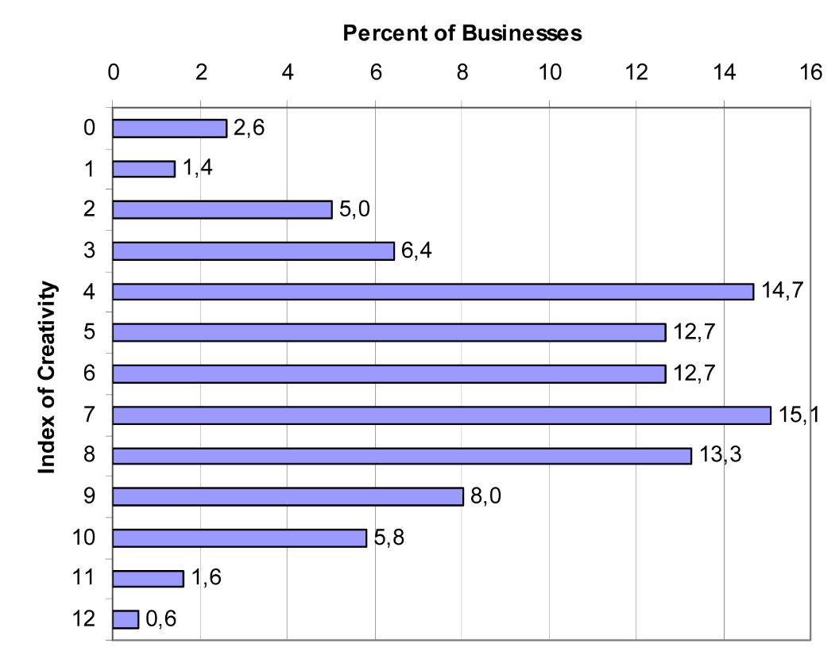
A TENTATIVE APPROACH OF OPERATIONALIZATION
Degree of creativity according to index

Slide 23
CONCLUSIONS AND OPTIONS CHALLENGES FOR RESEARCH AND POLICY
New approach focusing on the definition of creative activities instead of using industrial sectors enriching existing approaches
No sharp line between ‘creative’ and ‘not creative’ – creativity as a continuum
Micro-level, firm-based approach which categorizes specific forms of behavior
‘index of creativity’ – results show that there is a broad range of being more or less creative
Approach can be extended, refined and made to include additional forms of behavior
Like all survey-based approaches it is time- and resource intensive
It provides a tool to get better insights into (also) spatially differentiated attitude to creativity
Repeated surveys would allow a monitoring of creative activities
Policy: differentiated perspective as to the objects of policy support
new focus: how to increase the degree of creativity in various industries
not sector-, but business oriented with a behavioral perspective

Slide 24
Further Reading
Acs, Z.J., Armington, C. (2006), Entrepreneurship, Geography, and American Economic Growth, Cambridge;New York, Cambridge University Press.
Audretsch, D. B., Lehmann, E. E., (2006), The role of clusters in knowledge creation and diffusion: An institutional perspective, in: Asheim, B., Cooke, Ph., Martin, R. (eds.) clusters and Development. Critical reflections and explorations, Routledge, Oxon, 188-98.
Fritsch, M. (2008), How does new business formation affect regional development? Introduction to the special issue, Small business Economics 30, 1-14
Steiner, M., (2006), Do clusters think? An institutional perspective on knowledge creation and diffusion in clusters, in Asheim, B., Cooke, Ph., Martin, R. (eds.) clusters and Development. Critical reflections and explorations, Routledge, Oxon, 199-217.
Steiner M., Hartmann, Ch. (2006), Organizational Learning in Clusters. A Case Study on Material and Immaterial Dimensions of Cooperation, Regional Studies, Vol. 40:5, 493-506.
Steiner, M., Ploder, M., (2008), Structure and Strategy within heterogeneity: Multiple Dimensions of Regional Networking, Regional Studies, Vol. 42.6, 793-815.
Steiner, M., Prettenthaler, F., (2015), Creativity reconsidered - So your firm is creative, but how much? A trans-sectoral and continuous approach to creative industries, Regional Studies, Regional Science, 2(1), 275-289.

