Slide 1
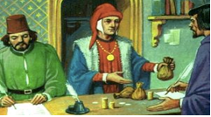
Is there a gender effect on the cost of bank financing?
– Evidence from European SMEs –
Stefania P.S. Rossi
Department of Economics, Business, Mathematics and Statistics (DEAMS), University of Trieste, Italy
This presentation relies on the paper by D.V. Mascia and S.P.S. Rossi published in Journal of Financial Stability 31 (2017) 136–153

Slide 2
Motivation
Following the global financial crisis, liquidity shortage and heavy restrictions, registered in credit markets, worsened the access conditions to bank credit for non-financial firms in Europe.
This phenomenon has specifically affected SMEs because of their specific features.

Slide 3
Stylized Facts
SMEs dominate the business landscape in Europe and are the main drivers of employment, growth and innovation (Behr et al., 2013; De Kok et al., 2011; Ferreira Filipe et al., 2016; Popov and Udell, 2012).
SMEs heavily rely on bank credit because they are unable to access equity markets (Ayadi and Gadi, 2013; Kremp and Sevestre, 2013; Vermoesen et al., 2013).

Slide 4
Stylized Facts
SMEs have harder time in obtaining credit than large firms, due to their inability in producing high quality collateral and lack of transparency related to their creditworthiness (Cowan et al., 2015; Öztürk and Mrkaic, 2014; Vos et al., 2007).
Credit obstacles tend to be more severe in times of crisis thus leading to credit rationing phenomena (Popov and Van-Horen, 2015; Popov and Udell, 2012).

Slide 5
Research question
Are these difficulties in the banking credit access even greater for women-led SMEs?

Slide 6
Literature
The literature on gender bias in credit access has focused on:
demand-driven factors
supply-driven factors

Slide 7
Literature – the demand-driven factors
Demand-driven factors are the self-restrain motives of the female borrower who decides not to apply for bank loans.
women generally tend to be more risk-averse and less self-confident than men;
women exhibit a lower propensity toward indebtedness;
women are more cautious towards finance choices;
(Barber and Odean, 2001; Coleman and Robb, 2009; Croson and Gneezy, 2009; Marlow and Carter, 2006; Treichel-Zimmerman and Scott, 2006)
Women’s perception of facing more challenges to access bank credit, may itself explain their lower propensity to use external sources
(Coleman, 2000; Cole and Mehran, 2011)

Slide 8
Literature – the supply driven factors
The supply driven factors focus on the lander ‘s biases against female-led enterprises that apply for credit
As a consequence of the lender’s bias, female entrepreneurs may face:
higher rate of loan denial
lower credit availability
worse cost conditions,
than male firms in obtaining bank loans.
(Alesina et al., 2013; Aristei and Gallo, 2016; Bellucci et al., 2010; Calcagnini and Lenti, 2008; Colemann, 2000; Carter and Shaw, 2006; Cavalluzzo et al. 2002; Roper and Scott, 2009 ).
On the contrary, few papers on US data claim that - after controlling for credit history, assets, sales, and years in business - women who operate small businesses do not face on average higher loan denial rates (Blanchflower et al, 2003; Cavalluzzo and Cavalluzzo 1998; Robb and Wolken, 20009; Madill et al. 2006 (for Canadian firms)).

Slide 9
Literature – the cost of financing
A relatively small branch of the literature – though most closely related to ours – focuses on the effects of gender on the cost of financing for SMEs.
Alesina, Lotti, and Mistrulli (2013) have investigated whether the structure of the banking industry, the degree of competition and the presence of small banks, may affect credit access for women. They find that women pay higher interest rates within any structure of the banking industry.
Muravyev, Talavera and Shäfer (2009) find that - for the transition countries - women are more credit constrained and pay more.
Colemann (2000): Female firms use less external financing, pay more interest rates, are required more collateral.

Slide 10
Aim of the paper/our contribution
Following this strand of the literature, our contribution would like to shed additional light on the possible existence of gender discrimination related to the cost of bank financing in the credit markets of the 11 euro countries by employing a set of comparable data from non-financial SMEs.
While those studies that have investigated the issue of cost disparities in credit access either focusing on a single country or on a cross-country environment employing different datasets, to the best of our knowledge, this is the first attempt to test for such possible disparities in the cost of credit utilizing the ECB Survey on the Access to Finance of Enterprises (SAFE).

Slide 11
Aim of the paper/our contribution
Our contribution to the literature is threefold.
First, we examine the impact of gender on the change in the cost of bank financing employing the comprehensive survey from the European Central Bank.
Second, and more importantly, we develop further this issue by looking at the effects determined by change in gender leadership.
Third, causality and endogeneity problems are properly addressed as well.

Slide 12
Discrimination/1
The literature distinguishes two types of discrimination:
  taste-based or prejudicial discrimination (Becker 1957) which is not motivated by any economic reason but, rather, with the lender preferences and believes about the gender itself.
  As a consequence of this prejudicial discrimination, undesired group would either
  i) be charged a higher interest rate on loans, compared to the desired group; or
  ii) be required to have better characteristics, such as a lower rate of default at any level of interest rate (Blanchflower et al., 1998).

Slide 13
Discrimination/2
  the statistical discrimination occurs in situations characterized by imperfect information, where the collection of information on the riskiness and creditworthiness is difficult and costly.
    Thereby in these circumstances it is easier to infer the necessary information by observable demographic characteristics of individuals. Gender can be one o f those (Alesina et al., 2013; Aristei and Gallo, 2016; Moro, 2009).

Slide 14
Aim of the paper/our contribution
More specifically, following the theory of discrimination à la Becker (1957) – according to which undesired group would be charged higher interest rates on loans compared to the desired group – the hypotheses to test in this paper are two.

Slide 15
Hypotheses
We first test whether female-led firms perceive a form of discrimination in the price-terms and conditions of the bank financing.
H1: Female-led firms are more likely to experience a worsening in the price terms and conditions of the bank financing than male counterparts.
Second, we investigate whether a change in the gender leadership of the firm affects the shift in the cost of bank financing faced by the enterprises in our sample.
H2: A change in the leadership – i.e., from male to female (from female to male) – determines a worsening (an improvement) in the price terms and conditions of the bank financing.

Slide 16
Hypotheses (cont.)
Given the information available in our dataset, we try our best to discern from some types of statistical discrimination by controlling for a series of firm characteristic related to sector of activity, age, size, change in leverage, in profit, in credit history, in collateral, in the available maturity.
However, we are aware that any other possible statistical discrimination stemming from the lender side may be out of our control as it might result from the specific information characterizing the bank-firm relationship – e.g., any sort of risk factors only observable by the bankers.

Slide 17
SAFE Dataset
The SAFE (Survey on Access to Finance of Enterprises) is a survey of small- and medium- sized enterprises (SMEs) which is jointly run by the European Central Bank (ECB) and the European Commission (EC) every six months since 2009.
It collects data on SMEs’ financial needs, their experience in the access to finance, as well as a series of financial and firm-level characteristics (e.g., size, age, sector, profit, credit demand, creditworthiness, manager’s gender).
Each wave of the survey is addressed to a randomly selected sample of non-financial firms from the Dun & Bradstreet register.
The sample is stratified by country, firm’s size and activity. In order to restore the modified proportions, calibrated weights are available to adjust the sample to be representative of the population from which it is extracted.

Slide 18
Data/sample
Our main analysis is based on a sample of 19,969 observations – drawn from SAFE – related to SMEs chartered in 11 euro-area countries for the period 2009-2013 (i.e., from the 2nd to the 10th wave).
  The sample is stratified by country, firm’s size and activity.
Macro data are retrieved from several sources (ECB BLS, ECB Data Warehouse, Eurostat, OECD, World Bank, European Association of Co-operative Banks).

Slide 19
Observations by size
Micro firms are firms with less than 10 employees
  represent about 26% of the observations in our dataset.
  Female are 19% of the Micro firms
Small firms are firms between 10-49 employees
  represent about 34% of the observations in our dataset.
  Female are 11% of the Small firms
Medium firms are firms with 50-249 employees
  represent about 30% of the observations in our dataset.
  Female firms are 8% of the Medium firms
Large firms are firms with more than 250 employees
  represent about 10% of the observations in our dataset.
  Female firms are 5% of the Large firms

Slide 20
Table 1.a – Sample distribution
 | Total observations |  | Female observations
Country Name | Frequency | % (on the full sample) | Frequency | % (at the country level)
Austria | 1,162 | 5.82 | 140 | 12.05
Belgium | 1,078 | 5.40 | 119 | 11.04
Finland | 692 | 3.47 | 73 | 10.55
France | 3,620 | 18.13 | 415 | 11.46
Germany | 2,580 | 12.92 | 301 | 11.67
Greece | 1,059 | 5.30 | 92 | 8.69
Ireland | 920 | 4.61 | 97 | 10.54
Italy | 3,573 | 17.89 | 388 | 10.86
Netherlands | 647 | 3.24 | 39 | 6.03
Portugal | 997 | 4.99 | 126 | 12.64
Spain | 3,641 | 18.23 | 400 | 10.99
Sample mean |  |  |  | 11.00
Total | 19,969 | 100.00 | 2,190

Slide 21
Description of the dependent variables
The vector of dependent variables, called "Terms and conditions of the bank financing", consists of:
a) Level of interest rates
b) Level of the cost of financing other than interest rates (e.g. fees, commissions)
Our dependent variables are qualitative and ordinal and are based on the following question: | Code
For each of the above mentioned terms and conditions, could you please indicate whether they were increased, remained unchanged or were decreased over the past 6 months?
Was decreased by the bank | 1
Remained unchanged | 2
Was increased by the bank | 3
* The three answer options were recorded as shown above in order to make our dependent variable easier to interpret intuitively. Answers coded with 9 (n.a.) were disregarded. As the labeling is ordinal, any monotonic transformation of it is an equally valid labeling.

Slide 22
Key variables
  Female, a dummy equal to one if the owner/director/CEO of the firm is female.
  Change in the leadership is captured by using the first difference of our female dummy, i.e. (Female_{it} – Female_{it–1}). The possible outcomes of this first differentiation are three, namely “–1” if a firm changed from a female to a male leadership, “0” if a company did not change its gender leadership, “+1” if an enterprise moved from a male to a female guidance.
  On the basis of such outcomes, we generate two dichotomous variables – i.e., “female-to-male” when the first difference is equal to –1, and “male-to-female” when the first difference is instead equal to +1.

Slide 23
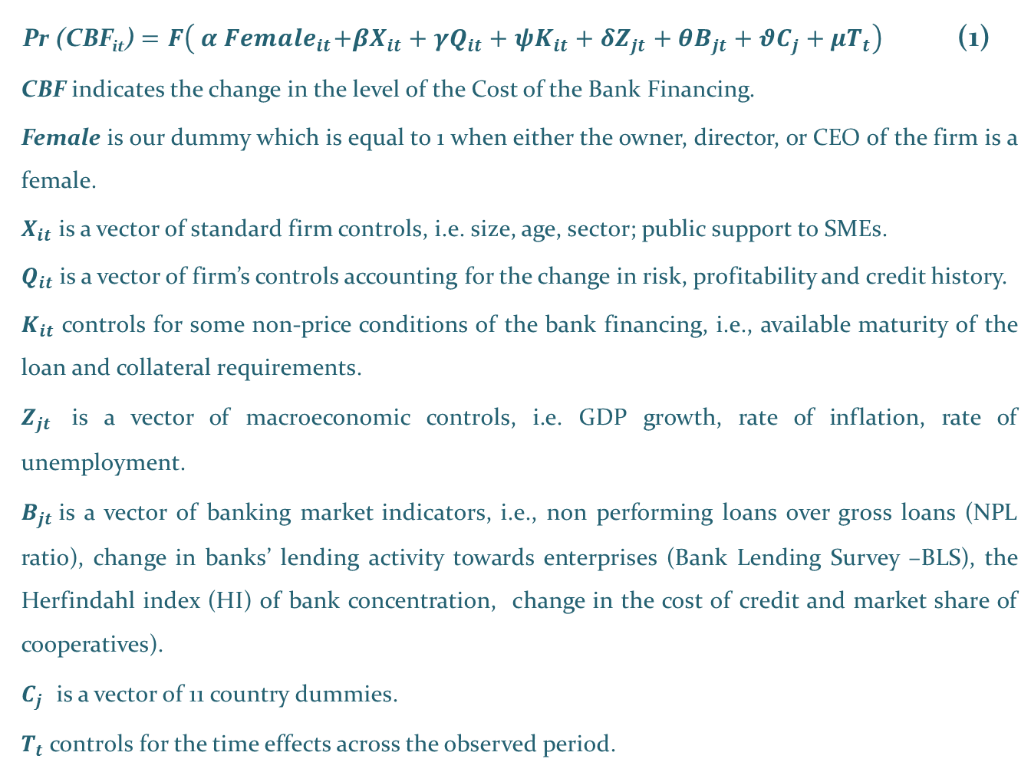
Empirical model #1
Pr (CBF_{it}) $=F\left({ α Female}_{it}+{βX}_{it}+{γQ}_{it}+ψK_{it}+{δZ}_{jt}+{θB}_{jt}+{θC}_{j}+{μT}_{t}\right)$ (1)
CBF indicates the change in the level of the Cost of the Bank Financing.
Female is our dummy which is equal to 1 when either the owner, director, or CEO of the firm is a female.
$X_{it}$ is a vector of standard firm controls, i.e. size, age, sector; public support to SMEs.
$Q_{it}$ is a vector of firm’s controls accounting for the change in risk, profitability and credit history.
$K_{it}$ controls for some non-price conditions of the bank financing, i.e., available maturity of the loan and collateral requirements.
$Z_{jt}$ is a vector of macroeconomic controls, i.e. GDP growth, rate of inflation, rate of unemployment.
$B_{jt}$is a vector of banking market indicators, i.e., non performing loans over gross loans (NPL ratio), change in banks’ lending activity towards enterprises (Bank Lending Survey –BLS), the Herfindahl index (HI) of bank concentration, change in the cost of credit and market share of cooperatives).
$C_{j}$ is a vector of 11 country dummies.
$T_{t}$ controls for the time effects across the observed period.

Slide 24
Table 1.b – Variable definition and sources
Variables | Description | Source
Dependent variables
Change in the level of interest rates | Ordinal variable that equals one/two/three if the level of interest rates – experienced by each firm – decreased/remained unchanged/increased during the past six months, respectively. | ECB: SAFE
Change in the level of the cost of financing | Ordinal variable that equals one/two/three if the level of the cost of financing (other than interest rates) – experienced by each firm – decreased/remained unchanged/increased during the past six months, respectively. | ECB: SAFE
Gender dummies
Female | Dummy variable that equals one if the firm’s owner/director/CEO is female, and zero otherwise. | ECB: SAFE
Male-to-Female | Dummy variable that equals one if a firm experienced a change in the leadership (from a male to a female owner/director/CEO). | ECB: SAFE
Female-to-Male | Dummy variable that equals one if a firm experienced a change in the leadership (from a female to a male owner/director/CEO). | ECB: SAFE
Controls for firm quality
Leverage up | Dummy variable that equals one if a firm experienced an increase in the debt-to-assets ratio in the past six months. | ECB: SAFE
Leverage down | Dummy variable that equals one if a firm experienced a decrease in the debt-to-assets ratio in the past six months. | ECB: SAFE
Profit up | Dummy variable that equals one if a firm experienced an increase of the net income after taxes in the past six months. | ECB: SAFE
Profit down | Dummy variable that equals one if a firm experienced a decrease of the net income after taxes in the past six months. | ECB: SAFE
Creditworthiness up | Dummy variable that equals one if the firm’s credit history improved in the past six months. | ECB: SAFE
Creditworthiness down | Dummy variable that equals one if the firm’s credit history worsened in the past six months. | ECB: SAFE
Controls for the non-price conditions of the bank financing
Maturity up | Dummy variable that equals one if a firm experienced an increase in the available maturity of the loan in the past six months. | ECB: SAFE
Maturity down | Dummy variable that equals one if a firm experienced a decrease in the available maturity of the loan in the past six months. | ECB: SAFE
Collateral up | Dummy variable that equals one if a firm experienced an increase in the collateral requirements in the past six months. | ECB: SAFE
Collateral down | Dummy variable that equals one if a firm experienced a decrease in the collateral requirements in the past six months. | ECB: SAFE
Additional firm controls
Micro | Dummy variable that equals one if the firm has between 1 and 9 employees. | ECB: SAFE
Small | Dummy variable that equals one if the firm has between 10 and 49 employees. | ECB: SAFE
Medium | Dummy variable that equals one if the firm has between 50 and 249 employees. | ECB: SAFE
Very recent | Dummy variable that equals one if the firm is less than 2 years old. | ECB: SAFE
Recent | Dummy variable that equals one if the firm is between 2 and 5 years old. | ECB: SAFE
Old | Dummy variable that equals one if the firm is between 5 and 10 years old. | ECB: SAFE
Construction | Dummy variable that equals one if the firm’s main activity is construction. | ECB: SAFE
Manufacturing | Dummy variable that equals one if the firm’s main activity is manufacturing. | ECB: SAFE
Wholesale/Retail | Dummy variable that equals one if the firm’s main activity is wholesale or retail trade. | ECB: SAFE
Not fully autonomous | Dummy variable that equals one if the firm is part of a profit-oriented enterprise, not taking fully autonomous financial decisions. | ECB: SAFE
Autonomous | Dummy variable that equals one if the firm is an autonomous profit-oriented enterprise, making independent financial decisions. | ECB: SAFE
Public support up | Dummy variable that equals one if a firm experienced an improvement in the access to public financial support in the past six months. | ECB: SAFE
Public support down | Dummy variable that equals one if a firm experienced a worsening in the access to public financial support in the past six months. | ECB: SAFE
Country level controls
GDP Growth | The annual growth rate of real GDP based on averages of quarterly data for each survey round. | OECD
Inflation | The annual inflation rate based on averages of quarterly data for each survey round. | OECD
Unemployment | The annual unemployment rate based on averages of quarterly data for each survey round. | Eurostat
Concentration | The Herfindahl index (HI) of total assets concentration (for the banking sector). | ECB: Data Warehouse
BLS | The bank credit standards (in the previous three months) based on averages of quarterly data for each survey round. | ECB: BLS
Cost of borrowing | The annual change in the cost of borrowing for loans to non-financial firms. | ECB: Data Warehouse
Cooperatives | The market share of cooperative banks. | European Association of Co-operative Banks
NPL ratio | The ratio of bank non-performing loans over total gross loans. | World Bank

Slide 25
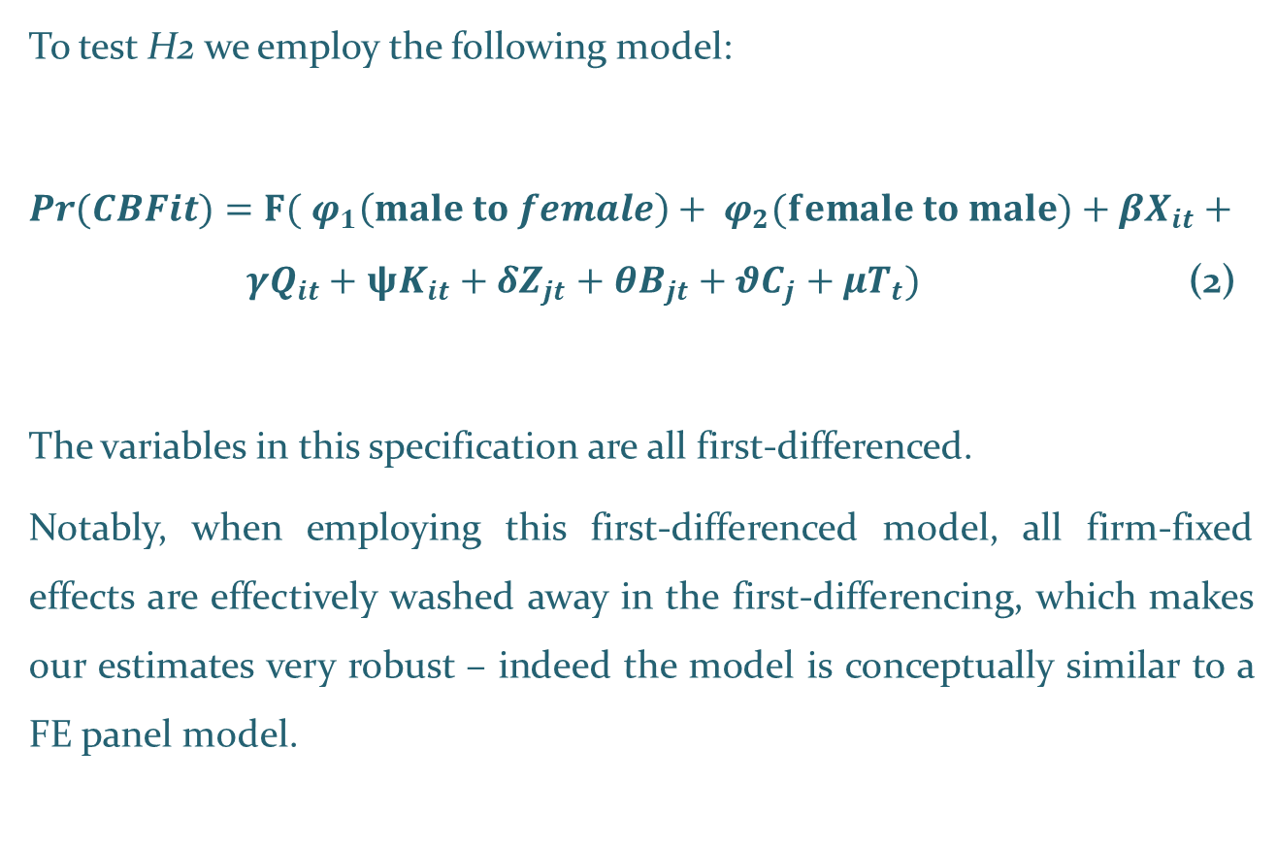
Empirical model #2
  To test H2 we employ the following model:
  $\operatorname{Pr}{(CBFit)}=F( φ_{1}\left(male to female\right)+ φ_{2}(female to male)+{βX}_{it}+ {γQ}_{it}+ψK_{it}+{δZ}_{jt}+{θB}_{jt}+{θC}_{j}+{μT}_{t})$ (2)
  The variables in this specification are all first-differenced.
  Notably, when employing this first-differenced model, all firm-fixed effects are effectively washed away in the first-differencing, which makes our estimates very robust – indeed the model is conceptually similar to a FE panel model.

Slide 26
Table 2 – Summary statistics
Variables | Observations | Mean | St. Dev. | p1 | p99
Dependent variables
Level of interest rates | 19,969 | 2.317 | 0.748 | 1.000 | 3.000
Level of the cost of financing | 19,774 | 2.485 | 0.581 | 1.000 | 3.000
Gender dummies
Female | 19,969 | 0.110 | 0.312 | 0.000 | 1.000
Male-to-Female | 5,915 | 0.033 | 0.179 | 0.000 | 1.000
Female-to-Male | 5,915 | 0.034 | 0.182 | 0.000 | 1.000
Controls for firm quality
Leverage up | 19,969 | 0.328 | 0.469 | 0.000 | 1.000
Leverage down | 19,969 | 0.282 | 0.450 | 0.000 | 1.000
Profit up | 19,969 | 0.240 | 0.427 | 0.000 | 1.000
Profit down | 19,969 | 0.501 | 0.500 | 0.000 | 1.000
Creditworthiness up | 19,969 | 0.237 | 0.426 | 0.000 | 1.000
Creditworthiness down | 19,969 | 0.214 | 0.410 | 0.000 | 1.000
Controls for the non-price conditions of the bank financing
Maturity up | 19,969 | 0.080 | 0.271 | 0.000 | 1.000
Maturity down | 19,969 | 0.095 | 0.293 | 0.000 | 1.000
Collateral up | 19,969 | 0.366 | 0.482 | 0.000 | 1.000
Collateral down | 19,969 | 0.030 | 0.170 | 0.000 | 1.000

Slide 27
Table 2 – Summary statistics (cont.)
Variables | Observations | Mean | St. Dev. | p1 | p99
Additional firm controls
Micro | 19,969 | 0.259 | 0.438 | 0.000 | 1.000
Small | 19,969 | 0.344 | 0.475 | 0.000 | 1.000
Medium | 19,969 | 0.302 | 0.459 | 0.000 | 1.000
Very recent | 19,969 | 0.015 | 0.120 | 0.000 | 1.000
Recent | 19,969 | 0.060 | 0.238 | 0.000 | 1.000
Old | 19,969 | 0.119 | 0.324 | 0.000 | 1.000
Construction | 19,969 | 0.098 | 0.297 | 0.000 | 1.000
Manufacturing | 19,969 | 0.243 | 0.429 | 0.000 | 1.000
Wholesale/Retail | 19,969 | 0.296 | 0.457 | 0.000 | 1.000
Public support up | 19,969 | 0.049 | 0.215 | 0.000 | 1.000
Public support down | 19,969 | 0.275 | 0.447 | 0.000 | 1.000
Country level controls
GDP Growth | 19,969 | -0.212 | 2.553 | -8.200 | 5.050
Inflation | 19,969 | 1.830 | 1.133 | -0.900 | 4.900
Unemployment | 19,969 | 12.170 | 6.494 | 4.700 | 27.400
Concentration BLS Cost of borrowing | 19,969 19,969 19,969 | 0.076 9.053 -0.100 | 0.064 15.288 0.877 | 0.021 -6.000 -2.947 | 0.355 85.000 1.323
Cooperatives | 19,969 | 23.930 | 18.501 | 0.000 | 60.300
NPL ratio | 19,969 | 7.426 | 5.940 | 0.500 | 31.899

Slide 28
Empirical strategy #1
We estimate an ordered logit model because:
our dependent variable is qualitative and strictly ordinal: Firms report the cost of bank loans in the previous six months as having “increased”, “remained unchanged”, or “deteriorated”, labeled respectively by 3, 2, 1.
This technique allows the use of continuous variables and multiple categorical variables as regressors.
We employ a pooled cross section analysis. All regressions include time and country dummies. Heteroskedasticity-robust standard errors, clustered at the country level, appear in parentheses.

Slide 29
Empirical strategy #1 - causality
As correlation is not causation to handle the issue we adopt two strategies:
first we include in model (1) an interaction term of the “female” dummy with a variable accounting for the firm performance.
The idea is to alleviate concerns that the observed variations in the cost of financing are driven by deteriorations in profits (experimented by female-led firms), rather than by the possible discrimination itself.

Slide 30
Empirical strategy #1 – causality and endogeneity
Potential endogeneity problem may surround the gender of a firm’s leader
  With no attempt to address endogeneity, one cannot provide evidence of a causal relation
Starting with Model 1 we cope with endogeneity
  utilizing three-step IV regressions à la Berger et al. (2016) – the share of female employment by sector of activity is used to instrument our female dummy
As for Model 2, we face possible endogeneity issues by employing
two-step system GMM approach

Slide 31
Empirical strategy #1 – iv method
The use of an instrumental variable (IV) method requires the identification of instruments that satisfy the following two criteria, namely the instruments i) must be correlated with the key explanatory variable, and ii) cannot be correlated with the error term.
We therefore identify the share of female employment by sector of activity (i.e., construction, manufacturing, mining, wholesale/retail) as a good instrument for our female variable.
Such ratio, drawn from Eurostat, is available for each country in our sample and for each survey round (i.e., we computed it as averages of quarterly data).

Slide 32
Empirical strategy #1 - iv method
Because female is dichotomous, we employ a dummy endogenous variable model and apply a three-step approach as proposed in Wooldridge (2002) and implemented by Berger et al. (2016).
This approach implies the use of a probit model for the first step, where we regress our female dummy on the rate of female employment and all the controls from model (1). The fitted value from the first step is then used as an instrument for the second stage.
Thus, the second step is a regression of the endogenous variable “female” on the predicted probability from the first stage and all controls.
Finally, the third stage is a regression of the change in the cost of bank financing on the predicted value from the second stage and all the controls as in model (1).

Slide 33
Empirical strategy #1 - robustness checks
We perform some additional robustness checks
- controlling for public support
-controlling for financial autonomy:
excluding subsidiaries and branches
Additional analyses
- cross-county heterogeneity
(three clusters based on Global Gender Gap Index, The World Economic Forum)
- macroeconomic shocks
Sovereign debt crisis (waves 3, 4, 5; i.e., from 1st April 2010 – until 30th September 2011) and announcement of the Outright Monetary Transaction (OMT) Program launched in 2012 (waves 8, 9, 10; i.e., from 1st October 2012 until 31st March 2014).

Slide 34
Table 3
The impact of gender on the level of interest rates

Slide 35
Table 4
The impact of gender on the level of the other costs

Slide 36
Table 5
Marginal effects
 | Change in the level of Interest rates |  |  |  |  | Change in the level of the cost of financing other than interest rates
 | dy/dx |  | dy/dx |  |  | dy/dx |  | dy/dx
 | Y=decreased |  | Y=increased |  |  | Y=decreased |  | Y=increased
 | (1) |  | (2) |  |  | (3) |  | (4)
Female | -0.012 | ** | 0.026 | ** |  | -0.004 | *** | 0.042 | ***
Controls for firm quality
Leverage up | -0.016 | * | 0.033 | * |  | -0.004 | * | 0.034 | ***
Leverage down | 0.005 |  | -0.010 |  |  | 0.003 | *** | -0.025 | **
Profit up | -0.002 |  | 0.005 |  |  | 0.003 | * | -0.028 | **
Profit down | -0.020 | *** | 0.042 | *** |  | -0.002 |  | 0.019
Creditworthiness up | 0.018 | *** | -0.035 | *** |  | 0.002 | * | -0.019 | ***
Creditworthiness down | -0.037 | *** | 0.082 | *** |  | -0.006 | * | 0.060 | ***
Controls for the non-price conditions of the bank financing
Maturity up | 0.010 |  | -0.020 |  |  | -0.004 |  | 0.039
Maturity down | -0.039 | *** | 0.090 | *** |  | -0.011 | *** | 0.115 | **
Collateral up | -0.076 | *** | 0.167 | *** |  | -0.024 | *** | 0.242 | ***
Collateral down | 0.101 | *** | -0.158 | *** |  | 0.036 | *** | -0.204 | ***
Additional firm controls
Micro | 0.002 |  | -0.003 |  |  | -0.008 |  | 0.079
Small | -0.002 |  | 0.004 |  |  | -0.006 |  | 0.052 | *
Medium | 0.004 |  | -0.009 |  |  | -0.003 |  | 0.024 | *
Very recent | -0.026 |  | 0.058 |  |  | 0.013 | *** | -0.093 | ***
Recent | 0.014 | * | -0.027 | ** |  | 0.005 |  | -0.042
Old | 0.001 |  | -0.002 |  |  | 0.003 |  | -0.027
Construction | -0.003 |  | 0.005 |  |  | -0.002 |  | 0.017
Manufacturing | 0.009 | ** | -0.019 | ** |  | -0.001 |  | 0.013
Wholesale/Retail | 0.003 |  | -0.006 |  |  | -0.002 |  | 0.016
Observations | 19,969 |  | 19,969 |  |  | 19,774 |  | 19,774

Slide 37
Table 6: Ologit and IV estimates

Slide 38
Table 7
Robustness: Controlling for public support

Slide 39
Table 8
Robustness: controlling for financial autonomy

Slide 40
Table 9
Exploring country and “time” heterogeneity

Slide 41
Empirical strategy #2 – Panel analysis
We exploit the panel nature of our dataset for
testing the second hypothesis (H2) of our study.
Indeed, the SAFE dataset has a complex panel structure where the number of firms that were repeatedly surveyed in more than one survey wave is limited.
Therefore, we employ an ordered logit panel model with random effects.
We use cluster (at the country-level) robust standard errors to control for possible heteroskedasticity and serial dependence across groups in the error structure.

Slide 42
Empirical strategy #2 – Dynamic System GMM estimates
Some papers have raised the concern that change in the gender leadership might not be fully exogenous.
Because of their features – that is, higher attendance at boards, better monitoring abilities, greater aptitude in solving conflicts (see, for instance, Adams and Ferreira, 2009) – women may be more likely to be appointed when firms are in critical conditions (see Adams and Ferreira, 2009; Campbell and Vera, 2010).

Slide 43
Empirical strategy #2 – Dynamic System GMM estimates
To address such concern we employ a two-step Dynamic System GMM approach (Roodman, 2009), as in Liu et al. (2014), and Pathan and Faff (2013).
Indeed, this is a suitable method
to overcome potential endogeneity issues arising from reverse causality and possible unobserved factors, and
to cope with the challenge of identifying proper exogenous instruments for our dummies that capture the change in the gender leadership.

Slide 44
Empirical strategy #2 – Dynamic System GMM estimates
Similarly to Pathan and Faff (2013), the model now includes one lag of the dependent variable as additional regressor.
Technically speaking, this approach allows us to treat the key dummies and all the explanatory variables as endogenous while using their past values as instruments.
All the explanatory variables are treated as endogenous with the exception of the country-level regressors and time dummies, as in Wintoki et al. (2012) and Pathan and Faff (2013).

Slide 45
Table 10
Change in leadership

Slide 46
Table 11
Change in leadership

Slide 47
Table 12
Change in leadership GMM

Slide 48
Empirical strategy #2 – Dynamic System GMM estimates
The diagnostic tests provided in Table 12 highlight that the model is properly fitted, with statistically insignificant statistics for both the second-order autocorrelation (i.e., AR(2)) test and the test of over-identifying restrictions (i.e., Hansen).

Slide 49
Conclusions/1
With all the caveats of the empirical investigation, our approach seems to exclude the presence of statistical discrimination (as we control for an ample series of firm characteristics).
Rather, our findings seem to support the hypothesis of prejudicial discrimination by the lender that lacks of objective standards when judging female-led applicants.

Slide 50
Conclusions/2
Our results show that:
female-led enterprises face a higher probability of being confronted with a worsening in the cost of the bank financing than male-led ones.
  female-led firms are 2.6% and 4.2% more likely to experience a worsening in the level of interest rates and in the other costs of the bank financing than their male counterparts, respectively.
Results turn to be robust to different model specifications and different econometric strategies.
We provide evidence of cross-countries heterogeneity: the female dummy is positive and significant for the first two clusters (i.e., the Southern and the “Germanic” countries), while no signs of discrimination seem to emerge from the “Northern” group (i.e., Finland and Ireland).
During the period of the Sovereign debt crisis, female-led firms appear to be more discriminated against male firms, compared to the period that followed the OMT announcement.

Slide 51
Conclusions/3
Our results show that:
The change in leadership from female to male increases the likelihood to experience a decrease in the level of interest rates
This highlights the existence of a sort of qualitative premium that firms may gain when experiencing a shift from a woman to a man leader.

Slide 52
Conclusions/interpretation
At least two explanations can be provided to support our findings.
First, we could argue that the loan officers may see women as less able to run a business, as opposed to men (Alesina et al., 2013). This aversion by the lenders hence results in worse price conditions of the bank loans.
Second, women may be more likely to experience higher costs of the bank funding because of their poorer bargaining ability when dealing with the bankers (i.a., Babcock and Laschever , 2003; Croson and Gneezy, 2009).
A deeper scrutiny of these two explanations would require additional information and investigation that are beyond the scope of this paper.

Slide 53
Conclusions/policy implications
Indeed, the existence of such biases plays in favour of the adoption of policy measures, addressed to female-led businesses, aimed at softening the burden of their bank financing as well as enhancing their entrepreneurial opportunities.

Slide 54
Further research
Albeit the robustness of our findings,
we are aware of the limitations that arise from the use of a survey-based dataset without any link to the firm’s financial statements.
we are conscious that the availability of information on the levels of education of the firms’ leaders would be an ideal additional asset to enhance our analyses.
Addressing such limitations, therefore, may lay the ground for future research.

Slide 55
THANK YOU
stefania.rossi@deams.units.it

