Slide 1


Psicologia dei processi cognitivi 1
Percezione 042PS-2
Lezione 16
15/05/2019
misura dell’effetto Stroop in classe
TR di elaborazione del colore (colour naming task)
TR di elaborazione della parola (word naming task)
Il compito di ricerca visiva
ricerca visiva seriale e TR di processamento dei singoli elementi
misura dell’effetto di conjunction search in classe
TR come sonda della memoria a breve termine e paradigma di Sternberg
prof. Carlo Fantoni
STP
2018-2019

Slide 2


Slide 3
elaborare il colore della parola
ROSSO richiede più tempo ed è più difficile di elaborare il colore della parola BLU
per verificare l’effetto bisogna eseguire un compito individualmente e
con molte prove

Slide 4

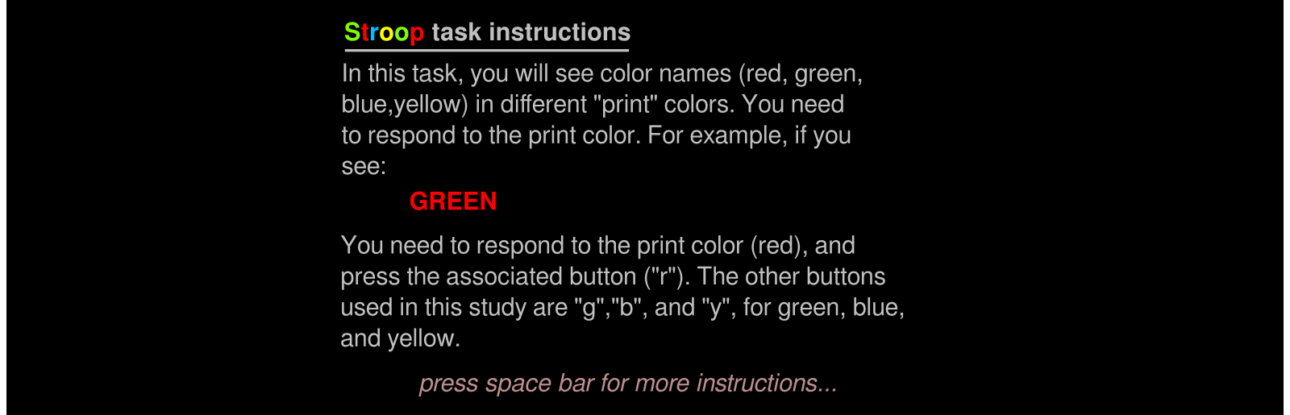

proviamolo con psytoolkit
https://www.psytoolkit.org/experiment-library/stroop.html

Slide 5
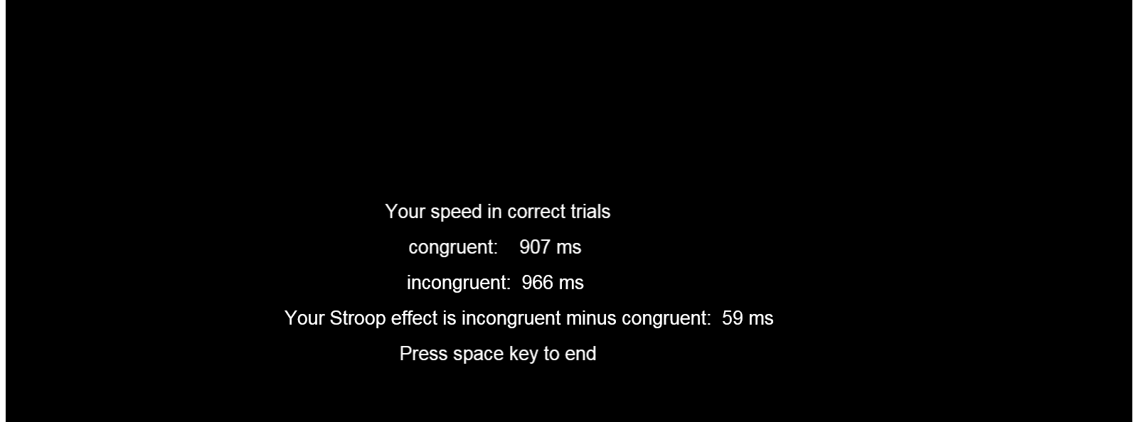
alla fine
(codifica risposte e dati)

Slide 6

alla fine
(codifica risposte e dati)
Cliccate

Slide 7
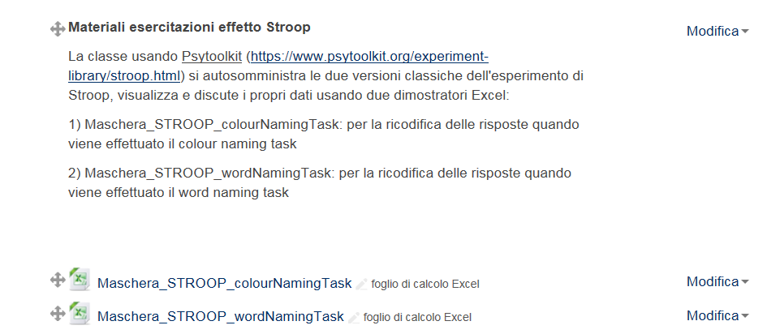
Maschere di codifica su Moodle2

Slide 8
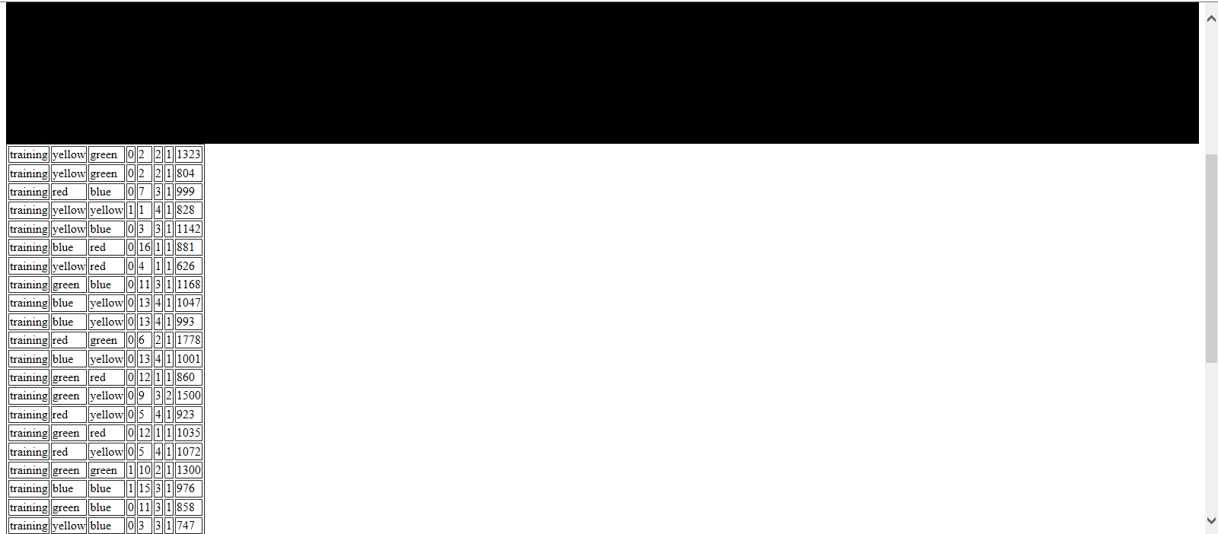

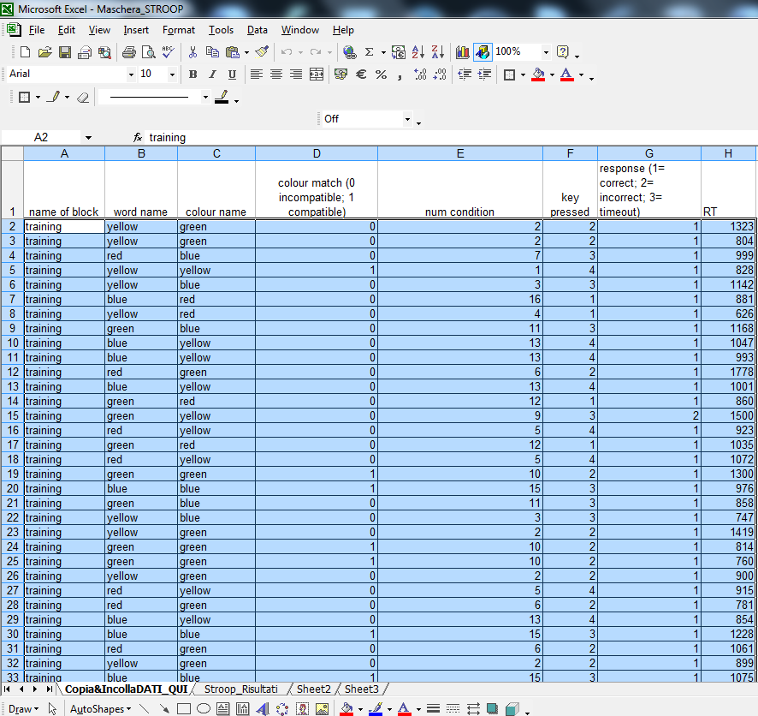

output risposte grezze
(codifica risposte e dati)
Seleziona e copia (ctrl + c)
Apri Maschera STROOP colournamingTask e seleziona la cella A2 e incolla (ctrl + v) i dati

Slide 9
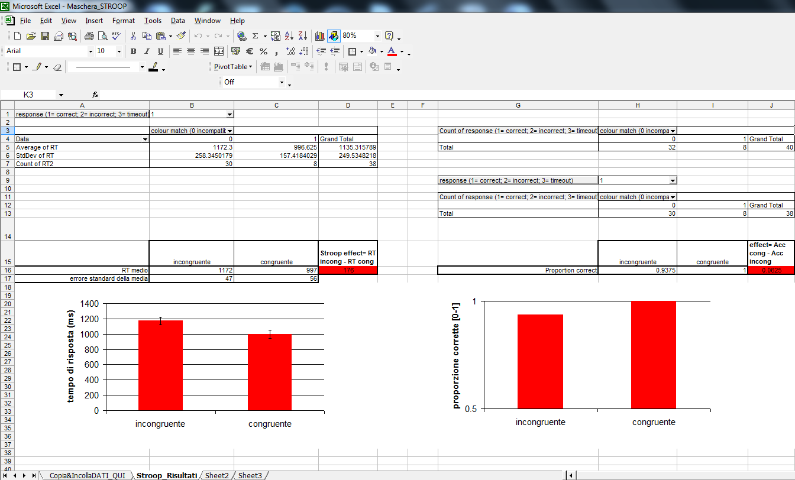
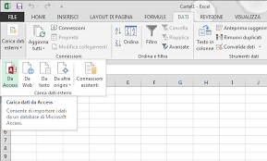
visualizza e analizza i tuoi dati
sul worksheet Stroop Risultati
1. vai su DATI e premi il tasto aggiorna

Slide 10
effetto Stroop
condizione neutrale – non fatta –: denominare il colore di un disco (non parola)
interferenza: denominare il colore del nome incongruente
facilitazione: denominare il colore del nome congruente
perchè?
Notes:
10

Slide 11
lo stimolo ROSSO
composito (compound)
parola + colore
diverso accesso
parola (accesso automatico) + colore (accesso controllato)
interferenza parola-colore: accesso automatico al significato delle parole che interferisce con il tempo di decodifica del colore
se è vero cosa manca?
Notes:
Nessuno tuttavia fino a Stroop pensò di combinare le parole con i colori. Since 1935, there have been hundreds of experiments conducted on the Stroop effect. C. M. MacLeod (1991) provides an overview of the findings, proposed theories and some well-grounded empirical facts (some of which are listed at the end of this discussion).

Slide 12
interferenza
parola colore vs. colore parola
paradigma completo (Stroop, 1935)
stroop classico
denomina il colore
stroop invertito
denomina la parola
ROSSO
ROSSO
ROSSO

Slide 13
verifichiamo con psytoolkit
https://www.psytoolkit.org/experiment-library/stroop.html
fate adesso il compito denominando la parola
attenzione! non seguite le istruzioni di psytoolkit ne il feedback automatico sulla corettezza della risposta
usate sempre gli stessi tasti per denominare la parola non il colore (“r”, “g” mano sx; “b”, “y” mano dx)
se vedete ROSSO la risposta corretta è il tasto “r”
usa la maschera_STROOP_wordnamingTask per ricodificare i dati
confrontiamo le performances
inviatemi file con grafico

Slide 14
TR come sonda del tempo di processamento visivo seriale
paradigma di ricerca visiva
(Treisman & Gelade, 1980)
Notes:
14
L’esperimento di stroop è basato sui TR ma certo non misura la durata di una certa operazione mentale. Sternberg studiava I processi con cui avviene la ricerca all’interno della MBT. SCopo era di stabilire se la ricerca era seriale o parallela

Slide 15
ricerca visive nel binding
conjunction search
o ricerca visiva seriale
Notes:
Conjunction search (also known as inefficient or serial search)^{[4]} is a visual search process that focuses on identifying a previously requested target surrounded by distractors possessing one or more common visual features with the target itself.^{[8]}
Questo tipo di Visual Search è noto perchè permette di rilevare il tempo processamento degli elementi di una serie.
An example of a conjunction search task is having a person identify a red X (target) amongst distractors composed of black Xs (same shape) and red Os (same color).^{[8]} Unlike feature search, conjunction search involves distractors (or groups of distractors) that may differ from each other but exhibit at least one common feature with the target.^{[8]} The efficiency of conjunction search in regards to reaction time(RT) and accuracy is dependent on the distractor-ratio^{[8]} and the number of distractors present.^{[5]} As the distractors represent the differing individual features of the target more equally amongst themselves(distractor-ratio effect), reaction time(RT) increases and accuracy decreases.^{[8]} As the number of distractors present increases, the reaction time(RT) increases and the accuracy decreases.^{[4]} However, with practice the original reaction time(RT) restraints of conjunction search tend to show improvement.^{[9]} In the early stages of processing, conjunction search utilizes bottom-up processes to identify pre-specified features amongst the stimuli.^{[5]} These processes are then overtaken by a more serial process of consciously evaluating the indicated features of the stimuli^{[5]} in order to properly allocate one's focal spatial attention towards the stimulus that most accurately represents the target.^{[10]} In many cases, top-down processing affects conjunction search by eliminating stimuli that are incongruent with one's previous knowledge of the target-description, which in the end allows for more efficient identification of the target.^{[6][7]} An example of the effect of top-down processes on a conjunction search task is when searching for a red 'K' among red 'Cs' and black 'Ks', individuals ignore the black letters and focus on the remaining red letters in order to decrease the set size of possible targets and, therefore, more efficiently identify their target

Slide 16
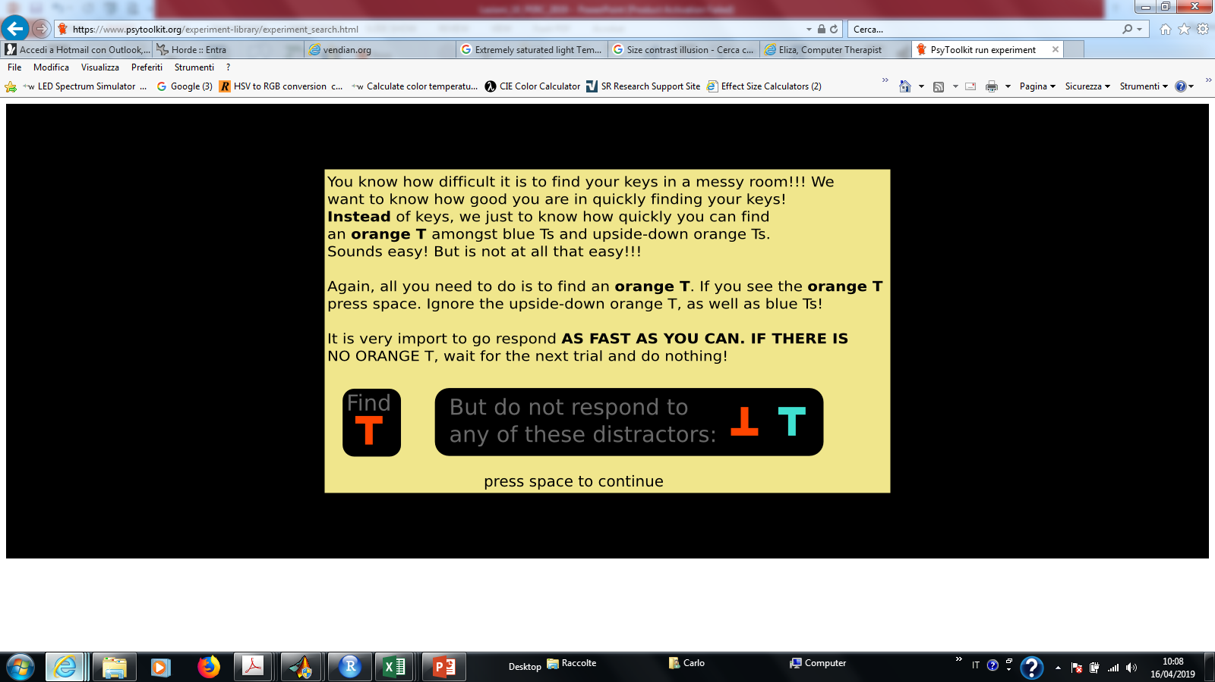
Il compito
Cerca la
Non rispondere mai a qualunque dei seguenti distrattori

Slide 17

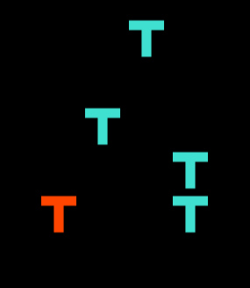
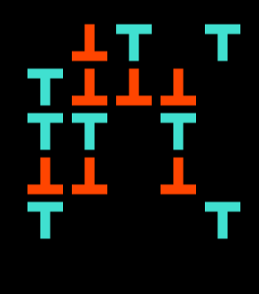
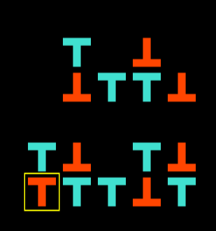
verifichiamo con psytoolkit
https://www.psytoolkit.org/experiment-library/search.html
Notes:
http://www.scholarpedia.org/article/Visual_search
Rate of search
Slopes of RT x set size functions for target-present trials of simple, inefficient searches (e.g. for a letter among other letters) are on the order of 20-40 msec/item. If items were being processed one after the other in series and if items were never revisited during a search (see next section), this would seem to imply that each item takes 40-80 msec to process; meaning that 12-25 items would be processed each second. (Why? In the serial, self-terminating search described here, observers will need to search through an average of (N+1)/2 items in order to find the target.).
A problem arises here because estimates of the minimum time required to recognize a single object are almost always greater than 100 msec. One solution is to assume that multiple items (perhaps all items) are processed in parallel (Palmer, 1995). A somewhat different approach notes that the slope of the RT x set size function is a measure of throughput but not necessarily a measure of the time required to process each item. A carwash can serve as a metaphor for this sort of pipeline process. It might take three minutes to wash each car, but the next car does not have to wait for the first car to be completely washed before entering. The carwash’s throughput might be one car every 30 seconds. The key insight is that while only one car can enter at a time, multiple cars can be in the carwash simultaneously (Wolfe, 2003).

Slide 18

seguite attentamente
la schermata di istruzioni

Slide 19
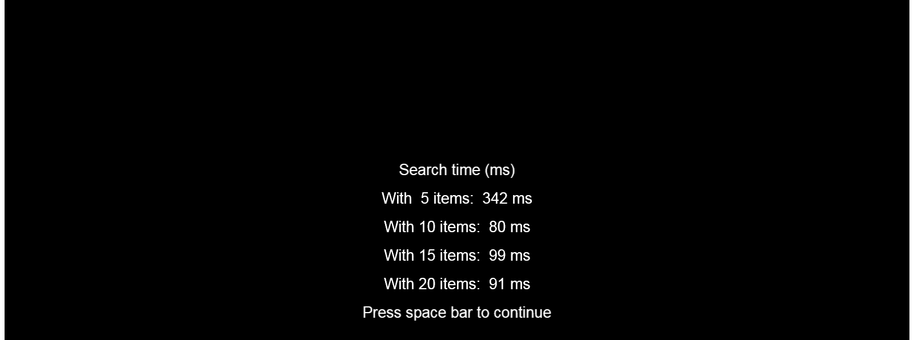
alla fine
(output sintetico)

Slide 20
alla fine
(codifica risposte e dati)
Cliccate, quindi selezionate e copiate i dati come in Stroop (ctrl + c)

Slide 21

output risposte grezze
(codifica risposte e dati)
Apri Maschera ConjunctionSearch seleziona la cella A2 e incolla (ctrl + v) i dati

Slide 22

Maschere di codifica su Moodle2

Slide 23
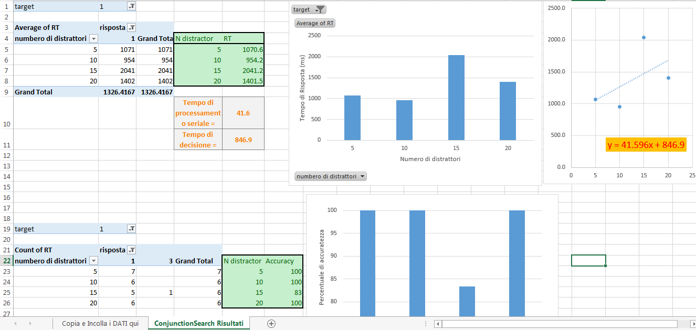
visualizza i tuoi dati
sul worksheet ConjunctionSearch Risultati
1. vai su DATI e premi il tasto aggiorna
Notes:
Slopes of RT x set size functions for target-present trials of simple, inefficient searches (e.g. for a letter among other letters) are on the order of 20-40 msec/item. If items were being processed one after the other in series and if items were never revisited during a search (see next section), this would seem to imply that each item takes 40-80 msec to process; meaning that 12-25 items would be processed each second. (Why? In the serial, self-terminating search described here, observers will need to search through an average of (N+1)/2 items in order to find the target.).

