Slide 1
University of Trieste
21 May 2019
Student: Caterina Vizintin

Slide 3
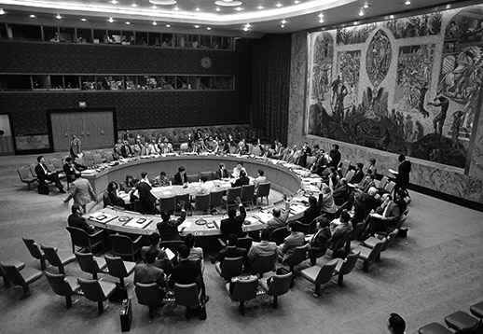
1992 Commission of Experts
25 May 1993 Resolution 827 ICTY

Slide 4
Arusha, United Republic of Tanzania
The Hague, Netherland

Slide 6
JUDGES
Elected by the UN (4 years)
Persons of high moral character, impartiality, integrity

Slide 7
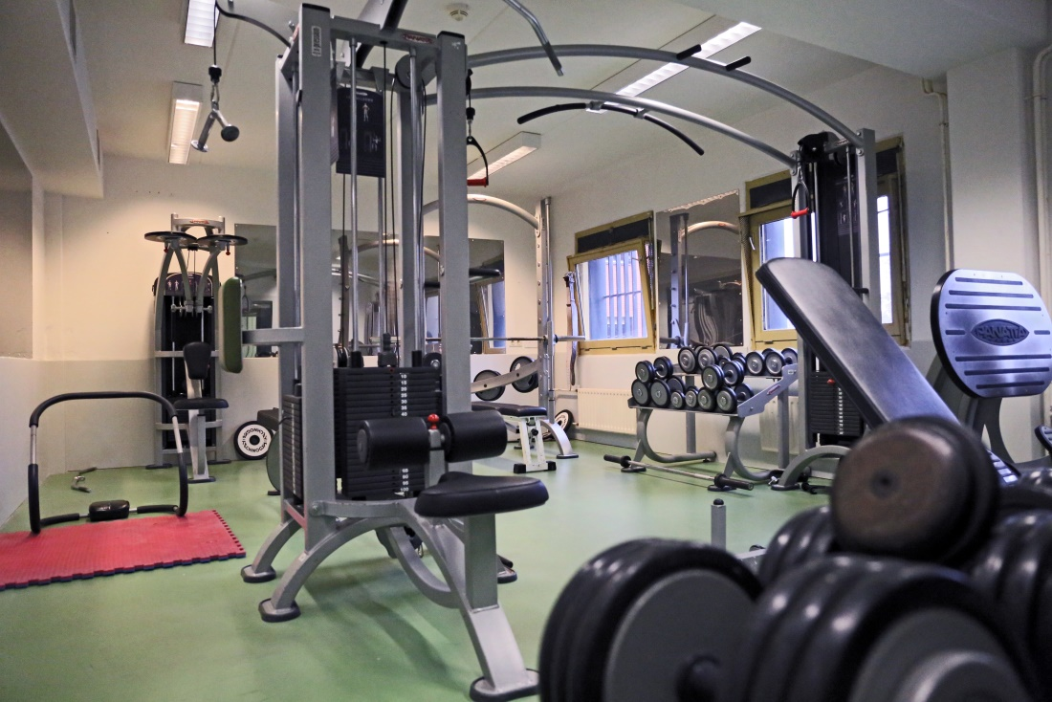
Detention

Slide 9
Crimes under ICTY Jurisdiction
Grave breaches of the 1949 Geneva conventions
Violations of the laws or customs of war
Genocide
Crimes against humanity
→ The tribunal has played a historic role in the prosecution of some crimes

Slide 10
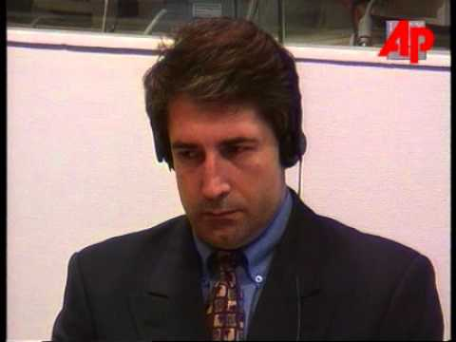
Sexual violence
Rape as a form of torture
Sexual enslavement
Sexual assault against man
Duško Tadić case. «Prijedor»

Slide 11
Genocide-Srebrenica
→First convictions for genocide in Europe to be entered by an international criminal tribunal
→7,000 persons killed
→20 individuals indicted by the ICTY for crimes committed in Srebrenica in 1995
→More than 1,000 witness testimonies

Slide 12
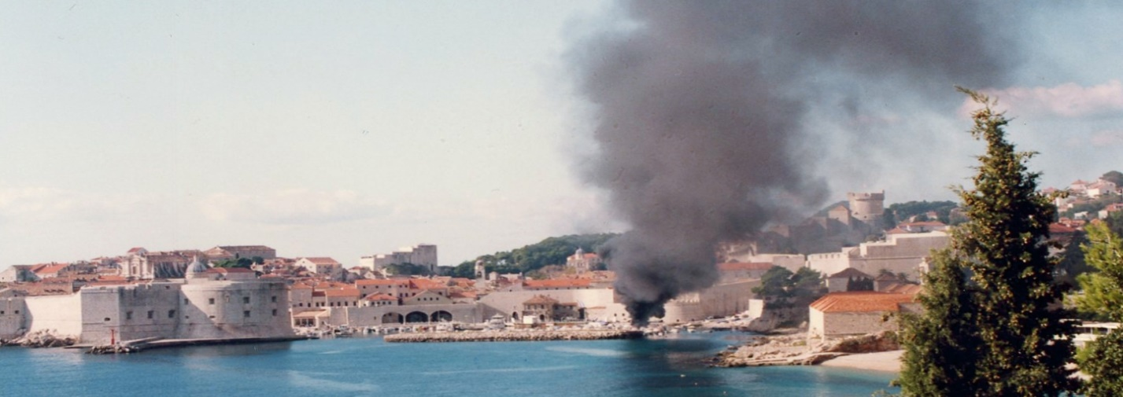
Crimes against CulturalHerritage
Kordić & Čerkez (IT-95-14/2) ''Lašva Valley''
Strugar (IT-01-42) "Dubrovnik"

Slide 13
Thank you!

