Slide 1
The norwegian COURT system
May 21st 2019
Elisabetta Favro

Slide 2
presentation
Main historical points
The court system
Lay judges

Slide 3
some main historical points
950: creation of ting
1300: King Haakon V and appeal to the king
1607: introduction of instances to appeal
1661: Supreme Court in Copenhagen
1797: high courts replace courts of appeal
1995: district courts become the first instance for all matters

Slide 4
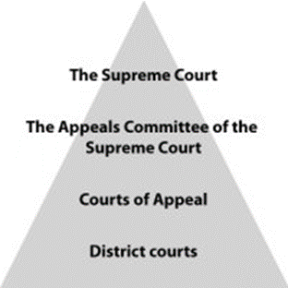
The court system
Ordinary/extraordinary courts of justice
Ordinary courts: three levels
District courts (63)
Courts of appeal (6)
Supreme Court
No constitutional court

Slide 5
DISTRICT COURTS (tingrett)
Jurisdiction in all matters
Conciliation boards (forliksråd)
3 lay members + 3 deputies
not all matters – excluded:
Family law
Trademark and patent issues
Cases against authorities
Cases with an opinion issued by an independent complaints committee

Slide 6
DISTRICT COURTS
CRIMINAL CASES
CIVIL CASES
Number of judges
Full confession + defendant agrees → 1 professional
Regular trials → 3 (1 professional, 2 lay)
Difficult cases → 5 (2 professional, 3 lay)
Majority of votes for verdicts and sentences
Number of judges
1 professional
+ 2 lay demanded by each party (optional)
+ 2 lay demanded by the law in certain cases

Slide 7
Courts of appeal (lagmannsrett)
Right to appeal
Civil cases
Criminal cases
Screening committee
Cases with more than 6 years imprisonment must proceed
If a case will clearly be not successful it can be decided by the s.c.
CIVIL CASES
3 professional judges (+2/4 lay judges)
CRIMINAL CASES
< 6 years → 7 judges (3 p., 4 l.)
5/7 for conviction
> 6 years → 3 p.j. + 10 jurors
7/10 for conviction
Verdict can be set aside by p.j. for a retrial

Slide 8
Supreme court (Høyesterett)
Estabilished in 1815
20 members appointed by the King
Right to appeal heavily restricted
Functions:
Uniformity of legal process
Resolution of matters on which the law is unclear
Evolution of the law

Slide 9
SUPREME COURT
4 institutional forms
Committee of 3 justices – interlocutory orders and appeals against judgments (leave to proceed)
Panel of 5 justices – daily work
Grand Chamber, 11 justices – compatibility statutory law/Constitution and international conventions
Plenary session, 20 justices – compatibility statutory law/human rights conventions
SUPREME COURT’S APPEAL COMMITTEE (Høyesteretts ankeutvalg)
3 Supreme Court justices appointed by the Chief Justice
Proceedings in writing
Leave from the A.C. is required for penal cases from the Court of appeal and in civil cases where the appeal < 100.000 NOK
Rejects appeals if the possibility of success is obviously non-existent

Slide 10
Lay judges
Appointed by the local authority for a period of 4 years
Judgement by peers
Civil and criminal cases
Expert lay judges
Judges/jury
Drawn from two panels (men and women)
Counterbalance to «official power»

Slide 11
Thank you for your attention

