Slide 1
The Annual Willem C. Vis International Commercial Arbitration Moot
Corso di Inglese giuridico
Giulia Picci

Slide 2
Index
What is arbitration?
Enforcement
Advantages
Disadvantages
The Willem C. Vis Commercial Arbitration Moot
What
Who
When
Where
Why

Slide 3
What is arbitration? Enforcement
Arbitration is a method of dispute settlement using private entities known as «arbitral tribunals»
Arbitral tribunals usually consist of either one or three arbitrators
Dispute decisions are called «arbitral awards» (final and binding)
Any arbitration proceeding is based on a written agreement between the parties
Two types of arbitration are available → institutional and ad-hoc

Slide 4
Advantages
Arbitration is private
Freedom and flexibility
Arbitrators are experts
Arbitral awards are enforceable
Arbitration may save time

Slide 5
Disadvantages
No appeals
Costs
Rules of evidence
Not public

Slide 6
What Who Where When
The Willem C. Vis International Commercial Arbitration Moot is a competition for law students established in 1993 The language of the competition is English It is based on a dispute arising out of an imaginary contract of sale
Law students from all over the world participate every year in the moot (this year there were almost 400 teams)
The moot takes place in Vienna
The moot starts the week before Easter

Slide 7
Timeline
End of Summer → after a selection, a team of students is formed
October → the problem is released. Teams start working on the case in order to write a memorandum for Claimant
Early December → memorandum for Claimant has to be submitted. Teams start working on the memorandum for Respondent
End of January → memorandum for Respondent has to be submitted
From February to March → teams attend the pre-moots that are organized all around the world
April → general rounds: every team has to dispute 4 rounds —> elimination rounds: only 64 teams with the highest ranking score can compete, eliminating each other —> the best team wins the competition

Slide 8
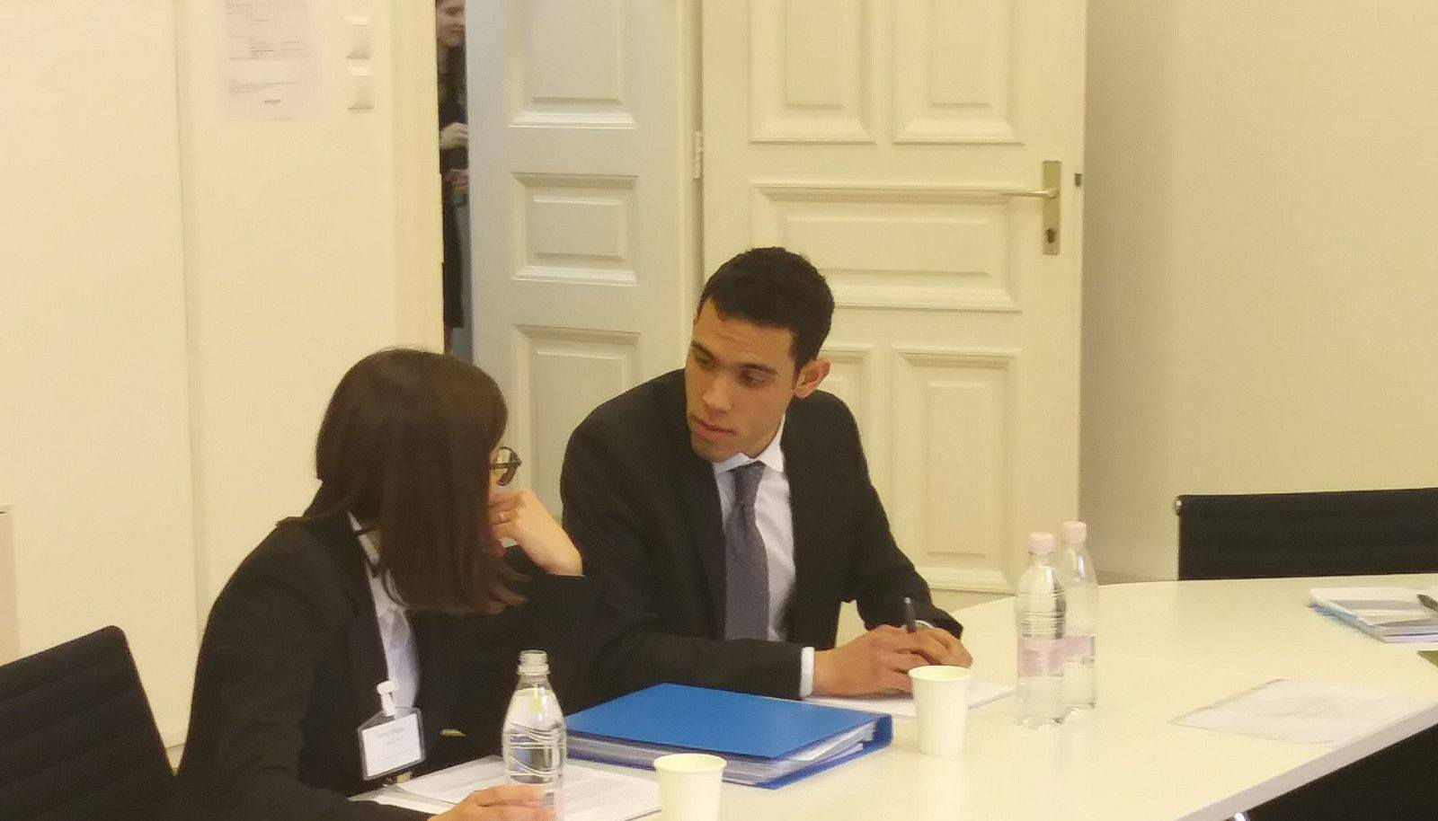
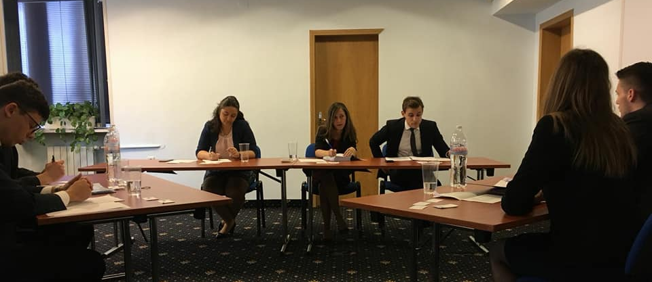
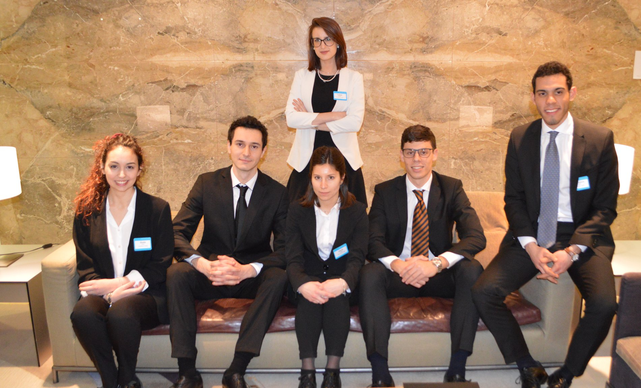

Slide 9
Why
A unique occasion to challenge yourself and to put into practice the things that you have learnt at university
A possibility to get to know different legal systems and approaches
A way to gain more confidence in yourself, to practice English and to learn to speak in public
A chance to meet students from all over the world
An opportunity to visit new places

Slide 10
Thank you for your attention

