Slide 1
Approach to aging and cellular senescence through bioactive compounds
Università degli Studi di Trieste
Dipartimento di Scienze della Vita
International Master’s Degree in Neuroscience
Neuro-molecular targets of nutraceuticals
Martina Canova – martina.canova@studenti.units.it
Valentina Tiriticco – valentina.tiriticco@studenti.units.it

Slide 2
Summary
Inflamm-aging and Senescence
Nutraceutical
Polyphenols, composts with anti-senescence and anti-inflammatory properties
Curcumin
Resveratrol
Flavanols
Others
Dietary intervention
Future perspectives

Slide 3
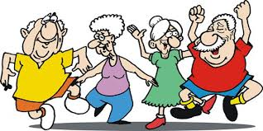
Aging
Aging is the result set of many changes that occur in cells and in tissues over time.
It is a multifactorial biological process that is characterized by:
Increase of the vulnerability to stressors
Progressive increase of a pro-inflammatory state
Age-related Diseases (ARDs)
Type 2 diabetes mellitus
Neurodegenerative & Cardiovascular diseases
Arthrosis
Cancers
Notes:
aging
What is?
Inflammaging
ARDs (age-related diseases)
The ever deeper study of the cellular and molecular mechanisms involved in the aging process have shown how lifestyle and nutrition play a fundamental role.
Many studies have also shown that cell senescence is at the basis of the onset of aging and age-related diseases.

Slide 4
Cellular Senescence
Cellular senescence is a process that imposes permanent proliferative arrest on cells in response to various stressors.
It is a cell-autonomous anti-proliferative program reflecting the normal aging process (hallmark of aging)
It also can be induced and plays an important role in restricting the propagation of damaged and defective cells.
Notes:
Cell senescence: It is a cellular process that involves the permanent arrest of the cell cycle and therefore of the proliferative capacity in response to a great variety of stress factors

Slide 5
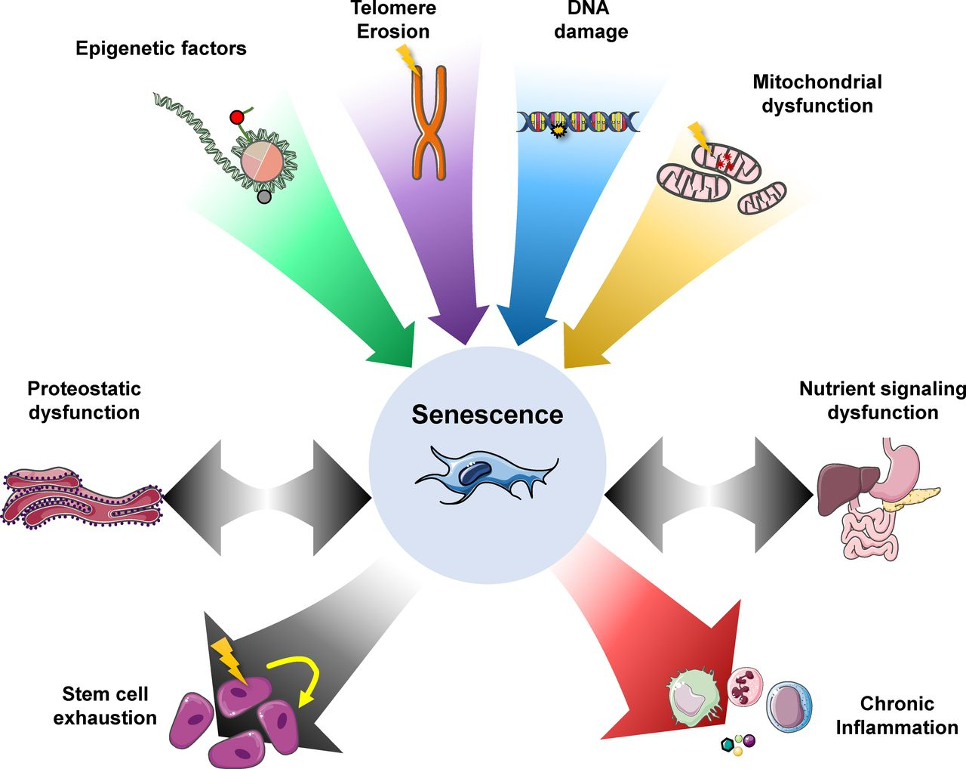
Notes:
The stress factors that lead to cellular senescence are various
It is possible to induce cells to senescence both in vitro and in vivo by applying exogenous or endogenous stimuli

Slide 6
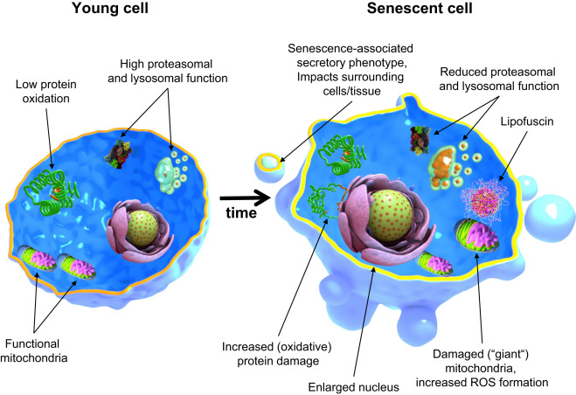
Notes:
The senescent cell acquires a particular morphology observable both in vitro and in vivo

Slide 7
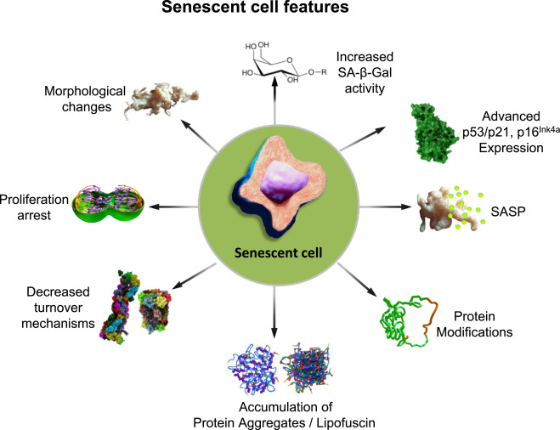
Notes:
Typical characteristics of senescent cells

Slide 8
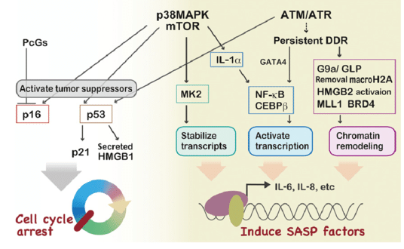
The SASP
The senescence-associated secretory phenotype is characterized by a powerful pro-inflammatory action and participates in microenvironmental modulation.
Factors differ in relation to the cell type and stressor involved:
IL-1α/β
IL-6
IL-8
TGF-β
TNF-α
Notes:
The set of signalling proteins produced by senescent cells is called SASP
SASP is mainly induced by the activation of the transcription factor NF-kB which, as we can see from the scheme, is an effector of the MAPK kinase pathway.

Slide 9
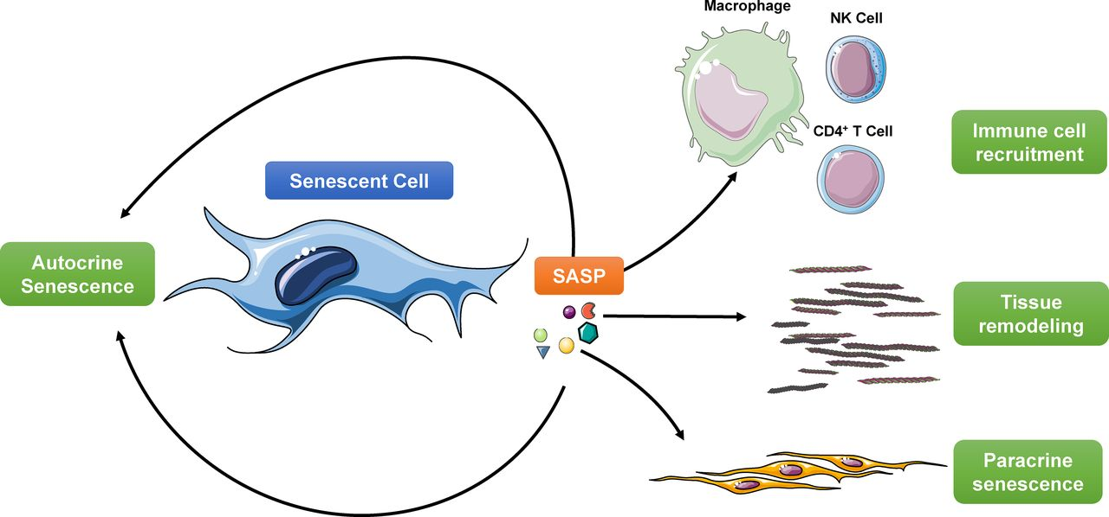
Some of these SASP can induce or reinforce the senescent phenotype by acting in an AUTOCRINE and PARACRINE manner, spreading senescence via a “BYSTANDER EFFECT”
The demonstration that senescence cell (SC) clearance is sufficient to delay ARD development and extend lifespan in mice has prompted intense research into the pathways leading to SC build-up and the molecular mechanism governing the SASP, with a view to developing new therapeutic strategies to eliminate SCs and/or attenuate the systemic and local effects of the SASP
Notes:
Some of these molecules can induce or strengthen the senescent phenotype by acting in an autocrine and paracrine manner, that is spreading senescence through a "bystander effect".
The release of SASP factors at the paracrine and systemic level feeds inflammation and induces the recruitment of immune cells (also thanks to NF-kB that we mentioned earlier as this activates inflamosome).
In vivo studies have shown that factors associated with SASP are over-expressed in all elderly organisms analyzed and are also involved in the development and progression of ARDs (age-related diseases).
The demonstration that the clearness of senescent cells is sufficient to delay the progression of ARDs and to extend the life span in mice has promoted many researches aimed at understanding the pathways that lead to senescence and that govern SASP factors with the aim of finding new targets and therapeutic strategies.

Slide 10
The goal of promoting healthy aging
2 mechanisms:
SC clearance → senolytic compounds
SASP suppression → anti-SASP compounds
3 types of compounds:
Synthetized
Semi-synthetized
Completely natural
Notes:
The goal of promoting healthy aging can be achieved by at least two molecular mechanisms: suppression of SASP and / or clearance of SC by senolytic compounds.
Compounds with anti-aging or anti-SASP properties can be divided into those that are completely synthesized (because they are not found in nature), semi-synthesized (by chemical modification of substances obtained from microorganisms or plants) or completely natural.

Slide 11
Synthetic compounds
Dasatinib → tyr kinase inhibitor
Navitoclax (ABT-263) → activator of the mitochondrial apoptotic pathway, inhibiting Bcl family members
Other Bcl inhibitors → siRNA inhibitors targeting Bcl family
Notes:
The SCs are mainly characterized by the loss of proliferation capacity. Cell cycle arrest has long been considered a powerful anticancer mechanism that prevents the expansion of premalignant cells.
However, the characteristics of senescence are expressed in premalignant tumours, in which the progression towards neoplasia requires the evasion of senescence.
Therefore among the synthesized drugs that have shown senolytic action we find some antitumor drugs.
Let's remember for example:
DASATINIB, an oral tyrosine kinase inhibitor that inhibits the ability of cells to duplicate and migrate by inducing apoptosis
NAVITOCLAX is also an activator of the mitochondrial apoptotic pathway - it inhibits the BCL family and promotes the release of the pro-apoptotic factor BIM
Also short interfering RNAs target BCL and demonstrate an effective senolytic action

Slide 12
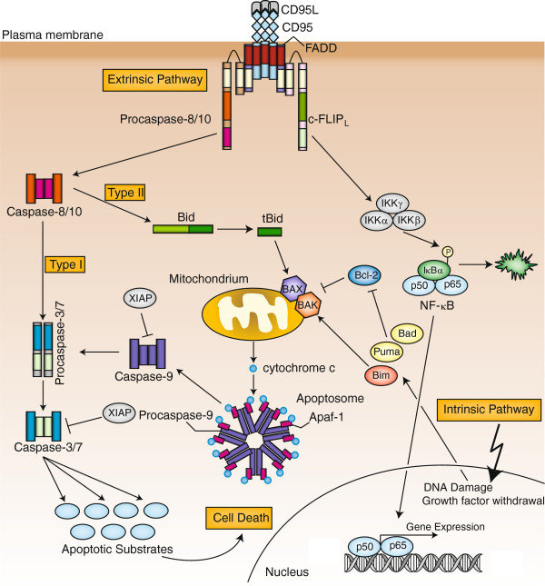

Slide 13
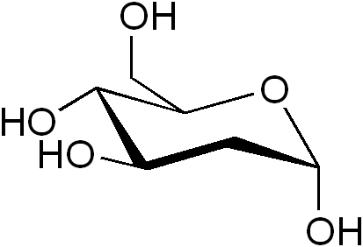
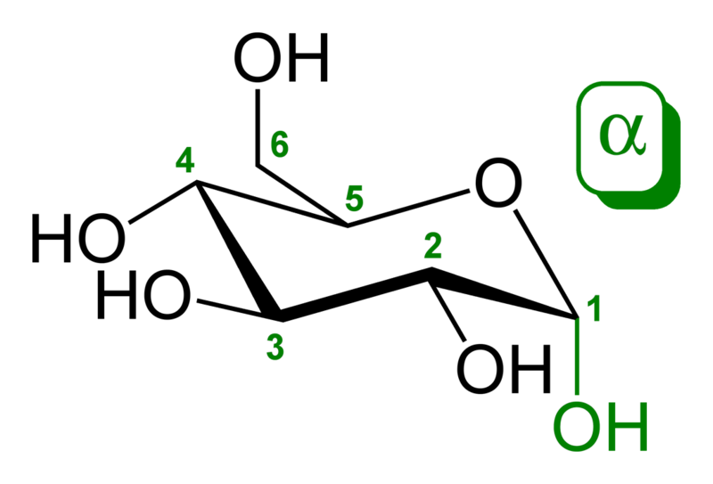
Synthetic compounds
Dasatinib → tyr kinase inhibitor
Navitoclax (ABT-263) → activator of the mitochondrial apoptotic pathway, inhibiting Bcl family members
Other Bcl inhibitors → siRNA inhibitors targeting Bcl family
HSP90 inhibitors
2-deoxy-D-glucose (2-DG)
Notes:
The SCs are mainly characterized by the loss of proliferation capacity. Cell cycle arrest has long been considered a powerful anticancer mechanism that prevents the expansion of premalignant cells.
However, the characteristics of senescence are expressed in premalignant tumors, in which the progression towards neoplasia requires the evasion of senescence.
Therefore among the synthesized drugs that have shown senolytic action we find some antitumor drugs.
Let's remember for example
DASATINIB, an oral tyrosine kinase inhibitor that inhibits the ability of cells to duplicate and migrate by inducing apoptosis
NAVITOCLAX is also an activator of the mitochondrial apoptotic pathway - it inhibits the BCL family and promotes the release of the pro-apoptotic factor BIM
Also short interfering RNAs target BCL and demonstrate an effective senolytic action

Slide 14
Synthetic compounds
Dasatinib → tyr kinase inhibitor
Navitoclax (ABT-263) → activator of the mitochondrial apoptotic pathway, inhibiting Bcl family members
Other Bcl inhibitors → siRNA inhibitors targeting Bcl family
HSP90 inhibitors
2-deoxy-D-glucose (2-DG)
Metformin → lowering of p16/p21, inhibits NF-kB and mTOR pathways and activates intracellular AMPK
JAK inhibitors
Aspirin → anti-inflammatory activity

Slide 15
There are many and severe ADVERSE EFFECTS
The use is limited to conditions where they have a favourable benefit/risk ratio.
Dasatinib → haematological toxicity, GI and respiratory side effects
Navitoclax (ABT-263) → GI effects and thrombocytopenia
Other Bcl inhibitors → effects limited to few cell-types
HSP90 inhibitors → poor solubility and high toxicity
2-deoxy-D-glucose (2-DG)
Metformin → GI effects and rare but severe lactic acidosis
JAK inhibitors → immune system diseases
Aspirin → GI side effects

Slide 16
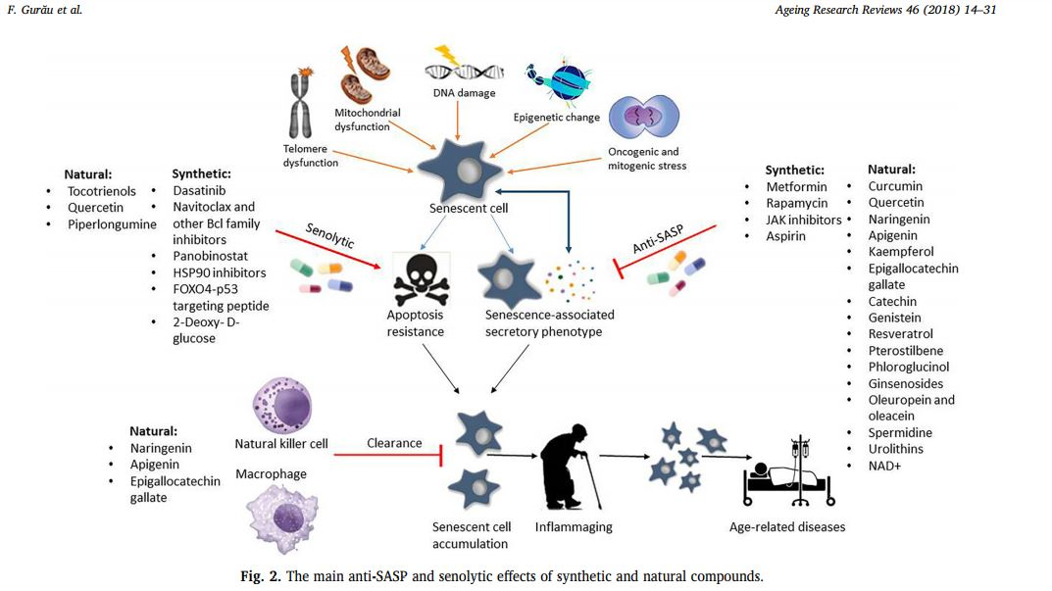
Bioactive compounds in food can help prevent pathological conditions,
and/or mimic the anti-aging drug action, but without the adverse effects.
Notes:
Collegamento, paragrafo 4 del 3o articolo
Substances from the natural world that can interact w/ biological precesses are referred to as bioactive compounds; those contained in food have been named “nutraceuticals”. Intense research work is being devoted to identify nuticeuticals that can help prevent pathological conditions, and/or mimic the anti-aging drug action, but w/o the adverse effects.
Little (but ample) evidence has been provided for the anti-SASP effects of a number of natural compounds, while data on their senolytic activity are even more limited.
Several studies have suggested that a diet which is high in antioxidants-rich foods, in particular polyphenols, is positively linked w/ cognitive performance in the elderly, and reduces cognitive decline and risk of dementia. We will focus on the three most largely investigated polyphenolic compounds, but first: what does Nutraceutical stand for?

Slide 17
Nutraceutical = Nutrient + pharmaceutical
(i) for food of vegetal origin, a nutraceutical is the phytocomplex; and (ii) for food of animal origin, a nutraceutical is the pool of secondary metabolites. Both are concentrated and administered in the proper pharmaceutical form. They are capable of providing beneﬁcial health effects, including the prevention and/or the treatment of a disease.
As commonly used in marketing, it has no regulatory definition → it's used for products available on the market without proper assessment of their beneficial health effects.
But efficacy, together with safety, is to be considered of utmost importance for nutraceuticals.
It is often confused with other terms (also because of the administration of the pharmaceutical form – pills, tablets and capsules).
Notes:
Nutraceutica x3 slide
The term nutraceutical is a syncretic neologism of the words nutrient and pharmaceutical. It should be noted that the term nutraceutical, as commonly used in marketing, has no regulatory definition, it's used for products available on the market w/o proper assessment of their beneficial health effects. But efficacy, together with safety, is to be considered of utmost importance for nutraceuticals. It is often confused with other terms. One possible source of confusing information could be administration of the pharmaceutical form – pills, tablets and capsules – which can be the same for food supplements and nutraceuticals.
Cfr: https://www.ncbi.nlm.nih.gov/pmc/articles/PMC3257668/

Slide 18
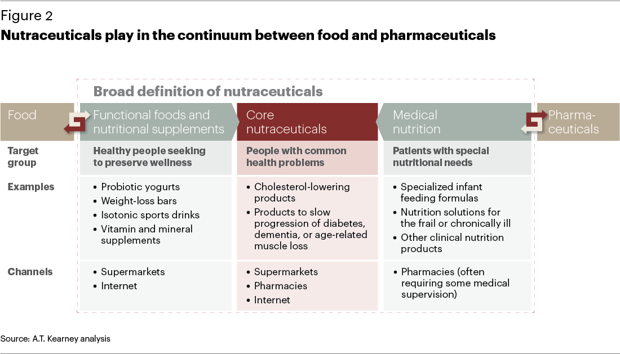
→ Nutraceuticals must have a proven pharmacological effect and rationale to be used in a pathological condition (in addition to their nutritional value), unlike food supplements and other food-derived substances, including herbal derivatives.
Notes:
Functional foods = similar in appearance to conventional foods; the former being consumed as part of the normal diet. In contrast to conventional foods, functional foods, however, have demonstrated physiological benefits and can reduce the risk of chronic disease beyond basic nutritional functions.
Nutraceuticals = Nutritional products that provide health and medical benefits, including the prevention and treatment of disease.
Food supplement = Food product whose purpose is to supplement the normal diet and which consists of a concentrated source of nutrients or other substances with nutritional effects or physiological, single or in combination, marketed in dosed formulations, such as capsules, tablets, tablets or pills, designed to be taken in small individual quantities measured.

Slide 19
A. Santini et al.: Regarding nutraceuticals, we propose the following deﬁnition: (i) for food of vegetal origin, a nutraceutical is the phytocomplex; and (ii)for food of animal origin,a nutraceutical is the pool of secondary metabolites. Both are concentrated and administered in the proper pharmaceutical form. They are capable of providing beneﬁcial health effects, including the prevention and/or the treatment of a disease.[...] Food supplements are often confused with functional food, which, as per their de ﬁnition, are food-derived products (or food with the addition of one or more active compounds) that are included as part of a normal diet with the aim of obtaining beneﬁcial health effects. These supplements and functional foods can compensate and/or can have a beneﬁcial effect due to the addition of speciﬁc components if there is a lack of one micro- or macronutrient in the body. They may not have any proven pharmacological effect.[...] Medicinal products are well-deﬁned for speciﬁc indications. They must follow speciﬁc legislation on efﬁcacy,safety, production and use in therapy to be authorized and marketed.
Nutraceuticals contain many active substances extracted from a vegetal matrix (as a phytocomplex) or from animal origin that are concentrated and administered in suitable pharmaceutical form, and as per their deﬁnition, they must have a proven pharmacological effect and rationale to be used in a pathological condition (in addition to their nutritional value), unlike food supplements and other food-derived substances, including herbal derivatives.
[…] The speciﬁcity of nutraceuticals would need a premarket approval system substantiated by scientiﬁc data (in vivo clinicaltrials) showing their complete safety and efﬁcacy proﬁle. The regulatory approach could be based on the one adopted for drugs, which is stricter and more complex.
[…] Moreover, relevant information and data should be related to the complex of substances forming a nutraceutical and should not refer to a single substance (or a mixture of different substances) of natural origin with physiological activity and/or beneﬁcial health effects, highlighting the difference between food supplements and nutraceuticals.
Notes:
Cfr:
http://www.atkearney.es/servicios-de-salud/ideas-perspectivas/article/-/asset_publisher/LCcgOeS4t85g/content/nutraceuticals-the-front-line-of-the-battle-for-consumer-health/10192?inheritRedirect=false&redirect=http%3A%2F%2Fwww.atkearney.es%2Fservicios-de-salud%2Fideas-perspectivas%2Farticle%3Fp_p_id%3D101_INSTANCE_LCcgOeS4t85g%26p_p_lifecycle%3D0%26p_p_state%3Dnormal%26p_p_mode%3Dview%26p_p_col_id%3Dcolumn-4%26p_p_col_count%3D1%26_101_INSTANCE_LCcgOeS4t85g_advancedSearch%3Dfalse%26_101_INSTANCE_LCcgOeS4t85g_keywords%3D%26_101_INSTANCE_LCcgOeS4t85g_delta%3D15%26p_r_p_564233524_resetCur%3Dfalse%26_101_INSTANCE_LCcgOeS4t85g_cur%3D3%26_101_INSTANCE_LCcgOeS4t85g_andOperator%3Dtrue
Dictionaries aside, searching for an authoritative definition of nutraceuticals is an exercise in futility. No broadly accepted legal classification exists, and each market research organization seems to apply its own criteria. At one end of the spectrum are functional foods and beverages, as well as dietary supplements, aimed primarily at maintaining health.5 At the other, more medical end of the spectrum are products aimed at people with special nutritional needs. In the middle is an emerging gray area of products that have a physiological effect to reduce known risk factors, such as high cholesterol, or appear to slow or prevent the progression of common diseases.
A functional food or beverage is one that has been fortified with added or concentrated ingredients to improve health or performance or to obtain a desired result—and is marketed as such. A dietary supplement, as defined by the U.S. Food and Drug Administration, is a product taken by mouth that includes vitamins, minerals, herbs or other botanicals, amino acids, or substances such as enzymes, organ tissues, glandulars, and metabolites.

Slide 20
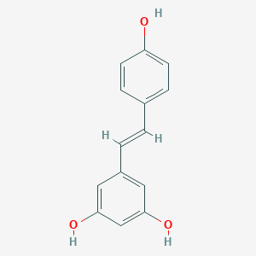
Polyphenols
A group of phytochemicals, frequently conjugated to organic acid and sugars.
The phenolic structure is characterized by one or more aromatic rings;
The hydroxyl groups in the polyphenol structure is positively correlated with increasing redox activity.
In nature, polyphenols are usually water-soluble compounds, but can also be volatile materials.
They can be produced by enzymatic or non-enzymatic reactions as secondary metabolites.
Notes:
https://pubchem.ncbi.nlm.nih.gov/compound/phenol

Slide 21
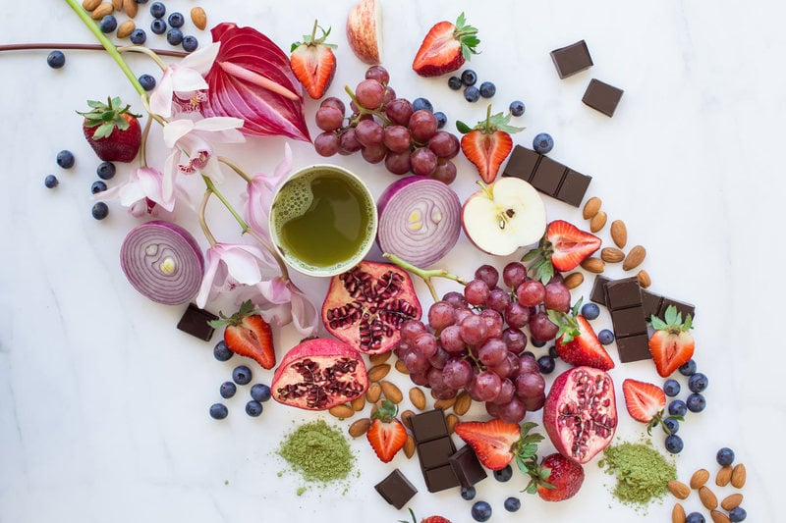

Slide 22
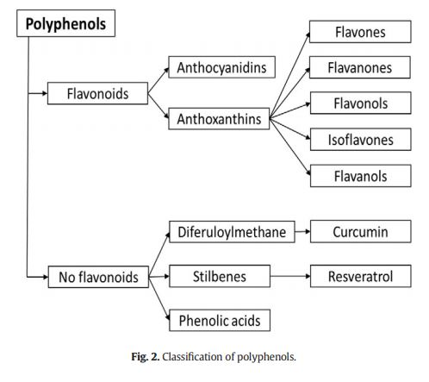
Notes:
PP_chemistry e classificazione
Polyphenols are nutraceuticals of interest for the healthy aging. What are polyphenols?
Polyphenols are a group of phytochemicals, frequently conjugated to organic acid and sugars. The phenolic structure is characterized by one or more aromatic rings; the hydroxyl groups in the polyphenol structure is positively correlated w/ increasing redox activity. In nature, pp are usually water-soluble compounds but can also be volatile materials. They can be produced by enzymatic or non-enymatic reactions as secondary metabolites. We distinguish flavonoids and non-flavonoid compounds.

Slide 23
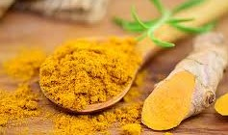
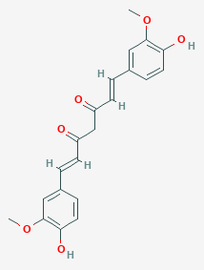
CURCUMIN (C₂₁H₂₀O₆)
1,7-bis-(4-hydroxy-3methoxyphenyl)-hepta-1,6-diene-3,5-dione
The yellow color of turmeric (Curcuma longa Linn).
Turmeric, the powdered rhizome of Curcuma longa, is extensively used as a spice in curries and mustards, is often responsible for their distinct color, and contributes much to their flavor due to the presence of its oleoresins and essential oil. Turmeric is a member of the ginger family (Zingiberaceae).
The antioxidant potential derives from its capacity to scavenge free radicals. Due to its unique structure that can donate H-atoms or transfer electrons from two phenolic sites.
As this phenolic compound is more soluble in lipophilic conditions, it performs the ROS scavenging activity most effectively within the polar cytoplasm.
Notes:
Curcumin (C21H20O6) is the yellow color of turmeric (Curcuma longa Linn), and its chemical name is 1,7-bis-(4-hydroxy-3methoxyphenyl)-hepta-1,6-diene-3,5-dione. The antioxidant potential of curcumin derives from its capacity to scavenge free radicals due to its unique structure that can donate H-atoms or transfer electrons from two phenolic sites. As this phenolic compound is more soluble in lipophilic conditions, it performs the ROS scavenging activity most effectively within the polar cytoplasm.
Turmeric, the powdered rhizome of Curcuma longa, is
extensively used as a spice in curries and mustards, is often
responsible for their distinct color, and contributes much to
their flavor due to the presence of its oleoresins and essential
oil. Turmeric is a member of the ginger family (Zingiberaceae)
and is prescribed abundantly for ailments in both traditional
Chinese and Indian medicine.31 For example, turmeric
preparations are applied to fresh wounds and bruises and as
counterirritants for insect bites. Turmeric paste is used to
facilitate scabbing in chicken pox and small pox. It is used in
urologic diseases, hepatobiliary diseases and as an anthelminthic. Turmeric has also been described as a cancer remedy
in Indian natural medical literature.
Major phytoconstituents of turmeric are diarylheptanoids,
which occur in a mixture termed curcuminoids that generally
make up approximately 1−6% of turmeric by dry weight.

Slide 24
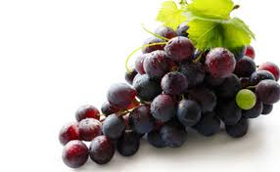
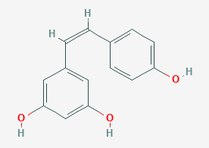
RESVERATROL (C₁₄H₁₂O₃)
3,5,40-trihydroxystilbene
Two geometric isomers: cis-resveratrol (less common and very unstable), trans-resveratrol (biologically more active, well soluble in fat, ethanol and DMSO, but practically insoluble in water).
Resveratrol is produced by numerous plants in response to ultraviolet radiation, injury, fungal or bacterial infection
In red wine, and in natural foods including grape, blueberry and raspberry
Resveratrol demonstrates an unusually strong ability to remove free radicals thanks to the presence of three groups -OH in positions 3, 4 and 5, two aromatic rings and a double bond in the molecule.
Notes:
Resveratrol (C14H12O3) exists in two geometric isomers. CisResveratrol is less common and very unstable, while trans-resveratrol is biologically more active It's well soluble in fat, ethanol and DMSO, but practically insoluble in water. This makes it poorly bioavailable to the human body. Resveratrol demonstrates an unusually strong ability to remove free radicals thanks to the presence of three groups\\OH in positions 3, 4 and 5, aromatic rings and a double bond in the molecule.

Slide 25
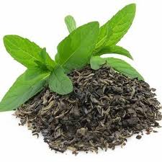
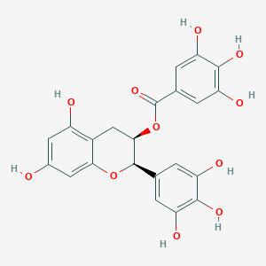
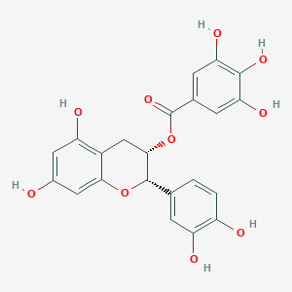
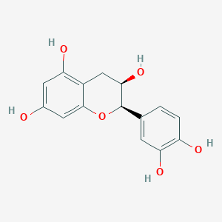
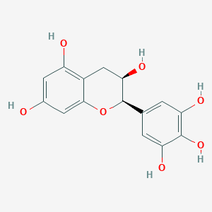
FLAVANOLS
Usually called CATECHINS, they are different from most ﬂavonoids, because they do not possess a double bond between C2 and C3, and they do not possess C4 carbonyl in ring C.
There is a very high content of catechins in green tea.
(−)-epigallo-catechin-3-gallate (EGCG) is the most abundant
(65% catechin content) and the main therapeutic agent of green tea, followed by (−)-epicatechin-3-gallate (ECG), (−)-epicatechin (EC),
(−)-epigallocatechin (EGC), and (+)-catechin (C) .
Notes:
Flavanols, which are usually called catechins, are different from most ﬂavonoids, because they do not possess a double bond between C2 and C3, and they do not possess C4 carbonyl in ring C. There is a very high content of catechins in green tea, comprising 30–42% of solid green tea extract, and (−)-epigallo-catechin-3-gallate (EGCG) is the most abundant (65% catechin content). Among green tea catechins, EGCG is thought to be the main therapeutic agent of green tea, followed by (−)-epicatechin-3-gallate (ECG), (−)-epicatechin (EC), (−)-epigallocatechin (EGC), and (+)-catechin (C)

Slide 26
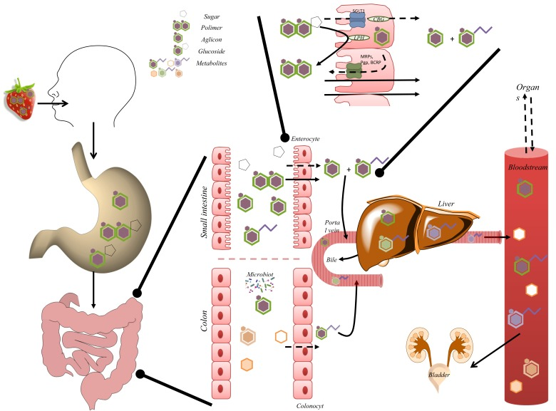
Low bioavailability
Figueira I. et al., 2017
Notes:
PP_Bioavailability
The absorption, rate, metabolism, and biological activities of pp are affected by their composition, but also depend on the direct interaction w/ other dietary components. To reach the brain, they need to cross the enterocytes in the intestine and the BBB (some compounds or metabolites are able to reach the brain). Most pp compounds are normally highly metabolized or quickly eliminated. They undergo a series of removal reactions. Once absorbed, pp compounds are released from the enterocytes into the lymph and subsequently into the blood, and undergo substantial biotransformation in the form of methylation, sulfation, glucuronidation, and thiol conjugation reactions. The biovalitability of: curcumin is low, poorly absorbed (adjuvants are added); resveratrol is low, rapidly metabolized (the metabolites are responsible for the biological activity). Catechins are absorbed, metabolized, excreted within 24h.

Slide 27
THERAPEUTIC BENEFITS from:
Antioxidant activity
Modulatory role in cell signaling
Anti-inﬂammatory activity
→ prevention of multiple diseases, i.e. cardiovascular and neurodegenerative diseases (our main interest), atherosclerosis, type II diabetes, and cancer.
The antioxidant power given by phenolic groups, which can accept an electron to form relatively stable phenoxyl radicals.
Notes:
PP_Pharma_antiossidante
Antioxidant activity; therapeutic beneﬁts also from their modulatory role in cell signaling and anti-inﬂammatory activity; pp may be important in the prevention of multiple diseases, i.e. cardiovascular and neurodegenerative diseases (our main interest), atherosclerosis, type II diabetes, and cancer.
The antioxidant power of polyphenolic compounds is given by phenolic groups, which can accept an electron to form relatively stable phenoxyl radicals. Polyphenols thus disrupt chain oxidation reactions in cellular components.
C: scavenge intracellular smaller oxidative molecules such as H2O2, HON, ROON. Curcumin has also been shown to interact with glutathioneS-transferase and reduced glutathione(GSH), leading to lower ROS production. More importantly, as curcumin restores the glutathione content and induces the antioxidant enzyme, hemeoxygenase-1, it has salubriouseffects on the brain.
R: Some authors prefer to ascribe its positive effect to the upregulation of endogenous antioxidant enzymes such as superoxide dismutase (SOD), glutathione peroxidase (GPx), catalase (CAT) and heme oxygenase, and the downregulation of enzymes involved in the production of ROS, such as xanthine oxidase.
F: EGCG reduces in vivo Aβ (β amyloid)-induced oxidative stress, decreasing hippocampal lipid peroxide in the brains of rats. EGCG also involves the control of antioxidant protective enzymes. A few preclinical studies have highlighted that EGCG increases the levels and the activity of glutathione reductase, GPx, SOD, and CA.

Slide 28
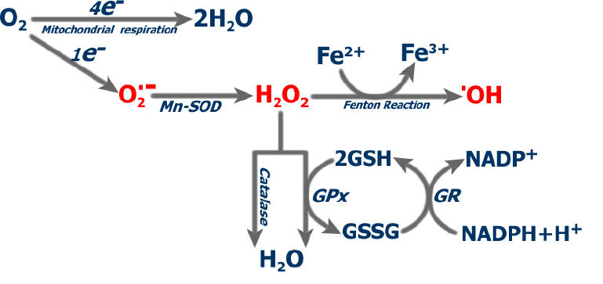
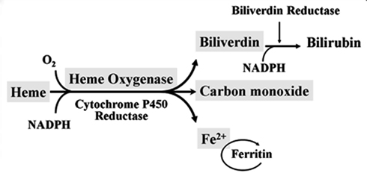
CURCUMIN
Scavenges H₂O₂, and reactive nitrogen species.
Interacts with glutathione-S-transferase and reduced glutathione (GSH) → lower ROS production
Restores the glutathione content and induces the antioxidant enzyme, heme oxygenase-1 (highly inducible and ubiquitous cellular enzyme that subserves cytoprotective responses to toxic insults, including inflammation and oxidative stress)
Valle et al., 2010
Araujo JA et al., 2012

Slide 29
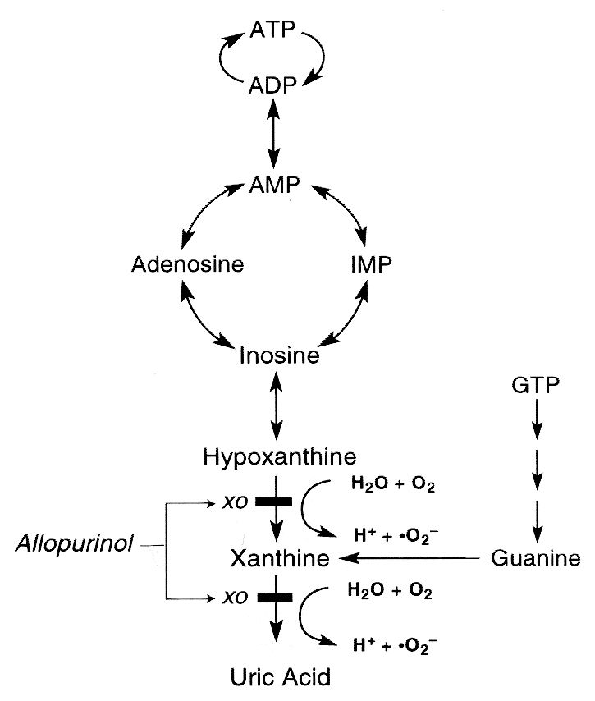
RESVERATROL
Upregulation of endogenous antioxidant enzymes such as superoxide dismutase (SOD), glutathione peroxidase (GPx), catalase (CAT) and heme oxygenase, and downregulation of enzymes involved in the production of ROS, such as xanthine oxidase
P.J.Marro et al., 1997

Slide 30
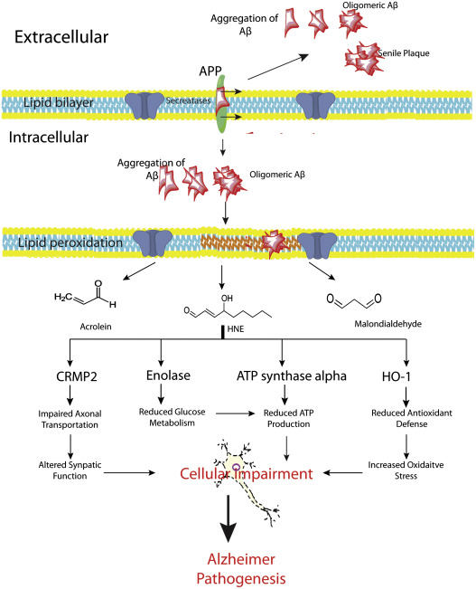
FLAVANOLS (EGCG)
Reduces lipid peroxidation → reduces in vivo Aβ (β amyloid)-induced oxidative stress, decreasing hippocampal lipid peroxide in the brains of rats.
Involves the control of antioxidant protective enzymes, it increases the levels and the activity of glutathione reductase, GPx, SOD, and CA
R. Sultana et al., 2012

Slide 31
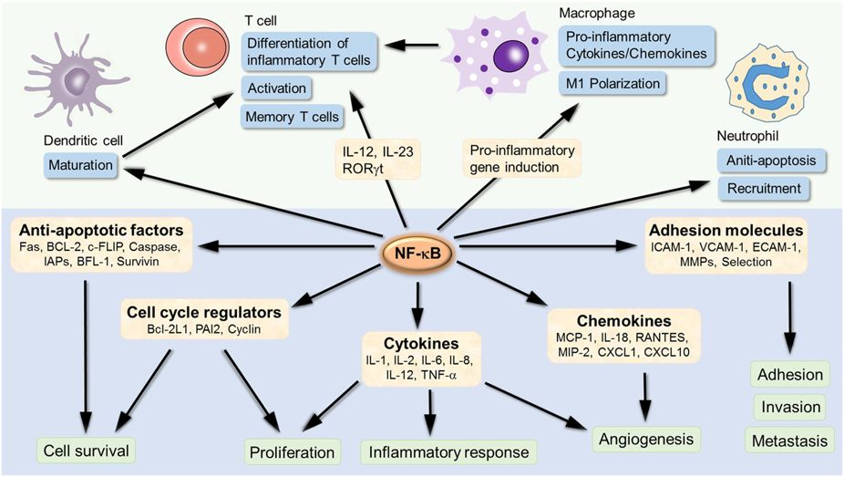
Cellular signaling modulation: NFkB pathway
Polyphenols modulate pro-inflammatory gene expression like lipoxygenase (LOX), cycloxygenase (COX), nitric oxide synthases (NOS), and some pivotal cytokines, mainly through the downregulation of Nuclear Factor-kappa B (NFkB).
NFkB is a transcription factor that is largely expressed in the nervous system, and in neurons it may be found in an inducible or constitutively active form.
T. Liu at al., 2017
Notes:
PP_Pharma_NFkB
Pp may also control signaling processes during inflammation. They modulate pro-inflammatory gene expression like lipoxygenase, cycloxygenase, nitric oxide synthases, and some pivotal cytokines, mainly through Nuclear Factor-kappa B (NfkB). This transcription factor is largely expressed in the nervous system, and in neurons it may be found in an inducible or constitutively active form.
C: inhibits NfkB; suppresses TNF-mediated NfkB activation, thus blocking the production of inducible nitric oxyde synthase.
R: inhibits Abeta-induced neural inflammation through a mechanism that involves the downregulation of the NfkB signaling pathway.
F: few evidence; some metabolites inhibit the expression of NfkB, or its signaling pathway, and therefore the pro-inflammatory changes.

Slide 32
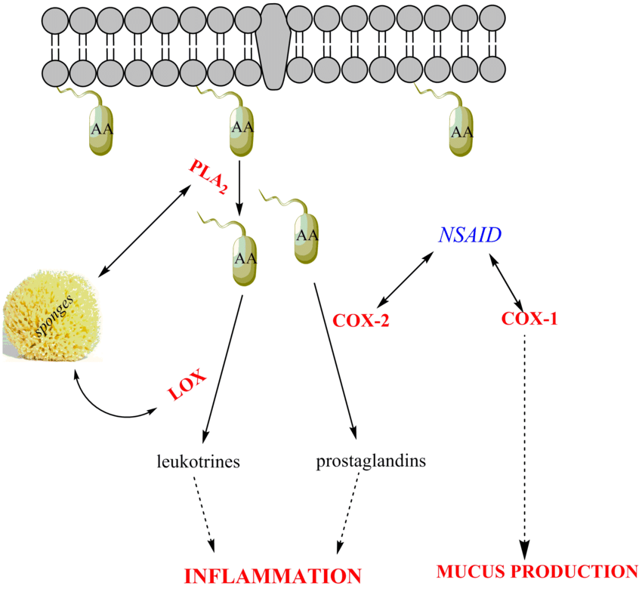
Anti-inflammatory effect
The molecular targets are related to the inhibition of: phospholipase A₂ (PLA₂), lipoxygenase (LOX), and ascorbic acid (AA) dependent pathways.
The immune response in neurodegenerative diseases is modulated through the enhanced expression of antiapoptotic factors, the modulation of cell signaling and the control of neuroinflammation.
Anjum K. et al., 2016
Curcumin: inhibits several signaling pathways (COX-2, TNF-α, cyclinD1, STAT, NFkB).
Resveratrol: blocks the expression of inducible NO synthase and COX-2, conceivably through the inhibition of NFkB activation.
Flavanols: plenty of information; influence the generation of pro- and anti-inflammatory cytokines; modulates the expression of IL-1β mRNA and TNF-α, and the suppression of NO production.
Notes:
PP_Pharma_antinfiammatorio
The molecular targets are related to the inhibition of: phospholipase A2, lipoxygenase, and AA dependent pathways (i.e. cyclooxygenase).
The immune response in neurodegenerative diseases is modulated through the enhanced expression of antiapoptotic factors, the modulation of cell signaling and the control of neuroinflammation.
C: inhibits several signaling pathways (COX-2, TNF-alpha, cyclinD1, STAT, NFkB)
R: blocks the expression of inducible NO synthase and COX-2, conceivably through the inhibition of NfkB activation.
F: plenty of information; influence the generation of pro- and anti-inflammatory cytokines; modulates the expression of IL-1beta mRNA and TNF-alpha, and the suppression of NO production.

Slide 33
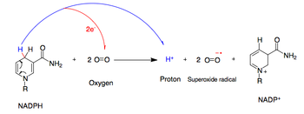
Metal ion chelation
Some polyphenolic compounds possess the ability to bind and chelate an exuberance of bivalent metals, such as copper (Cu²⁺), zinc (Zn²⁺) and iron (Fe²⁺).
In this way the rate of Fenton reaction directly diminishes and the oxidation caused by reactive hydroxyls radicals can be prevented.
Some authors argue that there is an apparent link between metal dyshomeostasis and neurodegenerative diseases.
This activity has been observed for curcumin (in rat-brain homogenates and rat model of Parkinson's disease) and flavanols.
Notes:
PP_Pharma_Chelante ioni metallici
Some polyphenolic compounds possess the ability to bind and chelate an exuberance of bivalent metals, such as copper (Cu2+), zinc (Zn2+) and iron (Fe2+). In this way the rate of Fenton reaction directly diminishes and the oxidation caused by reactive hydroxyls radicals can be prevented. Some authors argue that there is an apparent link between metal dyshomeostasis and neurodegenerative diseases.
C: observed in rat-brain homogenates and rat model of Parkinson's disease.
F: effective metal chelators.

Slide 34
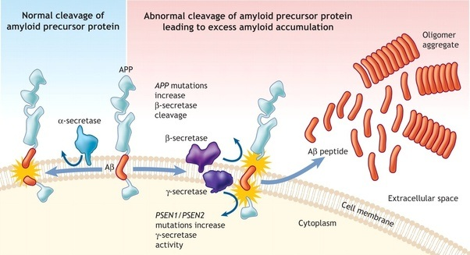
Neuroprotection
Only a minority of polyphenols, which have shown strong neuroprotective effects in animal or in vitro studies, have progressed successfully into active clinical trials in neurodegenerative disorders. One such polyphenol is curcumin.
Curcumin: strong ability to inhibit oligomer and ﬁbril formation, amyloid aggregation of various amyloidogenic proteins (Aβ and α-synuclein), by attenuating Aβ precursor protein maturation at endoplasmatic reticulum level. At the same time, it disintegrates preformed aggregates by directly binding to plaques.
Resveratrol:
Mainly through the activation of sirtuins and counteraction in forming peptide aggregates
Also activates the proteasome, whose activity is signiﬁcantly reduced in the brain of Alzheimer patients.
Flavanols (EGCG): can directly transform large, mature Aβ ﬁbrils into minor, non-toxic amorphous amasses of protein
Notes:
PP_Pharma_Neuroprotection
Pp modulate the activity of intracellular signal transduction molecules and reduce oxidative stress and inflammation. Only a minority of pp, which have shown strong neuroprotective effects in animal or in vitro studies, have progressed successfully into active clinical trials in neurodegenerative disorders. One such pp is curcumin.
C: strong ability to inhibit oligomer and ﬁbril formation, amyloid aggregation of various amyloidogenic proteins,such as Aβ and α-synuclein. Curcumin prevents the formation of Aβ aggregates by attenuating Aβ precursor protein maturation at endoplasmatic reticulum level. At the same time, it disintegrates preformed aggregates by directly binding to plaques.
R: mainly through the activation of sirtuins and counteraction in forming peptide aggregates. Resveratrol also activates the proteasome, whose activity is signiﬁcantly reduced in the brain of Alzheimer patients.
F: can directly transform large, mature Aβ ﬁbrils into minor, non-toxic amorphous amasses of protein
Sirtuins are a class of proteins that possess either mono-ADP-ribosyltransferase, or deacylase activity, including deacetylase, desuccinylase, demalonylase, demyristoylase and depalmitoylase activity. The name Sir2 comes from the yeast gene 'silent mating-type information regulation 2', the gene responsible for cellular regulation in yeast.
Sirtuins have been implicated in influencing a wide range of cellular processes like aging, transcription, apoptosis, inflammation and stress resistance, as well as energy efficiency and alertness during low-calorie situations. Sirtuins can also control circadian clocks and mitochondrial biogenesis

Slide 35
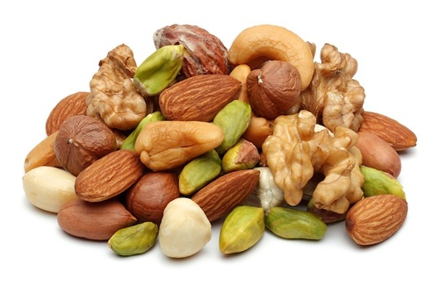
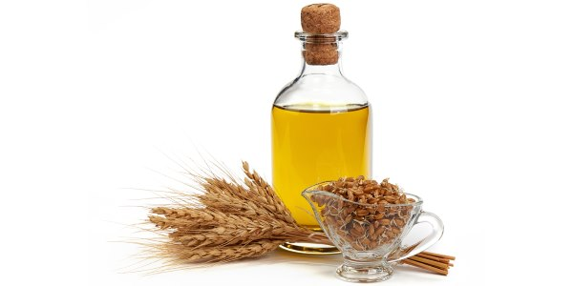
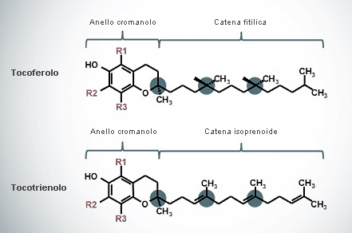
TOCOTRIENOLS
Vitamin E family
Anti-oxidant activity
Damage recovery
Two complementary effects
← More efficient molecular structure
Notes:
TOCOTRIENOLS
They are part of the vitamin E family.
Vitamin E is a group of eight liposoluble substances, closely related to each other and subdivided into 4 tocopherols (α, β, γ, δ) and 4 tocotrienols (α, β, γ, δ).
The molecular structure of tocotrienols allows this molecule to be more efficient in restoring oxidation damage inside the cell membrane (it has greater antioxidant power and greater flexibility).
Recently their senolytic properties have also been discovered. They have two complementary effects:
- stimulate senescence in cancer cells (thus reducing their potential malignancy) e
- slow down the aging process by decreasing the accumulation of SC in healthy tissues.
Present in high concentrations in vegetable oils, especially wheat germ oil, and in dried fruit.

Slide 36
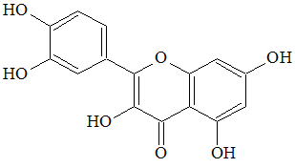
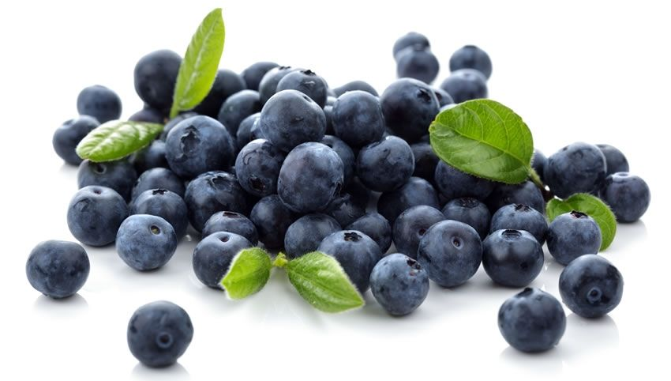
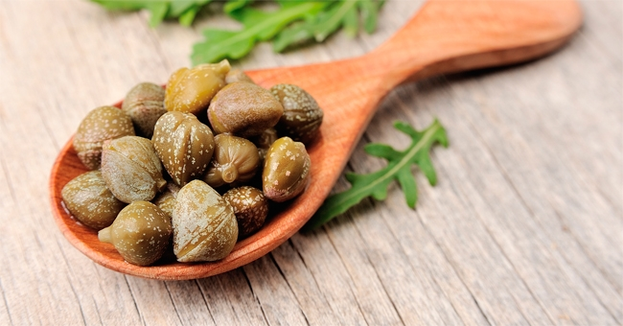
QUERCETIN
Flavonoid group
Natural enzymatic inhibitor
Anti-oxidant (superoxide anion)
Vitamin E recovery
Senolytic & anti-SASP
Notes:
QUERCETIN
Quercetin, belonging to the flavonol group (and more precisely it is a tetraoxiflavonol)
It is one of the most common flavonoids as it can be isolated from numerous plant species (hawthorn, chamomile, calendula, hypericum)
It is considered a natural inhibitor of various intracellular enzymes and for these properties it has been studied in oncology and is also a natural antioxidant.
- Restores tocopherol (Vitamin E), after it has turned into a radical when it has carried out its antioxidant action,
- Detoxifies the cell from superoxide
- Stops the production of nitric oxide during inflammation.
Some studies have found that quercitin has both senolytic and anti-SASP properties.
It is mainly present in capers and blueberries

Slide 37
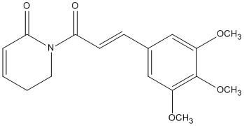
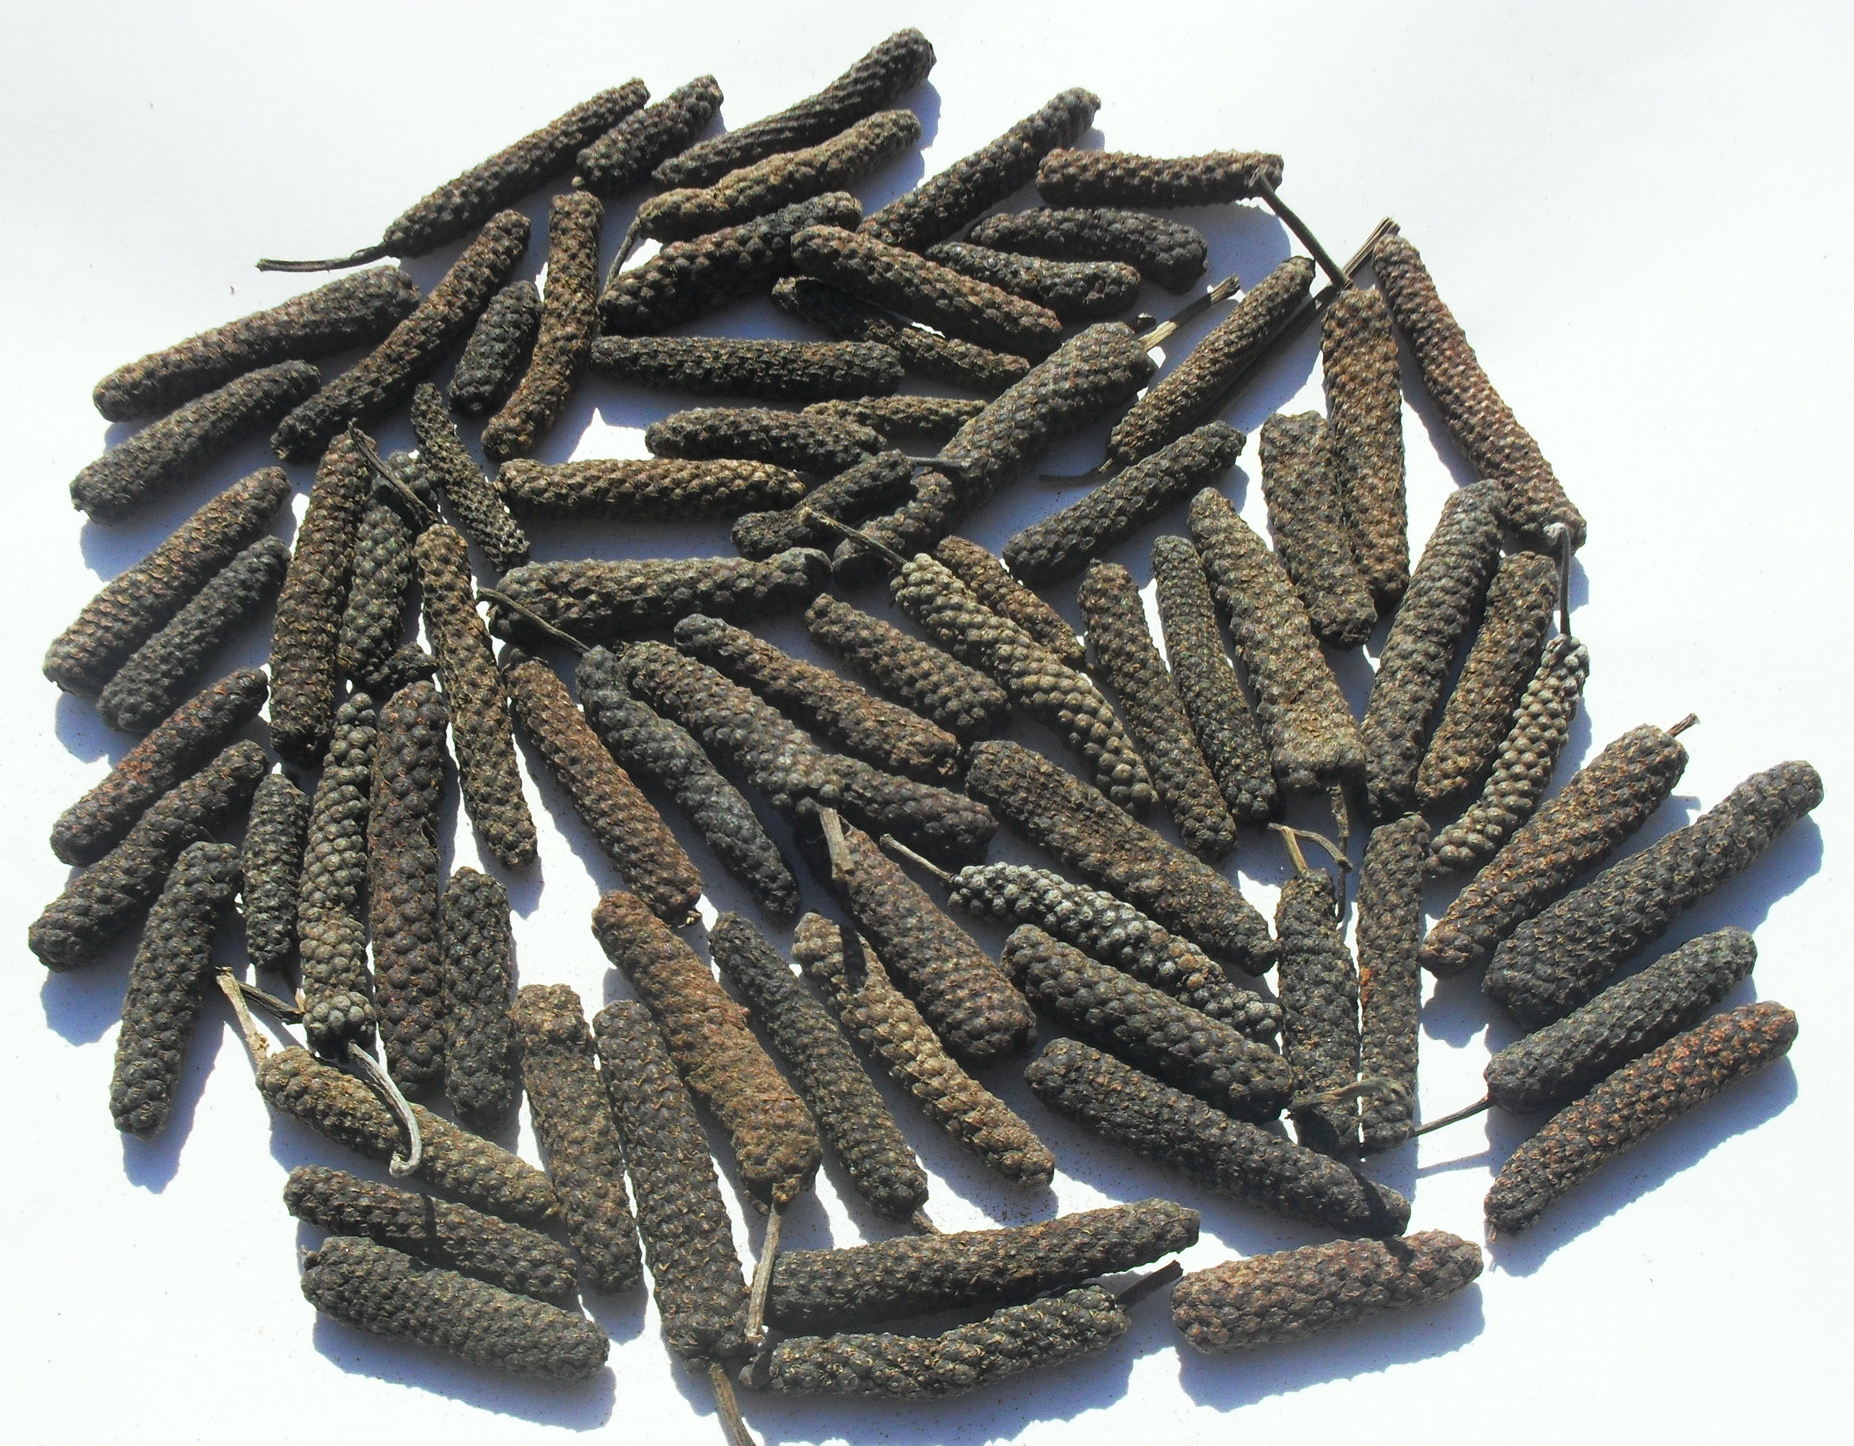
PIPERLONGUMINE
Piper Longum
Indian medicinal tradition
Anti-inflammatory activity (also locally)
Anticancer activity
Turmeric absorption
Senolytic
Notes:
PIPERLONGUMINE
It is a natural product of long pepper, a little-known spice with a very particular aroma.
It has a long medicinal tradition in India: it is used as a sedative, anti-inflammatory, remedy for gastric, vascular, hepatic and airway disorders. It is used locally on skin inflammations. But above all it is very well known for its anticancer activity.
It has a high content of piperine which allows it to enhance the absorption of many other substances (such as turmeric for example).

Slide 38
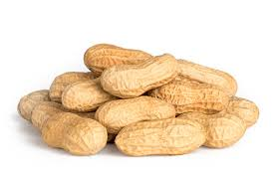
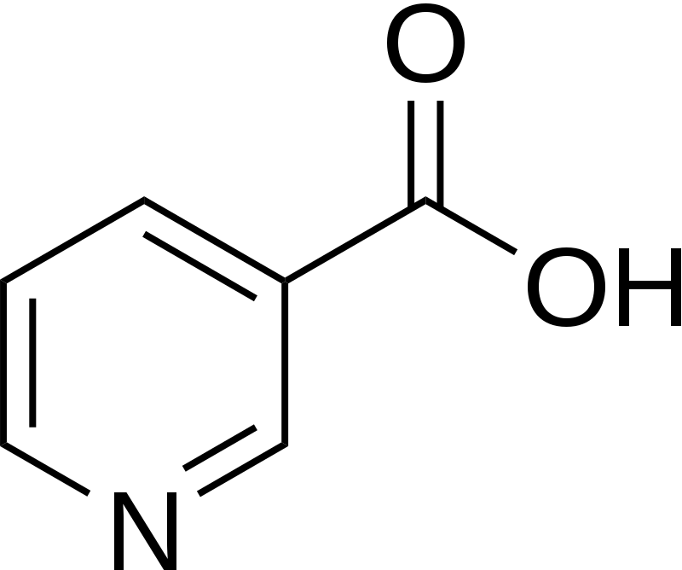
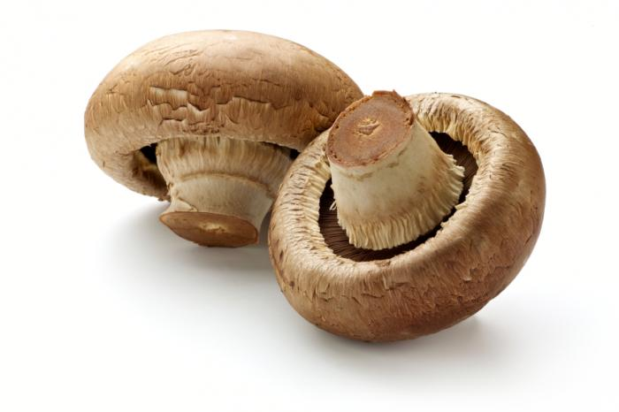
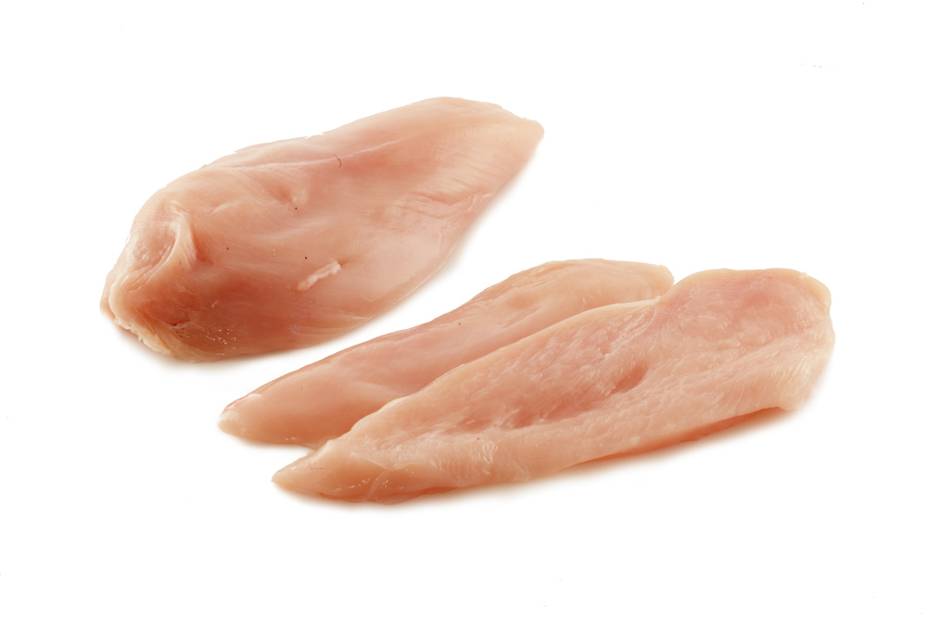
VITAMIN B3 COMPLEX
NAD precursors
Anti-SASP
Niacina
Notes:
The vitamin B3 family includes niacin (represented formula) and other precursors of NAD (nicotinamide adenine dinucleotide).
We know that its oxidized form, NAD +, is a crucial cofactor in several cellular pathways.
Furthermore, a low ratio between NAD + and NADH (reduced form) favors the onset of senescence, reducing the ability to repair DNA.
Treatment by supplementing with NAD + intermediates promotes longevity in C. elegans by performing an anti-SASP activity.
Vitamins B3 are contained in white meat, peanuts and mushrooms.

Slide 39
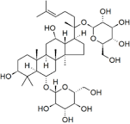
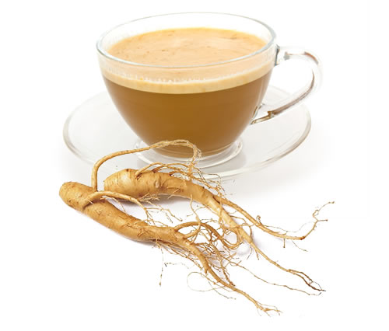
GINSENOSIDES
Anti-metastatic activity
Reduce malondialdehyde concentrations
Increase SOD activity
Reduce β-gal activity
Induce SIRT1
Anti-SASP
Neuroprotective role
Notes:
GINSENOSIDES
Ginsenosides have been studied for their anti-metastatic activity in breast cancer.
In fact, they reduce the concentrations of malon-dialdehyde, increase the activity of superoxide dismutase, reduce the activity of β-galactosidase and induce the expression of SIRT1 of which we spoke yesterday.
They have a neuroprotective effect by activating telomerase which repairs telomeres and reduces levels of pro-inflammatory cytokines.
An increase in cognitive and neurogenesis abilities was also found in studies in mice.
Furthermore, recovery of synaptic efficiency induced by beta-amyloid in mice suggests that this type of molecule can reactivate neuronal function in subjects suffering from Alzheimer's disease.
Ginsenosides are extracted from the roots of ginseng plants

Slide 40
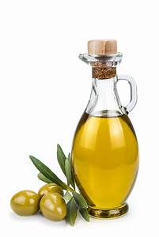
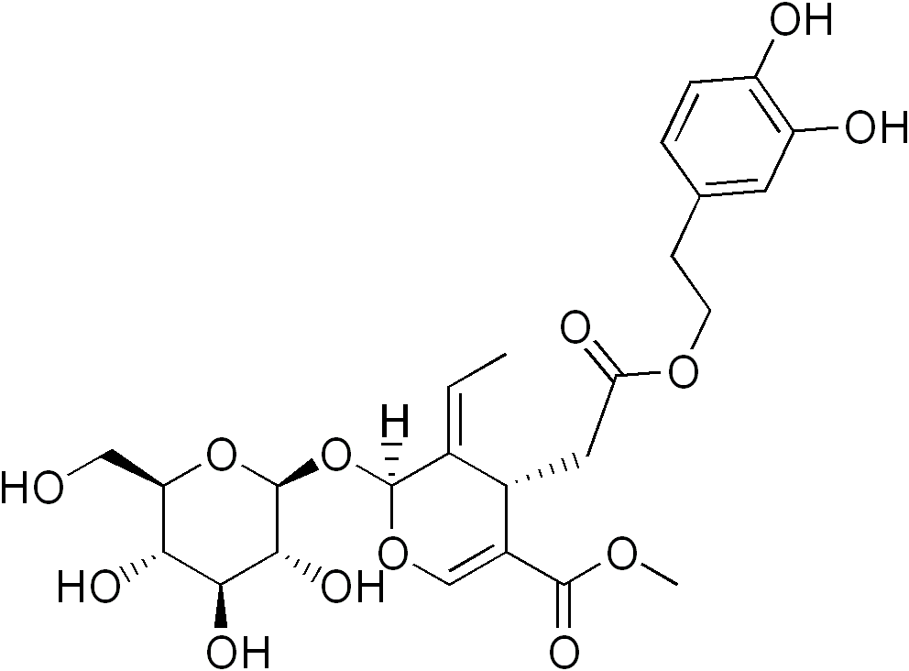
OLEUROPEIN
Antimicrobial, fungicidal and insecticidal activity
Anti-inflammatory, anti-oxidative and anti-cancer activity
Anti-SASP
Notes:
OLEUROPEIN
Oleuropein is the main polyphenol present in the leaves and fruits of the olive tree.
It is responsible for the bitter taste of olives and olive leaves.
It has antimicrobial, fungicidal and insecticidal activity, acting as a defense against infections and infestations.
It has an anti-inflammatory, anti-oxidative, anticancer, cardio- and neuroprotective action.
These effects are the basis of the nutritional virtues commonly associated with the so-called Mediterranean diet.

Slide 41
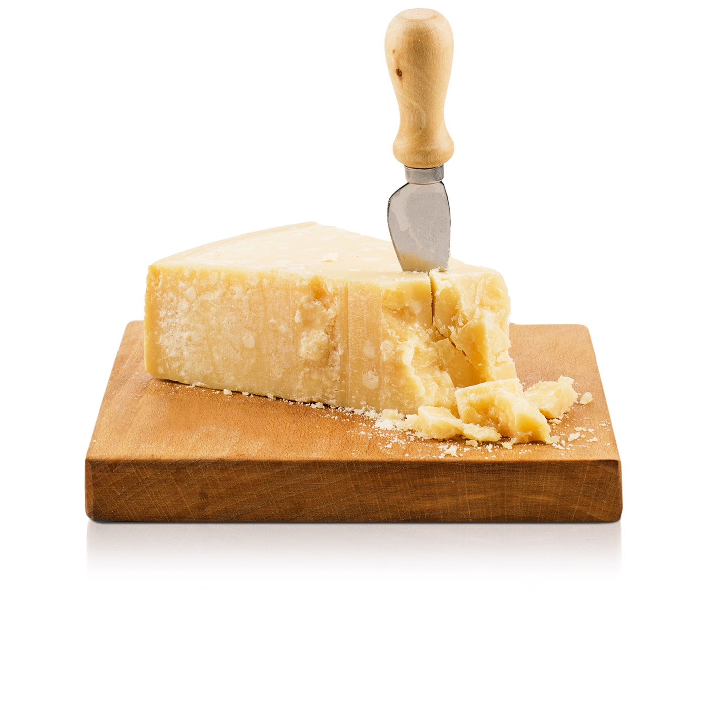
SPERMIDINE
Poliammine class
Anti-oxidant, cardioprotective and neuroprotective
Anti-SASP
Notes:
SPERMIDINE
Spermidine belongs to the class of polyamines. Its name derives from the fact that it was isolated in human sperm.
It induces autophagy (and therefore cell renewal), is anti-oxidant, cardioprotective and protects against neurodegeneration.
She was involved in a Phase II trial of subjects with cognitive decline.
La spermidina è contenuta in diversi cibi come formaggi stagionati, funghi, cereali.

Slide 42
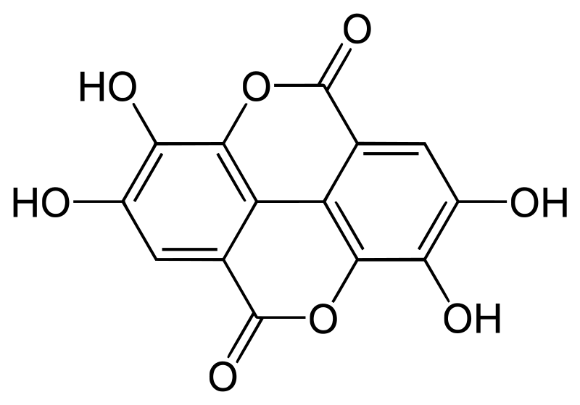
UROLITHINS
Ellargitannins
Act against LPS-induced inflammation
Inhibitor of NFkB activity
Anti-SASP
Notes:
UROLITHINS
They are metabolites of the human gastric microbiota derived from ellagic acid introduced with the diet.
Foods rich in ellagic acid are pecans, blackberries and pomegranate.
They are able to attenuate LPS-induced inflammation, inhibit NFkB activity and act as anti-SASP.

Slide 43
Dietary intervention: the Mediterranean Diet (MD)
Experimental and epidemiological data indicate that dietary habits, exercise, and genetic make-up play a central role in healthy aging.
The Mediterranean diet (MD), which is characterized by a high quota of vegetables, fruits, whole cereals and fish, has proven beneficial effects on human health and prevents a variety of ARDs.
The inclusion of phenol-rich foods in the diet is consistent with the advice to eat 5 or more portions of fruit and vegetables per day (high content of anti-aging bioactive compounds).
Notes:
Experimental and epidemiological data indicate that eating habits, exercise and genetic makeup play a central role in aging in good health.
The Mediterranean diet (MD), characterized by a high percentage of vegetables, fruits, whole grains and fish, has shown beneficial effects on human health and prevents a variety of ARD.
The inclusion of foods rich in phenols in the diet is consistent with the advice of eating 5 or more servings of fruit and vegetables per day (high content of bioactive anti-aging compounds).

Slide 44
Future perspectives
Some natural components share the same mechanism of action with conventional medications, and that natural molecules with anti-SASP and/or senolytic activity are naturally available through the diet, for instance the MD.
Although considerable work is still required to explore the toxicity profile and the extent of the benefits provided by natural compounds, there is mounting evidence that nutritional approaches provide new tools to combat ARDs, including cognitive decline.
Human studies and clinical trials are required. More information about absorption, metabolism, how these compounds can pass through the BBB and long-term effect is needed.
New paradigms for testing senolytics and measuring surrogate endpoints of aging should be identified.
An univocal definition of Nutraceuticals is required.
Notes:
Information on the different classes of molecules, given above, shows that some natural components share the same mechanism of action with conventional drugs and that natural molecules with anti-SASP and / or senolytic activity are naturally available through the diet, for example the Mediterranean one.
Although considerable work is still needed to explore the toxicity profile and the magnitude of benefits provided by natural compounds, there is increasing evidence that nutritional approaches provide new tools to combat ARDs, including cognitive decline.
Studies on cell cultures and studies on mouse models have provided information on the mechanisms of action and effective concentrations of these compounds. However, human studies and clinical studies are required. Further information on absorption, metabolism, how these compounds can pass through the blood-brain barrier and the long-term effect are needed.
New paradigms should be identified to test senolytes and measure the endpoints of surrogate aging.

Slide 45
BIBLIOGRAFIA
Felicia Gurău et al., Anti-senescence compounds: A potential nutraceutical approach to healthy aging (2018).
Antonello Santini et al., Nutraceuticals: opening the debate for a regulatory framework (2018).
Silvia Molino et al., Polyphenols in dementia: From molecular basis to clinical trials (2016).

Slide 46
BIBLIOGRAFIA
Marro PJ et al., Purine metabolism and inhibition of xanthine oxidase in severely hypoxic neonates going onto extracorporeal membrane oxygenation (1997).
Rukhsana Sultana et al., Lipid peroxidation triggers neurodegeneration: A redox proteomics view into the Alzheimer disease brain (2013).
Ting Liu et al., NF-κB signaling in inflammation (2017).
Anjum K et al., Marine Sponges as a Drug Treasure (2016).
Araujo JA, Zhang M, Yin F, Heme oxygenase-1, oxidation, inflammation, and atherosclerosis (2012).
Eva Brglez Mojzer et al., Polyphenols: Extraction Methods, Antioxidative
Action, Bioavailability and Anticarcinogenic Effects (2016).
Inês Figueira et al., Polyphenols Beyond Barriers: A Glimpse into the Brain (2017).
Valle A. et al, Role of uncoupling proteins in cancer (2010).
Bennett G Childs et al., Cellular senescence in aging and age-related disease: from mechanisms to therapy (2015).
Amaia Lujambio, To clear, or not to clear (senescent cells)? That is the question (2016).
Annika Höhn et al., Happily (n)ever after: Aging in the context of oxidative stress, proteostasis loss and cellular senescence (2017).
Notes:
Altri paper consultati:
Heme Degradation by Reactive Oxygen Species ENIKA NAGABABU and JOSEPH M. RIFKIND;
Effects of Polyphenol Intake on Metabolic Syndrome: Current Evidences from Human Trials, Gemma Chiva-Blanch and Lina Badimon;
Dietary Polyphenols in the Prevention of Stroke, A. Tressera-Rimbau et al.
Polyphenol-Rich Lentils and Their HealthPromoting Effects, Kumar Ganesan et al.
Polyphenols and Glycemic Control, Yoona Kim et al.

