Slide 1
Analisi dei mercati e delle imprese

Slide 2
Industry analysis (settore produttivo)
Industry analysis is a tool that facilitates a company's understanding of its position relative to other companies that produce similar products or services.
Understanding the forces at work in the overall industry is an important component of effective strategic planning. Industry analysis enables business owners to identify the threats and opportunities facing their businesses, and to focus their resources on developing unique capabilities that could lead to a competitive advantage.

Slide 3
Market analysis (mercato)
A market analysis studies the attractiveness and the dynamics of a special market within a special industry.
It relates both to the competitors and the consumers (clients)
Market analysis is used to inform a firm's planning activities, particularly:
Inventory and purchase decisions,
work force expansion/contraction,
facility expansion,
purchases of capital equipment,
promotional activities,
and many other aspects of a company.

Slide 4
Components of market analysis
Definition of the market and market segmentation
Dimensions of market analysis: market size, market trends, market growth rate, market opportunity, market profitability, industry cost structure, distribution channels, environmental factors, SWOT

Slide 5
1. Definition of the market and market segmentation
Market segmentation is the basis for a differentiated market analysis. Differentiation is important.
Segmentation involves a lot of market research
Market segmentation is an important way to find competitive advantage with its differentiation in market analysis.
There is no unique way to segment market. However, businesses can follow generalized rules like geographic, demographic, psychographic, and behavioral.

Slide 6
2. Dimensions of market analysis
There are several dimensions of a market analysis:
Market size (current and future)
Market growth rate
Market trends
Market profitability
Industry cost structure
Distribution channels
Environmental factors
SWOT

Slide 7
Market size
The market size is defined through the market volume and the market potential.
The market volume exhibits the totality of all realized sales volume of a special market.
The market potential defines the upper limit of the total demand and takes potential clients into consideration. Although the market potential is rather fictitious, it offers good values of orientation. The relation of market volume to market potential provides information about the chances of market growth.

Slide 8
Market growth rate
A simple means of forecasting the market growth rate is to extrapolate historical data into the future. While this method may provide a first-order estimate, it does not predict important turning points.
Ultimately, many markets mature and decline. Some leading indicators of a market's decline include market saturation, the emergence of substitute products, and/or the absence of growth drivers.

Slide 9
Market trends
Market trends are the upward or downward movement of a market, during a period of time.
Changes in the market are important because they often are the source of new opportunities and threats. Moreover, they have the potential to dramatically affect the market size. Examples include changes in economic, social, regulatory, legal, and political conditions and in available technology, price sensitivity, demand for variety, and level of emphasis on service and support.
Available techniques to analyze market trends are: Customer analysis, Choice modelling, Competitor analysis, Risk analysis, Product research, Marketing mix modeling, Simulated Test Marketing
The market trends is more difficult for completely new product.

Slide 10
Market opportunity
There is market opportunity for product\service if it fulfills the needs of the customers better than the competition or better than the current technologies

Slide 11
Market profitability
Michael Porter’s framework identifies five factors that influence the market profitability:
Buyer power
Supplier power
Barriers to entry
Threat of substitute products
Rivalry among firms in the industry

Slide 12
Industry cost structure
The cost structure is important for identifying key factors for success.
The cost structure also is helpful for formulating strategies to develop a competitive advantage.

Slide 13
Distribution channels
Examining the following aspects of the distribution system may help with a market analysis:
Existing distribution channels - can be described by how direct they are to the customer.
Trends and emerging channels - new channels can offer the opportunity to develop a competitive advantage.
Channel power structure - for example, in the case of a product having little brand equity, retailers have negotiating power over manufacturers and can capture more margin.

Slide 14
Key success factors
The key success factors are those elements that are necessary in order for the firm to achieve its marketing objectives. Examples of such factors include:
Access to essential unique resources
Ability to achieve economies of scale
Access to distribution channels
Technological progress
It is important to consider that key success factors may change over time, especially as the product progresses through its life cycle.

Slide 15
Environmental analysis
The environmental analysis can be divided into two parts which are external and internal factors.
External factors: political issues, social potential force, and local economy.
Internal factors: belongs to company's internal position such as employees, department structure, budget and so forth

Slide 16
SWOT analysis
SWOT is Strengths, Weakness, Opportunities, And Threats.
Strengths and weakness are internal factors which we can control. Businesses need to collect raw data to get information. Businesses can get information by customer feedback, employee surveys. Furthermore, businesses also can identify the capability if it is weakness or strengths, resources and process.
Opportunities and threats are external factors that businesses can't control, but can however impact on. Business can get information from secondary data like environmental information, industry information and competitive data.
The purpose of the business use the SWOT analysis is to get the information from it and match each other to develop the ideas and get into goal statement to form strategic development (Olsen, 2008).

Slide 17
Studio di un settore produttivo
http://www.osservatoriodistretti.org/
http://www.eiu.com/
https://www2.deloitte.com/us/en.html

Slide 18
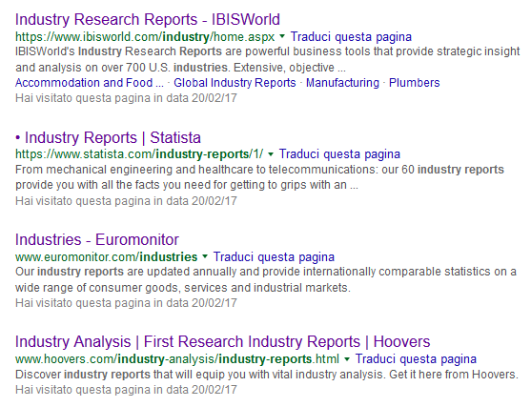
Altre fonti …

Slide 19
Esempi interessanti
Studi di settore
2015 - I distretti in Italia rapporto-2015
2015 - Hoovers- Snack food manufacturing
2015 - The Economist - ASEAN-Automotive: Looking to 2015
2016 -RE-Action Focus sulla meccanica strumentale
2016 - IBISWorld - Pet Stores in the US Industry Report
2016 - Deloitte - Automotive suppliers in the evolving transportation ecosystem
2016 - Deloitte - Global aerospace and defense sector outlook
2016 - Statista - Utilities U.S. Industry Report 2016
2017 - Svimez - Rapporto sull’agricoltura del Mezzogiorno

Slide 20
Esempi interessanti
Studi di paese
2012 - The Economist - Into Africa: Emerging opportunities for business
2014 - The Economist - The Chinese consumer in 2030
2015 - The Economist - An analysis of manufacturing labour costs in China
2016 - The Economist - Healthcare-markets-in-Europe. What would be the impact of Brexit
2016 - The Economist - Measuring-the-middle. Quantifying market opportunities in Latin
Analisi statistiche
2016 - The Economist - The Global Food Security Index 2016
Scenari tecnologici
2016 - The Economist - Driving-to-the-future-The-development-of-connected-cars
2016 - The Economist - The-role-of-coal-in-Europe’s-power-mix
Scenari economici
2016 - The Economist - Industries-in-2017
2016 - The Economist - Out-and-down-Mapping-the-impact-of-Brexit

Slide 21
Rapporto di ricerca 2017
L’Italia di lusso
Le previsioni sull’impatto di Brexit per l’economia inglese
I consumatori cinesi nel 2030
Il ruolo del carbone in Europa&Eurasia e in asia pacifica
L’industria 4.0 e la scommessa sul lavoro
Le opportunità di mercato in America latina
Market opportunities in Serbia
L’impatto della Brexit sull’UK
Norme tecniche nel settore mobili-arredamento
Gli investimenti diretti esteri in Italia
Opportunità di sviluppo nei paesi del sud-est asiatico
Gli investimenti in infrastrutture di trasporto in Italia

