Slide 1
GRAVITY FIELD: introduction
The gravitational field of the Earth reflects the kind of mass distribution within our planet and is closely linked to the shape of the Earth. The gravitational attraction between two objects (point) with mass M and M₀ at a distance r is given by
where G=6.67x10⁻¹¹ m³kg⁻¹s⁻² is the universal gravitational constant.
Experimental determination of G was extremely difficult, and was first achieved more than a century after the publication of Principia by Lord Charles Cavendish (1731–1810). From a set of painstaking measurements of the force of attraction between two spheres of lead, Cavendish in 1798 determined the value of G to be 6.754·10⁻¹¹ m³ kg⁻¹ s⁻². A modern value is 6.674·10⁻¹¹ m³ kg⁻¹ s⁻²
It has not yet been possible to determine G more precisely, due to experimental difficulty. Although other physical constants are now known with a relative standard uncertainty of much less than 1·10⁻⁶, the gravitational constant is known to only 1·10⁻⁶

Slide 2
The force for unit mass
is the acceleration of an object in free fall directly into M.
The gravity due to the various masses is the vectorial sum in the measurement point r_{m} of gravity due to the individual masses at the points r_{s}
NB: In physics r is usually directed from the mass M to observer, so in expressions above it would take a minus sign. In geophysics it is however convenient to define the acceleration of gravity towards the center of the Earth as positive.

Slide 3
GRAVITATIONAL POTENTIAL
A way to represents indirectly the gravitational field is its potential, that for a point mass is
For example:
The gravity is obtained by its gradient:
NB: For physicists it would take a minus sign.
The gravitational field is conservative because allows potential:

Slide 4
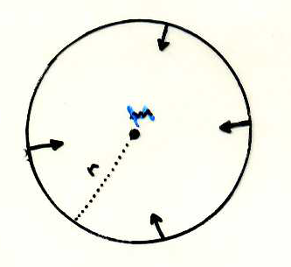
Gauss law
Considering the gravitational flow through a spherical surface centered on a point mass. For symmetry the gravity is the same in each point on the surface:
For any surface the result is the same. This is represents the Gauss law and is equivalent to
Considering the flow for volume unit, the divergence, that is the Gauss theorem:
We have:
From which, replacing
we obtain the Poisson equation:

Slide 5
The Gauss law implies that the gravitational potential outside of an extended body (sphere) with total mass M is equal to that due to a point mass placed at the center of gravity of the extended body.
Therefore, if the Earth were perfectly spherical and non-rotating with a density distribution depending only on the radius ρ = ρ (r), the external gravitational potential would simply
Newtonian potential
with the distance r between the center of the Earth and the mass of Earth M. Gravity would be equal on each point on the Earth's surface. The value of the gravitational acceleration on the Earth's surface varies, however - although less than a hundredth - with an average value of about 9.8 ms⁻² (981 cms⁻² = 980 gal).
The Earth, in fact, differs from spherical to one three-hundredth. It is flattened at the poles and bulging in the equatorial zones, very similar to an ellipsoid of rotation. The flattening of the Earth is given by
where a and b are polar and equatorial radius, respectively. The most recent value of f is given by f = 1 / 298,247.
The radius of the ellipsoid of rotation is given (to the first term in f) from
where ϕ is latitude, a=6378.14km ,b=6356.75 km.

Slide 6
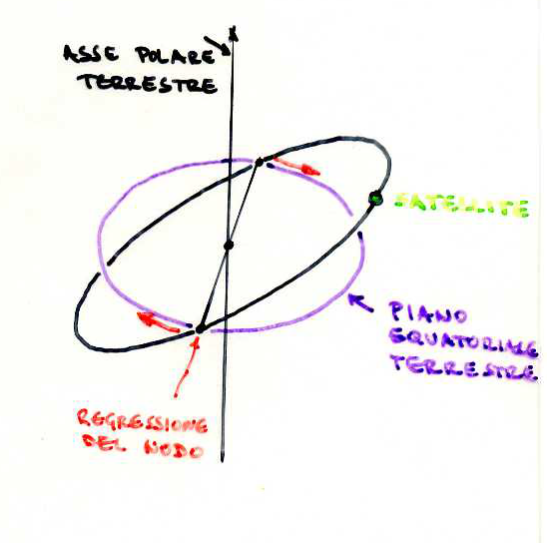
DEVIATION IN SFERIC SIMMETRY
Also the deviation of the external gravitational field of the Newtonian potential is of the order of the three hundredth and less still. Before the advent of artificial satellites had failed (with earthly measures) to determine the first correction J₂ of the Newtonian gravitational field
C= the inertial moment respect to the polar axes
Ᾱ= is the average inertial moment respect to the equatorial axes
with
is the second Legendre’s polynomial and Θ is the colatitude : Θ=π/2-ϕ
The present value is J₂= 1082.65x10⁻⁶
J₂ measures the deviation of the real gravitational field of the Earth from spherical symmetry. Its contribution makes you that an artificial satellite revolves around the Earth on an orbital plane that rotates in turn retrograde, fixed prejudice to its inclination to the equatorial plane of the Earth: regression orbit.

Slide 7
General case
The gravitational potential can be developed in spherical functions, the so-called eigenfunctions of the sphere (sums of sines and cosines, grouped in a certain way, of the latitude and longitude variables).
with P_{nm} (cosΘ) associated Legendre polynomials (of order n than cosΘ and sinΘ) and J_{n}, A_{nm}, B_{nm} are the gravitational moments (to be determined experimentally). Note that the terms of first order in Θ (n = 1) do not appear, having chosen the center of gravity of the Earth as origin of the reference system!
By the early '60s were known a ten zonal moment J_{n} (generating secular perturbations in the orbits of artificial satellites) and a ten tesseral moment A_{nm}, B_{nm} create instead periodic variations of short duration.

Slide 8
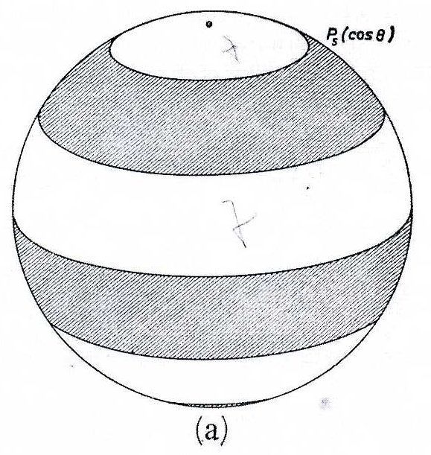
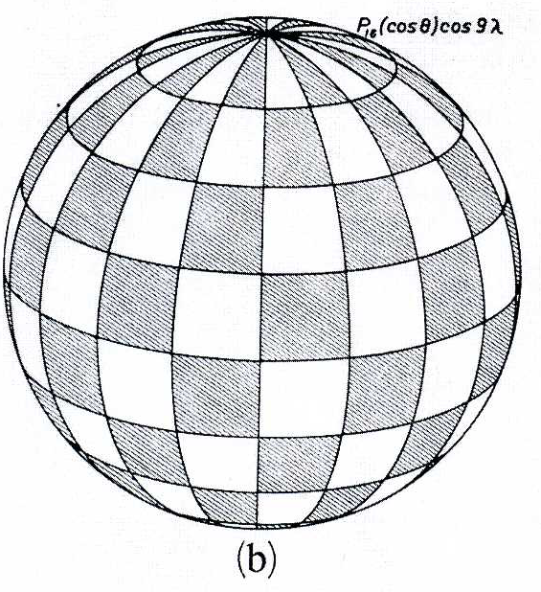
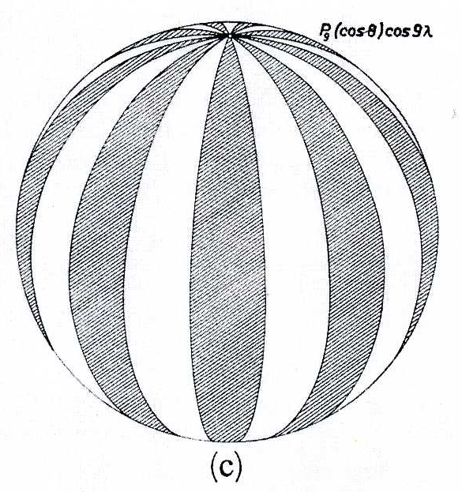

Slide 9
The figure of the Earth
The best mathematical approximation to the figure is an oblate ellipsoid, or spheroid. The precise determination of the dimensions of the Earth (e.g., its polar and equatorial radii) is the main objective of the science of geodesy. It requires an exact knowledge of the Earth’s gravity field, the description of which is the goal of gravimetry.
Modern analyses of the Earth’s shape are based on precise observations of the orbits of artificial Earth satellites. These data are used to define a best-fitting oblate ellipsoid, called the International Reference Ellipsoid
In 1980 the International Association of Geodesy adopted a Geodetic Reference System (GRS80)

Slide 11
EARTH DEVIATION FROM THE HYDROSTATIC EQUILIBRIUM
For an Earth exactly in hydrostatic equilibrium (i.e. no shear stress), the gravitational potential would be
with only zonal numbers equal J_{2N}. Furthermore, the values of J_{2N} should grow rapidly as n increases with
If so, the following corrective term after J₂ would be J₄. By measures from satellites it has however come to the conclusion that all the gravitational moments, starting with J₃, are about the same order and equal to some units per 10⁻⁶: the order of the square of the flattening, f². Also the decrease of the moments as n increases very slowly.
The deviation of the Earth hydrostatic equilibrium is therefore the order of the square of flattening!
It follows that in the Earth, in addition to the hydrostatic stress, also act tangential stresses, which are of the order of a few MPa.
The shape of the earth differs from the hydrostatic one: the thickness of the layer in equilibrium is ≈f²a = 70m

Slide 12
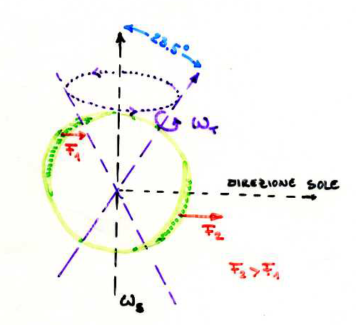
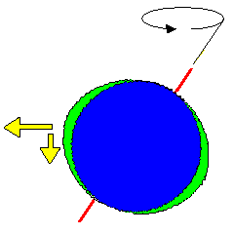
The precession of the Earth’s axis is the interaction between the Earth's rotation ω_{T} and the revolution around the sun ω_{S}, which take place according to two axes inclined by approximately 23.5 ° relative to one another. The non-parallelism between the two axes, together with the Earth flattering, generates a bend/twist moment which would tend to make them parallel, giving rise to the phenomenon of precession (T≈26000 years!)

Slide 13
INERTIAL MOMENT
For the study of the internal structure of the Earth is of great interest the average value of the moment of inertia
that together with the average Earth density
and seismological data, allows to determine the density distribution within the Earth. To determine I, we have to know, in addition to J₂, some other quantity related to the moments of inertia and C. A suitable information comes from astronomy, whose methods are used to determine the constant of precession of the Earth
H=0.0032732

Slide 14
As a result of the flattening, the distribution of mass within the Earth is not simply dependent on radius. The moments of inertia of the Earth about the rotation axis (C) and any axis in the equatorial plane (A) are unequal.
The inequality affects the way the Earth responds to external gravitational torques and is a determining factor in perturbations of the Earth’s rotation.
The principal moments of inertia define
the dynamical ellipticity:
The dynamical ellipticity is obtained from precise observations of the orbits of artificial satellites of the Earth. The current optimum value for H=1/305.457).

Slide 15
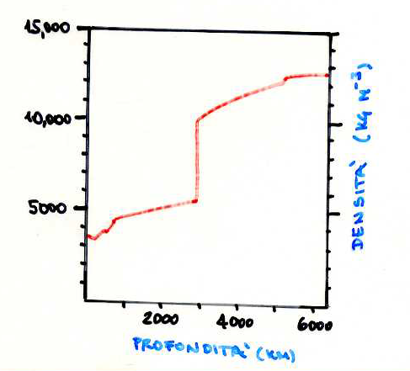
For a planet at constant density (homogeneous sphere) the dimensionless moment of inertia result
If the density inside the planet grows from the outside inwards, I* assumes values lower than 0.4; vice versa if the density decreases with depth, it will have a value greater than 0.4.
Based on the observations for the Earth is I* = 0.33076, which corresponds to a considerable concentration of the land mass in the central areas of the planet.
Causes of growth of the density with depth:
1. Compression due to overlying layers
2. Increase with the depth of the heavy elements
3. Possible phase transitions at high pressure
Causes of decrease in density with depth:
1. Temperature increase towards the interior of the Earth
2. Fusion (partial) separation of the components with the lower-density
Clearly they are more effective the causes of growth of density with depth.
In case of strong reversals of density, on the region of low density would act the so-called “Archimedes buoyancy" that brings back the regions with high density under those low density.

Slide 16
ROTATIONAL POTENTIAL AND TOTAL POTENTIAL
For the Earth that rotates around its axes with angular velocity ω, we must also consider the centrifugal force in a point at distance r from the rotational axes ω by:
The force field is conservative and the its potential is:

Slide 17
Gravity
Centripetal acceleration
Newton’s first law of motion states that every object continues in its state of rest or of uniform motion in a straight line unless compelled to change that state by forces acting on it.
The continuation of a state of motion is by virtue of the inertia of the body. A framework in which this law is valid is called an inertial system.
Motion in a circle implies that a force is active that continually changes the state of rectilinear motion. Newton recognized that the force was directed inwards, towards the center of the circle, and named it the centripetal (meaning “center-seeking”) force.
Arguing that the curved path of a projectile near the surface of the Earth was due to the effect of gravity, which caused it constantly to fall toward the Earth, Newton postulated that, if the speed of the projectile were exactly right, it might never quite reach the Earth’s surface.
Newton suggested that the Moon was held in orbit around the Earth by just such a centripetal force, which originated in the gravitational attraction of the Earth

Slide 18
Gravity
The mathematical form of the centripetal acceleration for circular motion with constant angular velocity ω about a point can be derived as follows: define orthogonal Cartesian axes x and y relative to the center of the circle. The linear velocity v at any point where the radius vector makes an angle θ=(ωt) with the x-axis has components:
The x- and y-components of the acceleration are obtained by differentiating the velocity components with respect to time. This gives:
These are the components of the centripetal acceleration, which is directed radially inwards and has the magnitude ω²r

Slide 19
Gravity
Centrifugal acceleration
The passenger in a car going round a corner experiences a tendency to be flung outwards. He is restrained in position by the frame of the vehicle, which supplies the necessary centripetal acceleration to enable the passenger to go round the curve in the car.
The inertia of the passenger’s body causes it to continue in a straight line and pushes him outwards against the side of the vehicle.
This outward force is called the centrifugal force. It arises because the car does not represent an inertial reference frame.
The centrifugal force feels real enough to the passenger in the car, but it is called a pseudo-force, or inertial force. In contrast to the centripetal force, which arises from the gravitational attraction, the centrifugal force does not have a physical origin, but exists only because it is being observed in a non-inertial reference frame.

Slide 20
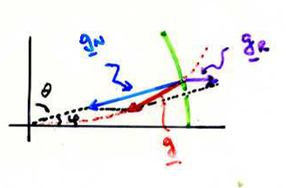
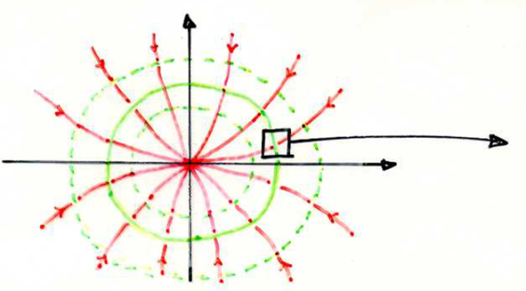
The gravitational acceleration acting on a body will be less than that acting on a body located on the Earth not rotating
The total gravitational potential is the sum of the field potential of the Newtonian’s force and of the centrifugal force
The concavity of the force lines of the total field is directed towards the axis of rotation and the equipotential surfaces have the ellipsoid shape closed

Slide 21
REFERENCE ELLIPSOID
The Earth should have the shape of a rotational ellipsoid if it were a fluid mass with density that increases with depth and rotating around the polar axis. Also its surface, being liquid, is necessarily equipotential surface. This ellipsoid is called reference ellipsoid and represents the equipotential surface of an Earth sferoidal model with real lateral variation of the density and with a centrifugal potential. The gravitational force is everywhere perpendicular to its surface and can be calculated mathematically. The formula adopted by the International Association of Geodesy in 1967 is
where ge=978.03185 gal, a=5.278895∙10⁻³, β=2.3462∙10⁻⁵
About the 40% of the gravity variation with the latitude is due to the difference between ellipsoid and sphere (that is to flattering), instead the 60% is due to Earth’ rotation. The maximum error in the formula is 4μgal. The gravity calculated with this formula is called normal gravity.

Slide 22
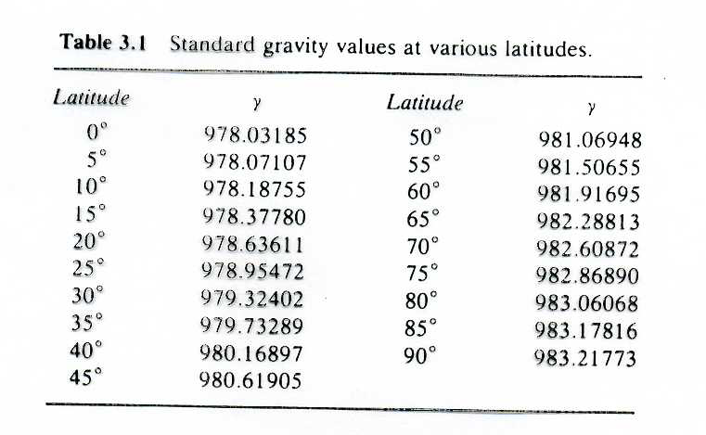

Slide 23
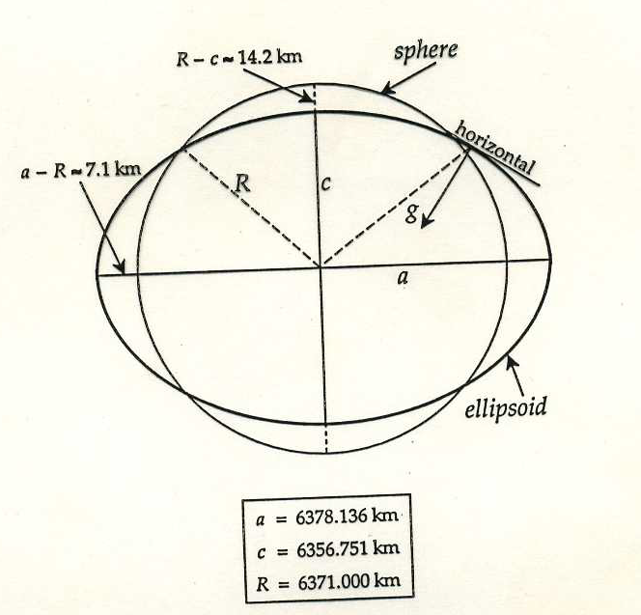

Slide 24
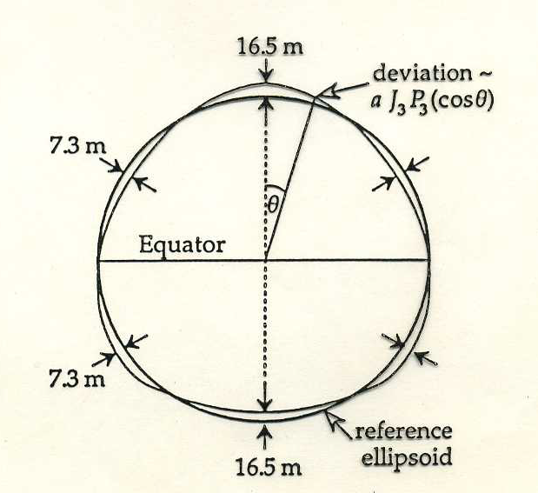

Slide 25
The four constants determination for calculate the normal gravity are:
a=6378.14 km, ω=0.72921151∙10⁻⁴s⁻¹, f=1/298.247, GM=398.603∙10⁹m³s⁻²
These parameters are linked with various relationships:
As just said, the J₂ value today is calculated by data obtained from the period of satellite orbit regression.
The GM value is determined observing the distances and the revolution period both of the artificial satellite and of those relative lunar orbit.

Slide 26
THE GEOID
The Earth is not a perfect sphere nor rotational ellipsoid. For example mountains and oceanic trenches represent variations of many kilometers. The equipotential surface that delimit the Earth mass is called geoid and differ less from the reference ellipsoid. Over the oceanic, the geoid coincides with the sea level. On the continentals the geoid can be visualized by the average level on which could arrange the water in a network of narrow canals dug across continents. The geoid is a reference surface for the navigation, survey and altimetry. In a point the vertical is not direct versus the centre of the Earth , but is perpendicular to local equipotential surface and, if close to level sea, it is perpendicular to the geoid.
The figure of the geoid derived from satellite data, in particular from radar altimetry measurements. These measurement have defined the marine geoid with an accuracy about 10 cm. The satellite and gravimetric measurements are in agree about of 50 cm indicating that the theory and assumptions are correct.

Slide 27
Geoid
The geoid can be elevated above ellipsoid by:
hill or mountain with center of gravity outside ellipsoid causes upward attraction;
B) mass excess below ellipsoid

Slide 28
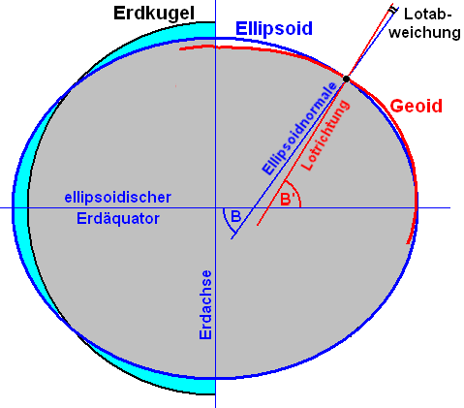

Slide 29
Satellite Geodesy
Modern satellite technology has greatly improved determination of the Earth’s ellipsoid.
Since the early 1960s knowledge of the geoid: features of the gravity field on a scale larger than 1000 km are discerned more effectively by studying perturbations of satellite orbits than would be possible from surface observations. With progressive improvements, satellite techniques have been used to distinguish increasingly fine features, although for exploration of local anomalies surface observations on land must still be used, sometimes in combination with satellite data

Slide 30
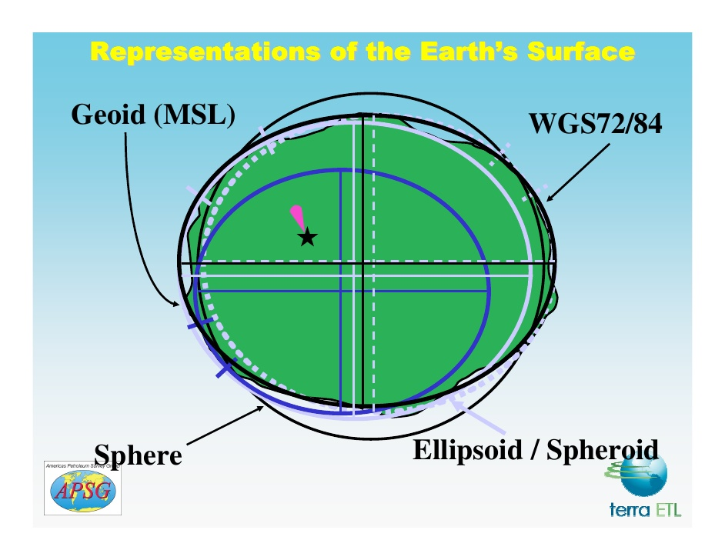
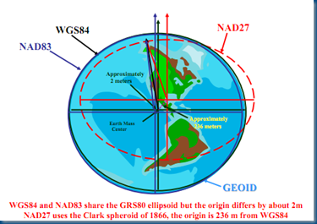
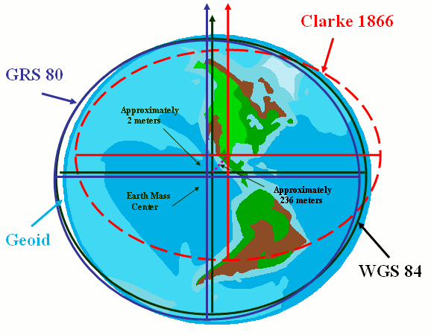

Slide 31
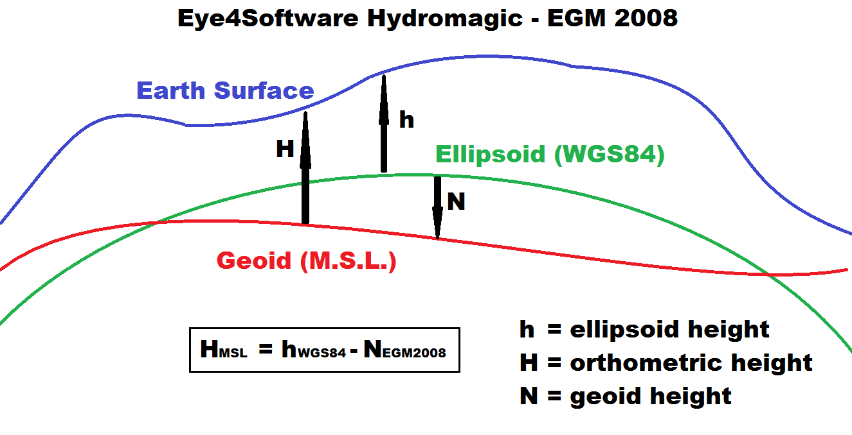

Slide 32
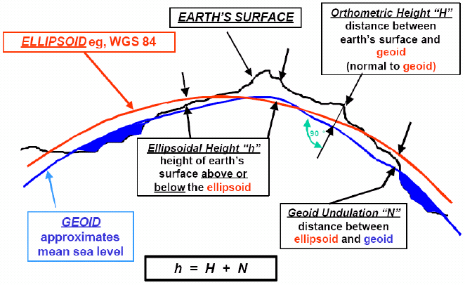

Slide 33
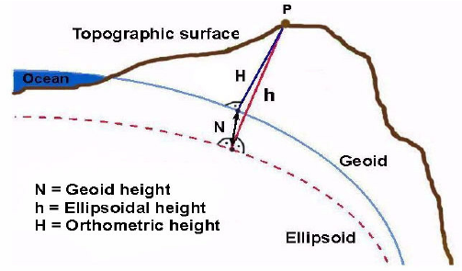

Slide 34
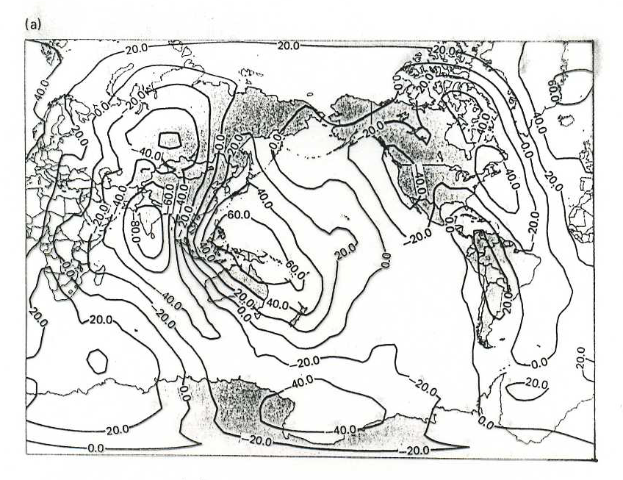
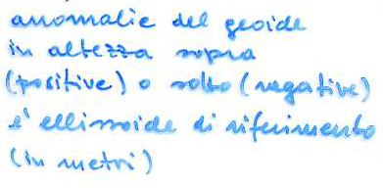

Slide 35
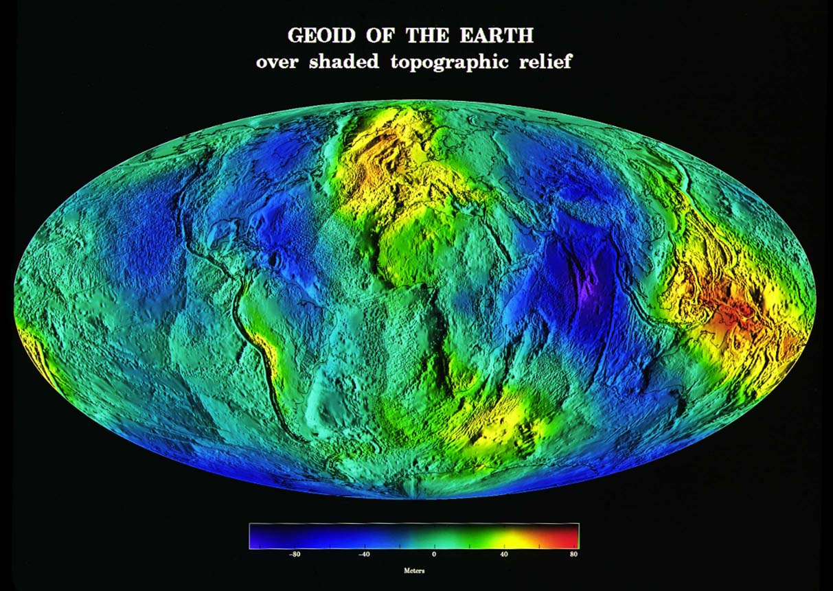

Slide 36
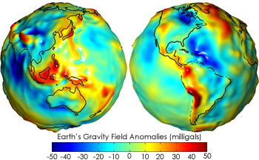

Slide 37
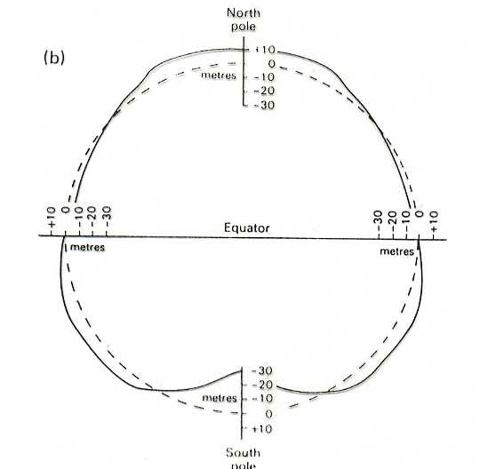
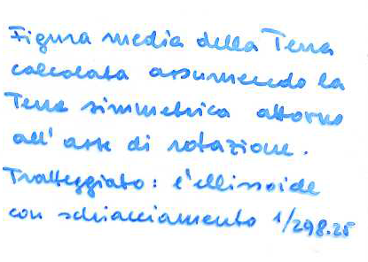

Slide 38
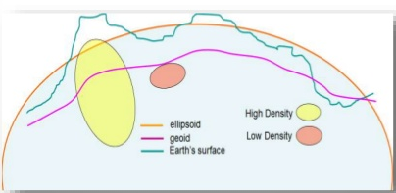
The gaps between the geoid and International Ellipsoid are about 10 m and not more than 70 m , in agree with the deviations from idrostatic equilibrium are of the order of f².
A geoid negative anomaly is in a region with a deficit of mass (depression in the ocean floor), instead a positive anomaly in a region with an excess of mass (mountain on the ocean floor).
The anomaly Δh is linked to the anomaly of the gravitational potential measured on the ellipsoid:
where g is the gravitational acceleration on the ellipsoid.
The deviations are due to the inhomogeneous in the Earth stratification and also are not in hydrostatic equilibrium.
Erosion, tectonic movements, accumulation and melting ice are the cause of slow and continuous variations of the shape of the geoid.

Slide 39
Geoid ondulation: displacement between the geoid and the ellipsoid

Slide 40
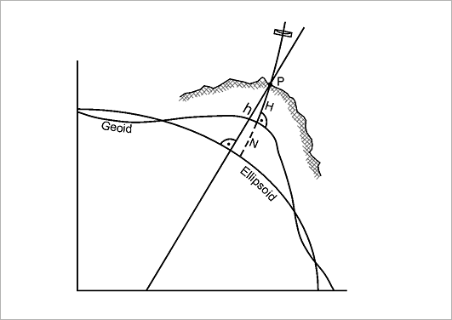
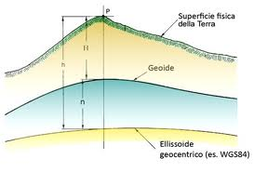
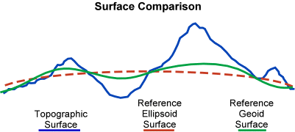

Slide 41
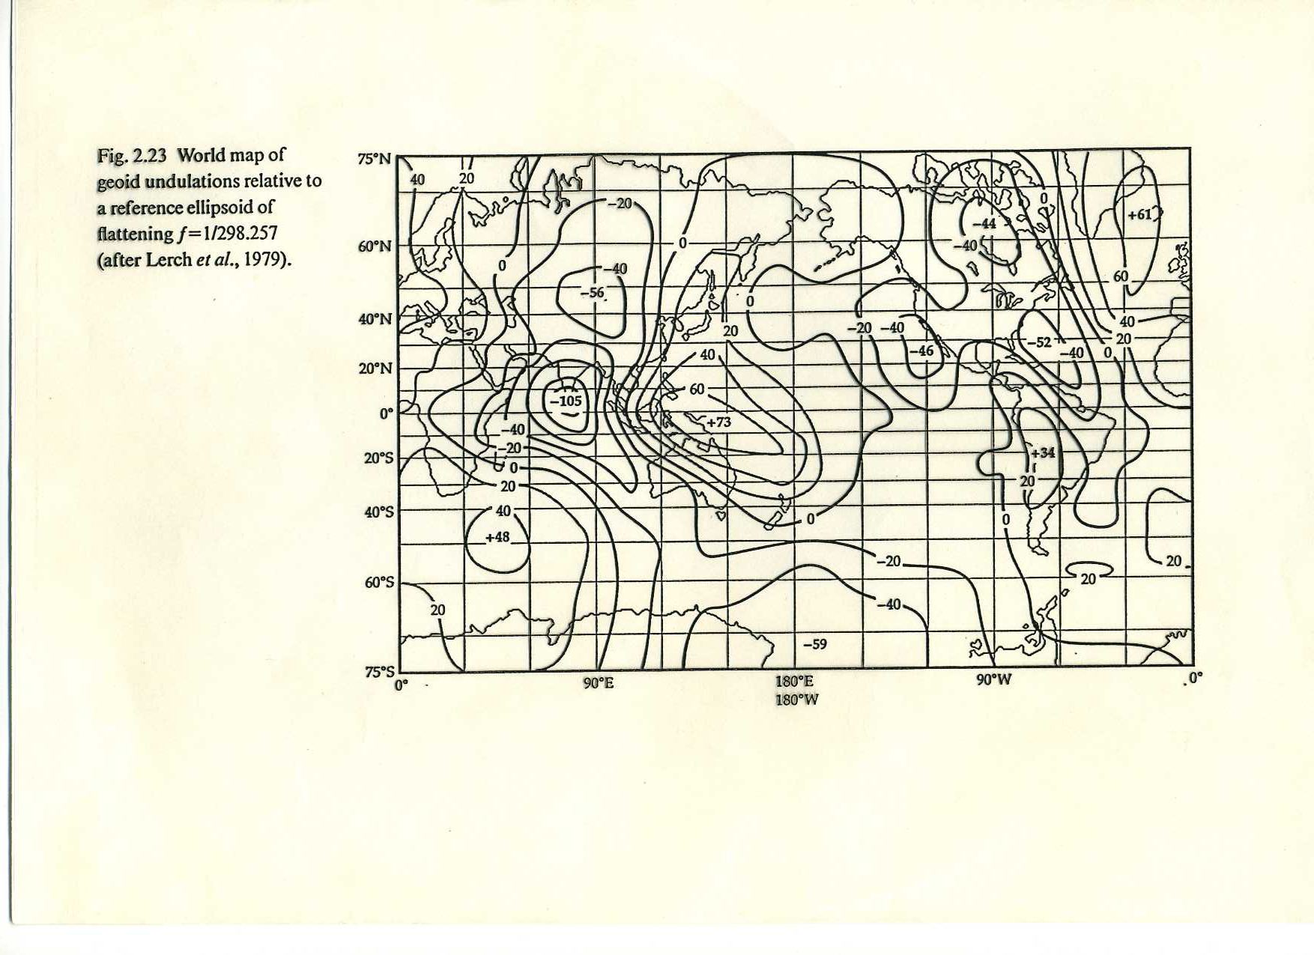

Slide 42
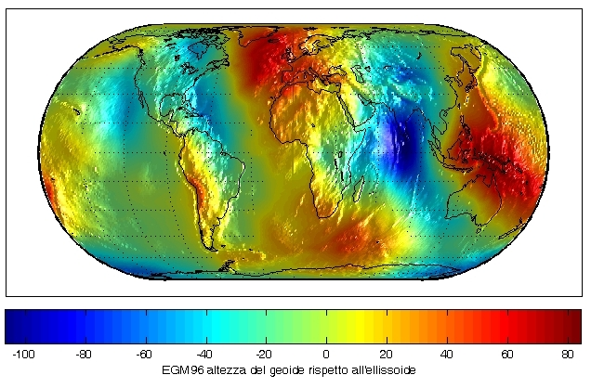

Slide 43
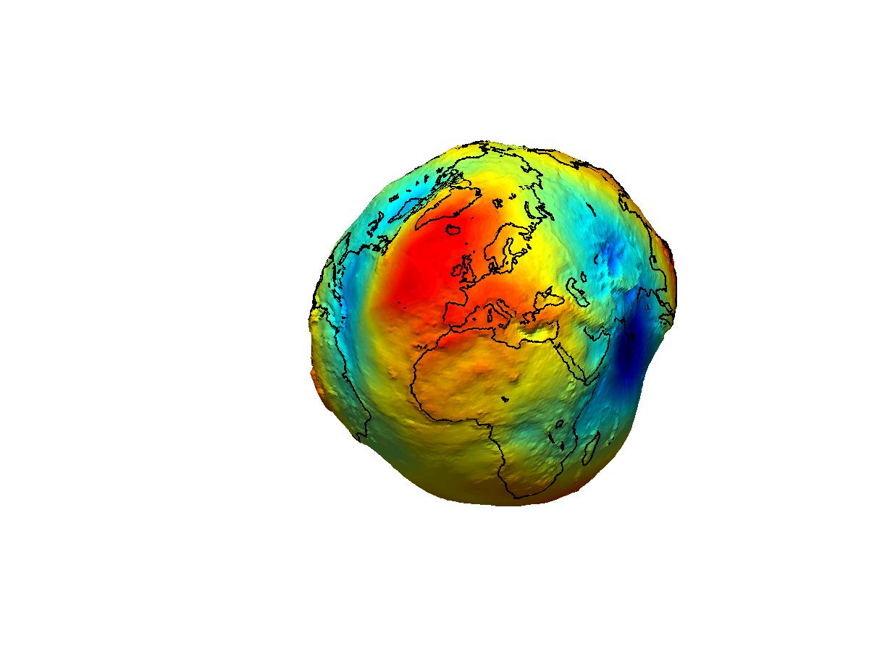
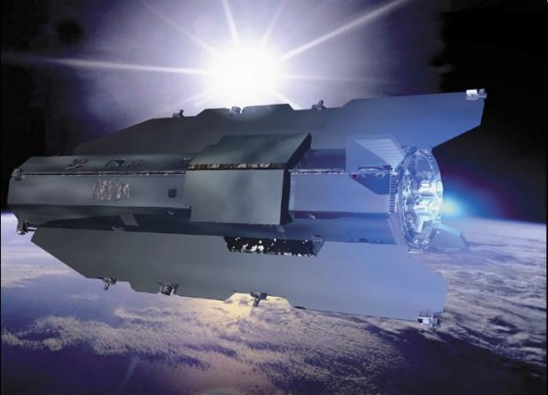
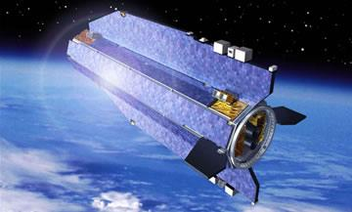
Just two years after its launch, the ESA's GOCE satellite has gathered enough data to create a map of the Earth's gravitational field, with a precision never before achieved. The scientific community now has access to more accurately model 'geoid' ever produced, which will allow us to better understand the functioning of our planet.
The map created by Goce shows the points of the Earth where there are gravitational alterations: in red, areas with gravitational pull above average, in blue ones where the gravitational pull is lower.

Slide 44
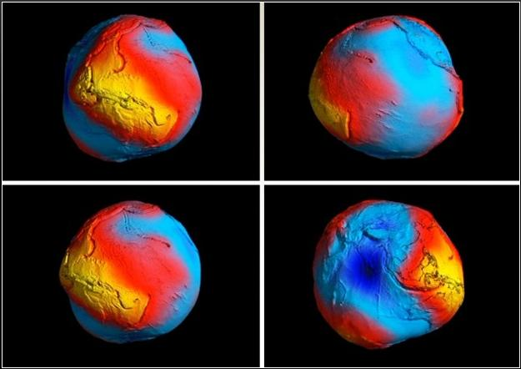

Slide 45
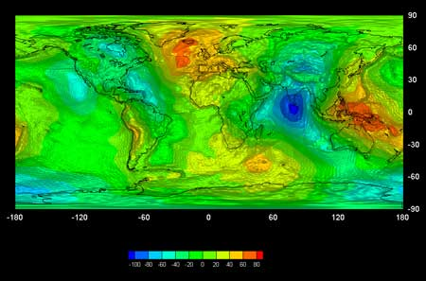

Slide 46
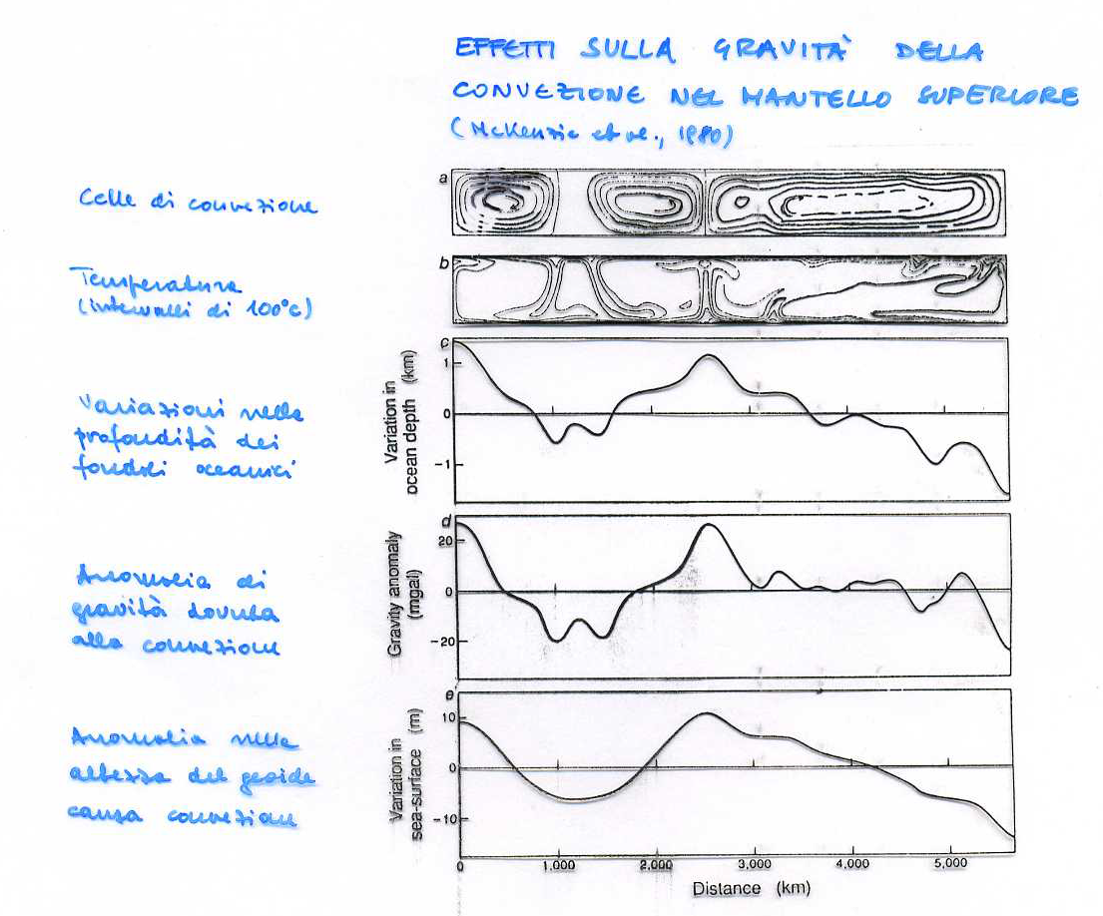

Slide 47
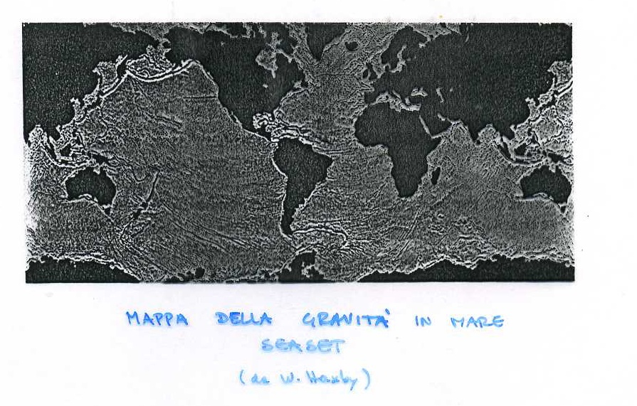

Slide 48
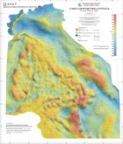

Slide 49
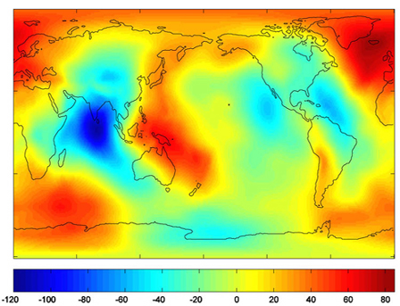
Geoid (meters), from GRACE satellite data

Slide 50
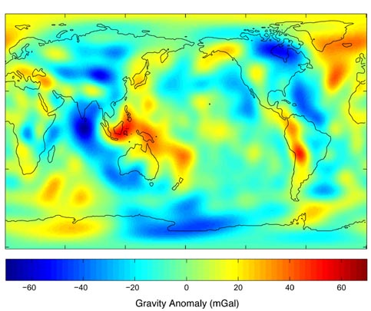
Gravity anomalies (mGal), from GRACE satellite data

Slide 51
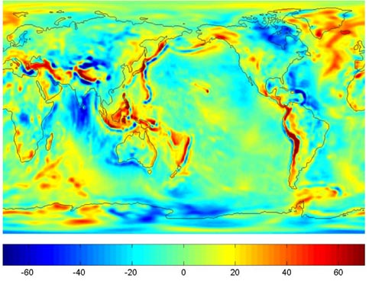
Gravity anomalies (mGal), from GRACE satellite data

Slide 52
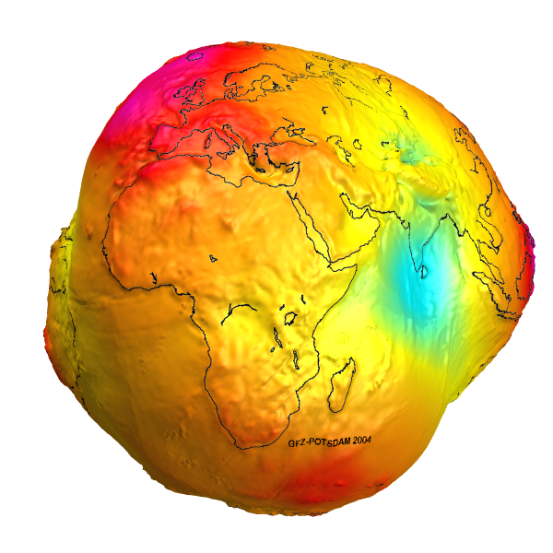

Slide 53
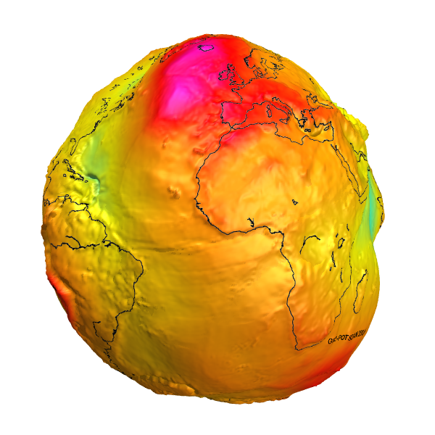

Slide 54
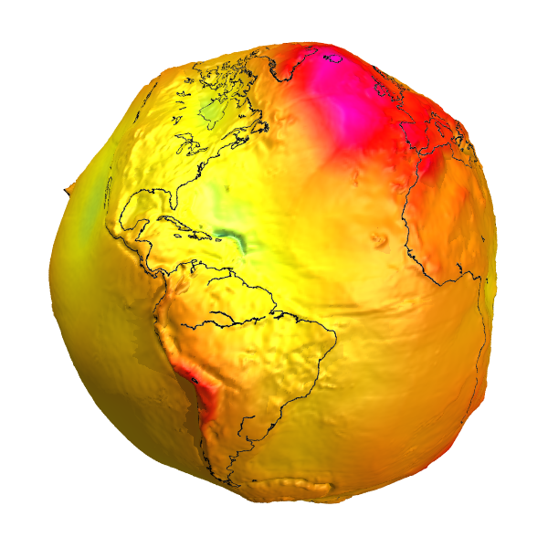

Slide 55
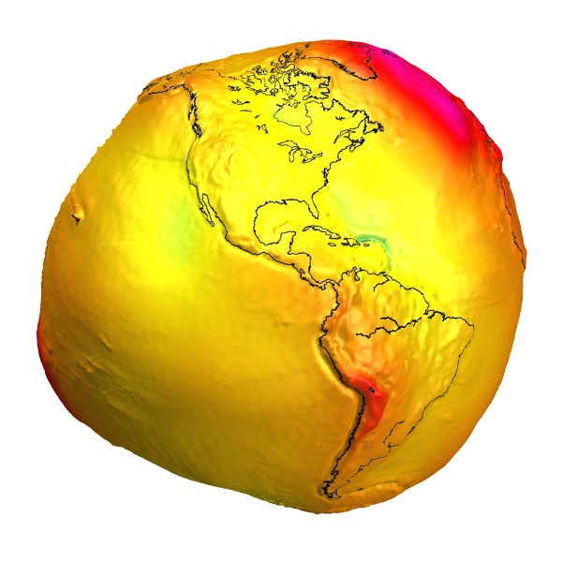

Slide 56
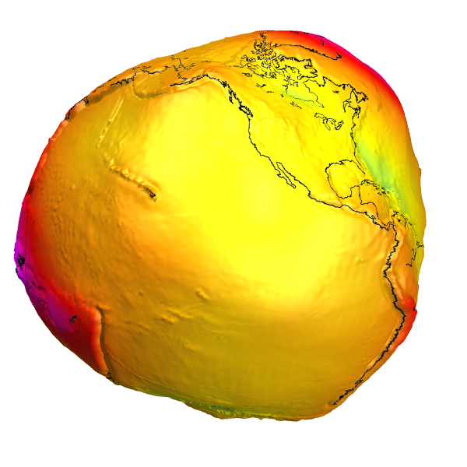

Slide 57
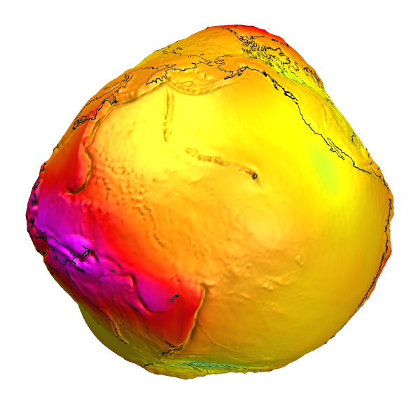

Slide 58
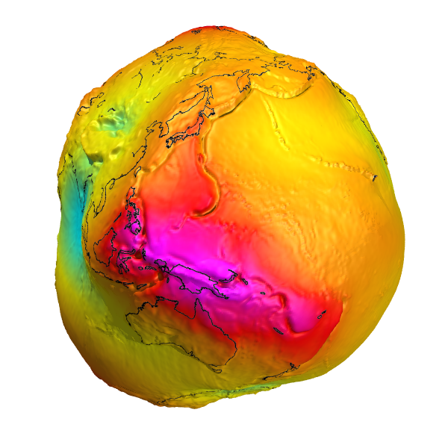

Slide 59


Slide 60


