Slide 1
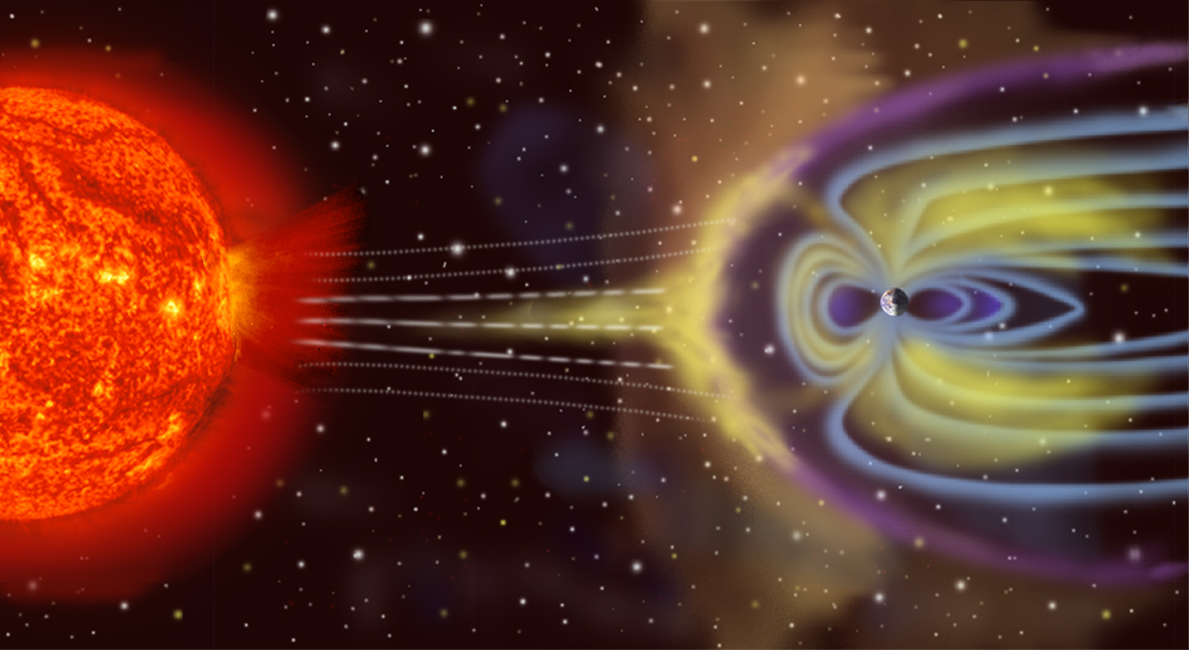
The Earth’s magnetic field
Notes:
1

Slide 2
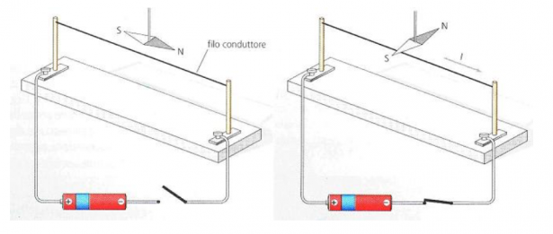
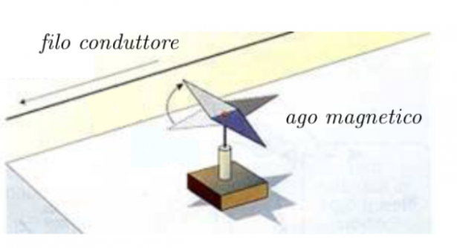
L’esperimento di Oersted
Il passaggio di corrente elettrica in un conduttore può generare un campo magnetico
Ponendo un filo conduttore percorso da corrente all’interno di un campo magnetico, esso può subire una forza.
L’esperimento di Faraday
La legge di Faraday asserisce quanto segue. In un circuito si genera una differenza di potenziale di intensità pari alla variazione nel tempo del flusso del campo magnetico che attraversa il circuito stesso

Slide 3
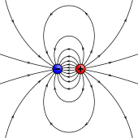
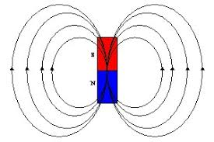

Slide 4
CAMPO MAGNETICO
Il fatto che la Terra avesse un campo magnetico era già noto dall’antichità: oltre mille anni fa i cinesi conoscevano l’ago magnetico (la bussola). Sir Willian Gilbert (1540-1602) fù il promo a studiare scientificamente il fenomeno e di mostrò che il campo magnetico della Terra era simile al campo magnetico del di un dipolo. Da allora cominciarono le ossevazioni sistematico.
Solamente nel 1843 però von Wrede utilizzò per primo le variazioni del campo magnetico per localizzare depositi di material ferromagnetico.

Slide 5
CAMPO MAGNETICO
Il campo magnetico ha molto in comune con il campo gravimetrico, essendo entrambi esprimibili mediante un potenziale. Il campo magnetico però risulta molto più complesso essendo le variazioni più forti e più localizzate. Questo è dovuto in parte al fatto che il campo magnetico ha una direzione variabile oltre all’intensità L’interpretazione delle anolmalie magnetiche risulta pertanto molto più difficile. D’altro canto le misure si ottengono in modo estremamente facile e non necessitano quasi di correzioni.

Slide 6
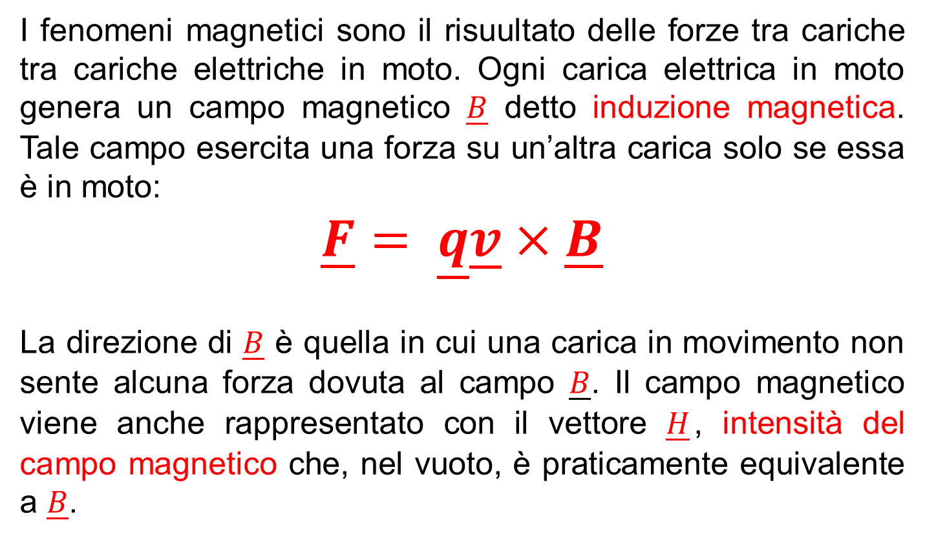
TEORIA

Slide 7
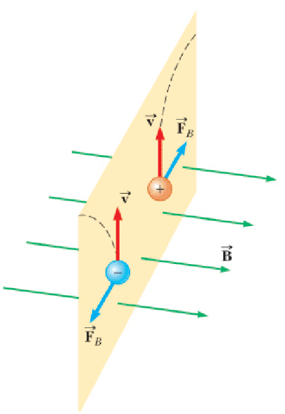
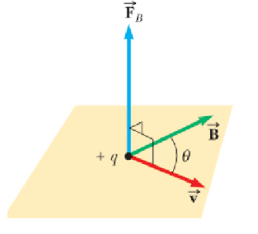

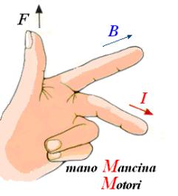
TEORIA

Slide 8
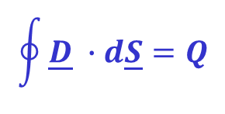

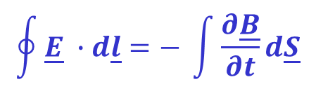
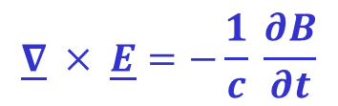
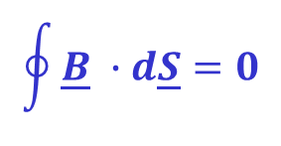

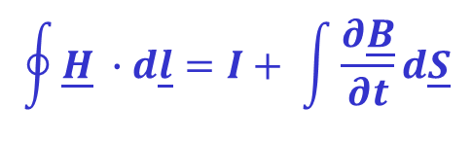
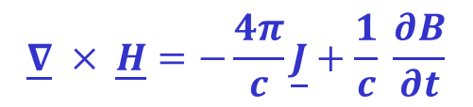

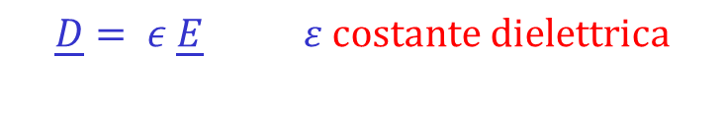
Le leggi dell’elettromagnetismo sono descritte dalle equazioni di Maxwell
Forma integrale(SI) forma differenziale (CGS) Significato
Il campo elettrico è generato da cariche elettriche
Il campo elettrico è generato da variare del campo magnetico
Non esistono cariche magnetiche
Il campo magnetico è generato da correnti di conduzione e dal variare del campo elettrico
con

Slide 9
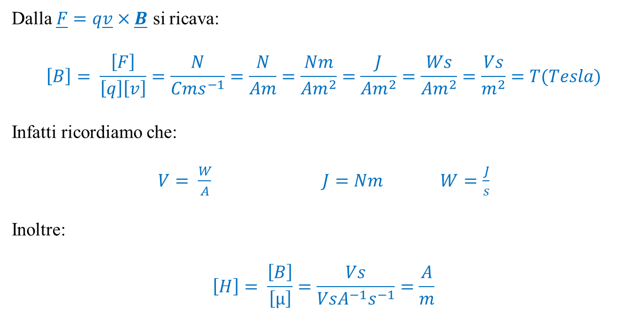
UNITA’ DI MISURA - SI
Dalla $\underline{F}=q\underline{v}×\underline{B}$ si ricava:
$$\left[B\right]= \frac{\left[F\right]}{\left[q\right]\left[v\right]}=\frac{N}{Cms^{−1}}=\frac{N}{Am}=\frac{Nm}{Am^{2}}=\frac{J}{Am^{2}}=\frac{Ws}{Am^{2}}=\frac{Vs}{m^{2}}=T(Tesla)$$
Infatti ricordiamo che:
$V= \frac{W}{A}$ $J=Nm W=\frac{J}{s}$
Inoltre:
$$\left[H\right]= \frac{\left[B\right]}{\left[µ\right]}=\frac{Vs}{VsA^{−1}s^{−1}}=\frac{A}{m}$$

Slide 10
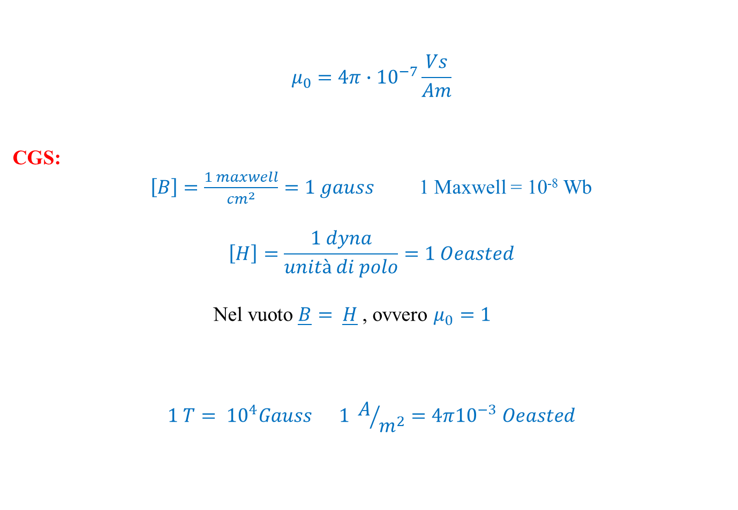
$$μ_{0}=4π∙{10}^{−7}\frac{Vs}{Am}$$
CGS:
$\left[B\right]=\frac{1 maxwell}{{cm}^{2}}=1 gauss$ 1 Maxwell = 10⁻⁸ Wb
$$\left[H\right]=\frac{1 dyna}{unità di polo}=1 Oeasted$$
Nel vuoto $\underline{B}= \underline{H}$, ovvero $μ_{0}=1$
$$1 T= {10}^{4}Gauss 1 A/{m^{2}}=4π{10}^{−3} Oeasted$$

Slide 11
In geofisica le unità di misura SI non sono state (finora) molto usate in quanto troppo grandi e poiché descrivono I fenomeni magnetici come dovuti a correnti elettriche. Pertanto risultano ancora molto diffuse le unità CGS.
Il campo magnetico terrestre ha un valore di circa 0.5 gauss e nelle prospezioni magnetiche si arriva a misurare variazioni dell’ordine di 1 nT

Slide 12
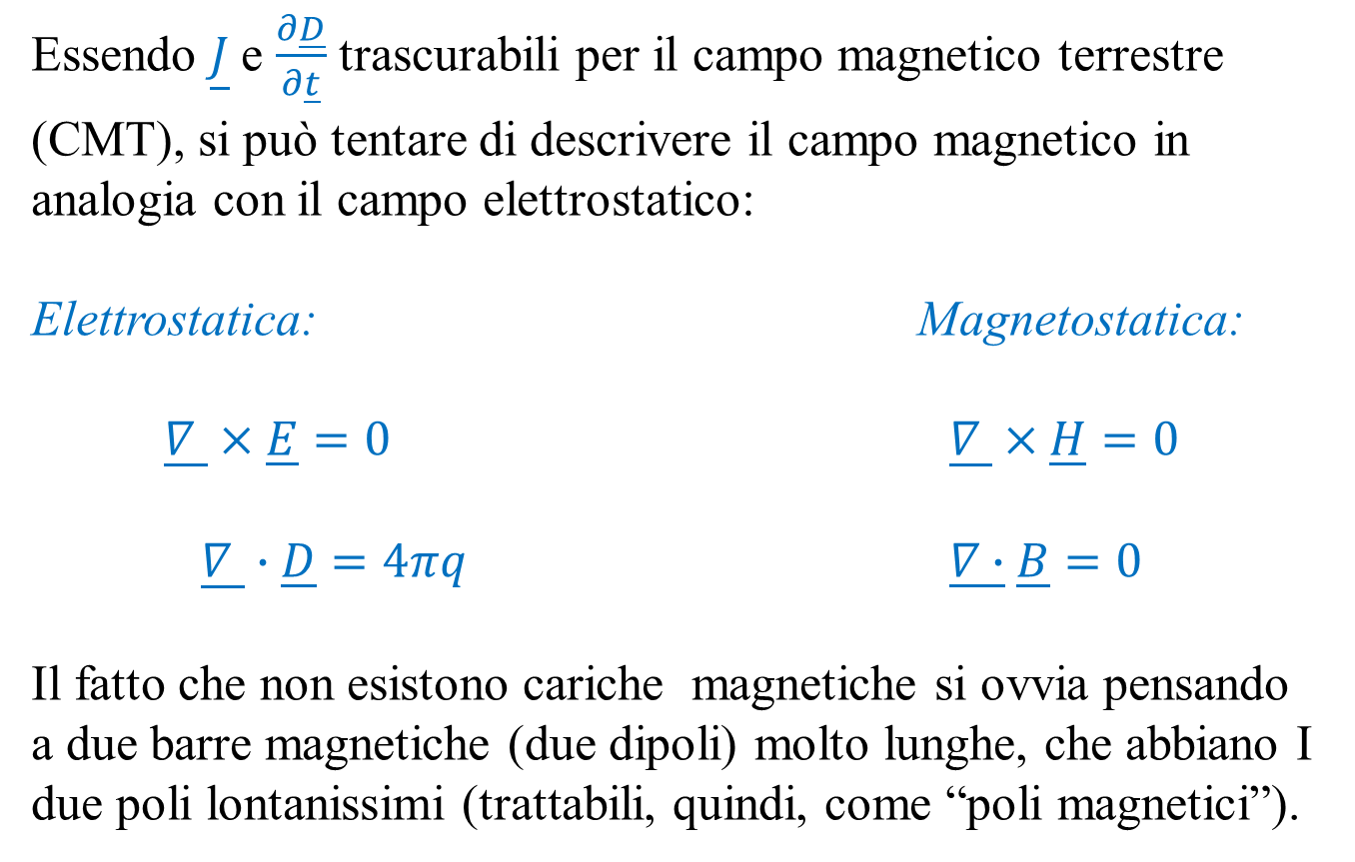
APPROSSIMAZIONE MAGNETICA
Essendo $\underline{J}$e $\frac{∂\underline{D}}{∂\underline{t}}$ trascurabili per il campo magnetico terrestre (CMT), si può tentare di descrivere il campo magnetico in analogia con il campo elettrostatico:
Elettrostatica: Magnetostatica:
$$\underline{∇ }×\underline{E}=0 \underline{∇ }×\underline{H}=0$$
$$\underline{∇ }∙\underline{D}=4πq \underline{∇∙}\underline{B}=0$$
Il fatto che non esistono cariche magnetiche si ovvia pensando a due barre magnetiche (due dipoli) molto lunghe, che abbiano I due poli lontanissimi (trattabili, quindi, come “poli magnetici”).

Slide 13
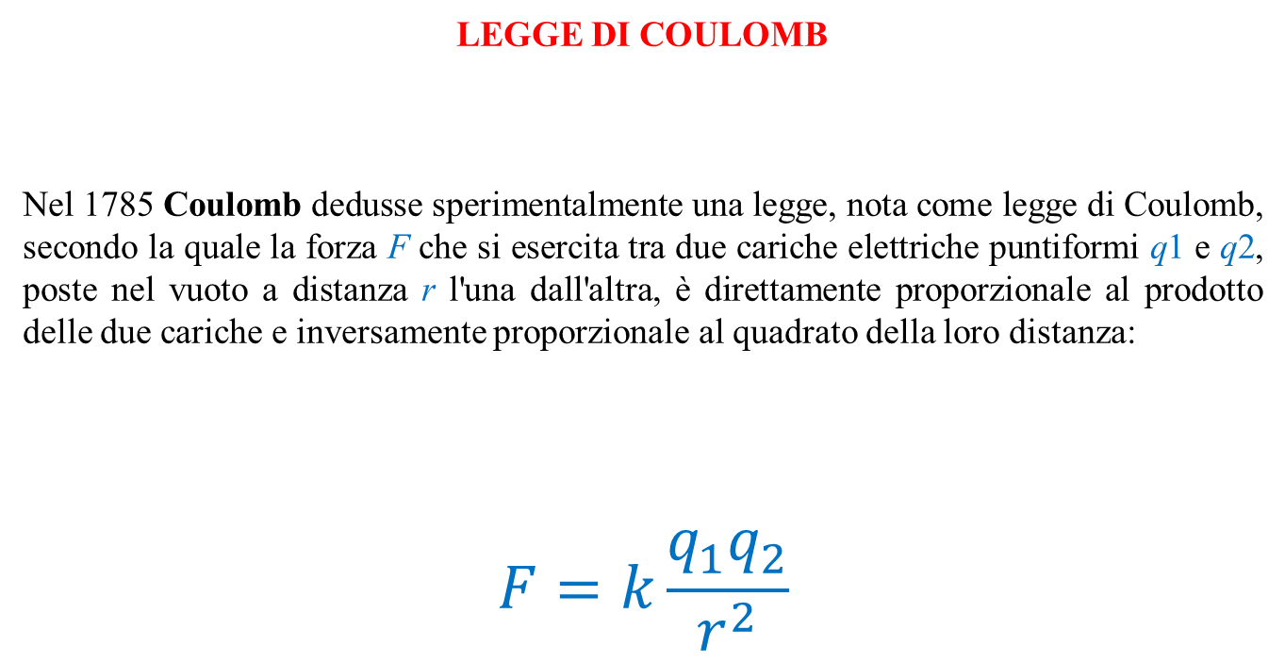
legge di Coulomb
Nel 1785 Coulomb dedusse sperimentalmente una legge, nota come legge di Coulomb, secondo la quale la forza F che si esercita tra due cariche elettriche puntiformi q1 e q2, poste nel vuoto a distanza r l'una dall'altra, è direttamente proporzionale al prodotto delle due cariche e inversamente proporzionale al quadrato della loro distanza:
$$F=k\frac{q_{1}q_{2}}{r^{2}}$$

Slide 14
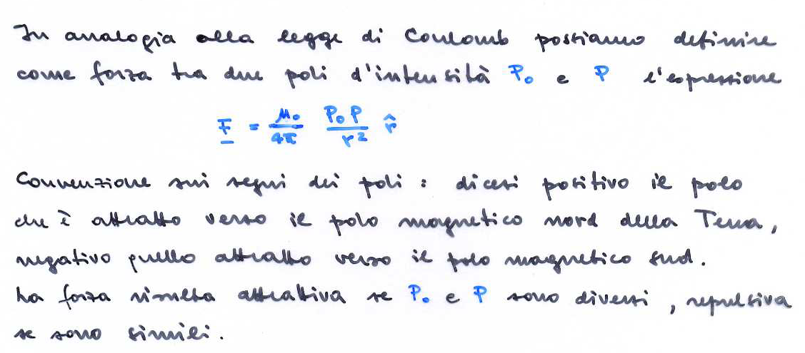
POTENZIALE MAGNETOSTATICO

Slide 15
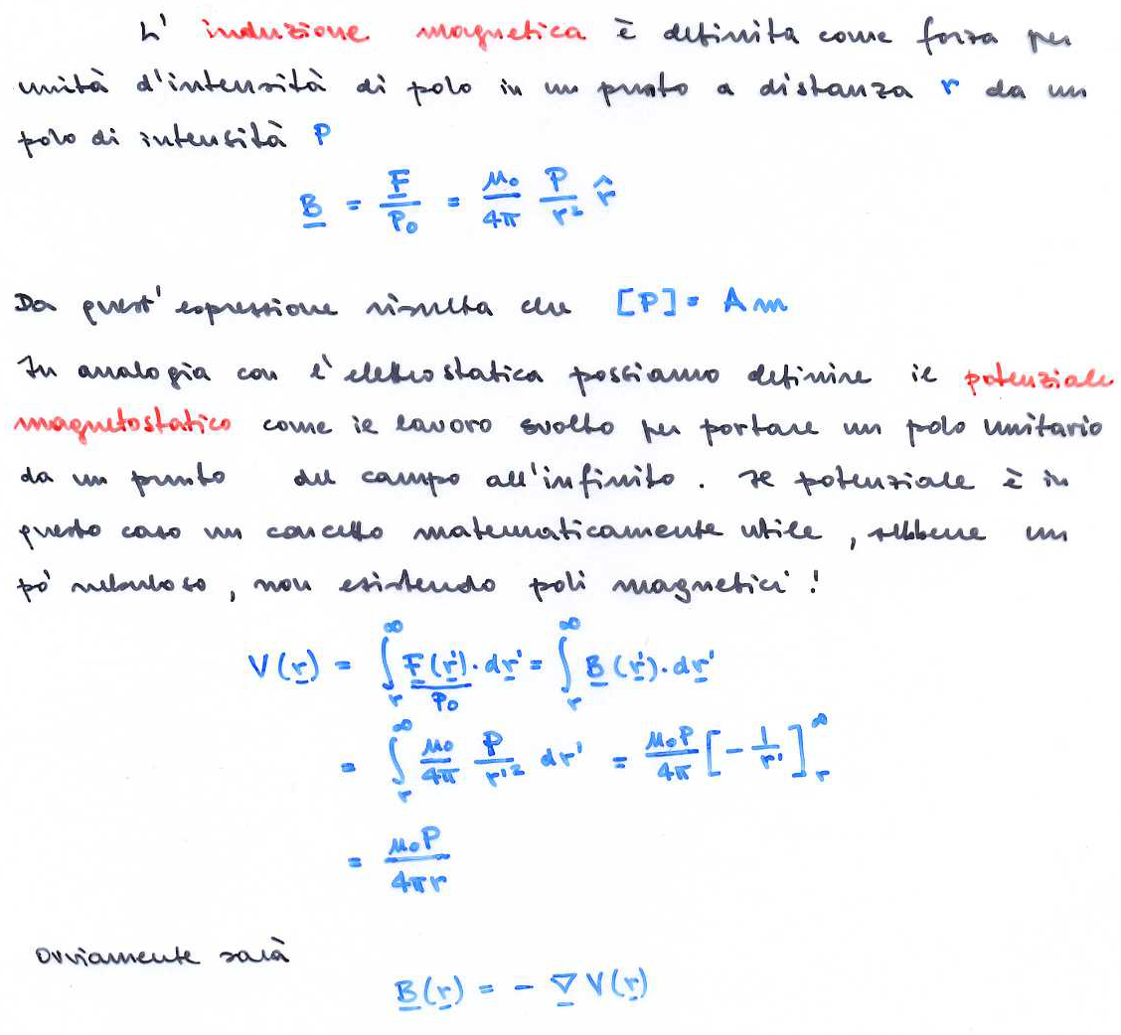

Slide 16
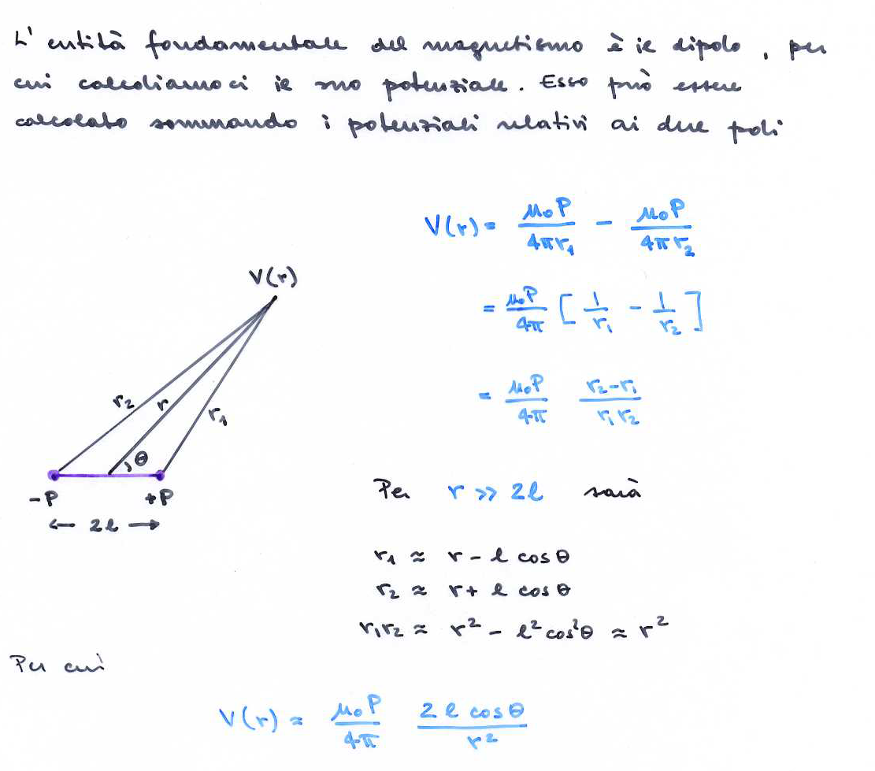
POTENZIALE DEL DIPOLO

Slide 17
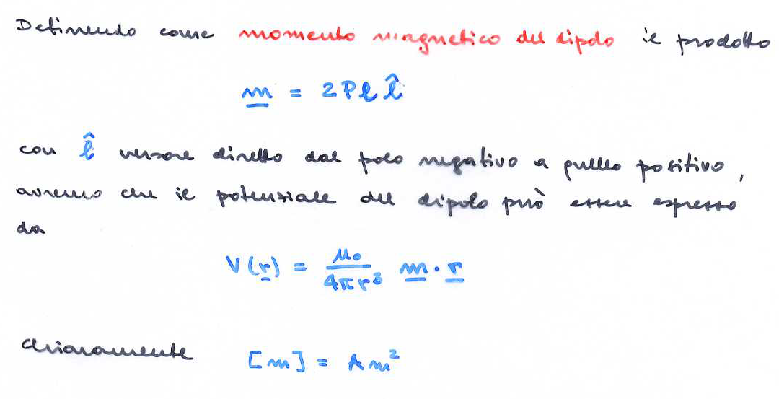

Slide 18
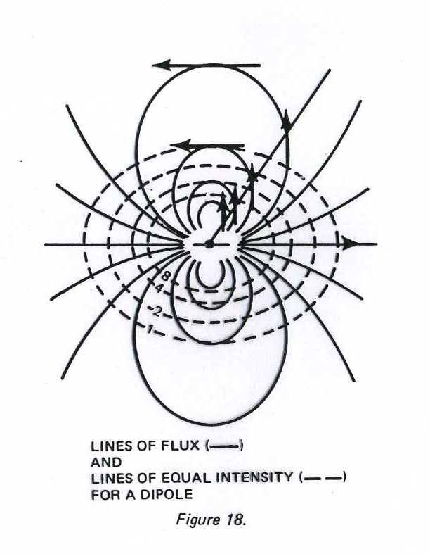
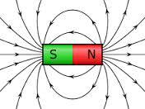

Slide 19
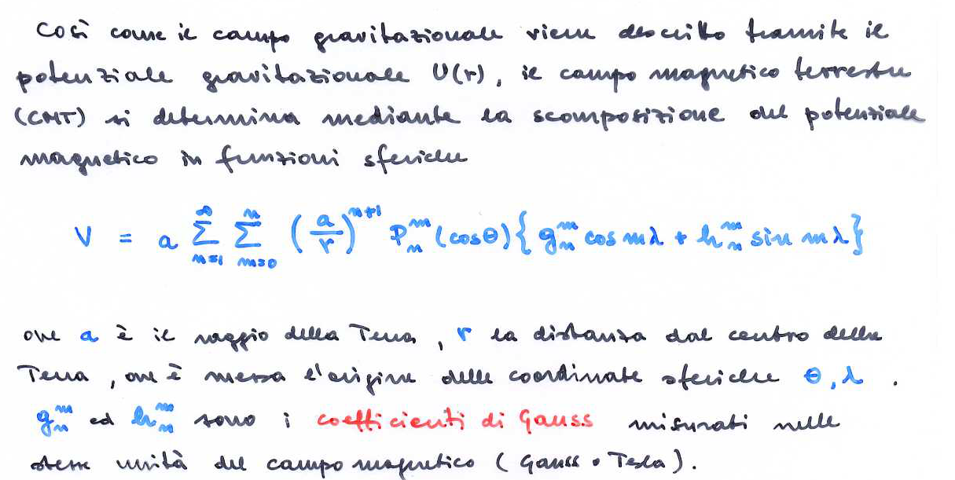
CAMPO MAGNETICO TERRESTRE

Slide 20
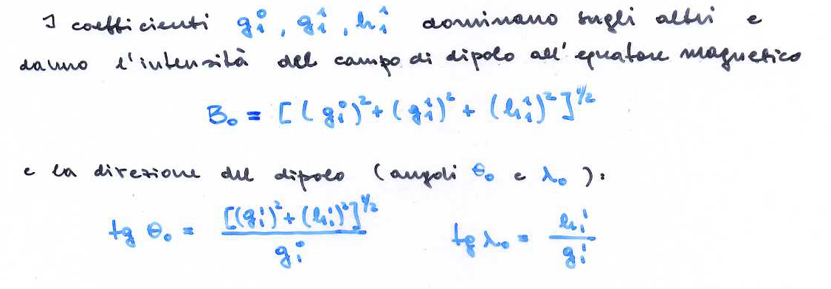
CAMPO MAGNETICO TERRESTRE

Slide 21
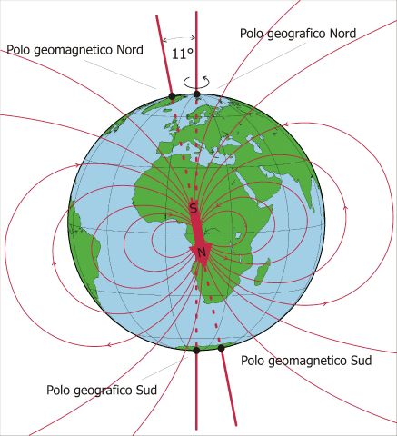
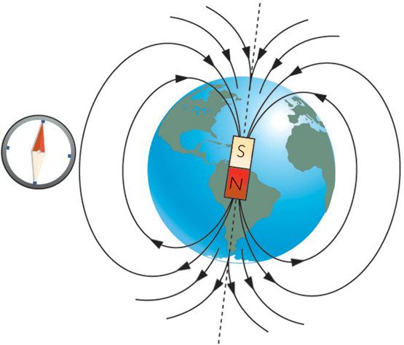

Slide 22
Geomagnetic field is generated in Earth’s core
Temperatures > 3000 K;
above Curie point (T_{c}(Fe) = 1043 K; T_{c}(Ni) = 627 K )
Magnetic field is generated by electrical current
Unsustained electrical current would dissipate within 20.000 years
Paleomagnetic records (ancient field recorded in sediment and lavas) Earth’s magnetic field exists millions of years
The polarity reversal
Earth will lose magnetic shield for high-energy particles
Notes:
22

Slide 23
Characteristics of Earth’s magnetic field
Nearly dipolar
Approximately aligned with Earth’s rotation axis
Changes slowly with time
Is at least 3 Ga old

Slide 24
The Earth’s magnetic field
The Earth's magnetic field crudely resembles that of a central dipole: To a first approximation the Earth’s magnetic field is a dipole field. This means that the Earth’s magnetic field can be represented by a magnetic dipole situated at the centre of the Earth (imagine a bar magnet at the centre of the Earth). This fact was first pointed out in 1600 by Sir William Gilbert. The difference between the Earth’s magnetic field and the best dipole field is termed the non-dipole field. On the Earth's surface the field varies from being horizontal and of magnitude about 30 000 nT near the equator to vertical and about 60 000 nT near the poles; the root mean square (rms) magnitude of the vector over the surface is about 45 000 nT.
NB
Notes:
24

Slide 25
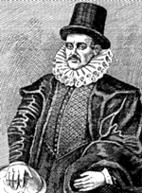
The Earth’s magnetic field: Gilbert
Personal Physician to Elizabeth I
Published De Magnete in 1600, a 6-volume treatise documenting his experiments with magnetism
Proposed that Earth behaves like a giant bar magnet
Died in 1603 of bubonic plague
William Gilbert, 1544-1603
Notes:
25

Slide 26
The Earth’s magnetic field: Gauss
1838, Carl Friedrich Gauss proved 95% of Earth's magnetic field is internal, 5% external. Earth's field is sum of 3 parts:
  Main magnetic field
  produced by electrical currents in outer core;
  steady on timescale of days, but variable over years;
  approximately 50,000 nT;
  accounts for large regional variations in intensity and direction.
  B) External magnetic field
  produced by electrical currents in ionosphere consisting of particles ionized by solar radiation;
  usually variable over hours, at tens of nT;
  occasionally variable over minutes, at hundreds of nT (magnetic storm).
  C) Anomalous, induced magnetic field
  magnetization induced in crust by Main Field (and External Field) or remanent magnetization ("permanently induced");
  limited to upper crust (Curie T);
  limited to ferromagnetic materials.

Slide 27
Dipole Field
To specify the geomagnetic field at any point on the Earth’s surface both a magnitude and a direction are required: the geomagnetic field is a vector quantity. It is far from being constant either in magnitude or in direction and varies spatially over the surface of the Earth.
Systematic mapping of the magnetic field began some five hundred years ago with the magnetic compass measurements carried out by the early mariners.
The internationally agreed values of the geomagnetic field are updated and published every few years as the International Geomagnetic Reference Field (IGRF).
The internal geomagnetic field also varies in time, on a time-scale of months and longer, in an as yet unpredictable manner. This so-called secular variation (SV) has a complicated spatial pattern, with a global rms magnitude of about 80 nT/year
Notes:
27

Slide 28
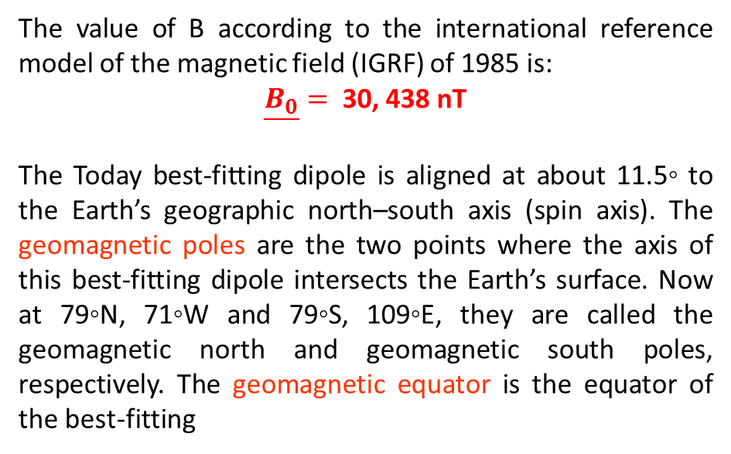
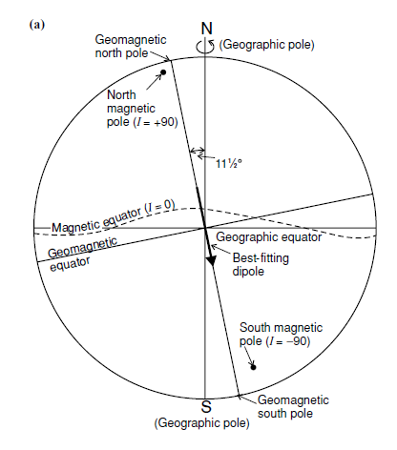
The Earth’s magnetic field
The two points on the Earth’s surface at which the magnetic field is vertical and has no horizontal component are called the magnetic poles, or dip poles. The present north magnetic pole is at 76◦N, 101◦W, and the south magnetic pole is at 66◦S, 141◦E. The magnetic equator is the line along which the magnetic field is horizontal and has no vertical component.

Slide 29
The Earth’s magnetic field: spherical harmonic field models
Gauss made the first quantitative spherical harmonic analysis of the geomagnetic field in 1838. He determined the harmonic coefficients from measurements of B at a total of only 84 points (spaced 30° a part in the f direction along seven circles of latitude) and concluded that the external coefficients g_{n}^{me} and h_{n}^{me} are zero.
Now we know that external sources contribute several tens of nT (and often much more) to the total magnetic field at the earth's surface, and that this contribution is highly variable in both time and space.
The Gauss coefficients are determined by fitting the gradient components to observations from magnetic observatories or satellite data for a particular time epoch. A maximum value of n to be used in the fitting procedure is usually assigned beforehand so that a finite number of coefficients can be resolved. Perhaps the most important result of this kind of analysis is that 99% of the field is of internal origin.
Notes:
29

Slide 30
The Earth’s magnetic field: Gauss coefficient
Data from several sources are integrated in modern analyses of the Earth’s magnetic field. Until the dawn of the satellite era, continuous records at magnetic observatories were the principal sources of geomagnetic data.
Average values of the geomagnetic elements were determined, from which optimum values for the Gauss coefficients could be derived. Currently, about 200 permanent observatories make continuous measurements of the field. However, satellites orbiting the Earth in low near polar orbits now provide most of the high-quality data used to model the field.
The Polar Orbiting Geophysical Observatory (POGO), launched in 1965, was the first to deliver field measurements, but the greatest advance came with the Magnetic Field Satellite (MAGSAT), which delivered high-quality data during a six-month mission in 1979–1980. In 1979, a Danish satellite, ØRSTED, was placed in an elliptical, low-polar orbit, with altitude between 650 km and 865 km. It carried a vector magnetometer and a total field magnetometer, each with a sensitivity of 0.5 nT.
Notes:
30

Slide 31
The Earth’s magnetic field: Gauss coefficient
Data from several sources are integrated in modern analyses of the Earth’s magnetic field. Until the dawn of the satellite era, continuous records at magnetic observatories were the principal sources of geomagnetic data.
In principle, an infinite number of Gauss coefficients would be needed to define the field completely. The coefficients of order and degree 8 and higher are very small and the calculation of Gauss coefficients must usually be truncated. A global model of the field is provided by the International Geomagnetic Reference Field (IGRF), which is based on coefficients up to n=10, although analyses of higher order have been made. It is updated at regular intervals. The IGRF also gives the rate of change of each of the Gauss coefficients (its secular variation), which permits correction of the current values between update years.
Notes:
31

Slide 32
The Earth’s magnetic field: Gauss coefficient
Notes:
32

Slide 33
The Earth’s magnetic field: Gauss coefficient
The most striking feature of the values for Gauss coefficients listed is that 90% of the field is represented by the terms where n=1 (check out g₁⁰). The functions associated with coefficients of degree have wavelengths of one Earth circumference and can be thought of representing geocentric dipole along three different axes: the spin axis (g₁⁰) and two equatorial axes intersecting at the Greenwich meridian (g₁¹) and 90° East (g₁¹).
Notes:
33

Slide 34
The Earth’s magnetic field: Gauss coefficient
The Gauss coefficients get smaller with increasing order n; this decrease provides a way of estimating the origin of the internal field. The analysis involves a technique called power spectral analysis. The distance across a feature of the magnetic field (for example, a region where the field is stronger than average) is called the wavelength of the feature.
As in the case of gravity anomalies, deep seated magnetic sources produce broad (long-wavelength) magnetic anomalies, while shallow sources result in narrow (short-wavelength) anomalies. Spectral analysis consists of calculating the power (alternatively called the energy density) associated with each “frequency” in the signal. This is obtained by computing the sum of the squares of all coefficients with the same order. In the case of the geomagnetic field, the spectral analysis is based on the values of the Gauss coefficients.
Low-order terms (those with small values of n) correspond to long-wavelength features, high-order terms are related to short-wavelength features.
Notes:
34

Slide 35
The Earth’s magnetic field: measuring the field today
Notes:
35

Slide 36
The Earth’s magnetic field: measuring the field today
Geomagnetic observatory locations.
Notes:
36

Slide 37
The Earth’s magnetic field
The Sun is also responsible for the diurnal (daily) variation in the Earth’s magnetic field. This variation, which has an amplitude of less than 0.5% of the total field, is the main short-period variation in the Earth’s magnetic field.
The long-term reversals of the magnetic field, are used to date the oceanic lithosphere.
However, the geomagnetic field changes on an intermediate timescale too: the pole wanders by a few degrees a century. This wandering has been measured throughout historical time and is termed secular variation. However, it appears that, on average over geological time, the geomagnetic field axis has been aligned along the Earth’s spin axis (i.e., on average the geomagnetic poles have been coincident with the geographic poles). This means that, to a first approximation, the geomagnetic field can be modelled as the field of a dipole aligned along the geographic north–south axis.
This assumption is critical to all palaeomagnetic work: if the dipole axis had wandered randomly in the past and had not, on average, been aligned along the geographic axis, all palaeomagnetic estimates of past positions of rock samples would be meaningless because they would be relative only to the position of the geomagnetic pole at the time each sample acquired its permanent magnetization and would have nothing at all to do with the geographic pole

Slide 38
Earth’s magnetic field: temporal variations
Temporal variations are classified according to the rate of occurrence and source:
Polarity reversal: 10³ - 10⁶ years
Secular variations: years
Diurnal variations: hours-days
Magnetic storms: minutes-hours

Slide 39
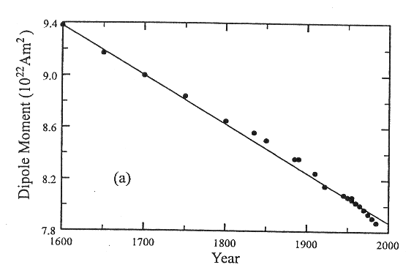
Secular Variation: Earth's magnetic field since 1600
At any particular place on the Earth the geomagnetic field is not constant in time. When the Gauss coefficients of the internal field are compared from one epoch to another, slow but significant changes in their values are observed. Over decades or centuries of observation and so they are called secular variations (from the Latin word saeculum for a long age). They are manifest as variations of both the dipole and non-dipole components of the field.
The dipole field exhibits secular variations of intensity and direction. Calculations of the Gauss coefficients for different historical epochs show a near-linear decay of the strength of the dipole moment at a rate of about 3.2% per century between about 1550 AD and 1900 AD. At the start of the twentieth century the decay became even faster and has averaged about 5.8% per century during the last 80 yr

Slide 40
Secular Variation: Earth's magnetic field since 1600
If it continues at the same almost linear rate, the field intensity would reach zero in about another 2000 yr. The cause of the quite rapid decay in intensity is not known; it may simply be part of a longer term fluctuation. However, another possibility is that the dipole moment may be decreasing preparatory to the next reversal of geomagnetic field polarity.

Slide 41
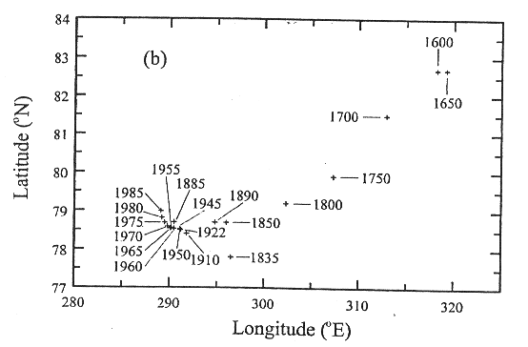
Secular Variation: Earth's magnetic field since 1600
The position of the dipole axis also shows secular variation

Slide 42
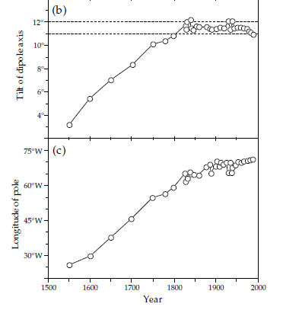
Secular Variation: Earth's magnetic field since 1600
Data are only sufficiently abundant for spherical harmonic analysis since the early nineteenth century. Less reliable data, enlarged by archeomagnetic results, allow estimates of the secular variation of the dipole axis since the middle of the sixteenth century.
The earlier data suggest that in the sixteenth century the dipole axis was tilted at only about 3°to the rotation axis; a gradual increase in tilt took place between the sixteenth and nineteenth centuries.
During the last 200 yr the dipole axis has maintained an almost constant tilt of about 11–12° to the rotation axis.
For the past 400 yr the longitude of the geomagnetic pole has drifted steadily westward. Before the nineteenth century the pole moved westward at about 0.14° yr⁻¹; this corresponds to a pseudo-period of 2600 yr for a complete circle about the geographic pole. However, since the early nineteenth century the westward motion of the pole has been slower, at an average rate of 0.044° yr⁻¹, which corresponds to a pseudo-period of 8200 yr.

Slide 43
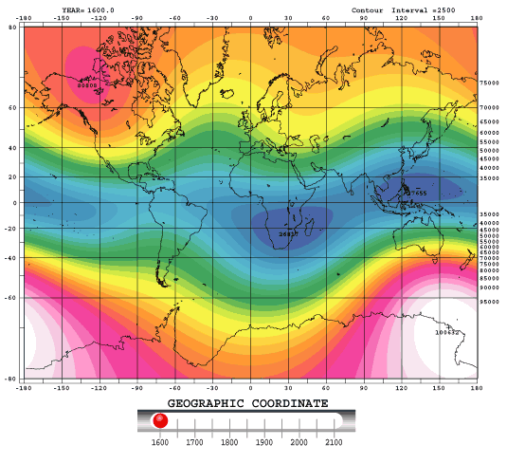
Secular Variation: Earth's magnetic field since 1600

Slide 44
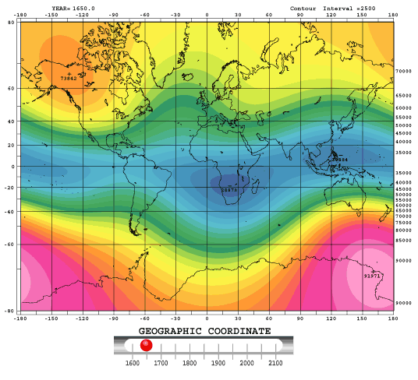
Secular Variation in Earth's magnetic field since 1600

Slide 45
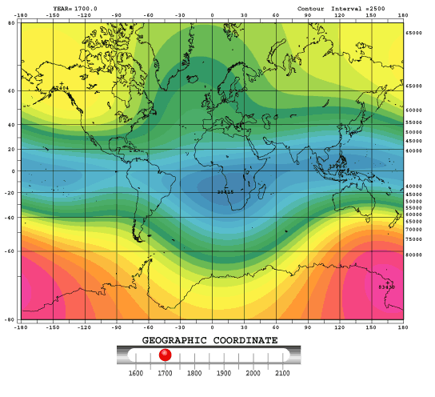
Secular Variation in Earth's magnetic field since 1600

Slide 46
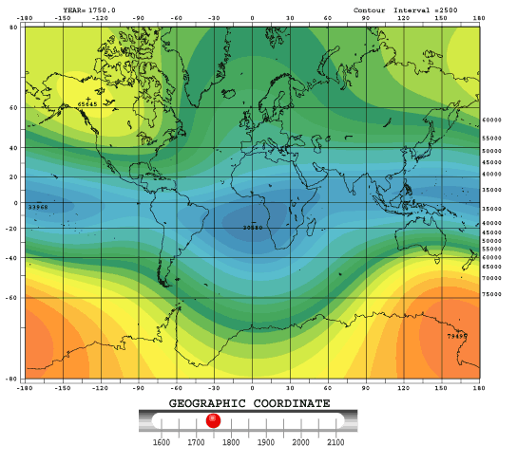
Secular Variation in Earth's magnetic field since 1600

Slide 47
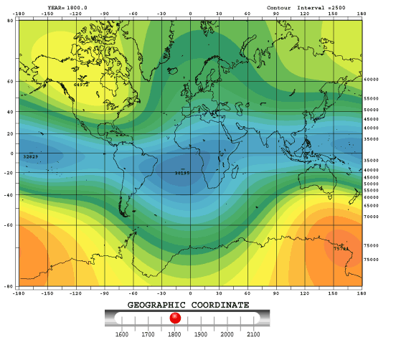
Secular Variation in Earth's magnetic field since 1600

Slide 48
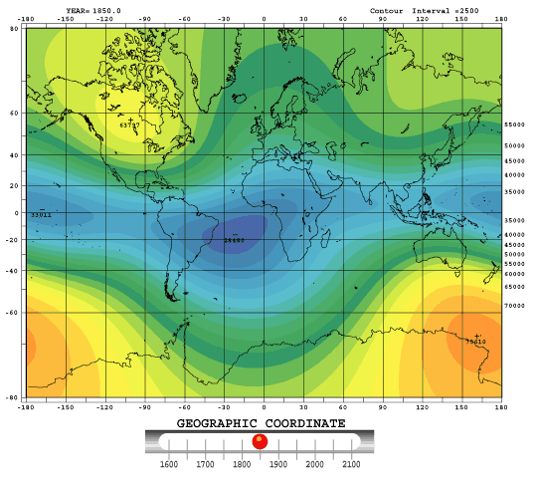
Secular Variation in Earth's magnetic field since 1600

Slide 49
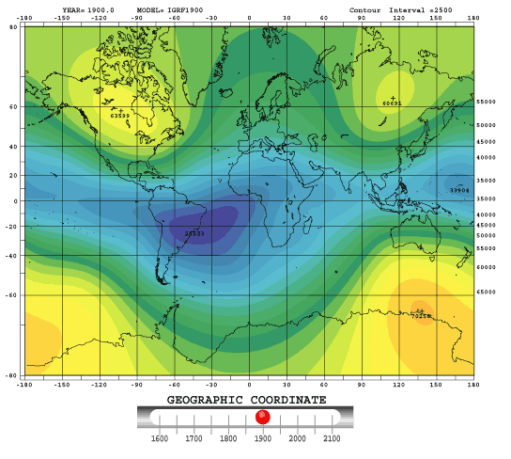
Secular Variation in Earth's magnetic field since 1600

Slide 50
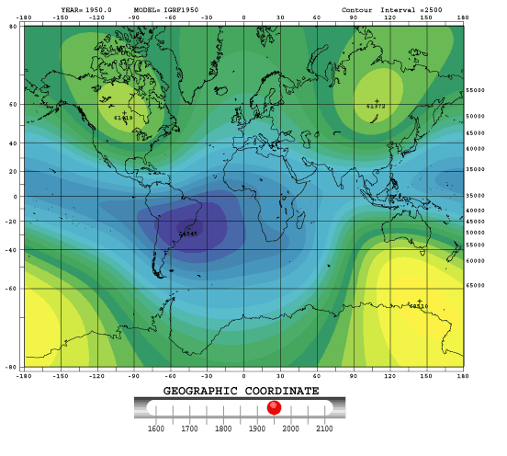
Secular Variation in Earth's magnetic field since 1600

Slide 51
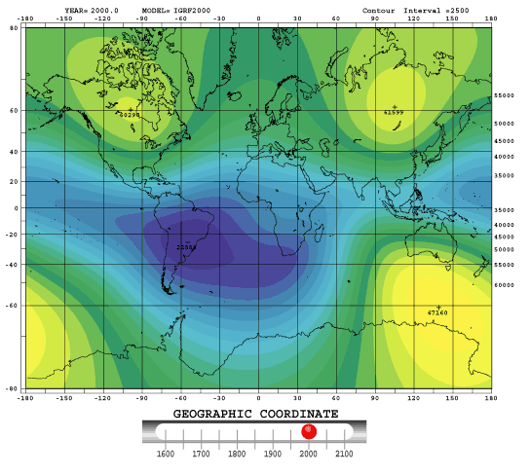
Secular Variation in Earth's magnetic field since 1600

Slide 52
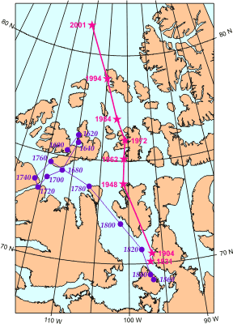
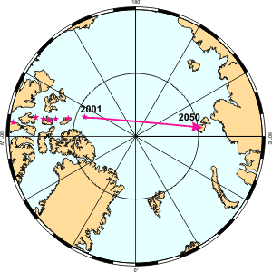
Secular Variation: migration of the magnetic North Pole
At the magnetic north pole, the inclination is 90º (straight down).
It has been in the Canadian arctic for centuries, but is migrating towards Siberia 40 km per year.

Slide 53
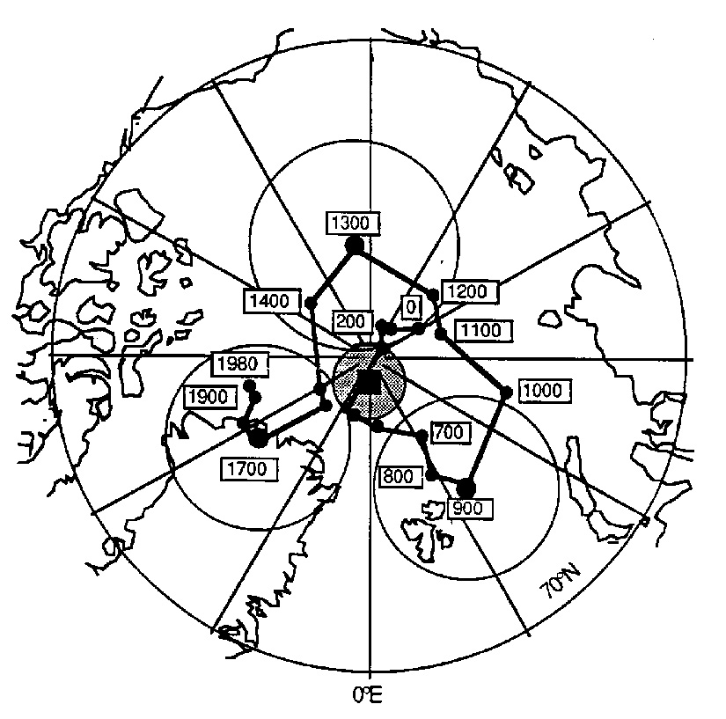
Secular Variation: migration of the magnetic North Pole

Slide 54
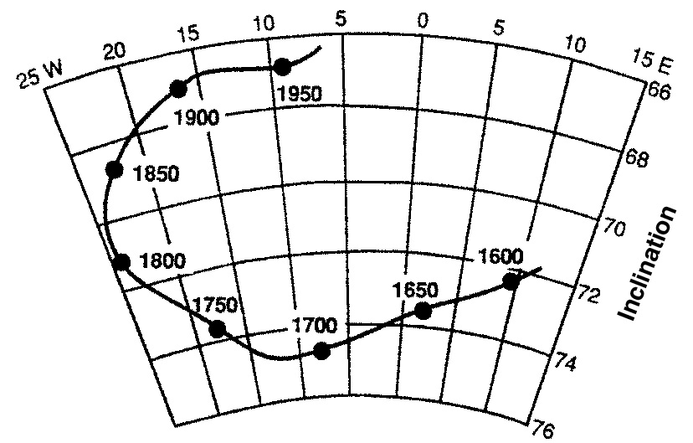
Secular Variation: Declination and Inclination in London

Slide 55
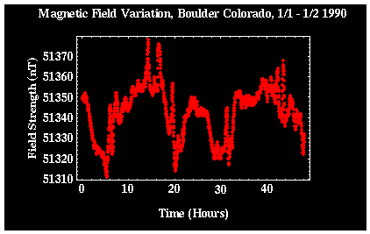
Temporal variations: diurnal variations
These variations occur over the course of a day, and are related to changes in the Earth's external magnetic field. Shown below is the typical variations in the magnetic data recorded at a single location (Boulder, Colorado) over a time period of two days.
Can be on the order of 20 to 30 nT per day and should be corrected for when conducting exploration magnetic surveys.

Slide 56

Temporal variations: magnetic storm
Occasionally, magnetic activity in the ionosphere will abruptly increase. These storms correlates with enhanced sunspot activity. The magnetic field observed during such times is highly irregular and unpredictable.
In this example, the magnetic field has varied by almost 100 NT in a time period shorter than 10 minutes!! Exploration magnetic surveys should not be conducted during magnetic storms.

Slide 57


Slide 58


Slide 59


Slide 60


Slide 61

The Maghetosphere
Solar wind = charged particles ejected from the Sun
Magnetosphere = a zone of charged particles trapped by Earth’s magnetic field
Magnetotail = portion of a magnetosphere that is pushed away from the sun by the solar wind

Slide 62



Slide 63




Slide 64


Slide 65

The Earth’s magnetic field: Gauss
According to Ampere’s Law, magnetic fields are produced by electric currents:
Magnetic dipole,
analogous to an
electric dipole
Earth's magnetic field is generated by movements of a conducting "liquid“ core, much in the same fashion as a solenoid. The term "dynamo" or “Geodynamo” is used to refer to this process, whereby mechanical motions of the core materials are electrical currents that give rise to magnetic fields.

Slide 66

The Earth’s magnetic field: Gauss
The magnetic field at the surface of the earth is determined mostly by internal currents with some smaller contribution due to external currents flowing in the ionosphere and magnetosphere

Slide 67


COMPONENTI DEL CMT

Slide 68

COMPONENTI DEL CMT

Slide 69


Slide 70


Slide 71



Slide 72

ELEMENTI MAGNETICI

Slide 73

The Earth’s magnetic field
Standard components and conventions relating to the Earth magnetic field.

Slide 74

Variazione della declinazione magnetica a Londra negli ultimi 400 anni

Slide 75

The Earth’s magnetic field (Total Intensity)

Slide 76
The Earth’s magnetic field

Slide 77

The Earth’s magnetic field

Slide 78

The Earth’s magnetic field: IGRF
Notes:
78

Slide 79
The Earth’s magnetic field: IGRF
Notes:
79

Slide 80
The Earth’s magnetic field: IGRF
Notes:
80

Slide 81

The Earth’s magnetic field: IGRF
Notes:
81

Slide 82

The Earth’s magnetic field: IGRF
Notes:
82

Slide 83
The Earth’s magnetic field: IGRF
Notes:
83

Slide 84

The Earth’s magnetic field: IGRF
Notes:
84

Slide 85

The Earth’s magnetic field

Slide 86


DECLINAZIONE

Slide 87


INCLINAZIONE

Slide 88

INTENSITA’

Slide 89

The Earth’s magnetic field

Slide 90


Slide 91


Slide 92


Slide 93


Slide 94


Slide 95


Slide 96


Slide 97


Slide 98
The origin of the Earth’s magnetic field
From historical field measurements and paleomagnetic data it is clear that the field morphology changes quickly in geological terms. The implication is that whatever causes these fast changes is associated with rapid movement somewhere in the Earth.
The only reasonable place for this to happen is the outer core which is known to be fluid (from seismology) and is inferred to be dominantly iron (from meteorites) and so is electrically conducting. Below a few 10’s of kilometers, the Earth is too hot to allow permanent magnetization and the field would decay rapidly away unless some regeneration mechanism is acting.
We therefore must appeal to some convective motion of the outer core material resulting in dynamo action and so generating the field

Slide 99



Slide 100





Slide 101

The origin of the Earth’s magnetic field
In order to test the convective dynamo hypothesis and attempt to answer these longstanding questions, the first self consistent numerical model, the Glatzmaier – Roberts model, was developed in the mid 1990s. It simulates convection and magnetic field generation in a fluid outer core surrounding a solid inner core with the dimensions, rotation rate, heat flow and (as much as possible) the material properties of the Earth’s core
Inner core
Core-mantle boundary
Yellow - where the fluid flow is the greatest.

Slide 102


3D Simulation of a geomagnetic fild
Glatzmaier-Roberts model: with the dimensions, rotate rate, heat flow and the material properties of the Earth’s core
Time step: 20 days
Simulation now spans more than 300.000 years
The simulation took several thousand CPU hours on the Cray C-90 supercomputer
G.A. Glatzmaier and P.H. Roberts

Slide 103


Geodynamo’s in other solar system planets?
Mercury: Little magnetic dynamo, 1% earth’s field strength.
Venus: Field at least 100,000 less than earth’s field. Why? The planet almost certainly has a liquid iron core like the earth. But, Venus only rotates once every 220 days.
Mars: No primary field now, but evidence for magnetic remanence. Small planetary radius means the liquid iron core solidified in first Ga.
Jupiter: largest dynamo of planets, 14 times stronger field than earth. Dynamo is core of liquid hydrogen.
Jupiter Aureo Borealis
Notes:
103

Slide 104


Geodynamo’s in other solar system planets?
URANUS
Axis tilted about 59 degrees and offset from center of planet by 30% of its radius, placing magnetic poles nearer the equator.
NEPTUNE
Field highly tilted: 47 degrees from rotational axis and offset at least 0.55 radius from physical center of planet.

Slide 105
https://www.youtube.com/watch?v=SJDcyyY01p4

