Slide 1
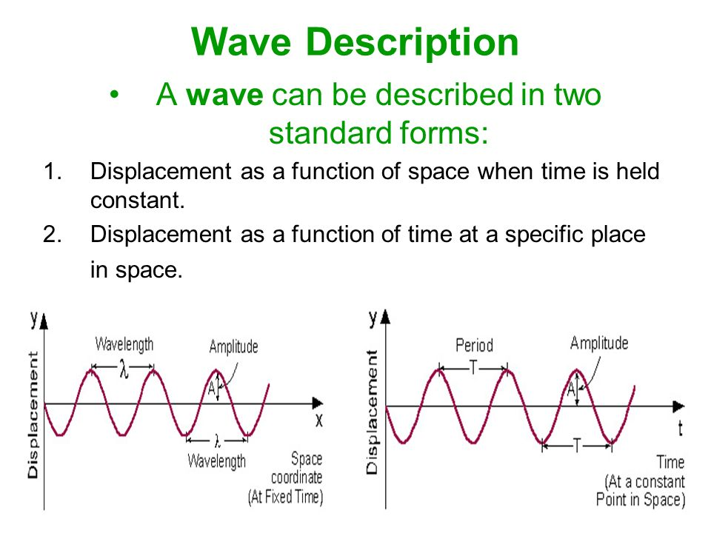

Slide 2
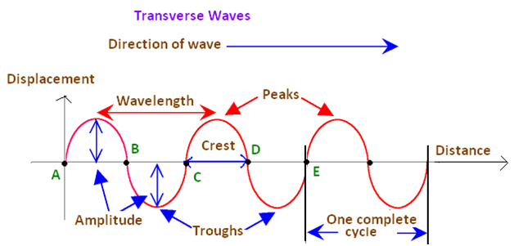

Slide 3
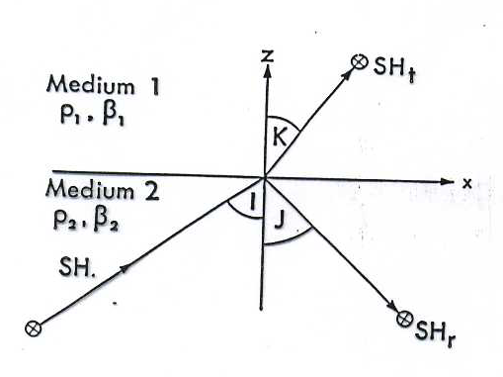
Finora abbiamo considerato la propagazione di onde in mezzi omogenei spazialmente infiniti. Consideriamo ora cosa succede se un’onda incide su un’interfaccia che separa due mezzi omogenei diversi. Se l’interfaccia salda i due mezzi, allora si dovrà avere continuità di spostamenti e sforzi attraverso essa – altrimenti si tenderebbe ad aprire un’interfaccia tra i due mezzi. L’altro tipo di interfaccia è quello tra un mezzo elastico ed il vuoto – come la superficie terrestre e viene detta superficie libera. Su tale superficie gli sforzi si annullano e cioè avremo
Vediamo come tali vincoli – detti anche condizioni al contorno – portano naturalmente alle leggi di riflessione e rifrazione.
Consideriamo un’onda SH che incide con un angolo I su un’interfaccia separante due mezzi elastici: il primo caratterizzato da ρ₁ e β₁, il secondo da ρ₂ e β₂. Essendo il moto polarizzato orizzontalmente e normale alla direzione di propagazione, la parte di energia trasmessa e di quella riflessa saranno ancora polarizzate nello stesso modo – rimaranno cioè onde SH.
3
Notes:
3

Slide 4
Consideriamo quindi un’onda SH incidente dal basso verso l’alto come in figura.
Indichiamo con l,m,n i vettori numeri d’onda associati all’onda incidente, riflessa e rifratta. Sarà
Se assumiamo l’ampiezza dell’onda incidente come unitaria, gli spostamenti associati ad ogni onda si possono esprimere come:
Onda incidente:
Onda riflessa:
Onda trasmessa:
dove R e T sono i coefficienti di riflessione e rifrazione.
4
Notes:
4

Slide 5
Il moto totale nel mezzo 2 è dato dalla somma dell’onda incidente e quella riflessa. La continuità degli spostamenti attraverso l’interfaccia posta a z=0 da:
La dipendenza temporale uguale a destra e sinistra può essere trascurata. Inoltre, essendo l_{y}=0 e z=0
Sostituendo quest’ultima nella prima equazione:
Poichè la relazione deve essere valida in ogni punto x, la cosa sarà possibile solo se la forma della funzione è uguale per ogni termine: l_{x}=m_{x}=n_{x}. In altri termini:
5
Notes:
5

Slide 6
La prima uguaglianza ci da la legge della riflessione:
La seconda uguaglianza ci da la legge della rifrazione (legge di Snell):
La condizione di continuità pertanto ci dice:
Il valore dei coefficienti R e T si ricava dalla continuità degli sforzi. Omettendo i calcoli:
Vediamo che R e T dipendono in ogni mezzo dalle quantità, detta impedenza:
Inoltre i coefficienti di R e T dipendono dall’angolo di incidenza dell’onda!
6
Notes:
6

Slide 7
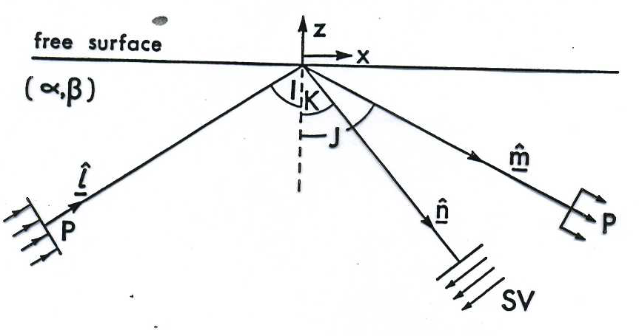
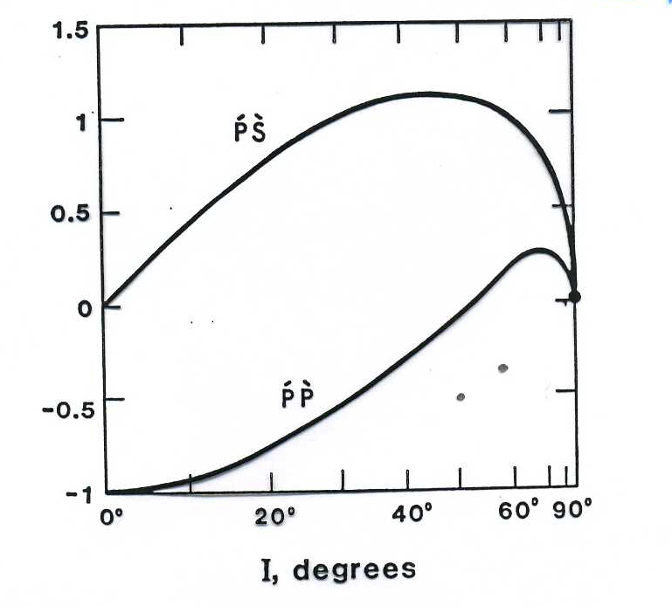
Caso onda P incidente su una superficie libera. L’angolo di riflessione per l’onda S (K) è minore, avendo essa velocità minore.
Coefficienti di riflessione corrispondenti in funzione dell’angolo di incidenza. Notare l’assenza di conversione P→S per incidenza normale (I=0°) e la conversione totale per I≈52°!
7
Notes:
7

Slide 8
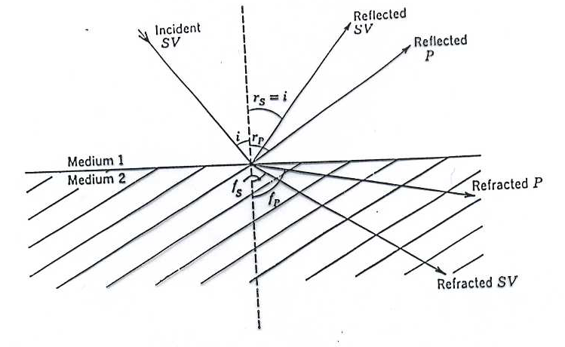
CASO ONDE P, SV
Nel caso delle onde P ed SV incidenti su una discontinuità il problema è leggermente più complicato in quanto in generale esse generano sia moto P che SV. Infatti sia per le P che per le SV il moto è confinato nel piano xz. Chiaramente non verrà invece generato nessuno spostamento lungo y, cioè non verranno generate onde SH.
8
Notes:
8

Slide 9
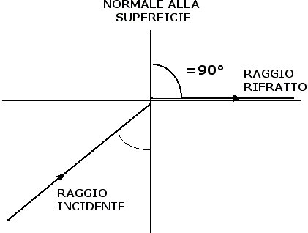
CASO ONDE P, SV
Consideriamo la legge di Snell per un’interfaccia tra due mezzi ed indichiamo con I l’angolo di incidenza, con T l’angolo di rifrazione (trasmissione). Avremo per un’onda P
Nel caso sia T=90°, l’angolo di incidenza dicesi angolo critico e risulta:
Per angoli di incidenza maggiori dell’angolo critico, non si ha energia rifratta nel secondo mezzo.
T
I
9
Notes:
9

Slide 10
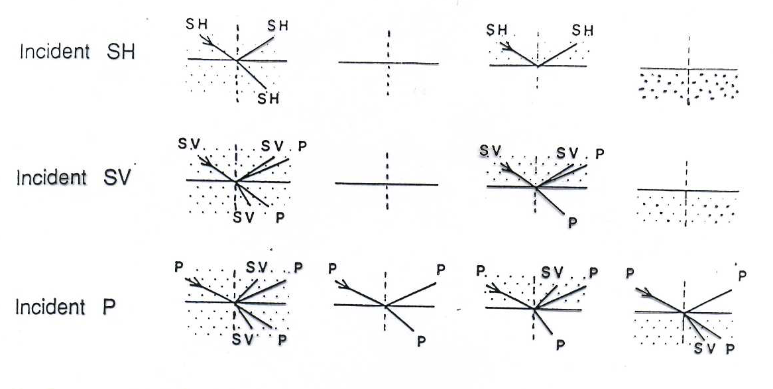
Casi relativi all’incidenza dall’alto dei tre tipi di onda su una interfaccia tra due mezzi(solido punteggiato; liquido bianco).
10
Notes:
10

Slide 11
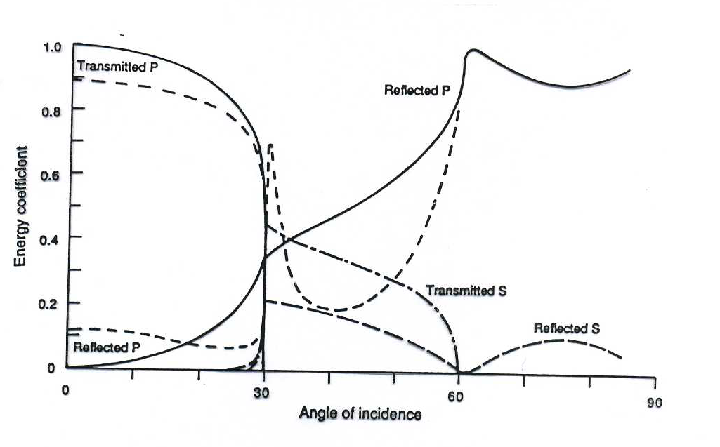
Variazioni con l’angolo di incidenza dei coefficienti di trasmissione e riflessione per un’onda P incidente su una interfaccia tra due solidi.
11
Notes:
11

Slide 12

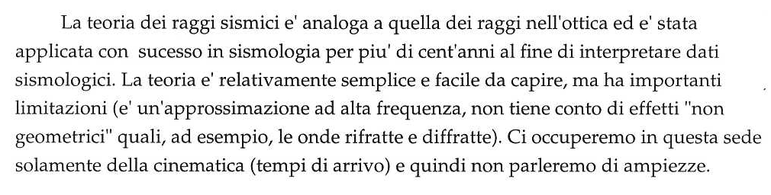
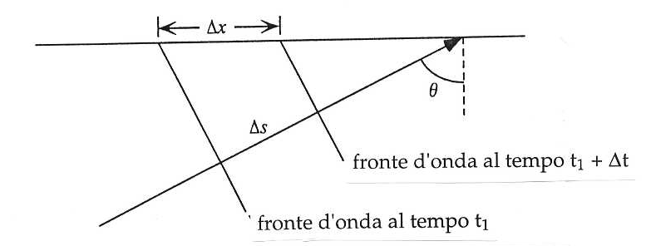
Notes:
12

Slide 13
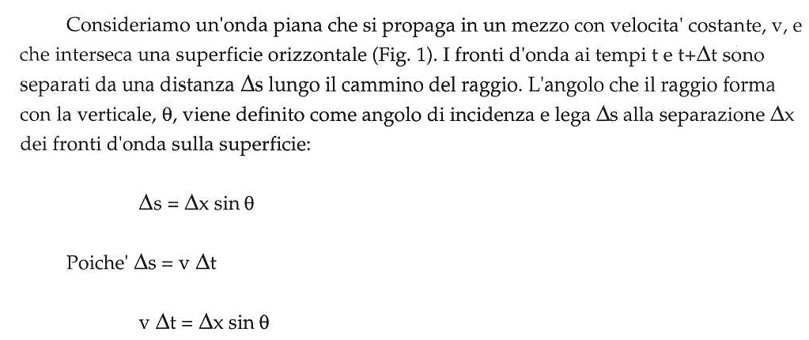
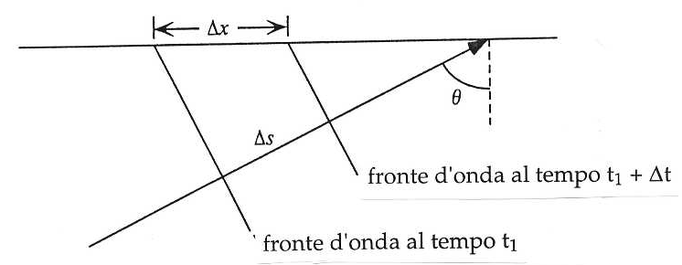

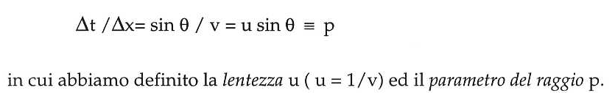
Notes:
13

Slide 14
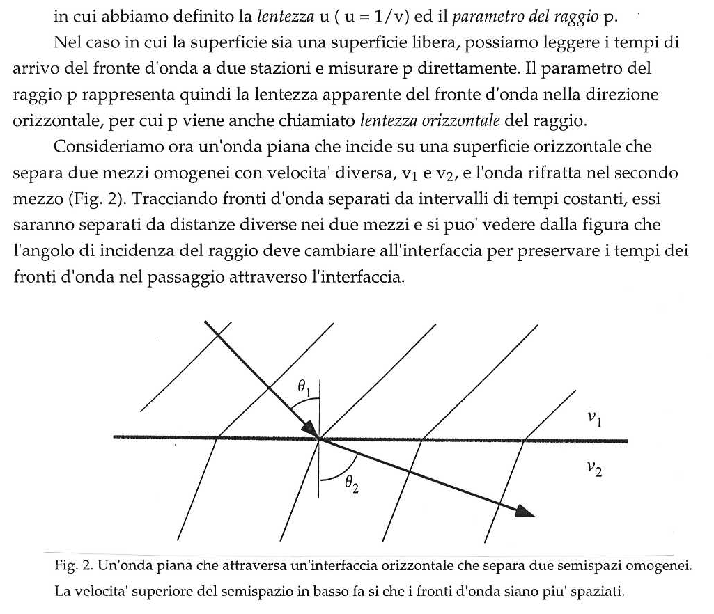
Notes:
14

Slide 15
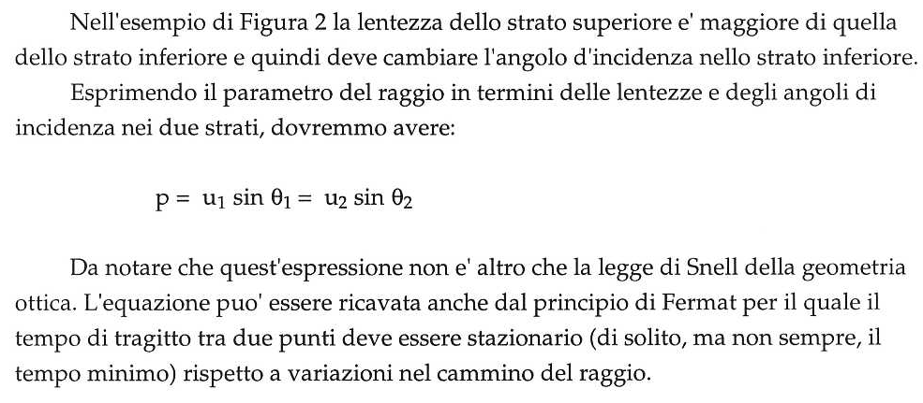
Notes:
15

Slide 16
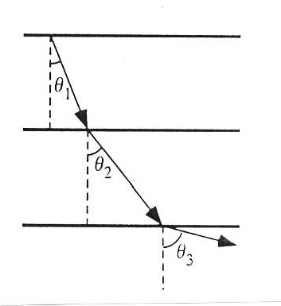
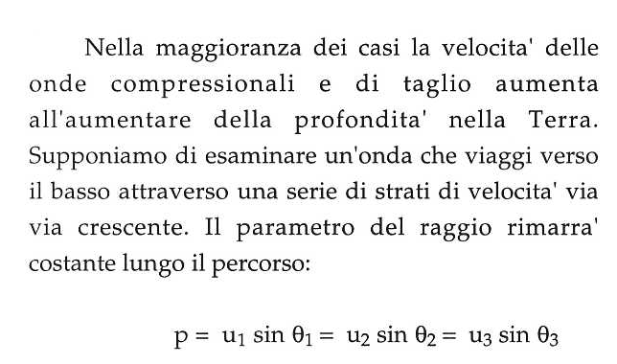
Notes:
16

Slide 17
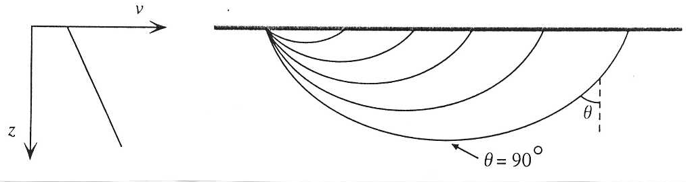
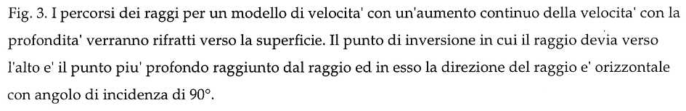
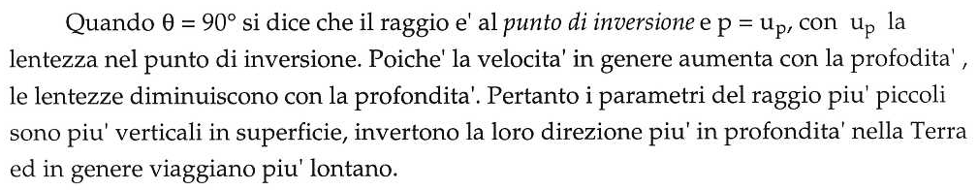
Notes:
17

Slide 18
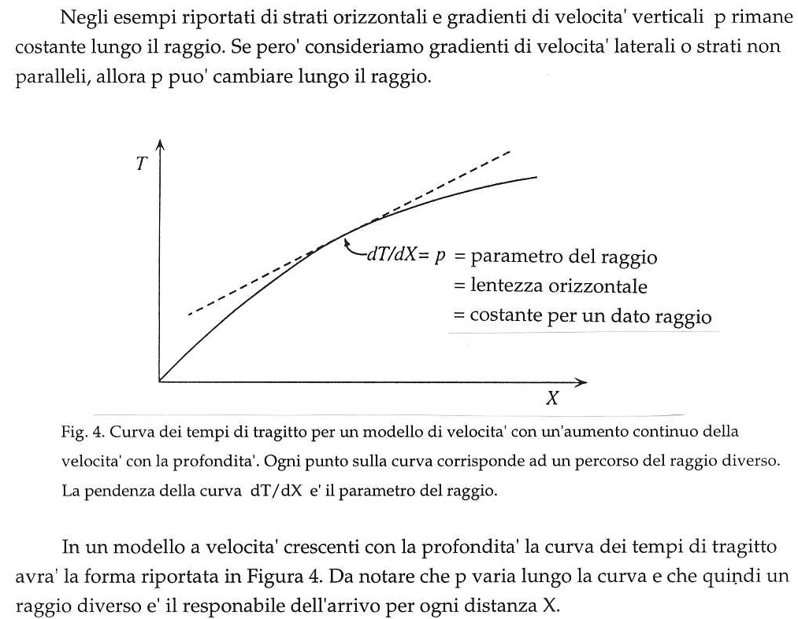
Notes:
18

Slide 19
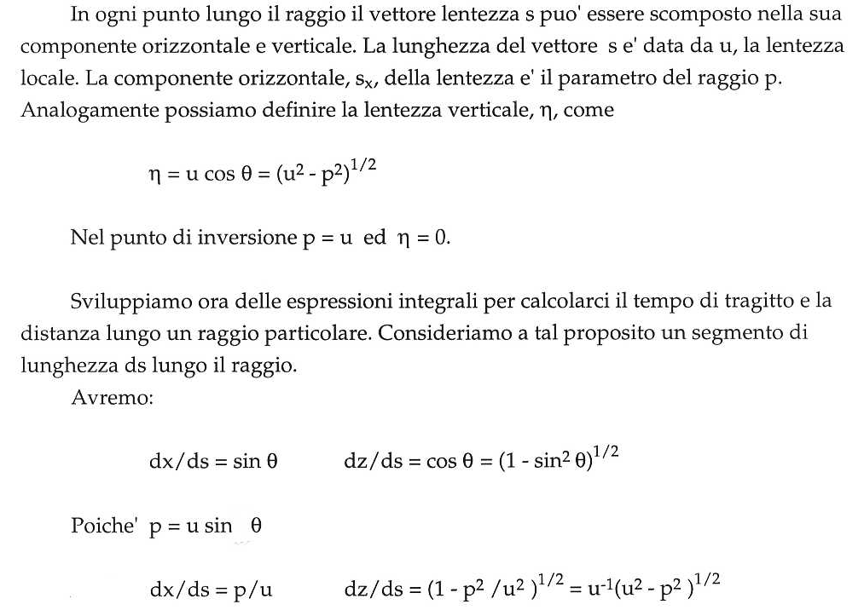
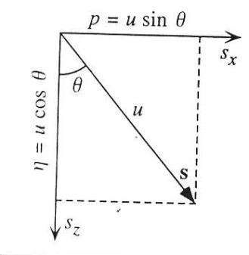
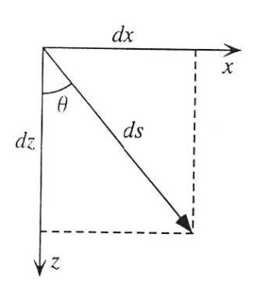
Notes:
19

Slide 20
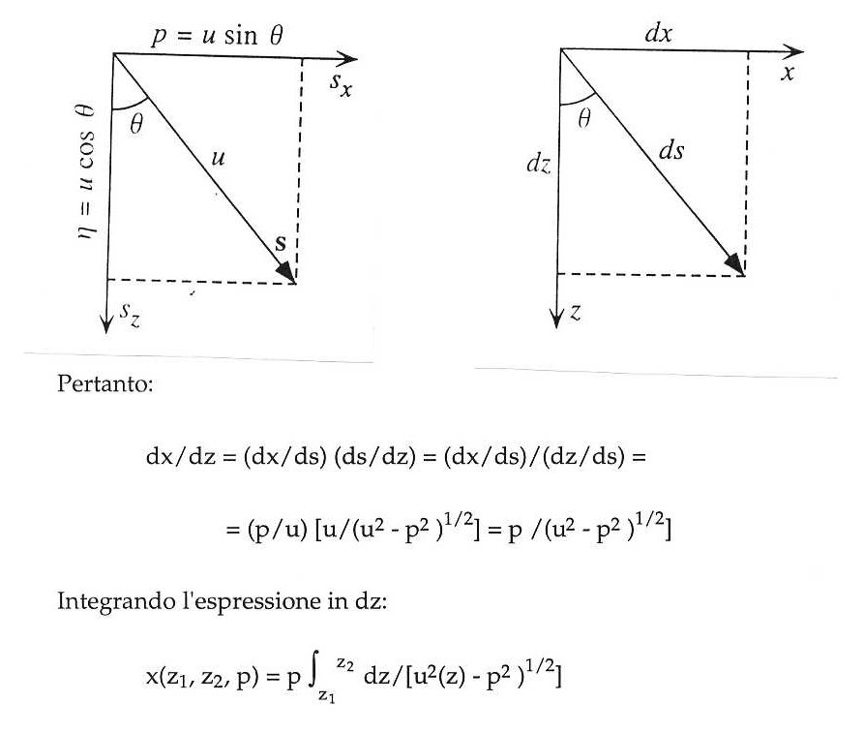
Notes:
20

Slide 21
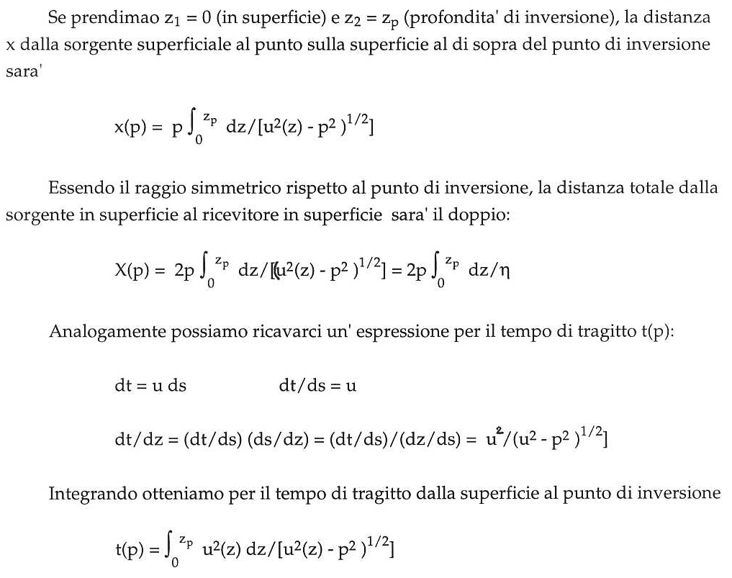
Notes:
21

Slide 22
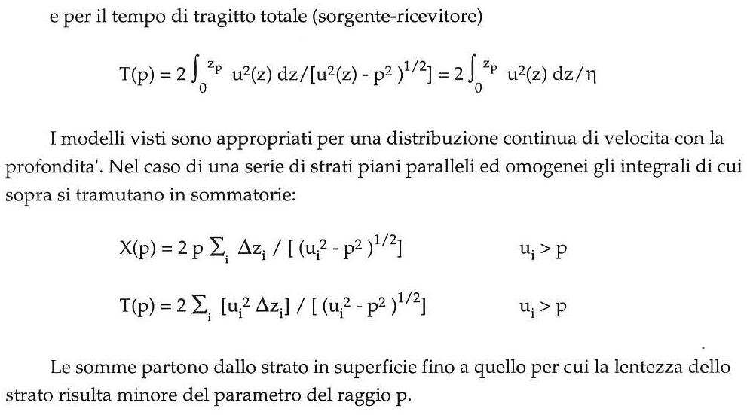
Notes:
22

Slide 23
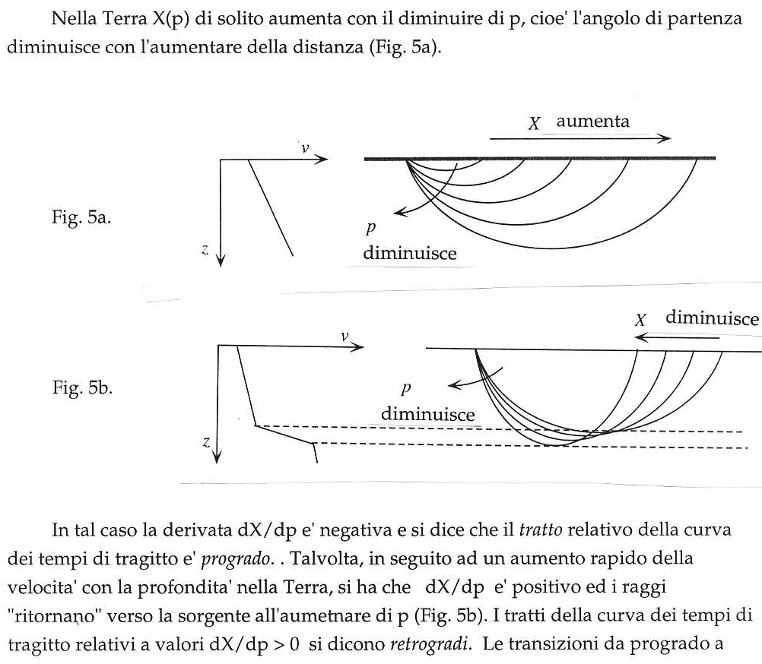
Notes:
23

Slide 24
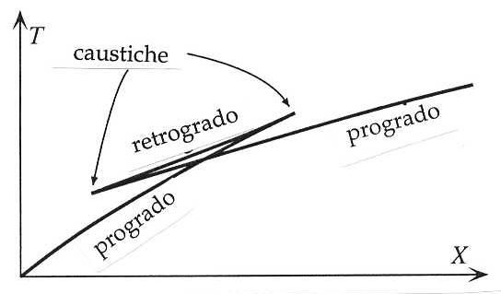
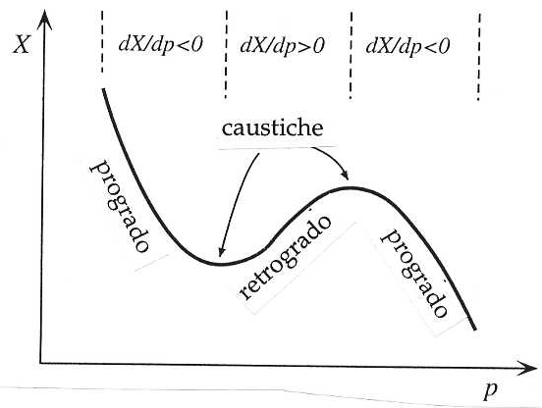
Notes:
24

Slide 25
25
Notes:
25

Slide 26
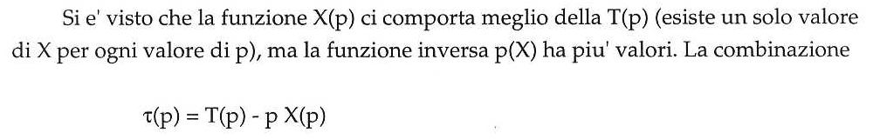
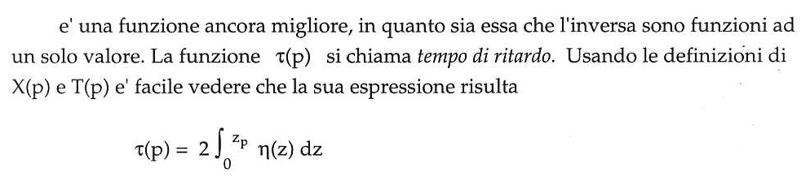
Notes:
26

Slide 27
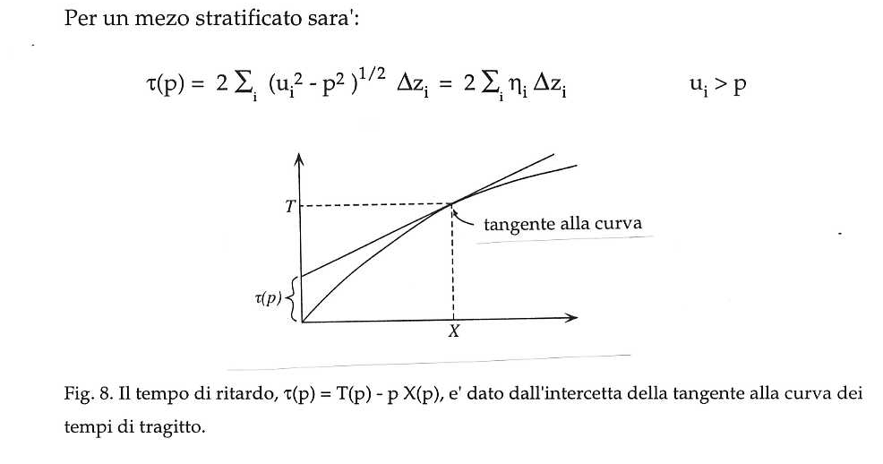
Notes:
27

Slide 28
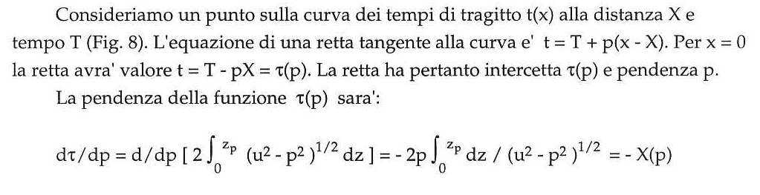
Notes:
28

Slide 29
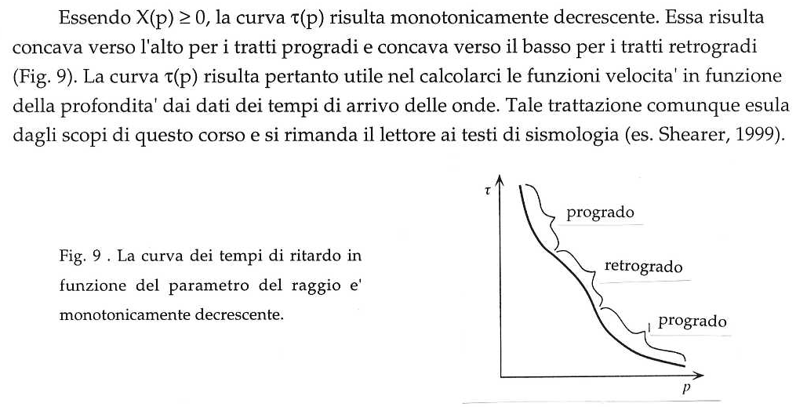
Notes:
29

Slide 30
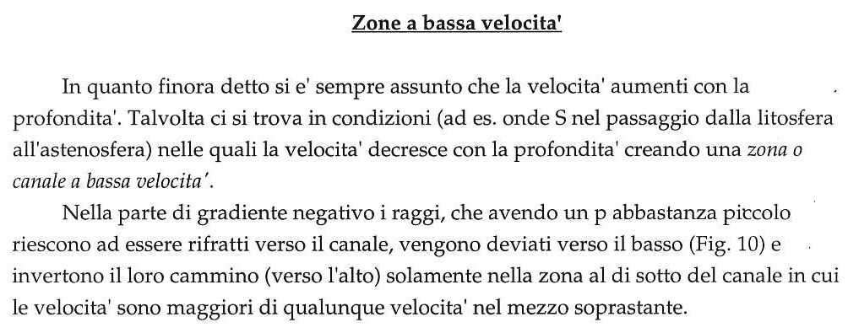
Notes:
30

Slide 31
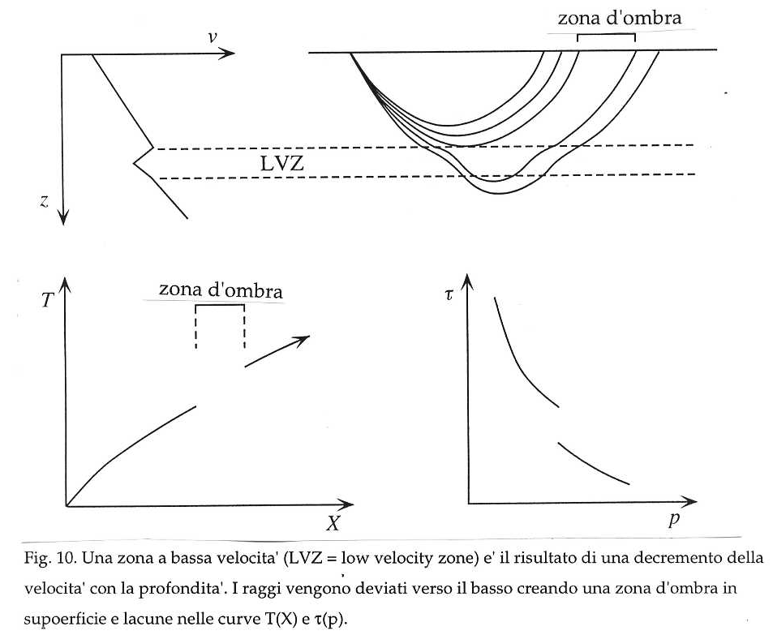
Notes:
31

Slide 32
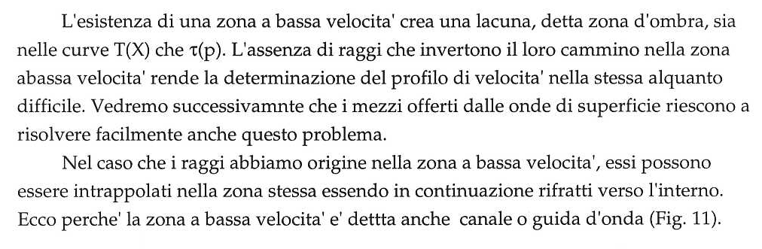
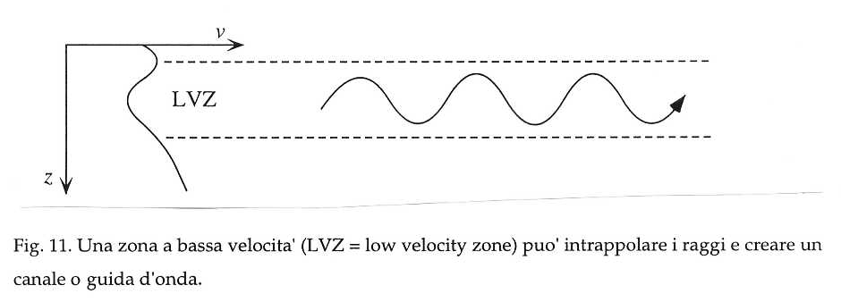
Notes:
32

Slide 33
In the above we have assumed that the refracting interfaces are horizontal. This type of analysis is common in seismic prospecting, where only local structures and comparatively shallow depths are evaluated. The passage of seismic body waves through a layered spherical Earth can be treated to a first approximation in the same way. We can represent the vertical (radial) velocity structure by subdividing the Earth into concentric shells, each with a faster body-wave velocity than the shell above it.
Snell’s law of refraction applies to the interface between each pair of shells. For example, at point A we can write:
Multiplying both sides by r₁ gives
In triangles ACD and BCD, respectively, we have:
Combining Eq. 55, 56 and 57 gives the result:
33
Notes:
33

Slide 34
The constant p is again called the ray parameter, although it has different dimensions than in Eq. 54 for flat horizontal layers. Here the seismic ray is a straight line within each spherical layer with constant velocity. If the velocity increases continuously with depth, the seismic ray is refracted continuously and its shape is curved concavely upward. It reaches its deepest point when sini=1, at radius r₀ where the velocity is V₀; these parameters are related by the Benndorf relationship:
Determination of the ray parameter is the key to determining the variation of seismic velocity inside the Earth. Access to the Earth’s interior is provided by analysis of the travel-times of seismic waves that have traversed the various internal regions and emerge at the surface, where they are recorded.
Travel-time (t) of a seismic ray to a known epicentral distance (Δ) can be mathematically inverted to give the velocity V₀ at the deepest point of the path. The theory applies for P- and S-waves, the general velocity V being replaced by the appropriate velocity α or β, respectively.
34
Notes:
34

Slide 35
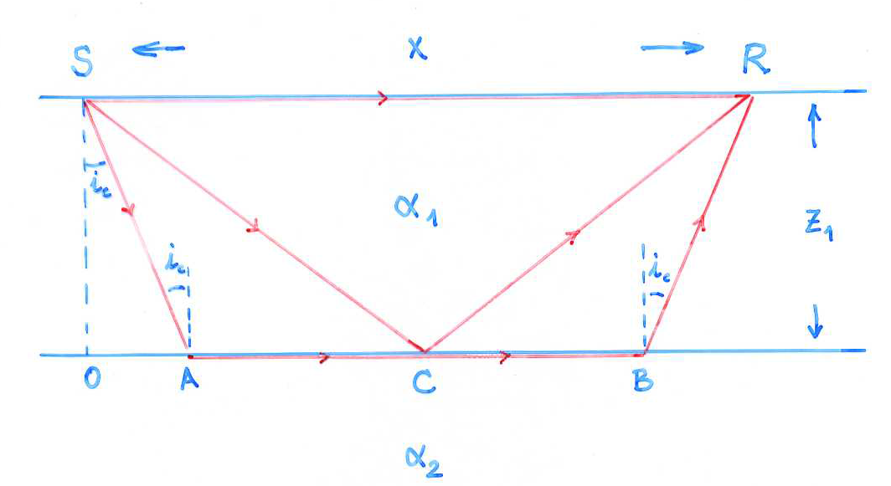
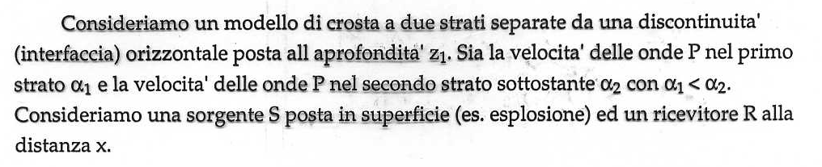
Notes:
35

Slide 36
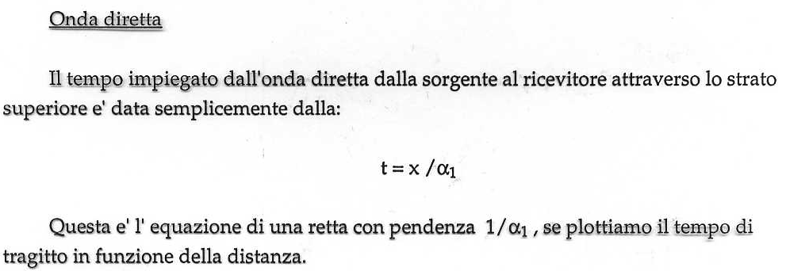
Notes:
36

Slide 37
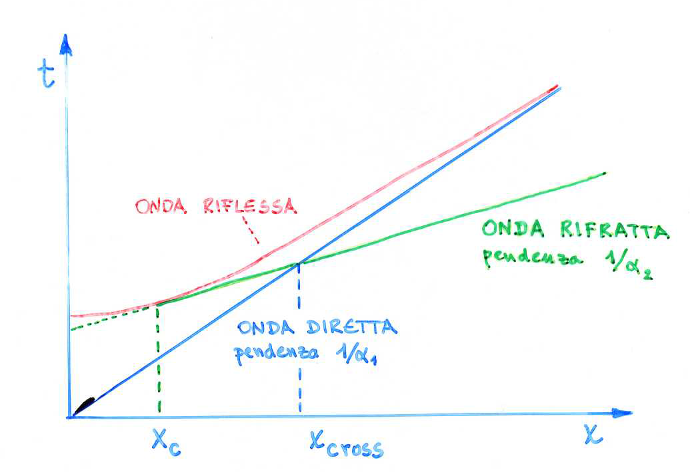
Notes:
37

Slide 38
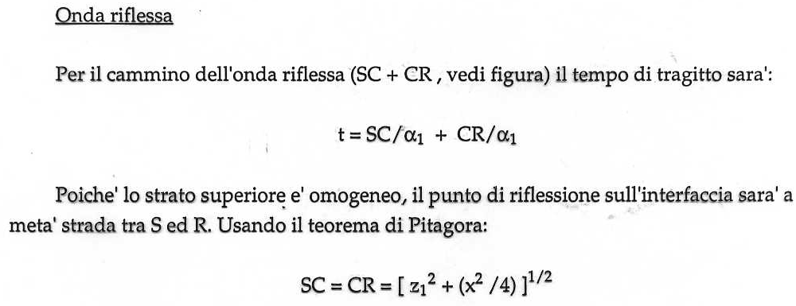
Notes:
38

Slide 39
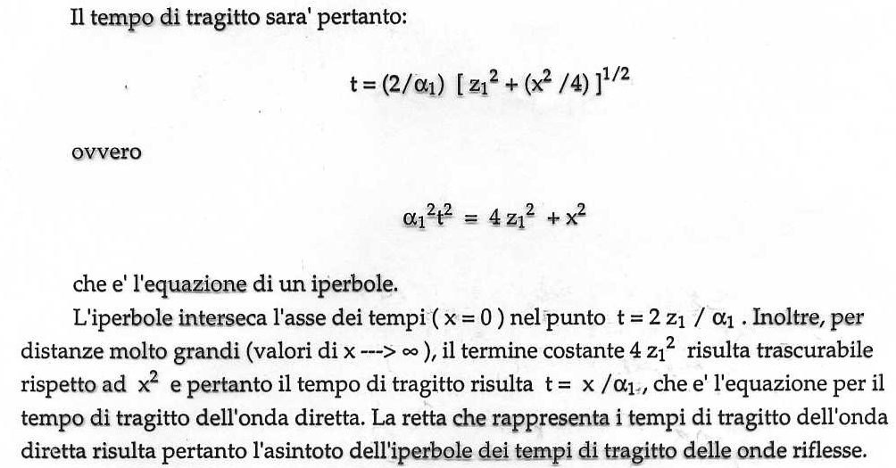
Notes:
39

Slide 40
Notes:
40

Slide 41
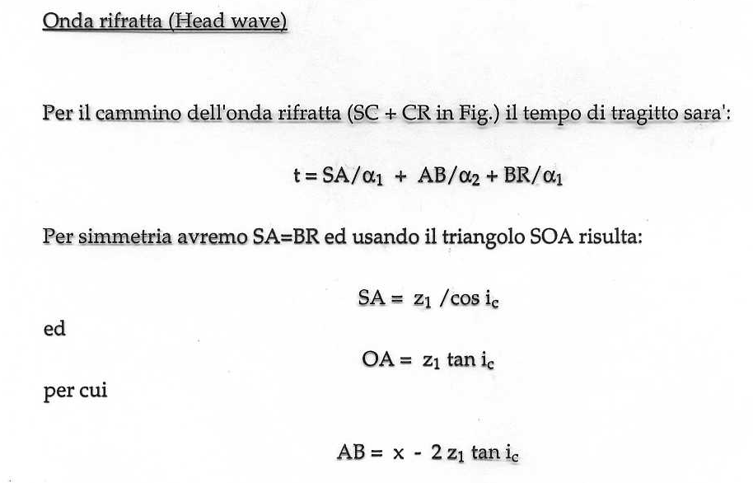
Notes:
41

Slide 42
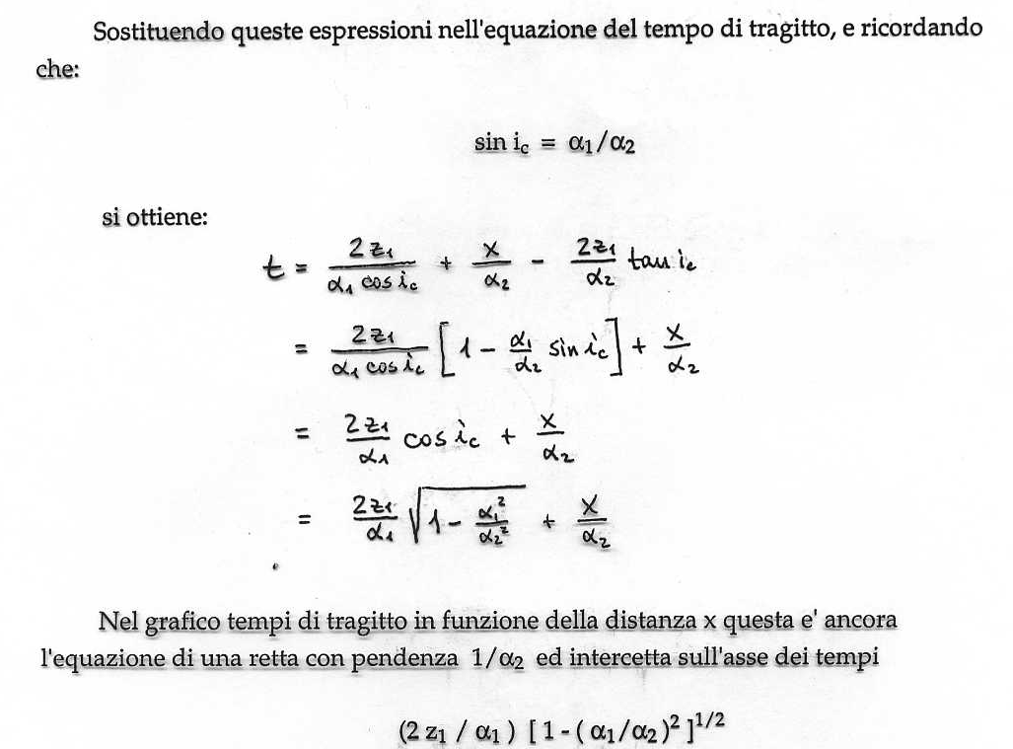

$$t= \frac{{2z}_{1}}{α_{1}{cosi}_{c}}+\frac{x}{α_{2}}−\frac{2z_{1}}{α_{2}}\tan{i_{c}}$$
$$= \frac{{2z}_{1}}{α_{1}{cosi}_{c}}\left[1−\frac{α_{1}}{α_{2}}\sin{i_{c}}\right]+\frac{x}{α_{2}}$$
$$= \frac{{2z}_{1}}{α_{1}}\cos{i_{c}}+\frac{x}{α_{2}}$$
$$= \frac{{2z}_{1}}{α_{1}}\sqrt{1−\frac{α_{1}^{2}}{α_{2}^{2}}}+\frac{x}{α_{2}}$$
Notes:
42

Slide 43
Notes:
43

Slide 44
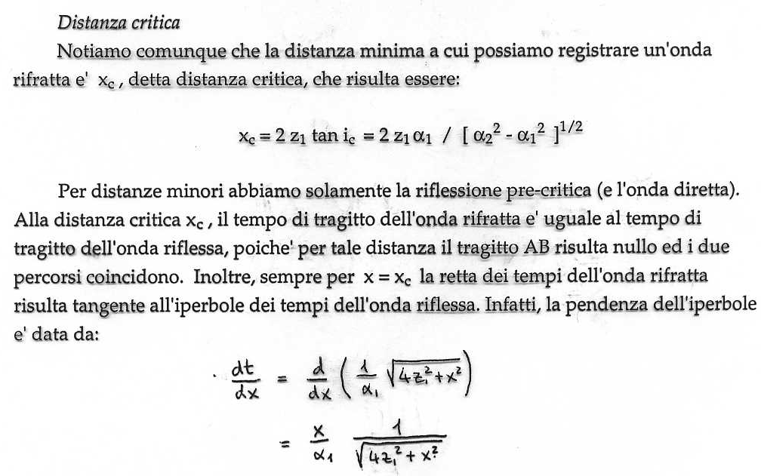
Notes:
44

Slide 45

$$\frac{dt}{dx}=\frac{d}{dx}\left(\frac{1}{α_{1}}\sqrt{4z_{1}^{2}+x^{2}}\right)= \frac{x}{α_{1}}\frac{1}{\sqrt{4z_{1}^{2}+x^{2}}}$$
Notes:
45

Slide 46
Alla distanza critica x_{c} l’onda riflessa e l’onda rifratta hanno pendenza uguale per cui risultano tangenti.
Notes:
46

Slide 47
Definiamo la distanza di crossover x_{cross} come la distanza a cui l’onda diretta e l’onda rifratta hanno il medesimo tempo di tragitto.
Notes:
47

Slide 48
Alla distanza critica x_{c} I tempi di arrive dell’onda riflessa e rifratta sono uguali.
Notes:
48

Slide 49
Alla distanza critica la retta dell’onda rifratta è tangente all’iperbole dell’onda riflessa.
Notes:
49

Slide 50
Notes:
50

Slide 51

Notes:
51

Slide 52

Notes:
52

Slide 53

Notes:
53

Slide 54

Notes:
54

Slide 55

Notes:
55

Slide 56

Notes:
56

Slide 57

Notes:
57

Slide 58

Notes:
58

Slide 59

Notes:
59

Slide 60

Notes:
60

Slide 61

Notes:
61

Slide 62
Reflection seismology
Reflection seismology is directed primarily at finding the depths to reflecting surfaces and the seismic velocities of subsurface rock layers. The techniques of acquiring and processing reflection seismology data have been developed and refined to a very high degree of sophistication as a result of the intensive application of this method in the search for petroleum.
The principle is simple. A seismic signal (e.g., an explosion) is produced at a known place at a known time, and the echoes reflected from the boundaries between rock layers with different seismic velocities and densities are recorded and analyzed. Compactly designed, robust, electromagnetic seismometers – called “geophones” in industrial usage – are spread in the region of subcritical reflection, within the critical distance from the shot-point, where no refracted arrivals are possible.
Within this distance the only signals received are the wave that travels directly from the shot-point to the geophones and the waves reflected at subsurface interfaces. Surface waves are also recorded and constitute an important disturbing “noise,” because they interfere with the reflected signal.
The closer the geophone array is located to the shot-point, the more nearly the paths of the reflected rays travel vertically. Reflection seismic data are most usually acquired along profiles that cross geological structures as nearly as possible normal to the strike of the structure.
The travel-times recorded at the geophones along a profile are plotted as a two-dimensional cross-section of the structure.
In recent years, three-dimensional surveying which covers the entire subsurface, has become more important
62
Notes:
62

Slide 63




63
Notes:
63

Slide 64
Several field procedures are in common use. They are distinguished by different layouts of the geophones relative to the shot-point. The most routine application of reflection seismology is in continuous profiling, in which the geophones are laid out at discrete distances along a profile through the shot-point. To reduce seismic noise, each recording point is represented by a group of interconnected geophones.
After each shot the geophone layout and shot-point are moved a predetermined distance along the profile, and the procedure is repeated. Broadly speaking, there are two main variations of this method, depending on whether each reflection point on the reflector is sampled only once (conventional coverage) or more than once (redundant coverage).
The most common form of conventional coverage is a split-spread method, in which the geophones are spread symmetrically on either side of the shot-point. If the reflector is flat-lying, the point of reflection of a ray recorded at any geophone is below the point midway between the shot-point and the geophone. For a shot-point at Q the rays QAP and QBR that are reflected to geophones at P and R represent extreme cases. The two-way traveltime of the ray QAP gives the depth of the reflection point A, which is plotted below the mid-point of QP. Similarly, B is plotted below the mid-point of QR.
The split-spread layout around the shot-point Q gives the depths of reflection points along AB, which is half the length of the geophone spread PR. The shot-point is now moved to the point R, and the geophones between P and Q are moved to cover the segment RS. From the new shot-point R the positions of reflection points in the segment BC of the reflector are obtained. The ray RBQ from shot-point R to the geophone at Q has the same path as the ray QBR from shot-point Q to the geophone at R.
64
Notes:
64

Slide 65
Redundant coverage is illustrated by the common-midpoint method, which is routinely employed as a means of reducing noise and enhancing the signal-to-noise ratio. Commonly 24 to 96 groups of geophones feed recorded signals into a multi-channel recorder. The principle of common-mid-point coverage is illustrated for a small number of 11 geophone groups in Figiure
When a shot is fired at A, the signals received at geophones 3–11 give subsurface coverage of the reflector between points a and e. The shot-point is now moved to B, which coincides with the position occupied by geophone 2 for the first shot, and the geophone array is moved forward correspondingly along the direction of the profile to positions 4–12. From shot-point B the subsurface coverage of the reflector is between points b and f. The reflector points b to e are common to both sets of data. By repeatedly moving the shot-point and geophone array in the described manner, each reflecting point of the interface is sampled multiply. For example, in Figure the reflecting point d is sampled multiply by the rays Ad 9, Bd8, Cd7, etc.
The lengths of these ray paths are different. During subsequent data-processing the reflection travel-times are corrected for normal moveout, which is a geometrical effect related to geophone distance from the shot-point. The records are then stacked, which is a procedure for enhancing the signal-to-noise ratio.
65
Notes:
65

