Slide 1
Lezione 4
Recettori enzimatici
Canali ionici controllati

Slide 2
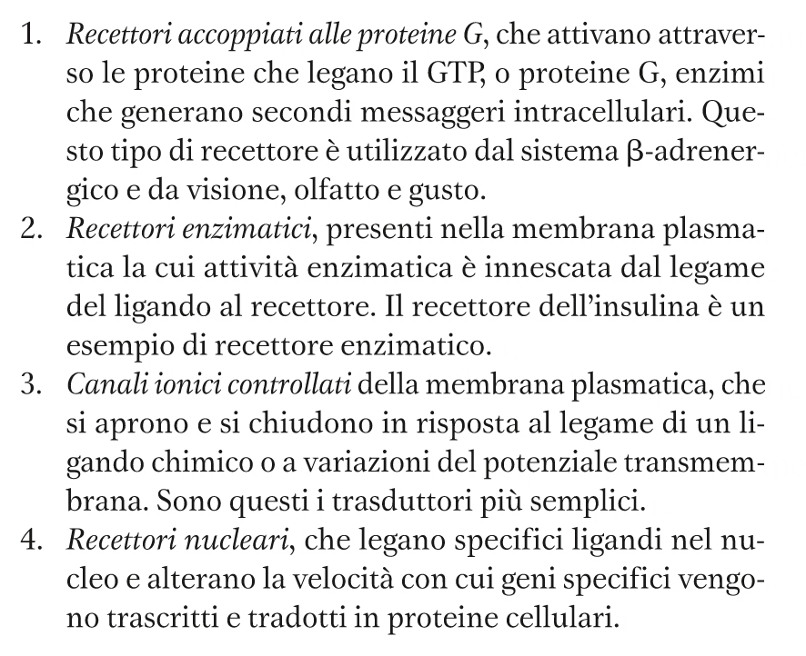
Lezione 3
Recettori

Slide 3
I recettori enzimatici con attività proteina tirosina chinasi RECEPTOR TYROSIN KINASE - RTK
Numerosi recettori compongono una FAMIGLIA PROTEICA, caratterizzata da una struttura comune:
proteina integrale di membrana, monotopica, mono-componente, TRI-FUNZIONALE
RECETTORE: dominio extracellulare con il sito di legame per il ligando.
MEDIATORE: 1 dominio transmembrana ad α-elica e 1 dominio juxta-membrana, funzionano da raccordo tra recettore ed effettore
EFFETTORE: dominio intracellulare con il sito catalitico per l’attività tirosina chinasi

Slide 4
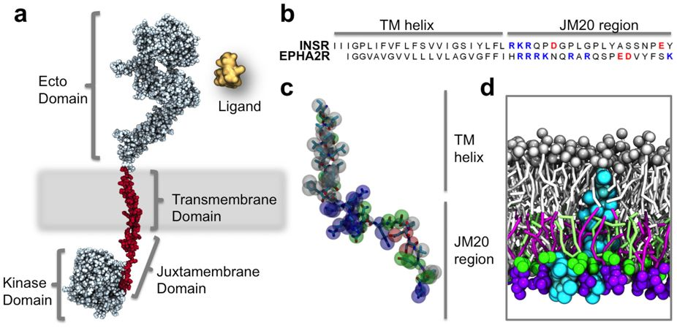
Il modello di un RTK generico
Notes:
source
https://www.nature.com/articles/srep09198/figures/1
(a) Schematic representation of a generic RTK model (generated using MODELLER69 based on PDB id: 2GS670, 3GOP26, 2JIU71 2M2072 and 3NJP73) with an extracellular ligand binding ectodomain, a single transmembrane spanning helix, a basic JM region, and a kinase domain. The TM and JM regions have been highlighted in red. (b) Sequence of INSR and the EphA2 receptor with charged residues within the JM region highlighted with basic residues in blue and anionic residues in red. (c) Protein model of the TM-JM region of the EphA2 receptor with CG beads overlaid onto an atomistic model: basic residues are shown in blue, acidic in red, polar in green, and non-polar in white. (d) Cross section of the same EphA2 receptor TM-JM model embedded in a lipid bilayer containing 20% PS and 20% PIP2 within the inner leaflet.

Slide 5
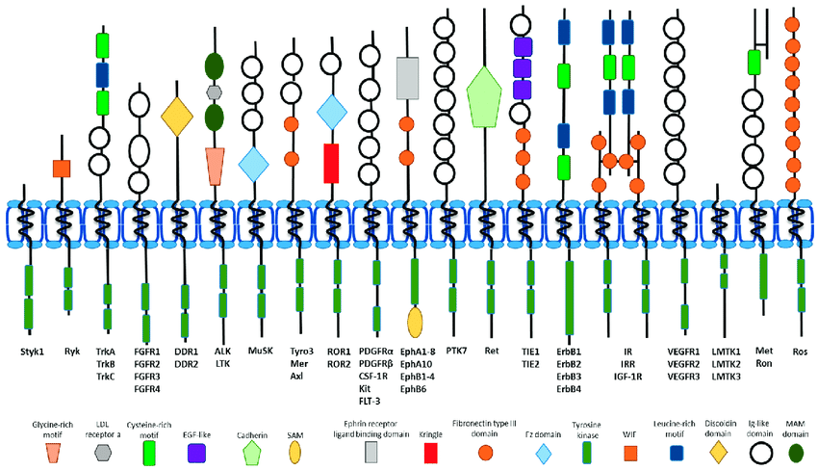
Le 20 famiglie dei recettori tirosina kinasi
recettore dell’insulina
circa 60 tipi, nell’uomo
Dominio extracellulare multimodulare, con sito di legame per il ligando
Singola α-elica transmembrana
Dominio intracellulare juxtramembrana
Dominio intracellulare, con attività proteina chinasi
fosforilazione a livello di residui TYR
Notes:
Figura 1. Panoramica dell'architettura di dominio delle 20 famiglie di RTK umane. Ogni RTK contiene cinque strutture fondamentali:
un dominio extracellulare legante-legante,
una breve regione transmembrana elicoidale,
una regione juxtamembrana,
un dominio citoplasmatico con attività tirosina chinasi
una regione di coda C terminale flessibile.
Il dominio extracellulare di legame con ligandi mostra una significativa variabilità tra le famiglie, con notevoli aggiunte di motivi ricchi di glicina, cisteina o leucina e domini immunoglobulinici tra gli altri. La famiglia del recettore dell'insulina si differenzia dal resto a causa del suo complesso multimerico pre-assemblato.
source
https://www.researchgate.net/publication/323790036_Receptor_Tyrosine_Kinase_Ubiquitination_and_De-Ubiquitination_in_Signal_Transduction_and_Receptor_Trafficking/figures?lo=1

Slide 6
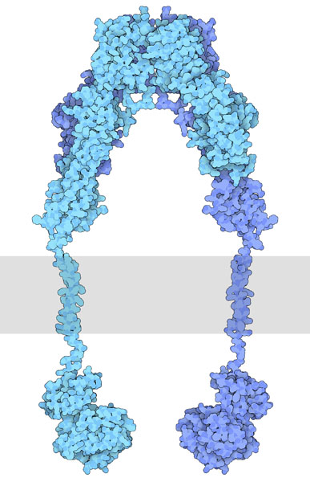
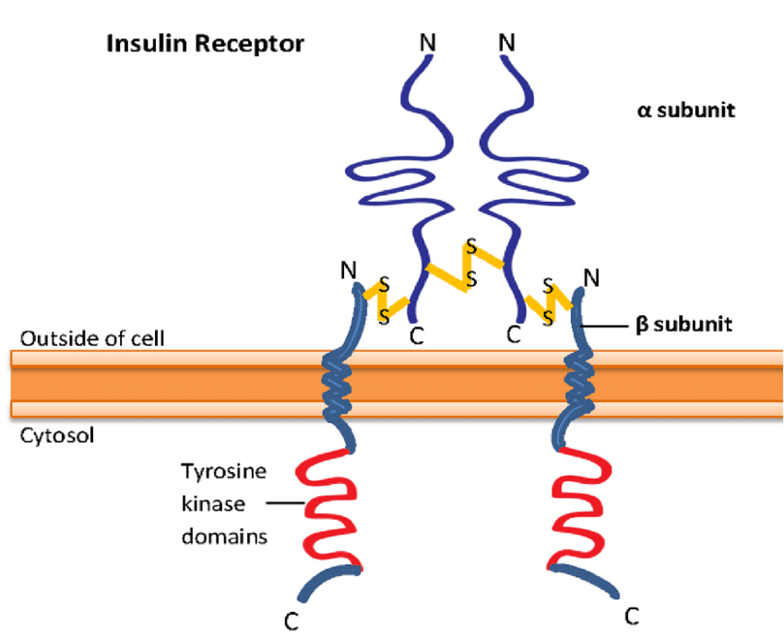
Il recettore per l’insulina è un tetramero Composto da due eterodimeri, uno extracellulare e uno di membrana, legati con un legame disolfuro. I due protomeri extracellulari solo legati con un ponte disolfuro
Notes:
source (left)
https://www.researchgate.net/publication/311994370_b-Adrenergic_Receptor_and_Insulin_Resistance_in_the_Heart/figures?lo=1
source (right)
https://pdb101.rcsb.org/motm/182

Slide 7
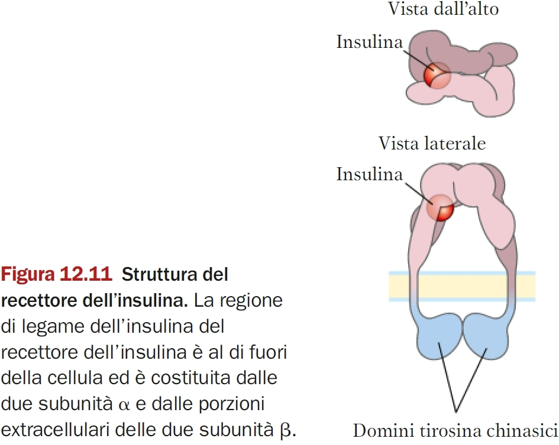

Slide 8
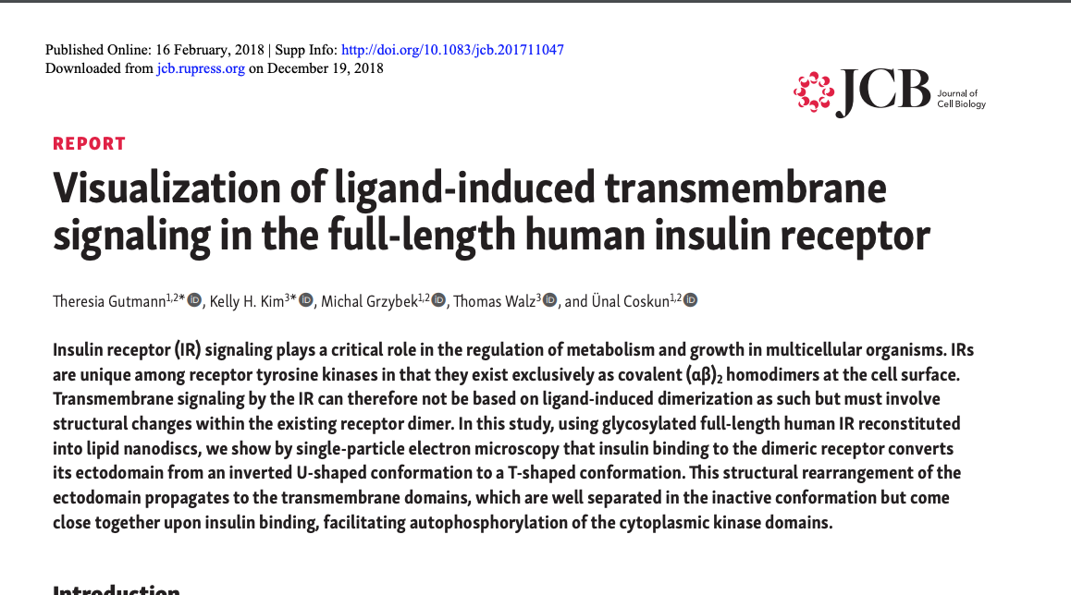
Struttura del recettore dell’insulina

Slide 9
IR reconstitution into nanodiscs and activity assay.
Theresia Gutmann et al. J Cell Biol 2018;217:1643-1649
© 2018 Gutmann et al.
Notes:
IR reconstitution into nanodiscs and activity assay. (A) Left: Schematic cartoon showing the ectodomain (ECD), transmembrane domain (TMD), and tyrosine kinase domain (TKD). Right: Structural model of the full-length human (αβ)₂ IR assembled from available crystal structures of the tyrosine kinase (Hubbard et al., 1994) and extracellular domain (Croll et al., 2016) as well as the nuclear magnetic resonance solution structure of the transmembrane domain (Li et al., 2014). (B) Silver-stained native PAGE of glycosylated full-length human IR reconstituted into MSP1E3D1 nanodiscs. (C) SDS-PAGE of nanodisc-embedded IRs under nonreducing (−DTT) and reducing conditions (+DTT). (D) Activity assay showing that both CHAPS-solubilized and nanodisc-embedded IRs are autophosphorylated upon exposure to insulin. IRα, IR α subunit; IRβ, IR β subunit; IR(αβ)₂, mature IR; pIRβ, phosphorylated IRβ; pro-IRαβ, unprocessed intracellular form of IR. Experimental details are provided in the In vitro phosphorylation assay and SDS-PAGE and Western blots sections in Materials and methods as well as Figs. S1 and S2.

Slide 10
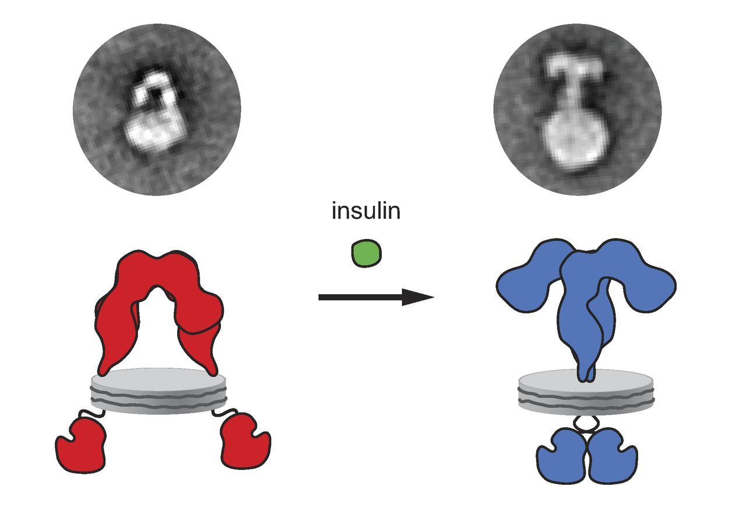
La variazione conformazionale del recettore, dopo il legame con l’insulina
Theresia Gutmann et al. J Cell Biol 2018;217:1643-1649
© 2018 Gutmann et al.
Notes:
Source: http://jcb.rupress.org/content/217/5/1643

Slide 11
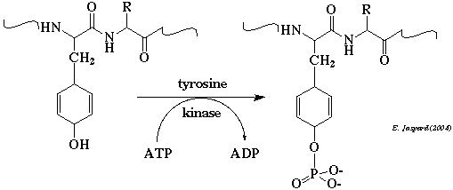
I recettori tirosina chinasi (RTK) sono una famiglia di fosfotransferasi EC 2.7.10.1

Slide 12
Cosa succede dopo il legame dell’insulina al suo recettore (IR)?
Il complesso insulina-recettore (I-IR) si attiva
la transizione allosterica indotta dal ligando sul dominio extracellulare causa l’attivazione del dominio catalitico intracellulare
IR attivato catalizza la fosforilazione di alcuni residui TYR su:
il suo dominio intracellulare (auto-fosforilazione)
una proteina intracellulare Insulin receptor substrate-1
IRS1+3 ATP→IRS1-3-P + 3ADP
vedi diapositiva seguente

Slide 13
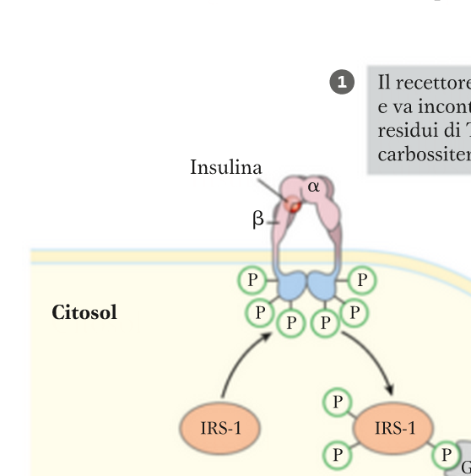
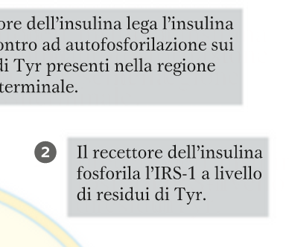
L’attività tirona chinasi del recettore dell’insulina, se attivato

Slide 14
La trasduzione intracellulare dell’insulina DUE VIE DISTINTE
IRS-1 fosforilato si lega a PROTEINE DI SEGNALE:
Via di attivazione dei geni
fosfo-IRS-1 si lega alla proteina di segnale GrB2
Figura 12.12
Via di controllo del metabolismo
fosfo-IRS-1 si lega alla proteina di segnale PI3K
PI3K: fosfatidil inositolo 3-fosfato chinasi
Figura 12.13

Slide 15
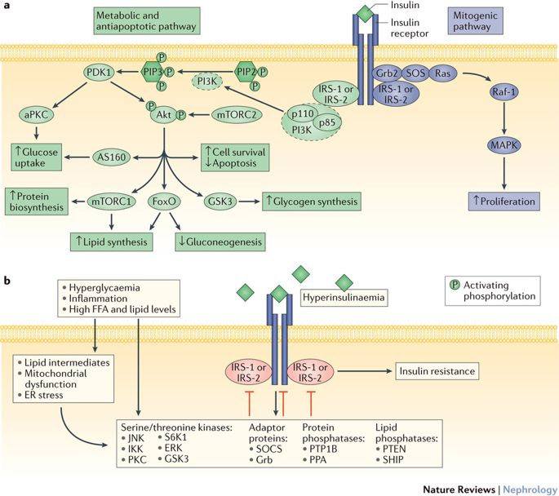
Notes:
source
Review Article | Published: 17 October 2016
The impact of insulin resistance on the kidney and vasculature
Ferruh Artunc, Erwin Schleicher, Cora Weigert, Andreas Fritsche, Norbert Stefan & Hans-Ulrich Häring
Nature Reviews Nephrology volume12, pages721–737 (2016)
Figure 1 | The insulin signalling pathway. a | Activation of insulin signalling pathways. Insulin binding activates the
insulin receptor and leads to the recruitment of insulin receptor substrate (IRS) isoforms and subsequent activation of
the phosphatidylinositol 3-kinase (PI3K)–Akt pathway, which regulates glucose and lipid metabolism, protein biosynthesis,
cell survival and apoptosis. Insulin-induced activation of the Ras–mitogen-activated protein kinase (MAPK) pathway
increases cell proliferation. b | Negative regulation of insulin signalling pathways. Hyperglycaemia, hyperinsulinaemia, high
plasma free fatty acid (FFA) levels and inflammation activate serine/threonine kinases, adaptor proteins and phosphatases
either directly or via lipid intermediates, mitochondrial dysfunction or the induction of endoplasmic reticulum (ER) stress.
Activation of these negative regulators results in a chronically reduced cellular response to insulin. aPKC, atypical protein
kinase C; AS160, Akt substrate 160kDa; FoxO, forkhead box O; Grb, growth factor receptor-bound protein; GSK3, glycogen
synthase kinase 3; IKK, IκB kinase; JNK, c‑Jun N‑terminal kinase; mTORC, mTOR complex; PDK1, phosphatidylinositidedependent protein kinase 1; PIP2, phosphatidylinositol 4,5‑bisphosphate; PIP3, phosphatidylinositol 3,4,5‑trisphosphate;
PKC, protein kinase C; PPA, protein phosphatase A; PTEN, phosphatase and tensin homologue; PTP1B, protein-tyrosine
phosphatase 1B; p85, PI3K 85kDa regulatory subunit α; p110, PI3K 110kDa catalytic subunit α; Raf‑1, RAF proto-oncogene
serine/threonine-protein kinase; SHIP, SH2 domain-containing inositol phosphatase; SOCS, suppressor of cytokine
signalling; SOS, son of sevenless homologue 1; S6K1, ribosomal protein S6 kinase β1.

Slide 16
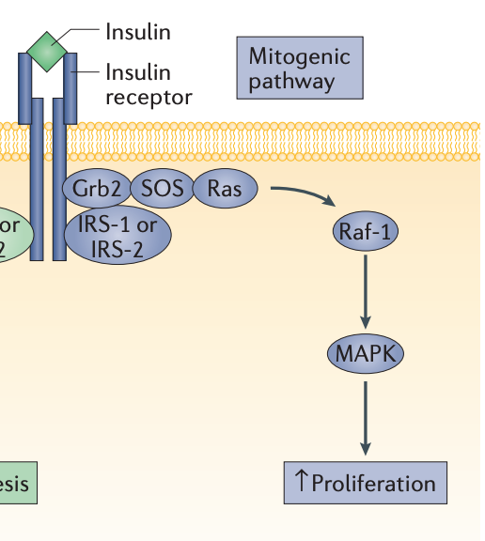
Via di attivazione della trascrizione dei geni
IRS-1 fosforilato si lega a Grb2
si forma un complesso pentamerico con attività proteina chinasi
(IRS1•Grb2•Sos•Ras•Raf-1)
si attiva una cascata di protein chinasi c.d. MAPK
(Mek e ERK; vedi libro)
si attiva il fattore di trascrizione Elk1
si attiva la RNA polimerasi II

Slide 17
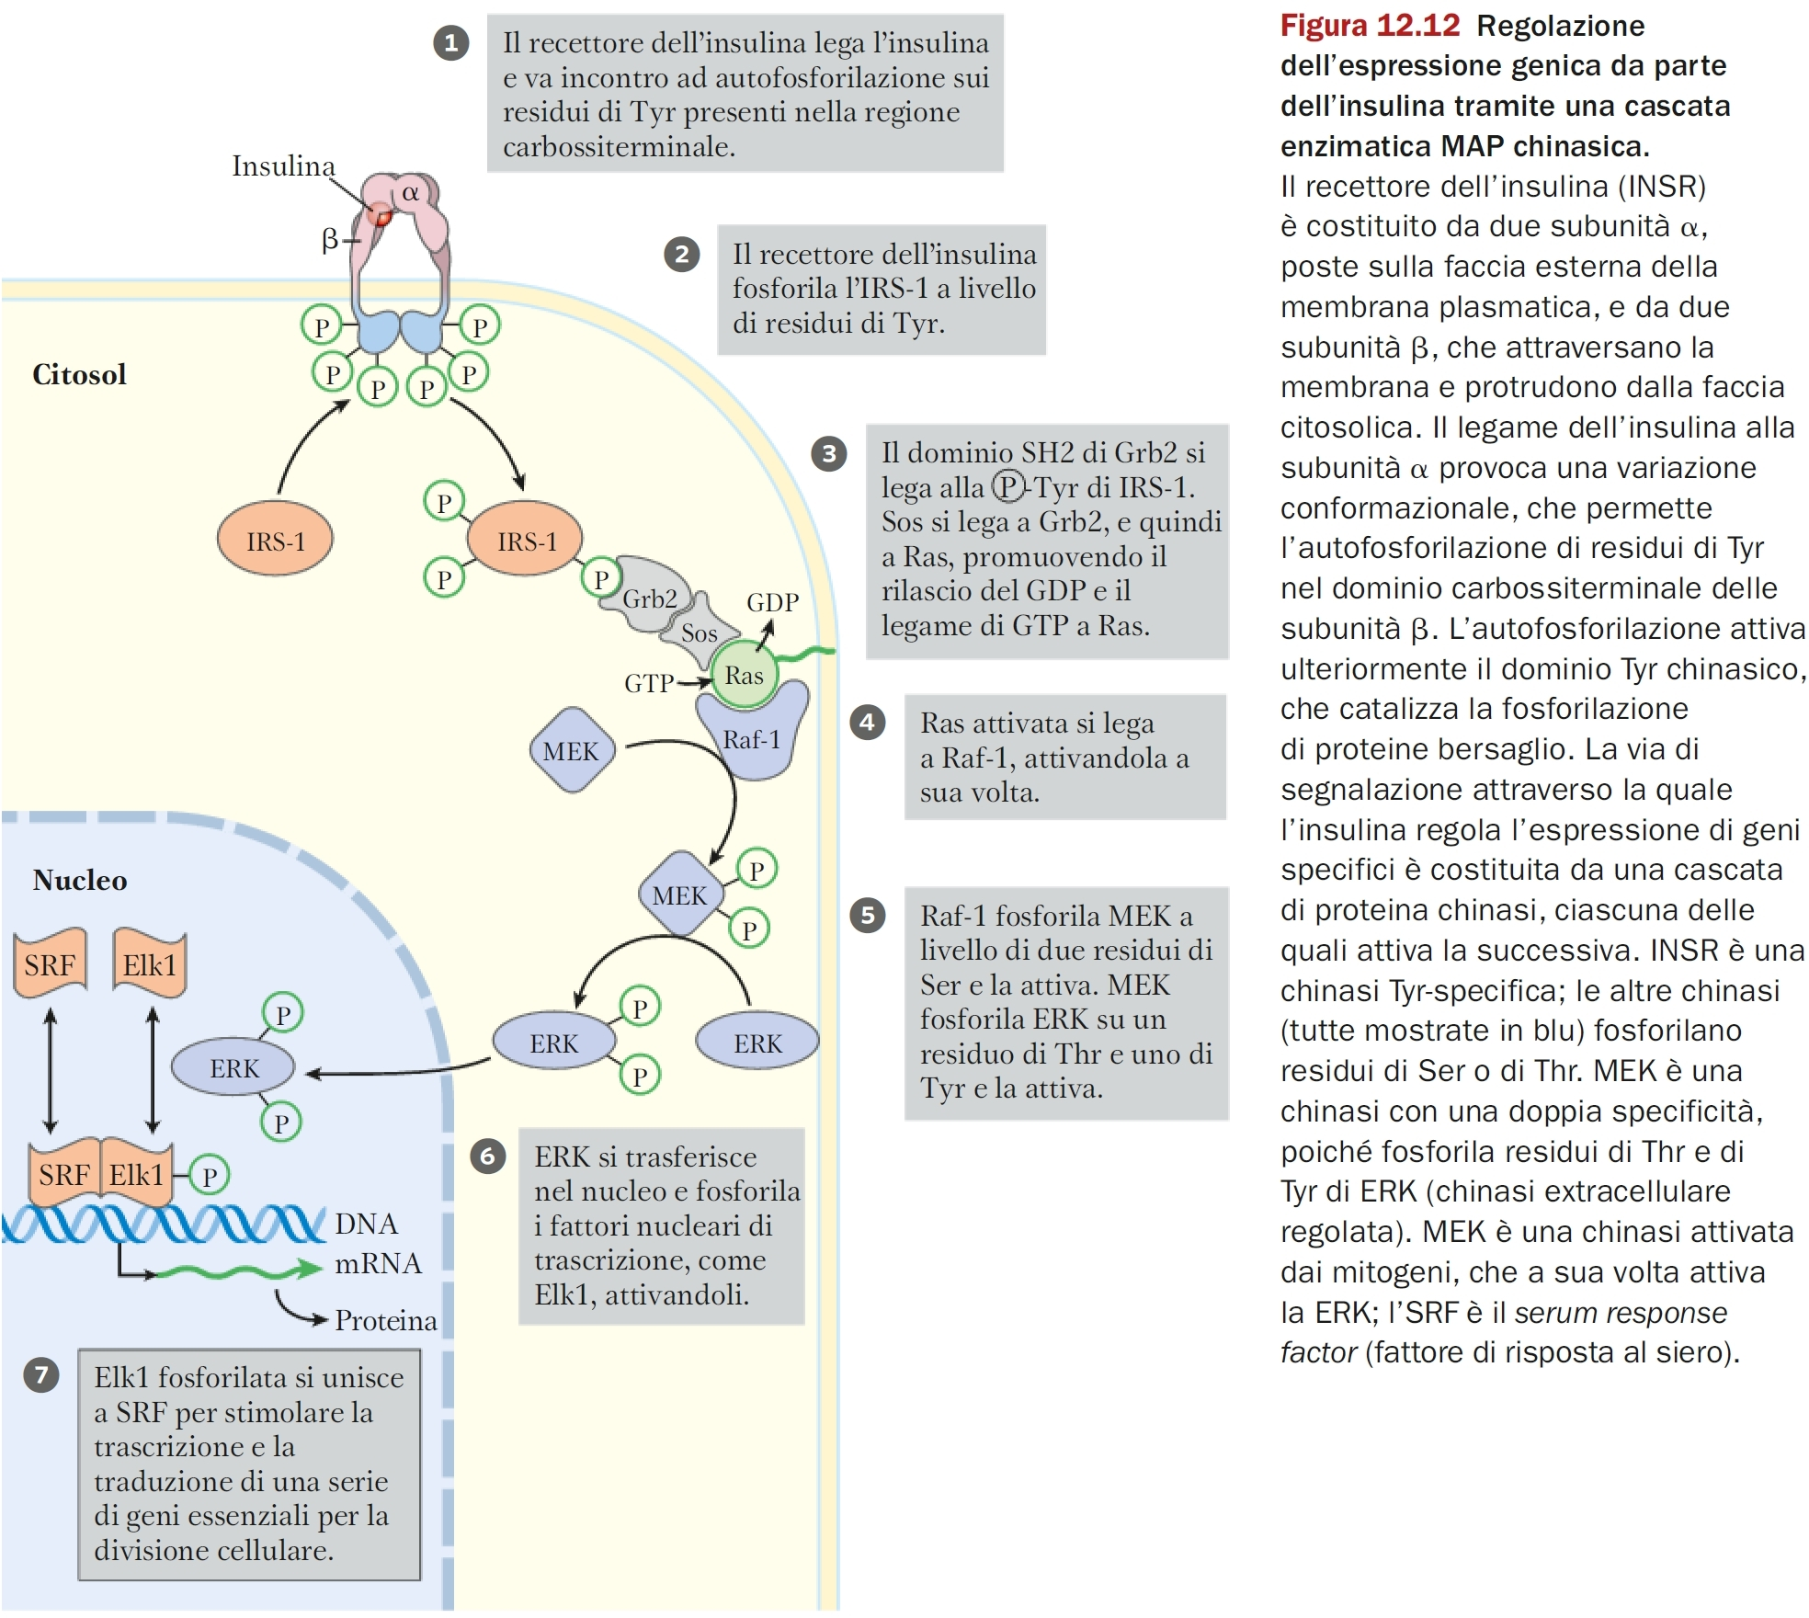

Slide 18
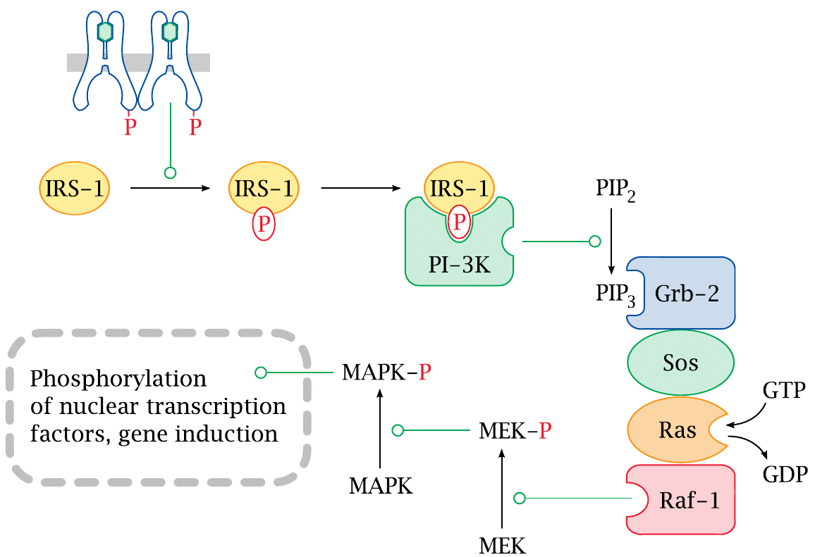
Transcriptional regulation by insulin

Slide 19
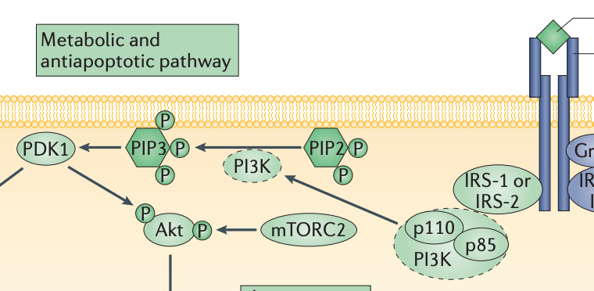
Via di controllo del metabolismo
IRS-1 fosforilato si lega a PI3K
(fosfoinositide 3-kinasi, chinasi lipidica)
PI3K associato a fosfo-IRS-1 si attiva
Catalizza la fosforilazione del fosfolipide PIP2 (fosfatidil inositolo 4,5-bisfosfato) in PIP3 (fosfatidil inositolo 3,4,5-trisfosfato)

Slide 20
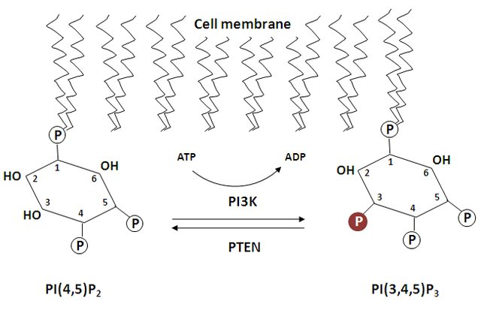
Conversione da PIP2 a PIP3 catalizzata dalla PI3K reazione inversa catalizzata dalla fosfatasi PTEN
Confronta con l’equilibrio tra adenilato ciclasi e fosfodiesterasi e il caso del DAG
Notes:
source
https://www.researchgate.net/publication/318084821_Investigating_the_role_of_Class_Ia_phosphoinositide-3_kinase_isoforms_in_Mantle_Cell_Lymphoma/figures?lo=1

Slide 21
Via di controllo del metabolismo
La protein chinasi B si associa a PIP3
La proteina chinasi B (PKB) si associa a PIP3 e si attiva
si attiva una cascata di protein chinasi
sintesi del glicogeno
esocitosi delle vescicole di GLUT4
Figura 12.13

Slide 22
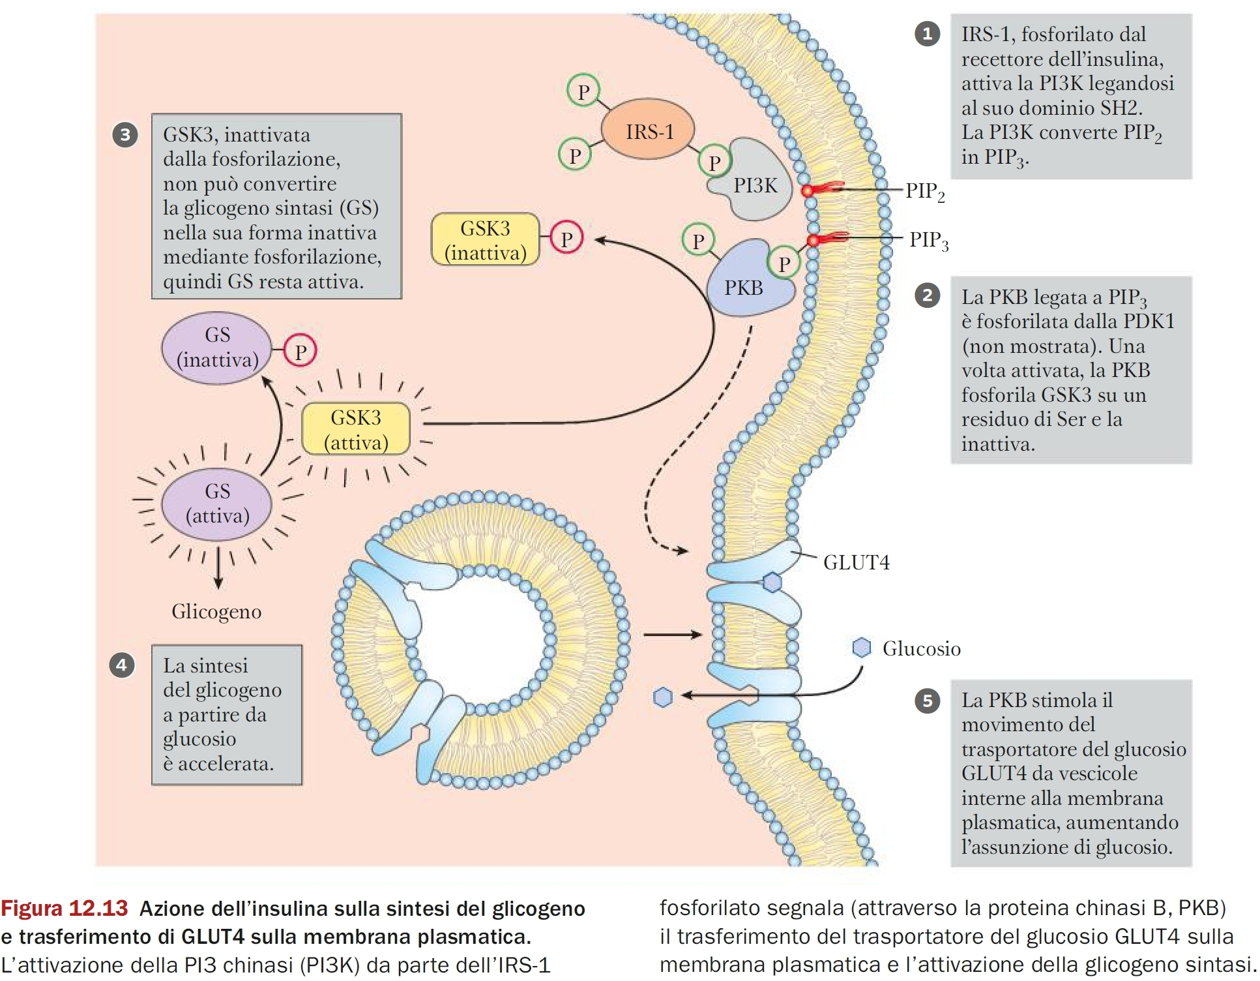

Slide 23
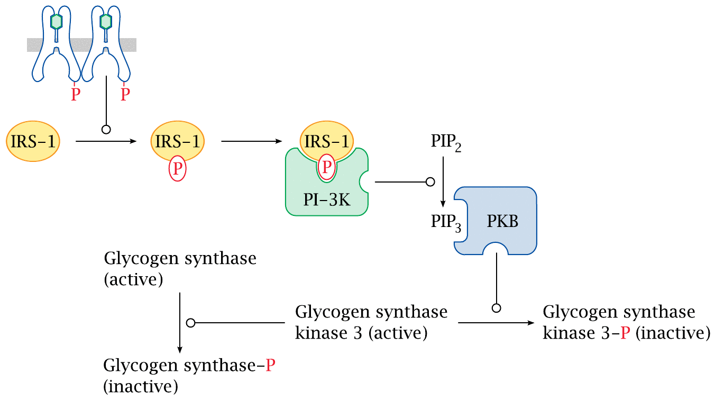
Insulin effects on glycogen synthesis

Slide 24
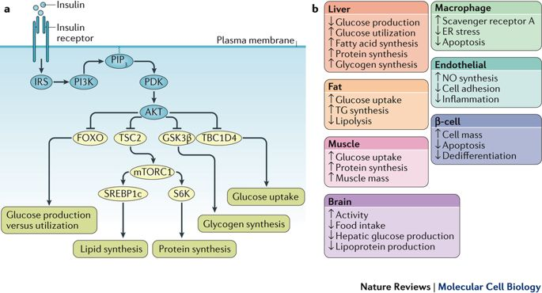
Effetti metabolici dell’insulina
Notes:
source
Review Article | Published: 04 October 2017
Biochemical and cellular properties of insulin receptor signalling
Rebecca A. Haeusler, Timothy E. McGraw & Domenico Accili
Nature Reviews Molecular Cell Biology volume19, pages31–44 (2018)
Figure 2 | Activation of insulin signalling. a | Following insulin binding, the insulin receptor (IR) tyrosine kinase is
activated, causing tyrosine phosphorylation of IR and of the IR substrate (IRS) proteins. Phosphotyrosine sites on IRS allow
binding of the lipid kinase PI3K, which synthesizes PtdIns(3,4,5)P3 (PIP3) at the plasma membrane. This recruits the
phosphoinositide-dependent kinase (PDK), which directly phosphorylates the Thr308 residue of AKT. A second
phosphorylation of AKT, at the Ser473 residue, is carried out by mTOR complex 2 (mTORC2) (not shown). Activated AKT
goes on to phosphorylate a number of substrates at Ser/Thr residues. These include: the forkhead family box O (FOXO)
transcription factors; the protein tuberous sclerosis 2 (TSC2), which permits activation of mTORC1 and its downstream
targets ribosomal protein S6 kinase (S6K) and sterol regulatory element binding protein 1c (SREBP1c); glycogen synthase
kinase 3β (GSK3β) and the RabGAP TBC1 domain family member 4 (TBC1D4). These effector proteins mediate the effects
of insulin on glucose production, utilization and uptake, as well as the synthesis of glycogen, protein and lipid. b | Effects of
insulin signalling in various tissues and cell types. ER, endoplasmic reticulum; NO, nitric oxide; TG, triglyceride.

Slide 25
Fine del rettore dell’insulina
segue
I recettori per i fattori di crescita

Slide 26
Recettori dei fattori di crescita
recettori dei fattori di crescita
Notes:
Figura 1. Panoramica dell'architettura di dominio delle 20 famiglie di RTK umane. Ogni RTK contiene cinque strutture fondamentali:
un dominio extracellulare legante-legante,
una breve regione transmembrana elicoidale,
una regione juxtamembrana,
un dominio citoplasmatico con attività tirosina chinasi
una regione di coda C terminale flessibile.
Il dominio extracellulare di legame con ligandi mostra una significativa variabilità tra le famiglie, con notevoli aggiunte di motivi ricchi di glicina, cisteina o leucina e domini immunoglobulinici tra gli altri. La famiglia del recettore dell'insulina si differenzia dal resto a causa del suo complesso multimerico pre-assemblato.
source
https://www.researchgate.net/publication/323790036_Receptor_Tyrosine_Kinase_Ubiquitination_and_De-Ubiquitination_in_Signal_Transduction_and_Receptor_Trafficking/figures?lo=1

Slide 27
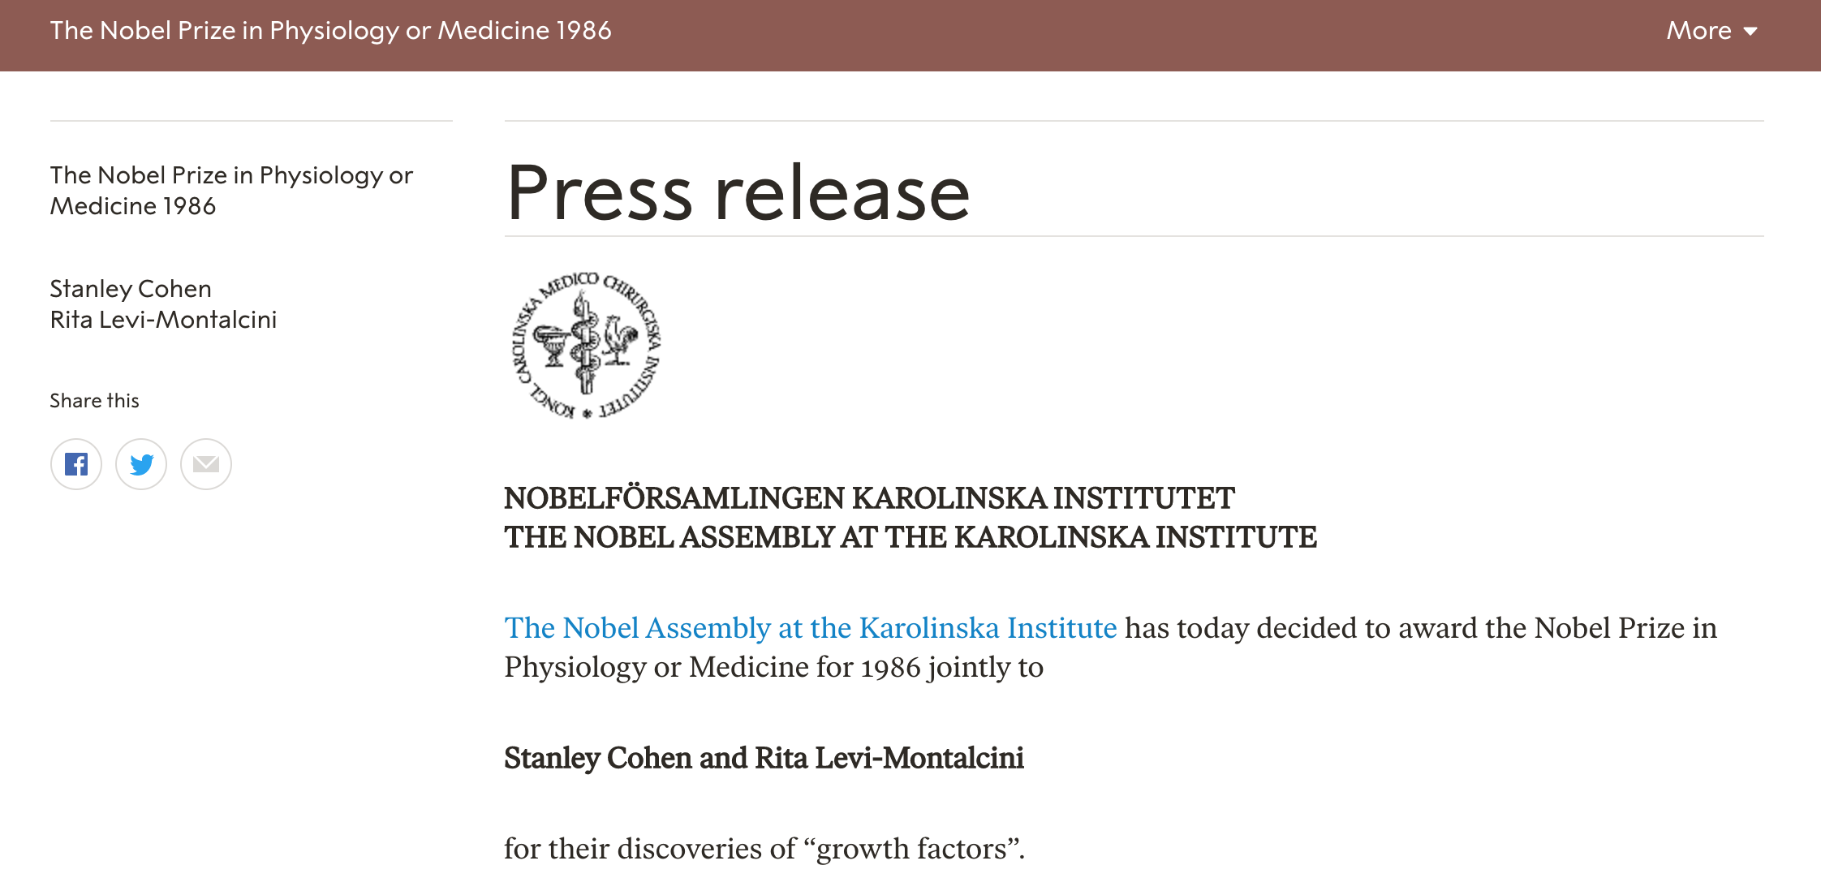
Nerve growth factor (NGF) and Epidermal growth factor (EGF)
Notes:
source
https://www.nobelprize.org/prizes/medicine/1986/press-release/

Slide 28
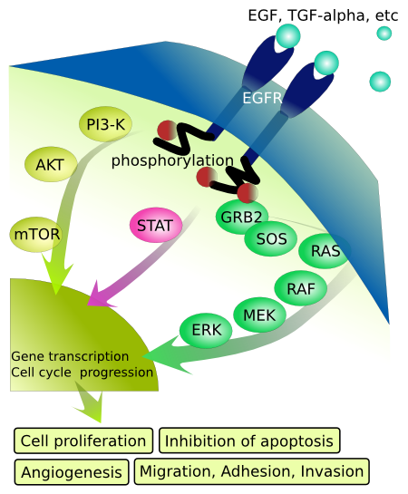
Epidermal growth factor e altri simili
Notes:
source
https://en.wikibooks.org/wiki/Structural_Biochemistry/Cell_Signaling_Pathways/Epidermal_Growth_Factor_Signaling
NOTE: questa fonte è stata citata anche dal National Cancer Institute, ai fini della divulgazione scientifica. Lo scopo di questa diapositiva è fornire un riassunto utile per l’apprendimento.
Un fattore di crescita epidermico o EGF è un tipo di fattore di crescita che controlla la proliferazione, la differenziazione e la sopravvivenza di una cellula. Si trova in tutti gli organismi viventi. Lo scopo degli EFG è proteggere tutti i tessuti viventi inviando segnali ad altre cellule per moltiplicare o rilasciare determinati prodotti chimici. Gli EGF vengono secreti dalle cellule e rilasciati nell'ambiente esterno dove possono legarsi ai recettori del fattore di crescita epidermico, o EGFR. Al momento del legame, gli EFG possono dimerizzare con se stessi (omodimero) o dimerizzare con altri fattori di crescita (eterodimero). Una volta dimerizzato, il lato interno dell'EGFR che contiene una proteina chinasi aggiunge un gruppo fosforico (donato da ATP) alle tirosine sulle catene vicine. In tal modo, le proteine si associano alle tirosine appena fosforilate attivando così una cascata di segnalazione che termina con la sintesi del DNA e la crescita cellulare.

Slide 29
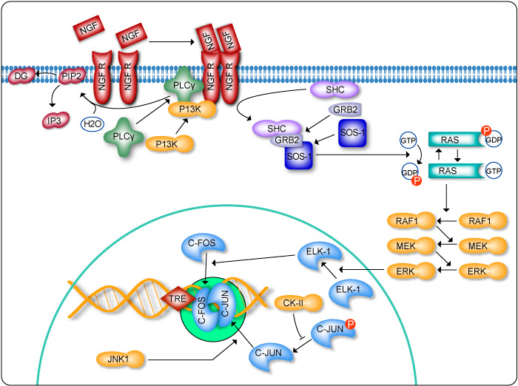
Il recettore del nerve growth factor e le sue 2 cascate di segnalazione
Notes:
source
https://www.genecopoeia.com/product/search/pathway/h_ngfPathway.php
Da notare:
1) Il recettore dimerizza dopo il legame con il fattore di crescita
2) Si attivano due vie di segnalazione:
2.1 Via GRB2, come nel caso del recettore per l’insulina.
2.2 Via PI3K, che catalizza la fosfoorilazione di PIP2 a PIP3 (non mostrato), che causa l’attracco (docking) alla membrana dell’enzima PLCgamma (fosfolipasi C). Quest’ultima catalizza l’idrolisi di PIP2, con formazione di DAG e IP3. IP3 causerà l’aumento intracellulare di Ca++, che insieme a DAG attiveranno la proteinc chinasi C (PKC).

Slide 30
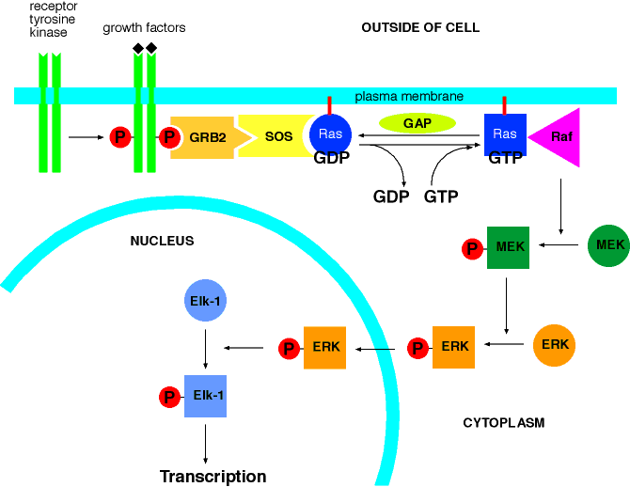
Approfondimento: la funzione di RAS
Notes:
source
http://oregonstate.edu/instruction/bb331/lecture14/ras3.html
Binding of growth factors to receptor tyrosine kinases stimulates the autophosphorylation of specific tyrosines on the receptors. The phosphorylated receptor then binds to an adaptor protein called GRB2 which, in turn, recuits SOS (son of sevenless) to the plasma membrane. SOS is a guanine nucleotide exchange factor which displaces GDP from Ras, subsequently allowing the binding of GTP (Ras is already anchored to the plasma membrane by post-translationally added lipids, shown as a red line). GTP-bound Ras recruits and activates Raf. Raf initates a cascade of protein phosphorylation by first phophorylating MEK. Phosphorylated MEK in turn phosphorylates ERK. Phosphorylated ERK moves from the cytoplasm into the nucleus where it subsequently phosphorylates a number of transcription factors, including the specific transcription factor called Elk-1. Phosphorylated transcription factors turn on transcription (gene expression) of specific sets of target genes. The activity of Ras is limited by the hydrolysis of GTP back to GDP by GTPase activating proteins (GAP). Other abbreviations are: MEK = MAPK/ERK kinase, ERK = extracellular receptor-stimulated kinase, MAPK = mitogen-activated protein kinase. Kinases are enzymes that add phosphates to molecules using ATP. Mitogens are factors (such as growth factors) that stimulate cell division.

Slide 31
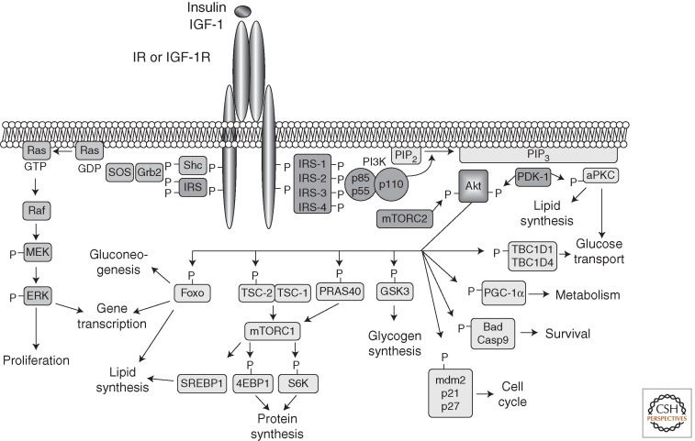
Il recettore dell’insulina lega anche IGF-1 (insulin-like growth factor 1)
Notes:
Utile questo schema delle due vie di segnalazione attivate dal recettore per l’insulina
Insulin- and IGF-1-signaling pathways. Activation of insulin and IGF-1 receptors by their ligands initiates a cascade of phosphorylation events. A conformational change and autophosphorylation of the receptors occur at the time of ligand binding, leading to the recruitment and phosphorylation of receptor substrates such as IRS and Shc proteins. Shc activates the Ras-MAPK pathway, whereas IRS proteins mostly activate the PI3K-Akt pathway by recruiting and activating PI3K, leading to the generation of second messenger PIP3. Membrane-bound PIP3 recruits and activates PDK-1, which phosphorylates and activates Akt and atypical PKCs. Akt mediates most of insulin's metabolic effects, regulating glucose transport, lipid synthesis, gluconeogenesis, and glycogen synthesis. Akt also plays a role in the control of cell cycle and survival. The Shc-Grb2-Sos-Ras-Raf-MAPK pathway controls cellular proliferation and gene transcription.
source
Cold Spring Harb Perspect Biol. 2014 Jan 1;6(1). pii: a009191. doi: 10.1101/cshperspect.a009191.
Insulin receptor signaling in normal and insulin-resistant states.
Boucher J1, Kleinridders A, Kahn CR.

Slide 32
Le proteine di segnalazione sono multimodulari
I moduli sono domini di legame ricorrenti e consentono l’interazione con
proteine partner
fosfolipidi di membrana (es. PIP3)

Slide 33
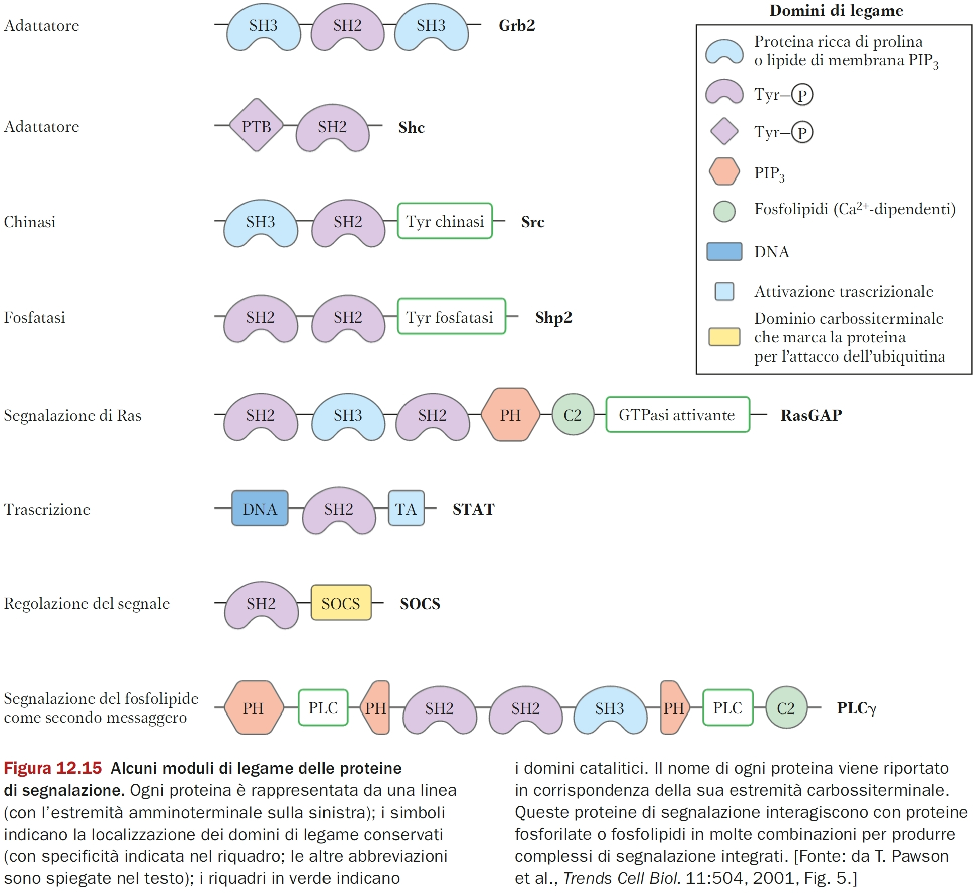
e partner di legame

Slide 34
Fine dei recettori enzimatici RTK

Slide 35
Un altro secondo messaggero il cGMP
È il prodotto della reazione della guanilato/guanilil ciclasi, di cui esistono due forme:
Recettore di membrana attivato da ligandi
Fattore natriuretico atriale (ANF); guanilina (peptide di 15 aa, rilasciato nell’intestino dalle cellule secernenti muco)
Recettore citoplasmatico attivato da monossido d’azoto (NO)
NO si lega al gruppo prostetico eme

Slide 36
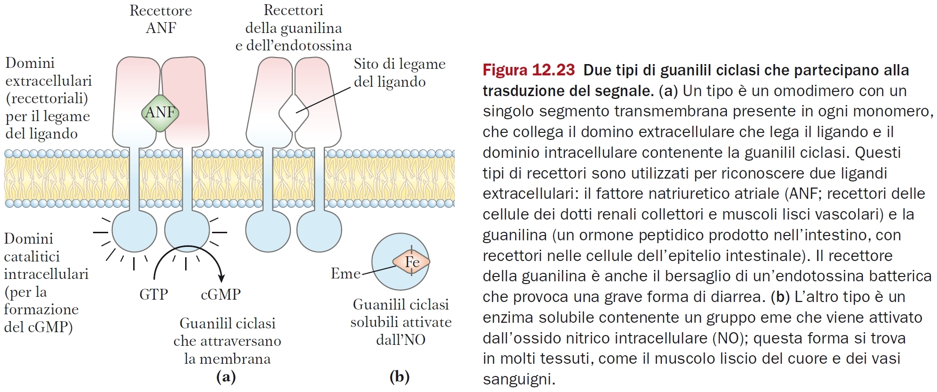

Slide 37
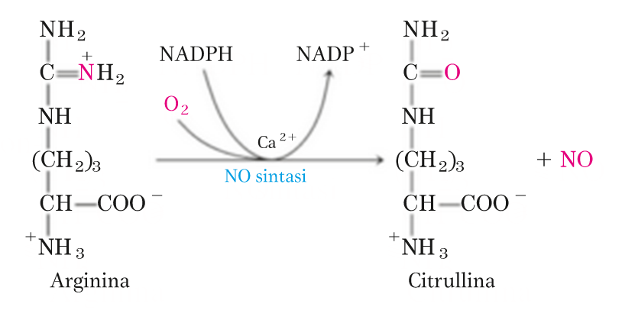
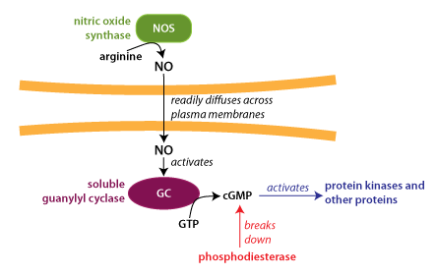
La guanilato ciclasi è il recettore intracellulare del monossido d’azoto
Molte azioni
rilassamento muscolare
vasodilatazione
fisiologia, farmacologia
Notes:
source
https://courses.washington.edu/conj/bess/nitric-oxide/nitric-oxide.html

Slide 38
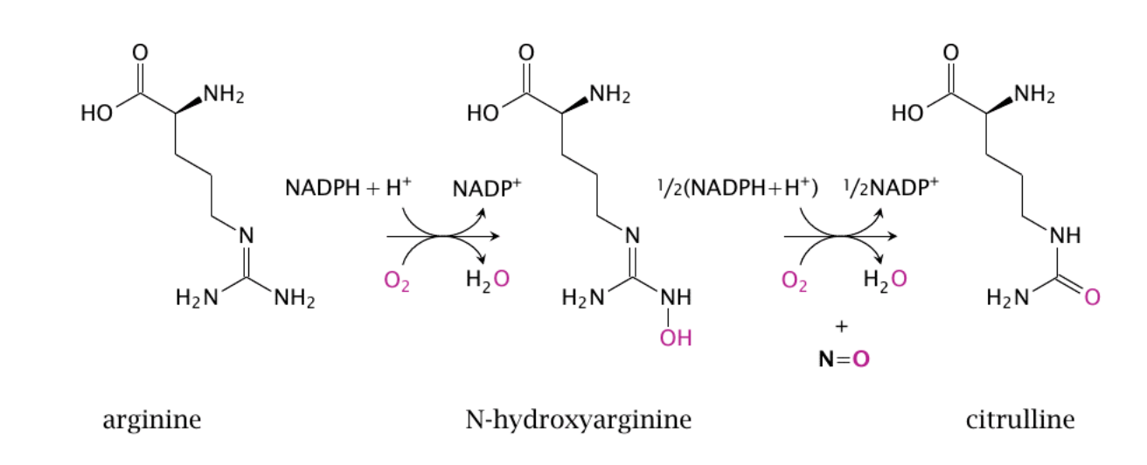
La sintesi del monossido d’azoto
è catalizzata dalla NO sintasi

Slide 39
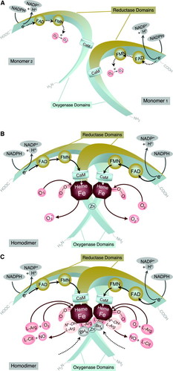
Basic structure of eNOS and scheme of NOS catalysis
Notes:
Source
Endothelial Nitric Oxide Synthase in Vascular Disease
From Marvel to Menace
Ulrich Förstermann and Thomas Münzel
Originally published4 Apr 2006 https://doi.org/10.1161/CIRCULATIONAHA.105.602532Circulation. 2006;113:1708–1714
https://www.ahajournals.org/doi/full/10.1161/circulationaha.105.602532
Figure 1. A, Basic structure of eNOS and scheme of NOS catalysis. All NOS enzymes are synthesized as monomers. Each subunit consists of a reductase domain and an oxygenase domain. Monomers and even isolated reductase domains are able to transfer electrons from NADPH to the flavins FAD and FMN and have a limited capacity to reduce molecular oxygen to O2·−. Monomers and isolated reductase domains can bind calmodulin (CaM), which stimulates the electron transfer within the reductase domain. However, monomers are unable to bind the cofactor BH4 or the substrate l-arginine and cannot catalyze NO· production. B, The presence of heme allows NOS dimerization; in fact, heme is the only cofactor that is absolutely required for the formation of active NOS dimers. Heme also is essential for the interaction between reductase and oxygenase domains and for the interdomain electron transfer from the flavins to the heme of the opposite monomer. NADPH oxidation rates are significantly enhanced in heme-containing substrate-free NOS dimers compared with monomers, consistent with a more effective O2·− production. C, When sufficient substrate l-arginine and cofactor BH4 are present, intact NOS dimers couple their heme and O2 reduction to the synthesis of NO·. l-Citrulline is formed as the byproduct; Nω-hydroxy-l-arginine is an intermediate in the reaction.

Slide 40
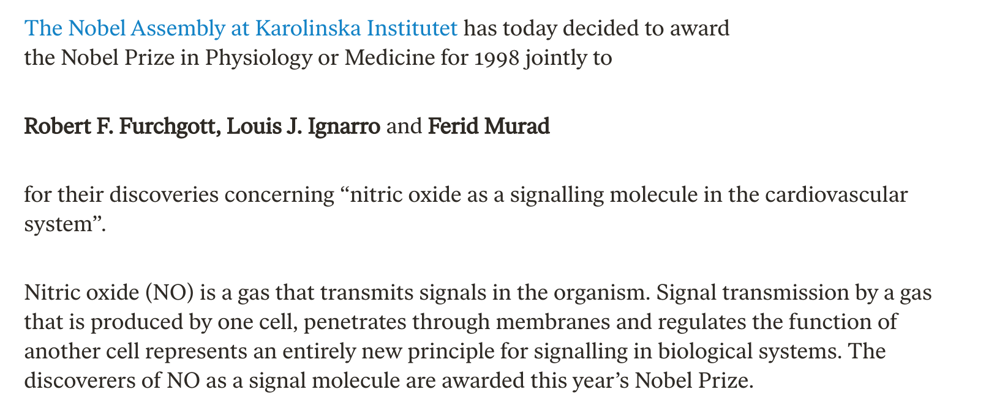
Premio Nobel 1998

Slide 41
L’effettore allosterico NO della guanilato ciclasi
Notes:
source
http://watcut.uwaterloo.ca/webnotes/Pharmacology/NitricOxide.html
NO binds to the heme group of soluble guanylate cyclase (sGC), dislodging a strategic histidine residue. This causes a conformational change that activates the enzyme, which then begins to make cyclic GMP (cGMP). The production of cGMP as a second messenger is the most important signal downstream of NO.

Slide 42
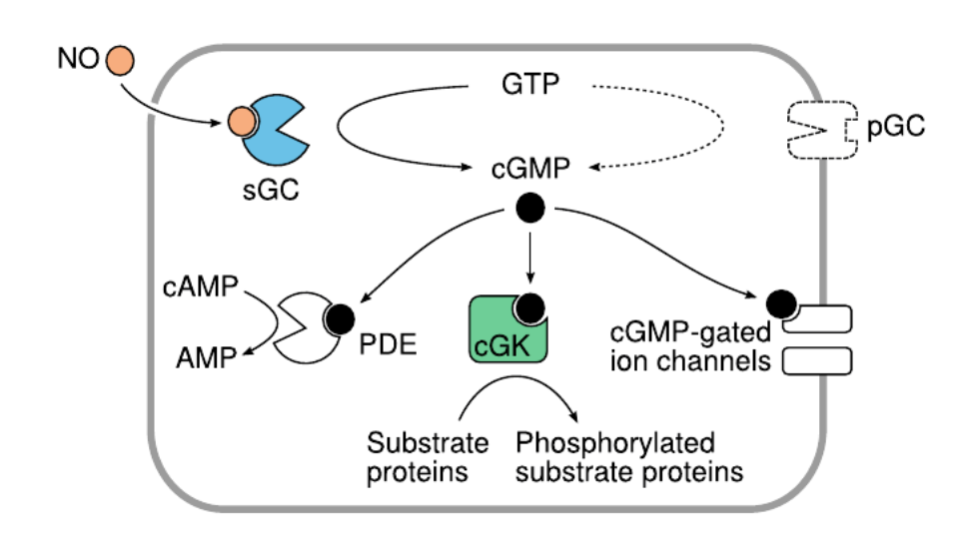
Gli effetti del cGMP

Slide 43
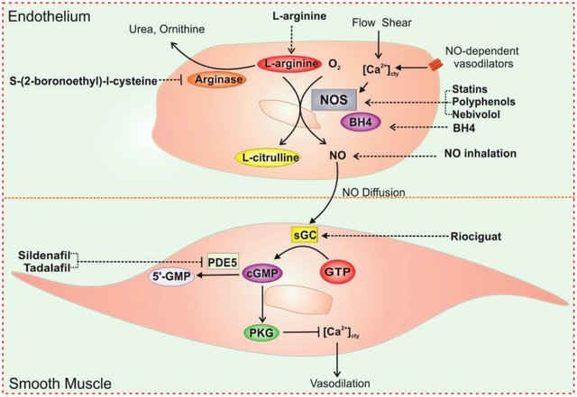
L’accoppiamento endotelio-muscolo liscio
Notes:
Targeting L-arginine-nitric oxide-cGMP pathway in pulmonary arterial hypertension
Haiyang Tang, Rebecca R. Vanderpool, Jian Wang, ...
First Published September 12, 2017 Editorial
https://doi.org/10.1177/2045893217728261
Fig. 1. Strategies for targeting L-arginine-nitric oxide signaling pathways in PH treatment. The increase of [Ca 2þ ] cty in response to receptormediated agonists or increased shear stress results in activation of NOS in ECs. Activated NOS converts L-arginine in the presence of oxygen to NO and L-citrulline. These processes also require BH4. NO released from ECs diffuses into PASMCs and binds to its intracellular receptor sGC, which produces cGMP from GTP. The increase in intracellular cGMP concentration results in activation of PKG. Activation of PKG leads to the decrease of [Ca 2þ ] cty and relaxation of smooth muscle via several mechanisms. cGMP are also determined by activity of type PDE5. There are several therapeutic strategies for targeting NO signaling in PAH including increasing NO formation or direct inhalation of NO, stimulating sGC activation, and preventing the breakdown of cGMP. Compounds, such as L-arinine, S-(2-boronoethly)-l-cysteine, L-citrulline, statins, polyphenols, Nebivolol, and BH4 can increase substrates or NOS activation leading to increase of NO formation. NO inhalation can also enhance NO signaling. Therapeutics also takes advantage of enhancing NO downstream pathways including stimulators or activators of sGC such as Riociguat and PED5 inhibitors, such as Sildenafil and Tadalafil.

Slide 44
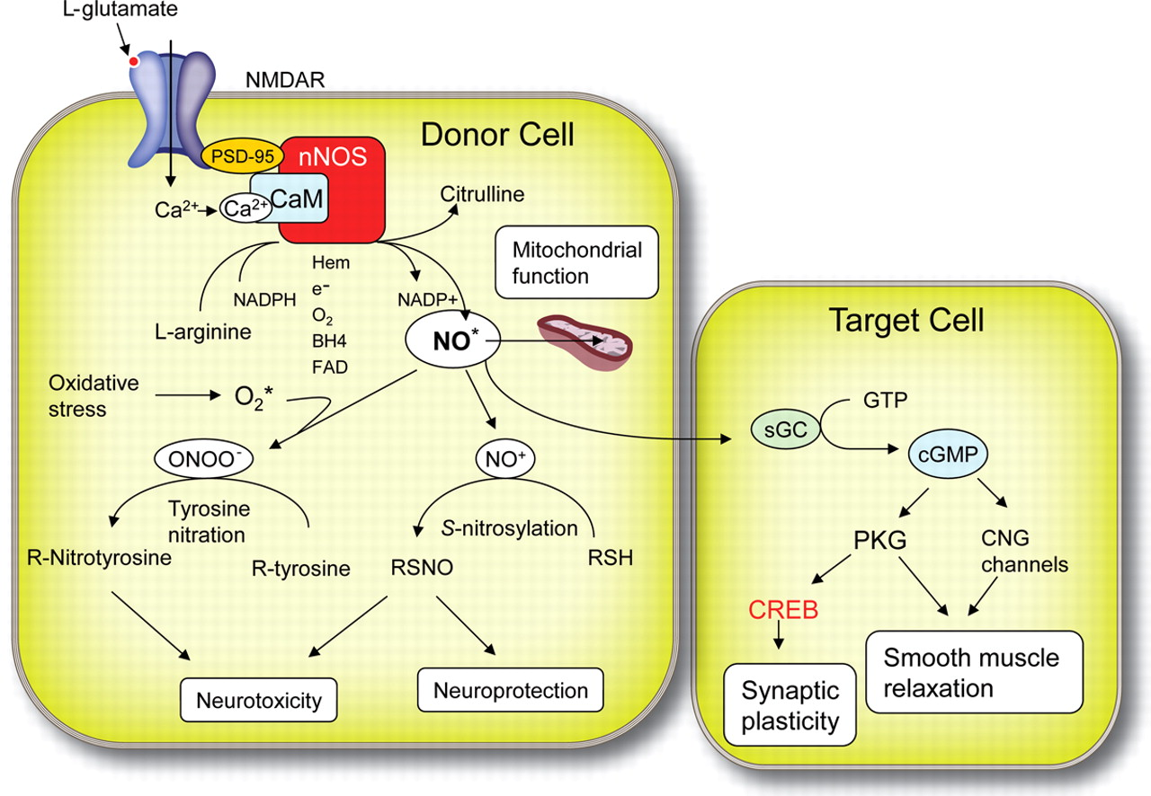
L’accoppiamento nelle cellule nervose
Notes:
Source
https://n.neurology.org/content/77/16/1568/tab-figures-data
Figure 1
General features of nitric oxide signaling
Nitric oxide (NO*) is produced from arginine by action of NO synthase (NOS) in the presence of heme, oxygen (O2), tetrahydrobiopterin (BH4) as flavin adenine dinucleotide (FAD), flavin mononucleotide (FMN), and reduced nicotinamide-adenine dinucleotide phosphate (NADPH). Neuronal NOS (nNOS) (like endothelial NOS) requires calcium (Ca2+)/calmodulin (CaM) complexes for its activation. The primary mechanism of activation of nNOS is Ca2+ influx via glutamate NMDA receptors (NMDARs). The NMDA receptor, CaM, and nNOS are part of a molecular complex assembled by action of PSD-95 (postsynaptic density protein of 95 kD). NO acts as a rapidly diffusible messenger that, under physiologic conditions, elicits activation of soluble (cytosolic) guanylyl cyclase (sGC), leading to formation of cyclic guanosine monophosphate (cGMP) in target cells. Cyclic GMP activates protein kinase G (PKG) and cyclic nucleotide gated channels (CNG). Downstream effectors include protein kinases and transcription factors such as cyclic adenosyl monophosphate (cAMP) response element-binding protein (CREB). These pathways mediate modulation of synaptic activity, smooth muscle relaxation, and neuroprotective effects. At high intracellular levels, NO combines with O2 to produce nitrosonium ion (NO+), which reacts with thiol radicals (R-SH) to elicit S-nitrosylation (RSNO). Nitric oxide may also react rapidly with superoxide radical (O2*−) to produce peroxynitrite (ONOO−), which elicits multiple neurotoxic effects, in part due to nitration of tyrosine residues of proteins (nitrotyrosylation), resulting in formation of 3-nitrotyrosine.

Slide 45
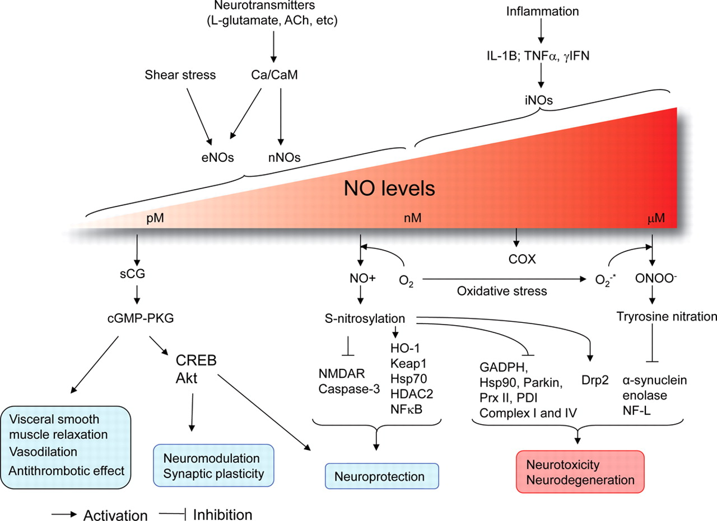
Notes:
https://n.neurology.org/content/77/16/1568/tab-figures-data
Neuroprotective and neurotoxic effects of nitric oxide (NO) NO can exert neuroprotective or neurotoxic effects according to its concentration and the cellular environment. Low and transient NO increases activates the soluble guanylyl cyclase (sCG)–cyclic guanosine monophosphate (cGMP) pathway, which exerts neuroprotective effects in part via activation of cyclic adenosyl monophosphate (cAMP) response element-binding protein (CREB) and the antiapoptotic Akt/protein kinase B pathway. NO may also exert neuroprotection via nitrosylation; this results in inhibition of NMDA receptor (NMDAR) and caspase 3, and activation of hypoxia-induced factor 1 (HIF-1) and heme oxygenase 1 (HO-1) histone deacetylase 2 (HDAC2) activity. Excessive NO production, particularly in the setting of oxidative stress leading to production of peroxynitrite (ONOO−), triggers S-nitrosylation or protein nitration of critical proteins in the cytosol and mitochondria, promoting cell injury via protein misfolding, mitochondrial dysfunction, synaptic injury, and apoptosis. Important target gets include glyceraldehyde-3-phophate dehydrogenase (GADPH), Hsp90, parkin peroxiredoxin II (Prx II) 2, and protein-disulfide isomerase (PDI). Tyrosine nitration of α-synuclein promotes its oligomerization and Lewy body formation and also affects neurofilament light chain (NF-L) and other targets. Hsp=heat shock protein; Keap1=Kelch-like ECH-associated protein 1; NFκB=nuclear factor κB.

Slide 46
Le vie di segnalazione si influenzano
Scambio di informazioni o cross-talk
Una proteina di segnale può essere regolata con meccanismi plurimi
controllo allosterico + modificazione covalente
modificazione covalente su due siti diversi
Il caso del recettore dell’adrenalina e dell’insulina (diapositiva seguente)

Slide 47
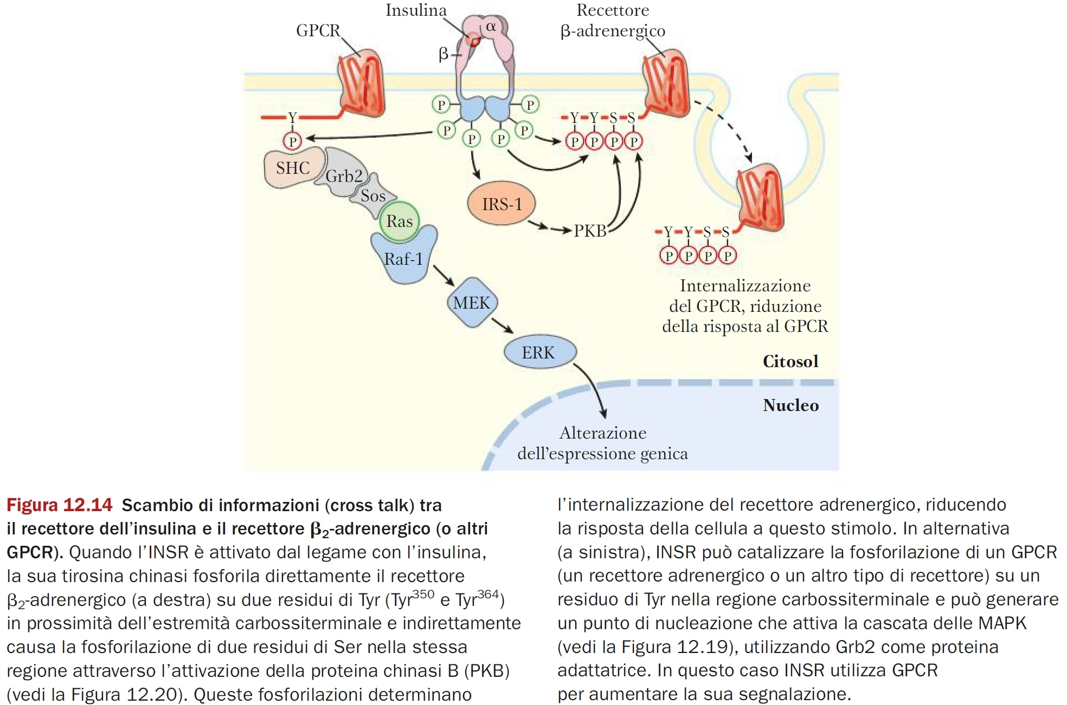

Slide 48
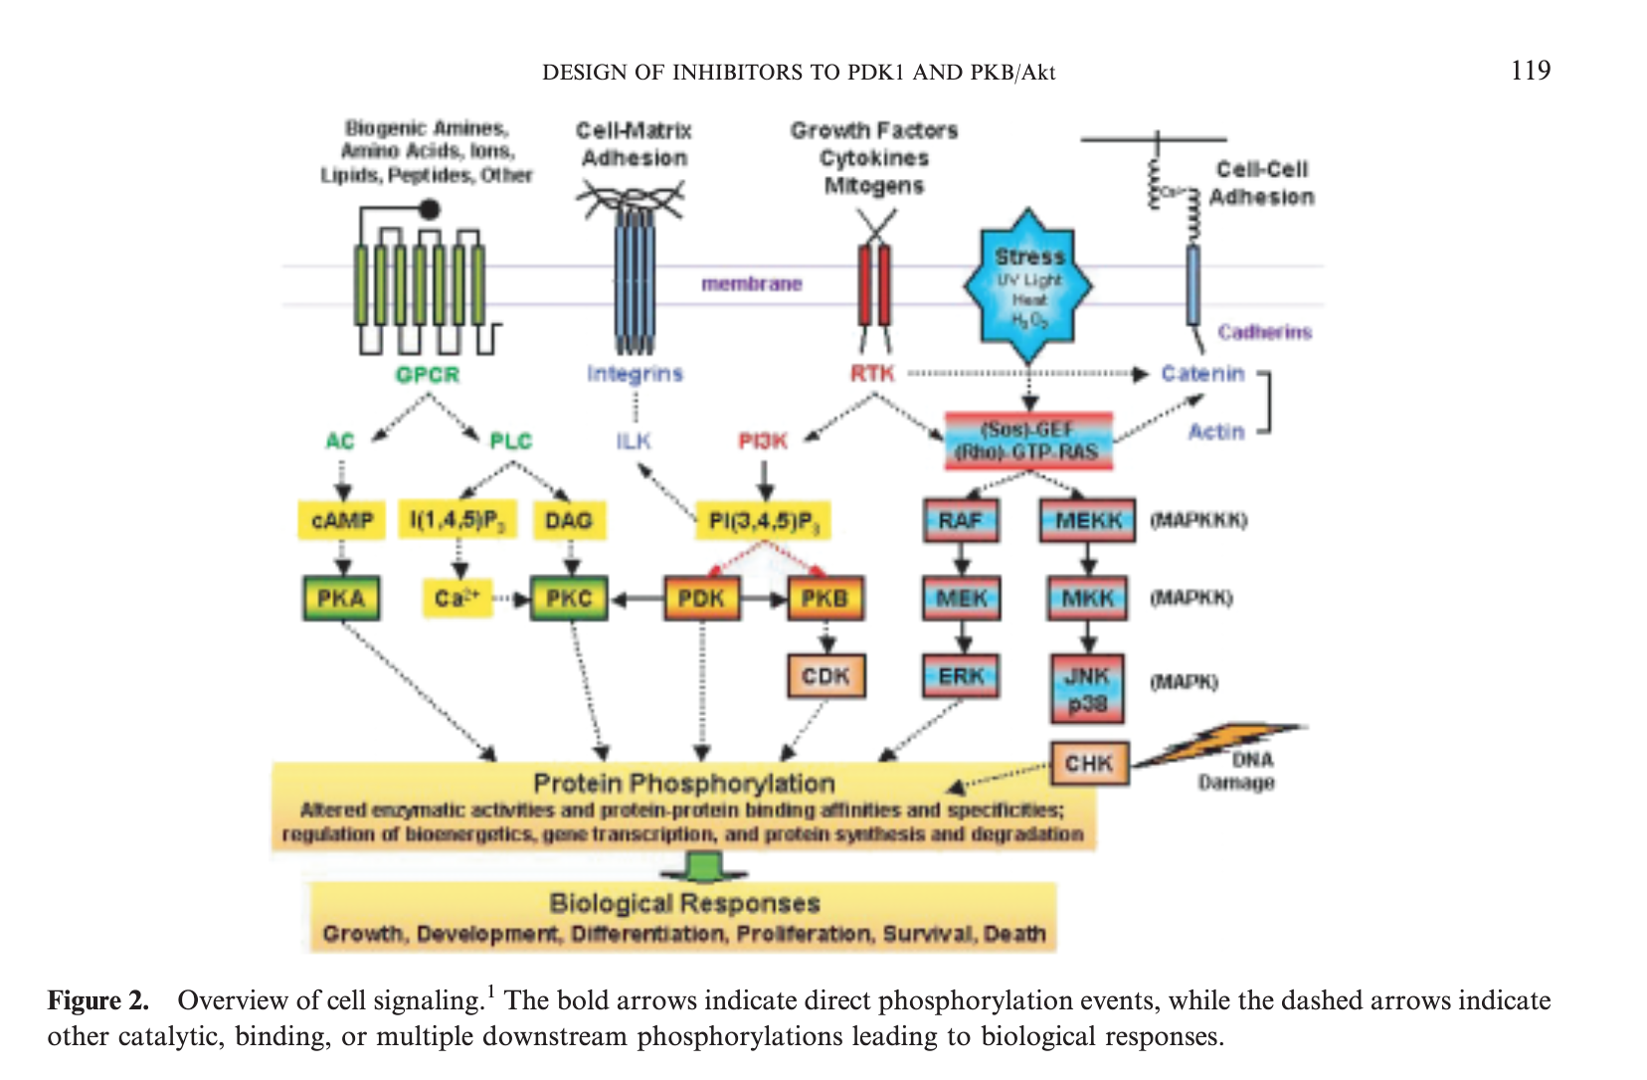
Notes:
source
https://iubmb.onlinelibrary.wiley.com/doi/epdf/10.1080/1521654031000115951

Slide 49
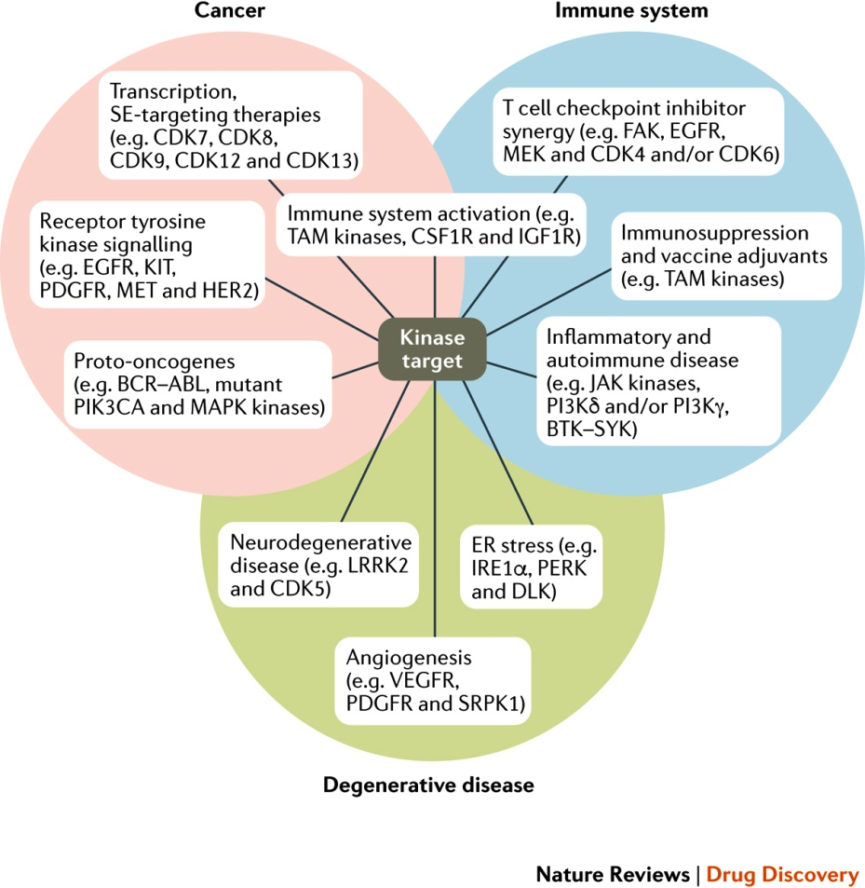
Figure 1 : Kinase inhibitors in diverse biological processes and new therapeutic areas.
Notes:
Cancer: proto-oncogenes such as breakpoint cluster region protein (BCR)–Abelson tyrosine kinase (ABL), phosphoinositide 3-kinase catalytic subunit-α (PIK3CA) and mitogen-activated protein kinase (MAPK) kinases drive aberrant proliferation in cancer. Approved anticancer drugs, such as imatinib, target this family. Receptor tyrosine kinases, such as epidermal growth factor receptor (EGFR) and vascular endothelial growth factor receptor (VEGFR), can also drive cancer proliferation and angiogenesis. Approved anticancer drugs such as erlotinib target this class of kinases282. Transcription-associated kinases, such as cyclin-dependent kinase 7 (CDK7) and CDK9, play key roles in regulating transcription. Recently, these kinases have emerged as potential cancer drug targets; the most advanced kinase inhibitors targeting transcriptional kinases are in phase I/II clinical trials17. Immune system-associated kinases, such as the TAM kinases (TYRO3, AXL and MER), play a key role in regulating the immune system; therefore, inhibiting these kinases may be beneficial both in cancer and in alleviating immunosuppression (for example, in the latter stages of septic shock) or as vaccine adjuvants. Immune system: T cell checkpoint inhibitors achieve a complete and durable response in a small number of cancer patients. As oncogenic kinases, such as EGFR and CDK4 and/or CDK6, aid immune system evasion in cancer, identifying kinase inhibitors that synergize with T cell checkpoint inhibitor therapy and sensitize resistant cancers to its effects has been the focus of extensive investigation101. Kinase inhibitors are also relevant for the treatment of autoimmune and inflammatory disorders, such as rheumatoid arthritis, where Janus kinase (JAK) inhibitors were recently approved103. Degenerative disease: excessive endoplasmic reticulum stress drives degenerative diseases such as retinitis pigmentosa and diabetes mellitus. Inhibition of kinases in the unfolded protein response pathway, such as IRE1α, are promising targets for these orphan diseases131. Kinases that drive angiogenesis are also highly relevant targets in ocular degenerative diseases, such as wet age-related macular degeneration151. Finally, there are a number of promising but relatively underexplored kinase targets in neurodegenerative diseases, such as leucine-rich repeat serine/threonine-protein kinase 2 (LRRK2) and CDK5 (Refs 156, 283). BTK, Bruton tyrosine kinase; CSF1R, macrophage colony-stimulating factor 1 receptor; DLK, dual leucine zipper kinase; FAK, focal adhesion kinase; HER2, human epidermal growth factor receptor 2; IGF1R, insulin-like growth factor 1 receptor; PDGFR, platelet-derived growth factor receptor; PERK, PRKR-like ER kinase; PI3Kδ, phosphoinositide 3-kinase-δ; SE, super-enhancer; SRPK1, SFRS protein kinase 1; SYK, spleen tyrosine kinase.
Review Article | Published: 16 March 2018
Kinase inhibitors: the road ahead
Fleur M. Ferguson & Nathanael S. Gray
Nature Reviews Drug Discovery volume17, pages353–377 (2018)

Slide 50
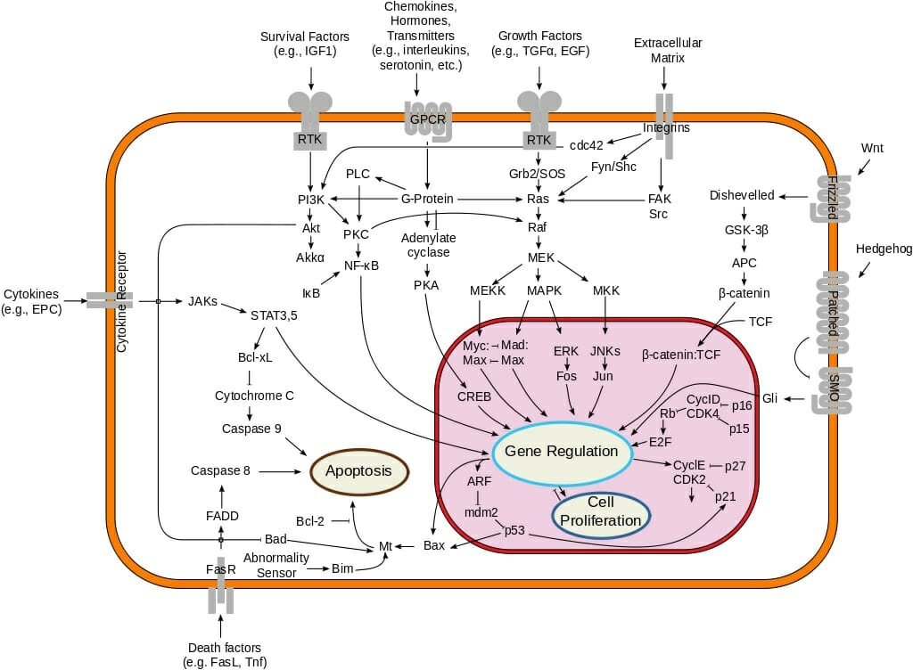
Notes:
https://en.wikipedia.org/wiki/Signal_transduction

Slide 51
Lezione 3
Recettori

Slide 52
Canali ionici

Slide 53
Le cellule eccitabili
Sono le cellule sensoriali, nervose e muscolari (e alcune altre)
Rispondono a segnali ambientali con un segnale elettrico
variazione del potenziale di membrana
I segnali ambientali sono:
fotoni (fotorecettori)
pressione (meccanorecettori)
molecole (chemorecettori).
La trasduzione elettrica del segnale è mediata dai CANALI IONICI

Slide 54
I canali ionici
Proteine transmembrana che consentono il trasporto selettivo di ioni e soluti attraverso la membrana plasmatica
Formano un poro acquoso altamente selettivo per i diversi ioni
Due stati funzionali
aperto
chiuso
Controllati da:
ligando
forza meccanica
potenziale di membrana
Notes:
source
https://www.slideshare.net/dralazeb/sonsory-receptors

Slide 55
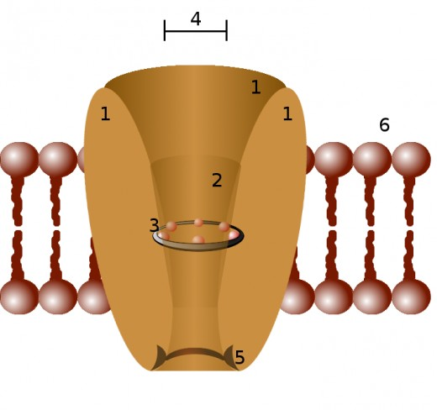
Canali ionici-elementi strutturali
Le subunità transmembrana (almeno 4)
Il vestibolo
Il filtro di selettività (catene R degli aac)
il diametro del filtro
il dominio intracellulare (modulatorio)
Notes:
source
https://hubpages.com/education/Ion-Channels-Definition-Types-Description-of-Sodium-Calcium-Potassium-and-Chloride-Ion-channels

Slide 56
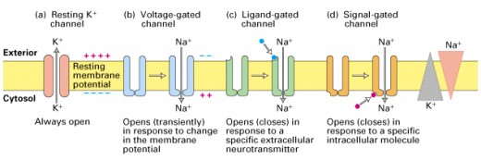
I principali tipi di canali
Notes:
source
https://hubpages.com/education/Ion-Channels-Definition-Types-Description-of-Sodium-Calcium-Potassium-and-Chloride-Ion-channels

Slide 57
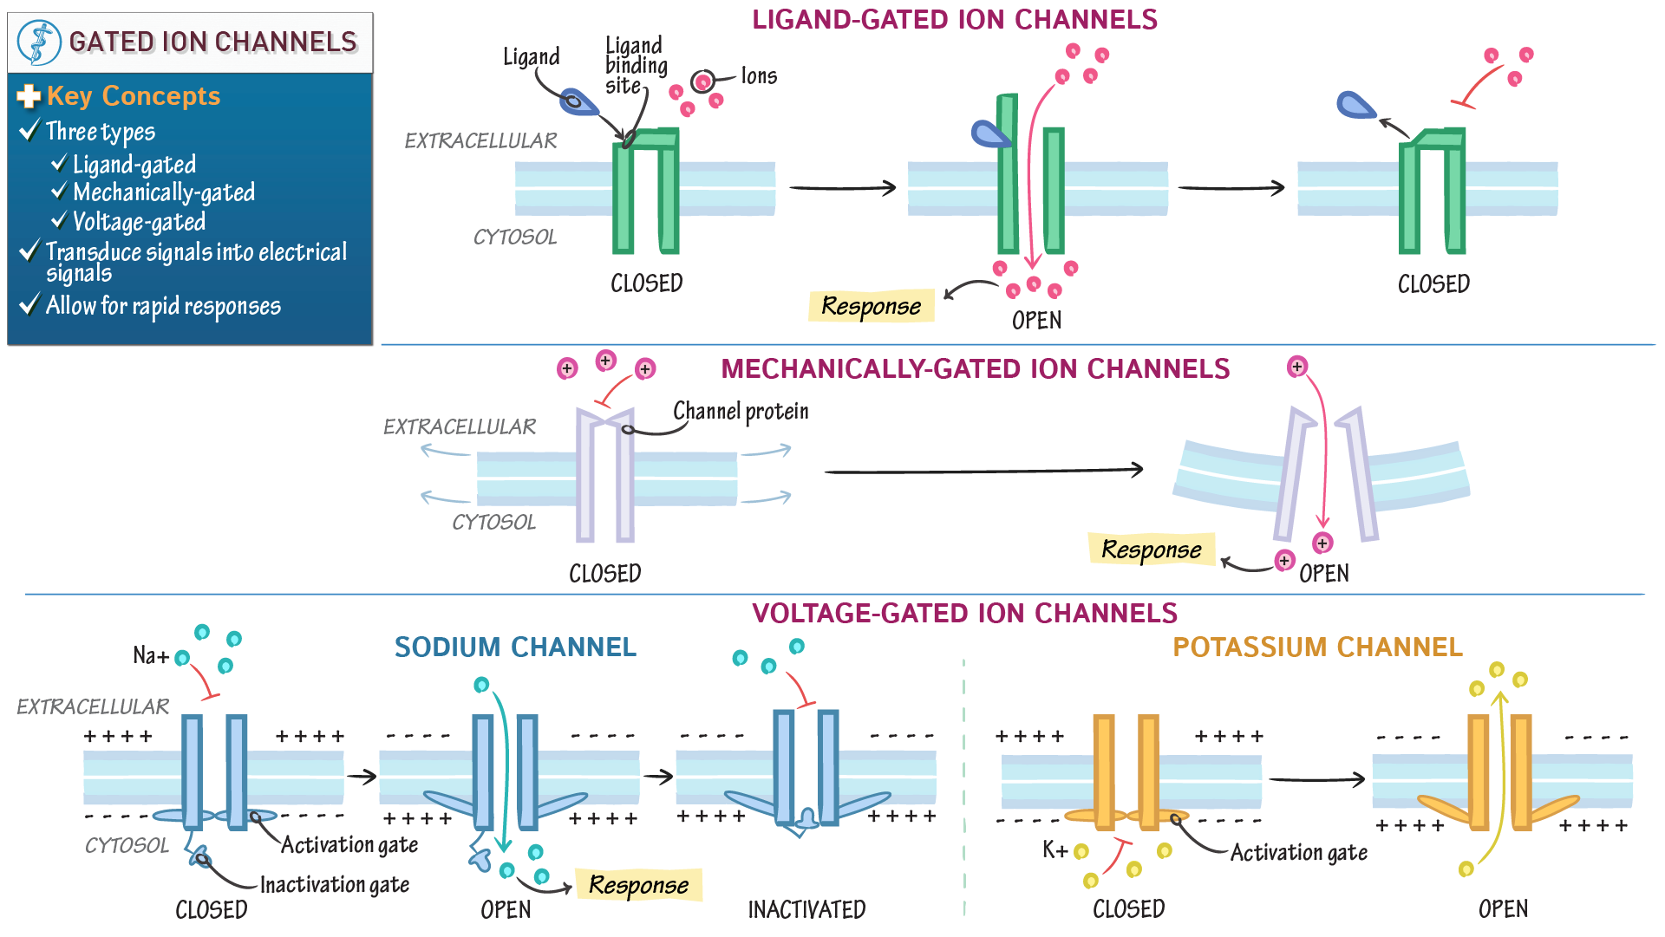
Notes:
source
https://drawittoknowit.com/course/anatomy-physiology/cells/communication-signals/1126/ligand-gated-ion-channels/video

Slide 58
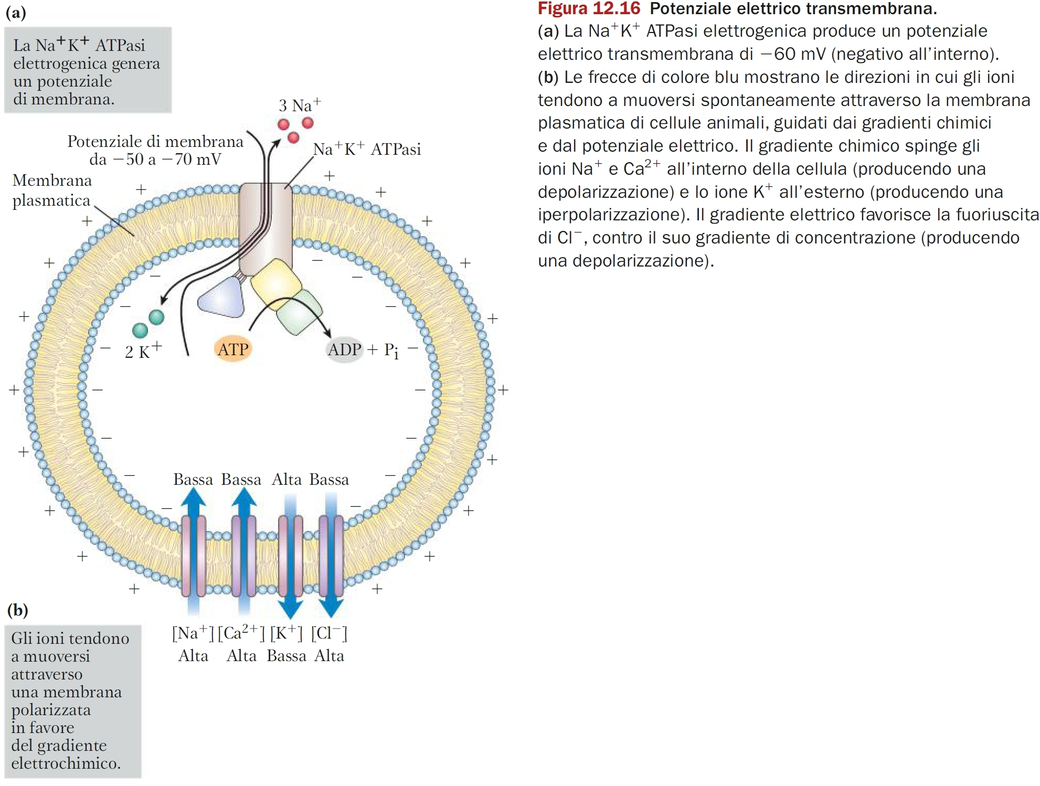

Slide 59
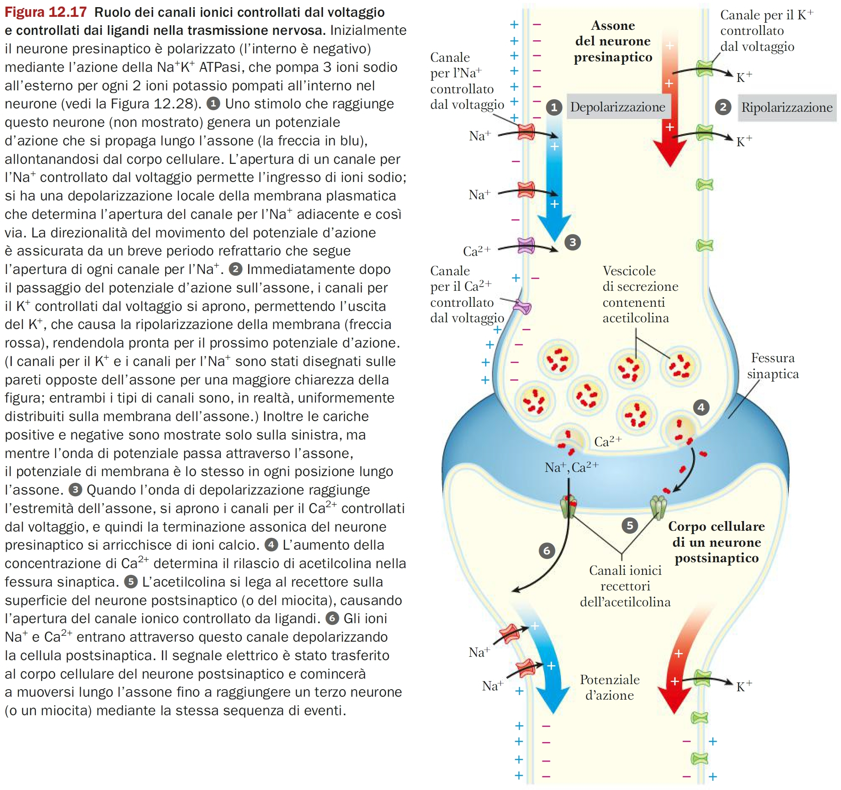

Slide 60
Fine

