Slide 1
Lezione 5
recettori nucleari
ormoni

Slide 2
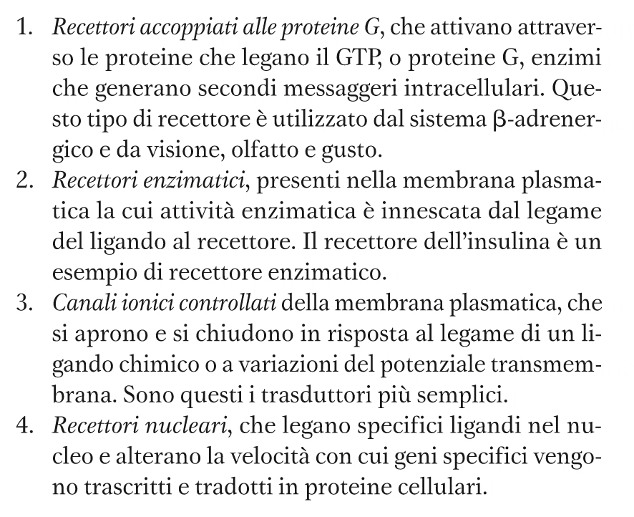
Lezione 3
Recettori

Slide 3
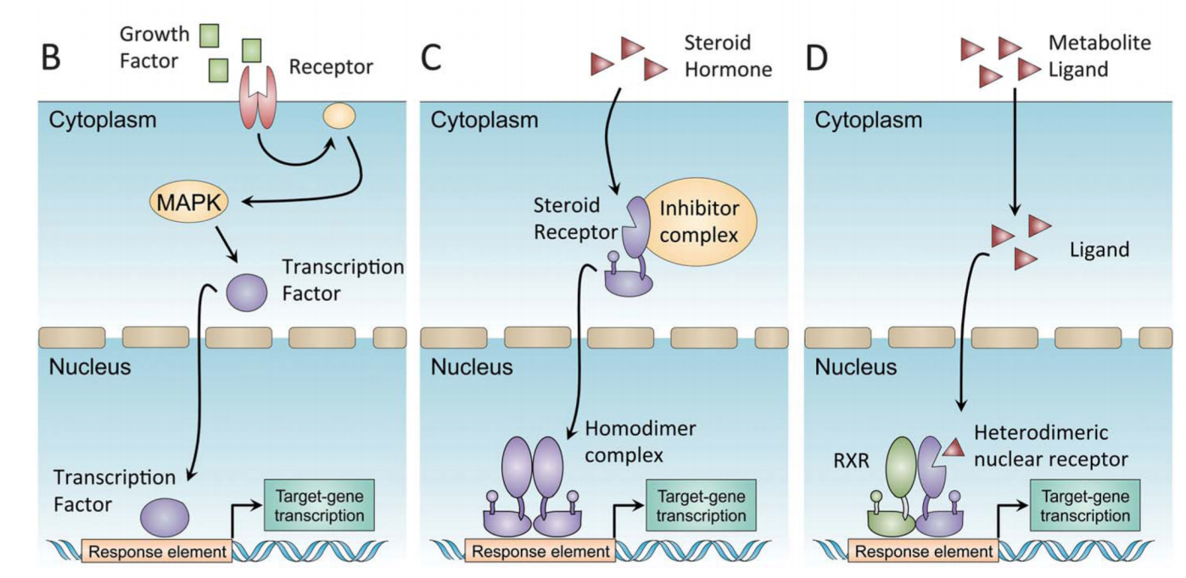
Il controllo dell’espressione genica Fattori di trascrizione e recettori nucleari di tipo I o II, a confronto
Notes:
source
https://www.ncbi.nlm.nih.gov/pmc/articles/PMC3781338/pdf/nihms474343.pdf
(B) In una cascata di trasmissione del segnale canonica, il legame del recettore sulla membrana plasmatica inizia una cascata enzimatica di fosforilazione di proteine, che culmina con la traslocazione del fattore di trascrizione nel nucleo.
(C) I recettori nucleari steroidei di tipo I sono sintetizzati in forme inattive e associate con complessi heat shock protein (HSP) nel citoplasma. Ill legame ormonale al recettore citosolico causa un suo cambiamento conformazionale, la dissociazione dai complessi HSP e la traslocazione nel nucleo. Un complesso omodimerico si associa al DNA.
(D) I recettori nucleari di tipo II si legano in modo costitutivo al DNA, formando un eterodimero con RXR (retinoid x receptor), come partner obbligato. Il legame con i ligandi provoca un cambiamento conformazionale, la dissociazione dei complessi corepressori e il reclutamento di co-attivatori trascrizionali, come PGC1α.

Slide 4
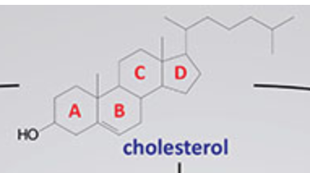
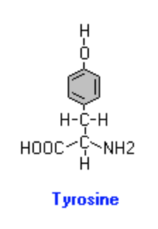
I ligandi dei recettori ormonali nucleari
Precursori degli ormoni elencati
Alcuni ormoni hanno il loro recettore specifico in sede nucleare
ormoni steroidei → derivano dal colesterolo
vitamina D → deriva dal colesterolo
ormoni tiroidei → derivano dalla tirosina
acido retinoico → deriva dal beta carotene

Slide 5
Il trasporto degli ormoni liposolubili nella cellula
I fatti
I recettori nucleari sono specifici per ormoni (o altre molecole) lipofilici
I paradigmi scientifici speculativi (o indimostrati)
La lipofilia di certi ormoni o molecole e la presenza di recettori all’interno della cellula, anziché sulla membrana, hanno fatto ritenere che queste molecole attraversassero la membrana plasmatica senza la partecipazione di proteine di trasporto (o altro apparato molecolare), quindi per diffusione passiva
I nuovi fatti che smentiscono i paradigmi speculativi
segue

Slide 6
La diffusione degli ormoni lipofili attraverso la membrana plasmatica
E’ mediata da trasportatori specifici

Slide 7
Il trasporto di membrana degli ormoni tiroidei
E’ mediato da almeno tre trasportatori:
MCT-8 (monocarboxylate transporter 8, SLC16A2)
trasporta T4, T3, rT3 e T2, lattato e piruvato
difetto geneico: grave ritardo psicomotorio ( sindrome di Allan–Herndon–Dudley)
OATP1C1 (organic anion transporting polypeptide 1C1, SLOCO1C1)
trasporto di farmaci e anioni organici aromatici
LAT2 (lactate transporter 1, SLC7A8)
Traporta tirosina, cisteina, fenilalanina e altri amminoacidi neutri

Slide 8
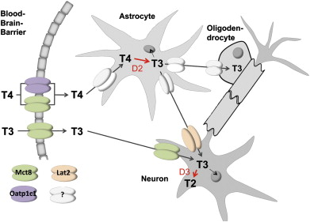
Il trasporto degli ormoni tiroidei nel cervello
Notes:
source
Heike Heuer, Theo J. Visser,
The pathophysiological consequences of thyroid hormone transporter deficiencies: Insights from mouse models,
Biochimica et Biophysica Acta (BBA) - General Subjects, Volume 1830, Issue 7, 2013, Pages 3974-3978, ISSN 0304-4165,
https://doi.org/10.1016/j.bbagen.2012.04.009. (http://www.sciencedirect.com/science/article/pii/S0304416512001080)
Fig. 1. Schematic illustration of thyroid hormone (TH) traffic in the mouse brain. T4 can pass the blood–brain barrier via the monocarboxylate transporter Mct8 and the organic anion transporting polypeptide Oatp1c1. Uptake of T3 into the CNS is dependent on Mct8. The transporters involved in glial TH passages are still largely unknown although subtypes of astrocytes have been reported to express Mct8 or Oatp1c1. Neurons can import T3 via Mct8 and the L-type amino acid transporter Lat2. Activation of T4 to T3 is mediated by type 2 deiodinase (D2) localized in astrocytes. In contrast, inactivation of TH takes place in neurons where type 3 deiodinase (D3) is expressed.

Slide 9
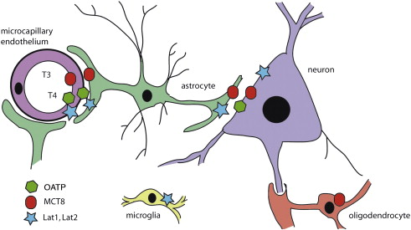
Il trasporto degli ormoni tiroidei nelle cellul
Notes:
source
https://www.sciencedirect.com/science/article/pii/S0304416512002206#f0005
Fig. 1. Expression of thyroid hormone transporters in brain cells. On their way from the microcapillary lumen to target cell nuclei, thyroid hormone molecules need to cross several membranes: The luminal and abluminal plasma membranes of endothelial cells, astrocytic plasma membranes, and the plasma membranes of neurons, oligodendrocytes, and microglia. Transporters may be differentially expressed in different brain regions and individual nuclei as recently demonstrated for the human hypothalamus. Moreover, species differences may exist that require systematic studies.

Slide 10
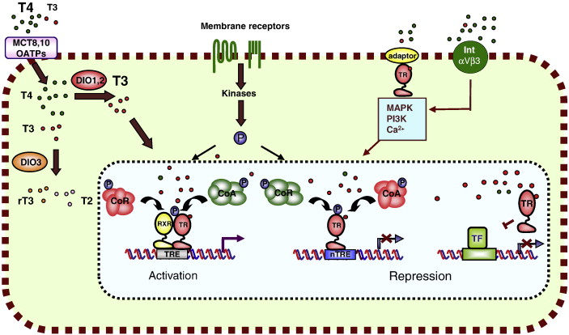
Notes:
source
https://www.sciencedirect.com/science/article/pii/S0304416512000852#f0005
Fig. 1. Mechanism of action of the thyroid hormone receptors. Thyroxine (T4) and triiodothyronine (T3) enter the cell through transporter proteins such as MCT8 and 10 or OATPs. Inside the cells, deiodinases (DIO1,2) convert T4, the major form of thyroid hormone in the blood, to the more active form T3. DIO3 produces rT3 and T2 from T4 and T3, respectively. T3 binds to nuclear thyroid hormone receptors (TRs) that activate transcription by binding, generally as heterodimers with the retinoid X receptor (RXR), to thyroid hormone response elements (TREs) located in regulatory regions of target genes. Activity is regulated by an exchange of corepressor (CoR) and coactivator (CoA) complexes. Negative TREs (nTRE) can mediate ligand-dependent transcriptional repression, although in this case the role of coactivators and corepressors is not well defined. TRs can also regulate the activity of genes that do not contain a TRE through “cross-talk” with other transcription factors (TF) that stimulate target gene expression. Both receptors and coregulators are targets for phosphorylation (P) by signal transduction pathways stimulated by hormones and growth factors. Binding of T3 to a subpopulation of receptors located outside the nuclei can also cause rapid “non-genomic” effects through interaction with adaptor proteins, leading to stimulation of signaling pathways. T4 can also bind to putative membrane receptors such as integrin αVβ3 inducing mitogen activated protein kinase (MAPK) activity.

Slide 11
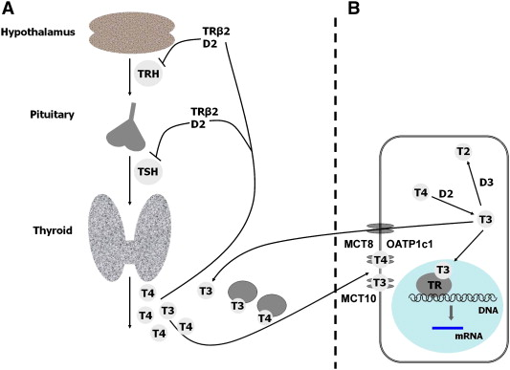
Notes:
https://www.sciencedirect.com/science/article/pii/S0304416512001389#f0005

Slide 12
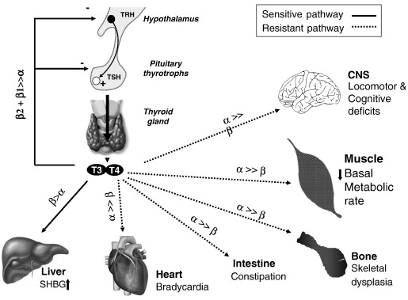
Notes:
https://www.sciencedirect.com/science/article/pii/S0304416513000962#f0010

Slide 13
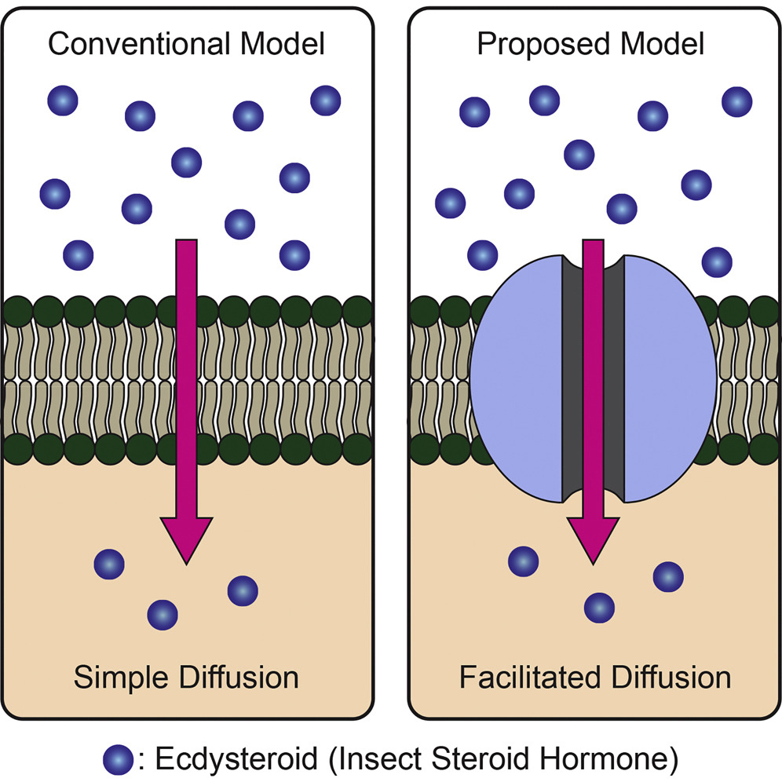
Trasporto dell’ecdysone in Drosophila
“Altogether, our results challenge the simple diffusion model for cellular uptake of ecdysone and may have wide implications for basic and medical aspects of steroid hormone studies.”
A Membrane Transporter Is Required for Steroid Hormone Uptake in Drosophila
Okamoto, Naoki et al.
Developmental Cell, Volume 47, Issue 3, 294 - 305.e7
DOI:https://doi.org/10.1016/j.devcel.2018.09.012

Slide 14
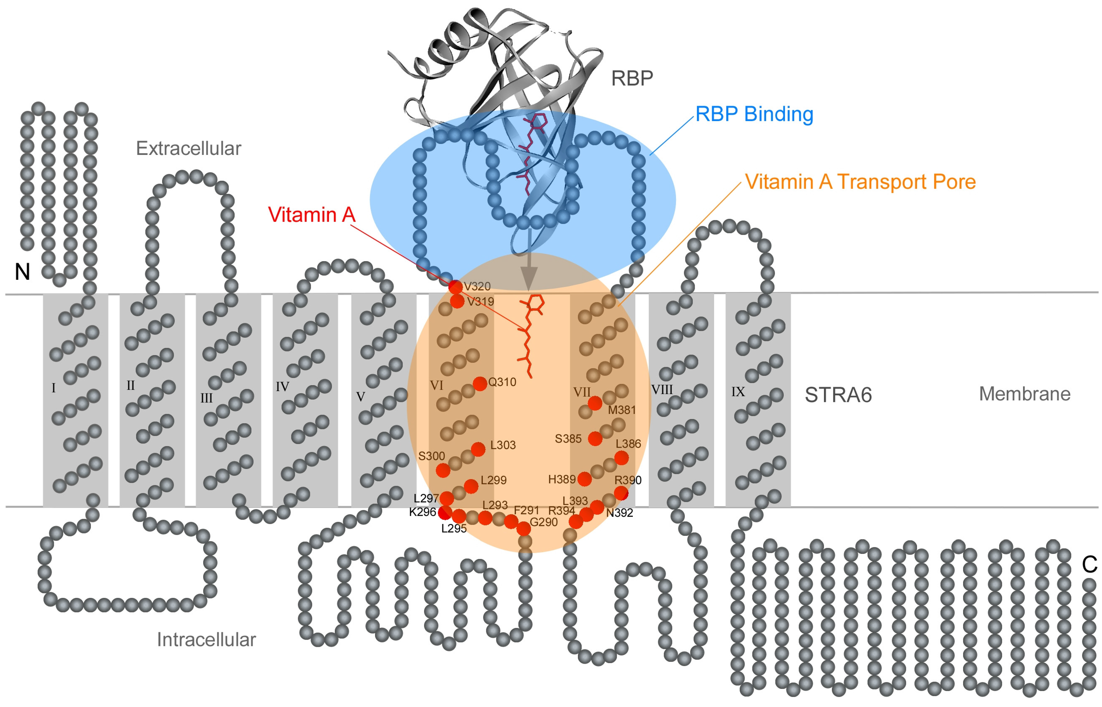
Il trasporto di membrana dell’acido retinoico
Notes:
https://doi.org/10.3390/membranes5030425
Figure 7
Schematic diagram of the locations of key positions in STRA6 whose acute modifications block vitamin A transport by STRA6. The transmembrane topology model of STRA6 is depicted together with the crystal structure of holo-RBP. STRA6’s key RBP binding domain is shaded in blue. The transmembrane domains and adjacent regions that are known to be part of the vitamin A transport pore are shaded in orange. Residues whose acute modification impedes vitamin A transport by STRA6 are represented as red circles. This figure is based on Figure 9 of reference 67.

Slide 15
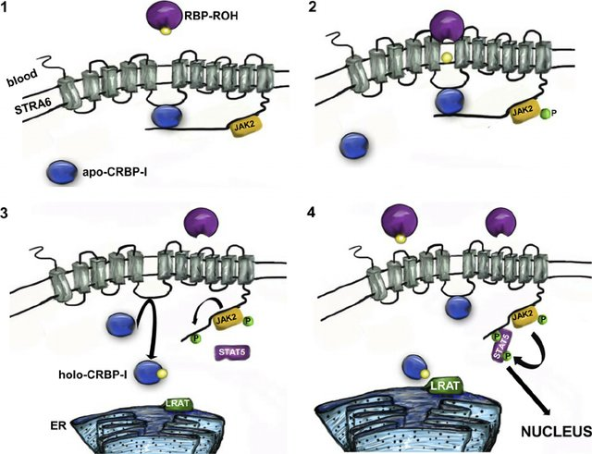
Notes:
source
Cross Talk between Signaling and Vitamin A Transport by the Retinol-Binding Protein Receptor STRA6
June 2012Molecular and Cellular Biology 32(15):3164-75
DOI: 10.1128/MCB.00505-12
FIG 7 Model describing retinol uptake and signaling by STRA6. (1) In its quiescent state, STRA6 is “primed” with basal levels of bound apo-CRBP-I and JAK2. (2) Upon binding of RBP-ROH to the extracellular moiety of STRA6, ROH moves through the receptor to apo-CRBP-I associated with the intracellular STRA6 loop CBL. Retinol transfer triggers phosphorylation/activation of JAK2. (3) Activated JAK2 catalyzes the phosphorylation of the STRA6 Y643 residue, leading to release of the C-terminus tail and increasing access of the CBL to the cytosol. Holo-CRBP-I dissociates from STRA6 and is replaced with high affinity by cytosolic apo-CRBP-I. (4) STAT5 is recruited to the phosphotyrosine of STRA6, is activated by JAK2, and subsequently moves to the nucleus, where it induces the expression of target genes. Holo-CRBP-I delivers retinol to LRAT, thereby regenerating apo-CRBP-I.

Slide 16
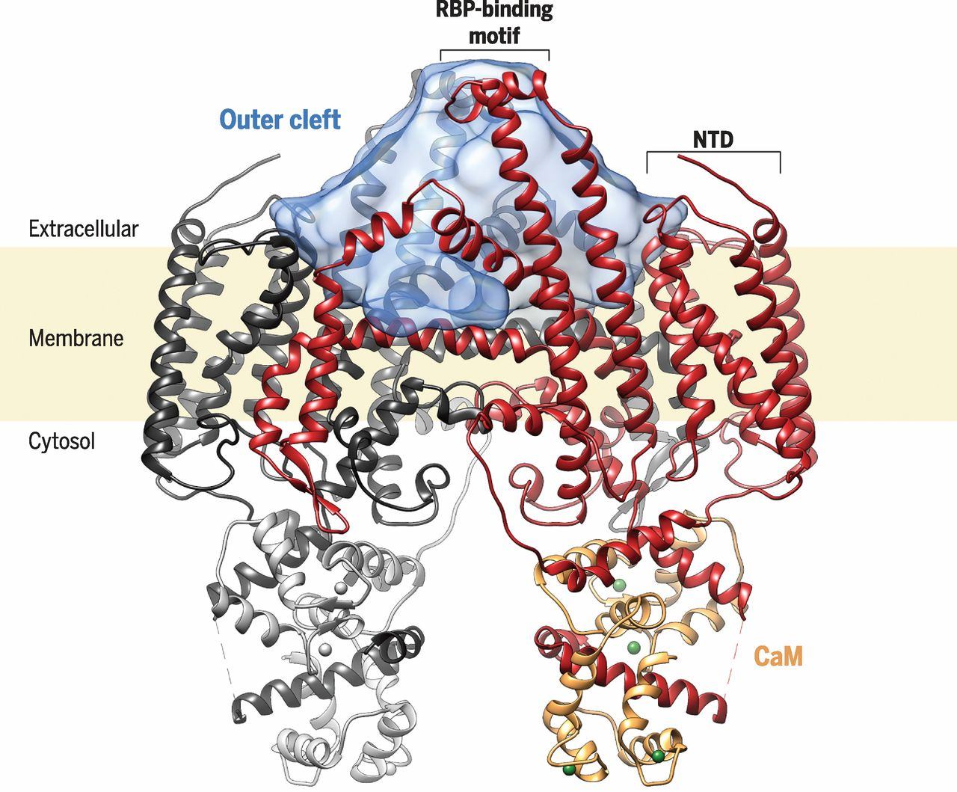
The structure of STRA6 in complex with CaM.
Yunting Chen et al. Science 2016;353:aad8266
Copyright © 2016, American Association for the Advancement of Science
Notes:
The structure of STRA6 in complex with CaM. The STRA6 dimer, drawn as a ribbon representation with one protomer in dark red and the other in black, is associated with two molecules of calmodulin, drawn in gray and gold. The internal volume of the outer cleft is represented as a semitransparent blue surface. Calcium ions are represented as green spheres.

Slide 17
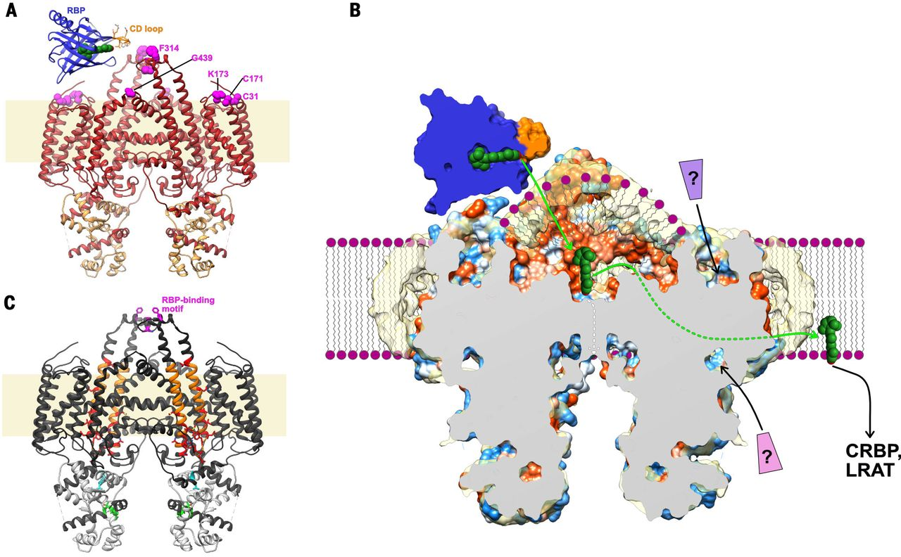
Fig. 5 Possible mechanism for STRA6-mediated retinol uptake.
Yunting Chen et al. Science 2016;353:aad8266
Copyright © 2016, American Association for the Advancement of Science
Notes:
Possible mechanism for STRA6-mediated retinol uptake. (A) Ribbon representation of the STRA6-CaM complex, viewed from the plane of the membrane, with STRA6 colored in red and CaM in gold. Residues previously shown to be important for RBP binding are shown as magenta spheres. Green spheres, retinol. (B) Schematic of STRA6-mediated retinol release from RBP into the outer cleft and translocation to the lipid bilayer (shown as purple spheres and wavy lines) through the lateral window. Question marks indicate putative ligands binding to the NTD; green and white arrows show two potential retinol exit pathways, via the lateral window and the central dimer interface, respectively; and coloring of the STRA6 surface is as in Fig. 3C (by hydrophobicity). (C) Previous work mapped onto the STRA6 structure, shown as follows: the RBP-binding motif in the lid peptide in magenta (38); the region probed by acute chemical modification of single cysteine point mutants (48) in orange, and residues in this region, modification of which severely affects retinol uptake from RBP, in red; the putative CRBP1 interacting motif (45), located in CaMBP0, in cyan; and the putative STAT5 binding motif (22), located in CaMBP2, in green.

Slide 18
I recettori nucleari degli ormoni
Polipeptidi di 450-933 amminoacidi
Struttura modulare comune, con domini proteici specific per:
legame con il ligando
legame al DNA
legami con complessi multimerici di controllo della trascrizione del DNA
co-attivatori
co-repressori
Molti recettori nucleari hanno diverse isoforme (uso alternativo del promotore, varianti di splicing) → risposta ormonale differenziata
Notes:
source
https://bio.libretexts.org/Bookshelves/Introductory_and_General_Biology/Book%3A_General_Biology_(Boundless)/9%3A_Cell_Communication/9.1%3A_Signaling_Molecules_and_Cellular_Receptors/9.1C%3A_Types_of_Receptors
Internal receptors, also known as intracellular or cytoplasmic receptors, are found in the cytoplasm of the cell and respond to hydrophobic ligand molecules that are able to travel across the plasma membrane. Once inside the cell, many of these molecules bind to proteins that act as regulators of mRNA synthesis to mediate gene expression. Gene expression is the cellular process of transforming the information in a cell’s DNA into a sequence of amino acids that ultimately forms a protein. When the ligand binds to the internal receptor, a conformational change exposes a DNA-binding site on the protein. The ligand-receptor complex moves into the nucleus, binds to specific regulatory regions of the chromosomal DNA, and promotes the initiation of transcription. Internal receptors can directly influence gene expression without having to pass the signal on to other receptors or messengers.

Slide 19
La struttura primaria modulare dei recettori nucleari
I DOMINI PROTEICI DEI RECETTORI NUCLEARI
N-terminale (NTD), con funzione AF-1 (activator factor 1)
di legame del DNA (DBD)
regione della cerniera (H)
di legame con il ligando (LBD), , con funzione AF-2 (activator f. 1)
regione C-terminale (F)
Notes:
source
https://www.ncbi.nlm.nih.gov/pmc/articles/PMC3871882/pdf/nihms530856.pdf
J Mol Endocrinol. Author manuscript; available in PMC 2014 Dec 1.
Published in final edited form as:
J Mol Endocrinol. 2013 Dec; 51(3): T1–T21.
Published online 2013 Nov 7. doi: 10.1530/JME-13-0173

Slide 20
I recettori nucleari (tipo I o II) sono attivati dal ligando
I recettori nucleari “vuoti” (non legati al ligando) formano dei complessi inattivi (incapaci di attivare la trascrizione→la RNA polimerasi II).
Il legame dei ligandi specifico determina:
una variazione conformazionale,
la formazione di un omodimero, che trasloca nel nucleo e si associa al DNA (tipo I), oppure
la formazione di un eterodimero a livello del DNA (tipo II)
sempre, la dissociazione del complesso co-repressore e associazione del complesso co-attivatore della trascrizione
Notes:
source
source
https://bio.libretexts.org/Bookshelves/Introductory_and_General_Biology/Book%3A_General_Biology_(Boundless)/9%3A_Cell_Communication/9.1%3A_Signaling_Molecules_and_Cellular_Receptors/9.1C%3A_Types_of_Receptors
Internal receptors, also known as intracellular or cytoplasmic receptors, are found in the cytoplasm of the cell and respond to hydrophobic ligand molecules that are able to travel across the plasma membrane. Once inside the cell, many of these molecules bind to proteins that act as regulators of mRNA synthesis to mediate gene expression. Gene expression is the cellular process of transforming the information in a cell’s DNA into a sequence of amino acids that ultimately forms a protein. When the ligand binds to the internal receptor, a conformational change exposes a DNA-binding site on the protein. The ligand-receptor complex moves into the nucleus, binds to specific regulatory regions of the chromosomal DNA, and promotes the initiation of transcription. Internal receptors can directly influence gene expression without having to pass the signal on to other receptors or messengers.

Slide 21
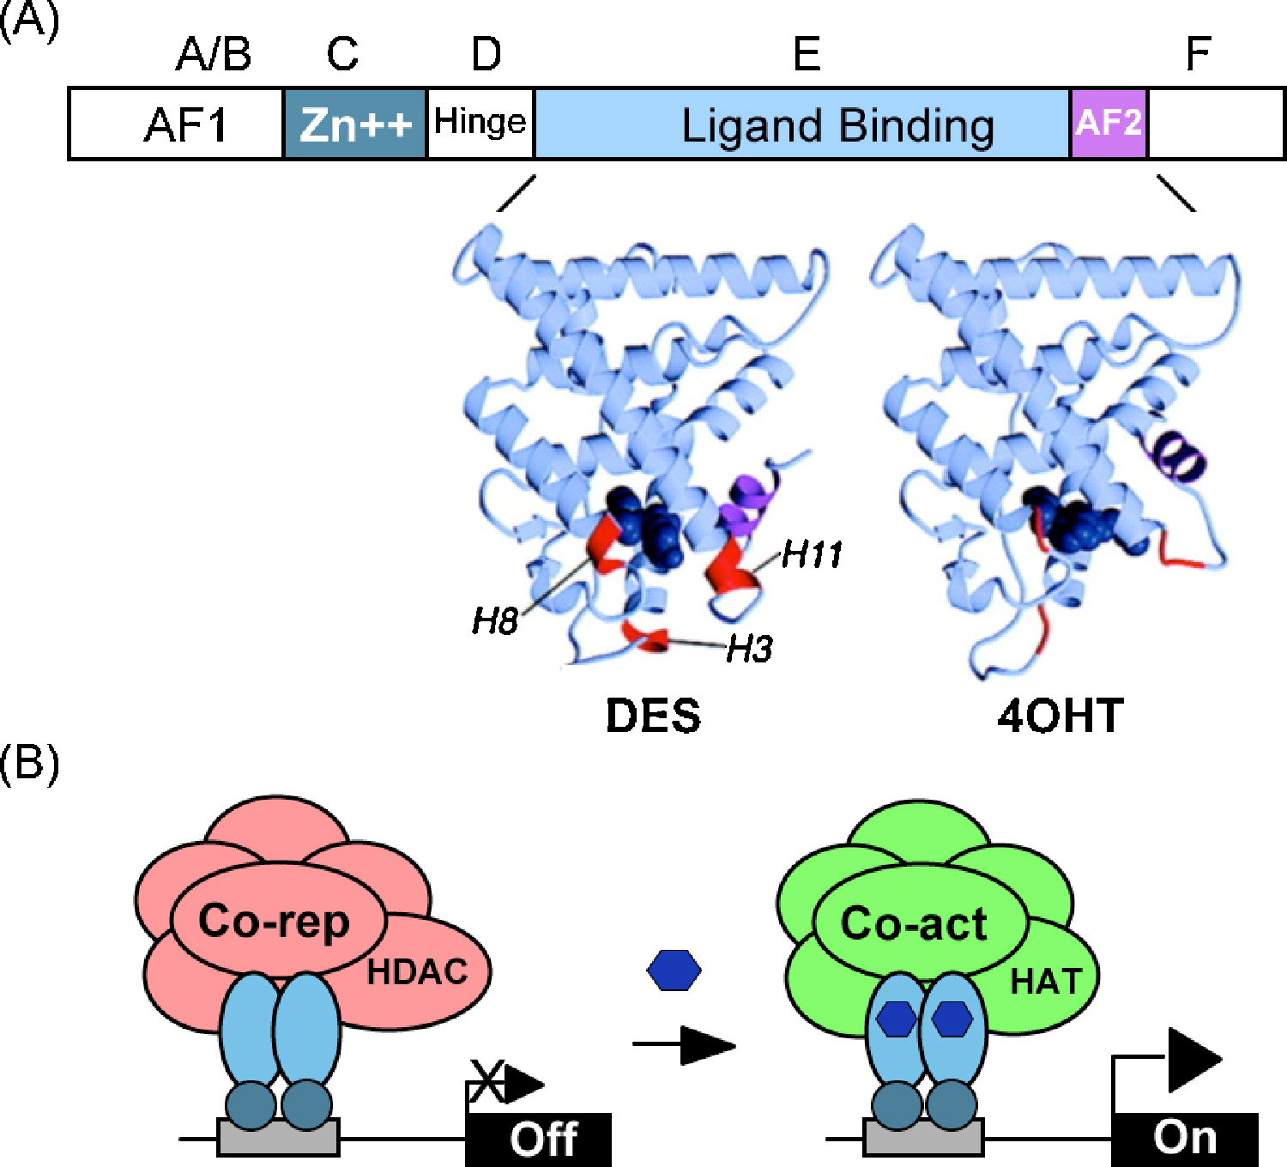
Struttura e funzione dei recettori nucleari
estrogeni sintetici
farmaci
Notes:
source
https://www.sciencedirect.com/science/article/pii/S030372071000359X#fig0005
Fig. 1. Struttura e modalità di azione dei recettori nucleari (NR).
Struttura a domini (A – F) dei recettori nucleari. Il dominio di legame al DNA (DBD) è costituito da due motivi di legame allo zinco (Zn2 +) e spesso include la regione della cerniera (H). Viene mostrata la struttura cristallografica del dominio di legame del recettore degli estrogeni (LBD) legato al dietilstilbestrolo (DES), un estrogeno non steroideo sintetico che funziona come un agonista puro e l'antagonista 4-idrossi tamoxifene (4OHT) (blu scuro). AF1, AF2, funzione di attivazione 1 e 2 (elica AF2, AF-2); entrambi contattano molecole di co-regolamentazione (co-repressori oppure co-attivatori), ma AF-1 è tipicamente indipendente dal ligando mentre AF-2 è ligando-dipendente (magenta colorato come elica 12). I NR hanno regioni AF1 e cerniera variabili e domini F e hanno dimensioni comprese tra 50450 e 33933 aminoacidi, sebbene la maggior parte sia ∼50 kDa. Molti geni NR hanno più isoforme generate dall'uso di promotori alternativi e varianti di giunzione.
Diagramma semplificato dell'azione NR classica. In assenza di ligando, i NR reclutano, a livello dei promotori dei geni, complessi di co-repressori multi-subunità, che contengono attività dell'istone deacetilasi (HDAC). La trascrizione dei geni bersaglio viene attivata quando il ligando (esagono) si lega alla NR e induce una variazione di conformazione nell'LBD che recluta complessi di co-attivatori che contengono attività dell'istone acetilasi transferasi (HAT). Non sono mostrati altri complessi di coregolamentazione necessari per la trascrizione come il rimodellamento della cromatina e i complessi mediatori e il meccanismo generale di trascrizione. Per questi dettagli si veda: M.G. Rosenfeld, V.V. Lunyak, C.K. Glass. Sensors and signals: a coactivator/corepressor/epigenetic code for integrating signal-dependent programs of transcriptional response. Genes Dev., 20 (2006), pp. 1405-1428 (http://genesdev.cshlp.org/content/20/11/1405.full.pdf).

Slide 22
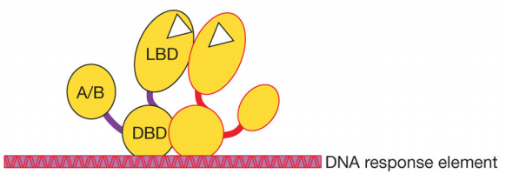
Schema della struttura quaternaria dei recettori nucleari
Il recettore nucleare è un dimero
Il dominio DBD è legato al DNA a livello di una DNA response element (sequenza polinucleotidica specifica)
Notes:
source
https://www.ncbi.nlm.nih.gov/pmc/articles/PMC3871882/pdf/nihms530856.pdf

Slide 23
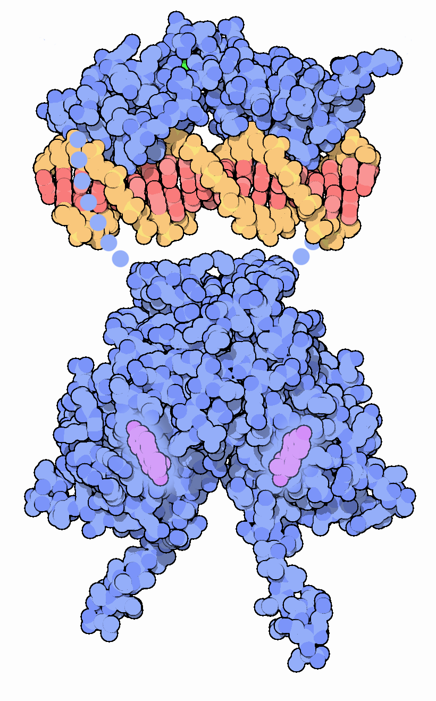
Il modello del recettore estrogenico associato al DNA tipo I, omodimerico
Notes:
source
https://pdb101.rcsb.org/motm/45

Slide 24
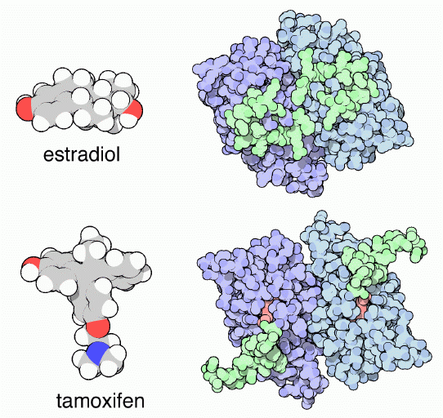
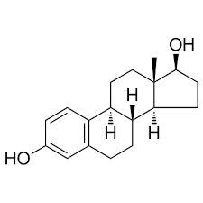
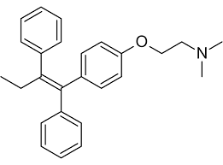
Il tamoxifene inibisce l’attivazione del recettore per gli estrogeni
Notes:
source
https://pdb101.rcsb.org/motm/45
Estrogen and Cancer
Estrogen gives cells permission to grow when appropriate. This is essential during puberty, but also necessary in adult life. For instance, estrogen is important in bone growth, and low levels of estrogens can lead to osteoporosis. But in the case of cancer, estrogen can enhance unnatural growth and make the disease worse. The drug tamoxifen is used to treat cancer by blocking the action of estrogen. Tamoxifen is a small drug that mimics the shape of estrogen and binds tightly to the estrogen receptor. When it binds, it changes the shape of a signaling loop on the surface the receptor, colored green here. The upper structure shown here, from PDB entry 1qku , has estradiol bound (estradiol is not seen in the picture, because it is bound under the loop). The compact conformation of this loop forms part of the activation signal that will stimulate normal growth. The lower structure, from PDB entry 3ert , has the drug bound. Since the drug is larger than the hormone, it forces the activation loop out into an inactive conformation, blocking the signal to grow.

Slide 25
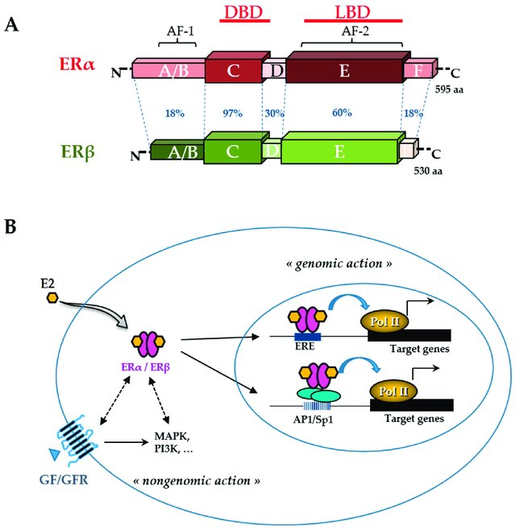
Struttura e funzione del recettore per gli estrogeni
Notes:
source
DOI: 10.3390/nu11010079
Figure 3: Estrogen receptor (ER) structure and action. The schematic structures of the two human ERα and ERβ and the percentage of homology between the different domains (annotated by the letters A to F) are indicated (A). Domains involved in DNA binding (DBD), ligand binding (LBD), ligandindependent transactivation function 1 (AF-1), and ligand-dependent transactivation function 2 (AF2) are shown. The number of amino acids for each receptor is also indicated on the right side. Estradiol (E2) mediates numerous phenotypic effects in cells by binding to and activating ERs (B). E2 enters the cell through the lipid membranes and binds ER, which can be present in the cytoplasm and the nucleus. The activated ER forms a dimer to tightly fix chromatin directly at the estrogen-responsive element (ERE) sites or indirectly at activator protein 1 (AP1) or specificity protein 1 (Sp1) sites. ER is then able to remodel chromatin by recruiting cofactors and activating RNA polymerase II (Pol II), at target genes (genomic action). Besides, ERs can use rapid non-genomic action through the interaction with intracellular kinases (mitogen-activated protein kinase (MAPK), phosphatidylinositol 3-kinase (PI3K),…) and the growth factor (GF) receptor (GFR) pathways.

Slide 26
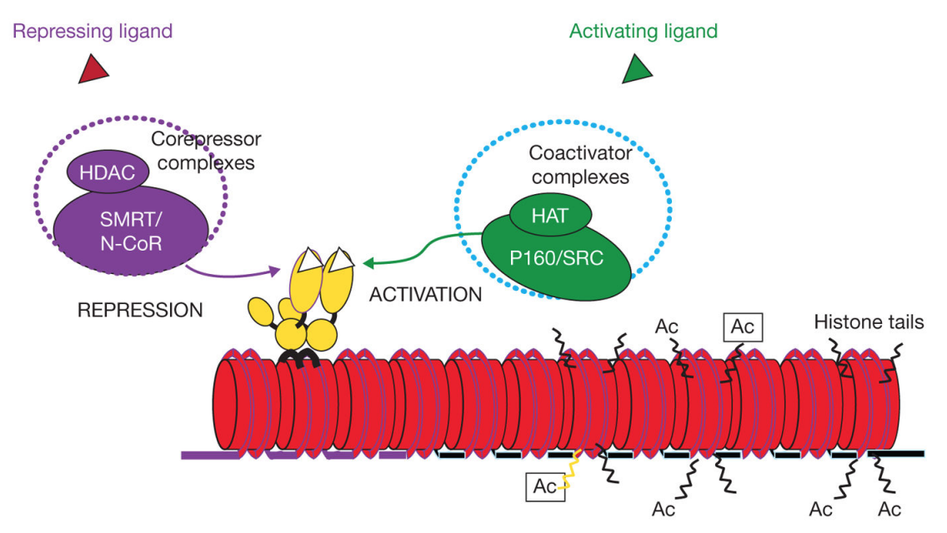
I recettori nucleari sono repressi o attivati da complessi proteici/enzimatici
HAT
istone acetil transferasi
HDAC
istone de-acetilasi
Notes:
source
https://www.ncbi.nlm.nih.gov/pmc/articles/PMC3871882/pdf/nihms530856.pdf

Slide 27
Attività enzimatiche dei complessi di regolazione co-repressione e co-attivazione
Modificazione post-traduzionale delle proteine
modificazioni conformazionali del nucleosoma, ATP-dipendenti
enzimi in grado di modificare le code degli istoni e altre proteine (DNA-binding factors)
attività acetilanti/deacetilanti
proteina chinasi/ fosfatasi
poli (ADP) ribosilasi,
ubiquitina- e SUMO ligasi.
DNA-binding factors
…
EFFETTO FINALE
Rimodellazione dei nucleosomi, con esposizione del promotore e del gene per il legame con la RNA polimerasi II

Slide 28
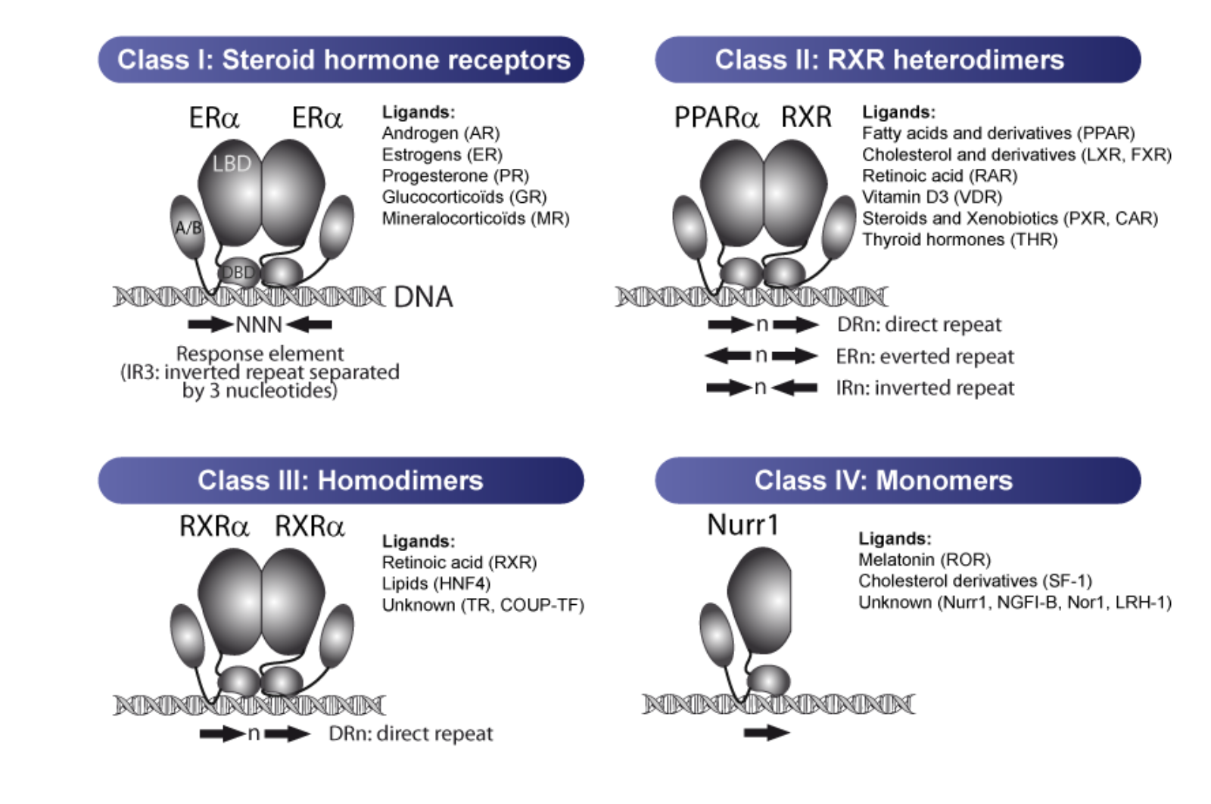
Le due classi di recettori (tipo I e tipo II) sono stati suddivisi in 4 CLASSI, per comprendere i recettori monomerici e separare i recettori steroidei
Notes:
source
http://genoweb.toulouse.inra.fr/~pmartin/pgpmartin/project/nuclearreceptors/
Steroid hormone receptors (androgen receptor AR, estrogen receptors ER, glucocorticoid receptor GR, mineralocorticoid receptor MR and progesterone receptor PR) comprise the class I nuclear receptors. These receptors function as homodimers, are activated by low doses of steroid hormones, bind IR3-like response elements (inverted repeats separated by 3 nucleotides) and regulate numerous physiological processes, including reproduction, metabolism or immunity.
Class II is composed of the nuclear receptors that function as heterodimers with the RXR (Retinoïd X Receptors). They include the PPARs, LXRs, FXR, RAR, PXR, CAR, VDR and TR. They generally bind to DR-like response elements (direct repeats of the consensus motif AGGTCA separated by a variable number of nucleotides) but other types of response elements have also been described.
Class III members are the non-steroid hormone nuclear receptors that also function as homodimers such as RXRs, HNF4 or COUP-TF and typically bind DR-like motifs.
Nuclear receptors of Class IV function as monomers and bind a single consensus motif. This class includes NGFI_B, Nur1, SF-1, LRH-1 and RORs.

Slide 29
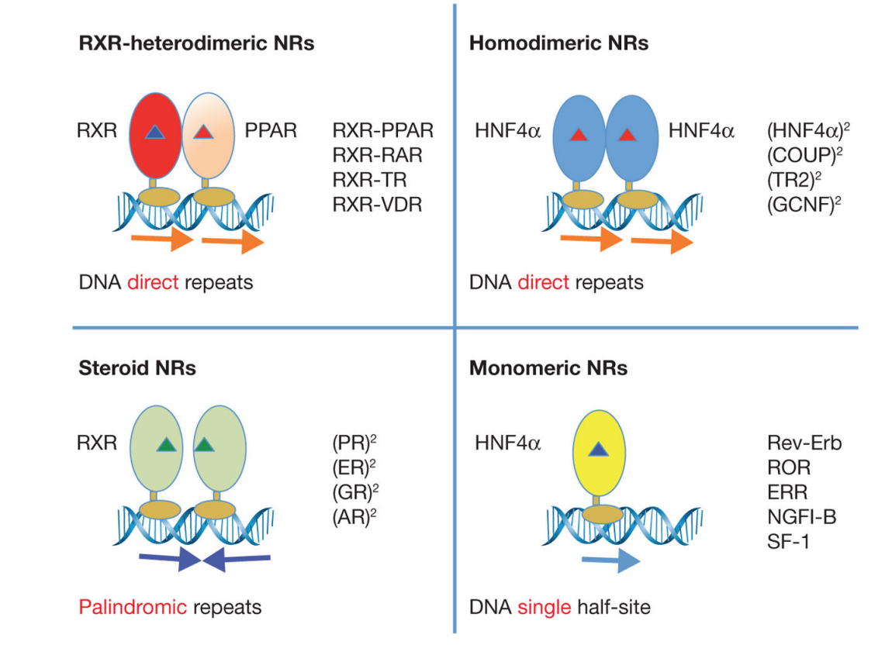
Le 4 classi di recettori nucleari
Notes:
source
https://www.ncbi.nlm.nih.gov/pmc/articles/PMC3871882/pdf/nihms530856.pdf
Oligomeric Complexes of NRs and DNA Response Element Repertoires. Receptors can be
organized into distinct oligomeric states such as heterodimers with the common partner
RXR, homodimers, or monomers. The non-steroid receptor heterodimers and many
homodimers bind to direct repeat response elements with various inter-half-site spacings.
Steroid receptor homodimers mainly use palindromic DNA elements, where the two half
sites are in an inverted repeat fashion. Other receptors use monomeric sites extended at their
5′ end with short sequences used for selectivity. Several examples of receptors falling into
each of these four categories are shown.

Slide 30
L’interazione dei recettori nucleari con il DNA
I requisiti strutturali sono
Struttura primaria (sequenza) conservata del DNA
Hormone Response Element
Struttura primaria conservata nel recettore nucleare
DBD, DNA binding domain
struttura secondaria conservata, con due domini zinc finger

Slide 31
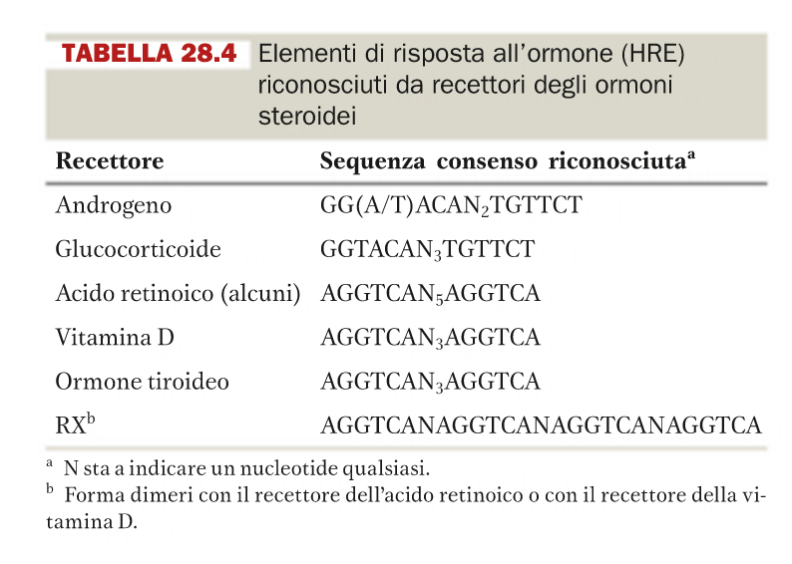
Le sequenze di DNA conservate

Slide 32
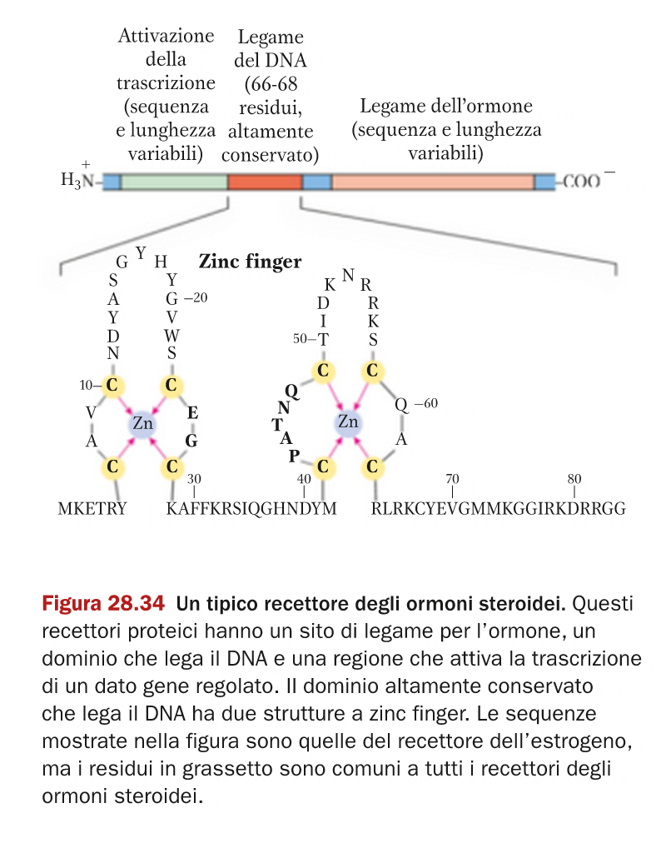
Il ruolo dei domini zinc finger

Slide 33
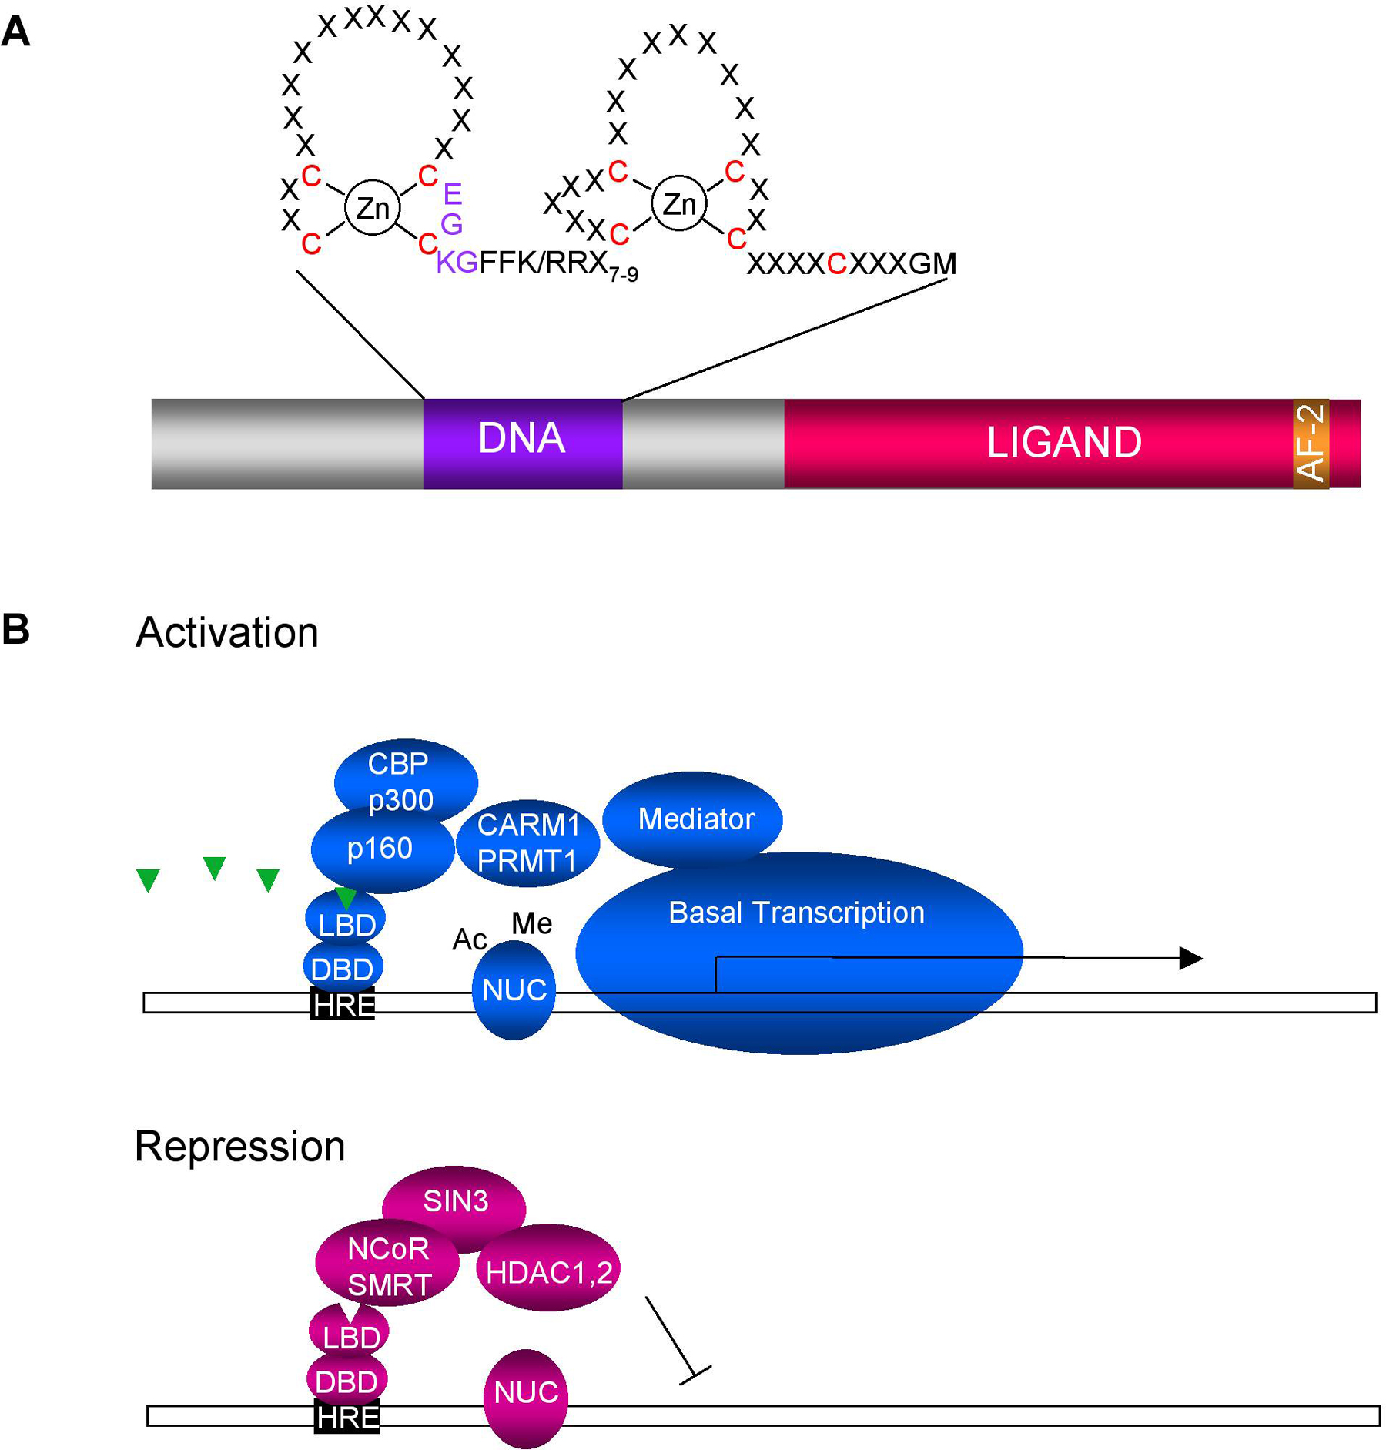
Il dominio di legame al DNA forma due anse tipo zinc finger
Notes:
source:
http://www.wormbook.org/chapters/www_nuclearhormonerecep/nuclearhormonerecep.html
Figure 1. (A) Schematic diagram of an exemplary nuclear hormone receptor. DNA binding domain (DNA) comprised of two Cys4 Zn fingers. Nine conserved cysteines are highlighted in red. A typical P-box, (CEGCKG) which confers DNA binding specificity, is shown. The ligand binding domain (ligand) contains multiple surfaces that recruit coactivators or corepressors. The AF-2 transactivation helix closes the ligand binding pocket during hormonal activation. (B) General model for transcriptional activation and repression based on vertebrate receptors. In the presence of hormone (triangle), NRs bind to their hormone response elements (HRE), and assemble coactivator complexes that acetylate (ac, p160, p300) or methylate (me, CARM1, PRMT1) nucleosomes (NUC). Mediator components contact NRs and facilitate the recruitment of the basal transcription machinery, turning on gene expression. Some nuclear receptors repress in the absence of hormone, by assembling corepressor complexes, such as SMRT and NCoR, which recruit histone deacetylases (HDACs) that inhibit transcription. The composition of activation and repression complexes depends on the NR as well as the promoter context. In addition, many NRs work as homo- or heterodimers.

Slide 34
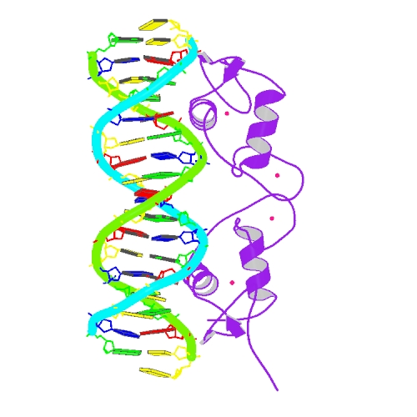
Gli atomi Zn sono indicati come punti rossi
Notes:
source
https://www.rcsb.org/structure/1hcq

Slide 35
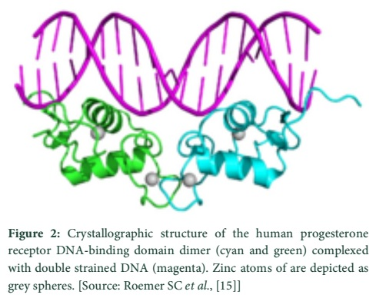
I due domini zinc finger rendono il dominio di legame al DNA adatto ad interagire con la scanalutura maggiore (major groove) del DNA
Notes:
source
http://www.als-journal.com/343-16/

Slide 36
Esempi di recettori nucleari eterodimerici di tipo II e specifiche interazioni con il DNA
Notes:
source
https://www.ncbi.nlm.nih.gov/pmc/articles/PMC4029515/pdf/nihms-578607.pdf

Slide 37
Fine dei recettori nucleari
segue
Gli ormoni, o primi messaggeri

Slide 38
Gli ormoni
Sono molecole (1) prodotte da cellule specializzate, con azione su (2) cellule bersaglio, dotate di recettori ormonali specifici.
A seconda della distanza tra la cellula specializzata e la cellula bersaglio, essi sono detti:
endocrini: trasportati a distanza per via ematica
paracrini: diffondono nello spazio interstiziale e agiscono su cellule vicine
autocrini: il recettore è presente sulla stessa cellula

Slide 39
Esempi di regolazione endocrina, paracrina e autocrina
La ghiandola gastrica
regolazione della secrezione acida
Le isole di Langherhans (pancrea endocrino)
regolazione del rilascio di insulina

Slide 40
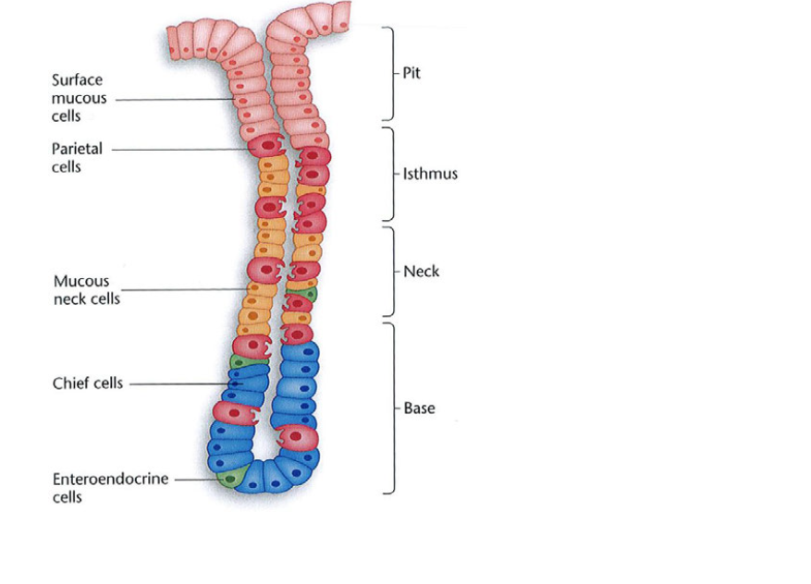
I 4 tipi cellulari della ghiandola gastrica
secernono muco
secernono HCl
secernono
pepsinogeno
Cell G: gastrina
Cell ECL: istamina
Cell D: somatostatina
secernono
ormoni
Notes:
source

Slide 41
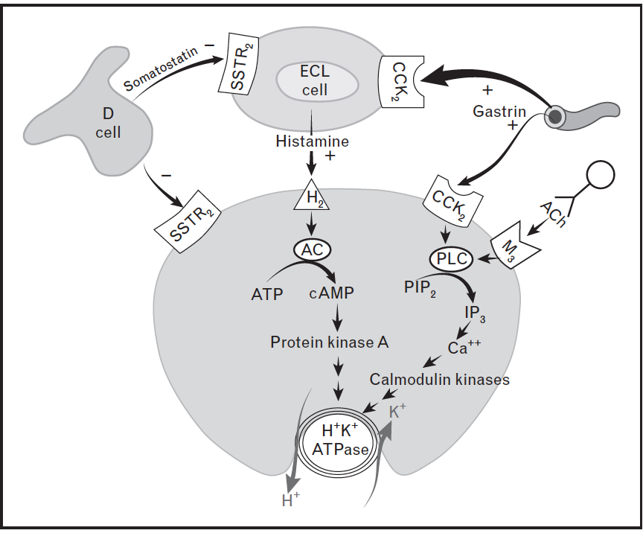
Ormoni endocrini e paracrini Azioni paracrine del neurotrasmettitore
Somatostatina: ormone paracrino, perché agisce
sulle cell bersaglio
vicine
Istamina: idem
Gastrina: ormone endocrino, perché trasportato dal sangue, anche se rilasciato da cellule G, che sono vicine
Acetilcolina: è un neurotrasmettitore, che agisce da ormone paracrino
Notes:
source
Functional anatomy and physiology of gastric secretion
Mitchell L. Schubert
Curr Opin Gastroenterol 2015, 31:479–485
DOI:10.1097/MOG.0000000000000213
FIGURE 1. Model illustrating parietal cell receptors and transduction pathways. The principal stimulants of acid secretion at
the level of the parietal cell are histamine, gastrin, and acetylcholine (ACh). Histamine, released from enterochromaffin-like
(ECL) cells, binds to H2 receptors that activate adenylate cyclase and generate cAMP. Gastrin, released from G cells, binds to
CCK-2 receptors that activate phospholipase C (PLC) to induce the release of cytosolic calcium (Caþþ). Gastrin stimulates the
parietal cell directly and, more importantly, indirectly by releasing histamine from ECL cells. ACh, released from intramural
enteric neurons, binds to the muscarinic type 3 (M3) receptors that are coupled to an increase in intracellular calcium. The
intracellular cAMP and calcium-dependent signaling systems active downstream protein kinases, ultimately leading to
translocation, fusion, and activation of H+/K+-ATPase, the proton pump. Somatostatin, released from oxyntic D cells, is the
principal inhibitor of acid secretion. Somatostatin, acting via the SSTR2 receptor, inhibits the parietal cell directly as well as
indirectly by inhibiting histamine secretion from ECL cells. þ, stimulatory; , inhibitory; AC, adenylate cyclase; IP3, inositol
trisphosphate; PIP2, phosphatidyl 4,5-bisphosphate.

Slide 42
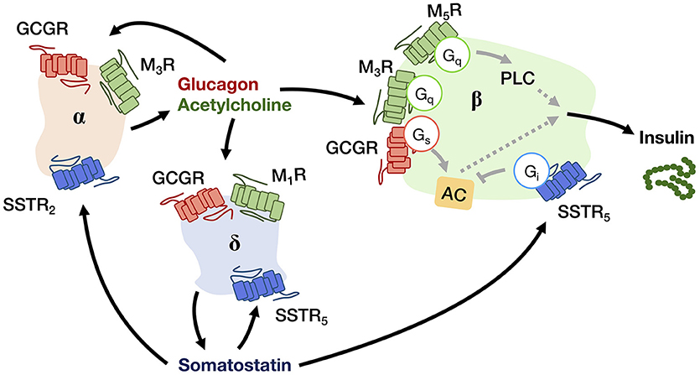
Interazioni autocrine e paracrine nelle isole di Langerhans (pancreas endocrino), per regolare il rilascio di insulina
Notes:
Source
https://www.frontiersin.org/articles/10.3389/fendo.2019.00428/full
Figure 2. A schematic diagram showing the autocrine and paracrine interactions between pancreatic α-, β-, and δ-cells that regulate the insulin output. Glucagon and acetylcholine from α-cell (beige), and somatostatin from δ-cell (blue) are stimulatory and inhibitory signals for hormone secretion, respectively, that can act in both autocrine and paracrine manners via their receptors (GCGR for glucagon; M1R, M3R, and M5R for acetylcholine; SSTR2 and SSTR5 for somatostatin). The insulin output from β-cell (green) is adjusted by an integration of paracrine signals from both α- and δ-cells within the niche.

Slide 43
Gli ormoni servono a coordinare funzioni complesse e che coinvolgono diversi organi
metabolismo di diversi organi
fegato, muscolo, cuore, cervello, tessuto adiposo
il ciclo appetito-sazietà
tessuto adiposo, cervello
la pressione arteriosa
cuore, vasi, rene
lo sviluppo sessuale e la riproduzione
organi sessuali; placenta, mammelle
diverse altre … vedi fisiologia

Slide 44
Gli ormoni – classi chimiche e ghiandole
derivati da amminoacidi
tiroidei (TIROIDE)
adrenalina (MIDOLLARE DEL SURRENE)
derivati dal colesterolo
glucocorticoidi (CORTICALE DEL SURRENE)
mineralcorticoidi (CORTICALE DEL SURRENE)
sessuali (estrogeni, progesterone, testosterone) (OVAIE, TESTICOLI, PLACENTA)
polipeptidici (classificati in base alla ghiandola endocrina che li sintetizza)
pancreatici (ISOLE DI LANGERHAS DEL PANCREAS)
insulina
glucagone
retro-ipofisari (IPOFISI POSTERIORE)
ossitocina
vasopressina
ante-ipofisari (IPOFISI ANTERIORE)
corticotropina
tirotropina
gonadotropine (ormone luteinizzante, ormone follicolo-stimolante)
somatotropina
ipotalamici (IPOTALAMO)
fattori di rilascio degli ormoni ante-ipofisari
prolattina

Slide 45
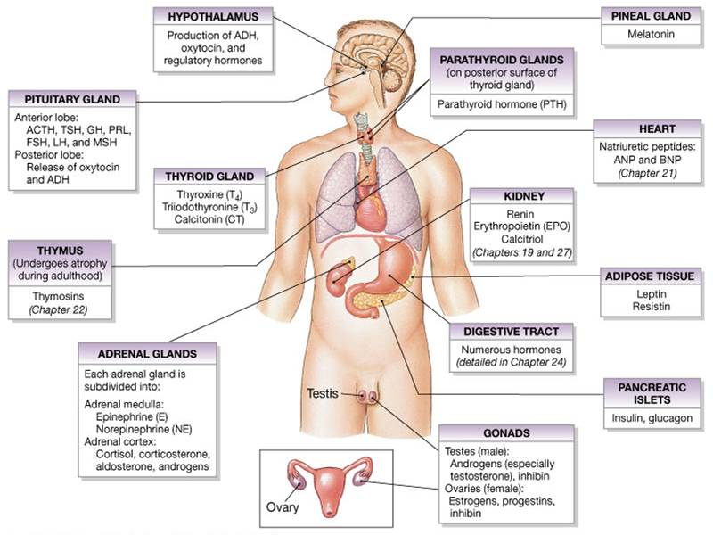
Notes:
source
https://www.austincc.edu/apreview/PhysText/Endocrine.html

Slide 46
Il rilascio degli ormoni è controlalto
Le ghiandole sono controllate direttamente da:
stimolazione del sistema nervoso (neuroni)
da segnali chimici nel sangue
dagli ormoni prodotti da altre ghiandole.

Slide 47
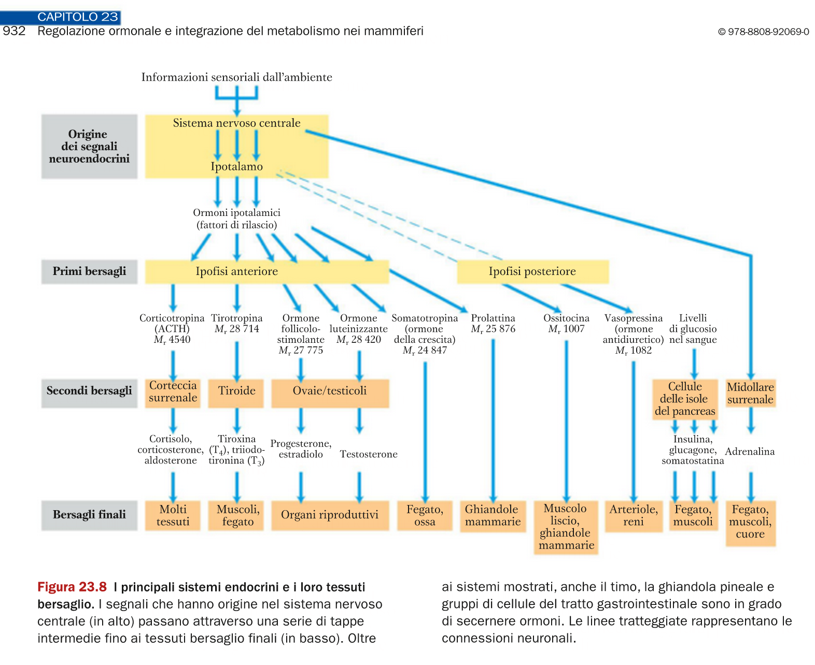
Le cellule specializzate liberano l’ormone in modo controllato
Le cellule specializzate
sono sotto il controllo
di altri ormoni
Le cellule specializzate
sono sotto il controllo
di altri ormoni
Le cellule specializzate
sono sotto il controllo
di altri ormoni

Slide 48
La liberazione dell’ormone è controllata con meccanismo a feed-back negativo
Il caso del testosterone
Il caso degli ormoni tiroidei

Slide 49
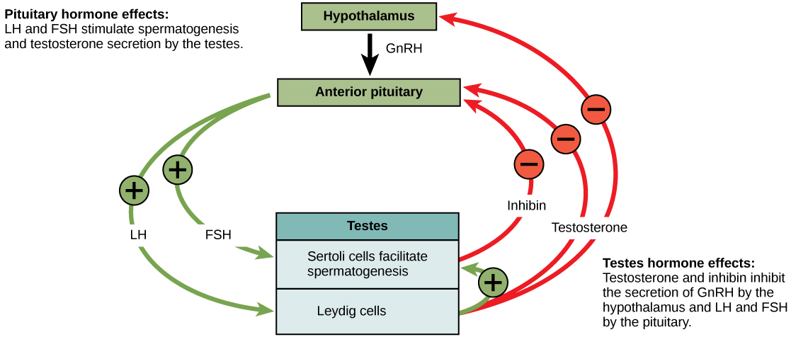
Il livello del testosterone nel sangue è costante il controllo a feedback negativo
GnRH
Gonadotropin releasing hormone
LH
Luteinising hormone
FSH
Follicle stimulating hormone
Notes:
source
https://opentextbc.ca/biology/chapter/24-4-hormonal-control-of-human-reproduction/

Slide 50
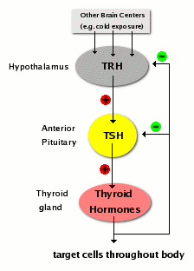
Il livello degli ormoni tiroidei nel sangue è costante il controllo a feedback negativo
Notes:
source
http://www.vivo.colostate.edu/hbooks/pathphys/endocrine/thyroid/control.html

Slide 51
Fine

