Slide 1
Così i filosofi ci insegnano a cercare la verità
Ci sono alcune domande e alcune risposte che generano un campionario di reazioni piuttosto prevedibili. E’ il caso di chi, al fatidico interrogativo sui propri studi o sul proprio mestiere, dichiari di ‘fare filosofia’. Troverà immancabilmente qualcuno che la filosofia ”avrebbe voluto studiarla” (ma alla fine ha scelto, che so, economia) e chi invece “non l’ha mai capita”. Ma dovrà stare attento soprattutto a chi gli chiederà, con ingenuità o malizia, a che cosa serve la filosofia. Di fronte a un tale quesito, Gilles Deleuze suggeriva di ricorrere alle male parole. Più pacifiche le repliche standard, come “ad aprire la mente” oppure “a dubitare, non a risolvere problemi”. Può anche capitare di ribattere, magari con un punta di orgoglio, che “non serve a niente”. Insomma, la filosofia scombussola, fa dialogare e fa pensare. Sia chi ignora la sua storia, sia chi la studia o insegna da tempo,
La filosofia, in sintesi, sarebbe ‘la volontà di portare alla luce il saphés, ciò che di per se stesso è chiaro, e di testimoniare ciò che di per se stesso si mostra ed è incontrovertibile. Non c’è ambito nel quale i filosofi non si intromettano, a caccia del vero.

Slide 2
How philosophers teach us to search for the truth
There are certain questions and certain answers that produce a whole array of rather predictable reactions. Take, for example, those who, when asked about their studies or their work, claim to “be doing philosophy”. There will always be someone who “would have liked to study it” (but in the end opted for, say, economics) and someone else who “has never understood what it’s about”. But one should, above all, be wary of those who ask, naively or malevolently, what the point of philosophy is. Faced with such a question, Gilles Deleuze suggested a resort to foul language. More pacific responses include the standard “in order to open one’s mind” or “to doubt, not to resolve problems”. One might also reply, perhaps with a hint of pride, that “it has no point”. So philosophy is unsettling, it leads to discussion and makes us think, both those of us who know nothing about it and those who have been studying or teaching it for some time.
Philosophy then would be “the desire to bring to light saphés, that which in itself is clearly evident and to testify to that which in itself appears to be and is incontrovertible. There is no area of knowledge into which philosophers do not venture in search of the truth.

Slide 3
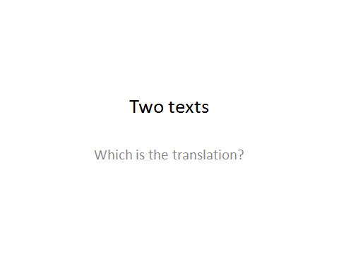

Slide 4
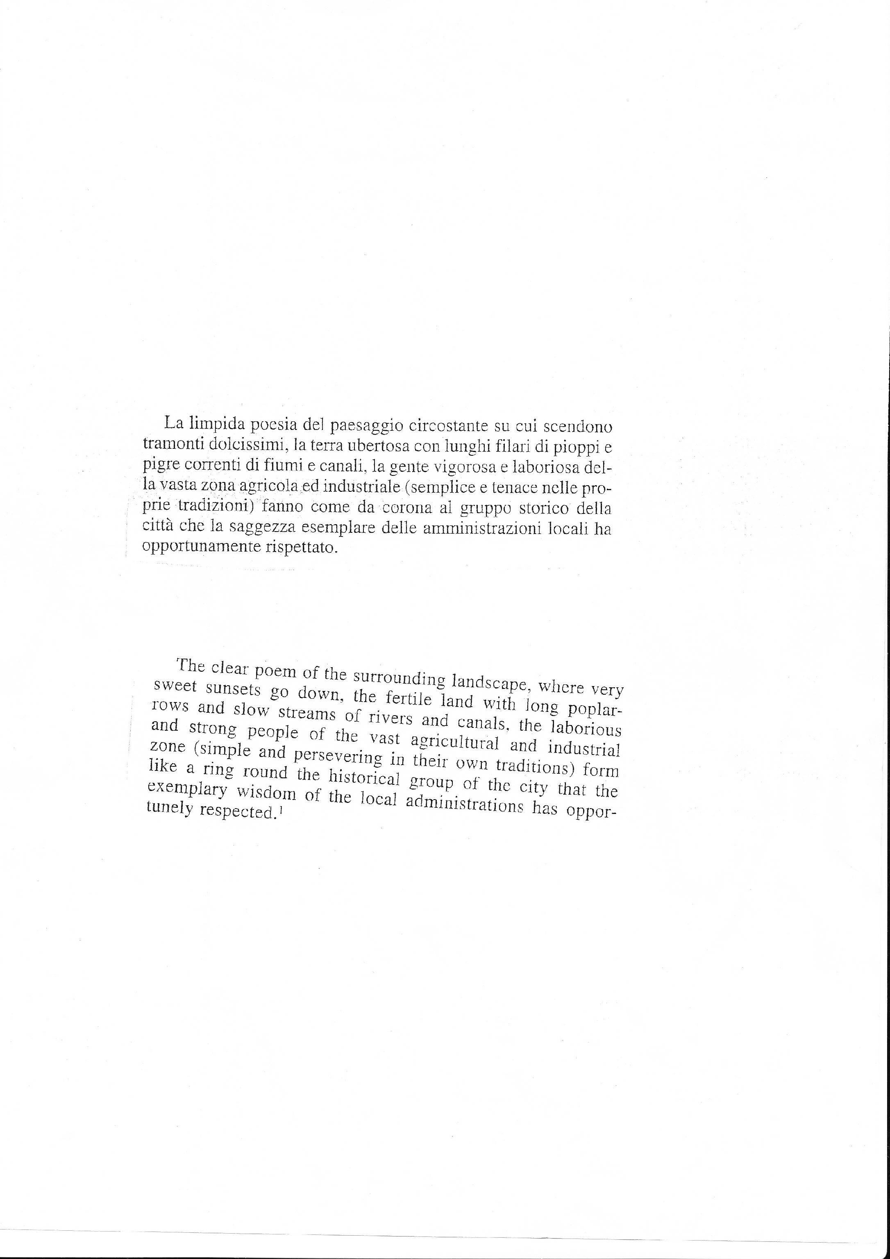

Slide 5
The poetic charm of the surroundings blessed by glorious sunsets, the fertile land with its long rows of poplars and slow-moving rivers and waterways, the hard-working people of this vast agricultural and industrial area, down-to-earth and strong in their traditions, form the backdrop to this historic city which, with exemplary wisdom, the local authorities have rightly respected.

Slide 6
The naturally poetic landscape …, simple magic of…, the poetic purity…, … are poetic.
… spectacular sunsets, … soft-hued sunsets
… the dusk comes very tenderly
… endless poplar rows
… the sluggish flow
… persevering, … determined, … vigorous, …tough
… set in their own traditions
… rural and industrial area
… was and has been perfectly preserved and respected
… has so properly protected
… has duly respected

Slide 7
Last exam

Slide 8
Film text
In the Name of the Father

Slide 9
Lesson One

Slide 10
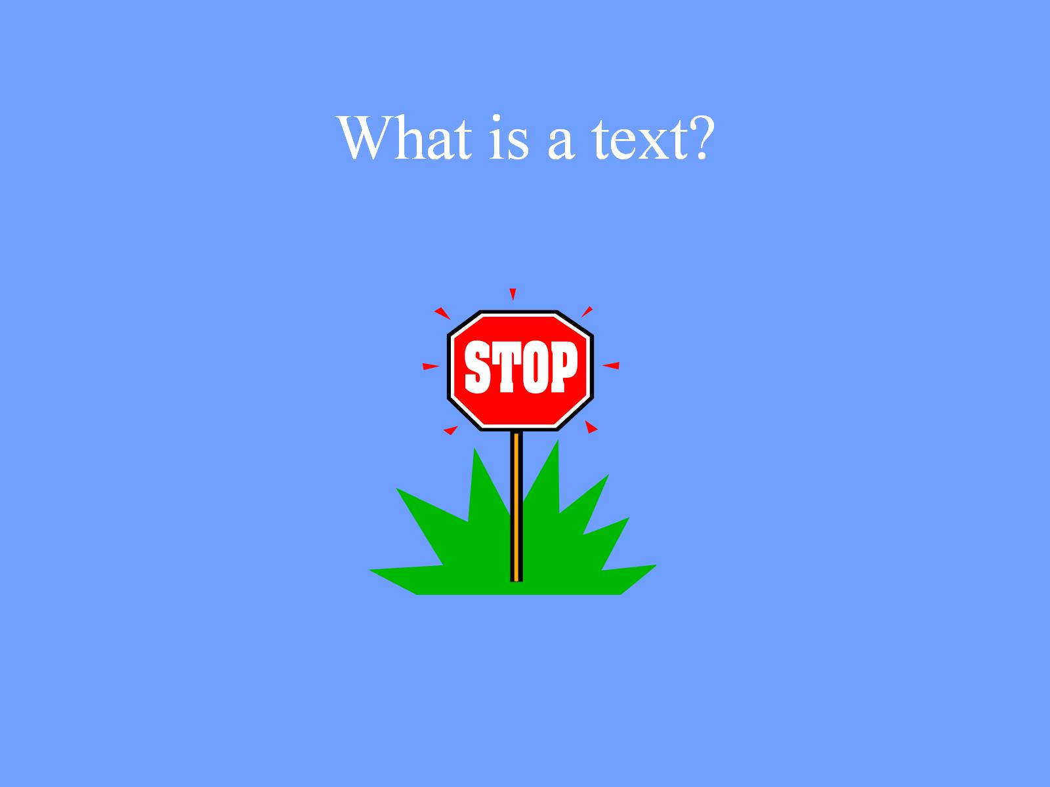
What is a text?

Slide 11
What is a multimodal text?

Slide 13
Seurat
Neo-impressionist
Sensation of light and warmth
Though chiaroscuro effect - shadow
Well defined figures are still in geometric lines (trees and people)
Either frontal or in profile
Rather unreal – almost Egyptian

Slide 14
Semiotic modalities

Slide 15
Written Words

Slide 16
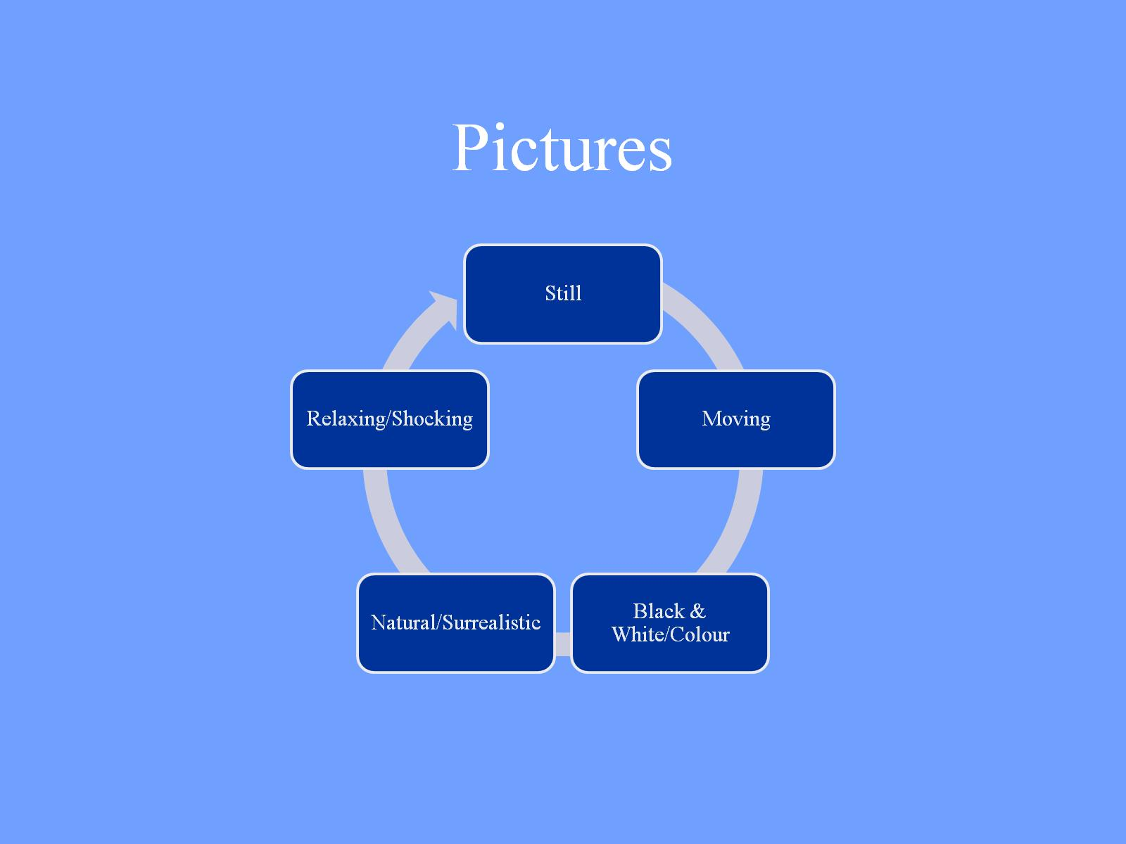
Pictures

Slide 17
Colour

Slide 18
Gesture

Slide 19
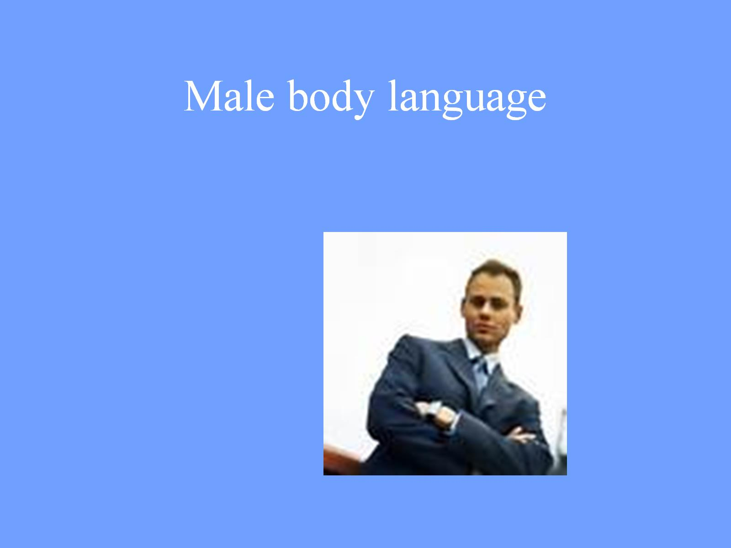
Male body language

Slide 20
Hand gesture

Slide 21
Female body language

Slide 22
Movement

Slide 23
Music

Slide 24
The Green Leaves of Summer The Alamo

Slide 25
The Green Leaves of Summer Inglourious Basterds

Slide 26
Perspective

Slide 27
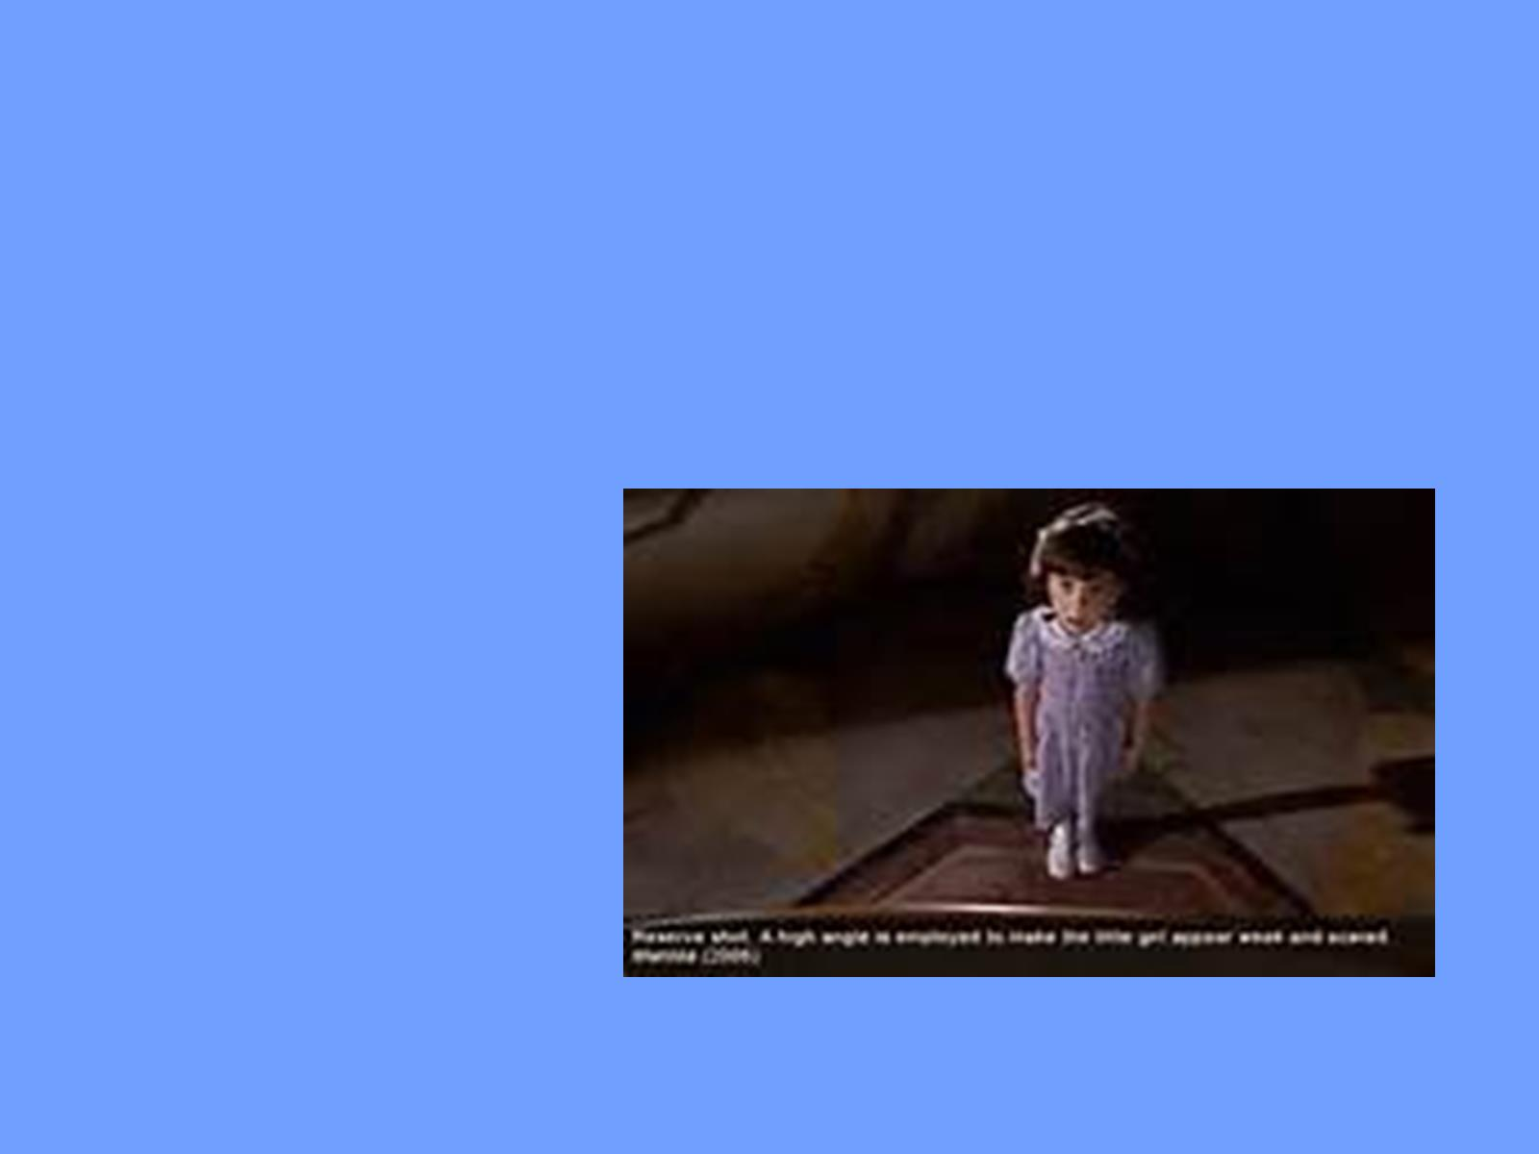

Slide 28
Spoken Words

Slide 29
Sounds

Slide 30
Light

Slide 31
Surreal

Slide 32
Sensual lighting

Slide 33
Signs

Slide 34
Film text Far from Heaven

Slide 35
Vectors

