Slide 1
Lesson Two
Audiovisual Texts:

Slide 2
Ivory Soap (1882 ) cf. 2000
The ‘IVORY’ is a laundry soap, with all the fine qualities of a choice toilet soap, and is 99 44/100 per cent pure.
Ladies will find this soap especially adapted for washing laces, infants’ clothing, silk hose, cleaning gloves and all articles of fine texture and delicate colour, and for the varied uses about the house that daily arise, requiring the use of soap that is above the ordinary in quality.
For the Bath, Toilet or Nursery it is preferred to most of the soaps sold for toilet use, being purer and much more pleasant and effective and possessing all the desirable properties of the finest unadulterated White Castile Soap. The Ivory Soap will ‘float’.

Slide 6
What is a multimodal text?
Several semiotic modalities
dialogue
pictures/design
background noise
gesture
music
colour & light

Slide 7
“Multimodal texts are texts which combine and integrate the meaning-making resources of more than one semiotic modality – for example, language, gesture, movement, visual images, sound, and so on – in order to produce a text specific meaning.” Thibault 2000)

Slide 8
Multimodality versus Multimediality
Radio is multimodal because it involves speech, music, other sounds, etc. but it is monomedial since it can only be heard, not seen, smelled, touched or tasted,

Slide 9
ANALYSIS OF AN AD. (link)

Slide 10
Linguistic Analysis
Theme and Rheme
Information Structure
Cohesion

Slide 11
Analysis of an ad.
Analysis of an advertisement
There are a number of approaches to analysing any text;
(a) The ‘Mitsubishi’ text is analysed both in terms of its written text and its non-verbal features:

Slide 12
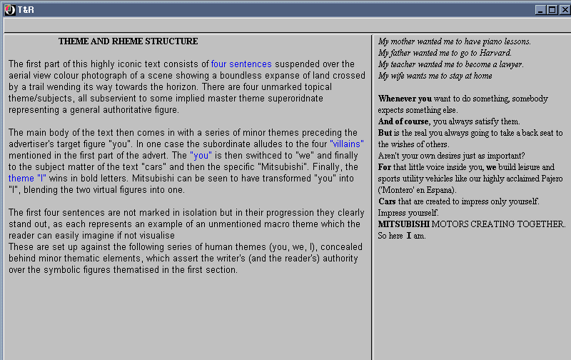

Slide 13
Analysis of a ad.
The grammar of visual design:
• in this case the superimposed verbal text blends in with the background;
• the four lines add to the sense of perspective, the punchline being foregrounded – semantic hierarchy;
• the (interested) reader gets the impression of being in the vehicle;
• the promise – “get away from it all” with the letters of ‘So here I am’ of an exaggerated size;
• a semiotic construct - the background is surreal (and therefore tempting) while the product is real (and therefore attainable);
• two unequal halves – the picture and product are salient;
sharp division of two parts of text – promise/information (two different kinds of meaning)

Slide 14
Analysis of an ad.
So this ‘ad’ is a semiotic unit, structured, not linguistically, but by principles of visual composition... verbal text becomes just one of the elements integrated by the codes of information value, salience and framing... reading is not necessarily linear, wholly or in part, but may go from centre to margin, or in circular fashion, or vertically,... (p 185)

Slide 15
Insert video Citroen

Slide 17
Multimodal transcription
analyse the various semiotic modalities
presentation in table form
assess how each modality works to give meaning and how they work together
(see next lesson for detailed explanation)

Slide 18
Practical applications
analysis of advertisements to check most effective modalities
use in deciding translation strategies for subtitling film, if (some of) the meaning is provided by the other semiotic modalities.

Slide 19
Application of multimodal transcription to film translation
BY
- simplifying the descriptions
- doubling up some columns
- eliminating other columns
- adding a translation column
the MT proved useful in deciding translation strategies for subtitling film…. and not missing anything!

Slide 20
Notting Hill

Slide 21
Notting Hill

Slide 22
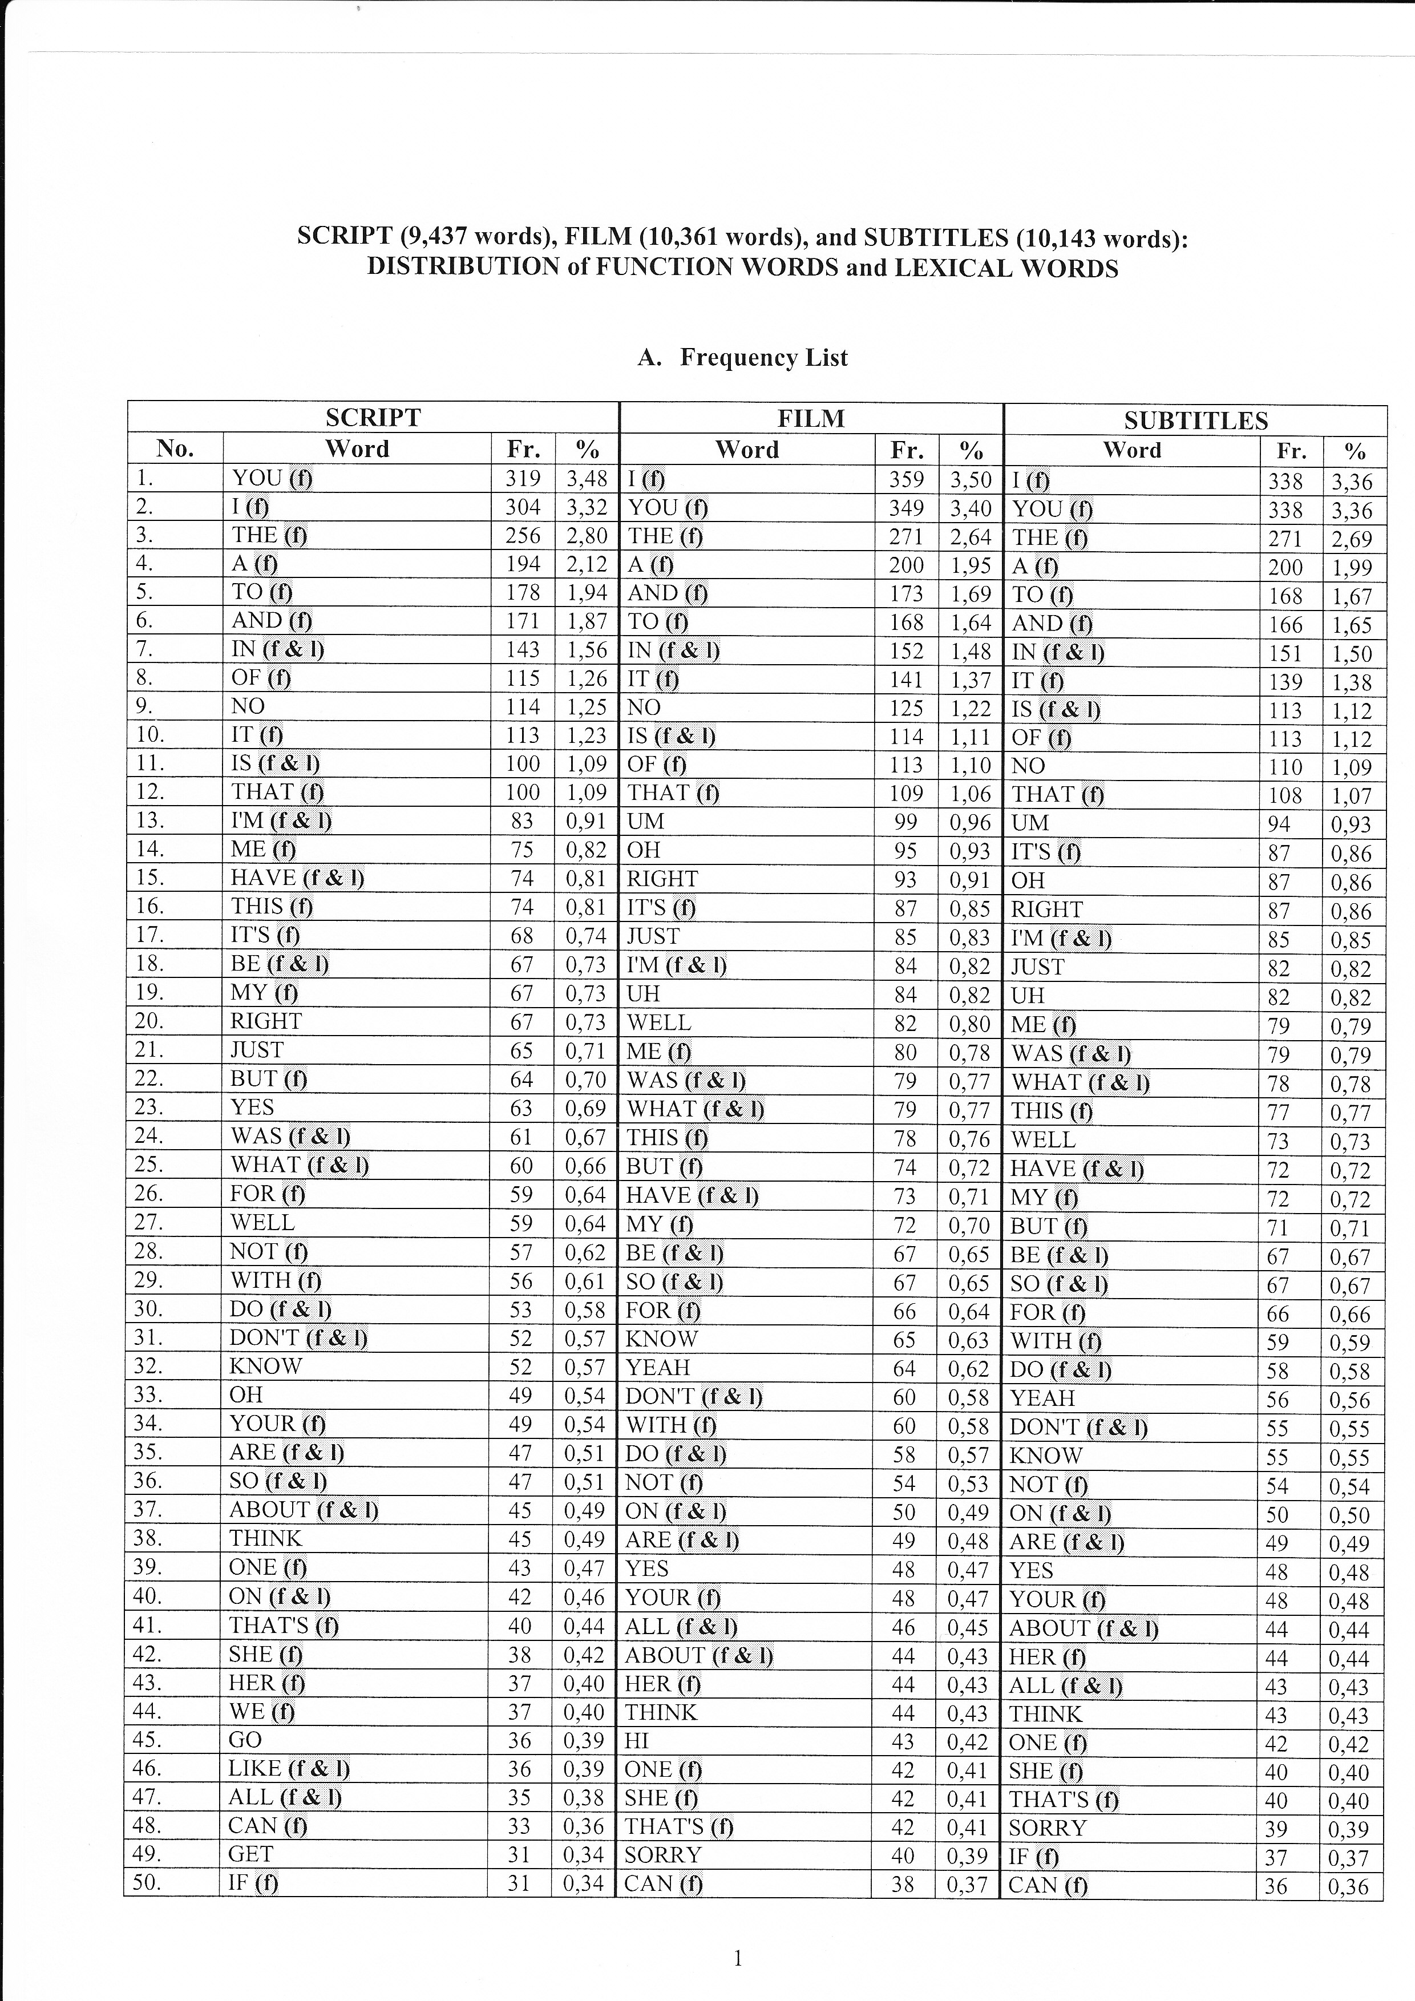

Slide 23
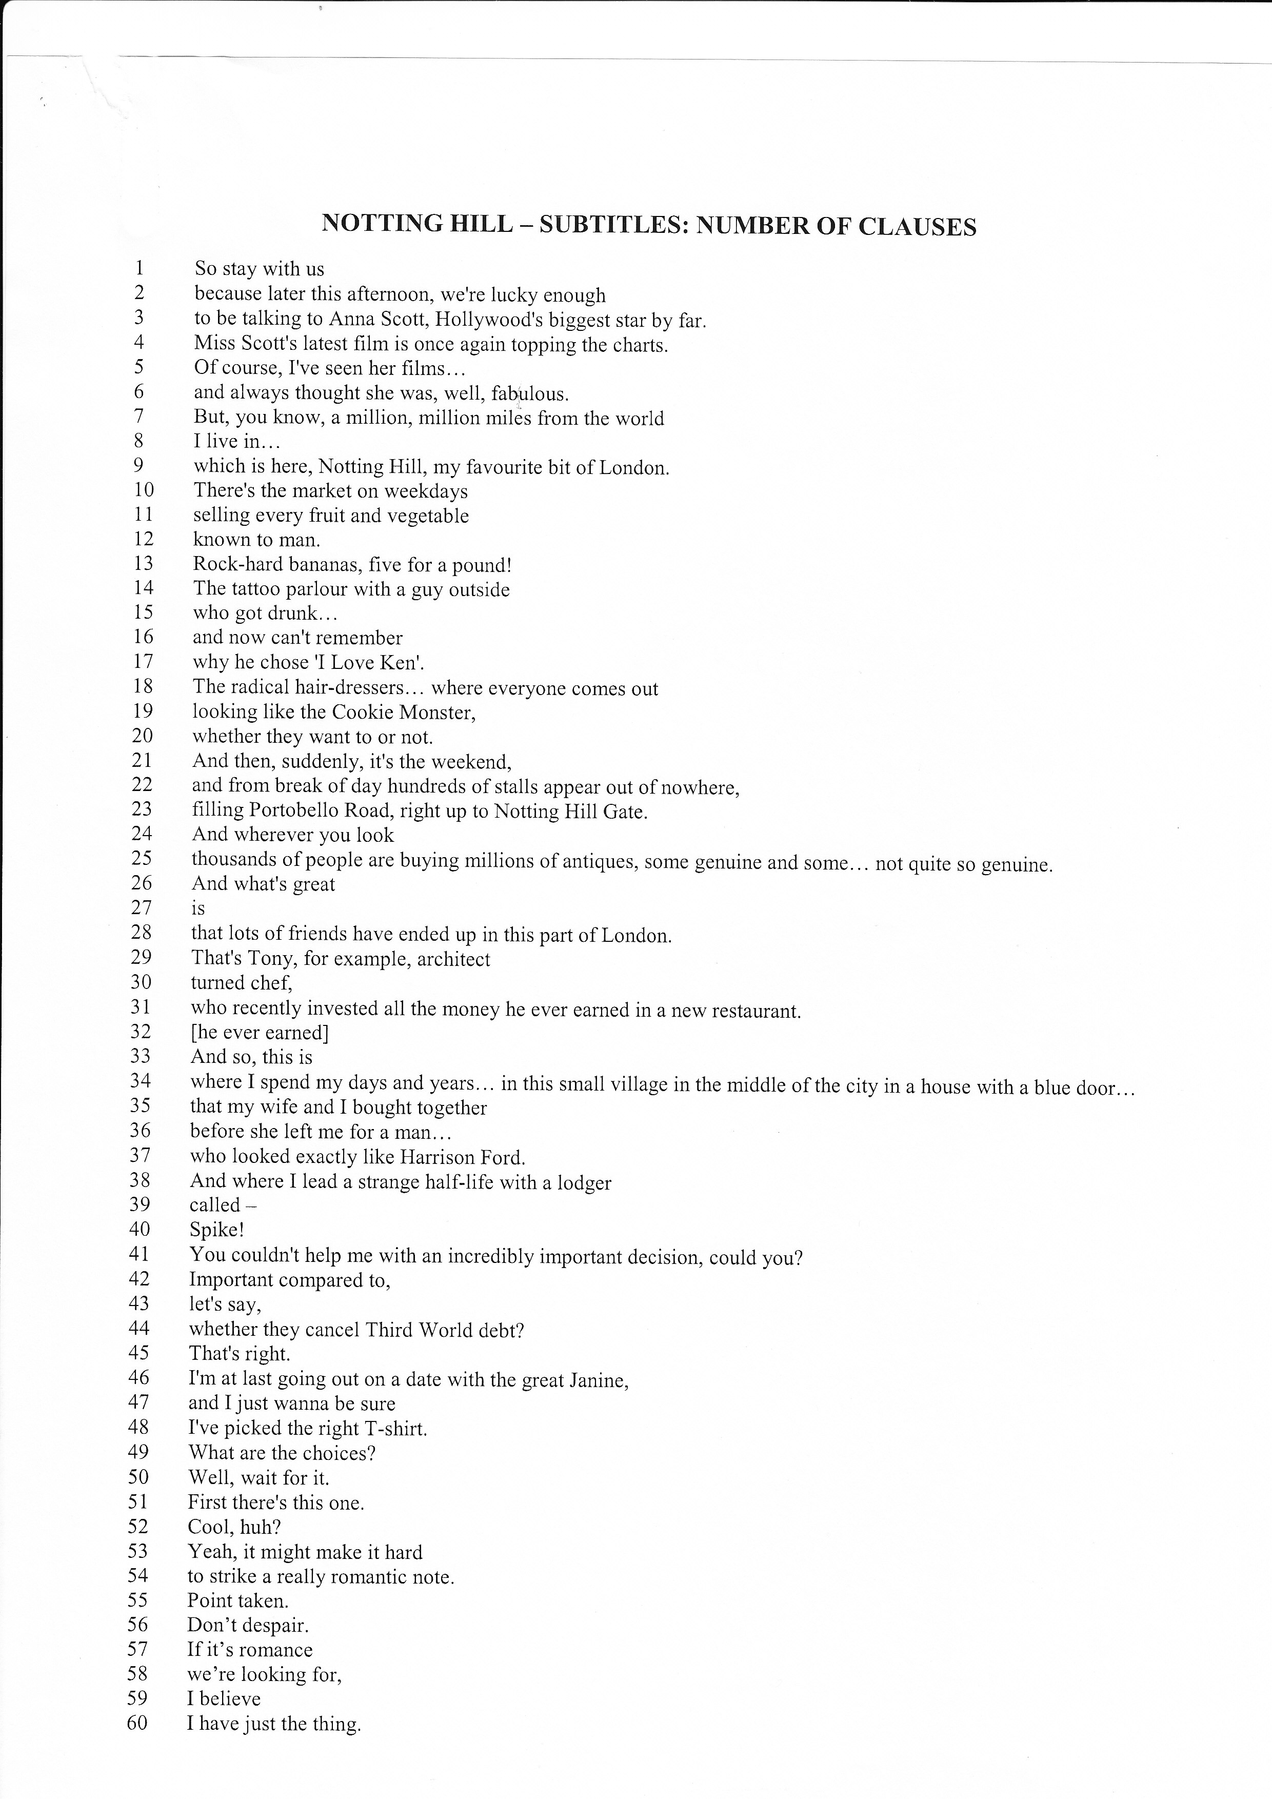

Slide 24
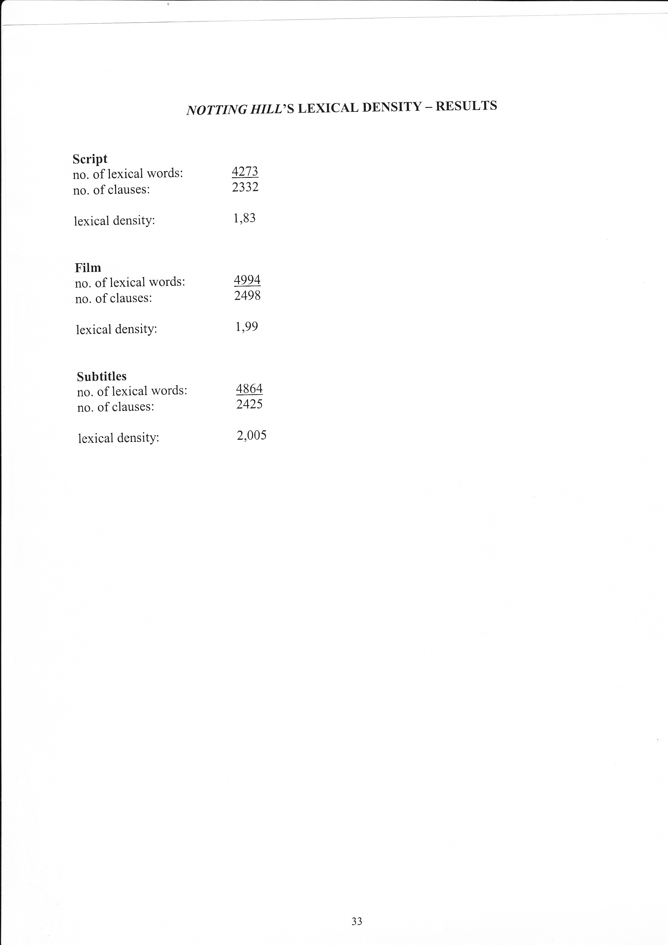

Slide 25
Multimodal Transcription

Slide 26
The Westpac video (from Australia,1983)

Slide 27
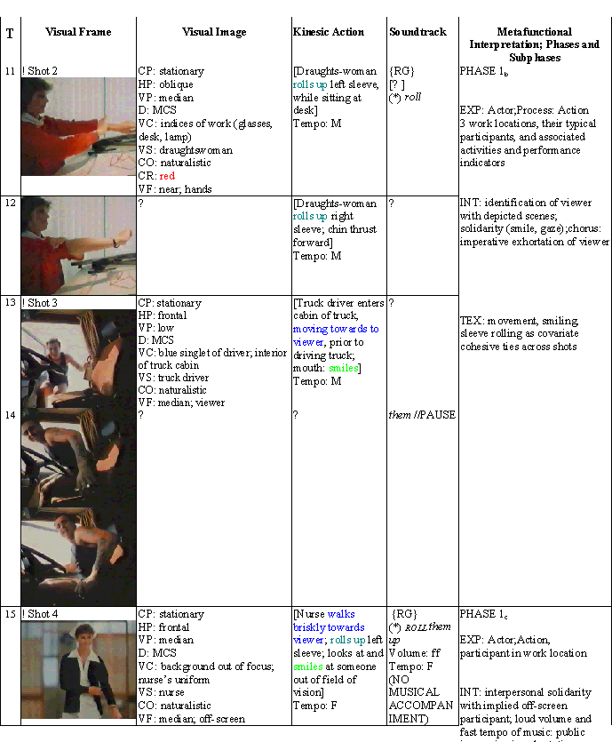
The transcription that is presented below is itself a multimodal text. Specifically, it is a Table

Slide 28
Column 2: The visual frame
The Visual Frame correlates with the time that is indicated in the first Column. Each frame was inserted into the Column by copying selected frames of the entire film text from the .tif file that was obtained from the video text. Clearly, the use of so many frames – more than sixty in the present case – is expensive from the point of view of their reproduction in print form. However, there are important analytical advantages to be gained if this approach is followed rigorously. In my experience, the main advantage lies in the discipline and exactitude that it imposes on the entire transcription procedure..

Slide 29
Column 3: The visual image

Slide 30
Column 4: Sample of kinesic action

Slide 31
Column 4: How to interpret kinesic acts?
The kinesic act ‘rolling the sleeves up’ may be interpreted as a gestural emblem with the culturally fixed meaning of ‘starting or getting on with the task to hand’. However, it does not follow that this body movement always has this particular cultural meaning. In some other context, the same action may be a purely physiological response to climactic conditions, with no specific semiotic significance in a given interactional context. What, then, helps us to motivate a specific semiotic significance for a given bodily act?

Slide 32
Column 4: a sample of kinesic transcription

Slide 33
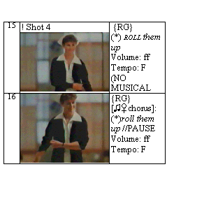
Column 5: Sample Transcription of Soundtrack

Slide 34
Column 5: Soundtrack Transcription System
[☼sheep] = other non-speech or non-musical sounds, including silence, followed by a brief verbal specification of the specific sound; in the present example, the sun symbol followed by the word ‘sheep’ designates the (non-linguistic/non-musical) sounds of the sheep, as in Row 2, Column 5; [☼silence] = silence other than rhythmic pause or juncture in speech and/or music (e.g. Row 1, Column 5); ↓ = continuation of previous, as, for example, when sung or spoken text is stretched over more than one Visual Frame or Shot (e.g. Row 3, Columns 3 and 5). As the example here shows, this notational symbol is not specific to the soundtrack and is also used in other Columns. In all cases, it has the same significance.

Slide 35
Blackadder video

Slide 36
Go on!
Go on! Go on!
Avanti! Avanti!
Sbrigati! Sbrigati!

Slide 37
Erm…
Percy: Erm, sorry about the delay madam, er, as you know, you are about to meet your husband, whom you’ll recognise on account of the fact that he has a bag over his head.
Lady Farrow: Why, I would know my darling anywhere.
Percy: Well, yes, there are a couple of things.

Slide 38
Scusate
Scusate il ritardo, milady…
…ora vedrete vostro marito’
Lo riconoscerete…
… dal sacco in testa.

Slide 39
Why, I’d recognise…
Why, I would know my darling anywhere.
- Lo riconoscerei comunque.

Slide 40
Well, yes…
Well, yes, there are a couple of other things.
- Sì … però … C’è dell’altro.
I am prepared for the fact that he may have lost some weight.
Sarei orientata a credere che potrebbe aver perso qualche chilo

Slide 41
…some height
Yes, and some height.
Sì … e qualche centimetro.

Slide 42
Blackadder
Multimodal Transcription

Slide 43
Phasal Analysis
Eg. Elizabethtown
Macro Phase 1: corporate Los Angeles
Macro Phase 2: family in the South
Macro Phase 3: love story with Kirsten Dunst
+ many micro phases

Slide 44
… and transitions
… in this case – travel.
But often
scrolling, wipes, dissolve, zoom, fade in, fade out

Slide 45
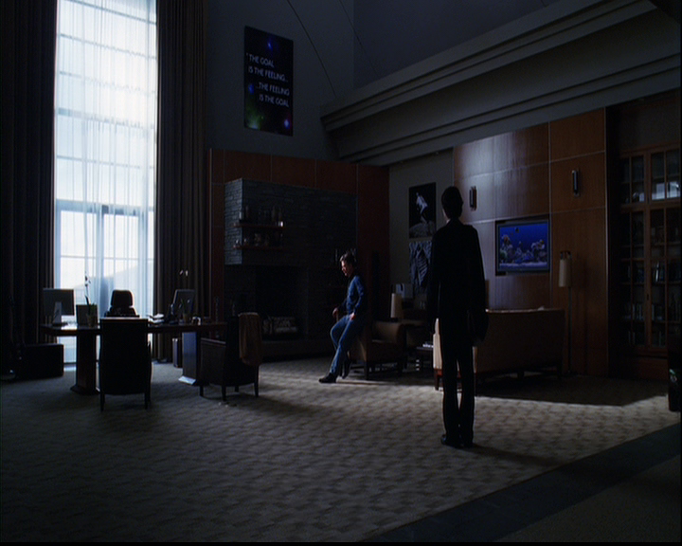

Slide 46
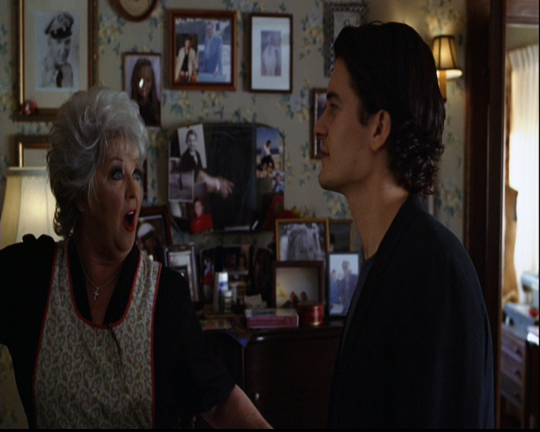

Slide 47
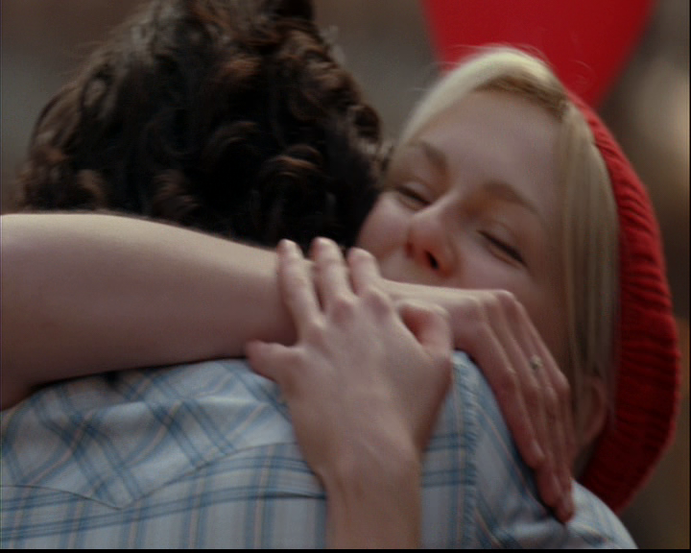

Slide 48
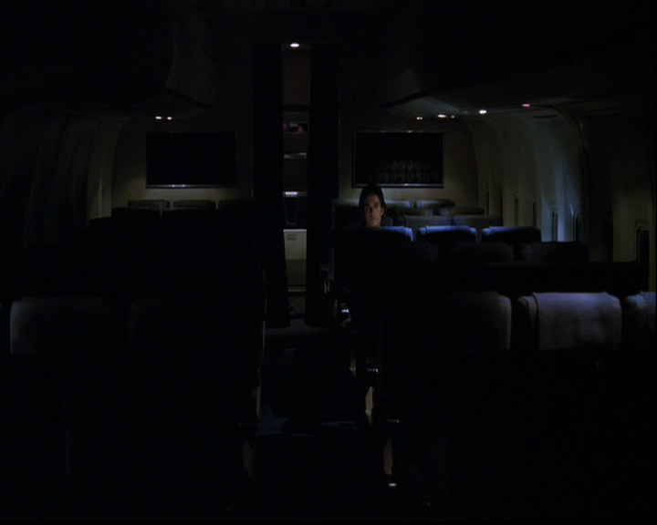

Slide 49
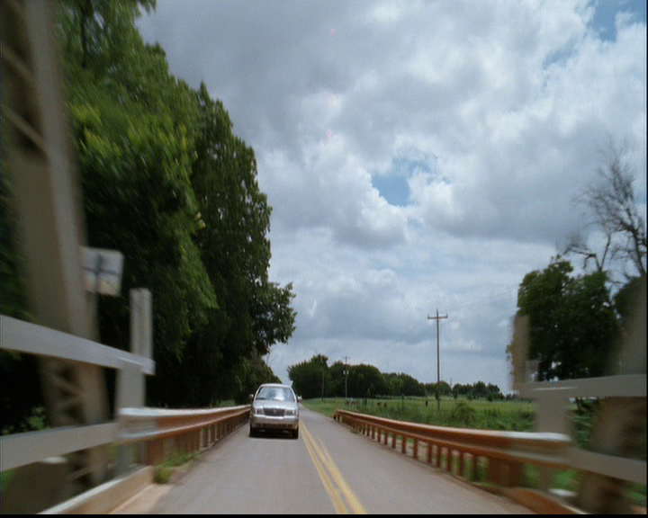

Slide 50
Phasal analysis
Californication

Slide 52
Phasal analysis: Memento

Slide 53
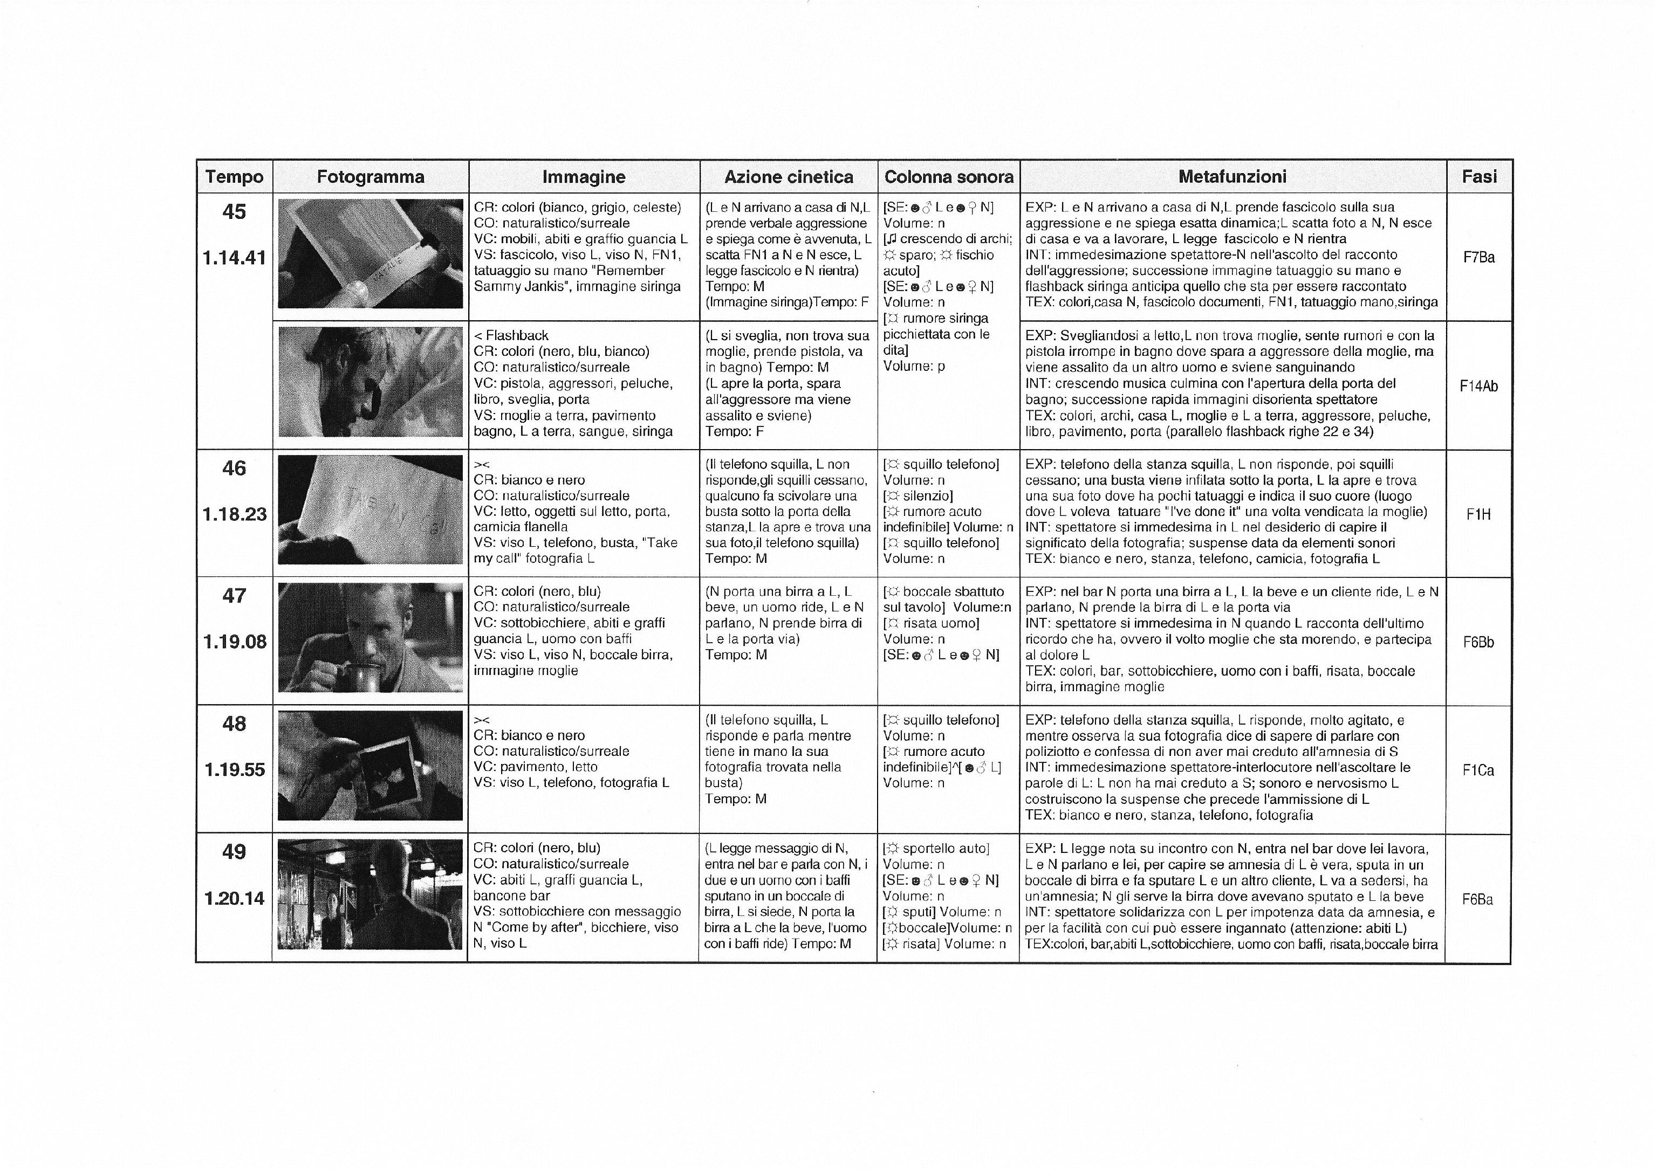

Slide 54
Phasal analysis
Volkswagen

Slide 55
Translate ‘La vita è bella’

