Slide 1
Materiale didattico-scientifico integrativo

Slide 2
L’ipofisi dal vivo
source
Development And Microscopic Anatomy Of The Pituitary Gland
https://www.ncbi.nlm.nih.gov/books/NBK425703/

Slide 3
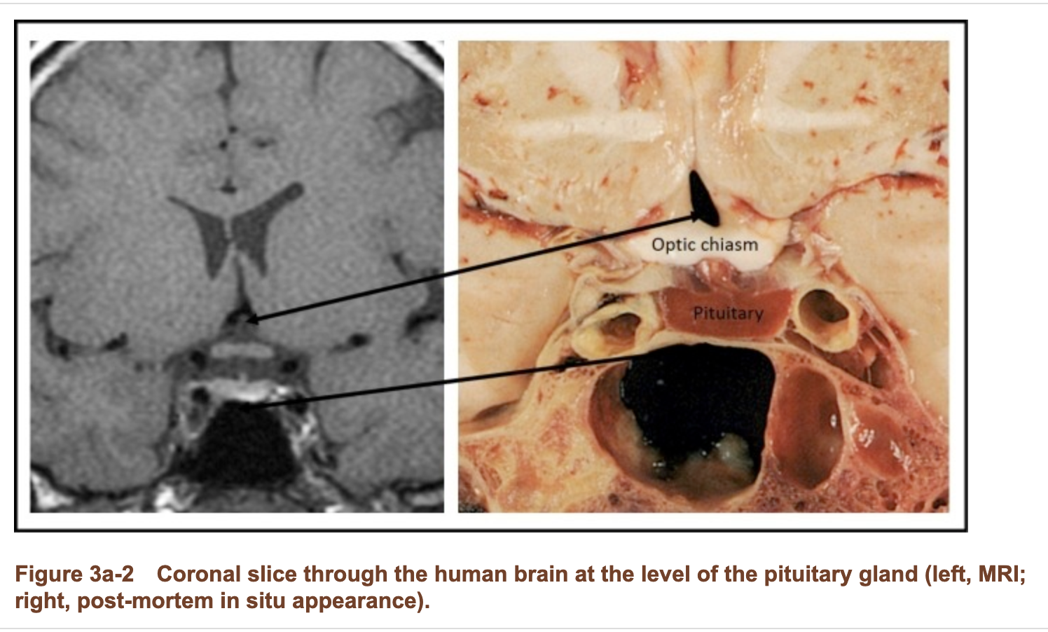

Slide 4
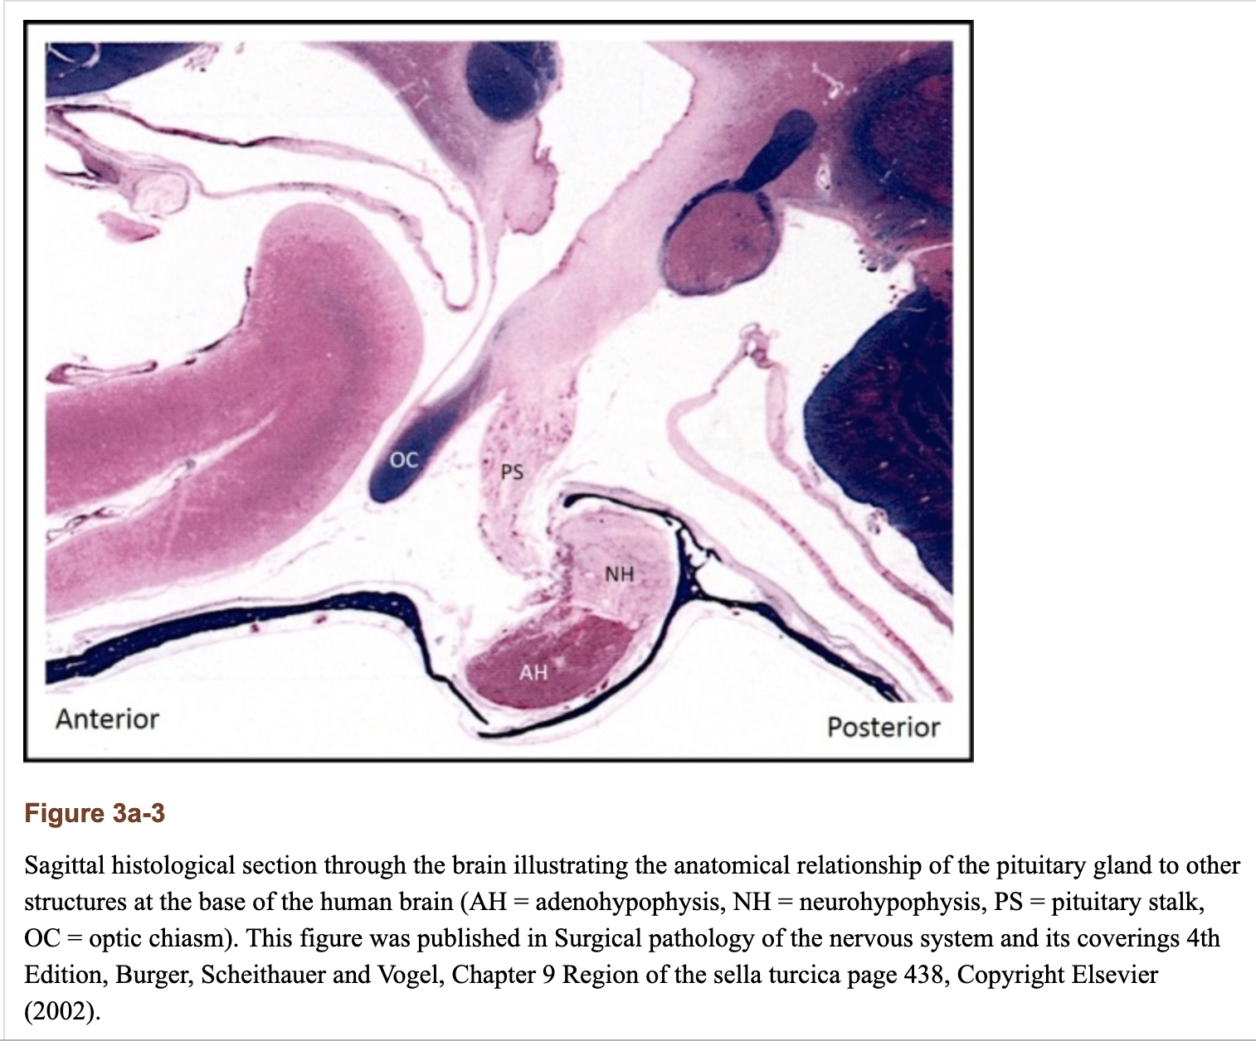

Slide 5
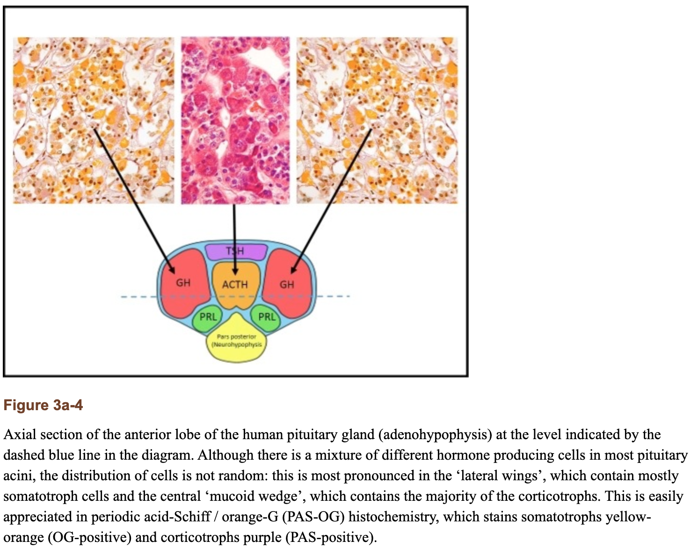

Slide 6
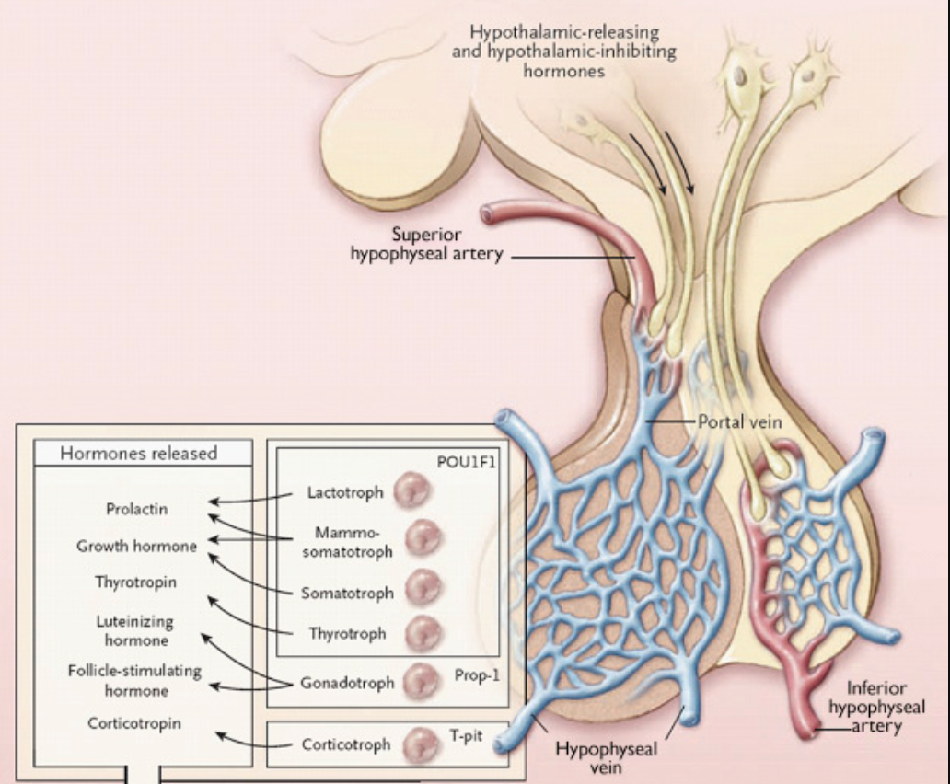
Le cellule endocrine dell’adenoipofisi
Notes:
source
The Pituitary
Book • 4th Edition • 2017
ISBN 978-0-12-804169-7

