Slide 1

Economic Geography
2 – Location theories: the Von Thunen Model
121EC
A.Y. 2019/2020
Dr. Giuseppe Borruso
Department of Economics, Business, Mathematics and Statistics
University of Trieste
E-mail. giuseppe.borruso@econ.units.it
Ph. +39 040 558 7008
Skype: giuseppe.borruso
Notes:
Slides with (*) in footnotes have been modified from Jean-Paul Rodrigue materials. (see copyright). I have modified and elaborated materials in order to be suitable for the current course.
Copyright © 1998-2010, Dr. Jean-Paul Rodrigue, Dept. of Global Studies & Geography, Hofstra University. For personal or classroom use ONLY.

Slide 2
Learning Objectives
In this lesson we will:
  Revise the importance of models in economic geography
  Introduce the simplifying assumptions and hypothesis of most location models
  Describe the Von Thunen model of agricultural organization

Slide 3
Topics
Location theories:
  Spatial organization of Agriculture
  Market and location of services
  The location of industries
  Human settlements =>
Retail and transport Geography
Geodemographics – GIS & Retail Geography
Notes:
Diparimento di Scienze Geografiche e Storiche - Introduzione ai GIS
3

Slide 4
Geographical models and the study of human space (1/2)
Replay
Model = an idealized representation of the real world, built to present some properties (social and economical phenomena).
Models become necessary as reality is complex

Slide 5
Geographical models and the study of human space (2/2)
Replay
Economic geography contributed to implementing theories based on the use of the geographical space and on criteria that orientate the location of human settlements and production activities
=>
how humans transform their environment to satisfy their needs
In time Geography and Economics reduced space to its essentials, by which analyse to understand the dynamics of an organized system (settlements or production).
Economic geographers simulated reality from empirical observations in order to understand and explain the complexity of the geographical space.
The simplification become a geographical economical model, based on inductive research (top down) rather than the micro and macro approach proper of economics.
First geographical economical models and the economical ones share schematic and simplified representations of reality and the reduced number of elements of reality (new geography and quantitative geography).
A model as a simplified description of reality to represent social and / or economical phenomena.
The models to be examined will focus on the localisation of :
  Agriculture
  Industry
  Services (including transport)
  Human settlements

Slide 6
Rent: Ricardo vs Von Thunen
David Ricardo
von Thünen
differences in productivity between two pieces of land, using same capital and technology
importance of differences in distance to markets and thus of transportation costs
Notes:
Diparimento di Scienze Geografiche e Storiche - Introduzione ai GIS
6
(*)

Slide 7
David Ricardo on Economic Rent
Economic rent on land is the value of the difference in productivity between
a given piece of land and the poorest piece of land (or the land most distant from the market)
producing the same goods (bushels of wheat) under the same conditions (of labour, capital, technology, climate)
Essence of argument: wide differences in production and marketing costs between the best and worst lands called into production to feed a given population
Productivity of agricultural land defined by:
  the natural fertility of the soil: as utilized by given technology and stock of capital
  the distance from the market in which the grains (or other agricultural goods) are sold
  the productivity differences involve the costs of both producing and marketing the grains in a given market.

Slide 8
Location theories
Different models adapted to different kinds of activities
Similar starting points
From simplified models to more complex ones
Hypothesis – generally a common starting point for the different models:
  Homogeneity and isotropy of space
  (no differences in morphology of space; no transport asymmetries; ecc.)
  Fertility of land is homogeneous – if a rent exists, it depends on transport costs based on distance
  Perfect competition (same price throughout the market; freedom of movements of factors of production; no transport costs)

Slide 9
Location theories (Agriculture)
Von Thunen (1/2)
John Heinrich Von Thunen (Jever, Oldemburg – East Germany 1783 - 1850): agronomer
number of important and original anticipations of modern economic theory:
  concepts of economic rent,
  diminishing returns,
  opportunity costs,
  the marginal-productivity theory of wages
  a pioneer in the economic theory of location
Ricardo and Von Thunen recognized that differences in the cost of producing agricultural products result from utilization of land of different quality and location
Ricardo focused on differ­ences in soil fertility
Von Thunen focused in differences in land location
  recognized that those products that are bulky in rela­tion to value are more costly to transport than those that are less so and that some farm products cannot stand a long period in transit because of their perishability
Problem: devise the best (most profitable) system of land utilization

Slide 10
Location theories (Agriculture)
Von Thunen (2/2)
John Heinrich Von Thunen (Jever, Oldemburg – East Germany 1783 - 1850): agronomer
1826: The isolated state
  Effects of a unique urban central market on the distribution of cultivations in a homogeneous space
  accessibility to the market (town) can create a complete system of agricultural land use.
Assumptions:
  The city is located centrally within an "Isolated State" which is self-sufficient and has no external influences.
  A large town (market) is situated in the center of a fertile plain that has neither canals nor navigable rivers
  Means of transport is a horse-drawn wagon or a similar
  All land within the plain is of equal fertility, and there are no other comparative advantages of production between plots
  At a considerable distance from the city, the plain ends in an uncultivated wilderness
  “isotropic plain” no site differences, no transportation barriers or roads
  “Isolated State” i.e. no trade with other communities
  all farmers receive the same marketplace price for the same crop at a given time
  all farmers seek to maximize profits, and they all have perfect information
  there is only one form of transportation (which is also uniform across the plain)
  the cost of transportation is directly proportional to distance (e.g. $x per mile)
  =>
Von Thunen hypothesized that a pattern of rings around the city would develop.
Concentric rings in a circular space with the market city at centre;
Rings are organized according to the production techniques of the time;
Positional rent articulates a physically uniform space in zones with specific land uses, corresponding to computable distances from the central place.
Notes:
The city is located centrally within an "Isolated State" which is self-sufficient and has no external influences.
The Isolated State is surrounded by an unoccupied wilderness.
The land of the State is completely flat and has no rivers or mountains to interrupt the terrain.
The soil quality and climate are consistent throughout the State.
Farmers in the Isolated State transport their own goods to market via oxcart, across the land, directly to the central city. Therefore, there are no roads.
Farmers act to maximize profits.

Slide 11
Von Thunen’s model of land use
The isolated state
Central market
Dairy & vegetables
forestry
Intensive crop rotation
Arable and pastures
Three-field crop rotation system
Extensive stock grazing
Notes:
Diparimento di Scienze Geografiche e Storiche - Introduzione ai GIS
11
(*)

Slide 12
Von Thunen’s model of land use
There are five rings of agricultural activity surrounding the city.
Dairying occur in the ring closest to the city.
  Since vegetables, fruit, milk and other dairy products must get to market quickly, they would be produced close to the city (no refrigerated oxcarts!)
Timber and firewood would be produced for fuel and building materials in the second zone.
  Before industrialization (and coal power), wood was a very important fuel for heating and cooking. Wood is very heavy and difficult to transport so it is located as close to the city as possible.
Intensive farming is located in the third zone
The fourth zone consists of extensive fields crops such as grains for bread.
  Since grains last longer than dairy products and are much lighter than fuel, reducing transport costs, they can be located further from the city.
The fifth zone occupies Three-field crop rotation system
Ranching is located in the final ring surrounding the central city.
  Animals can be raised far from the city because they are self-transporting. Animals can walk to the central city for sale or for butchering.
Beyond the fourth ring lies the unoccupied wilderness, which is too great a distance from the central city for any type of agricultural product.
Notes:
Diparimento di Scienze Geografiche e Storiche - Introduzione ai GIS
12
(*)

Slide 13
Von Thunen’s model of land use
Positional rent articulates a physically uniform space in zones with specific land uses, corresponding to computable distances from the central place.
Land uses given by
Where
  R_{p} = monetary rent of a unit surface in a given point p of the space [location rent per unit of land];
  R = physical rent of the same unit surface
  [yield per unit of rent];
  p = market price for each unit/weight of product at the marketplace
  [market price per unit of commodity];
  c = production cost at the location of growing
  [production cost per unit of commodity];
  t = transport cost per unit of distance between the growing location and the market
  [transport rate per unit of distance];
  d = distance between the point (growing location) from the market
The function becomes a line:
  y = a - bx
  With different parameters for each production in space.
  Zones derive from the crossing of different rent functions
  depending on a set of transport costs R_{i}t_{i}d

Slide 14
Von Thunen’s model of land use
Transport cost per unit
t_{a}
Transport
Costs
t_{b}
t_{c}
t_{d}
distance

Slide 15
Von Thunen’s model of land use the rent function
R_{a}
A
Rent
a: colture a
b: colture b
c: colture c
R_{b}
R_{c}
R_{d}
b
a
5
10
distance
c
 | R | p | c | t | d₀
a | 60 | 2.000 | 1.000 | 200 | 5
b | 50 | 3.000 | 2.200 | 80 | 10
c | 100 | 1.500 | 1.200 | 20 | 15
d | 50 | 2.000 | 1.600 | 50 | 8
=> D₁ = 2,5; D₂ = 5
Notes:
Diparimento di Scienze Geografiche e Storiche - Introduzione ai GIS
15

Slide 16
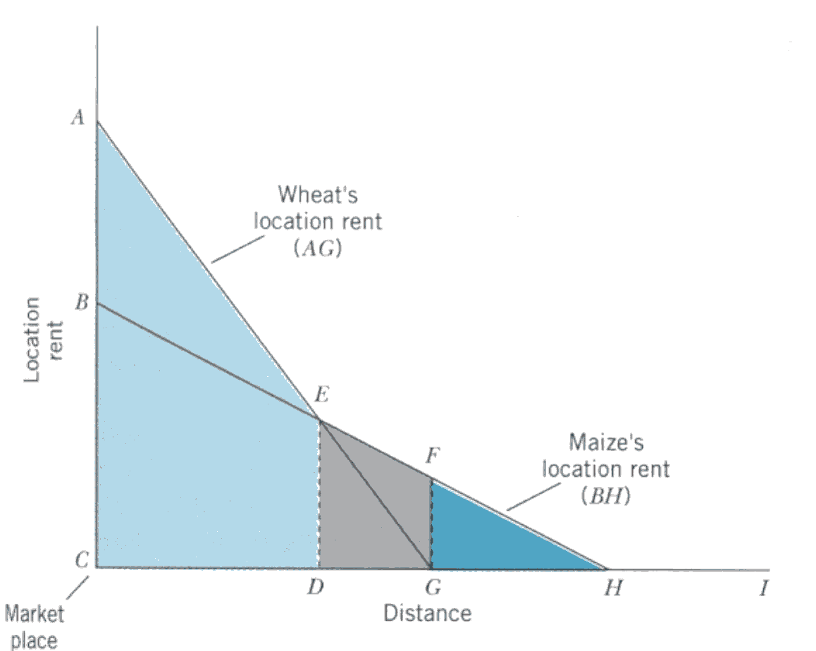
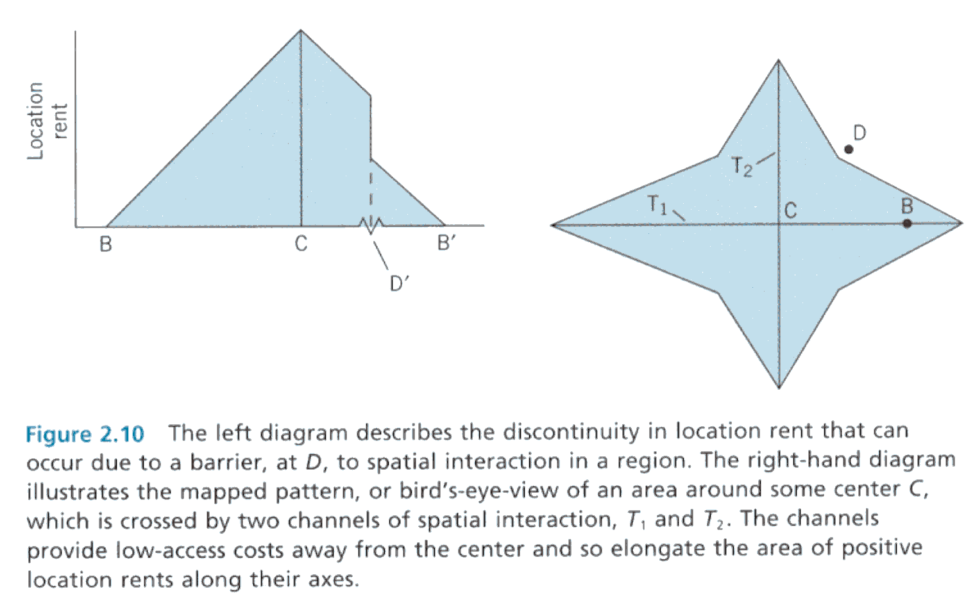
Notes:
Hanink (1997) Economic Geography, page 39 (a, b); page 54 (c)

Slide 17
Von Thunen’s model of land use
The isolated state
Modified conditions
Secondary market
Central market
River
dairy & vegetables
forestry
Intensive crop rotation
Arable and pastures
Three-field crop rotation system
Extensive stock grazing
Notes:
Diparimento di Scienze Geografiche e Storiche - Introduzione ai GIS
17
(*)

Slide 18
Von Thunen’s model of land use applied to mainland USA
Forest
Dairy
Wheat
Dairy
Forest
Wheat
Corn and
Soybeans
Vegetables
Beef Cattle
and Sheep
Vegetables
Beef Cattle
and Sheep
Corn and
Soybeans
Cotton and
Tobacco
Specialty
Crops
Cotton and
Tobacco
Assumptions
1. New York City the only market
2. Crops ranked by rent paying ability
3. No terrain variation
4. Climatic variation considered
Specialty
Crops
Assumptions
1. New York City the only market
2. Crops ranked by rent paying ability
3. No terrain or climatic variation
A
B
Notes:
Diparimento di Scienze Geografiche e Storiche - Introduzione ai GIS
18
(*)
Stutz, R. and A. de Souza (1998), "The World Economy: Resources, Location, Trade and Development." Third Edition, Toronto: Prentice Hall. P. 268.

Slide 19
Von Thunen’s model: critiques and limits
SINCLAIR R., VON THÜNEN AND URBAN SPRAWL, Annals of the Association of American Geographers Vol 57 Issue 1, pages 72–87, March 1967
In explaining agricultural patterns near urban areas, Von Thünen's theory is generally applicable where the primary force determining the pattern is transport cost to the market.
=> the pattern of agricultural land use is one of decreasing intensity with distance from the city.
Von Thünen's theory still applies in underdeveloped parts of the world, but no more valid in developed areas.
In many advanced industrialized parts of the world, the basic forces determining agricultural land use near urban areas are associated with urban expansion.
Where these forces are in operation, the agricultural pattern quite often is one of increasing intensity with distance from the city, quite the reverse of the pattern generalized by Von Thünen's theory.

Slide 20
Von Thunen’s model: critiques and limits
Rent
Rent
R_{x}
X
R_{by}
R_{by}
Y
Y
R_{z}
Z
distance
5
10
distance
5
10
SINCLAIR R., VON THÜNEN AND URBAN SPRAWL, Annals of the Association of American Geographers Vol 57 Issue 1, pages 72–87, March 1967
Why rent curves with negative slopes?
Sinclair hypothesizes an increase in land use values moving out from an urban centre

Slide 21
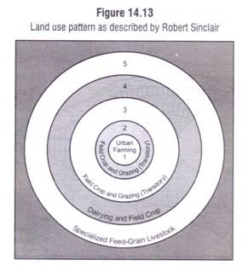
Von Thunen’s model:
Sinclair’s model
metropolitan expansion is perceived as a
displacement threat
investments rise with distance from the
frontier to the outer edge
four types of farming; fifth is a
wider regional speciality far
from the city
(i) urban farming (small producing units: poultry-keeping,
greenhouses, mushroom-raising, and other building-oriented uses)
(ii) vacant and temporary grazing, (empty spaces to be sold for speculation or grazing only under short-term leases)
(iii) transitory field crop and grazing (little investment beyond the short term)
(iv) dairying and field crop farming (farmers begin shifting towards more extensive agriculture).
(v) specialised feed-grain livestock or Corn Belt agriculture
http://www.yourarticlelibrary.com/wp-content/uploads/2014/02/clip_image028_thumb.jpg

Slide 22
Von Thunen Rent and the city
From the isolated state….
…to the bid rent theory applied to urban areas

Slide 23
The bid-rent (I)
...a step forward
Pattern of land uses depend on a variety of settlements’ decisions
Decisions guided by economic process operating within the system. The distribution of urban areas’ use represent a visual and structured phenomenon.
Basic aspects:
  Each activity derives utility from every site of the urban area;
  Utility is measured by the rent an activity is willing to pay for the use;
  Among the different rents from the utility of the site, the maximum one will determine the market value
The location rent curve can be regarded as a “bid-rent curve” (Alonso, 1960), because it gives an indication of how much farmers would be prepared to pay for a unit of land at varying distance from the market.

Slide 24
Bid rent and land use
...a step forward
1 – bid rent lines
2 – Overlay of rents
rent
B- Industry and retail
A- Retail
Distance
City borders
C - Apartments
D – Detached
houses
Notes:
Diparimento di Scienze Geografiche e Storiche - Introduzione ai GIS
24
(*)

Slide 25
Bid-rent
...a step forward
A
rent
Area A: commercial land use
Area B: industrial land use
Area C: residential land use
B
C
C’
A
B
P
A’
Q
B’
distance
C
Curva AA’: commercial activities’ rent
Curva BB’: industrial activities rent
Curva CC’: residential ativities rent
Notes:
Diparimento di Scienze Geografiche e Storiche - Introduzione ai GIS
25

Slide 26
Variations to bid-rent theory
...a step forward
A – CBD
B – Commerce / industry
C – residential high– medium density
D – sub-centres
E – Suburbia
rent
A
B
C
D
E
Notes:
Diparimento di Scienze Geografiche e Storiche - Introduzione ai GIS
26
(*)

Slide 27
Land use value for activity sector according to the distance from the CBD
...a step forward
Retail
Residential (several components families)
Land use value
Residential (single families)
Distance from the centre
Notes:
Diparimento di Scienze Geografiche e Storiche - Introduzione ai GIS
27
(*)

Slide 28
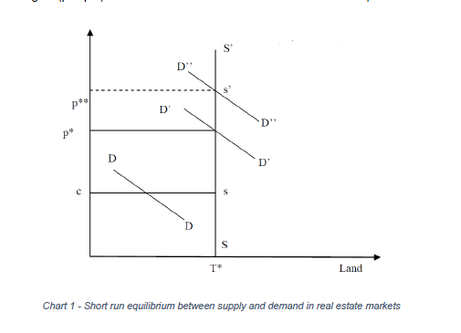

Slide 29
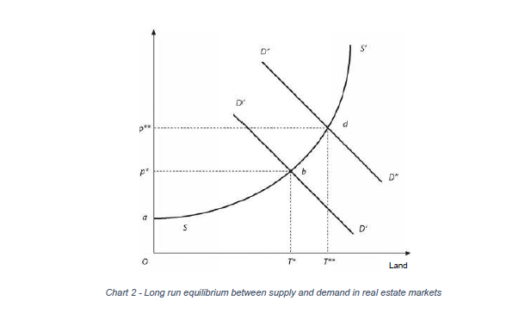

Slide 30
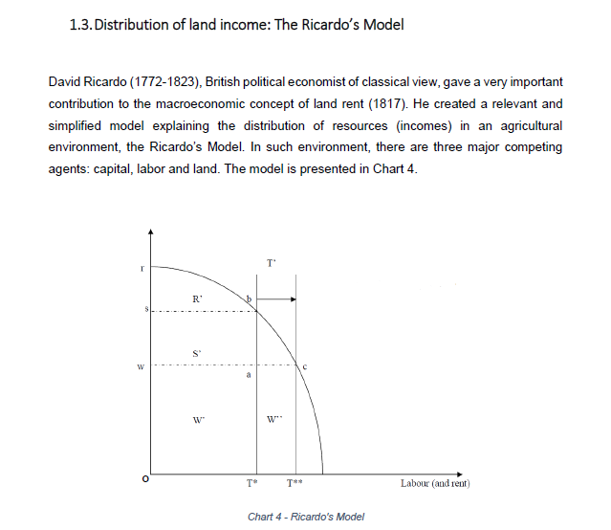

Slide 31
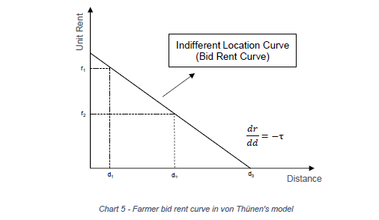

Slide 32
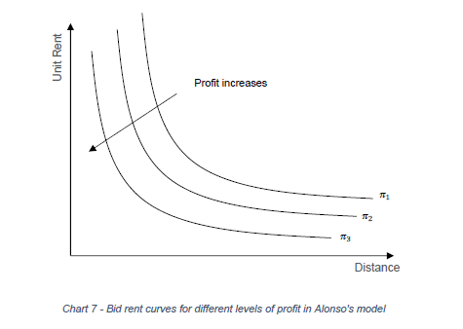

Slide 33
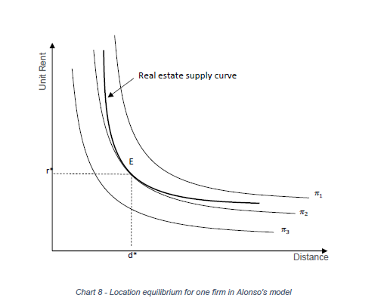

Slide 34
