Slide 1

Economic Geography
3 – Central Place Theory
121EC
A.Y. 2019/2020
Dr. Giuseppe Borruso
Department of Economics, Business, Mathematics and Statistics
University of Trieste
E-mail. giuseppe.borruso@econ.units.it
Ph. +39 040 558 7008
Skype: giuseppe.borruso
Notes:
Slides with (*) in footnotes have been modified by Jean-Paul Rodrigue materials. (v. riferimenti copyright a seguire). I have modified and elaborated materials in order to be suitable for the current course.
Copyright © 1998-2010, Dr. Jean-Paul Rodrigue, Dept. of Global Studies & Geography, Hofstra University. For personal or classroom use ONLY.

Slide 2
Learning Objectives
In this lesson we will:
  Revise the assumptions of location in a simplified economic landscape
  Present Christaller’s central place theory
    Define a central place;
    Observe the hierarchical organization of places
  Understand (once again!) the importance of some kinds of distance in the (business & economic) geographical reasoning.

Slide 3
Topics
Location theories:
  Spatial organization of Agriculture
  Market and location of services
    Christaller’s central place theory
    Loesch & Isard’s theories
  The location of industries
  Human settlements =>
Retail and transport Geography
Geodemographics – GIS & Retail Geography
Notes:
Diparimento di Scienze Geografiche e Storiche - Introduzione ai GIS
3

Slide 4
Location in a simplified economic landscape

Slide 5
Simplifying assumptions: the initial constraints of the model
The complexities of the real world are simplified in the model by the use of two sets of assumptions:
  The first is concerned with the nature of the land surface in the model region
  The second is concerned with the people who inhabit it
Initial constraints:
  The land surface is an unbounded plain which is homogeneous in all respects:
    The surface is perfectly flat with no barriers to movement. Movement is therefore possible in all directions.
    Transport costs are proportional to distance and there is a single uniform transport system.
    Physical resources are evenly distributed, that is, soils are of equal fertility throughout, raw materials are ubiquitous.
  The population living on the plain has the following characteristics:
    An even spatial distribution.
    Identical incomes, demand schedules, and propensities to consume
    Both producers and consumers have perfect knowledge and act perfectly rationally with respect to this knowledge. They are able, therefore, to behave in an optimum fashion.
      As producers they are assumed to seek a single goal – the maximization of profits
      As consumers they seek to minimize their outlays in meeting their consumption needs
Notes:
LLOYD P. E., DICKEN P., Location in space. A theoretical approach to economic geography, Harper International, New York, 1972.

Slide 6
Location of central places
Walter Christaller
The German geographer Walter Christaller introduced central-place theory in his book entitled Central Places in Southern Germany (1933). The primary purpose of a settlement or market town, according to central-place theory, is the provision of goods and services for the surrounding market area. Such towns are centrally located and may be called central places. Settlements that provide more goods and services than do other places are called higher-order central places. Lower-order central places have small market areas and provide goods and services that are purchased more frequently than higher-order goods and services. Higher-order places are more widely distributed and fewer in number than lower-order places.
Christaller’s theory assumes that central places are distributed over a uniform plane of constant population density and purchasing power. Movement across the plane is uniformly easy in any direction, transportation costs vary linearly, and consumers act rationally to minimize transportation costs by visiting the nearest location offering the desired good or service.
The determining factor in the location of any central place is the threshold, which comprises the smallest market area necessary for the goods and services to be economically viable. Once a threshold has been established, the central place will seek to expand its market area until the range—i.e., the maximum distance consumers will travel to purchase goods and services—is reached.
Since the threshold and range define the market area of a central place, market areas for a group of central places offering the same order of goods and services will each extend an equal distance in all directions in circular fashion.
https://www.britannica.com/topic/central-place-theory#ref155353

Slide 7
Location of central places
Central place = a place whose prime function is the provision of a wide range of goods and services to a dispersed population around it.
How such centre would be located?
  1 individual member of the evenly distributed population who decides to produce a good over and above his own needs.
  Whether there would be sufficient returns from the sale of the good to neighbours to cover the producer’s additional costs and to provide him with a reasonable profit.
  The minimum level of demand required to ensure this would be the threshold value for the good in question
  Unless such a threshold condition were met it would not be produced for sale
=>
Notes:
LLOYD P. E., DICKEN P., Location in space. A theoretical approach to economic geography, Harper International, New York, 1972.

Slide 8
Location of central places
=>
The quantity of the good that a customer will be prepared to buy depends, other thing being equal, on the actual price he is called upon to pay for it
In a simplified economical space, since everything else has been constrained, the price to customer varies only with the distance from the point of production.
The further he/she is from this point, the less he will consume.
In general terms, the greater the distance from the production point the higher the price of the good and the smaller the quantity of the good demanded by prospective customers
Notes:
LLOYD P. E., DICKEN P., Location in space. A theoretical approach to economic geography, Harper International, New York, 1972.

Slide 9
Central place theory
Results:
  Regular network of centres with a fixed ratio between those belonging to a given hierarchical order
  All the others located at a computable theoretical distance from each other
  Circular area around each centre (hexagon in case of a spatially exhaustive market)
  Each supply place is related to:
    A demand cone
    The limit of the cone is the range = maximum distance a consumer is willing to travel to reach the final good/service
    A threshold = minimum volume of demand necessary to keep production and distribution economically viable

Slide 10
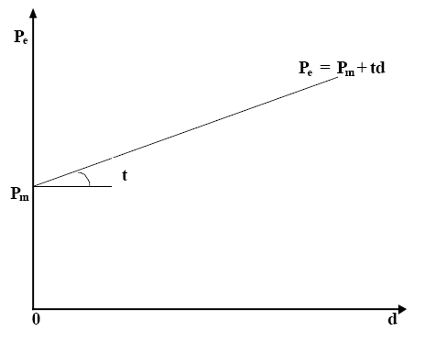
The spatial organization of market
Spatial range of demand
Price paid by the consumer:
Price of the good + transport cost
=> The final effective price paid is a linear function of distance d (as distance increases, also the effective price paid by the consumer does so)

Slide 11
The spatial organization of market
Spatial range of demand
Prices/
costs
Theorem 1: the real price is a linear function of distance
C
D
P’
the real price is formed by:
the good’s price at the marketplace
Plus a variable component depending
on the transport cost a consumer
will pay to reach the market
P
C’
O
D’
O = place of supply
OP’ = maximum price the consumer is willing to pay (including distance’s costs)
OP = product’s price
OC’ a OD’ = range of the market (circular market centred in O)

Slide 12
The spatial organization of market
Spatial range of demand
We can recall the law of demand, where price and quantity are inversely related.
As price decreases, the demanded quantity increases and vice versa.
As price (Theorem 1) can be considered as a function of distance, we can assume that quantity (= demand for a good) varies inversely with distance.
The demand curve can therefore be modified:
  Substituting price with distance;
  Putting it into space!
    That means ‘rotating the axes’
    (see next graph)
Price (distance)
A
p₁
B
p₂
quantity
q₁
q₂

Slide 13
The spatial organization of market
Hypothetical demand curve for a good
The overall quantity demanded by consumers will be maximum at the market place /place of production
And will decrease as distance increases as the effective price paid by customers will increase - compare points A and B in the previous graph
Theorem 2: the quantity demanded is a linear inverse function of distance
Quantity (demand)
Range of the good / service
Price (distance)

Slide 14
The spatial organization of market
Hypothetical demand cone for a good
As population is evenly distributed and movement is unrestricted, the demand for a good can be visualized as a cone produced rotating the demand function in two axis.
Spatial variation in demand for the good is expressed as a conical surface with the highest point centred on the point of production L and sloping evenly in all directions to the perimeter at d
The circumference of the cone represents the range of good, delimiting the maximum spatial extent of this good from production point L
The range is circular as this is the most efficient and ideal form for the market area, enabling the maximum number of customers to be supplied at the minimum aggregate cost.
D
Quantity
d
L
Distance
Range of the good
Theorem 3: as space is isotropic, the demand curve
can be centred in L and rotated by 360°
Threshold level of demand in a spatial context:
It can be expressed as a circle centred on the production point
Within it there should be just sufficient demand to make the sale of the good commercially worthwhile
Notes:
LLOYD P. E., DICKEN P., Location in space. A theoretical approach to economic geography, Harper International, New York, 1972.

Slide 15
Market Threshold and Range
    range = maximum distance a consumer is willing to travel to reach the final good/service
    threshold = minimum volume of demand necessary to keep production and distribution economically viable
    If the good is to be produced and is to continue in production =>
    range > threshold
Range
Threshold
3
Market
D(T)
D(R)
Distance
1
Customer
2

Slide 16
The spatial organization of market
Single to multiple players
a single production point is unlikely to serve all the population
Free entrance for other suppliers
Same range and thresholds for different producers
If the demand for a good remains unsatisfied there is place for newcomers to enter the market.
(b)
(a)
(c)
Places of supply and demand cones:
Few places of supply
Closed places with vacuums of supply
Exhaustive network of places of supply

Slide 17
The spatial organization of market
From circles to hexagons

Slide 18
The spatial organization of market
If the demand for good G remains unsatisfied, then a third, fourth and nth producer of the good will be established according to the same principles.
Each will supply a circular market area of the same size
As the number of producers increases, problems arise in regarding the precise spatial relationships of the respective market areas.
If the circular market areas just touch without overlap, although they give complete coverage from the consumer viewpoint, this is unsatisfactory for the producer because it generates competition.
Since the price to the consumer depends solely on his distance from the point of production, it is clear that the area of overlap would be bisected, with consumers purchasing goods from the nearest production center.
The boundary (of the hexagons) is known as the line of indifference, as consumer placed there will be equally interested in purchasing the good indifferently in one centre or in another one.
The packing of market areas compresses them into an alternative shape.
The hexagon is the most efficient theoretical shape for market areas because it allows the maximum amount of packing of market areas consistent with the minimizaion of movement costs (Haggett, 2001)
From circles to hexagons

Slide 19
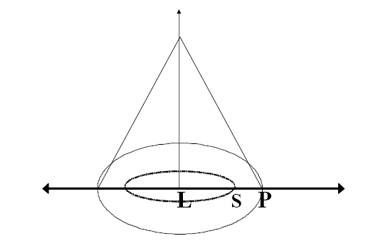
The spatial organization of market

Slide 20
Central-place theory
From a single-good economy to a multiple goods economy:
  Range and thresholds different for different goods / services;
  Some goods have a low threshold and a correspondingly low range (low-order goods)
  Others need a much higher level of demand for their existence and a more extensive range (high-order goods):
    Bread = low order
    University = high order
BUT
Christaller hypothesizes a hierarchical structure of places;
Higher order central places offer also all the goods and services supplied by lower order places
K = fixed ratio between the number of centres of order n-1 and centres of order n
Principles of:
  Market (k=3)
  Traffic (K=4)
  Administration (k=7)
https://www.e-education.psu.edu/geog597i_02/node/681

Slide 21
Central-place theory (k=3)
Marketing principle:
Optimization is given by the minimization of the number of
supply places covering the whole space
For each centre of order n, three (3) a n-1 centres and market areas are identified.
B
B
B
B
B
B
B
B
B
B
B
B
B
Centres of order n
Centres of order n - 1
Market of centres n
Market of centres - 1
https://www.e-education.psu.edu/geog597i_02/node/682

Slide 22
Central-place theory (k=3)
B
Centres of order n
Centres of order n - 1
Market of centres n
Market of centres - 1
Marketing principle:
Optimization is given by the minimization of the number of supply places covering the whole space
a n-1 centre is located at the centre of an equilateral triangle having centres of order n as vertices.
It is the closest point to the three centres of order n
1/3 of it and of its market area is therefore tributary of a higher order centre B
The process is repeated and different centres of order n-1 are set.
A total of 6 centres of order n-1 are set, with 1/3 of each market area being tributary of a higher order centre B
The market area of each centre B is therefore covering 3 market areas of order n-1 (1+6/3)
B
B
B
B
B
B

Slide 23
Central-place theory (k=3)
B
B
B
B
B
B
B
B
B
B
B
B
B
Centres of order n
Centres of order n - 1
Market of centres n
Market of centres - 1

Slide 24
Central-place theory (k=4)
Traffic principle:
Optimization is given by rationalization of transport network and straight line paths. Centres of n-1 order are located on the straigh line conneting two higher order centres
4 n-1 centres for each n centre
B
B
B
B
B
B
B
B
Centres of order n
Centres of order n - 1
Market of centres n
Market of centres - 1
https://www.e-education.psu.edu/geog597i_02/node/683

Slide 25
Central-place theory (k=7)
Administrative principle:
Optimization is given by no subdivision of centres. All the tributary centres are under control of the higher order one
7 n-1 centres for each n centre
B
B
B
B
B
B
Centres of order n
Centres of order n - 1
Market of centres n
Market of centres - 1
https://www.e-education.psu.edu/geog597i_02/node/684

Slide 26
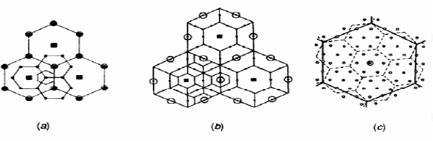
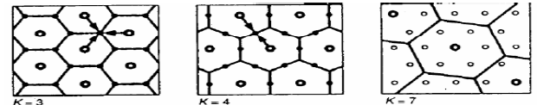
Central place theory
Market principle (K = 3)
Transport principle (K = 4)
Administrative principle (K = 7)

Slide 27
Central-place theory

Slide 28
The central place system – some (partial!) conclusions
On the basis of the distance variable it was possible to generate on the hypothetical plain a complex network of hierarchically ordered centres with predictable functional and locational characteristics;
A spatially organized system;
Objects (central places and consumers) are linked by flows of goods and cash as supplies and demands are matched by exchange;
Dynamic force shaping the system is the cyclical energy-exchange process in which inputs of money (demand) from a dispersed population are transformed in outputs of goods and services by the individual production subsystems (bakers, banks, universities, etc.) making up the central places;
Such energy-exchange process has a spatial form because of the differences in location between points of demand and points of supply.
In moving to a central place a consumer must use up scarce resources to overcome the friction of distance.
The process stops when distance is so high that, if its price is added to the good’s one, the consumer is no more interested in purchasing that good.
The spatial extent of the process varies from one good to another, generating a hierarchical structure of centres supplying goods and services of different orders
The perfectly hierarchical structure represents the steady state of the central place system

Slide 29
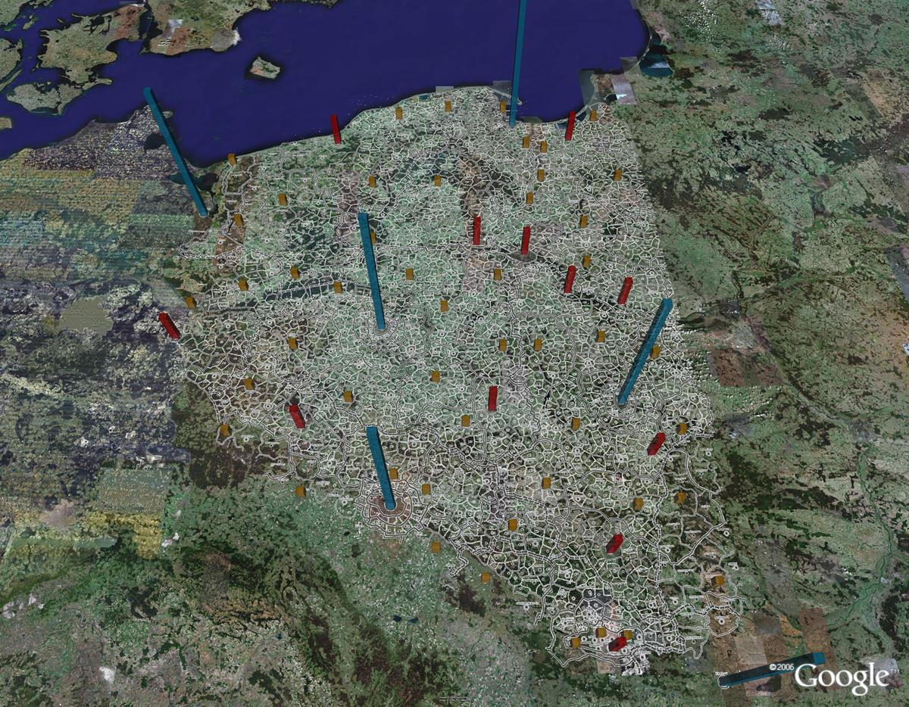
Central place theory for fun
What if Christaller had Google Earth?
http://urbandemographics.blogspot.it/2013/10/if-christaller-had-google-earth.html
http://www-personal.umich.edu/~copyrght/image/solstice/win06/Germany/index.html

Slide 30
Central-place theory – What’s next
Loesch
August Lösch German economist.
“The Spatial Organization of the Economy” (1940).
(Economics of Location). Much of his work in USA (Iowa).
Extended the work begun by Christaller.
Demonstrated that the hexagon is the most efficient shape.
Starts at the ‘bottom’ of the system: unlike Christaller, whose system of central places began with the highest-order, Lösch began with a system of lowest-order (self-sufficient) farms, which were regularly distributed in a triangular-hexagonal pattern. From this smallest scale of economic activity, Lösch mathematically derived several central-place systems, including the three systems of Christaller. Lösch’s systems of central places allowed for specialized places. He also illustrated how some central places develop into richer areas than others.
https://www.e-education.psu.edu/geog597i_02/node/685

Slide 31
Central-place theory – What’s next
Loesch
August Lösch
German economist.
The Economics of Location.
Much of his work in USA (Iowa).
Extended the work begun by Christaller.
Demonstrated that the hexagon is the most efficient shape.
Starts at the ‘bottom’ of the system.
One ‘equivalent customer’
Or one unit of consumption.
Build ‘up’ from there.

Slide 32
Central-place theory – Loesch
The city effect
Loesch introduces the city effect:
Generalization of Christaller’s three principles.
Geometric observation of the rotation of hexagons around a central metropolis =>
Organizing centre on wide areas (with k increasing) intersected with each others
Number of centres of supply is reduced because of :
  Closeness between places of supply of the same good;
  Economies of agglomeration from the presence of places of supply of goods in the same place
Loesch hypothesizes:
  Number of places of supply differentiated in sectors around the maximum centre (6 rich sectors – 6 poor)
  Relative scarcity of places of supply around the metropolitan area becausee of polarization economies

Slide 33
Central-place theory (k=3)
A
A
A
A
A
A
A
A
A
A
A
A
A
Centres of order n
Centres of order n - 1
Market of centres n
Market of centres - 1

Slide 34
Central-place theory (k=4)
Traffic principle:
Optimization is given by rationalization of transport network and straight line paths. Centres of n-1 order are located on the straigh line conneting two higher order centres
4 n-1 centres for each n centre
B
B
B
B
B
B
B
B
Centres of order n
Centres of order n - 1
Market of centres n
Market of centres - 1

Slide 35
Central-place theory (k=7)
Administrative principle:
Optimization is given by no subdivision of centres. All the tributary centres are under control of the higher order one
7 n-1 centres for each n centre
C
C
C
C
C
C
Centres of order n
Centres of order n - 1
Market of centres n
Market of centres - 1

Slide 36
Central-place theory (pricinples overlap)
Loesch foresees the possibility of overlapping hexagons belonging to different principles.
He foresees also the possibility of having many more principles and not jus the 3 ones hypothesized by Christaller
Overlapping principles, very few centres become central for all the principles (see location «D»)
A
A
C
A
B
A
B
D
B
A
C
A
A
A
B
A
B
C
A
A
C
A
Centres of order n
Centres of order n - 1
Market of centres n
Market of centres - 1

Slide 37
Central-place theory: Three orders coexisting
D
D
Super Centre: Metropolis
Centres of order n - 1
k = 7
k = 4
k = 3

Slide 38
Central-place theory – Loesch
Locations for settlements must be as advantageous as possible.
Locations for settlements must fill all of space (establishes the shape of market areas -hexagons).
Excess profits must disappear.
Market areas must be as small as possible (establishes the size of market areas).
Consumers at the boundary are indifferent.

Slide 39
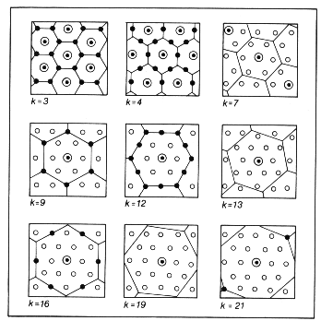
Central-place theory: how many k?
Loesch foresees the existence of several order of k
And the possibility for the different pattern of k to coexist and overlap
Thus forming places ‘even more central’ according to several principles (=> metropolitan areas)

Slide 40
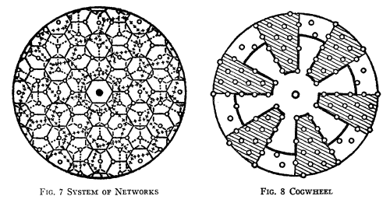
Central-place theory: the spatial distribution of market centres around a metropolitan area
Rotation of the hexagons’ network

Slide 41
Central-place theory: the spatial distribution of market centres around a metropolitan area (che ‘city effect’)
Polarization of supply :
In the metropolitan area along privileged sectors
Some sectors out of major route (dark areas) suffer of limited accessibility to a high order central place

Slide 42
Central place theory:
Christaller vs. Loesch
Both recognized a triangular pattern of settlement and hexagonal market areas.
Both used the major concepts of central place theory -range, threshold, hierarchy.
Christaller starts from the ‘top’.
Lösch starts from the ‘bottom’ of the hierarchy.
Christaller concerned with retailing/services alone.
Lösch adds local manufacturing.
Settlements offer a good, but smaller settlements may make that good.
Christaller interested in planning.
Lösch interested in theory.

Slide 43
Central-place theory – What’s next
Isard
Isard’s Modifications
Regular hexagons are unlikely to occur in reality.
Larger places increase the surrounding population density.
Urban economies of scale are important.
Two key modifiers.
Variation in population density.
Major transportation arteries.
Both will distort the pattern.
https://www.e-education.psu.edu/geog597i_02/node/686

Slide 44
Central-place theory
Isard’s modifications - Density effect
Network system as modified by agglomeration
(Isard, 1962)
Uneven density of population generates a distortion of Loesch’s Hexagons
Effect of uneven population densities
on the size of hexagonal market areas

Slide 45
Spatial organization of market and density effect
Loesch model is good for examining the spatial structure of markets around a metropolis
Isard introduces the varying population density
=>
Esplicative variable of different width and and ‘thickness’ of market areas
‘Spiderweb’ network of points and areas more interlinked in demographically denser centres

Slide 46
The density effect
System of networks modified by agglomeration processes (Isard, 1962)

Slide 47
Model of duopolistic competition
(Hotelling, 1929; Alonso, 1973)
Ice cream vendor model (Hotelling, 1929; Alonso, 1973)
One vendor – location in the beach’s centre (or median location)
More vendors allowed – a ‘game’ to adjust locations!
Retail planning / new players
Structural changes

Slide 48

Model of duopolistic competition
(Hotelling, 1929; Alonso, 1973)
Beach
1° Stage
2° Stage
3° Stage
Final Stage
Planned
locations
New
competitors
allowed

Slide 49
Hotelling Principle of Market Competition
Prix
P1
P1
P2
A
F1
F2
B

Slide 50
Spatial competition and structural differences
A competitor moves
Market is divided between two competitors
Effect of a price reduction
Effect of a transport cost reduction

